Slide 1
IceCube Flashers
Dawn Williams
University of Alabama
IceCube Bootcamp 2016
Madison, WI

Slide 2
IceCube
Strings are numbered 1-86
DOMs are numbered 1-60, top to bottom (in ice)
Surface (IceTop) DOMs are numbered 61-64, not used in flasher analysis

Slide 3
IceCube Strings

Slide 4
IceCube Digital Optical Module (DOM)
Every DOM in IceCube is equipped with flasher LEDs
This gives us a controlled light source at every location in the detector

Slide 5
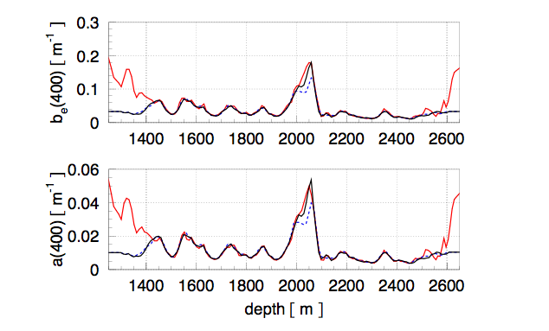
Calibration: from photon to data
Propagation through ice
Light source
We use flashers:
To verify that DOMs are properly connected and functioning during commissioning
To verify the detector geometry
To study the optical properties of the ice
To study the response of the DOMs themselves

Slide 6
Flasher references
https://wiki.icecube.wisc.edu/index.php/Flashers
https://wiki.icecube.wisc.edu/index.php/CDOM_Info

Slide 7
LED Flasher Board
12 LEDs
Arranged in pairs, evenly spaced 60° apart
1&7, 2&8, 3&9, 4&10, 5&11, 6&12, going clockwise seen from above
1-6 are tilted, upward at about 45° from horizontal
7-10 are horizontal

Slide 8
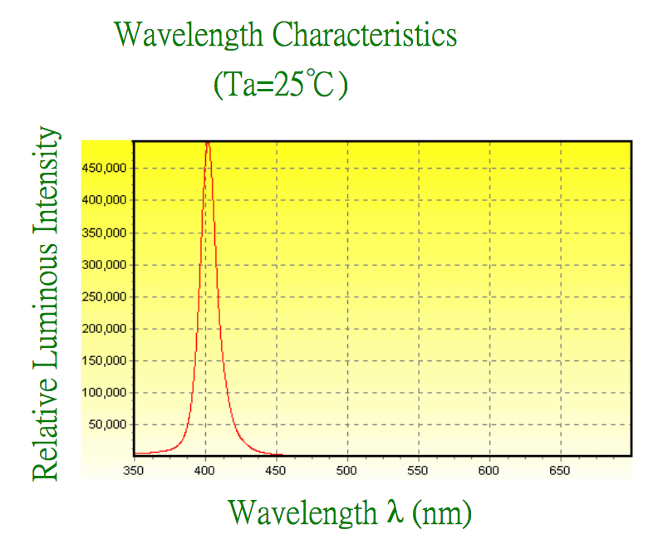
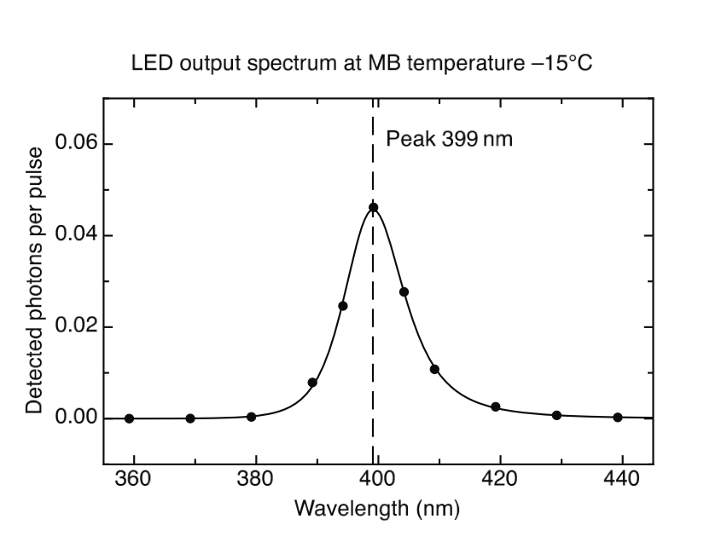
Flasher properties
The vast majority of IceCube LEDs are ETG-5UV405-30, nominally 405 nm wavelength, actually 399 nm, FWHM of 14 nm

Slide 9
cDOMs
8 DOMs each on string 14 and string 79 have multiwavelength flashers called cDOMs
For the remainder of this lesson we will use the standard 400 nm flashers

Slide 10
Flasher properties: Angular emission profile (beam width)
Nominal beam width is 30° in air
In ice, accounting for refraction from air to glass and glass to ice, the beam width is 10°
Can be modeled as a 2-D Gaussian with σ = 10° in both directions

Slide 11
Flasher operating parameters
Parameter | Allowed values | Description
string | 1 - 86 | String where flashing DOM is located
DOM | 1 – 60 | Flashing DOM number
brightness | 0 - 127 | LED driver current intensity, up to 240 mA
width | 0 - 127 | 2x duration of LED current pulse, in ns
mask | 0001 - 0FFF | Hex representation of bitmask controlling which LEDs flash
rate | 0 - 610 | Rate of LED flashes in Hz

Slide 12
Flasher operation: String and DOM
Multiple flashers can be run simultaneously
The data acquisition system can withstand about 3x the normal background rate from muons (~70 bright flashing DOMs simultaneously)
A typical run might have 4-6 flashers simultaneously
It is not advised to have neighboring flashers on the same string run together
Old DOMs (produced in 2004 and 2005) have “afterburst” properties which make them difficult to run
Flashers cannot be synchronized using the current firmware

Slide 13
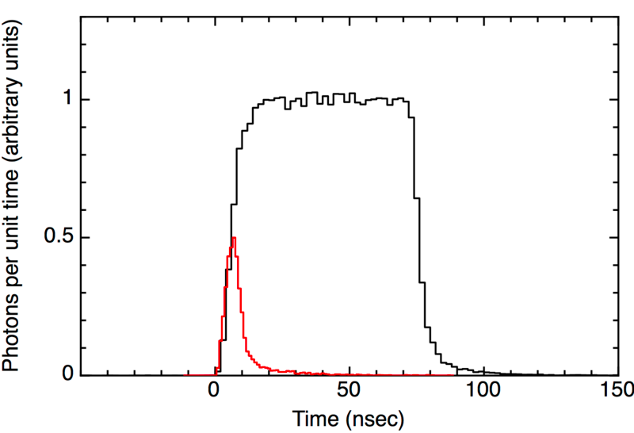
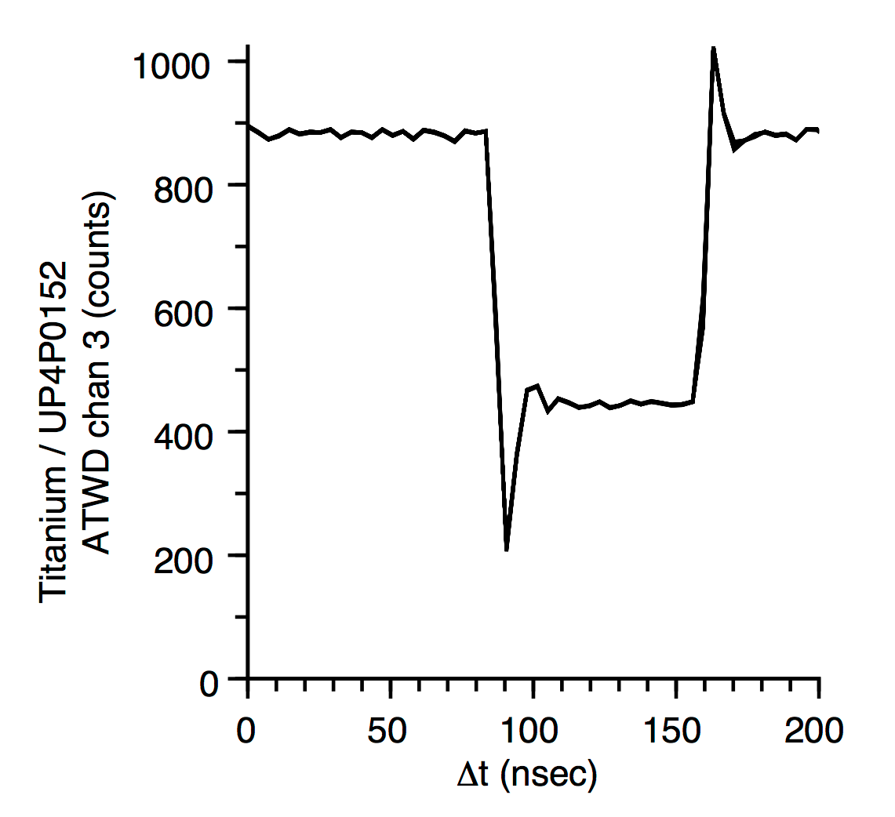
Running flashers: brightness and width
Maximum photon output per LED is 1.17e10 photons per flash
With all 12 LEDs running this is about equal to a 500 TeV cascade
The brightness and width parameters determine the photon output
Width: duration of driver current, effectively 10-70 ns
Brightness: amplitude of driver current, up to 240 mA
Width 15
Width 124

Slide 14
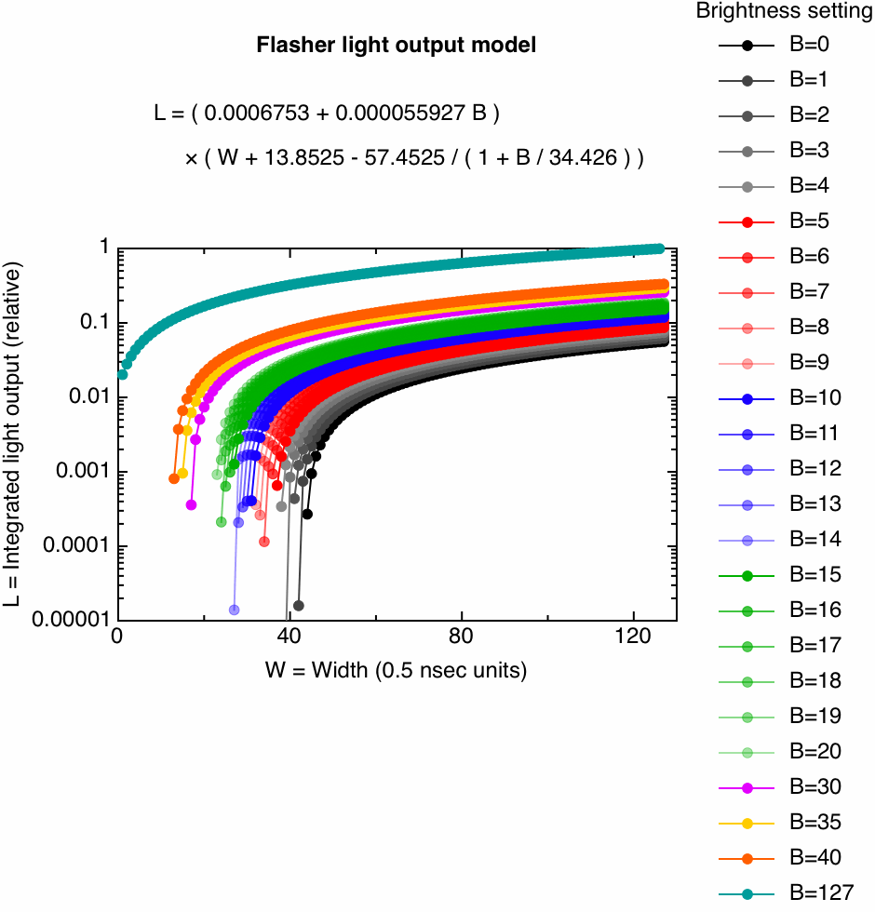
How light output scales with brightness and width

Slide 15
Running flashers: mask
The 12 LEDs can be run in an combination. Each LED is controlled by a bit, and the “mask” is the hex representation of the bits
Example: flash LED 7 only
horizontal
tilted
LED | 12 | 11 | 10 | 9 | 8 | 7 | 6 | 5 | 4 | 3 | 2 | 1
Bit | 0 | 0 | 0 | 0 | 0 | 1 | 0 | 0 | 0 | 0 | 0 | 0
HEX mask is 0064

Slide 16
Running flashers: mask
The 12 LEDs can be run in an combination. Each LED is controlled by a bit, and the “mask” is the hex representation of the bits
Example: flash all tilted LEDs
horizontal
tilted
LED | 12 | 11 | 10 | 9 | 8 | 7 | 6 | 5 | 4 | 3 | 2 | 1
Bit | 0 | 0 | 0 | 0 | 0 | 0 | 1 | 1 | 1 | 1 | 1 | 1
HEX mask is 003f

Slide 17
Running flashers: mask
The 12 LEDs can be run in an combination. Each LED is controlled by a bit, and the “mask” is the hex representation of the bits
Example: flash all horizontal LEDs
horizontal
tilted
LED | 12 | 11 | 10 | 9 | 8 | 7 | 6 | 5 | 4 | 3 | 2 | 1
Bit | 1 | 1 | 1 | 1 | 1 | 1 | 0 | 0 | 0 | 0 | 0 | 0
HEX mask is 0fc0

Slide 18
Running flashers: rate
Maximum rate is 610 Hz, lower rates are 610 Hz divided by a power of 2
The setting in the configuration is an integer, the actual value of the rate is the next lowest value to that integer which is 610 divided by a power of 2
So for example if the rate setting is 2, the actual rate is 1.191 Hz = 610 Hz/2⁹

Slide 19
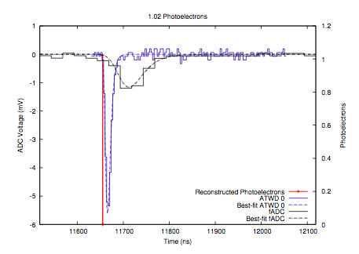
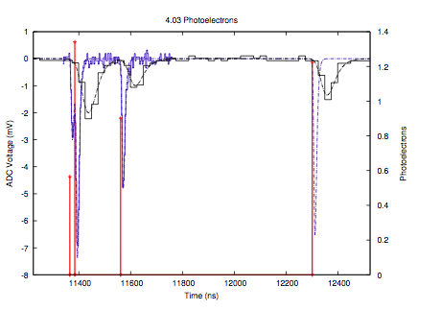
Flasher data processing
Raw waveform
(ADC counts)
Calibrated waveform
(mV)
Pulses
(PE)
We will now look at some flasher data and do some exercises to look at the pulses detected by neighboring DOMs from a flasher.

