Slide 1
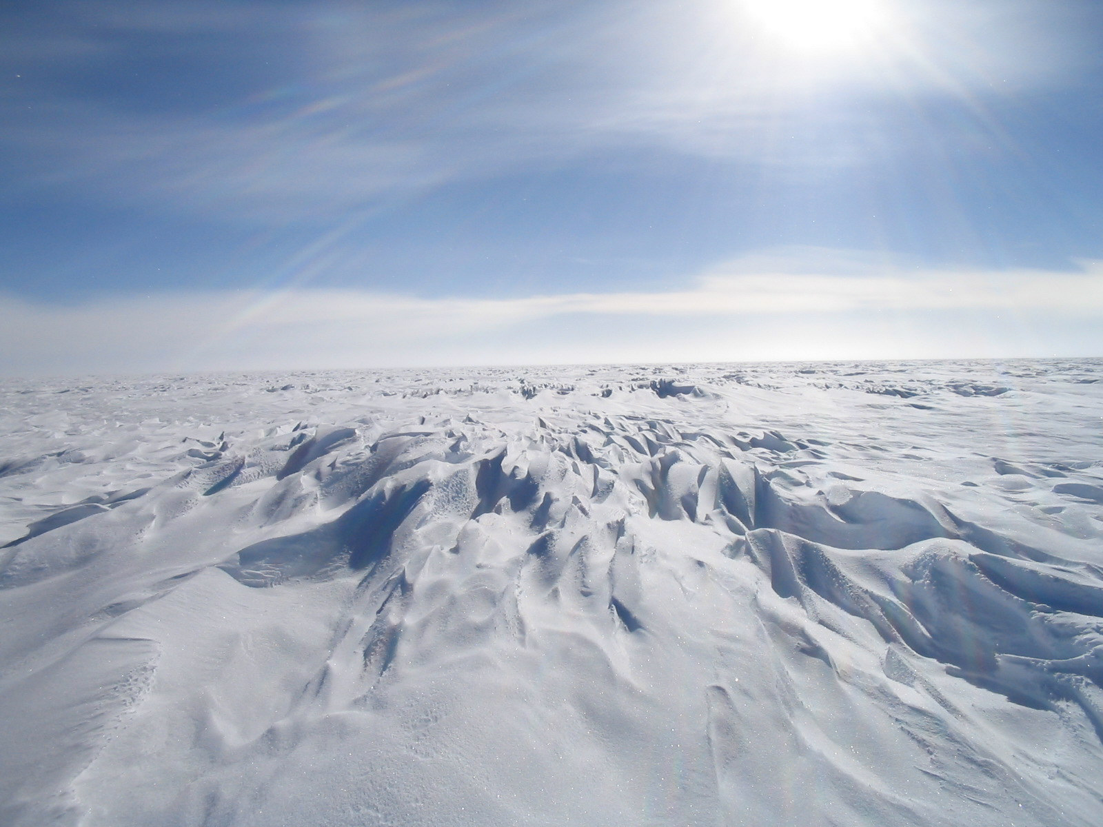
Askaryan Radio Array (ARA)
Michael DuVernois
Wisconsin IceCube Particle Astrophysics Center (WIPAC)
University of Wisconsin—Madison

Slide 2
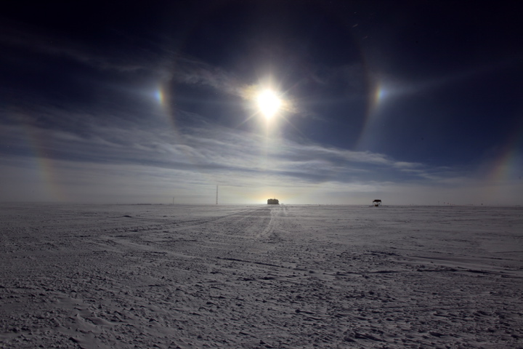
Physics

Slide 3
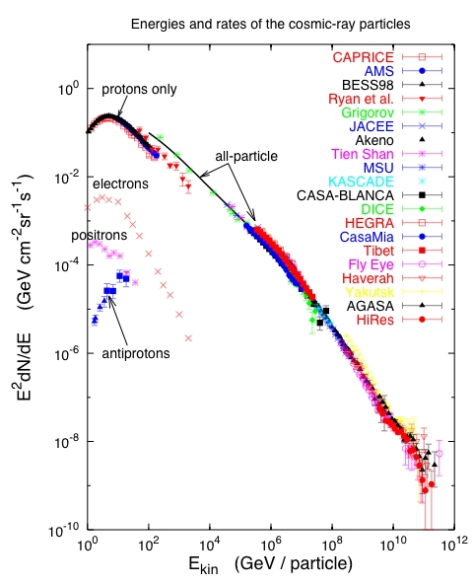
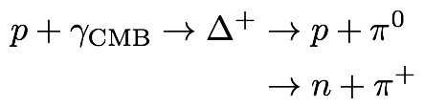
Cosmic Rays and Neutrino Sources
Cosmic rays exist at highest energies:
The puzzle
No nearby (<50Mpc) sources observed.
More distant sources are not observable in cosmic rays due to collisions with microwave background.
Neutrinos above 10¹⁷⁻¹⁹ eV, GZK or cosmogenic neutrinos are at some level guarantueed.
However, fluxes will be small, requires very large detectors
T. Gaisser 2005
knee
1 part m⁻² yr⁻¹
Ankle
1 part km⁻² yr⁻¹
Notes:
Cosmic rays have been observed to energies above 1E20eV. Spectrum and composition give some ideas of the nature of the acceleration and transport.
Most candidates of astrophysical neutrinos are closely related to the observation of high energy cosmic rays. We know that cosmic rays exist to highest energies. Possible sources are SN remnants, active galaxies or gamma ray bursts. Neutrino production may take place in the source region or on other, not too dense targets such as the Earth’s atmosphere, the interstellar medium or the cosmic microwave background.

Slide 4
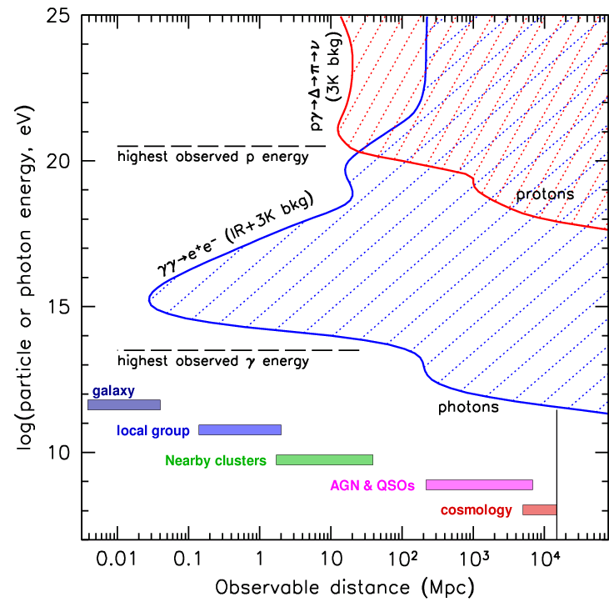
Neutrinos as messengers
Study of the highest energy processes and particles throughout the universe requires PeV-ZeV neutrino detectors
To “guarantee”EeV neutrino detection, design for the GZK neutrino flux
Existence of extragalactic neutrinos inferred from CR spectrum, up to 10²⁰ eV, and similarly, Galactic up to 10¹⁸ eV
Need gigaton (km³) mass (volume) for TeV to PeV detection, and teraton at 10¹⁹ eV
Neutrino detection associated with EM sources will ID the UHECR sources
“EM Hidden” sources may exist, visible only in neutrinos.
Neutrino eyes see farther (z>1), and deeper (into compact objects), than gamma-photons, and straighter than UHECRs,with no absorption at (almost) any energy

Slide 5
T. Gaisser 2005
T. Gaisser 2005
Atmospheric
neutrinos:
AMANDA, IceCube
Waxman –Bahcall upper bound
IceCube signal
Galactic neutrino
flux model:
e.g., Ingelman & Thunman
Cosmogenic neutrino flux,
e.g. ESS (blue line)
Notes:
Cosmic rays have been observed to energies above 1E20eV. Spectrum and composition give some ideas of the nature of the acceleration and transport.
Most candidates of astrophysical neutrinos are closely related to the observation of high energy cosmic rays. We know that cosmic rays exist to highest energies. Possible sources are SN remnants, active galaxies or gamma ray bursts. Neutrino production may take place in the source region or on other, not too dense targets such as the Earth’s atmosphere, the interstellar medium or the cosmic microwave background.

Slide 6
The cosmic energy frontier, 10⁷ to 10¹¹ GeV Cosmogenic or GZK neutrinos

Slide 7
The cosmic energy frontier, 10⁷ to 10¹¹ GeV Cosmogenic or GZK neutrinos
Sensitivity of 3 years
of ARA 37

Slide 8
10^16 – 10^20 eV energy scale
Need detection rates such that the the normalization of the GZK neutrino flux can be reliably determined.
Requires 100 times better sensitivity than published results and more than 10 times the sensitivity of IceCube at 10¹⁸ eV.
Alternatives to water/ice based optical Cherenkov detectors:
Radio detection in the Antarctic ice
Sensitivity of 3 years
of ARA 37

Slide 9
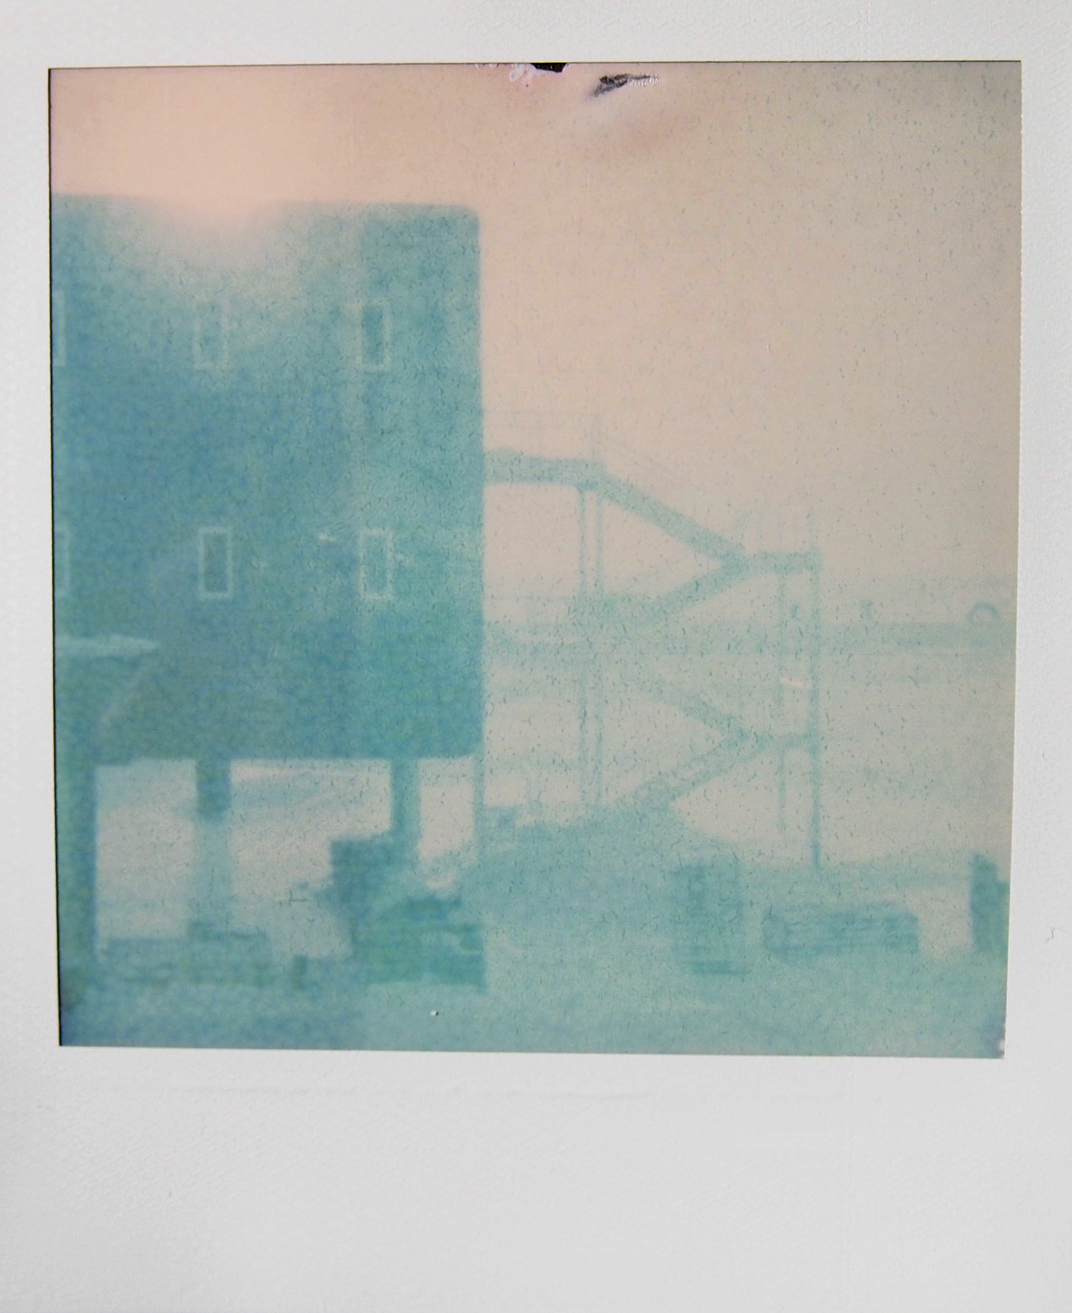
Askaryan Effect

Slide 10

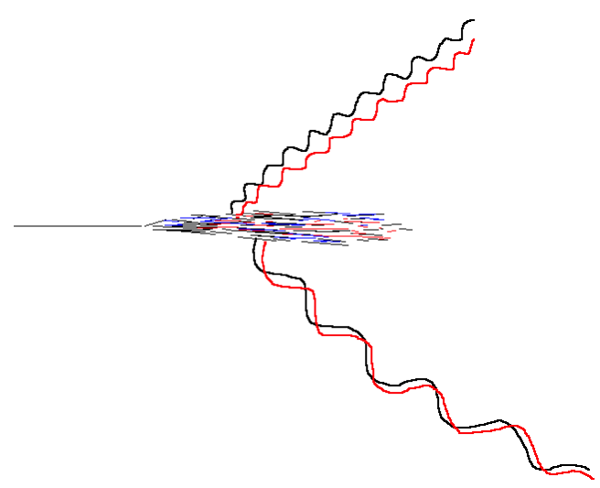
Detection mechanism proposed by G. Askaryan (1962):
Measure the coherent RF signal generated by neutrino interaction in dielectric media (such as ice)
moves as a compact bunch, a few cm wide and ~1cm thick → Moving net charge in a dielectric
wavelengths shorter than the bunch length suffer from destructive interference
charge asymmetry in particle shower development results in a 20% excess of electrons over positrons in a particle shower
nucleus
L is the length of the bunch
E > 10¹⁷eV
Particle cascade
electric field strength proportional to the square of the shower energy
Add coherently!
Notes:
The emission of a coherent radio signal comes from the charge asymmetry in particle shower development. The asymmetry is due to combined effects of positron annihilation and Compton scattering on atomic electrons. There is a 20% excess of electrons over positrons in a particle shower, which moves as a compact bunch, a few cm wide and ~1cm thick, at a velocity above the speed of light in the medium. The frequency dependence of Cherenkov radiation emitted is dP proportional to nu dnu. For radiation with wavelength lambda much greater than l, where l is the length scale of the bunch, the radiated electric field will add coherently and thus be proportional to the square of the shower energy. A radio signal emitted by a particle shower in a dielectric material such as ice or salt is coherent up to a few GHz, is linearly polarized, and lasts less than a nanosecond. A shower with energy less than 10^19 eV interacting in ice will produce a peak strength of ~1mV/m/Mhz at the distance of 1 km.

Slide 11
Askaryan Effect
In electron-gamma shower in matter, there will be ~20% more electrons than positrons.
Compton scattering: γ + e⁻_{(at rest)} → γ + e⁻
Positron annihilation: e⁺ + e⁻_{(at rest)} → γ + γ
In dense material R_{Moliere}~ 10cm.
λ<<R_{Moliere} (optical case), random phases⇒ P∝ N
λ>>R_{Moliere} (microwaves), coherent ⇒ P∝ N²

Slide 12
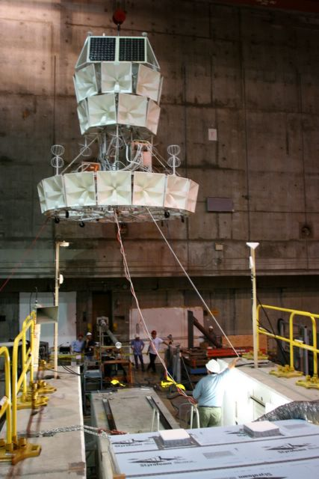
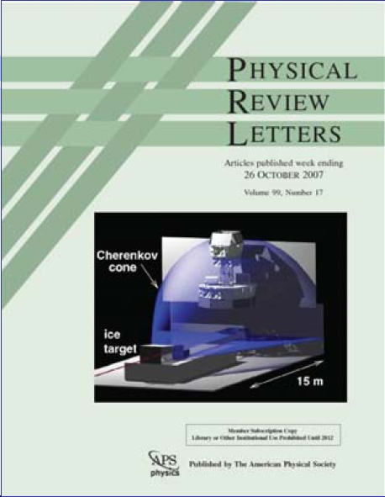
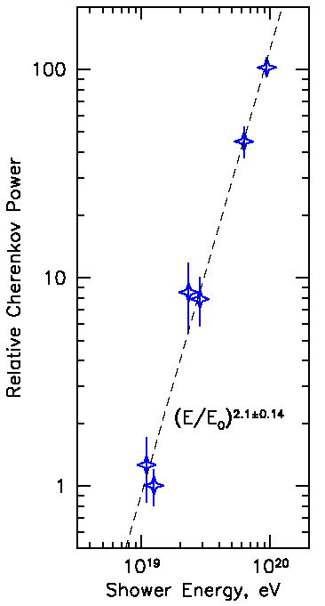
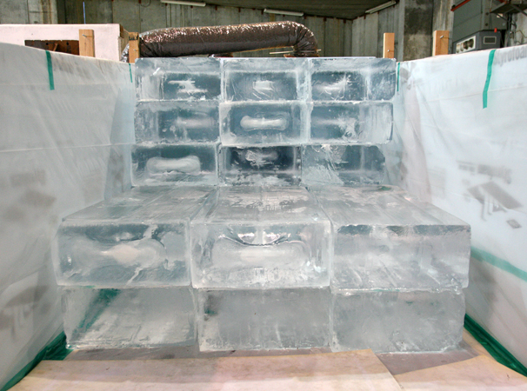
Validation at SLAC
ANITA I beamtest at SLAC (June06): proof of Askaryan effect in ice
Coherent (Power ~ E²)
Linearly Polarized
“Little Antarctica”

Slide 13
Natural target material?
Lunar regolith (20m attenuation length) Parkes Telescope; GLUE; WSRT; …
Ice (100-1500m attenuation lengths) Forte (satellite); ANITA (balloon); ARA
Salt (100-500m attenuation lengths) SalSA (proposed, salt dome)
Air is too thin (though effect is seen in cosmic-ray air shower radio emission)
Water is RF lossy, natural, outdoor, sand (as opposed to pure silica) is also lossy

Slide 14
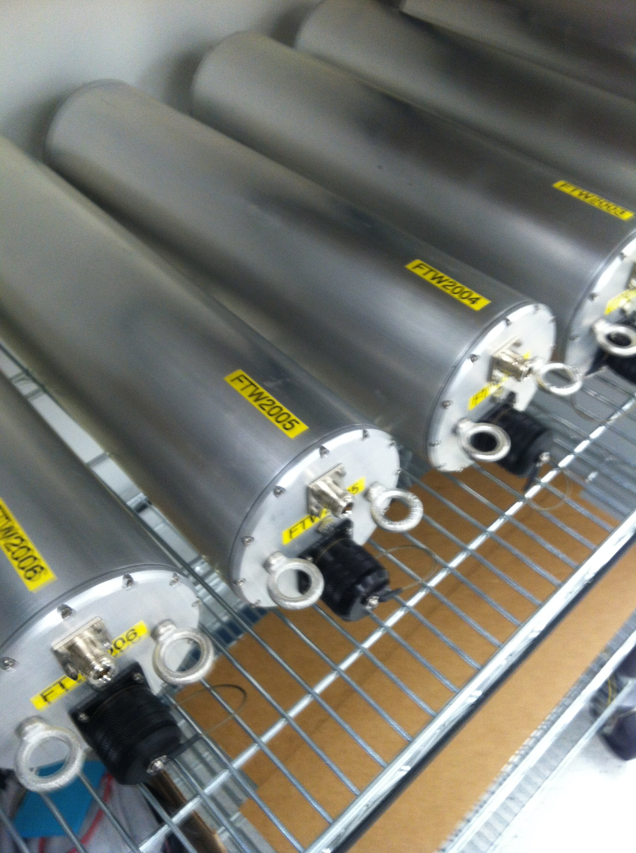
Instrumentation

Slide 15
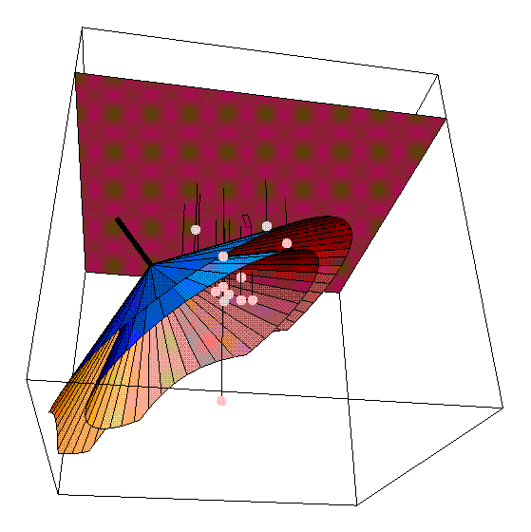
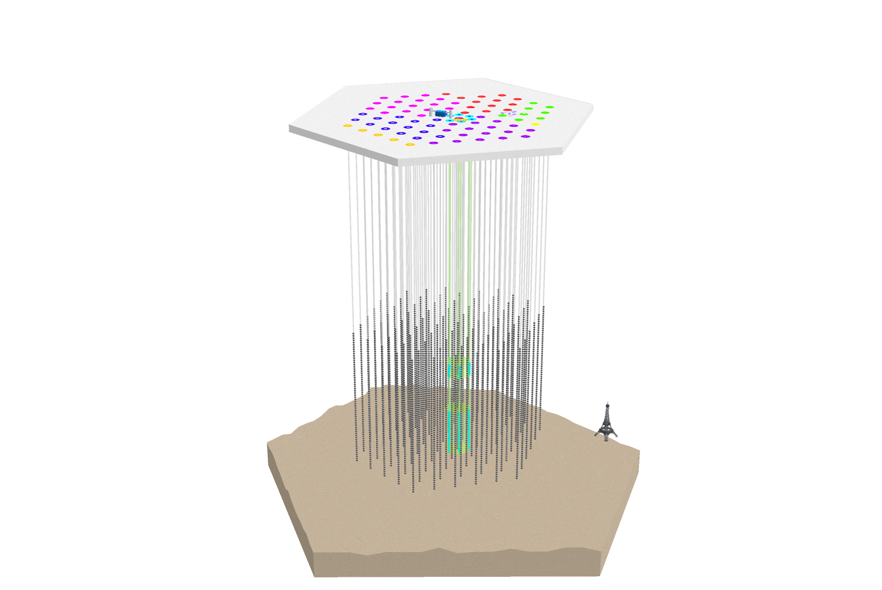
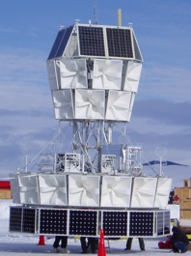

10⁷ to 10¹¹ GeV: Radio ice Cherenkov detection
Askaryan Radio Array (ARA) heritage:
Existing and previous instruments using radio in Polar ice
Members of all three efforts are currently involved with ARA
RICE
Special radio detectors
and pulsers in IceCube
ANITA
array of single dipole antennas deployed between 100 and 300m near the Pole
much of the instrumentation was deployed in AMANDA holes
Pioneered technique in the ice
balloon payload of horn antennas
surveys the ice cap from high altitude for RF refracted out of the ice
→ high fidelity data acquisition system >Gs/sec waveform capture

Slide 16



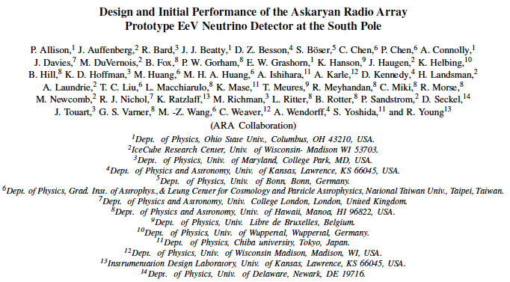









ARA- Collaboration
ARA is an international Collaboration
14 institutions
~50 authors
.

Slide 17
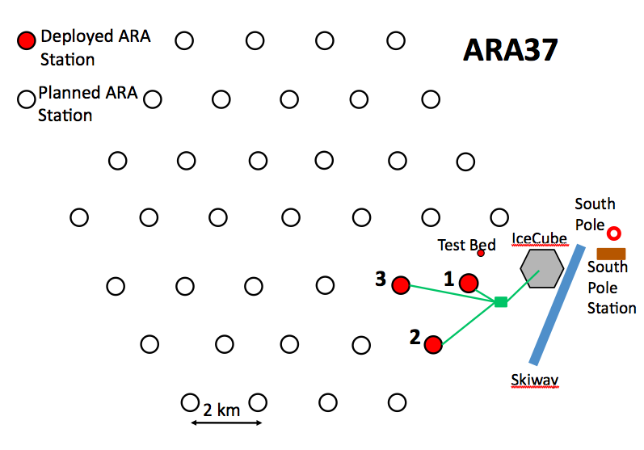
Askaryan Radio Array (ARA) - a very large radio neutrino detector at the South Pole
10⁷ to 10¹¹ GeV: Radio ice Cherenkov detection
Ref: Allison et al., Astropart.Phys. 35 (2012) 457-477,
arXiv:1105.2854 (Design and performance paper)
Scientific Goal:
Discover and determine the flux of highest energy cosmic neutrinos.
Understanding of highest energy cosmic rays, other phenomena at highest energies.
Method:
Monitor the ice for radio pulses generated by interactions of cosmic neutrinos with nuclei of the 2.8km thick ice sheet at the South Pole
Areal coverage: ~150km^2

Slide 18
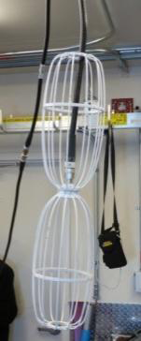
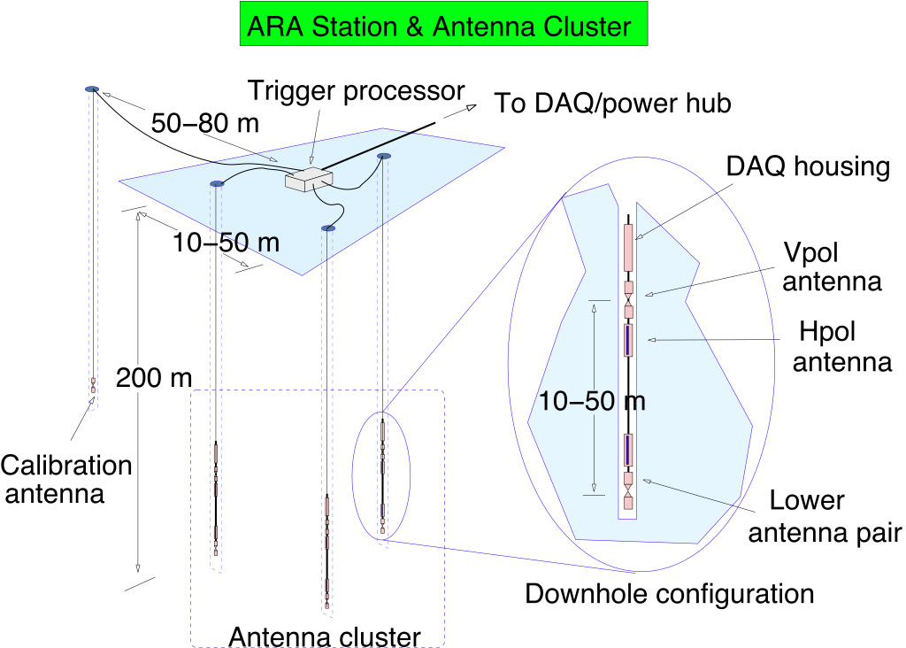
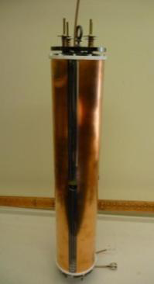
ARA station geometry
10⁷ to 10¹¹ GeV: Radio ice Cherenkov detection
Design goals and choices:
Every station is a fully functioning detector.
→ Lower energy threshold: nearby events (300m) can be reconstructed.
Background rejection:
Embedded strings: Allow good vertex resolution and high vertical resolution for background rejection

Slide 19
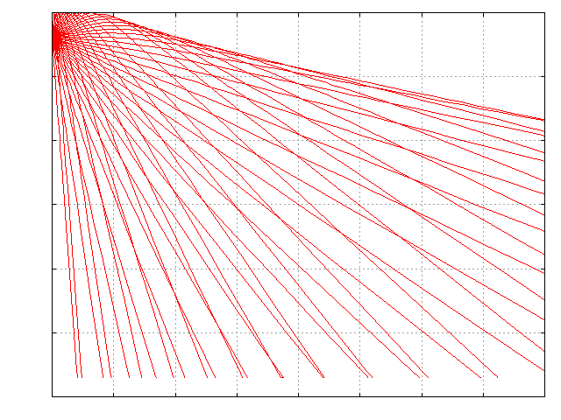
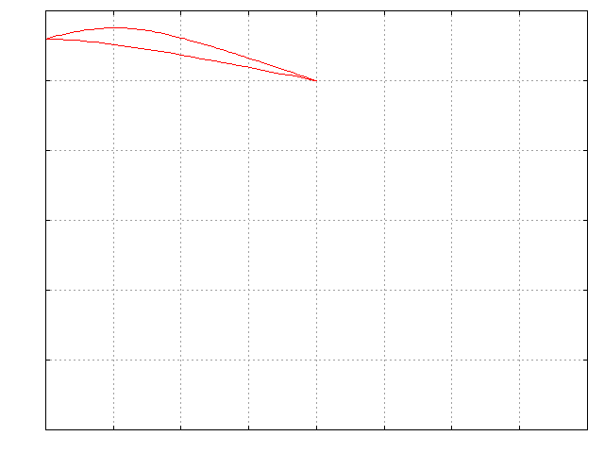
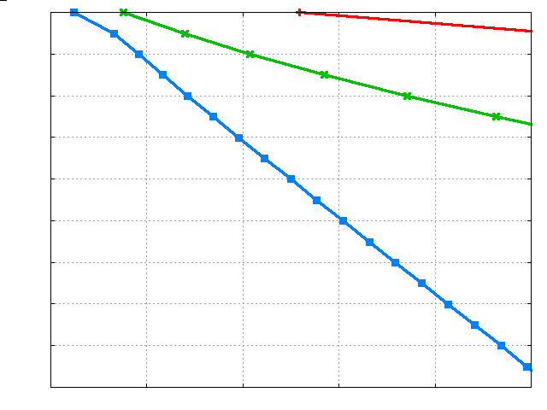
Why strings?
(rather than surface antennas)
Acceptance: x2
Embedded detectors have larger acceptance due to shadowing caused by gradual change of index of refraction in the upper 200m of ice.
Gain at 200m depth compared to surface: > x2 event rate
Background rejection:
Transient backgrounds, man made and natural come from surface!
Neutrino events generate vertex in the ice and the signal can be uniquely separated by basic event reconstruction.
Ray traces 200m
0
Receiver
1
Depth [km]
Transmitter
2
3
0
1
2
3
4
Distance [km]
Horizon for 3 different receiver depths
0
1000m
0.6
200m
Depth [km]
20 m
1.2
1.8
0
0.5
1
1.5
2
2.5
Horizon [km]

Slide 20
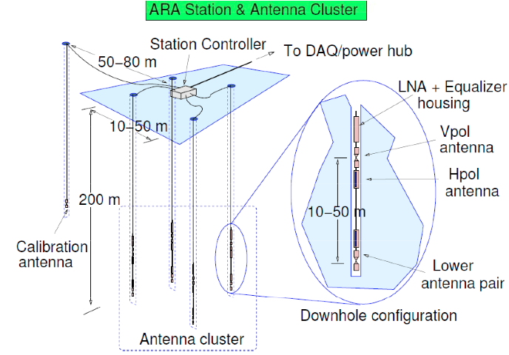
~15m
~15m

Slide 21
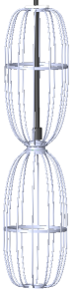
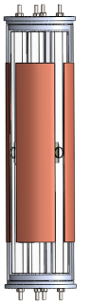
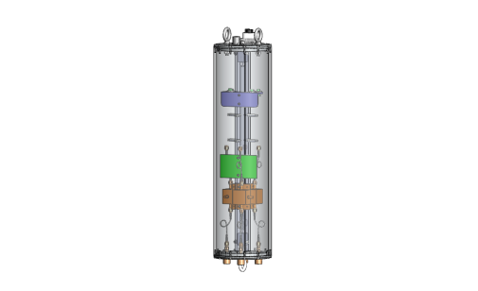

Slide 22
Signal Chain
Physics: Neutrino interacts in the ice, charged particles generate shower, Askaryan radio pulse
Antennas: Radio pulse wave-front arrives, superimposed on thermal (background) noise
LNA: Amplify the delicate signal with minimum additional noise, close to the antenna
RFoF (transmitter & receiver): Transmit signal to the surface without cable distortions, and then return optical to electrical signal
Trigger: Diode detectors (“square law”) followed by combinatorial logic (e.g., 5/16 or in the future something more complex)
Readout: Analog capacitor storage, triggered readout, digitization, transfer to station computer, fiber to IceCube Lab building, hard drive storage, & satellite to North

Slide 23

Recent Work

Slide 24
ARA37
Rev 2/4/13
Deployed ARA Station
Planned ARA Station 13/14
Test Bed
IceCube
3
1
South Pole Station
Deployed Cabling
WT3
7 (?)
6
2
Planned 13/14 Cabling
Skiway
5
4
2 km

Slide 25
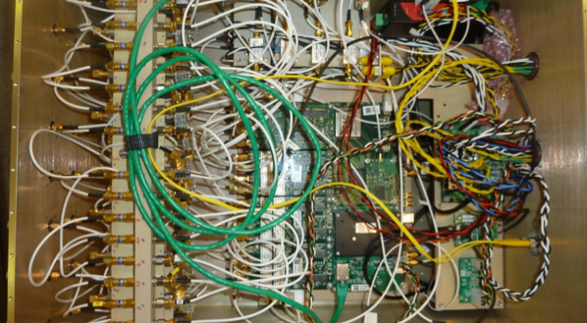

Slide 26
Receiver boxes

Slide 27
RFoF Transmitter

Slide 28
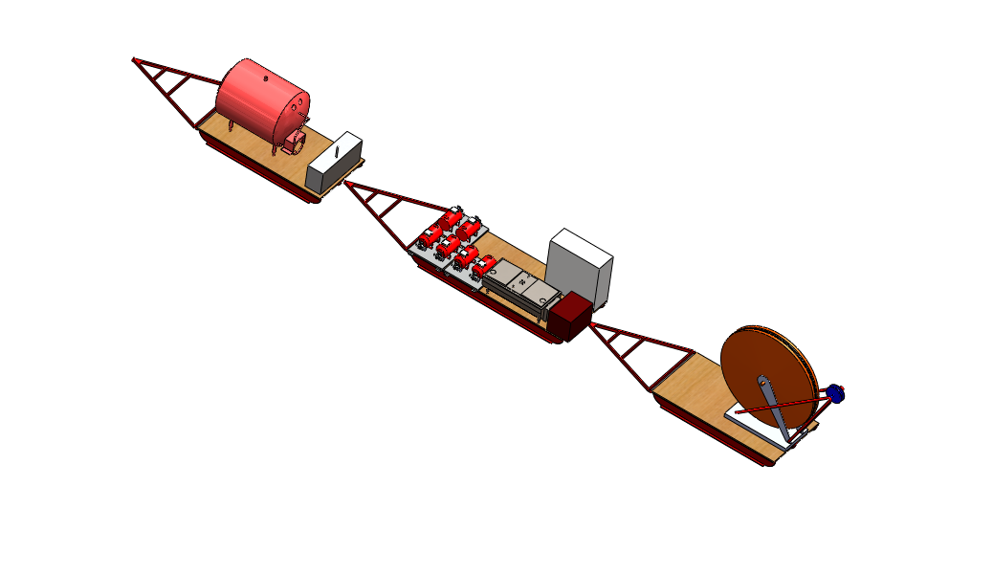
Drilling: Upgrades 2012
Substantial upgrades were originally planned for 2013, but 2011/12 experience showed the upgrade was needed to be able to drill to 200m
Switch to a full recirculation system with water recovery.
Replaced lost equipment
Drill Head
Pump
Hose
Cable
Hose reel damaged
Substantial effort (>$500k)
Used redirected some funds from MRI,
and located additional cost-share

Slide 29
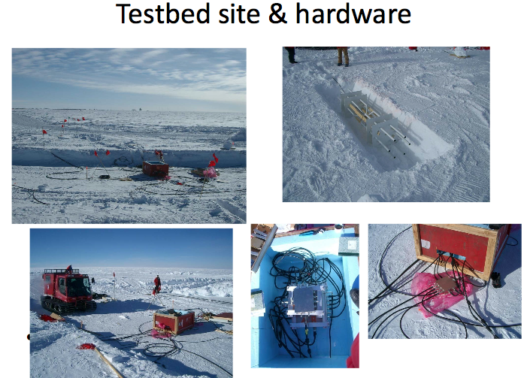
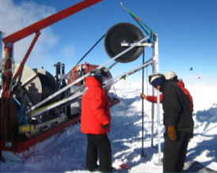
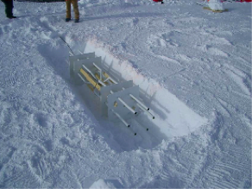
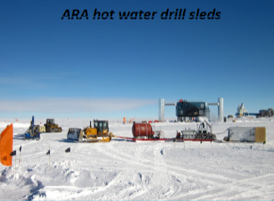
ARA field activities on the ice

Slide 30
ARA field activities on the ice
Status:
2010-11: Test detector (TestBed, shallow) deployed
Deep calibration pulsers deployed with IceCube
2011-12: ARA1 prototype deployed: ~70m due to drill limitations
2012-13: Drill upgrade,
Built and Deployed two more stations, now at 200m depth
3 stations Comparable to sensitivity of IceCube at 10¹⁸eV
2013-14: Calibration activities
2014-15: Calibration activities, repairs on ARA1
2016-17: Planned deployment of ARA4-ARA??? stations

Slide 31
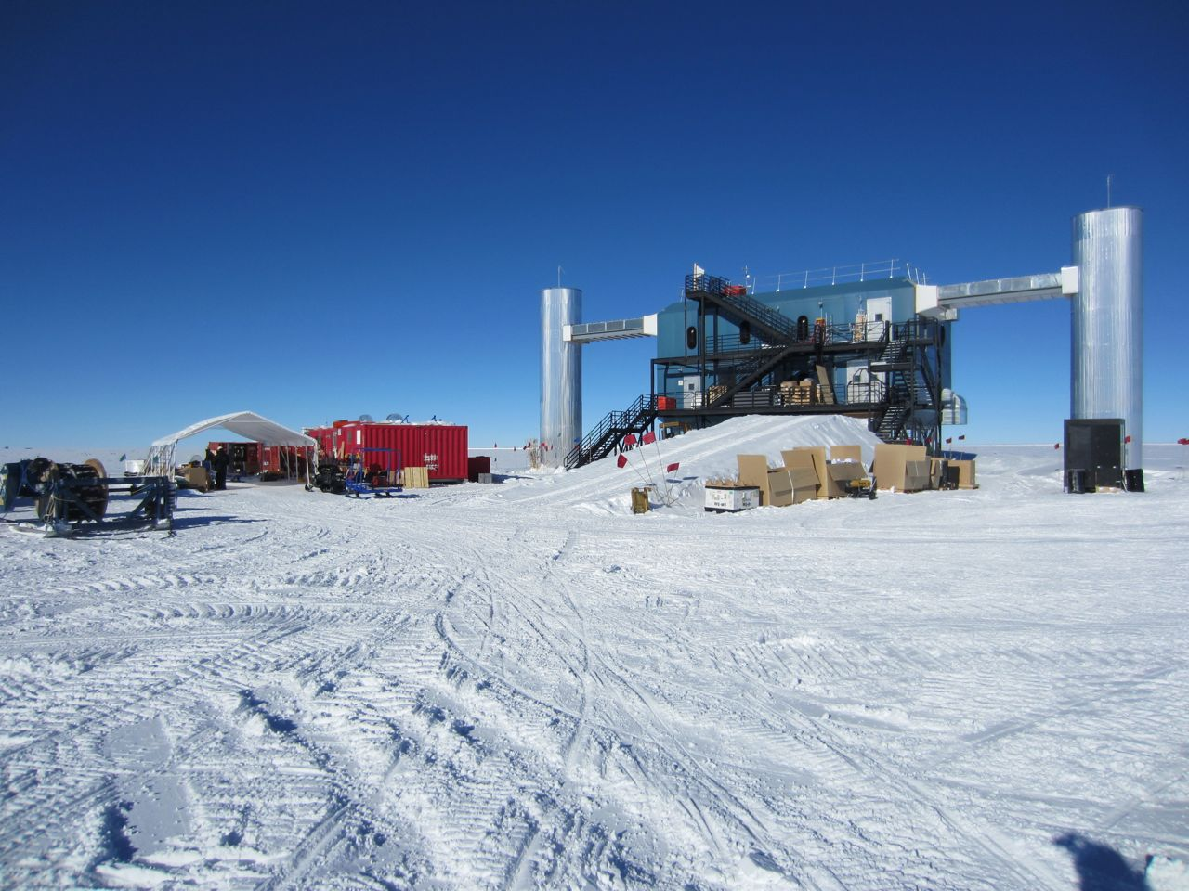
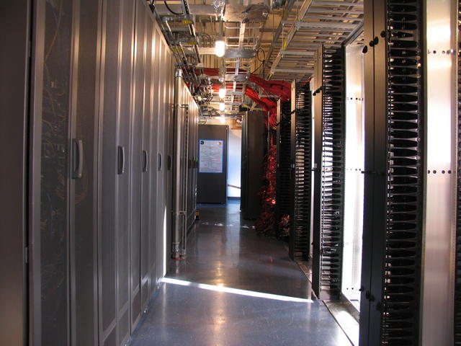
IceCube Laboratory
ARA equipment base and shop
(former IC equipment)
IceCube infrastructure
helpful as a lab to host the ARA DAQ
and facilitate ARA operations
(similar data flow mechanisms)
Two IceCube winter-overs

Slide 32
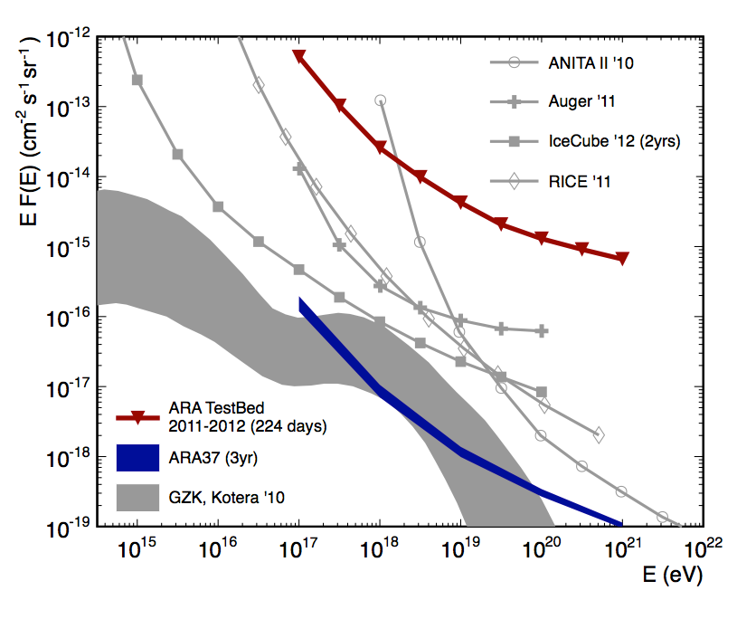
TestBed limit to exercise full analysis process with new simulations
arXiv:1404.5285

Slide 33
The Future…
NSF funding has been difficult
Three similar, competing projects (ARA, ARIANNA, GNO) now coming together
Looking ahead for a four year deployment push to complete the ARA-37 design
Electronics updates
Better trigger algorithms
Data reduction at on-line & off-line
Farther out, even larger detector…
But first, an interesting calibration:

Slide 34
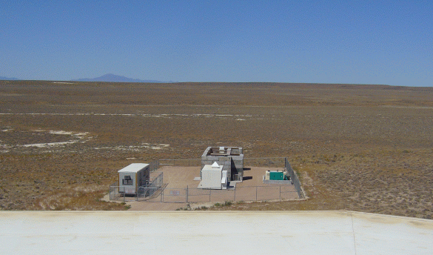
End-to-end calibration of the ARA detectors using the Telescope Array LINAC
TA LINAC @Utah
Antenna
Filter + LNA
radio signal
Ice (75 kg)
~10 m
40 MeV electrons
Oscilloscope
Electron Light Source
~6 m
Generator (80 kW)
Cooling unit container
Control room
Purpose: Confirmation of Askaryan signals and the ARA detector calibration

Slide 35
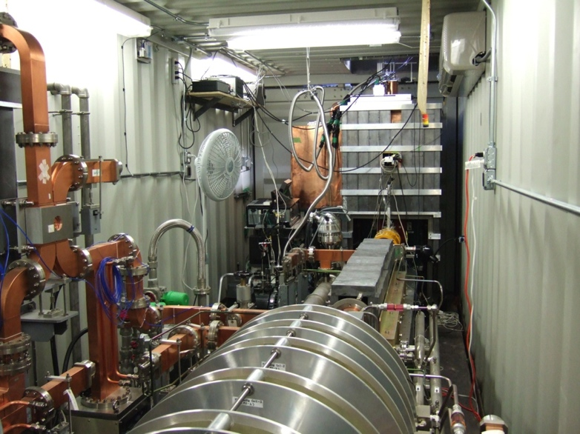
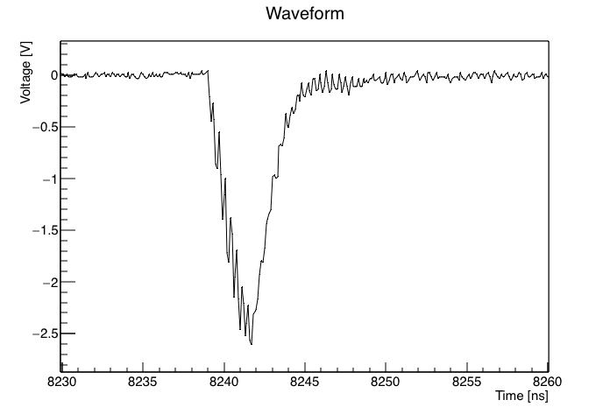
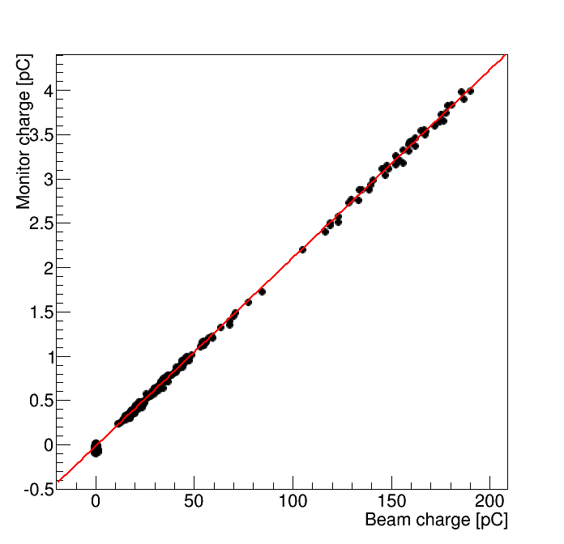
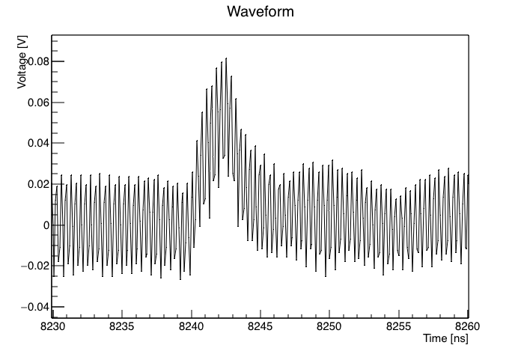
TA accelerator configurations
Investigated the suitability of their accelerator for our experiment
Beam waveform
5ns
Bunch structure clearly seen!
→ Precise signal estimation
10⁹ electrons
→ Enough signal strength
Monitor waveform
Cover wide range
Correlation
→ Electron number monitoring
The accelerator is confirmed to be suitable for the ARA detector calibration

Slide 36
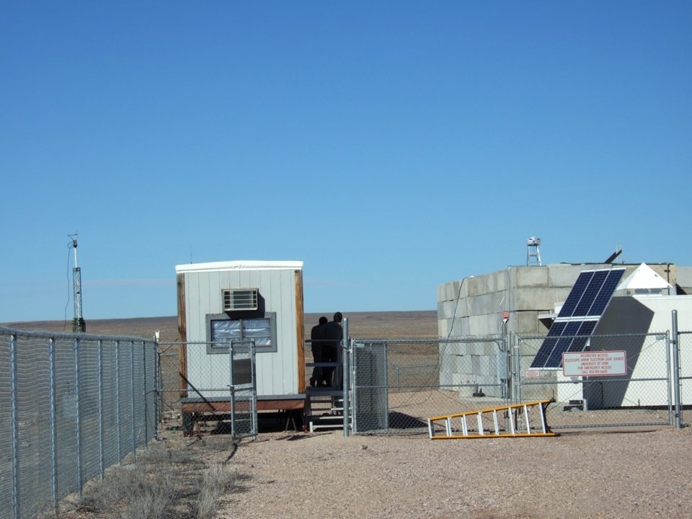
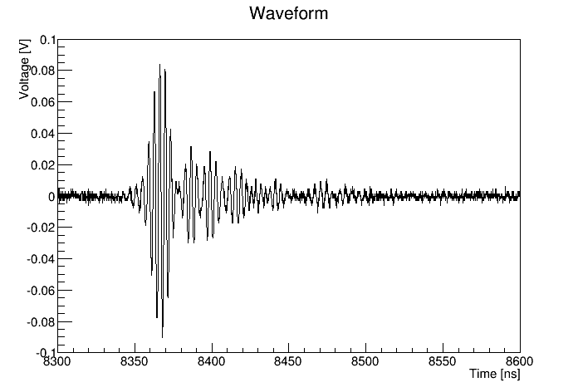
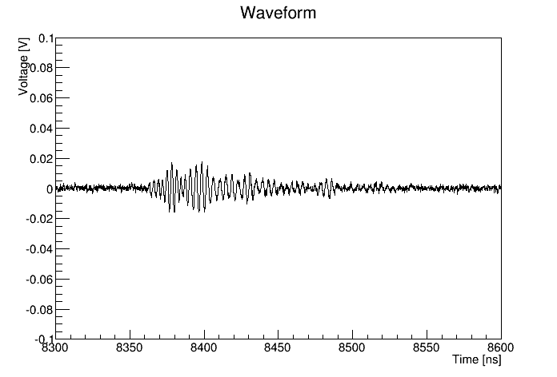
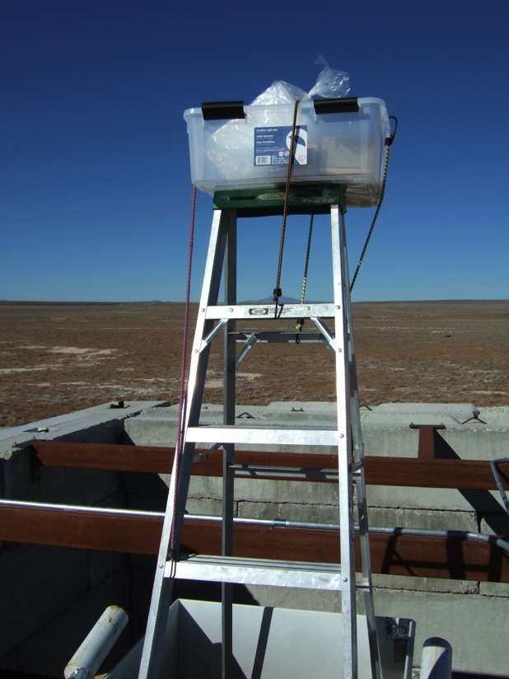
Radio signals from a target: ice + plastic + ladder
First attempt to observe radio signals
Bicone antenna
Target
Vpol
15.5 m
Hpol
ice
plastic box
ladder
Radio signal detected! Polarized!

Slide 37
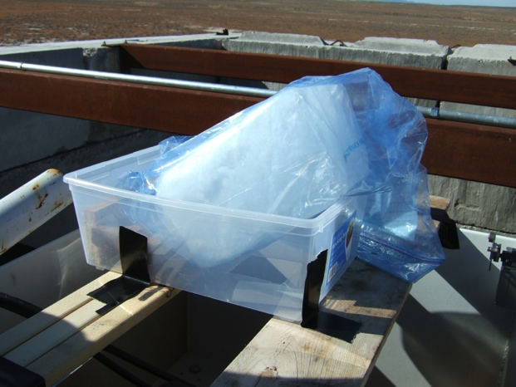
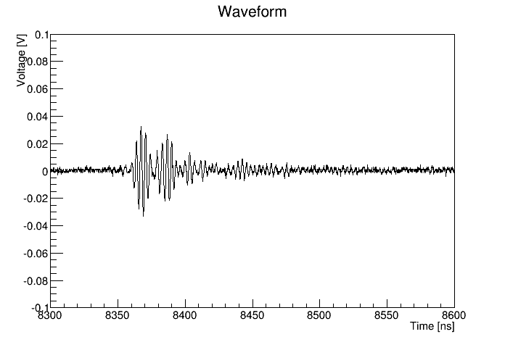
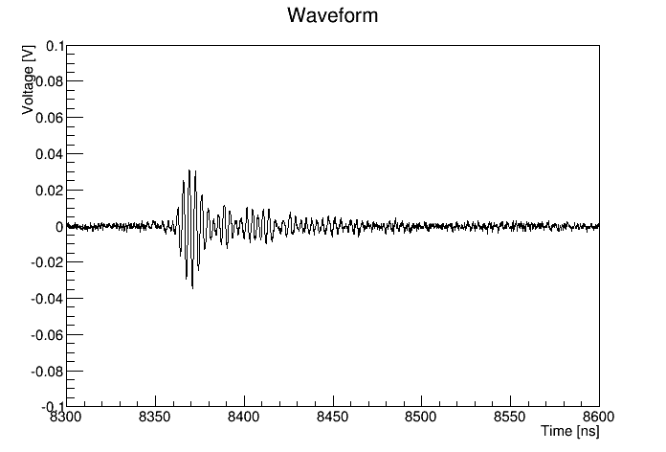
Radio signal from a target: only ice
Attempt to reduce emissions from plastics
40 MeV beam
ice
plastic box
Hole underneath the plastic box
Vpol
Hpol
Radio signal from ice!

Slide 38
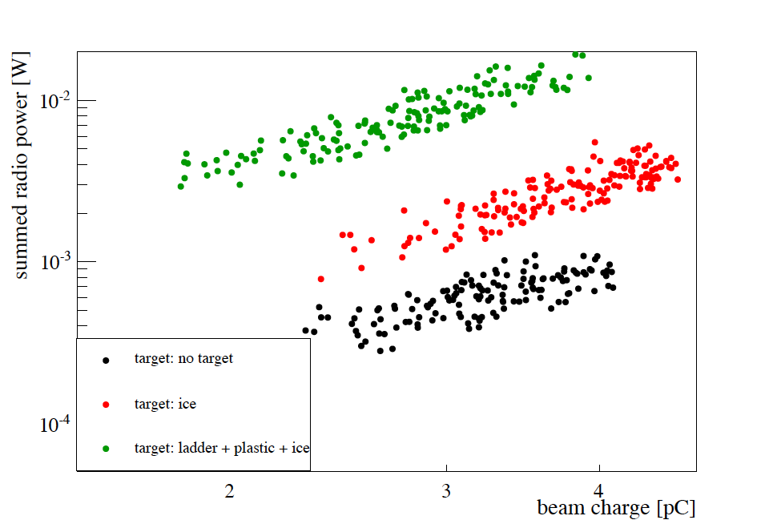
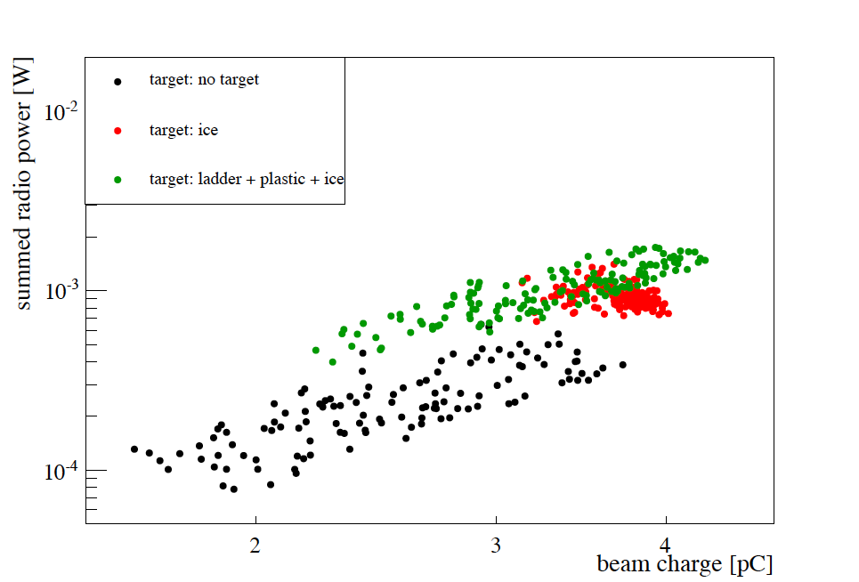
Radio power Vs. monitor charge
Vpol
● no target
● ice
Hpol
● ice + plastic + ladder
● no target
● ice
● ice + plastic + ladder
Monitor charge [pC]
Monitor charge [pC]
Radio power is proportional to square of beam charge
Signals are polarized
More detail analysis is on going

Slide 39


Actual calibration in January
Test of antenna tower and antenna support structure in Japan
The actual calibration will be performed in January, 2015
Actual ice target (100 x 25 x 30 cm³)
40 MeV electrons

Slide 40

Backup Slides

Slide 41

Deployment setup

Slide 42


Slide 43


Slide 44

Cutting main trench

Slide 45

Hole qualifier

Slide 46


Ice Attenuation Length
Most radio transparent material on Earth!
Depends on ice temperature. Colder ice at the top.
Reflection Studies (2004) (Down to bedrock, 200-700MHz): “normalize” average attenuation according to temperature profile.
Besson et al. J.Glaciology, 51,173,231,2005

Slide 47



Preliminary test in October/November
Preview the TA-LINAC site in October/November (2 weeks)
The actual experiment is planned in January, 2015 for 3 weeks
Investigated the suitability of their accelerator for our experiment
Environmental noise measurements (turned out to be very low noise for frequencies of our interest)
Performed preliminary tests for several targets
Ice + plastic + ladder
Plastic + ladder
No target
Plastics (1 layer and 3 layers)
Only ice
Bigger ice block (100 x 25 x 30 cm³) will be used for the actual experiment in January with a better configuration
15.5 m

Slide 48

TA accelerator configurations
Achieved narrow bunch train width of ~3ns
The bunch structure clearly seen
Monitoring electron numbers possible
Electron numbers reaches to 10⁹ (160 pC)
→ Measurable signals of ~100 mV expected
Faraday Cup (FC)
Monitor

Slide 49

Frequency spectrum
Peak of 5 bunch is 300 MHz
→ Optimal
3 bunch
4 bunches
5 bunches
6 bunches
7 bunches
8 bunches
9 bunches
10 bunches
200-400 MHz

Slide 50

Effect of group delay
250-350 MHz
Black: without group delay
Red: with group delay
Group delay effect is small

Slide 51

Correlation between FC and WCM
No cable
with cables

Slide 52




Radio signal from targets: ice+plastic
Vpol, high
Hpol, high
Vpol, low
Hpol, low

Slide 53




Radio signal from targets: only ice
Vpol, high
Hpol, high
Vpol, low
Hpol, low

