Slide 1



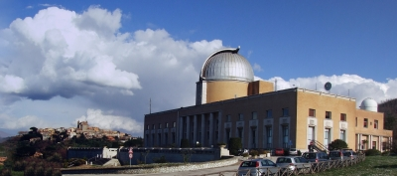

Neutrinos from Gamma Ray Bursts in the IceCube and ARA Era
טכניון
Dafne Guetta
Notes:
We would like you to talk about Gamma-ray Burst Theory in the Fermi Era . In addition to a review of progress to date, we would also like you to include, as appropriate, the following topics:
* Synergies with other measurements both current and in the near future
* Specific areas that need more effort
* Future prospects

Slide 2
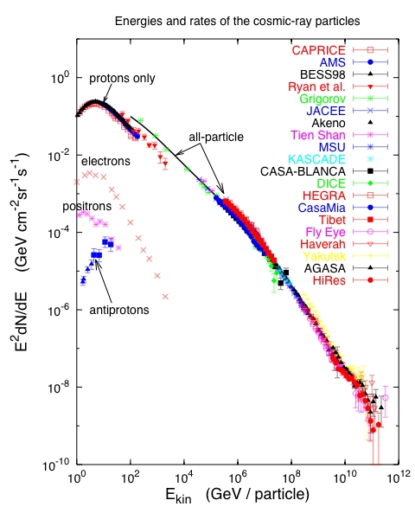
Cosmic Rays and Neutrino Sources
Can neutrinos reveal origins of cosmic rays?
Cosmic rays
  Cosmic ray interaction in accelerator region
  Prime Candidates
  SN remnants
  Active Galactic Nuclei
  Gamma Ray Bursts
knee
1 part m⁻² yr⁻¹
Ankle
1 part km⁻² yr⁻¹
Notes:
Cosmic rays have been observed to energies above 1E20eV. Spectrum and composition give some ideas of the nature of the acceleration and transport.
Most candidates of astrophysical neutrinos are closely related to the observation of high energy cosmic rays. We know that cosmic rays exist to highest energies. Possible sources are SN remnants, active galaxies or gamma ray bursts. Neutrino production may take place in the source region or on other, not too dense targets such as the Earth’s atmosphere, the interstellar medium or the cosmic microwave background.

Slide 3
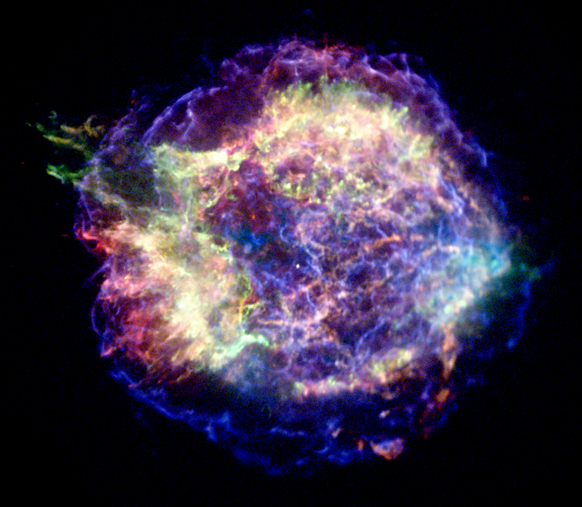
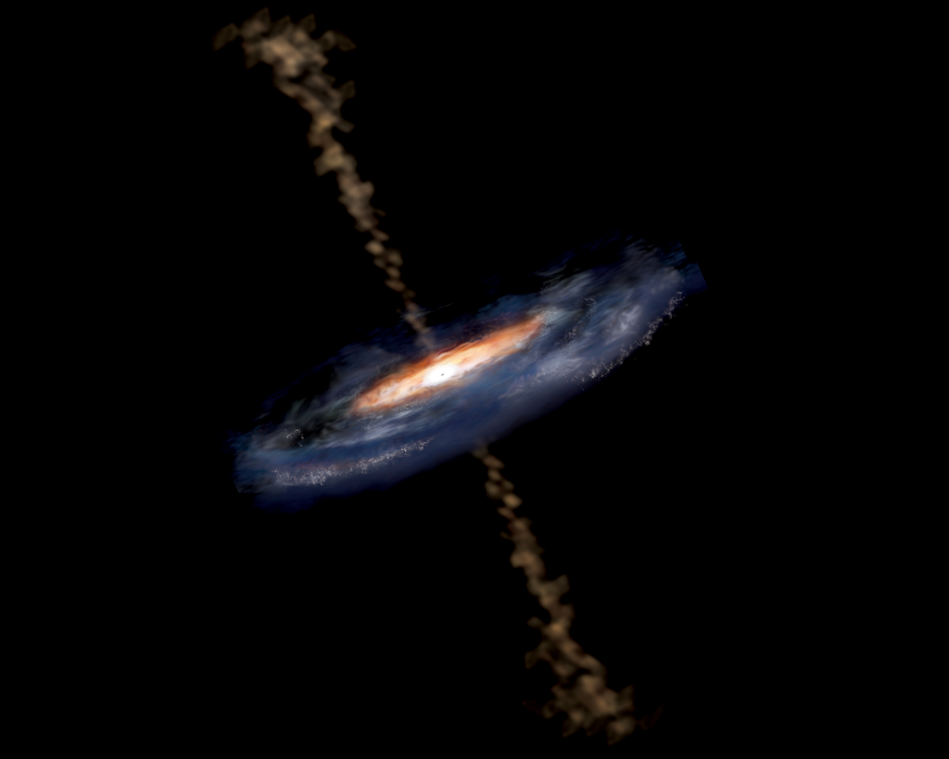
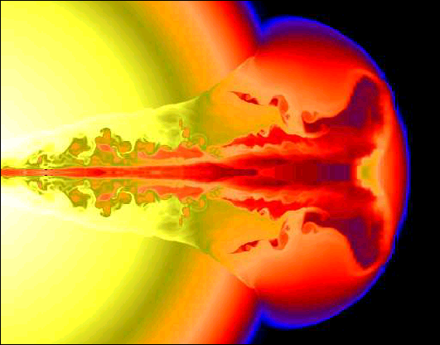
Cosmic Rays and Neutrino Sources
Can neutrinos reveal origins of cosmic rays?
Cosmic rays
  Cosmic ray interaction in accelerator region
  Prime Candidates
  SN remnants
  Active Galactic Nuclei
  Gamma Ray Bursts
knee
1 part m⁻² yr⁻¹
Ankle
1 part km⁻² yr⁻¹
Notes:
Cosmic rays have been observed to energies above 1E20eV. Spectrum and composition give some ideas of the nature of the acceleration and transport.
Most candidates of astrophysical neutrinos are closely related to the observation of high energy cosmic rays. We know that cosmic rays exist to highest energies. Possible sources are SN remnants, active galaxies or gamma ray bursts. Neutrino production may take place in the source region or on other, not too dense targets such as the Earth’s atmosphere, the interstellar medium or the cosmic microwave background.

Slide 4
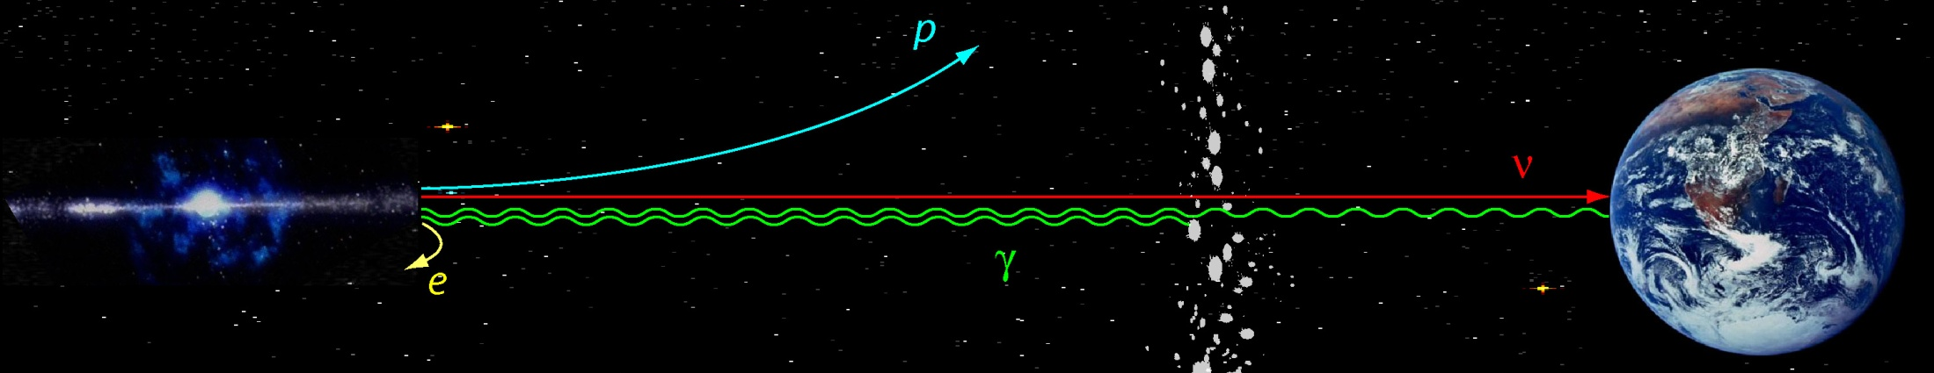
Cosmic neutrinos?
Why look for them?
They could tell us about the origin of high energy cosmic rays, which we know exist.
  There are numerous ways how neutrinos can tell us about fundamental questions in nature: dark matter, supernova explosions,
  Composition of astrophysical jets, physics of the source core
Can they reach us?
High energy neutrinos will pass easily and undeflected through the Universe
  That is not the case for other high energy particles: such as photons or other cosmic rays, eg protons.
p
ν
γ

Slide 5
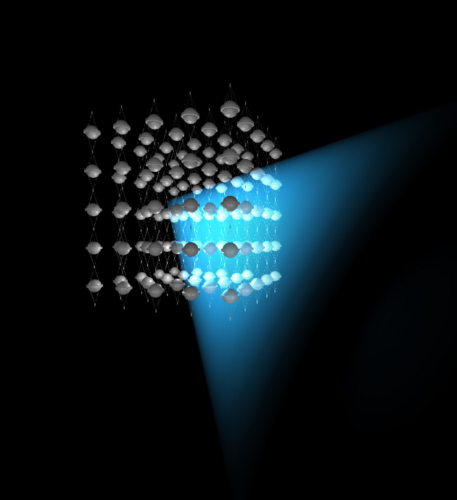
How to catch them? Detection principle
Deep detector made of water or ice – lots of it - let’s say 1 billion tons
Place optical sensors into the medium
μ
neutrino travels
through the earth
and …
sometimes interacts to make a muon
that travels through the detector

Slide 6
From 2 to 3 years: Declination vs energy
Botner talk
Most events in Southern hemisphere (downgoing).

Slide 7
An astrophysical neutrino flux?!
IceCube data provide strong evidence for an astrophysical neutrino flux
Consistent with:
  1:1:1 all flavor neutrino flux – as expected for astrophysical sources
  Isotropic distribution, north, south – specifically no evidence for galactic association.
The data suggest that we see an extragalactic neutrino flux.
The level of this flux is exactly and thus intriguingly so at the level of the Waxman-Bahcall upper bound.
- Is it a clue for it’s origins? Eli’s talk

Slide 8
GRB Theoretical Framework:
Progenitors:
  Long: massive stars
  Short: binary merger?
Acceleration: fireball or magnetic?
Prompt γ-rays: internal shocks?
magnetic plasma?
Deceleration: the outflow decelerates as it sweeps-up the external medium
Afterglow: from the long lived forward shock going into the external medium; as the shock decelerates the typical frequency decreases: X-ray ➔optical ➔ radio

Slide 9
Gamma-ray Bursts as particle accelerators and neutrino sources
M on ~1 Solar Mass BH
Relativistic Outflow
Γ~300
e⁻ acceleration in
Collisionless shocks
e⁻ Synchrotron MeV γ’s
L_{γ}~10⁵²erg/s
UHE p Acceleration
[Meszaros, ARA&A 02;
Waxman, Lecture Notes in Physics 598 (2003).]
]

Slide 10
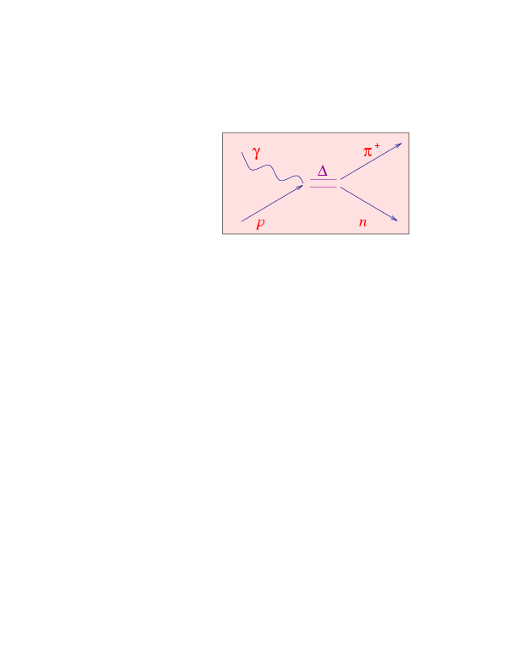
The main mechanism: photomeson interaction
In each collision Eν ~ 0.05 E_{p}
Fireball
Ep ~ 10¹⁶ eV
Eν ~ 10¹⁴ eV
Int. Shocks Eγ~MeV:
Ep ~ 10¹⁹ eV
Eν ~ 10¹⁷ eV
Ext. shock Eγ~keV :
0.2 I.S.
0.01 E.S.
proton en. lost to pion production: f_{π}~f(Γ,tv, L)
Burst to burst fluctuations look at each burst detected by BATSE [Guetta, Hooper, Halzen et al. 2003]

Slide 11
For a typical burst at z~1, E ~ 10⁵³erg
Internal shocks ν:
“effective” f_{π} ~20% [Guetta Spada Waxman 2001]
■ Fluence E²_{ν}dN/dE_{ν} ~ 10⁻³(f_{π} /0.2)(E_{ν}/10¹⁴ eV)^{β} GeV/cm²
β=0 E_{ν} > E_{ν}^{b}
β=1 E_{ν} < E_{ν}^{b}
Detection probability ~ 0.01 per burst in km-cube neutrino telescope
Ten events per yr correlated in time and direction with GRBs!
External shock : “effective” f_{π} ~0.01 [Waxman & Bahcall 2000]
■ Fluence E²_{ν}dN/dE_{ν} ~ 10^{-4.5}(f_{π} /0.01)(E_{π}/10¹⁷ eV)^{β} GeV/cm²
β=½ E_{ν} > E_{ν}^{b}
β =1 E_{ν} < E_{ν}^{b}
0.06 events per yr in a km-cube detector delayed ~10s after the GRB

Slide 12
(No) neutrinos in coincidence with gamma ray bursts
-----------
90% c.l. = 0.47 model
IC59+40 combined limit
5.2 events expected
0 events observed
Abbasi et al. Nature Vol 484, 351 (2012)
GRB fireball neutrino models tested.
From this analysis GRBs fireball model strongly constrained (Hummer, Baerwald & Winter 2012) and GRBs as the primary source of highest energy CR strongly disfavored for classes of models (neutron escape)
Bustamante talk

Slide 13
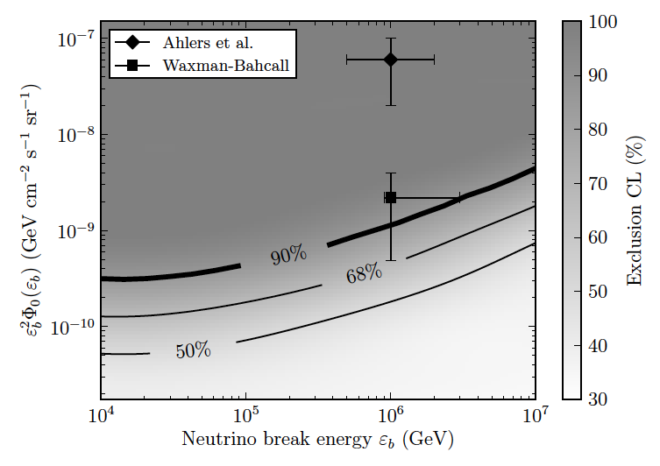
Updated IceCube analysis
Aartsen et al. 2014
WB limit revisited using Katz et al. 2009: If protons from GRBs can leave the source then GRBs can be the sources of UHECR
Ahlers et al. 2011 only neutrons can leave the GRB source EXCLUDED from this analysis
IceCube put strong constraints on several GRB models and models parameters like the barion loading and the Lorentz factor

Slide 14
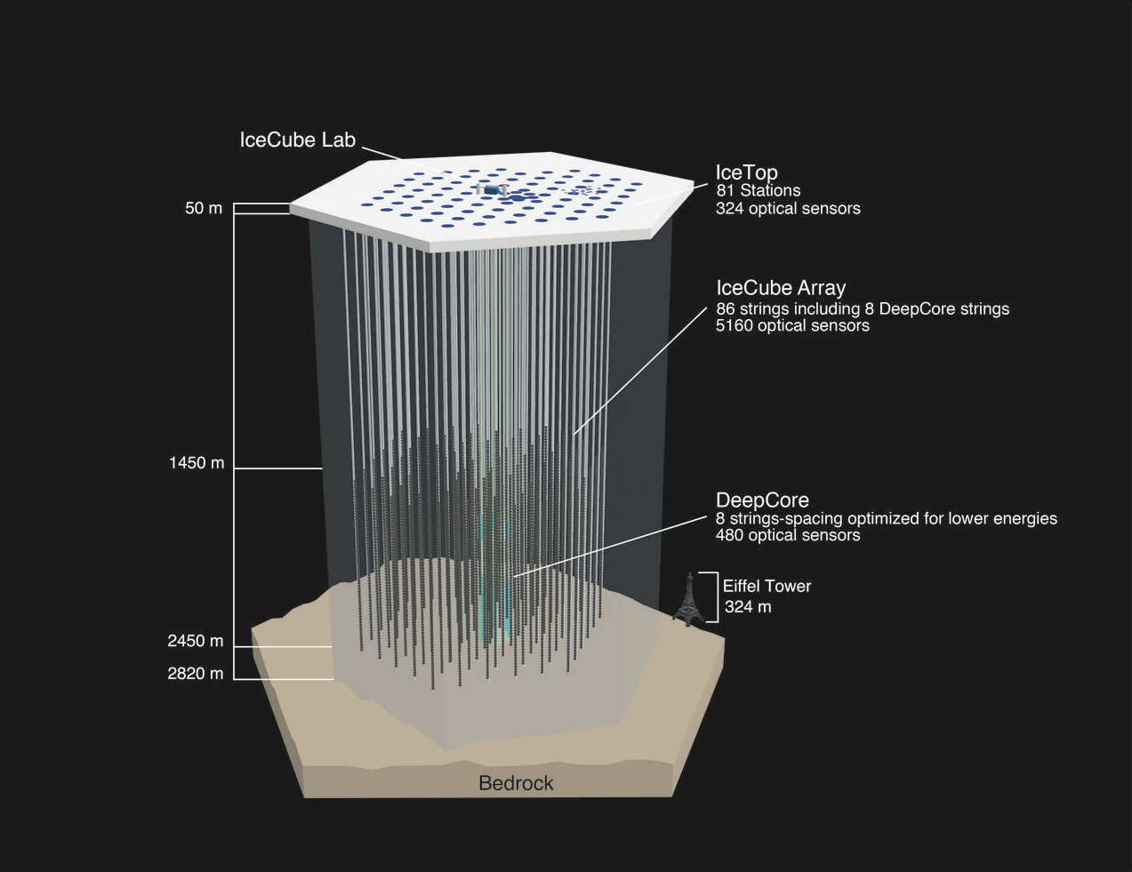
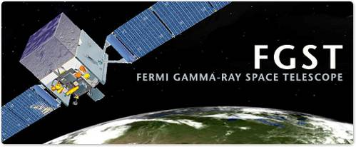

Fermi and IceCube Synergy
Hadronic component in GRB GeV emission?
Hadronic component of the GRB jet?

Slide 15
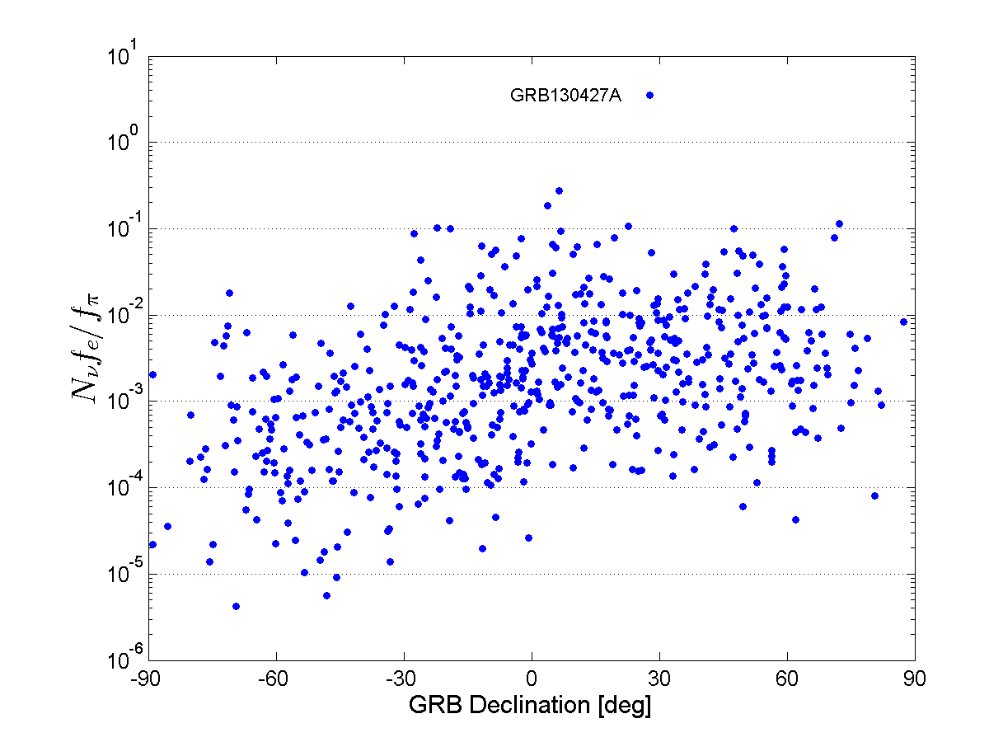
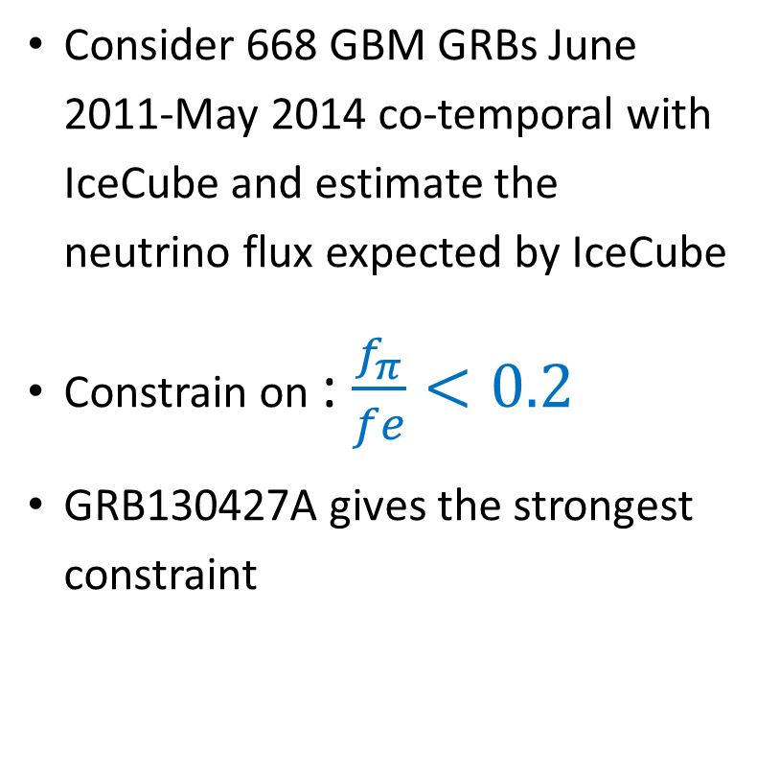
Further Constraints on GRBs neutrino flux using Fermi data and IceCube results
Lee, Guetta & Behar 2014, ApJ 793, 48
Consider 668 GBM GRBs June 2011-May 2014 co-temporal with IceCube and estimate the neutrino flux expected by IceCube
Constrain on : $\frac{f_{π}}{fe}<0.2$
GRB130427A gives the strongest constraint

Slide 16

Hadronic Content Constraint with LAT
$p+γ→Δ^{+} →\left\{\begin{aligned}n+π^{+} \\ p+π^{0} \end{aligned} \begin{matrix}1/3 \\ 2/3\end{matrix}\right.$ $\begin{matrix}π^{+}→e^{+}+ν_{e}+ν_{μ}+{\overline{ν}}_{μ} \\ π^{0}→γ+γ \end{matrix}$
High energy photons cascade through pair production to GeV regime
Aditional GeV photons can arise from the $e^{+}$ in the $π^{+}$ decay
At the GeV regime we would expect LAT to detect
$$F_{LAT}=F_{γ}^{π}+F_{γ}^{e}=\frac{3}{4}\frac{f_{π}}{f_{e}}\frac{F_{GBM}}{\ln\left(10\right)}+F_{γ}^{e}$$
$F_{γ}^{e}$ All other processes yield GeV photons, include IC and synch
Notes:
Photon cascade: pair production (e-,e+) which release energy to photons: e -> e + gamma. E can annihilate, gamma interact with gamma to pair production again.
At GeV gamma-gamma is less probable.

Slide 17
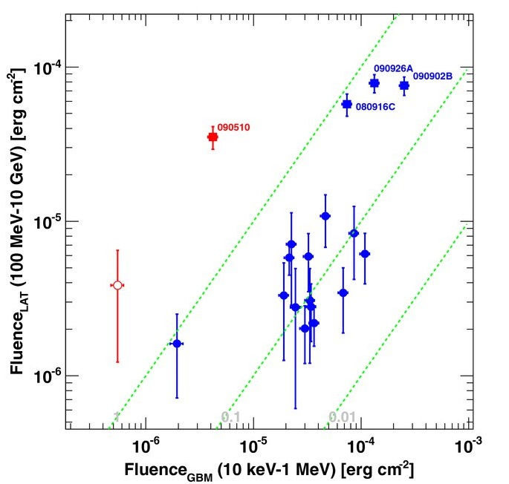

LAT Hadronic Content Constraint
The hadronic fraction of LAT fluence is
$f_{Had}=\frac{3}{4\ln\left(10\right)}\frac{f_{π}}{f_{e}}\frac{F_{GBM}}{F_{LAT}}$
$f_{Had}≤1$ constrain a single GRB
hadronic content $\frac{f_{π}}{f_{e}}≤\frac{4\ln\left(10\right)}{3}\frac{F_{LAT}}{F_{GBM}}$
For a typical $F_{LAT}{/F}_{GBM}=0.1$
$\frac{ f_{π}}{f_{e}}≤0.3$
For arbitrary GRB such as GRB080916C $\frac{ f_{π}}{f_{e}}≤0.03$
LAT 1st GRB CATALOG
Notes:
Photon cascade: pair production (e-,e+) which release energy to photons: e -> e + gamma. E can annihilate, gamma interact with gamma to pair production again.
At GeV gamma-gamma is less probable.

Slide 18

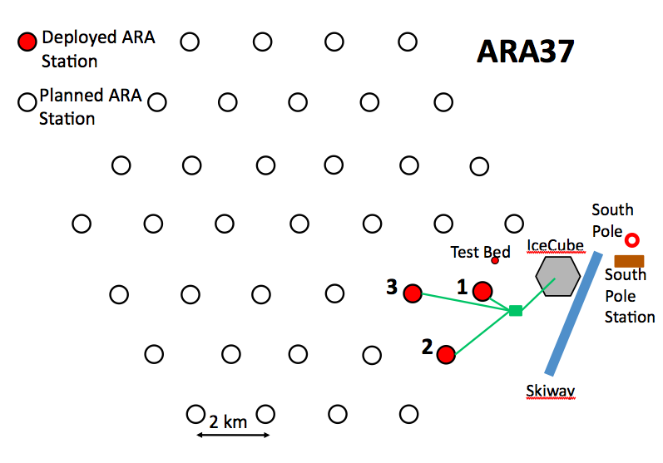
Askaryan Radio Array (ARA)
- a very large radio neutrino detector at the South Pole
10⁷ to 10¹¹GeV: Radio ice Cherenkov detection
Aongus talk
Scientific Goal:
Discover and determine the flux of highest energy cosmic neutrinos.
Understanding of highest energy cosmic rays, other phenomena at highest energies.
Method:
Monitor the ice for radio pulses generated by interactions of cosmic neutrinos with nuclei of the 2.8km thick ice sheet at the South Pole
A real coverage: ~150 km²

Slide 19
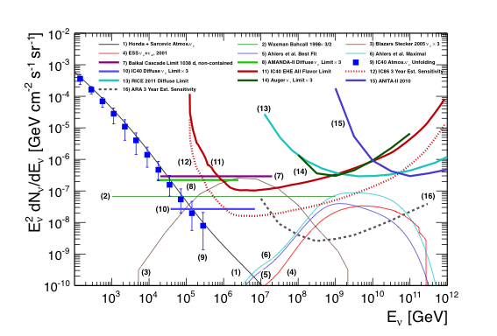
The cosmic energy frontier, 10⁷ to 10¹¹ GeV
Cosmogenic or GZK neutrinos
Sensitivity of 3 years
of ARA 37

Slide 20
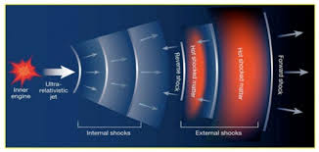
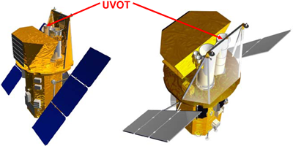
Prediction for GRB afterglow neutrinos in ARA
Nir, Guetta, Behar & Landsman in preparation
Consider UVOT sample includes long GRBs detected by Swift from March
2005 up to November 2014 with known redshifts. This selection results in 116 GRBs
Use the UVOT data on Swift to determine the photon flux of the reverse shock
During the afterglow emission
The accelerated protons may interact with these low energy photons producing
10¹⁷ eV neutrinos
Estimate the neutrinos afterglow flux and compare it with future ultra high energy
neutrinos detector sensitivities (calculation based on Waxman & Bahcall 2000)

Slide 21
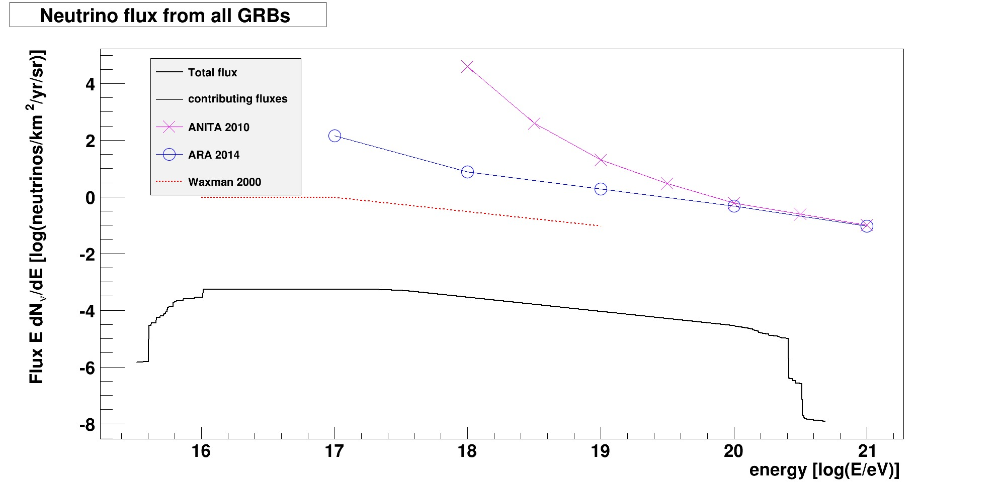
Predictions for afterglow neutrinos
GRB990123

Slide 22
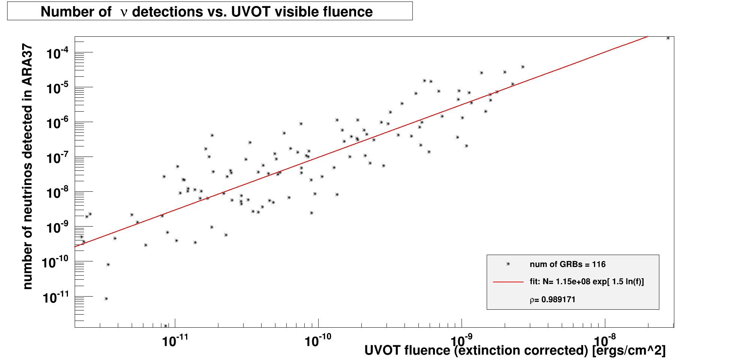
Number of AF neutrinos predicted for ARA
No chance to be detected by ARA

Slide 23
Sensitivity to the UHEN flux from GRBs
with the prototype station of ARA
Results from the search for ultra-high energy (UHE) neutrinos from Gamma-Ray Bursts (GRBs) with the Askaryan Radio Array (ARA) Testbed station's (Murchadha talk) 2011-2012 data set.
57 GRBs were selected to be analyzed. because they occurred during a period of low anthropogenic background and high stability of the station, and fell within our geometric acceptance.
NeuCosmA model (Hummer, Baerwald & Winter 2012) for the Testbed GRB neutrino search
Searched for UHE neutrinos from 57 GRBs and observed 0 events, which is consistent with 0.1 estimated background events.

Slide 24
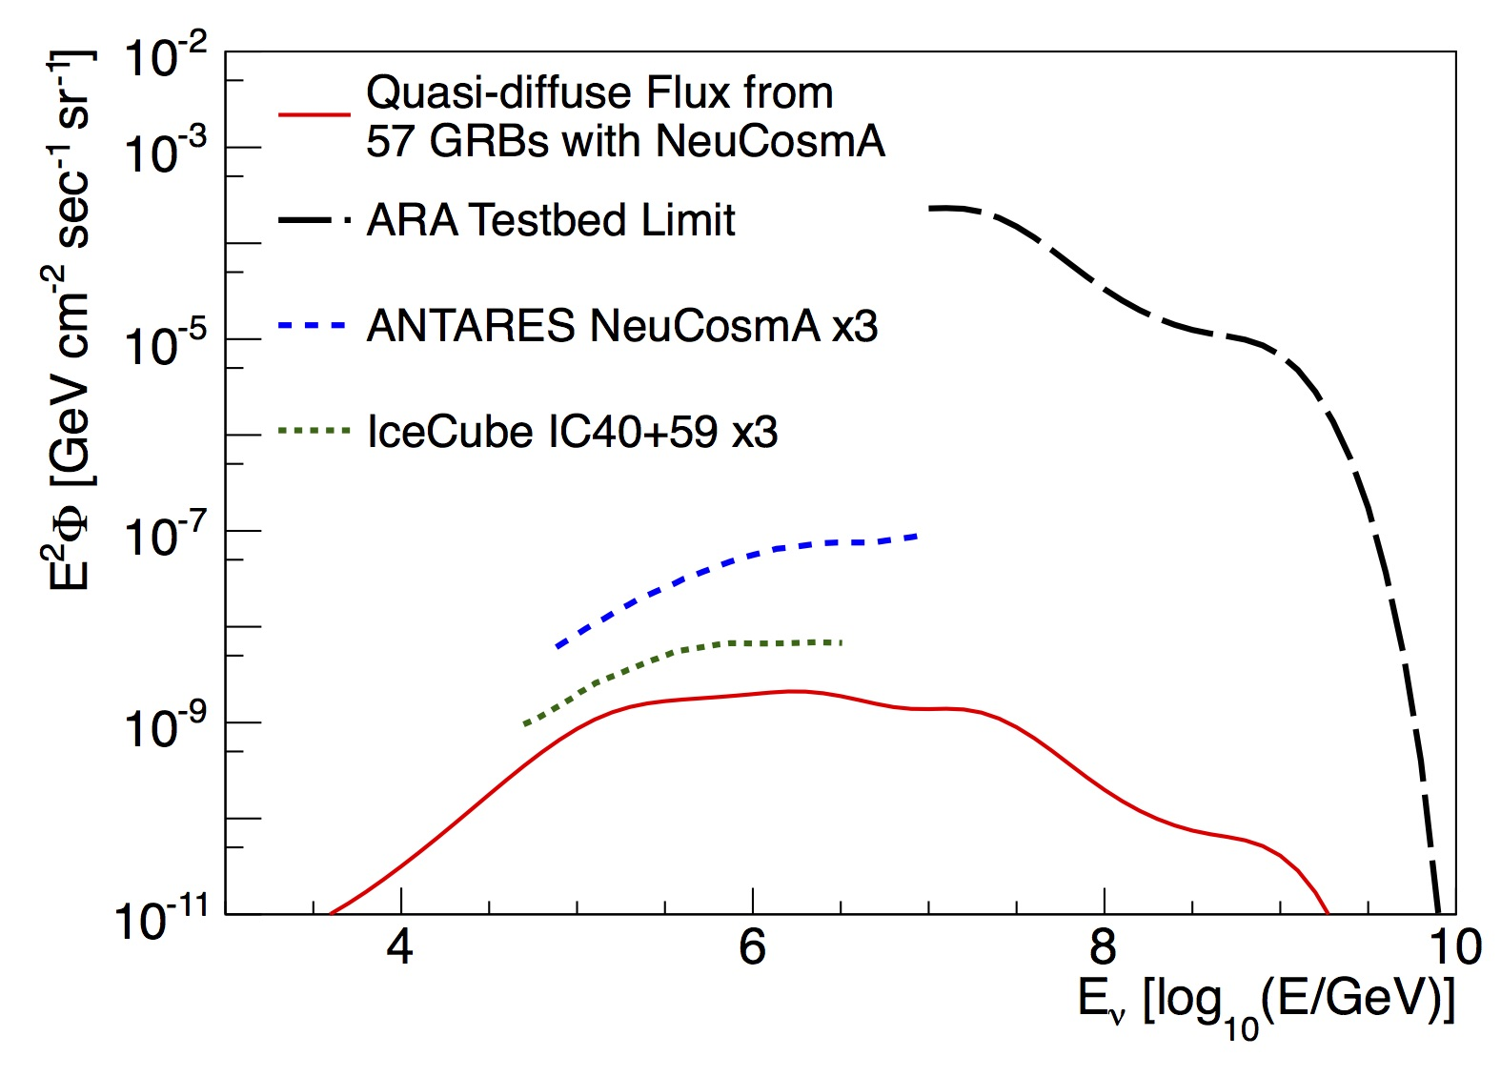
The Testbed analysis estimate the sensitivity to UHE GRB neutrino fluence and quasi-diffuse flux from 10¹⁶ to 10¹⁹ eV.
Preliminary

Slide 25
Summary and Conclusions
IceCube put strong constraints on several GRB models and models parameters like the barion loading and the Lorentz factor
IceCube constrain E₀²φ₀=10⁻¹⁰ GeVcm⁻²s⁻¹sr⁻¹ . Therefore GRBs can contribute to the diffuse flux detected by IceCube no more than 1%
In the absence of an emerging signal in the coming years, IceCube limits will increasingly constrain GRBs as dominant sources of UHECRs.
Further constraints on the GRB prompt neutrinos will come from ARA.GRB UHEN neutrino afterglow flux too low to be constrained by IceCube and ARA

Slide 26
No risk to be unemployed……
What are the sources of UHECR?
What are the sources of the HEN?
Multiwavelength analysis a must (parallel talks)
Km3NET (Bruijn talk)

