Slide 1
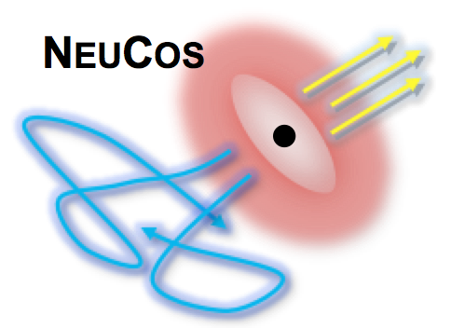
Theory benchmarks for IceCube-Gen2?
Walter Winter
DESY, Zeuthen, Germany IPA 2015 Madison, Wisconsin, USA
May 5, 2015
TexPoint fonts used in EMF: AAA

Slide 2
Contents
Introduction
Theory benchmarks
Example: Flavor
Example: Flux
Example: Special topologies
Summary

Slide 3
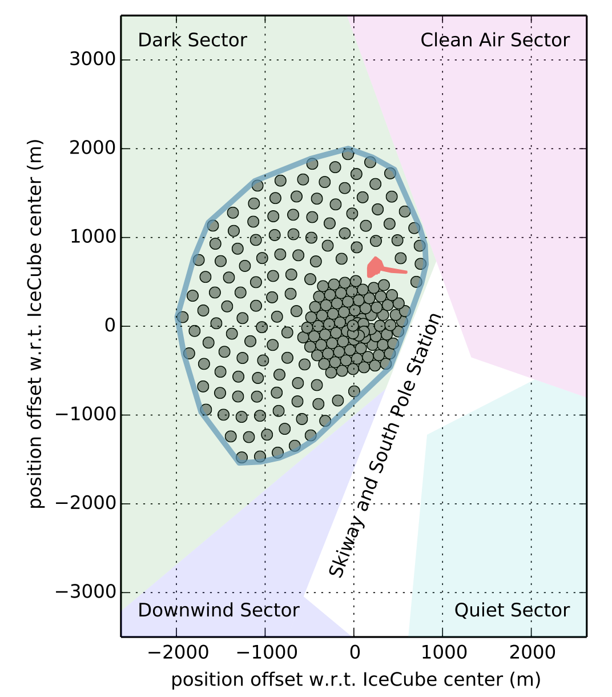
IceCube – Generation Two?
Plans for upgrade of IceCube experiment
Volume upgrade: Instrumented volume O(10) km³, string spacing 240-300m
Purpose: “deliver substantial increases in the astrophysical neutrino sample for all flavors”
This talk: How much “substantial increase” is actually needed/desirable from the theory perspective?
(arXiv:1401.2046, arXiv:1412.5106)

Slide 4
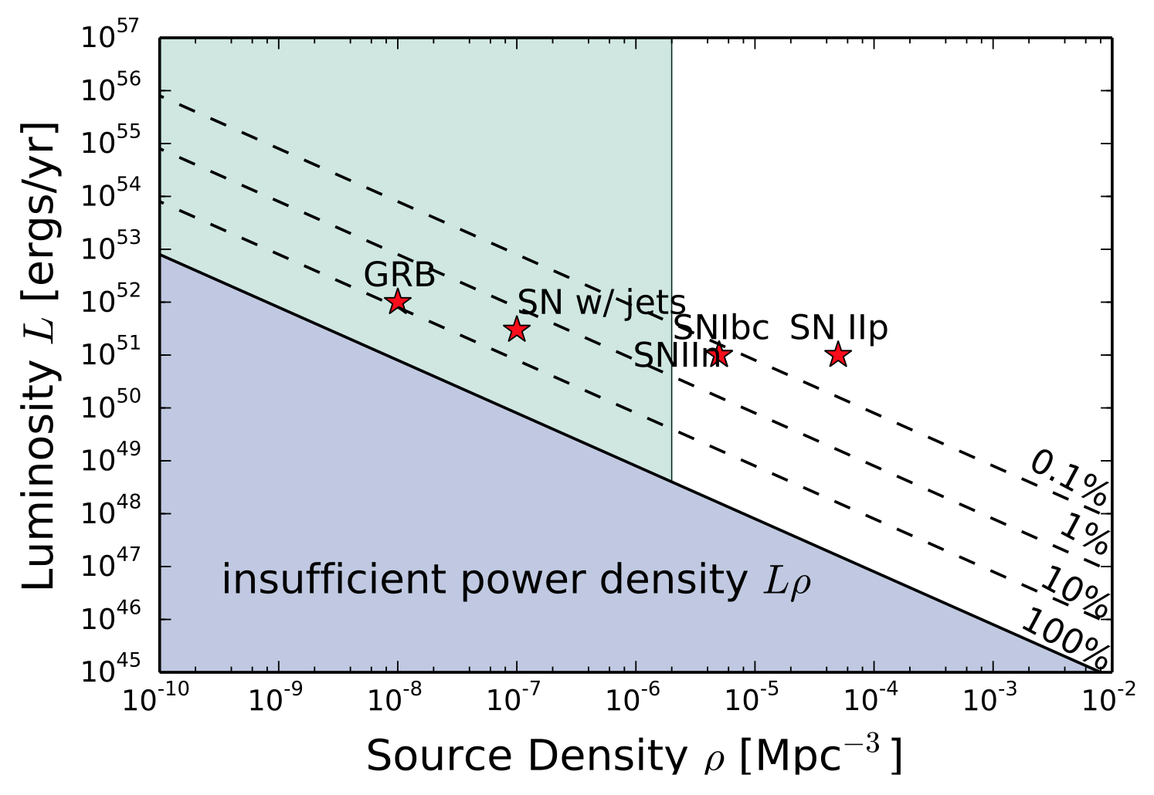
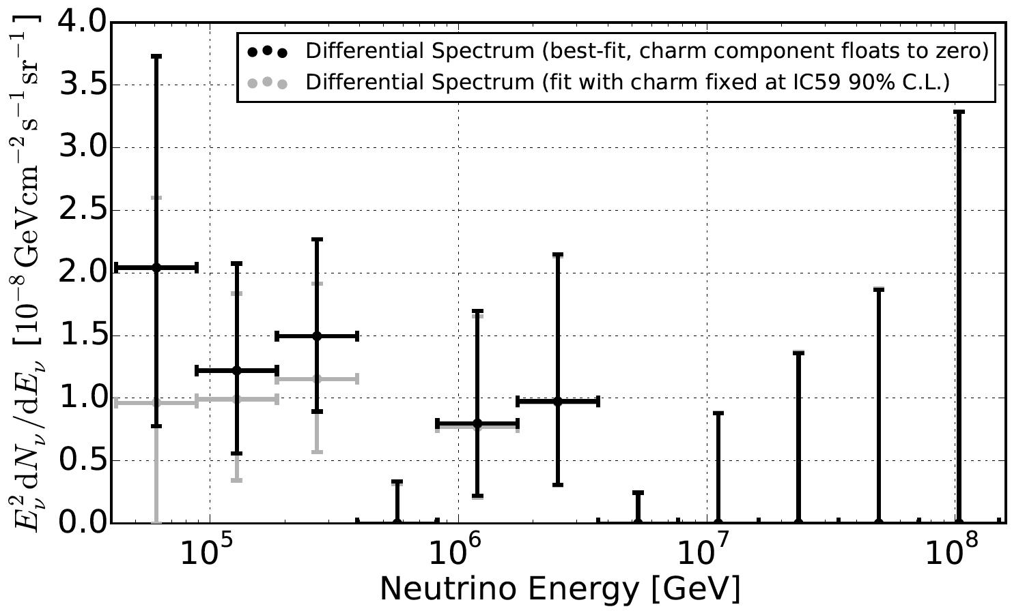
Targets for optimization (volume upgrade)?
Flux Many applications, e. g. use constraints on event multiplets to constrain source density (from Kowalski, arXiv:1411.4385; see also Ahlers, Halzen, arXiv:1406.2160)
Flavor
Cooling/acceleration of secondaries,
New physics searches
Special event “topologies” (Glashow res., double bang, …) Challenging if there is a cutoff at PeV energies
Future bound
Frac. energy release in ν
Saturate measured ν flux
IceCube, PRL 113 (2014) 101101
PeV energies
?
?
Are there any quantitative benchmark scenarios, which tell us how much exposure (= detector size x running time) is needed or desireable?

Slide 5
Example: Flavor

Slide 6
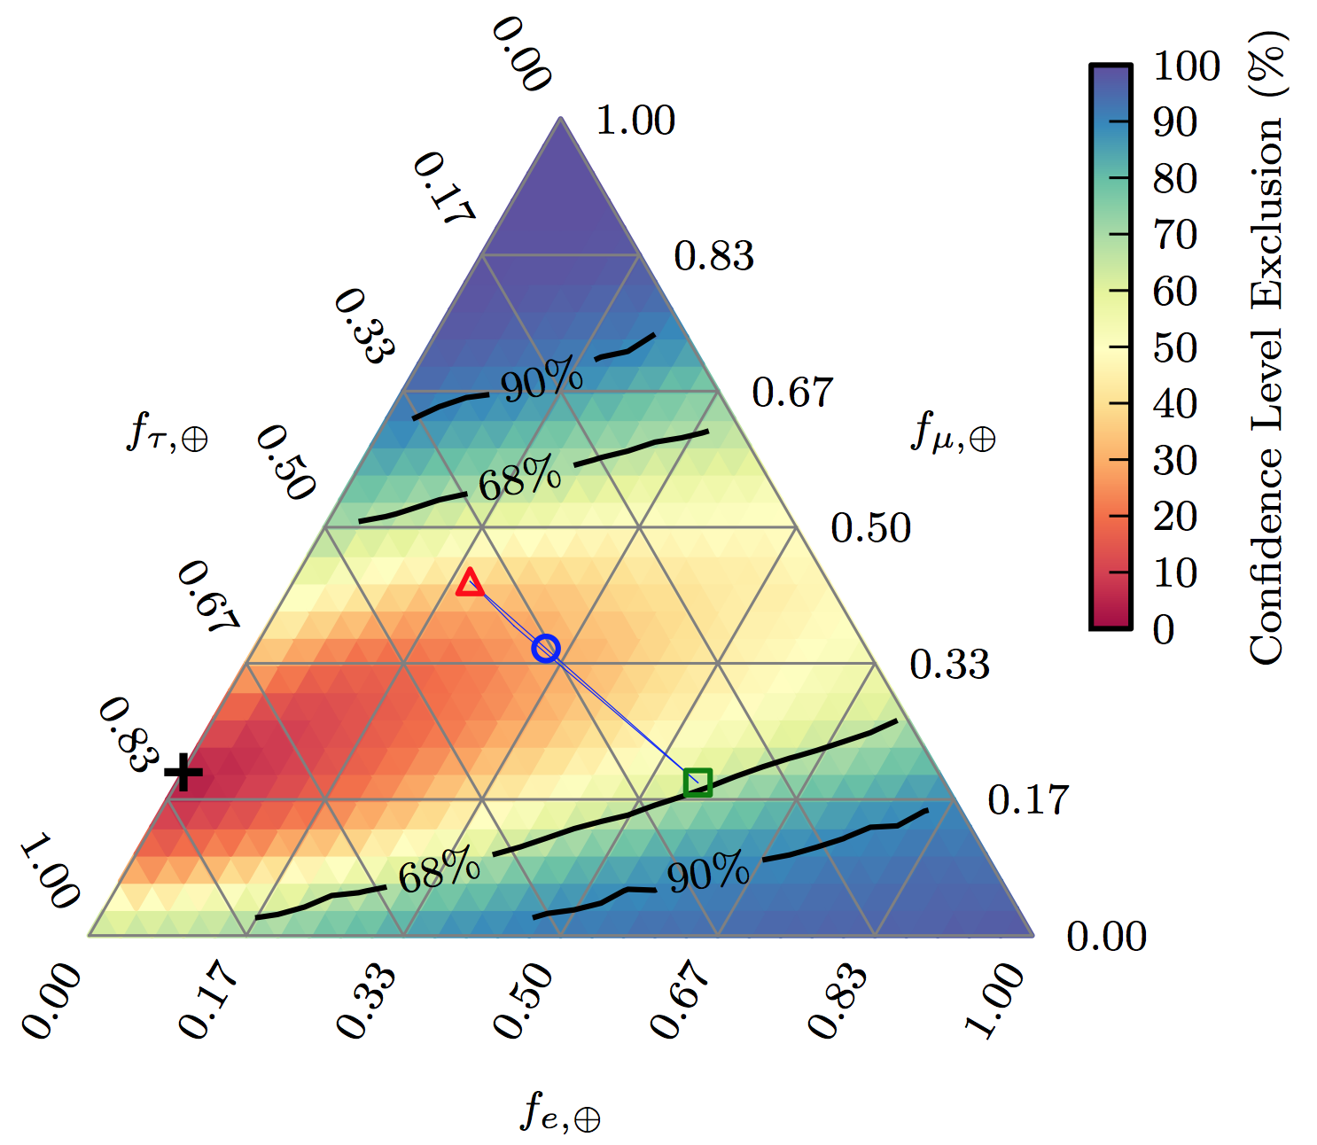
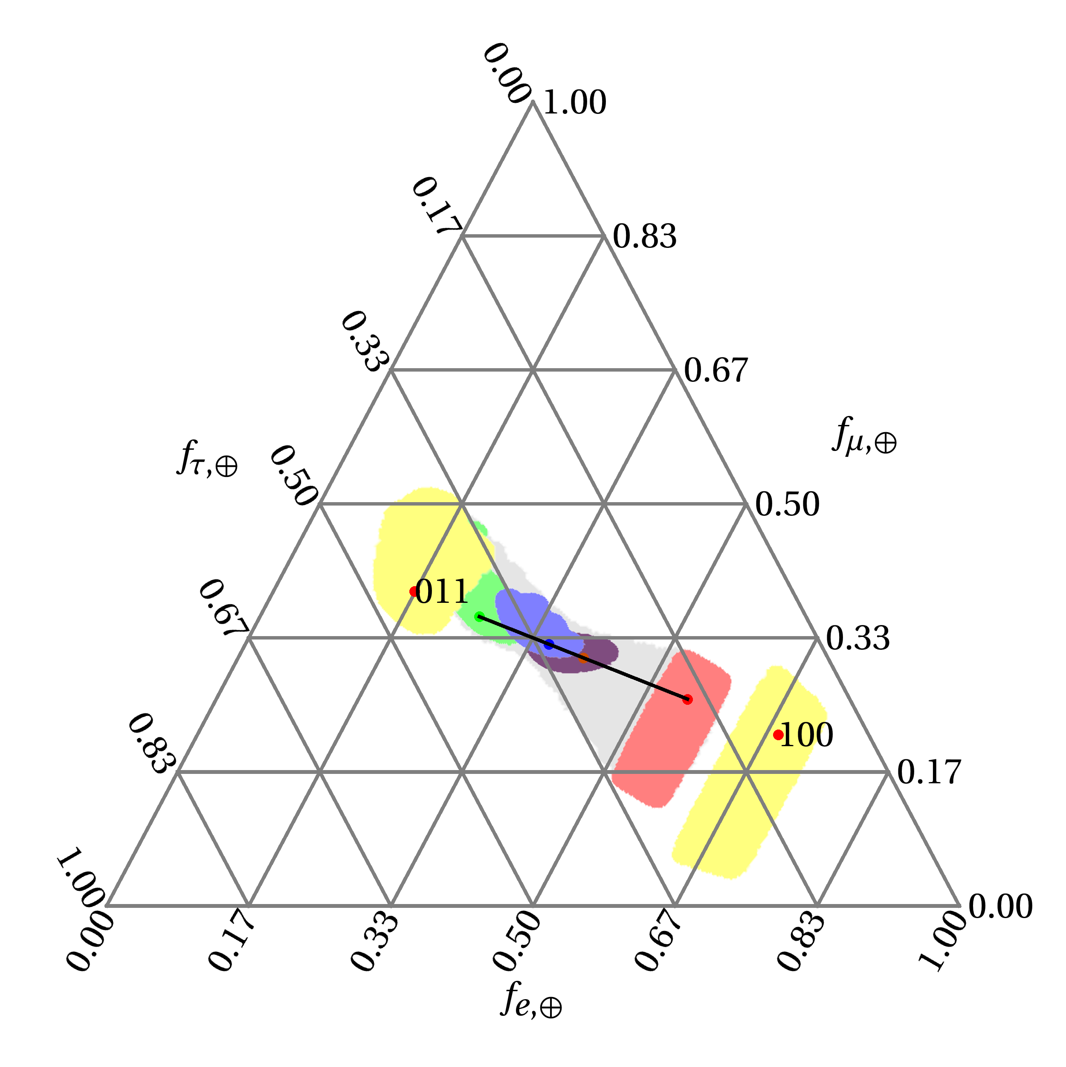
Potential of flavor information
Experiment (IceCube, arXiv:1502.03376)
Theory (WW, unpublished)
(shaded regions: current 3σ range for mixing params)
Theory degeneracy (ν_{μ} and ν_{τ} maximally mixed)
Experimental degeneracy (ν_{e} and ν_{τ} cascades look alike)
Exposure x 40 (extrapol.)
At source: ν_{e}:ν_{μ}:ν_{τ}
- 1:2:0 (blue) - 0:1:0 (green)
- 1:0:0 (red)
- 1:1:0 (purple) - X:1-X:0 (gray)
Decay scenarios (yellow) - 011: ν₁ unstable
- 100: ν₂, ν₃ unstable
Some regions can be excluded
Precision in relevant region too small, yet

Slide 7
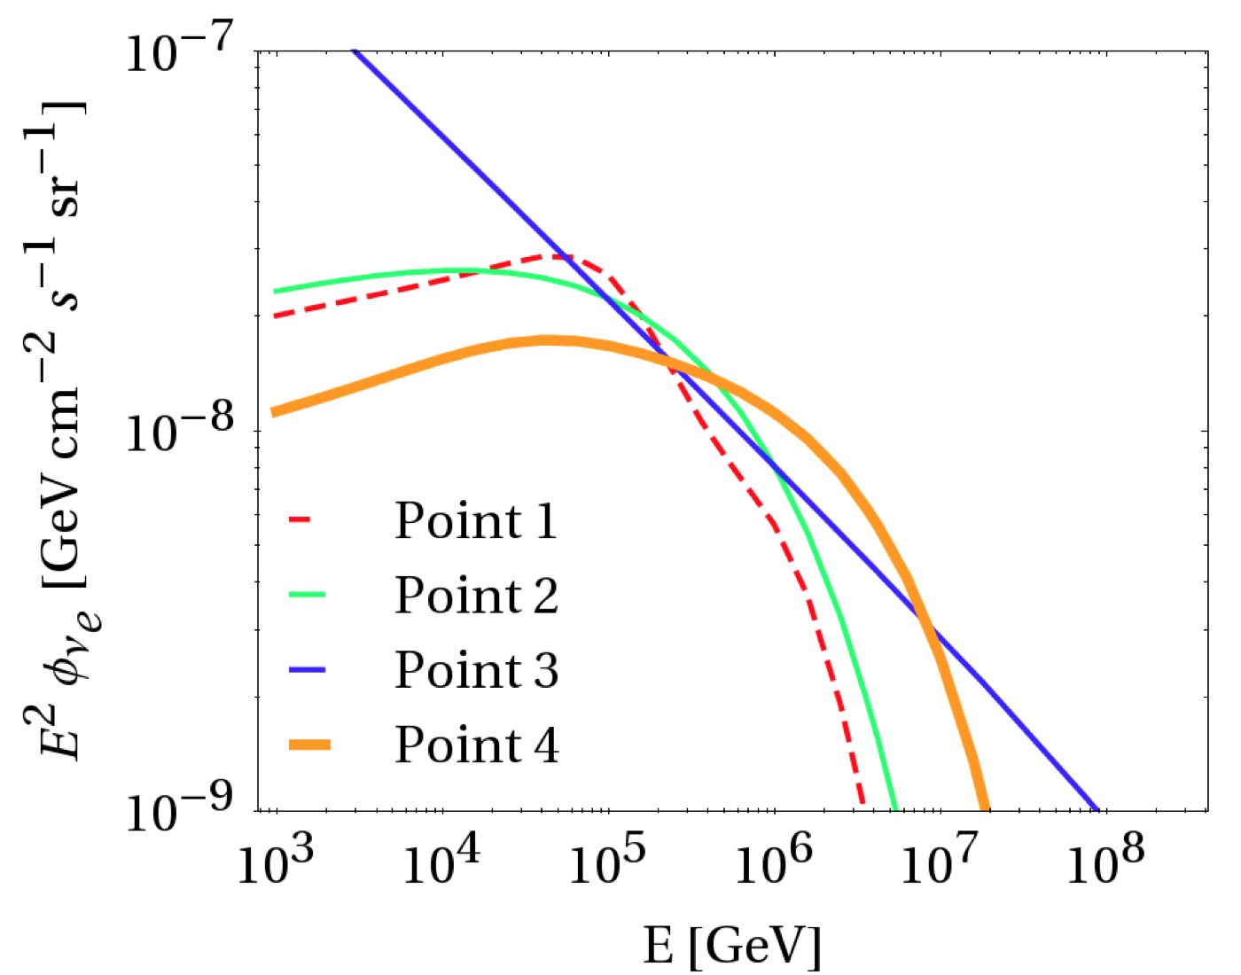
Spectral information has limitations
Example: Neutrinos from Ap interactions; sources cosmologically distributed
Find possible fits to data:
Protons α=2 B ~ 10⁴ G (magnetic field effects on sec. pions, muons, kaons)
Protons, α=2.5 (agrees with arXiv:1410.1749)
Nuclei
α=2, E_{max}=10^{10.1} GeV Composition at source with β=0.4
Protons α=2 E_{max}=10^{7.5} GeV
Winter, PRD 90 (2014) 103003, arXiv:1407.7536

Slide 8
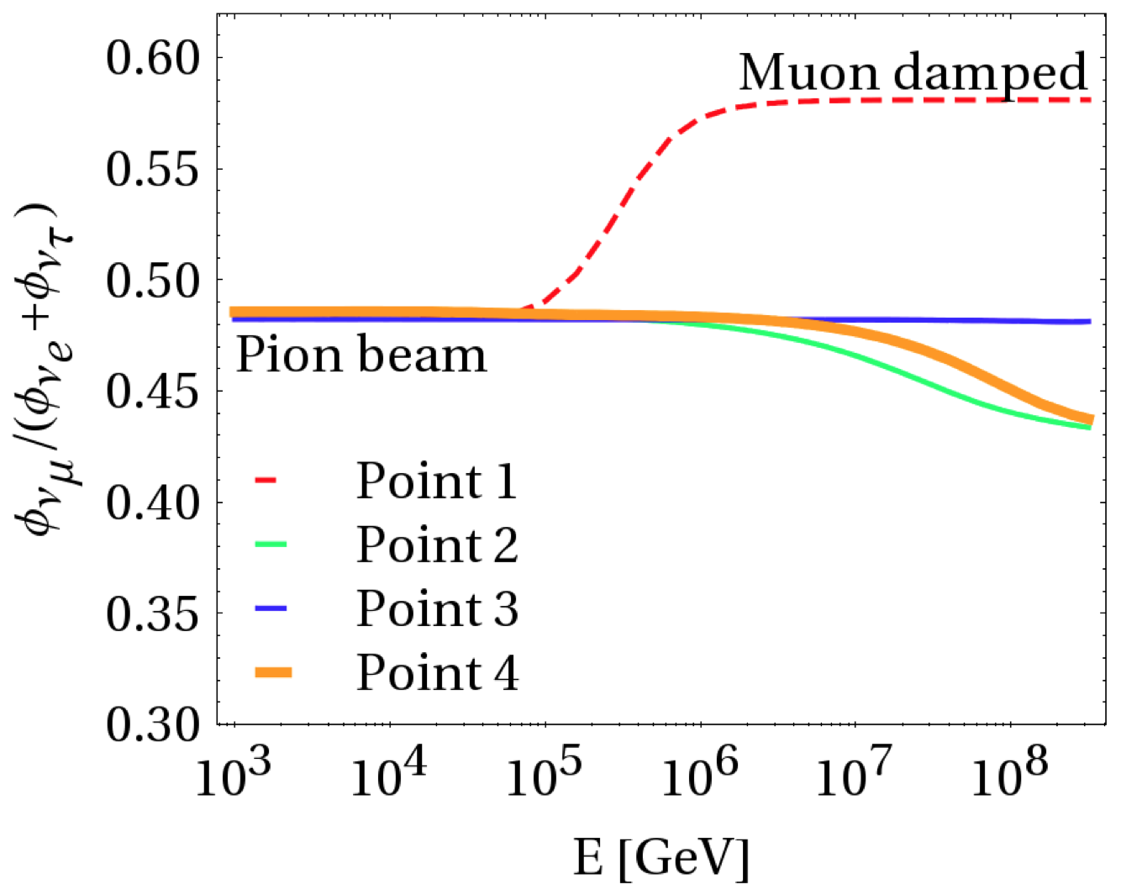
Energy-dependent flavor composition
Basically indistinguishable
Spectral shape vs. Flavor
Muon tracks/
cascades
Cutoff produced by magnetic field effects on μ, π? Change of flavor composition!
Need to identify 20% effect on flavor ratio in cutoff region
Winter, arXiv:1407.7536, PRD; first in Kashti, Waxman, 2005

Slide 9
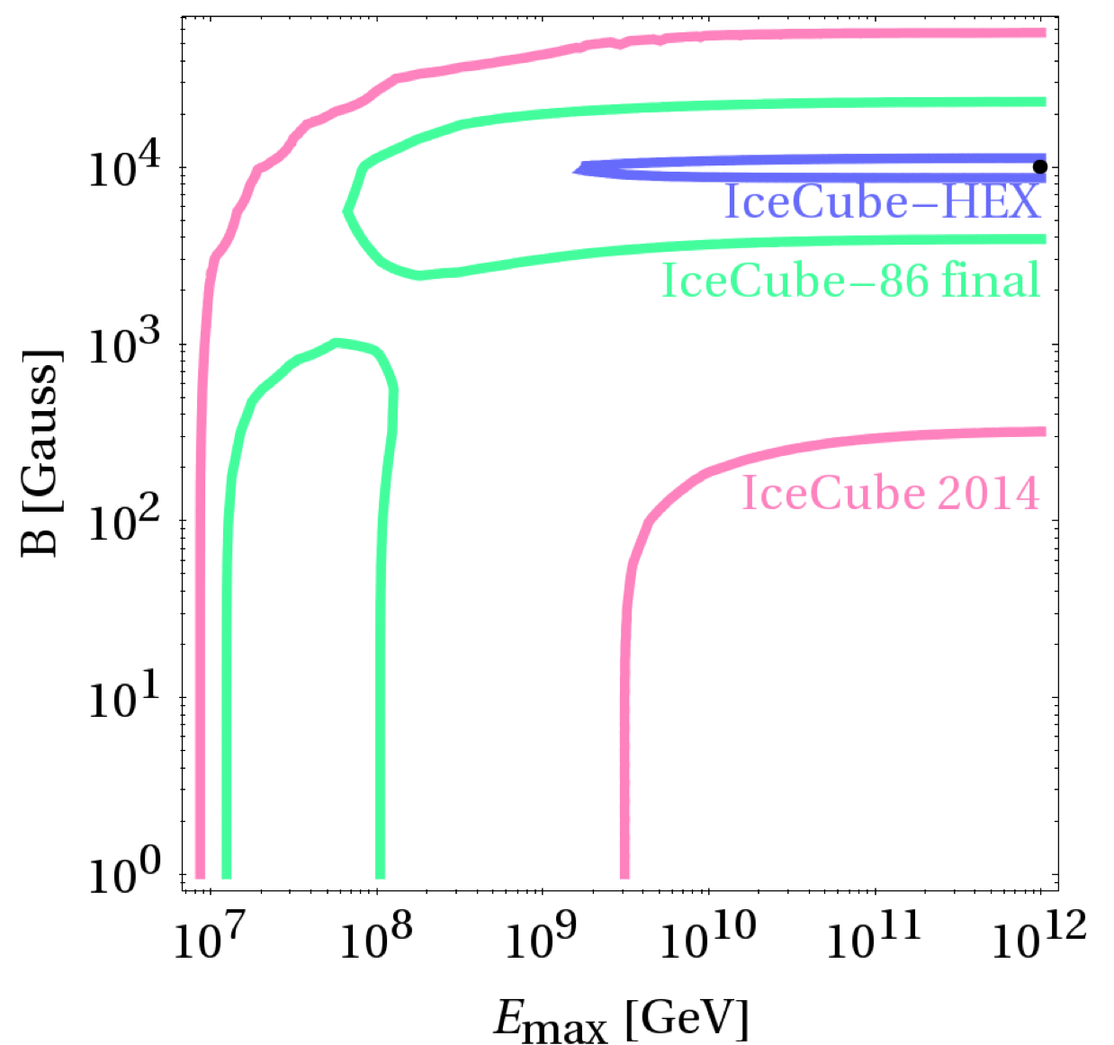
Required exposure?
Currently: about 0.6 tracks and 0.9 cascades in relevant bins (out of 37 events)
Need about 40 times higher exposure (compared to 37 events) to lift degeneracy between maximal energy and magnetic field effect cutoffs (figure)
Winter, PRD 90 (2014) 103003, arXiv:1407.7536

Slide 10
Example: Flux

Slide 11
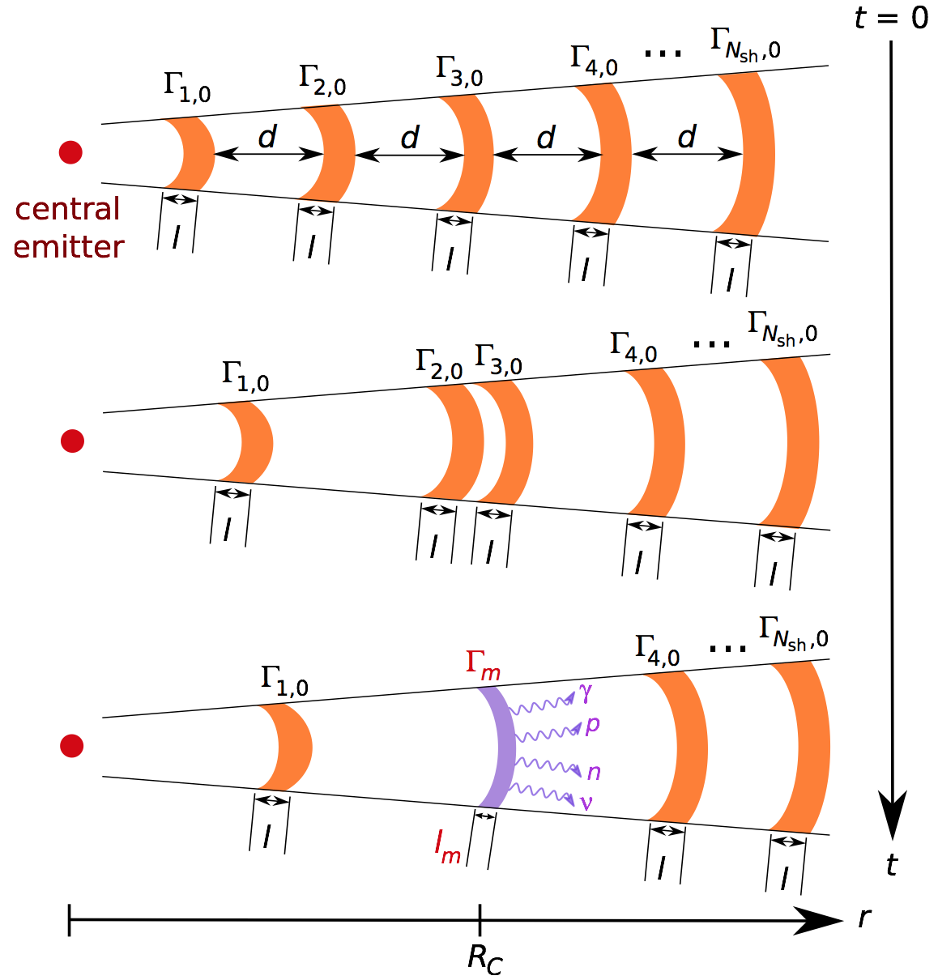
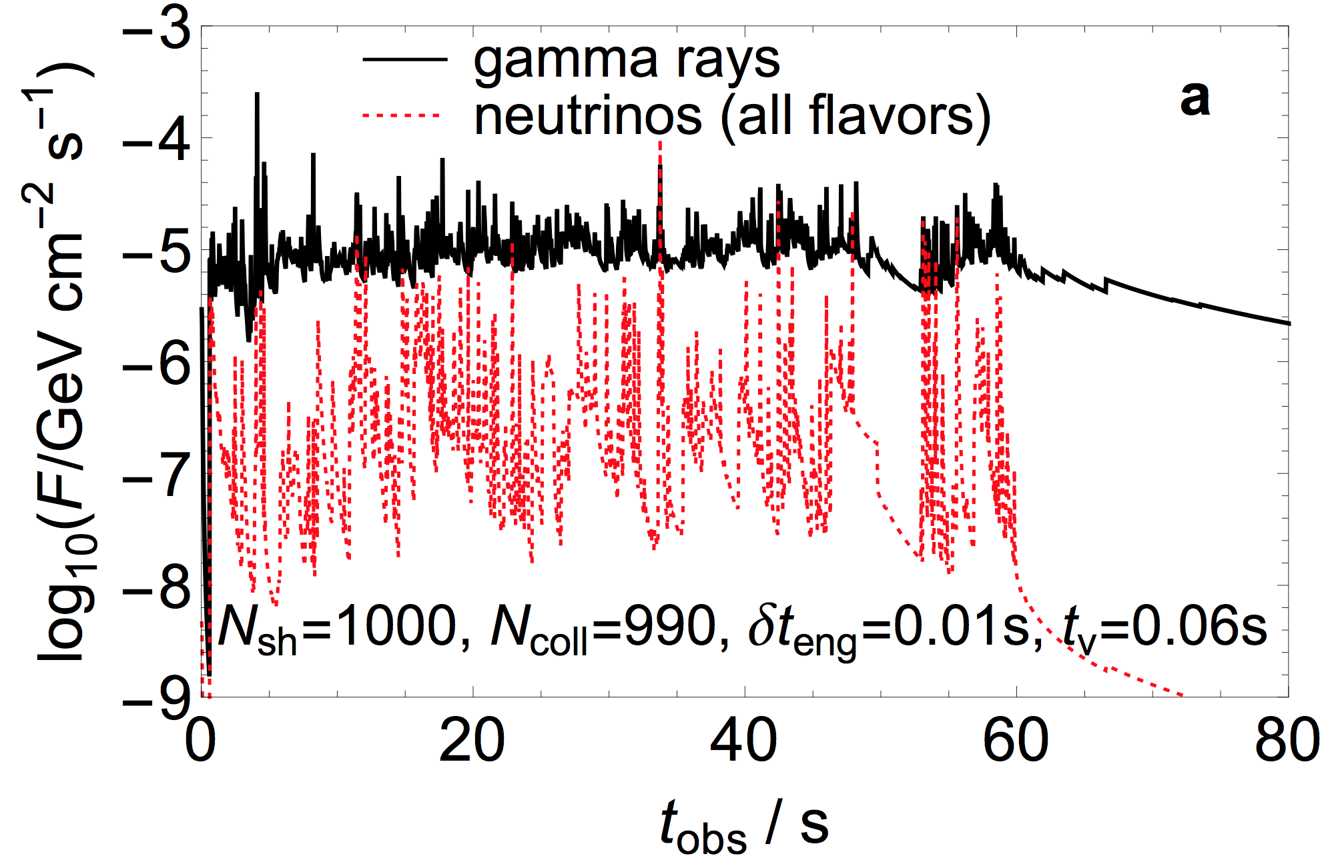
Gamma-ray bursts: Multiple collision models
Set out a number of shells with a Lorentz factor distribution
Shells collide, merge and cool by radiation of energy
Light curve predictable (see below)
Efficient energy dissipation (e. g. into gamma-rays) requires broad Lorentz factor distribution
(Bustamante, Baerwald, Murase, Winter, Nature Commun. 2015, arXiv:1409.2874; based on Kobayashi, Piran, Sari, 1997)

Slide 12
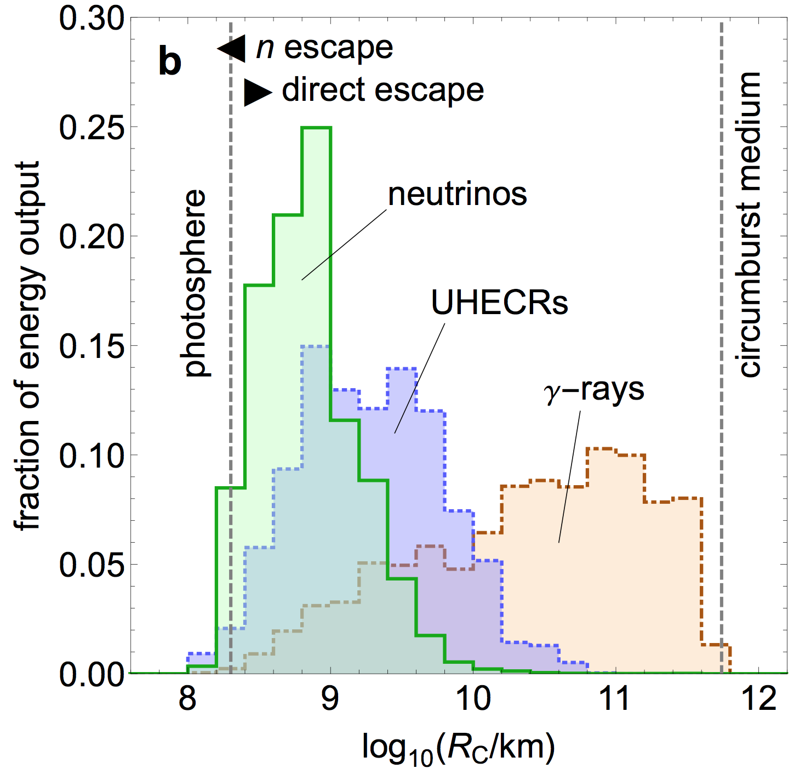
Production of different messengers
(protons)
The different messengers originate from different regimes of the GRB
Are parameters derived from gamma-ray observations (Γ, t_{v}, etc) really appropriate indicators for the neutrino flux?
(Bustamante, Baerwald, Murase, Winter, Nature Commun. 2015, arXiv:1409.2874; see also Globus et al, arXiv:1409.1271)

Slide 13
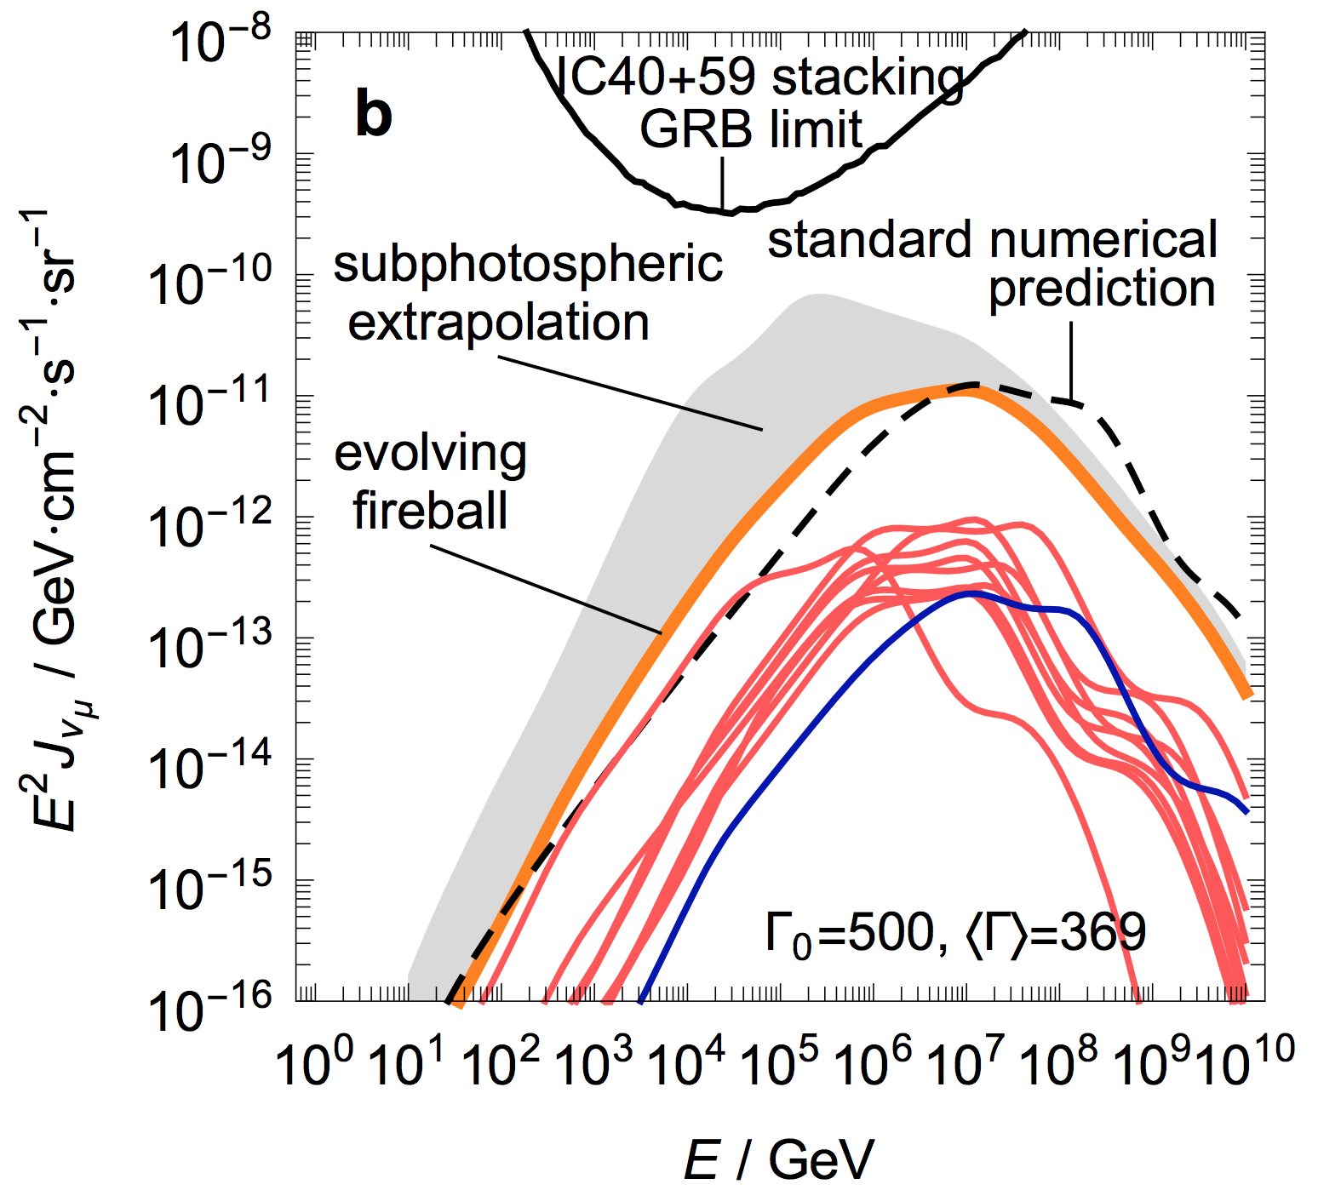
Consequences for neutrino production
Can be used to predict a “minimal” (indep. of params) super-photospheric neutrino flux ➔ IceCube-Gen2? Benchmark: E² φ ~ 10⁻¹¹ GeV cm⁻² s⁻¹ sr⁻¹ (requires at least factor 40 higher exposure in stacking searches)
The prediction is robust (hardly depends on Γ, baryonic loading) as
Few collisions around photosphere dominate flux
The production volume cancels from the pion production efficiency at the photosphere
E_{iso}=10⁵³ erg per GRB
(Bustamante, Baerwald, Murase, Winter, arXiv:1409.2874, Nature Commun.)
For details: See Maurico Bustamante’s talk

Slide 14
Special event types/topologies Example: Glashow resonance

Slide 15
Glashow resonance to discriminate pp from pγ?
In theory (Δ-resonance), pγ interactions produce mostly π⁺, pp interactions produce π⁺ and π⁻ about equally
Glashow resonance (electron antineutrinos!) at 6.3 PeV can be used for discrimination (few electron antineutrinos at source for pγ) Anchordoqui, Goldberg, Halzen, Weiler, Phys. Lett. B621, 18 (2005), hep- ph/0410003
Caveats (pγ): (see Hümmer, Maltoni, Winter, Yaguna, Astropart. Phys. 34 (2010) 205, arXiv:1007.0006)
Flavor mixing re-introduces electron antineutrinos
Flavor composition at source needs to be known
Multi-pion production introduces π⁻ in pγ sources Hümmer, Rüger, Spanier, Winter, ApJ 721 (2010) 630
Optical thickness (to pγ) adds π⁻ contamination through neutron interactions
How much exposure is needed in presence of intrinsic contaminations?
Problem: so far no events >> PeV
IceCube, PRL 113 (2014) 101101

Slide 16
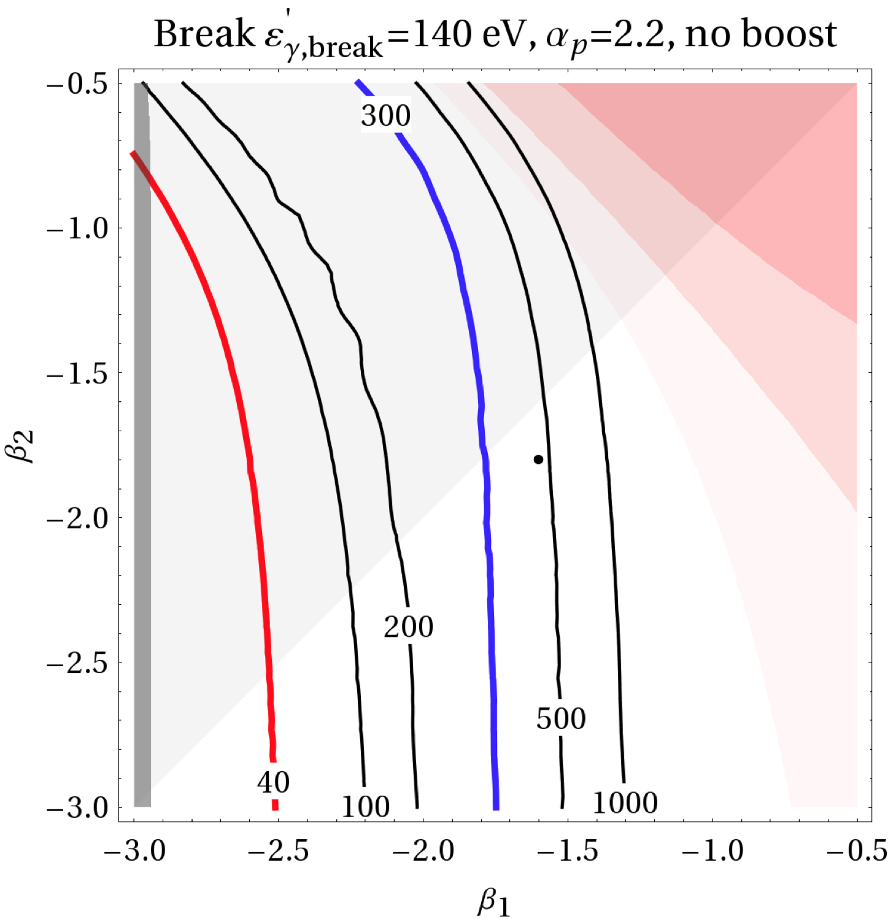
Required exposure to discriminate pp from pγ
Exposure (assumptions):
Current: 7.25 Mt yr IceCube, Science 342, 1242856 (2013), 1311.5238.
IC-86 over ten years: 40 Mt yr?
IceCube-Gen2: 300 Mt yr?
Example: AGN-like target photons (β₁, β₂: spectral indices)
Significant increase of parameter space for IceCube-Gen2. Required exposure to cover benchmark: 300-500 Mt yr (in ideal case: ~100 Mt yr, 90% CL)
However: Tension with best-fit (colored contours) region
Have to see > PeV events soon for reasonable perspectives
90% CL
Weiler, Winter, in preparation.
Dot: AGN benchmark from Mücke, Protheroe, Astropart. Phys., 15, (2001) 121

Slide 17
Summary and conclusions
Purpose of IceCube Gen-2: “deliver substantial increases in the astrophysical neutrino sample for all flavors”
Motivations for this talk: How much “substantial increase” is actually needed/desirable for reasonable physics applications?
Possible applications point towards ~ 40 times higher exposure than current analyses (based on 37 events) for reasonable target of opportunity
Flavor identification highly desirable for physics case
GRB analyses still promising:
although GRBs may not be the dominant contribution to the observed diffuse flux, they can be the sources of the UHECRs – an hypothesis which is testable with IceCube-Gen 2 (see Astroparticle Physics 62 (2015) 66)
a minimal “guaranteed” flux may be within the reach of IceCube-Gen2

Slide 18
BACKUP

Slide 19
Parameter space dependence: Numerical cross-check!
(Bustamante, Baerwald, Murase, Winter, Nature Commun.)

Slide 20
Why is the new GRB prediction robust?
Neutrino flux comes from a few collisions at photosphere
Photospheric radius (➔Thomson optical depth) and photohadronic interactions both depend on particle densities (scale in same way)
Consequence: Pion production efficiency at photosphere does not depend on Γ:
(ε: overall dissipation efficiency: dissipated/initial kinetic energy)
Changing the energy in electrons/photons also hardly affects results (if baryons dominate: ε_{p} ~ 1):
Compare to Guetta et al, Astropart. Phys. 20 (2004) 429
(Bustamante, Baerwald, Murase, Winter, arXiv:1409.2874, Nature Commun. 6:6783 doi: 10.1038/ncomms7783 (April 2015))

Slide 21
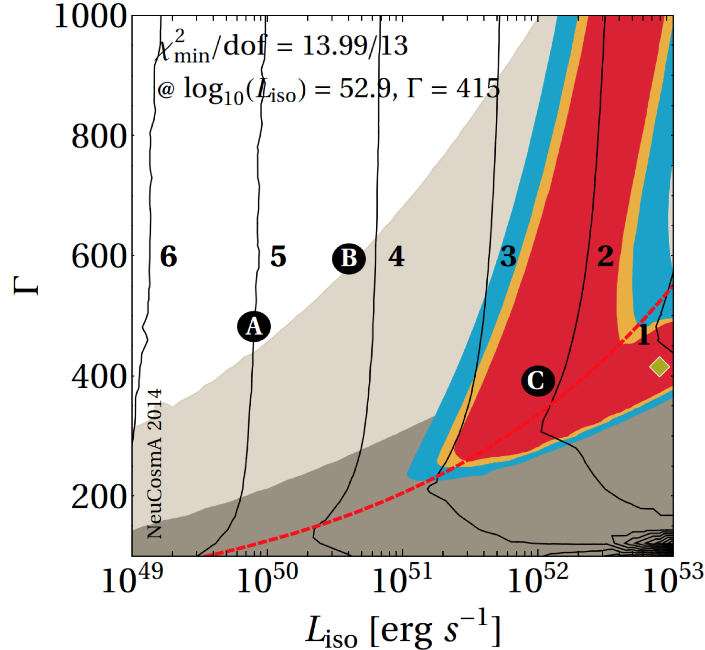
UHECR fit of single-collision model
UHECR fit
Direct/diffusive escape significant
Baryonic loading log₁₀f_{e}⁻¹
IceCube excluded (15 years)
Neutron model dominates
IceCube excluded (current); Neutron model ruled out!
Example: Efficient escape by Bohm-like diffusion, η=0.1
(Baerwald, Bustamante, Winter, Astropart. Phys. 62 (2015) 66)

Slide 22
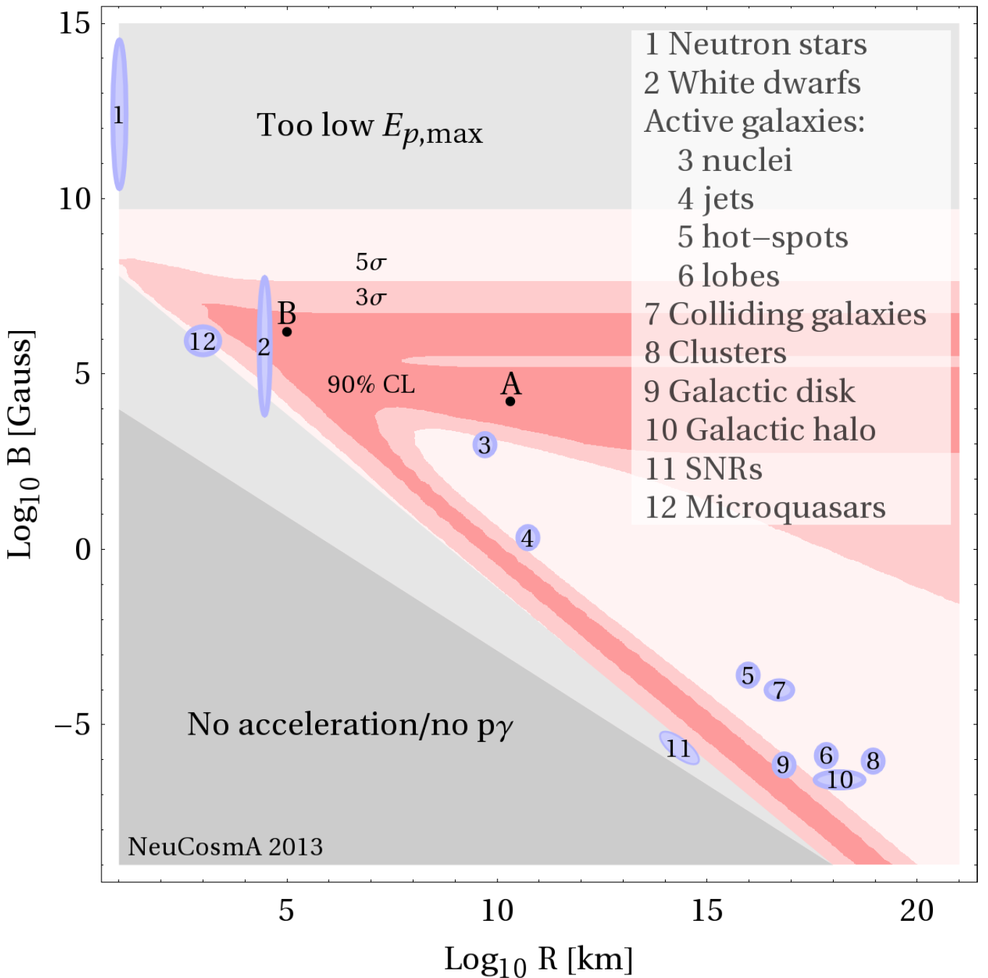
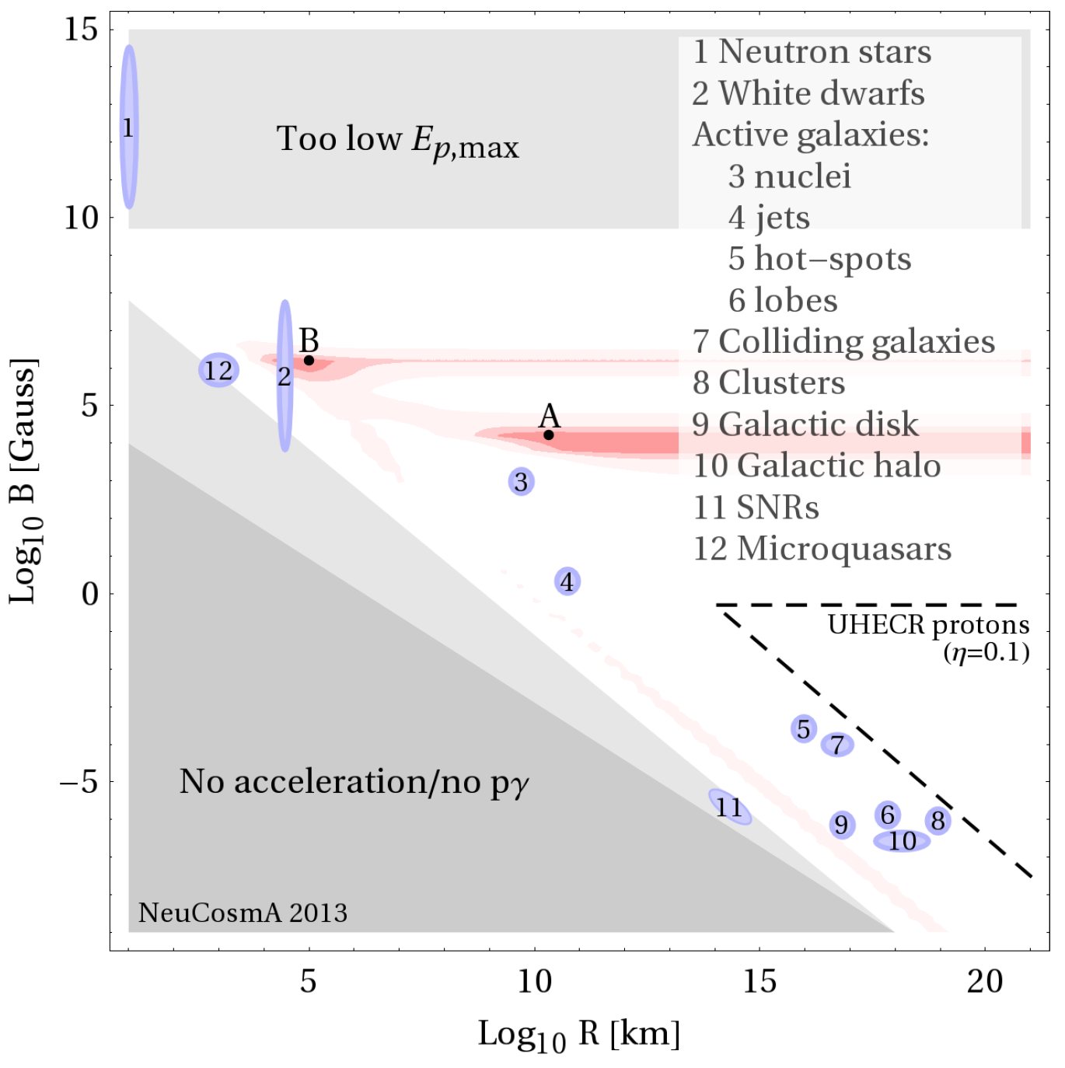
Example: Photohadronic neutrino production model
Exposure x 10
WW, arXiv:1307.2793, PRD88 (2013) 083007

