Slide 1
Results from Telescope Array
Douglas Bergman
University of Utah
IPA 2015
5 May 2015

Slide 2
TA Experiment
RU Abbasi¹, M Abe¹³, T Abu-Zayyad¹, M Allen¹, R Anderson¹, R Azuma², E Barcikowski¹, JW Belz¹, DR Bergman¹, SA Blake¹, R Cady¹, MJ Chae³, BG Cheon⁴, J Chiba⁵, M Chikawa⁶, WR Cho⁷, T Fujii⁸, M Fukushima^{8,9}, T Goto¹⁰, W Hanlon¹, Y Hayashi¹⁰, N Hayashida¹¹, K Hibino¹¹, K Honda¹², D Ikeda⁸, N Inoue¹³, T Ishii¹², R Ishimori², H Ito¹⁴, D Ivanov¹, CCH Jui¹, K Kadota¹⁶, F Kakimoto², O Kalashev¹⁷, K Kasahara¹⁸, H Kawai¹⁹, S Kawakami¹⁰, S Kawana¹³, K Kawata⁸, E Kido⁸, HB Kim⁴, JH Kim¹, JH Kim²⁵, S Kitamura², Y Kitamura², V Kuzmin¹⁷, YJ Kwon⁷, J Lan¹, SI Lim³, JP Lundquist¹, K Machida¹², K Martens⁹, T Matsuda²⁰, T Matsuyama¹⁰, JN Matthews¹, M Minamino¹⁰, K Mukai¹², I Myers¹, K Nagasawa¹³, S Nagataki¹⁴,T Nakamura²¹, T Nonaka⁸, A Nozato⁶, S Ogio¹⁰, J Ogura², M Ohnishi⁸, H Ohoka⁸, K Oki⁸, T Okuda²², M Ono¹⁴, A Oshima¹⁰, S Ozawa¹⁸, IH Park²³, MS Pshirkov²⁴, DC Rodriguez¹, G Rubtsov¹⁷, D Ryu²⁵, H Sagawa⁸, N Sakurai¹⁰, AL Sampson¹, LM Scott¹⁵, PD Shah¹, F Shibata¹², T Shibata⁸, H Shimodaira⁸, BK Shin⁴, HS Shin⁸, JD Smith¹, P Sokolsky¹, RW Springer¹, BT Stokes¹, SR Stratton^{1,15}, TA Stroman¹, T Suzawa¹³, M Takamura⁵, M Takeda⁸, R Takeishi⁸, A Taketa²⁶, M Takita⁸, Y Tameda¹¹, H Tanaka¹⁰, K Tanaka²⁷, M Tanaka²⁰, SB Thomas¹, GB Thomson¹, P Tinyakov^{17,24}, I Tkachev¹⁷, H Tokuno², T Tomida²⁸, S Troitsky¹⁷, Y Tsunesada², K Tsutsumi², Y Uchihori²⁹, S Udo¹¹, F Urban²⁴, G Vasiloff¹, T Wong¹, R Yamane¹⁰, H Yamaoka²⁰, K Yamazaki¹⁰, J Yang³, K Yashiro⁵, Y Yoneda¹⁰, S Yoshida¹⁹, H Yoshii³⁰, R Zollinger¹, Z Zundel¹
¹High Energy Astrophysics Institute and Department of Physics and Astronomy, University of Utah, Salt Lake City, Utah, USA, ²Graduate School of Science and Engineering, Tokyo Institute of Technology, Meguro, Tokyo, Japan, ³Department of Physics and Institute for the Early Universe, Ewha Womans University, Seodaaemun-gu, Seoul, Korea, ⁴Department of Physics and The Research Institute of Natural Science, Hanyang University, Seongdong-gu, Seoul, Korea, ⁵Department of Physics, Tokyo University of Science, Noda, Chiba, Japan, ⁶Department of Physics, Kinki University, Higashi Osaka, Osaka, Japan, ⁷Department of Physics, Yonsei University, Seodaemun-gu, Seoul, Korea, ⁸Institute for Cosmic Ray Research, University of Tokyo, Kashiwa, Chiba, Japan, ⁹Kavli Institute for the Physics and Mathematics of the Universe (WPI), Todai Institutes for Advanced Study, the University of Tokyo, Kashiwa, Chiba, Japan, ¹⁰Graduate School of Science, Osaka City University, Osaka, Osaka, Japan, ¹¹Faculty of Engineering, Kanagawa University, Yokohama, Kanagawa, Japan, ¹²Interdisciplinary Graduate School of Medicine and Engineering, University of Yamanashi, Kofu, Yamanashi, Japan, ¹³The Graduate School of Science and Engineering, Saitama University, Saitama, Saitama, Japan, ¹⁴Astrophysical Big Bang Laboratory, RIKEN, Wako, Saitama, Japan, ¹⁵Department of Physics and Astronomy, Rutgers University - The State University of New Jersey, Piscataway, New Jersey, USA, ¹⁶Department of Physics, Tokyo City University, Setagaya-ku, Tokyo, Japan, ¹⁷Institute for Nuclear Research of the Russian Academy of Sciences, Moscow, Russia, ¹⁸Advanced Research Institute for Science and Engineering, Waseda University, Shinjuku-ku, Tokyo, Japan, ¹⁹Department of Physics, Chiba University, Chiba, Chiba, Japan, ²⁰Institute of Particle and Nuclear Studies, KEK, Tsukuba, Ibaraki, Japan, ²¹Faculty of Science, Kochi University, Kochi, Kochi, Japan, ²²Department of Physical Sciences, Ritsumeikan University, Kusatsu, Shiga, Japan, ²³Department of Physics, Sungkyunkwan University, Jang-an-gu, Suwon, Korea, ²⁴Service de Physique Theorique, Universite Libre de Bruxelles, Brussels, Belgium, ²⁵Department of Physics, School of Natural Sciences, Ulsan National Institute of Science and Technology, UNIST-gil, Ulsan, Korea, ²⁶Earthquake Research Institute, University of Tokyo, Bunkyo-ku, Tokyo, Japan, ²⁷Graduate School of Information Sciences, Hiroshima City University, Hiroshima, Hiroshima, Japan, ²⁸Advanced Science Institute, RIKEN, Wako, Saitama, Japan, ²⁹National Institute of Radiological Science, Chiba, Chiba, Japan, ³⁰Department of Physics, Ehime University, Matsuyama, Ehime, Japan
USA, Japan, Korea, Russia, Belgium

Slide 3
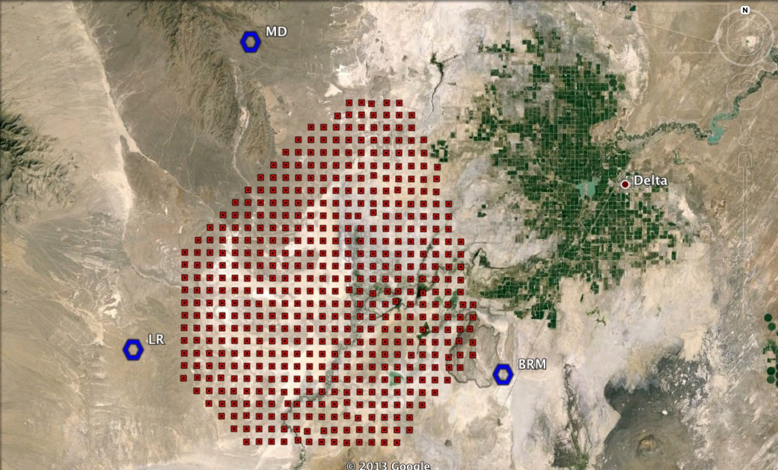
TA Experiment
TA is in Millard Co, Utah, 2 hours from Salt Lake City.
SD: 507 scintillator counters, 1.2 km spacing, 3-m² active area, two layers.
FD: 3 sites, each covers 120° azimuth, 3°–31° elevation
Nearly 7 years of data have been collected.

Slide 4
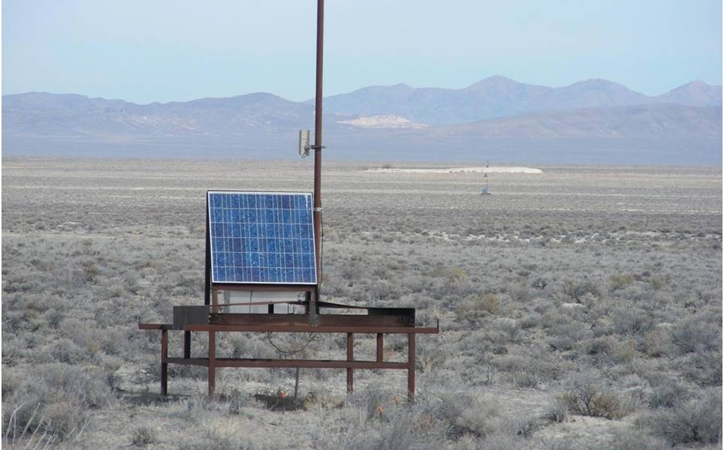
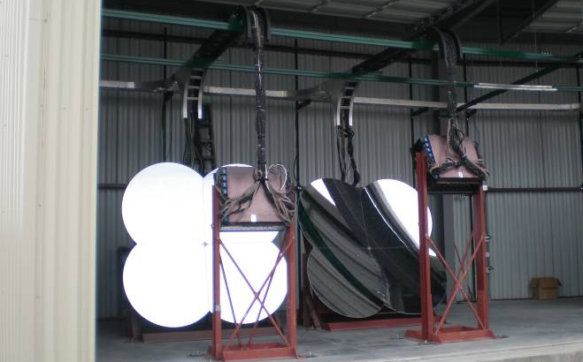
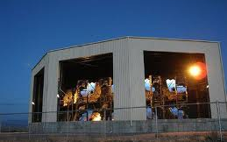
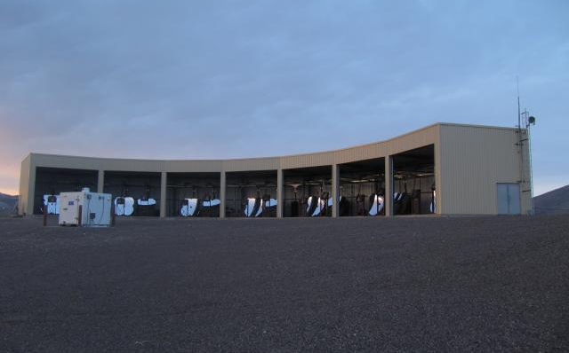
TA Experiment

Slide 5
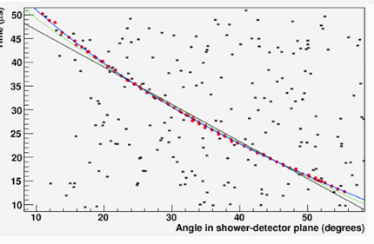
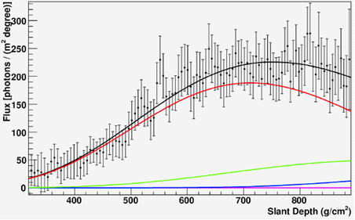
Fluorescence
Black Rock Mesa Event Display
Monocular timing fit
Fluorescence
Direct (Cerenkov)
Rayleigh scatt.
Aerosol scatt.
Reconstructed Shower Profile

Slide 6
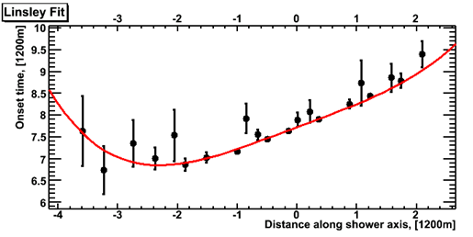
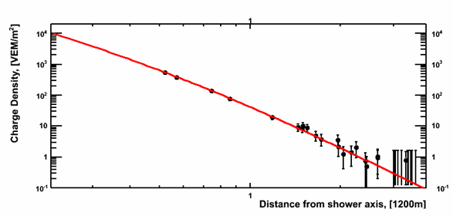

Surface
2008/Jun/25
19:45:52.588670 UTC
Geometry Fit (modified Linsley)
Lateral Density Distribution Fit
Fit with AGASA LDF
  S(800): Primary Energy
  Zenith attenuation by MC (not by CIC).
r = 800m

Slide 7
UHECR Composition

Slide 8
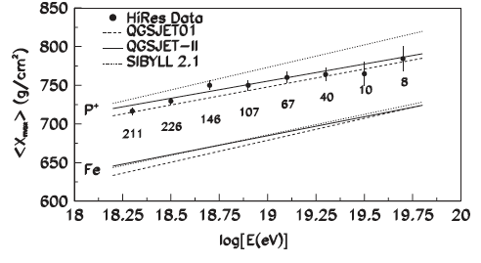
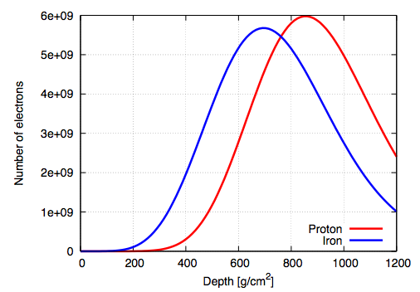
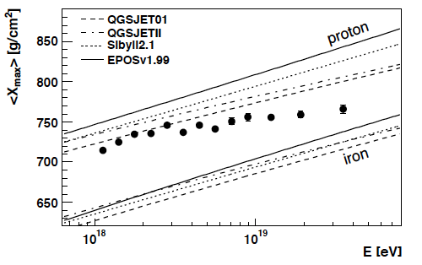
Composition from X_{max}
Longitudinal development depends on primary
FD observes development directly
X_{max} is the most efficient parameter for determining primary particle type
HiRes
PRL 104 161101 (2010)
X_{max}
Auger
PRL 104 091101 (2010)

Slide 9
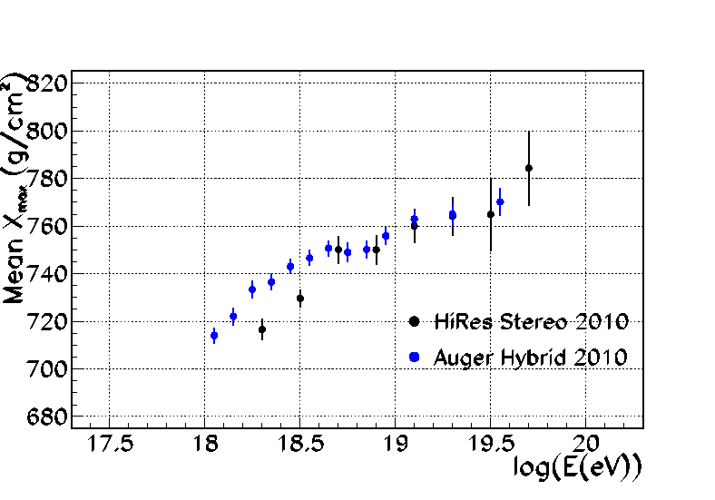
Composition from X_{max}
Longitudinal development depends on primary
FD observes development directly
X_{max} is the most efficient parameter for determining primary particle type
No difference in HiRes and Auger data above 10^{18.5} eV …
X_{max}

Slide 10
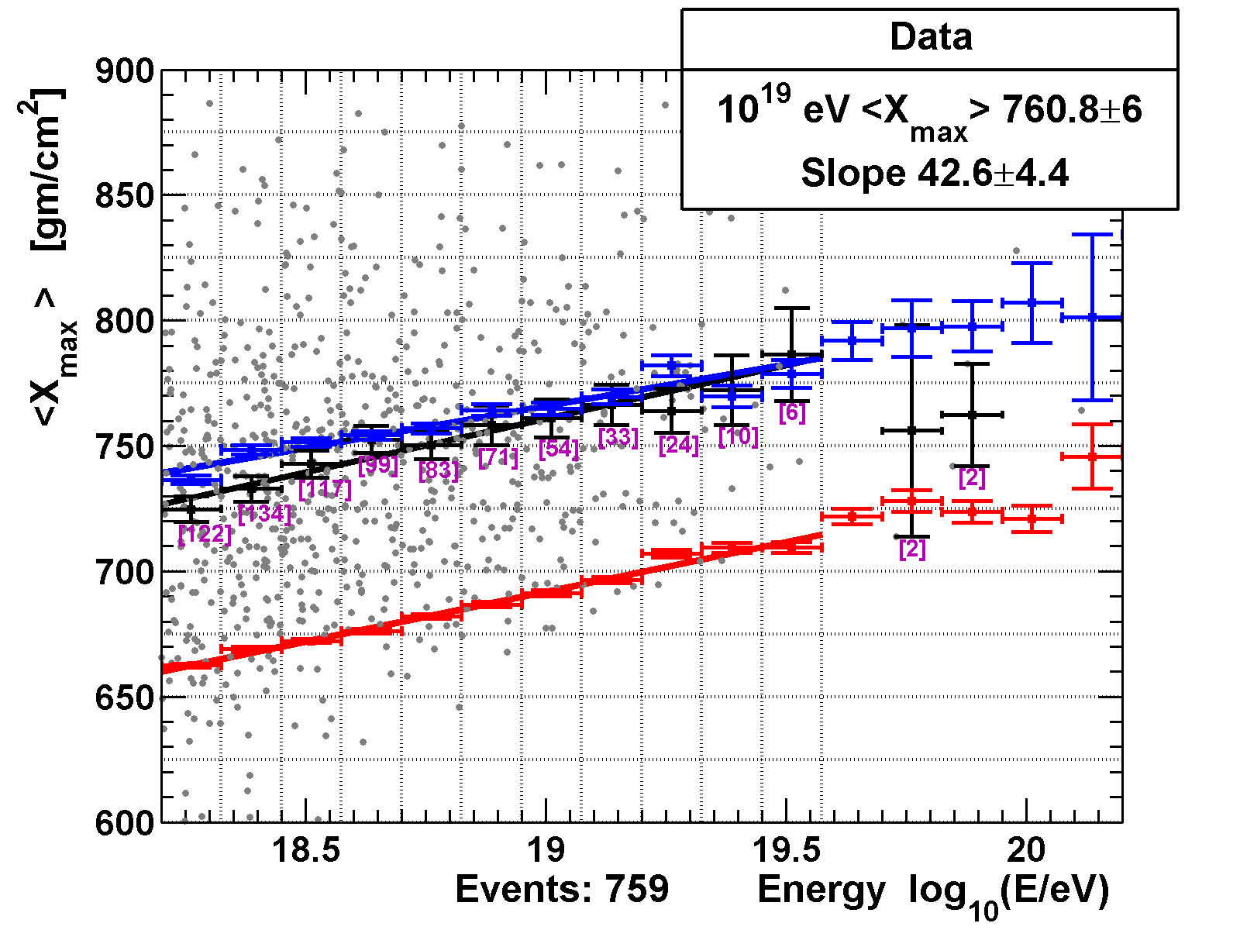
TA MD-Hybrid Composition
Most recent <X_{max}> result
  6 years data
  Quality factor cut
  Update of APP 64 49 (2015)
  Model predictions (QGSJetII-03) come from full MC detector simulation with identical analysis and cuts as for the data
Preliminary
Model: QGSJetII-03

Slide 11
TA MD-Hybrid Composition
Problems with moments
  Just using the mean or width as a statistic of merit is problematic since the distribution is far from Gaussian
  Replacing mean with median gives quite a different impression
Preliminary
Model: QGSJetII-03

Slide 12
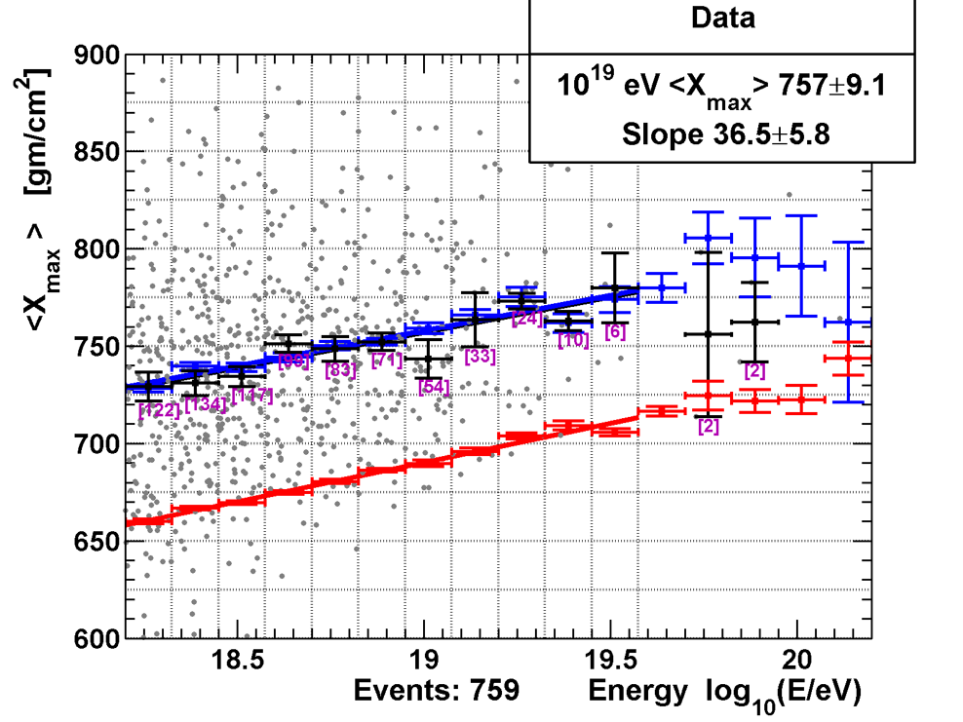
TA MD-Hybrid Composition
Problems with moments
  Just using the mean or width as a statistic of merit is problematic since the distribution is far from Gaussian
  Replacing mean with median gives quite a different impression
Want to use the whole distribution
  Kolomogorov-Smirnov
  Cramér-von Mises
Median X_{max}
Preliminary
Model: QGSJetII-03

Slide 13
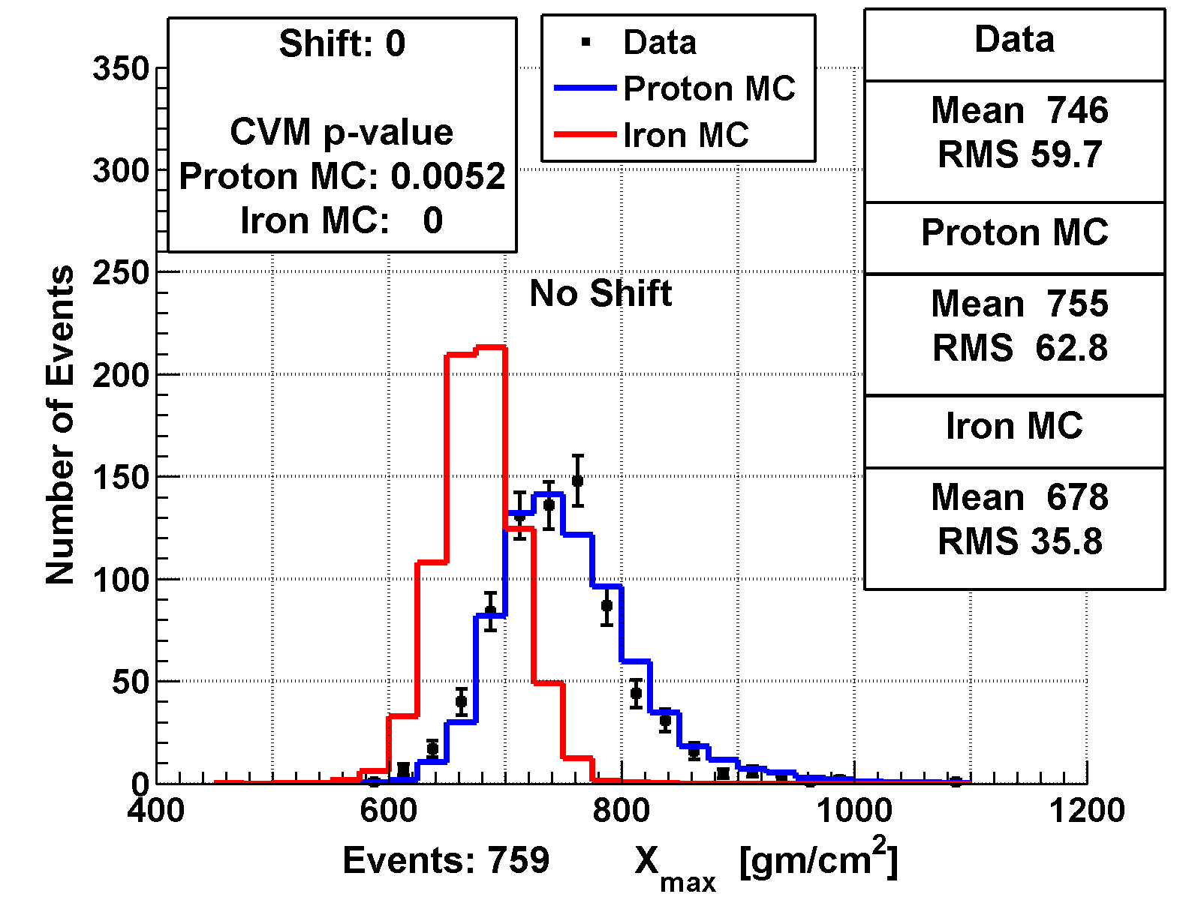
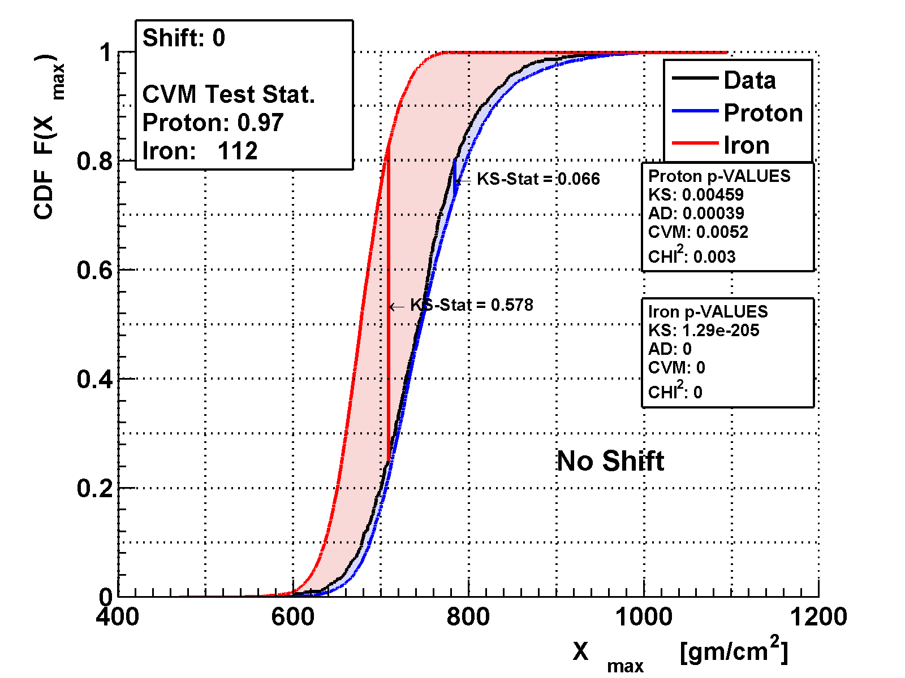

Shift & Quality
Model uncertainty mostly in the position of X_{max}
  Shift the MC distribution, then see how likely the data and MC come from the same distribution
  KS uses the maximum difference in cumulative distribution
  CvM uses the integral of the difference between the distributions
Model: QGSJetII-03

Slide 14
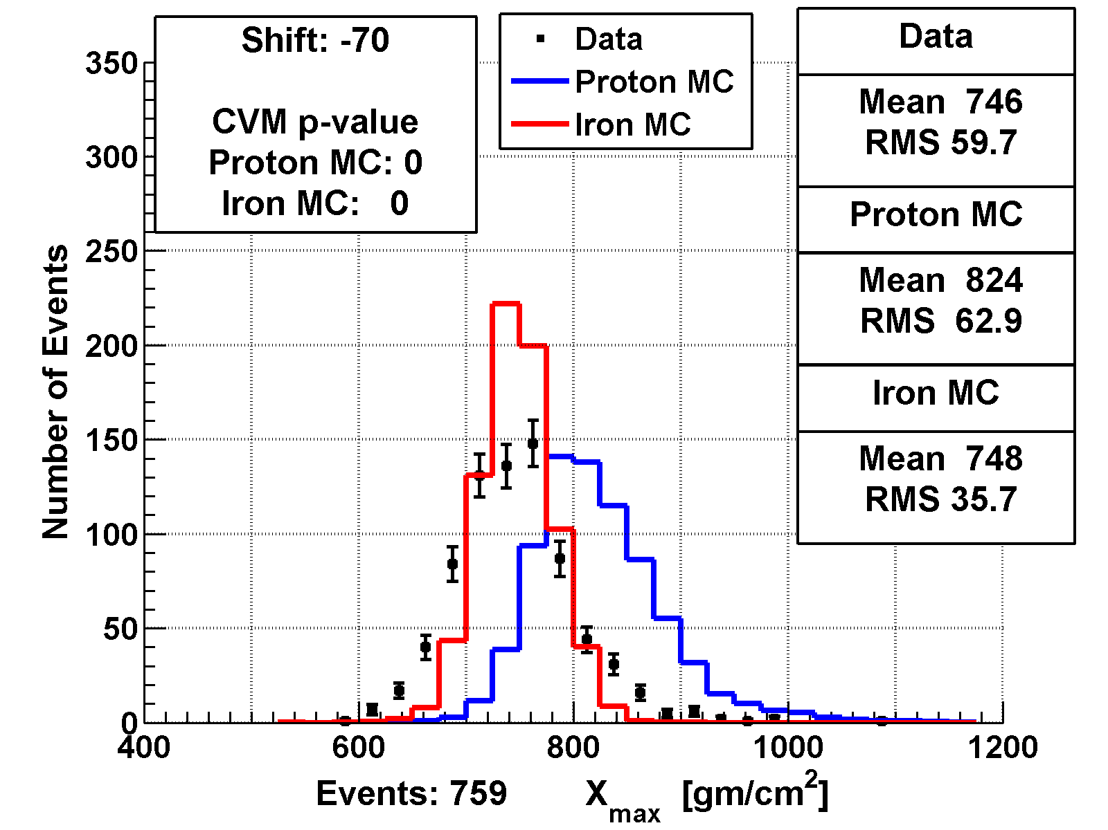
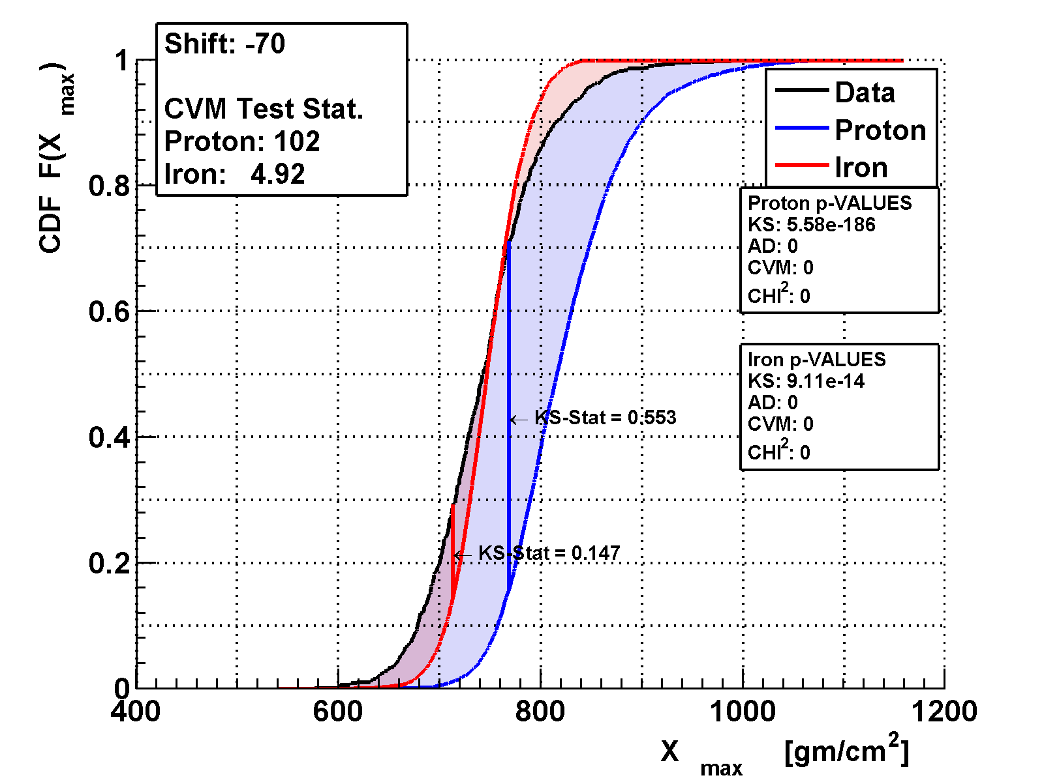
Shift & Quality
Model: QGSJetII-03

Slide 15
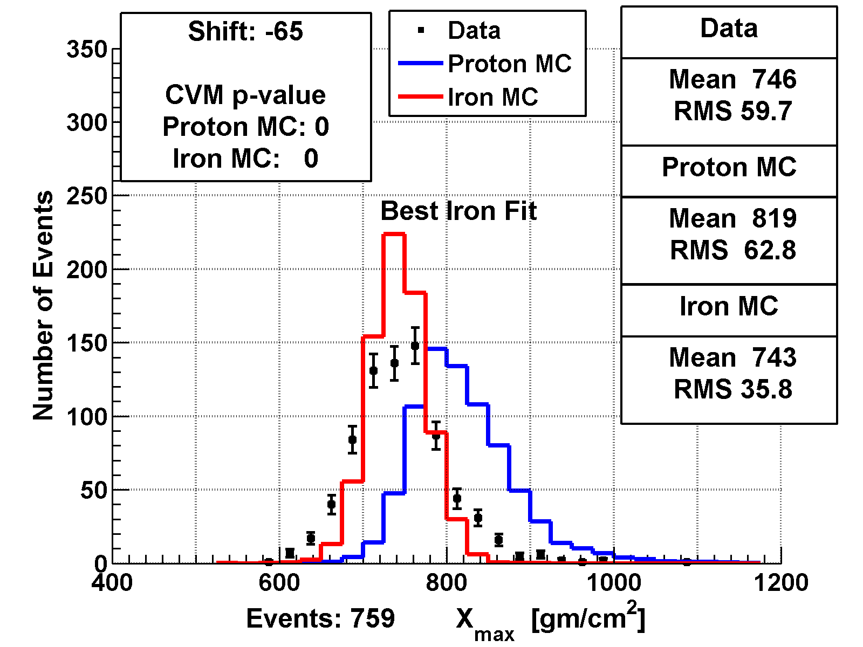
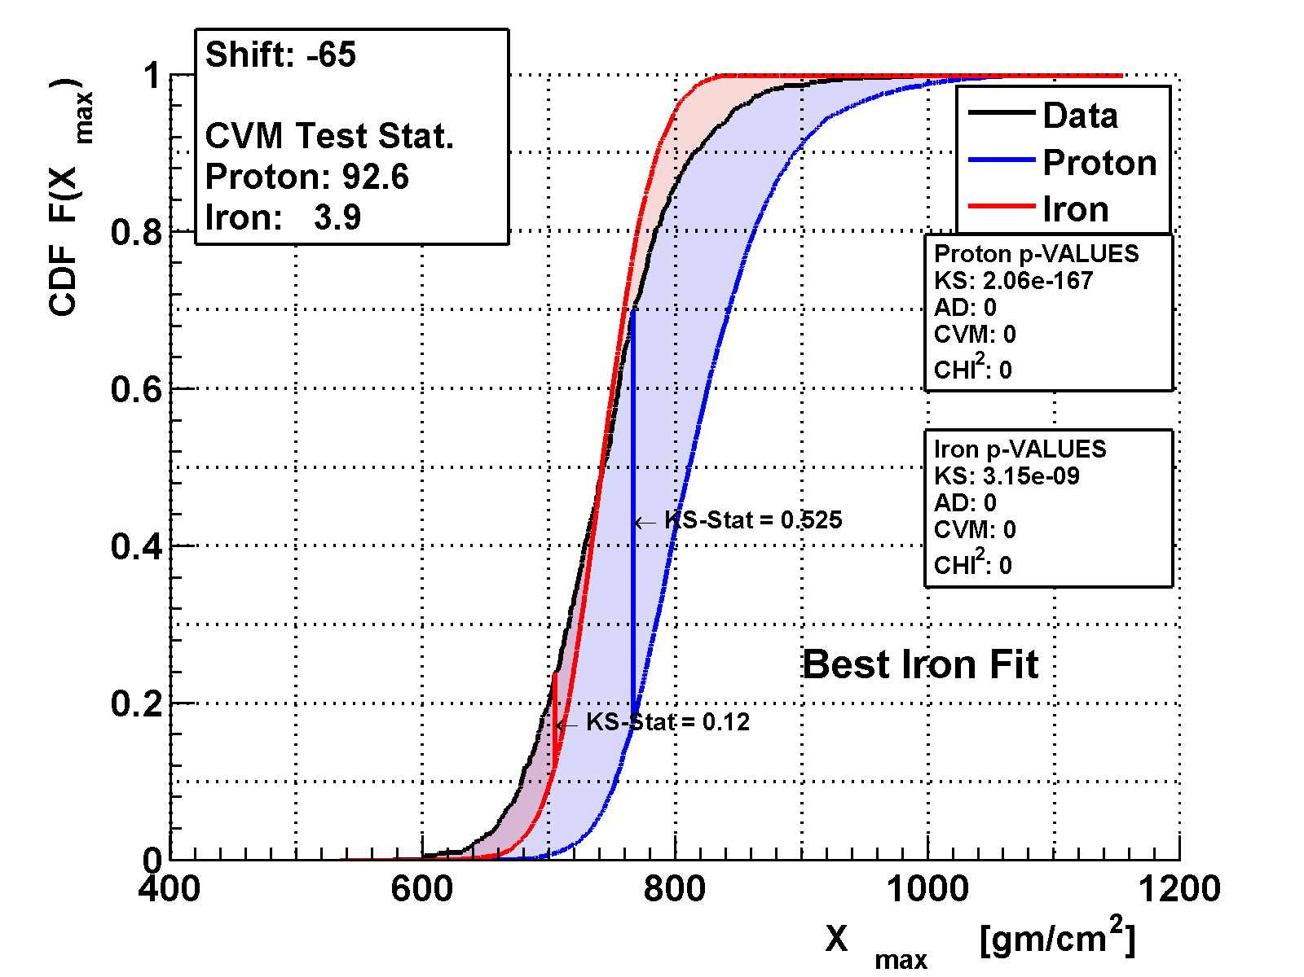
Shift & Quality
Best iron: shift data down by 65 g/cm²
Model: QGSJetII-03

Slide 16

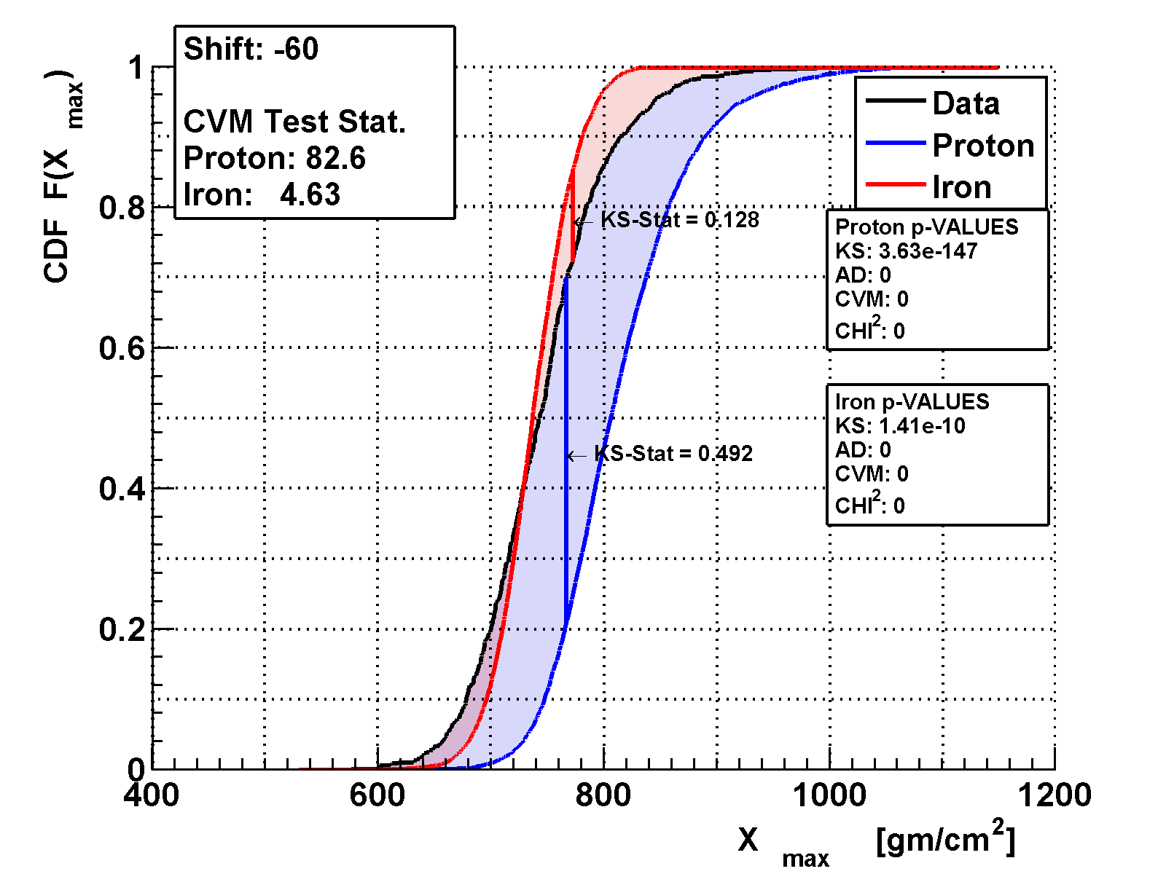
Shift & Quality
Model: QGSJetII-03

Slide 17
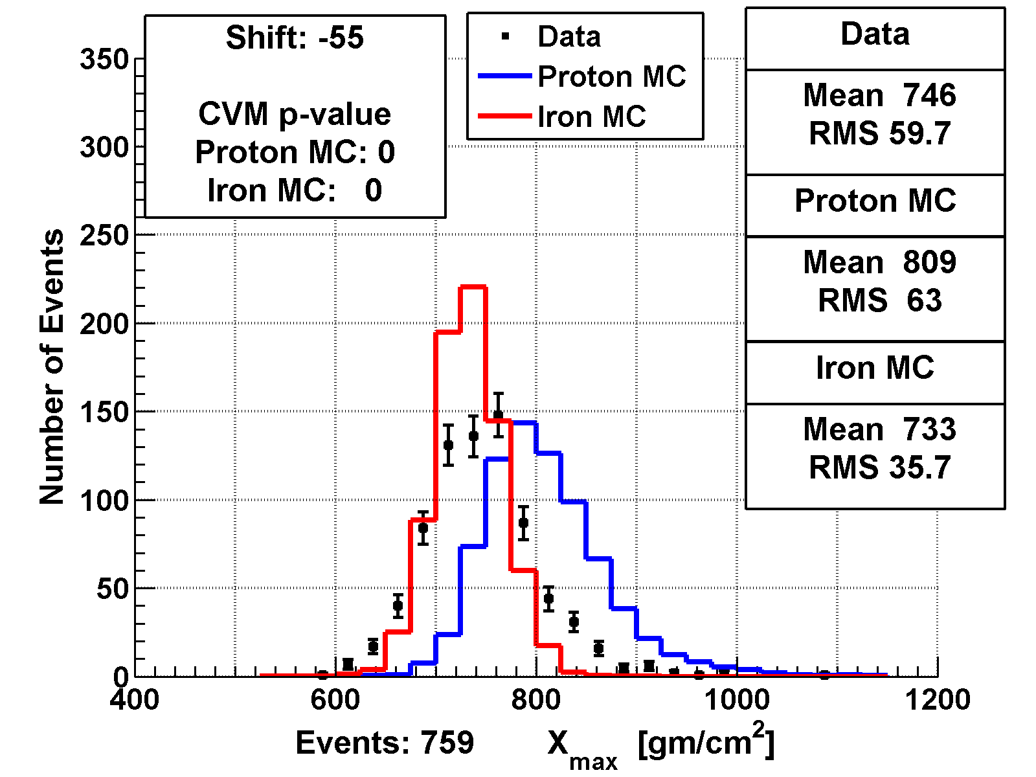

Shift & Quality
Model: QGSJetII-03

Slide 18

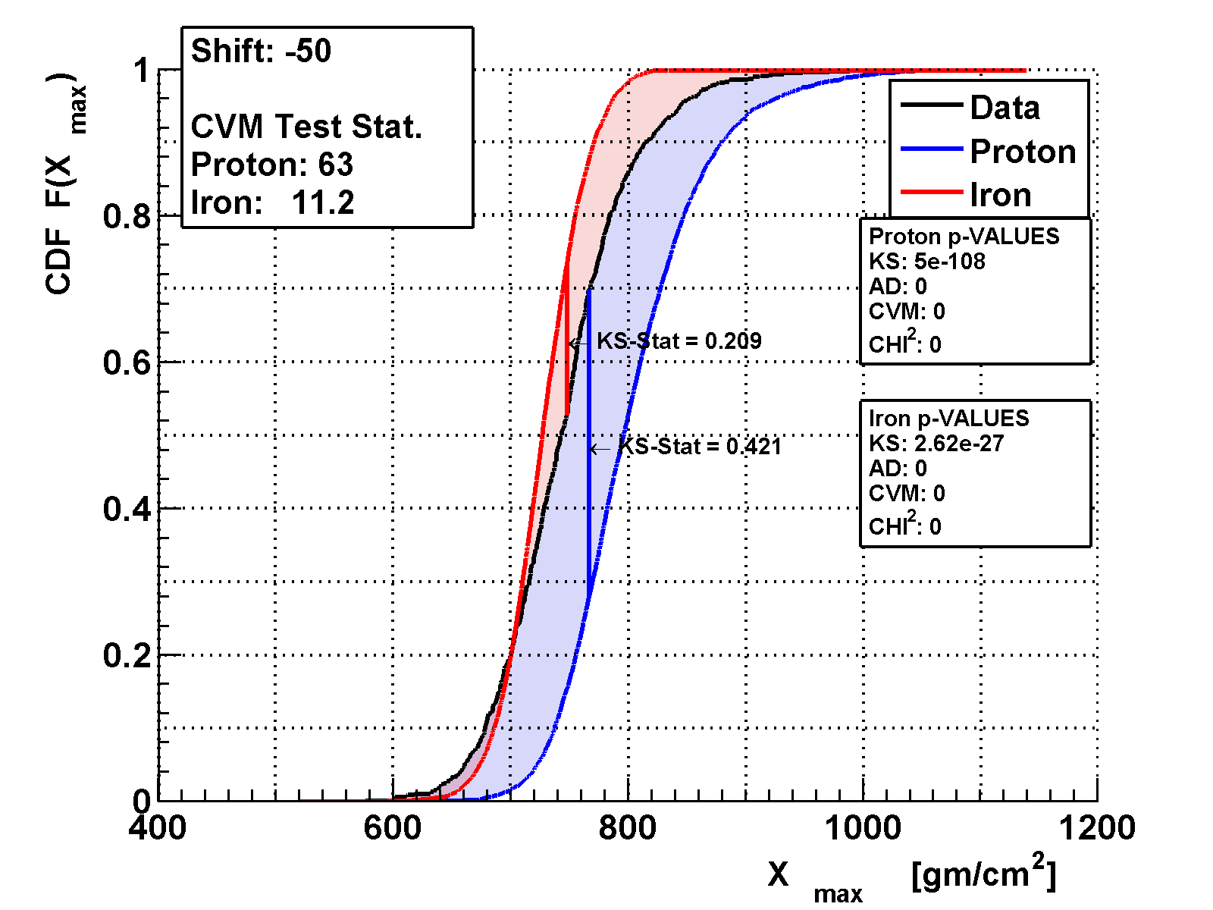
Shift & Quality
Model: QGSJetII-03

Slide 19

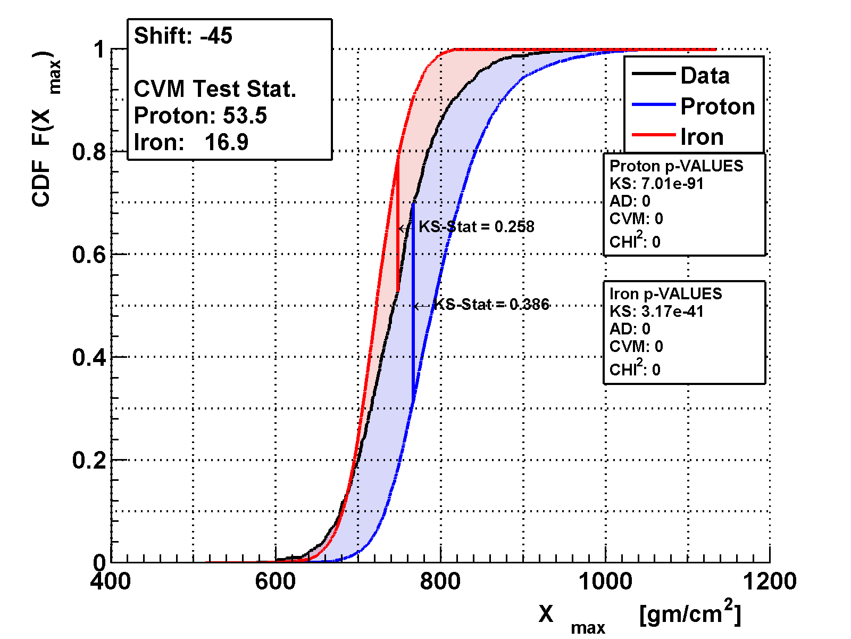
Shift & Quality
Model: QGSJetII-03

Slide 20
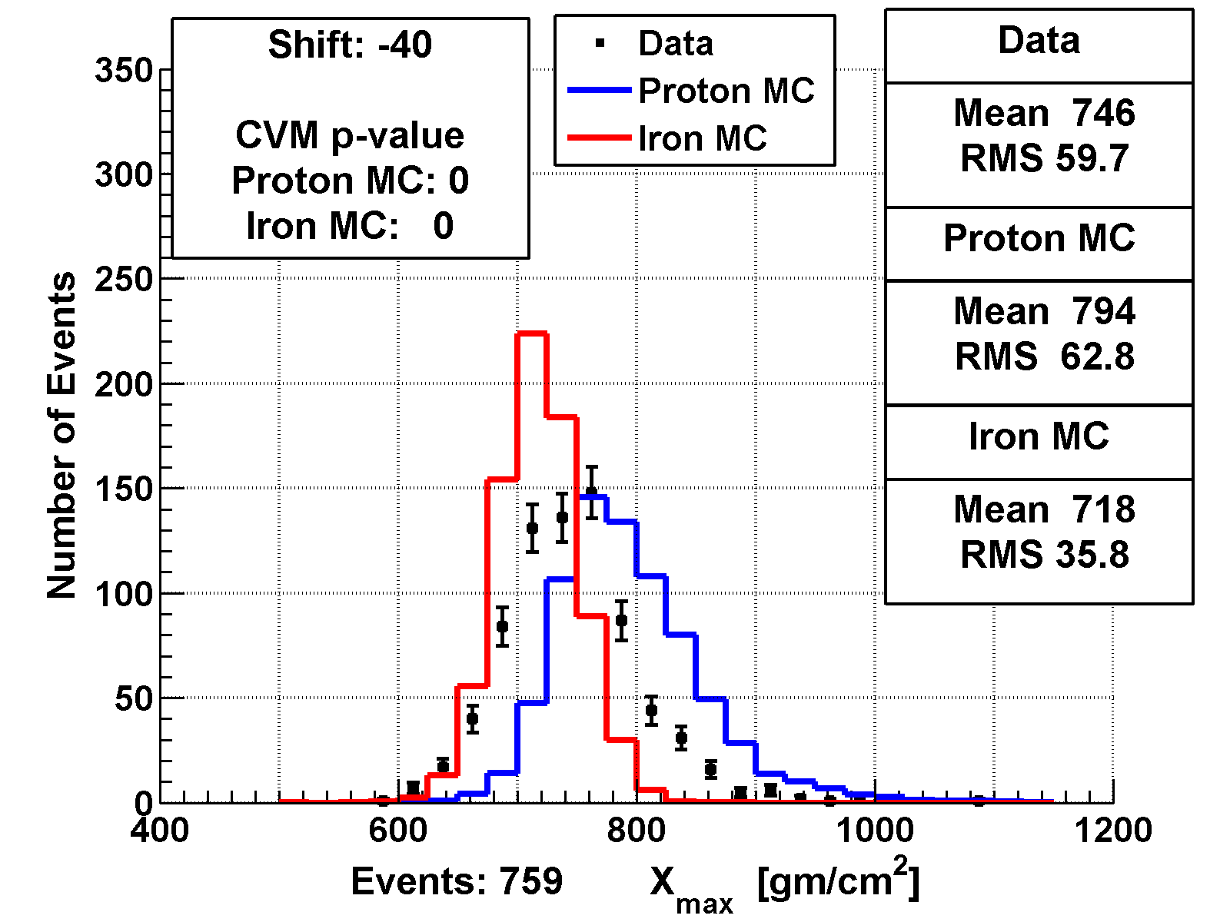

Shift & Quality
Model: QGSJetII-03

Slide 21
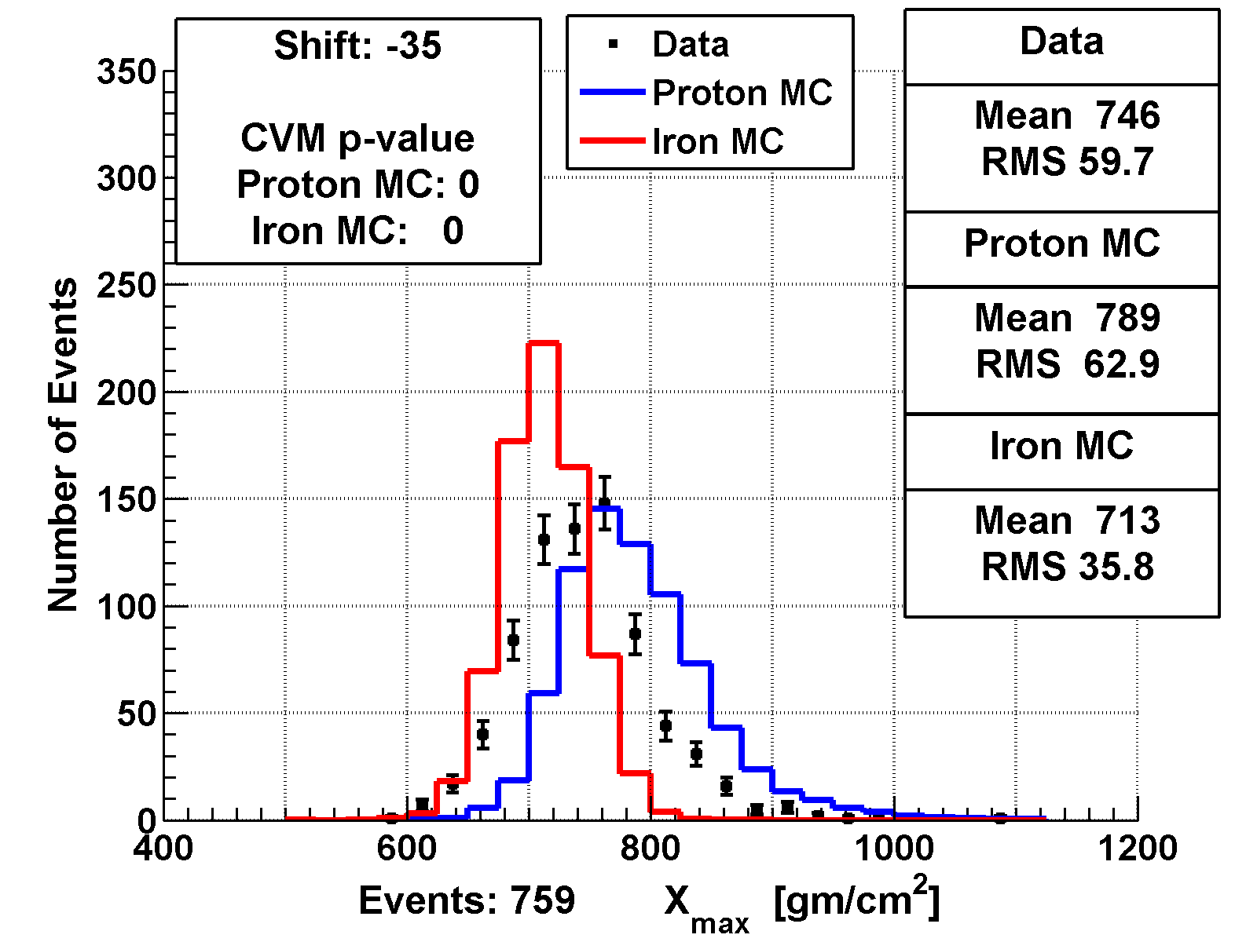

Shift & Quality
Model: QGSJetII-03

Slide 22
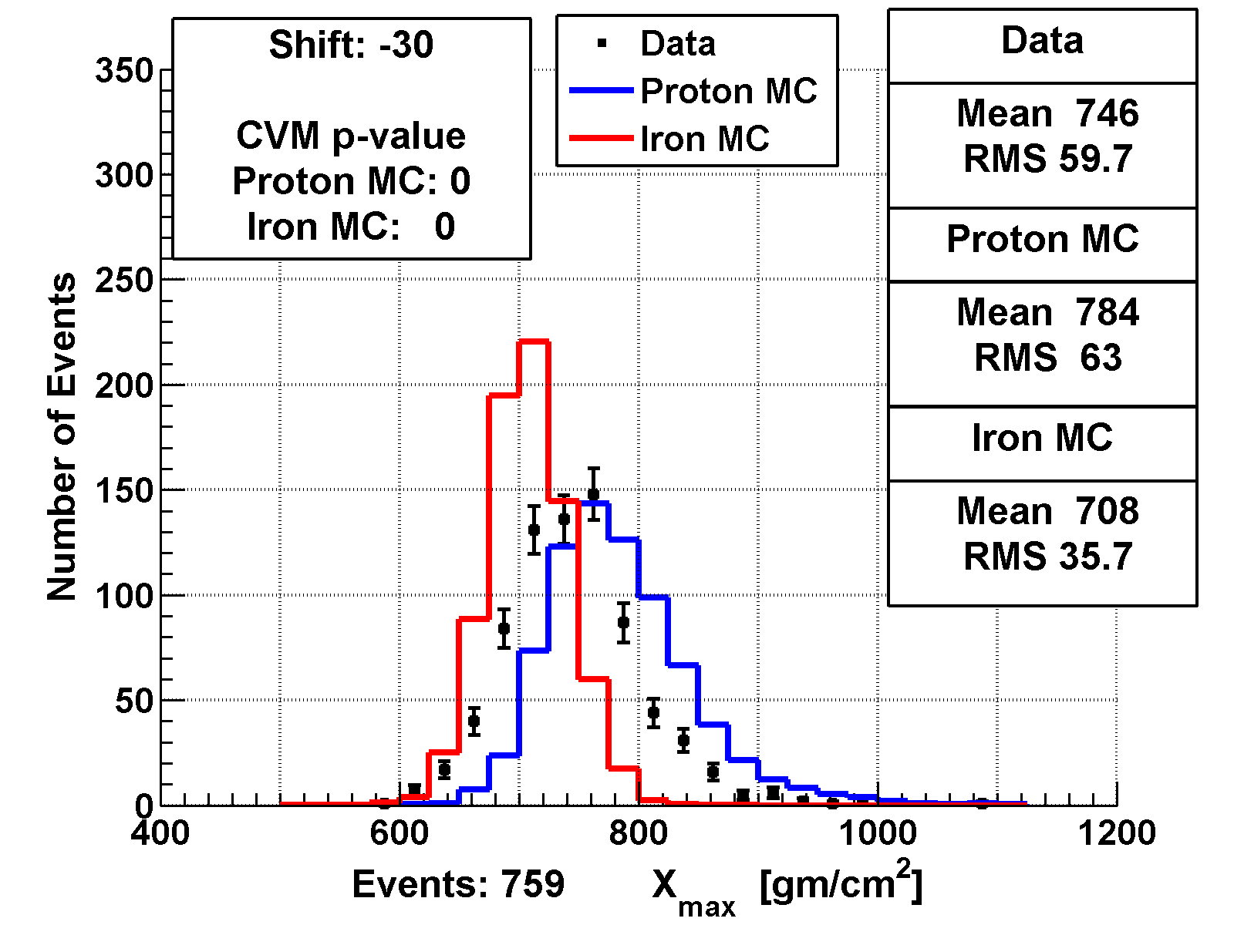
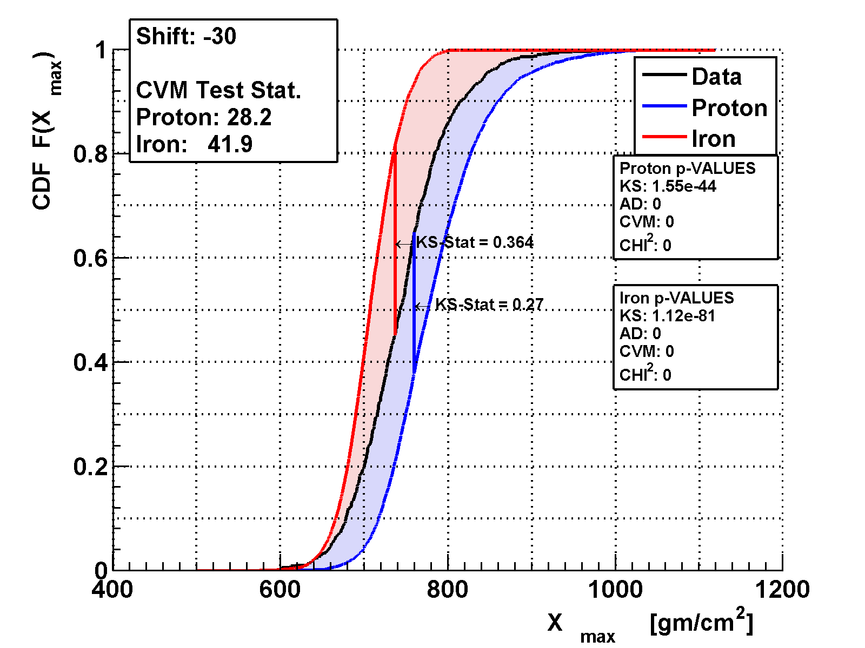
Shift & Quality
Model: QGSJetII-03

Slide 23

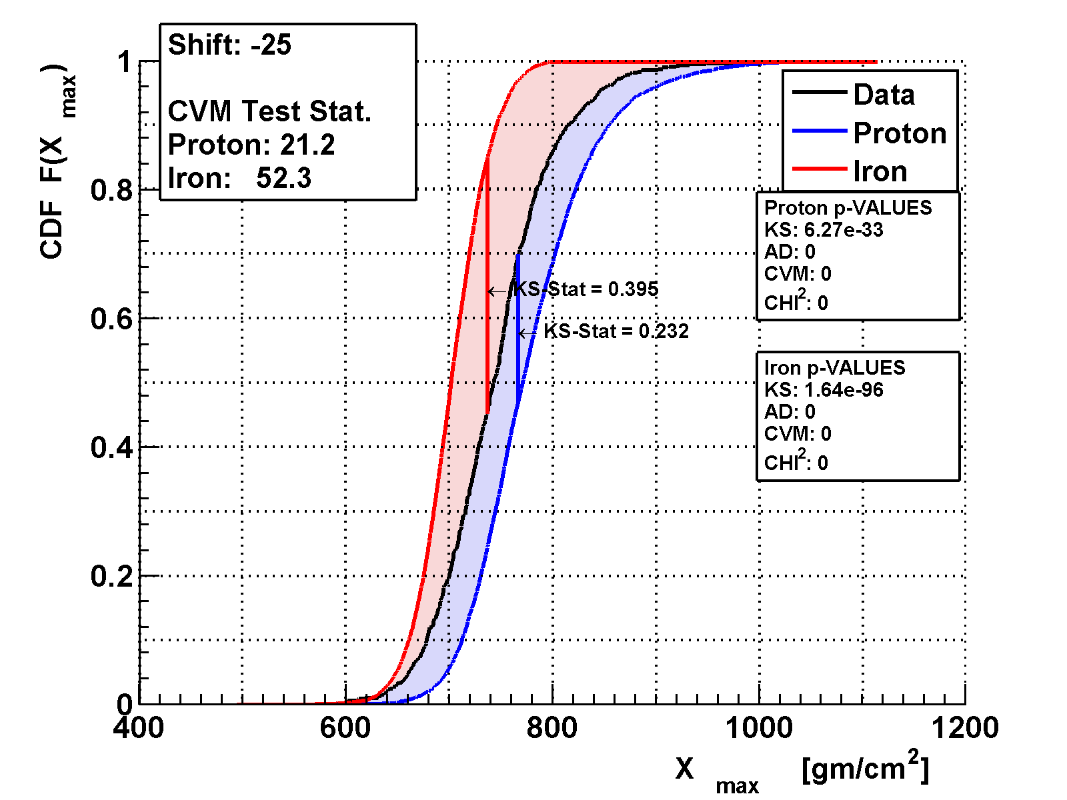
Shift & Quality
Model: QGSJetII-03

Slide 24

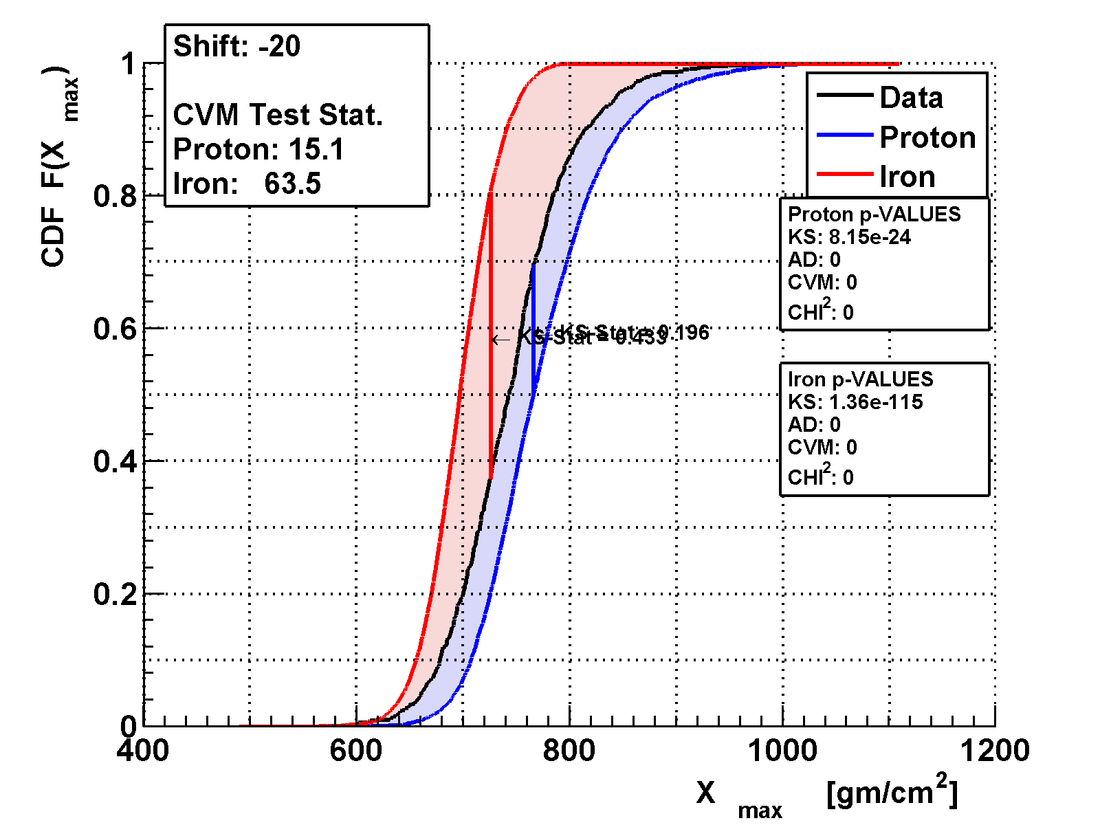
Shift & Quality
Model: QGSJetII-03

Slide 25
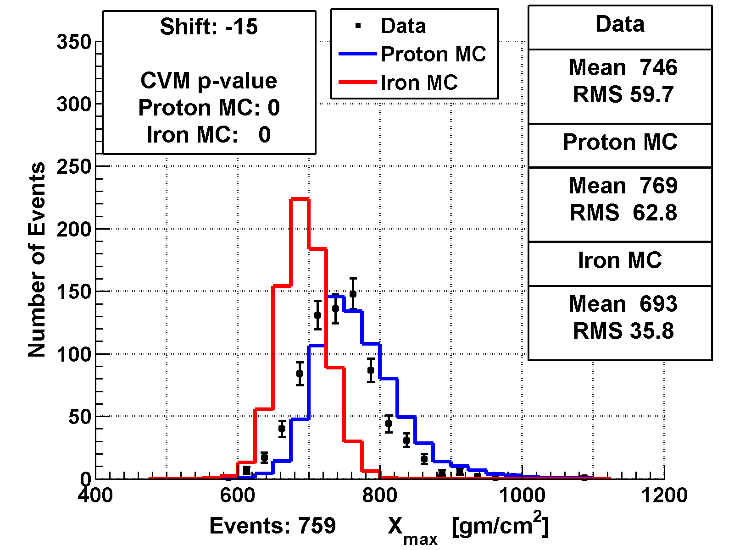
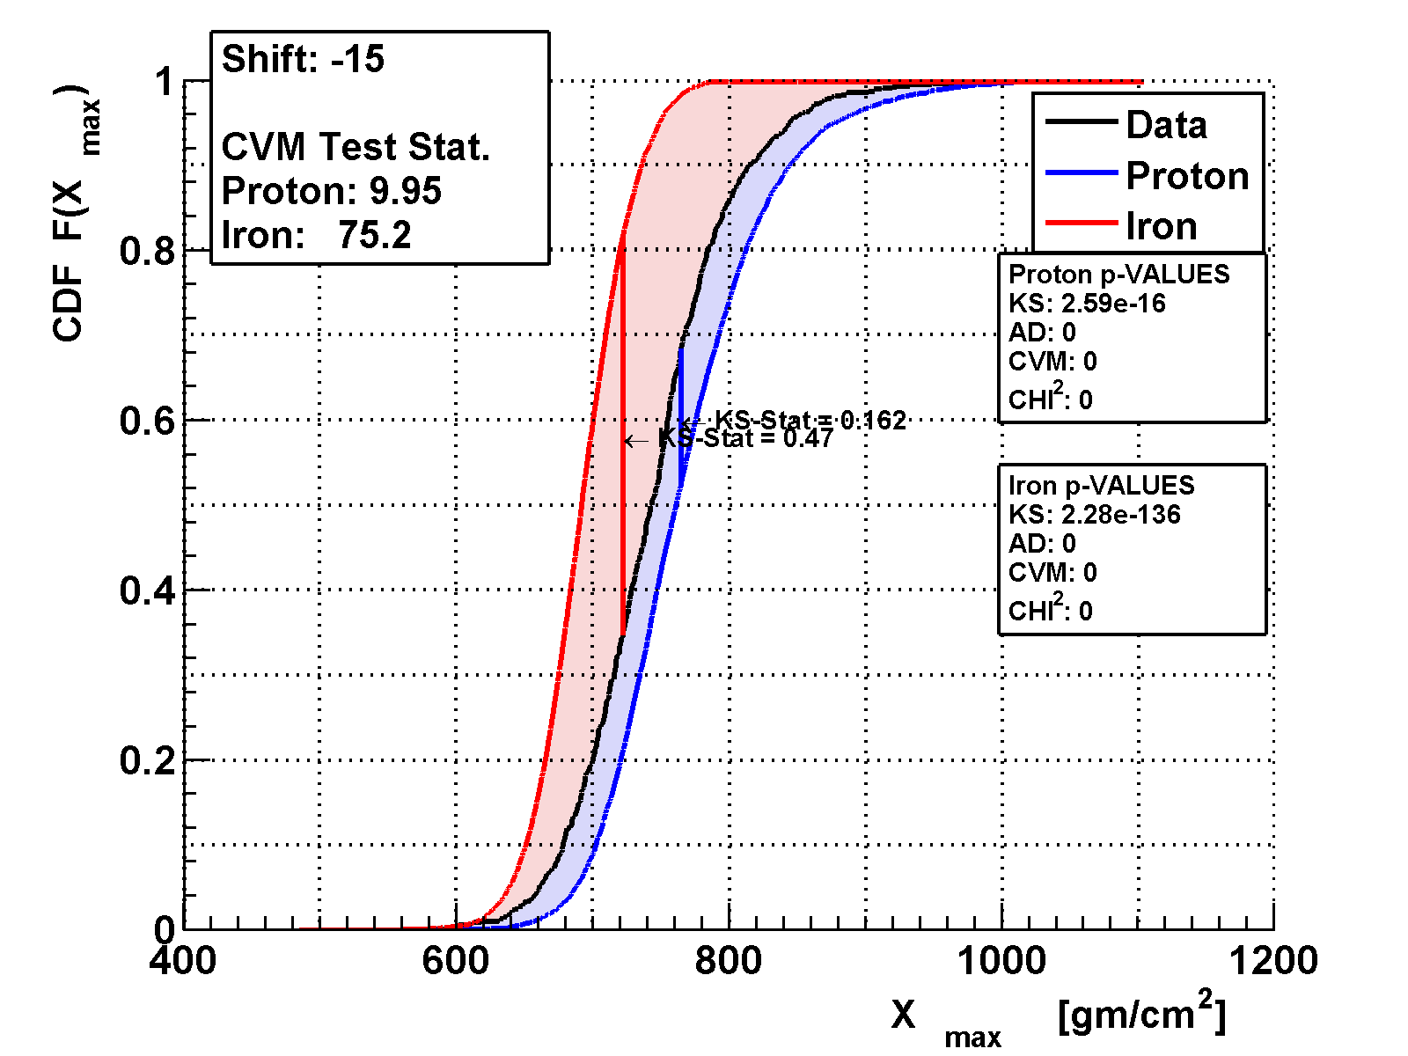
Shift & Quality
Model: QGSJetII-03

Slide 26
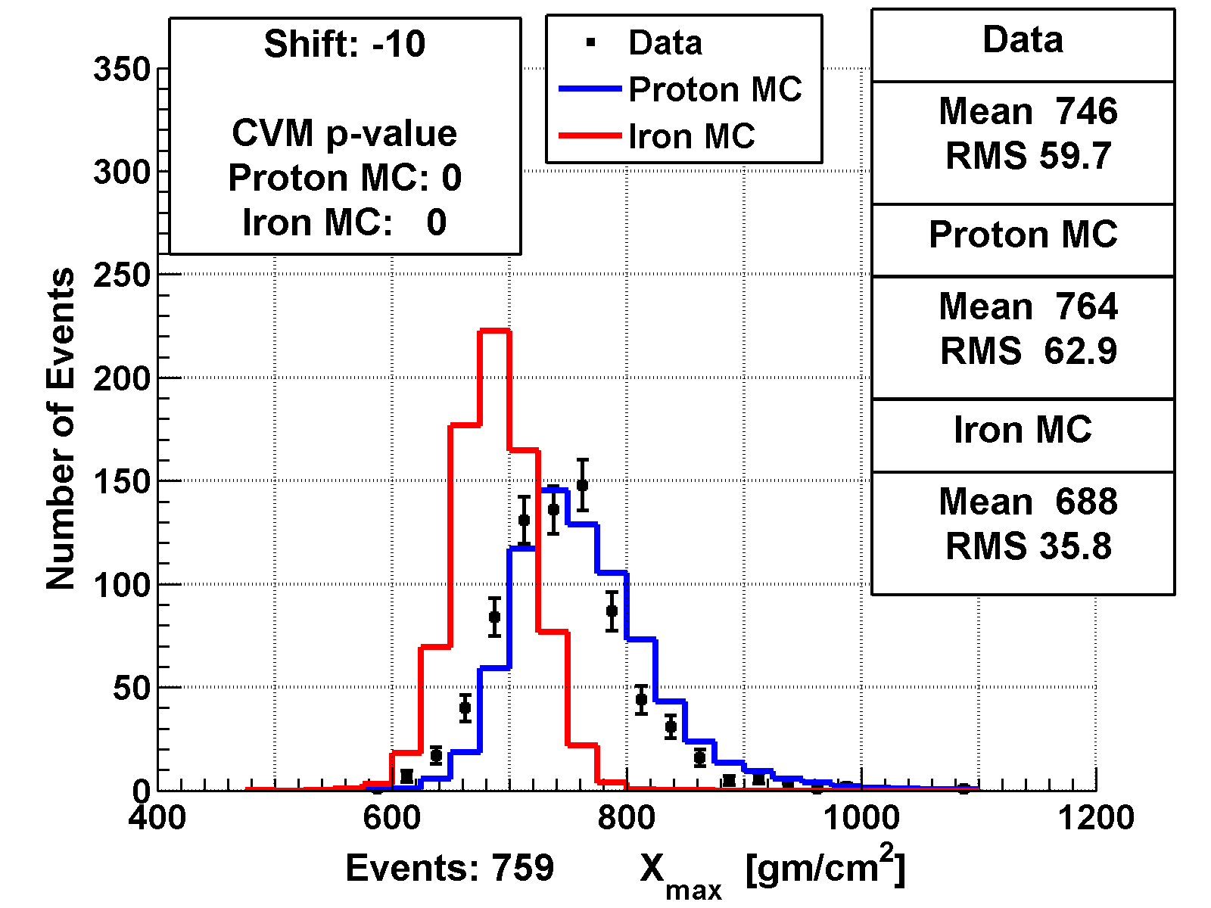

Shift & Quality
Model: QGSJetII-03

Slide 27

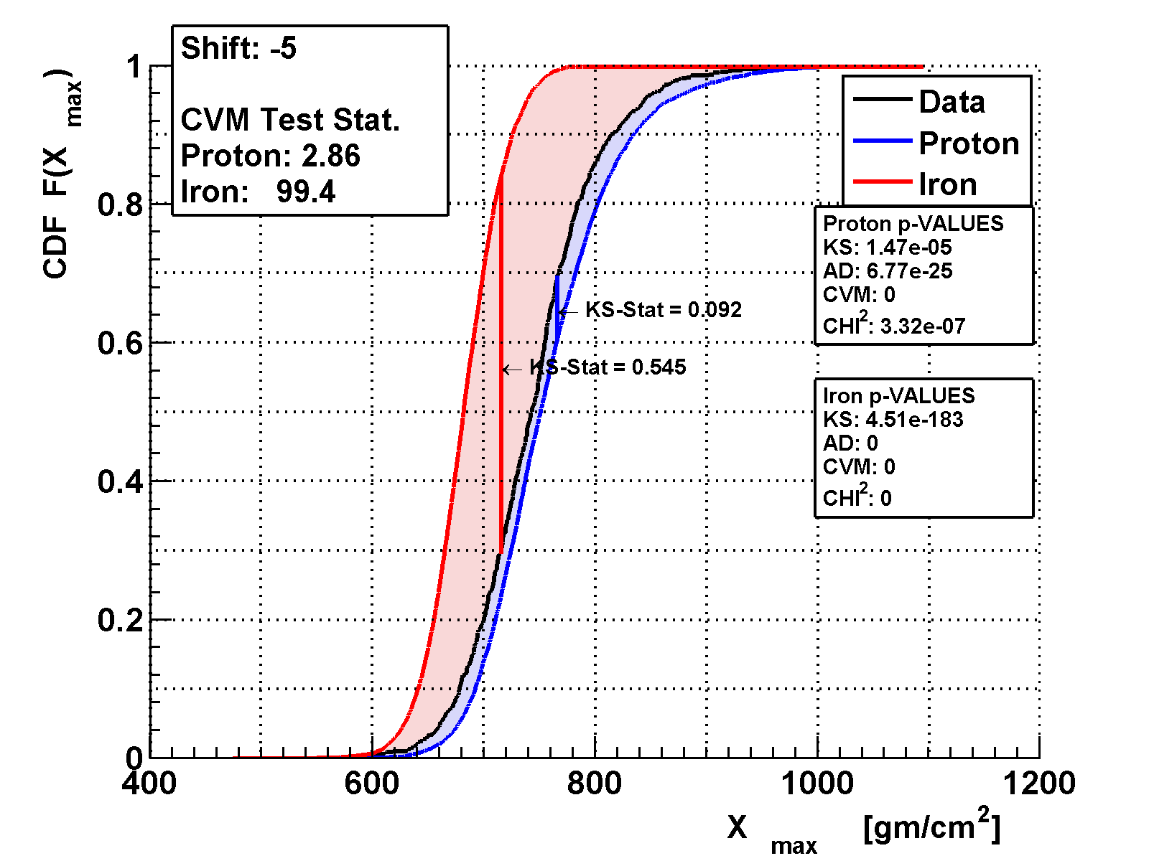
Shift & Quality
Model: QGSJetII-03

Slide 28
Shift & Quality
No shift
Model: QGSJetII-03

Slide 29
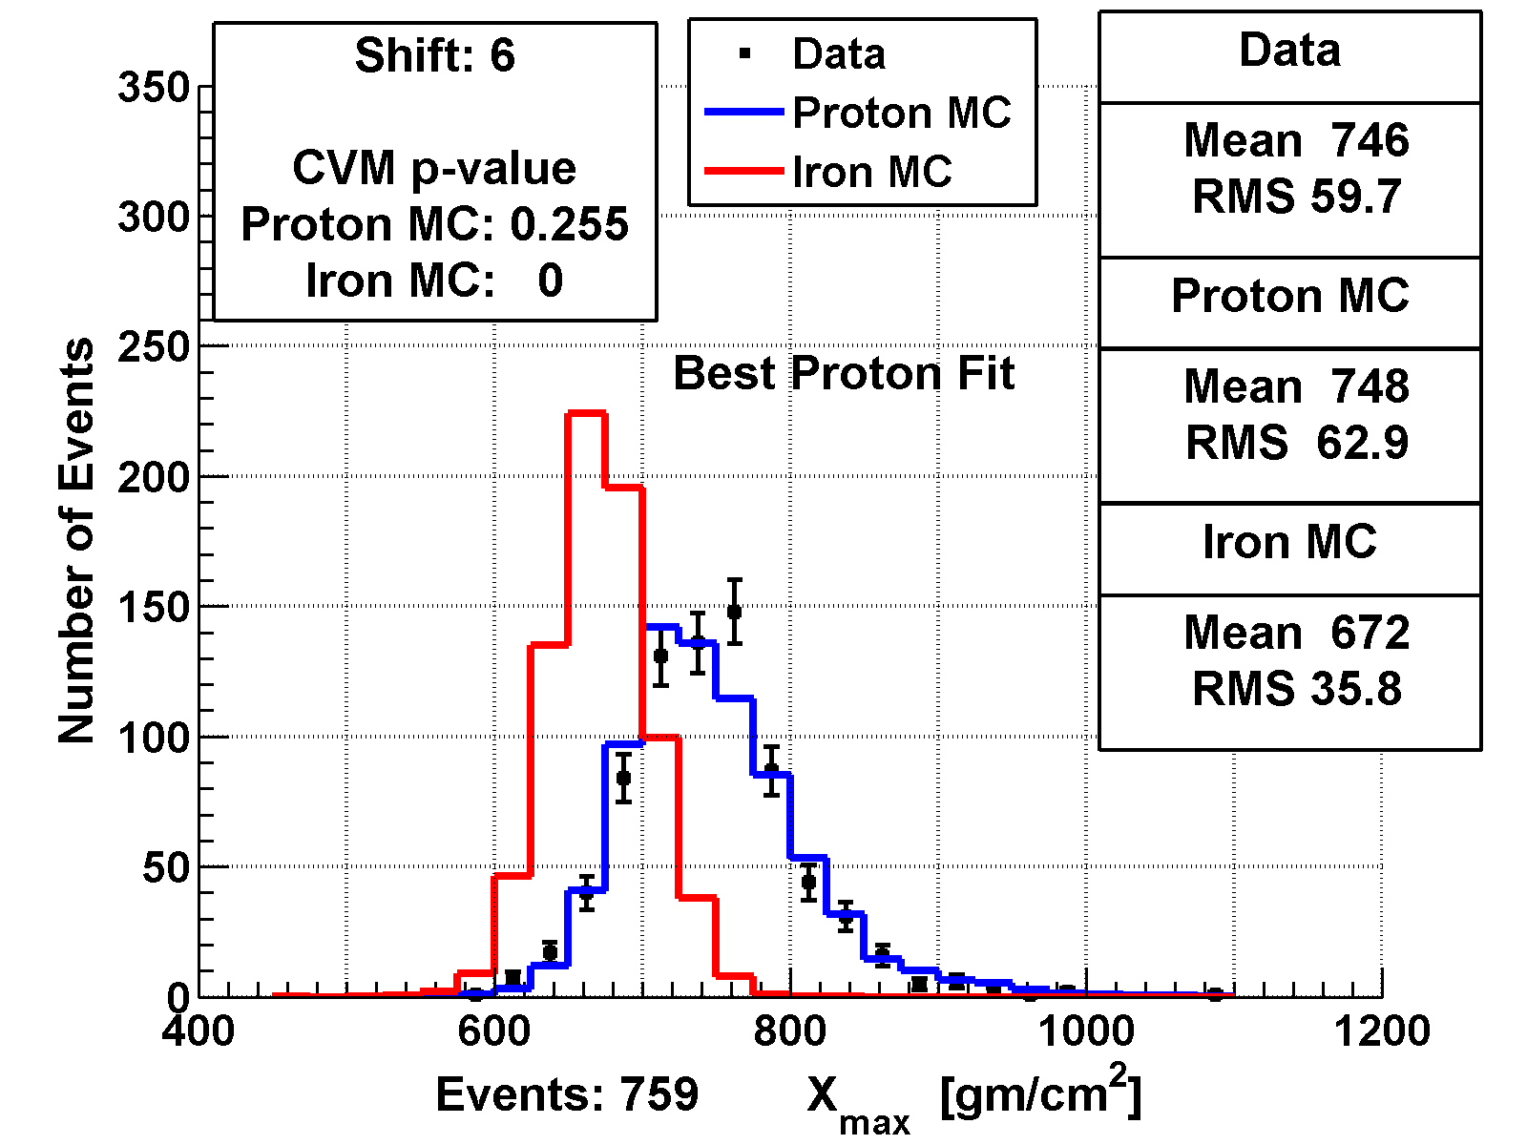
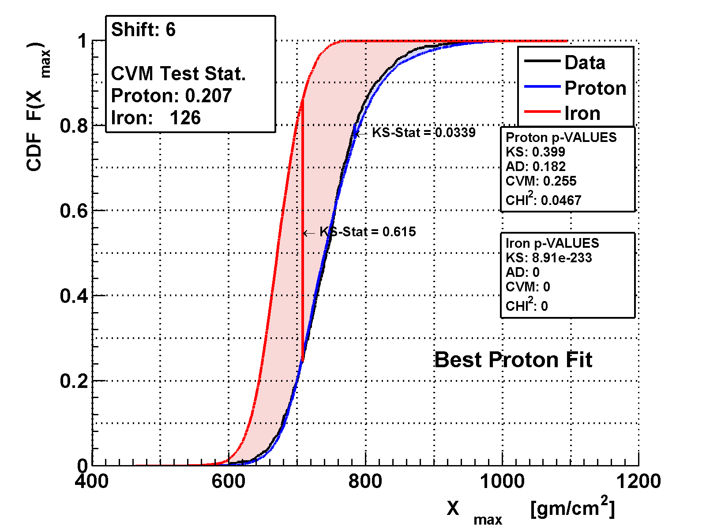
Shift & Quality
Best proton: shift data up by 6 g/cm²
Model: QGSJetII-03

Slide 30
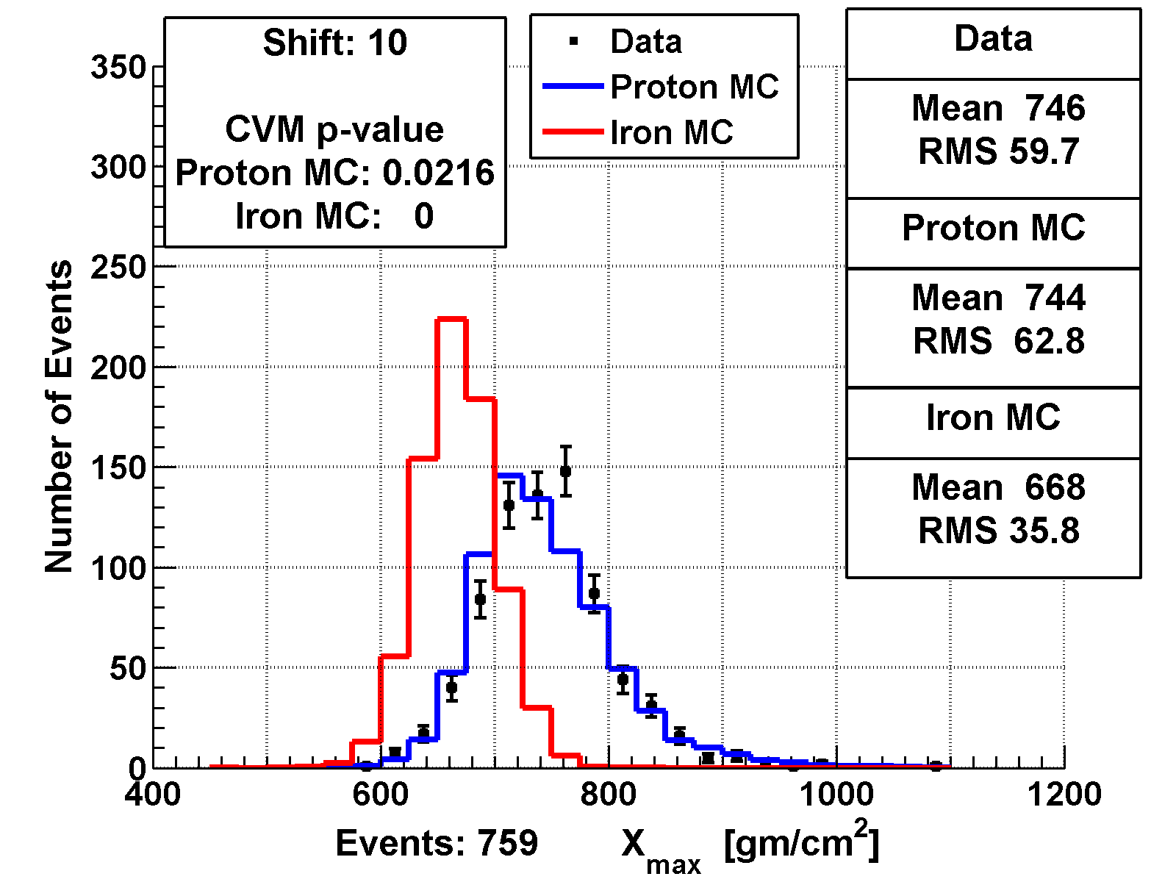
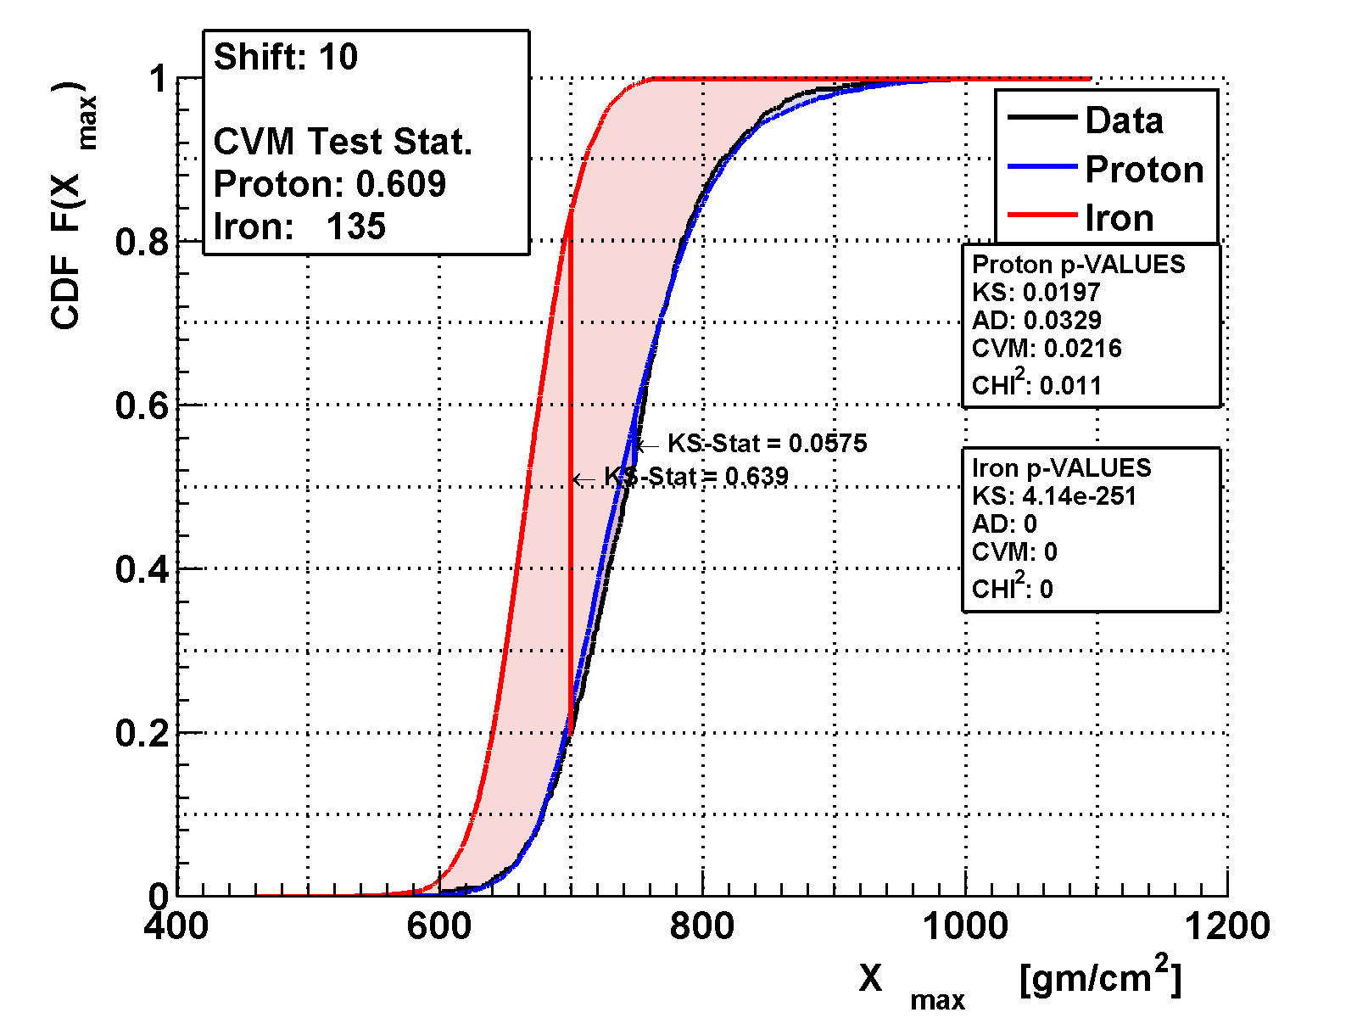
Shift & Quality
Model: QGSJetII-03

Slide 31
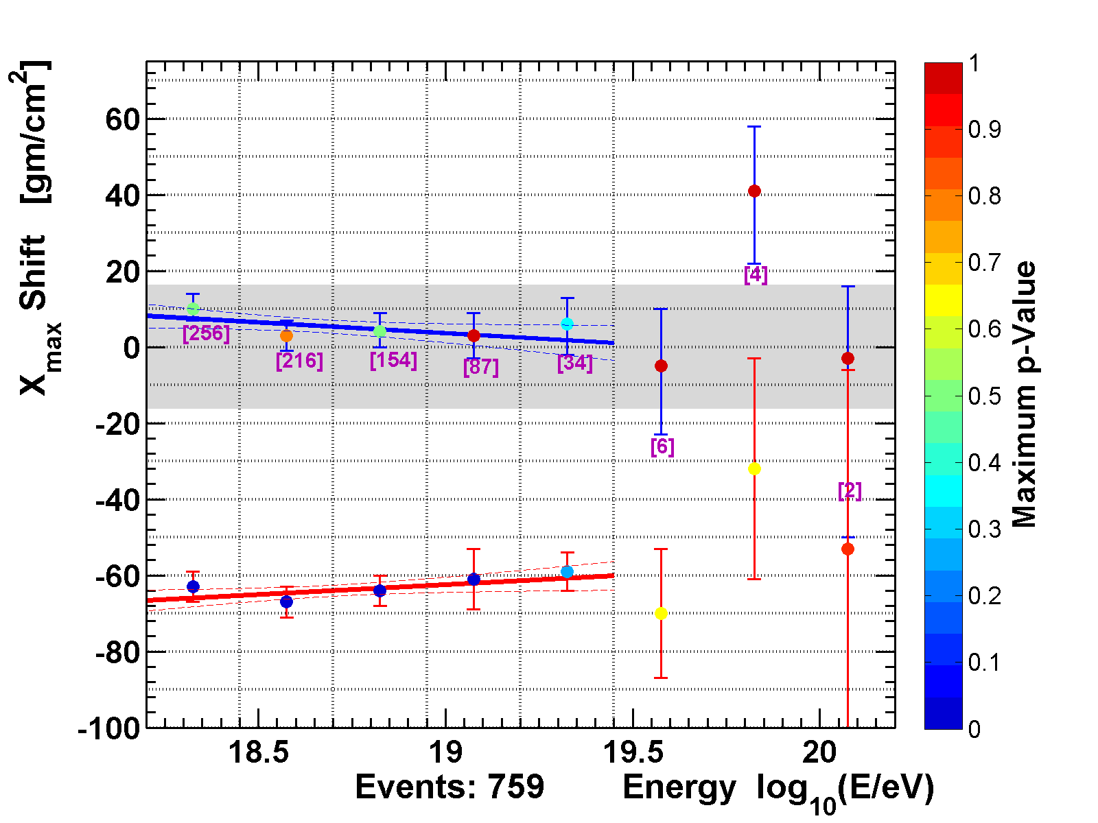
TA MD-Hybrid Composition
Composition analysis using CvM shifts
  Using QGSJetII-03 with quarter decade bins
Protons
  5–10 g/cm² shifts
  Matching distributions
Iron
  60 g/cm² shifts
  Distributions don’t match
Consistent with protons
Model: QGSJetII-03
Preliminary

Slide 32
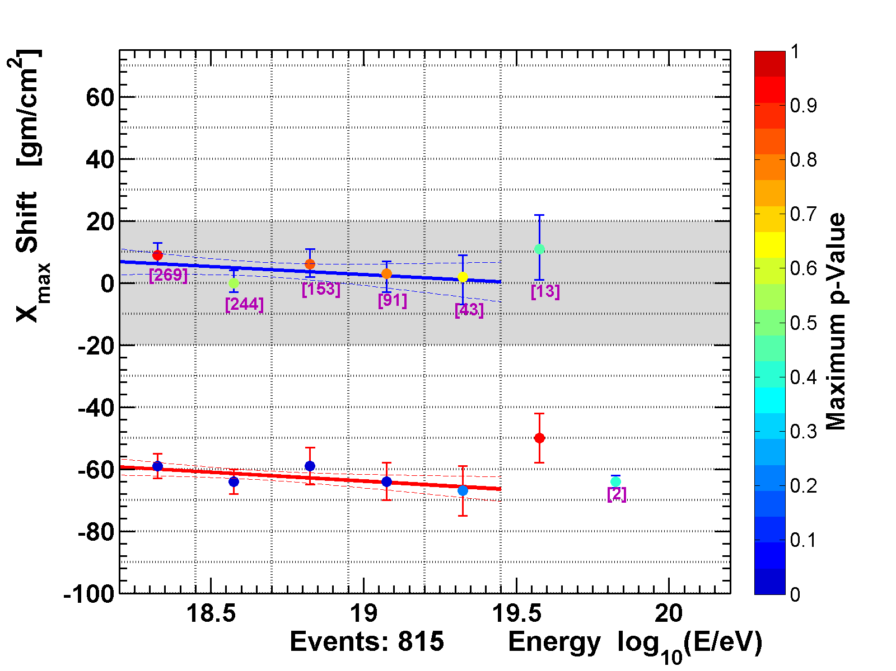
HiRes Composition
HiRes results for comparison
  Same conclusions
  Consistent shifts (not necessarily expected)
  Consistent p-values
Model: QGSJetII-03
HiRes

Slide 33
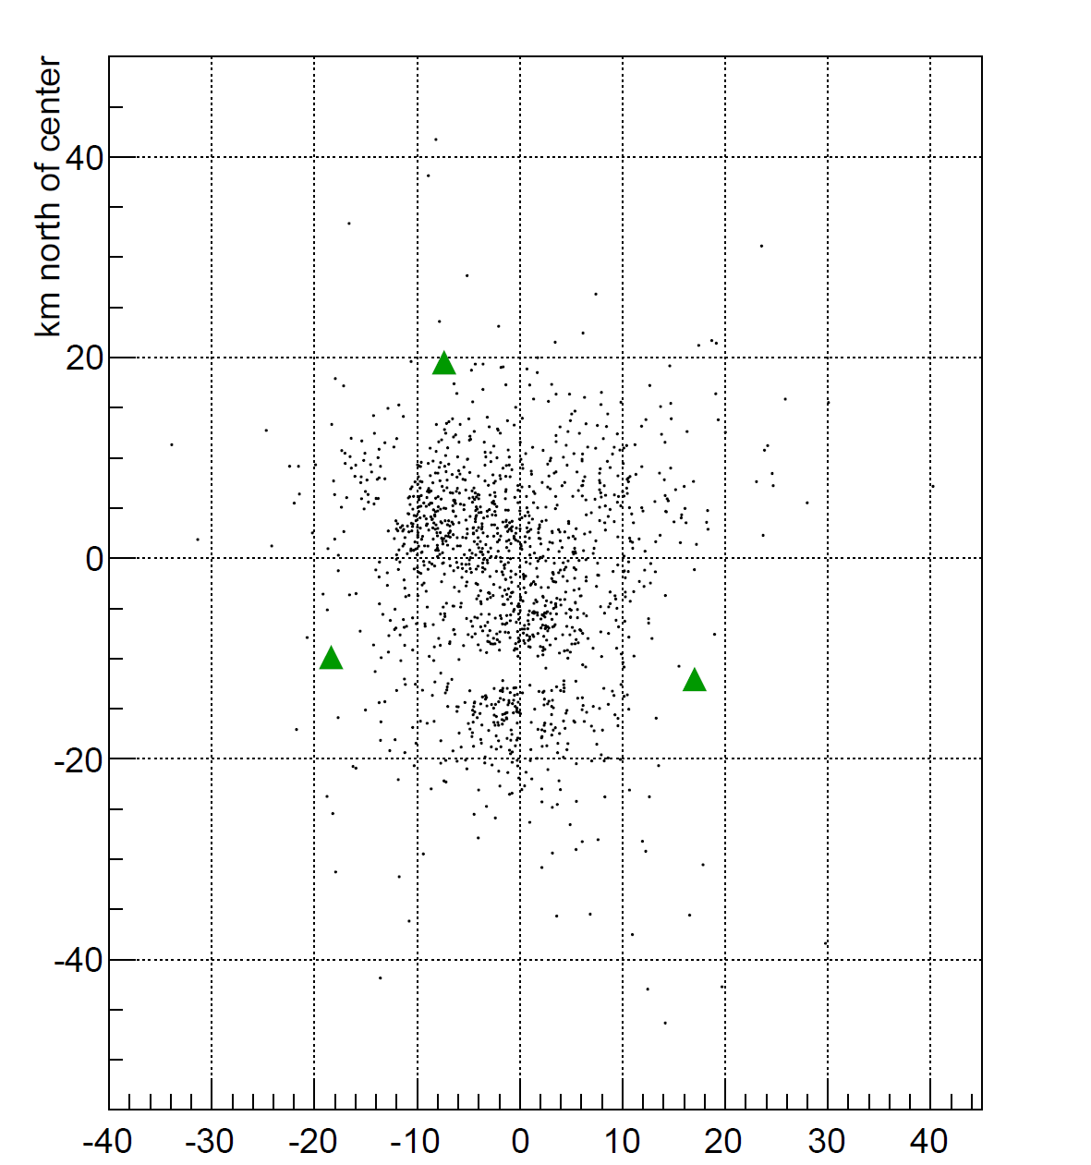
TA Stereo
We also have stereo results for comparison
MD FD
LR FD
BRM FD

Slide 34
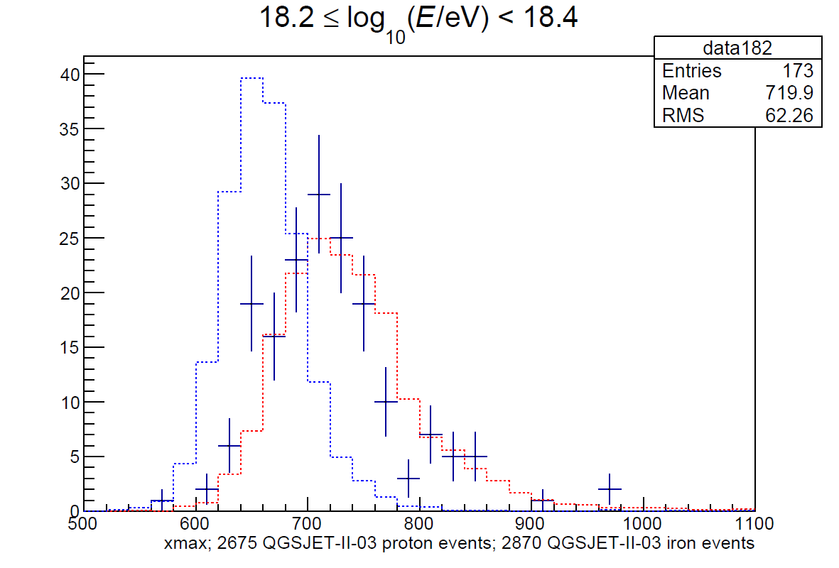
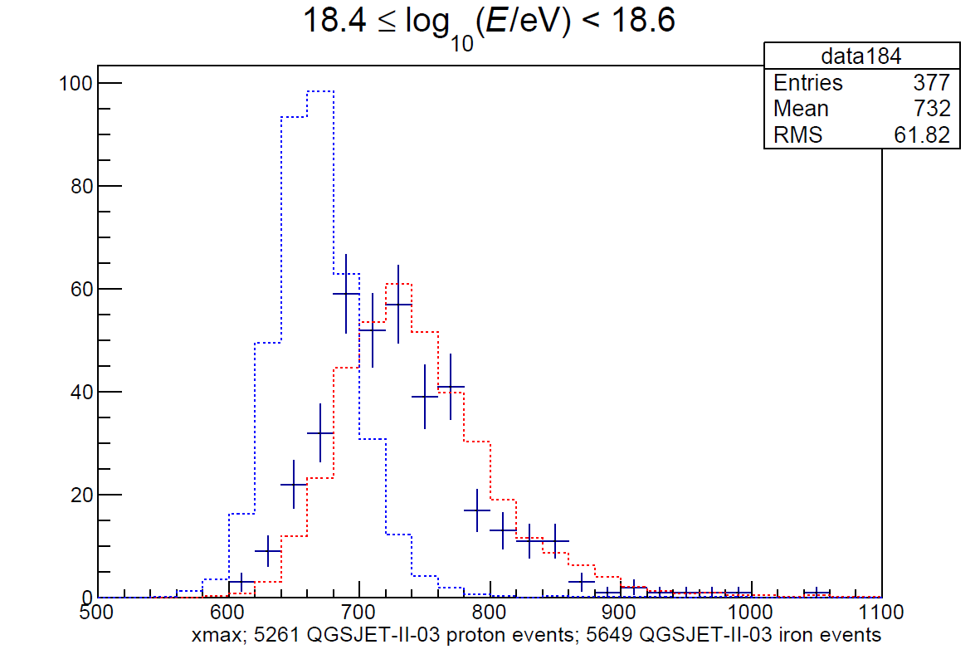
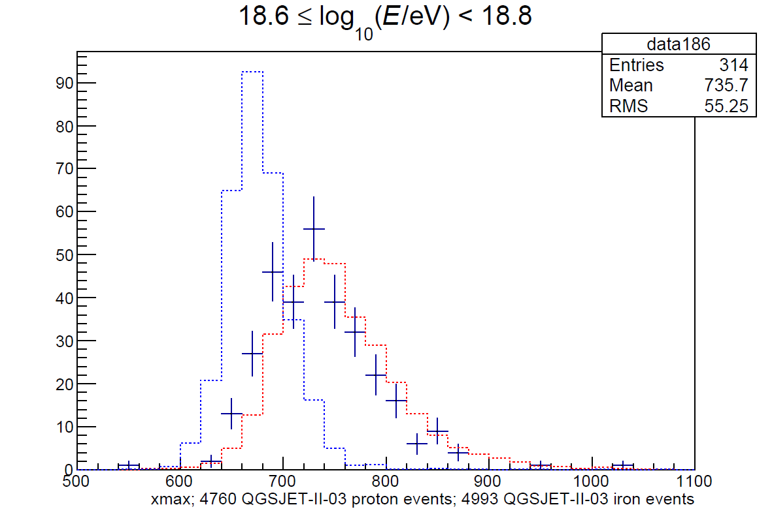
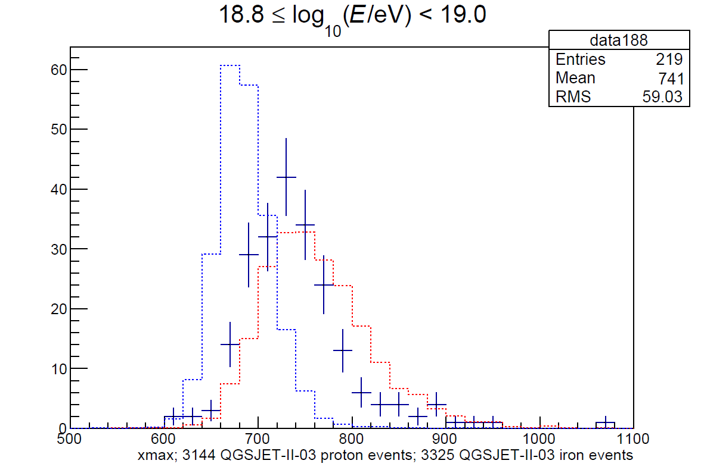
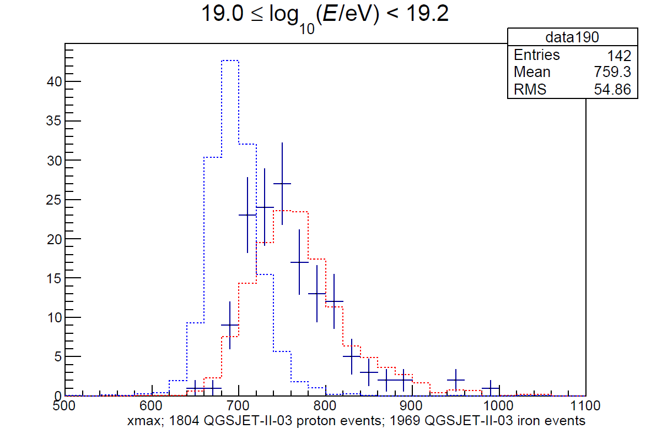
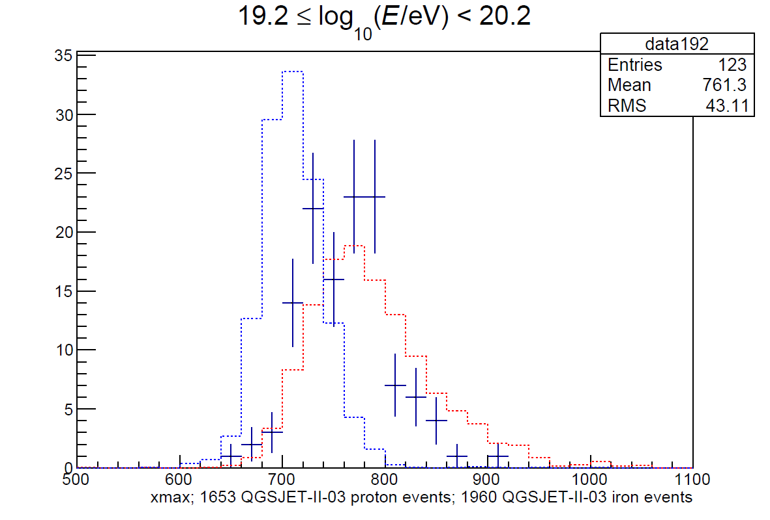
TA Stereo
Model: QGSJetII-03
Preliminary
Preliminary

Slide 35
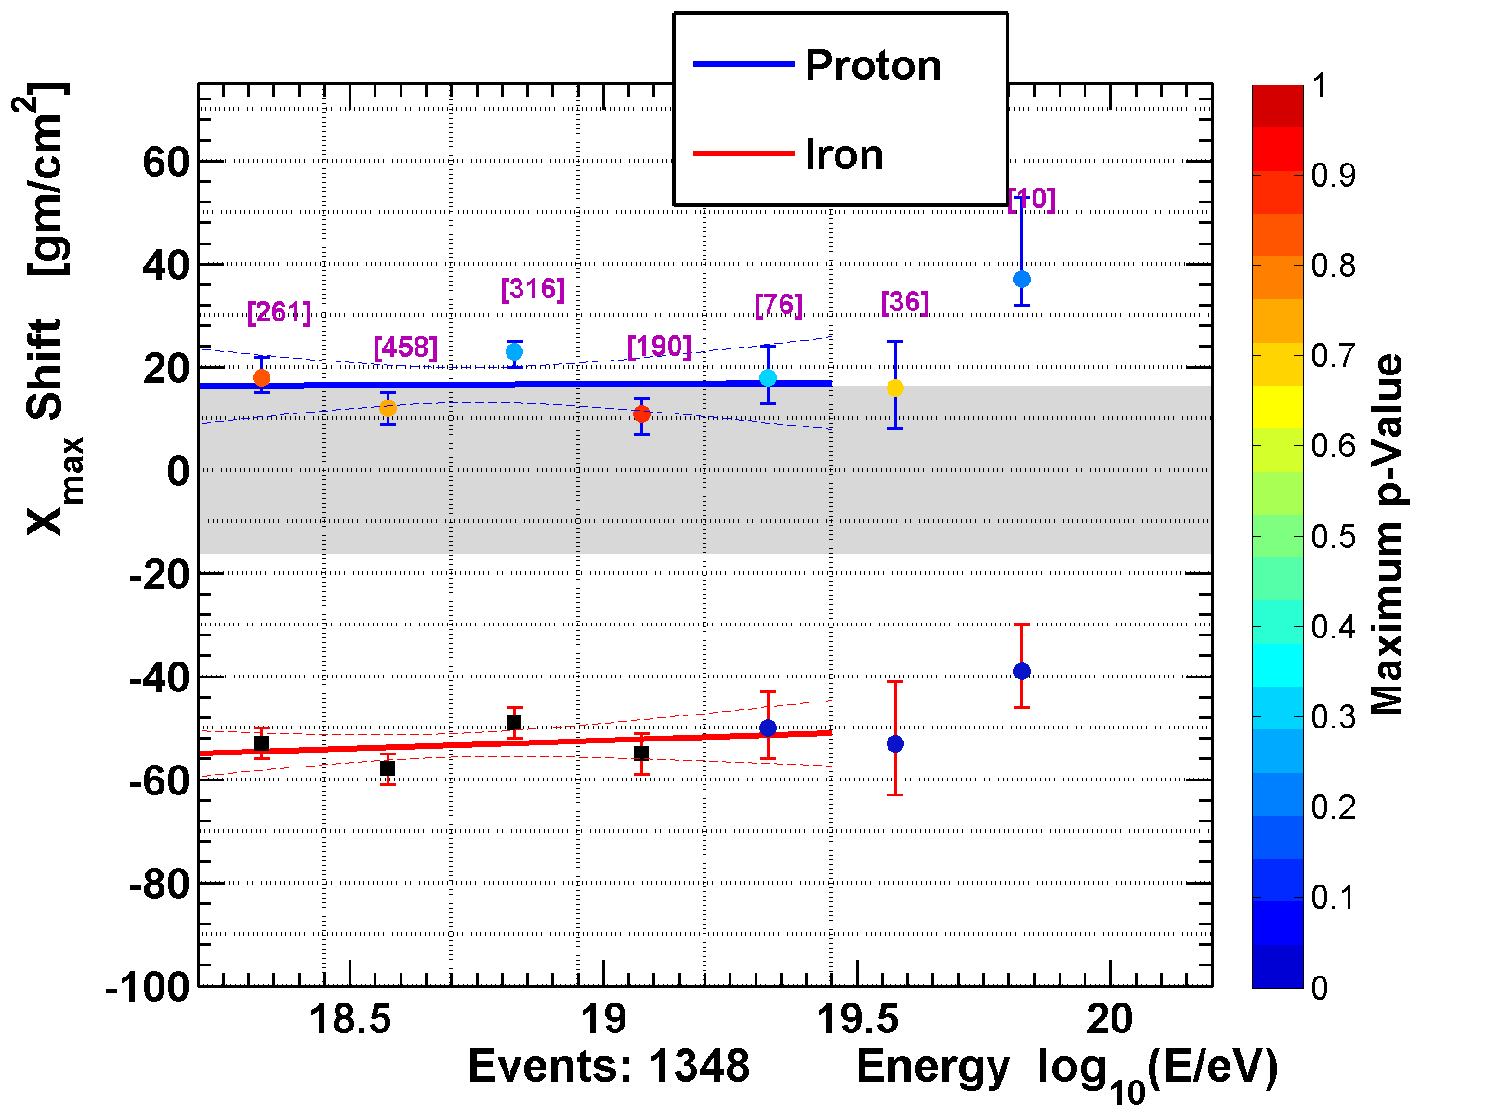
TA Stereo
With stereo we also see very consistent comparison with proton distribution
Different shift but within the 15 g/cm² systematic uncertainty
Model: QGSJetII-03
Preliminary

Slide 36
TA Stereo
MD Shifts for comparison
Model: QGSJetII-03
Preliminary

Slide 37
Anisotropy

Slide 38
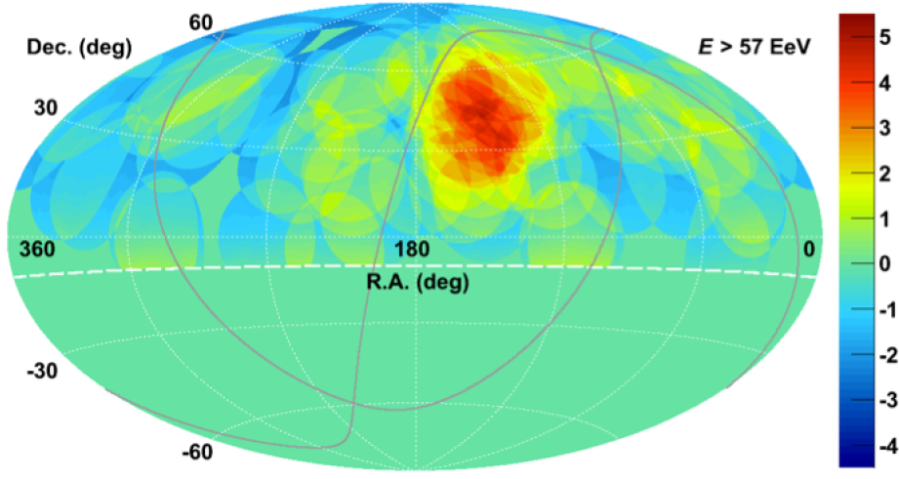
The TA Hotspot
The TA Hotspot: 5 years
  19/72 events above 57 EeV, 26% in 6% of sky
  Li-Ma significance: 5.1σ, Post-trial: 3.4σ
5 year data
ApJ 790 L21 (2014)

Slide 39

The TA Hotspot: Update
The TA Hotspot: 5+1 years
  15 events, 4 in hot spot

Slide 40
The TA Hotspot: Update
The TA Hotspot: 5+1 years
  15 events, 4 in hot spot

Slide 41

The TA Hotspot: Update
The TA Hotspot: 5+1 years
  Li-Ma significance: 5.5σ, post-trial: 4.0σ
  Sixth year increases significance from 3.4σ to 4.0σ

Slide 42
TALE & Spectrum

Slide 43

TALE
Add 10 telescopes at the Middle Drum site, looking from 31°-59° in elevation.
  High elevation angle allows measurement of close-by showers
Add infill array (400m and 600m spacing) for hybrid observation.
TALE
mirrors
TA
mirrors

Slide 44


TALE
Can use traditional fluorescence reconstruction allowing for additional direct Cherenkov contribution

Slide 45


TALE Cherenkov
Can also, surprisingly, look for events dominated by Cherenkov radiation
  This makes TALE the IACT with the largest instantaneous aperture!
  But not-so-great great resolution
  Can’t do photons, sorry

Slide 46

Spectrum
TA (six-year) spectrum

Slide 47

Spectrum
TA (six-year) spectrum
Three months of TALE fluorescence
Preliminary

Slide 48

Spectrum
TA (six-year) spectrum
Three months of TALE fluorescence
Three months of TALE Cherenkov
Preliminary

Slide 49

Spectrum
TA (six-year) spectrum
Three months of TALE fluorescence
Three months of TALE Cherenkov
4.4 orders of magnitude in energy
  Four features
Nota bene: systematic uncertainties from composition (it’s not all protons!) become very important
Preliminary

Slide 50

Spectrum
TA (six-year) spectrum
Three months of TALE fluorescence
Three months of TALE Cherenkov
4.4 orders of magnitude in energy
  Four features
Nota bene: systematic uncertainties from composition (it’s not all protons!) become very important
Preliminary

Slide 51
Future Plans

Slide 52

TAx4
Fourfold increase in size of TA.
  Add 500 SD counters, 2.08 km spacing.
  Add two FD sites, 28 telescopes
Get 20 TA-years by 2019: Definitive answer to hotspot question.
$3.7M from JSPS to build SDs
  Trying to get NSF funding for FD buildings

Slide 53

NICHE: Cherenkov Hybrid
To go lower in energy than TALE, need to use Cherenkov light
Aim to build a Non-Imaging CHErenkov array (NICHE) within the field-of-view of TALE.
$188k from Kakenhi grant to Yoshiki Tsunesada
  Build 15 counter prototype array

Slide 54




NICHE: Cherenkov Hybrid

Slide 55

NICHE:
Advent of TALE Cherenkov allows us to consider doing imaging-non-imaging Cherenkov hybrid
  Since the goal is overlap at 10¹⁶ eV instead of 10¹⁷ eV need only a smaller array
  Close spacing means better resolution and lower energy threshold
Measure down to 10¹⁵ eV in standalone mode

Slide 56
Summary
Proton-like composition using the full shape of the X_{max} distribution (CvM test)
Sixth year of anisotropy data increases significance of TA Hotspot to 4σ
Seventh year of TA data will be available in about a week. Expect updates at the ICRC
With TALE and especially TALE Cherenkov we can measure the spectrum over 4.5 orders of magnitude
Planned extensions at high energy, TAx4, and low energy, NICHE

Slide 57
Backup Slides

Slide 58

TA MD-Hybrid Composition
Astroparticle Physics result
APP 64 49 (2015)

Slide 59
TA MD-Hybrid Composition
New result with 6 years of data, quality factor cut
Preliminary

Slide 60
TA MD-Hybrid Composition
New result with 6 years of data, quality factor cut
Median
Median X_{max}
Preliminary

