Slide 1
Atmospheric neutrinos from perturbative charm production and decay
Hallsie Reno
University of Iowa
Work with I. Sarcevic, A. Bhattacharya, R. Enberg, A. Stasto
IPA Symposium, May 5, 2015
arXiv:1502.01076

Slide 2
Energy dependence, schematically
Cosmic rays produce hadrons. They decay to neutrinos (low energy-all, high energy- few)
Scaling by approximate CR energy spectrum

Slide 3
Energy dependence, schematically
“conventional”
Scaling by approximate CR energy spectrum
“prompt”
Electron neutrino flux from K-short, Gaisser & Klein, Astropart. Phys. 64 (2015)
Notes:
120 TeV for Ks is critical energy

Slide 4
Prompt neutrinos: charm contributions using perturbative QCD
PDF = parton distribution function
One approach, perturbative QCD with PDFs:
Disadvantage: need gluon PDF in low x, not very big Q range.
Refs: e.g., Thunman, Ingelman, Gondolo, Astropart. Phys. (1996) at LO,
Pasquali, MHR, Sarcevic, Phys. Rev. D (1999) at NLO modeled with x dependent k-factor (PRS)
Necessarily involve extrapolations at low x (sometimes explicit, sometimes implicit).
What about large logarithms?

Slide 5
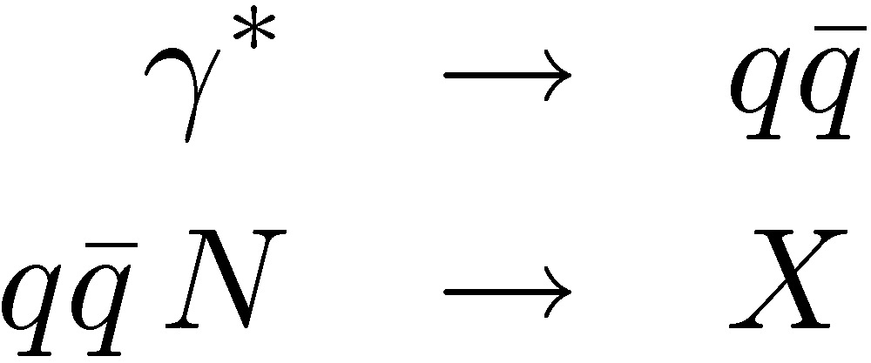
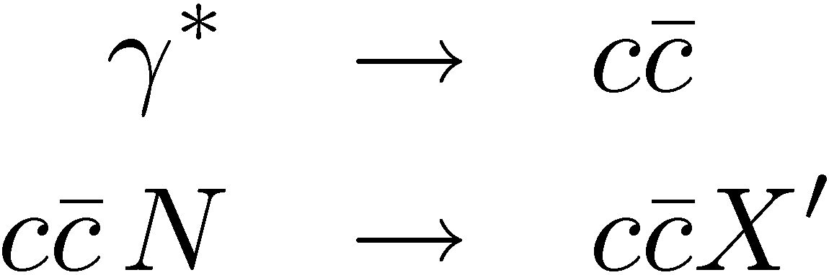
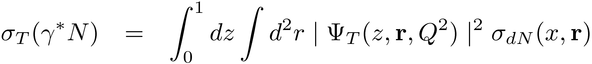
Prompt neutrinos: charm contributions with dipole approach
Advantage: don’t need small x gluon PDF
r
heavy quarks:
Golec-Biernat & Wusthoff (GBW, PRD 59 (1999))
Improved QCD motivated form – Balitsky-Kovchegov (BK) evolution
Modified for gluon -> charm anticharm pair
This is what we used in Enberg, MHR & Sarcevic, PRD 78 (2008): ERS

Slide 6
What is new in this perturbative evaluation?
NLO QCD evaluation of charm pair cross section and energy distribution using the FONLL code (low pT, so no log(pT/mc) required here) with CT10 PDFs (modern PDFs).
Cacciari, Greco, Nason, JHEP 9805 (1998); Cacciari, Frixion, Nason, JHEP 0103(2001); Mangano, Nason, Ridolfi, NP B273 (1992); Nason, Dawson, Ellis, NP B303 (1988), NP B373 (1992)
Old evaluations use broken power law for the cosmic ray spectrum – more realistic spectrum included here.
Gaisser, Astropart. Phys. 35 (2012); Gaisser, Stanev & Tilav, NIM A742 (2014)

Slide 7
PDF comparison

Slide 8
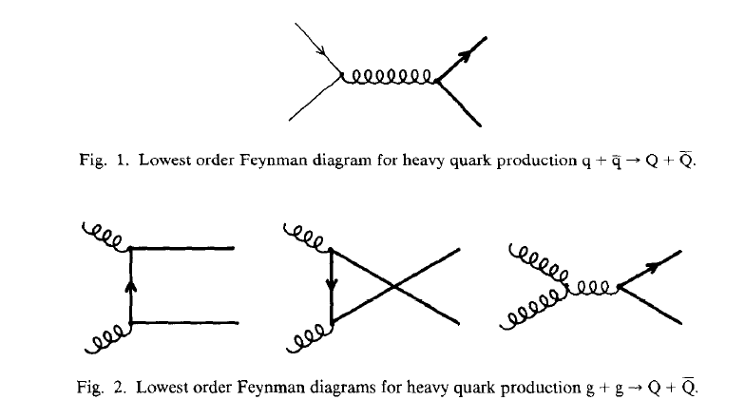
Reminder: leading order charm production in perturbation theory
Nason, Dawson & Ellis, Nucl. Phys. B303(1988); Nucl. Phys. B327 (1989)

Slide 9
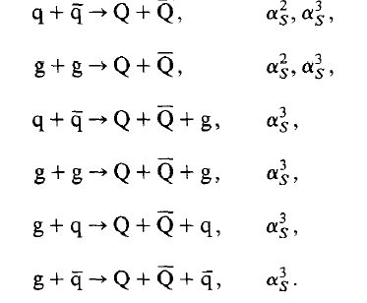
NLO perturbative contributions
We use the FONLL program that incorporates these processes. We take
Nason, Dawson & Ellis, Nucl. Phys. B303(1988); Nucl. Phys. B327 (1989); Mangano, Nason, Ridolfi, Nucl. Phys. B373 (1992);
FONLL: Cacciari, Greco and Nason, JHEP 9805 (1998); Cacciari, Frixione and Nason, JHEP 0103 (2001),

Slide 10
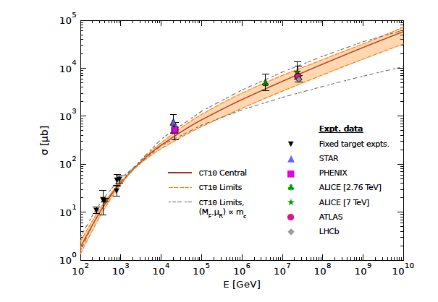
Charm pair cross section guides our choices of scales
Central
Shaded band
Dashed band
arXiv:1502.01076
Guidance from Nelson, Vogt & Frawley,
PRC 87 (2013)

Slide 11
Transport equations
High enough energies that muons are “stable”.
Production
Decay
Need energy distribution of the final state particle.
Notes:
Charm production is what we will be looking for

Slide 12
Z-moments-spectrum weighted moments
Approximate relation – flux factorizes so Z only depends on E.
Calculate the differential cross section or decay distribution,
convolute with the flux, integrate to get Z.
Notes:
Talk about what are the moving parts here.

Slide 13
Approximate formulae
Exponential atmosphere, 1D, approximate factorization of depth dependence.
Cosmic Rays and Particle Physics, T. Gaisser, Cambridge U Press; L. V. Volkova, Sov. J. Nucl. Phys. 31 (1980);P. Lipari, Astropart. Phys. 1 (1993)
Notes:
Comment on ZNN, Production and Decay moments

Slide 14
CR all particle spectrum
From Table 1, Gaisser, Astropart. Phys. 35 (2012) 801

Slide 15
CR nucleon spectrum
From Table 1, Gaisser, Astropart. Phys. 35 (2012) 801

Slide 16
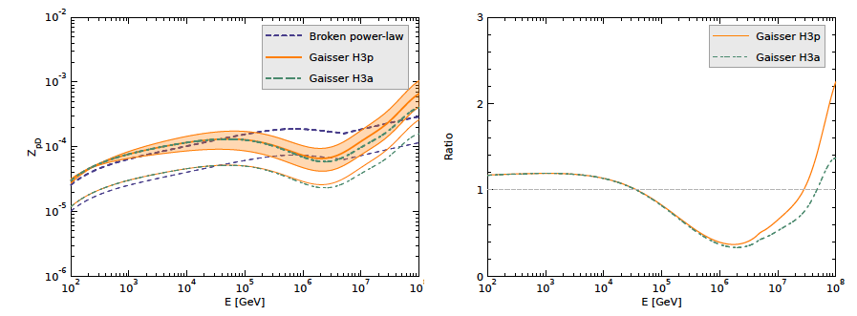
Z moments - production
arXiv:1502.01076

Slide 17
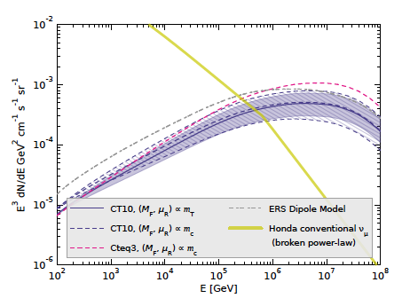
Broken power law CR flux: muon neutrinos plus antineutrinos
arXiv:1502.01076, Honda et al., PRD75 (2007)

Slide 18
Comparison with ERS
Upper band: ERS (dipole model)
arXiv:1502.01076, Honda et al., PRD75 (2007)

Slide 19
Comparison with ERS
PDFs nearly the same, but the differential energy distribution of the charm is different: dipole model vs perturbative calculation. The Z-moment emphasizes large xE, which does not have a large contribution to the cross section. The ratio of the Z-moments is approx. factor of 1.5 (ERS approximately 1.5xBERSS).
We use a different value of Zpp: in ERS, we used the Thunman et al (TIG, Astropart. Phys. 5 (1996)) PYTHIA value,
Here:

Slide 20
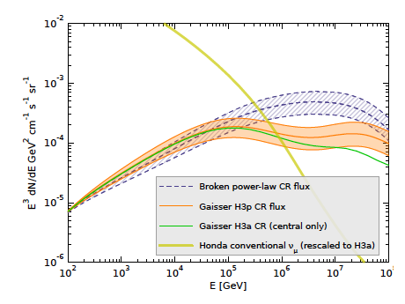
Muon neutrinos plus antineutrinos
arXiv:1502.01076
arXiv:1502.01076, Honda et al., PRD75 (2007)

Slide 21
Conclusions & Future Work
The cosmic ray spectrum and composition is crucial – corrections from broken power law to more realistic composition and spectrum mean a lower prompt flux.
The modern PDFs and high energy constraints on the cross section are a start to developing an understanding of the QCD uncertainties in the prediction.
The perturbative approach is not the only way to proceed. We are re-evaluating the prompt flux using the dipole model to get a better handle on the range of theoretical predictions.

Slide 22
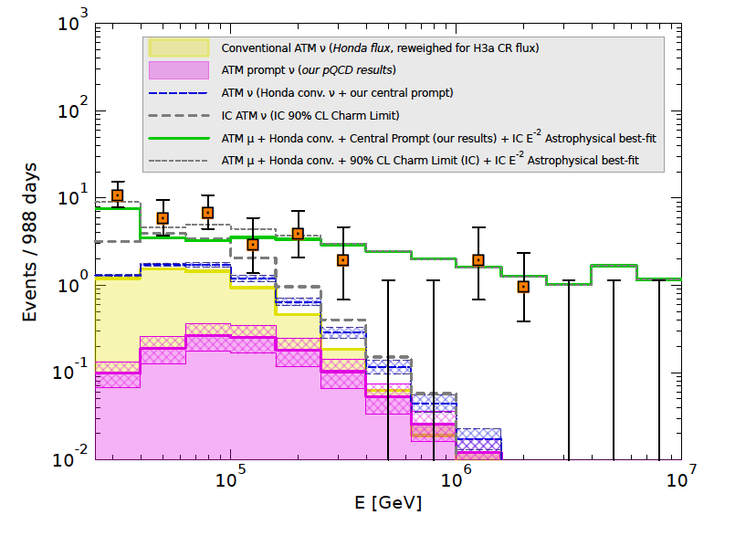
Event rates at IceCube with new prompt flux evaluation
arXiv:1502.01076

