Slide 1
Measurement of the neutrino velocity with the OPERA detector in the CNGS beam
G. Giacomelli
University of Bologna and INFN
1. Introduction
2. The OPERA detector and the CNGS beam
3. Principle of the time of flight measurement
4. Measurement of the neutrino baseline
5. Data selection
6. Neutrino event timing
7. Data analysis
8. Conclusions
Main Authors : D. Autiero, G. Brunetti
Task force : A. Ereditato, G. Wilquet, H. Pessard, P- Migliozzi, F. Terranova, M. Dracos, J.L.Vuilleumier, M. Komatsu, G. Giacomelli
Internal reviewers: P. Monacelli, H. Shibuya, A. Badertscher, S. Aoki, Y. Gomushkin
arXiv:1109.4897 hep/ex (23/9/2011) : The OPERA Collaboration

Slide 2
    1. INTRODUCTION
In the past :
for E_{ν} > 30 GeV , short baseline: no deviation down to v-c/c =4 10⁻⁵
⁻ MINOS : v-c/c=5.1 +-2.9 10⁻⁵
SN1987A : E_{ν} = 10 MeV : limit v-c/c=2.9 10⁻⁹
-Method of measurement of the velocity : v_{ν}=l/TOF [+corrections]
Precise measurement of the CERN-OPERA distance l by geodesy to 20 cm
“ “ TOF via GPS synchronzed atomic clocks+……
2.1 OPERA
The hybrid OPERA detector at LNGS is composed of two identical Super Modules each consisting of an instrumented target section with a mass of 625 t followed by a magnetic muon spectrometer. Each target section is a succession of walls filled with high spatial resolution emulsion/lead units interleaved with pairs of 6.7 × 6.7 m² planes of 256 horizontal and vertical scintillator strips composing the Target Tracker (TT). The TT allows the localisation of neutrino interactions in the target and is used to measure the interaction time of neutrinos .
2.2 CNGS
Protons ejected from the SPS: 2 extractions, each of 10.5 μs, spaced by 50 ms.

Slide 3
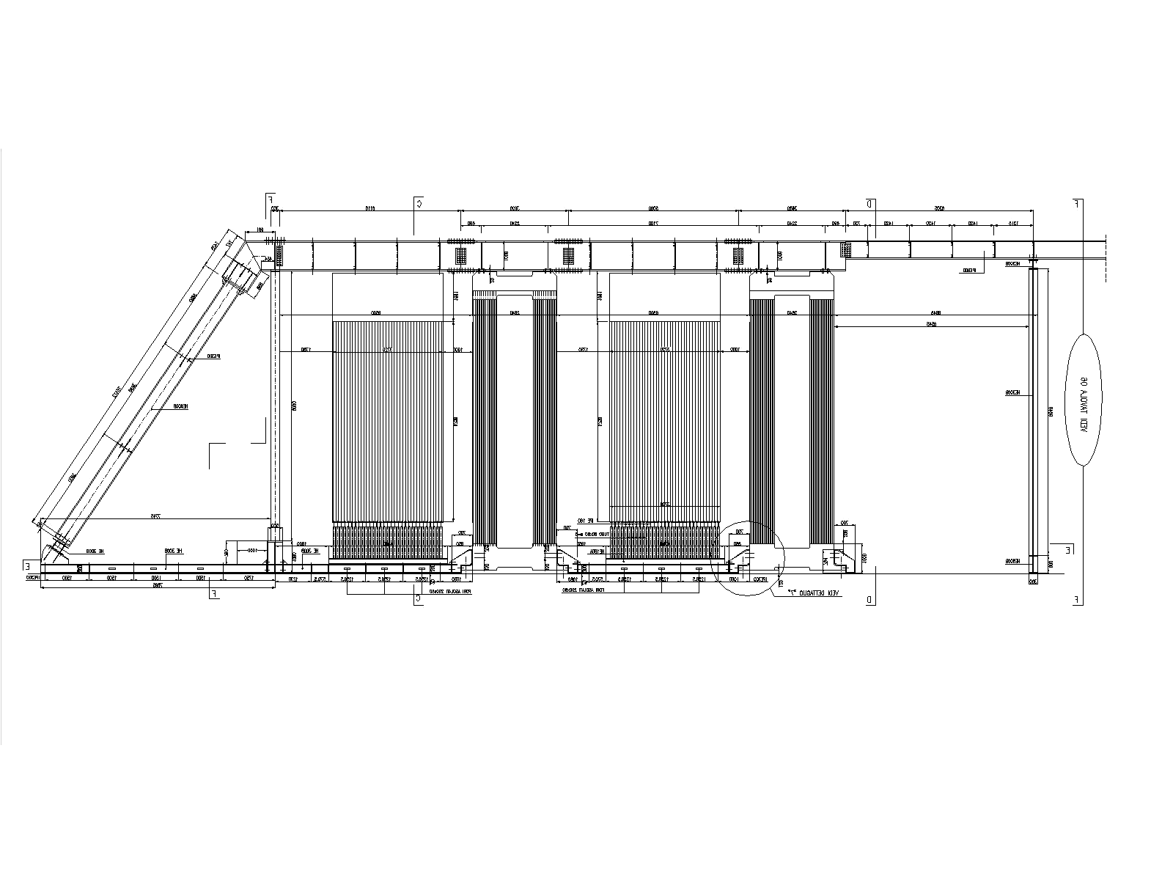
The OPERA hybrid detector
Old slide
31 target planes / supermodule (in total: 150000 bricks, 1350 tons)
SM1
SM2
υ
Magnetic Spectrometers
Targets

Slide 4
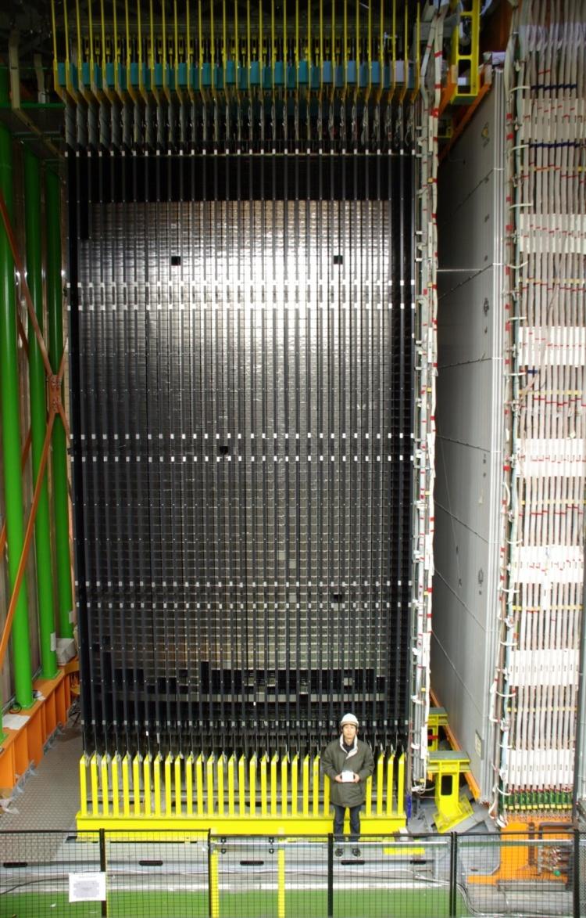
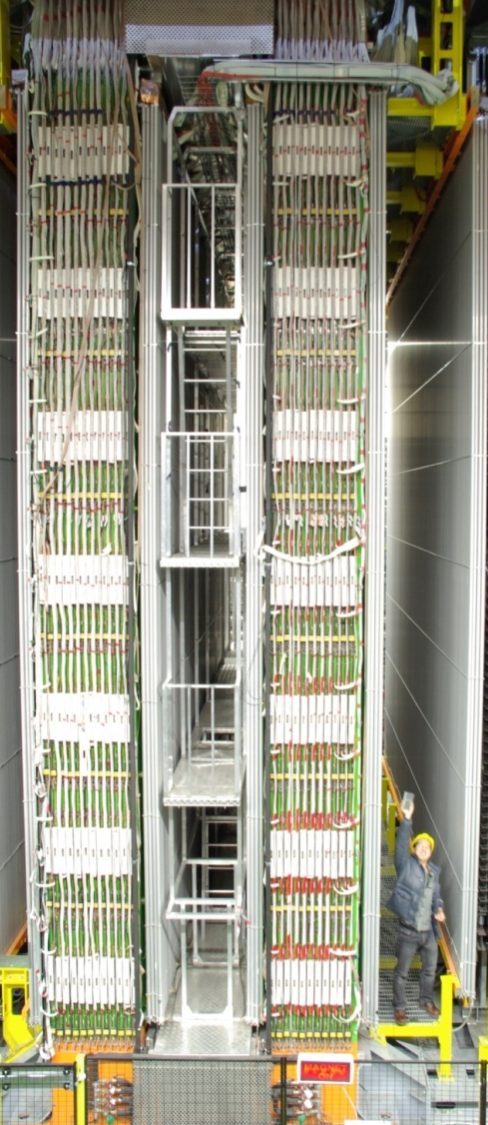
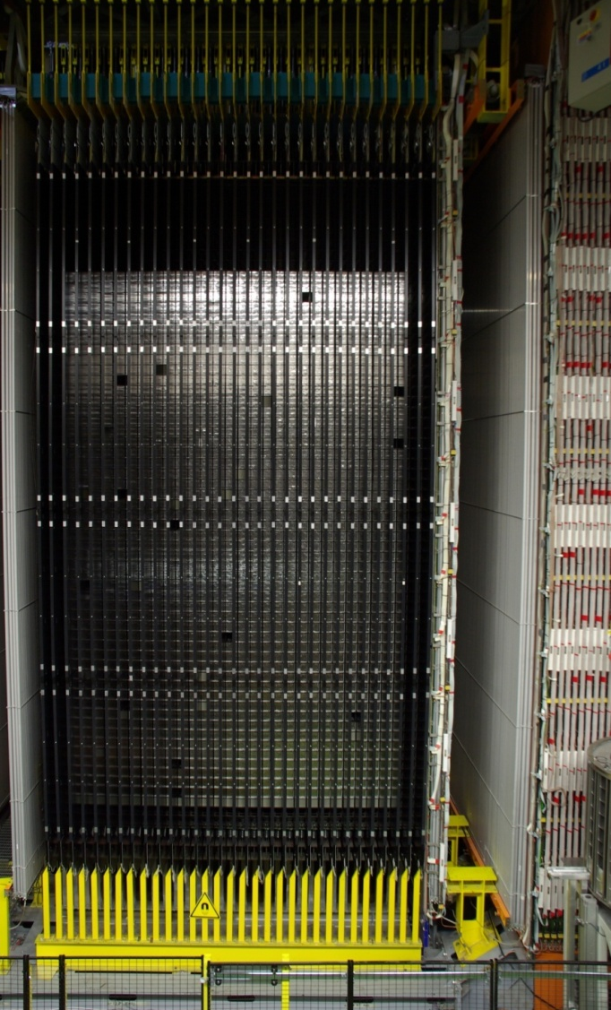
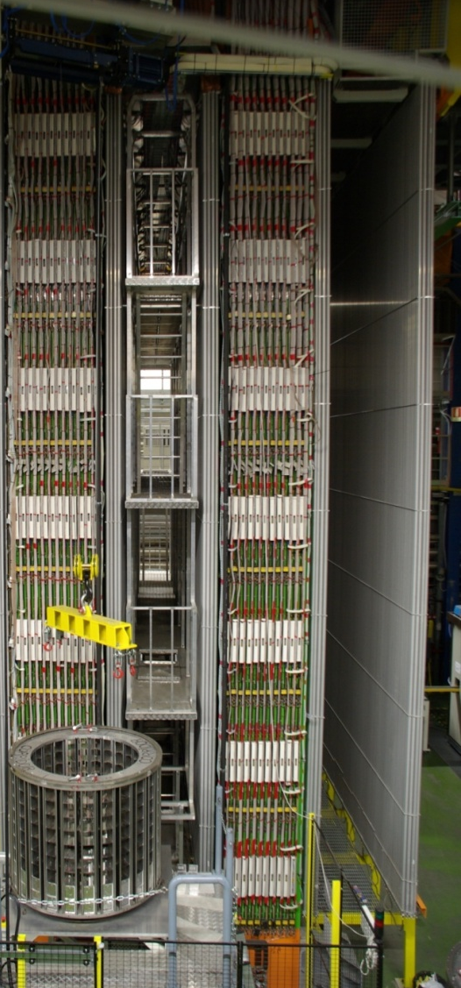
Side photograph of OPERA
SM1
SM1
SM2
SM2
Target area
Muon spectrometer
A. Ereditato - CERN - 4 June 2010

Slide 5
Artistic view of the SPS/CNGS layout.
400 GeV protons

Slide 6
Details of the CNGS beam line.

Slide 7
3. Neutrino TOF measurement
The time of flight of CNGS neutrinos (TOF_{n}) cannot be precisely measured at the single interaction level since any proton in the 10.5 μs extraction time may produce the neutrino detected in OPERA. However, by measuring the time distributions of protons for each extraction for which neutrino interactions are seen in the detector, and summing them together, after proper normalisation one obtains a probability density function (PDF). It is a good prediction of the time distribution of neutrinos that can be compared with the time distribution of their interactions detected in OPERA in order to measure TOF_{ν}. The deviation δt from the transit time assuming neutrinos travelling at the speed of light is determined by performing a likelihood maximization of the time tags of the OPERA events with respect to the PDF as a function of δt.
400 GeV Protons measured by a Beam Current Transformer (BCT)
Full FLUKA based simulation of the CNGS secondary beam.
Precise identical GPS receivers and Cs clocks at CERN and LNGS.
Intercalibrated by Swiss METAS and permanently time-linked.
4. Measurement of the neutrino baseline
Precision measurement of CNGS-OPERA distance: 73053461+-20 cm.

Slide 8
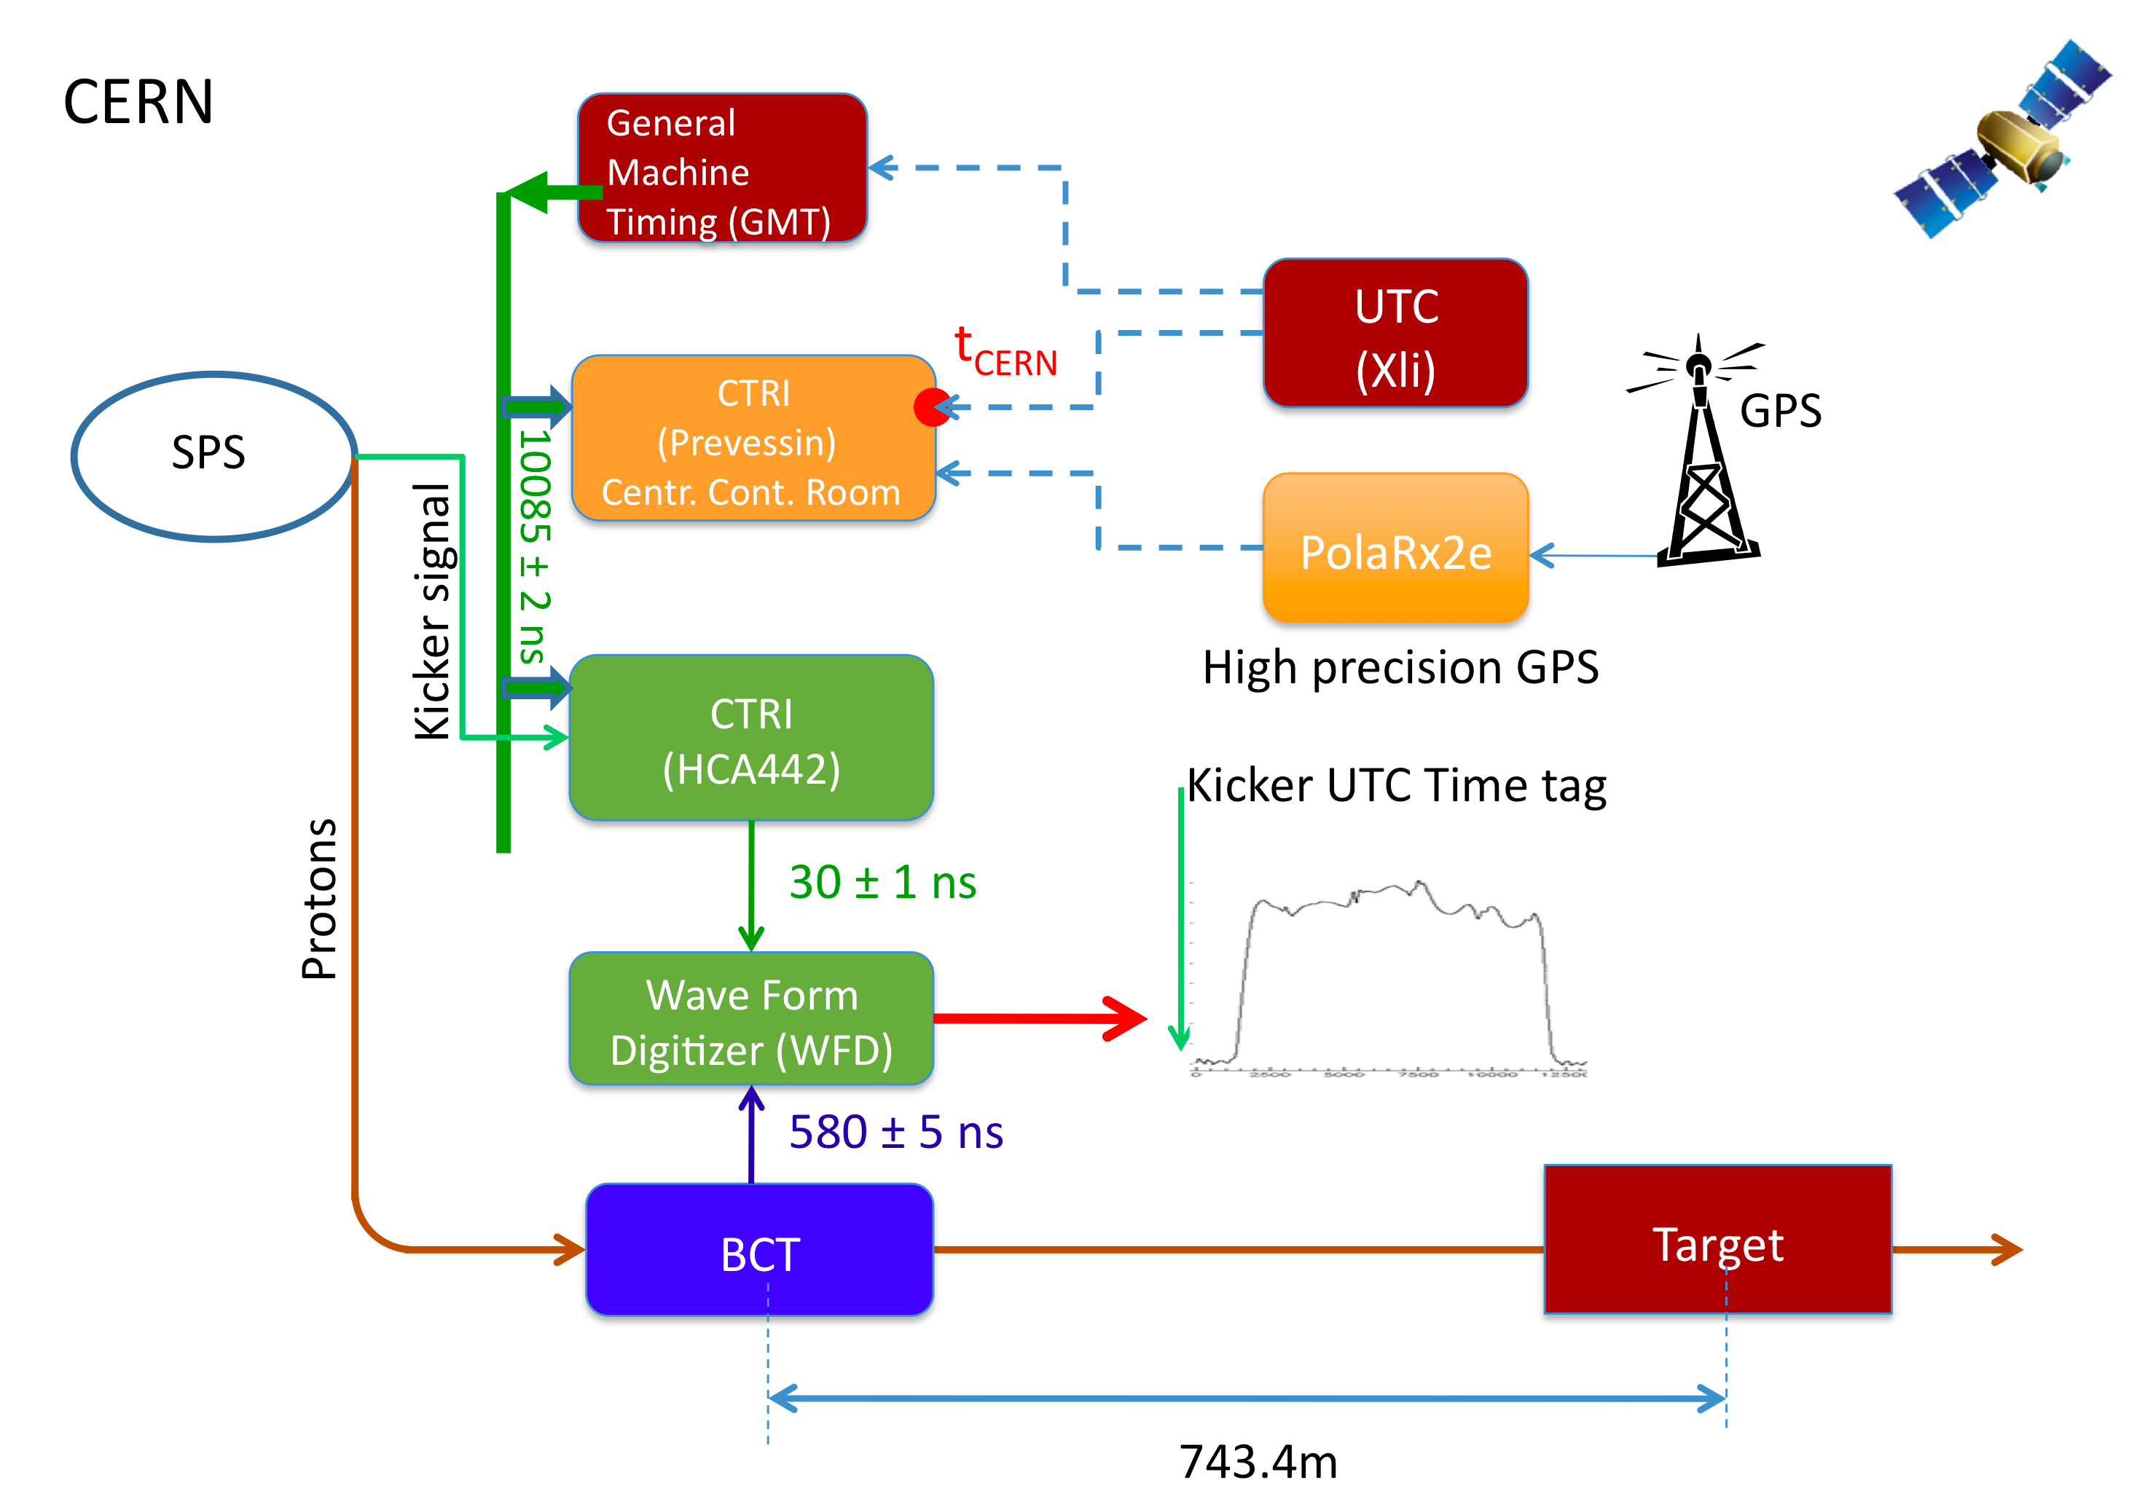
Schematic of the CERN/CNGS timing system

Slide 9
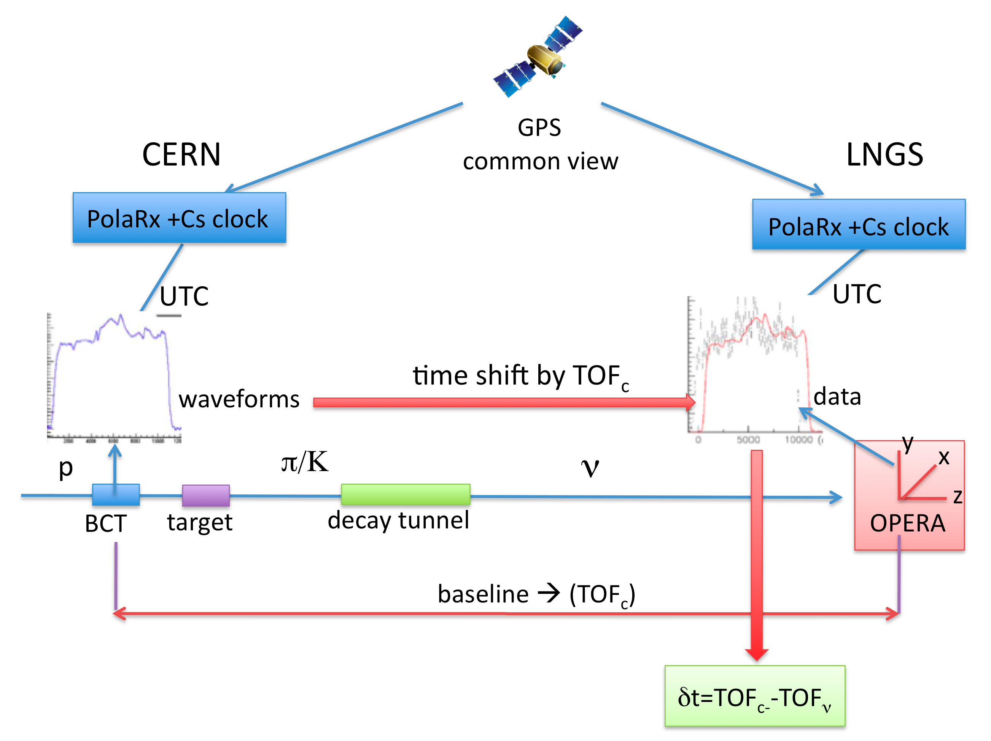
Schematic of the time of flight measurement

Slide 10
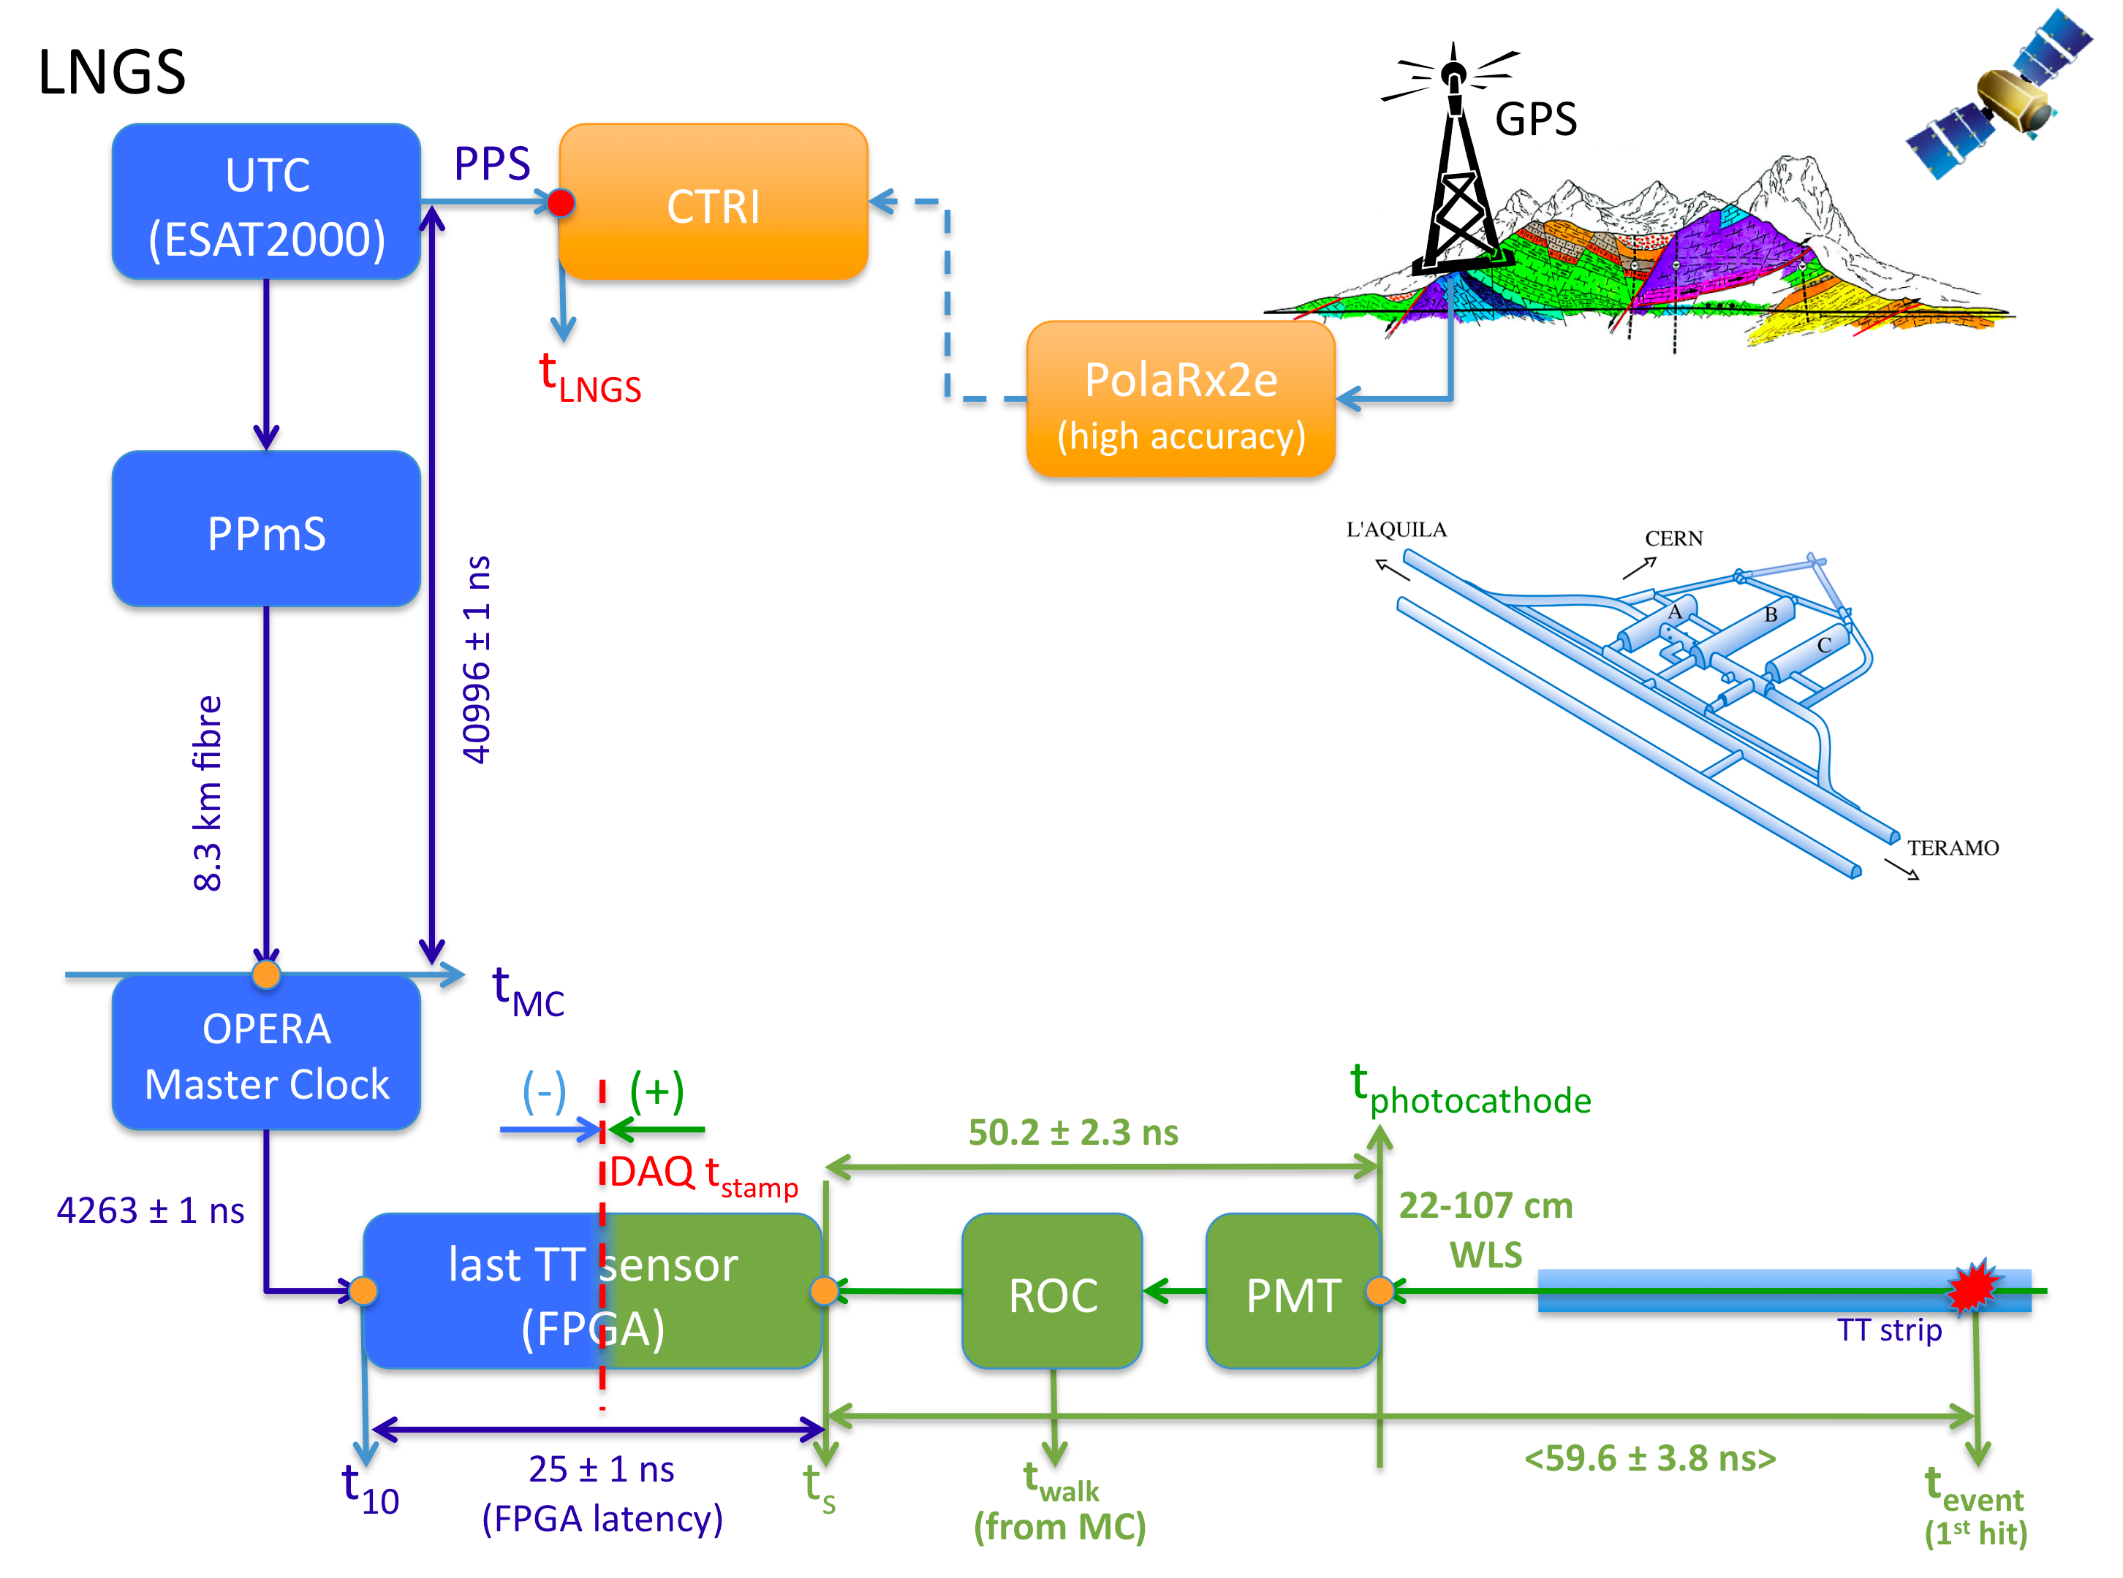
Schematic of the OPERA timing system at LNGS

Slide 11
5. Data selection. 6. Neutrino timing
Data from 2009+2010+2011 runs: 7586 Internal(CC+NC) +8525 external events
In OPERA the time of a ν interaction is that of the earliest hit in TT ( checked)
The synchronisation of the two timing systems at CERN and OPERA was calibrated by the German Metrology Institute PTB by taking data at CERN and LNGS with a portable time-transfer device.
7. Data analysis
A separate likelihood maximisation procedure was carried out for each extraction. The likelihood function to be maximised for each extraction is a function of the single variable δt to be added to the time tags t_{j} of the OPERA events. These are expressed in the time reference of the proton waveform digitizer assuming neutrinos travelling at the speed of light, such that their distribution best coincide with the corresponding PDF:
the likelihood probability is defined by :
L_{k}(δt_{k}) =Π_{j} w_{k} (t_{j}+δ_{k})

Slide 12
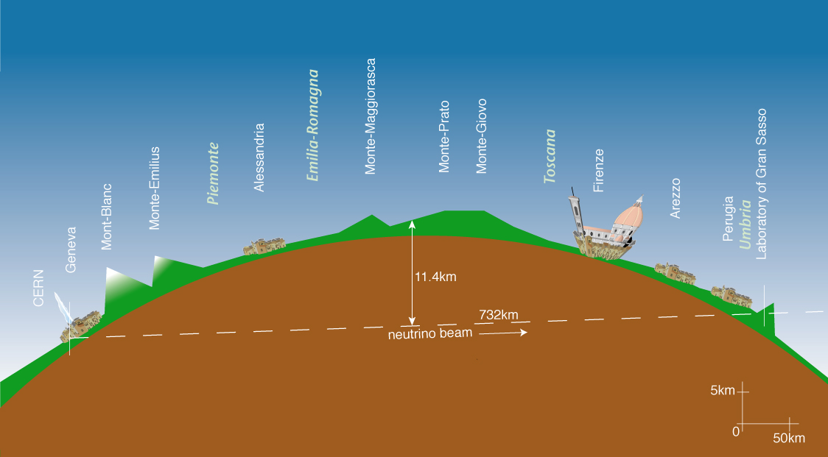
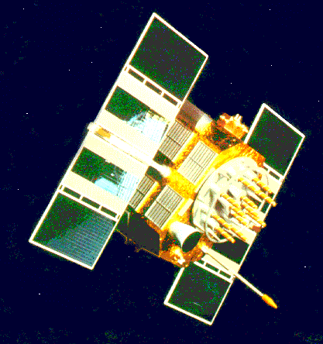
Time Selection of Beam Events
GPS
T_{flight} = 2.44 msec
T_{OPERA} = Event TimeStamp
T_{CERN} = Time Stamp SPS extraction
T_{OPERA} - (T_{CERN} + T_{flight}) < ∆T_{Gate}
< E > | 17 GeV
L | 730 km
( ν_{e} + ν_{e}) / ν_{μ} (CC) | 0.87%
ν_{μ} / ν_{μ} (CC) | 2.1%
ν_{τ} prompt | negligible
GPS Time Stamp resolution ~100 ns

Slide 13
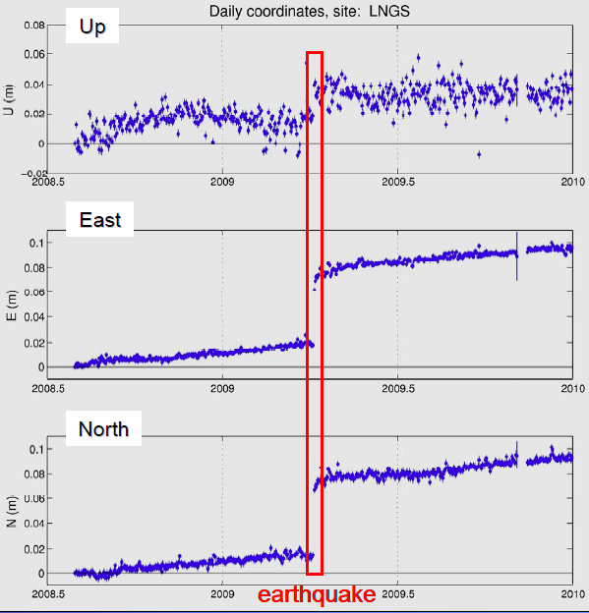
Monitoring of the PolaRx2e GPS antenna position, showing the slow earth crust drift and the fault displacement of the 2009 earthquake in the LNGS region.

Slide 14
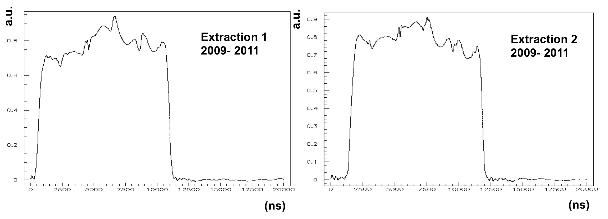
Waveforms of the OPERA neutrino events corresponding to the two SPS extractions for the 2009, 2010 and 2011 data samples.

Slide 15
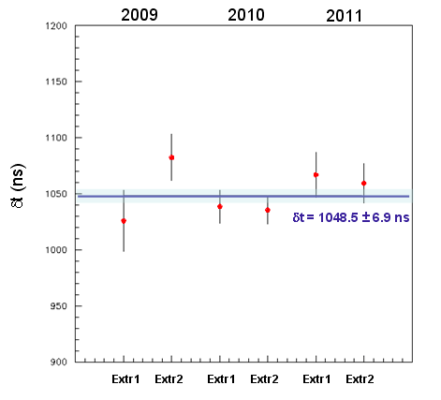
Results of the likelihood maximization corresponding to the two SPS extractions for the 2009, 2010 and 2011 data .
The likelihood maximization procedure was checked with a Monte Carlo simulation.

Slide 16
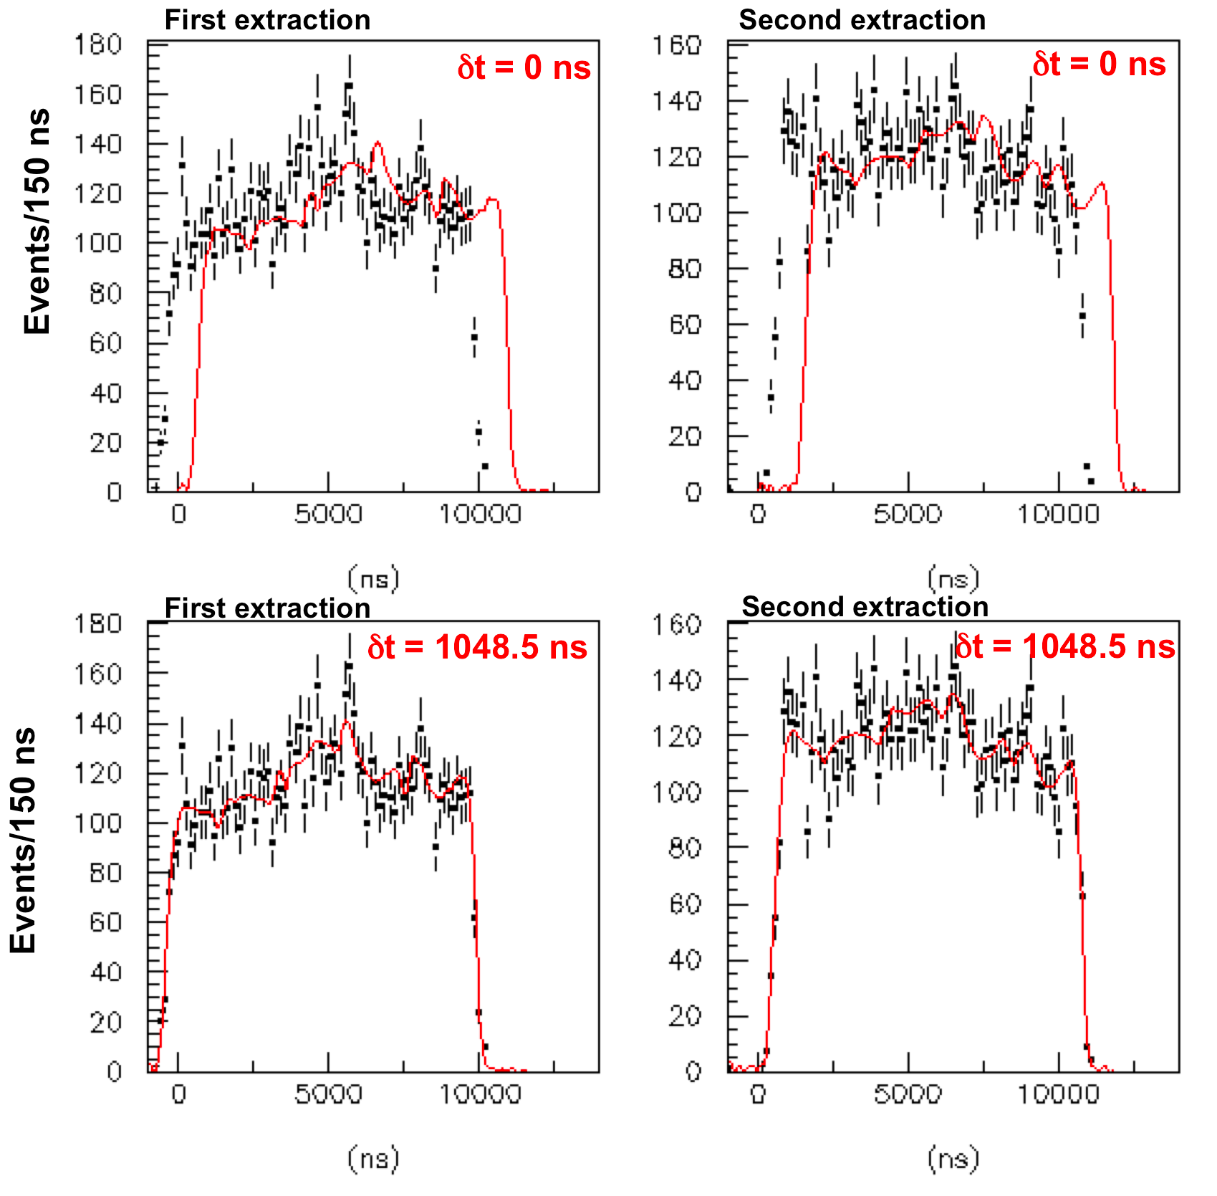
Wave Form Digitizers
Comparison between the data distributions and the PDF for the two SPS extractions before and after applying corrections for δτ resulting from the likelihood maximization.

Slide 17
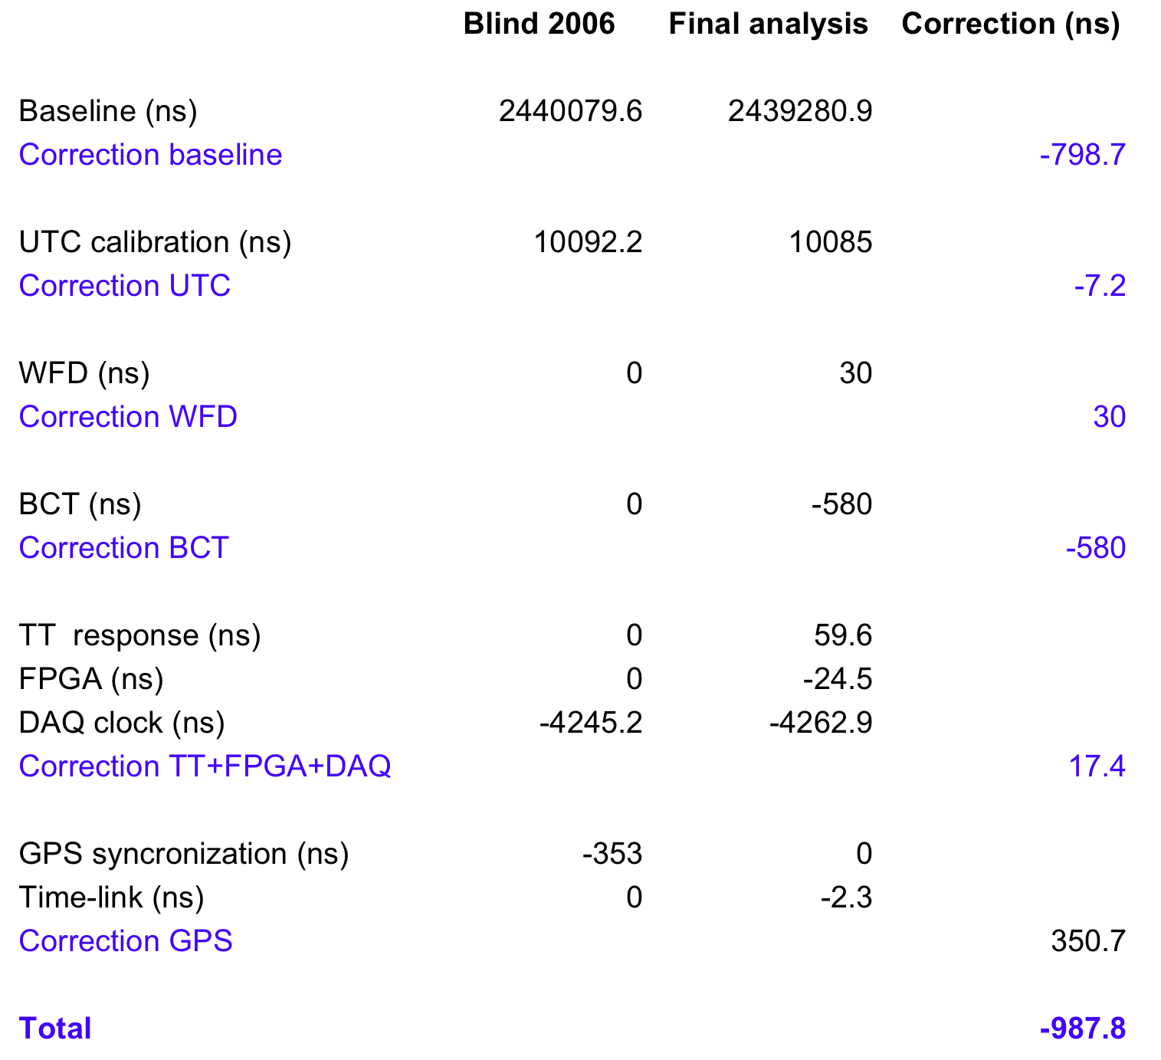
Table 1: Summary of the calibration values assumed in the blind analysis and those corresponding to the final analysis.

Slide 18
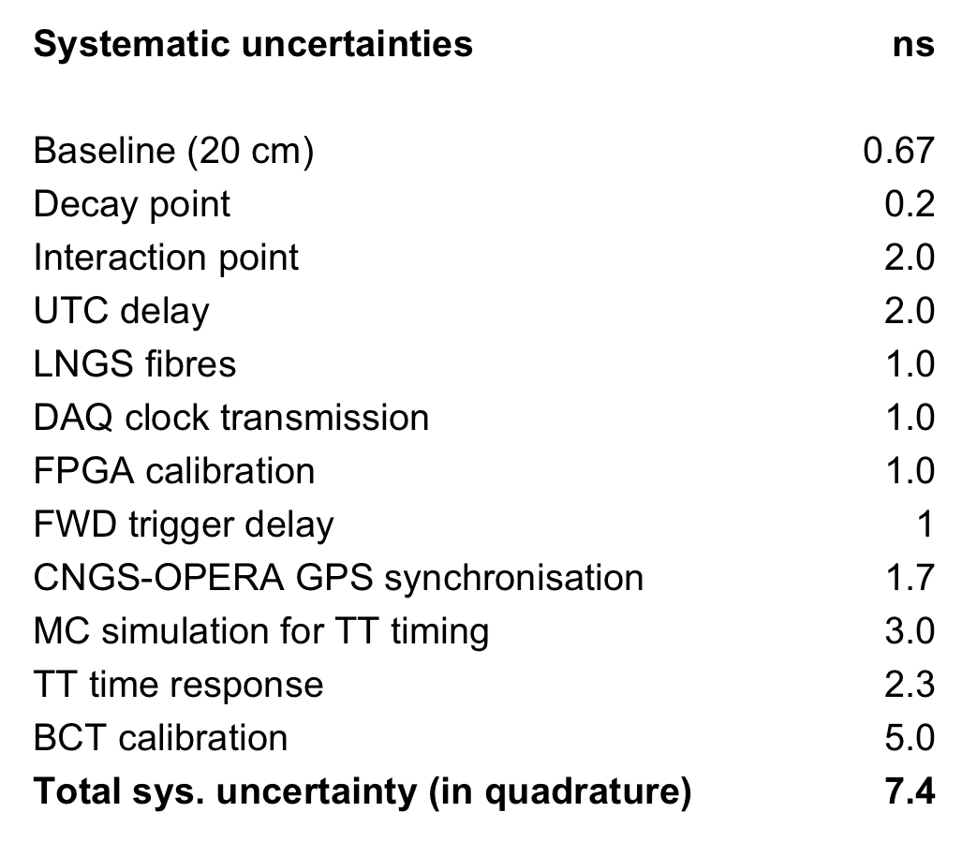
Table 2: Contributions to the overall systematic uncertainty on the measurement of δt.

Slide 19
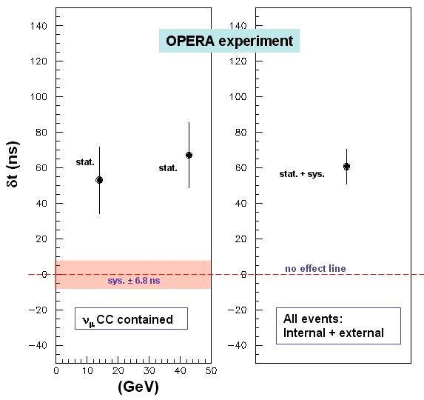
The left plot shows the energy dependence of ν_{μ} CC internal events (for E_{ν}<20 Gev and E_{ν}>20 GeV). The errors attributed to the two points are statistical in order to make easier their relative comparison since systematic errors cancel out; the systematic error is represented by a band around the zero effect line. The right plot shows the global result of the analysis including both internal and external events (for the latter the energy cannot be measured). The error bar includes statistical and systematic uncertainties added in quadrature.

Slide 20
8. Conclusions
δt = (60.7 ± 6.9 (stat.) ± 7.4 (sys.)) ns at <E_{ν}>=17 GeV
significance 6.0 σ (stat + sys added in quadrature)
(v-c)/c = δt /(TOF_{c} - δt) = (2.48 ± 0.28 (stat.) ± 0.30 (sys.)) ×10⁻⁵
No energy dependence in our range of energies
“Despite the large significance of the measurement reported here and the stability of the analysis, the potentially great impact of the result motivates the continuation of our studies in order to investigate possible still unknown systematic effects that could explain the observed anomaly. We deliberately do not attempt any theoretical or phenomenological interpretation of the results.”

