Slide 1
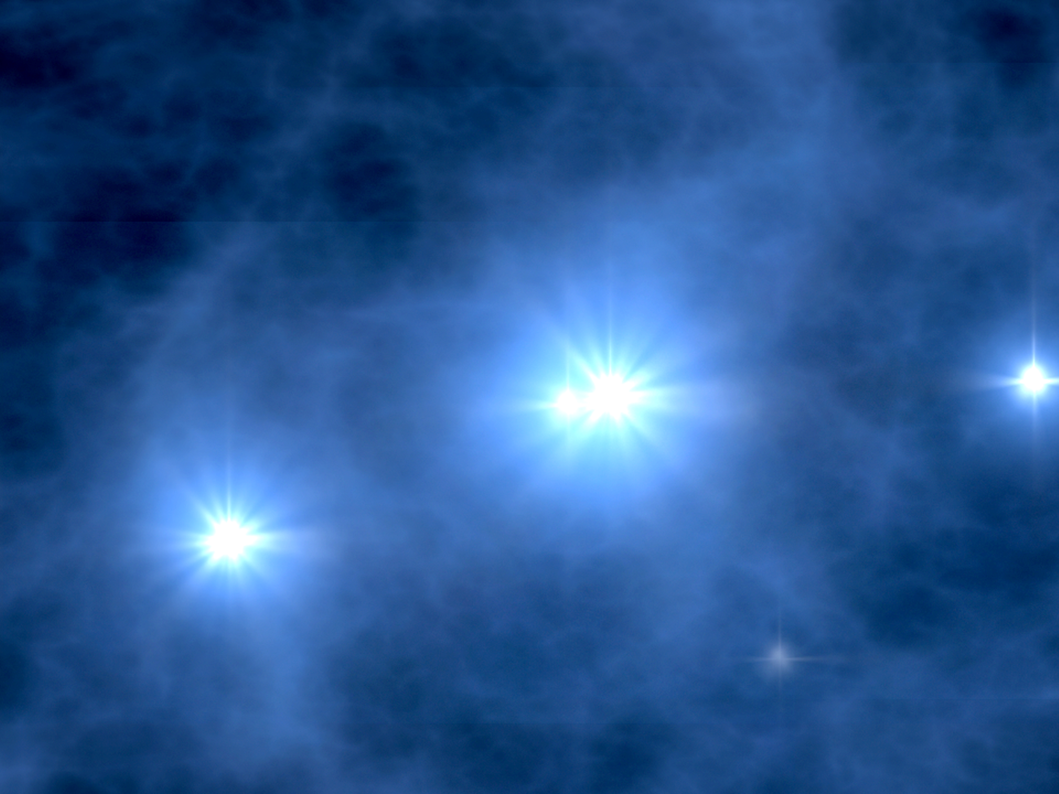

AMON
AMON
Astrophysical Multimessenger
Observatory Network
Under development at
The Pennsylvania State University
http://amon.gravity.psu.edu
http://amon.gravity.psu.edu

Slide 2
Introduction
AMON generalizes on the good ideas being used in a number of active follow-up programs (e.g., SNEWS, IceCube-ROTSE):
  use global multilateral coincidence among (ν, γ, GW, n)
  use above- and sub-threshold data from contributing observatories
  use unified approach to all datagrams, anonymity, data access, data dissemination, archived data, etc.
  enable all possible communication channels before the first big multimessenger source “pops”

Slide 3
Observatories & the Four Forces
Swift
Fermi
HAWC
VERITAS
PTF, LSST
Weak force
Electromagnetic*
IceCube
Antares
SuperK
KM3net
Key:
NSF
NASA
Other
Pierre Auger
KASCADE
Telescope Array
LHASSO
LIGO/Virgo
Pulsar timing
LISA
Gravitational
Hadronic
* Many optical/NIR/radio observatories not listed

Slide 4
AMON Collaboration
The AMON Collaboration
Penn State
Abhay Ashtekar^{1,3} , Jogesh Babu^{4,6} , Niel Brandt^{2,3} , Stephane Coutu^{1,2,3} , Doug Cowen^{1,2,3} , Tyce DeYoung^{1,3}, Abe Falcone^{2,3} , Eric Feigelson^{2,4} , Michael Fenn⁵ , Sam Finn^{1,2,3,4}, Derek Fox^{2,3} , Bobak Hashemi¹, Jason Holmes⁵, Peter Meszaros^{1,2,3}, Benjamin Owen^{1,3}, Scott Roths⁶, Miles Smith^{1,2,3}, and Paul Sommers^{1,2,3}
¹Department of Physics
²Department of Astronomy and Astrophysics
³Institute for Gravitation and the Cosmos
⁴Center for Astrostatistics
⁵Research Computing and Cyberinfrastructure
⁶Department of Statistics
Plus:
Gaspar Bakos¹,Szabolcs Marka²,
Neil Gehrels³, Scott Barthelmy³, Ignacio Taboada⁴
¹Harvard Smithsonian Center for Astrophysics
²Columbia University, Dept of Physics
³NASA GSFC
⁴Georgia Tech
We enthusiastically welcome new AMON collaborators

Slide 5
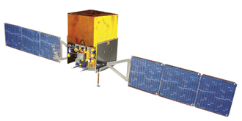
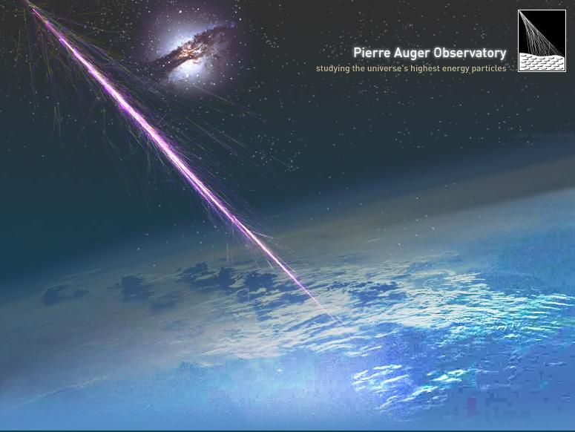
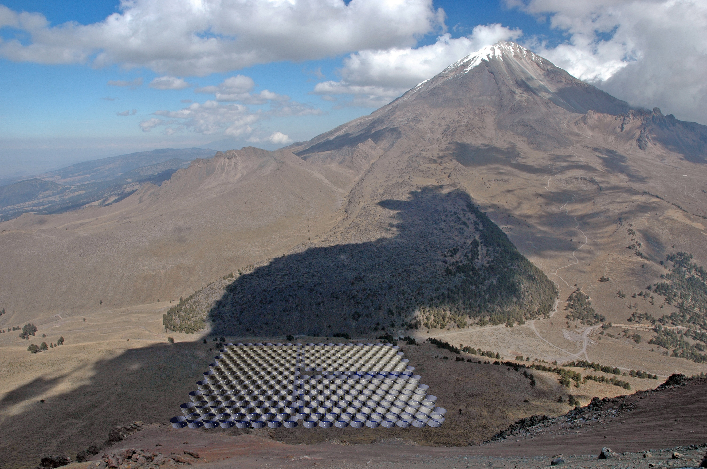
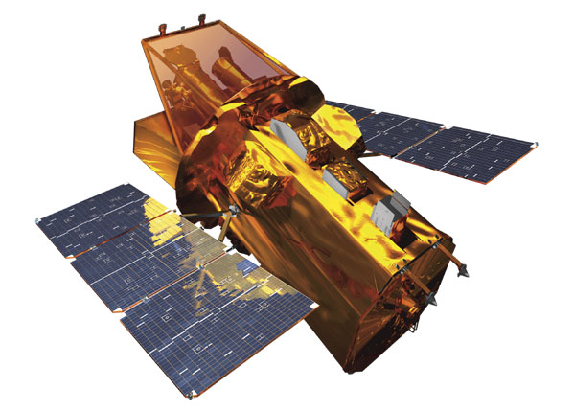
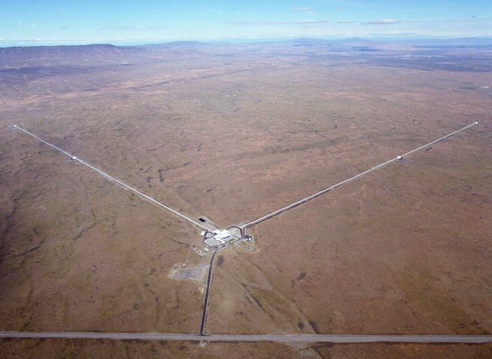
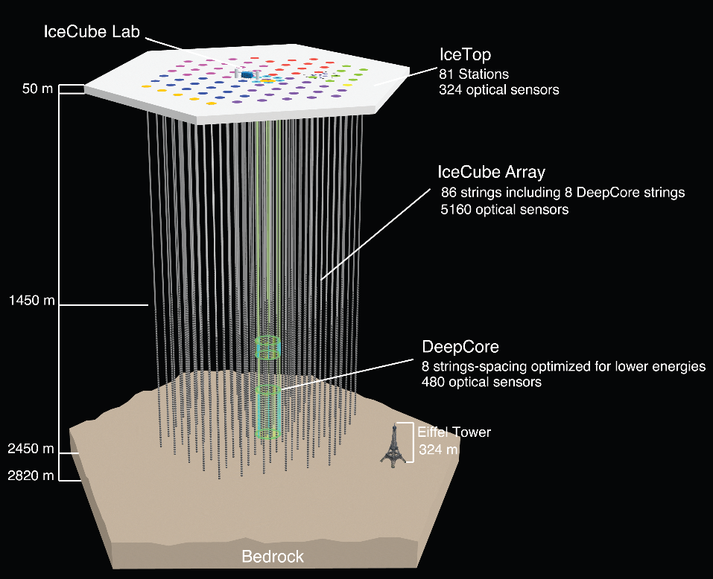
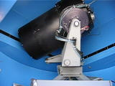
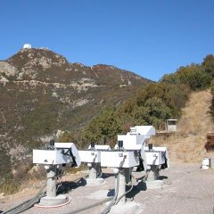
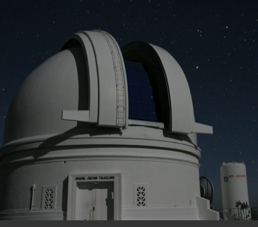
Definitions
“Triggering” observatories provide sub- & above-threshold candidate events to AMON in real time
AMON:
  Actively aggregates events and seeks realtime coincidences in (t,ψ)
    archival searches also foreseen
  Generates, broadcasts and archives alerts
    alerts will not indicate source detector
“Follow-up” observatories:
  Respond in real time to alerts
  Will include numerous optical telescopes around the globe
  (Triggering observatories can also do follow-up)

Slide 6
Definitions
Triggering & Follow-up
Observatories
(Another View)
Follow-up
Observatories
IceCube
ROTSE
LIGO
AMON
Auger
PTF
HAWC
Swift
HAT
Fermi

Slide 7
Definition: Sub-Threshold
Example Above and
Sub-Threshold Potential Signals
IceCube
  neutrino triplet (sub-threshold: single neutrino)
Swift (following Wanderman & Piran)
  0.4 photons/cm²/s (sub-threshold: 0.1)
Fermi (an educated guess)
  5 photons (sub-threshold: 1)

Slide 8
Coincidence Search
new event
new event
Real-time events
rate
Monitor each observatory’s status, sub-threshold event rate
Time filter: Events occur within Δt window
Position filter: Events occur in same part of sky
Calculate False Alarm Rate (FAR)
Calculate best-fit position, uncertainty
Distribute alert based on FAR
Database
?
Δt
t
t
time- correlated events
DEC
RA
time + spatially correlated events
FAR
P
σ
x
AMON Alert

Slide 9
AMON Observatories
Candidate AMON Triggering Observatories
  Auger
  Fermi
  HAWC
  IceCube
  LIGO
  Swift
  (ANTARES,…)
Candidate AMON Follow-up Observatories
  All triggering observatories
  HAT (Hungary)
  IUCAA (India)
  PTF (California)
  Veritas (Arizona)
  ROTSE

Slide 10
AMON Observatories
Candidate AMON Triggering Observatories
  Auger (collaboration-approved)
  Fermi (public data)
  HAWC (collaboration-approved)
  IceCube (under consideration)
  LIGO (Spokesperson supportive)
  Swift (PI-approved)
  (ANTARES,…)
Candidate AMON Follow-up Observatories
  All triggering observatories
  HAT (Hungary) (Strong interest)
  IUCAA (India) (Strong interest)
  PTF (California) (under consideration)
  Veritas (Arizona) (under consideration)
  ROTSE

Slide 11
Physics Potential
Quantifying what AMON can contribute:
  sky coverage, pointing
  first test case simulated: Long GRBs
Prompt
Delayed
Candidate Transient Multi-messenger Sources | Gamma | Neutrino | Neutron | Grav. wave | X-ray | IR/O/UV | Radio
Long GRB | ✔ | ✔ |  | ✔ | ✔ | ✔ | ✔
Short GRB | ✔ | ✔ |  | ✔ | ✔ | ✔ | ✔
Obscured GRB | ✔ | ✔ |  | ✔ |  |  | ✔
AGN Flare | ✔ | ✔ |  |  | ✔ | ✔ | ✔
“Quenched Jet” GRB/SN |  | ✔ |  | ✔ | ✔ | ✔ | ✔
LocalSupernova |  | ✔ | ✔ |  | ✔ | ✔
Cataclysmic Variable |  |  | ✔ |  | ✔ | ✔
Pulsar Quake |  |  | ✔ | ✔ | ✔ | ✔ | ✔
Magnetar Flare | ✔ | ✔ | ✔ | ✔ | ✔ | ✔ | ✔

Slide 12
Simulations: pointing
Simulated 10⁷ source locations throughout a year
7 event streams: IceCube Northern & Southern hemispheres, Auger, Swift, Fermi, LIGO, HAWC
Used Fermi and Swift 2010 pointing information
Did not consider detector downtime
Number of co-pointing observatories for each source
32.1%
32.0%
mean: 3.45
20.2%
Fraction of sources
13.9%
1.8%

Slide 13
Simulations: pointing
Number of co-pointing observatories
N ≥ 1
N ≥ 3
N ≥ 4
N ≥ 6
N ≥ 2
N ≥ 5

Slide 14
Simulations: Long GRBs
Test Case: Long-GRB model for IceCube and orbital observatories
  Wanderman and Piran (2010) model for GRB luminosity and redshift
  Waxman and Bahcall (1997) model for neutrino flux
  Fiducial parameters:
    Photon Band function with α =-1, β=-2.25
    E_{γ,break}= 634 keV
    Lorentz factor: Γ = 300
    t₉₀ = 20 s
    Δt = 1 ms
    ε_{p}/ε_{e} = 1
Extrapolating Swift data results in 17,000 GRBs below BAT threshold
  Neutrino model from IC22 GRB paper, scaled by 0.2 to account for newest limits; IC86 A_{eff}
  Track observatories’ pointing with time
  Not surprisingly…
    Most of the GRBs produce << 1ν and << 1γ
    Poisson fluctuations are our best friend
    Using sub-threshold events will enhance sensitivity to possible coincident signals

Slide 15
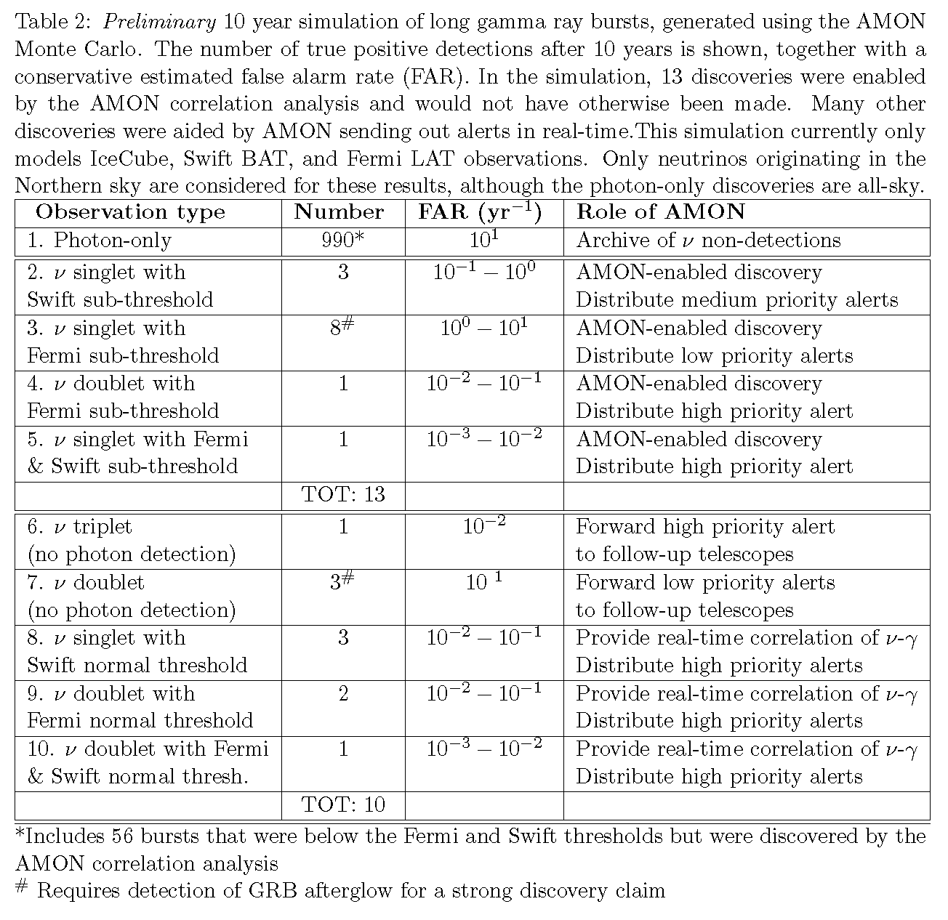
Simulations: Long GRBs
Preliminary Results
N_{ν}=1
log(Expected number of
IceCube neutrinos)
N_{γ}=1
log(Expected number of Fermi photons)

Slide 16
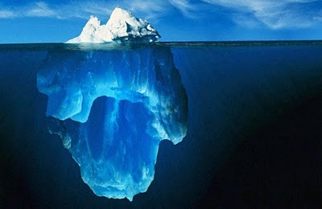
Simulations: Long GRBs
Preliminary Results
N_{ν}=1
log(Expected number of
IceCube neutrinos)
N_{γ}=1
log(Expected number of Fermi photons)

Slide 17
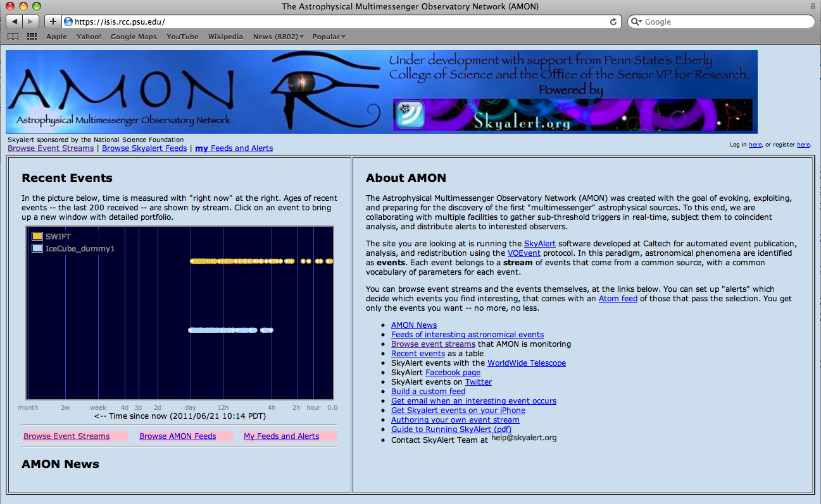
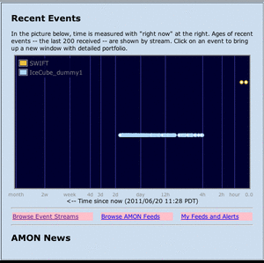
Technical Details: VOEvents
AMON will use the International Astronomical Union VOEvent standard
  Represents the current evolution in transient astronomy reporting (previously by hand)
SkyAlert software package
  Archives/analyzes/responds to VOEvents
  Developed with NSF funding
Pipeline Status:
IceCube (test)
Auger (test)
Fermi
Swift

Slide 18
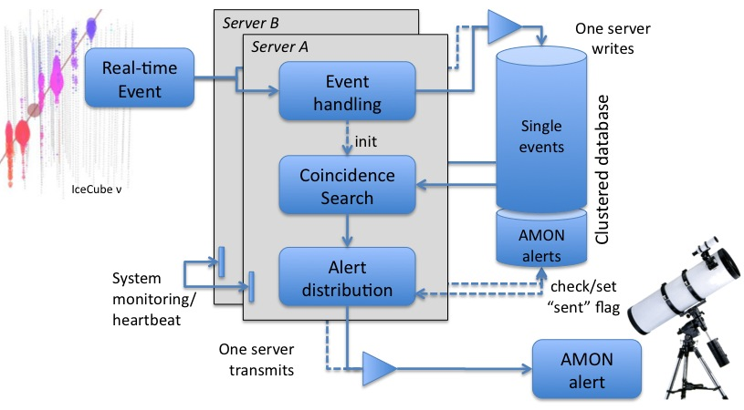
Technical Details: Systems
Dual servers and “clustered” database for redundancy
Systems physically and cyber-secure
Very high level of uptime
Data needs are modest:
  Traffic: 10 kB/sec (average), 1 MB/sec (peak)
  Storage: 2 TB (5 years)
  Processing: < 0.1 CPU

Slide 19
Timeline
Phase 1 (2011):
- Develop prototype system
- Motivation/simulation paper
- Proposal to NSF Early Nov.
Phase 2 (2012):
- Operate in development/archival mode
- Work with ≥ 3 event streams
Phase 3 (2013 ff):
- Real-time, fully operational with follow-up network in place

Slide 20
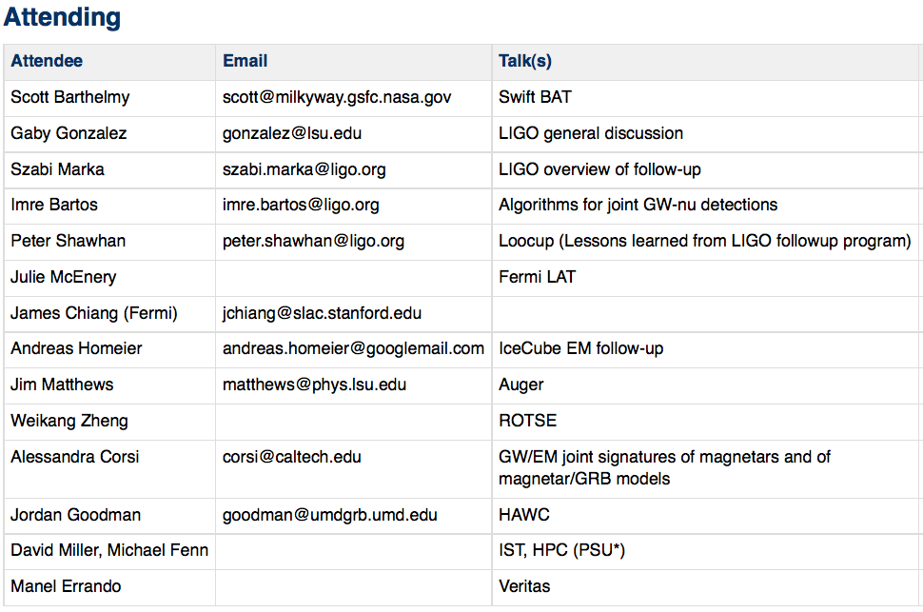
Workshop
1st AMON Workshop
1-2 October 2011, Penn State
Agenda:
Multimessenger Theory
Triggering Observatories
Existing Multimessenger and Follow-up Programs
Simulation Results
Cyberinfrastructure

Slide 21
Conclusion
AMON will leverage existing high-energy and optical observatories
  Can make discoveries that would otherwise be missed
AMON is strongly motivated by a variety of known astrophysical sources
  Multimessenger signals expected
We have started making significant progress
  Poised to implement a full system on the <1 year time scale
Neutrinos are VIPs for AMON
New members enthusiastically welcomed!

Slide 22
The End

