Slide 1
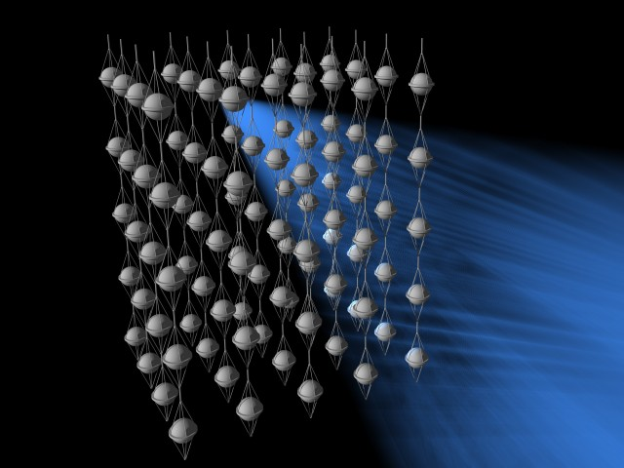
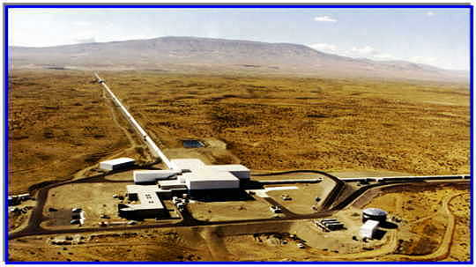
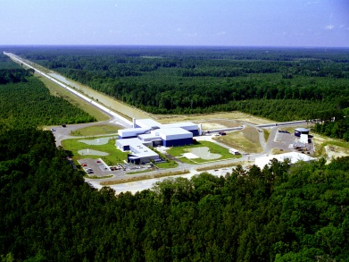
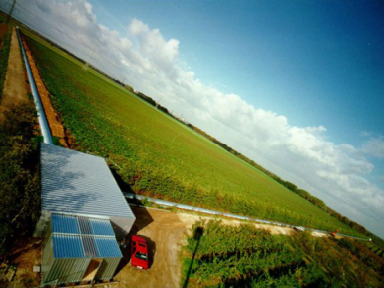
Observational Constraints on Multi-messenger Sources of Gravitational Waves and High-energy Neutrinos
Imre Bartos
Columbia University
MANTS Meeting (Sep 24 – 25, 2011 -- Uppsala, Sweden) LIGO-G1100951

Slide 2
What do we know already from existing observations?
…
What can we expect from future measurements?
…

Slide 3
Outline
Introduction: Antoine’s talk
Joint sources of interest
GW and HEN source rate constraints (Bartos et al., 2011)
first observation-based results
projected results with advanced detectors
GW+HEN source rate constraints
Joint GW+HEN search with IceCube+LIGO+Virgo
Conclusion.

Slide 4
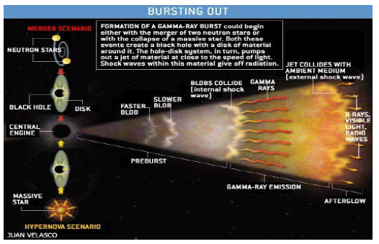
FG
Science Case
Choked GRBs (Mészáros & Waxman, 2001)
Choked GRBs (Mészáros & Waxman, 2001)
Low-luminosity GRBs (Murase et al., 2006)
Gravitational High-energy waves neutrinos

Slide 5
FG
Science Case
Choked GRBs (Mészáros & Waxman, 2001)
Choked GRBs (Mészáros & Waxman, 2001)
Low-luminosity GRBs (Murase et al., 2006)
Choked/LL GRB
Gravitational High-energy waves neutrinos

Slide 6
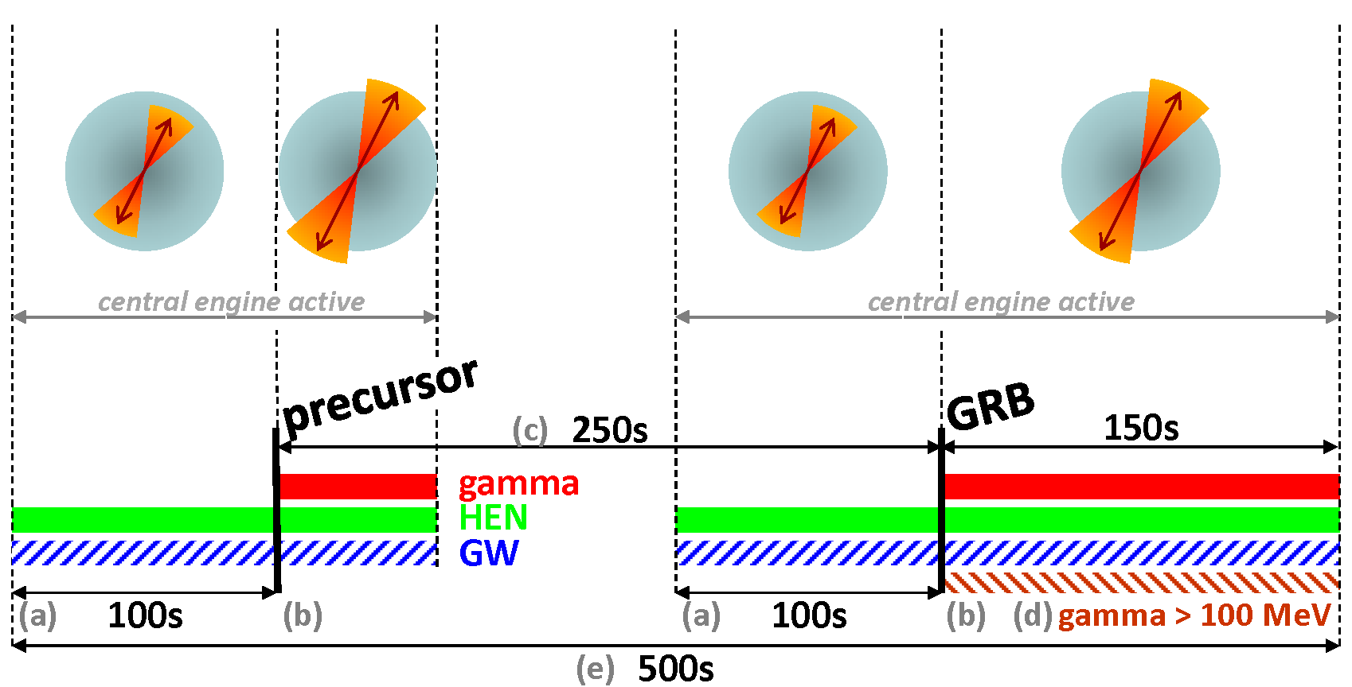
Coincidence Time Window
Baret et al., 2011
Jet is still inside star
observed gamma emission
Observed precursor time difference
BATSE precursors (374) Burlon et al., 2008
BATSE GRBs (1234)
Ott, 2009 ++
> 100 MeV photons from Fermi
Coincidence time window: 500s

Slide 7
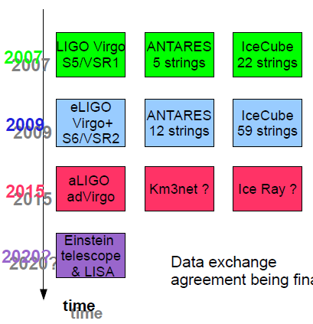
Common Calendar
Antares 12 strings
IceCube 86 strings
Simultaneous operation for (at least) the next decade
+Km3net?
+Enhanched DeepCore ?

Slide 8
Source PDF – Galaxy Catalog
host galaxy
P ~ BL / r²
observer

Slide 9
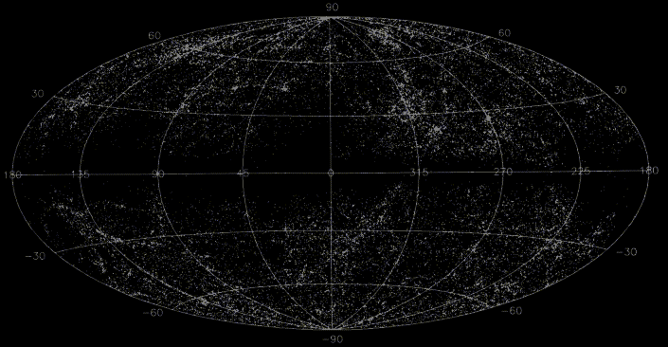
upper limits
Upon non-detection: source rate upper limit that would exceed loudest background event with p = 90%.
observer
Galaxy distribution

Slide 10
upper limits
GW horizon distance: source with given E_{gw} is detected with p=50%
All-sky GW results with initial LIGO-Virgo Abadie et al., 2010
observer
GW horizon distance
Galaxy catalog

Slide 11
upper limits
Neutrino 3 coincident neutrinos would make 5σ detection
IceCube 40 string: Abbasi et al., 2011 (2011arXiv1104.0075T)
observer
GW horizon distance
neutrino detection probability

Slide 12
upper limits
Neutrino 3 coincident neutrinos would make 5σ detection
IceCube 40 string: Abbasi et al., 2011
observer
GW horizon distance
beamed
neutrino detection probability
f_{b} ~ 14 (LL-GRBs)
NOT beamed

Slide 13
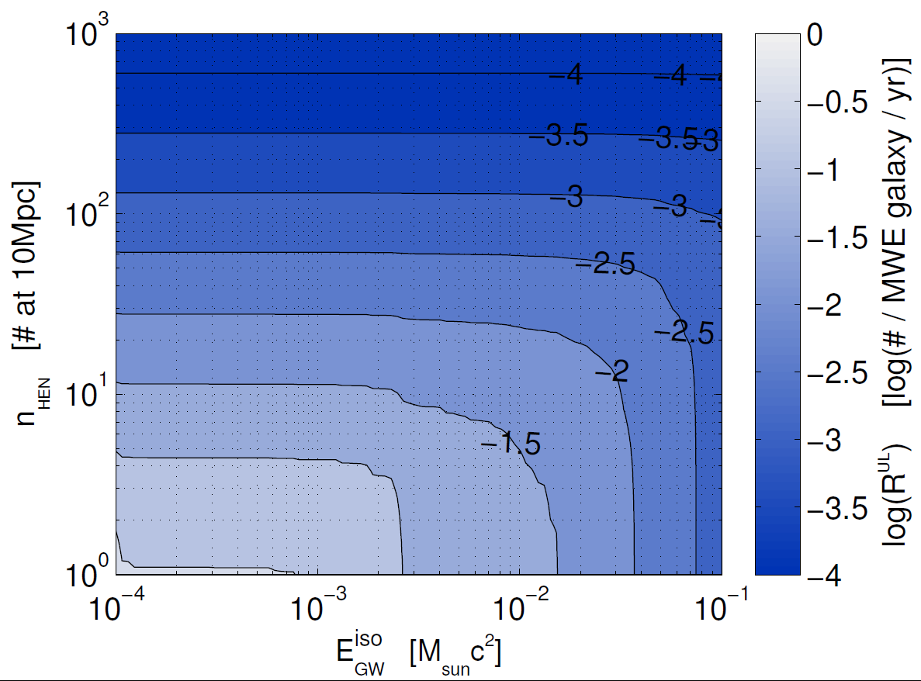
Observational Population upper limit
We can constrain source population with average source parameters…
…emitted in gravitational waves, …
…emitted neutrino flux …
…below this source rate!
bluer – better (lower) constraint

Slide 14
Observational Population upper limit
Combination of individual GW and HEN measurements
Neutrino beaming angle: f_{b} ~ 14
initial LIGO-Virgo IceCube (40 string)
First observation-based result for GW+neutrino sources
Bartos et al., 2011

Slide 15
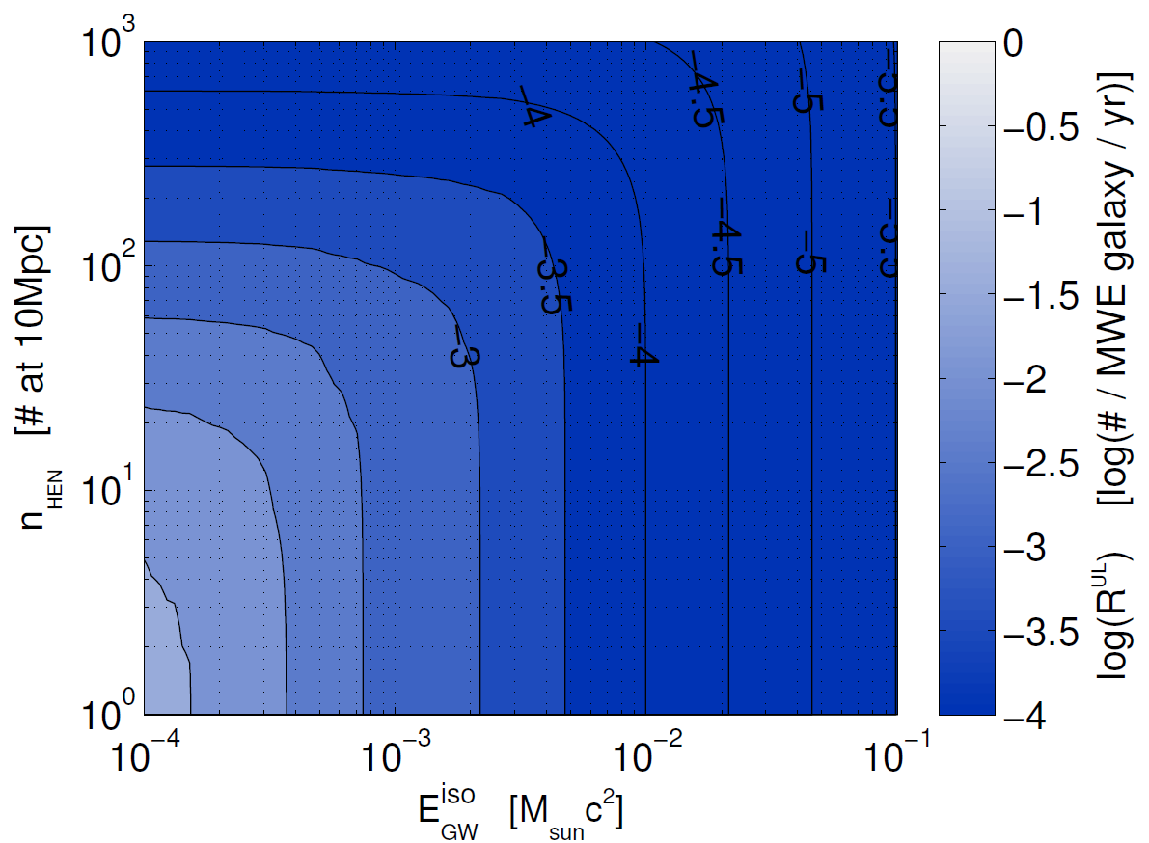
Advanced LIGO-Virgo + IceCube (86 string)
Bartos et al., 2011
GRBs
rate: SN I b/c with relativistic (successful) jets (inferred from radio observations)
Guetta et al., 2004
mildly relativistic jets in CCSNe
rate: SN I b/c
Ando & Beacom, 2005
reverse shocks
Horiuchi & Ando, 2008
fragmentation of collapsar accretion disks
Davies et al., 2002
suspended accretion
van Putten et al., 2004
compact binary mergers
Schutz, 1989

Slide 16
upper limits
Neutrino 3 coincident neutrinos would make 5σ detection
IceCube 40 string: Abbasi et al., 2011
observer
GW horizon distance
neutrino detection probability

Slide 17
upper limits
GW + neutrino GW coincident with ≥ 1 neutrino
Horizon estimate based on ExtTrig GW searches: Abbott et al., 2010
observer
GW horizon distance
neutrino detection probability
GW+neutrino horizon distance

Slide 18
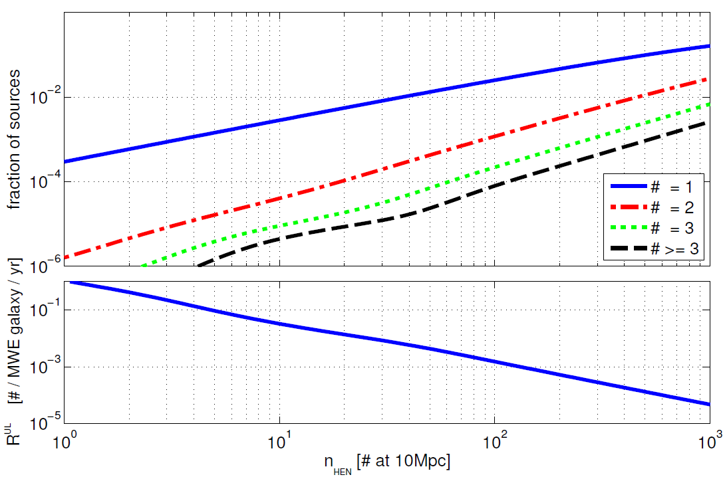
HEN source Population
IceCube-40 – triple-coincidence within 500 s (Baret et al., 2011) would be discovery (Abbasi et al., 2011 (2011arXiv1104.0075T))
Bartos et al., 2011
Fraction of sources with N detected neutrinos within 1 Gpc
1 neutrino – joint search
n_{ν} - average # of deceted neutrinos from a source at 10Mpc
≥ 3 neutrino – joint search

Slide 19
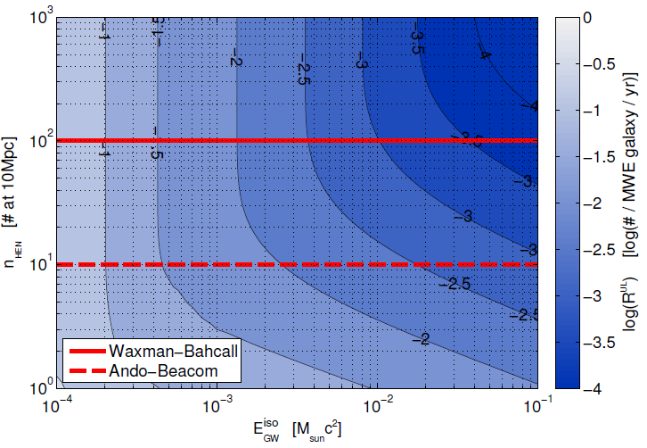
Multi-messenger GW+neutrino search
Projected upper limits of joint GW+neutrino search
Upper limit comparable to individual searches for GW horizon distance increase of ~f_{b}^{1/3}
Further advantages of joint search upon detection are increased confidence and additional source information.
adv. LIGO-Virgo + IceCube-86
Bartos et al., 2011

Slide 20
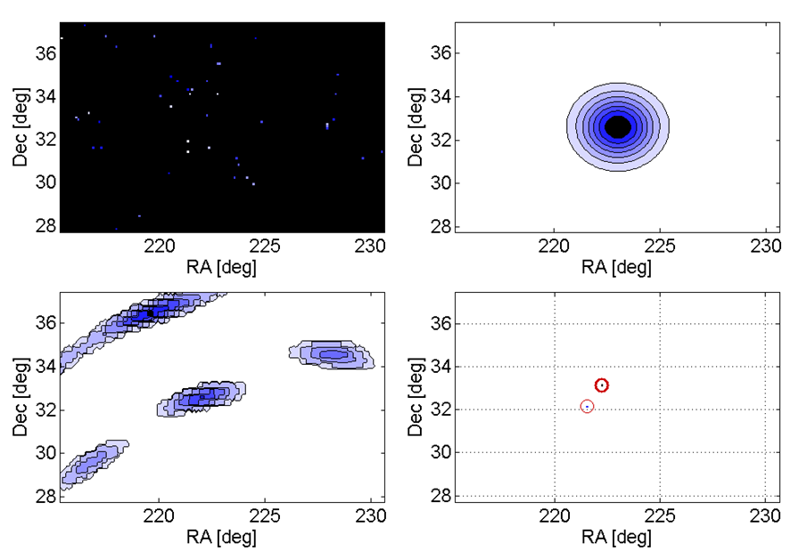
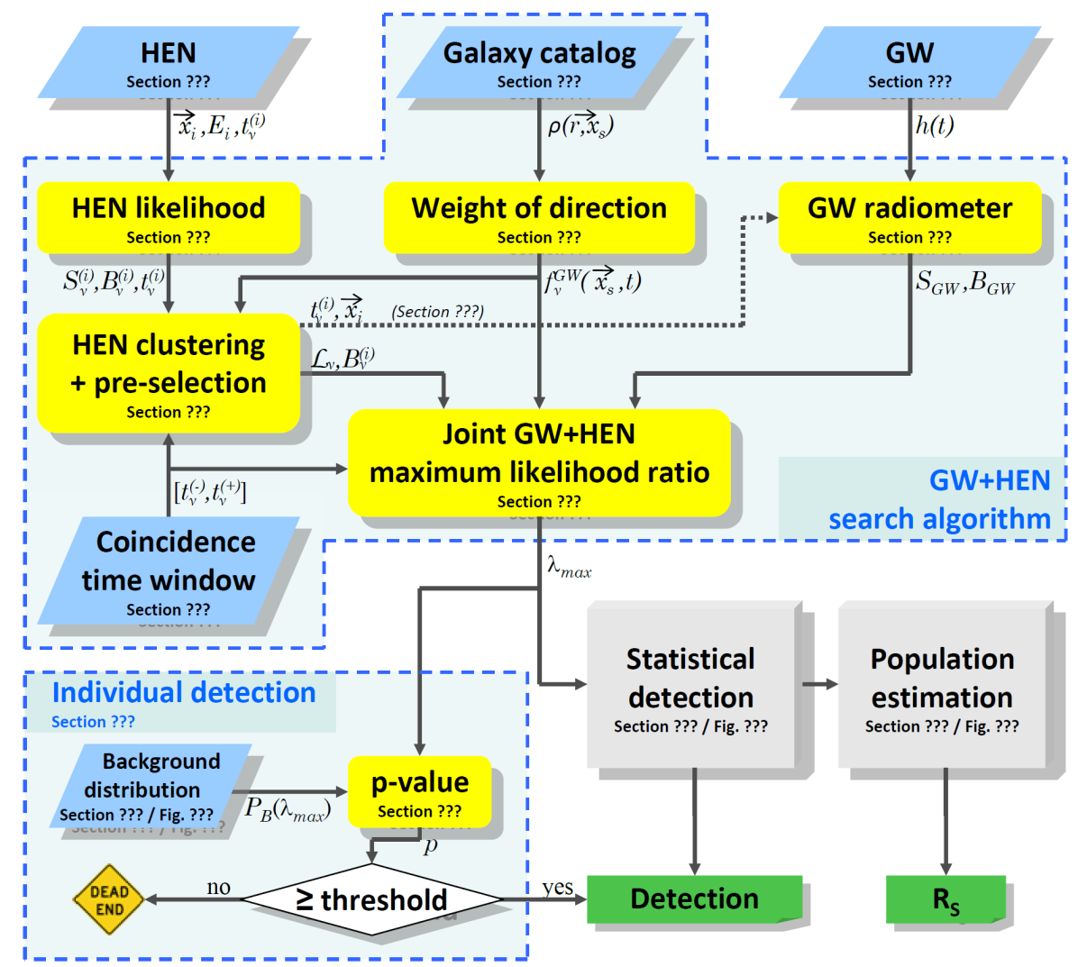
Status of multi-messenger GW+ν search
Natural extension: MeV neutrinos
Joint GW+neutrino search
Baret et al., 2011
MeV, supernova neutrinos also detectable with IceCube – global detector noise rate increases –
same analysis algorithm can be readily run (by design)
sole difference – no spatial information for MeV neutrinos
Distribution weighted with signal probability (BL/r²)
Galaxy Catalog
Neutrino
Skymap and Significance
Gravitational Wave
Joint test statistic

Slide 21
Summary
First observational joint GW+neutrino source rate upper limits
Projected upper limits for advanced detectors
Advanced detectors will exclude/constrain emission models
Comparison of projected GW+neutrino search upper to individual upper limits.
Joint GW+neutrino search (IceCube-LIGO-Virgo)

Slide 22
Thank You

Slide 23
Population upper limits
observer
GW horizon distance
GW+HEN horizon distance
HEN detection probability

Slide 24
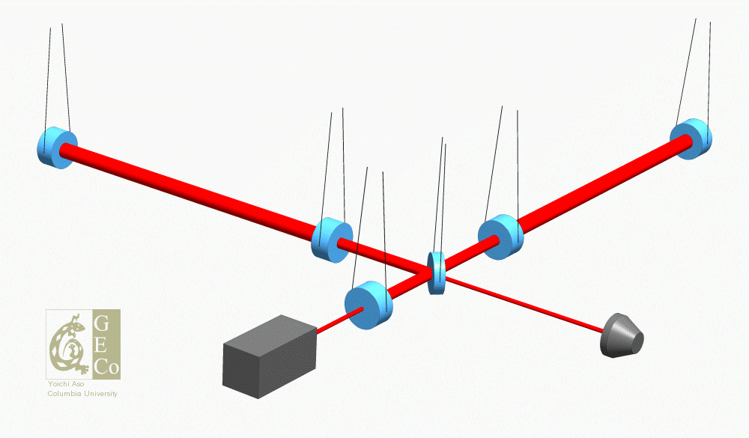
Initial LIGO Optical Layout (not to scale)
~ 10kW
Suspensions
Fabry-Perot arm cavity
Fabry-Perot arm cavity
End mirror
End mirror
Input mirror
Input mirror
~6W
Beam splitter
“Recycling” mirror
“Antisymmetric” photodiode

Slide 25
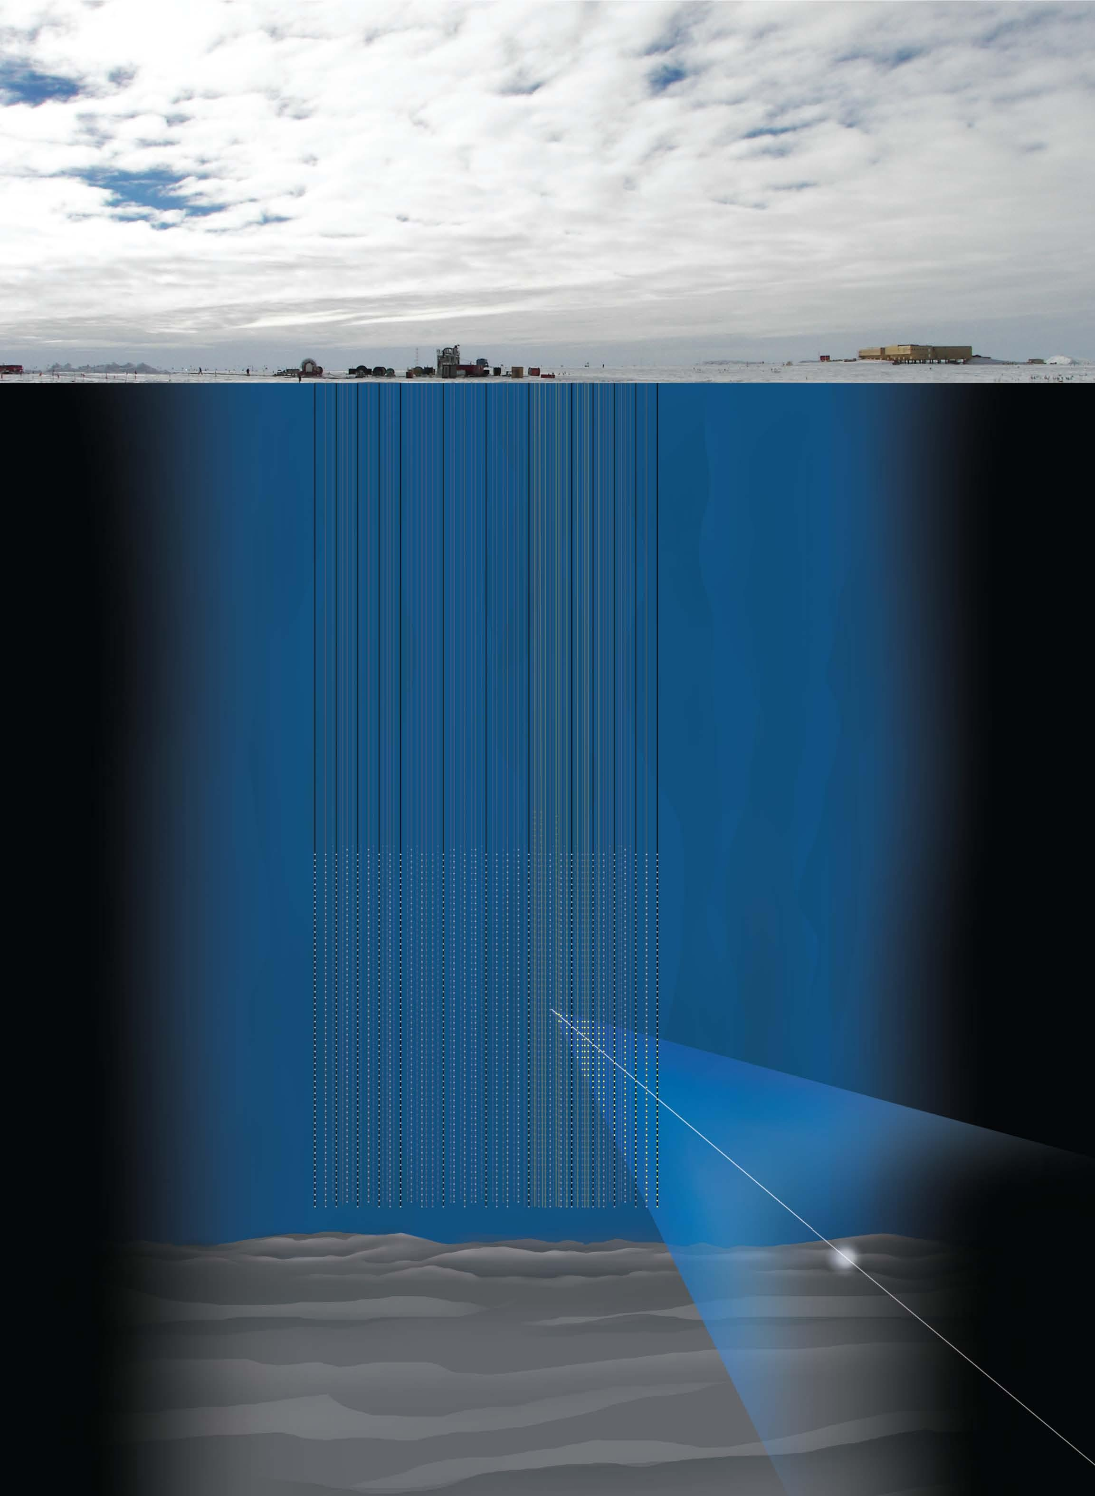
HEN
IceCube 22 string
5000 neutrino
~1000 coincident with S5/VSR1
Signal and BG likelihoods with energy dependence
Directional uncertainty
Multiple neutrino clusters (up to 2 HENs)

Slide 26
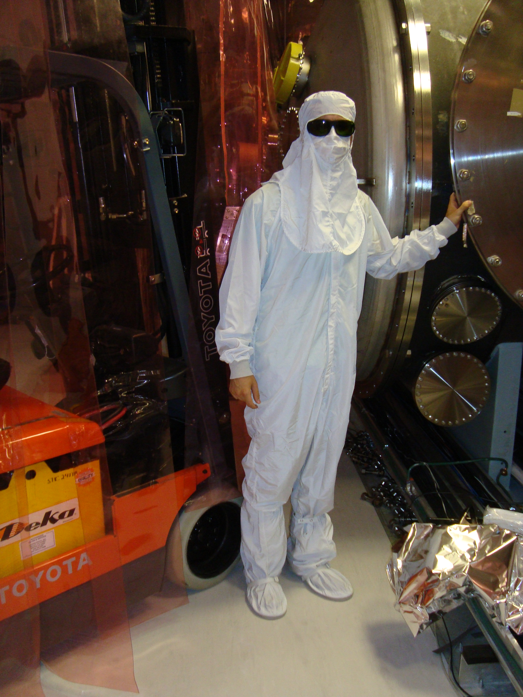
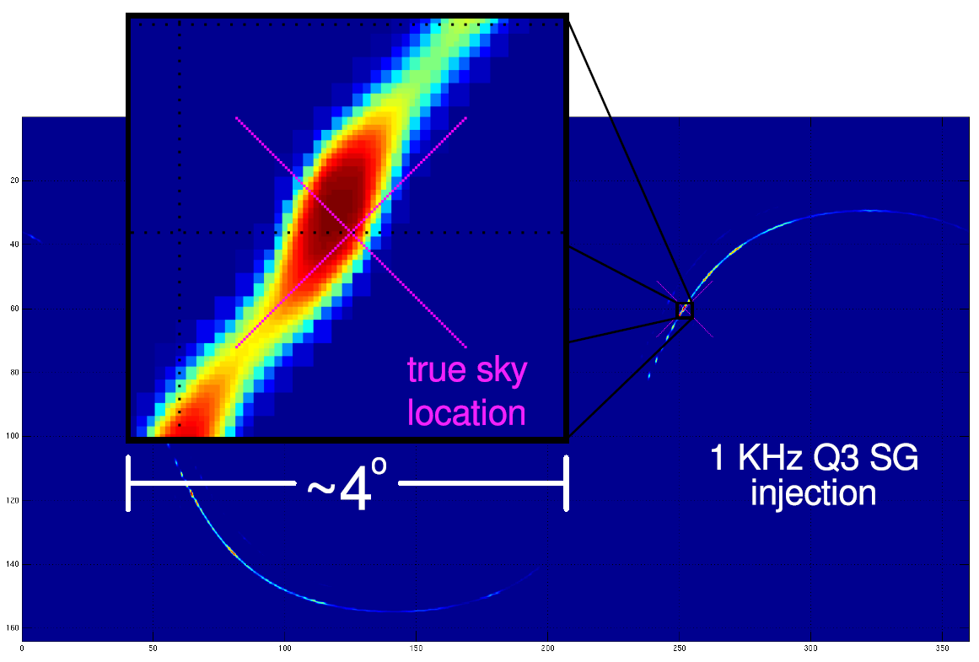
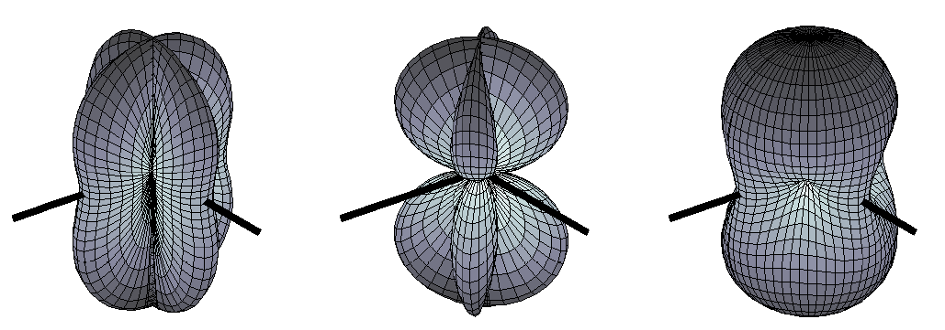
GW
LIGO-Virgo S5/VSR1 science run
strain
triggers
h_{rss}
reconstructed signal parameters:
Likelihood
Skymap (spatial PDF)
Jameson Rollins, PhD thesis
Abbott et al., 2009
antenna pattern

Slide 27
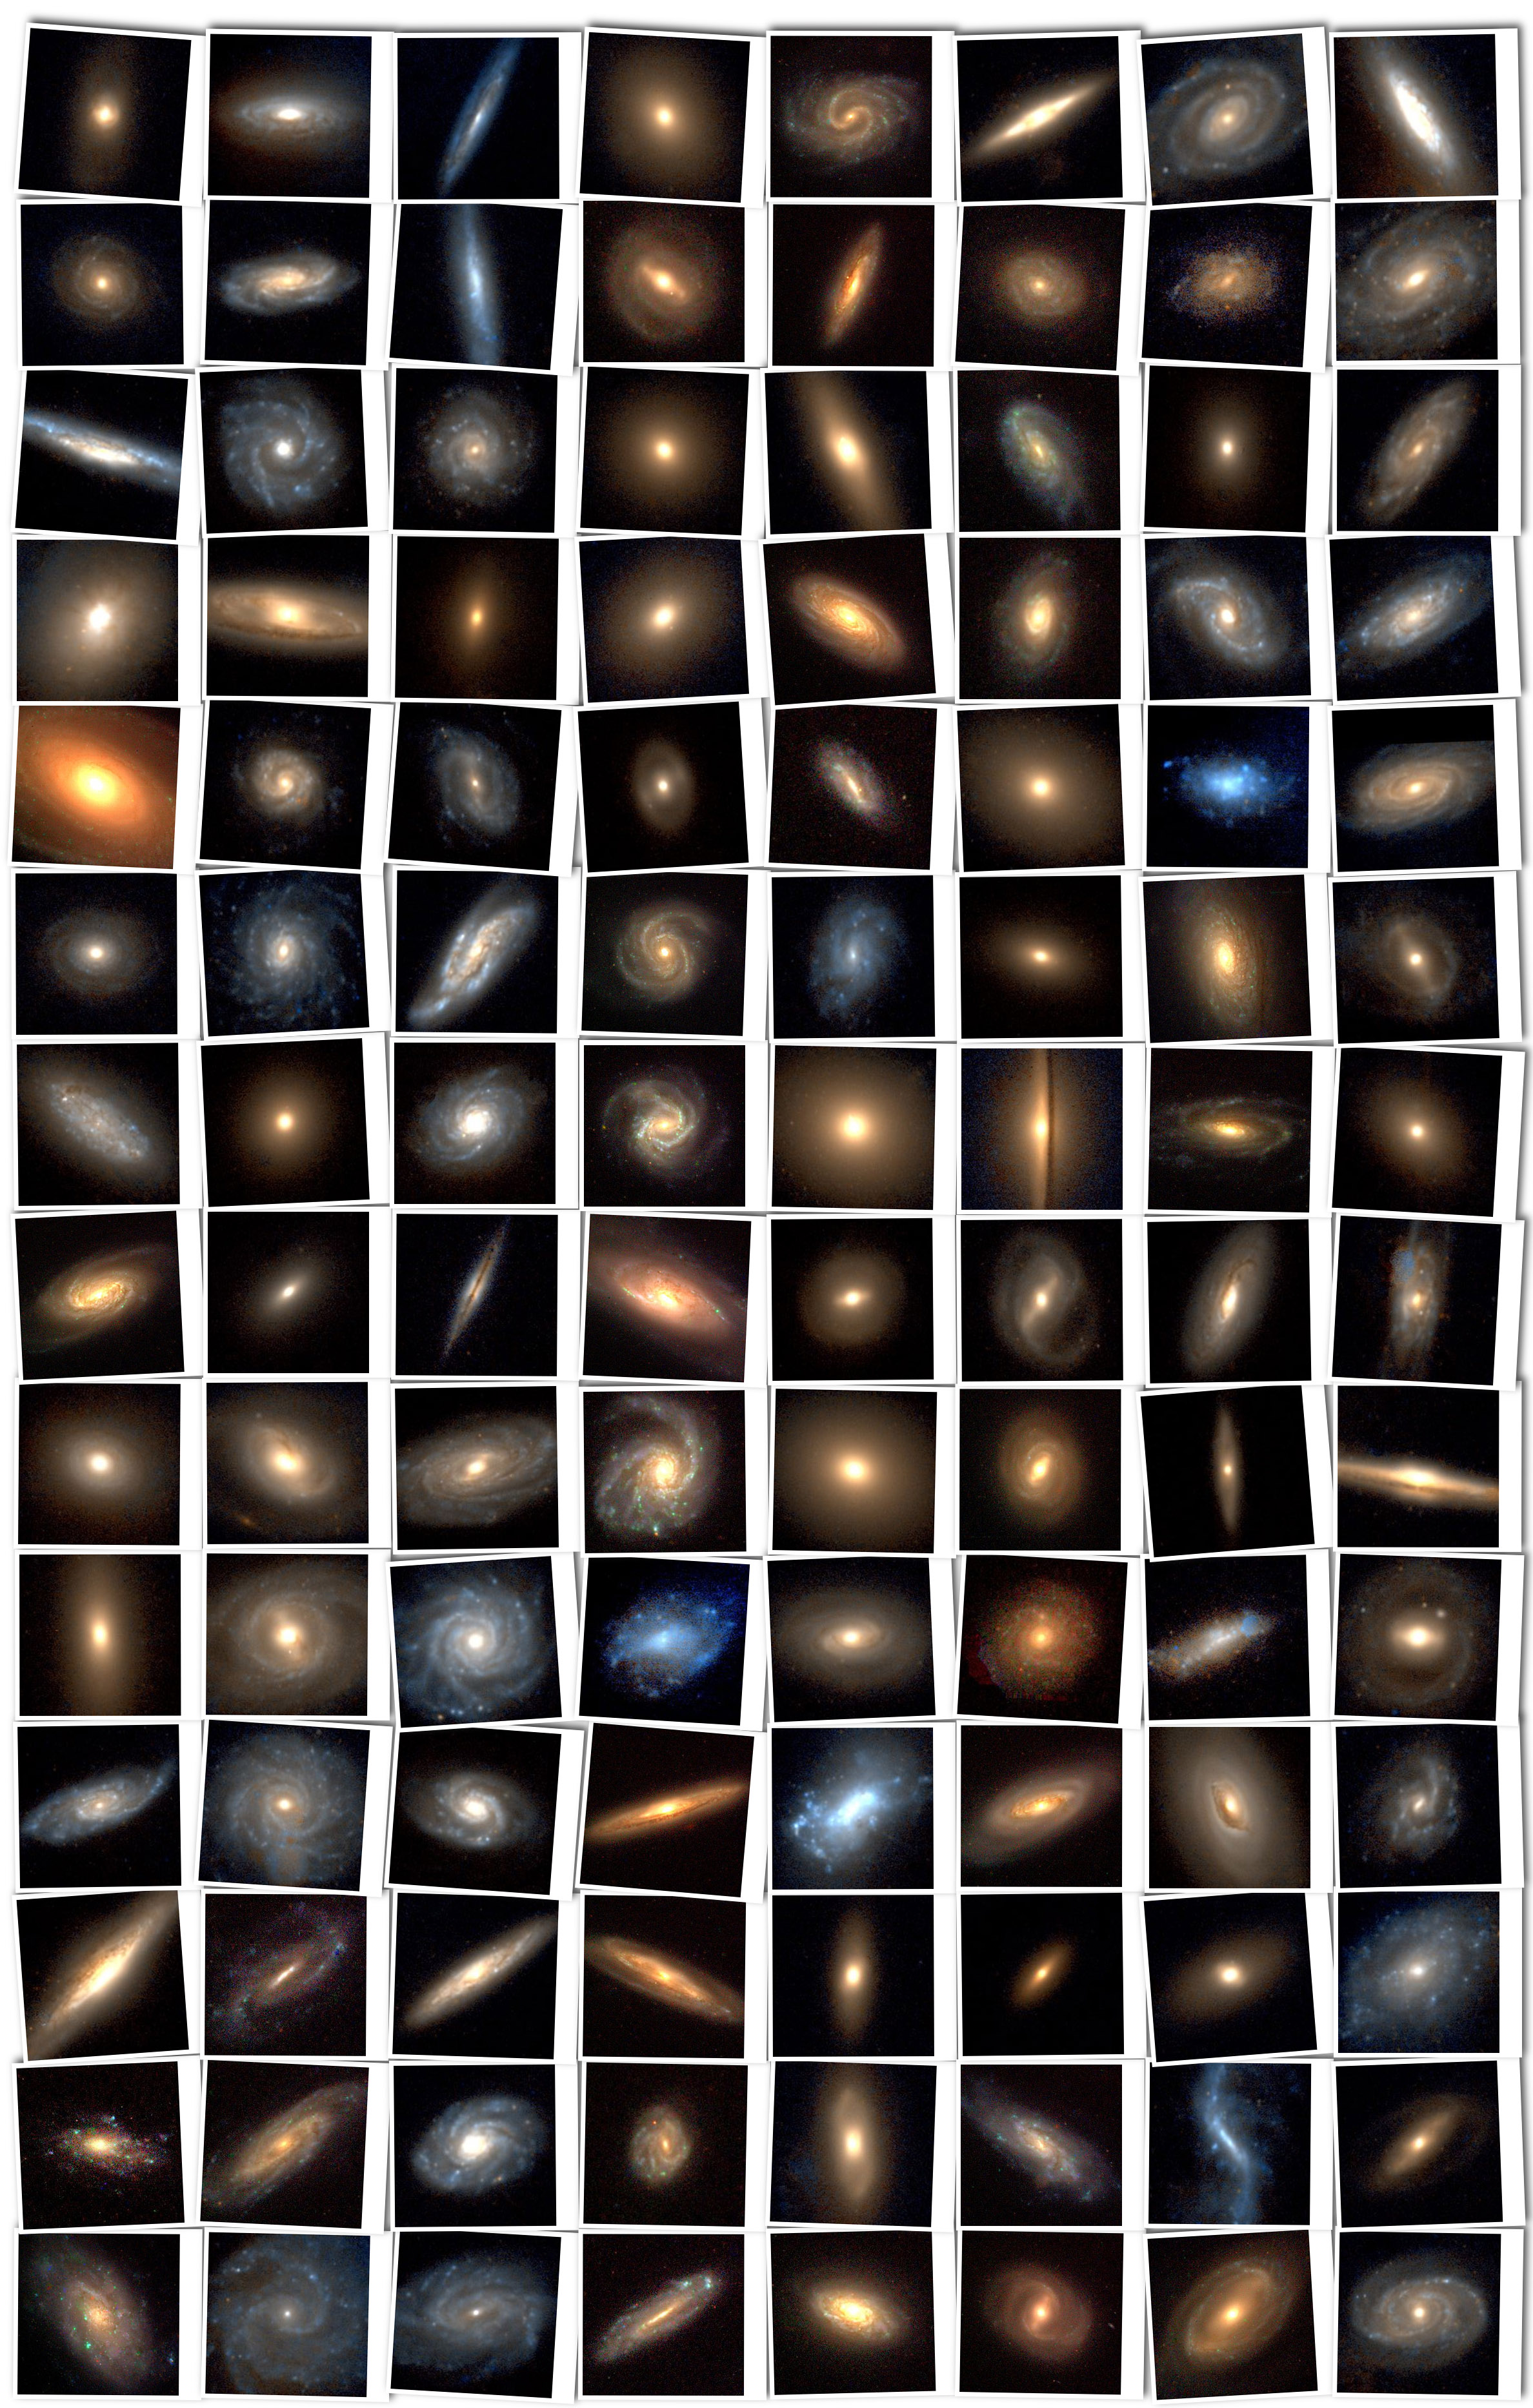
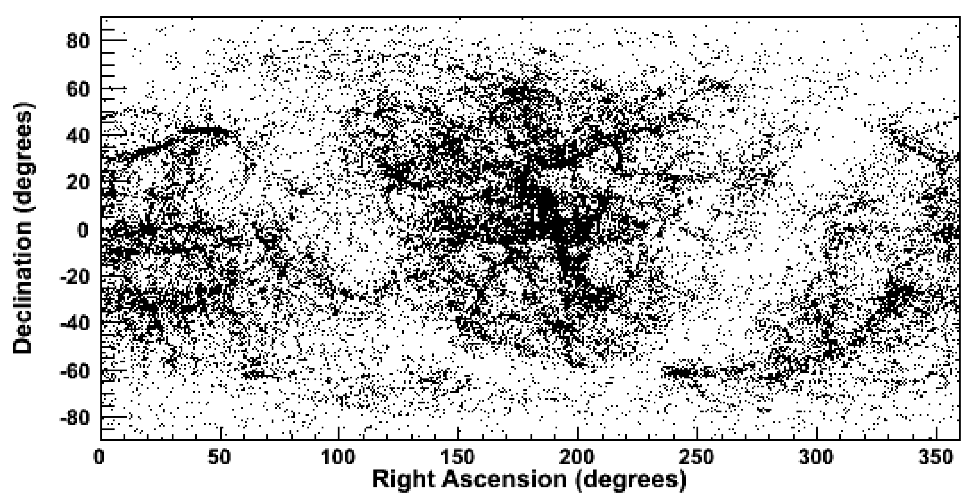
Galaxy Catalog
Gravitational Wave Galaxy Catalog
arXiv:1103.0695v1
Galaxies within 40Mpc (~12000)
arXiv:1103.0695v1
Courtesy of Zsolt Frei and James E. Gunn

Slide 28
Joint Analysis
input
science reach

