Slide 1
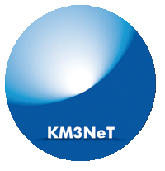
MANTS meeting, Uppsala,
24‒25 September 2011
Maarten de Jong

Slide 2
What & why?
Large deep-sea infrastructure in the Mediterranean Sea
  next generation neutrino telescope
  cabled observatories for Earth & Sea sciences
Science
  discovery of sources of (high-energy) cosmic neutrinos
  continuous and long-term measurements in the areas of oceanography, geophysics and marine biological sciences

Slide 3
Scientific focus
Geographical location
  Field of view includes Galactic centre
Optical properties of deep-sea water
  Excellent angular resolution
Envisaged budget 220‒250 M€
  Large effective neutrino area
Observe Supernova remnants in our Galaxy

Slide 4
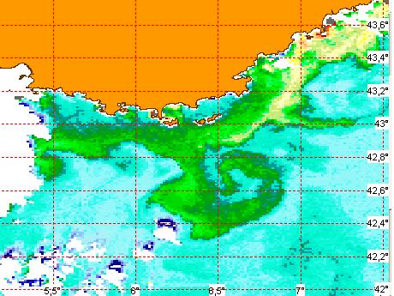
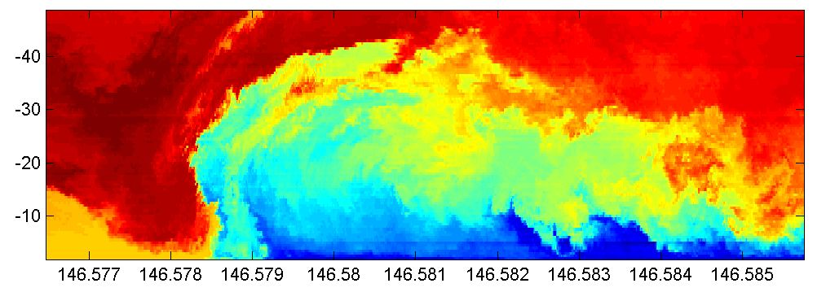
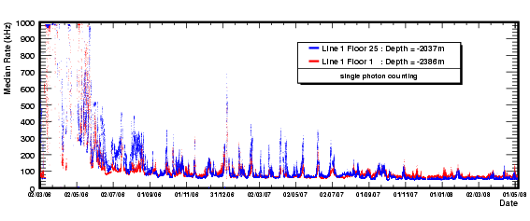
Synergy with Earth & Sea sciences
France
short lived (rare) events
dominate deep-sea life
permanent observatory
Temperature
Bioluminescence
sudden
Eddy currents
food supply
observatory
time profile

Slide 5
Design aspects

Slide 6
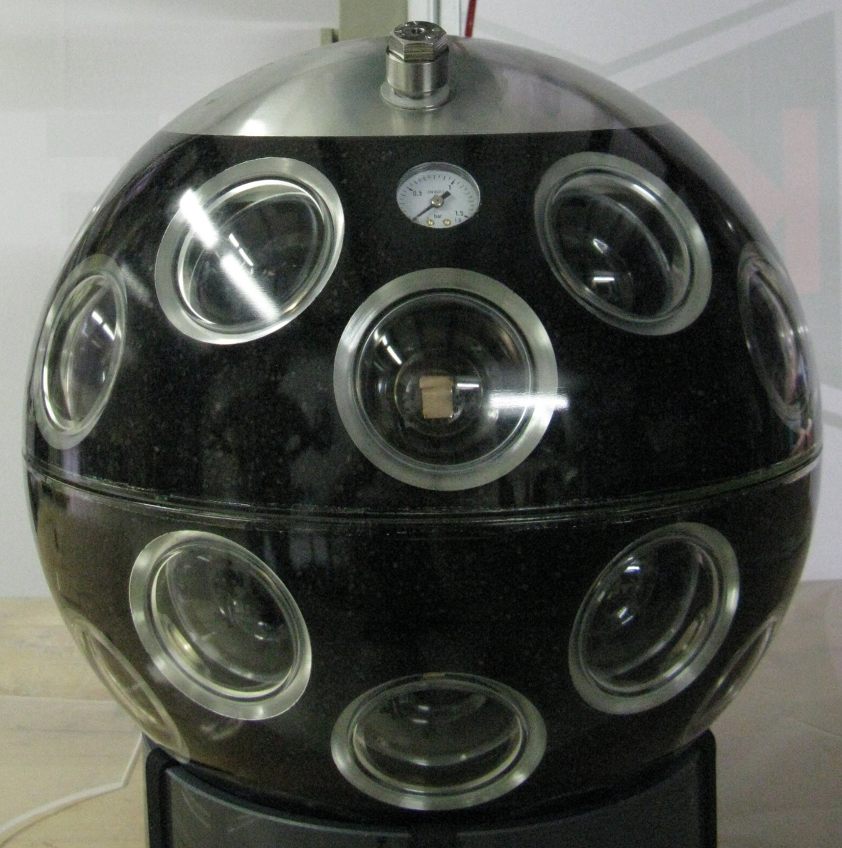
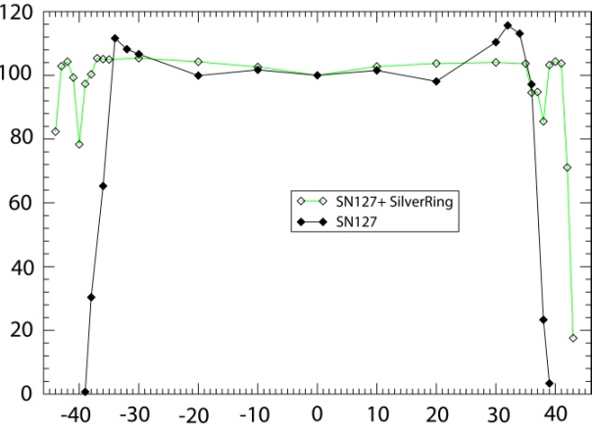
Digital Optical Module
31 x 3” PMT
3 x 10” PMT
light concentrator ring
increase of photo-cathode area by 20‒40%

Slide 7
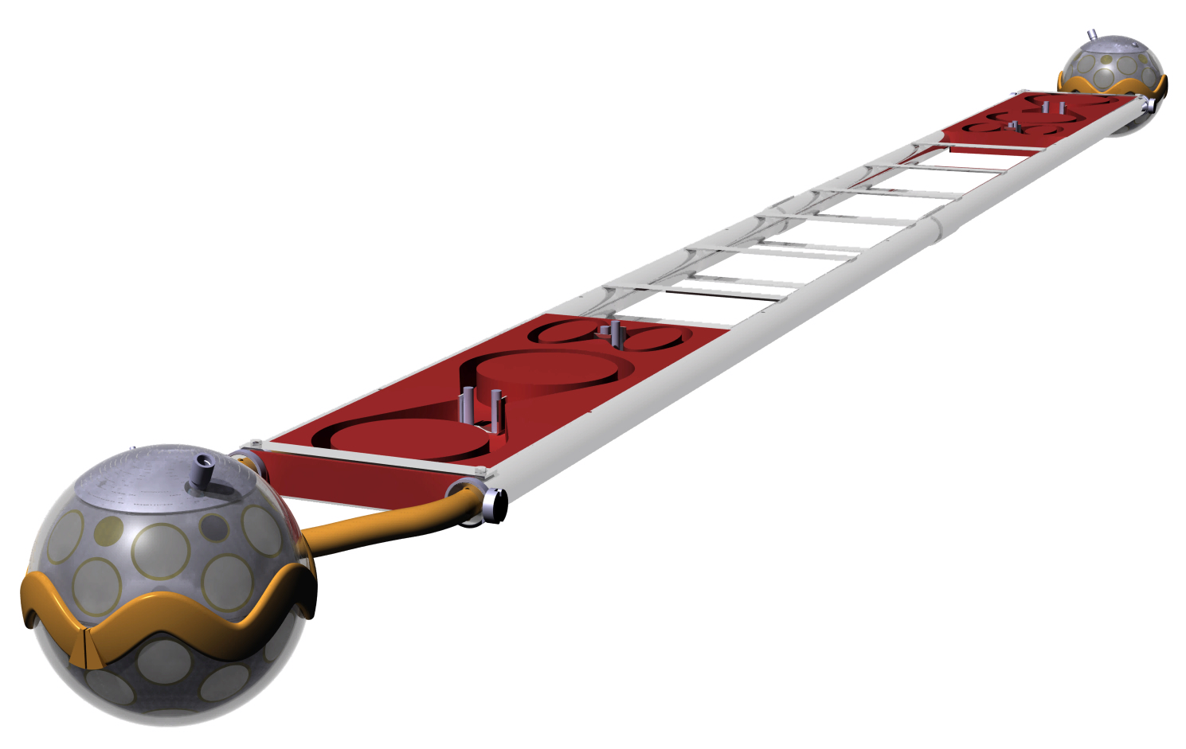
Storey
Frame with buoyancy (not shown)
Mechanical cable storage
Data cable storage
Mechanical cable connection
Optical module
6 m
Mechanical holder
1 Digital Optical Module = Dom
40 Dom’s on 1 tower = Dom tower

Slide 8
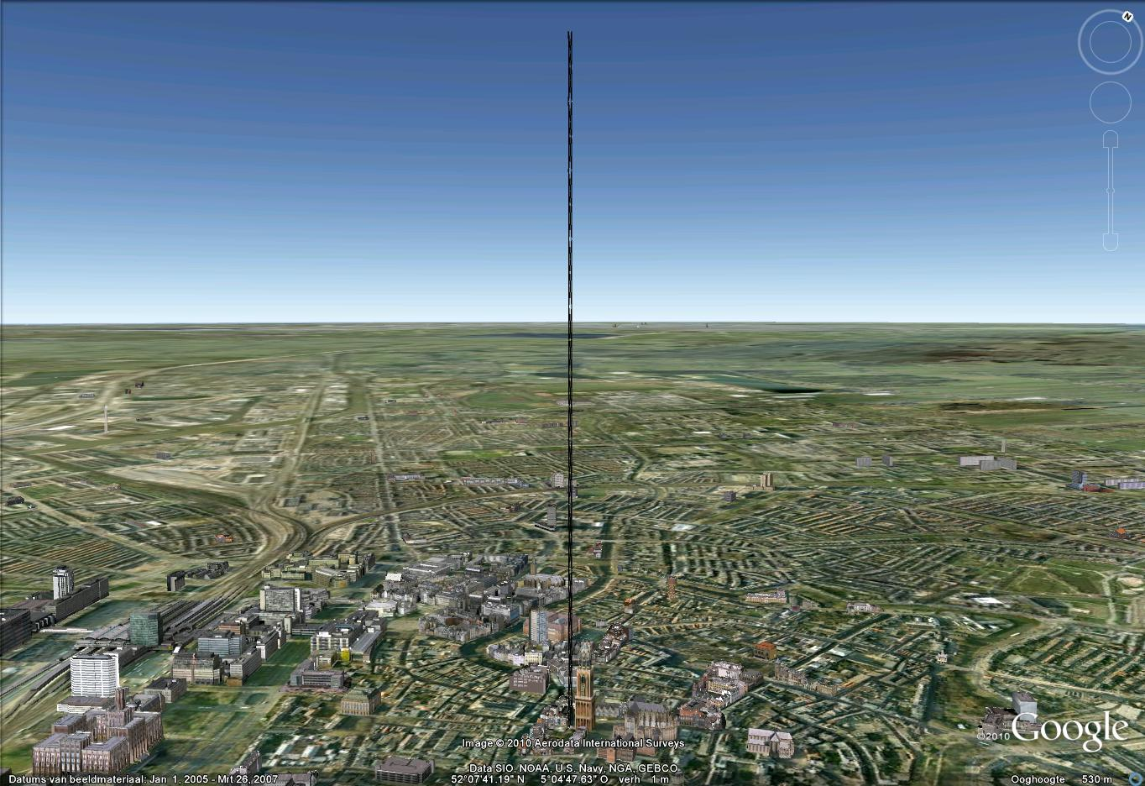
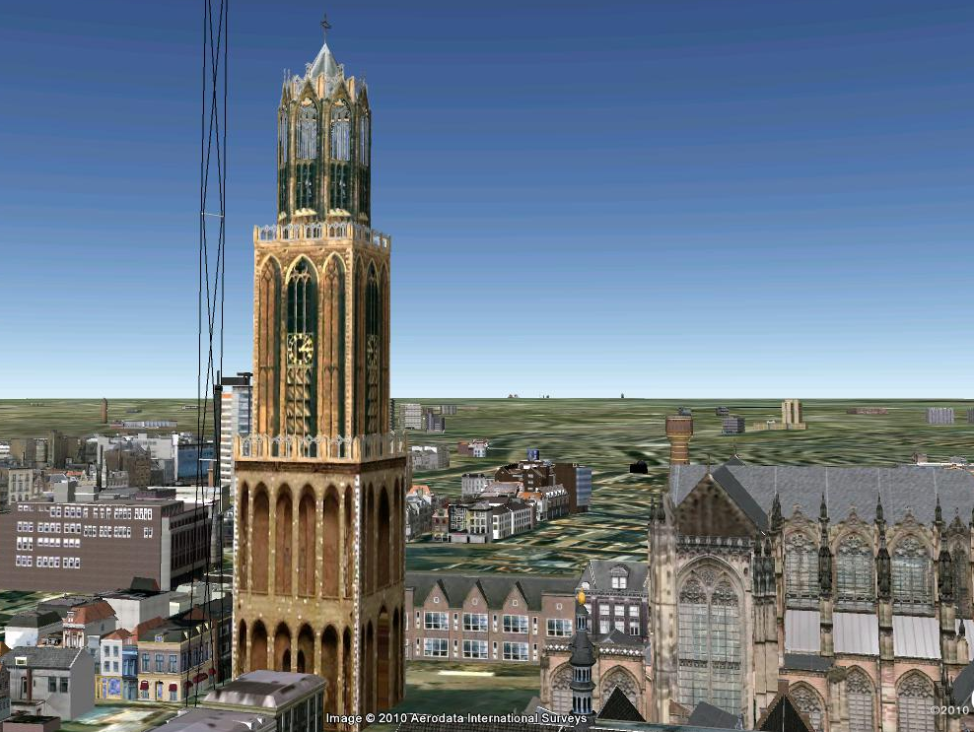
Dom tower,
Utrecht, the Netherlands
a.d. 1254

Slide 9
Readout & Trigger
“All-data-to-shore” concept
    Fibre-optics system with lasers on shore and modulators off-shore
    Applies to all deep-sea instrumentation
Trigger
  Multi-PMT optical modules provides for excellent level 1 filter
    Local coincidence of ≥ 2 L0 hits in one optical module (Δt ≤ 10 ns)
  Bar provides for easy level 2 filter
    Local coincidence of ≥ 2 L1 hits on one bar (Δt ≤ 50 ns)
  Muon trigger for any detector design
    “Ω + 1D trigger algorithm” developed for Antares proved viable
    Possible to track astrophysical source(s) real-time

Slide 10
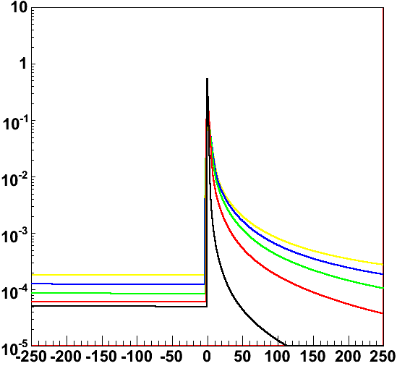
Reconstruction
Antares
  Expected angular resolution of 0.4 degrees proved
  In the absence of excessive bioluminescence, it is possible to cope with the optical background (⁴⁰K)
KM3NeT
  Expected angular resolution of 0.1 degrees
    Rigorous solution to start value problem
      promising results combined with Kalman filter
    Likelihood fit based on PDF of light
PDF of light

Slide 11

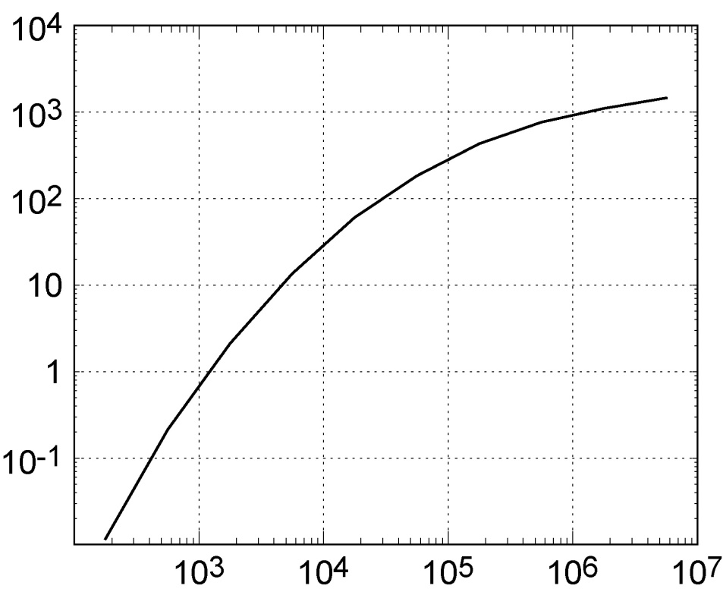
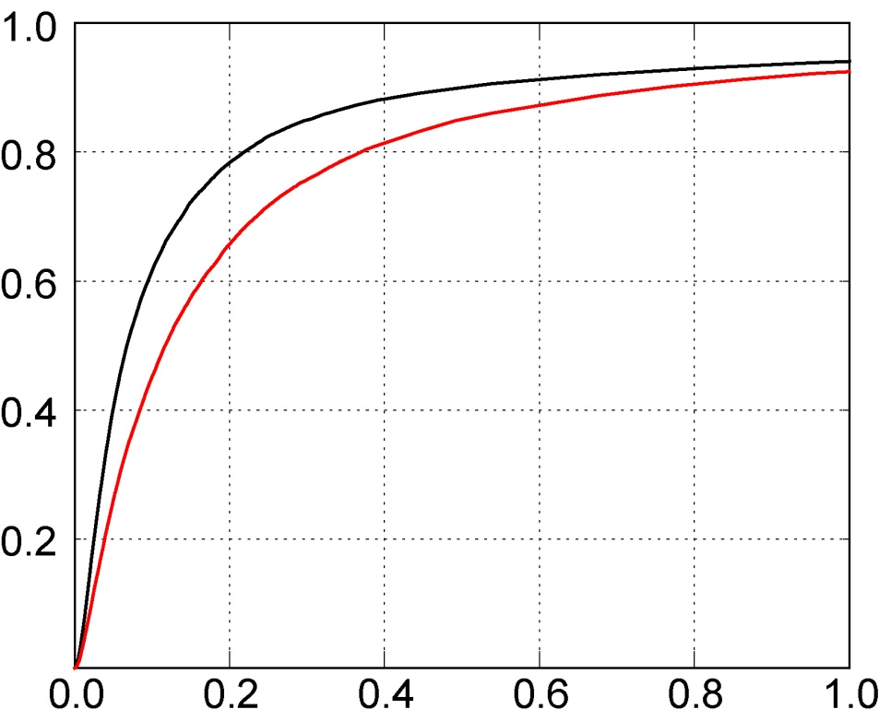
Performance
“WPD reference detector”
Effective neutrino area
Angular resolution
Effective area [m²]
ΣP
muon
neutrino
E_{ν} [GeV]
Angle [degrees]

Slide 12
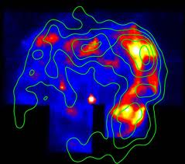
Example: RXJ 1713
Status quo
  About 5 years for 3 sigma discovery
Anticipated improvements
  Energy estimator in Likelihood (known spectrum)
  event-by-event angular resolution
  morphology of source
  looking (few degrees) above the horizon
RXJ 1713
Aim: 5 sigma in 5 years (5/5)

Slide 13
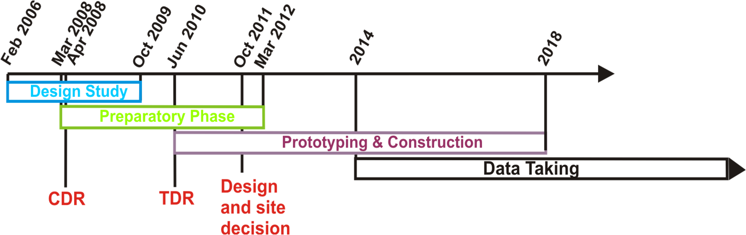
Time lines
Fig. 10-1 TDR
Conceptual Design Report. 2008. ISBN 978-90-6488-031-5
Technical Design Report. 2011. ISBN 978-90-6488-033-9

Slide 14
Status
Science
  Galactic sources (Supernova remnants)
  GRBs, cosmogenic neutrinos (e.g. Galactic plane), ...
Technology
  “Multi-PMT on a bar”
    2 (+2) manufacturers of 3 inch PMTs have been identified
Funding
  A significant part of the funding is anticipated before summer 2012
    start of construction should follow immediately
Governance
  First steps towards legal framework have been taken
    European Research Infrastructure Consortium (ERIC) is favoured solution
Site
  With present funding scenario, the site issue evolves to “a remotely operated distributed network of neutrino telescopes”
    performance of neutrino telescope not affected
    augments the scope of Earth & Sea sciences

Slide 15
Conclusions
Antares proved feasibility of (high-energy) neutrino astronomy in the Mediterranean Sea
Major investments paved the way for KM3NeT
  site preparations, shore stations, ROV, assembly lines, prototyping, logistics, ...
Science case
  “Raison d’être” is Galactic sources
  Provides for independent observation of a possible discovery by IceCube with improved significance within reasonable amount of time
Don’t ask me why it’s called KM3NeT

