Slide 1
GitHub and Submitting Jobs
Alicia Mand for IceCube Summer School 2026

Slide 2
GitHub

Slide 3


rm -fr *

Slide 4
This could be you!
rm -fr *

Slide 5
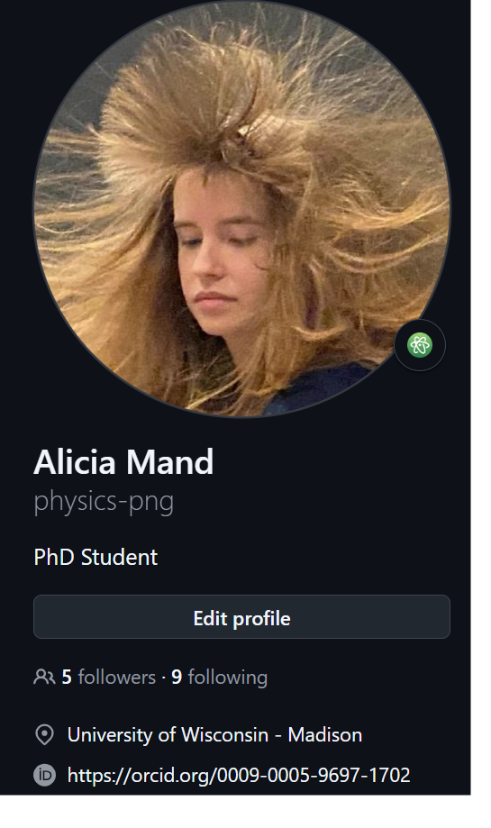
GitHub Setup
Create a GitHub Account
To join the IceCube Organization you must:
  Have your full name in your GitHub Profile
  Include your institution
  Set up 2-factor authentication (required)
Message in #software or #icecube-it on Slack for an invite
Read the IceCube GitHub Guide
A
SEND YOUR GITHUB TO THE Q&A CHANNEL!
B

Slide 6

Setting up on Cobalt
GitHub is preinstalled on Cobalts
Set your name and email on the command line client
Make sure this is associated with your GitHub account
Add and use ssh keys (can’t push without them!)
  Guide here

Slide 7
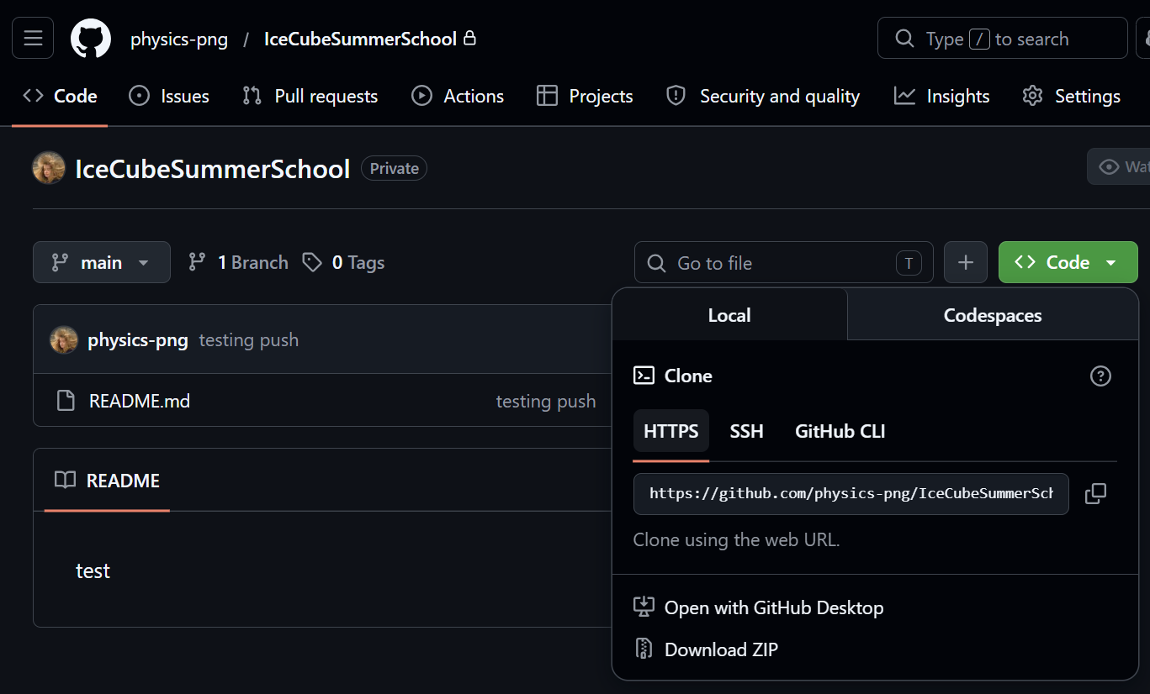
Cloning
Have someone’s repository you want to look at?
git clone [link]

Slide 8



Making a branch
To create a new branch:
Make changes and then:
Add and commit files:
Always, always, always have a descriptive commit message (don’t be that person who changes 96 files with the message “small update”)

Slide 9


Push your changes!
Generally, before you push, its good to pull (checks the repo for changes!)
Push your changes!

Slide 10
The Submit Machine

Slide 11

Why use submit?
Most IceCube analyses can be pretty CPU or Memory intensive
The cobalts are meant for general use only, not for heavy work
The submit nodes (a high-computing cluster) are:
  Fast
  Have a ton of memory
  Will run code while you’re not logged on

Slide 12
Setup for npx tutorial
You need a few libraries (can install using pip3 install <LIBRARY> --user):
  pycondor
  numpy
  pandas
You must ssh into the npx-submitter machine
  “ssh npx-submitter”
Navigate to the directory you have put the github repo in

Slide 13
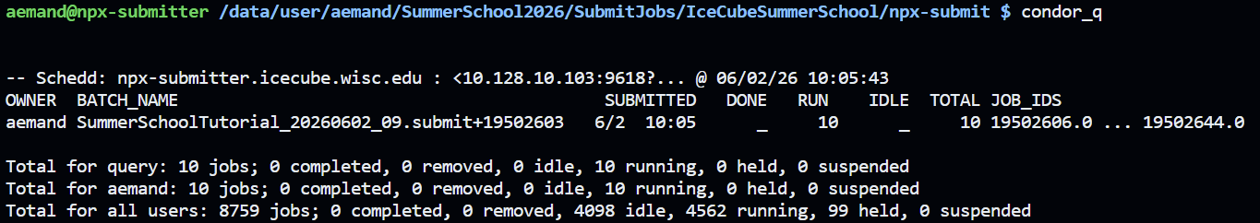
Do the NPX Submitter Tutorial:
Using the github repo that is linked earlier in the slides, try to run the submit script:
python3 submit.py
Let any of us know if you run into any trouble!

Slide 14
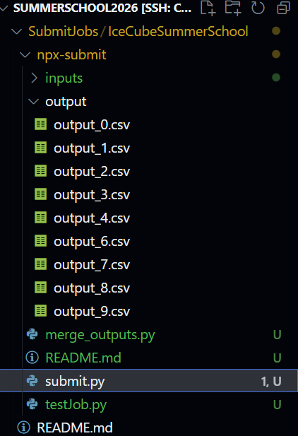
Outputs after the jobs are done!

Slide 15
Exercise: Creating a repo and submitting jobs!

Slide 16
Your Mission (if you choose to accept)
Create your own github repo
  You can follow this guide: https://docs.github.com/en/repositories/creating-and-managing-repositories/creating-a-new-repository
  Follow the web UI tutorial
Clone the repo on the cobalts
Write a program that:
  Takes an input file of numbers
  Calculates the sum of those numbers
  Creates an output file with the sum of the numbers
Write a submit script for the above task
Submit to npx-submitter and wait for job to finish
Commit changes to GitHub and let us know once you’re done!
You will need to create all input files and programs!

