Slide 1
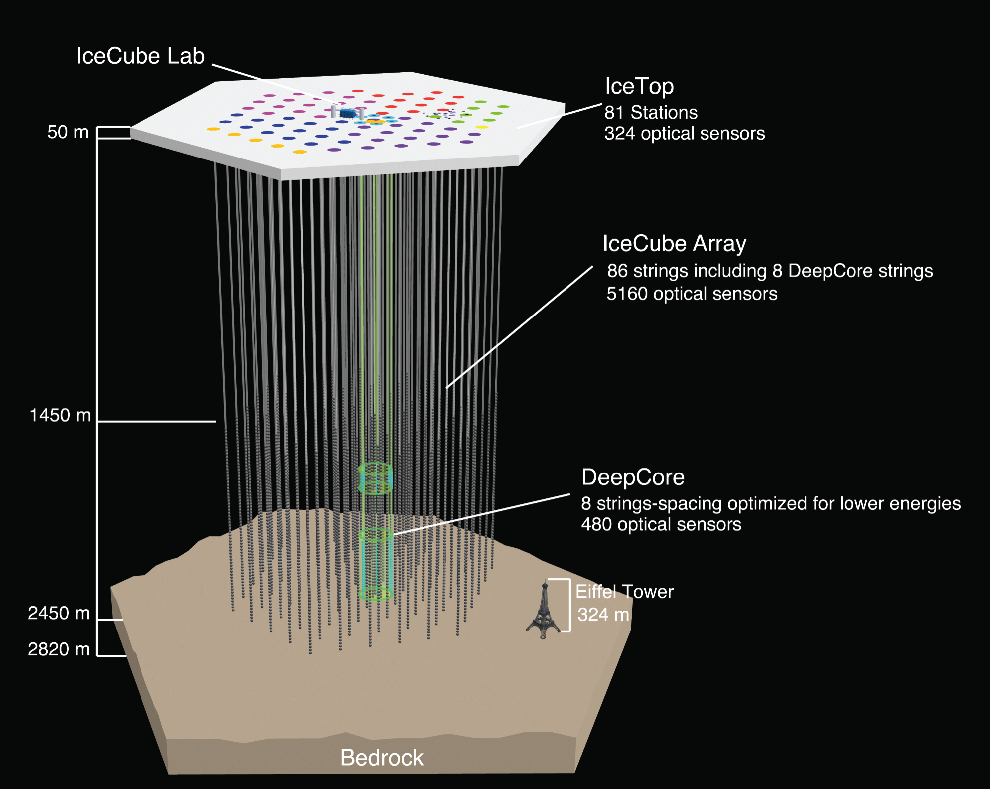
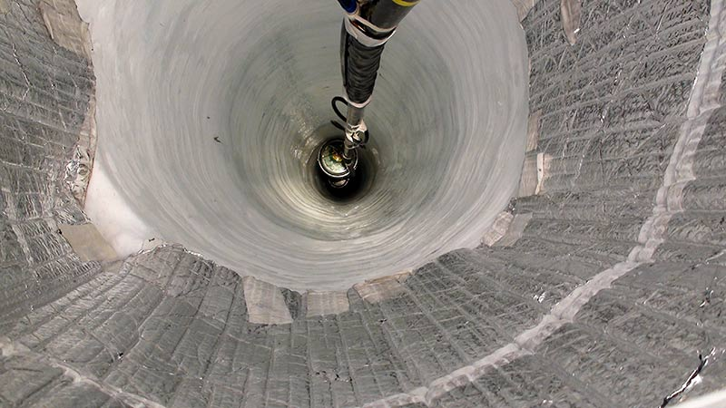
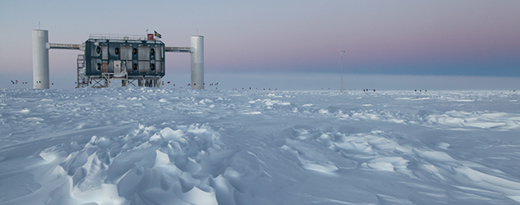
Ice Calibration and Ice Models
AMANDA-A
AMANDA (turned off in 2009)
19 strings, 677 optical sensors
Dmitry Chirkin, UW Madison
IceCube summer school 2026

Slide 2
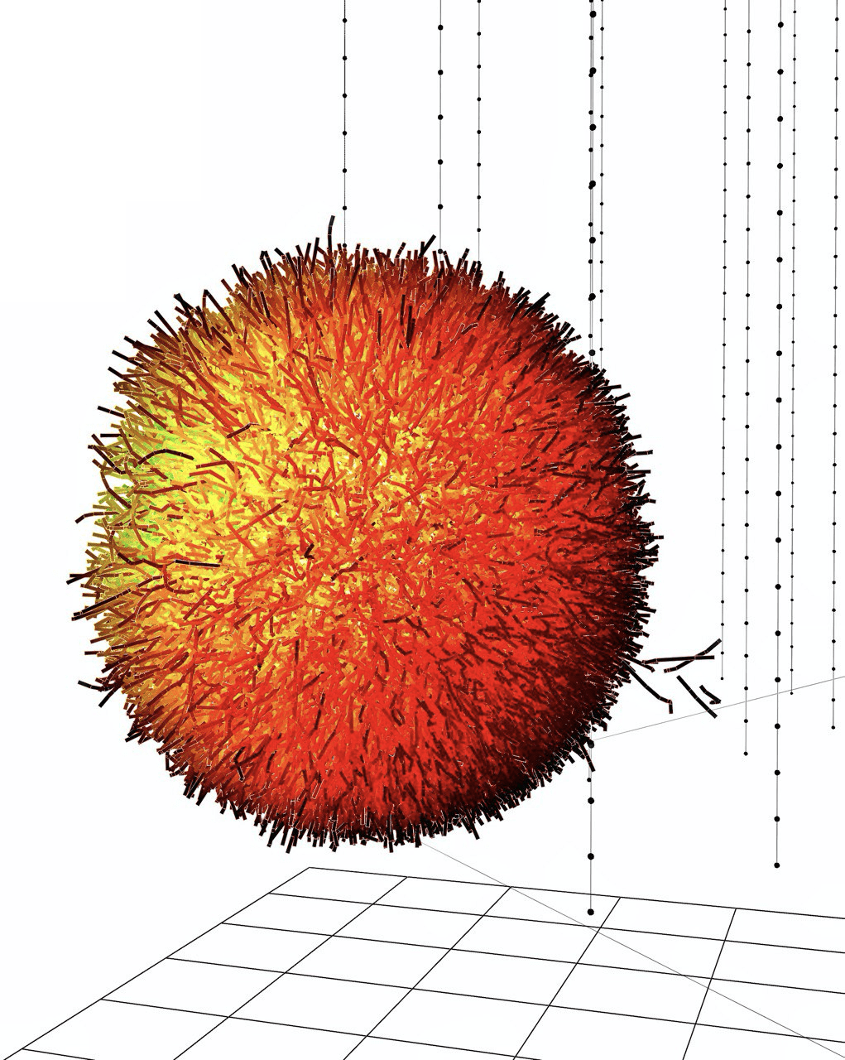



what does ice do to photons
Source is
blurred
scattering
absorption
Source is
dimmer
a = inverse absorption length (1/λ_{abs})
b = inverse scattering length (1/λ_{sca})

Slide 3
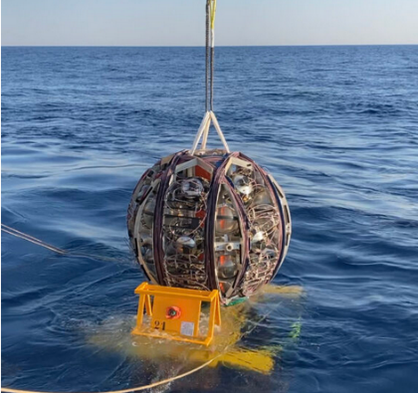
Antarctic ice
Absorption length: very high, 100-200+ m
Scattering length: relatively shorter 20-50 m
Dust impurities, air bubbles, air hydrate crystals
Sea/lake water
Absorption length: moderate, 30-70 m
Scattering length: very high, 40-60+ m
Seawater salinity, sediment, biological materials

Slide 4
Measuring Scattering & Absorption
Install light sources in the ice
Use light sensors to:
- Measure how long it takes
for light to travel through ice
- Measure how much light is delayed
- Measure how much light does not
arrive
Use different wavelengths
Do above at many different depths
scattered
absorbed

Slide 5
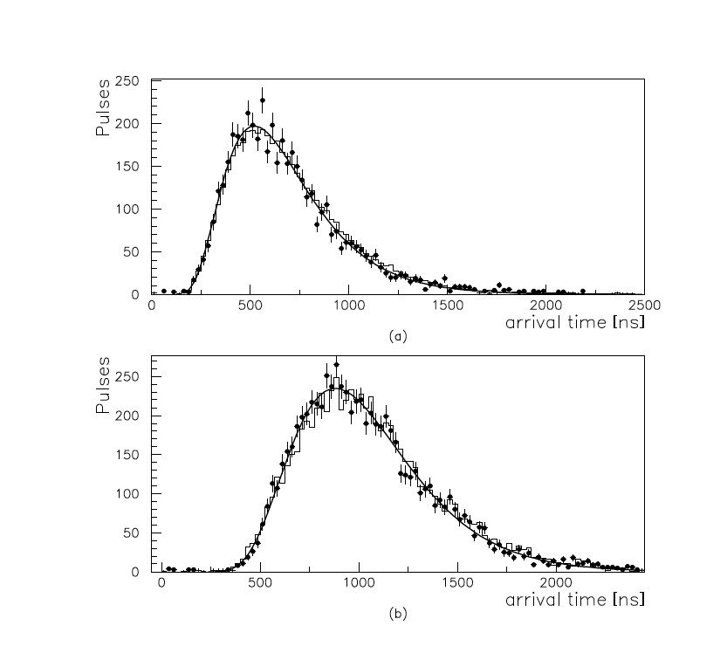
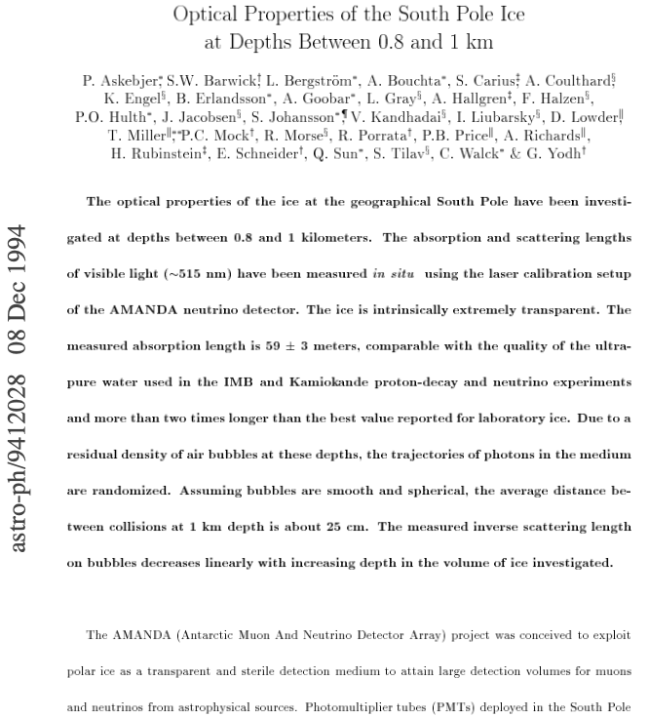
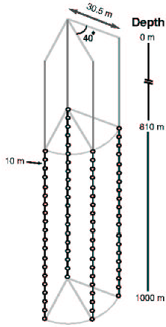
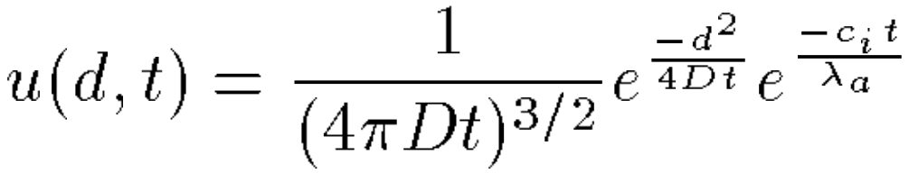
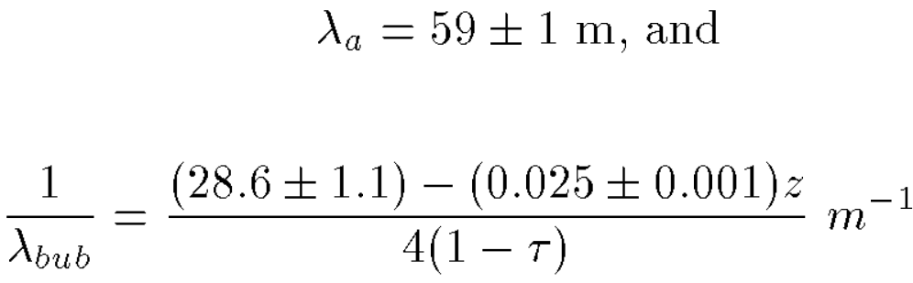
AMANDA-A: scattering on air bubbles ☹
1994
Distance between sensors 10 m
Long absorption length: 60-200 m
Short effective scattering length: 1 m
Very clean ice with low impurities
Scattering due to air bubbles
Air bubbles predicted to disappear
(convert to clathrate hydrates) at 1150 m
Analytical description (diffusive regime)
Possible due to very small scattering length

Slide 6
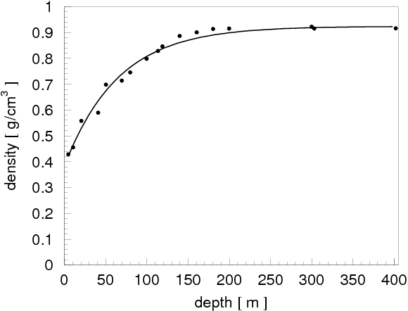
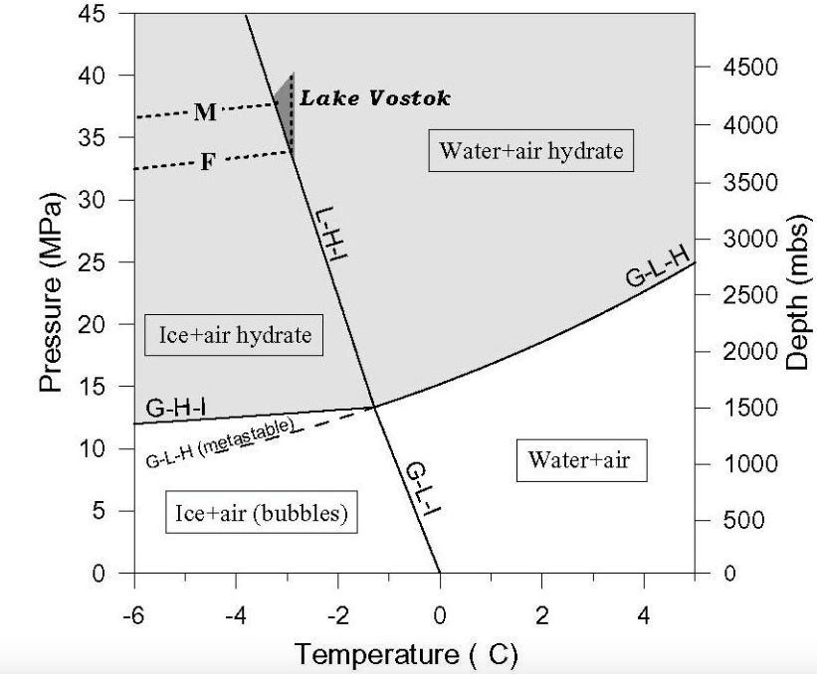
Trapped air bubbles and their conversion into air hydrates
At some depth between 0 and 200 m air bubbles become trapped and are squeezed into the ice as ice packs under pressure.
-50…-20 C
At depth of 1350 m all air bubbles have converted into air hydrates,
which have the same refractive index as ice, so no longer a nuisance

Slide 7
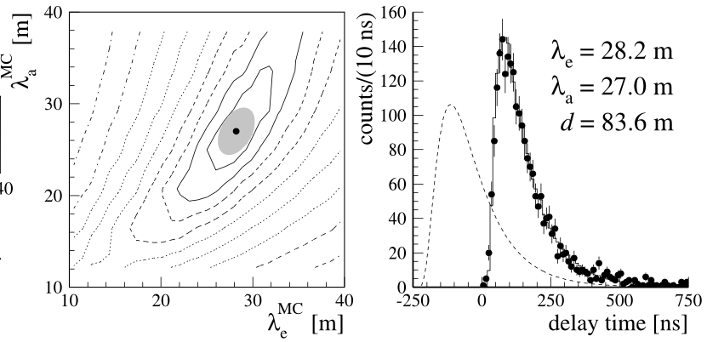
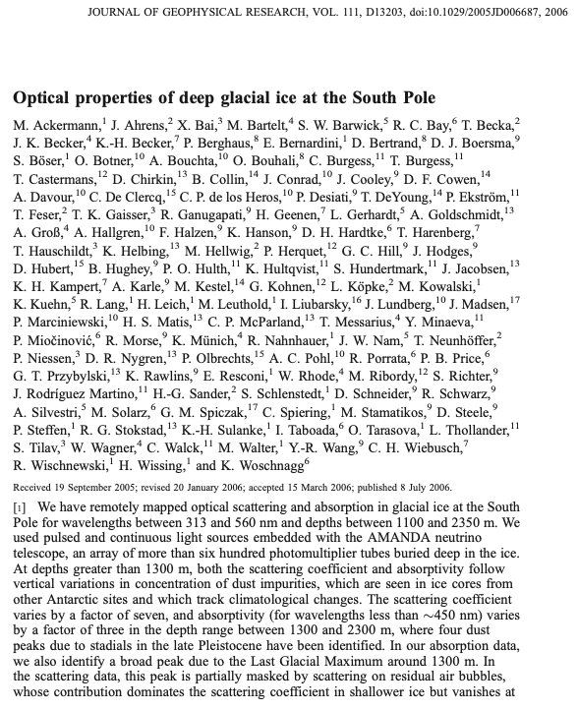
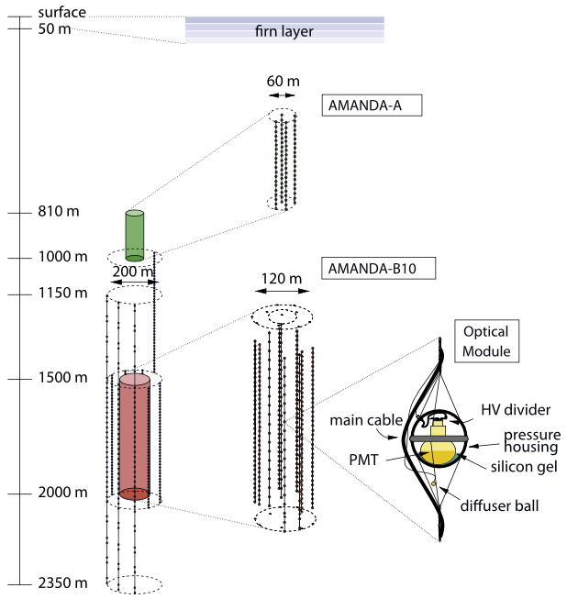
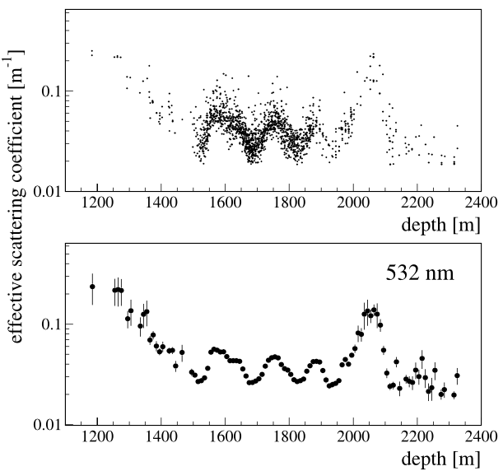
AMANDA-II: clean ice ☺
2006
Found transparent ice at detector depths
Confirmed absence of air bubbles, refined their disappearance depth to 1350 m
Fitted λ_{a} and λ_{e} to each emitter-receiver pair, had to average for each 10 m ice layer
Limitation of this method, later understood: average values did not describe well fitted emitter-receiver pairs. Need to fit entire ice depth table simultaneously from the start.
Ice cleaner than best lab ice
Concept of 10 m layered ice
Wavelength dependence
Air bubble fit

Slide 8
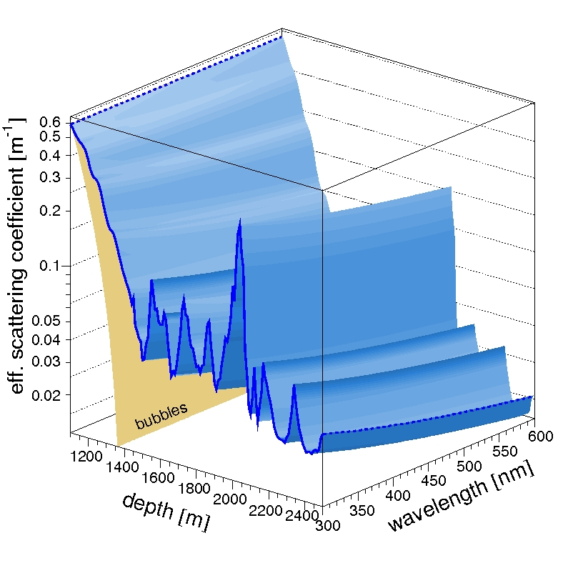
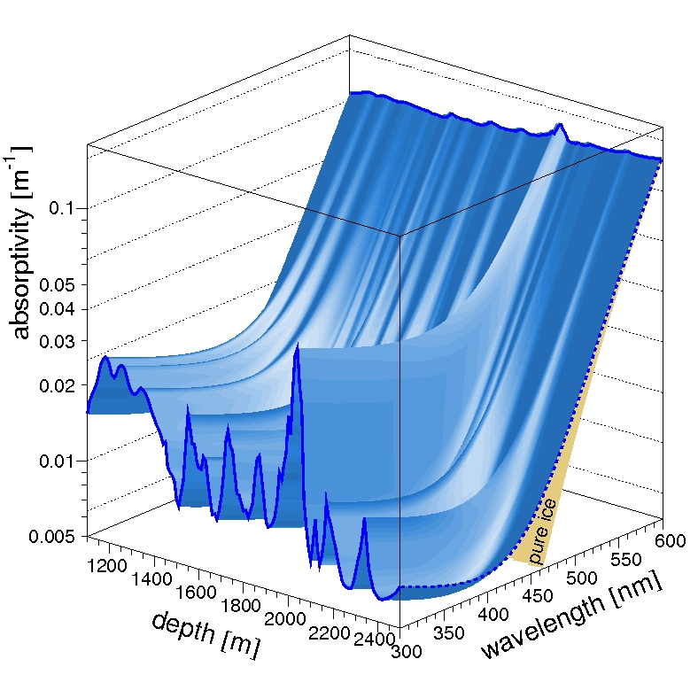
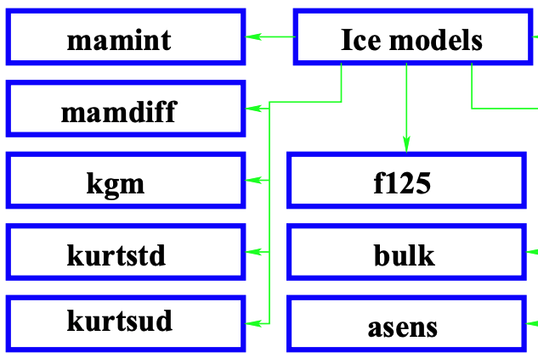
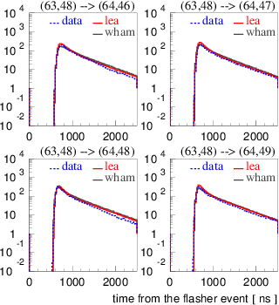
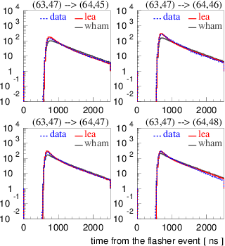
AMANDA-era ice models
2011
Kurt
KGM (Kurt-Gary)
MAM (modified absorption)
Millennium/Y2K
AHA 2006-2007
Lordi
WHAM! (Water Hardened Antarctic Measurement)
1995-2003
Models with an IceCube wiki page
Comparison with SPICE family (lea)

Slide 9
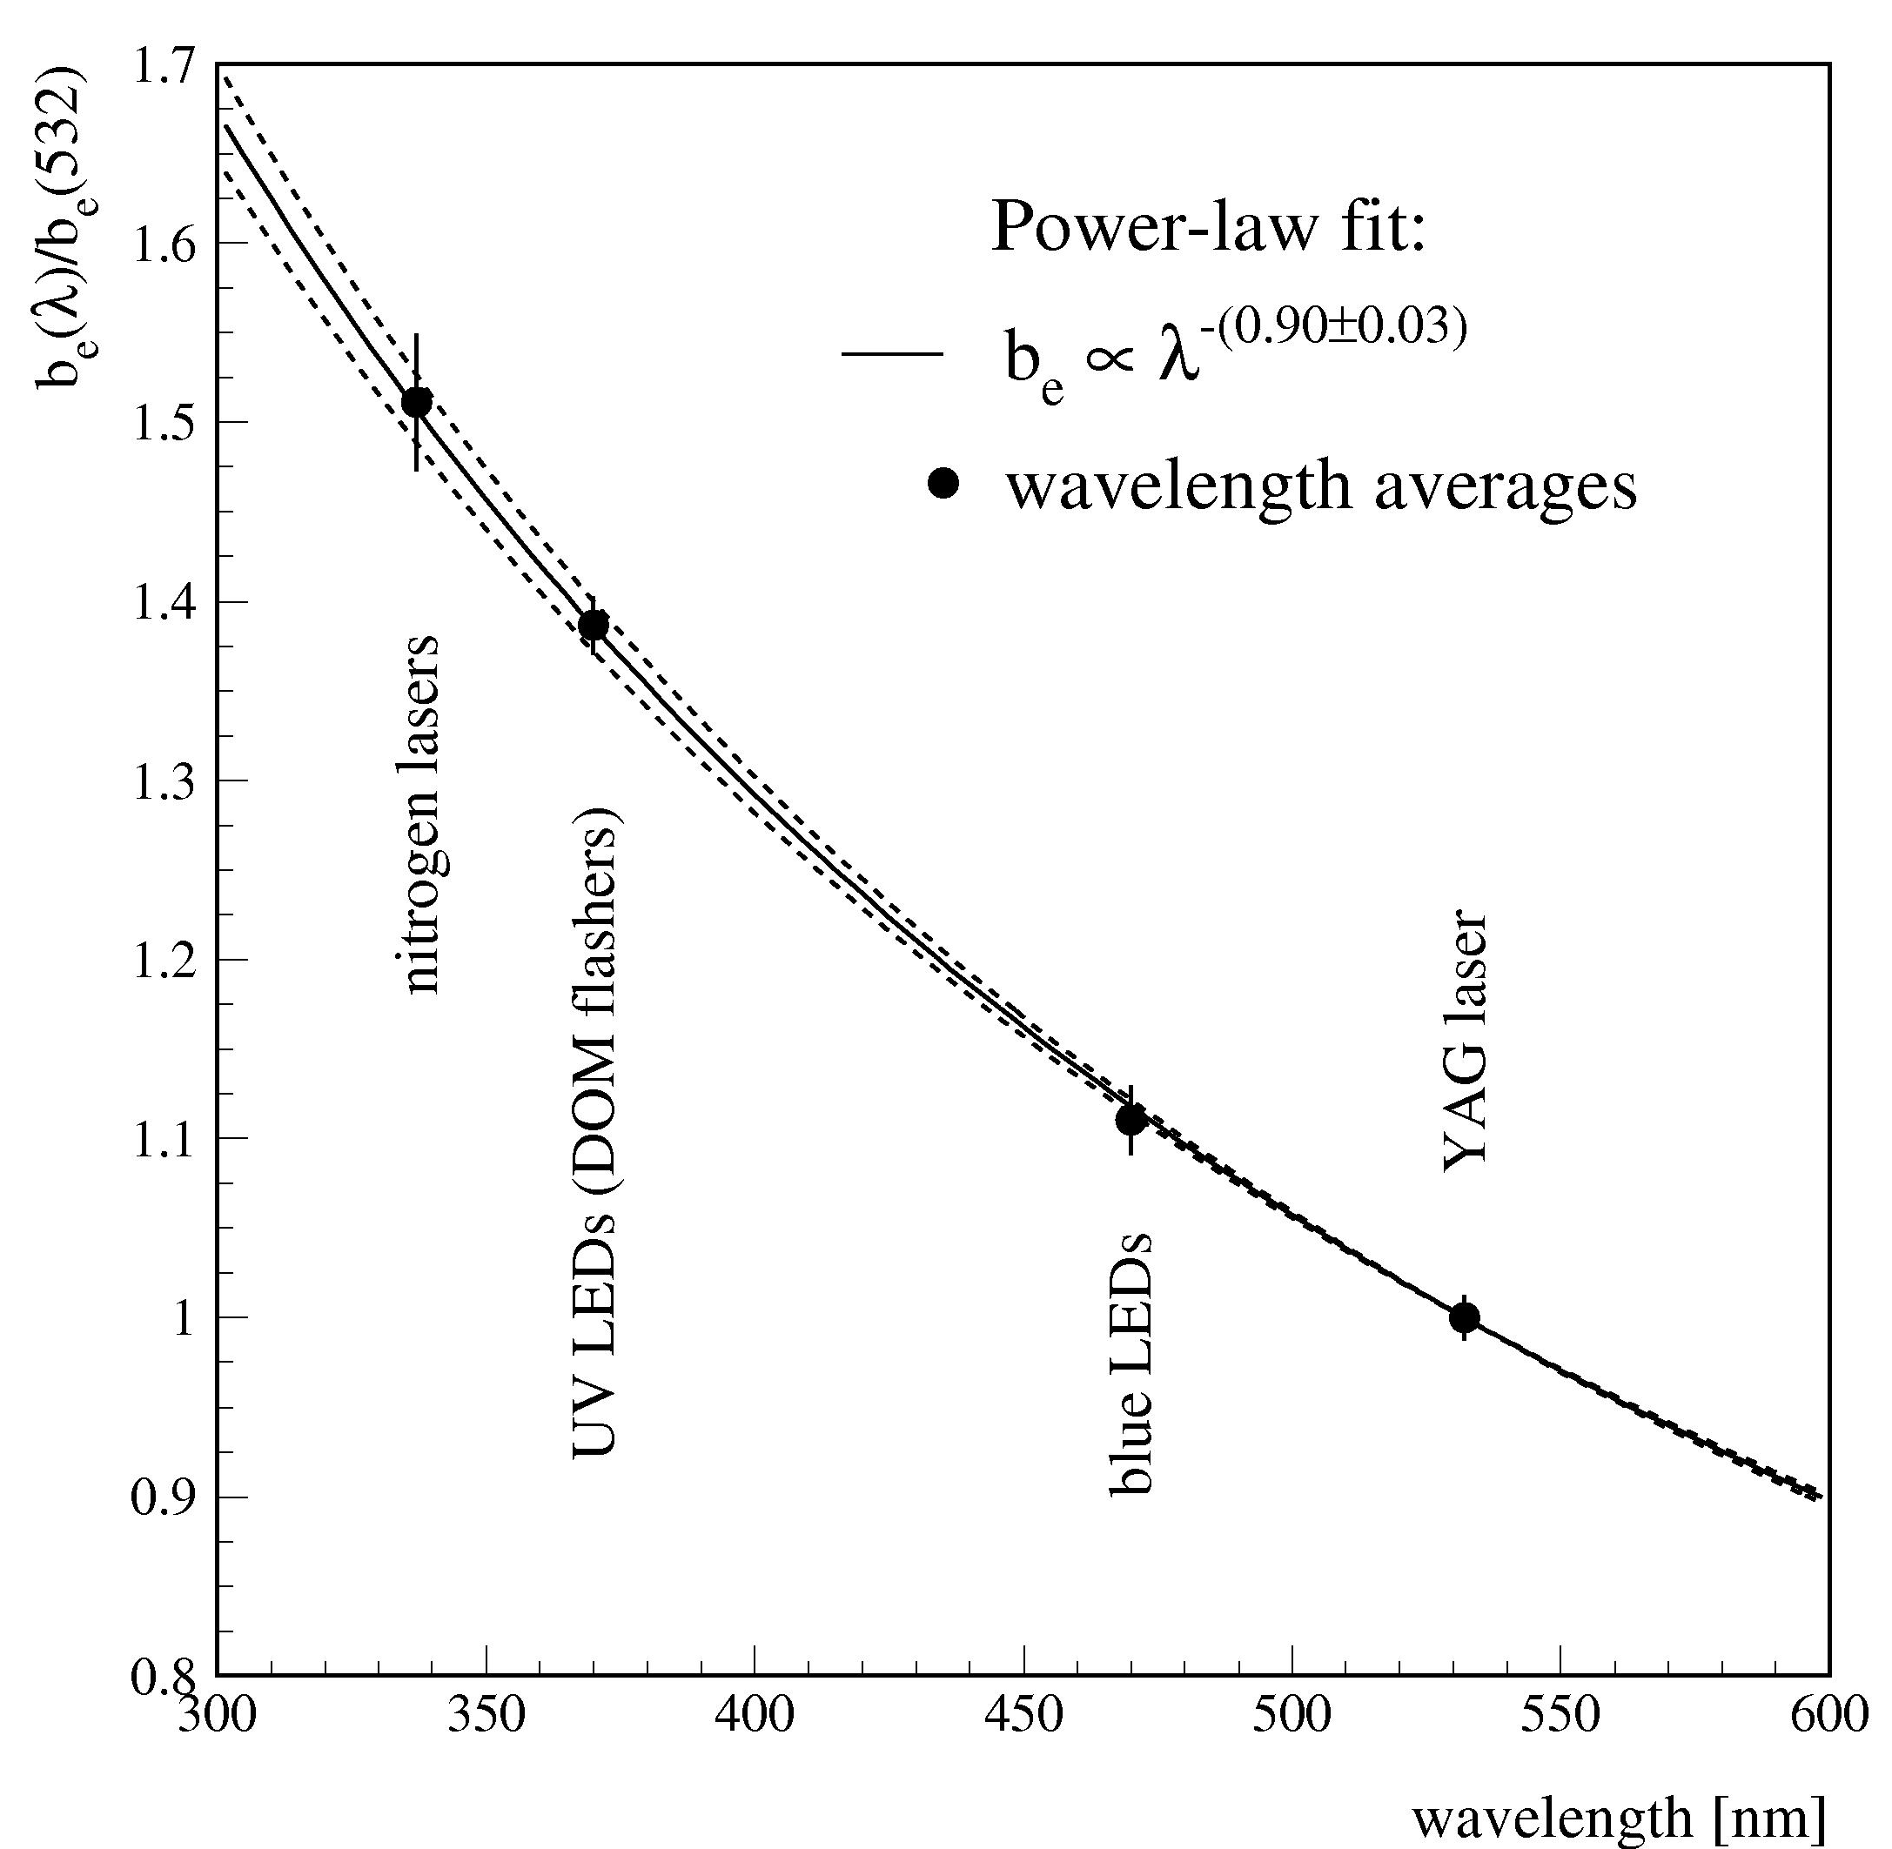
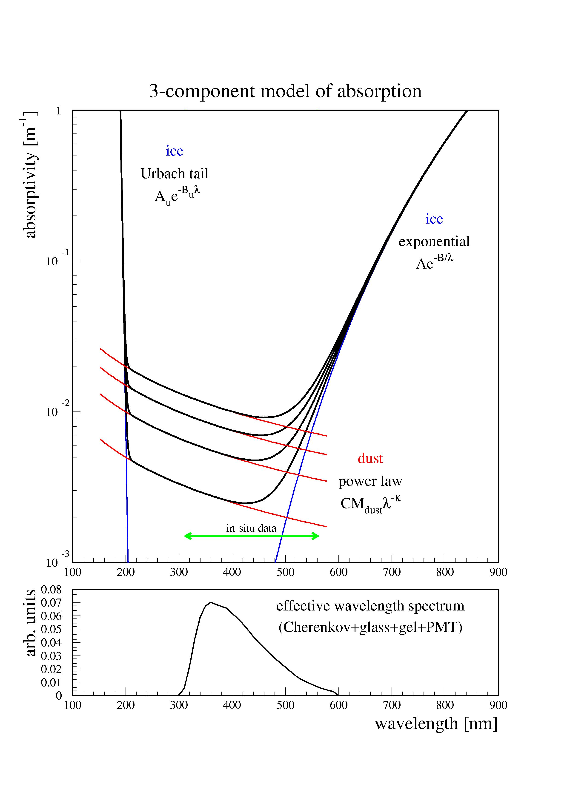
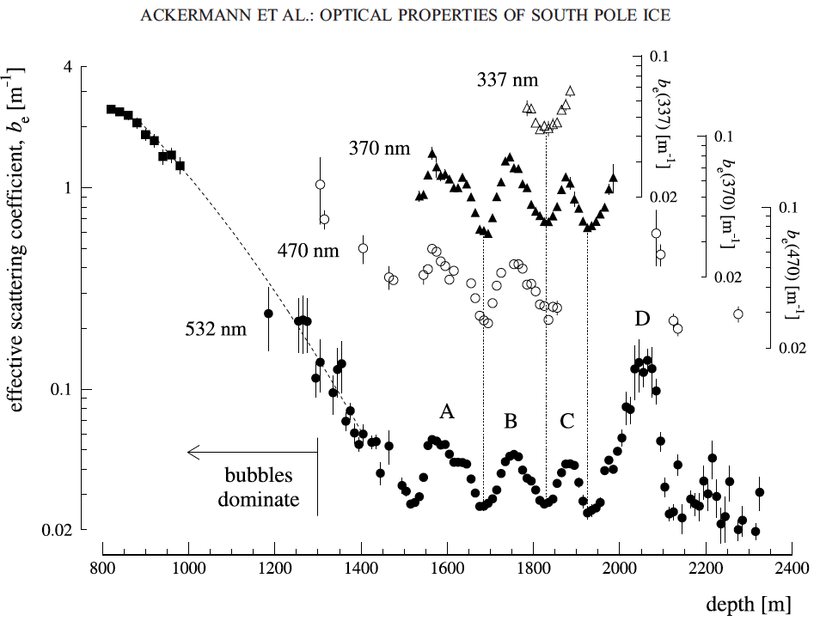
AMANDA-II: comprehensive ice model
Ice is extremely transparent between 200 nm and 500 nm
Ice is very transparent at depths below 1350 m
Scattering and absorption are determined by dust concentration
Wavelength dependence of dust scattering and absorption follow power law
Wavelength dependence was verified with IceCube, but is still used basically unchanged

Slide 10
Ice layer parametrization
In each 10-meter layer define:
  scattering
  absorption
  ice crystal density
Source is
blurred
10 m
scattering
absorption
Source is
dimmer
a = inverse absorption length (1/λ_{abs})
b = inverse scattering length (1/λ_{sca})

Slide 11
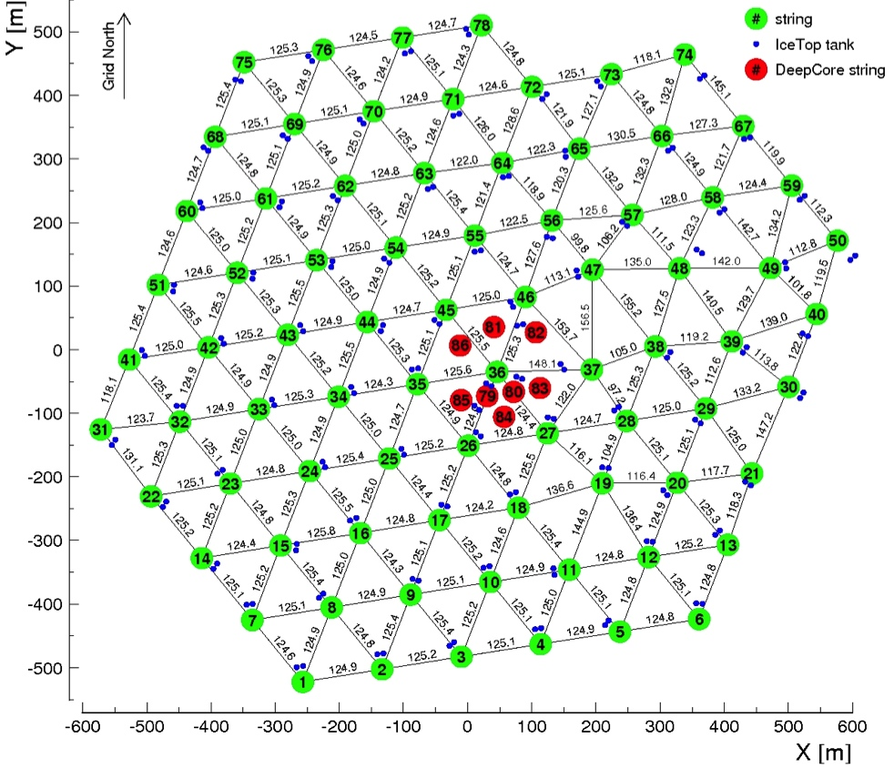
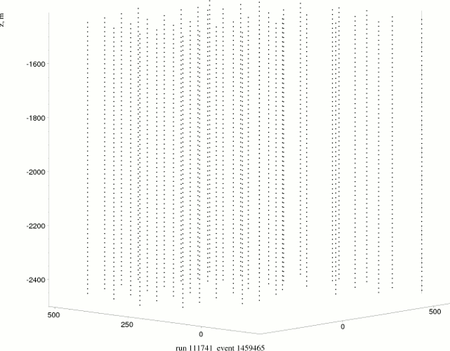
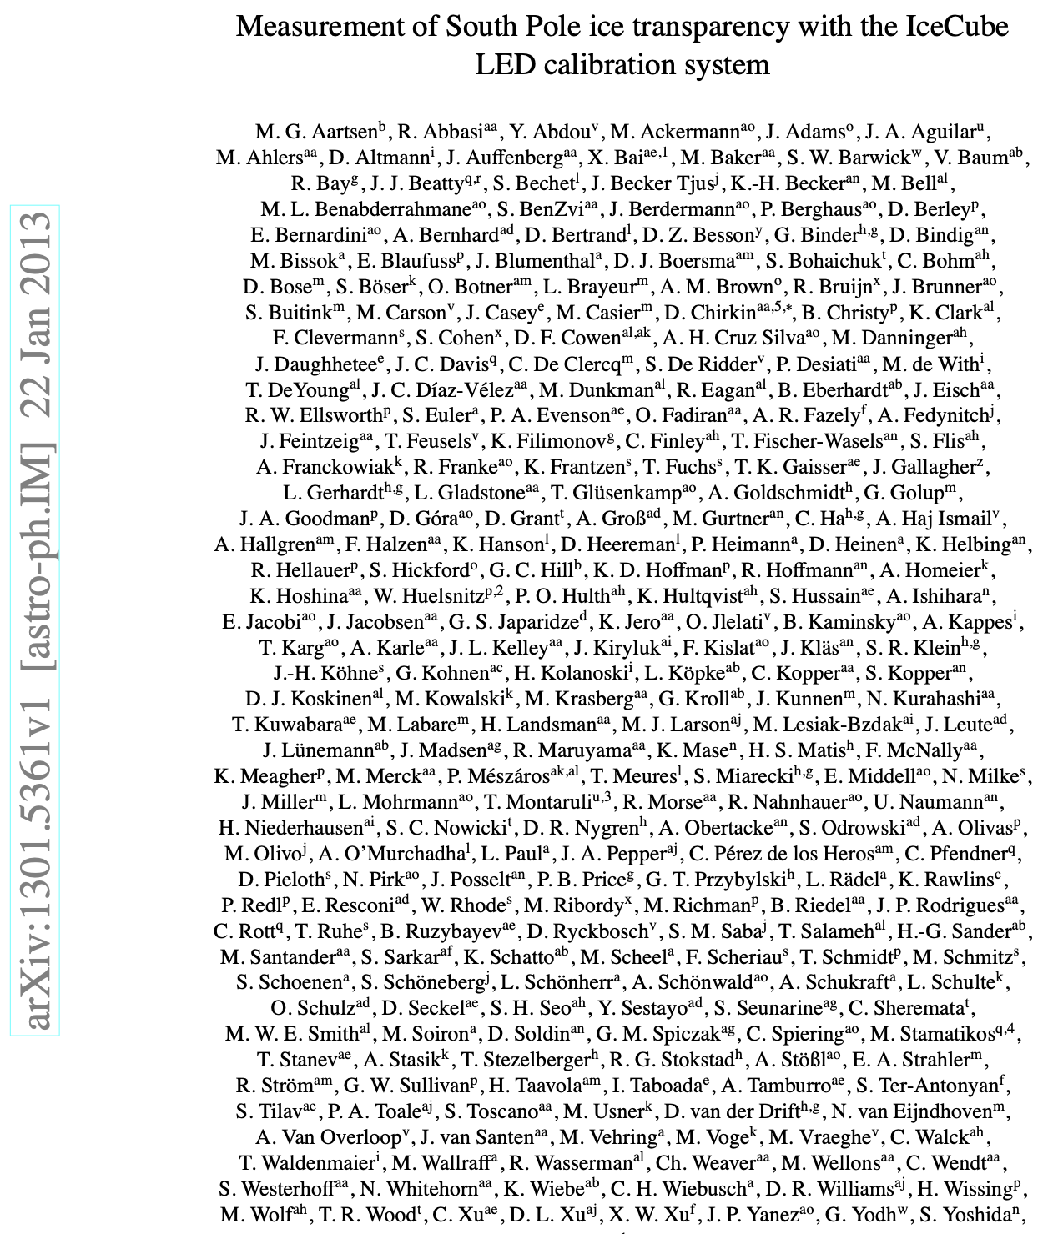
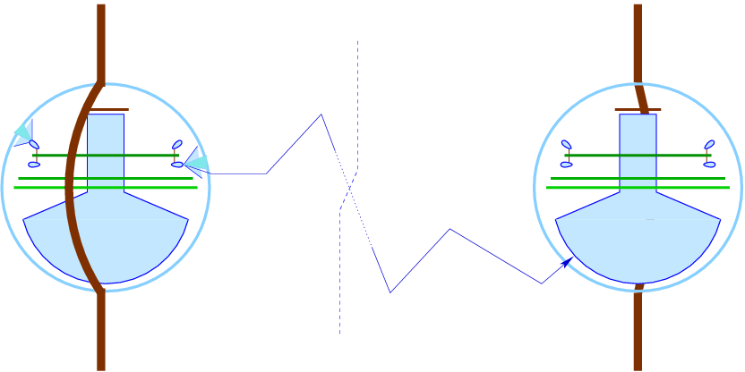
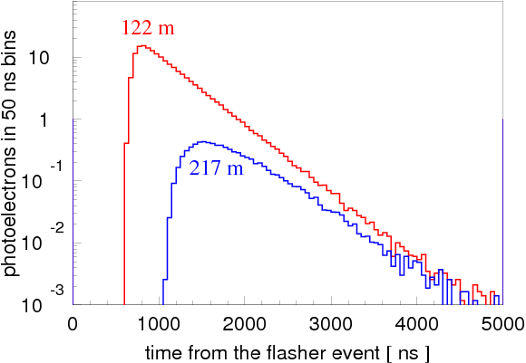
SPICE models: simultaneous direct fit to all layers
2013
Fitted the entire λ_{a}, λ_{e} ice depth table to all calibration data simultaneously → this overcomes previous limitation in 2006 paper
Developed photon propagation code (ppc), which re-simulates calibration data on the spot, allows for easy updates to simulation when tweaking the underlying ice model
In later sets, 12 LEDs on each of nearly 5160 DOMs are flashed individually, with 100s of receivers for each event with many time bins for each → a wealth of data

Slide 12
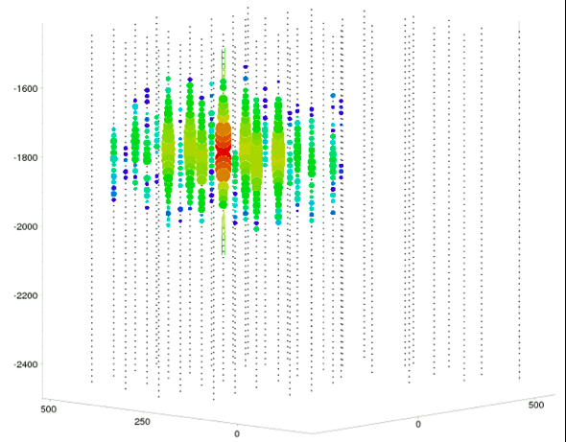
SPICE models: simultaneous direct fit to all layers
2013
Fitted the entire λ_{a}, λ_{e} ice depth table to all calibration data simultaneously → this overcomes previous limitation in 2006 paper
Developed photon propagation code (ppc), which re-simulates calibration data on the spot, allows for easy updates to simulation when tweaking the underlying ice model
In later sets, 12 LEDs on each of nearly 5160 DOMs are flashed individually, with 100s of receivers for each event with many time bins for each → a wealth of data

Slide 13
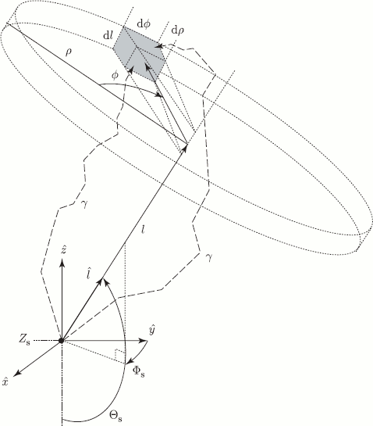
Photon tracking with tables
First, run photonics to fill space with photons, tabulate the result
Create such tables for nominal light sources: cascade and uniform half-muon
Simulate photon propagation by looking up photon density in tabulated distributions
Table generation is slow
Simulation suffers from a wide range of binning artifacts
Simulation is also slow! (most time is spent loading the tables)

Slide 14
Direct photon tracking
photon propagation code (ppc) or OpenCL simulation (clsim)
or photon simulation (photosim)
propagate photons directly when needed
insert photon
length to absorption
distance to next scatter
scatter
propagate to next scatter
check for intersection with OMs
Check for distance to absorption
hit
lost

Slide 15
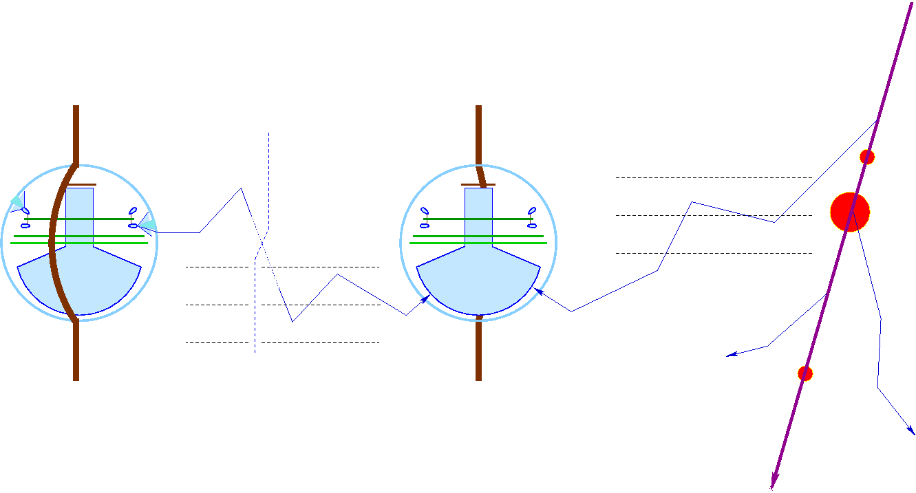
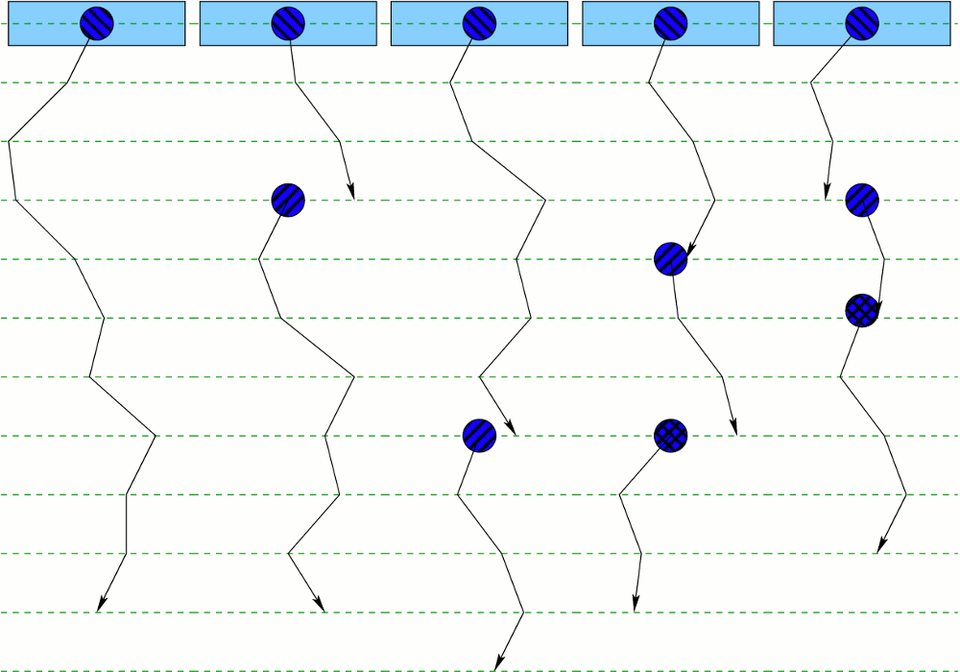
Simulation: Direct photon tracking
execution threads
propagation steps
scattering (rotation)
photon absorbed
Same code used for both flasher simulation/ice calibration and muon/physics data simulation
new photon created
(taken from the pool)
threads complete
their execution
(no more photons)

Slide 16
Oversized DOM treatment
This is a crucial optimization.
The oversize model was chosen carefully to produce the best possible agreement with the nominal x1 case.
Some bias is unavoidable since DOMs occupy larger space:
x1: diameter of 33 cm
x5: 1.65 m
x16: 5.3 m
nominal DOM
oversized DOM
oversized ~ 5 times
photon

Slide 17
Mie scattering theory
Continuity in E, H: boundary conditions in Maxwell equations
θ
Analytical solution!
However:
Solved for spherical particles
Need to know the properties of dust particles:
refractive index (Re and Im)
radii distributions
e^{-ikr+iωt}
e^{-i|k||r|}
r
17

Slide 18
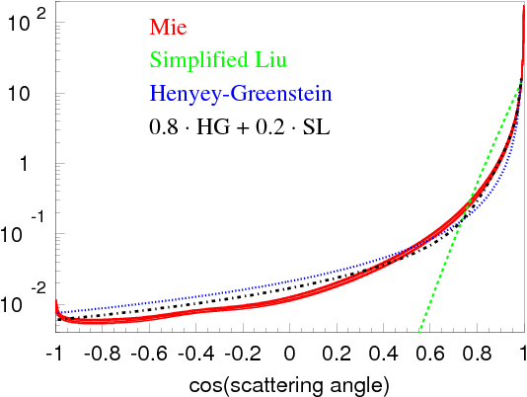

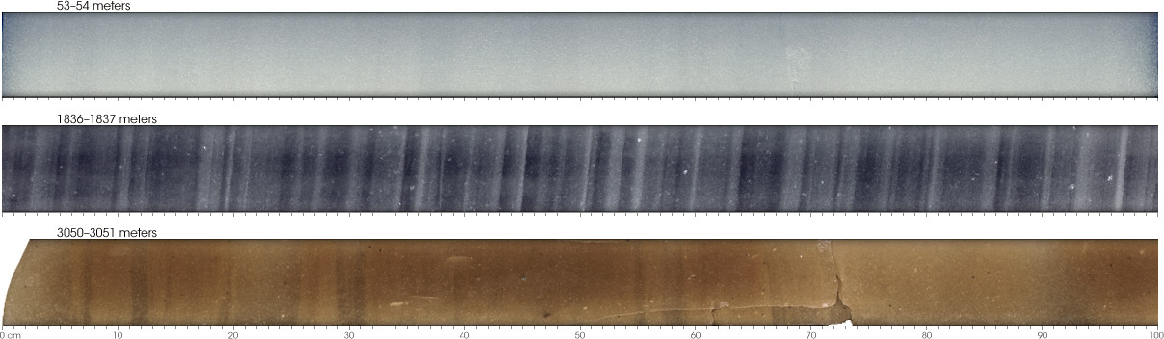

Approximation to Mie scattering
θ
Simplified Liu:
Henyey-Greenstein:
Mie:
Describes scattering on acid, mineral, salt, and soot with concentrations and radii at SP collected in ice cores elsewhere in Antarctica
f_{SL}

Slide 19
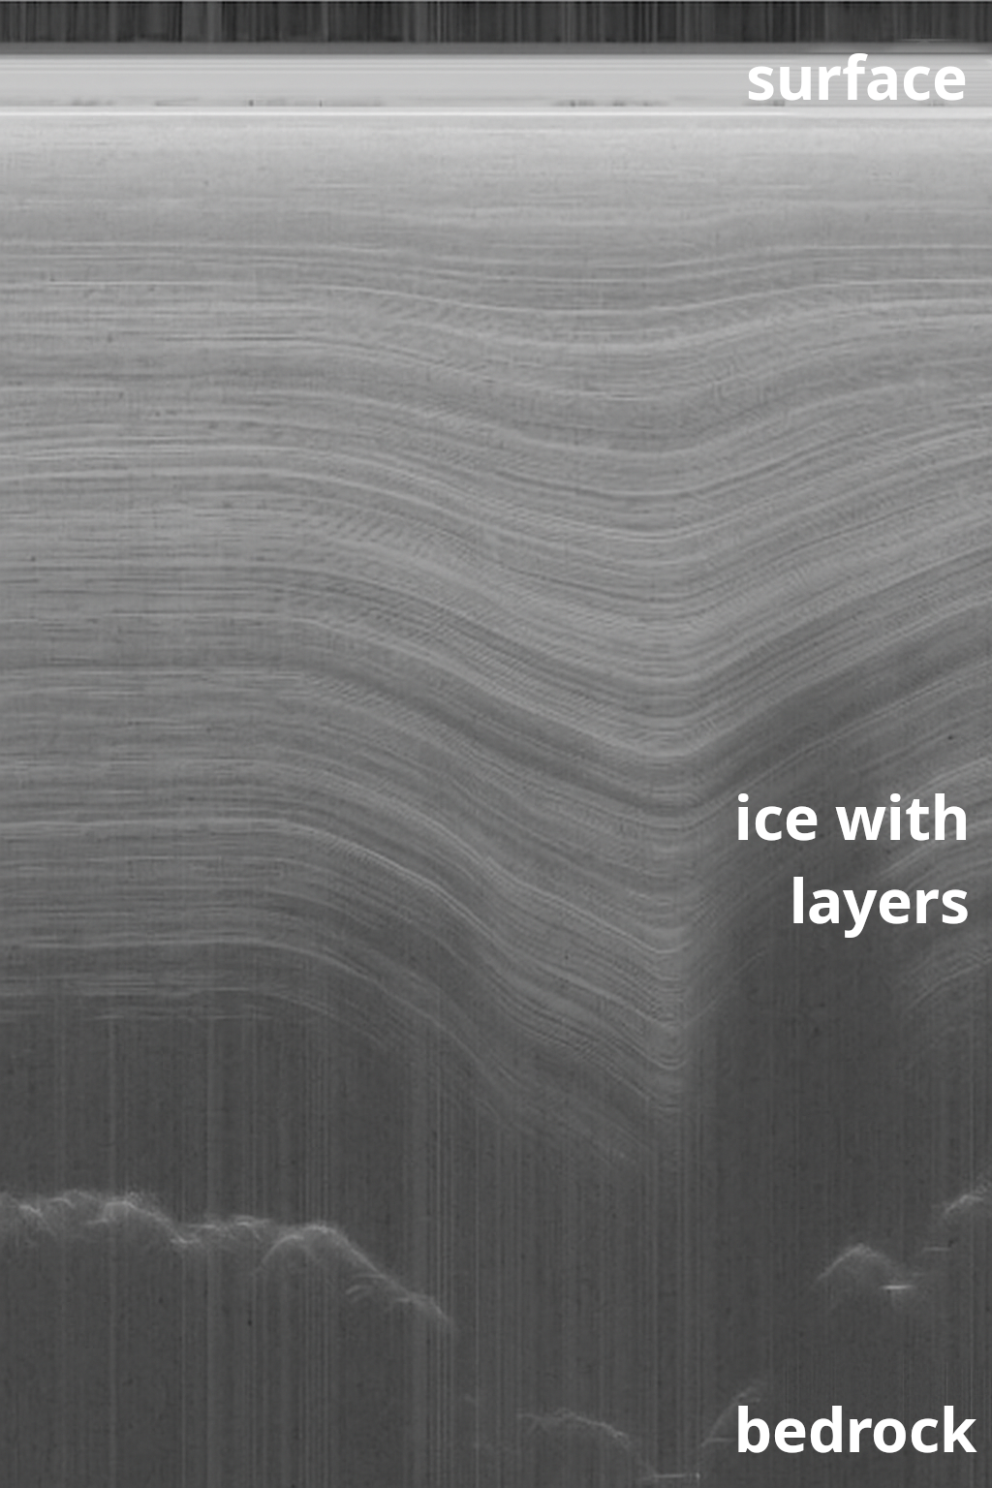
Ice layer tilt
Ice at the South Pole is flowing downhill at a rate of ~10 m/year
While the surface of the ice is flat, the bottom of the ice sheet rests atop of bedrock, which has irregular features such as hills and valleys
The ice sheet deforms as it flows through these features, and this results in lower ice layers following the shape of the bedrock; the closer to bedrock, the more the ice layers deviate from the flat that we see on the surface
An ice layer consists of ice deposited at around the same time, so should have the same concentration of impurities across the layer, thus same scattering and absorption properties. The “dirtier” layers will create bands of reflected radar signal
Initially ice layer elevation changes (tilt) within IceCube were characterized with a special-purpose dust logger, which surveyed 8 of the drilled holes before the string deployment
Illustration borrowed from RAID

Slide 20
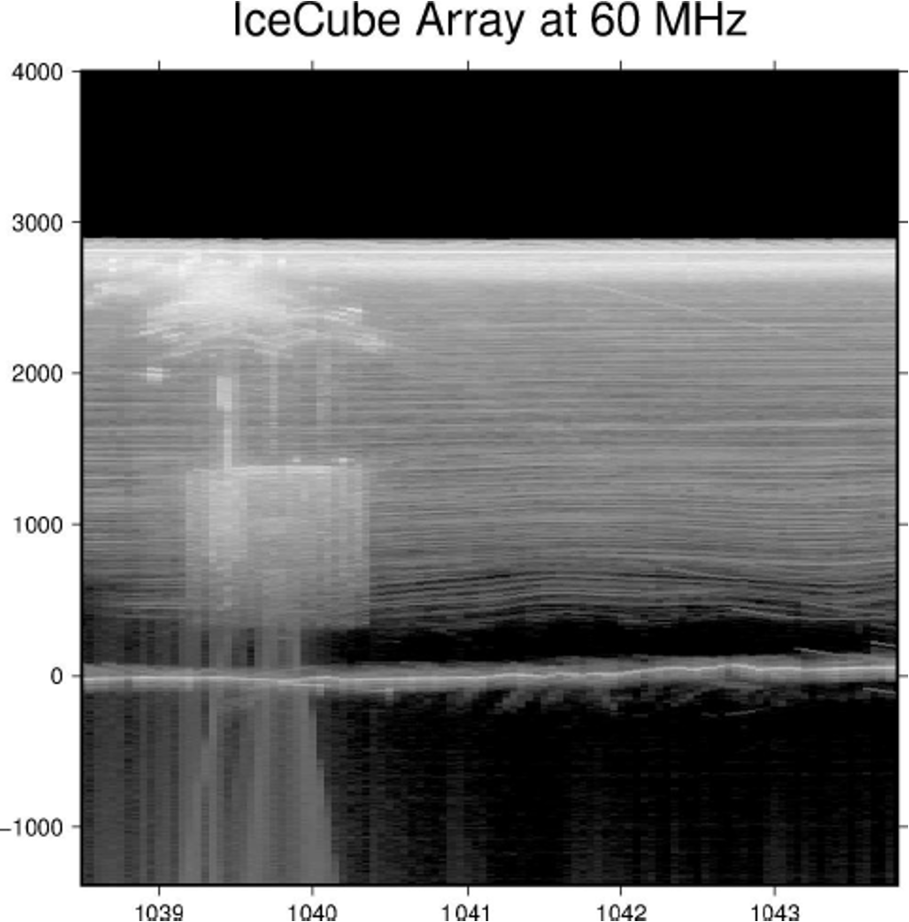
Ice layer tilt
Ice at the South Pole is flowing downhill at a rate of ~10 m/year
While the surface of the ice is flat, the bottom of the ice sheet rests atop of bedrock, which has irregular features such as hills and valleys
The ice sheet deforms as it flows through these features, and this results in lower ice layers following the shape of the bedrock; the closer to bedrock, the more the ice layers deviate from the flat that we see on the surface
An ice layer consists of ice deposited at around the same time, so should have the same concentration of impurities across the layer, thus same scattering and absorption properties. The “dirtier” layers will create bands of reflected radar signal
Initially ice layer elevation changes (tilt) within IceCube were characterized with a special-purpose dust logger, which surveyed 8 of the drilled holes before the string deployment

Slide 21
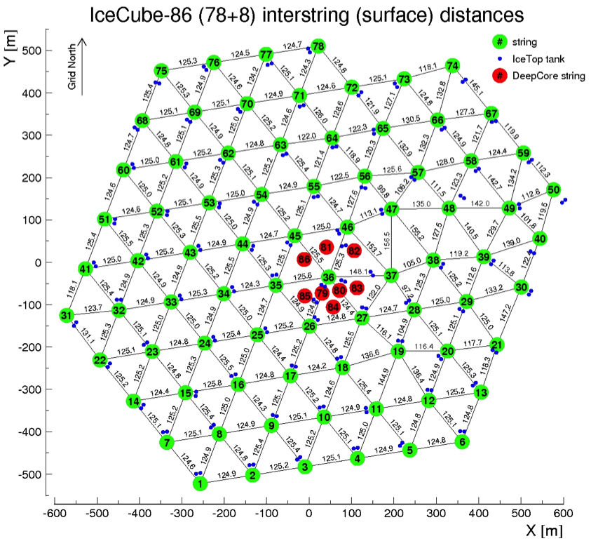
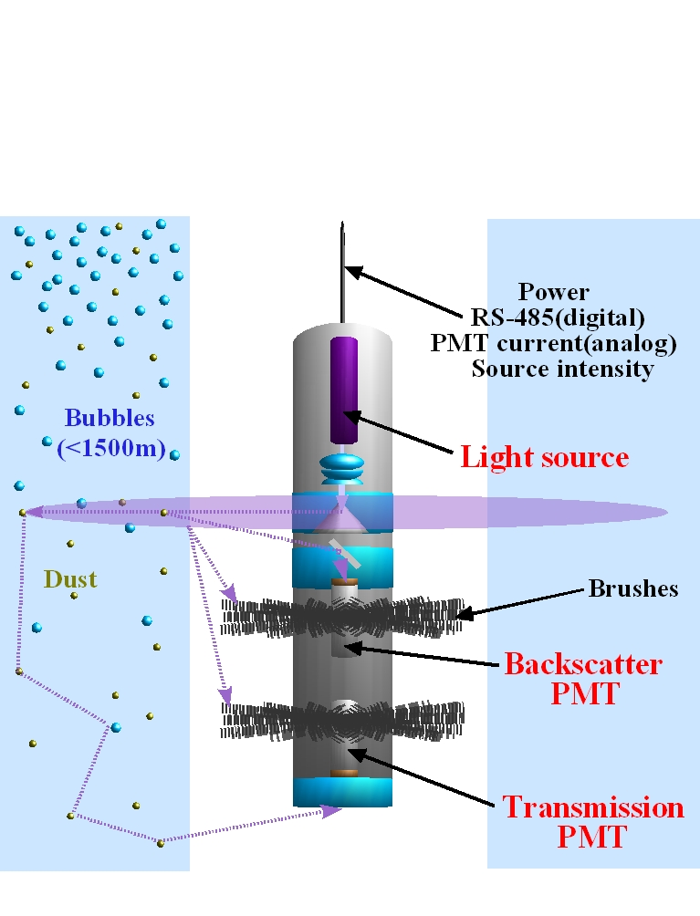
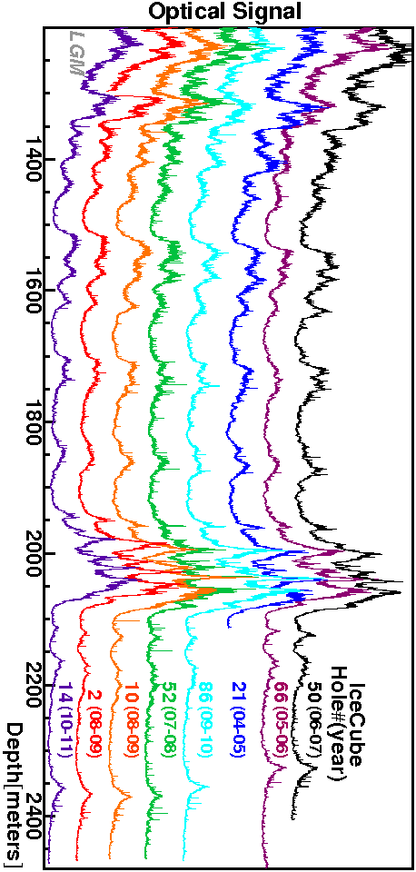
Dust logger mapping of the ice tilt
Dust logger
N
E
ice layer tilt direction: 225º SW
The ice layers (i.e. layers of ice with similar optical properties) change in depth by as much as 60 m when going from NE to SW corners of the detector

Slide 22
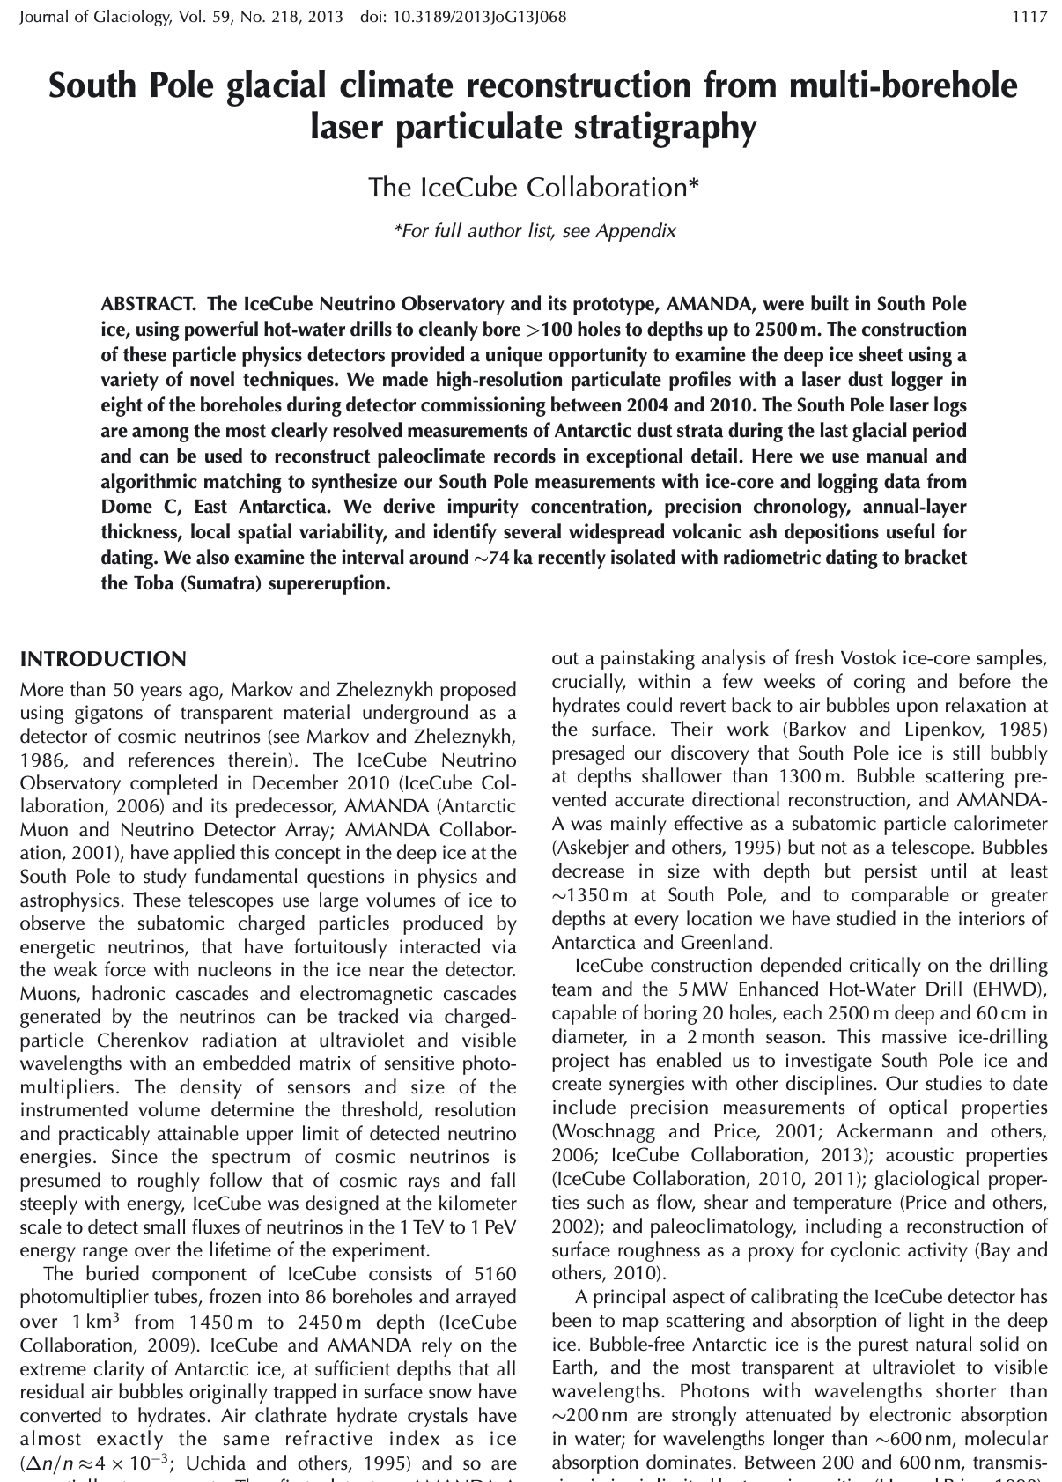
Dust logger mapping of the ice tilt
Dust logger
2013
N
E
ice layer tilt direction: 225º SW
The ice layers (i.e. layers of ice with similar optical properties) change in depth by as much as 60 m when going from NE to SW corners of the detector

Slide 23
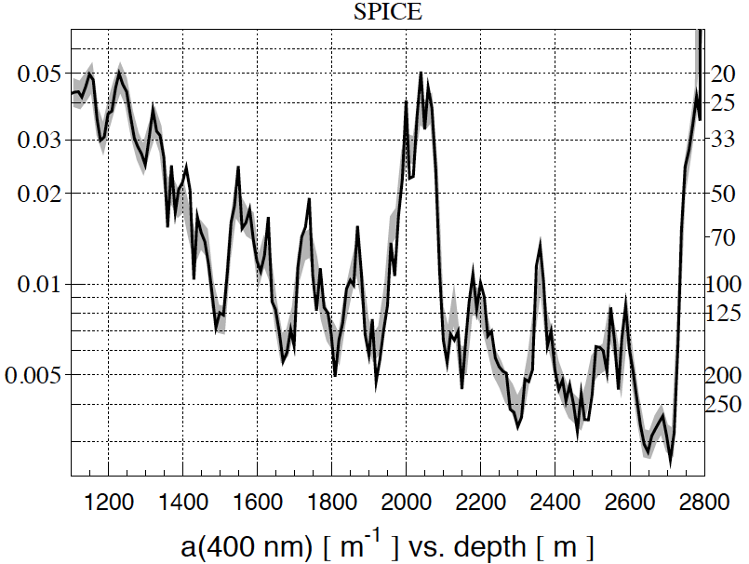
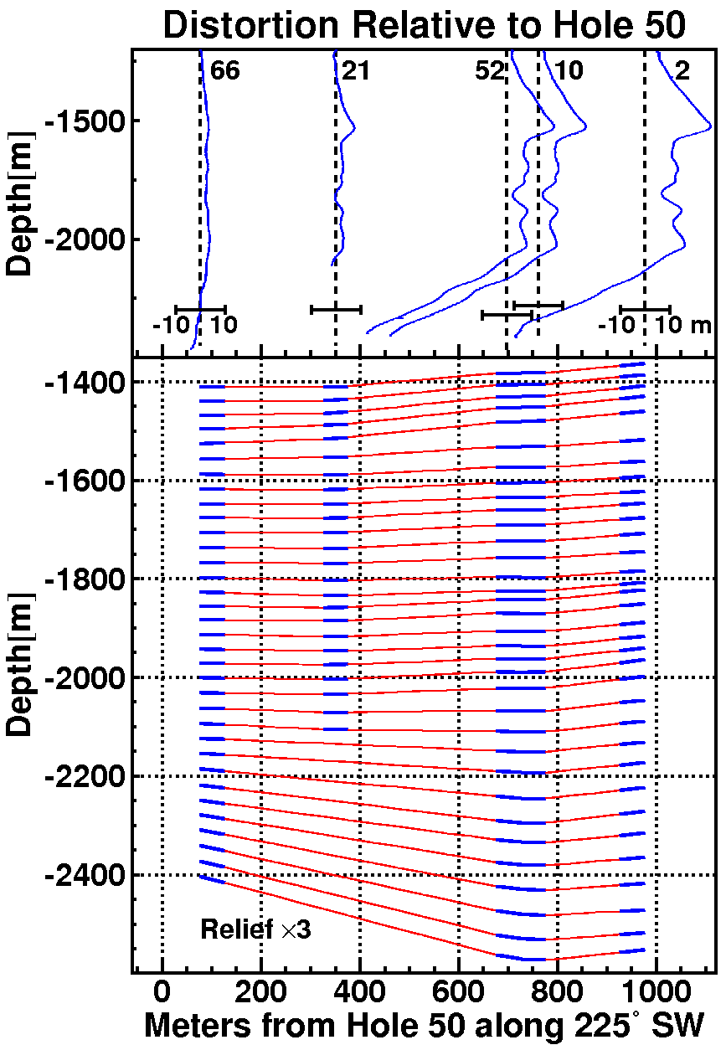
Correlation of fitted optical properties with dust logger data
black line: fit to flasher data
gray band: scaled merged dust log
SPICE 2
(m⁻¹)
(m)
extrapolation region
fit region (inside detector)
(outside detector)

Slide 24
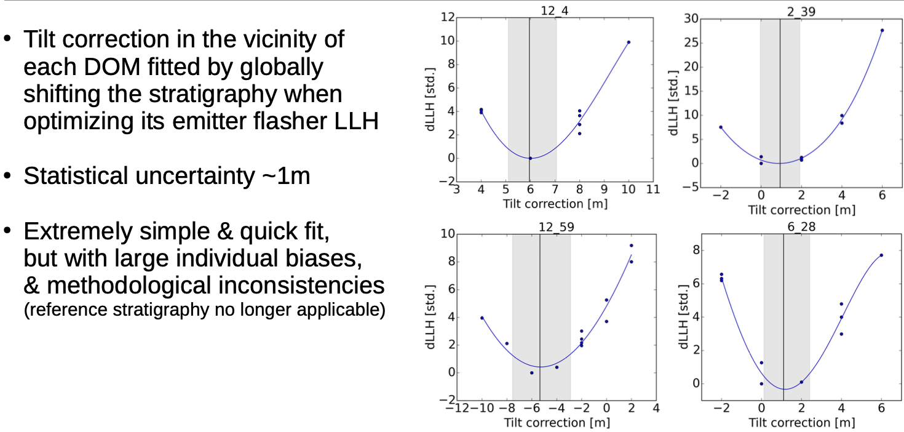
Per-DOM flasher fits

Slide 25
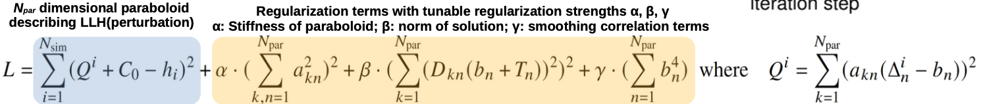
Iterative Positive-Definite Fit (IPDF)
A second-order Taylor expansion is used to fit the shape of the llh in the vicinity of best previous solution
  i.e., a paraboloid fit
  llh values are computed for nominal+100-1000 random perturbations set of simulations at each iteration
Some regularizations are necessary
  α: stiffness of paraboloid fit (curvature)
  β: correlation terms (to smooth unnecessary up/down oscillations in solution)
  γ: norm of solution (to keep it in bounds of the perturbation set)
Search for solution (minimization)
A direct matrix regularized inversion was tried first but often resulted in non-positive-def solutions
Newton’s gradient descent method was adopted with explicit positive-definite curvature matrix
L = Σ_{i}(Q^{i}+C₀-f_{i})² + α(Σ_{kn}a_{kn}²)² + β(Σ_{k}(D_{kn}(b_{n}+T_{n}))²)² + γ(Σ_{n}b_{n}⁴),
where Q^{i} = Σ_{k}(a_{kn}(x_{n}^{i}-b_{n}))².
Value of L at the minimum
regularization term (2nd derivative, etc.)
a_{kn}a_{km} is curvature matrix
deviations solution vector (main result)

Slide 26
Paraboloid Fit
ice
Curvature matrix AA^{T}
2nd order Taylor expansion around the (presumed) minimum is a paraboloid with the curvature expressed as AA^{T} (to enforce positive-definite quality)
Solution vector consists of:
10000 tilt corrections (on a grid of 80 xy locations, times 125 depth points)
513 ice parameters at grid point 36 (scattering, absorption, crystal density at 171 depth points)
The paraboloid is flat as possible, by regularization reducing the norm of AA^{T}
Additional regularizations to smooth the jaggedness in tilt solutions
10000 tilt components (80 grid locations * 125 depth points)

Slide 27
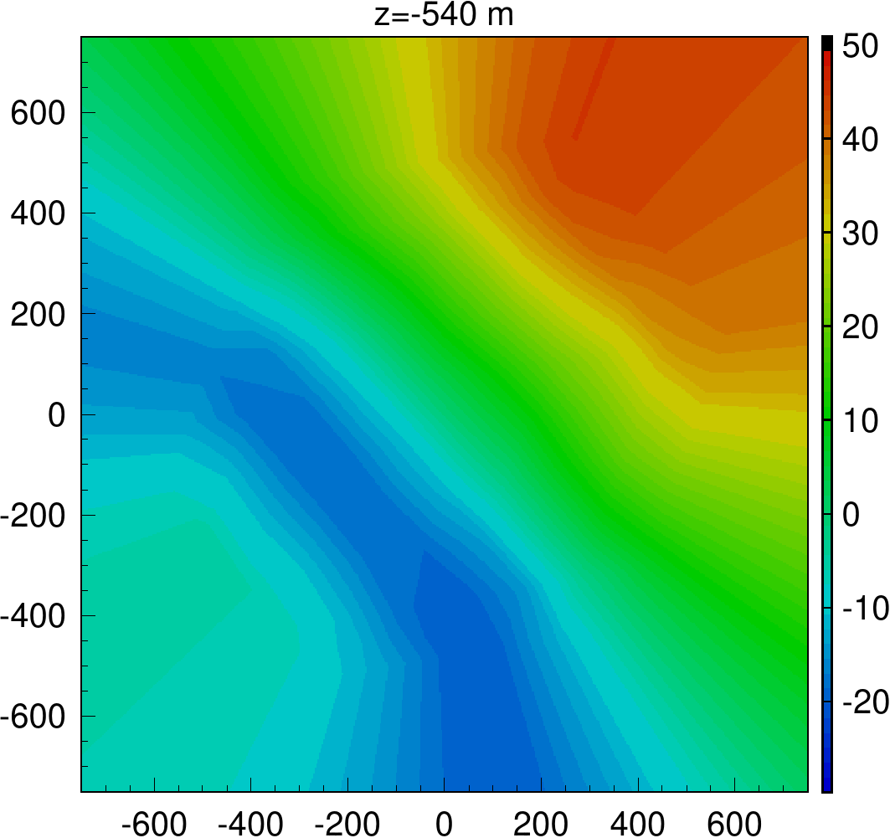
Ice tilt fitted with IceCube calibration data
y, m
elev., m
We have recently fitted ice layer elevations using the flasher LED calibration data.
Ice layer elevations relative to a point near center were tabulated on a hexagonal grid of 80 xy points, 125 depth values per xy point.
Regions outside of detector hexagon outline, above and below +-500 m are extrapolations
Nearly 2 years of fitting to ~10k parameters and a correlation matrix. Regularizations, sparsity conditions, were needed.
The new ice layer tilt model (FTP) is an improvement over the 1d gradient tilt built from the dust logger findings (which only accounted for tilt in the direction NE-SW)
main tilt gradient direction
ice flow direction (10 m/year)
x, m

Slide 28
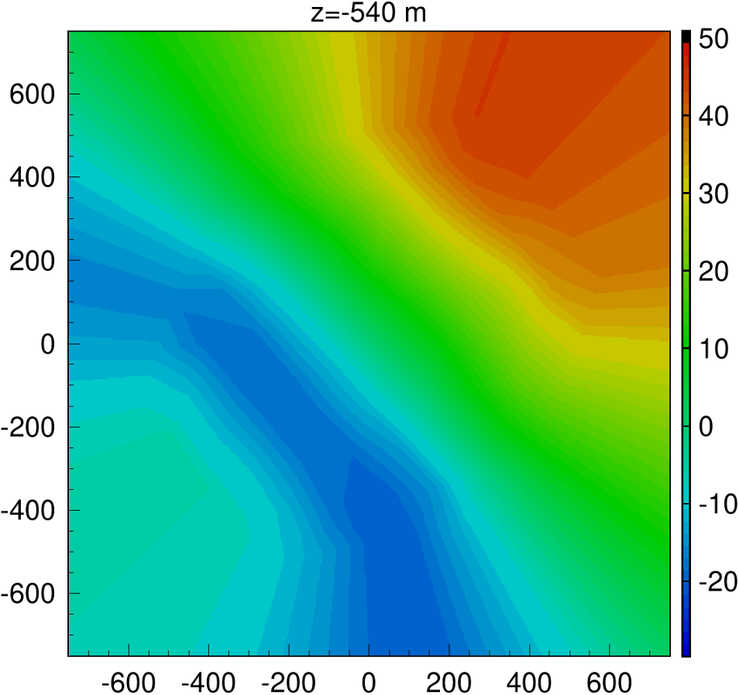
Ice tilt fitted with IceCube calibration data
y, m
Bottom of IceCube, z=-540 m
elev., m
We have recently fitted ice layer elevations using the flasher LED calibration data.
Ice layer elevations relative to a point near center were tabulated on a hexagonal grid of 80 xy points, 125 depth values per xy point.
Regions outside of detector hexagon outline, above and below +-500 m are extrapolations
Nearly 2 years of fitting to ~10k parameters and a correlation matrix. Regularizations, sparsity conditions, were needed.
The new ice layer tilt model (FTP) is an improvement over the 1d gradient tilt built from the dust logger findings (which only accounted for tilt in the direction NE-SW)
main tilt gradient direction
ice flow direction (10 m/year)
x, m

Slide 29
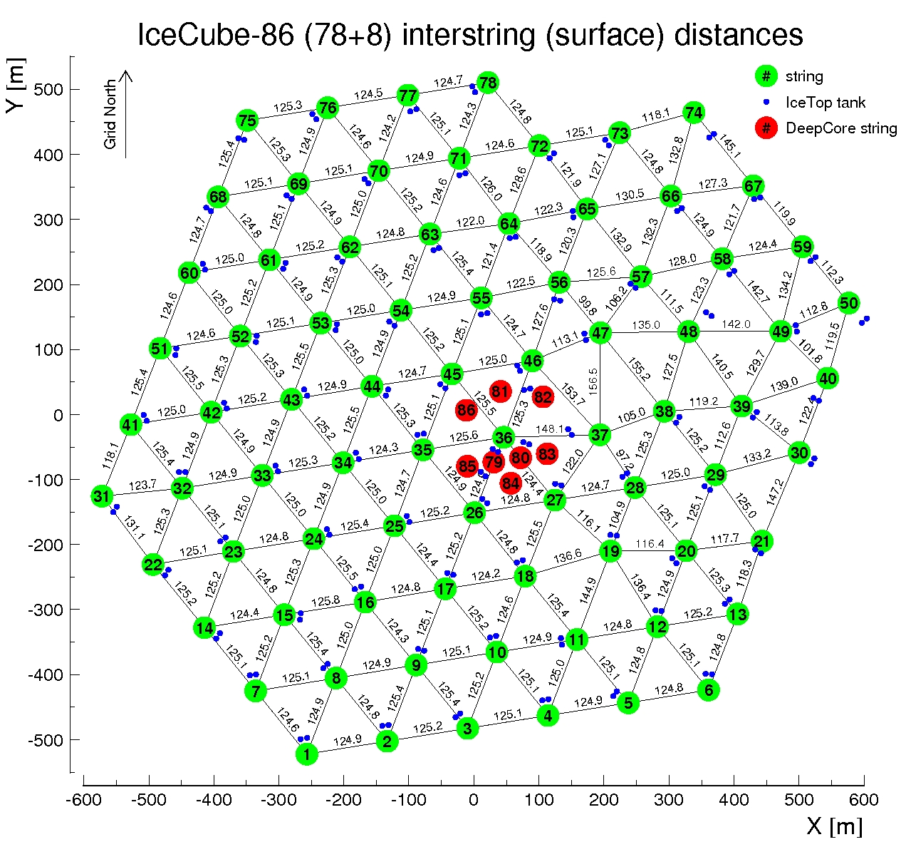
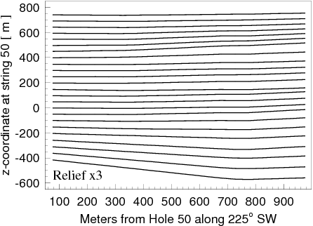
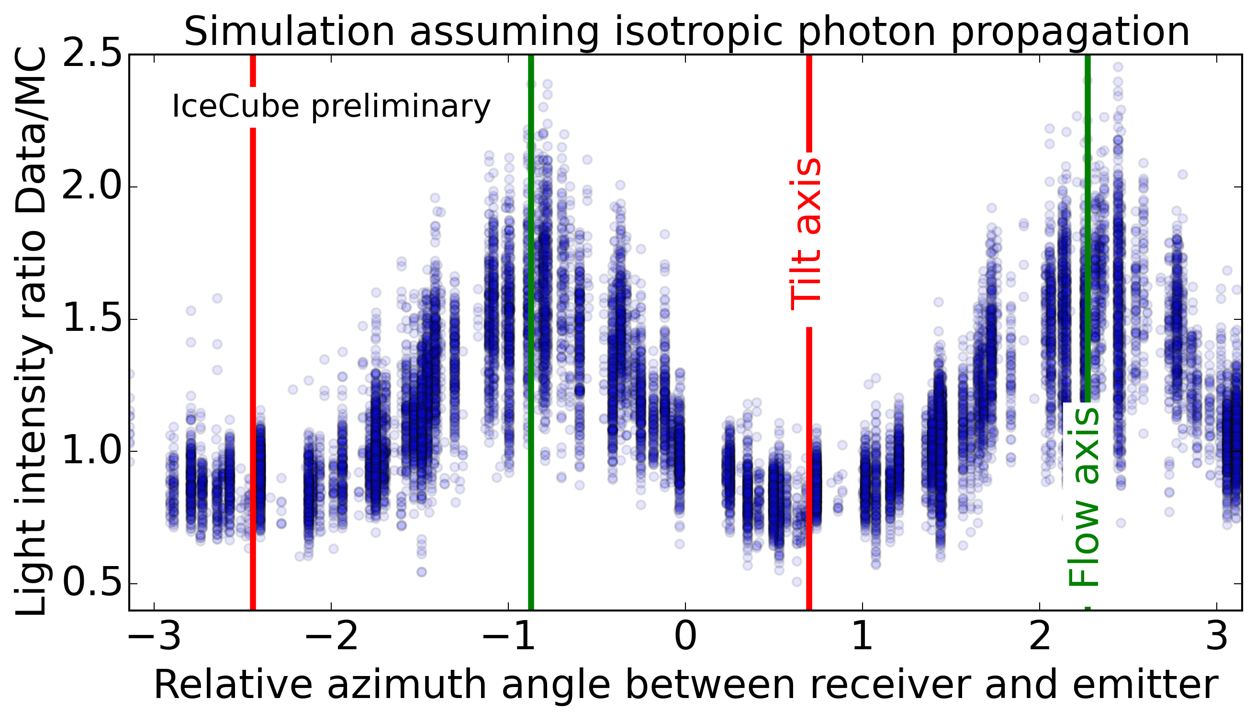

Glacial ice flow, ice layer tilt, and optical anisotropy
SPICE Lea
N
Ice Layer tilt direction
225º SW
E
Ice flow direction
41º NW
Less attenuation
41º NW

Slide 30





Models of optical ice anisotropy in IceCube
scattering-based
Scattering (mainly): direction dependent scattering function (ICRC 2013)
Absorption (mainly): direction dependent absorption (studied in 2018)
Introduced depth-dependence (2017)
Discrepancies between data and simulation remain
Cannot simultaneously fit total charge and
arrival time distribution to statistical precision
SPICE Lea, 3.2.x
Absorption driven
absorption-based
prolate
oblate
SPICE EMRM
Scattering driven

Slide 31



Optical anisotropy of ice due to Birefringence
Early scattering and absorption-based anisotropy models were abandoned in favor of the birefringence-based model
Ice is a uniaxial birefringent material with n_{e}-n_{o}=0.0015. This tiny difference builds to a macroscopic effect due to 1000s of ice crystal boundaries crossed per meter of distance
At each grain boundary every ray is split into two reflected and two refracted rays, one ordinary and one extraordinary ray each, building to a diffusion pattern after a few scatters
Each ice crystal has a hexagonal lattice structure, easiest to deform along the basal (hexagon) plane
Forces associated with the ice flow, and hydrostatic pressure at depth, result in preferred ice crystal orientations at depth, in particular “girdle” fabric of ice crystal optical axis orientations around the ice flow
This builds into 2 macroscopic effects: larger diffusion along, and slow bending of the photon path towards the ice flow

Slide 32






Scattering patterns birefringent ice
Running MC simulation with realistic crystal size, elongation, and orientation distributions (correlated to flow direction):
Diffusion is largest on flow axis and smallest orthogonal to it
Photons on average get deflected towards the flow axis
→ photons effectively fly a curve towards the flow axis
after ~ 1 m of propagation:
towards flow
along flow
orthogonal to flow

Slide 33


Scattering patterns birefringent ice
Running MC simulation with realistic crystal size, elongation, and orientation distributions (correlated to flow direction):
Diffusion is largest on flow axis and smallest orthogonal to it
Photons on average get deflected towards the flow axis
→ photons effectively fly a curve towards the flow axis
after ~ 1 m of propagation:
2024
towards flow
along flow
orthogonal to flow

Slide 34

Ice crystal grain size vs. depth
Due to the assumptions on unconstrained parameters (elongation, absorption anisotropy…) the size has an overall scaling uncertainty
The fixed parameters (such as fabric) may also bias the result
Still we see that grain size increases with depth and in particular below the dust layer
Grain size seems to be anticorrelated to scattering
  → crystals are smaller where scattering is stronger, i.e., where there is more dust

Slide 35
SPICE model vs. statistical floor
Latest (WG-approved) ice model SPICE FTP v3 represents some of our latest and best understanding of the IceCube ice.
It incorporates the birefringence model of anisotropy from the previous model SPICE BFR, refines our model of the scattering function, and describes ice layer undulations everywhere in the detector with unprecedented precision.
It also comes with a full covariance matrix and thus a model of statistical uncertainties. However, the g.o.f. improvements from the previous ice model (BFR) go far beyond what is expected from these uncertainties, and thus a question was raised: how much more improvement is possible.
We simulated the complete flasher dataset with the best ice and detector description. The g.o.f. and model error, calculated in the same way as for data, are indicated as “statistical floor”.
goodness of fit
RPM

Slide 36
Uniformity in quality of detector description
Average llh (over all LEDs) on each string.
Overall average for the entire detector is 0.664
Cf. reconstruction of simulated data:
range of 0.42 to 0.45 with the average of 0.439.
Quality of description of data is worse than simulated data everywhere but also varies in different parts of the detector.
This is seen in a variety of metrics (flasher LED brightness, DOM sensitivity, hole ice quality)
Not explained by deployment order or time/fuel spent on string deployment

Slide 37


Hole ice cameras
AMANDA:
Sweden camera deployed in 1998 in AMANDA hole 13
IceCube:
Bubble camera deployed in the 2006/7 season with string 57
Sweden camera deployed in the 2010/11 season with the last string (80)
Upgrade:
Four working Sweden cameras on three upgrade strings
3-4 smaller cameras on most Upgrade sensors (mDOMs and dEggs)

Slide 38


Slide 39


Refrozen hole ice is more complex than thought before the Swedish Camera took its pictures
We find:
DOM touches the hole wall, is 2/3 of the hole diameter
Most of the HI is transparent, except for the milky central column centered in the hole and 1/3 of hole diameter (referred to as HI in the following, starting with the next line)
HI diameter is ½ of DOM diameter

Slide 40

92H upwards, Day 1

Slide 41


Freeze-in imaging
(ideal case with centered DOM)
Time sequence of daily images shows freezing of drill hole - smooth freeze in process example

Slide 42











IceCube Upgrade

Slide 43

IceCube Upgrade

Slide 44
Summary and Outlook
Much progress over 30 years
From air bubbles in AMANDA-A to ice anisotropy due to birefringent ice crystals
Improvements can be gauged with llh, model error, and average waveform plot
We have a full description of statistical uncertainties of ice layer properties
However, interpretation of uncertainties is complicated since we have not yet reached the statistical floor
Are we still missing a major piece of the ice model puzzle?
Special calibration devices in IceCube Upgrade may shed light on this.

Slide 45
Why do we care about ice
IceCube detector uses Antarctic ice as its detection medium
Charged particles moving through its volume generate Cherenkov light
Need to describe light propagation in both simulation and event reconstruction
This is a major source of systematic uncertainties of IceCube analyses
Links to other fields: glaciology, climate science

Slide 46
Impact of ice improvements to data analysis
SPICE FTP
SPICE Mie
Simulation: SPICE FTP
3.2.1 vs. ftp-v1
3.2.1 vs. ftp-v1
For data simulated with the best current ice model a large improvement is observed in angular resolution of reconstructed cascade directions with the same ice vs. older model.
For real data (2 HESE cascades shown above), systematic shifts may go beyond statistical uncertainties as seen from the updated ice model.
As we get closer to the statistical floor with our ice model description, we gain more confidence that the reconstruction direction and associated uncertainty contours are accurate.

Slide 47
Timeline
AMANDA ice models: model error
bulk, f125, mam, mamint, stdkurt, sudkurt, kgm, …
millennium (published 2006) → AHA (2007) 55%
IceCube ice models:
WHAM (2011) 42%
SPICE 1 (2009) 29%
SPICE 2, 2+, 2x, 2y (2010) added ice layer tilt
SPICE Mie (2011) fit to scattering function 29%
SPICE Lea (2012) fit to scattering anisotropy 20%
SPICE (Munich) (2013) 7-string, LED unfolding 17%
SPICE³ (CUBE) (2014) llh fixes, DOM sensitivity fits 11%
SPICE 3.0 (2015) improved RDE, ang. sens. fits 10%
SPICE 3.1, 3.2 (2016) 85-string, correlated model fit <10%
SPICE HD, 3.2.2 (2017) direct HI and DOM sens., cable, DOM tilt
SPICE EMRM (2018) absorption-based anisotropy single
SPICE BFR (v1, v2) (2020) birefringence-based anisotropy LEDs
SPICE FTP (v0, v1) (2022) precise fit to tilt across detector volume
SPICE FTP (v2, v3) (2023) w/precise covariance matrix calculation
SPICE RPM (2025) smoothed ice tables, cleaner data and fit
Model error (precision in charge prediction): <10%
Extrapolation uncertainty: 13% (sca) / 15% (abs)
Linearity: < 2% in range 0.1 … 500 p.e.

Slide 48
Things we learned
Dust/impurities
Air bubbles/hydrates
Hole ice
Ice anisotropy Ice tilt
Dust logger
N
Ice Layer tilt direction
225º SW
E
Ice flow direction
41º NW
anisotropy axis
41º NW

Slide 49
llh and model error
The quantity that we use during the fit is “llh”, which is constructed as a saturated Poisson likelihood for data and simulation with their expectation values compared with the “model error term”:
For each flasher LED configuration, this quantity is summed over Bayesian-blocked time bins in receiving DOMs and normalized by their number. Then this normalized quantity is summed for all flasher configurations (of which we have 60614 – 12 LEDs times 5160 DOMs minus broken and cDOMs and minus some failed LEDs).
We have made multiple improvements to llh over the years, with each new ice model much better than the previous one. Naturally, a question arises: how far are we from the best possible llh? Say, if the physics of flasher LED events is modeled perfectly, in the absence of any (known or unknown) systematic uncertainties, what is the expected value of the llh? We can refer to such a value as a “statistical floor” of llh.

Slide 50

Model error
The size of σ in the model error term in the llh construction is estimated from plots as shown here. A logarithm of charge ratio in simulation over data is histogrammed for all receiving DOMs for all flasher configurations. The charge we use in this construction is integrated over the time window used by this analysis (i.e., full charge per receiving DOM).
The plot shows 5 histograms (with their rms and width of fitted gaussian listed in the caption) for different threshold value of accepted charge: (1) no cut, (2) 1 p.e., (3) 10 p.e., (4) 100 p.e., and (5) 400 p.e.
The rms/width at each threshold level depends on statistics of data and simulation (i.e., how many events in data and simulation for each configuration). Typically, data has more than 100 events, while simulation (shown here) has only 10. We usually take the middle value (10 p.e. cut – 12.9% here). This number will reduce to 11.8% for 100 simulated events. We had previously estimated (for SPICE 3.2) that after subtracting statistical contribution the model error is 9.8%.

Slide 51
Average (at ~125 m) waveform
/ 25 ns
/ 25 ns

Slide 52
Recent ice model progression

Slide 53
Ice model progression (zoomed out)

