Slide 1
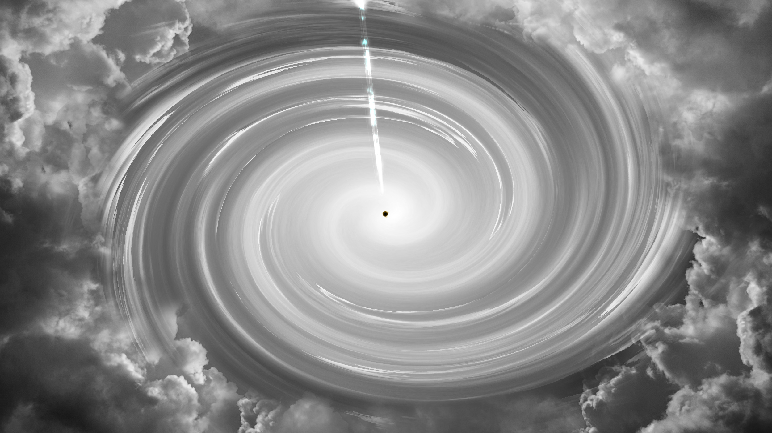

Multi-wavelength view of multi-messenger sources
Presented by Lea Marcotulli
MACROS 2026, 24th April 2026

Slide 2
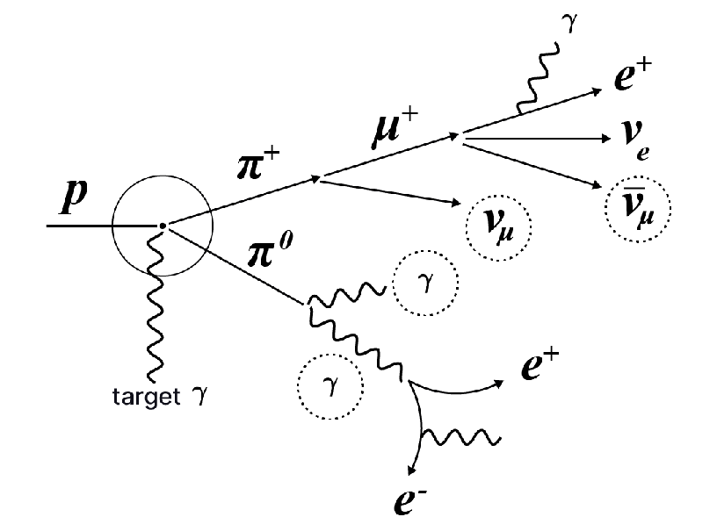
If we see neutrinos, do we expect photons? YES!
Hadronic & photo-hadronic interactions
Remember:
Neutrino sources can be steady electromagnetic emitters
Lea Marcotulli | lea.marcotulli@desy.de

Slide 3
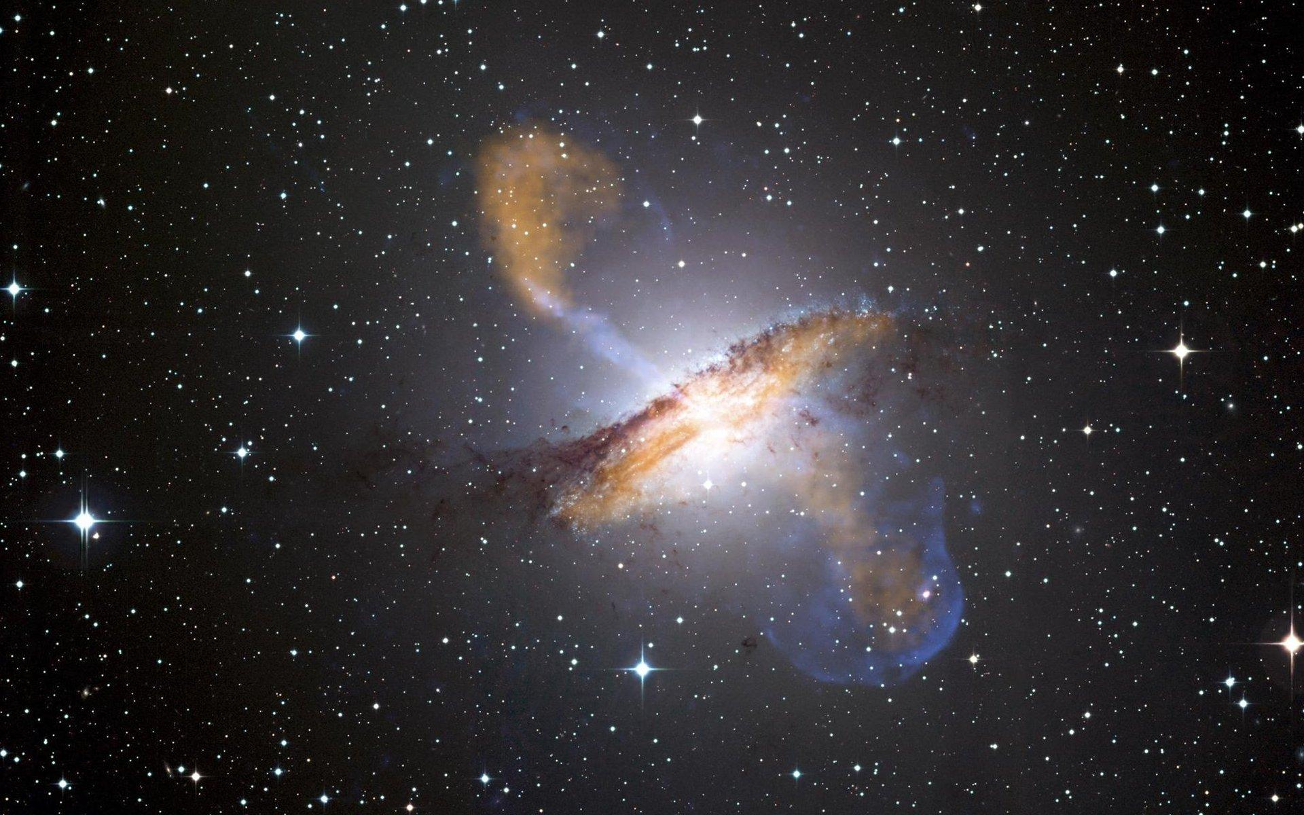
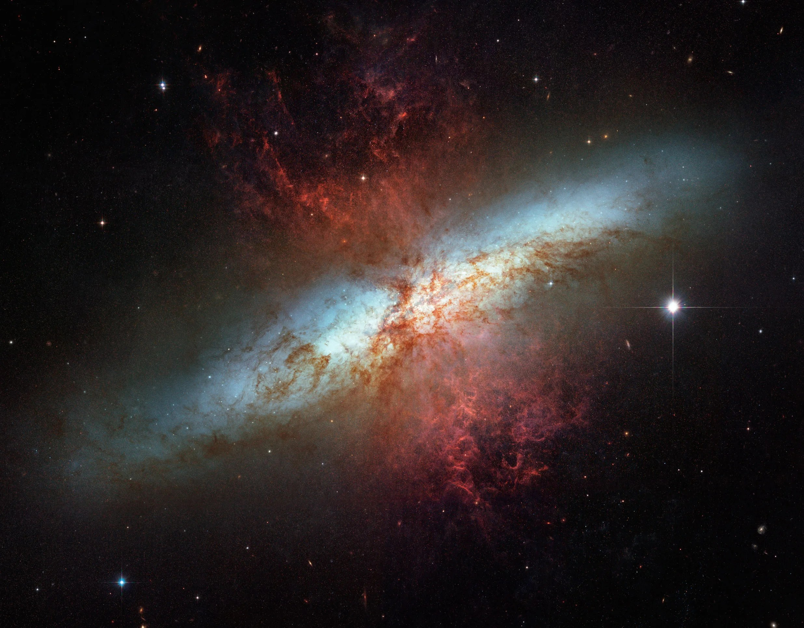
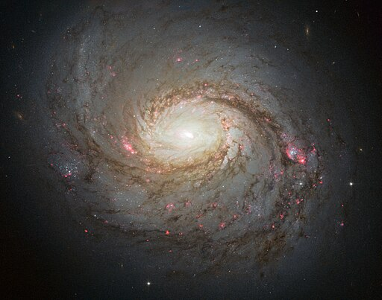
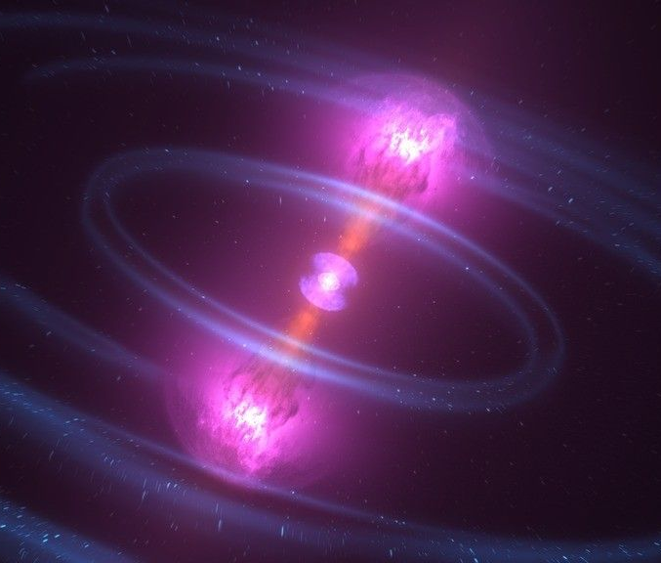
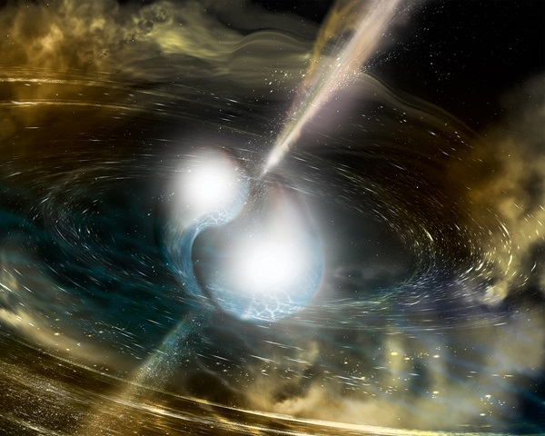
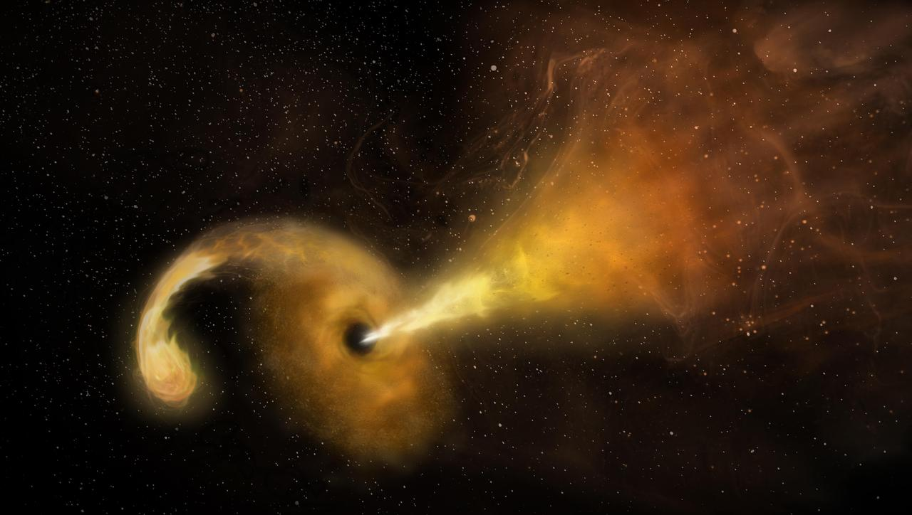
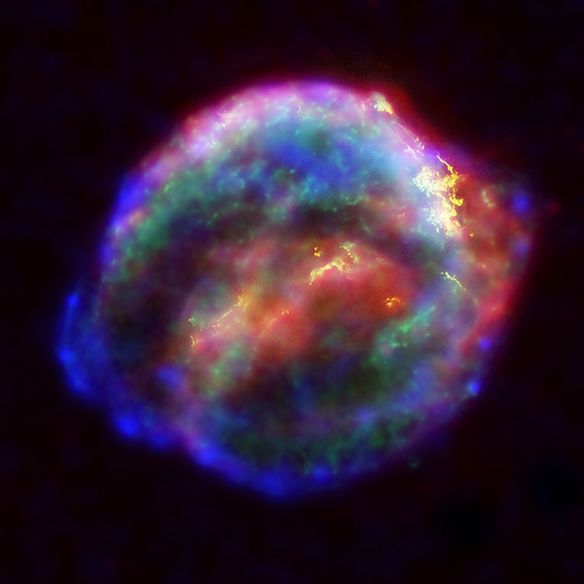
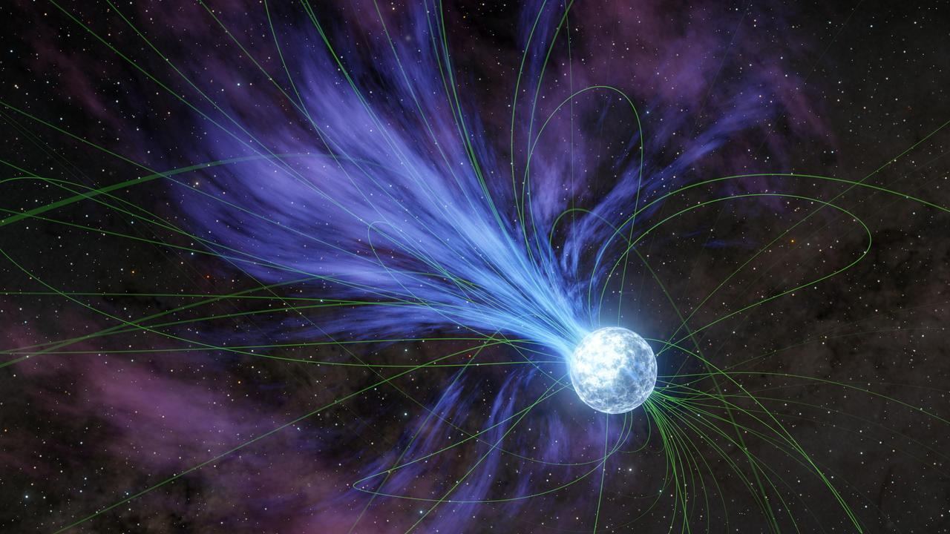
Extreme environments in the universe
Lea Marcotulli | lea.marcotulli@desy.de
NGC 1068 [HST]
Cen A [ESO,NASA]
M82 [NASA/ESA]
Active Supermassive Black Holes..
..and their jets
Gamma-ray Burst (GRB)
Starburst Galaxies
Supernovae
Pulsars and Magnetars
Black holes/Neutron Stars mergers
Tidal Disruption Events (TDEs)
Kepler SN [NASA/ESA/JHU]

Slide 4
Extreme environments in the universe
Lea Marcotulli | lea.marcotulli@desy.de
NGC 1068 [HST]
Cen A [ESO,NASA]
M82 [NASA/ESA]
Active Supermassive Black Holes..
..and their jets
Gamma-ray Burst (GRB)
Starburst Galaxies
Supernovae
Pulsars and Magnetars
Black holes/Neutron Stars mergers
Tidal Disruption Events (TDEs)
Kepler SN [NASA/ESA/JHU]

Slide 5
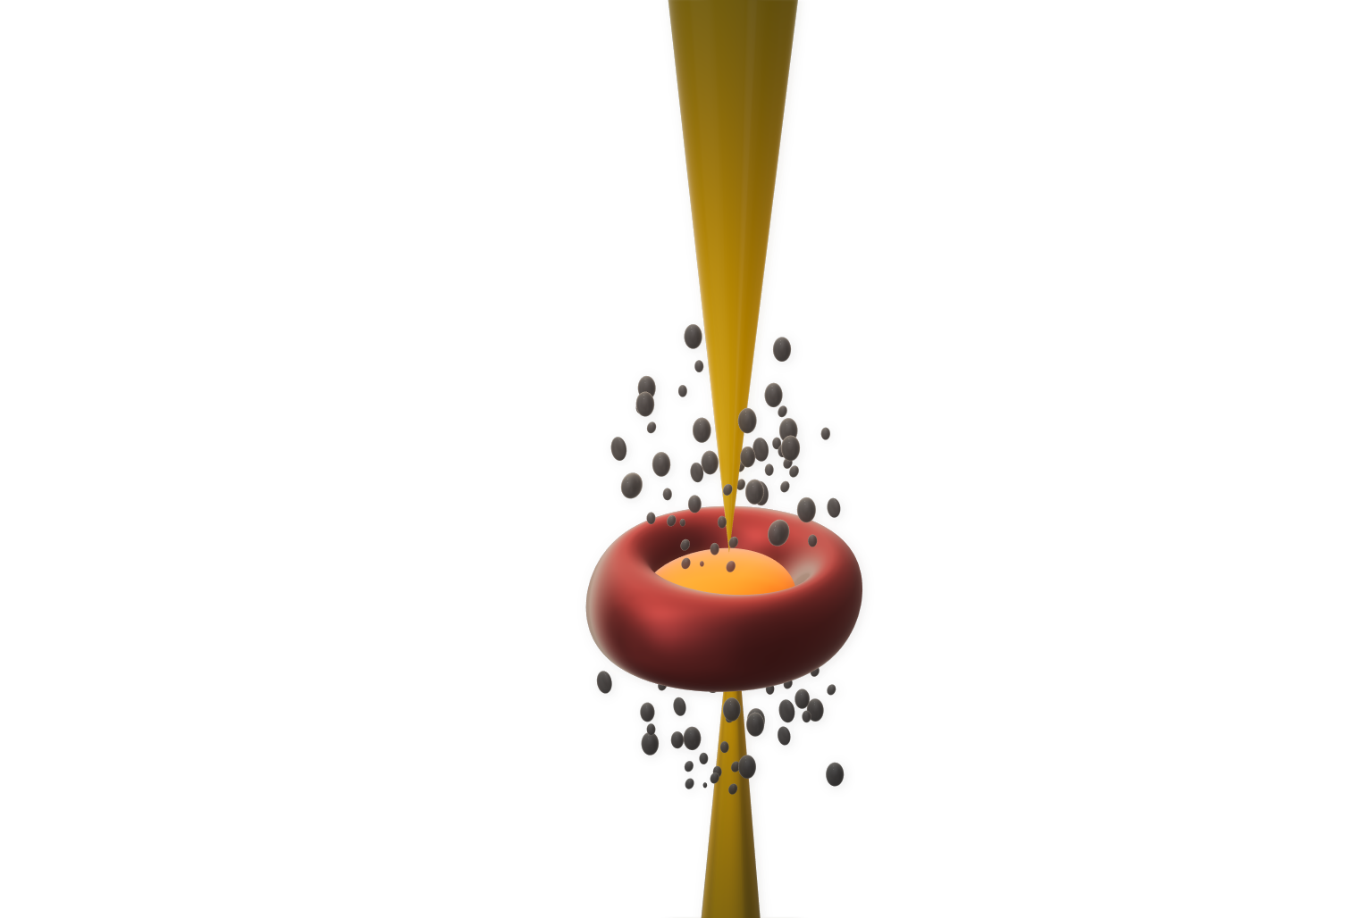
AGN Components
Lea Marcotulli | lea.marcotulli@desy.de
Urry & Padovani 1995

Slide 6
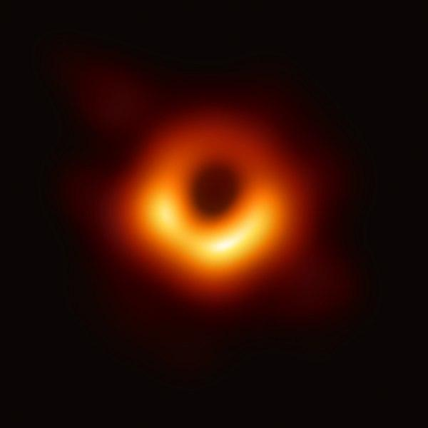
AGN Components
Lea Marcotulli | lea.marcotulli@desy.de
SMBH
Supermassive Black hole (SMBH)
M87 black hole, Credits: EHT
Urry & Padovani 1995

Slide 7
AGN Components
Lea Marcotulli | lea.marcotulli@desy.de
Accretion Disk
&
X-ray corona
M87 black hole, Credits: EHT
Accretion Disk
Urry & Padovani 1995

Slide 8
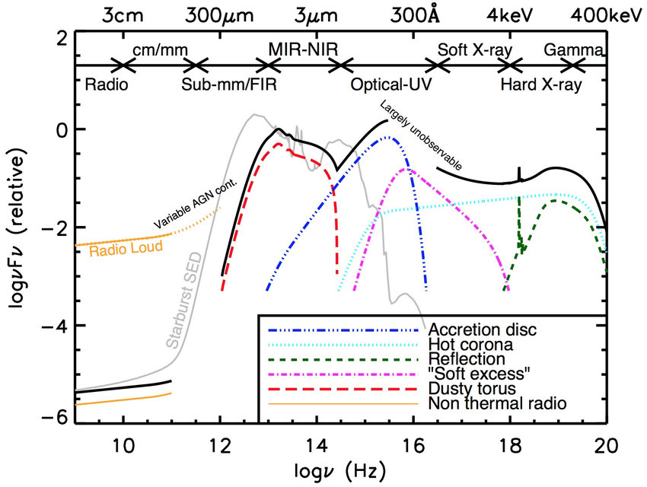
AGN Components
Lea Marcotulli | lea.marcotulli@desy.de
ENERGY FLUX [log(νF_{ν})]
Accretion Disk
&
X-ray corona
M87 black hole, Credits: EHT
Accretion Disk
Baldini 2015
FREQUENCY (ν, [Hz])
Urry & Padovani 1995

Slide 9
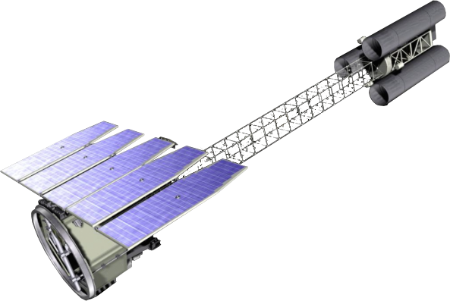
AGN Components
Giannoli+23
Lea Marcotulli | lea.marcotulli@desy.de
ENERGY FLUX [log(νF_{ν})]
Accretion Disk
&
X-ray corona
M87 black hole, Credits: EHT
Accretion Disk
Baldini 2015
FREQUENCY (ν, [Hz])
Urry & Padovani 1995

Slide 10
AGN Components
Lea Marcotulli | lea.marcotulli@desy.de
ENERGY FLUX [log(νF_{ν})]
Dusty torus
(NOT a uniform donut)
Baldini 2015
FREQUENCY (ν, [Hz])
Urry & Padovani 1995

Slide 11
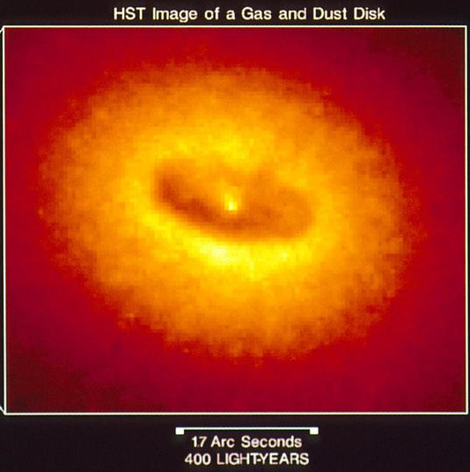
AGN Components
Lea Marcotulli | lea.marcotulli@desy.de
ENERGY FLUX [log(νF_{ν})]
Dusty torus
(NOT a uniform donut)
NGC 4261 - Credit: NRAO, Caltech,
Walter Jaffe/Leiden Observatory, Holland Ford/JHU/STScI, and NASA
Baldini 2015
FREQUENCY (ν, [Hz])
Urry & Padovani 1995

Slide 12
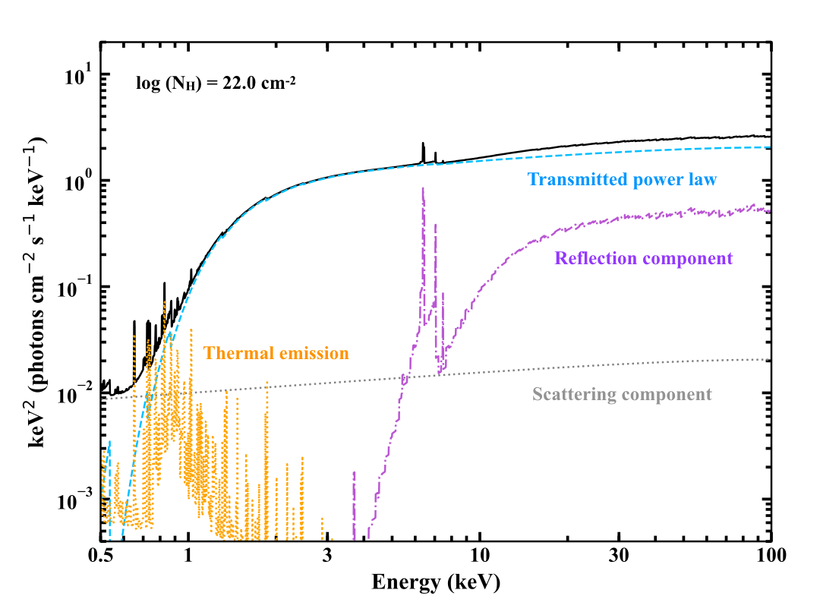
AGN Components
Credit: Zhao, Torres-Alba
Lea Marcotulli | lea.marcotulli@desy.de
ENERGY FLUX [log(νF_{ν})]
ENERGY FLUX [log(νF_{ν})]
Dusty torus
(NOT a uniform donut)
Baldini 2015
Baldini 2015
FREQUENCY (ν, [Hz])
FREQUENCY (ν, [Hz])
Urry & Padovani 1995

Slide 13
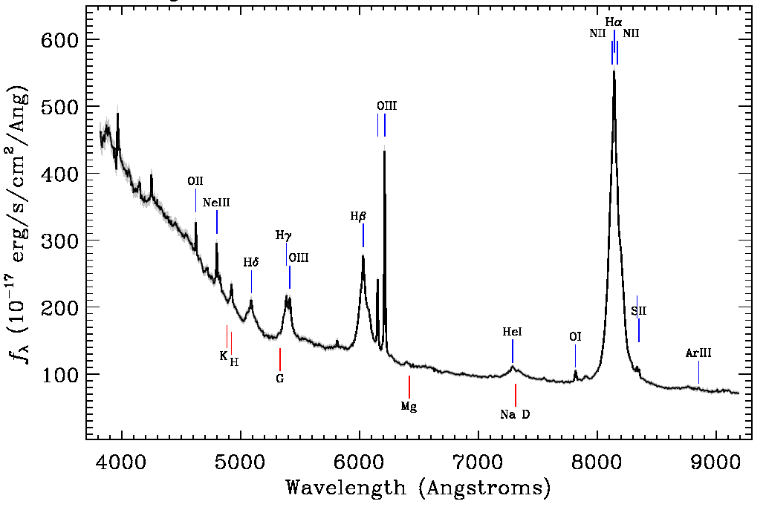
AGN Components
Lea Marcotulli | lea.marcotulli@desy.de
Broad & Narrow Line Regions
(BLR & NLR)
PKS 1217+02, from SDSS
ENERGY FLUX [log(νF_{ν})]
Baldini 2015
FREQUENCY (ν, [Hz])
Urry & Padovani 1995

Slide 14
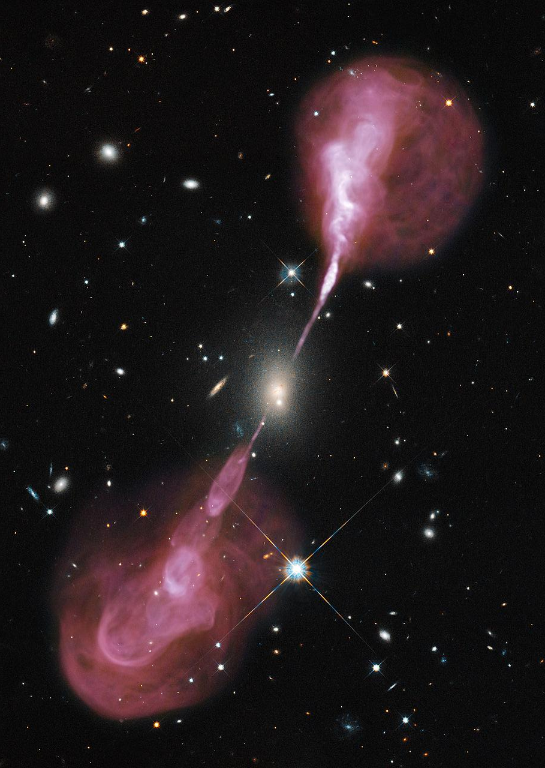
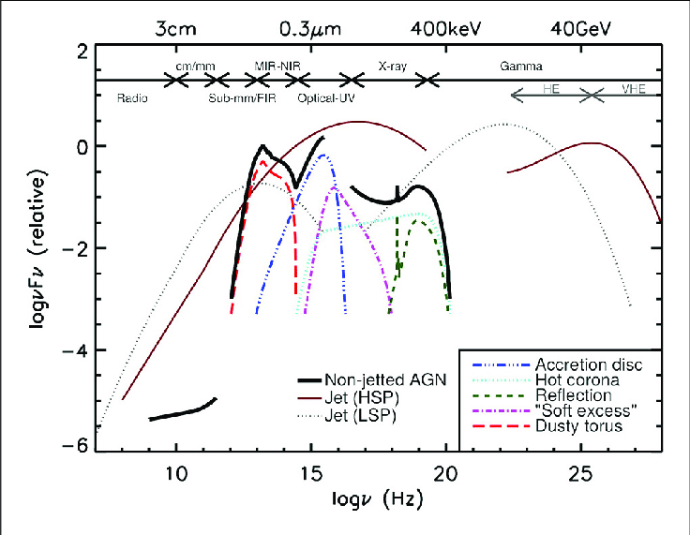
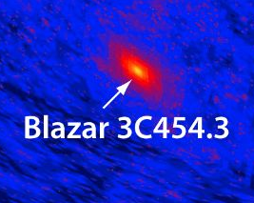
AGN Components
Hercules A, Credit: NASA, ESA, S. Baum and C. O'Dea (RIT), R. Perley and W. Cotton (NRAO/AUI/NSF), and the Hubble Heritage Team (STScI/AURA)
Lea Marcotulli | lea.marcotulli@desy.de
Relativistic
Jets
ENERGY FLUX [log(νF_{ν})]
ENERGY FLUX [log(νF_{ν})]
Baldini 2015
FREQUENCY (ν, [Hz])
Credit: Fermi-LAT
FREQUENCY (ν, [Hz])
Urry & Padovani 1995

Slide 15
What do blazar jets look like?
Lea Marcotulli | lea.marcotulli@desy.de

Slide 16
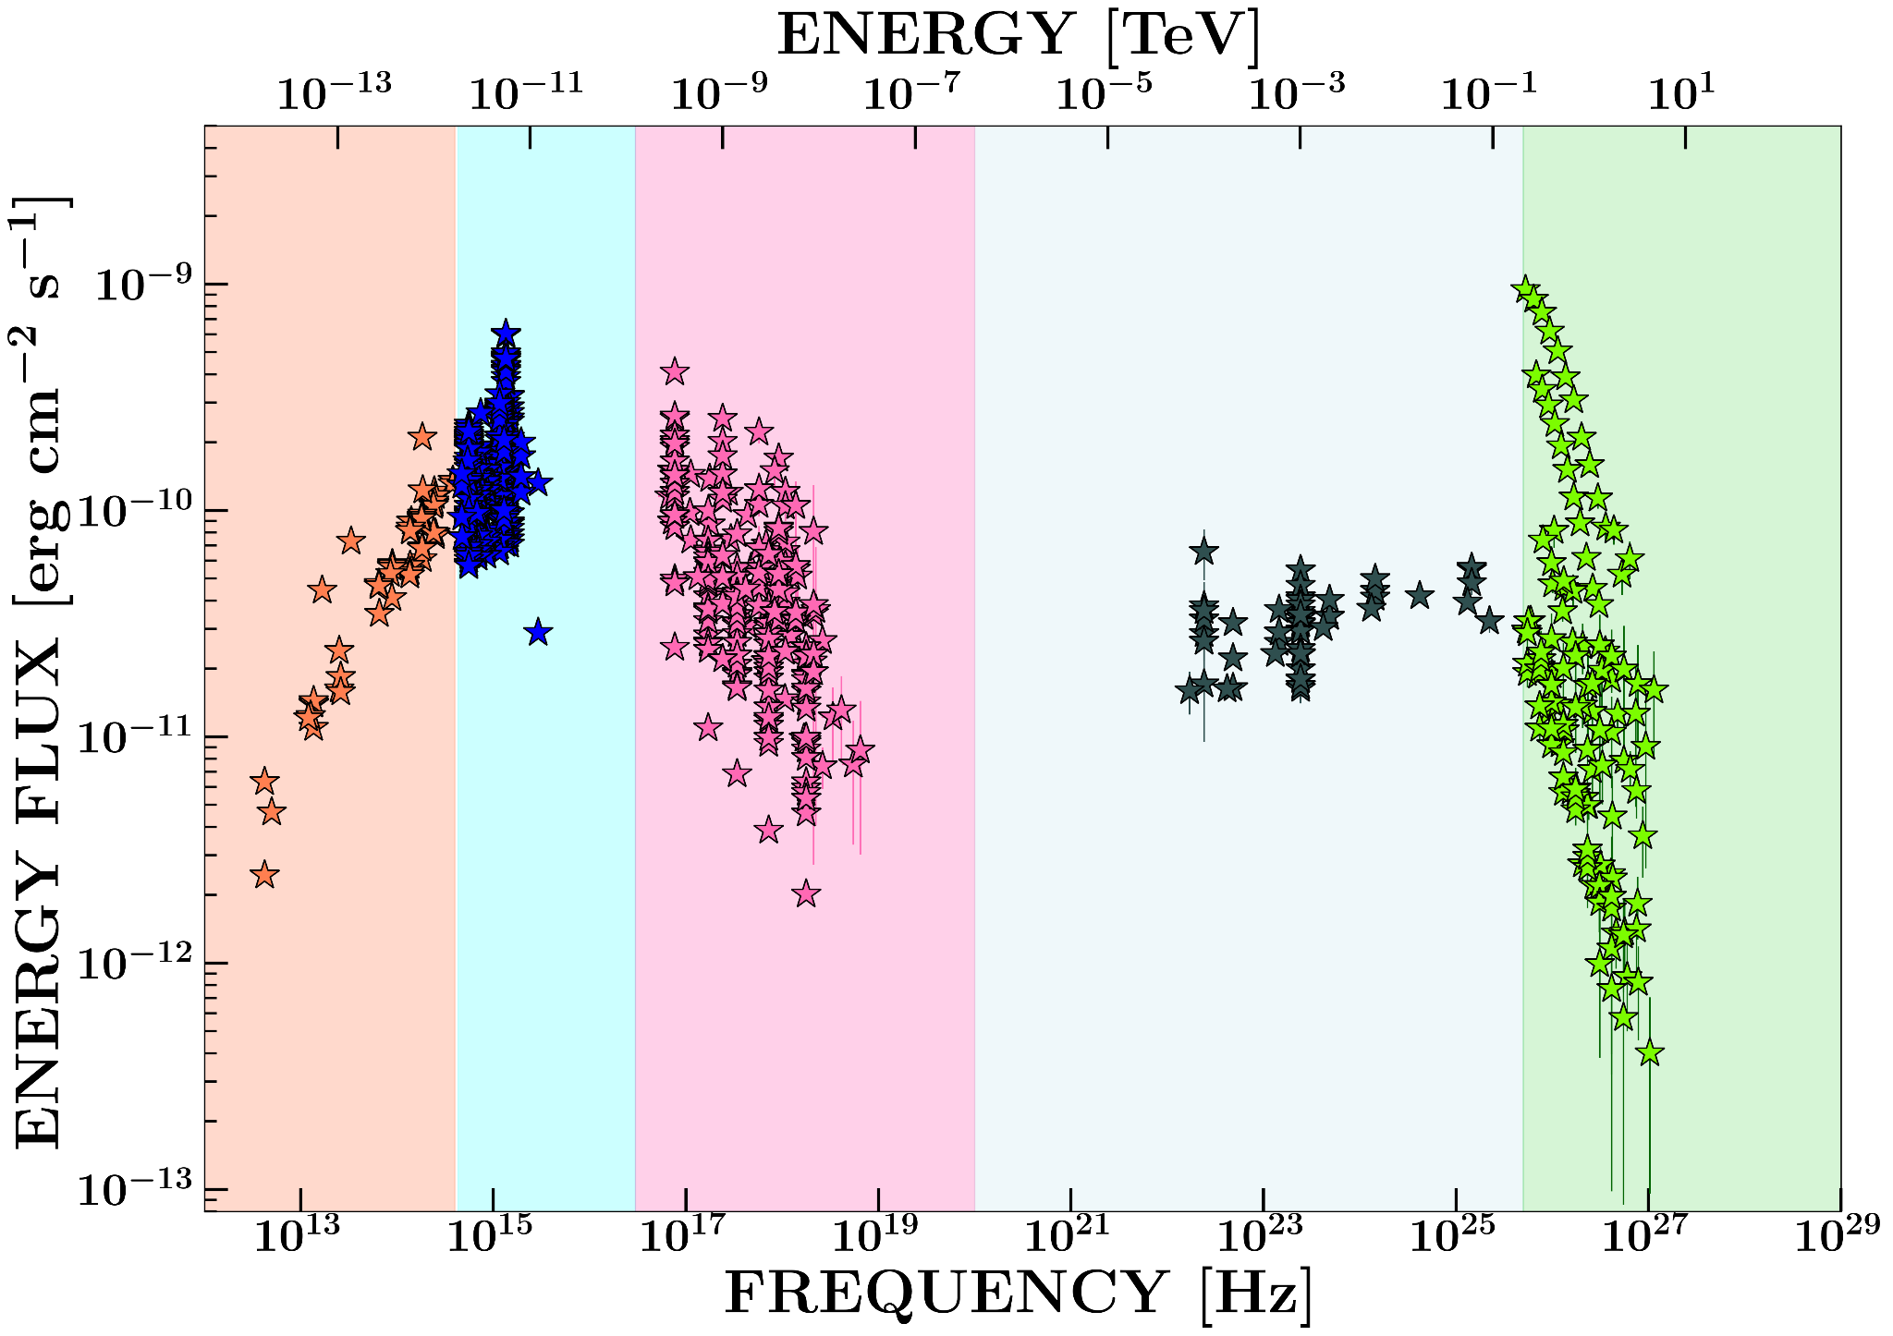
Blazar jet emission: multiwavelength & highly variable
Lea Marcotulli | lea.marcotulli@desy.de
Infrared
Optical
UV
X-rays
Low-energy γ-rays
Very High Energy (VHE) γ-rays
Typical picture of a blazar monitored for several years at all accessible wavelengths
Adapted from
Marcotulli+24

Slide 17
Blazar jet emission: multiwavelength & highly variable
Lea Marcotulli | lea.marcotulli@desy.de
Infrared
Optical
UV
X-rays
Low-energy γ-rays
Very High Energy (VHE) γ-rays
Typical picture of a blazar monitored for several years at all accessible wavelengths
15 orders of magnitude in frequency
Adapted from
Marcotulli+24

Slide 18
Blazar jet emission: multiwavelength & highly variable
Lea Marcotulli | lea.marcotulli@desy.de
Infrared
Optical
UV
X-rays
Low-energy γ-rays
Very High Energy (VHE) γ-rays
Typical picture of a blazar monitored for several years at all accessible wavelengths
~2-3 orders of magnitude in flux variations!
Adapted from
Marcotulli+24

Slide 19
Blazar jet emission: multiwavelength & highly variable
Lea Marcotulli | lea.marcotulli@desy.de
Infrared
Optical
UV
X-rays
Low-energy γ-rays
Very High Energy (VHE) γ-rays
Typical picture of a blazar monitored for several years at all accessible wavelengths
GAPS!
Adapted from
Marcotulli+24

Slide 20
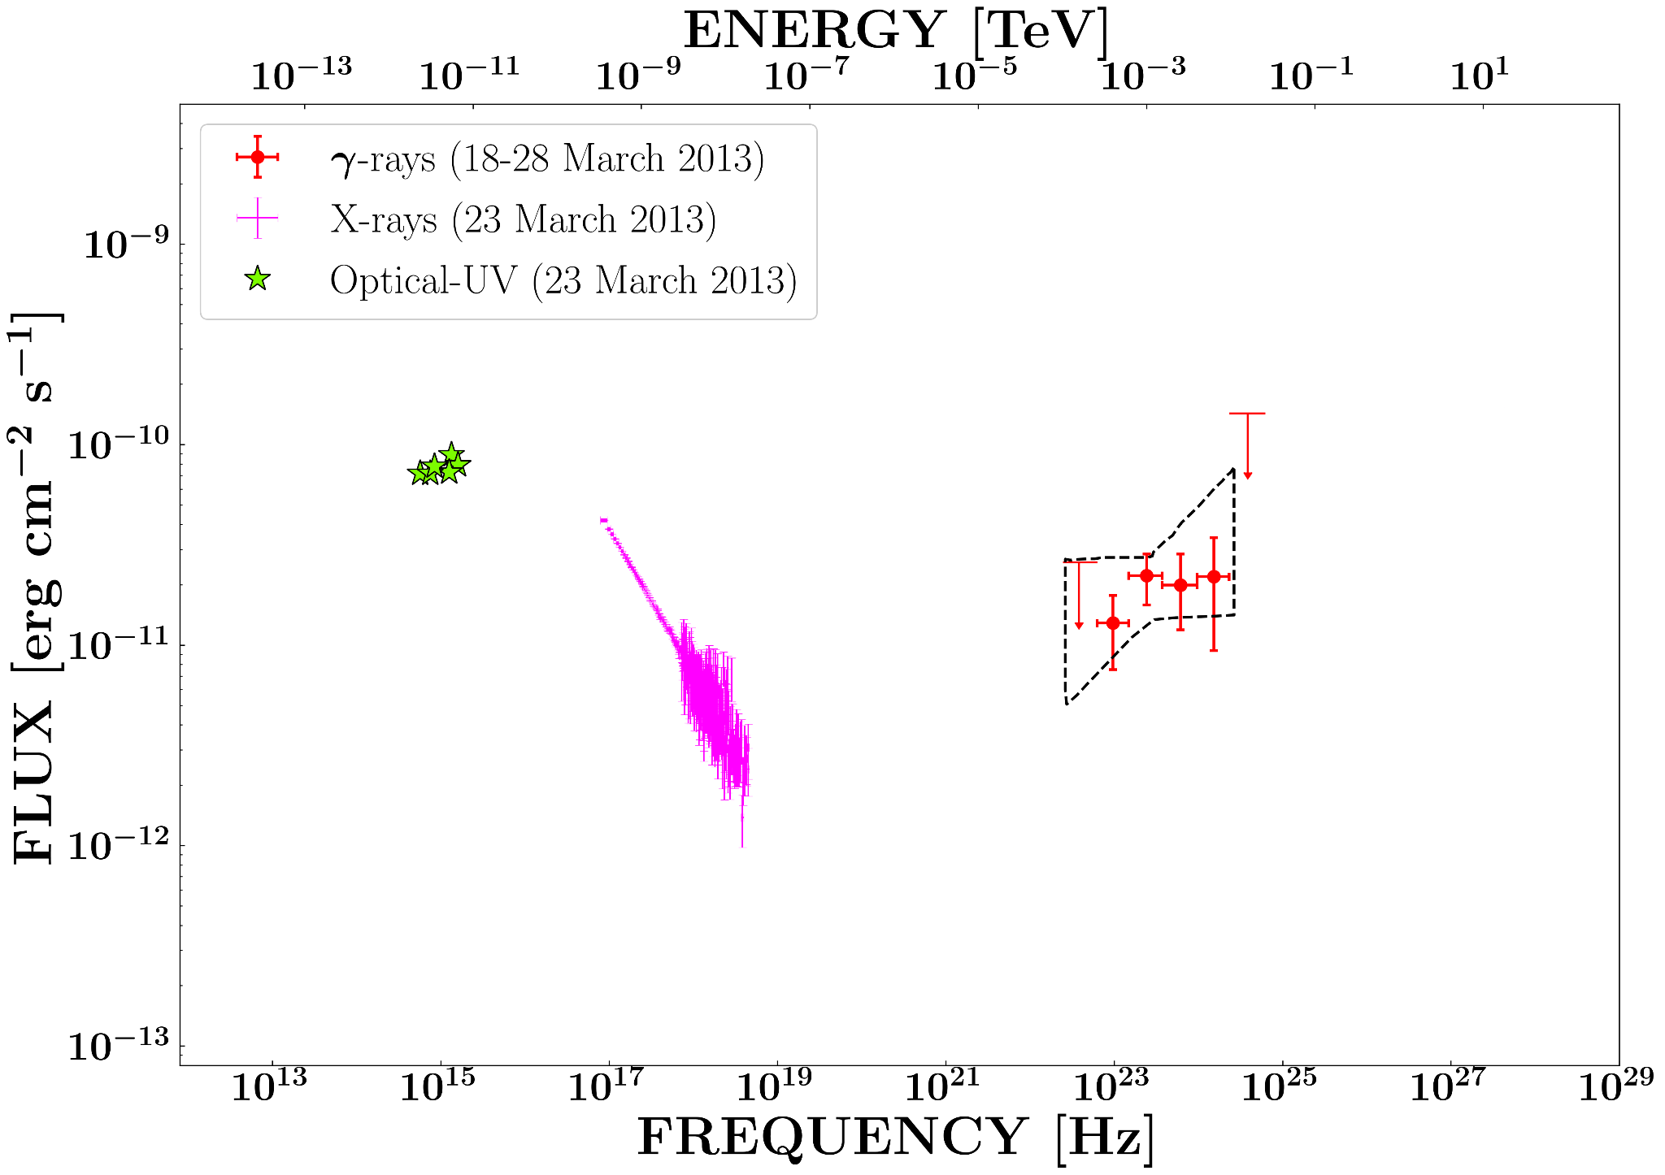
Timing is of the essence
Lea Marcotulli | lea.marcotulli@desy.de
Adapted from
Marcotulli+24, Madejski+13

Slide 21
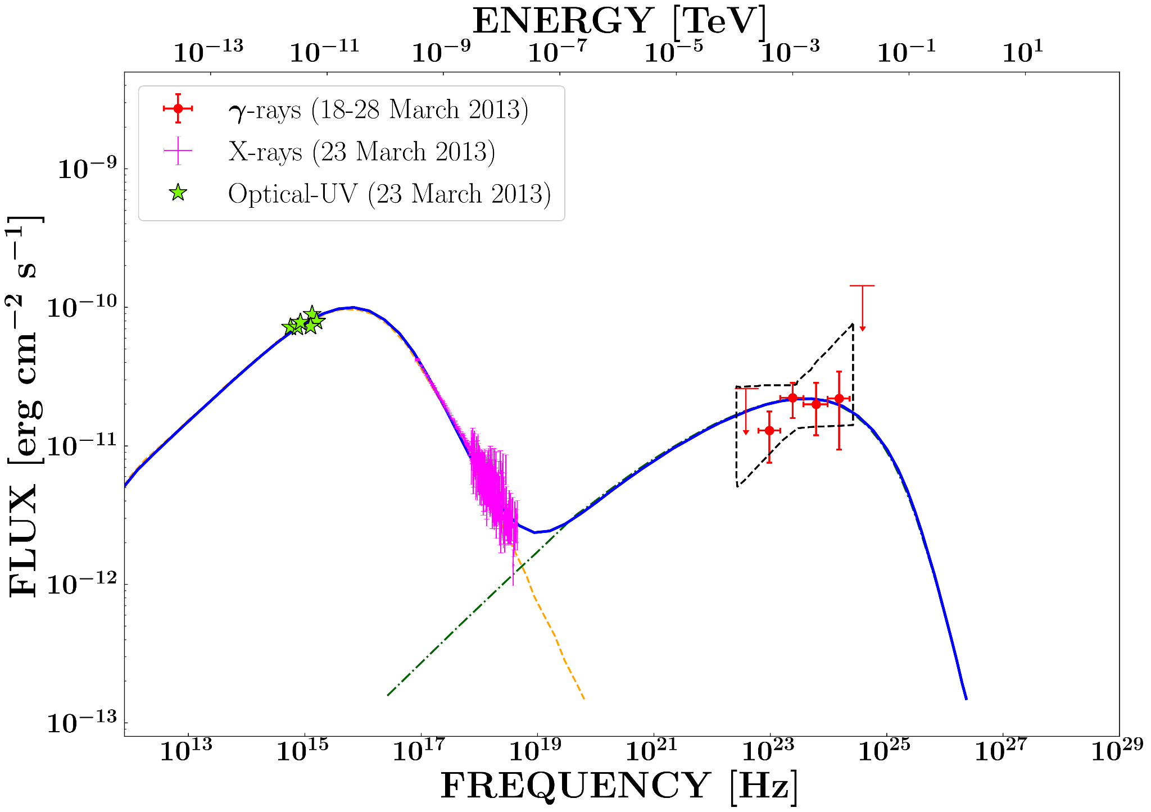
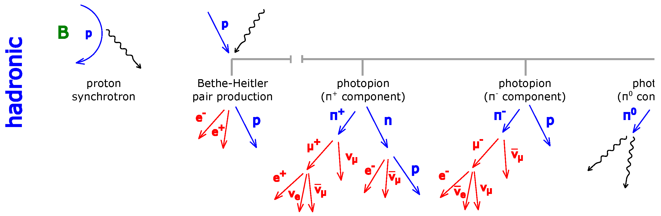
Timing is of the essence
Lea Marcotulli | lea.marcotulli@desy.de
Mastichiadis 2016
B
photon
Synchrotron radiation from the jet
Leptonic scenario
electron
Inverse Compton radiation from the jet
High-energy photon
Low-energy photon
Adapted from
Marcotulli+24, Madejski+13
electron

Slide 22
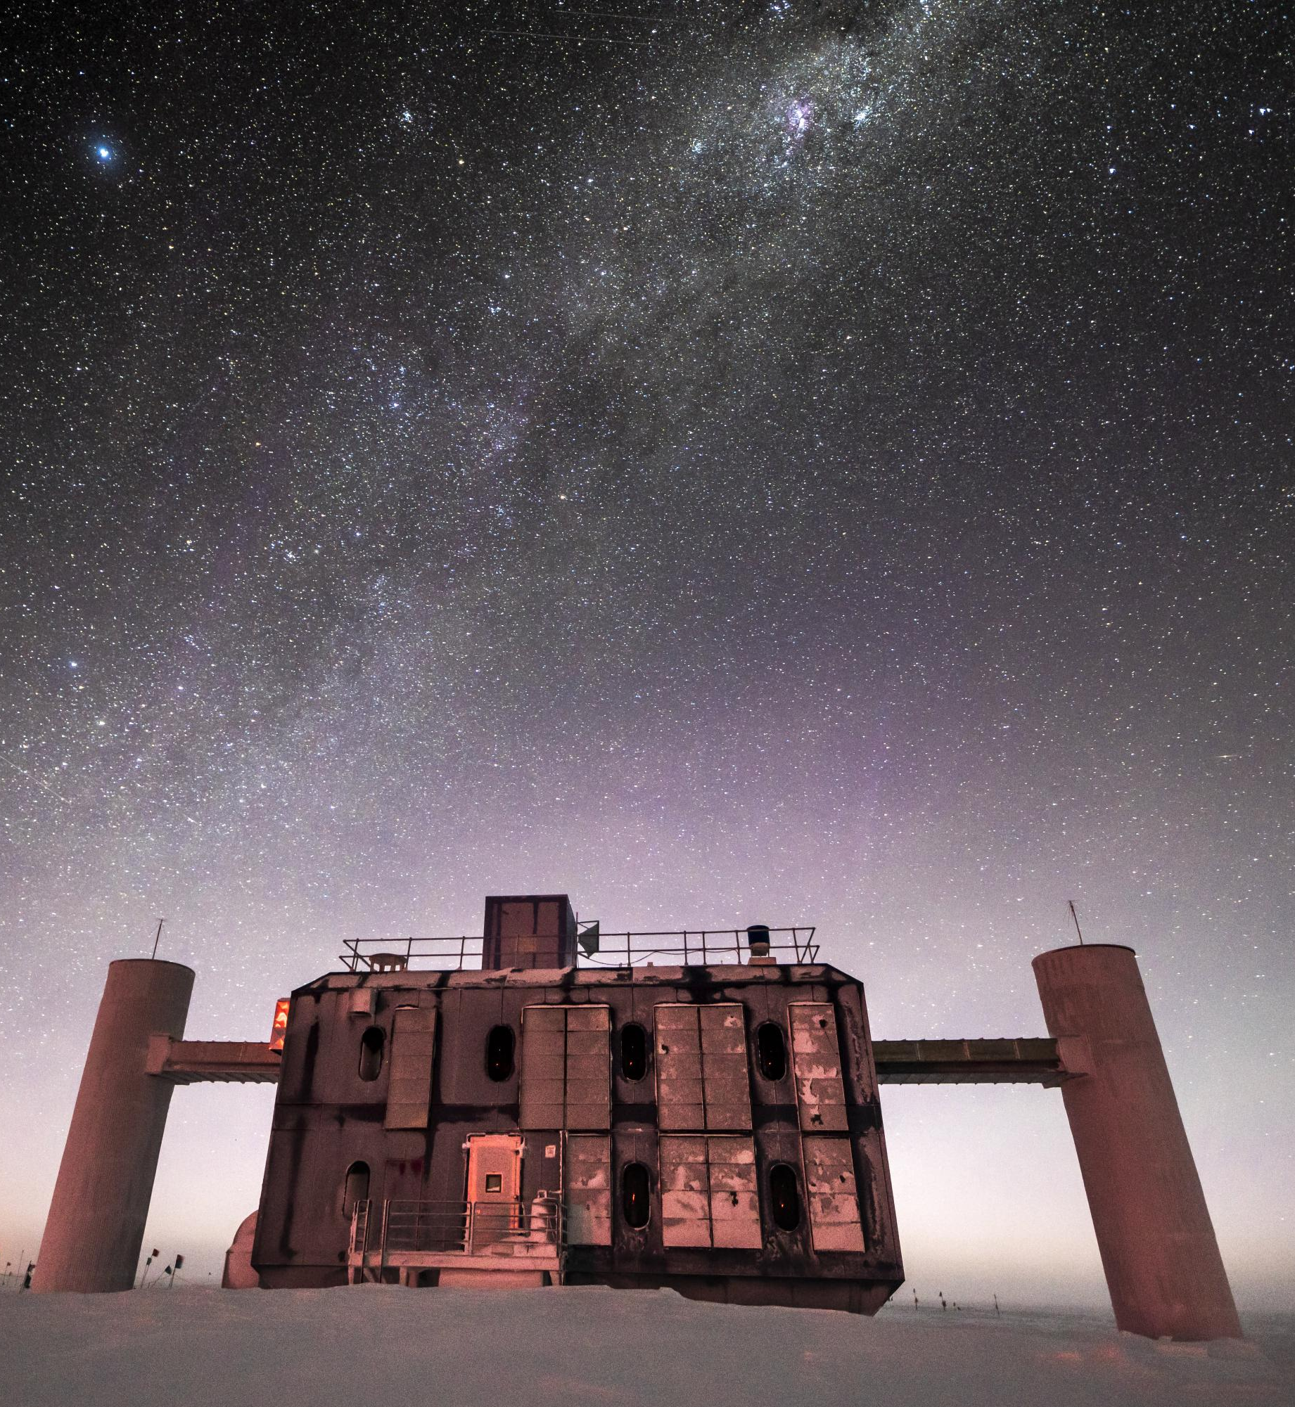
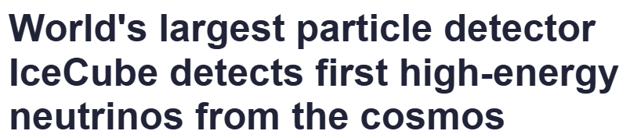
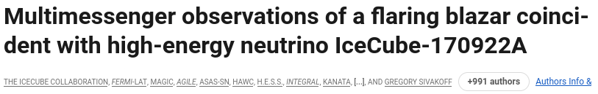
Multi-messenger
Lea Marcotulli | lea.marcotulli@desy.de
November 2013
September 2017
IceCube

Slide 23
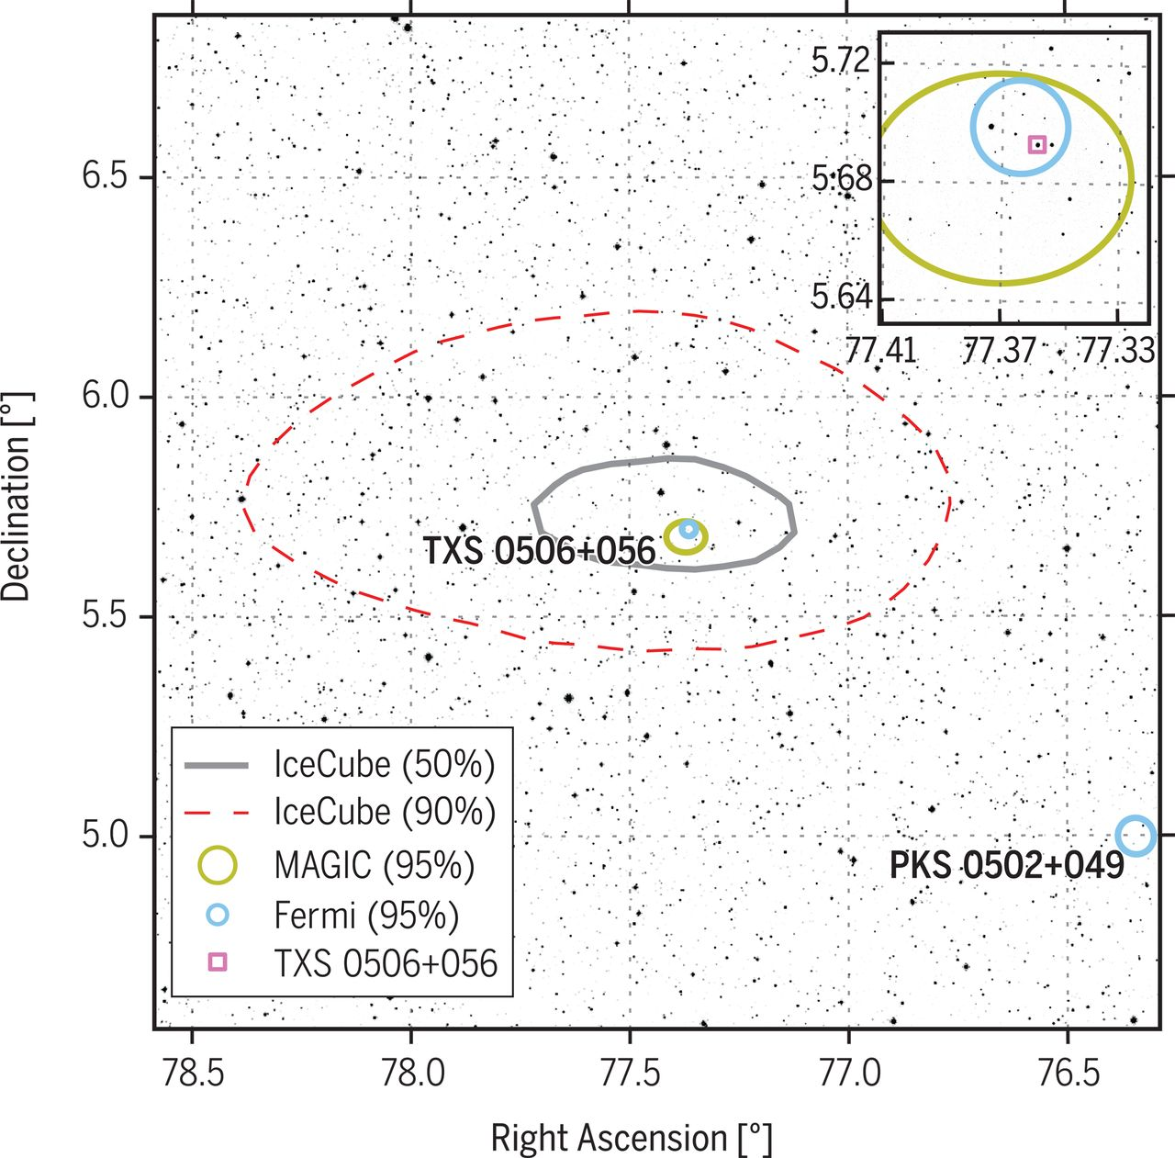
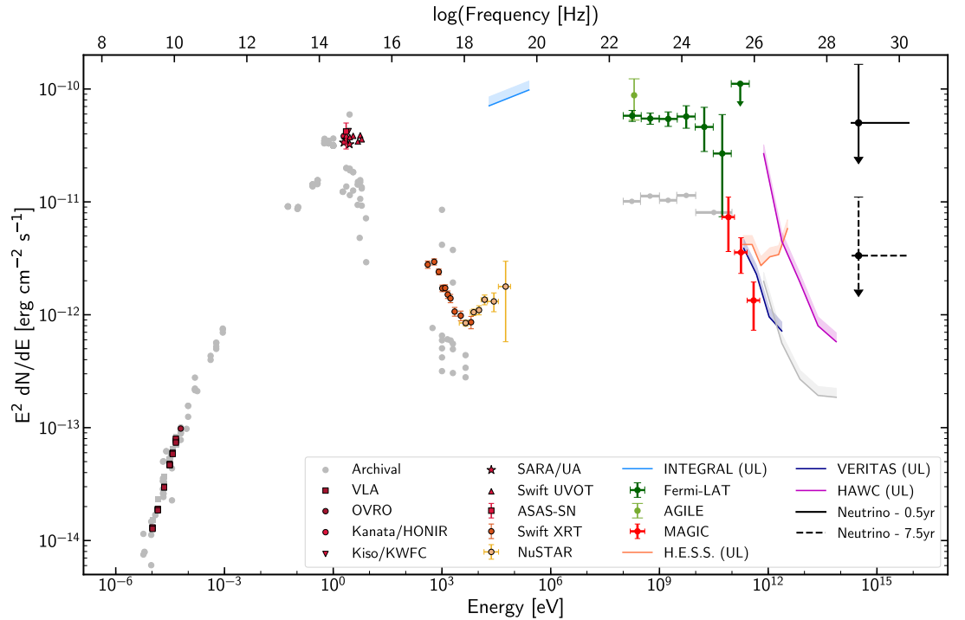
TXS 0506+056 (z=0.33)
The IceCube, Fermi-LAT, MAGIC, AGILE, ASAS-SN, HAWC, H.E.S.S, INTEGRAL, Kanata, Kiso, Kapteyn, Liverpool telescope, Subaru, Swift/NuSTAR, VERITAS, and VLA/17B-403 teams, 2017
Lea Marcotulli | lea.marcotulli@desy.de

Slide 24
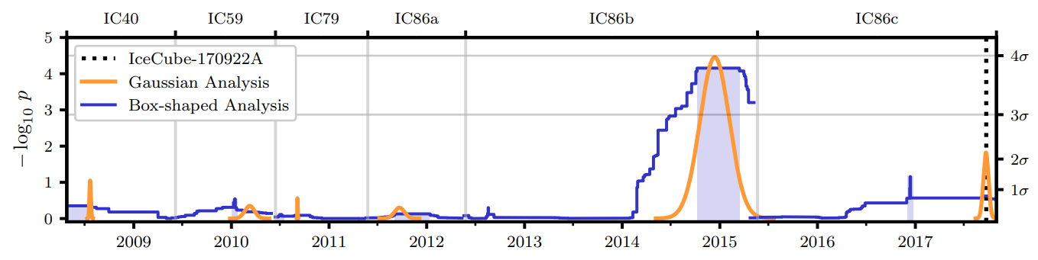
TXS 0506+056 (z=0.33)
e.g. Cerruti+2018, Keivani+2018, Gao+2019, Rodrigues+2018, Palladino+2019, Reimer+2019, Murase+2018, Sahakyan+2018, Tavecchio+2019, Petropolou+2020
Lea Marcotulli | lea.marcotulli@desy.de
IceCube Collaboration 2018

Slide 25
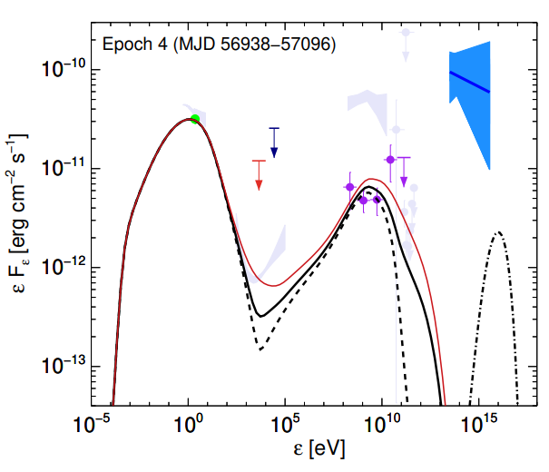
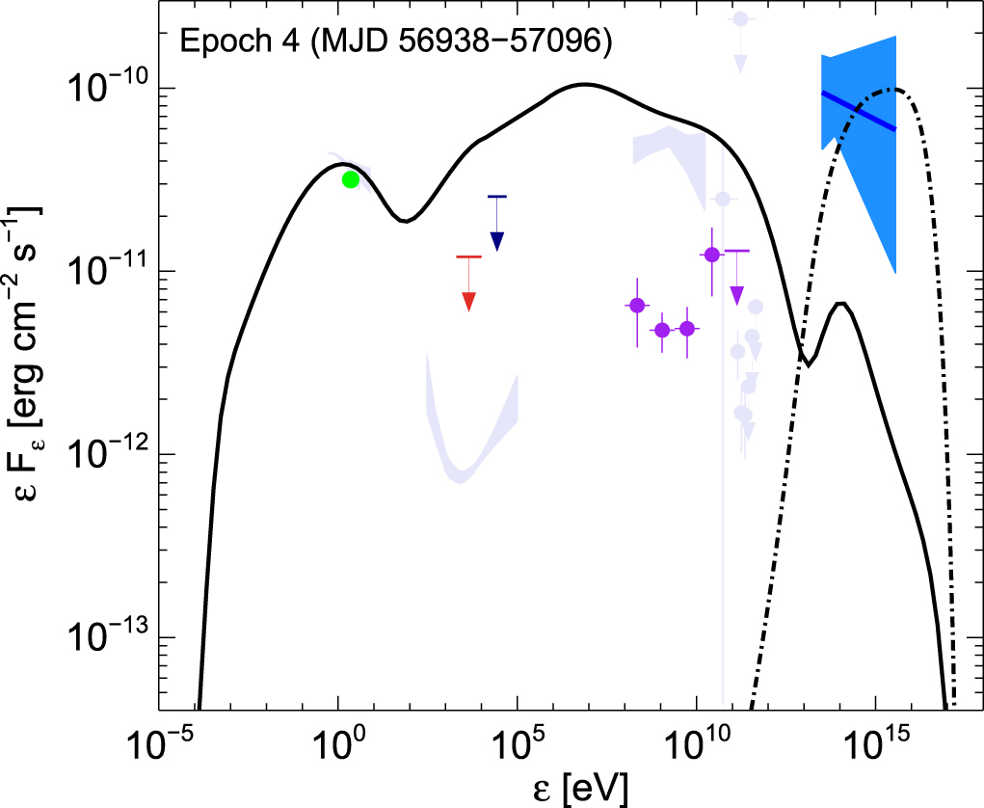
TXS 0506+056 (z=0.33)
e.g. Cerruti+2018, Keivani+2018, Gao+2019, Rodrigues+2018, Palladino+2019, Reimer+2019, Murase+2018, Sahakyan+2018, Tavecchio+2019, Petropolou+2020
Petropolou+2020
Petropolou+2020
Lea Marcotulli | lea.marcotulli@desy.de
IceCube Collaboration 2018

Slide 26
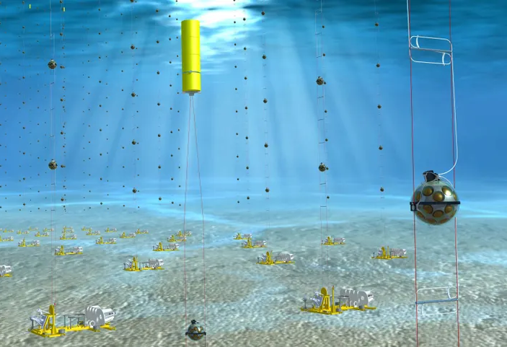
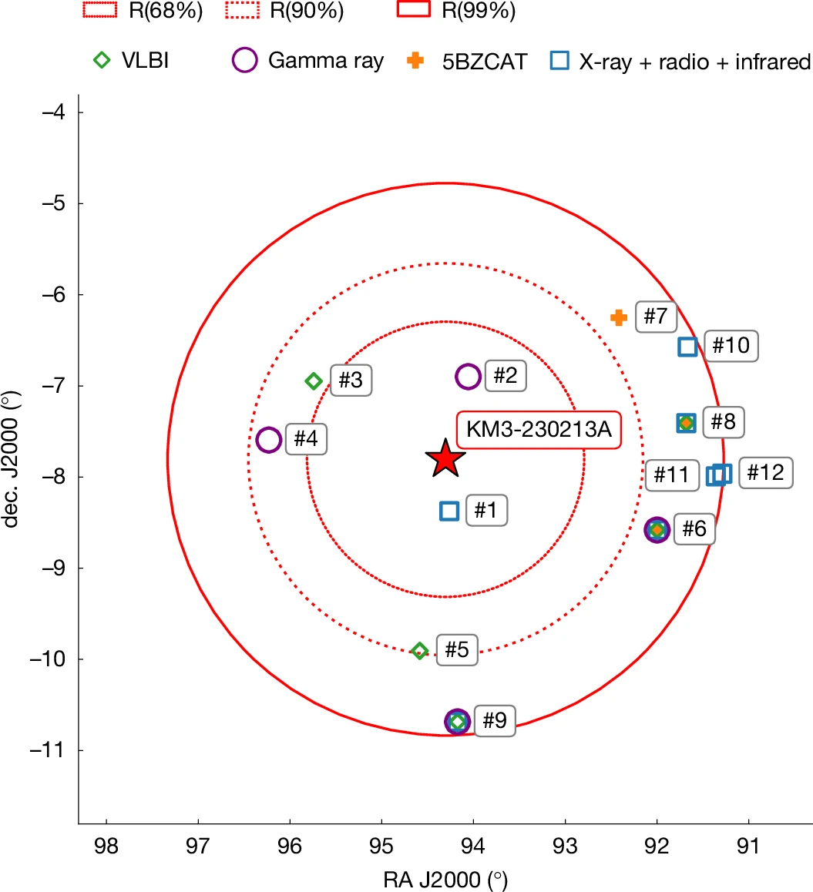
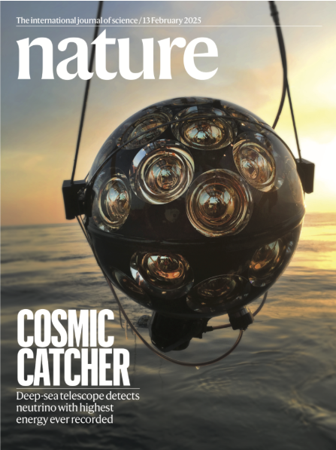
KM3NET
Lea Marcotulli | lea.marcotulli@desy.de
February 2023
KM3NET Coll. 2025

Slide 27
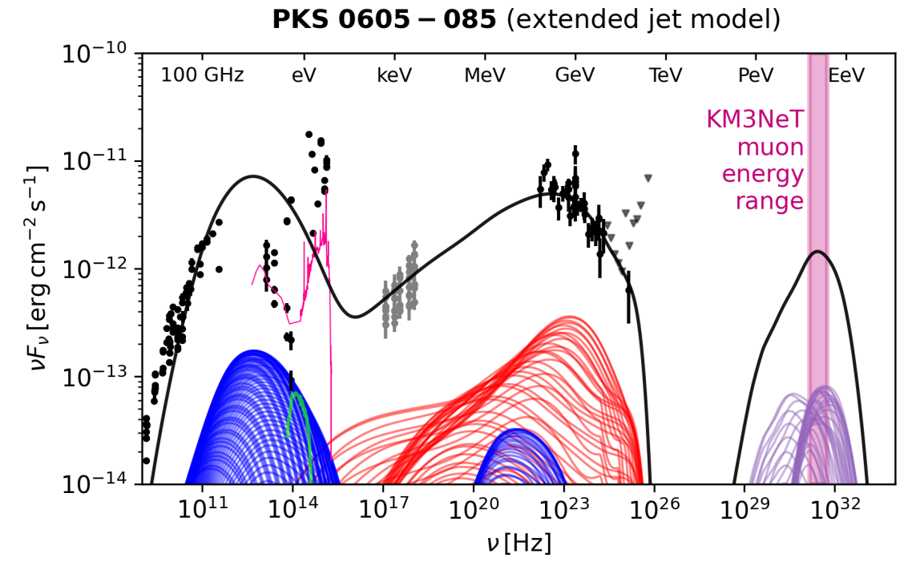
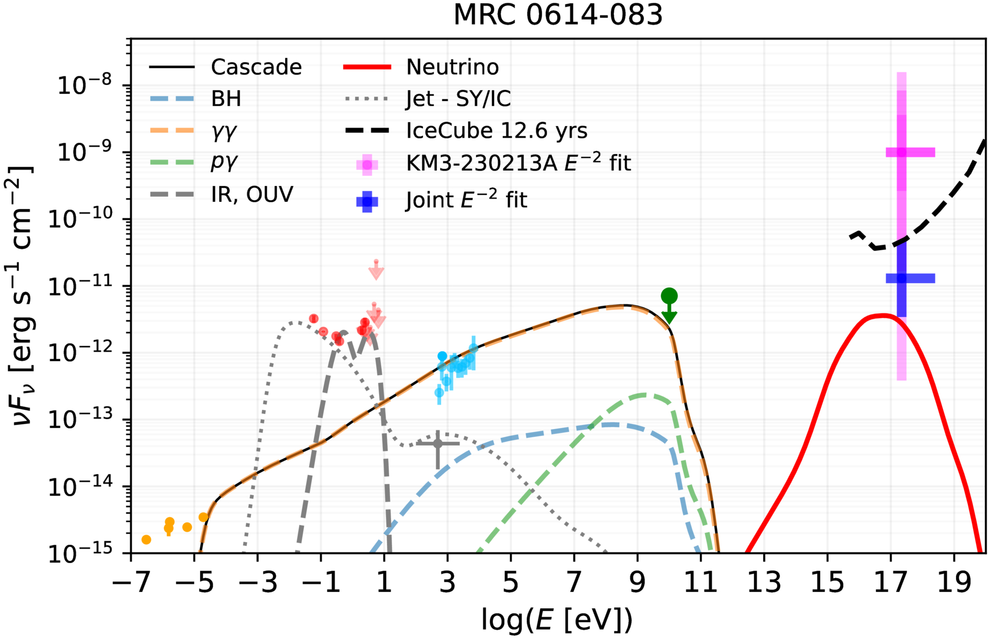
Lea Marcotulli | lea.marcotulli@desy.de
Rodrigues+26
No redshift info
Yuan+26

Slide 28
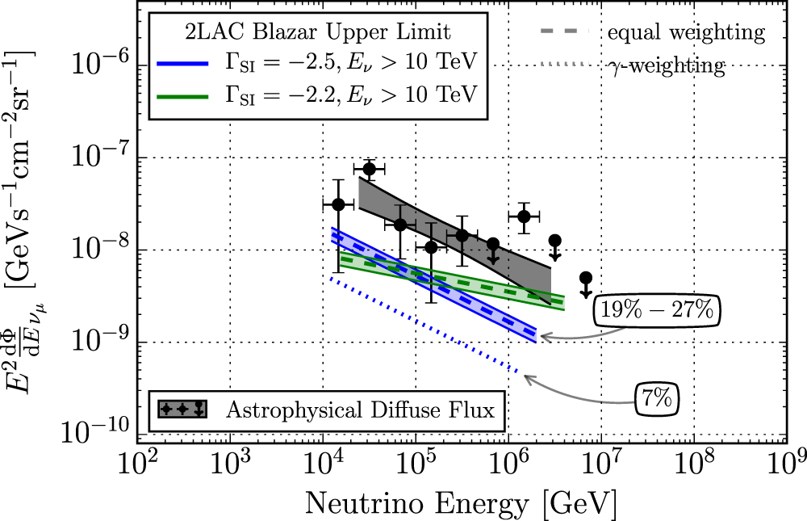
Contribution to the diffuse neutrino flux
Lea Marcotulli | lea.marcotulli@desy.de
Blazars can contribute to <30% to the diffuse neutrino flux
Aartsen+2017
e.g. Padovani+2015, Aartsen+2017, Palladino+2018, Yuan+2019

Slide 29
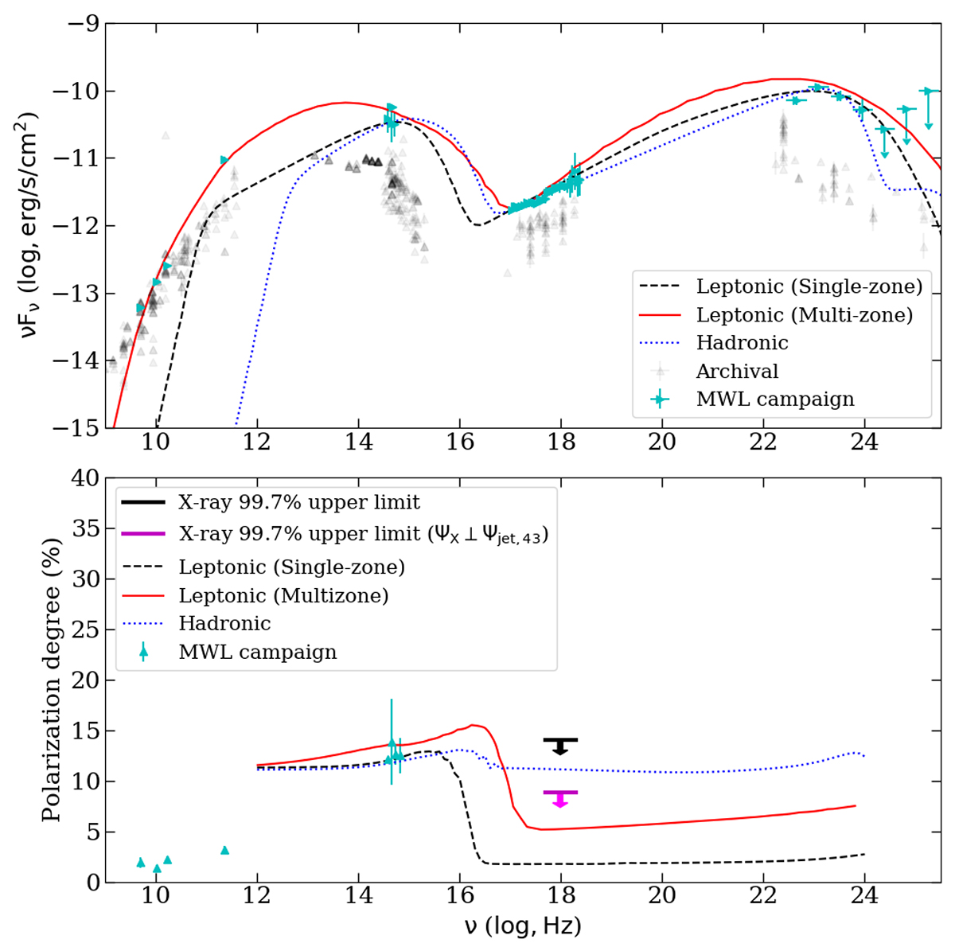
Are blazar jets hadronic?
Lea Marcotulli | lea.marcotulli@desy.de
Maybe not…
Need for a more sensitive X-ray/gamma-ray polarimeter
IXPE, 2-8 keV
Kouch+2025
see also Marshall+25

Slide 30
AGN CORONAE
Lea Marcotulli | lea.marcotulli@desy.de

Slide 31
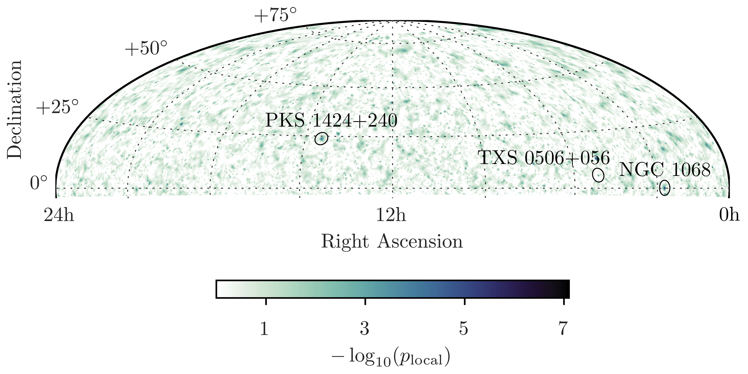
AGN seen by IceCube
Lea Marcotulli | lea.marcotulli@desy.de
IceCube Collaboration 2022

Slide 32
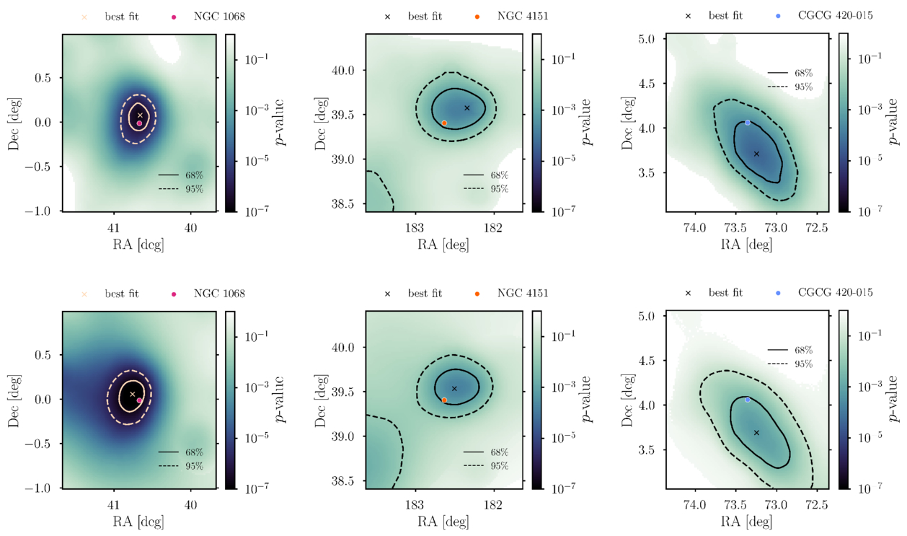
AGN seen by IceCube
Lea Marcotulli | lea.marcotulli@desy.de
IceCube Collaboration 2025

Slide 33
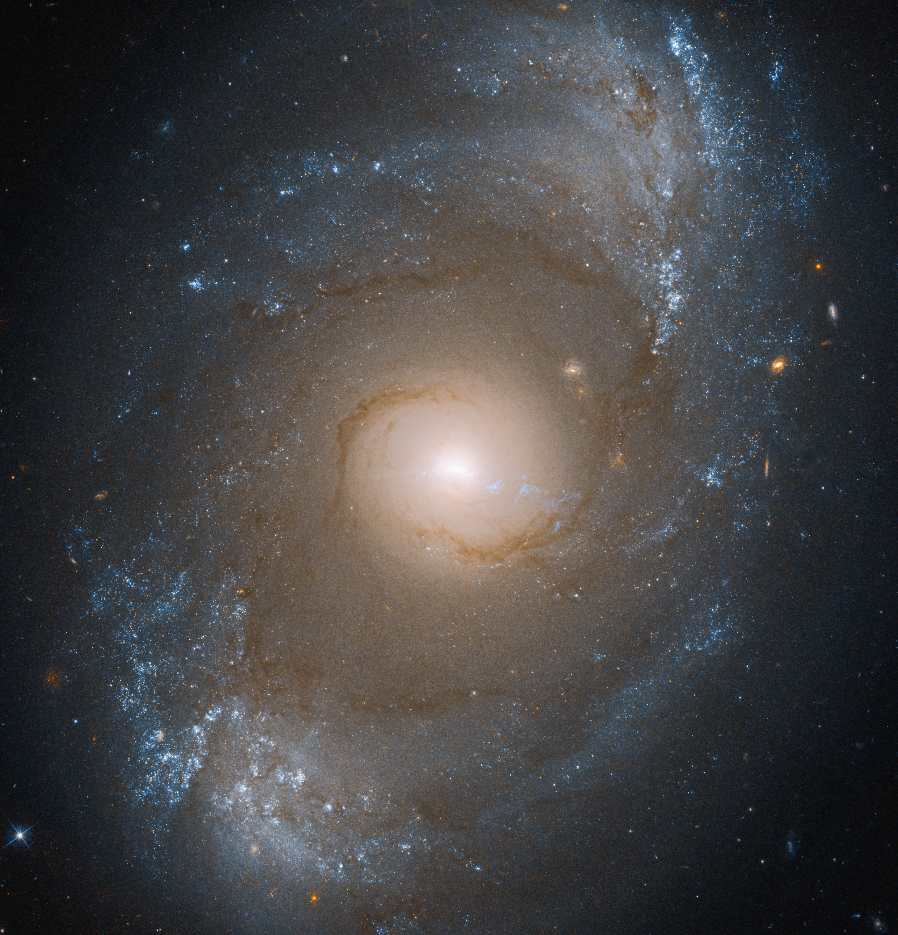
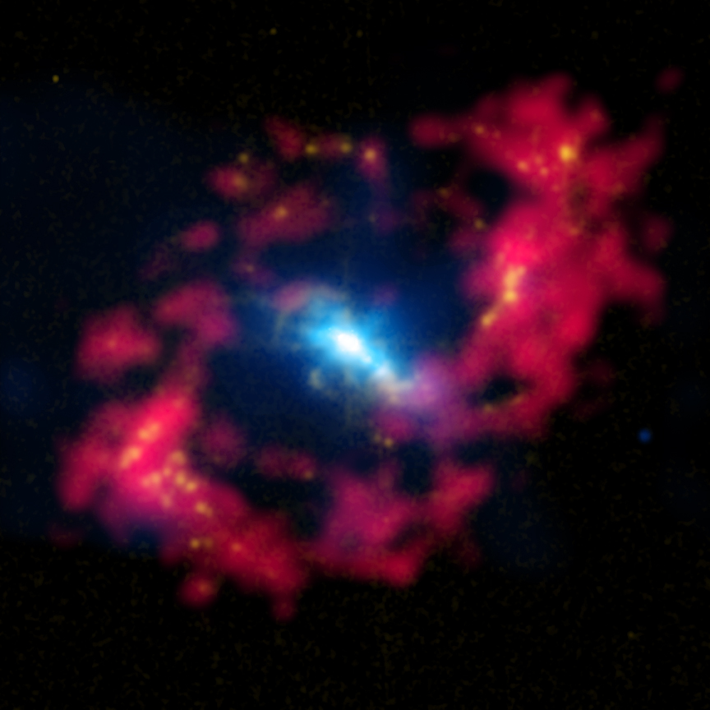
NGC 4151 (~15.8 Mpc away)
Lea Marcotulli | lea.marcotulli@desy.de
Brightest X-ray unobscured AGN
Composite X-rays, optical and radio [Chandra]
Credits: Hubble

Slide 34
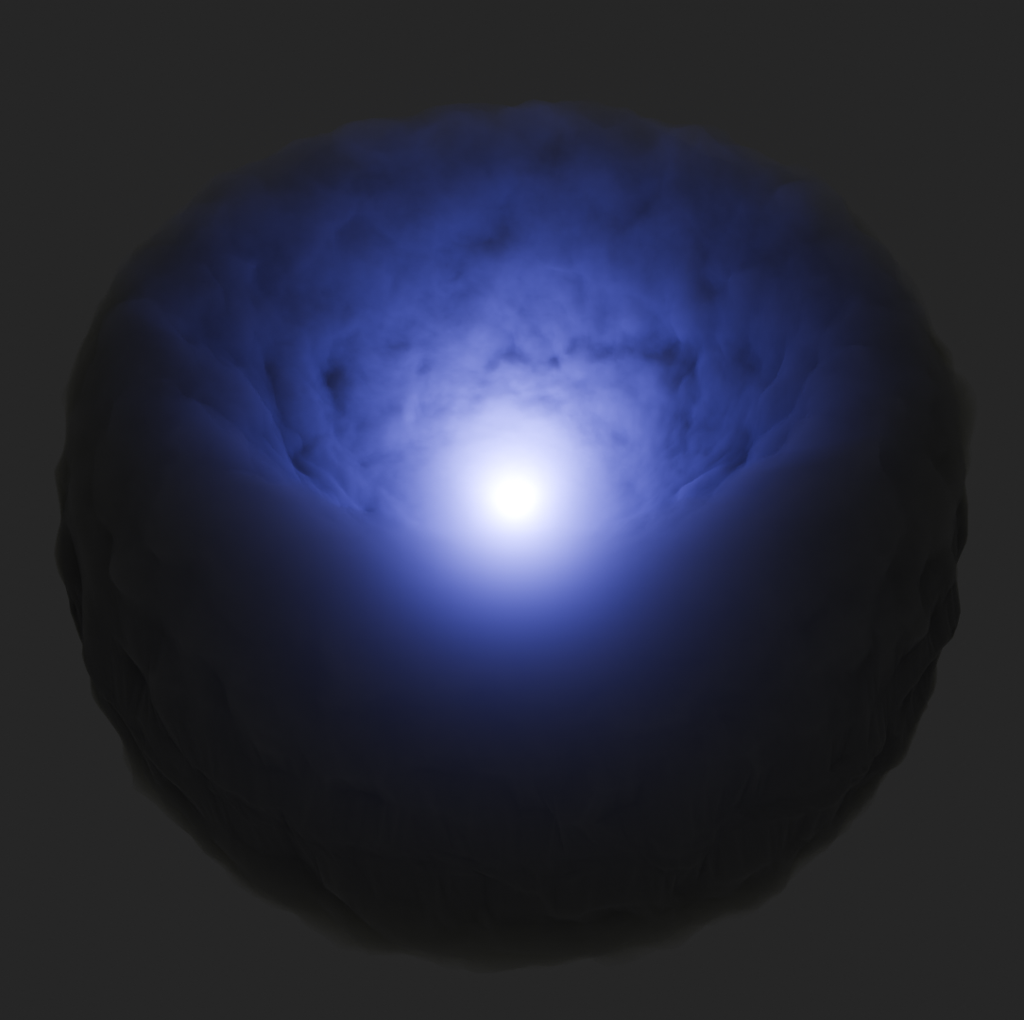
NGC 4151 (~15.8 Mpc away)
Lea Marcotulli | lea.marcotulli@desy.de
Transmitted
(corona powerlaw)
Unobscured
1
0.1
Intensity (EF_{E})
0.01
Reprocessed
0.001
1
2
5
10
20
50
Energy / keV
Schematics from P. Boorman
Credits: Hubble

Slide 35
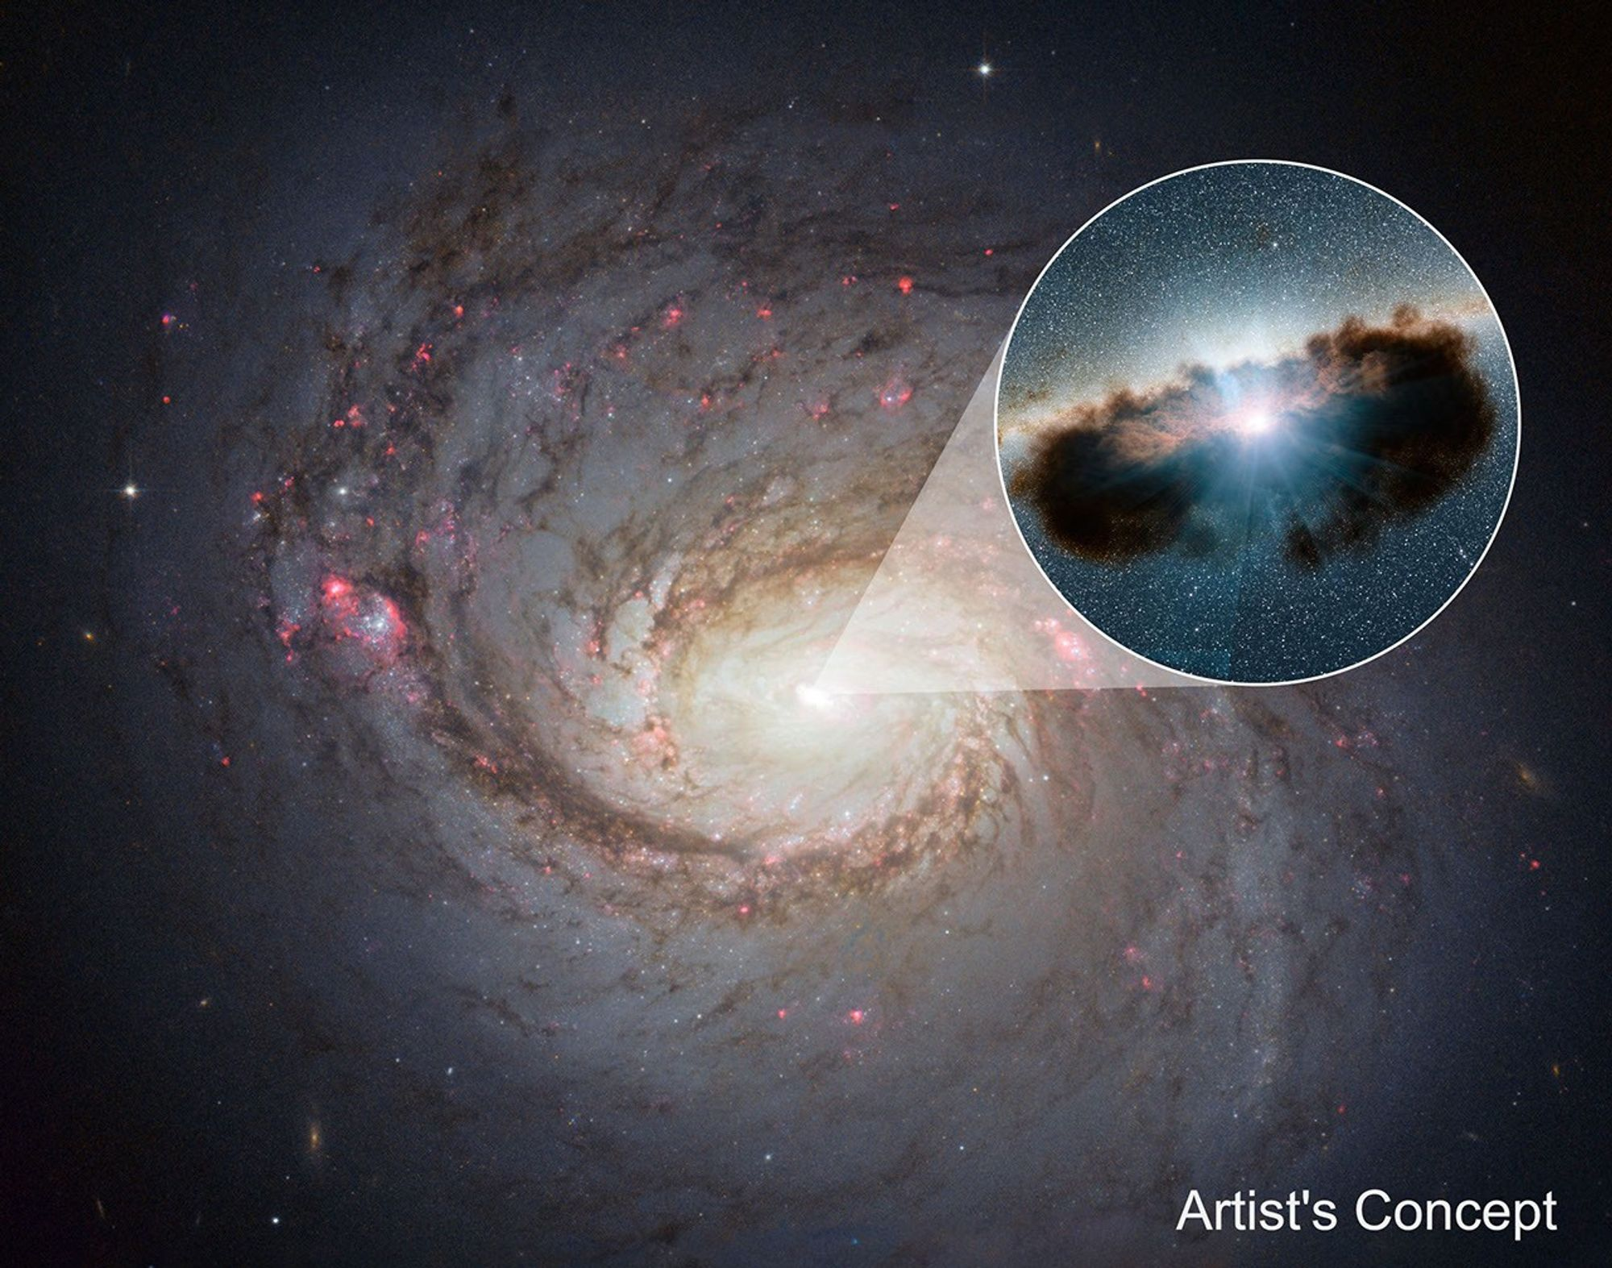
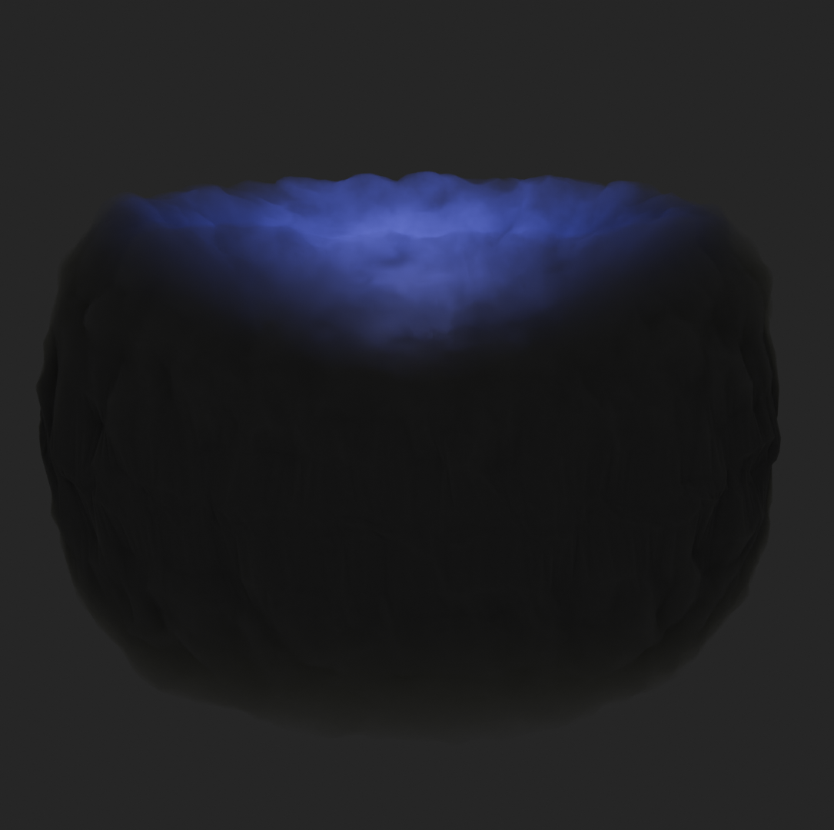
NGC 1068 (~14.4 Mpc away)
Lea Marcotulli | lea.marcotulli@desy.de
Close-by heavily obscured AGN
Compton-thick
1
0.1
Intensity (EF_{E})
0.01
Transmitted
0.001
1
2
5
10
20
50
Reprocessed
Energy / keV
Schematics from P. Boorman

Slide 36
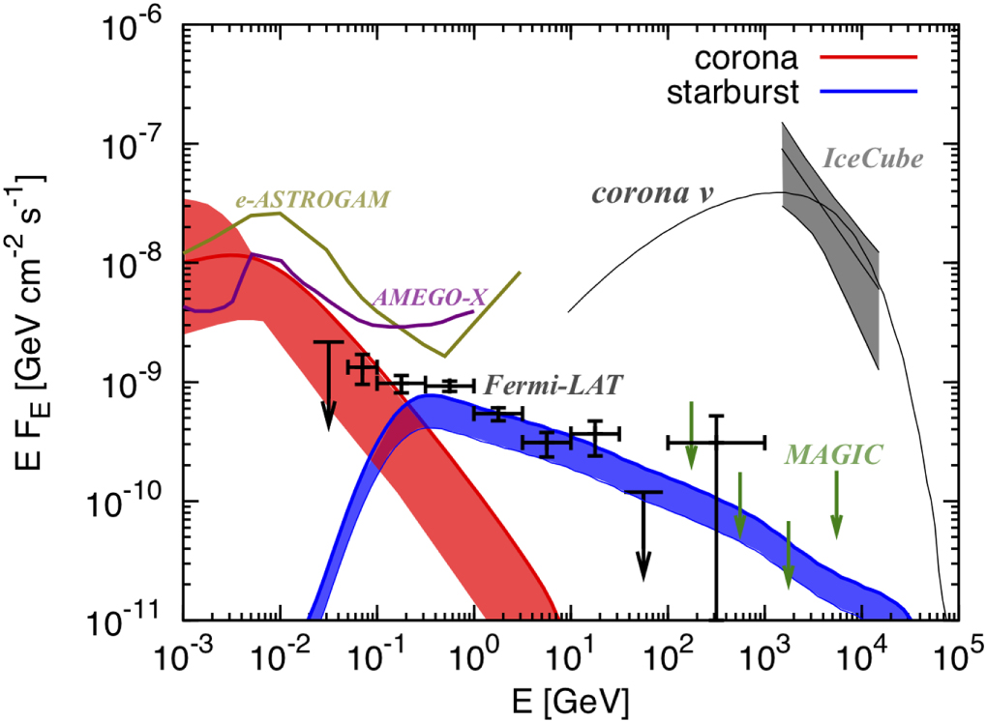
Neutrino production in coronae
Lea Marcotulli | lea.marcotulli@desy.de
High photon density (X-rays from corona) → efficient p–γ
Compact size → large interaction probability
Strong B-fields → acceleration possible (turbulence, magnetic reconnection, shocks)
High opacity → suppress gamma rays
NGC 1068
e.g., Murase+20, Inoue+21, Fiorillo+24, Mbarek+24, Lemoine+25, Yang+25, Karavola+26, Testagrossa+26, Murase+26, Das+26
Ajello+23

Slide 37
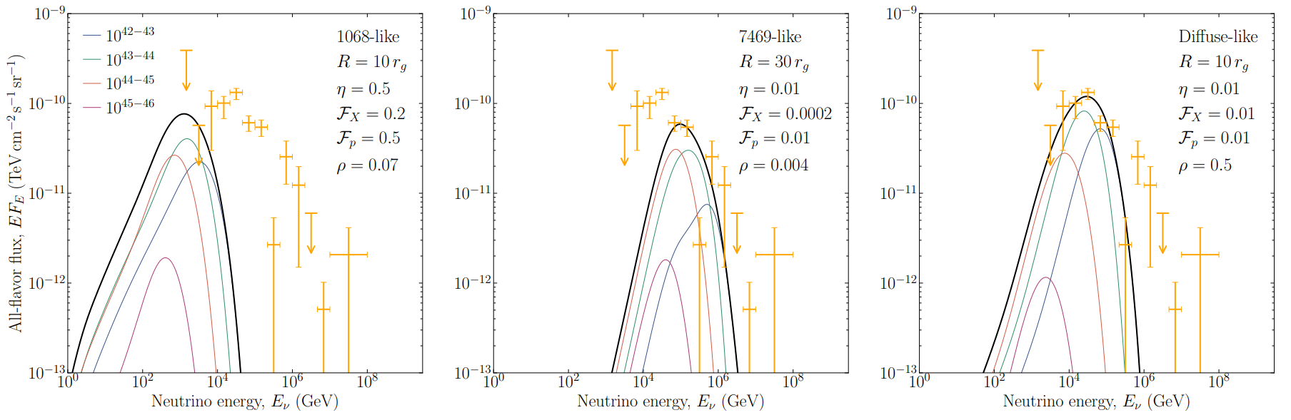
Neutrino production in coronae – background
Lea Marcotulli | lea.marcotulli@desy.de
ALL AGN ARE NGC 1068-like (heavily obscured)
ALL AGN ARE NGC 7469-like (unobscured)
MIX
NGC 1068
Testagrossa+26
Only ~4-50% of AGN can be neutrino emitters to avoid overshooting the diffuse flux
e.g., Murase+20, Inoue+21, Fiorillo+24, Mbarek+24, Lemoine+25, Yang+25, Karavola+26, Testagrossa+26, Murase+26, Das+26

Slide 38
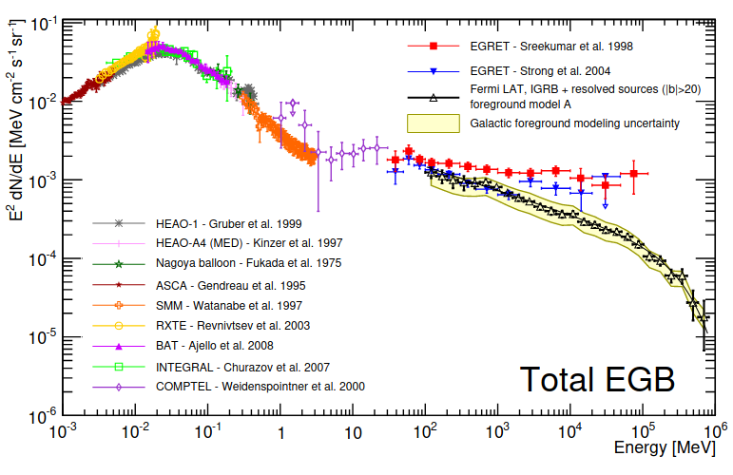
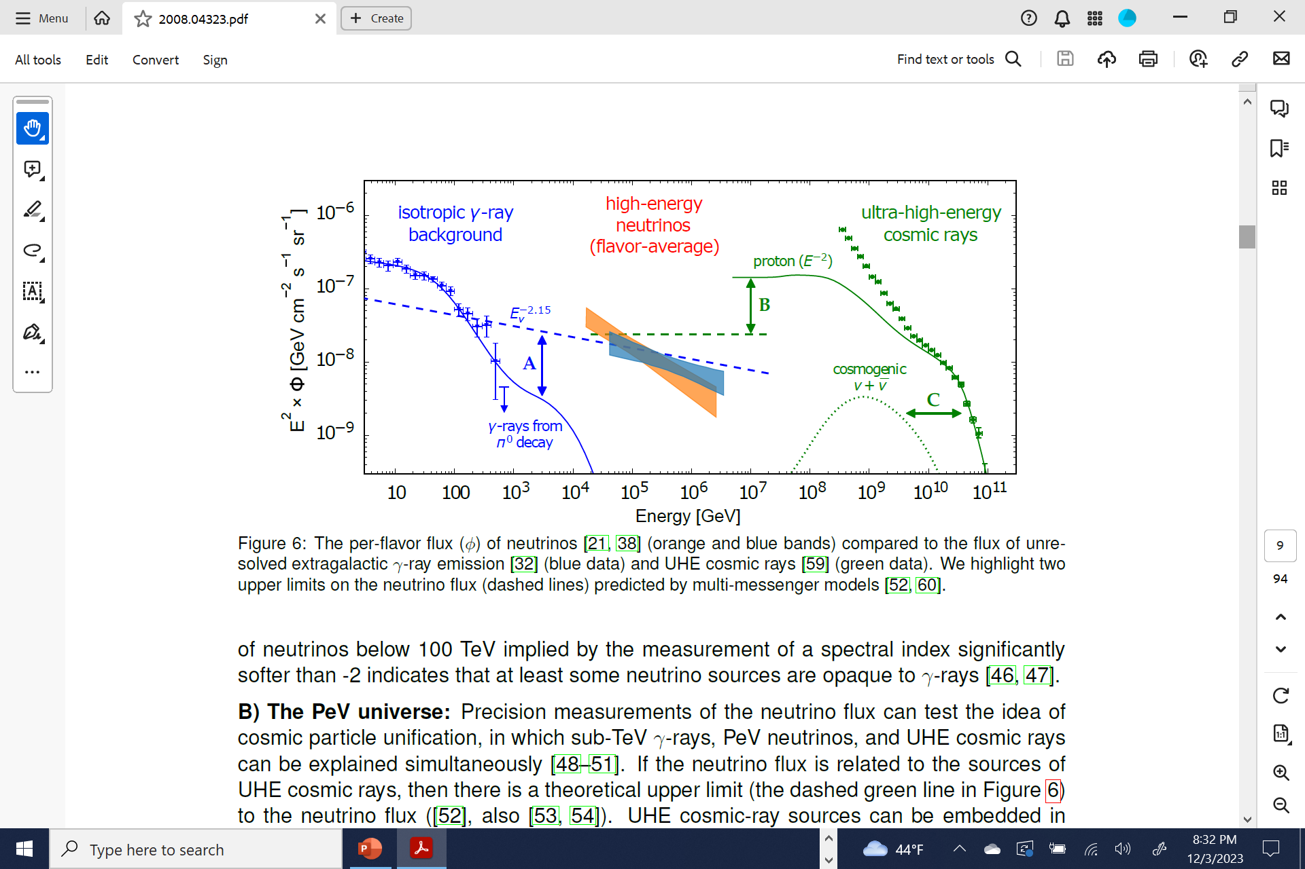
Cosmic high-energy background
AGN cumulative emission (50% heavily obscured)
ENERGY [MeV]
Ackermann et al. 2015, IceCube Coll. 2018

Slide 39

NGC 1068 – intrinsic corona spectrum
Lea Marcotulli | lea.marcotulli@desy.de
Bauer+15
Coronal cutoff 50-300 keV [not directly measured]
Γ ≈ 2.1 [not directly measured]
L_{X} (intrinsic) ~10⁴³-10⁴⁴ erg/s [not directly measured]
Compton-thick, clumpy, multi-component reflector combining a dense torus, polar dust/outflows, and extended scattering regions
see Bauer+15, Marinucci+16, Ricci+18

Slide 40

X-ray luminosity – a general problem for Compton Thick AGN
Boorman+24
DoCTA
Collection of most reliable Compton-Thick AGN to date (66 sources) including all literature X-ray luminosity measurements
Lea Marcotulli | lea.marcotulli@desy.de

Slide 41

NGC 4151 – intrinsic corona spectrum
Coronal cutoff 200 keV to >1000 keV [directly measured]
Γ ≈ 1.5-1.7 [directly measured]
L_{X} (intrinsic) ~10⁴²-10⁴³ erg/s [directly measured]
e.g. Lubinski+10, Keck+15, Beuchert+2017
Lubinski+10
Lea Marcotulli | lea.marcotulli@desy.de

Slide 42
Future Prospects
Lea Marcotulli | lea.marcotulli@desy.de

Slide 43



New High-Energy missions on the Horizon
Optimized to detect MeV lines, but has continuum sensitivity and polarization capabilities
COSI detectors, credit: John Tomsick
Compton Spectrometer and Imager (COSI)
E = 0.2 - 5 MeV
Launch 2027
Tomsick+23
Lea Marcotulli | lea.marcotulli@desy.de

Slide 44



AGN Coronae with COSI – thermal corona cutoff
Parshad Patel
9 months exposure
COSI only data
3 months exposure
Joint fit BAT + COSI data
Patel et al in prep
Patel et al in prep
Lea Marcotulli | lea.marcotulli@desy.de

Slide 45


AGN Coronae with COSI – thermal corona+non-thermal component
Parshad Patel
9 months exposure
COSI only data
9 months exposure
COSI only data
Patel et al in prep
Patel et al in prep
Lea Marcotulli | lea.marcotulli@desy.de

Slide 46


AGN Coronae with COSI – testing physical models
Parshad Patel
Testagrossa+26
Ongoing
Lea Marcotulli | lea.marcotulli@desy.de

Slide 47


A new MeV catalog – 2nd Fermi LAT Low-Energy catalog (2FLE)
Fermi LAT Collaboration in prep.
NO Seyferts detected ☹
450 sources at 5σ level (2/3 extragalactic; 1/3 galactic)
About 10% of the catalog is unassociated (new MeV emitters?)
Fermi-LAT all sky counts map (PSF3), 20-200 MeV
Lea Marcotulli | lea.marcotulli@desy.de

Slide 48

New High-Energy missions on the Horizon
Cherenkov Telescope Array Observatory (CTAO)
E = 30 GeV to 300 TeV
4 LSTs in northern site almost ready!
COSI detectors, credit: John Tomsick
Compton Spectrometer and Imager (COSI)
E = 0.2 - 5 MeV
Launch 2027
Parshad Patel - AGN Coronae with COSI
Lea Marcotulli | lea.marcotulli@desy.de

Slide 49





How to catch a snapshot of a jet?
Lea Marcotulli | lea.marcotulli@desy.de
Repointing within 3 days!!!
Coordinate simultaneous multi-wavelength campaigns with telescopes on the ground and satellites in space to look at the same source all at once → informs us on the underlying jet physics
LST-1
Effelsberg radio telescope
NuSTAR
XMM-Newton
Fermi-LAT
PI: Marcotulli
Palomar optical telescope

Slide 50

New High-Energy missions on the Horizon
Cherenkov Telescope Array Observatory (CTAO)
E = 30 GeV to 300 TeV
4 LSTs in northern site almost ready!
COSI detectors, credit: John Tomsick
Compton Spectrometer and Imager (COSI)
E = 0.2 - 5 MeV
Launch 2027
NewAthena
E = 0.2-10 keV
Launch est. 2037
Parshad Patel - AGN Coronae with COSI
Lea Marcotulli | lea.marcotulli@desy.de

Slide 51
Summary
1. Active nuclei of galaxies and their jets are multi-wavelength, multi-messenger and flickering emitters in the universe → timing is of the essence
2. AGN Coronae are excellent sites to produce neutrinos while blazar jets may not contribute significantly to the neutrino flux
3. High-energy missions (both current and future) will be necessary to continue the quests for these cosmic accelerators
Lea Marcotulli | lea.marcotulli@desy.de

Slide 52
EXTRA
Lea Marcotulli | lea.marcotulli@desy.de

Slide 53


PROSPECTS for jet detection with COSI
PRELIMINARY
~40 MeV blazars
~0-2 coincident neutrinos
Marcotulli+22
Latiolais [incl. LM]+25, under review

