Slide 1



Lessons from Analyzing the Cosmic-Ray Spectrum and Composition Across All Energies
Anatoli Fedynitch
High-Energy Theory Group
Institute of Physics, Academia Sinica
IPA 2026, Madison
Notes:
Update of GSF2017/2019 with the data of the past decade; paper in final draft (PRX).

Slide 2

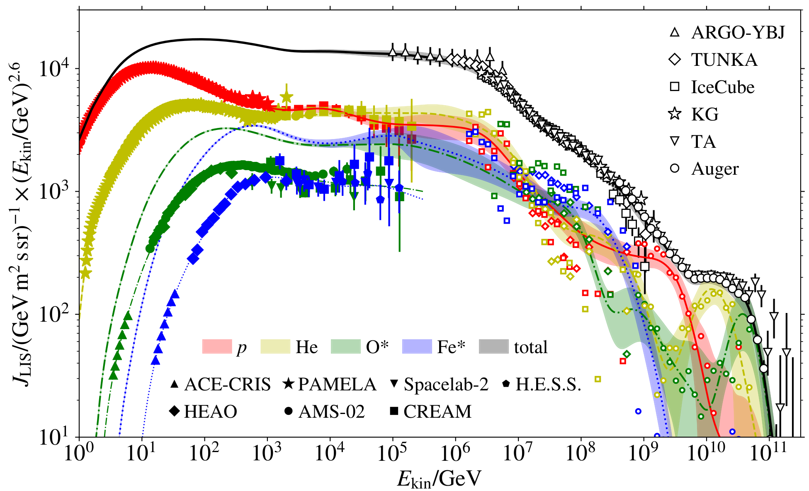
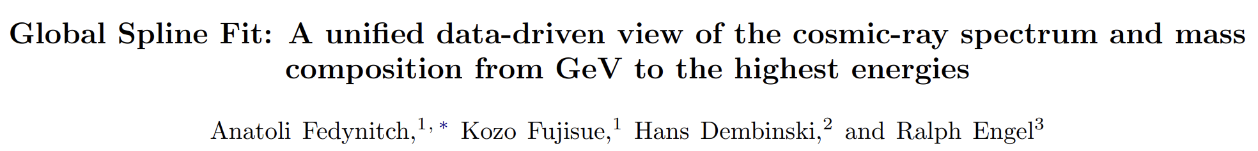
2017: a purely data-driven flux and composition model
Global Spline Fit: 2017 (Dembinski, Engel, Fedynitch, Gaisser, Riehn Stanev, PoS ICRC2017 533)
Intentionally theoretically “unmotivated”
Aim: represent the data and the uncertainties of the data
Splines as mathematical foundation, energy-scale cross-calibration between experiments
New method to connect direct to indirect experiments
arXiv:2609.32649
2

Slide 3
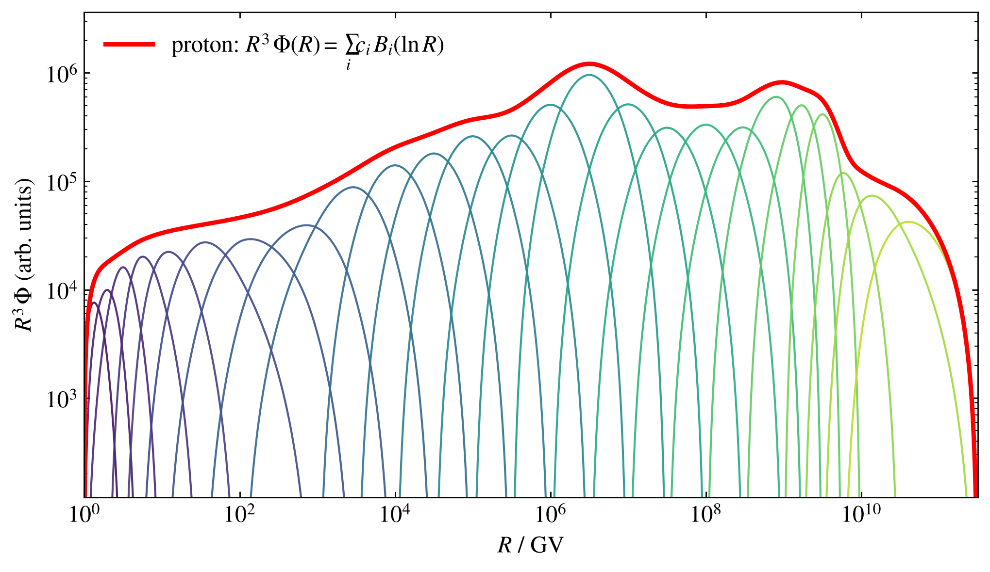
Why splines? Or: how many broken power laws can you count?
Each leading flux: R³Φ is a cubic B-spline in ln R
Smoothness, but no functional form from acceleration or propagation
No assumption needed for generations or components
Defined derivatives → defined covariance, gradient-based minimizers
Spectral features emerge from the data without being built into the model
3

Slide 4
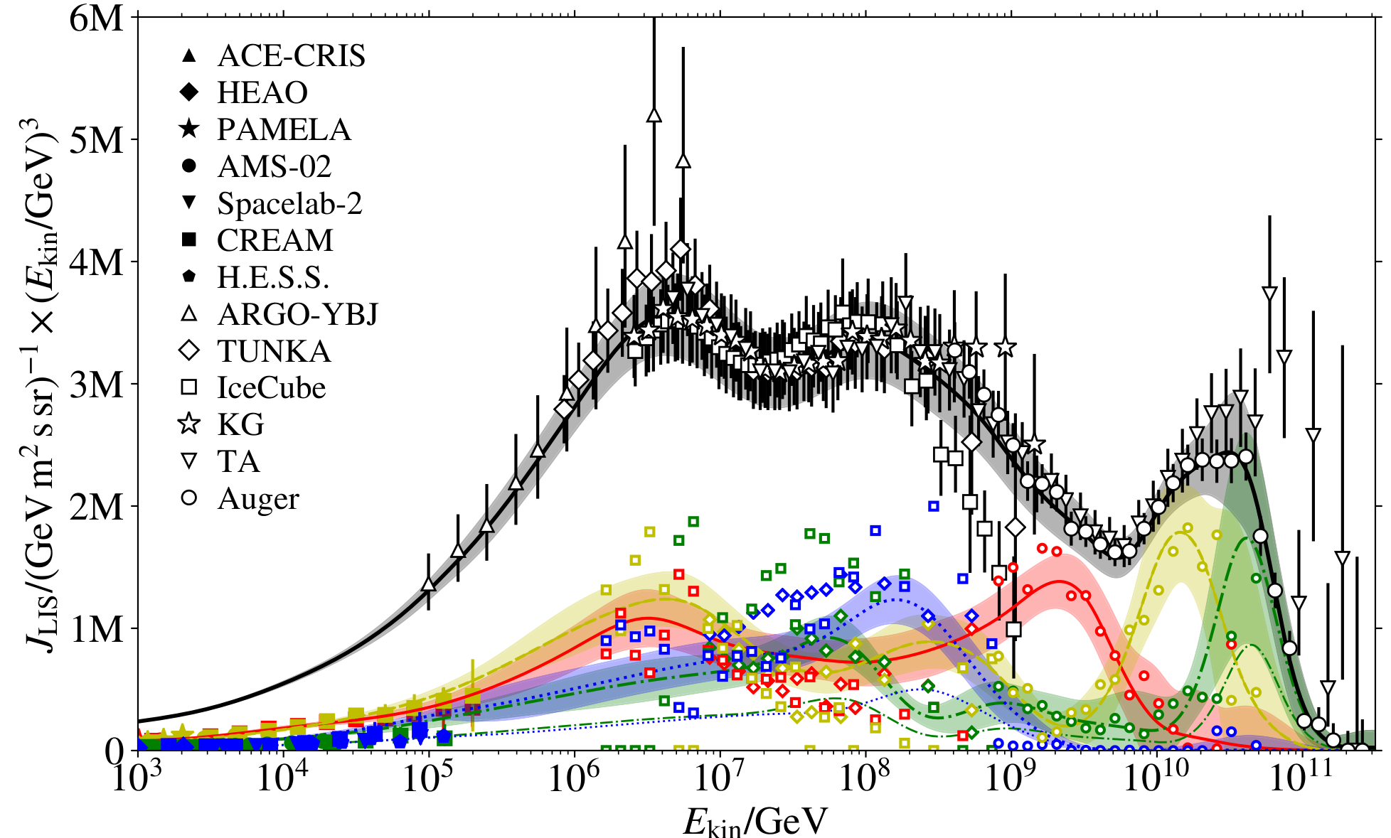
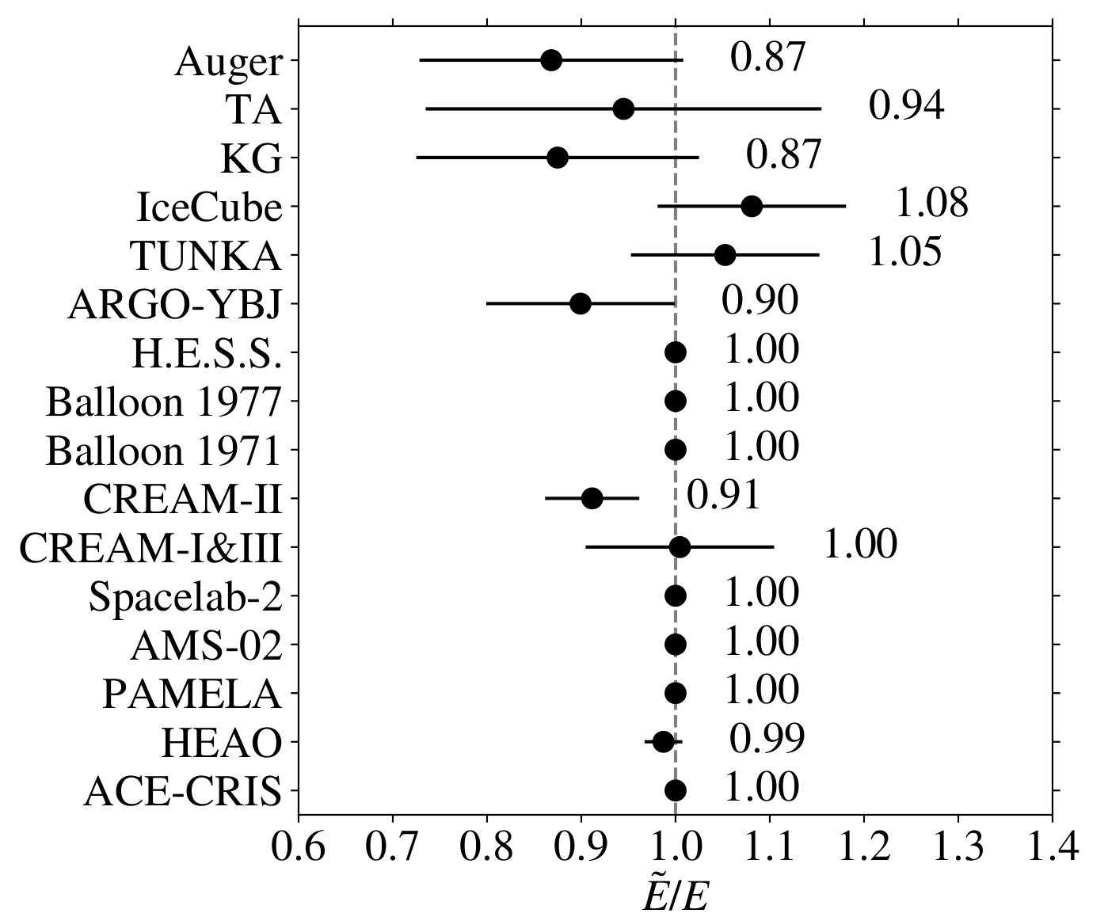
2017: what remained open
GSF 2017 energy scales
GSF 2017, all-particle flux and groups
Direct and air-shower measurements barely overlapped: the composition entering the knee was weakly constrained
The iron group above the direct range was a near-flat direction of the fit; the energy scale was the dominant flux uncertainty
No data from the recent space calorimeters
4

Slide 5
2017 → 2026: An important decade for cosmic rays < 10 PeV
Energy range | GSF 2017 | New or updated by 2026
Direct 1 GV – 100 TeV | AMS-02 (p, He), PAMELA, HEAO, CREAM | AMS-02 elements through Fe; DAMPE p, He, C, O, Fe toward PeV; CALET p, He, Ti, Cr, Ni; NUCLEON-KLEM; ISS-CREAM
Knee 100 TeV – 30 PeV | ARGO-YBJ (p+He) | LHAASO all-particle, ⟨ln A⟩, proton and helium; HAWC; GRAPES-3 proton; IceTop low-energy spectrum
Second knee 30 PeV – 1 EeV | IceCube, Tunka-133, KASCADE-Grande | IceCube/IceTop 3-yr spectrum and four mass fractions; Tunka-133 update; TALE hybrid ⟨ln A⟩
Ultra-high > 1 EeV | Auger, TA | Auger combined spectrum and 17-yr FD composition (SIBYLL-2.3e / EPOS-LHC-R); TA surface detector
Full dataset list and treatment: GSF 2026 paper, Table I (≈18 experiments, 15 fitted energy scales)
5

Slide 6
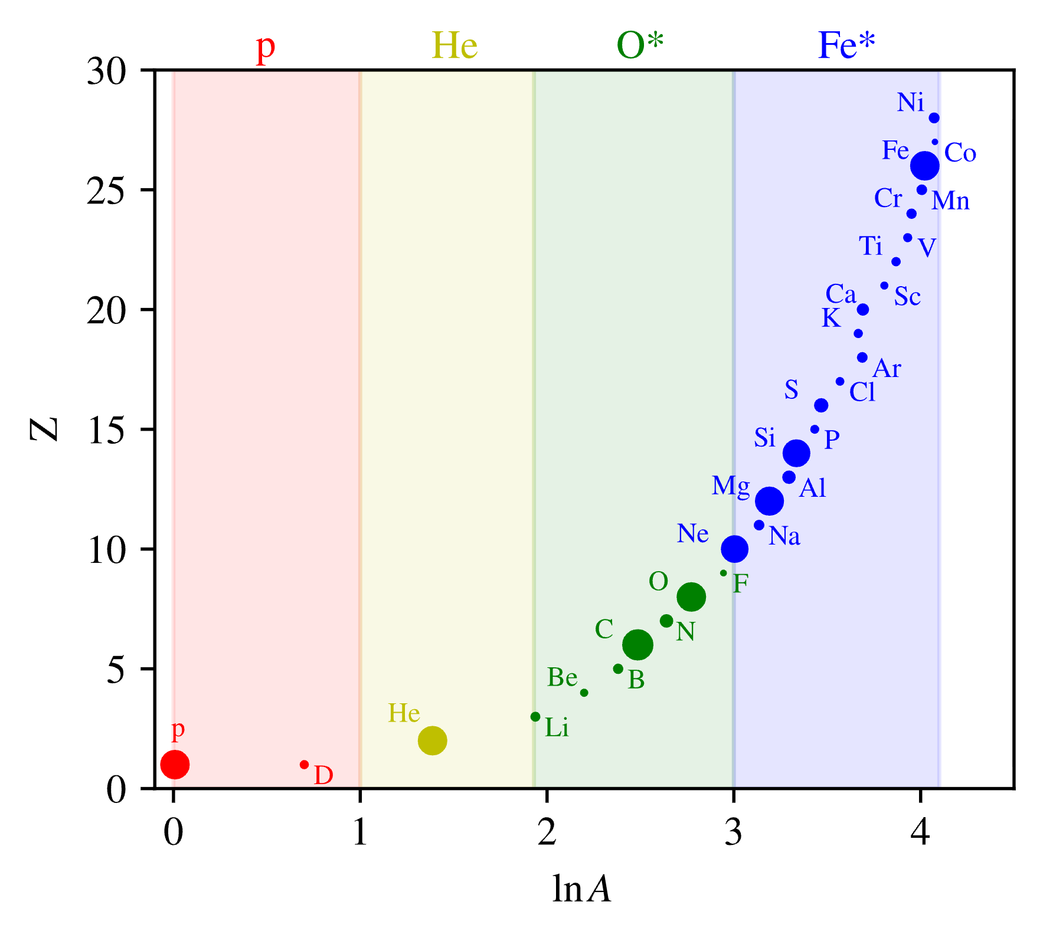
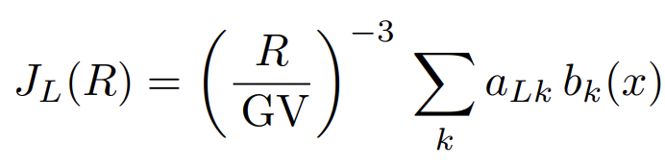
How GSF works
Four mass groups H*, He*, O*, Fe*, roughly equal intervals in ln A: roughly the mass resolution of air shower arrays
Leading fluxes are cubic B-splines in log rigidity: smoothness, no functional form from acceleration or propagation
Sub-leading elements: own short splines in the direct range; defined as a scale relative to their group leader
Model lives as Local Interstellar Spectrum (LIS), then forward-folded with a force field approximation to each experiment's observation window
274 free parameters incl. 15 energy scales; written in JAX and auto-derivatives; published covariances of the data used directly
Basis groups are B-splines (b) in x = ln(R) with rigidity (R)
6
Notes:
Recap only; no new content on this slide. Four leading mass groups at roughly equal intervals in ln A, matching air-shower mass resolution; each leader is a clamped cubic B-spline in ln(R/GV) with an R^-3 prescale. Sub-leading elements are carried within their group; the all-particle flux is the sum. Per-experiment energy-scale offsets are fitted simultaneously, penalized within the quoted systematics, which cross-calibrates direct and air-shower measurements. Deliverable: best-fit spectrum with full covariance, usable for mean ln A, mass fractions, nucleon flux.

Slide 7
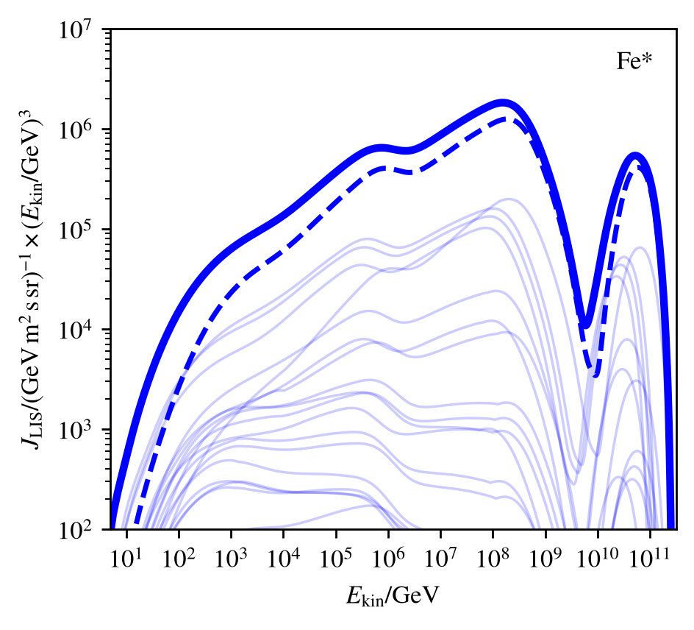
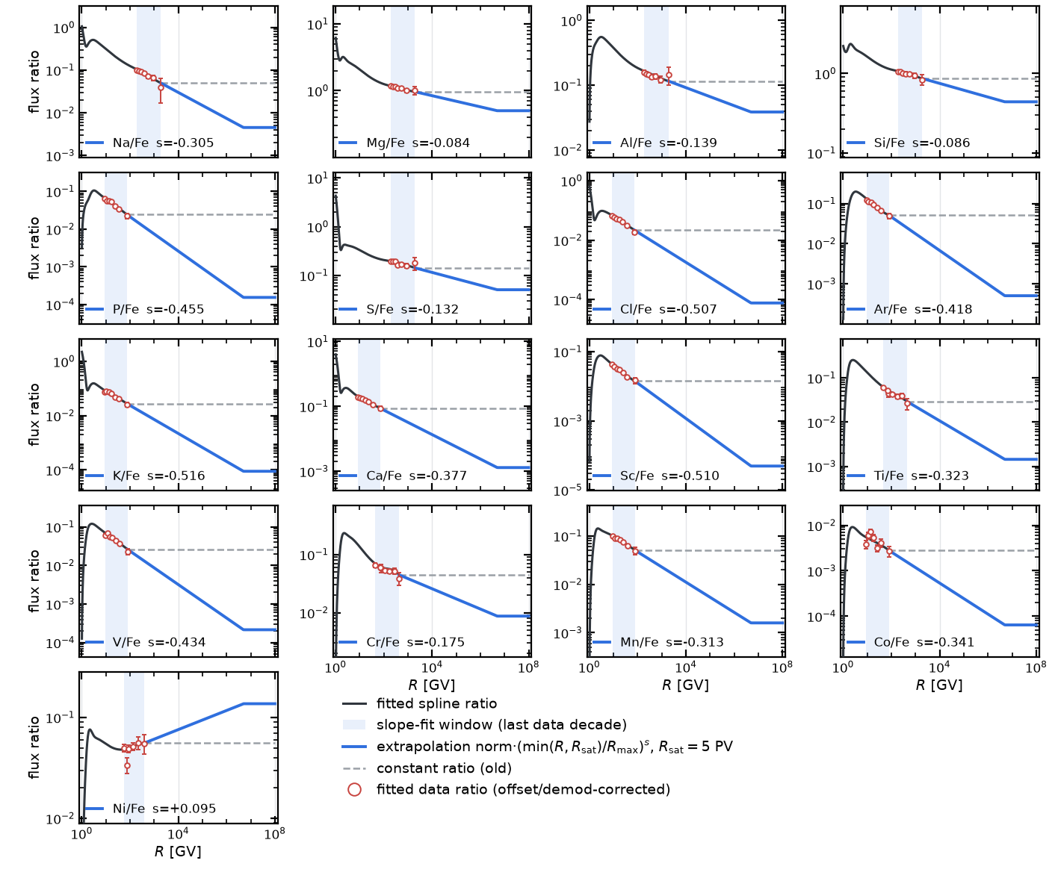
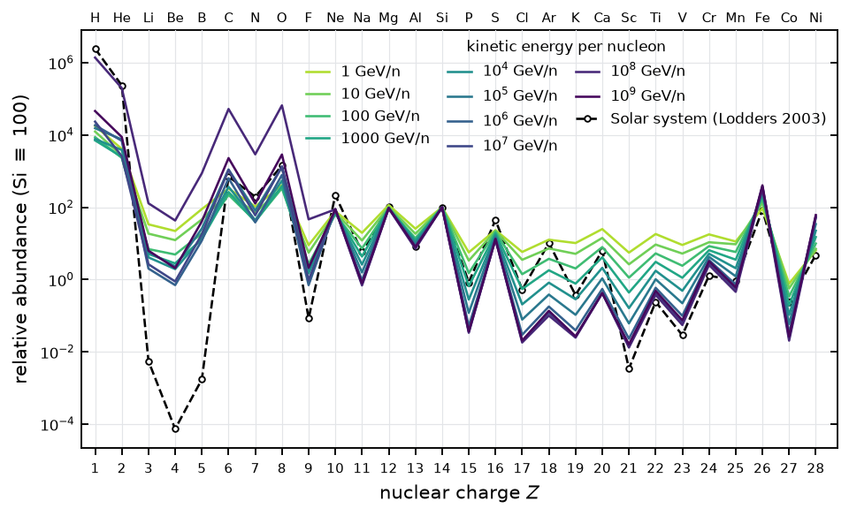
Fe* group: members
Leading and sub-leading components
Sub-leading/leader ratios
7

Slide 8
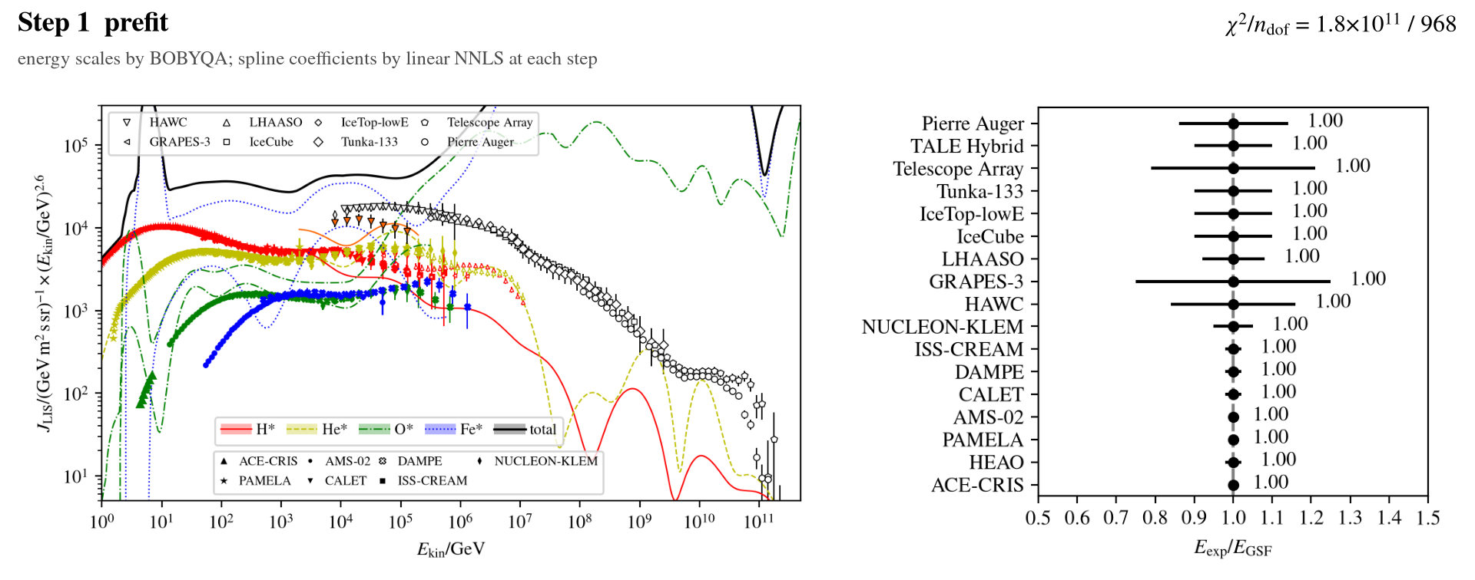
How the fit proceeds
Warm start: energy scales by BOBYQA (NLOPT), spline coefficients by NNLS; then a Gauss–Newton fit of all parameters
Where the ensemble disagrees, data are de-weighted beyond their published errors (PDG scale factors), then refit; the band is prevented from shrinking
Fit with the Auger EPOS-LHC-R interpretation
8

Slide 9
Method: 2017 vs 2026
 | GSF2017/2019 | GSF2026
Free parameters | 268 | 274
Sub-leading | constant flux ratios above max rigidity | own splines, then extrapolated ratios up to a max rigidity
Range | ~few GV upward | 0.5 GV upward
Solar modulation | data demodulated with a single eff. potential | forward-folded from LIS → observation window
Uncertainties | stat (+) sys in quadrature | correlated sys, published covariance blocks
Hadronic models | min/max over models | UHECR SIBYLL2.3e (+) EPOS LHC-R mixture covariance. Still not possible to get “Single-Model Interpretation” over wide energy range)
9
Notes:
Highlight three rows: sub-leading treatment, solar modulation, covariance philosophy (the band is constructed to cover the spread between experiments). Details if asked: 321 amplitudes, 250 free; power-law ratio extrapolation saturating at R = 5 PV, AMS-02 deuteron carried under p; forward-modeled LIS x force field with monthly phi(t) (Ghelfi-Maurin-Derome), 9 fitted phi shifts; covariance blocks from IceCube fractions, Auger FD posterior, LHAASO p/He; covariance scaled by chi^2_corr/ndof; two single-model fits combined as a SIBYLL + EPOS mixture.

Slide 10
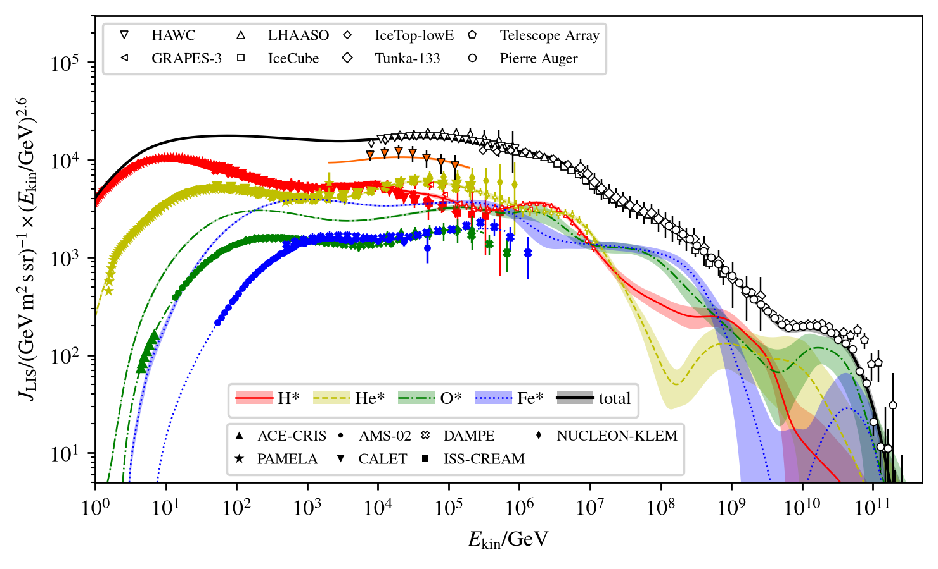
GSF 2026
One model for direct and air-shower data, 0.5 GV to 10¹¹ GeV (χ²_{corr} = 805/972 = 0.83)
10
Notes:
chi^2 = 1260/971 = 1.30 before the weight correction; chi^2_corr = 807/971 = 0.83 after the two-pass PDG per-bin de-weighting of localized disagreements. Fit range extends down to R = 0.5 GV (ACE-CRIS solar-minimum spectra). Alternative all-particle figure (cr_flux_all) is in backup.

Slide 11
GSF 2026
Direct
Knee
Second knee
Ultra-high
One model for direct and air-shower data, 0.5 GV to 10¹¹ GeV (χ²_{corr} = 805/972 = 0.83)
11

Slide 12
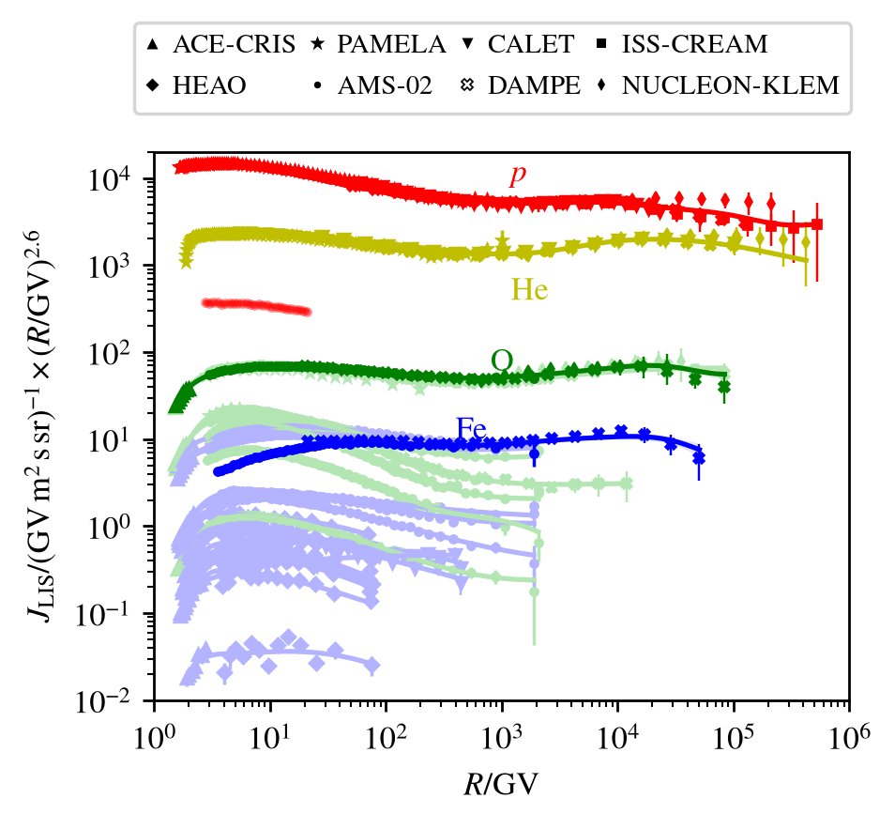
Direct: 1 GV – 100 TeV
The landscape changed most on the direct side
AMS-02: elemental spectra from hydrogen to iron
DAMPE: p, He, C, O, Fe with a common softening
CALET and DAMPE extend calorimetry; charge-resolved data reach almost to the PeV scale
Direct 1 GV – 100 TeV
12

Slide 13
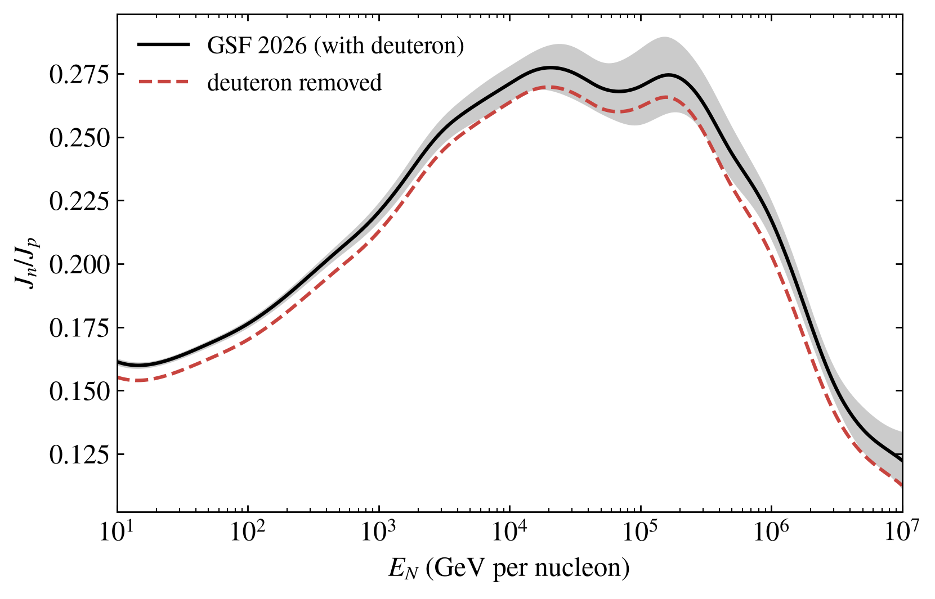
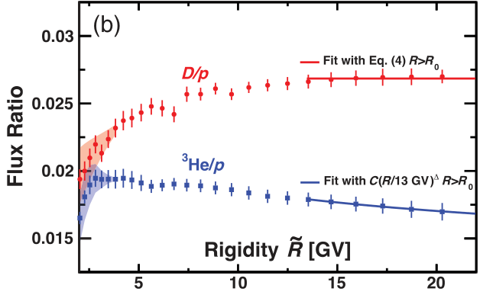
Deuterons
New in GSF 2026: the AMS-02 deuteron flux, carried as a sub-leading Z = 1 species of the Hydrogen group
The AMS-02 proton spectrum is deuteron-subtracted, so D adds to the hydrogen flux
Raises the neutron fraction n/p at all energies
Muon charge ratios from GSF nucleon fluxes expected slightly lower
AMS-02, PRL 132 (2024): D/p
GSF 2026 neutron fraction, with and without the deuteron contribution (same fit)
13

Slide 14
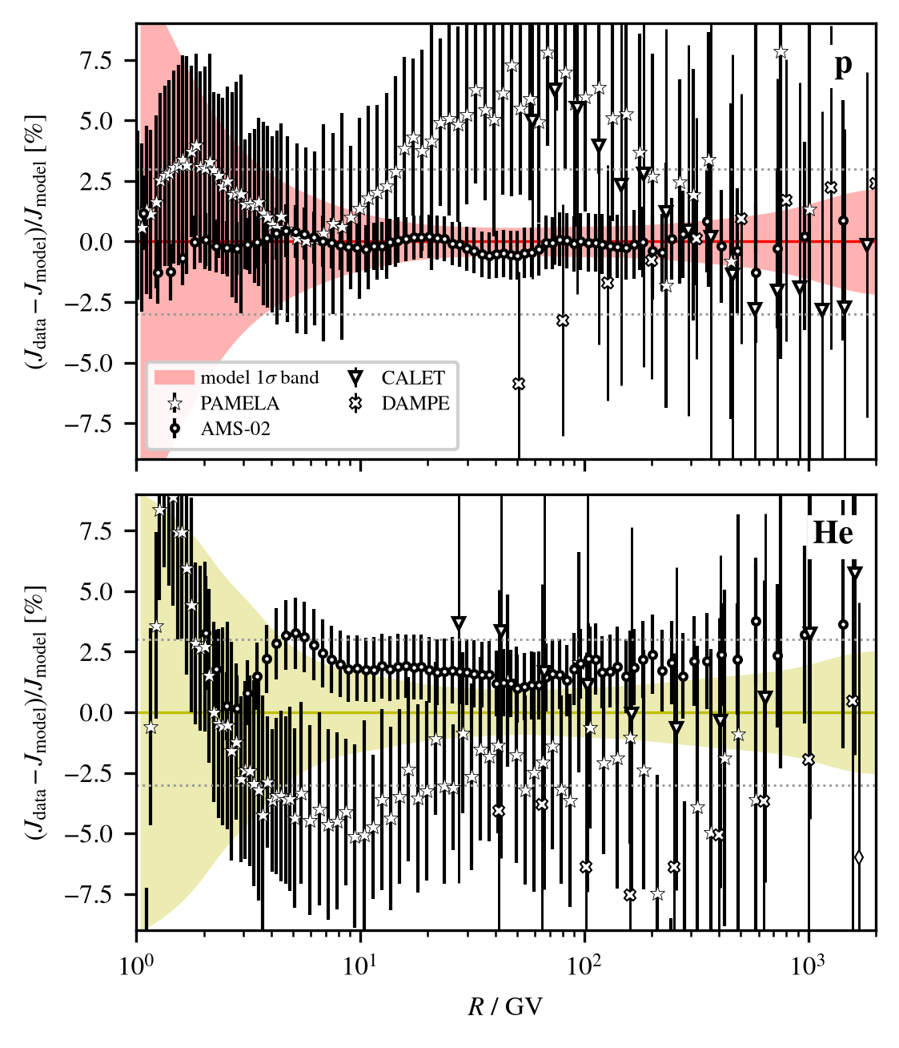
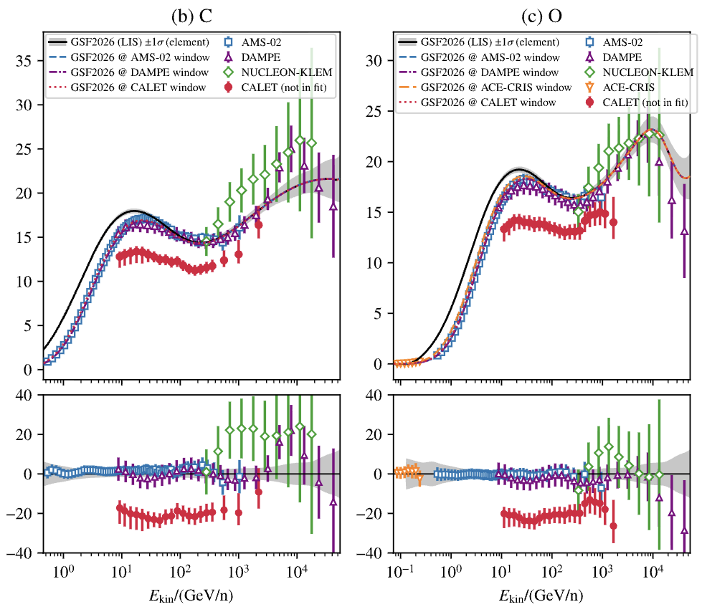
p and He residuals at low rigidity, relative to GSF 2026
AMS-02 versus PAMELA
The strongest low-energy de-weighting is for helium, where AMS-02 and PAMELA disagree
The lowest PAMELA helium points are too steep for modulation (without breaking protons) and not seen by AMS-02: likely a PAMELA systematic
Sources of the PAMELA and CALET tensions with AMS-02 unclear, some CALET datasets excluded
Direct 1 GV – 100 TeV
14

Slide 15
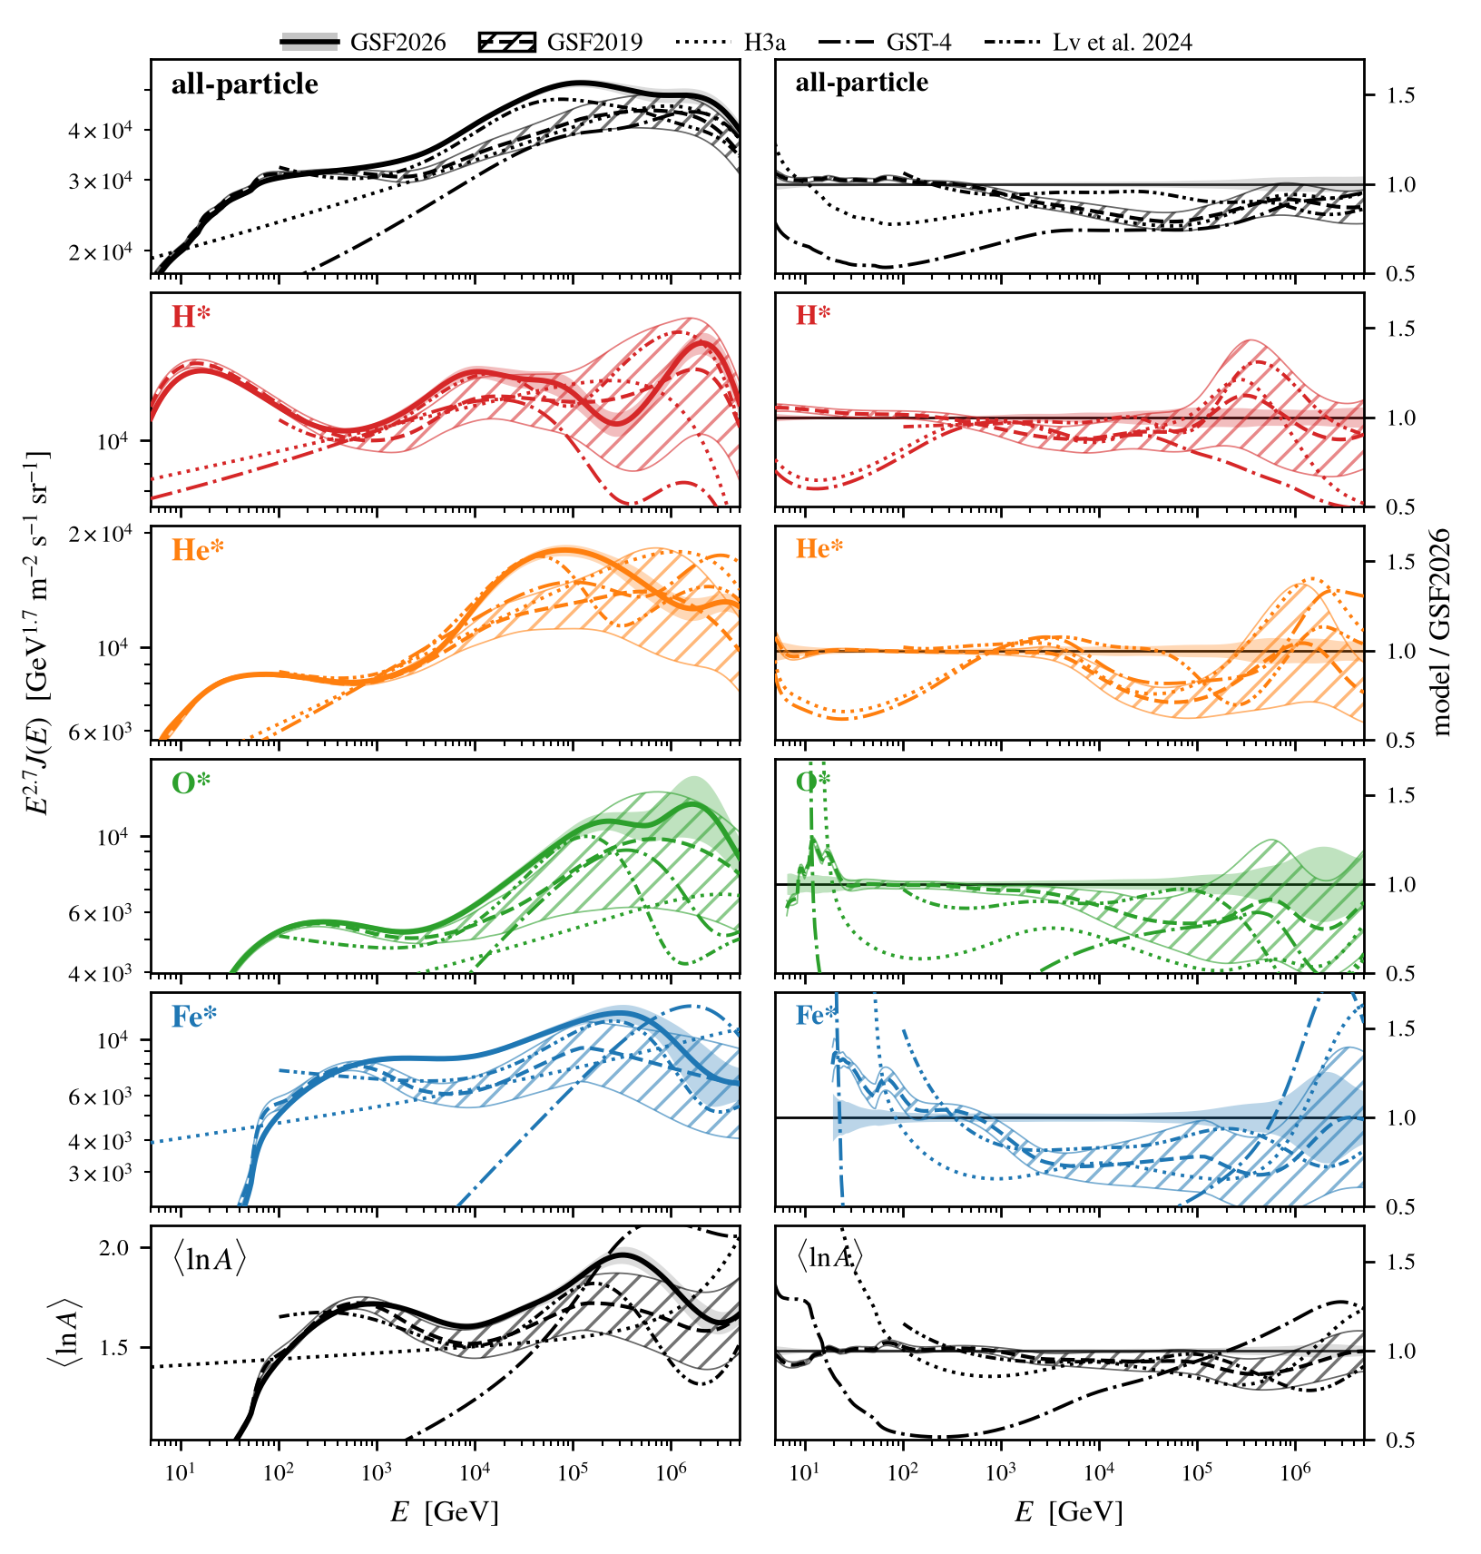
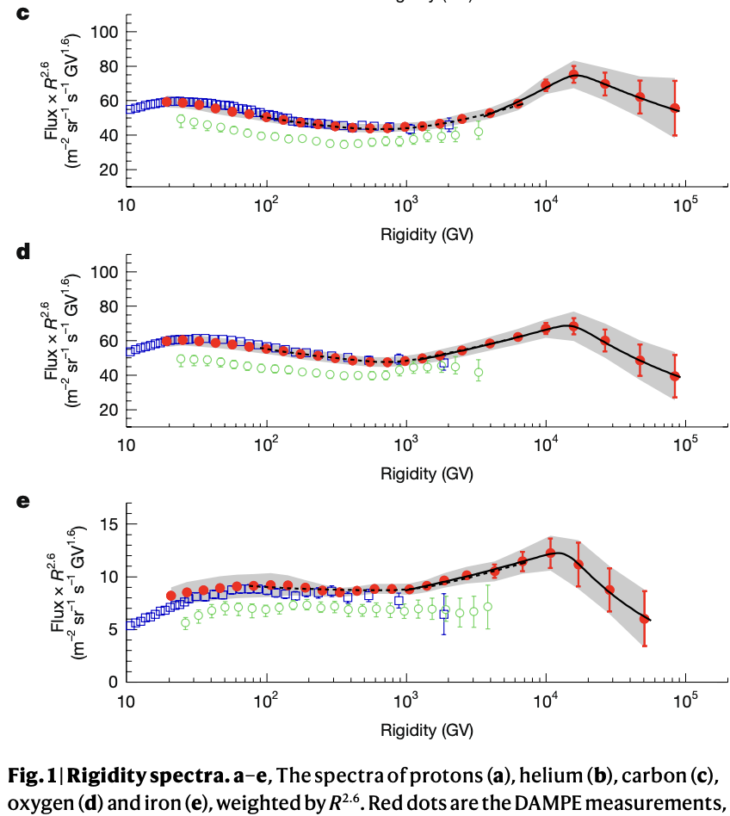
Impact of DAMPE
DAMPE, Nature (2026)
DAMPE covers p, He, C, O, Fe and sees a common softening near 15 TV
The iron group, almost flat in previous GSF, is now constrained directly
Heavy fluxes entering the LHAASO range are anchored by direct data
Direct 1 GV – 100 TeV
15
Notes:
TO SETTLE: exact wording of the outside-the-band statement (which groups and energy range). The manuscript states it for the iron group at 10^4 to 10^5 GeV. DAMPE-2025 gives p, He, C, O, Fe rigidity spectra to ~100 TV (Fe to ~1.5 PeV total energy) with a common softening near 15 TV/Z. The GSF2019 iron group at 10^4 to 10^5 GeV was constrained only by sparse IACT data and formed a near-flat direction of that fit. Treatment detail if asked: DAMPE-2025 is top-of-atmosphere and period-averaged over 2016-2024, which moved its fitted energy scale from -1.4 sigma to -0.7 sigma.

Slide 16
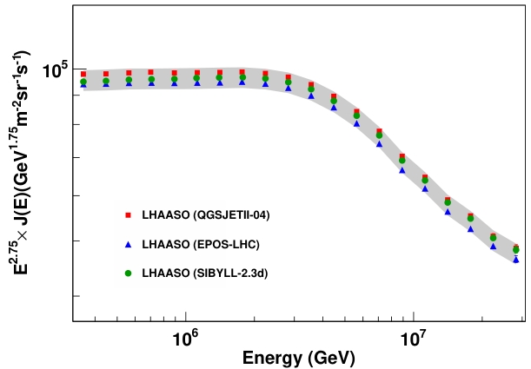
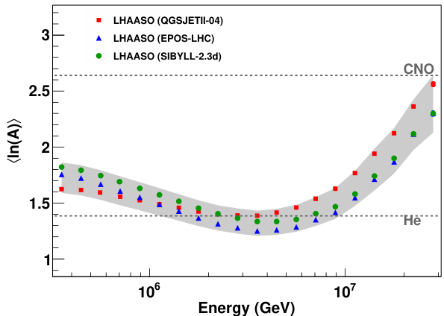
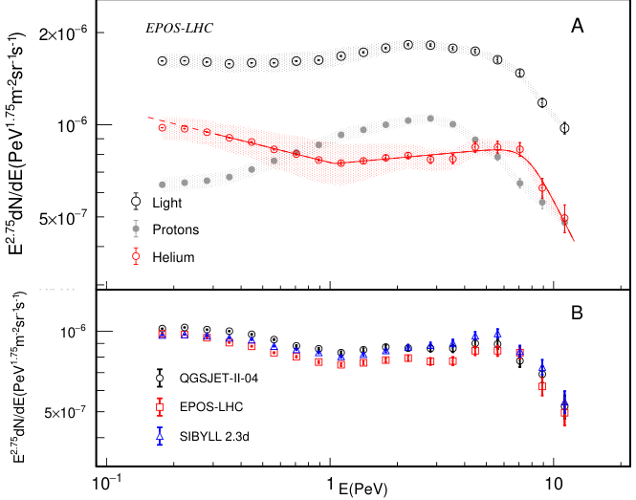
LHAASO, PRL 132 (2024): all-particle
LHAASO, PRL 132 (2024): ⟨ln A⟩
Knee: 100 TeV – 30 PeV
LHAASO, PRL 136 (2026): helium
LHAASO is the elephant in the room
Measured so far all-particle flux and ⟨ln A⟩ with a composition-independent energy scale (surface det.; muon + electron number)
Energy scale calibrated with the cosmic-ray Moon shadow, PRD 112, 123051 (2025)
Proton and helium spectra through the knee (Sci. Bull. 70, 4173–4180 (2025) & PRL136); KM2A + surface
HAWC, GRAPES-3, IceTop low-energy in the overlap with direct data
LHAASO (2026): light, proton, helium
Knee 100 TeV – 30 PeV
16

Slide 17
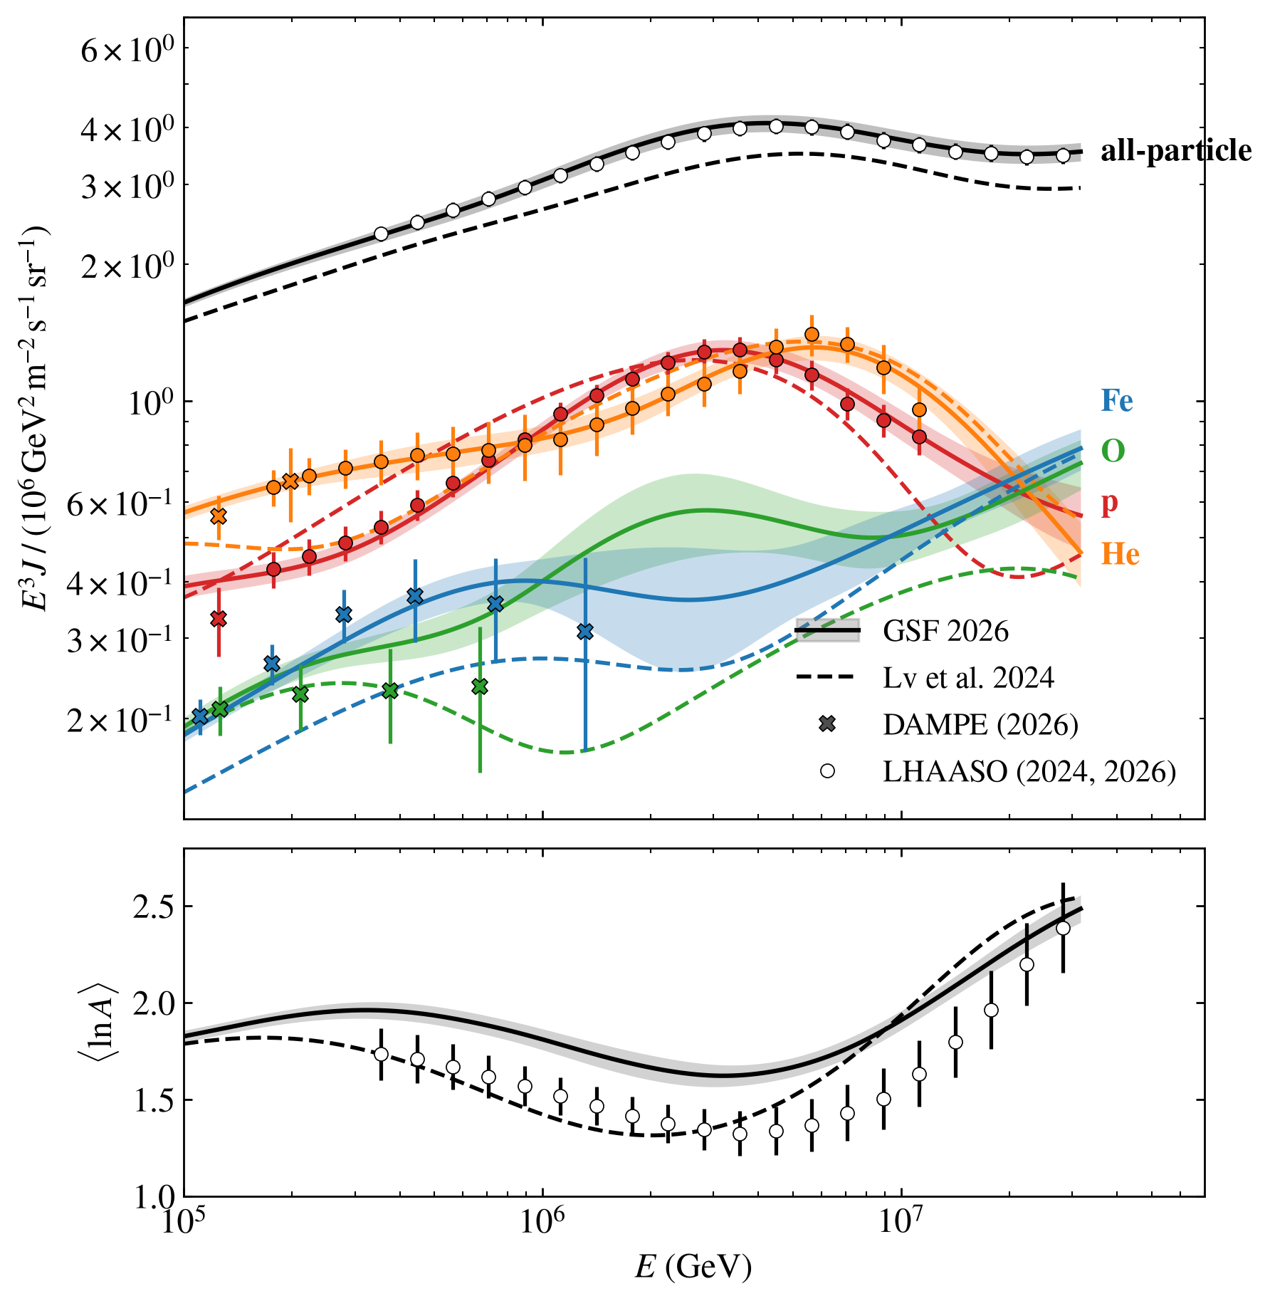
Deeper look at LHAASO
The fit reproduces LHAASO's light fraction but implies a heavier ⟨ln A⟩ than published
Neither hadronic model, spline freedom nor data removal can fix this; the only way to fit all 3 datasets is to set heavy fraction to ~0
Presence of O, and Fe in DAMPE results disfavor the “ultra-light” knee
GSF: left as is, admitting a tension in lnA
LHAASO, PRL 136 (2026)
p+He almost saturate the all particle flux
Knee 100 TeV – 30 PeV
17
Notes:
The fitted (p+He)/all ratio matches the LHAASO flux measurements at the percent level across 0.3-3 PeV. That composition is a mean ln A 0.2-0.3 heavier than the value LHAASO publishes from the same detector (1.58 vs 1.32 at the 10^15.5 eV dip), giving pulls of +1.5 to +2.4 sigma. The pulls are robust: the hadronic-model spread is folded into the published uncertainties, and extra spline freedom or removing other datasets leaves them unchanged. Possible resolutions: an underestimated systematic in one of the two KM2A analyses, or a knee composition dominated by elements lighter than the N-O mass scale. The LHAASO-anchored model of Lv et al. reaches the lighter mean ln A with an iron flux about 0.4x what DAMPE measures, so the direct iron data disfavor it. Reported in the paper as a result and a target for the next composition analyses. Caveat: the LHAASO p/He 2025 analysis uses GSF as its composition prior; independent anchors are the KM2A all-particle flux and the IceCube/Tunka fractions.

Slide 18
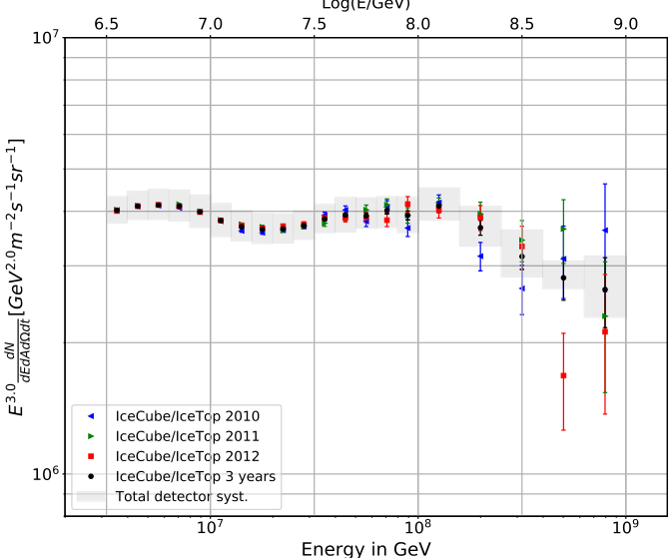
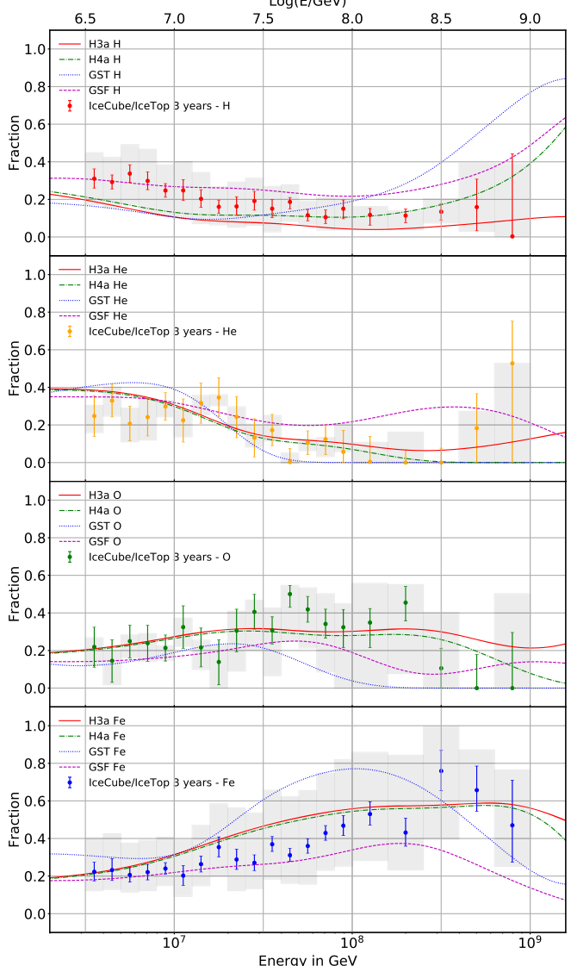
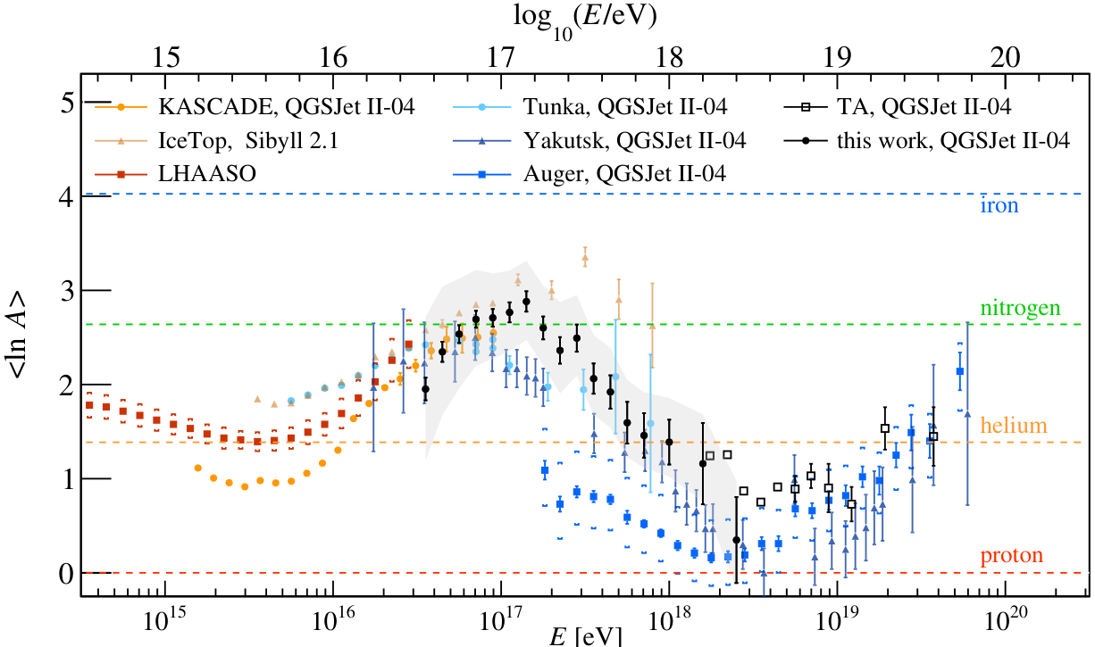
IceCube, PRD 100 (2019): spectrum
IceCube (2019): fractions
Second knee: 30 PeV – 1 EeV
IceCube/IceTop: spectrum and four mass fractions with published correlations → I was surprised how important the measurement is
TALE hybrid constrains ⟨ln A⟩ across the second-knee region; but no Cov for mass fractions ☹
Tunka-133 flux overlaps with IceCube/IceTop but less constraining
KASCADE-Grande incompatible even with a large energy-scale shift
TALE hybrid (2026): ⟨ln A⟩ compilation
Second knee 30 PeV – 1 EeV
18

Slide 19
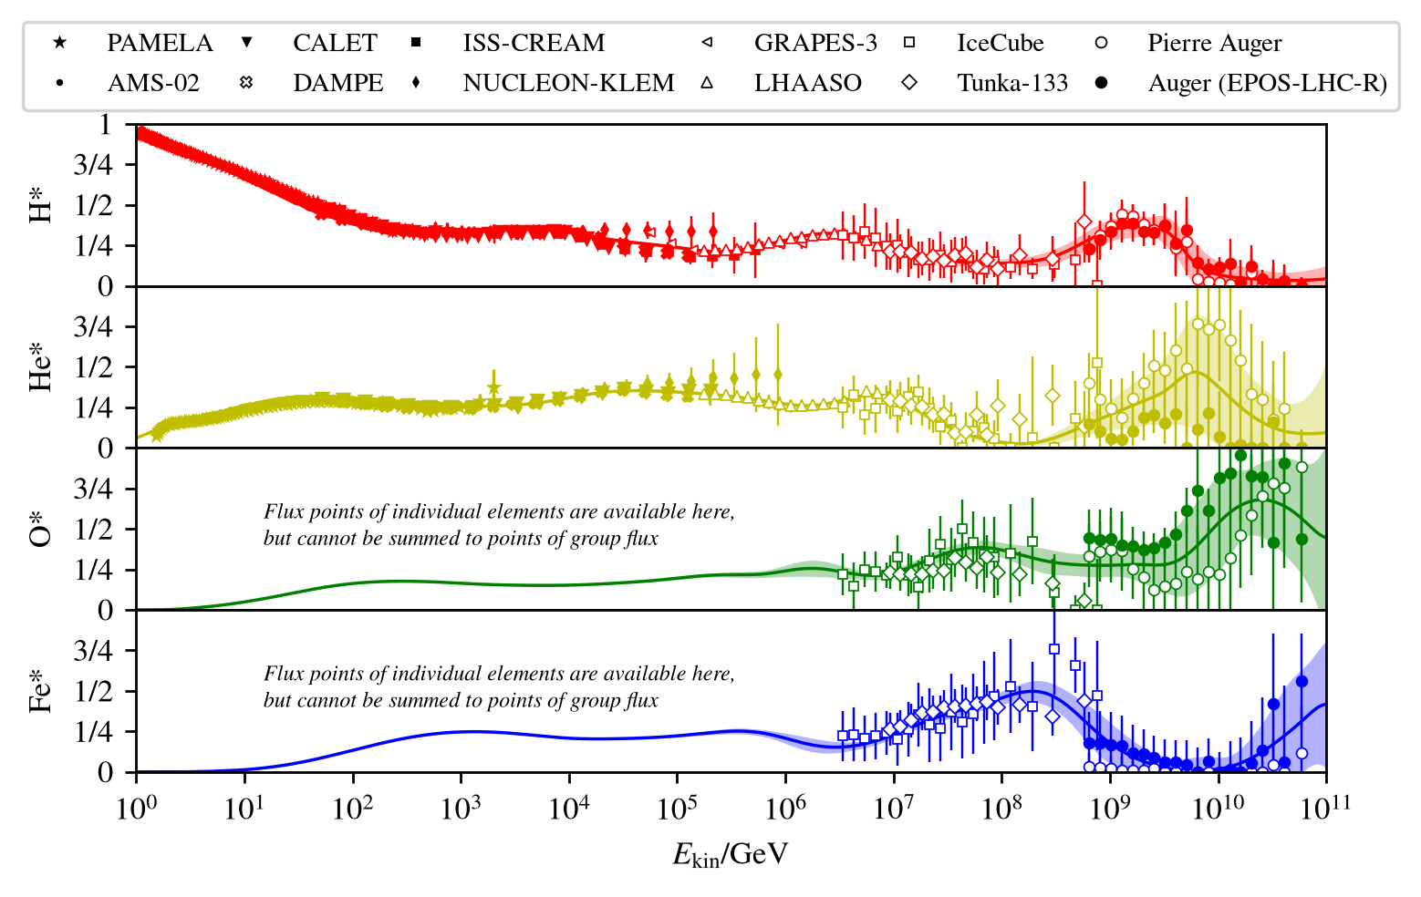
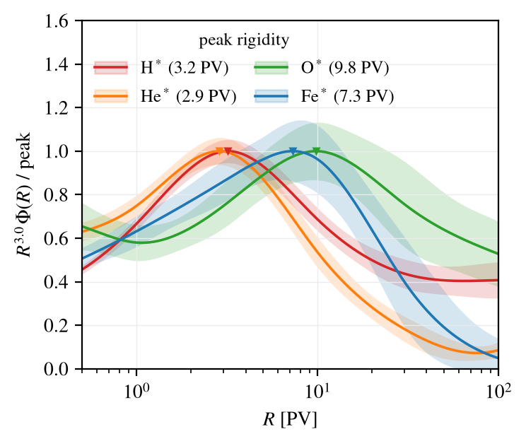
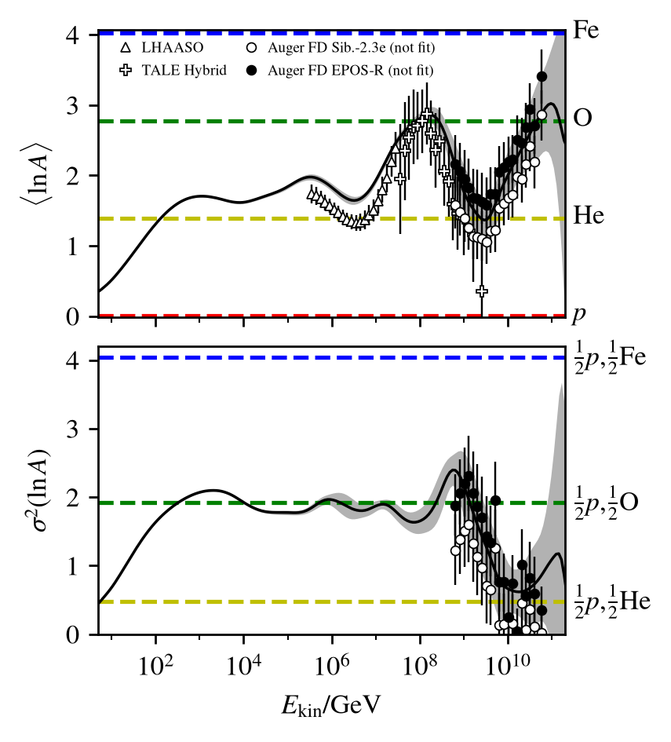
Second knee: the end of the galactic spectrum?
Group spectra in rigidity, peak-normalized
H*, He*, Fe* knees compatible with a common cutoff rigidity (Peters cycle); O* less clear
Resembles a Peters cycle; a decisive test needs more precise heavy-group spectra (IceTop, TALE, Auger?)
Second knee 30 PeV – 1 EeV
19

Slide 20
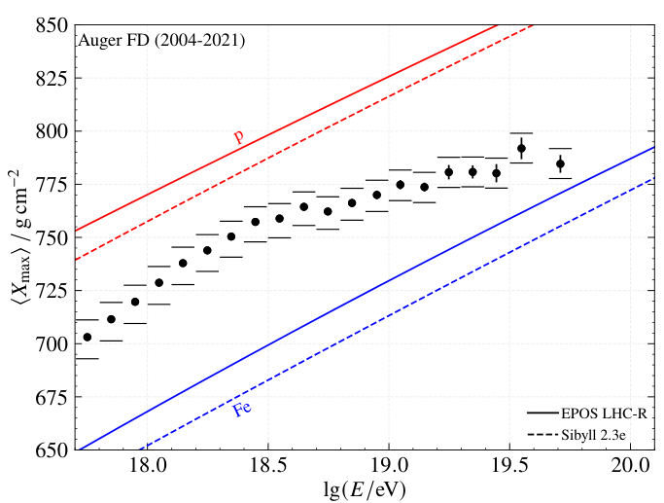
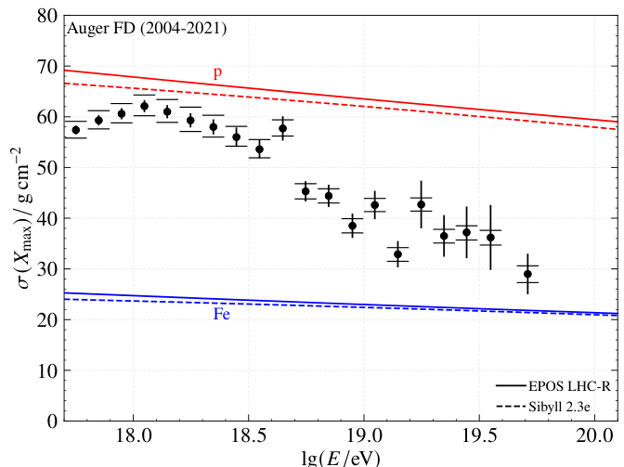
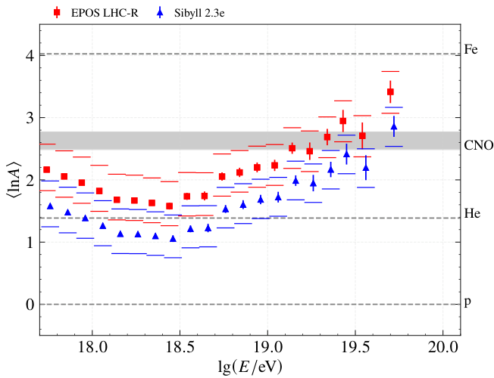
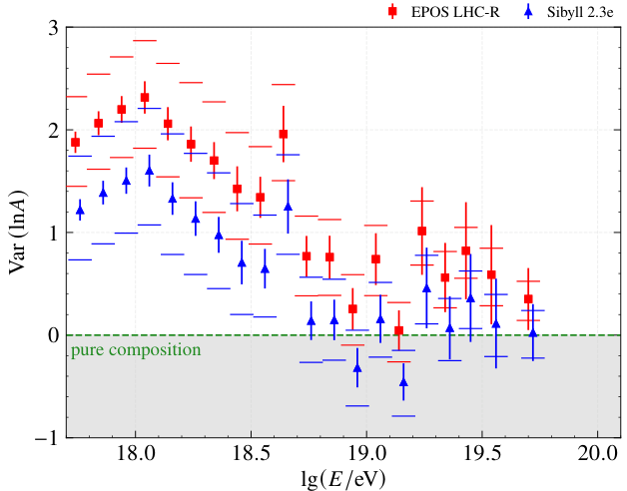
Auger FD (2026): ⟨Xmax⟩
Auger FD (2026): σ(Xmax)
Ultra-high: > 1 EeV
Auger FD composition from the 17-year fluorescence-detector analysis (PRD114, 2026)
Published trials (10k mass spectra within the data posterior) ~ better than Covariance
“Supersedes” DNN SD dataset
Interpretations under SIBYLL-2.3e and EPOS-LHC-R differ strongly
TA: updated spectrum
Auger FD (2026): ⟨ln A⟩
Auger FD (2026): Var(ln A)
Ultra-high > 1 EeV
20

Slide 21
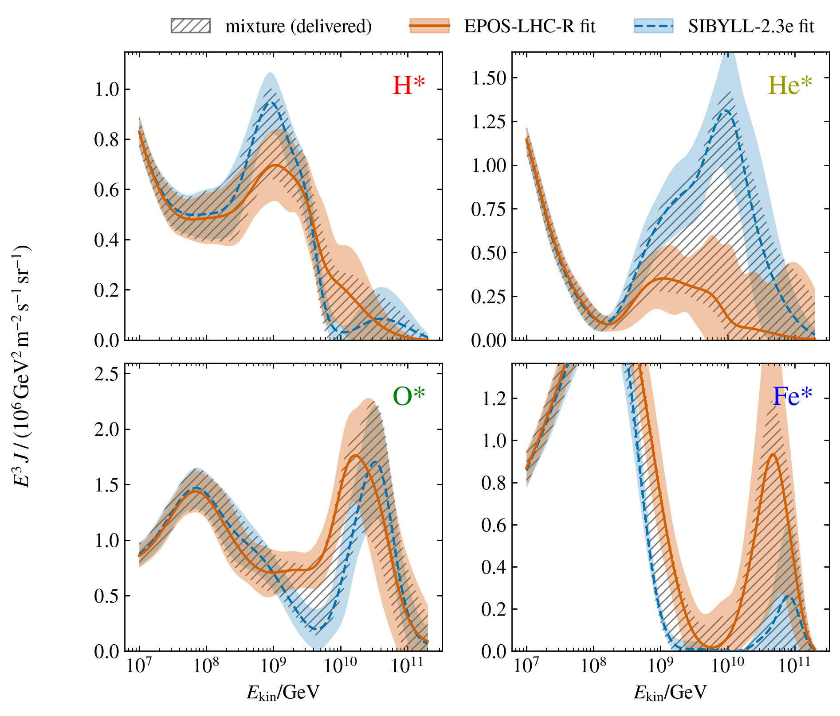
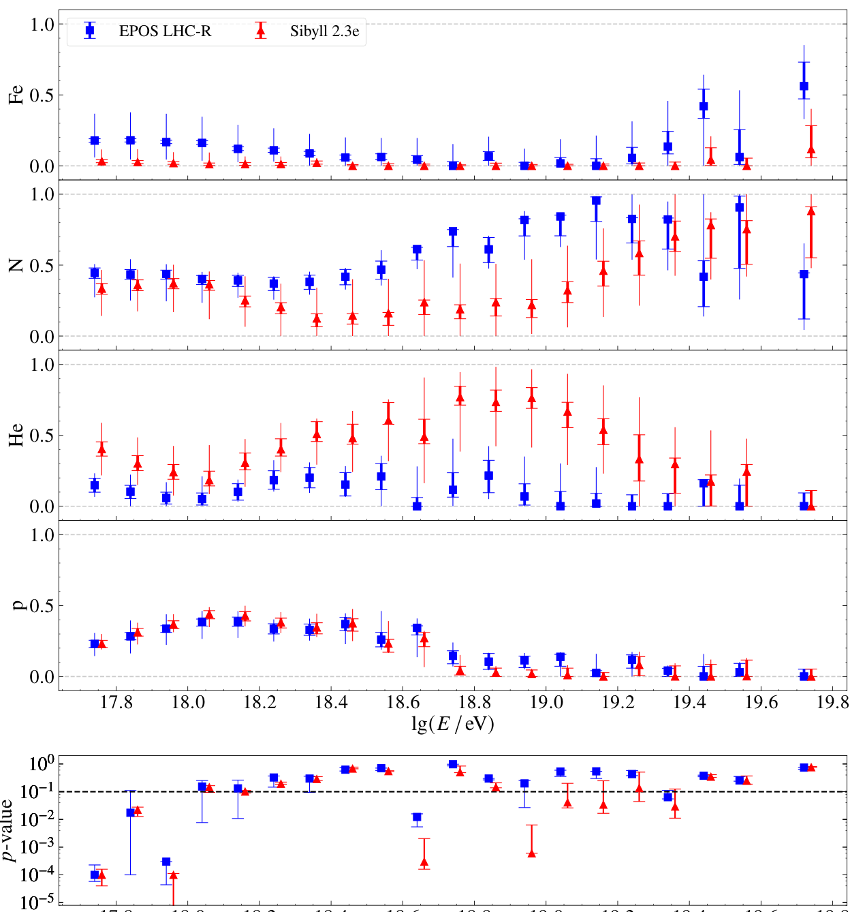
GSF mixture model SIBYLL-2.3e versus EPOS-LHC-R
Pierre Auger Coll. 2605.12598 (2026)
Ultra-high > 1 EeV
21
Notes:
TO SETTLE: whether to quote quantitative divergence numbers (Fe* ratio, mean ln A at 10^11 GeV). The available numbers are from the 2026-07-05 exploratory run and predate the current deliverable; re-derive from the adopted fit first. The Auger FD Phase-I fractions are published under both post-LHC models with per-bin posterior correlations. EPOS-LHC-R is substantially heavier above the ankle, larger Fe and smaller He; the interpretations coincide below ~2x10^8 GeV, so the choice never propagates to the knee. The two fits are of equal quality: 807/971 versus 806/969, both 0.83. SIBYLL-2.3e is the baseline for composition continuity: no other dataset in the fit is EPOS-interpreted, and EPOS alone would imprint an artificial step against the QGSJET-interpreted TALE range. Delivered uncertainty combines the two fits at parameter level as an equal-weight two-point mixture; the band spans both single-model solutions. Energy scales are insensitive to the swap (Auger f_e changes by +0.4%).

Slide 22
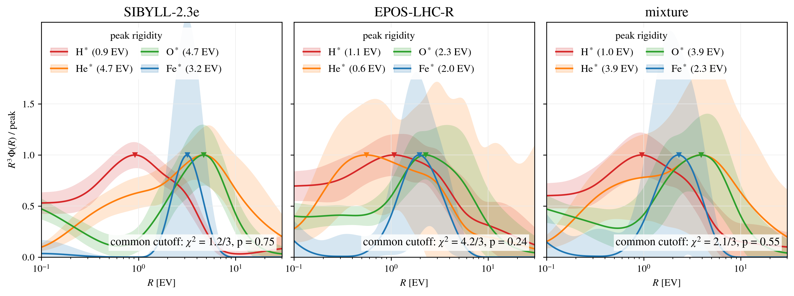
Ultra-high energies: a Peters cycle?
GSF 2026 groups in rigidity, R³-weighted, each normalised to its own UHE peak; common-cutoff fit 0.5–8 EV per element
Same test as at the second knee: under a Peters cycle the four groups coincide in rigidity
All three interpretations are consistent with a common cutoff rigidity, but the test has little power: He and Fe cutoffs are barely constrained
Ultra-high > 1 EeV
22

Slide 23
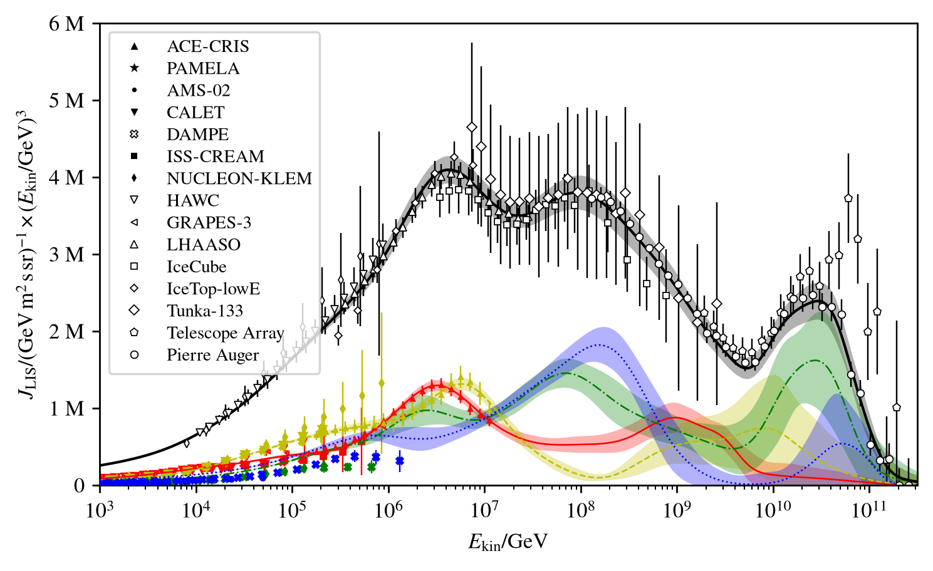
Impact of the energy-scale cross-calibration
GSF 2026 all-particle flux and groups; data at fitted energy scales applied to the data
23

Slide 24
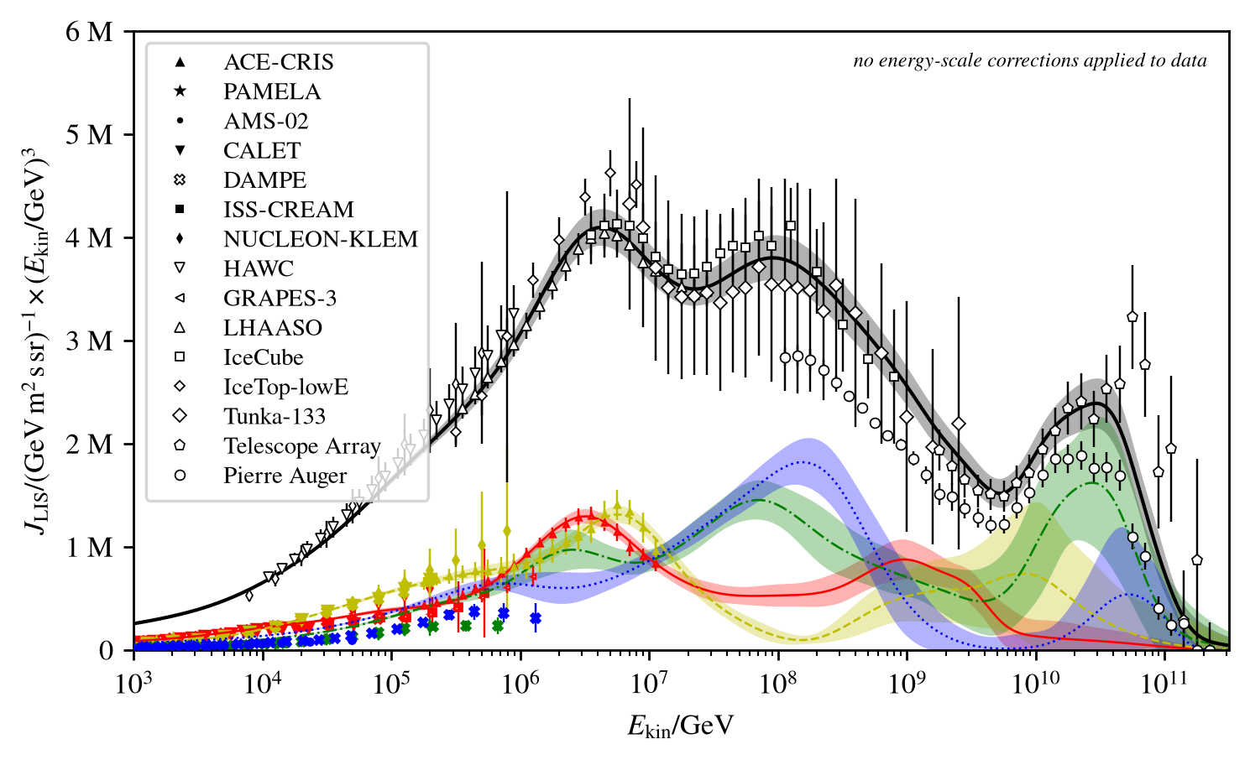
Impact of the energy-scale cross-calibration
GSF 2026 all-particle flux and groups; data at published energy scales (no offsets applied)
24

Slide 25
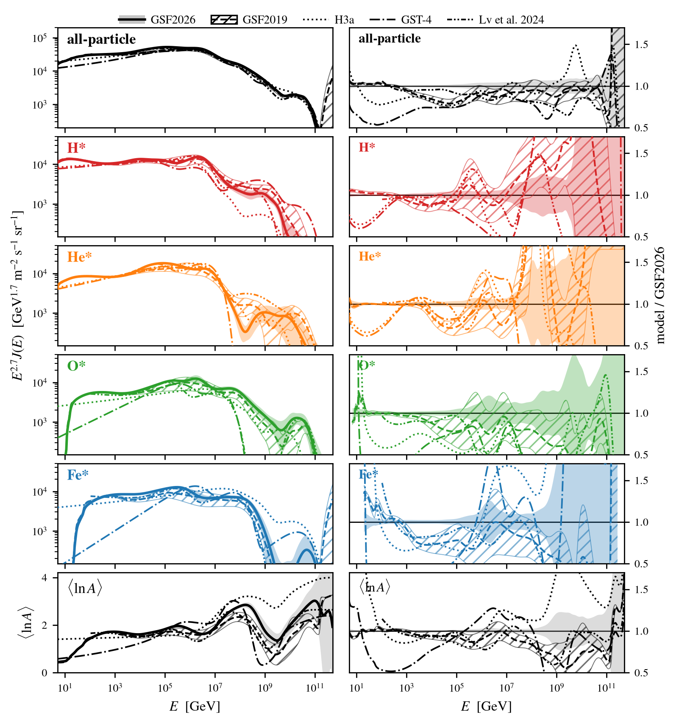
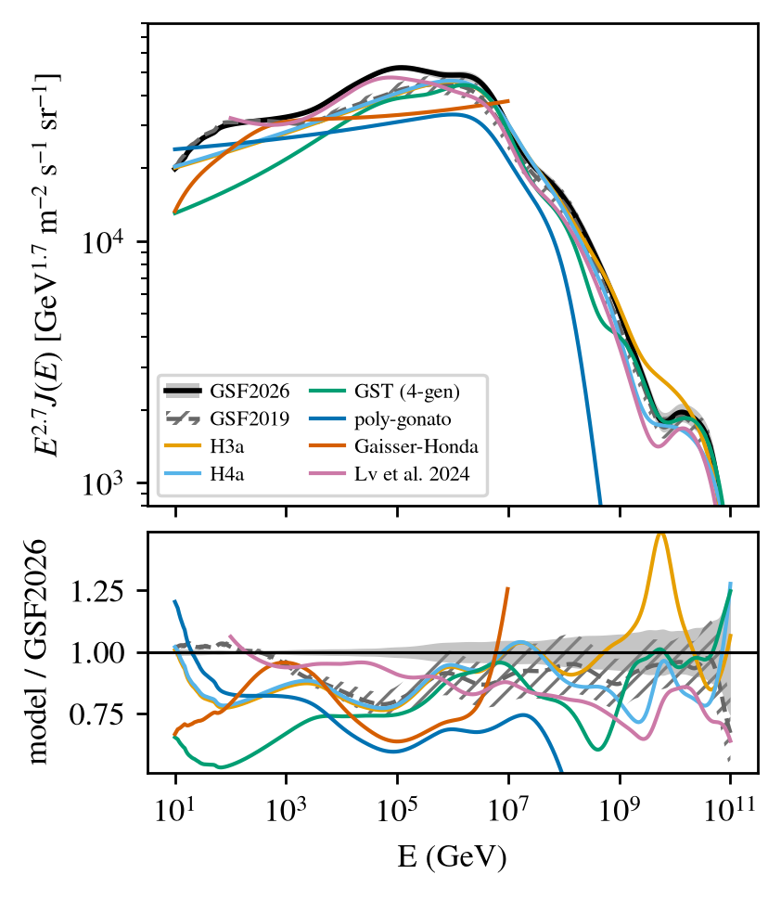
Compared against other models
All-particle flux: GSF 2026 vs earlier models
25

Slide 26
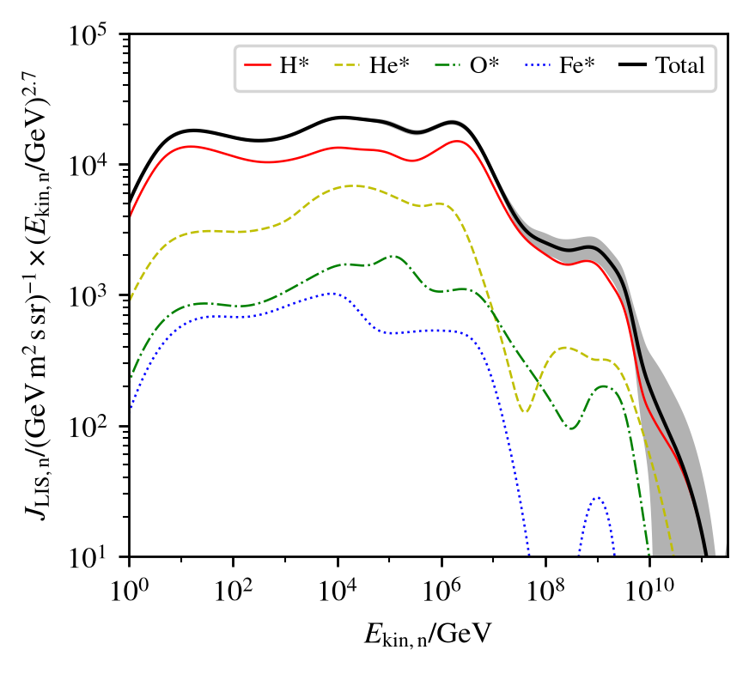
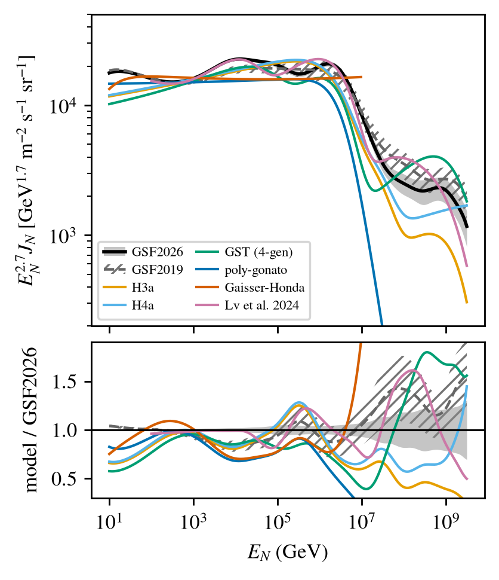
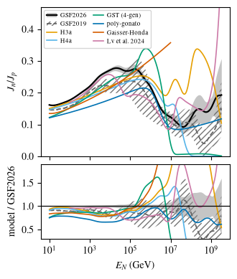
Nucleon flux
Nucleon flux vs other models
Neutron/proton ratio
GSF 2026 nucleon flux by group
Derived quantity, full covariance; dominated by p and He, so the uncertainty is small
Older parametrizations deviate well beyond the GSF band: they average over structures the new data resolve
Heavier composition and Deuterons below the knee gives a larger neutron fraction; muon charge ratios expected slightly lower
26

Slide 27
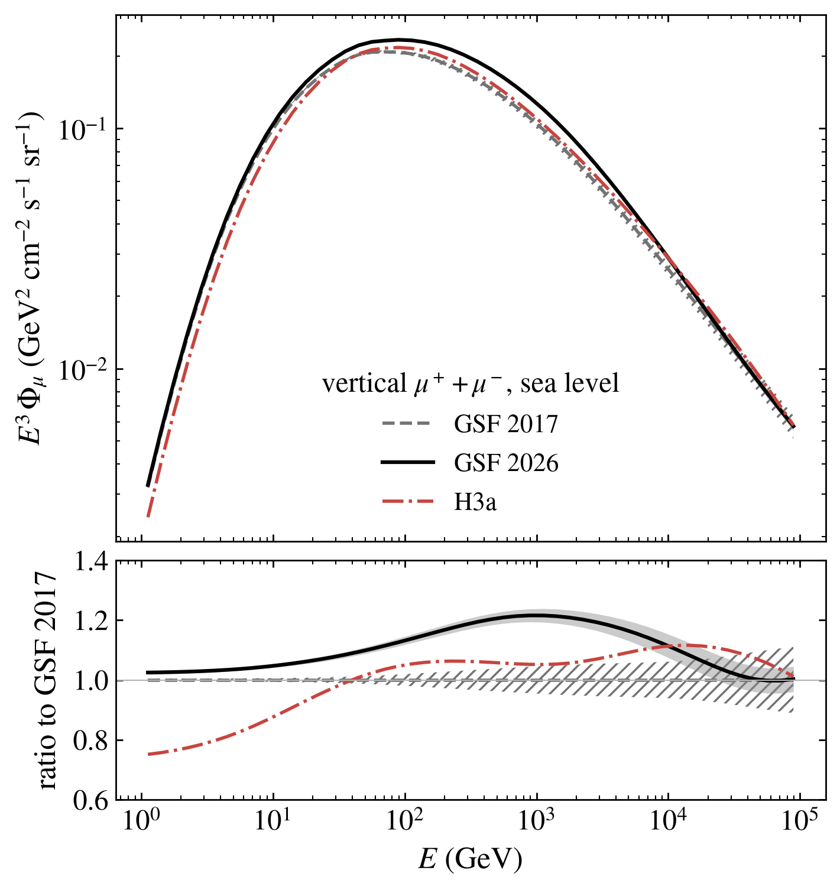
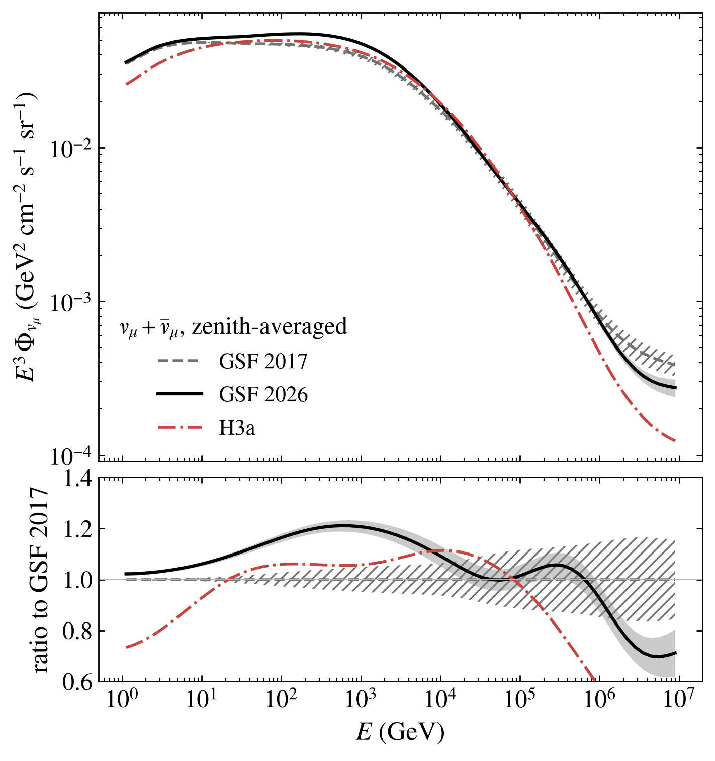
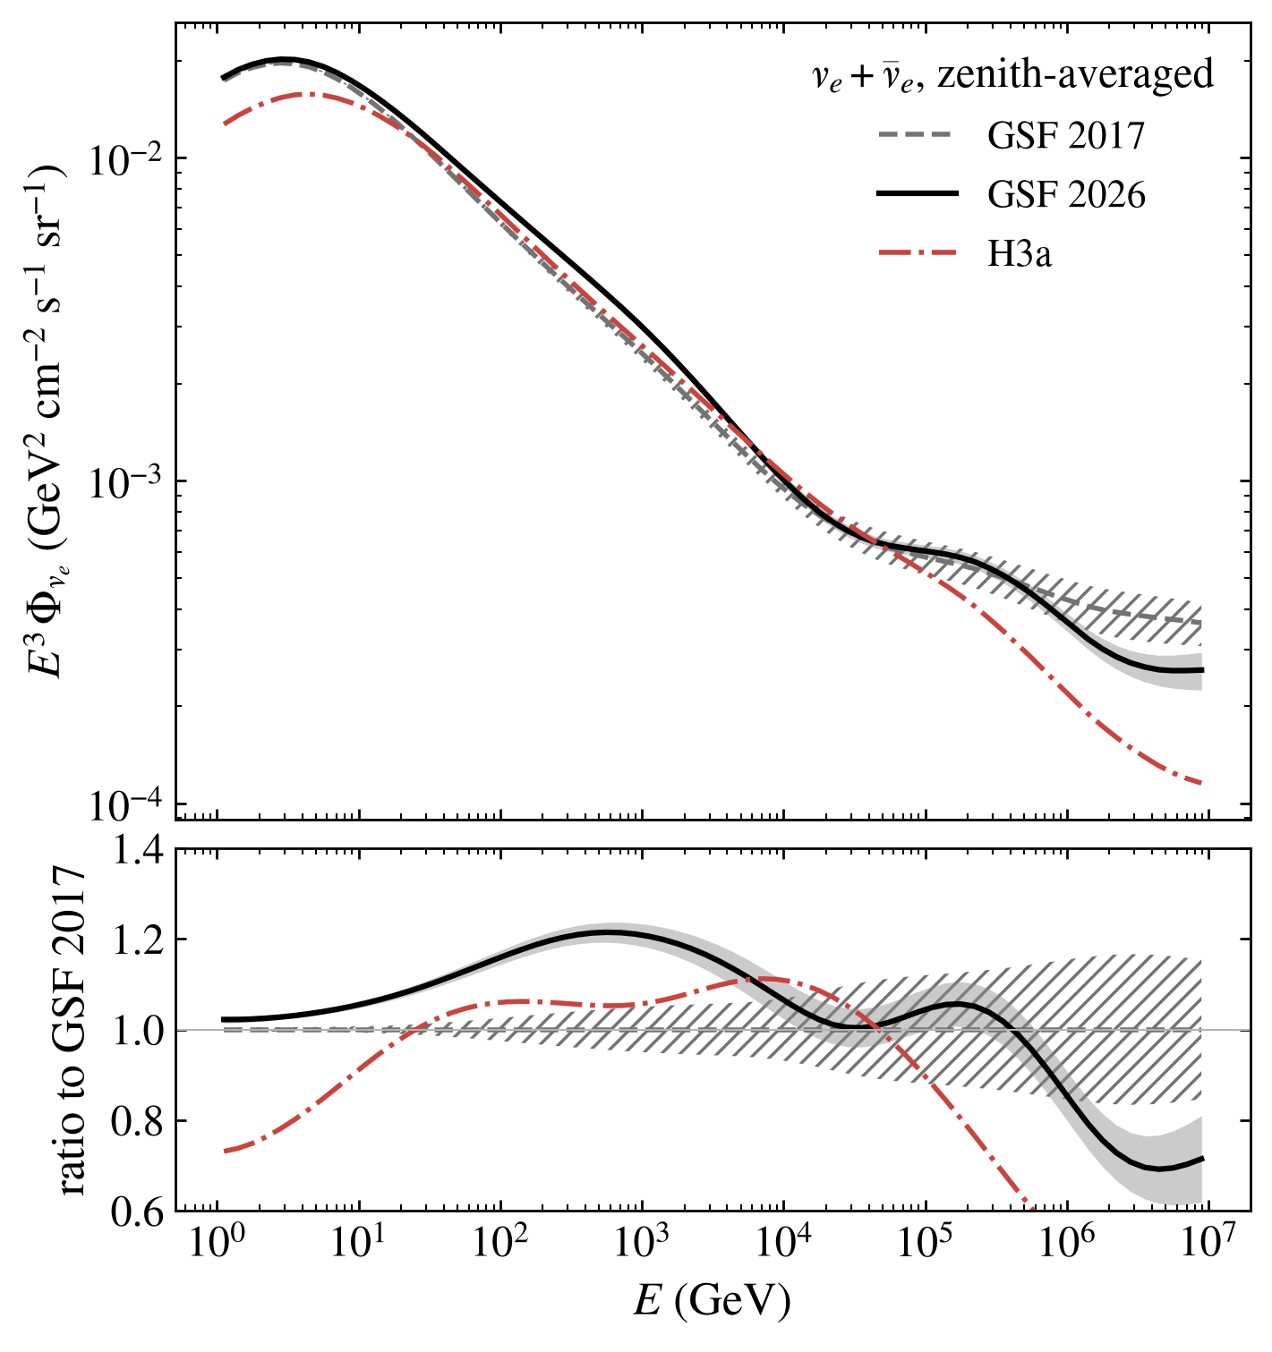
Atmospheric muons and neutrinos: GSF 2017, GSF 2026, H3a
Vertical muons
νμ + ν̄μ, zenith-averaged
νe + ν̄e, zenith-averaged
Same cascade model and atmosphere (MCEq v2, SIBYLL-2.3e + FLUKA, US standard); only the primary flux changes
Hardening, softening and light knee of the nucleon flux show up as structure in the lepton spectra; GSF 2026 sits above GSF 2017 around TeV
Neutrinos zenith-averaged over cos θ ∈ [0, 1], conventional + prompt. Bands: GSF 2026 (grey) and GSF 2017 (hatched) 1σ, each from its reduced model (24 p/n components, exact covariance).
27

Slide 28
Conclusions
What we learned
Once the energy scales are cross-calibrated within their quoted systematics, the data from GV to 10¹¹ GeV form one consistent picture
Uncertainties shrank substantially since 2017, without changing the overall picture
Hardening, softening, knees and ankle emerge from the data, not from the model
Now well established
Proton and helium from GV through the knee, with direct and air-shower measurements overlapping
The heavy flux entering the knee, anchored by direct measurements (DAMPE)
The nucleon flux: older parametrizations deviate significantly (global data + mainly DAMPE)
Open and needed
LHAASO p & He flux versus ⟨ln A⟩ tension
Second knee: precise heavy-group spectra, TALE hybrid fractions with covariance, IceCube with post-LHC models
Highest energies: hadronic-model ambiguity of the composition; TA with quantified systematics and mass groups
Direct: PAMELA and CALET versus AMS-02, DAMPE versus LHAASO near 100 TeV, heavy elements into the PeV range
Next: atmospheric neutrino and muon predictions with updated primary fluxes and error budgets
You have just seen ~ 100 spectrum or composition plots in a single talk. A new world record?
28
Notes:
Uncertainties shrink substantially relative to 2017 while the overall picture is unchanged, which supports the stability of the method. Close with the measurement wish list from the paper's outlook: an updated IceCube composition analysis with post-LHC hadronic models (the current input uses SIBYLL 2.1) and published mass-group covariances; a four-group TALE hybrid composition with covariance; direct heavy-element data reaching the PeV range. The IceCube items are among the limiting inputs in the knee-to-second-knee range.

Slide 29
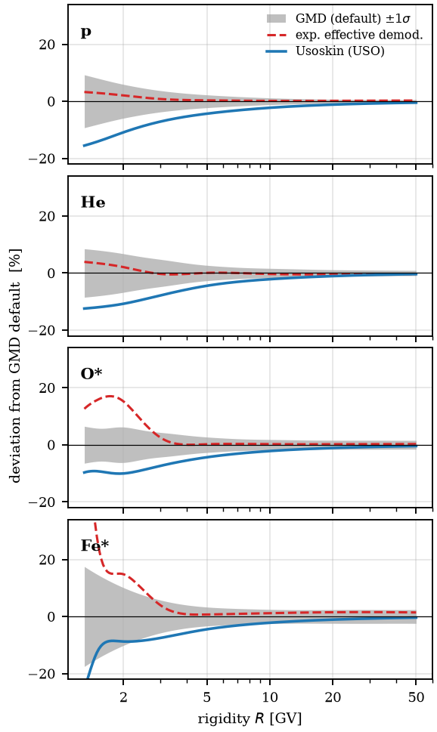
Backup: solar modulation
Force field, averaged over each observation window; replaces the single demodulation of 2017
Default Ghelfi–Maurin–Derome, mildly preferred by the data; Usoskin provided as alternative
The two differ only in the LIS at low rigidity; fluxes at Earth agree
Common and per-experiment modulation nuisances widen the low-rigidity band
LIS from GMD vs Usoskin modulation potentials
29

Slide 30
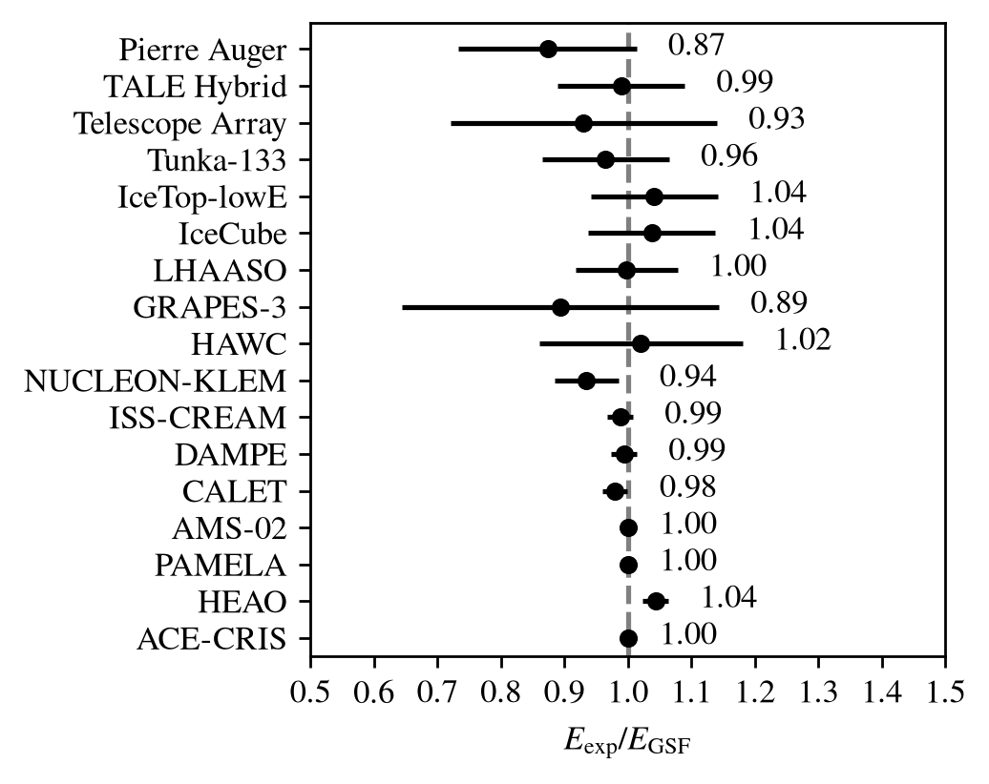

Energy-scale cross-calibration
15 fitted offsets within the systematics quoted by the experiments
Spectrometers anchor the scale
Minor normalization tensions are absorbed by the offsets
Minimal “common mode”, i.e. almost no global tilt
30
Notes:
15 fitted offsets, all within the quoted systematics; spectrometers anchor the fit at the percent level; air-shower examples: LHAASO 1.00, IceCube 1.04, Tunka-133 0.95, TA 0.93, Auger 0.88. Composition observables pull the air-shower scales up by 2-3%. Above the ankle the spectrum follows Auger, which has about twice TA's statistical weight there; the SD-750 spectrum anchors the spline below the ankle. The ensemble mean offset is ~ -0.2 sigma and is carried by the covariance; the global scale mode is exposed as model.energy_scale. Residual TA excess if asked: coherent ~10% through the ankle decade, below 1.5 sigma per point, energy-dependent above 3x10^19 eV, so a flat rescaling would over-correct.

Slide 31
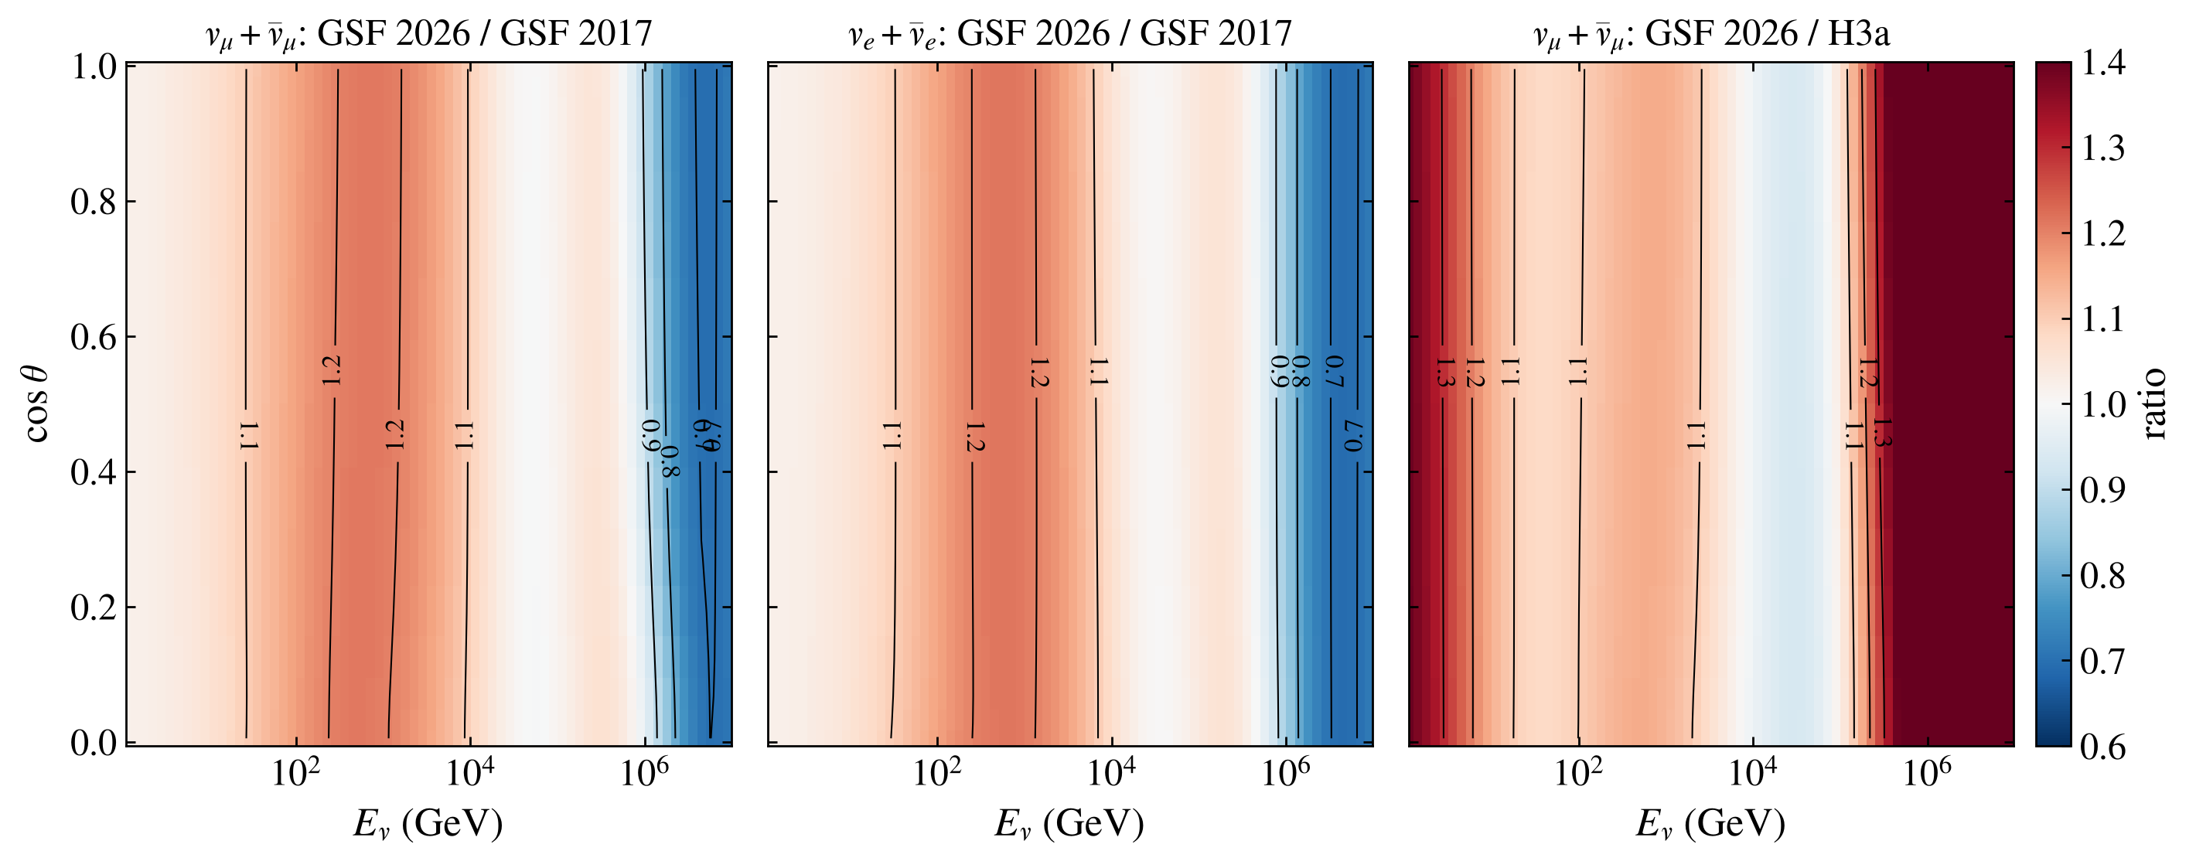
Atmospheric neutrinos versus zenith angle
Flux ratios in (Eν, cos θ), sea level, MCEq v2 with SIBYLL-2.3e + FLUKA
The primary-flux change is nearly independent of zenith angle: it acts as an energy-dependent normalization
31

Slide 32
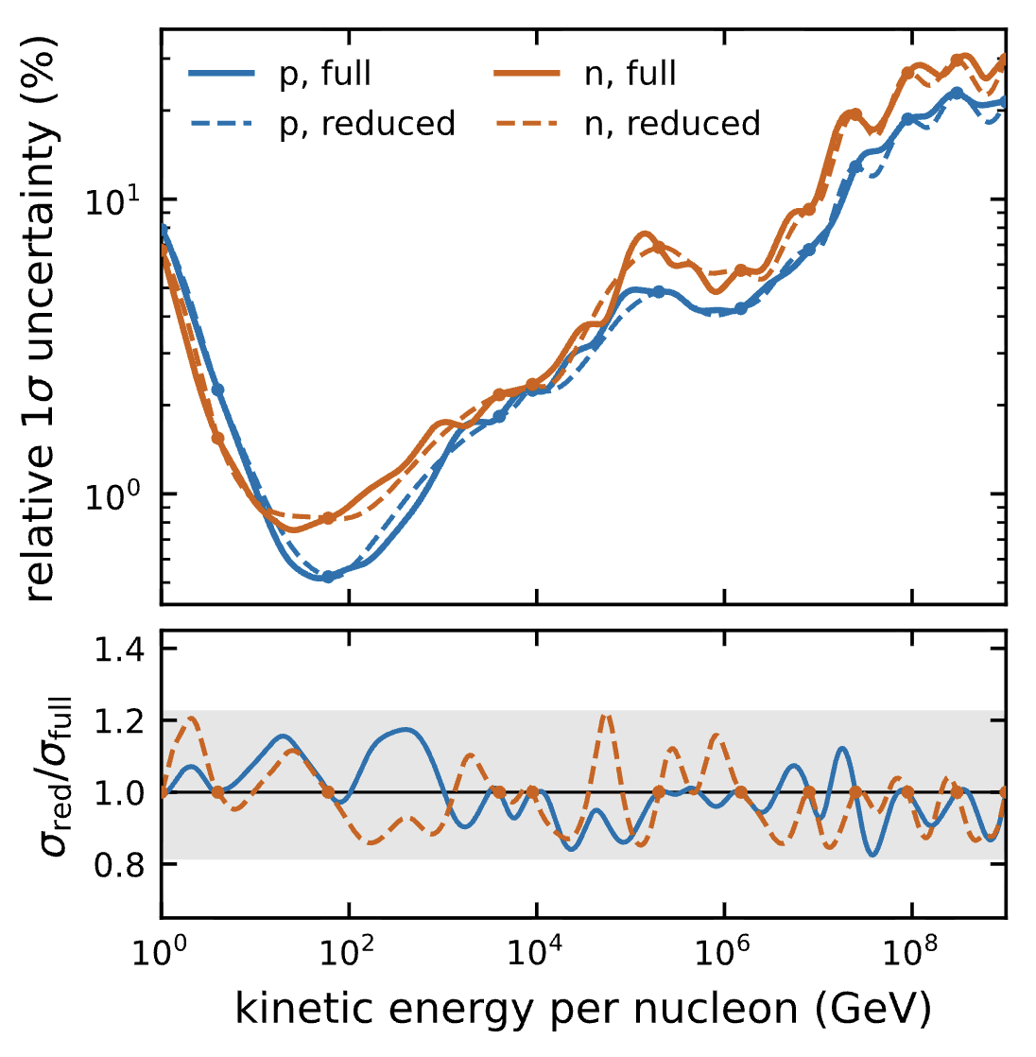

Reduced model
Full model has too many parameters to be gradients
Reduced model has 24 highly correlated parameters, 12 for p and n each
Parameters affect energy blocks, …100 GeV, 1 TeV.. etc. Easier to interpret.
32
Notes:
Atmospheric lepton fluxes are computed from the nucleon flux and inherit its uncertainties. The proton flux is data-covered from GeV to EeV, so the nucleon-flux uncertainty is small where conventional atmospheric nu/mu are produced. GSF differs from H3a/H4a and other broken-power-law parametrizations by 20-50% between 10^4 and 10^9 GeV per nucleon. The 15 TV softening (DAMPE) and the light-component knee (LHAASO) appear directly in J_N. The paper recommends re-evaluating atmospheric lepton flux predictions with GSF2026 and its covariance.

Slide 33



Backup: pulls and residuals
All pulls
Local PDG scale factors
Residuals per group
33

Slide 34

Backup: all datasets
34
Notes:
Alternative to the slide 3 figure: all-particle flux with every fitted dataset.

Slide 35

Backup: KG light and heavy fractions
35
Notes:
Light and heavy split in the knee region, backup for the LHAASO discussion.

Slide 36

Backup: Auger posterior correlations
Pierre Auger Coll. (2026)
36
Notes:
Posterior correlations of the Auger four-group fractions.

