Slide 1
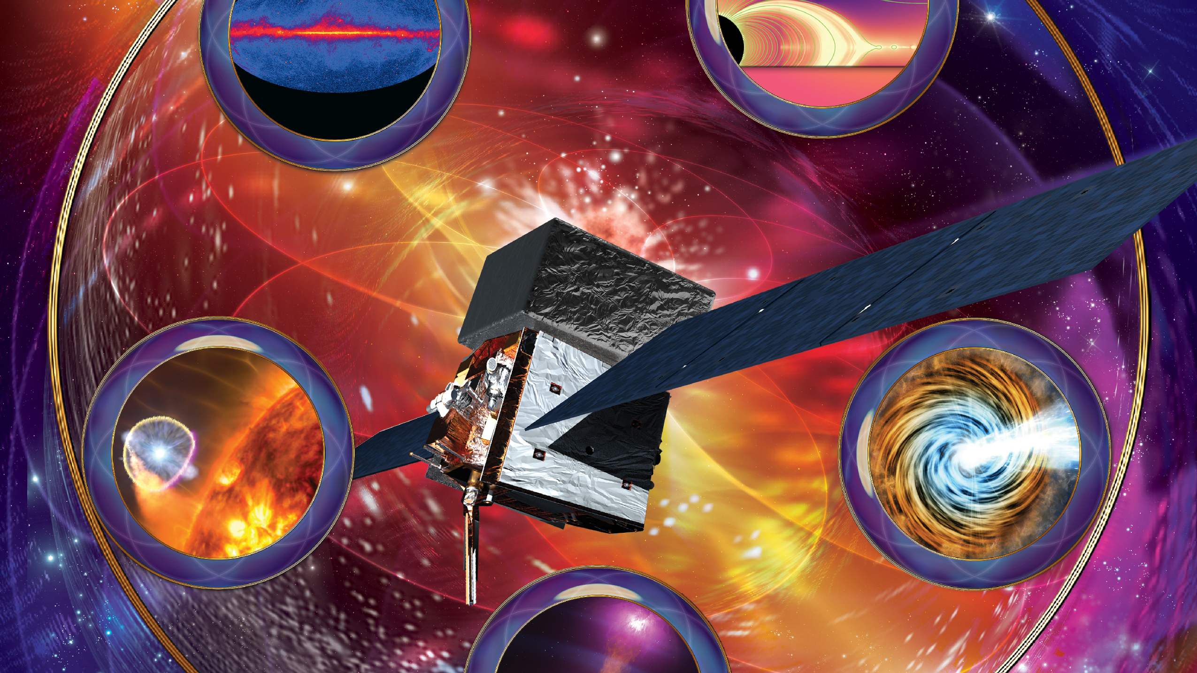
Space-based Gamma-ray Astronomy in the Fermi Era
Elizabeth Hays
NASA Goddard Space Flight Center

Slide 2
Overview
Space-based gamma rays
Fermi mission status
High impact science in Fermi’s latest decade
Science and capabilities for the future

Slide 3
Space-based Gamma Ray Astronomy
Energies from 100s keV to TeV
  Techniques range from photon absorption (scintillators, e.g. Fermi GBM)and shadowing (coded mask, e.g. Swift BAT) to Compton scattering (COSI) and pair production (e.g. AGILE, Fermi LAT)
Instruments typically wide or very wide field
  Collection areas are relatively small (m²) – many sources require relatively long exposures; data is “sparse” (with some notable exceptions)
  Time scales of phenomena run from ms to years
  Angular resolution limited and energy/process/physics dependent
  Backgrounds are large (and some are also gamma rays)
Astronomy beyond the onset of non-thermal processes
(why gamma-ray astronomers love particle astrophysics symposia)

Slide 4
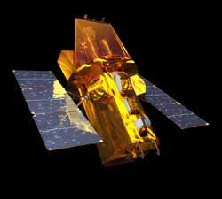
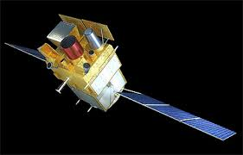
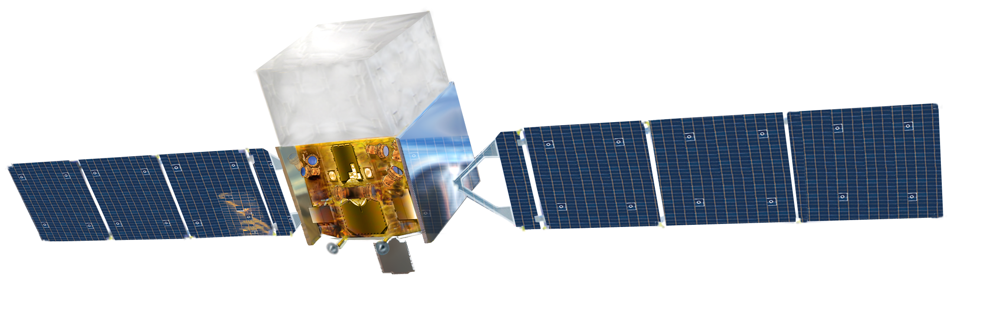
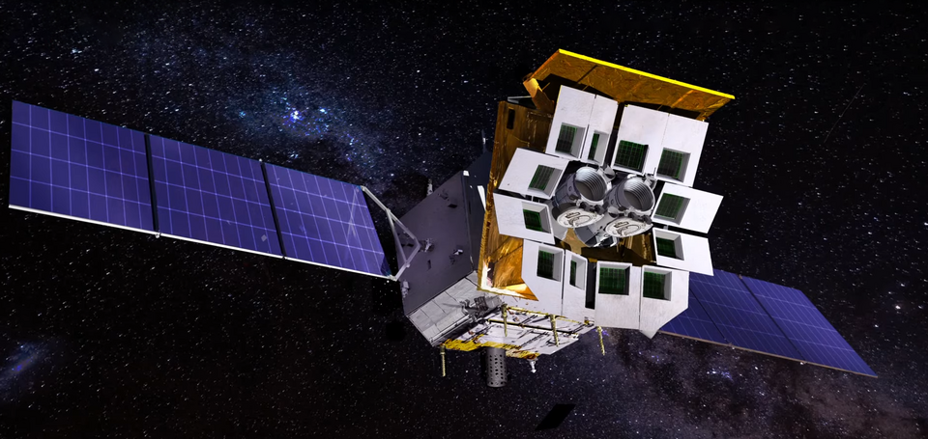
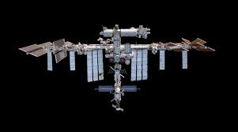
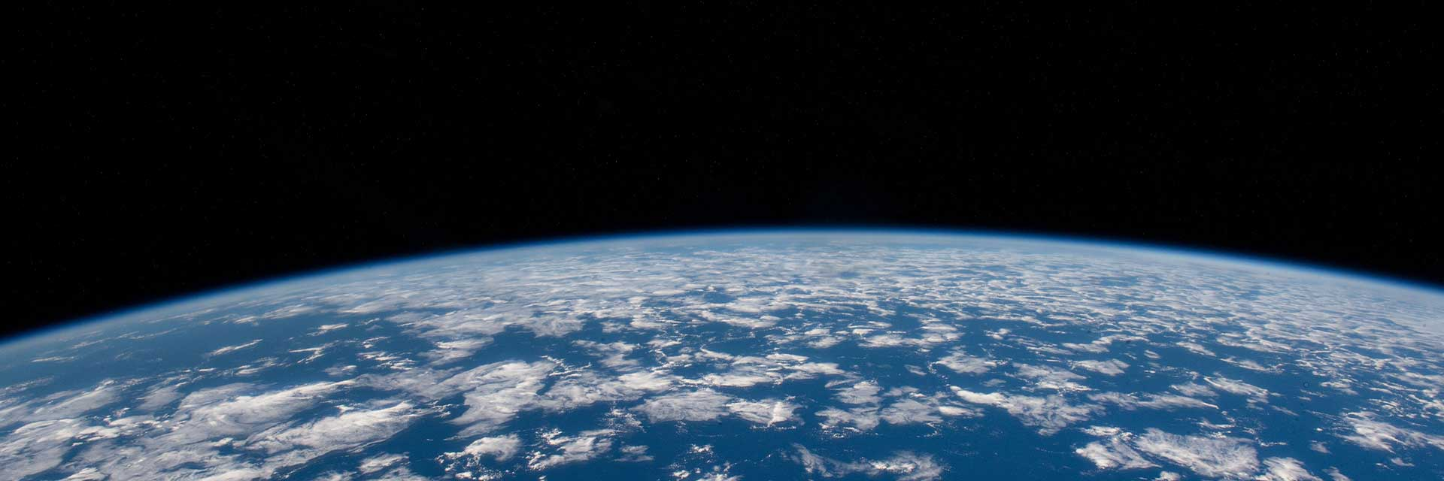
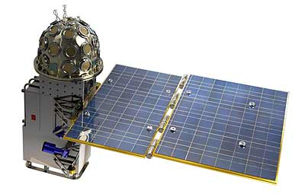
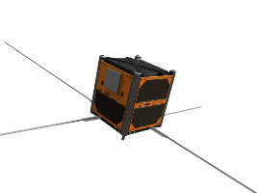
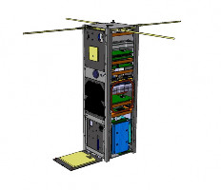
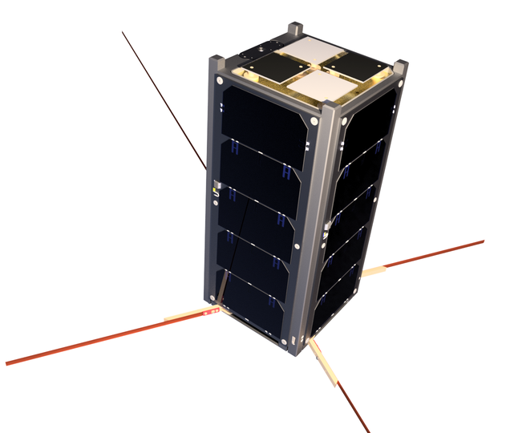
Neil Gehrels Swift (BAT)
Fermi
SVOM (ECLAIRS, GRM)
Einstein Probe (WXT)
COSI
(NET 2027)
Gamma-ray Burst small satellites
StarBurst
(NET 2028)
On ISS
GlowBug, MAXI
CALET
VZLUSAT-2
GECAM
GRBAlpha
EIRSAT-1

Slide 5
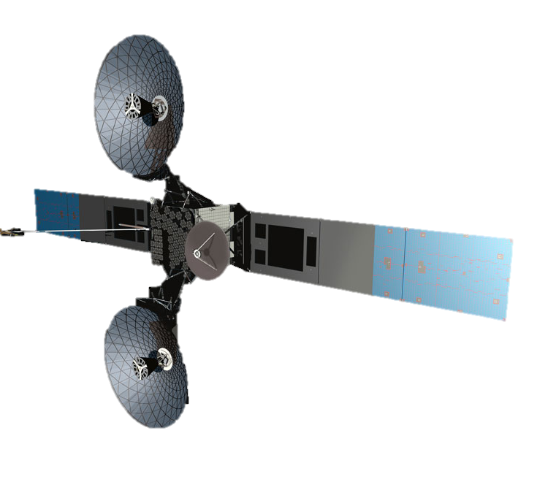
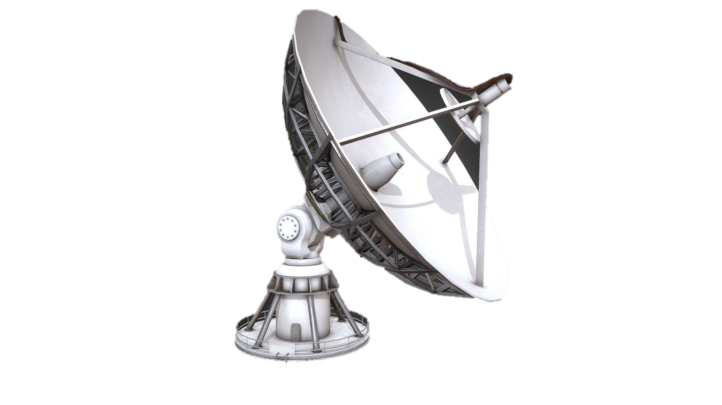
Fermi Mission Elements
Large Area Telescope (LAT)
TDRS SN
S & Ku Band
Gamma-ray Burst Monitor (GBM)
Fermi Science Support Center (FSSC)
High Energy Astrophysics Science Archive Research Center (HEASARC)
Mission Operations Center (MOC)
LAT Instrument Science Operations Center (LISOC)
White Sands
General Coordinates Network (GCN)
GBM Instrument Operations Center (GIOC)
Notes:
Data flows from spacecraft through the MOC to the FSSC and out to the instrument operations centers to be distributed and archived through HEASARC and available immediately to the public. Science alerts are rapidly distributed through GCN.

Slide 6
Fermi Status and Updates
Spacecraft and instruments healthy. Instruments performing better than at launch (due to software and process imporvements).
  Target of opportunity observations restored last year!
New public products from LAT and GBM for transients and variable sources in work.
Public photon data server modernization and integration into cloud-based platforms underway.
5FGL preliminary LAT source list released last year.
  5FGL catalog and diffuse model underway
Announcement for Cycle 20 GI proposals will be out soon.

Slide 7
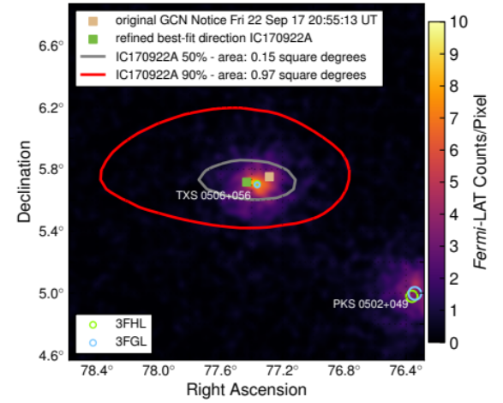
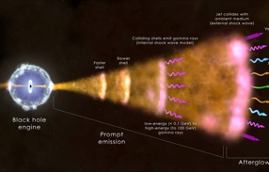
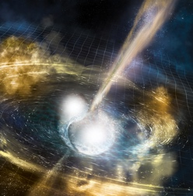
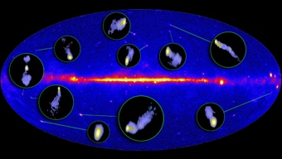
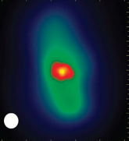
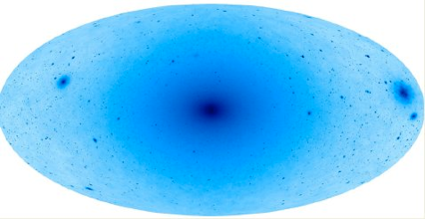
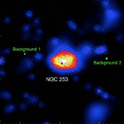
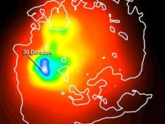
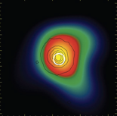
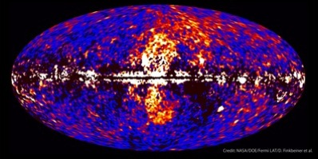
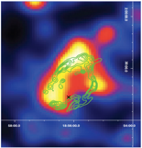
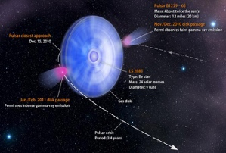
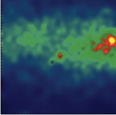
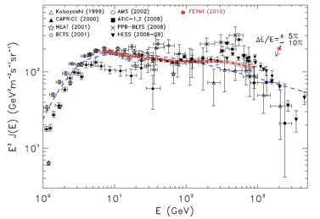
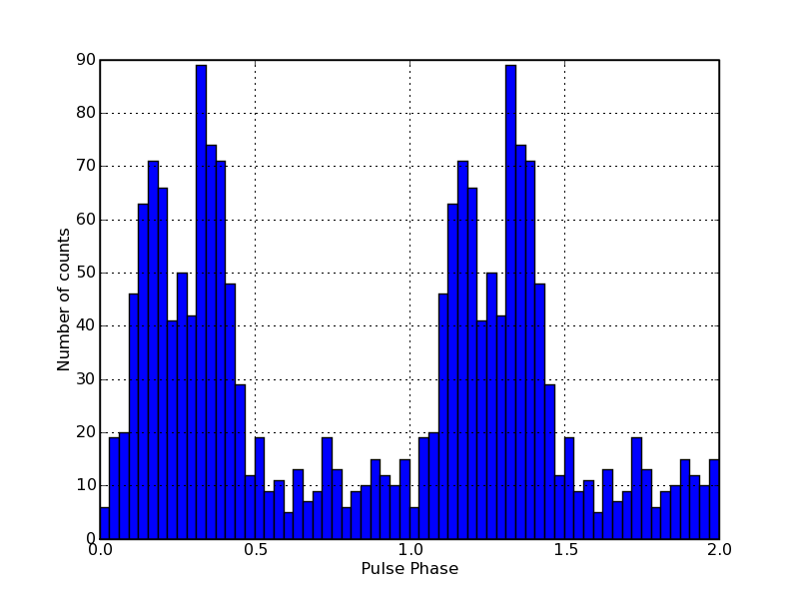
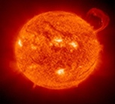
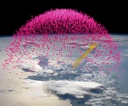
The science drivers for Fermi continue to expand.
Gamma Ray Bursts
Neutrino Counterpart searches
Blazars
Gravitational Wave Counterparts
Radio Galaxies
Extragalactic
Starburst Galaxies
LMC & SMC
Dark Matter searches
Globular Clusters
Fermi Bubbles
Supernova Remnants & Pulsar Wind Nebulae
Galactic
γ-ray Binaries
NEW!
Magnetar Giant Flares
Superluminous SN
Novae
Pulsars: isolated, binaries, & MSPs
e⁺e⁻ spectrum
Unidentified Sources
Sun: flares & Cosmic Ray interactions
Cosmic Rays
Terrestrial γ-ray Flashes
Notes:
New and missing from this list! Magnetar Giant Flares, counterparts of fast radio bursts, SLSNe, pulsar planets (pending publication), the stochastic GW background (pending publication)

Slide 8
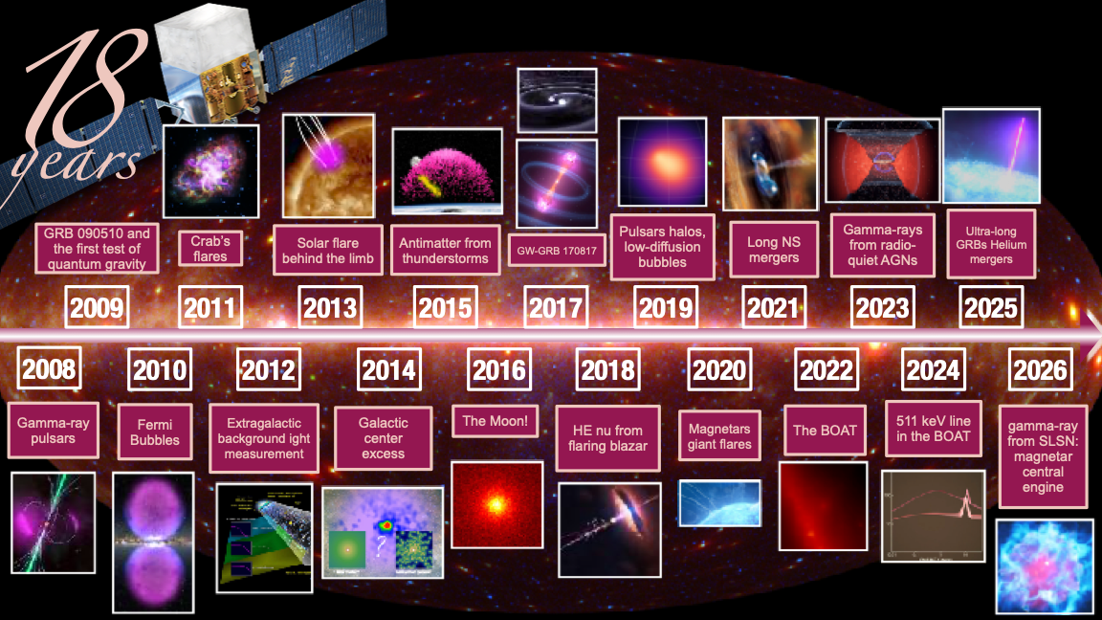
Credit: Michela Negro, AAS 248

Slide 9
High impact science in Fermi’s latest decade

Slide 10
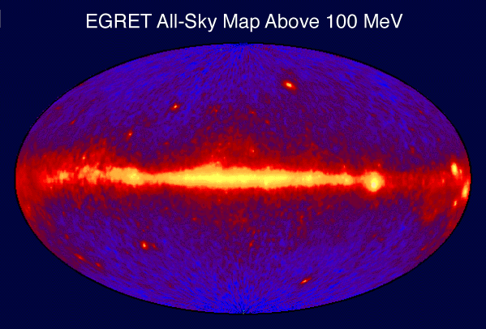
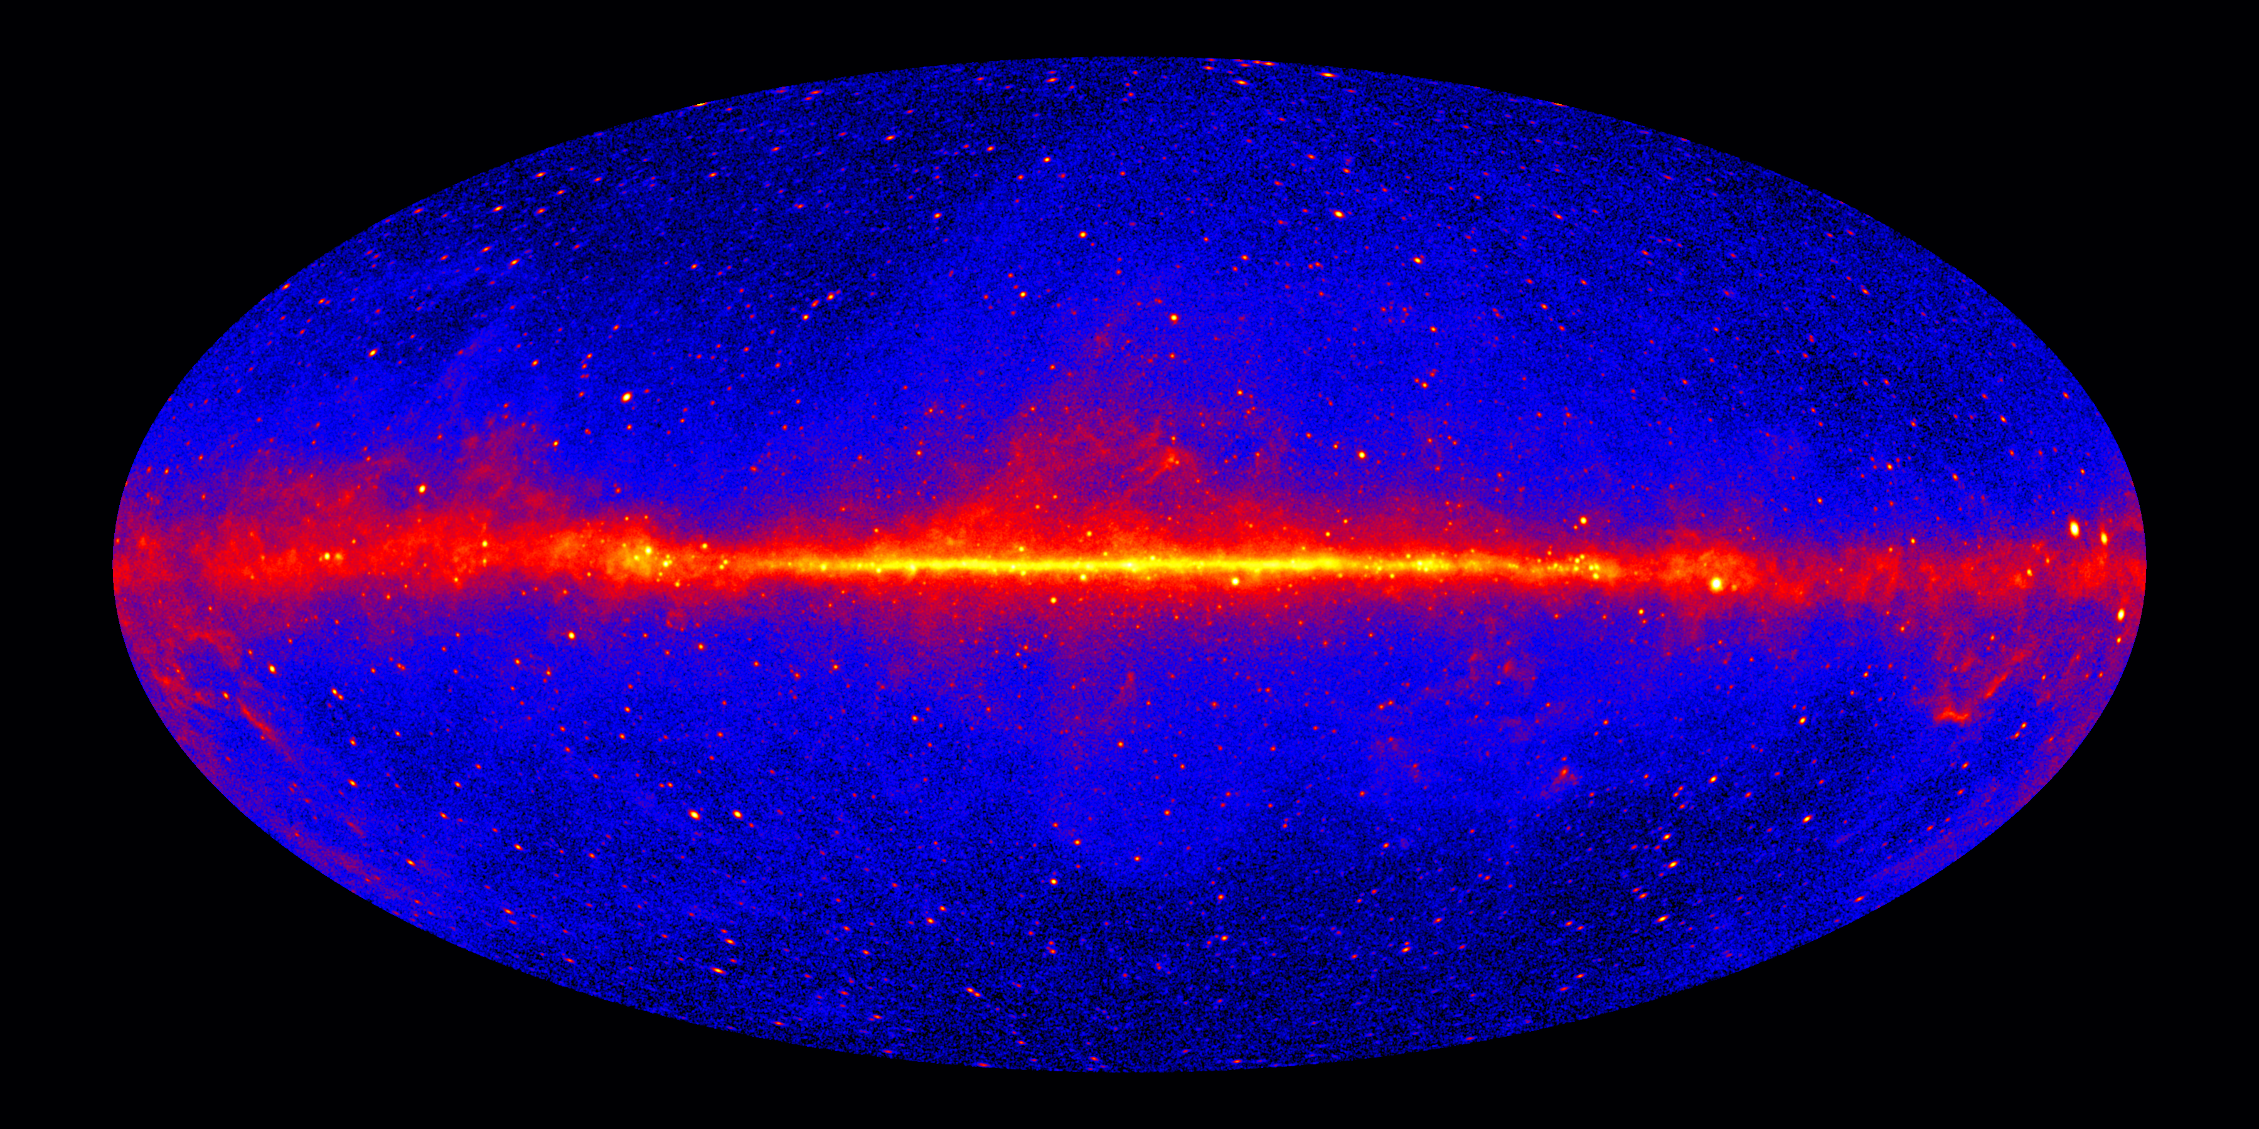
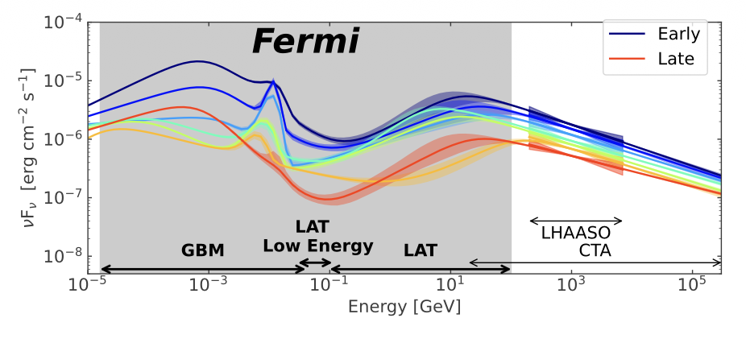
Mapping Gamma Rays over Space, Energy and Time
LAT All-Sky Map Above 1 GeV
GRB 221009A
Notes:
End states of stellar evolution and cores of galaxies are highly dynamic and highly energetic.
Fermi’s broad sky coverage and resolution have provided thousands of well located and identified sources - ongoing work! Still some hard cases and intriguing hints of emerging classes.
The gamma-ray diffuse emission is being mapped beyond the ability of any other data set to predict it.
Fermi’s broad spectral context for transients across orders of magnitude in energy has revealed the multiple components at work in gamma-ray bursts and new features to be explained.

Slide 11
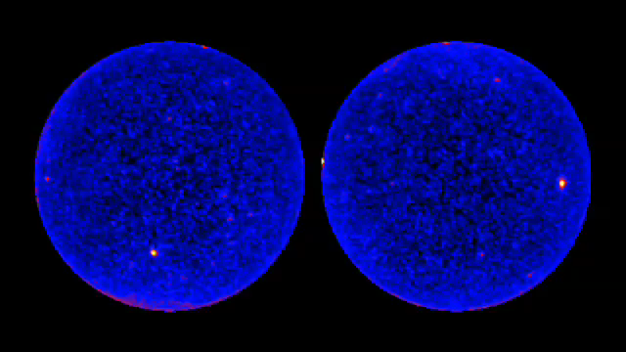
The Dynamic GeV Gamma-ray Sky
Fermi LAT photons
1 day frames over 1 year
Northern Hemisphere
Southern Hemisphere
Notes:
Not just a deep image! Fermi’s movie of the Universe shows just how dynamic the sky can be.

Slide 12
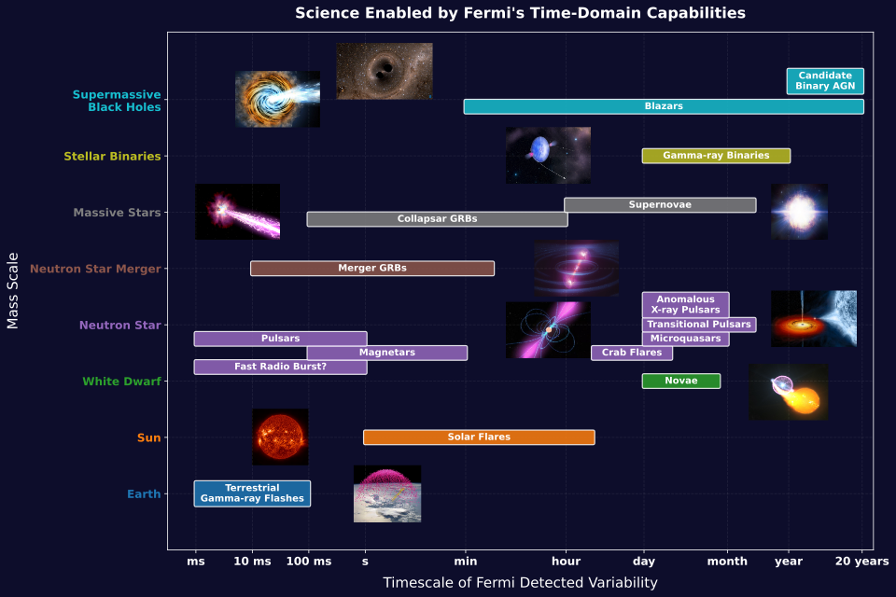

Slide 13
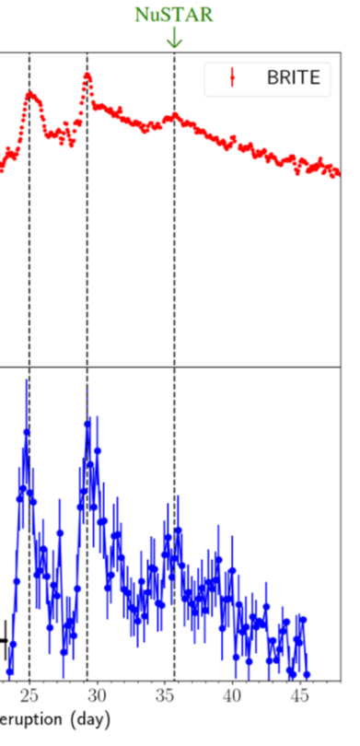
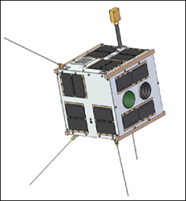
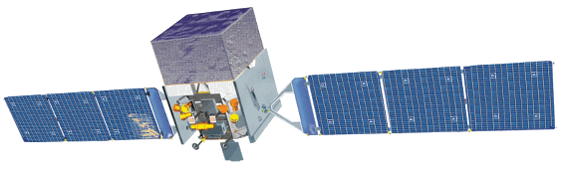
Optical and gamma-ray signals reveal a common origin in novae
BRITE
Most of the optical light from the nova
comes from the shockwave producing the gamma rays
Optical Brightness
(mag)
Fermi
Gamma-ray Flux
(erg cm⁻² s⁻¹)
Aydi et al. 2020, Nature Astronomy
25 30 35 40 45
Time since eruption (days)
Notes:
Recent observations of V906 Carinae show that not only do novae produce optical light and gamma rays, but most of the optical light is actually produced in the same place as the gamma rays.
The BRITE Constellation is a partnership among Canada, Austria, and Poland. The constellation includes 5 nanosatellites.
https://www.asc-csa.gc.ca/eng/satellites/brite/default.asp

Slide 14
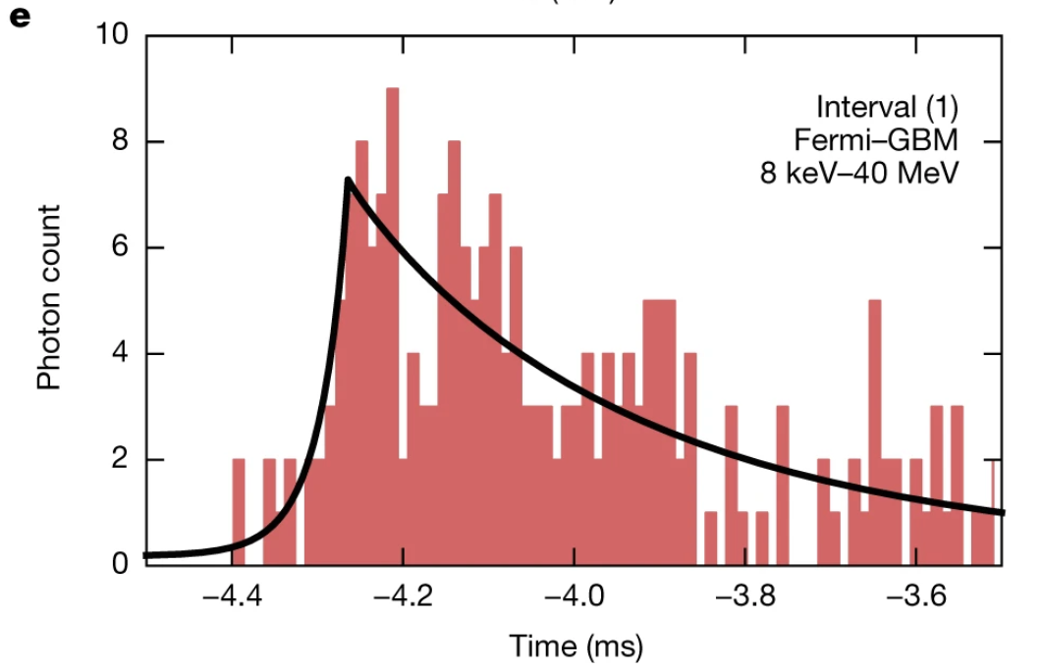
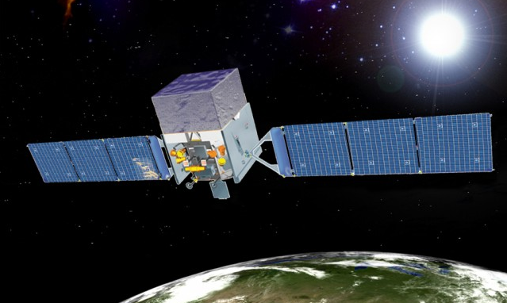

Fermi reveals a magnetar giant flare
Fermi's Gamma-ray Burst Monitor detected a short outburst of gamma rays on April 15, 2020.
Emission rose in 77 ms, 100 times faster than typical neutron star merger events that generate short gamma-ray bursts
A giant flare from a magnetar explains the rapid variability and the coincidence with nearby galaxy Sculptor (NGC 253, 3.5 Mpc) of the multi-mission location for the burst.
Fermi's Large Area Telescope detected GeV photons within minutes of the outburst.
Highest energy light ever detected from a magnetar flare
Higher energy and later timing suggest an ultra-relativistic outflow collided with the magnetar bow shock to produce GeV photons.
A few percent of short gamma-ray bursts may be magnetar giant flares.
https://www.nature.com/articles/s41550-020-01287-8
https://www.nature.com/articles/s41586-020-03077-8

Slide 15
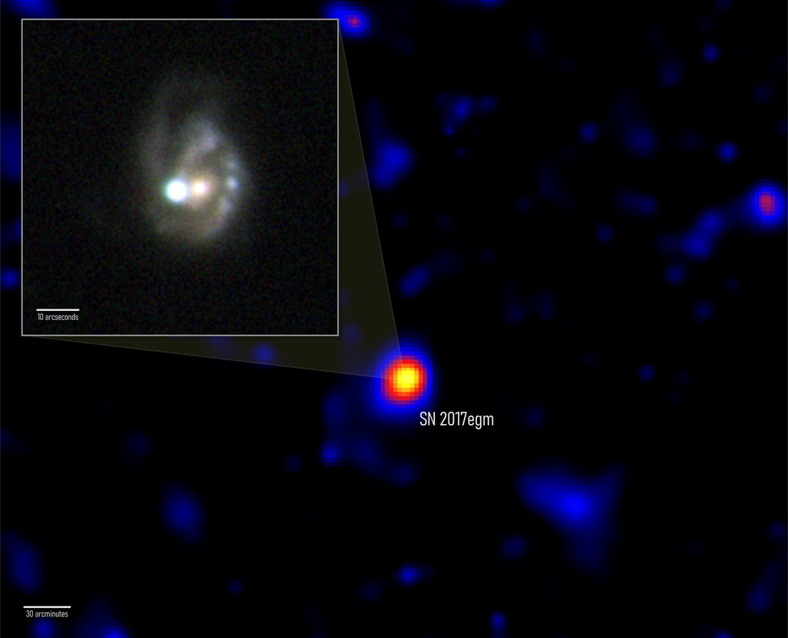
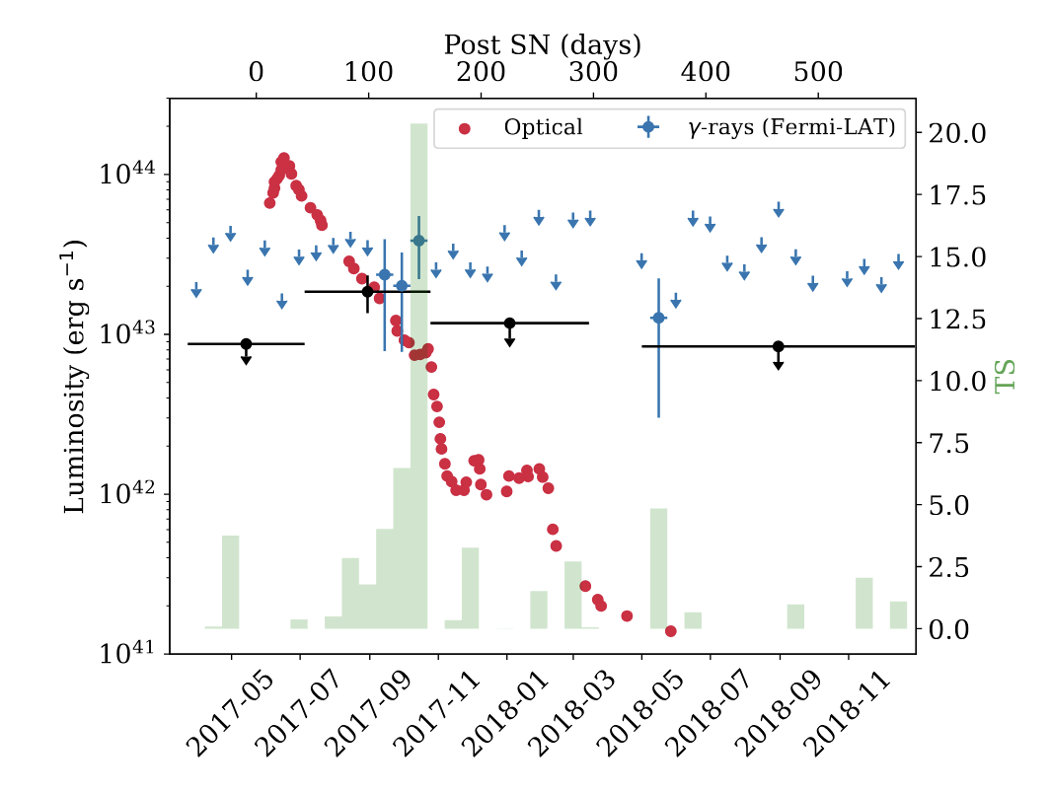
optical
Gamma ray
SN 2017egm
First Fermi Detection of a Supernova
NGC 3191
The Large Area Telescope (LAT) detected gamma rays from a rare, superluminous supernova.
SN 2017egm is one of the closest core collapse supernovae sighted during the past 17 years of Fermi observations. It is the only one detected by LAT so far.
What we learned:
Gamma rays emerged about 3 months after the optical peak when the explosion debris sufficiently expanded and cooled.
Some supernovae can be as luminous in gamma rays as they are in visible light.
The extra light in superluminous supernovae could be produced by a newly formed magnetar, a pulsar with an extremely strong magnetic field.
10 arcseconds
30 arcminutes
Acero, F. et al., 2026, A&A, 709, A229

Slide 16
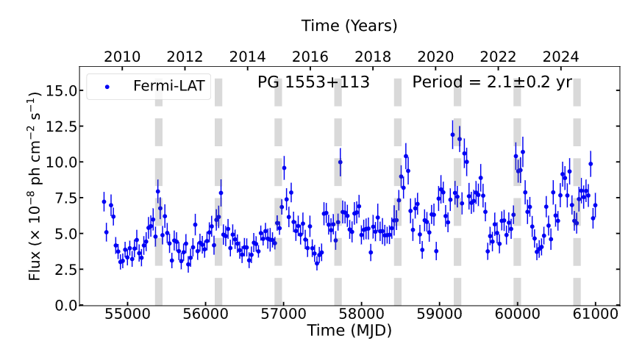
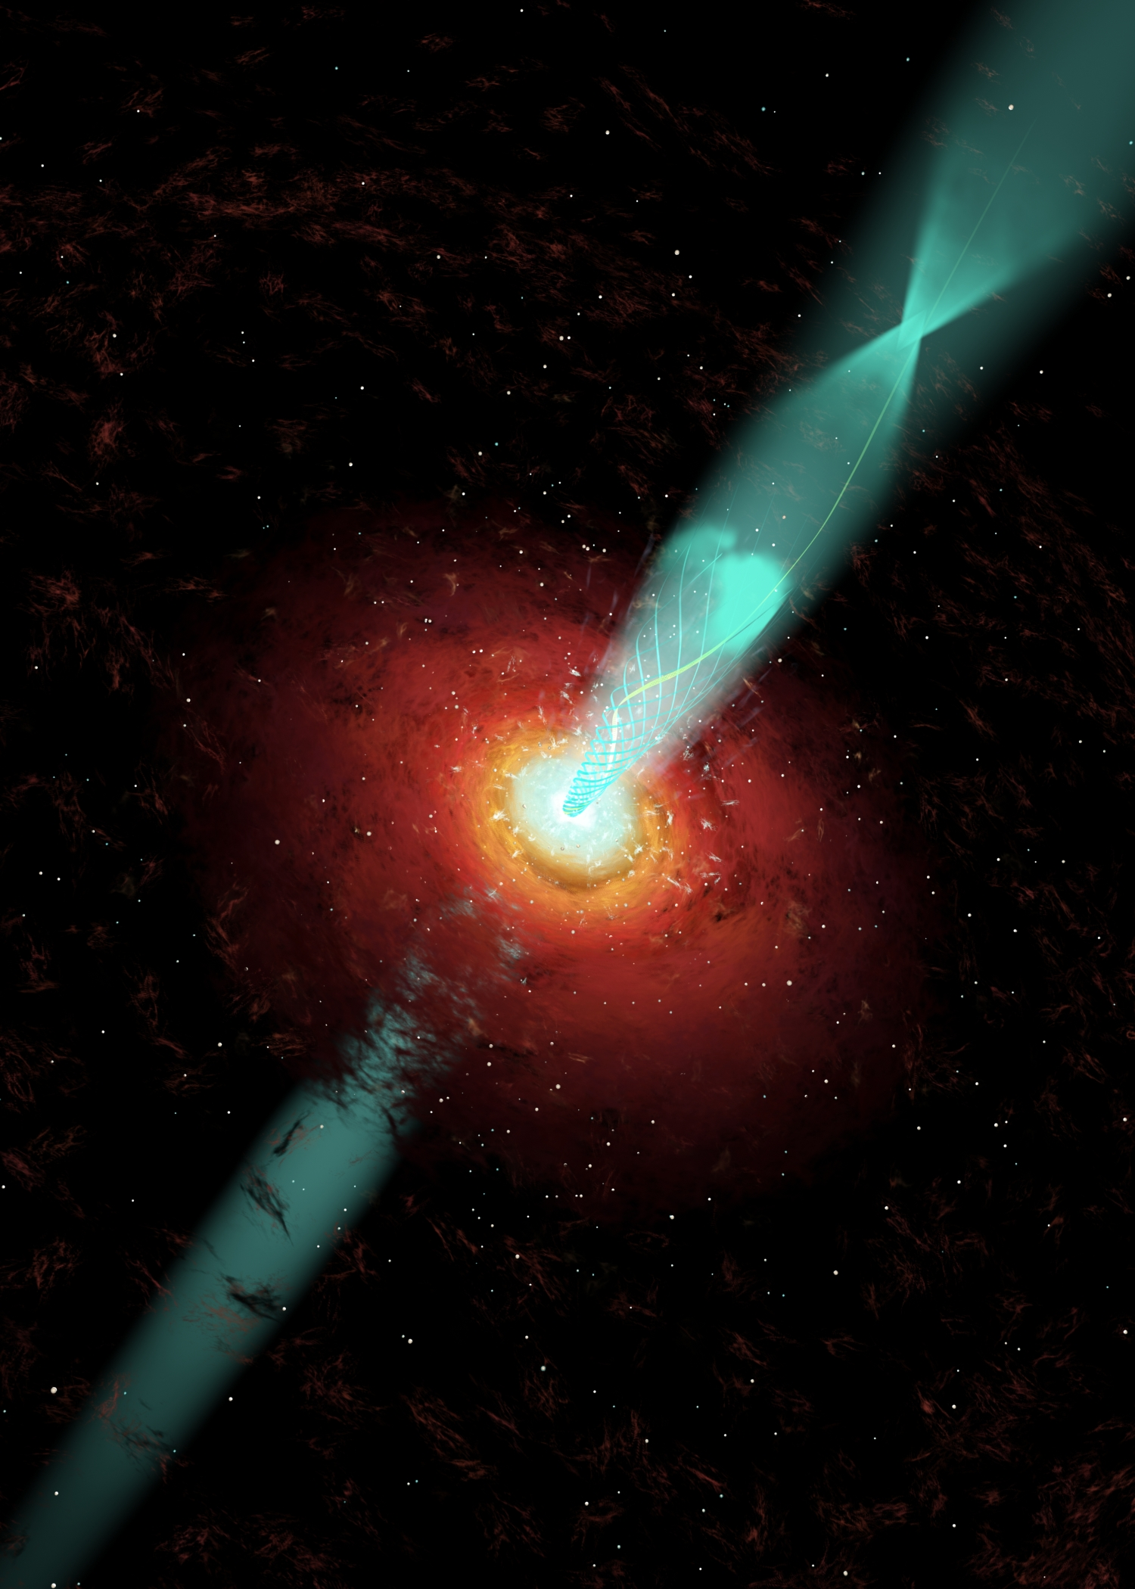
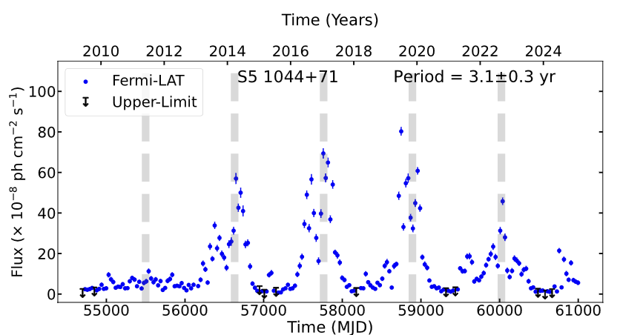
Transient periodicity in blazar jets
Quasiperiodic signals from blazars: highest confidence signals from PG 1553+113 and S5 1044+71. Half-dozen more at lower confidence.
  Orbital motion of plasma in the jet?
  Periodic changes in the Doppler factor caused by twisted or helical jet structures?
  Jet precession?
  Modulated accretion rate?
  Influence of supermassive black hole binary?
Peñil et al. 2026, MNRAS 550, 1-29
Notes:
When will we detect the GWB and will it confirm radio measurements? Does it make sense with our understanding of SMBH binaries?
15.5 yr measurement constraint of GW background is below predicted sensitivity. Running a little ahead on this due to improvements in the method.

Slide 17
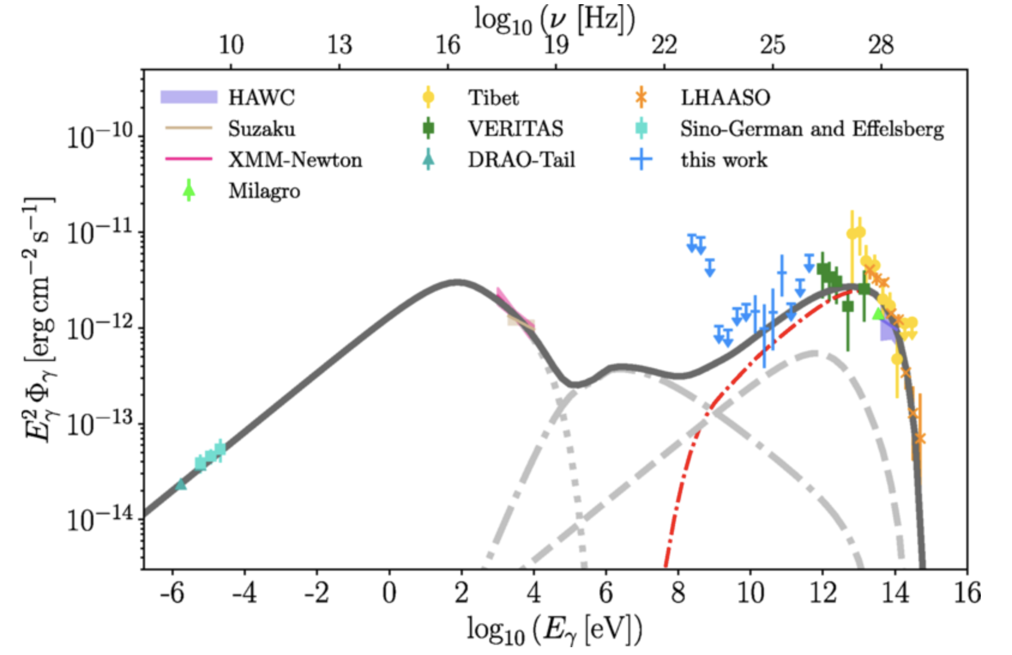
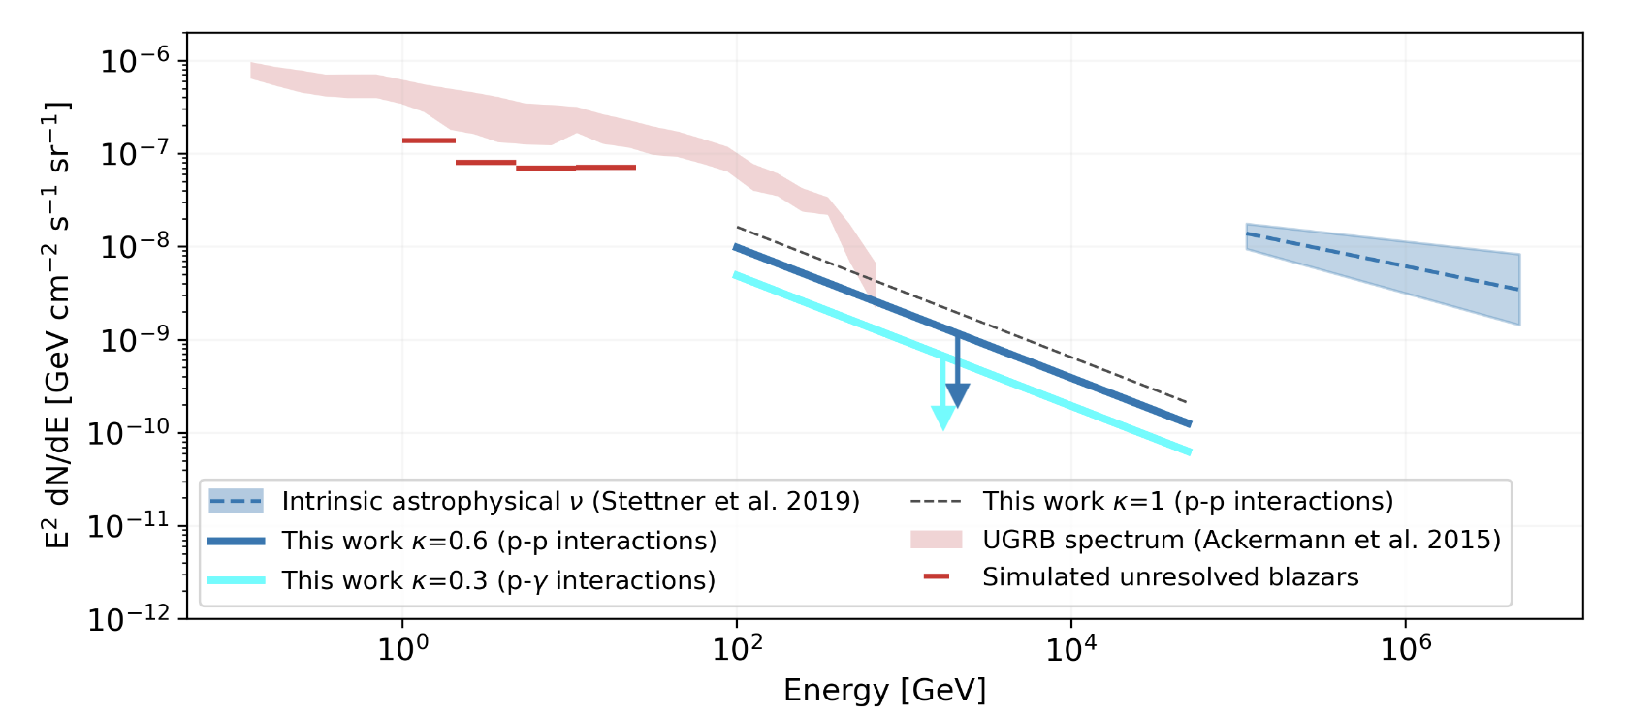
Cosmic-ray and Neutrino Origins
Fermi data reveal sources of proton acceleration in the Galaxy and candidate sources of extragalactic neutrinos.
Neutrino counterpart candidates have been found through follow-up searches of events and catalog correlations, e.g.
  TXS 0506+056, gamma-ray blazar
  NGC 1068, luminous Seyfert II galaxy detected by LAT
2D cross-correlation study of gamma-ray and neutrino data finds that unresolved blazars could contribute up to 1% of the astrophysical neutrino flux at 100 TeV.
Gamma-ray spectrum indicates PeV proton acceleration in SNR G106.3+2.7.
Fang et al., Phys Rev Letters, 2022
Negro et al., ApJ, 2023
Notes:
From Abassi 2023 https://arxiv.org/pdf/2304.12675 (paper on IceCube method to calculate the overall
correlation between neutrino alerts and a catalog of candidate sources. which uses LCR for weighting of 4FGL-DR2 blazars)
Correlation not significant but is also compatible with hints of signal in pub (TXS 0506 and PKS 1502)
The observed TSdata is compatible with the TS distribution that one would obtain if only 1% of the blazars in the selected Fermi 4LAC-DR2 catalog emits
neutrinos.
The same study was performed with RFC 2022a, with similar results. This indicates the possibility that only a small
fraction of the gamma-ray bright and radio-bright AGN population are sources of high-energy neutrinos.
Why??
From Neilson, Murase, Santander Annual Review: “NGC 1068, at a ∼ 14 Mpc distance, is
the most luminous Seyfert II galaxy detected by Fermi-LAT, making it a not surprising source to emerge this way. “
From Negro et al.
under the assumption that there is no intrinsic cutoff and/or hardening of the spectrum above Fermi -LAT energies, and that all gamma-rays from the unresolved blazars dominating the UGRB fluctuation field
are produced by neutral pions from p-p (p-γ) interactions, up to 60% (30%) of such population may contribute to the total neutrino events observed by IceCube. This translates into a O(1%) maximum
contribution to the astrophysical high-energy neutrino flux observed by IceCube at 100 TeV.
N.B.: the resolved blazars contribute less than ∼30% and 1% of the measured diffuse flux (Aartsen et al. 2017; Abbasi et al. 2022),

Slide 18
Looking to the Future

Slide 19
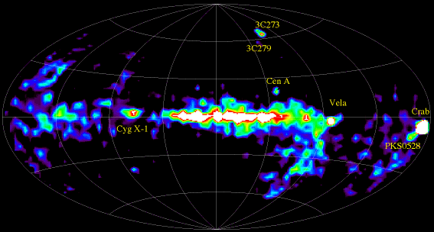
The MeV Gamma-ray Sky
1991-2000: 1 – 30 MeV (CGRO COMPTEL)
Today?
Not Deeply Explored
Notes:
Excellent work in transient detection and spectra, but from 100s of keV to 10s of MeV, we remain blind.

Slide 20
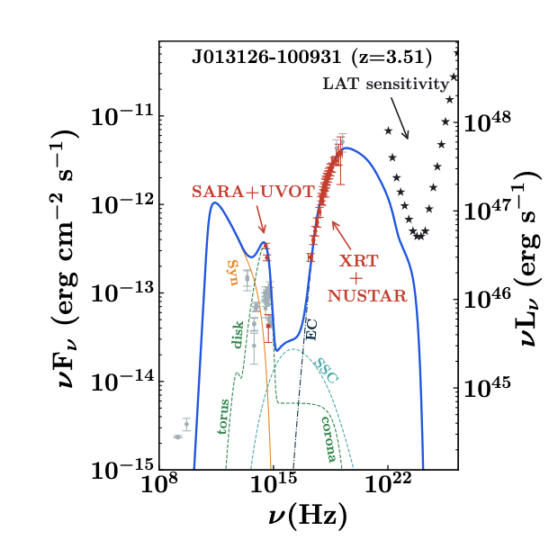



Missing MeV Science
Blazar populations:
Total extragalactic $γ$-ray intensity from 1 keV to 820 GeV
Marcotulli et al. 2020
TXS 0506+056
Lewis et al. 2021
Notes:
Transitions in blazar populations falls in that blind spot. Blazars at higher red shift tend to peak below the LAT band.

Slide 21



Missing MeV Science
Nucleosynthesis in stellar explosions and winds – supernovae: Type 1a and core collapse, novae, Wolf Rayet – produce isotopes with long half lives.
For SN, directly test models by probing isotopes produced in the developing explosion.
Gamma-ray lines from Radioisotopes
COSI planned for launch in 2027 is a critical pathfinder for gamma-ray line studies.

Slide 22

Cosmic Explosions
Where, when, and how do they happen?
Time-domain and multimessenger strategies can help
Gamma rays from jetted emission emerge early during stellar collapse and compact binary mergers.
Increased sensitivity of future Hertz-scale gravitational wave interferometers will add jointly detect mergers to peak in star formation.
Neutrinos??
Needs for future gamma ray telescopes
Wide field and sensitive gamma-ray transient monitors with sufficient localization for MMA studies
Spectral and timing information in the gamma-ray band to test the end state of the explosion and the jet engine.

Slide 23
Relativistic Jets
  Jets at all scales, pc to Mpc, from microquasars to supermassive black holes, generate gamma rays but composition and mechanisms undetermined.
Gamma rays detected up to very high gamma-ray energies.
  Gamma-ray burst record holder GRB 221009A, SS 433, M87…
  Joint projects with radio, X-ray and TeV test spectral models
Variability can indicate spatial scales of internal structures
Origins of highest energy cosmic rays and neutrinos?
  Neutrino detections could address questions about jet composition or the complex region around the black hole.
Needs for future gamma ray telescopes
Gamma-ray monitoring and sensitive MeV - GeV imaging spectroscopy enable target selection and model tests.
  Potential for gamma-ray polarization diagnostics to pin down mechanism for acceleration
Marcotulli et al. 2020
TXS 0506+056
Lewis et al. 2021
Notes:
Jet decline?

Slide 24
Some Science Questions from Astro 2020
Panel on Compact Objects and Energetic Phenomena
What powers the diversity of explosive phenomena across the electromagnetic spectrum?
Why do some compact objects eject material at nearly-light-speed jets, and what is that material made of?
Panel on Cosmology
What are the properties of dark matter and the dark sector?
What physics drives the cosmic expansion and the large-scale evolution of the universe?
Panel on Galaxies
How do supermassive black holes form and how is their growth coupled to the evolution of their host galaxies?
Help from astroparticles?

Slide 25



Activities in the Gamma-ray Science Interest Group
Future Large Mission Concepts
Science Analysis Group
Chartered to collect and synthesize community input on potential Probe-class and Flagship-class space-based gamma-ray mission concepts in the coming decade.
Report in development for completion this year.
Co-chairs:
Henric Krawczynski,
Liz Hays

Slide 26

Looking to the Future
2026 Fermi Summer School
Now recruiting graduate student and postdoc applicants for Year 15!
May 25 – June 4, 2027, in Lewes, Delaware.
https://fermi.gsfc.nasa.gov/science/mtgs/summerschool/
Opening for 2027 applications
in November.
Notes:
Recent Highlights

Slide 27
Conclusions
Fermi will continue providing access to the gamma-ray sky for years to come.
  Public data, analysis tools, and derived products continue to modernize in support of community science.
From the very small and rapid to the very large and diffuse, Fermi observations have changed our understanding of the sky, the Sun, our Galaxy, and the Universe.
  Multi-wavelength and multimessenger observations have been critical!
Fundamental questions remain for the future; new capabilities are needed to make progress.
  NASA studies for future large missions will be announced and start next year.
Astroparticle

Slide 29











Fermi Transient Searches & Catalogs
LAT Transient Factory (LTF)
Likelihood Around GBM/BAT triggers
seconds to orbits
LAT Team - Results in GCNs
Triggered + Blind Search
Fermi All-sky Variability Analysis (FAVA)
Aperture Photometry, 1 week
ATels, FAV catalogs
Pipeline
Method
Timescale
Distribution
Status
Fermi LAT Light Curve Repository
Likelihood LAT Catalog Sources
3 days, Weekly, Monthly
LAT Burst Advocate Tool
Likelihood Around GBM/BAT triggers
100 s, 1000 s
LAT Team - Results in GCNs
Pipelines
Fermi LAT Monitored Sources
Daily, Weekly above 10⁻⁶ cm⁻²s⁻¹
GBM Targeted Search
ground search
ms - s
Temporal/Spatial Input
LAT Automated Science Processing (ASP) + Flare Advocates
Likelihood
6 & 24 hour
ATels, GCN notices (on AGN)
GBM Onboard Triggers
rate triggers
16 ms - minutes
GCN Notices
LAT Catalogs
Likelihood, associations
FGL, FHL, LAC, FLE, PSR, SFR
GBM Untargeted Search
ground search
ms - s
GCN Notices
Timescale
μs
ms
s
minutes
hours
days
months
years
Pulsars
Solar Flares
Novae
BNS
All Sky Cadence
γ-ray Binaries
Photon Timing
Blazar Flares
Terrestrial γ-ray
Flashes
GRBs
Magnetar Flares
Crab Flares
Transients
Periodic AGN
Not to scale
Notes:
We don’t just provide photon lists to the community, we’ve built many onboard/ground/automated/catalog analyses that guide multiwavelength and multimessenger studies on timescales from microsec to years from sources earth to the cosmological scales.
Critical community enabling services.
Utilize skills and processing capacity we have access to get the most for the user community.
Teams take advantage of skills already needed to support parts of science operations to also generate a large menu of PUBLIC data products, many continuously updated, to support very broad science

Slide 30

Gamma-ray blazars reveal supermassive black hole activity
3C 279
Variability over minutes probes very small regions within a plasma jet 5 billion light years away.
Too small for shocks? Could this be magnetic-driven acceleration in the jet?
Ackermann et al. 2016, ApJL
Notes:
This suggests that the emitting region is smaller than the size of the BH event horizon for comparison. The expected size of shocked regions is larger and makes magnetic reconnection an interesting effect to consider?

Slide 31




Fermi fills a gap to reveal gamma rays from two novae
Gamma rays reveal how nova shock power accelerates relativistic particles and produces optical emission.
Novae emit gamma rays within a few days of the optical peak.
Target of opportunity (TOO) pointing allowed Fermi to detect the onset of gamma rays from V462 Lupus and 2 days later from nova V572 Velorum.
Start of TOO
optical
gamma rays
June 11 gamma ray counts
June 12
June 25
2-sided all-sky survey mode
Partial sinusoidal survey mode
TOO
Exposure gap
V462 Lup & V572 Vel
Fermi’s all-sky survey uses 3 observing modes. One mode leaves a small exposure gap that lasts ~1 week. The gap can be partly filled using pointed observations during orbit night following the new Fermi Target of Opportunity (TOO) process.

Slide 32


Gamma-ray Cosmology
Below 10s of GeV, the Universe is transparent to gamma rays
Each higher redshift blazar samples an entire population from an earlier epoch.
Independent probe of cosmic structure
Test intergalactic magnetic field strength
Independently measure the Hubble constant (several methods)
  Aside: a benefit of modeling quasiperiodic oscillations in merger-type GRBs is a distance constraint (Guedes et al. 2024. ApJ 983)
Notes:
Fermi sources are tracing large scale properties of the Universe independently of other methods.
Update:
Work presented at the AAS and under journal review shows that the more distant gamma ray blazars correlate with cosmic voids suggests that we are seeing the impact of these intergalactic effects.
This becomes even more interesting as complementary gamma-ray facilities come online on the ground and larger optical surveys will help characterize the gamma-ray blazars.

