Slide 1

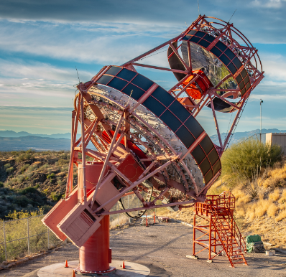




IPA 2026
Observations of Markarian 421 by the upgraded prototype Schwarzschild-Couder Telescope
Luca Riitano
University of Wisconsin-Madison
For the SCT Collaboration and CTAO Consortium

Slide 2
pSCT Background
CTAO candidate medium sized telescope
Prototype co-located with VERITAS at Fred Lawrence Whipple Observatory in Arizona
~100 GeV to ~100 TeV energy range
Novel dual-mirror Schwarzschild-Couder design matched with use of silicon photomultipliers (SiPMs)
Undergoing camera upgrade after previous camera detected Crab Nebula in 2020
Notes:
More info on reference

Slide 3
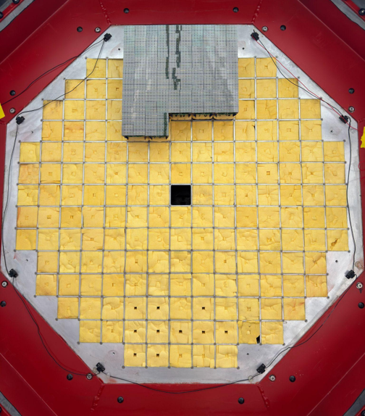
pSCT Background
Full camera will feature 177 modules, 11,328 pixels, and 8-degree FoV
Top sector of camera was populated in April 2026
First light achieved April 2nd with 19 fully functional and substantially upgraded modules
Off-axis observations
  Center of sector is 2.7 degrees off-axis
  Field rotation due to tracking limitations

Slide 4
Mrk 421 Observations
Simultaneous observing campaign of blazar Markarian 421 in a flaring state with VERITAS and IXPE
Mrk 421 is a nearby (~100 Mpc) blazar and first detected extragalactic TeV source (1992, Whipple)
Observing campaign of 9 nights between April 11th and April 21st (UTC date)
22.5 hours of on-source data and 19.25 hours of matching off-source data
~100min of on-source data used as burn sample
  Burn sample – data to optimize cuts on, excluded from final significance
Obtained VERITAS gamma rays that triggered pSCT for burn sample

Slide 5
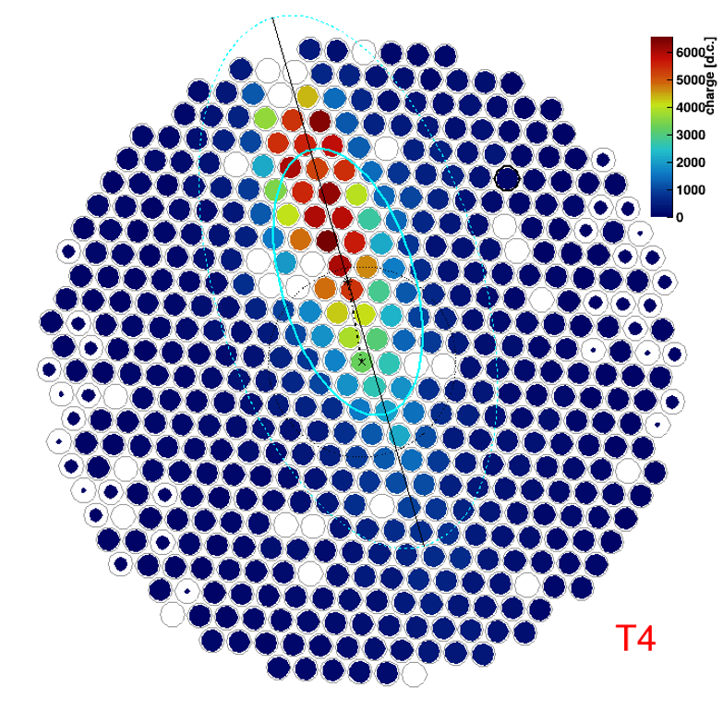
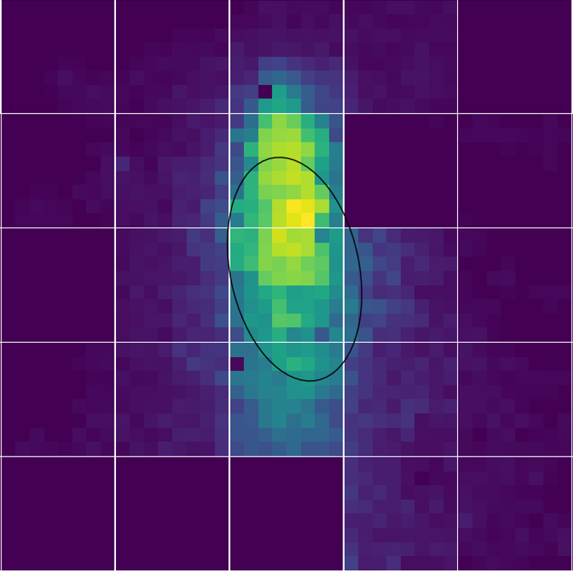
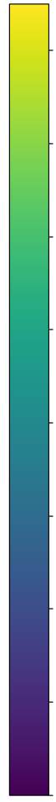
Matched Cosmic Ray
VERITAS T4 – (35m from pSCT)
pSCT
200
175
150
125
p.e.
100
Photoelectrons
75
50
25
0
Notes:
Circle is 0.5 degree radius. T4 is 35 meters from psct

Slide 6
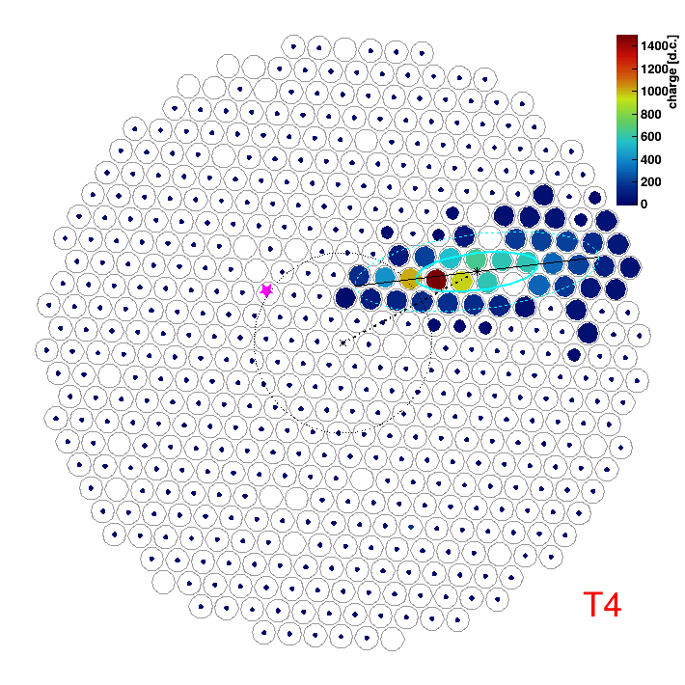
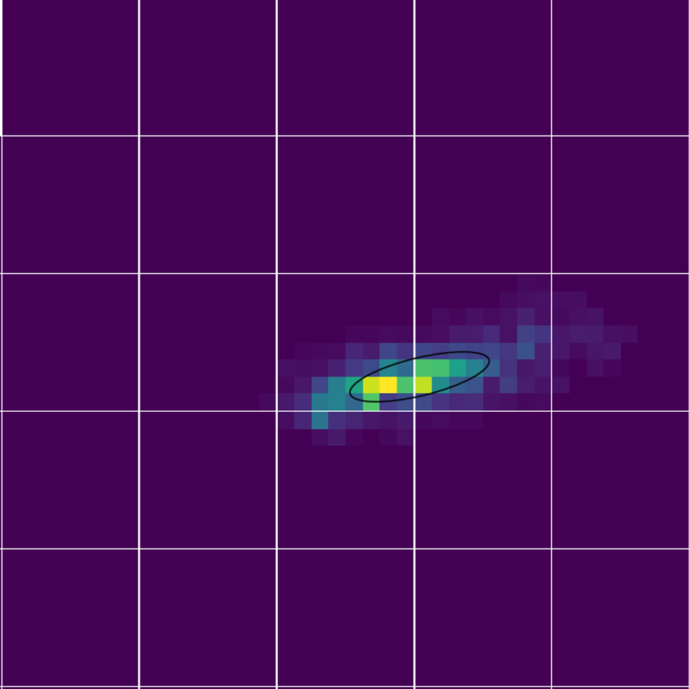
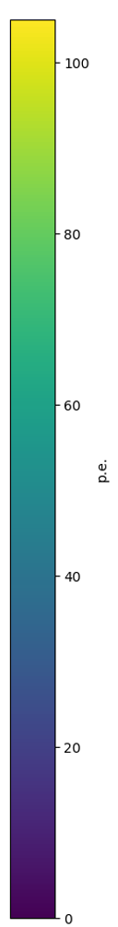
Matched 3.4 TeV Gamma Ray
VERITAS T4 – (35m from pSCT)
pSCT
100
80
60
Photoelectrons
40
20
0

Slide 7
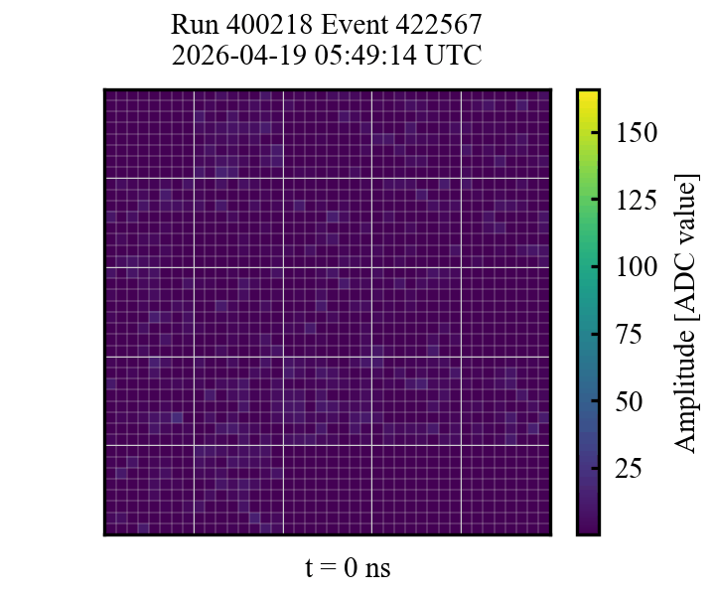
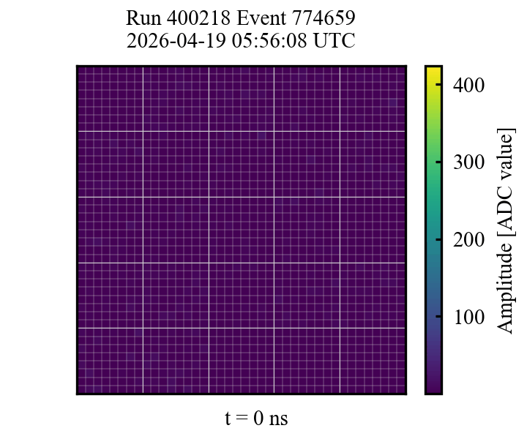
Matched Gamma Rays

Slide 8
Data Processing and Quality Cuts
Raw data calibrated and gain corrected
Ctapipe python package used to process charge images
  Applied tailcuts cleaning method
  Extracted Hillas parameters
Quality cuts – removed image if:
  Centroid within 2 pixels of the camera edge or a non-functional module
  Less than 5 pixels passed cleaning

Slide 9
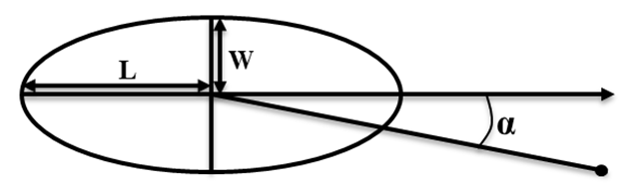
Hillas Parameters
Method of parameterizing shower images as ellipses using moments
Used in this analysis
  Size/Intensity
  Length
  Width
  Distance
  Alpha
Distance
Source

Slide 10
Cut Optimization
Burn sample for cut optimization
4 runs/99min of on-source data from April 16th and 19th
Tested various parameters to cut on
Maximized significance of burn sample
Final Cuts:
Intensity > 150p.e.
Length/Intensity < 6e-5 m/p.e.
Width < 0.008m
0.05m < Distance < 0.10m
Alpha < 6 degrees

Slide 11
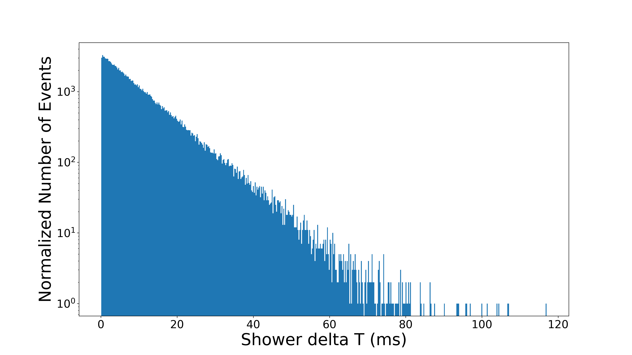
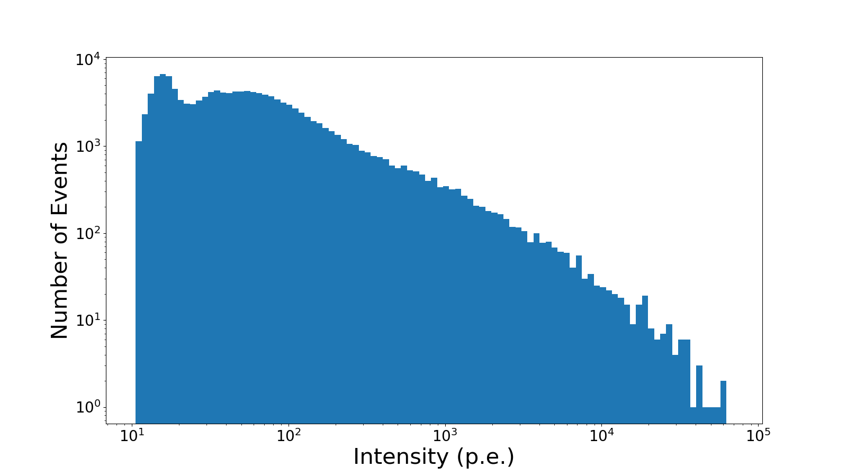
Data Quality Plots – Run 400128
Number of Eventsf
Intensity (photoelectrons)

Slide 12
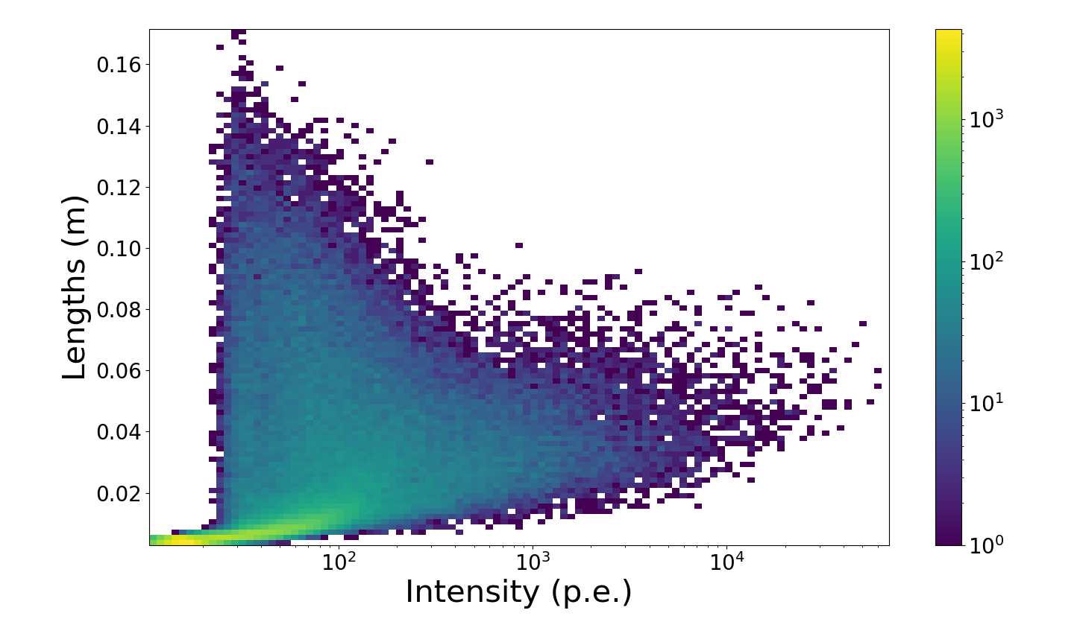
Data Quality Plots – Run 400128
Events per Bin
Intensity (photoelectrons)

Slide 13
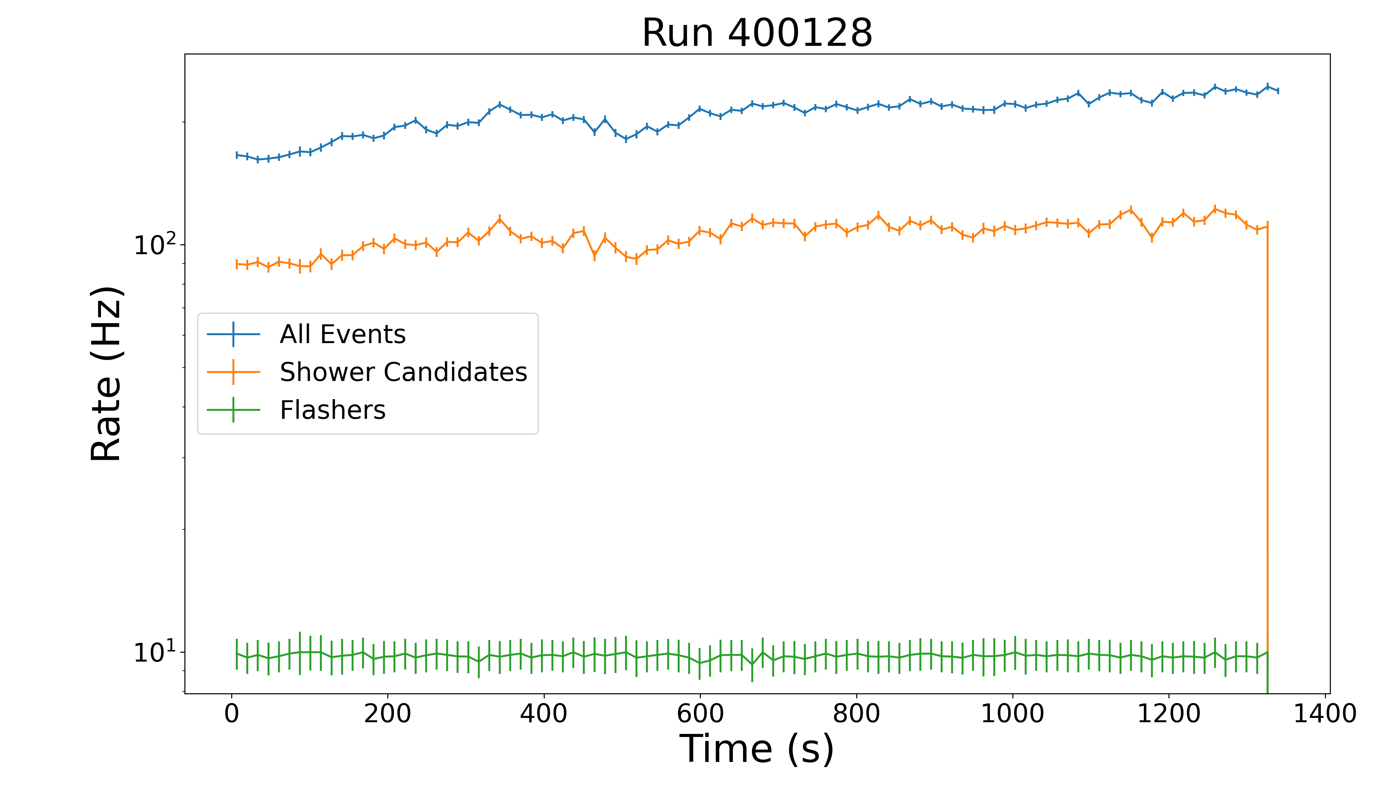
Data Quality Plots – Run 400128

Slide 14
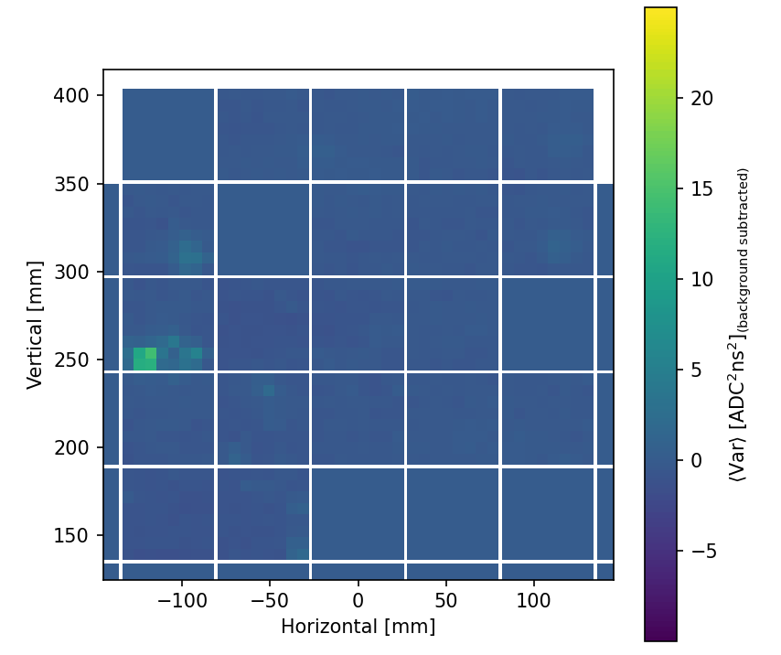
Pointing Corrections
Bright star -> waveform baseline voltage variance increase
Identifying stars near Mrk 421 allows for pointing corrections

Slide 15

Off-axis Observations – FoV Comparison
Full pSCT FoV is 8 degrees
Typical IACT FoV - 3.5 to 5 degrees
Average Mrk 421 offset was ~2.7 degrees from camera center
Average Mrk 421 Position
VERITAS FoV

Slide 16
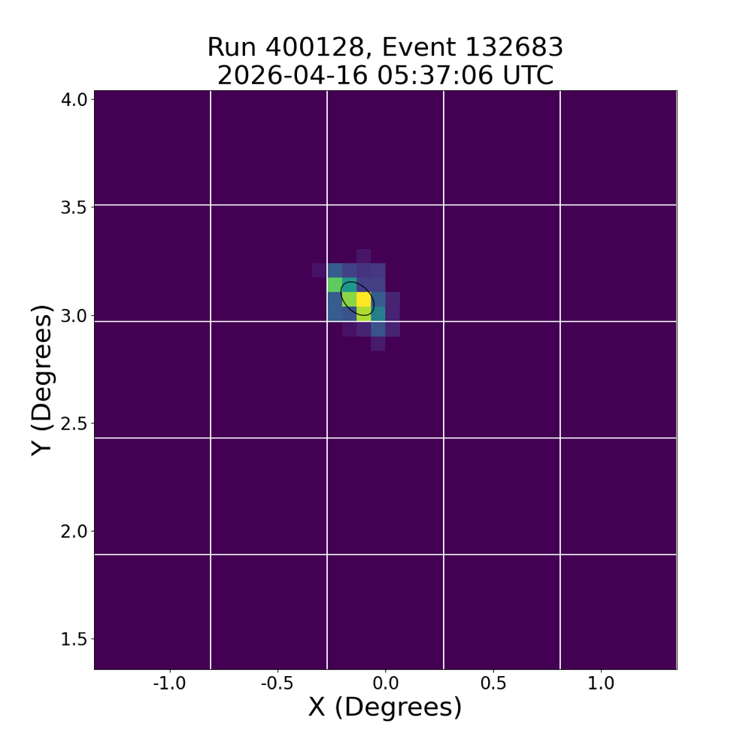
Gamma Ray Candidates

Slide 17
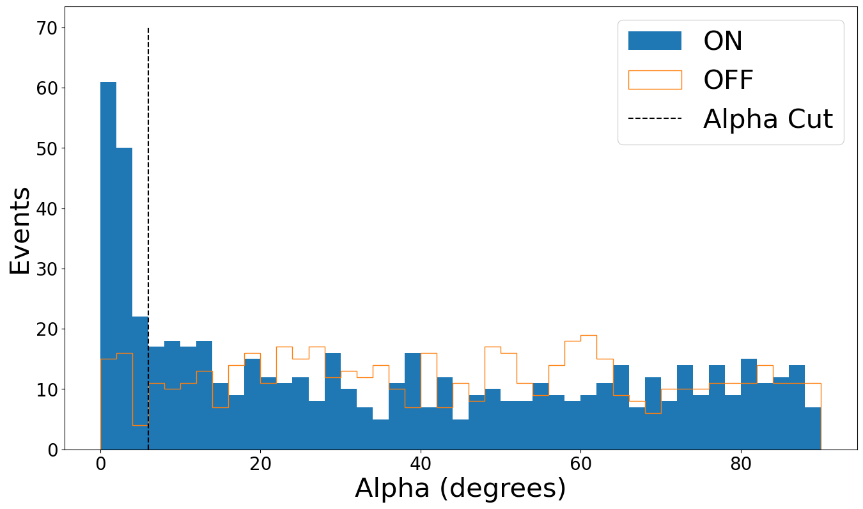
Results of One Night of Observations
Remaining 2.75 hours of data from April 19th used
Elevation matched off- source data used for background
Alpha cut of 6 degrees applied
Significance of 7.8 sigma
Preliminary

Slide 18
Summary
Observed Mrk 421 in a flaring state shortly after partial camera commissioning
Analyzed night of data taken during good weather with Mrk 421 flaring above Crab flux
19 fully functional modules, off-axis observations, moving source, during camera commissioning, and only one night of data analyzed.
Similar significance to 2020 Crab detection with previous camera but several times less livetime
Detection of a source located 2.5 to 3 degrees off-axis – outside of most IACTs FoV
Outlook
  System improvements over past few months to improve data quality
  Module count to increase to ~70 in the next few months
  Further analysis improvements and analysis of full Mrk 421 campaign to be continued
  Camera expected to be fully instrumented with 177 modules in 2027

Slide 19
Backup

Slide 20
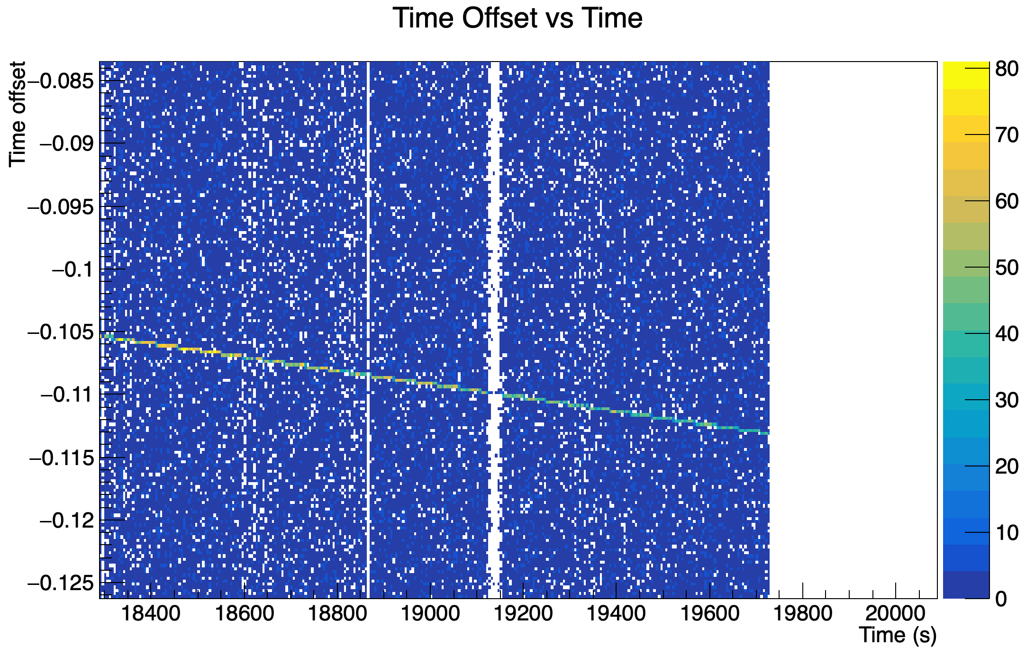
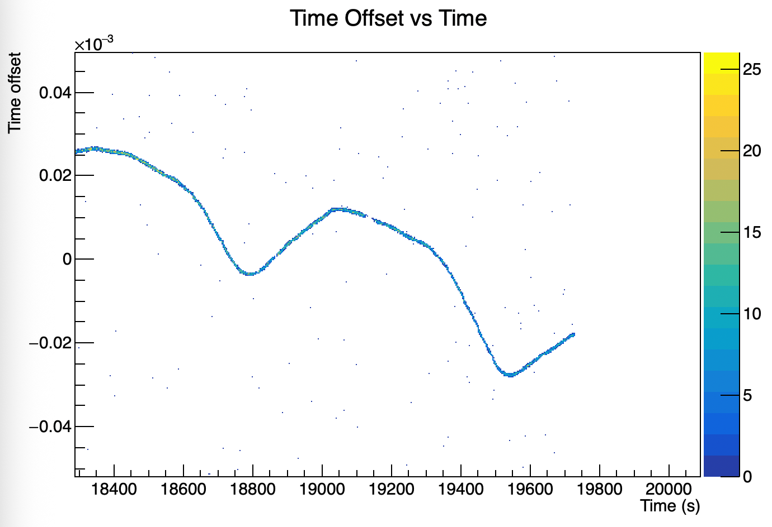
pSCT Clock Correction

Slide 21
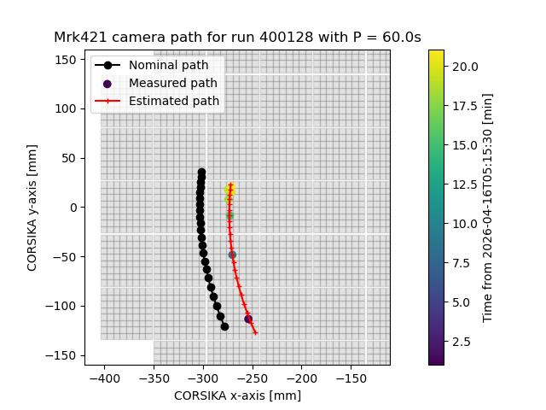
Pointing Corrections

Slide 22
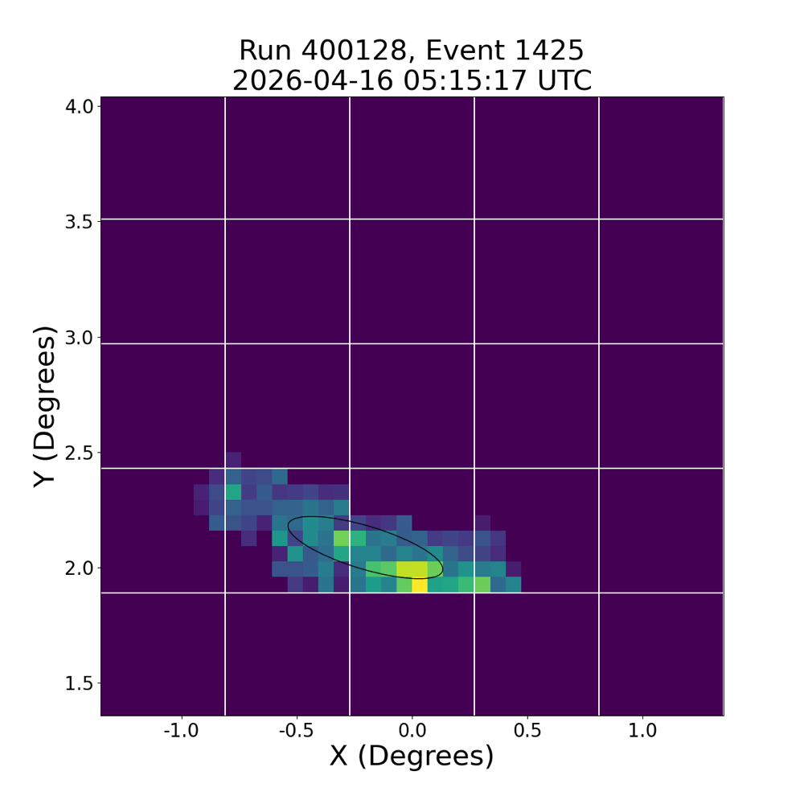
Gamma Ray Candidates

Slide 23
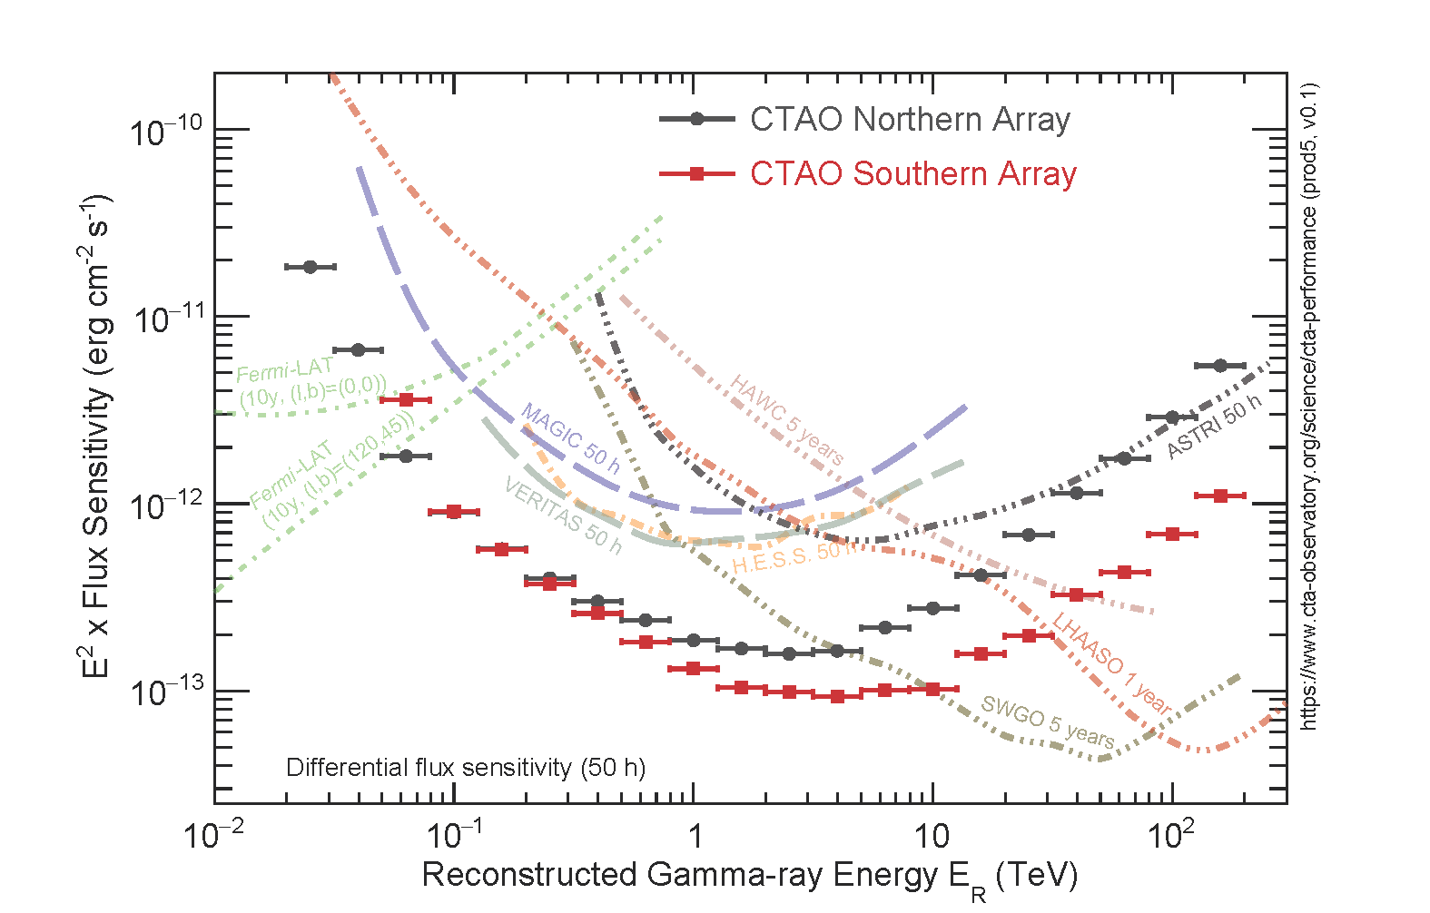
Cherenkov Telescope Array Observatory (CTAO)
Very high energy (VHE) imaging atmospheric Cherenkov telescope (IACT) array
Three telescope sizes – Large (LST – 23.0m primary), Medium (MST – 11.5m primary), and Small (SST – 4.3m primary)
20 GeV – 300 TeV energy range
La Palma, Spain – 4 LSTs, 9 MSTs
Paranal, Chile – 14 MSTs, 37 SSTs (+ 2 LSTs, +5 SSTs)
Sensitivity from Prod5 – 5th generation of IRFs from 2021
Motivation - exploring relativistic particle accelerators and extreme environments
*Prod5

Slide 24
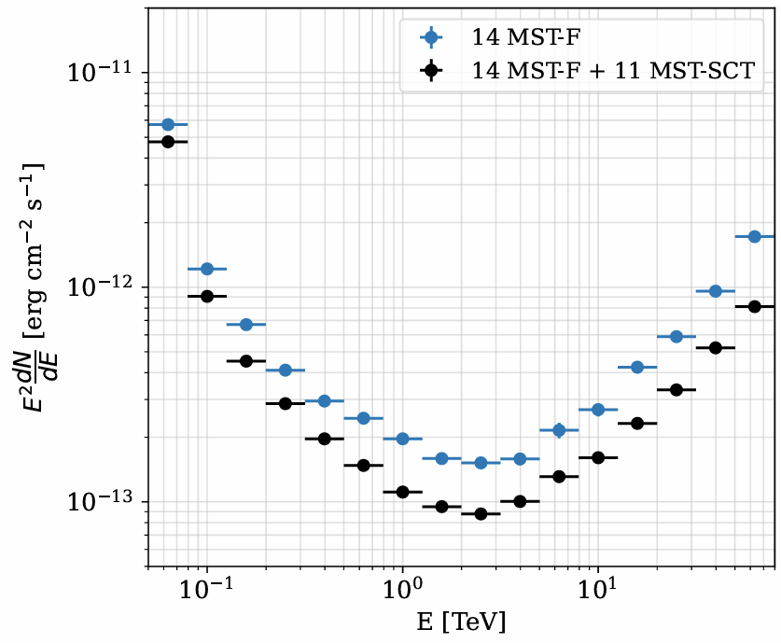
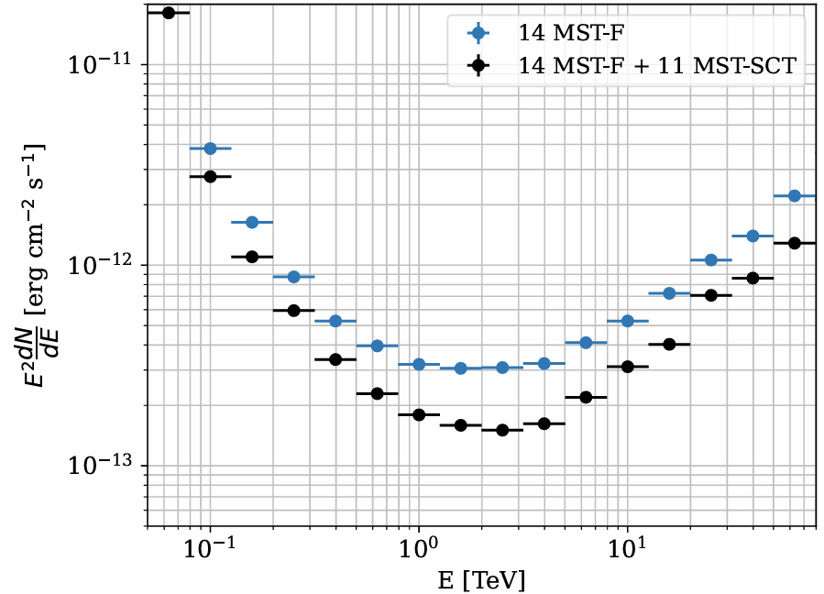
Sensitivity
On-axis
3.5º off-axis
*Prod3b

Slide 25
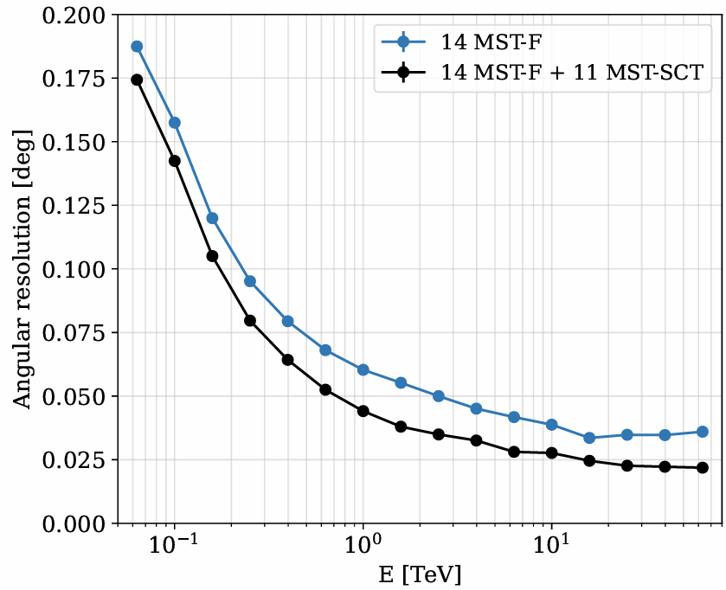
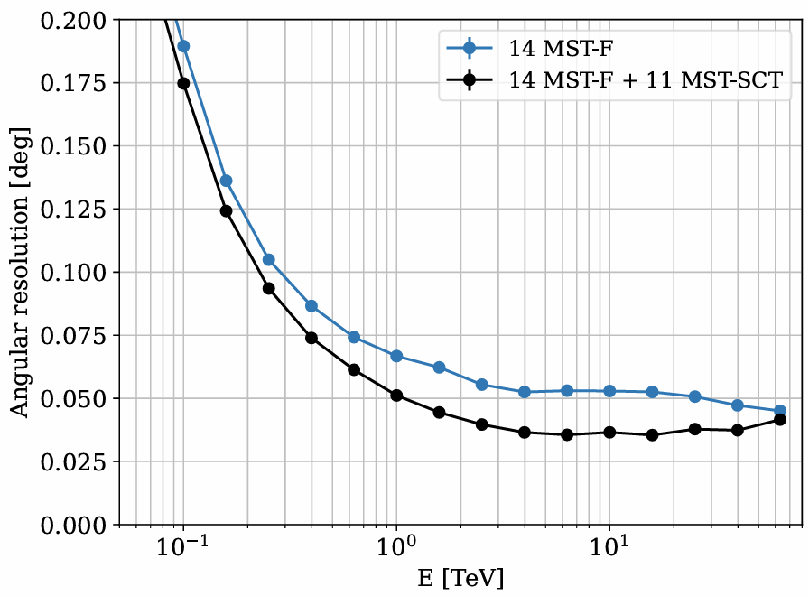
Angular Resolution
On-axis
3.5º off-axis
*Prod3b

Slide 26
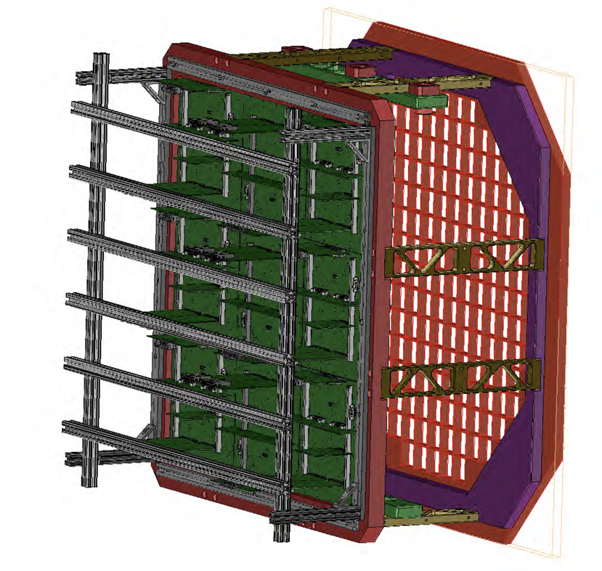
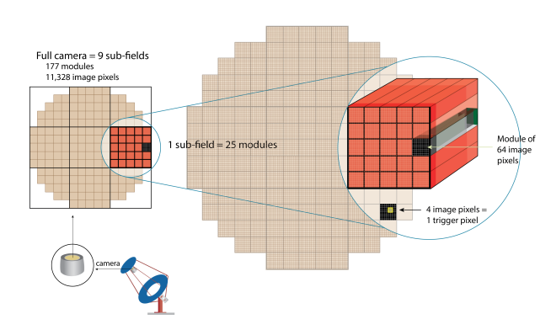
pSCT Camera

Slide 27
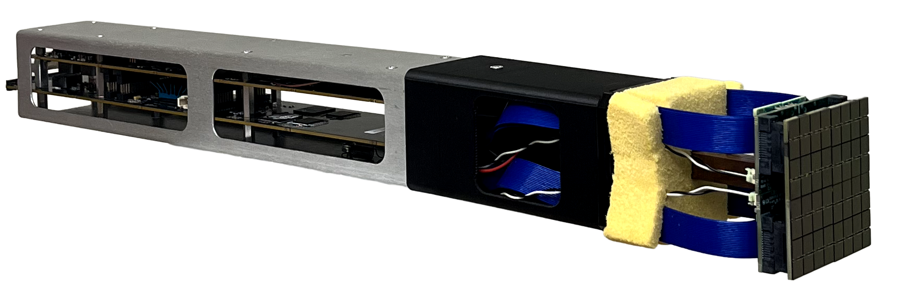
Upgraded pSCT Camera Module
Module performance paper: https://arxiv.org/abs/2512.12529

Slide 28
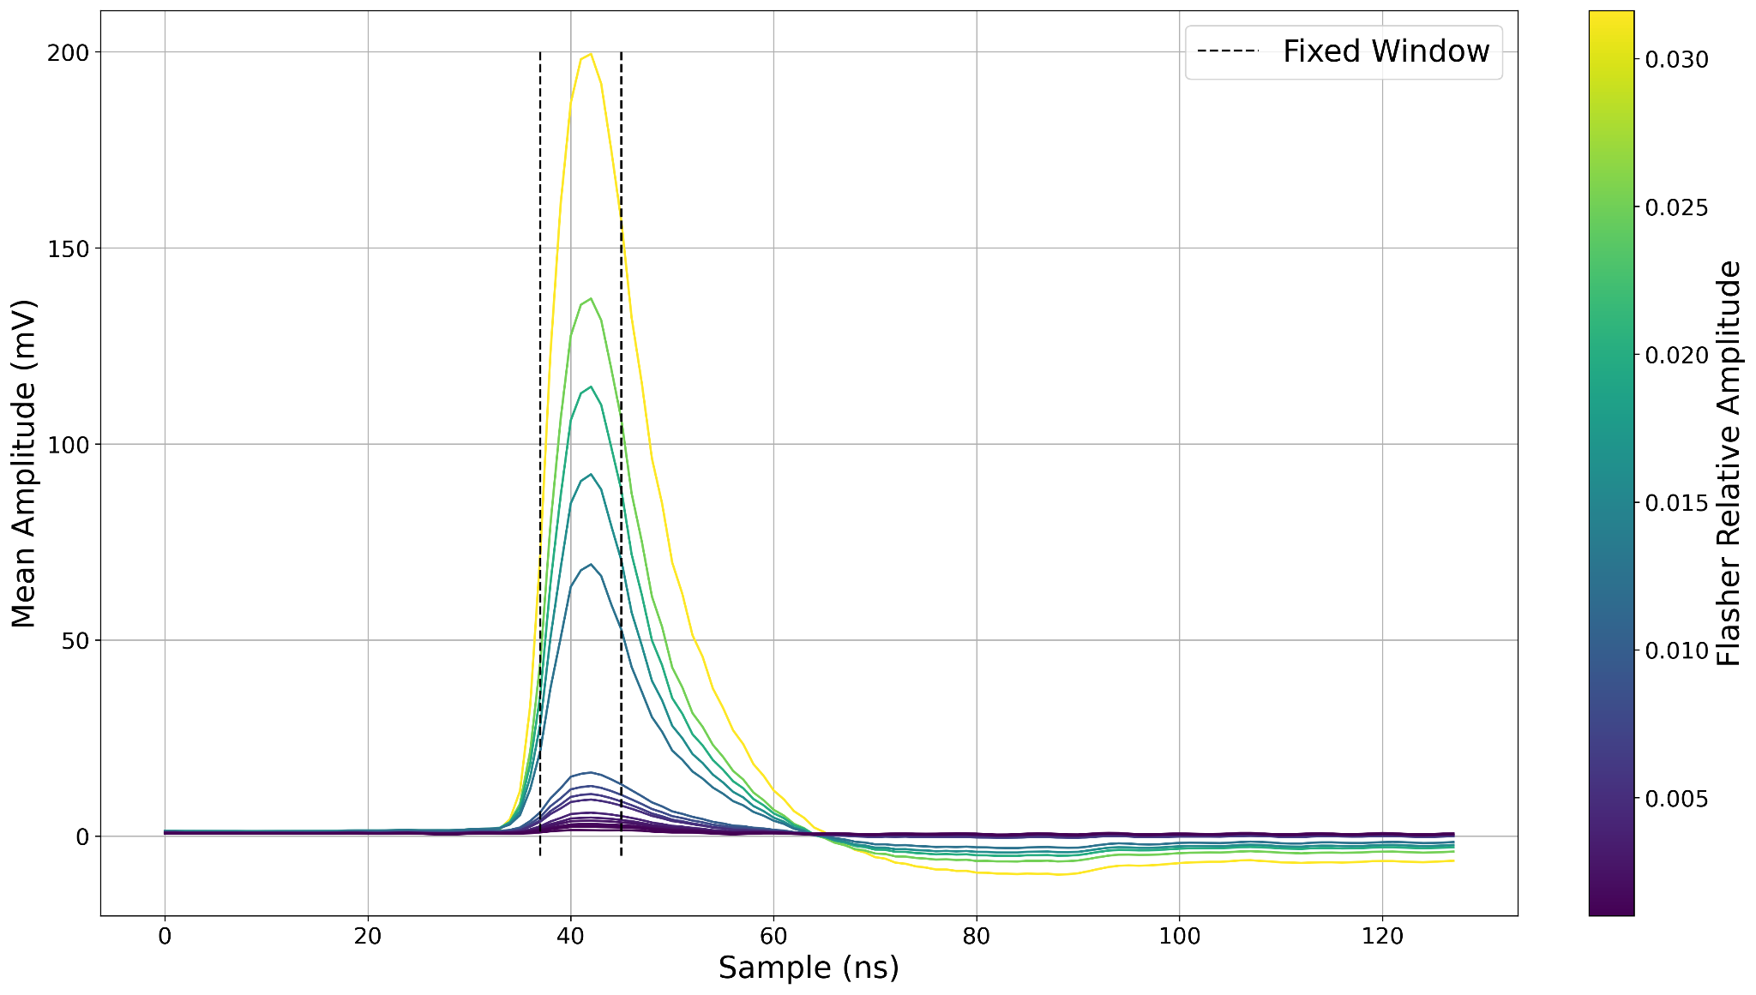
LED Flasher Tests

Slide 29
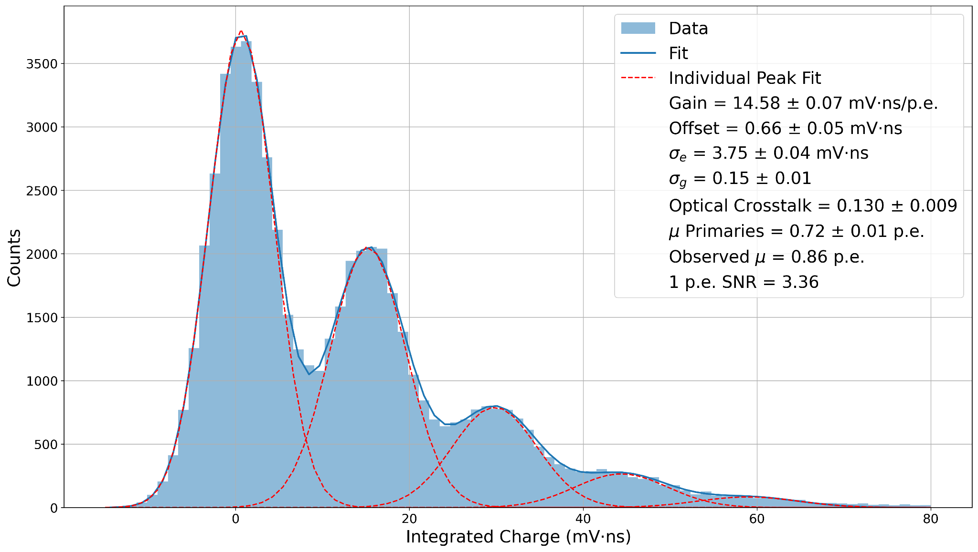
Charge Histograms

Slide 30
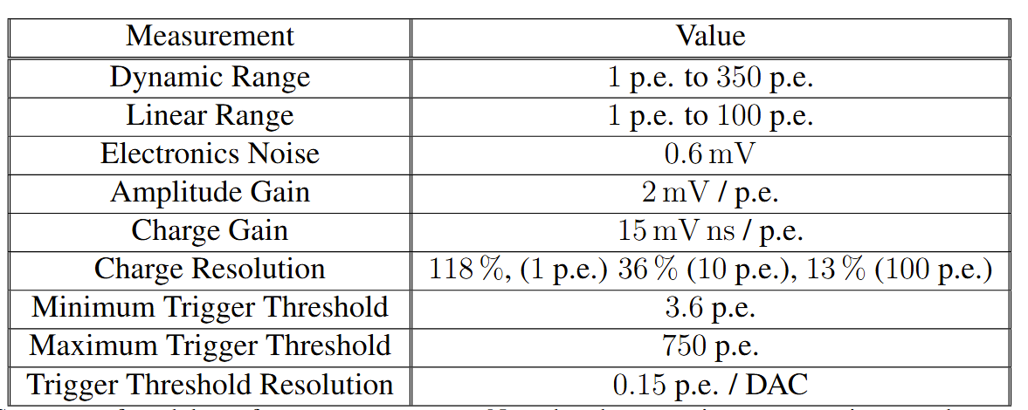
Measured Module Performance

Slide 31
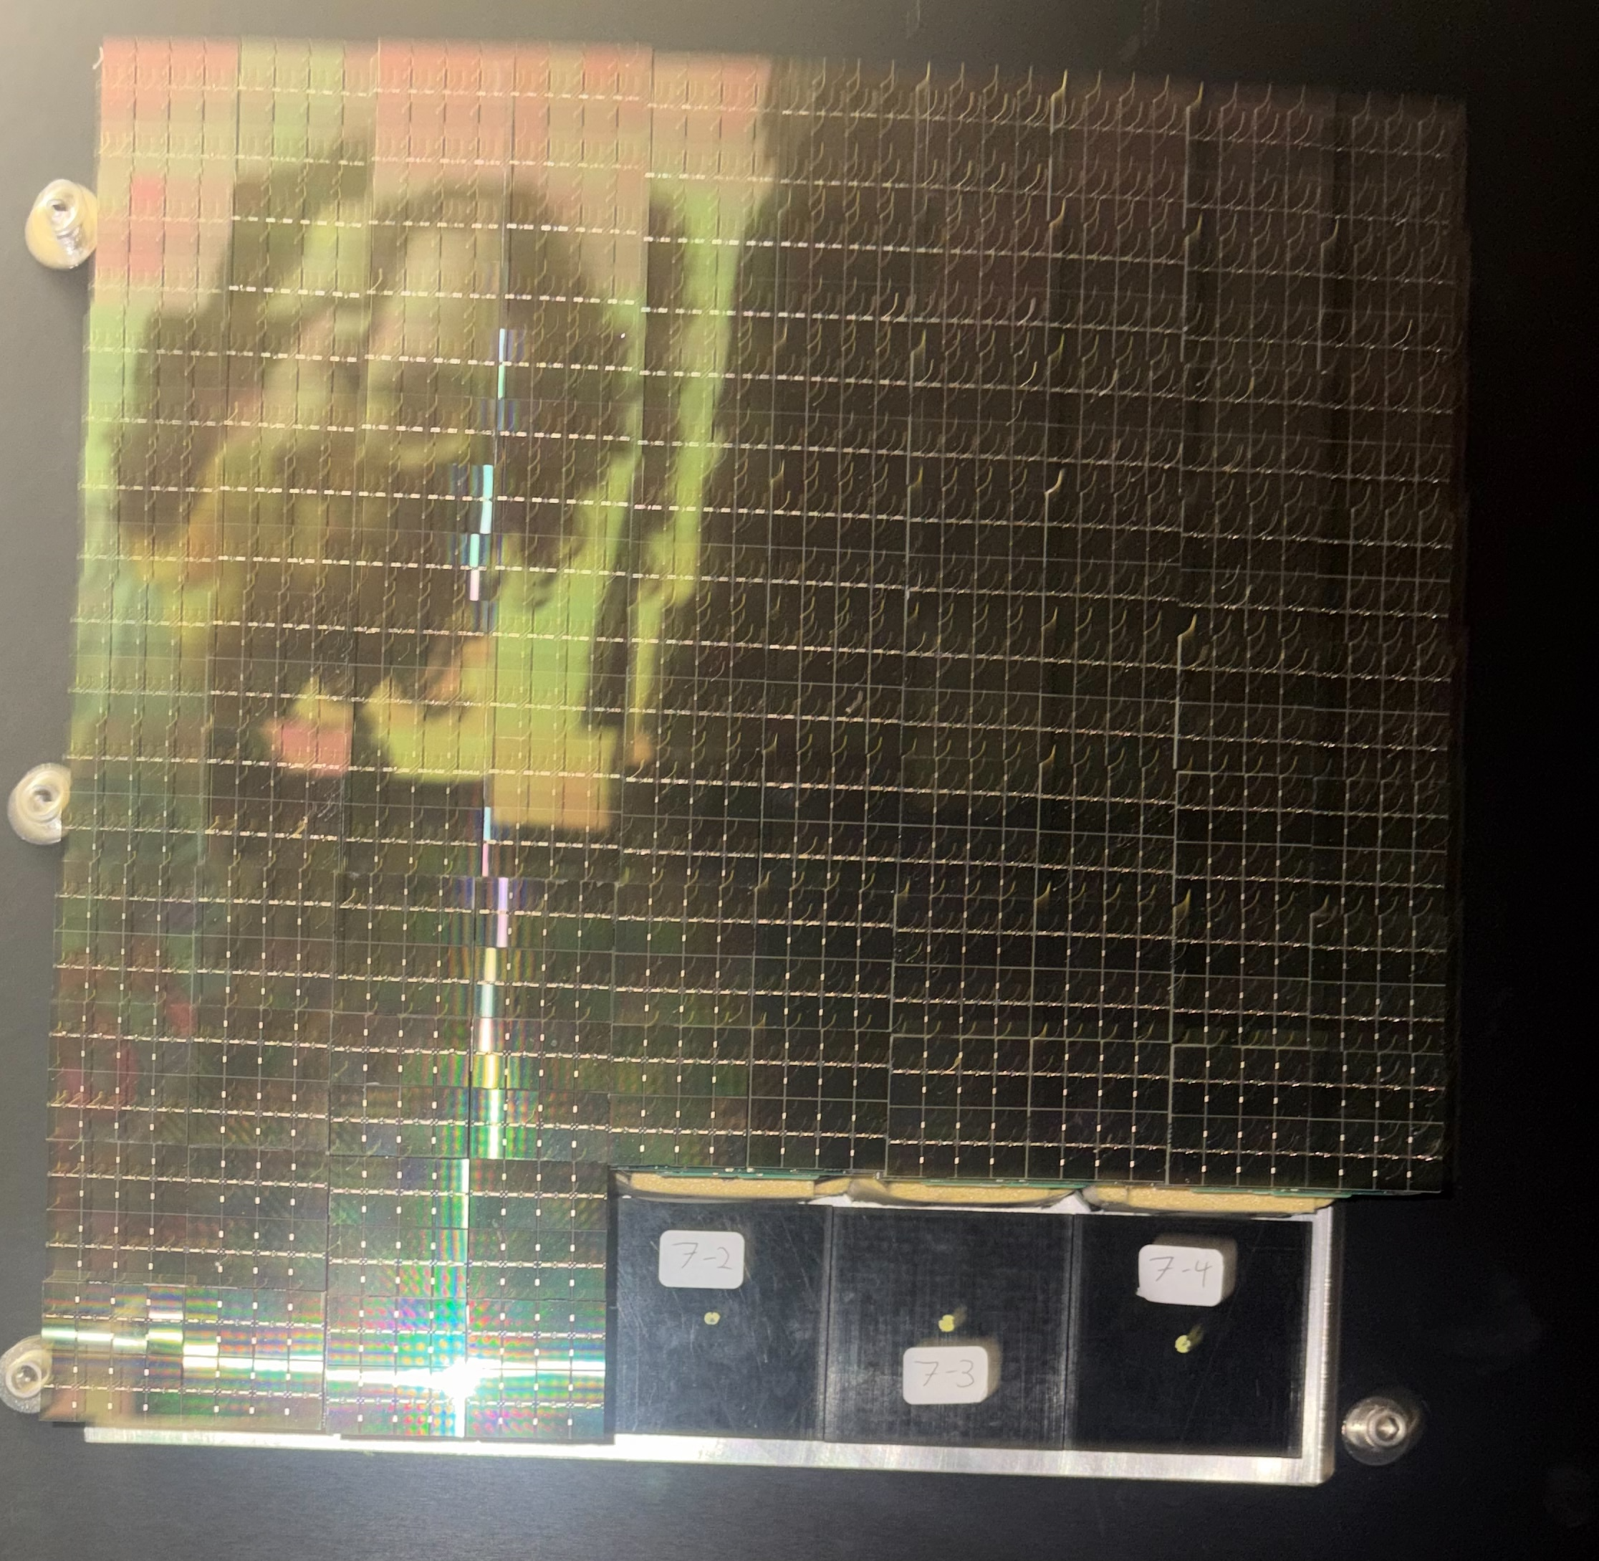
First Camera Sector Testing
First batch of production focal plane modules and front-end electronics modules received in January-February
Optimization, calibration, assembly, and testing of 22 modules / 1408 pixels completed on March 12th

Slide 32
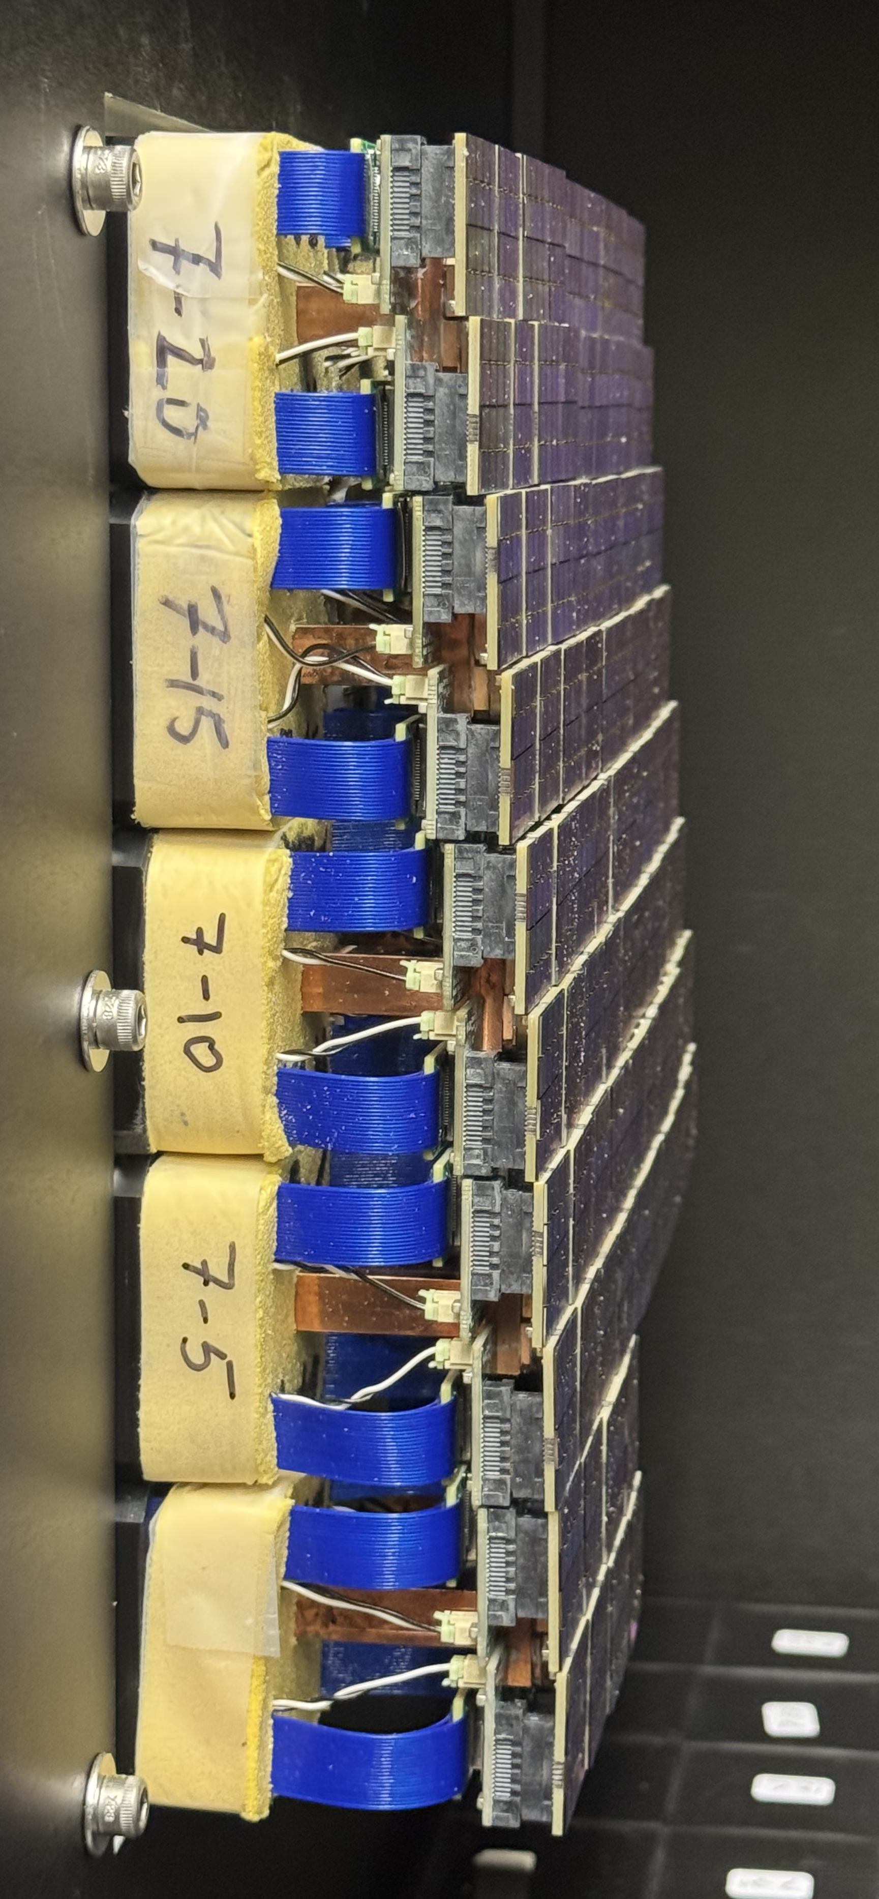
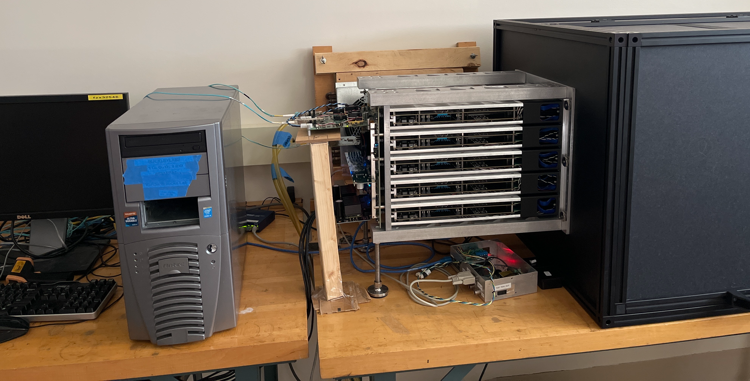
Minicam Test Setup

Slide 33
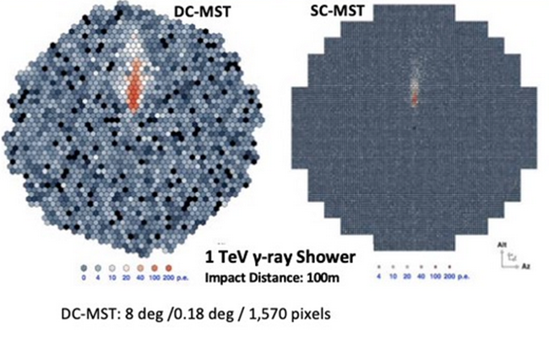
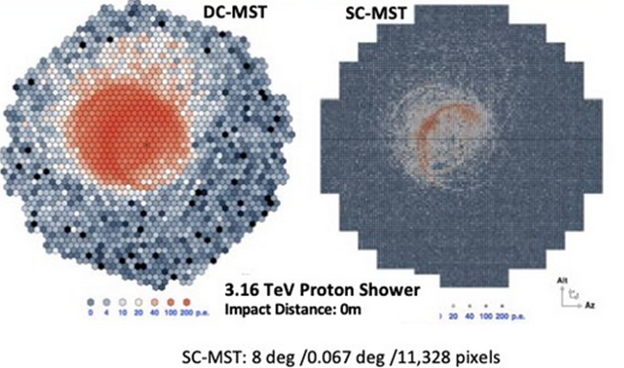
Outlook
Improved simulations of SCTs underway
Camera module behavior thoroughly tested
pSCT camera module fabrication has started
NSF funding for 10 Small-Sized Telescope cameras using similar technology
1,855

Slide 34
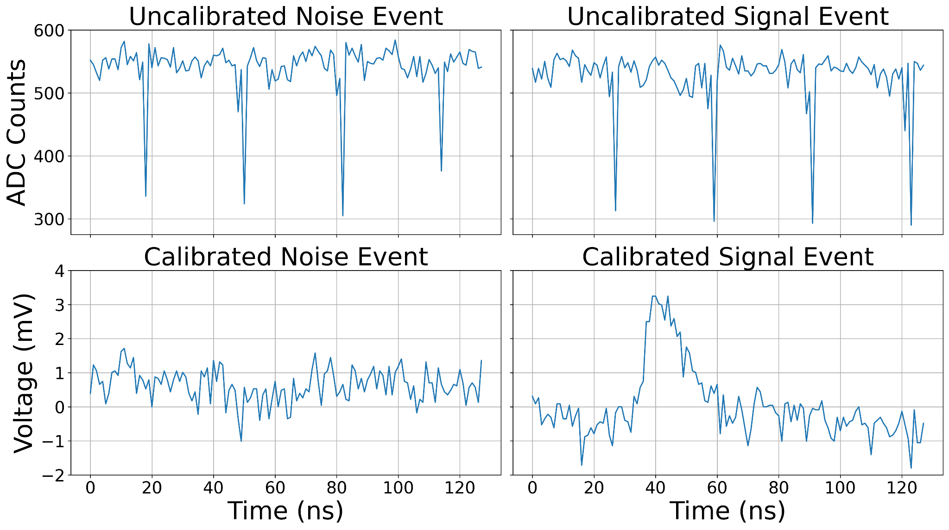
Module Waveform Calibration

Slide 35
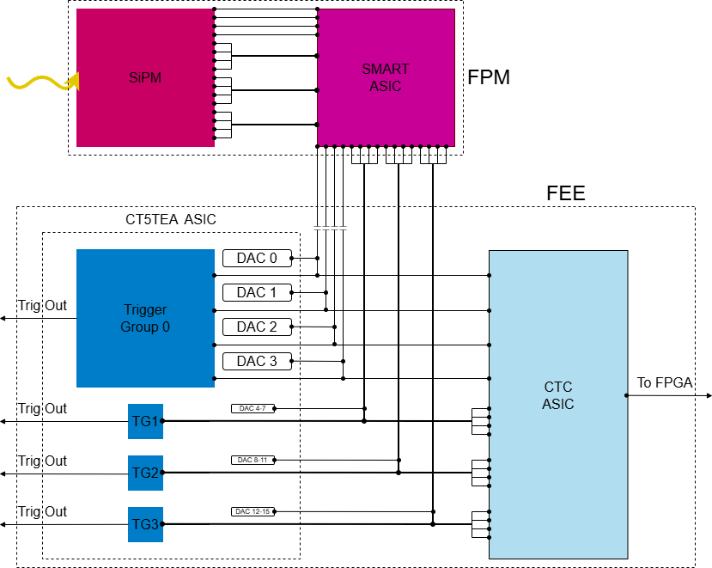

Slide 36
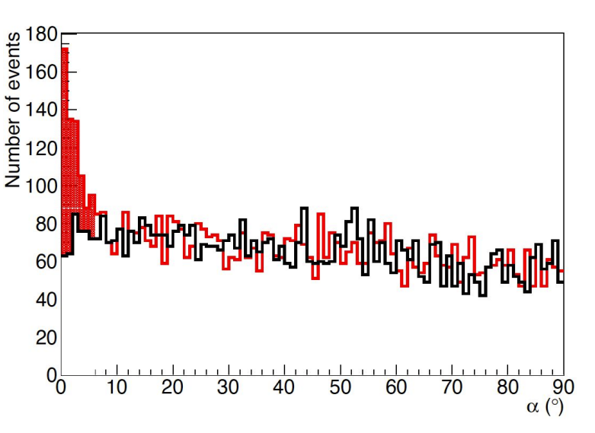
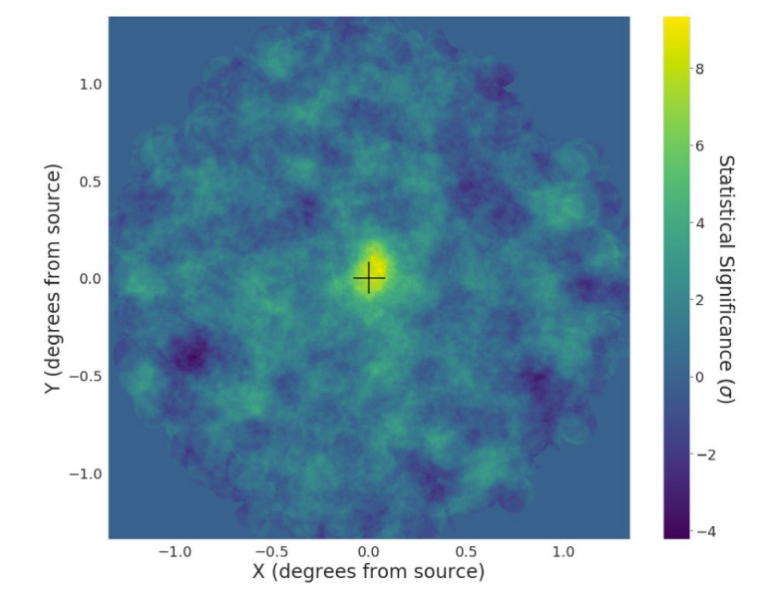
Crab Detection
Crab Nebula detected at 8.6 sigma using data from February 2020
17.6 hours of on and off-source data
Hillas parameterization used to establish gamma-ray selection cuts
Adams et al. (2021)²

Slide 37
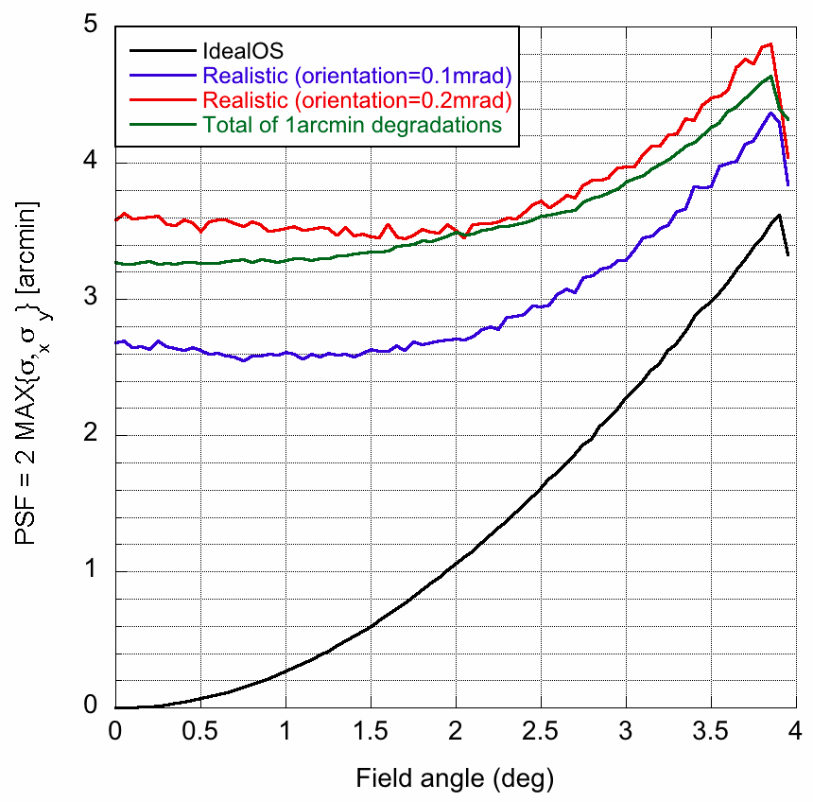
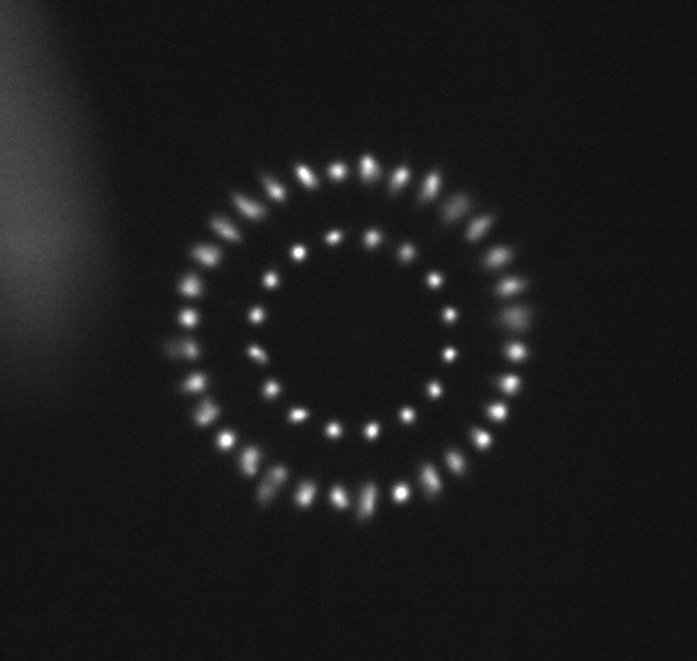
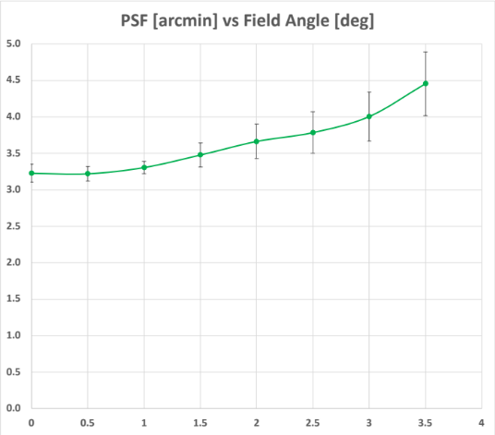
Optics
9.7m primary and 5.4m secondary mirror
48 segments in primary and 24 segments in secondary
On-axis point spread function (PSF) - 2.8’
Excellent off-axis PSF achieved
PSF (arcmin)
Field angle (deg)

Slide 38
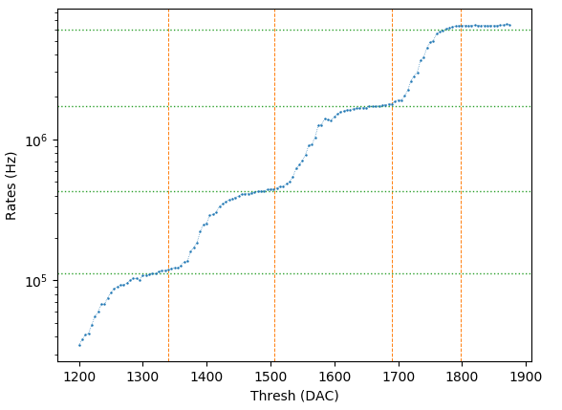
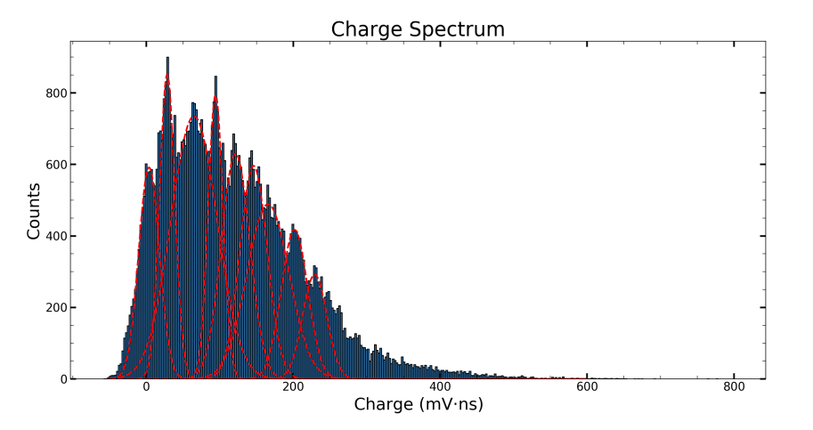
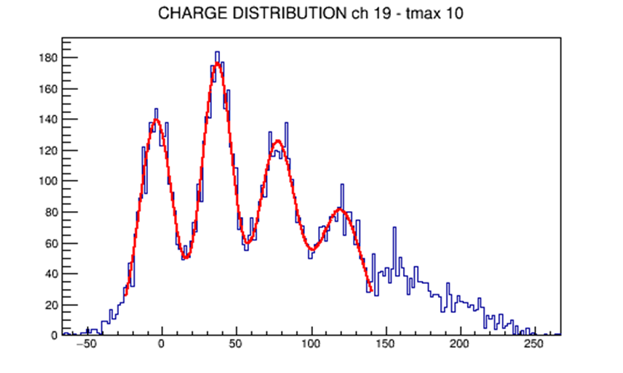
Module Overview
See Ambrosi et al. for SiPM details
Current module – TARGET7 ASIC
Upgrade module – T5TEA and TARGETC ASICs
SMART ASIC pulse shaper and preamp
Counts
Charge (ADC • ns)

Slide 39
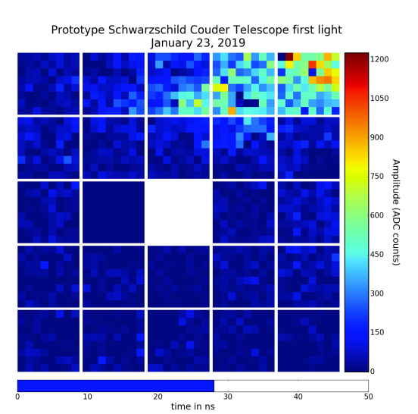
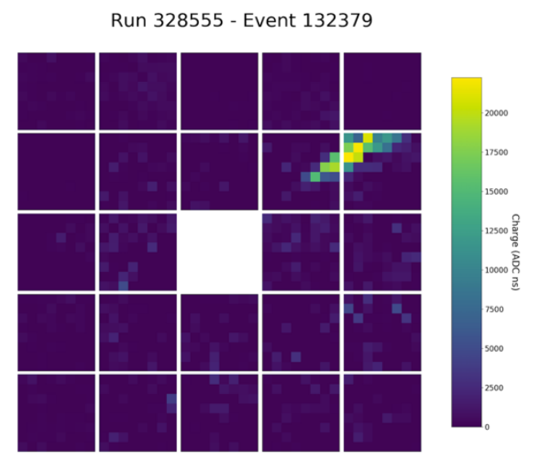

Slide 40


Slide 41


Slide 42




Slide 43


Slide 44


Slide 45


Slide 46
References
Adams et al. Design and performance of the prototype Schwarzschild-Couder telescope camera, J. Astron. Telesc. Instrum. Syst. 8(1), 014007 (2022).
Acharyya et al. The Optical System of the Schwarzschild-Couder Telescope and the Performance Improvement to the CTA, PoS ICRC 2023, 587 (2023).
Cerasole et al. Comparative Study of CTAO Medium-Size Telescope Array Layout Performances in Gamma-Ray Burst Observations. PoS ICRC 2023, 726 (2023).

