Slide 1


An Exceptionally Extended TeV Halo around HAWC J0542+2315
Hongyi Wu, Sam Groetsch, Ke Fang
UW-Madison
10/14/2026 IPA Symposium

Slide 2
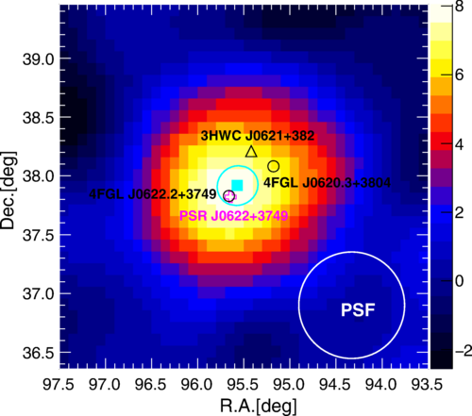
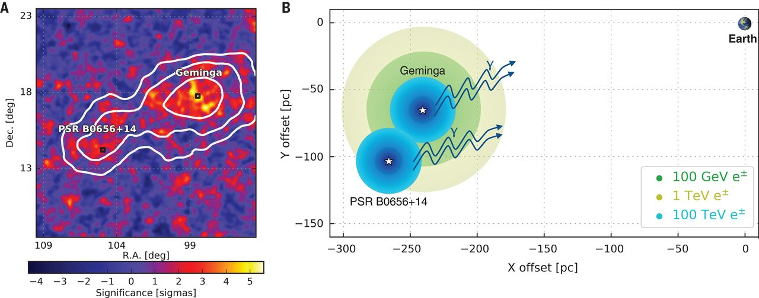
Introduction: TeV Halos
Geminga & Monogem
PSR J0622+3749
Source: A. U. Abeysekara et al., Science 358, 911 (2017).
Source: LHAASO Collaboration et al., Phys. Rev. Lett. 126, 241103 (2021).

Slide 3
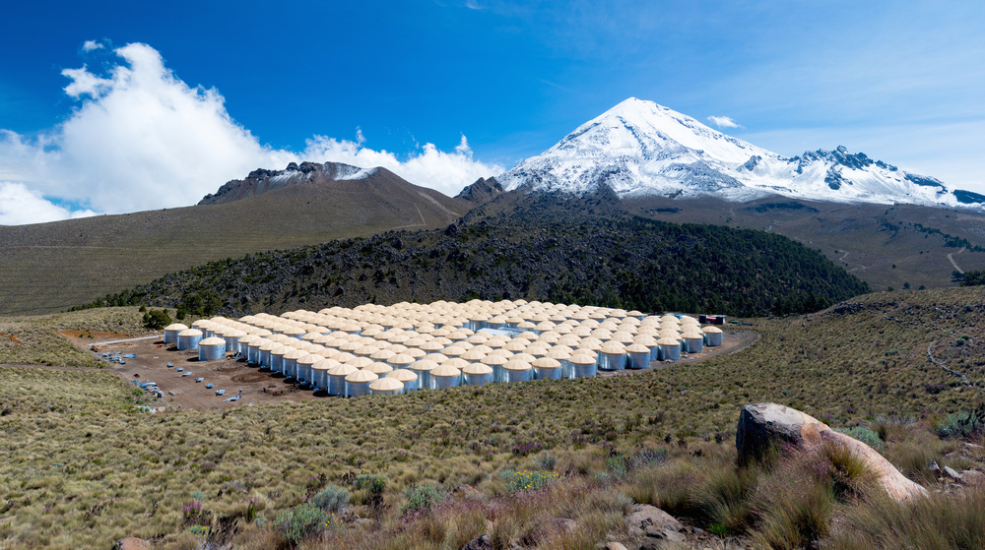
Data
Located at an altitude of 4100m in Sierra Negra, Mexico, the High-Altitude Water Cherenkov Observatory (HAWC)
This analysis uses 2860 days of HAWC data (ground-parameter data set)

Slide 4
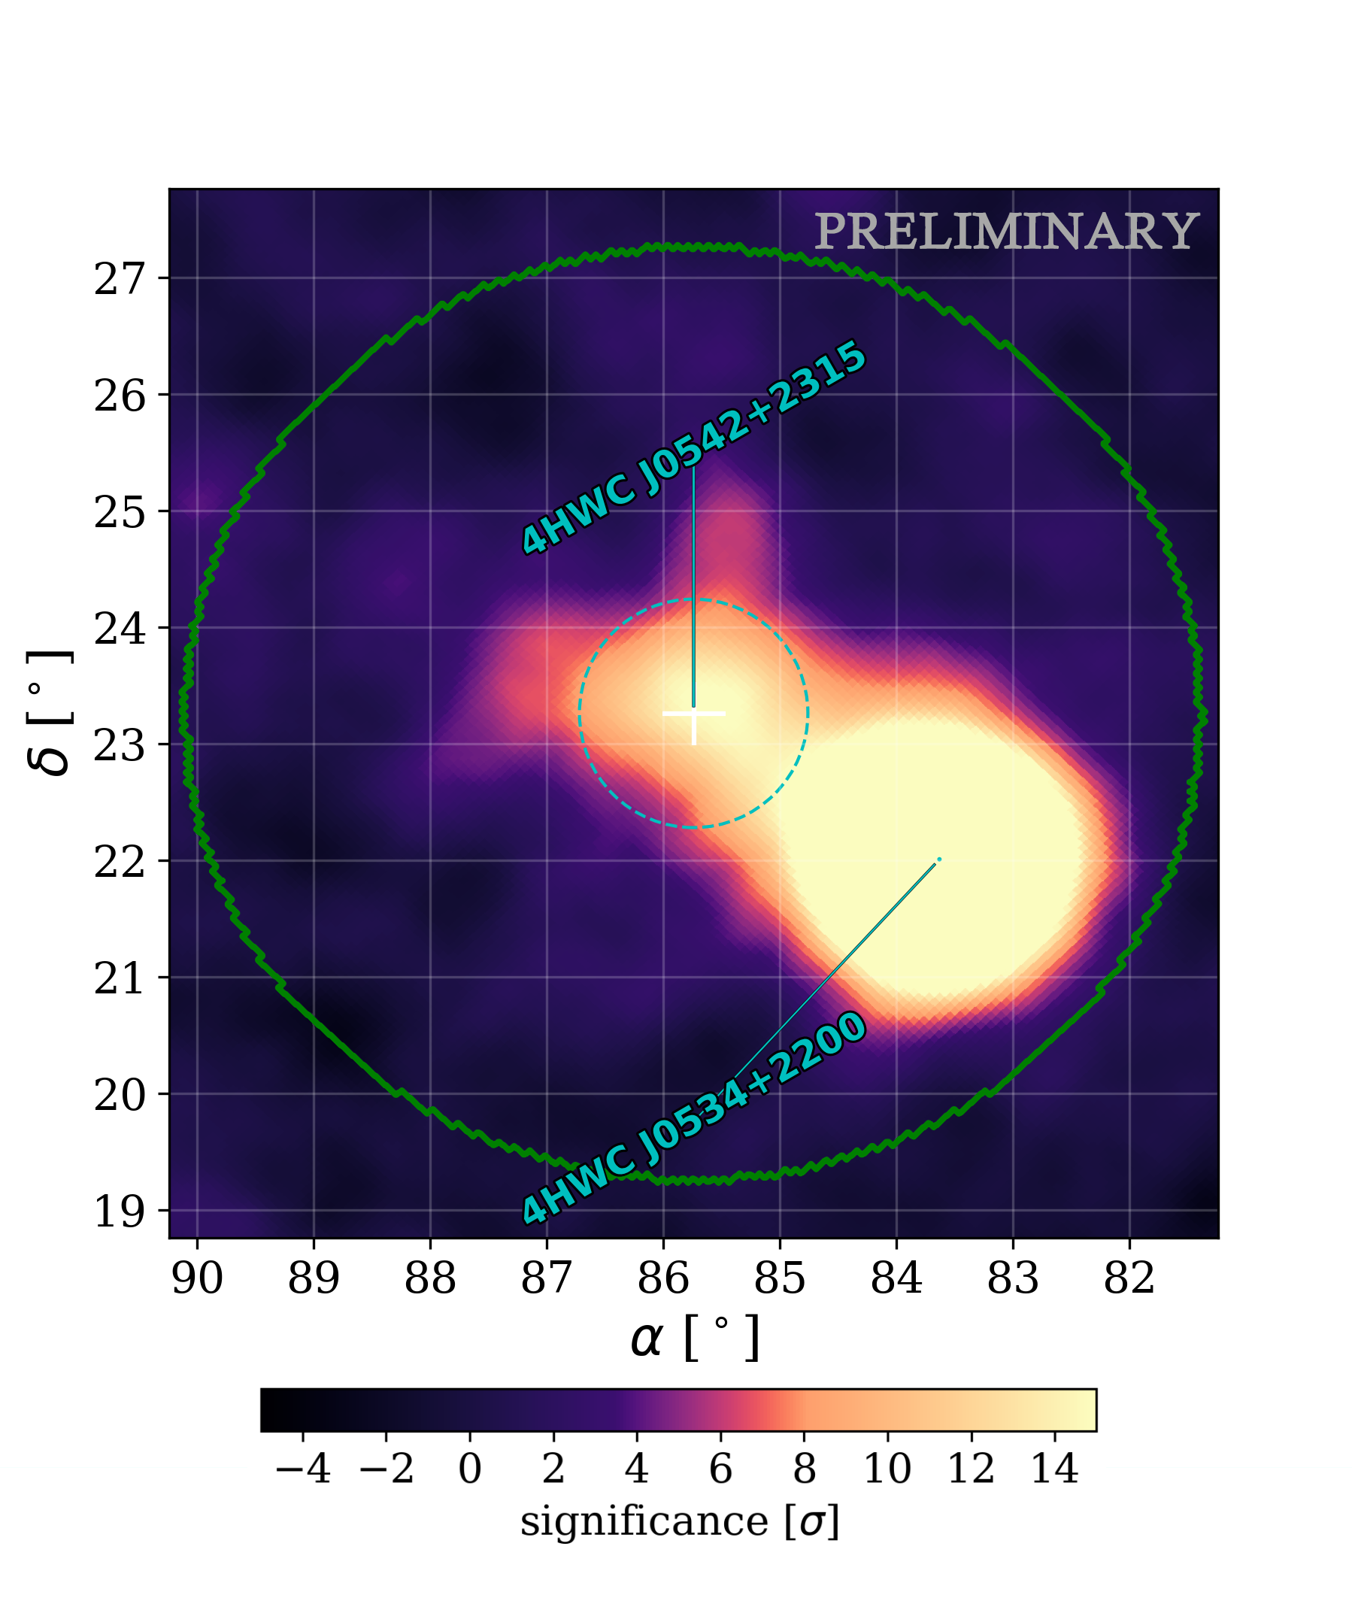
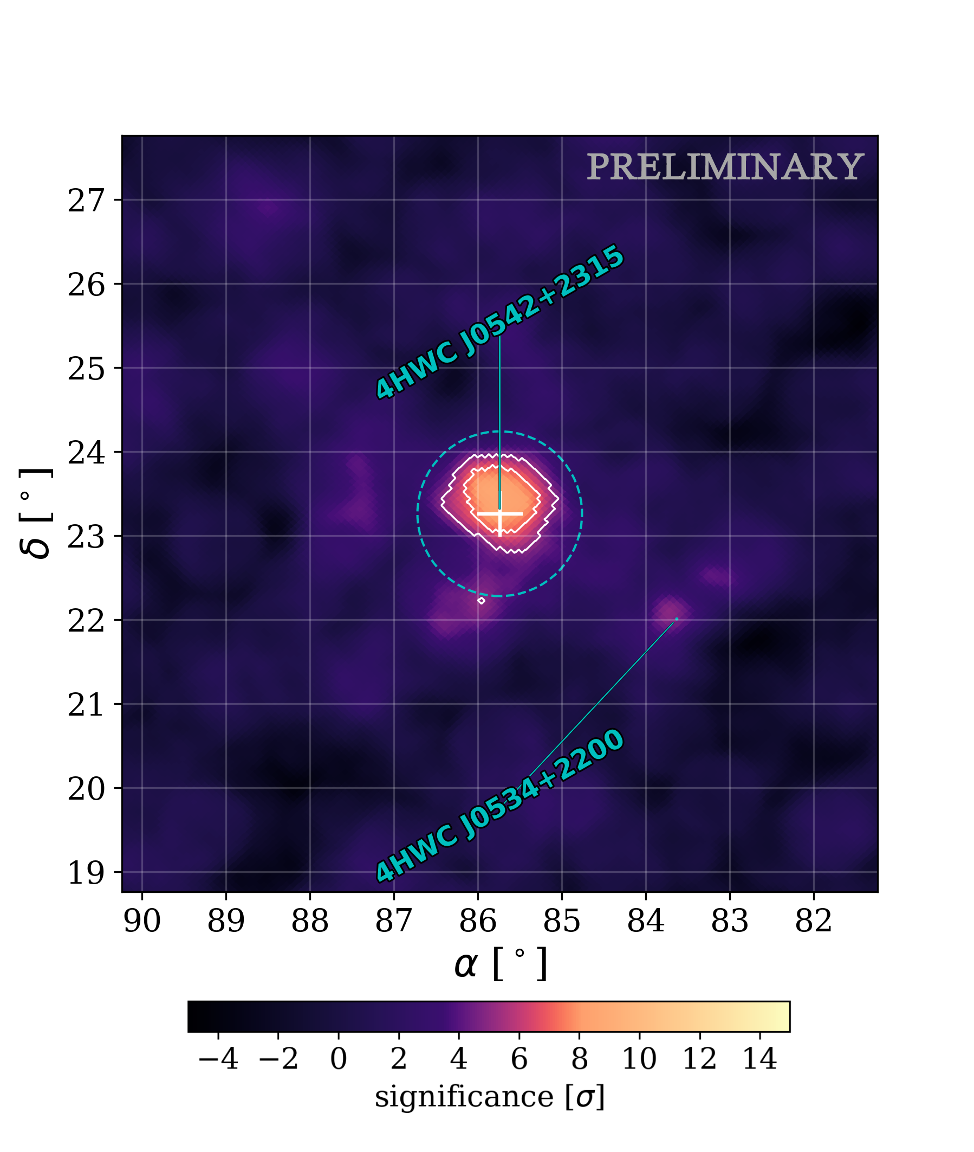
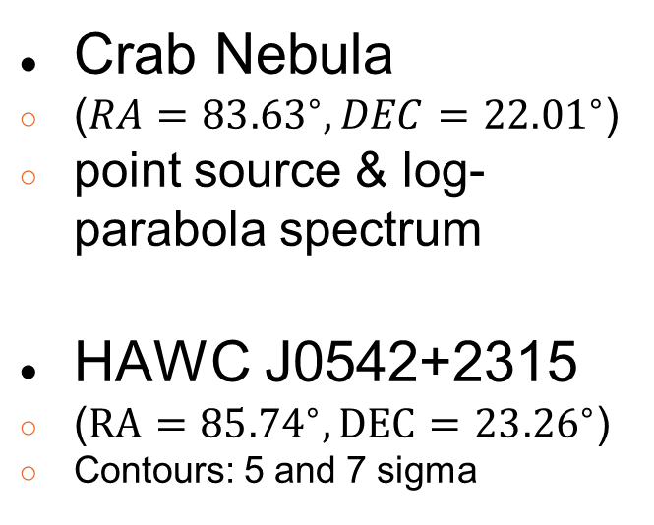
Region of Interest (ROI)
Crab Nebula
  ($RA={83.63}^{∘},DEC={22.01}^{∘}$)
  point source & log-parabola spectrum
HAWC J0542+2315
  ($RA={85.74}^{∘},DEC={23.26}^{∘}$)
  Contours: 5 and 7 sigma

Slide 5
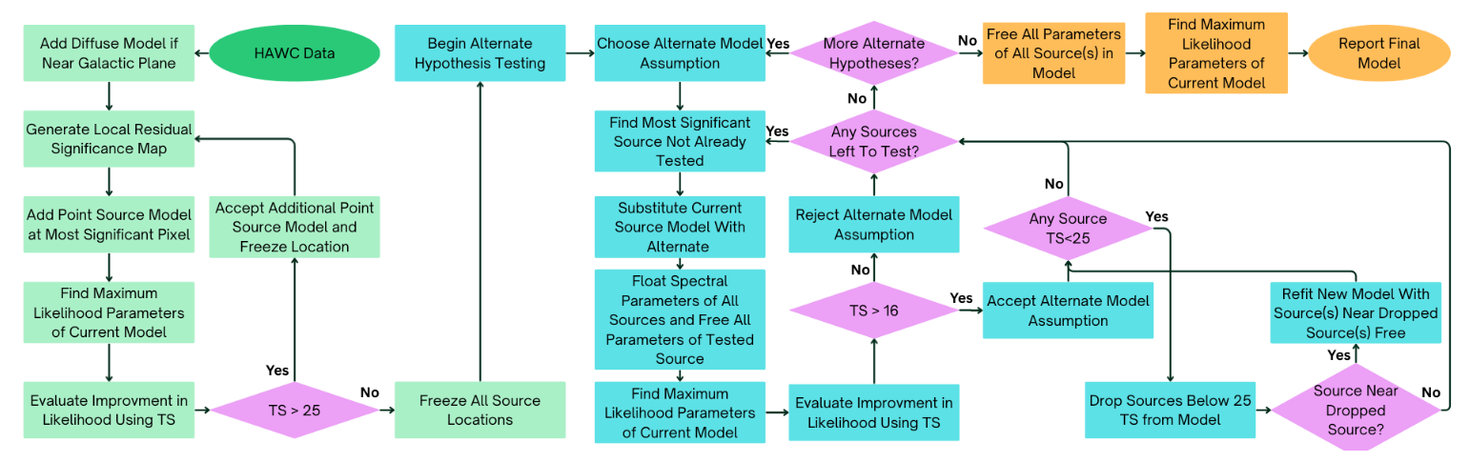
Systematic Source Search
Source: R. Alfaro et al., (2026).
No necessary individual sources other than the Crab or HAWC J0542+2315 within 6° was found

Slide 6
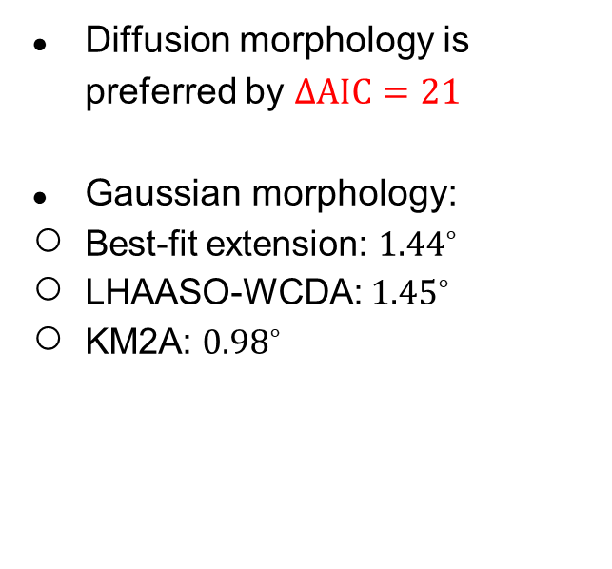
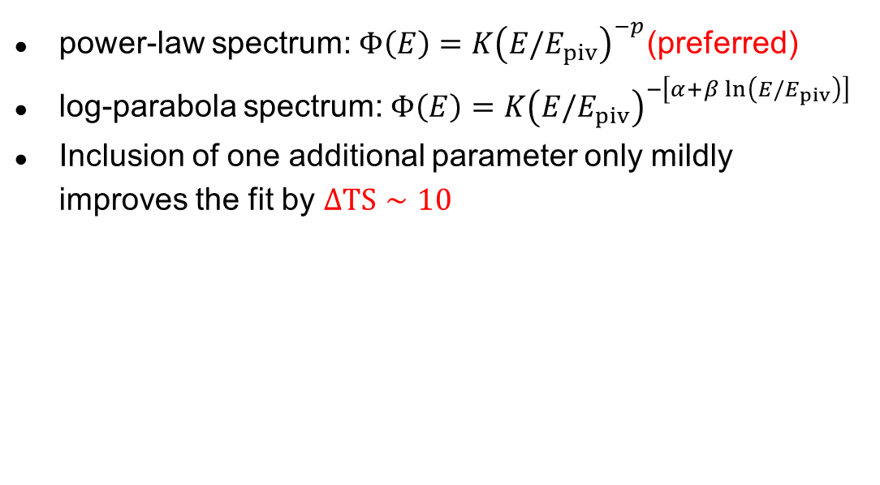
Model Comparison Results
Spectral
Spatial
power-law spectrum: $Φ\left(E\right)=K{\left(E/E_{piv}\right)}^{−p}$(preferred)
log-parabola spectrum: $Φ\left(E\right)=K{\left(E/E_{piv}\right)}^{−\left[α+β\ln\left(E/E_{piv}\right)\right]}$
Inclusion of one additional parameter only mildly improves the fit by $ΔTS∼10$
Diffusion morphology is preferred by $ΔAIC=21$
Gaussian morphology:
  Best-fit extension: ${1.44}^{∘}$
  LHAASO-WCDA: ${1.45}^{∘}$
  KM2A: ${0.98}^{∘}$

Slide 7
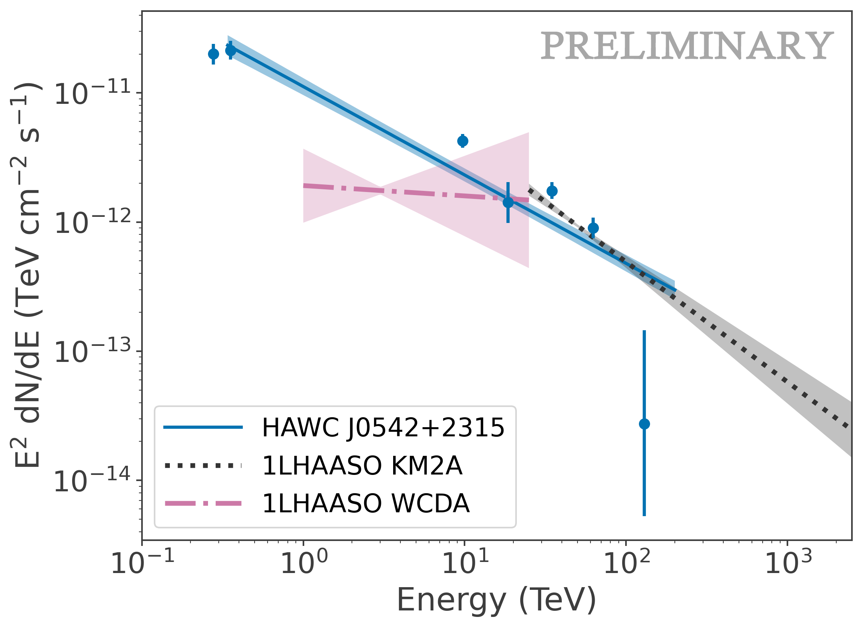
Spectral Profile
Best-fit model of HAWC J0542+2315
Consistent with 1LHAASO J0542+2311u by KM2A
Softer than WCDA

Slide 8
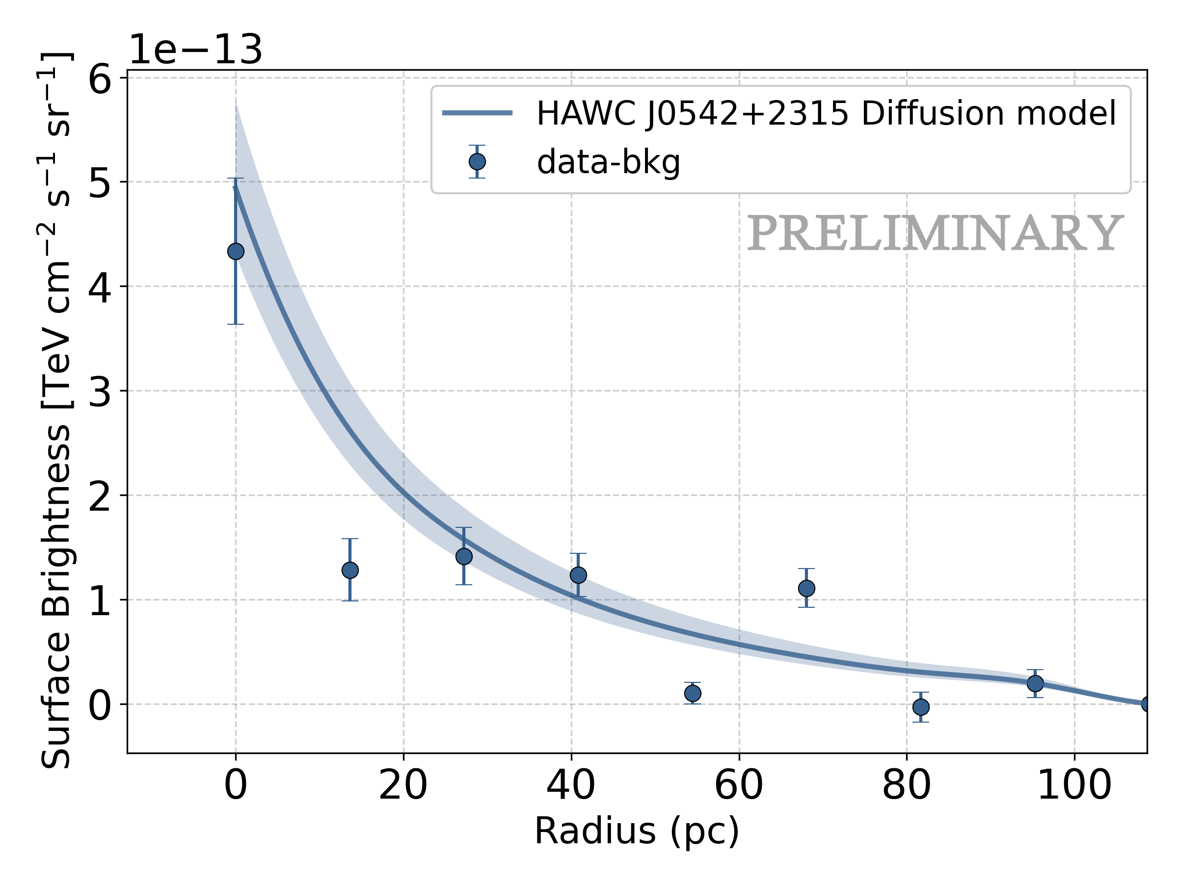
Exceptionally Large Halo
Radial Flux Profile
Physical extension of approximately 86 pc (assuming a source distance of 1.56 kpc)

Slide 9
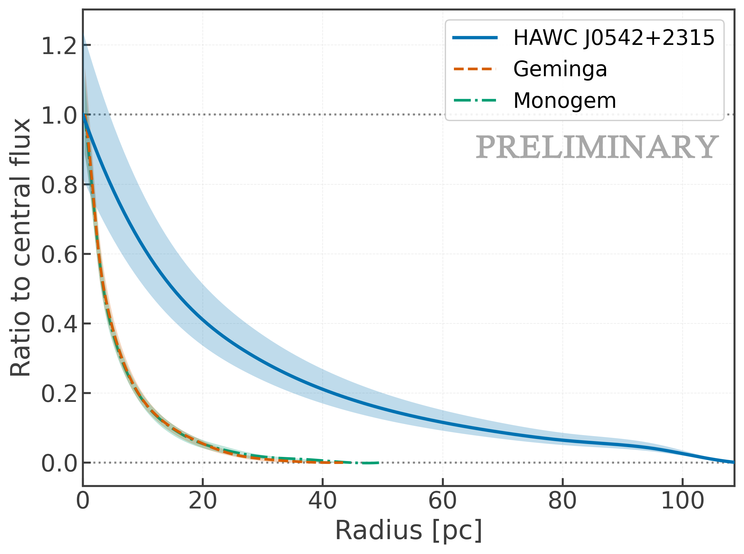
Exceptionally Large Halo
Ratio to Central Flux
HAWC J0542+2315 exhibits a substantially broader radial profile

Slide 10

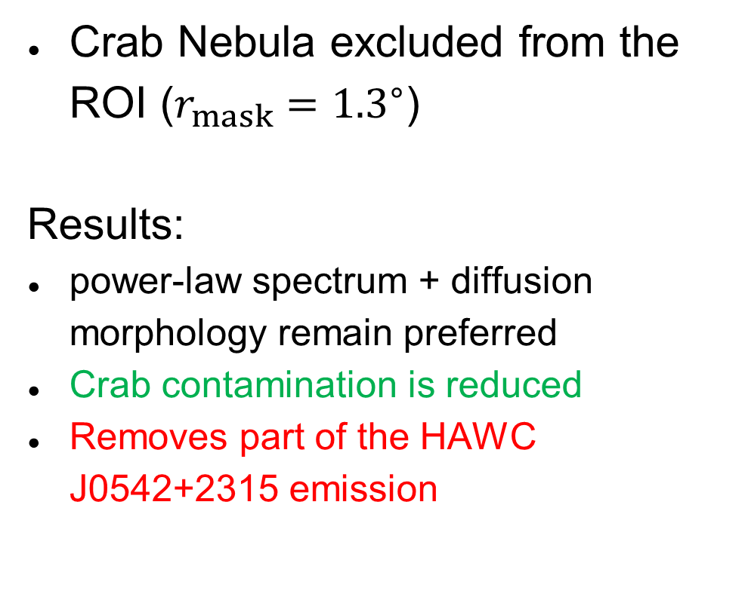
Masking Analysis
Crab Nebula excluded from the ROI ($r_{mask}={1.3}^{∘}$)
Results:
power-law spectrum + diffusion morphology remain preferred
Crab contamination is reduced
Removes part of the HAWC J0542+2315 emission

Slide 11
Symmetry Analysis
3 quadrants that do not overlap with the Crab are analyzed
Results:
All 3 regions show comparable extensions

Slide 12
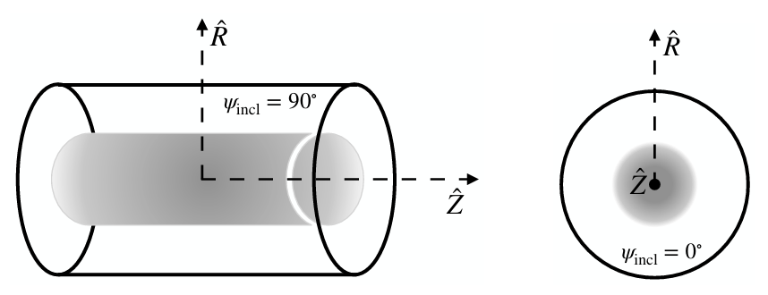
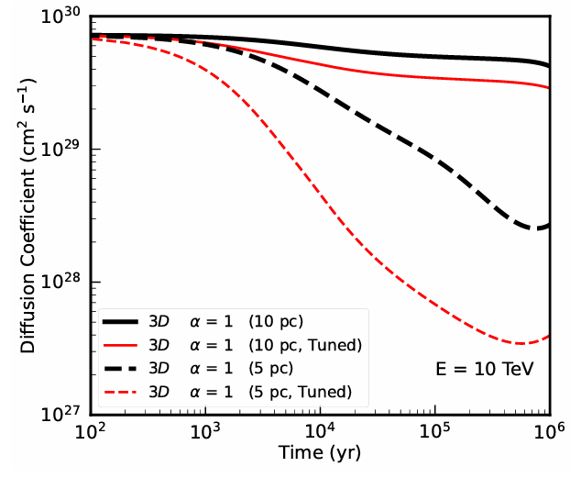
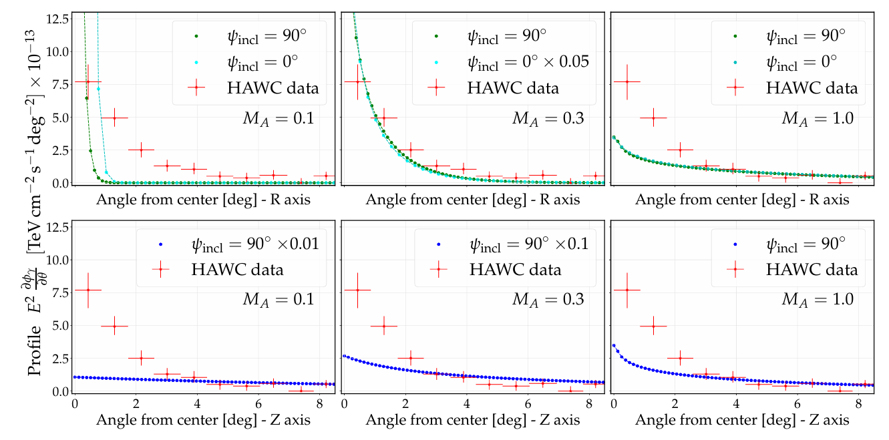
Discussions: TeV Halo models
Self-Generated Cosmic-Ray Turbulence
Anisotropic diffusion
Source: C. Evoli, T. Linden, and G. Morlino, Phys. Rev. D 98, 063017 (2018).
Source: P. D. L. T. Luque, O. Fornieri, and T. Linden, Phys. Rev. D 106, 123033 (2022).
Notes:
Figures: [Evolutionofthediffusioncoefficientasafunctionofthepul saragefor3Ddiffusionmodels]
Cosmic ray turbulence explains slow diffusion regime
in1Dmodels (where thevolume increases linearlywithdistance), thediffusioncoefficient remains in hibitedmore than100pcfromthepulsar
Anisotropicdiffusion serve as a scpecialsolution,but cannot apply to allpopulation

Slide 13
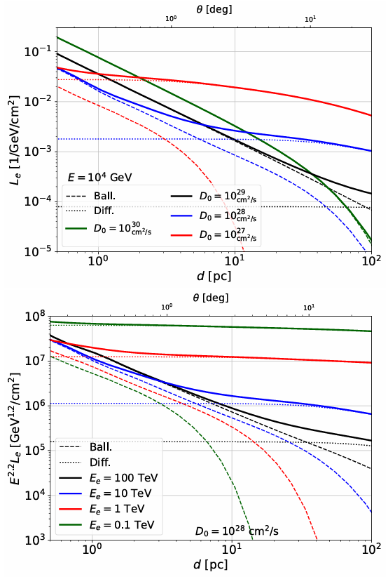
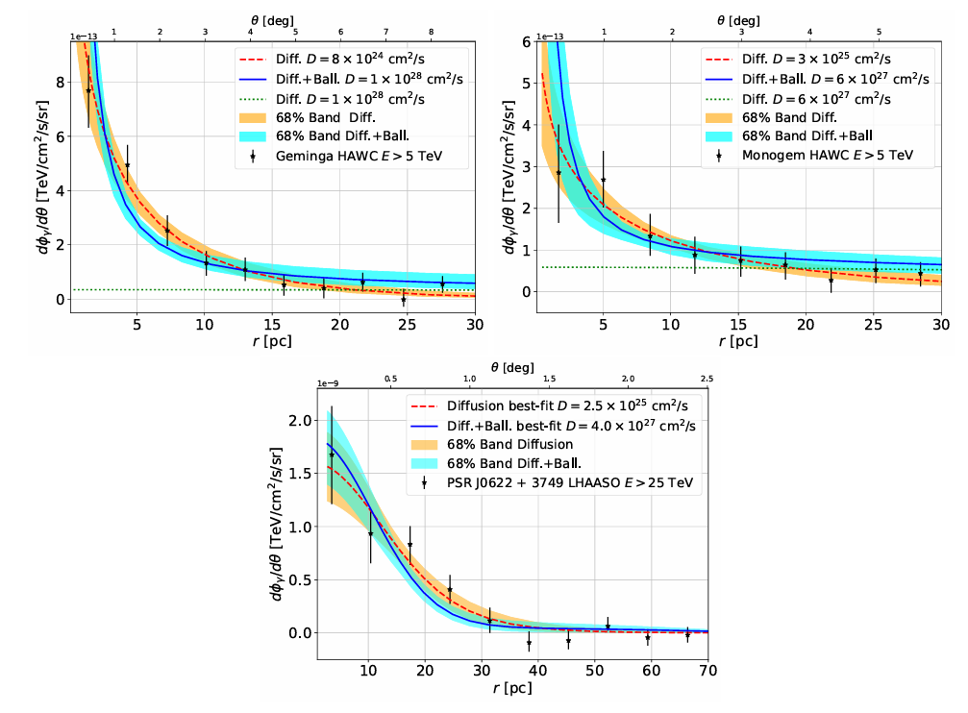
Discussions: TeV Halo models
Quasi-ballistic Regime
Source: S. Recchia et al., Phys. Rev. D 104, 123017 (2021).
Notes:
Figures: [Electrondensityof theGemingapulsar integrated alongthelineofsightasafunctionoftheprojecteddistance formthesourced]
[FittotheHAWCdataforGeminga(topleftpanel)andMonogem(toprightpanel),andtothePSRJ0622+3749 (bottompanel)]

Slide 14
Conclusions
We detect extended TeV emission around HAWC J0542+2315, whose spectral and morphological properties are consistent with a TeV-halo interpretation
A physical extentension roughly ~3 times as large as those of previously identified halos
The TeV-halo population may span a broad range of physical sizes

Slide 15
Thank you

Slide 16
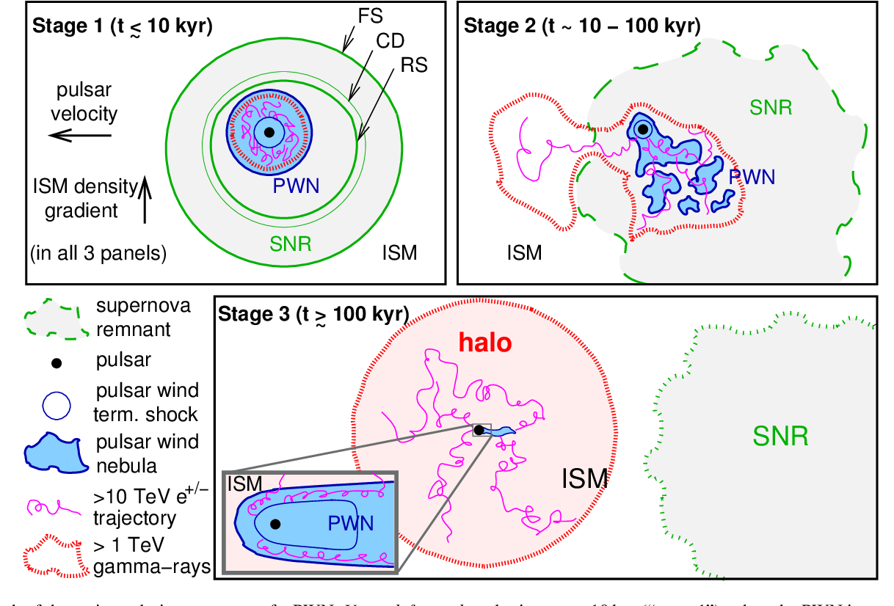
TeV Halo
BACKUP SLIDES
Source: G. Giacinti et al., A&A 636, A113 (2020).

Slide 17
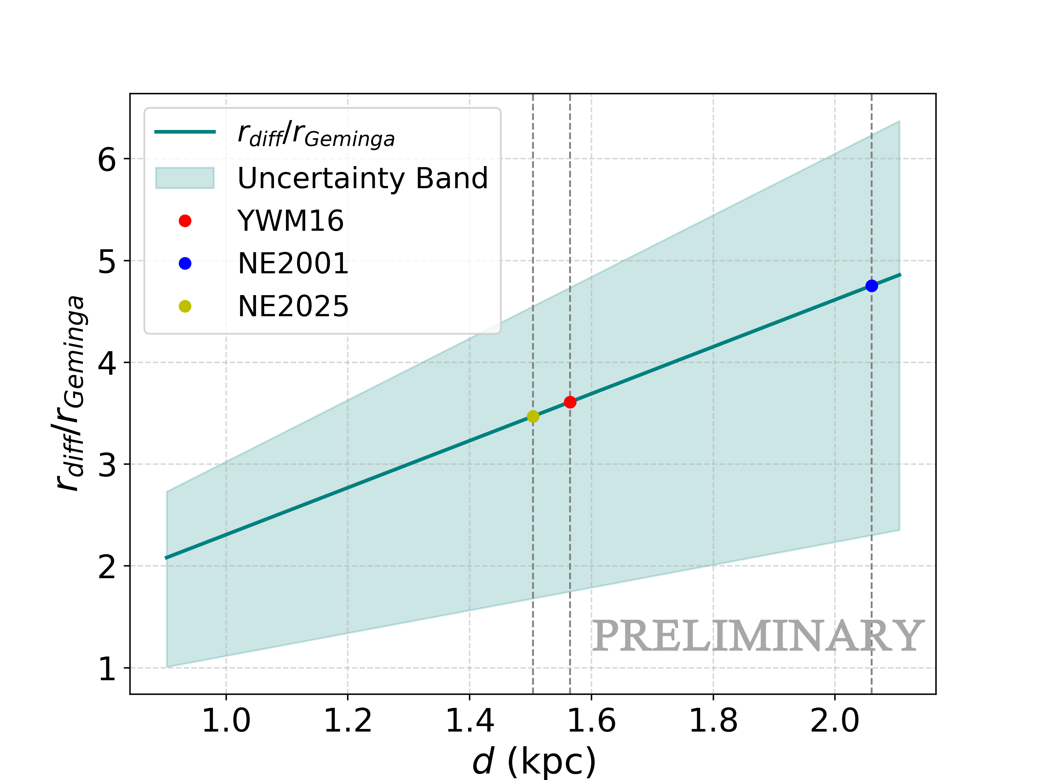
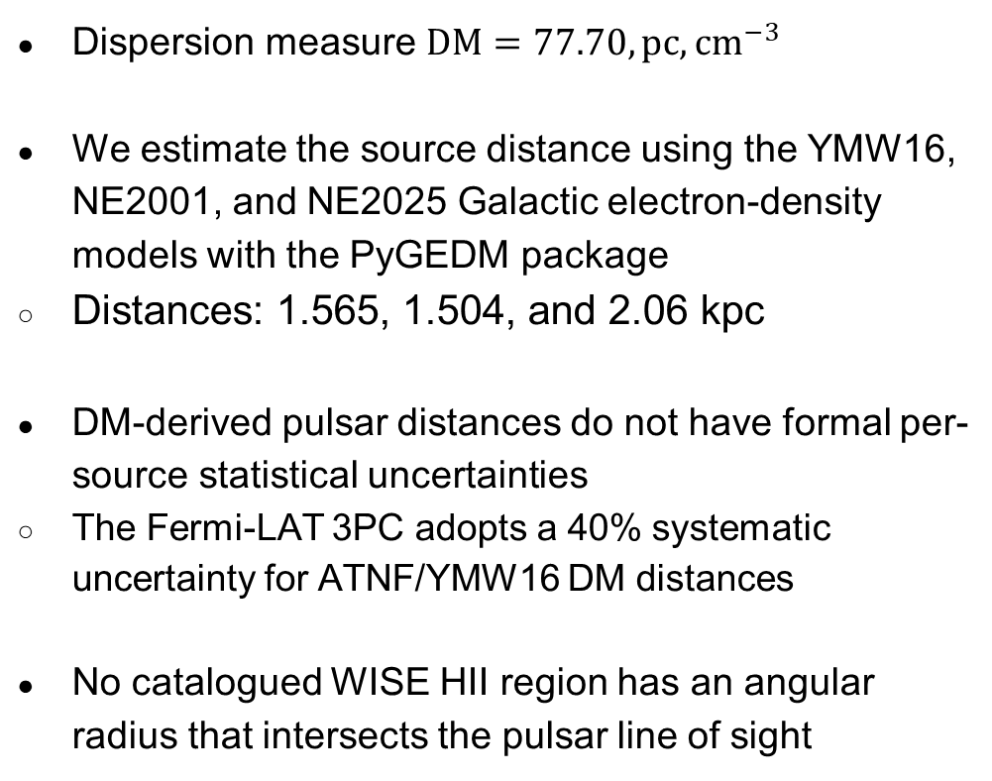
Distance and Diffusion Radius
BACKUP SLIDES
Dispersion measure $DM=77.70,pc,cm^{−3}$
We estimate the source distance using the YMW16, NE2001, and NE2025 Galactic electron-density models with the PyGEDM package
  Distances: 1.565, 1.504, and 2.06 kpc
DM-derived pulsar distances do not have formal per-source statistical uncertainties
  The Fermi-LAT 3PC adopts a 40% systematic uncertainty for ATNF/YMW16 DM distances
No catalogued WISE HII region has an angular radius that intersects the pulsar line of sight

Slide 18
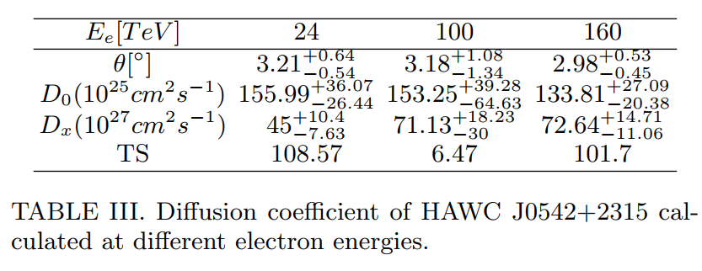
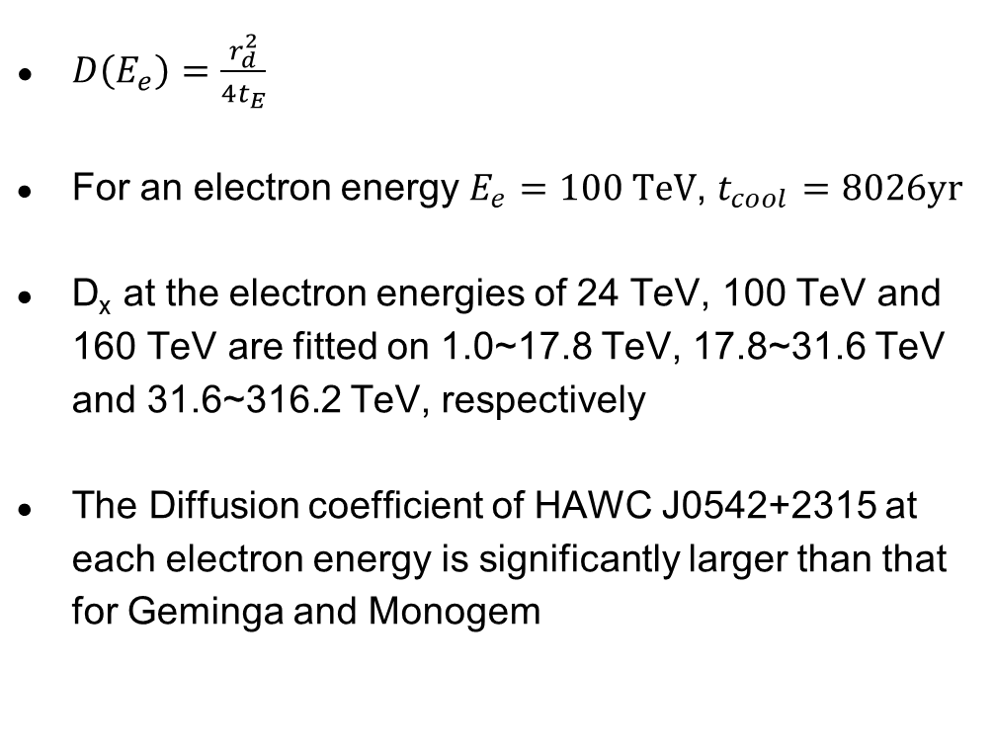
Diffusion Coefficient
BACKUP SLIDES
$D\left(E_{e}\right)=\frac{r_{d}^{2}}{4t_{E}}$
For an electron energy $E_{e}=100 TeV$, $t_{cool}=8026yr$
D_{x} at the electron energies of 24 TeV, 100 TeV and 160 TeV are fitted on 1.0~17.8 TeV, 17.8~31.6 TeV and 31.6~316.2 TeV, respectively
The Diffusion coefficient of HAWC J0542+2315 at each electron energy is significantly larger than that for Geminga and Monogem

Slide 19
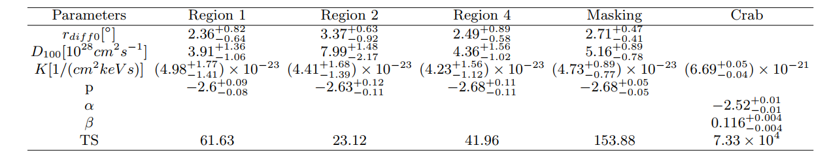
Symmetry Study and Crab Model
BACKUP SLIDES
The best fit Crab parameters remain highly stable regardless of the spatial and spectral model we choose for HAWC J0542+2315.

