Slide 1




Upgrading the prototype Schwarzschild-Couder Telescope Camera for Gamma-Ray Astronomy
Viviana Rickert - University of Wisconsin-Madison
On behalf of the SCT Collaboration and the CTAO Consortium
IceCube Particle Astrophysics Symposium 2026
October 14th-16th, 2026

Slide 2
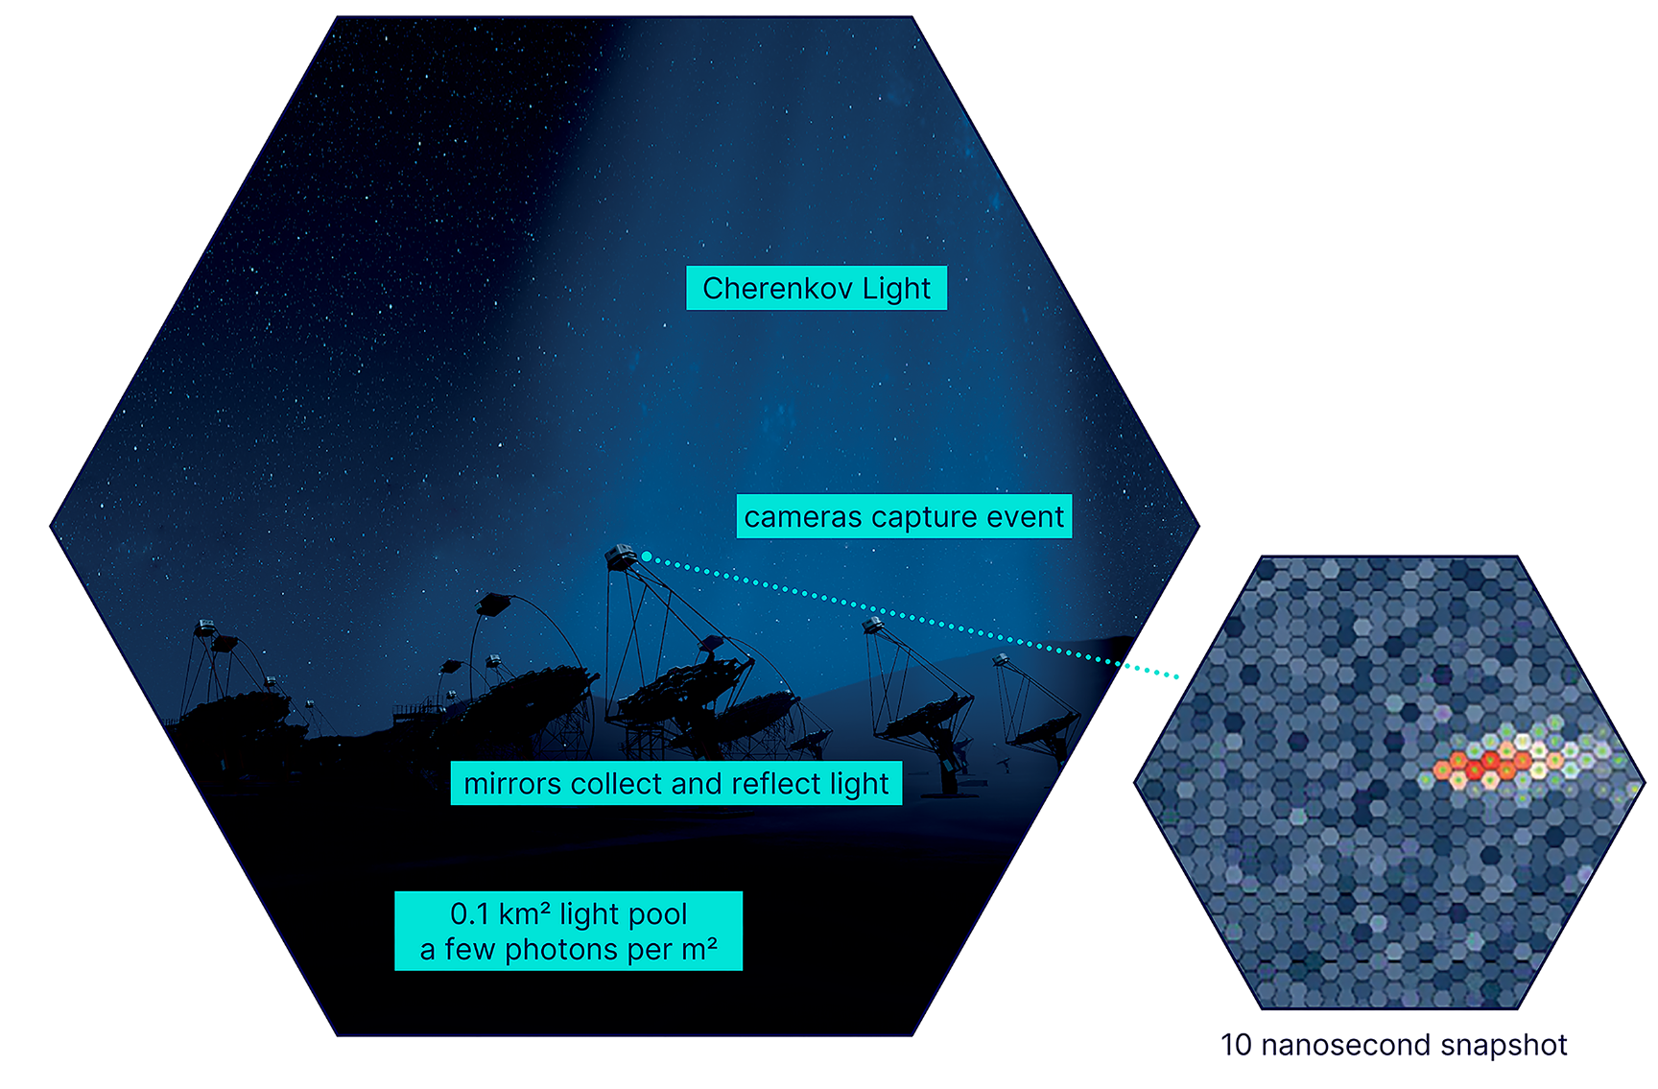
Imaging Atmospheric Cherenkov Telescopes
Imaging Atmospheric Telescopes (IACTs) detect Cherenkov light in the atmosphere from particle showers initiated by gamma ray and cosmic ray interactions in the atmosphere
Images from these showers used to reconstruct the incident gamma rays and cosmic rays
Example Shower Image
Image: ctao.org
Viviana Rickert - Upgrading the pSCT camera for gamma-ray Astronomy

Slide 3
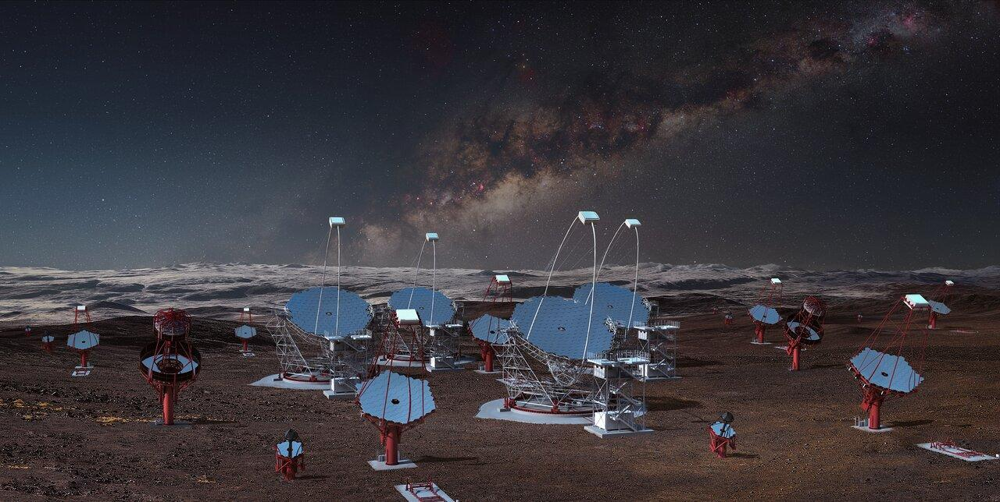
CTAO
The Cherenkov Telescope Array Observatory is a next generation IACT observatory
Two arrays, one in La Palma, Spain and the other in Paranal, Chile
Three telescope types covering gamma ray energies of 20 GeV to 300 TeV
  Large-Sized Telescope (LST): 20 GeV to 3 TeV
  Medium-Sized Telescope (MST): 80 GeV to 50 TeV
  Small-Sized Telescope (SST): 2 TeV to 300 TeV
Both arrays currently under construction
Image Credit: eso.org
Viviana Rickert - Upgrading the pSCT camera for gamma-ray Astronomy

Slide 4
Schwarzschild-Couder Telescope (SCT)
Medium-sized dual-mirror telescope design
The dual-mirror design reduces off-axis optical aberrations and improves point-spread function across field of view, allowing for better angular resolution
Candidate MST design
Image Credit: eso.org
Viviana Rickert - Upgrading the pSCT camera for gamma-ray Astronomy

Slide 5
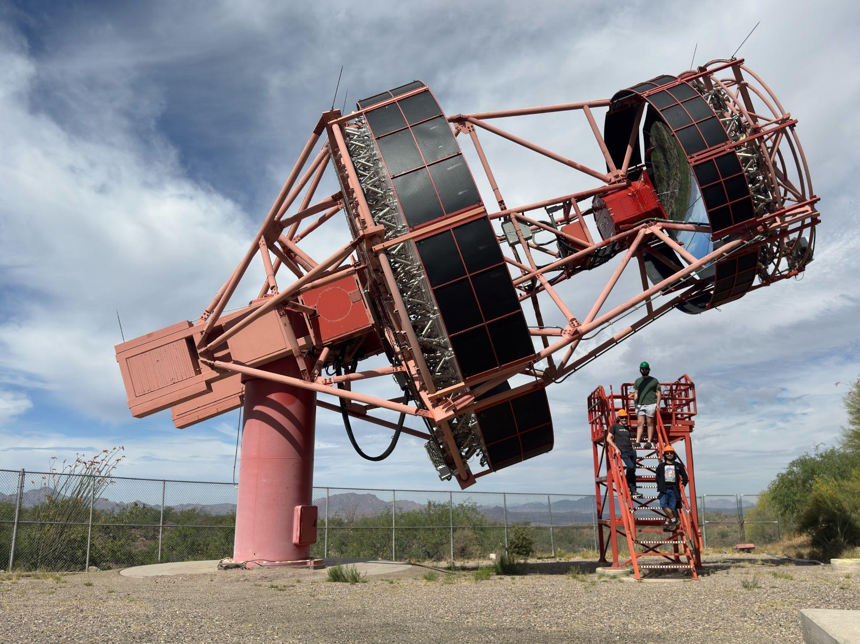
Prototype Schwarzschild-Couder Telescope (pSCT)
Located at Fred Lawrence Whipple Observatory (FLWO) in Arizona
  Located next to VERITAS
Dual-mirror optical system
  Good optical resolution across entire FoV
  Fine pixel resolution to match the optical resolution
8° FoV with near constant point spread function
Viviana Rickert - Upgrading the pSCT camera for gamma-ray Astronomy

Slide 6
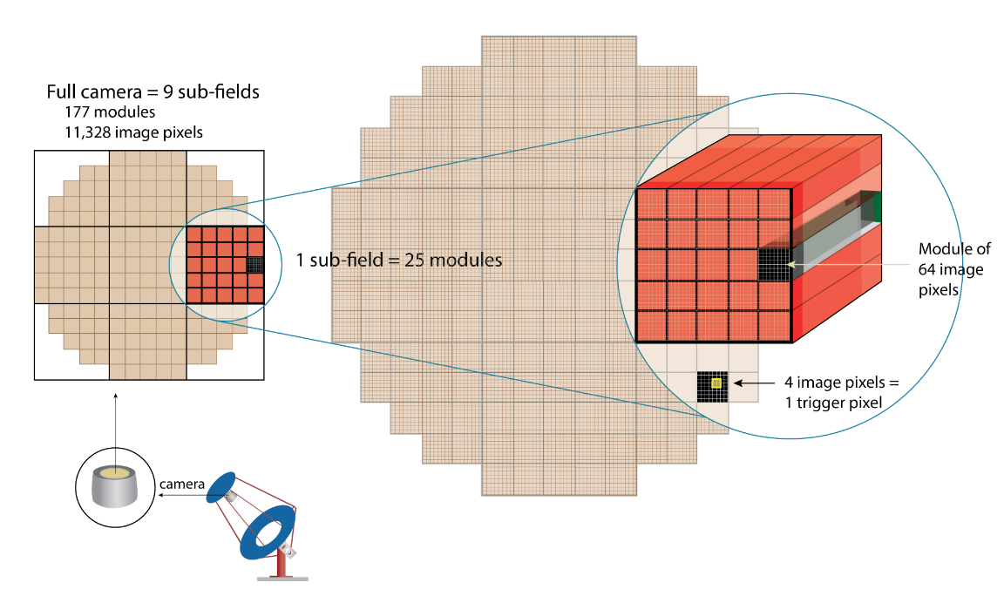
pSCT Camera
Modular camera split into 9 sectors
177 camera modules each with 64 pixels
11,328 total 6x6 mm silicon photomultiplier pixels
  0.067° per pixel
Previous camera detected Crab Nebula in 2020 with only the central sector installed
Adams, C. B., et al. Astroparticle Physics 128 (2021)
Ambrosio, et al. JATIS Feb 2022
Viviana Rickert - Upgrading the pSCT camera for gamma-ray Astronomy

Slide 7

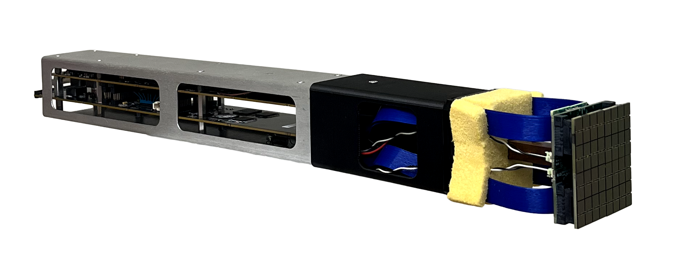
pSCT Camera Upgrade
Upgrade in progress to improve camera electronics and mechanics
Camera will be fully populated
The upgraded electronics will reduce trigger noise and crosstalk
Upgraded camera modules consist of a Focal Plane Module (FPM) and Front-End Electronics (FEE)
JATIS Volume 12 Issue 3 Article 034001 (2026)
FEE
FPM
Viviana Rickert - Upgrading the pSCT camera for gamma-ray Astronomy

Slide 8
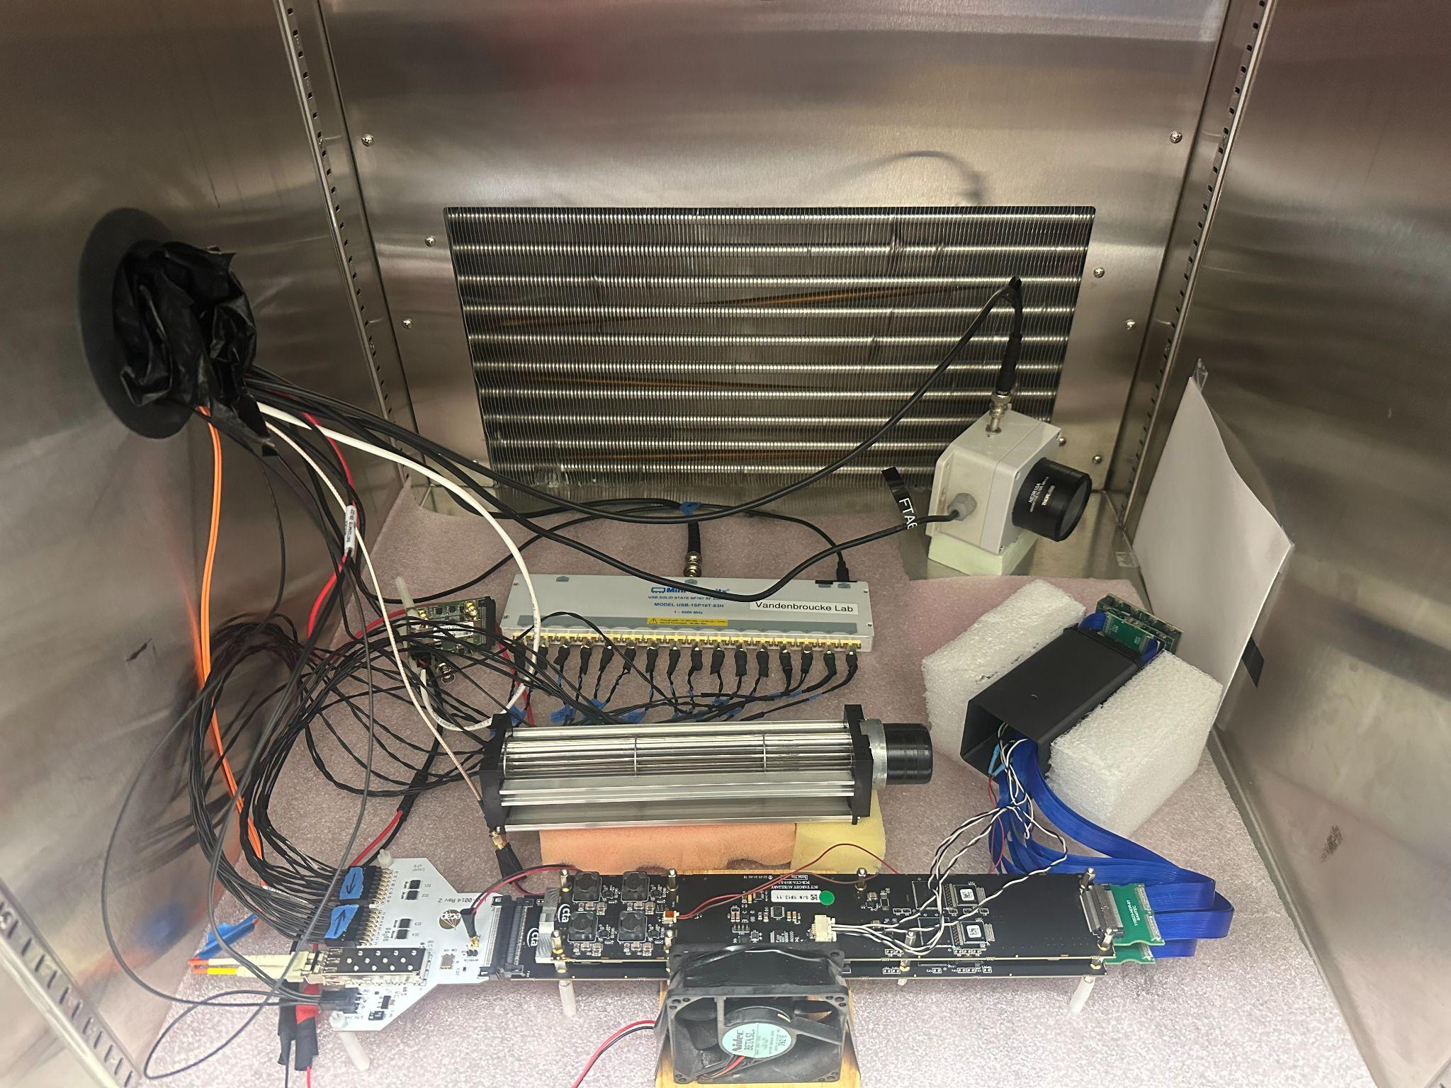
Calibration Overview
Each individual camera module needs to be calibrated to operate together as one camera and to perform optimally
7 Calibrations:
  Wilkinson ADC ramp
  Gain equalization
  Trigger threshold
  Trigger pulse width
  Thermistor
  Timing calibration
  Transfer function
After calibrations finish, modules are assembled
Modules delivered in 3 batches
Viviana Rickert - Upgrading the pSCT camera for gamma-ray Astronomy

Slide 9
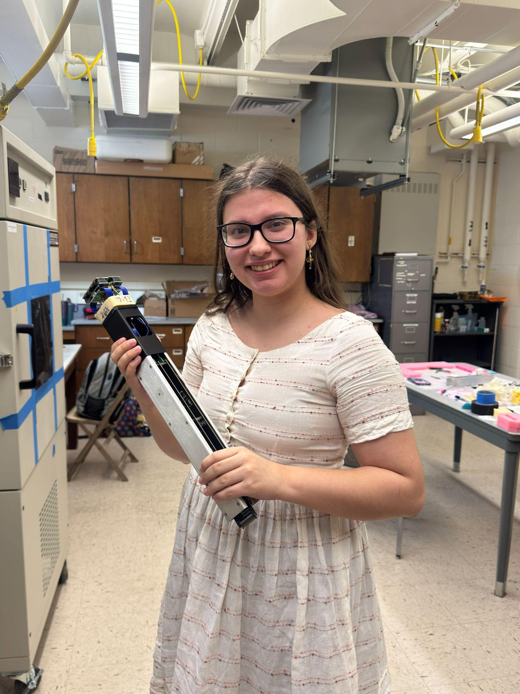
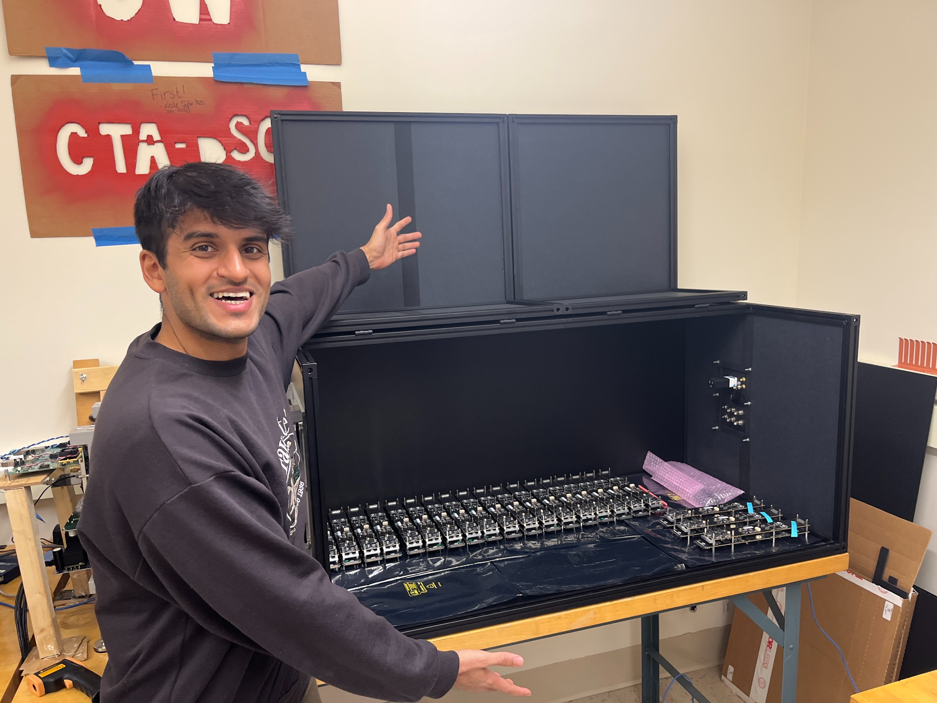
Batch 1
Arrived at UW Madison on January 6th, 2026
Many of the calibration scripts were still being optimized during calibration
All modules were run through a single calibration before moving onto the next calibration
Viviana Rickert - Upgrading the pSCT camera for gamma-ray Astronomy

Slide 10
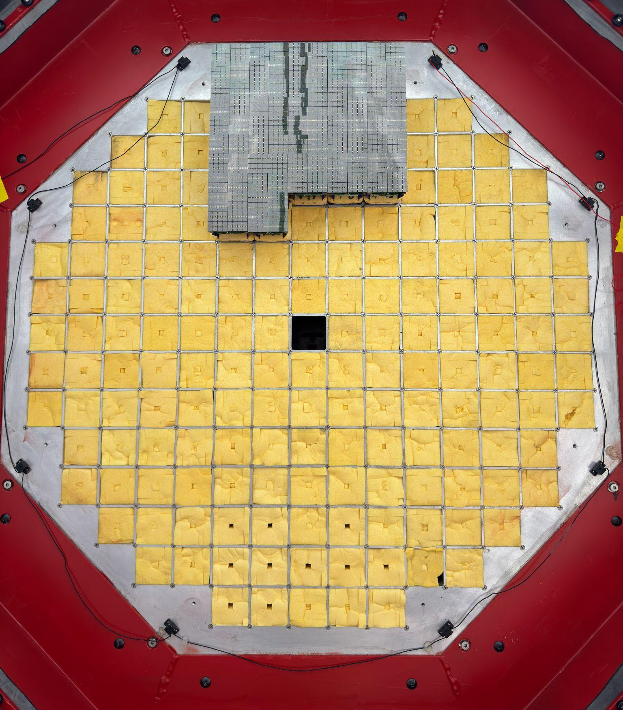
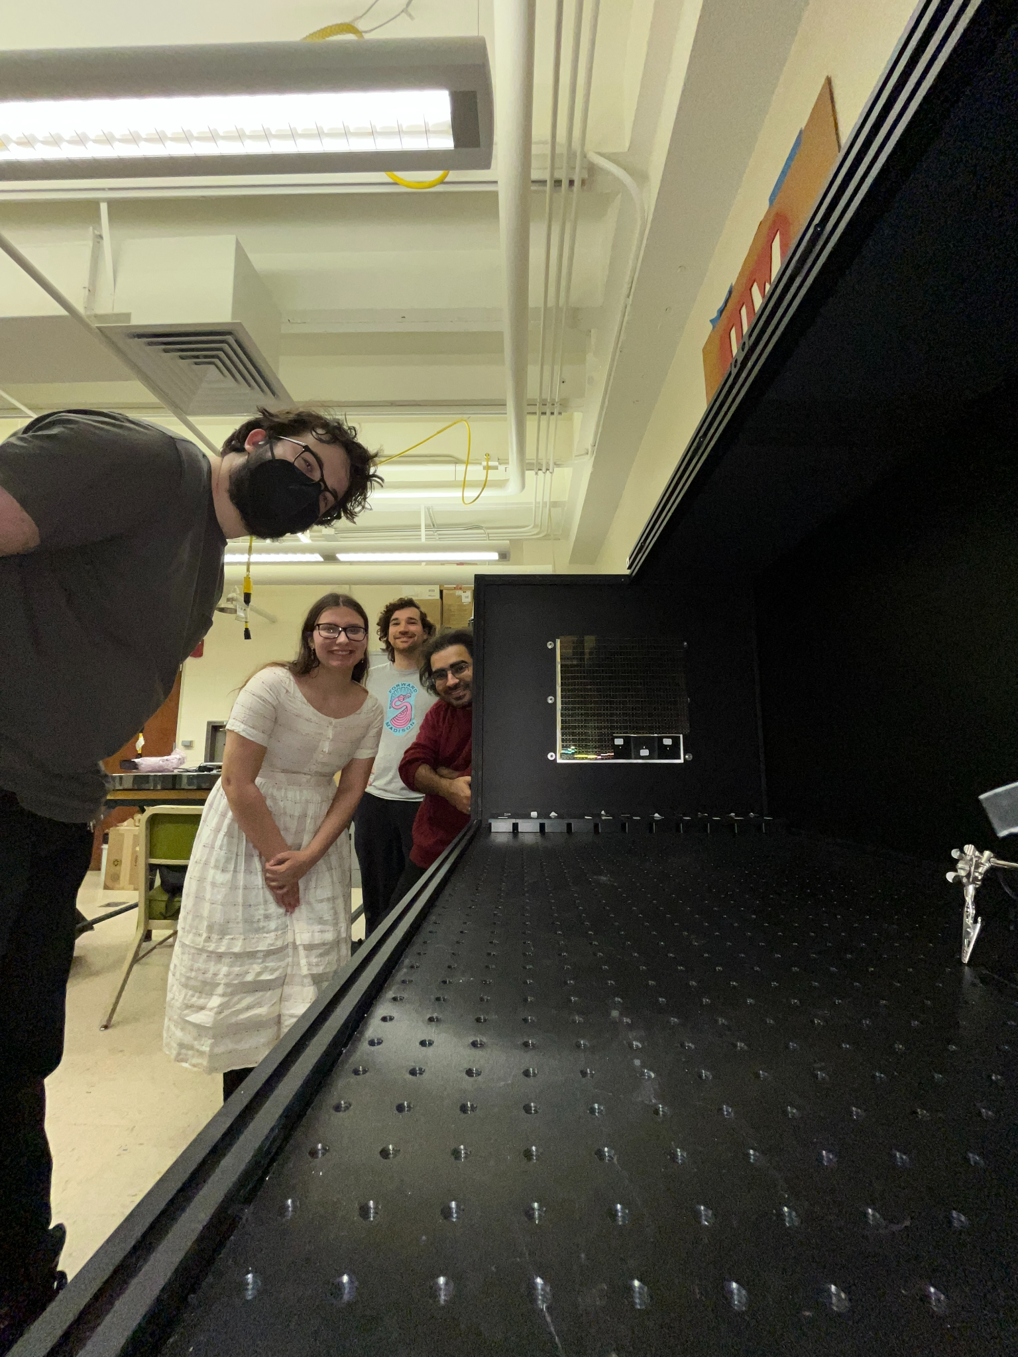
Batch 1 continued
Calibration and assembly finished March 17th, 2026
After additional tests, modules were shipped to Whipple Observatory on March 24th
Modules arrived at Whipple Observatory on March 30th
Modules then installed in the camera
Viviana Rickert - Upgrading the pSCT camera for gamma-ray Astronomy

Slide 11
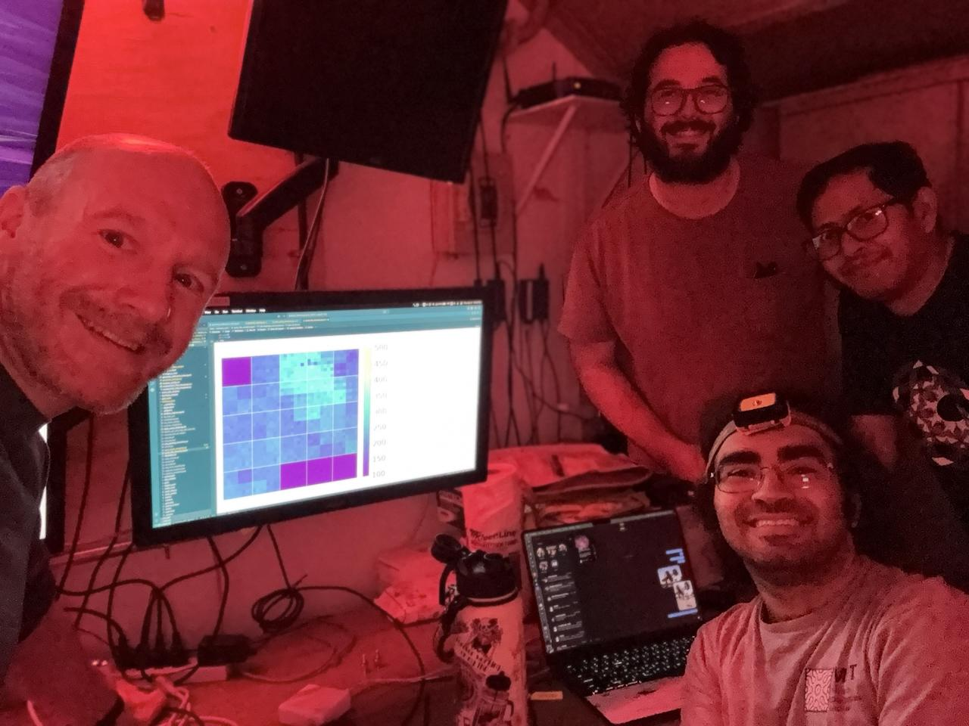
On Site Commissioning
After installation the tarps on the mirrors were removed
Camera was then turned on that same night without applying calibrations
First light was acheived
Applying calibrations and commissioning for a few weeks
Followed by observation campaign of Markarian 421 (see Luca Riitano’s talk)
Viviana Rickert - Upgrading the pSCT camera for gamma-ray Astronomy

Slide 12
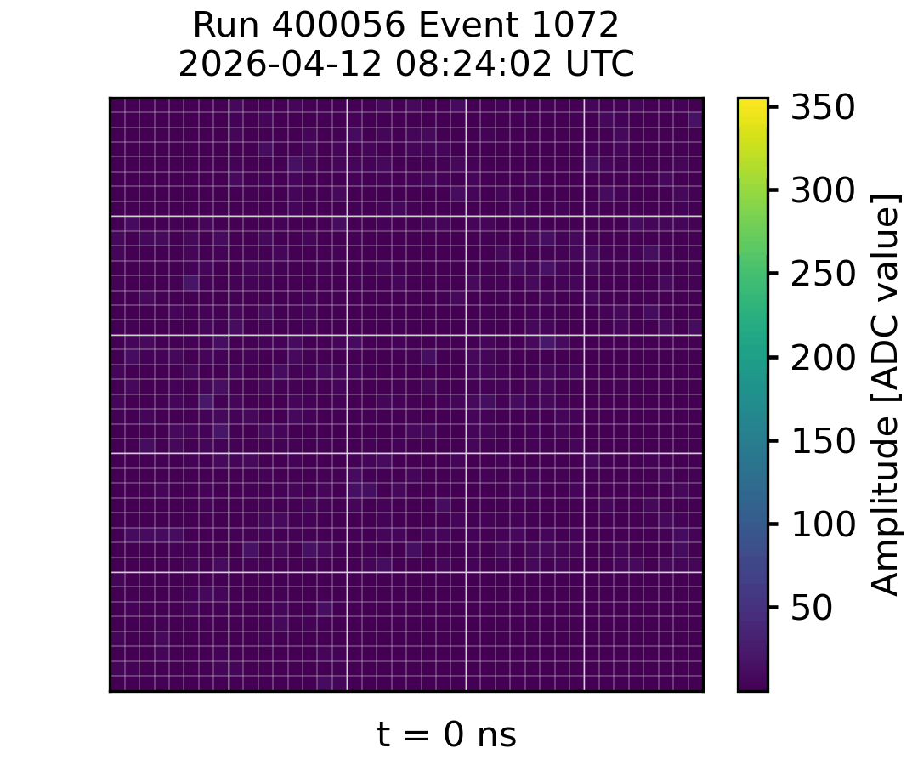
Commissioning Events!
Viviana Rickert - Upgrading the pSCT camera for gamma-ray Astronomy

Slide 13
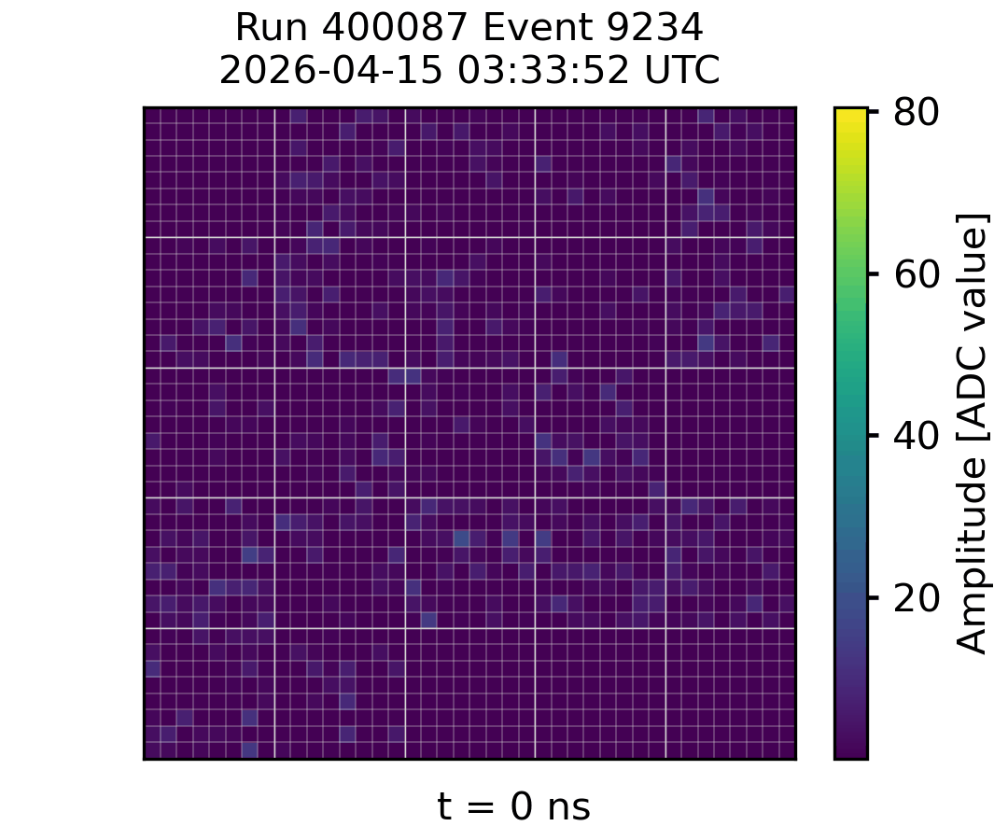
Commissioning Events!
Viviana Rickert - Upgrading the pSCT camera for gamma-ray Astronomy

Slide 14
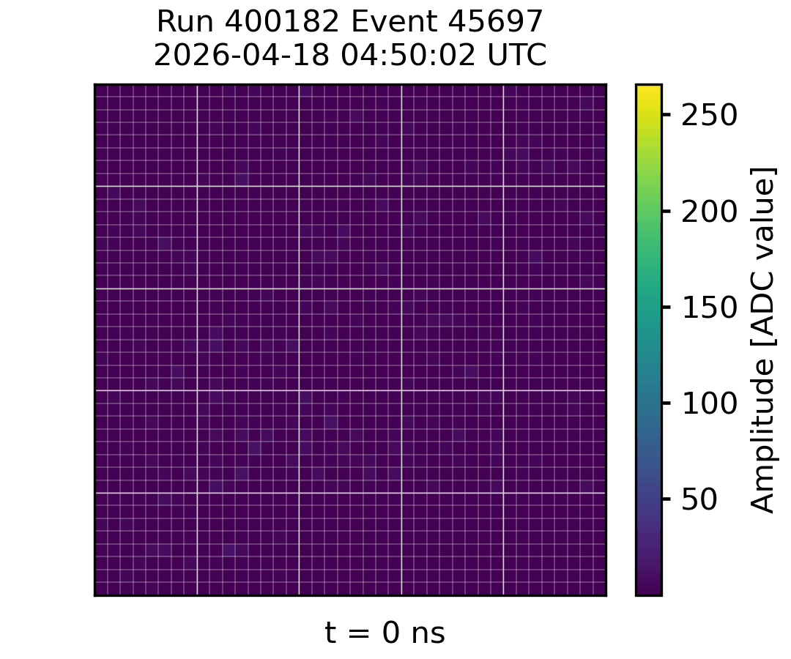
Commissioning Events!
Viviana Rickert - Upgrading the pSCT camera for gamma-ray Astronomy

Slide 15
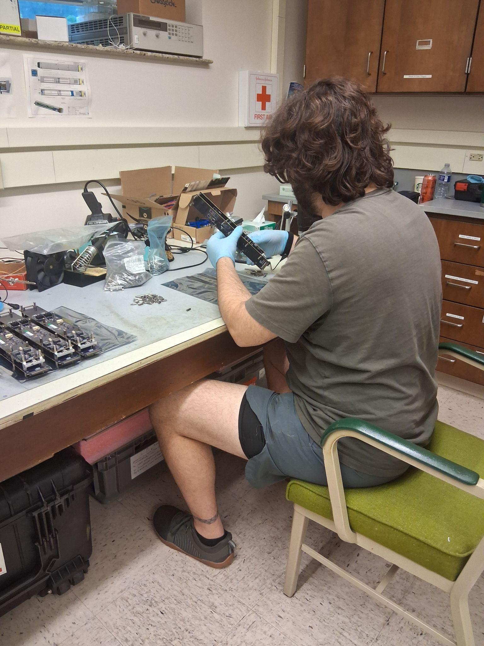
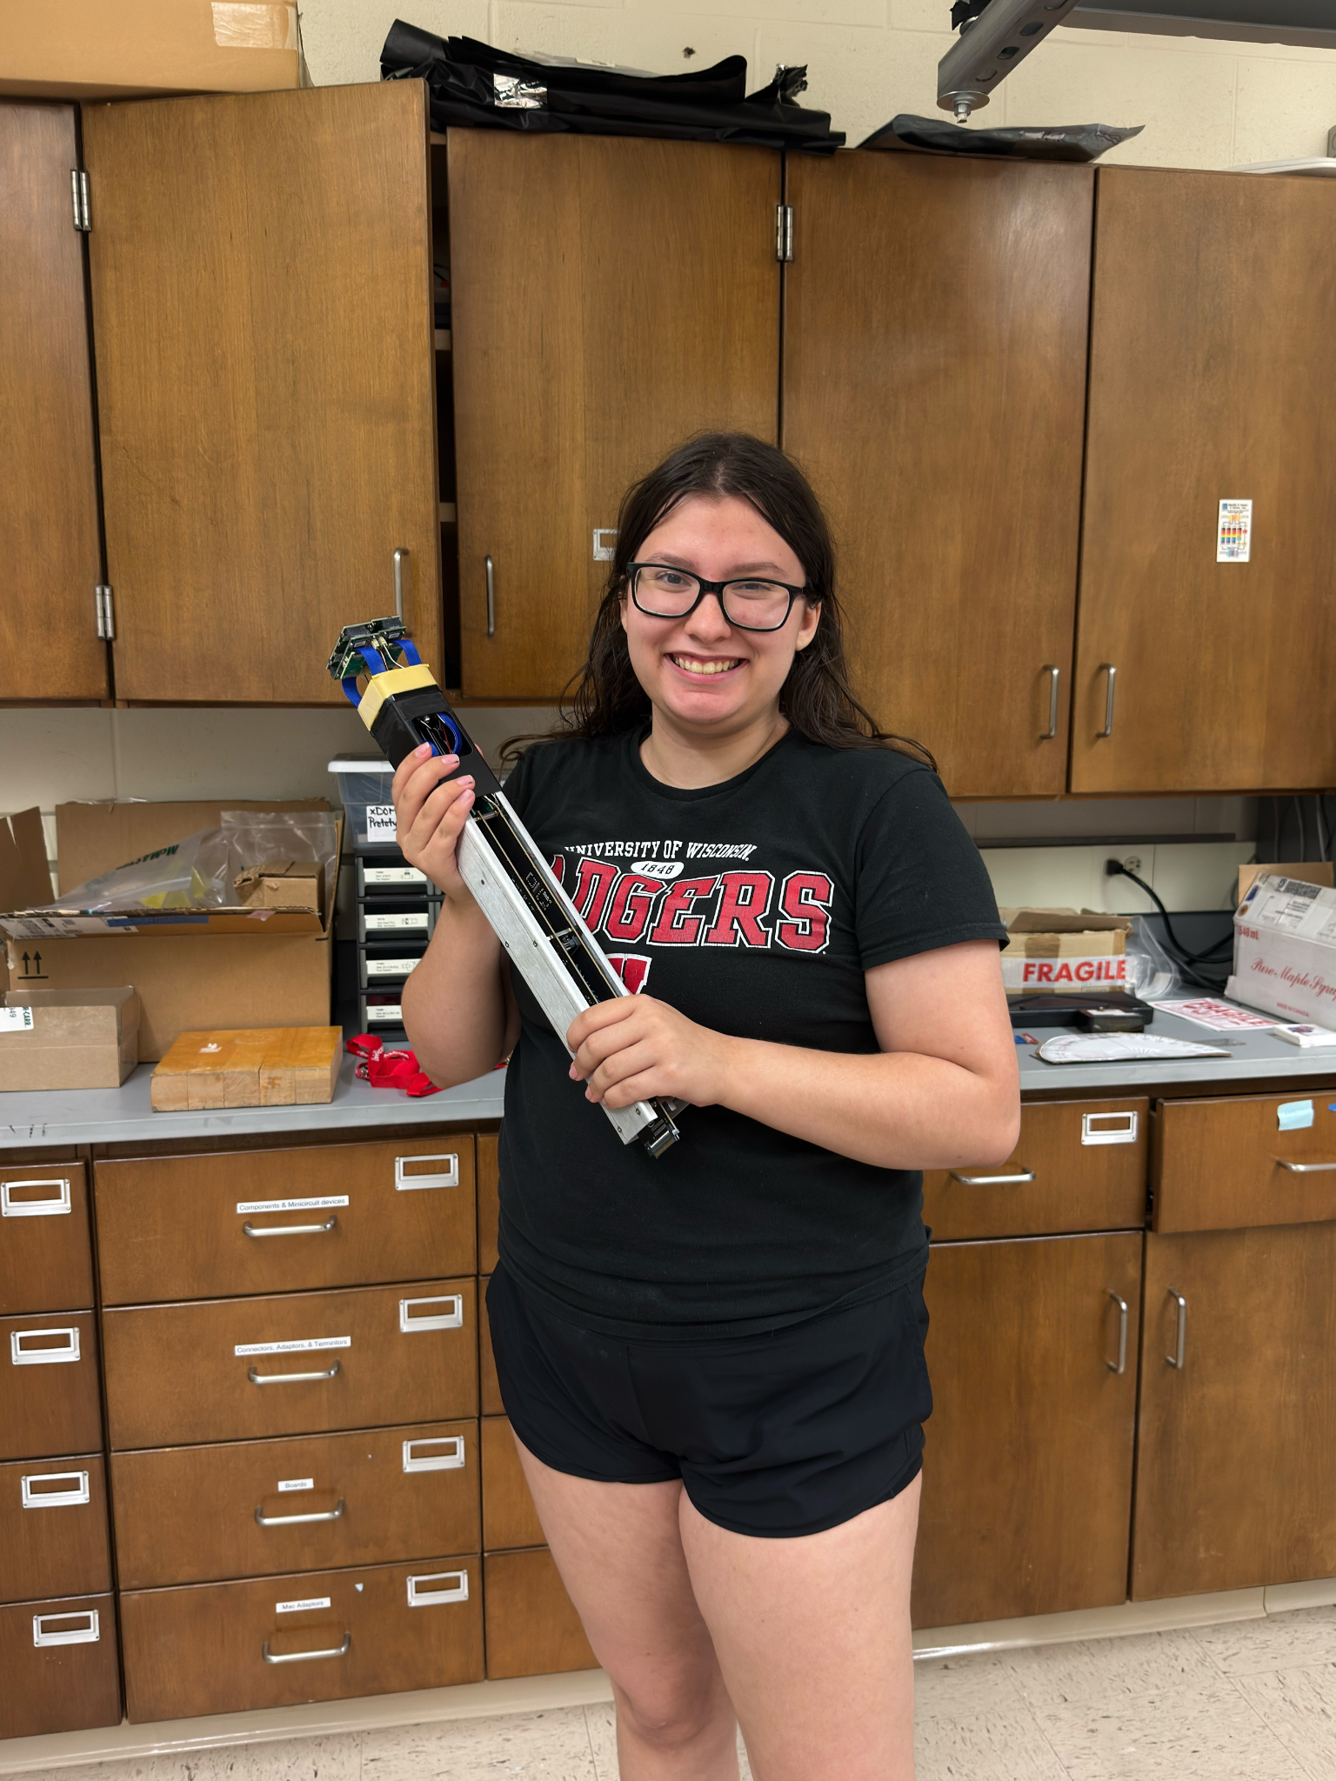
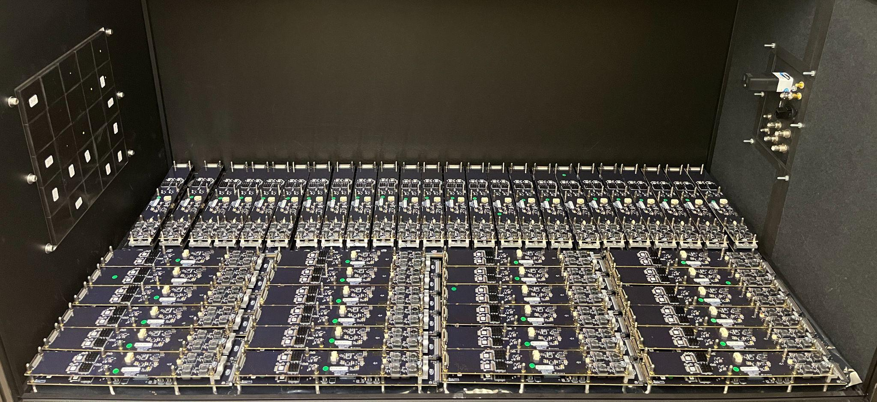
Batch 2: 52 Modules
Arrived at UW Madison on August 14th
Calibration scripts and procedures were updated and further optimized before the arrival of the modules
Visitors from other institutions came to help with calibrations
Viviana Rickert - Upgrading the pSCT camera for gamma-ray Astronomy

Slide 16
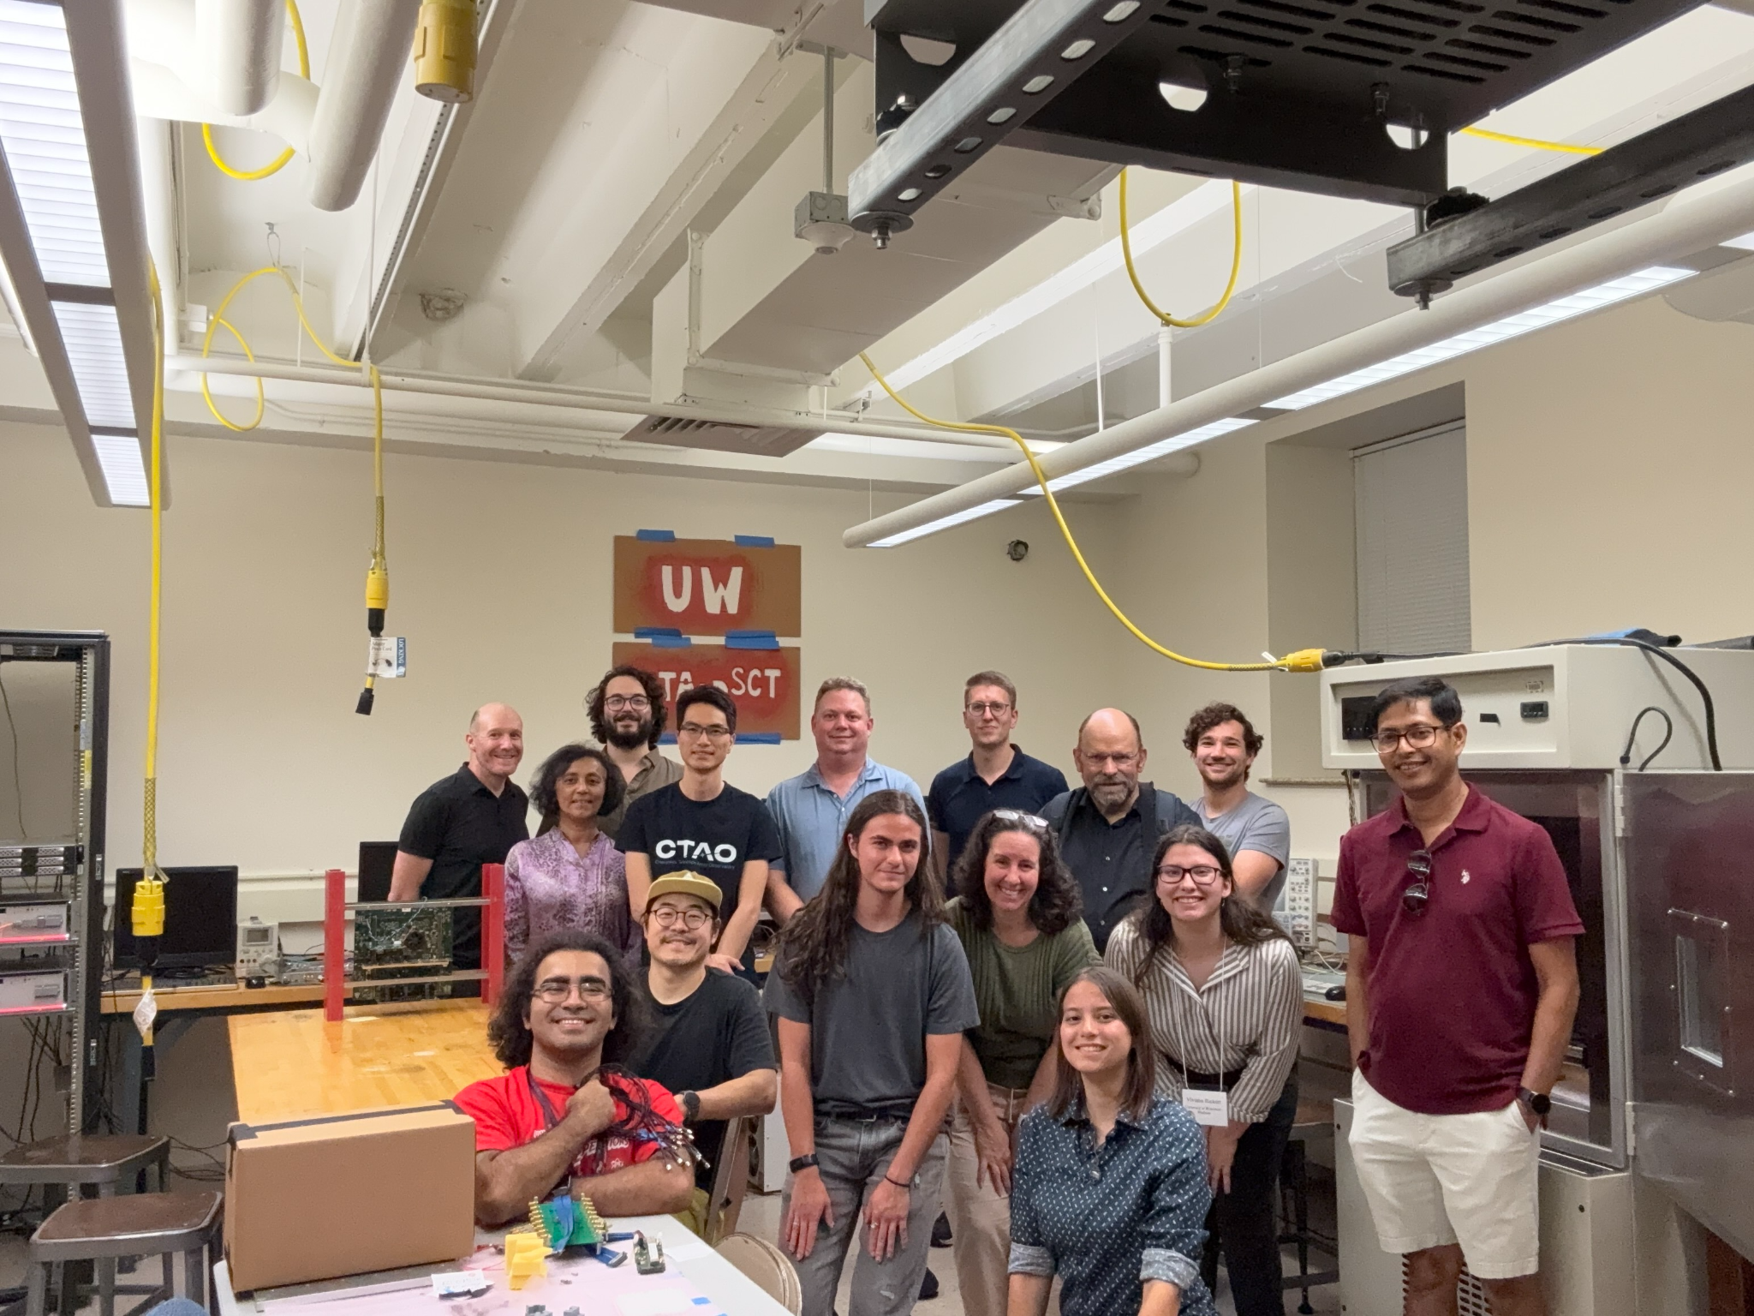
Current Status and Conclusions
22 modules commissioned in Spring 2026
We are working towards having ~70 modules total installed in the next few months
Full camera (all 177 modules) expected to be installed in 2027
Viviana Rickert - Upgrading the pSCT camera for gamma-ray Astronomy

Slide 17
Backup
Viviana Rickert - Upgrading the pSCT camera for gamma-ray Astronomy

Slide 18
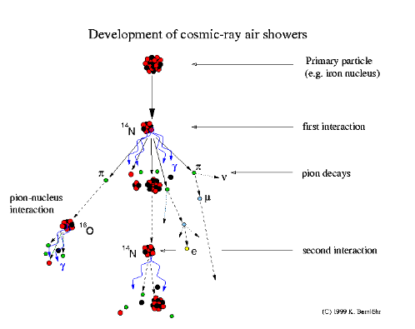
Air Showers
Viviana Rickert - Upgrading the pSCT camera for gamma-ray Astronomy

Slide 19
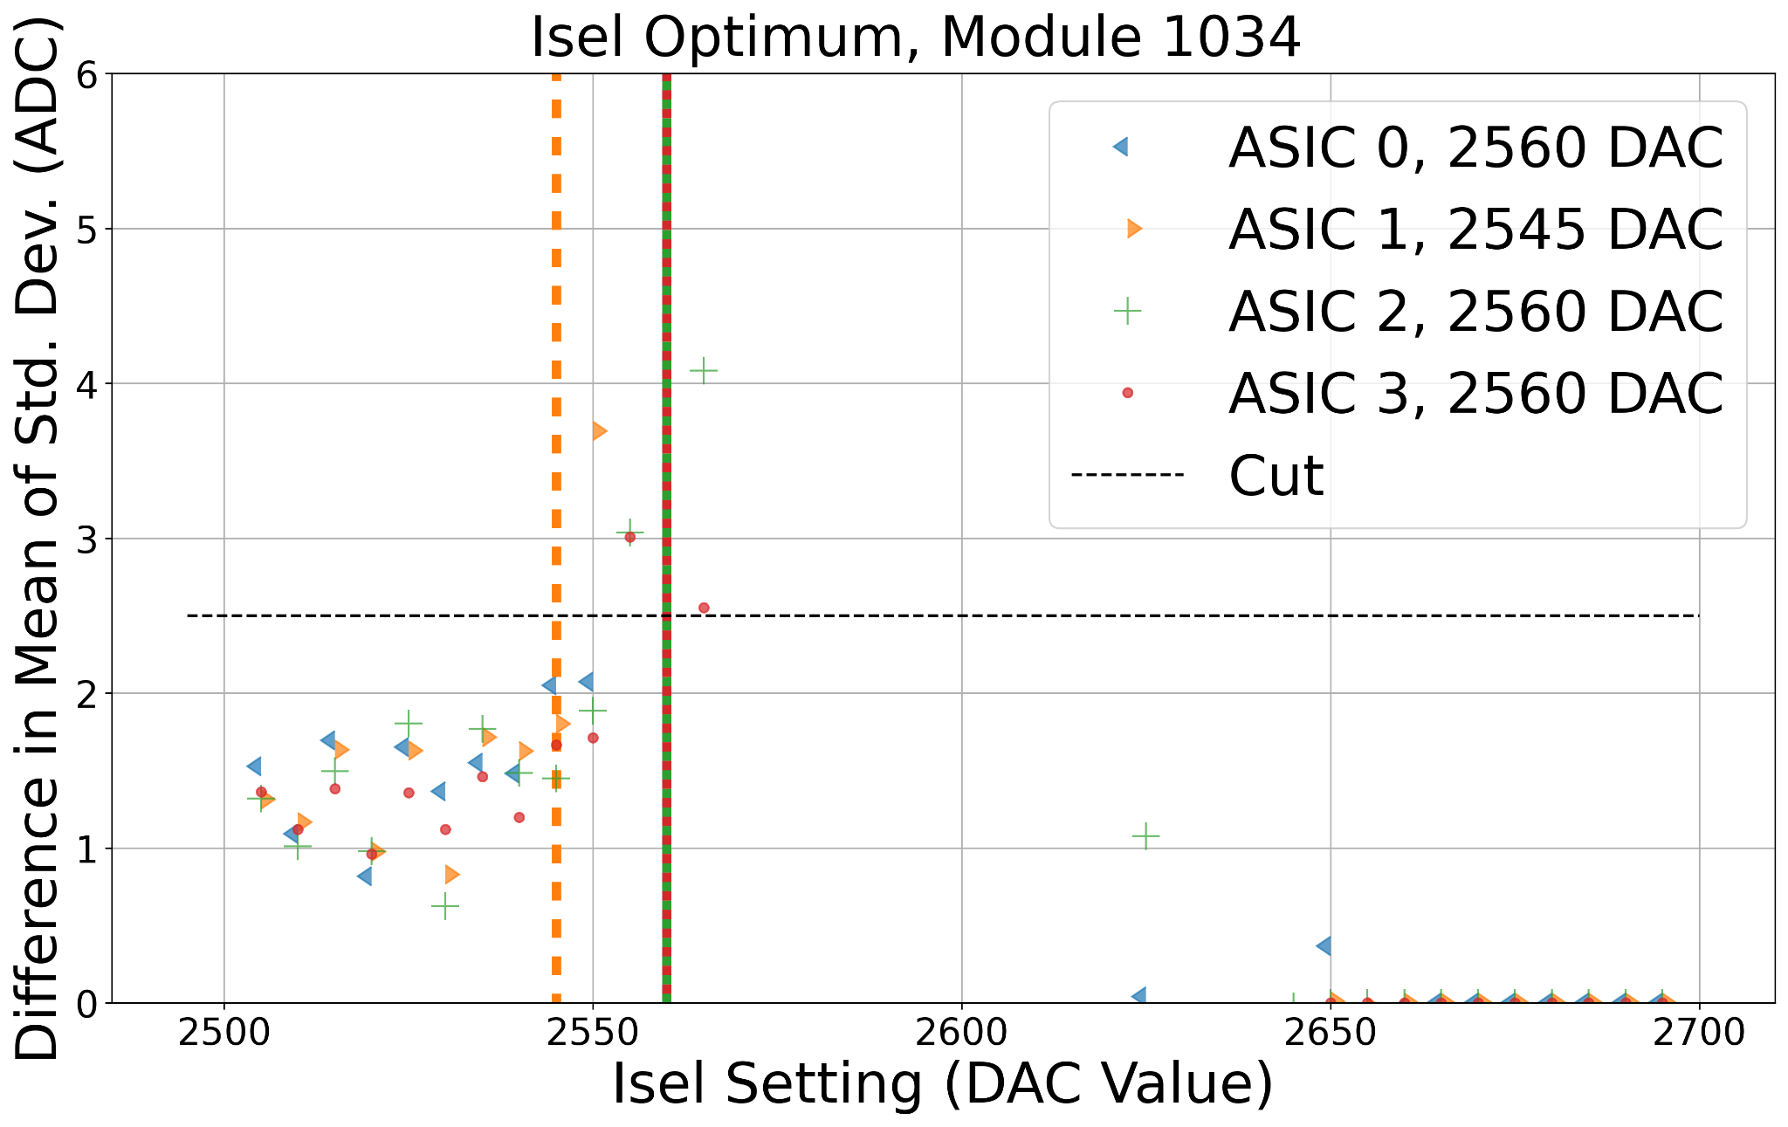
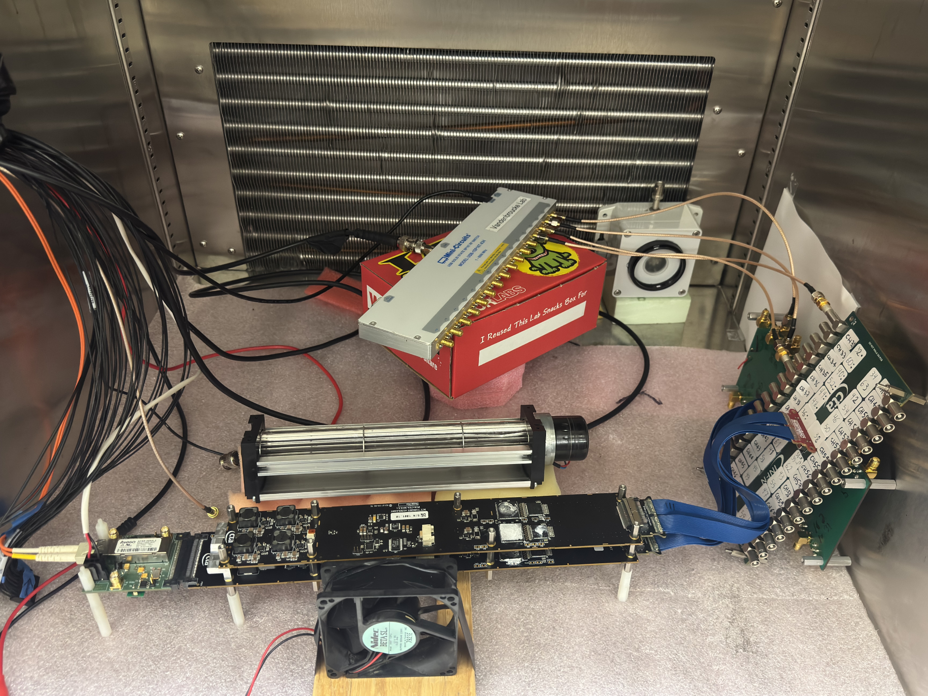
Wilkinson ADC
Finds the optimal slope of the Wilkinson Analog to Digital converter ramp
Takes about 8 minutes per module
Viviana Rickert - Upgrading the pSCT camera for gamma-ray Astronomy

Slide 20
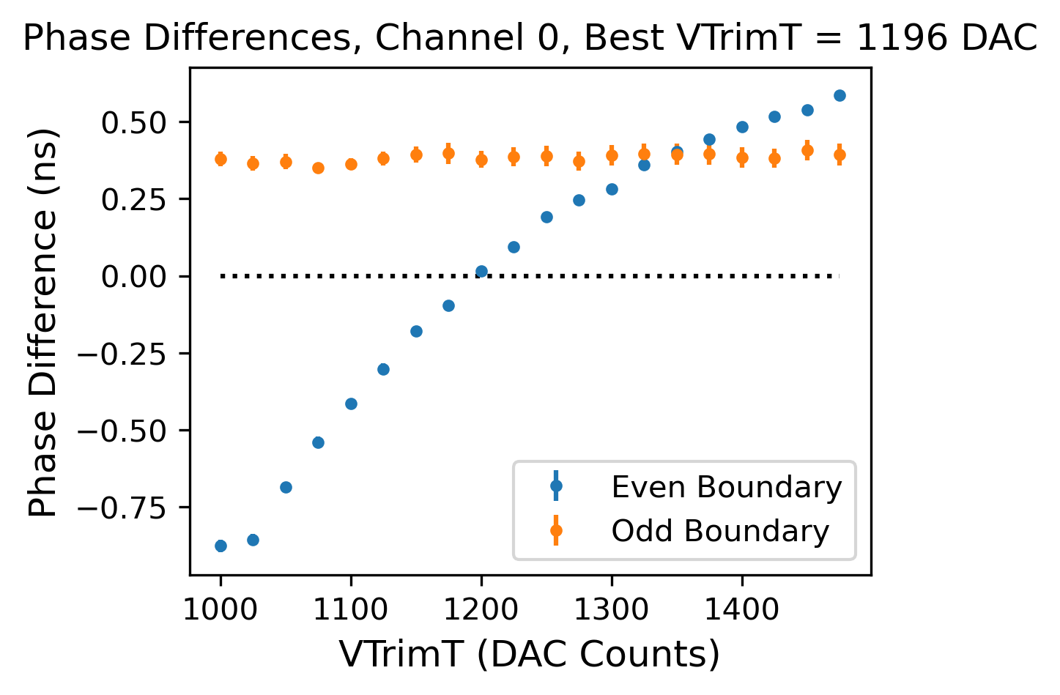
Phase Equalization
Optimizes a setting in the module to remove the phase difference between pulses
Takes about 20 minutes per module
Viviana Rickert - Upgrading the pSCT camera for gamma-ray Astronomy

Slide 21
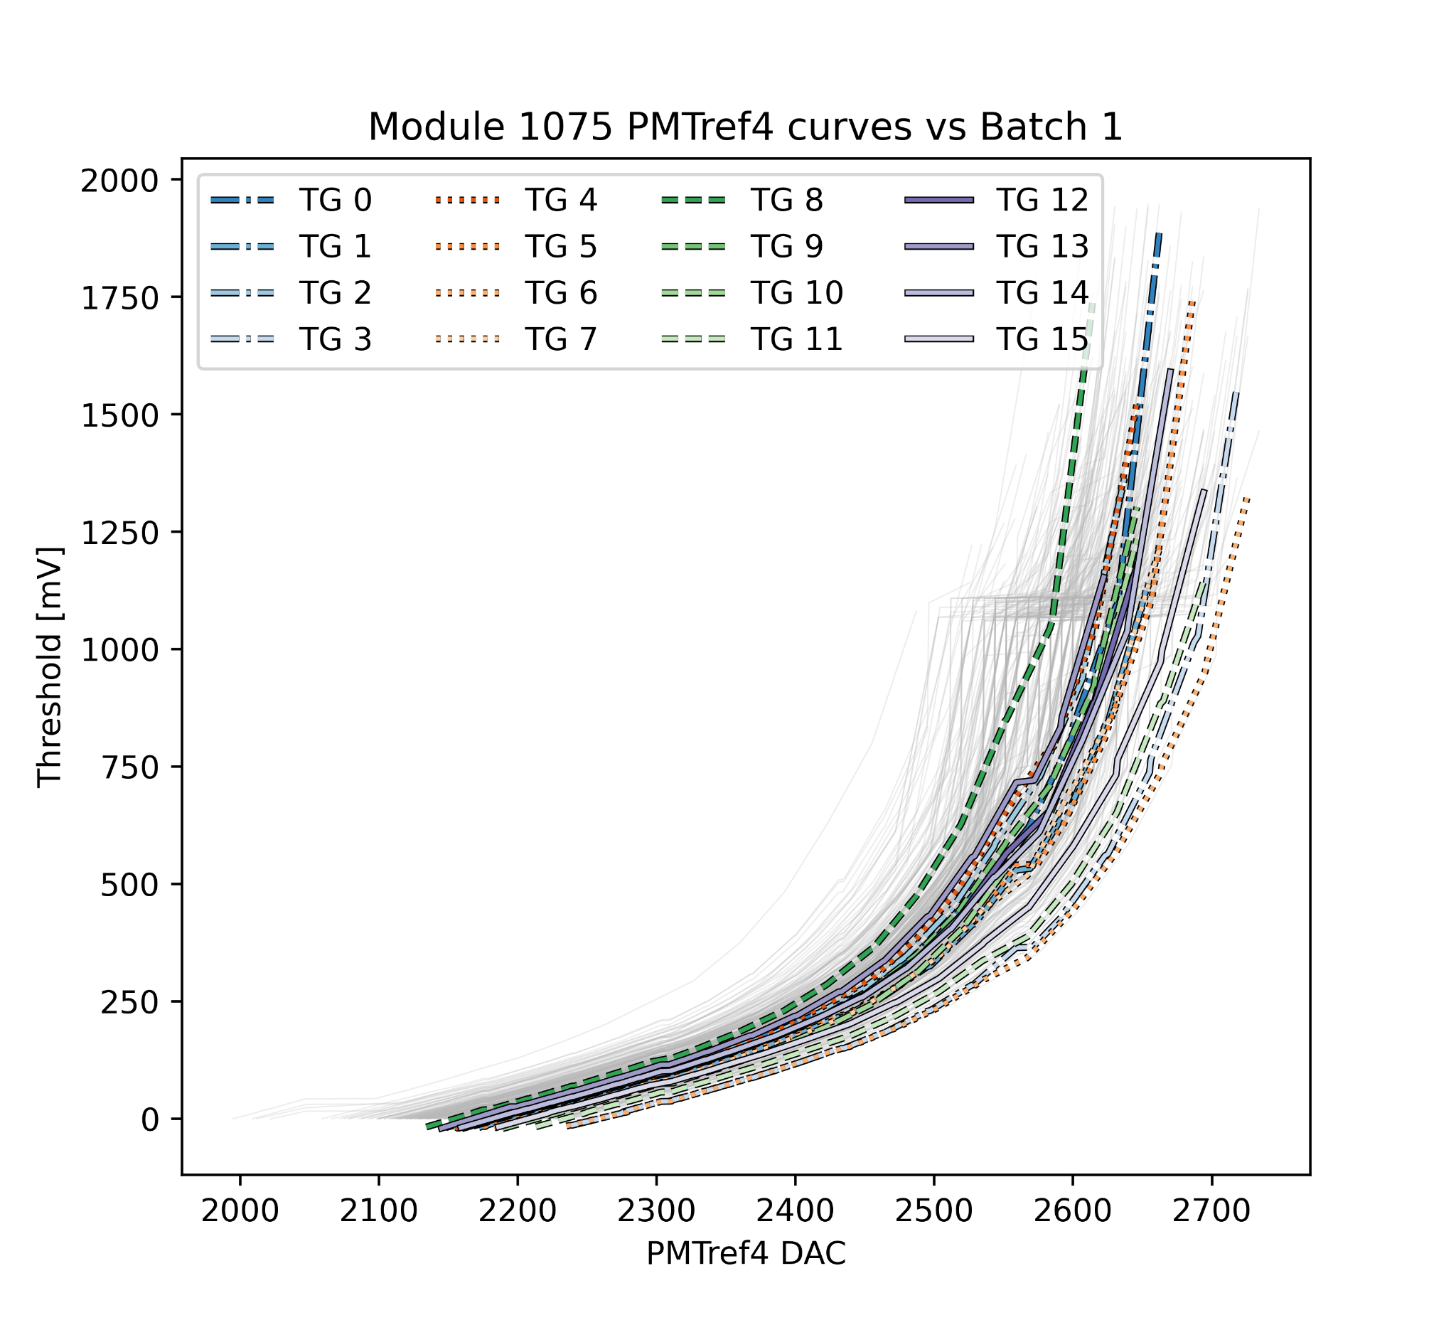
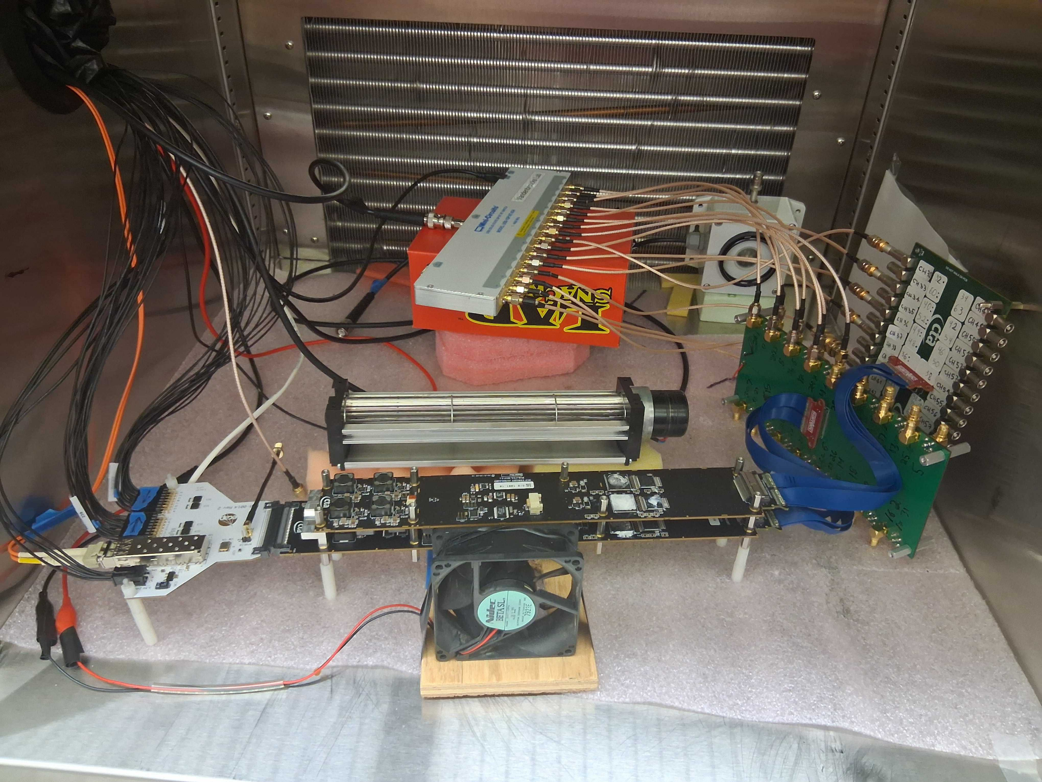
Trigger Threshold
Maps a setting in the module to be able to change the threshold for the camera to trigger
Takes about 45 minutes per module
Viviana Rickert - Upgrading the pSCT camera for gamma-ray Astronomy

Slide 22
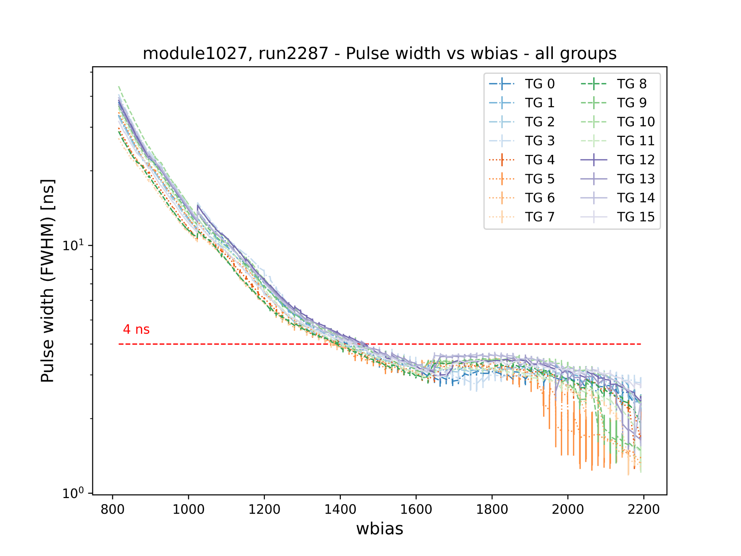

Trigger Pulse Width
Maps a value of a module setting to a pulse width to make all trigger groups have the same pulse width
Takes about 15 minutes per module
Viviana Rickert - Upgrading the pSCT camera for gamma-ray Astronomy

Slide 23
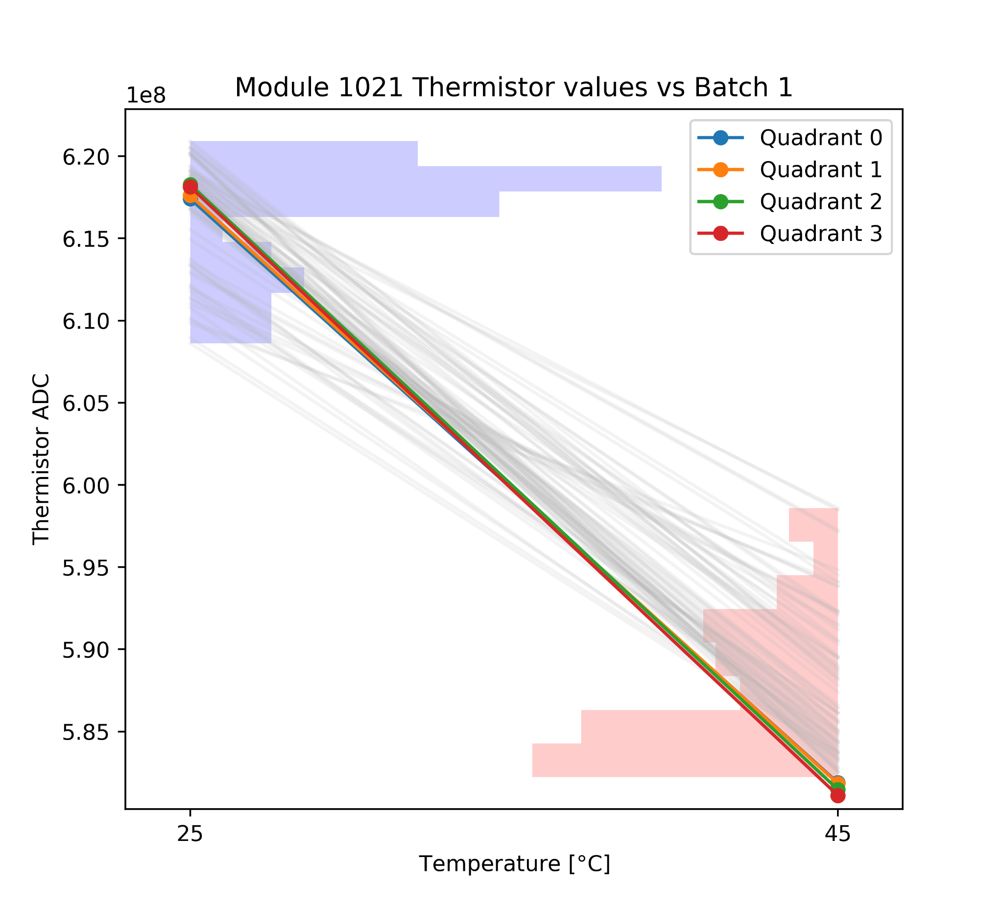
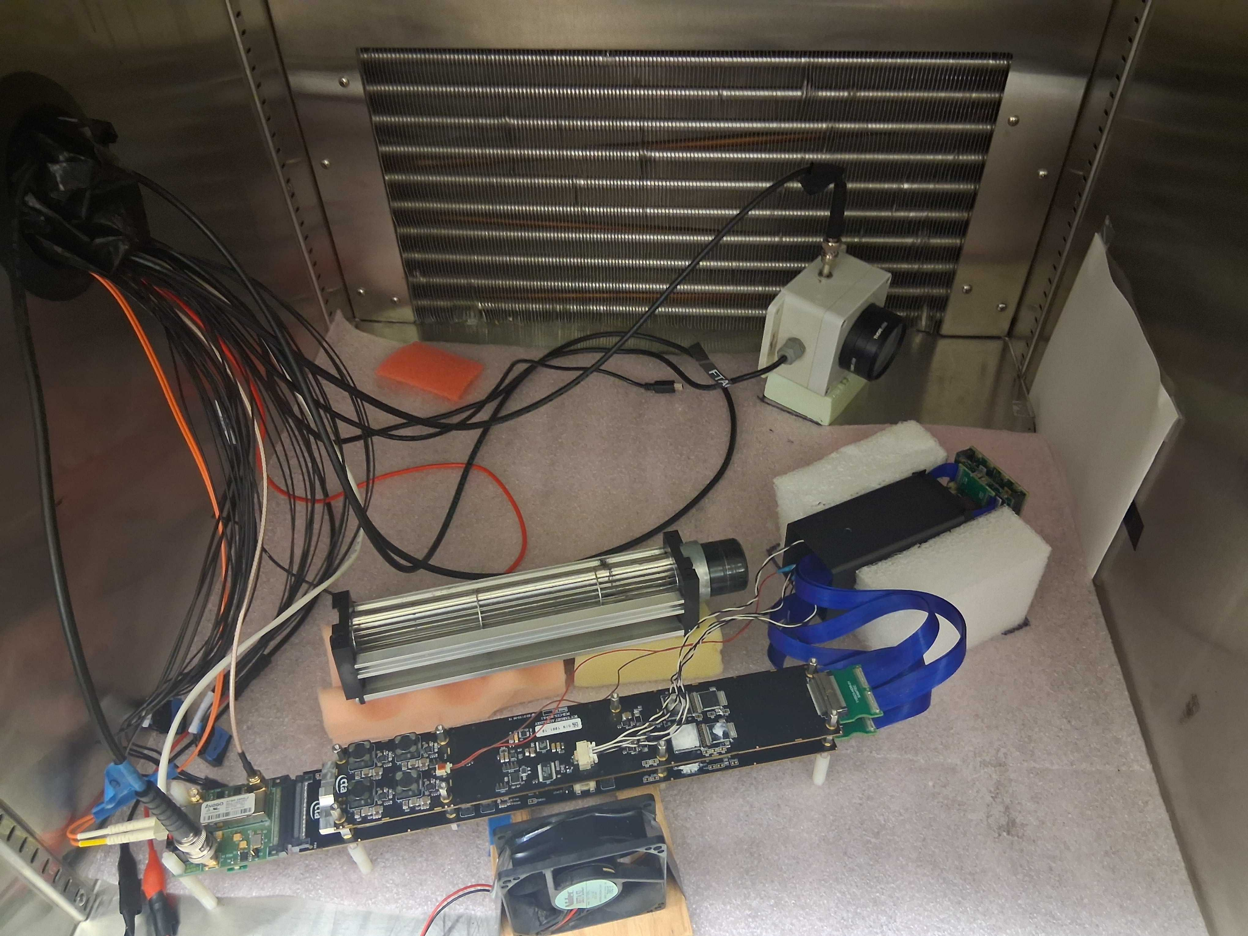
Thermistor
Measures the conversion between the actual environmental temperature and the value recorded by the thermistor ADC
Takes about 30 minutes per module
Viviana Rickert - Upgrading the pSCT camera for gamma-ray Astronomy

Slide 24
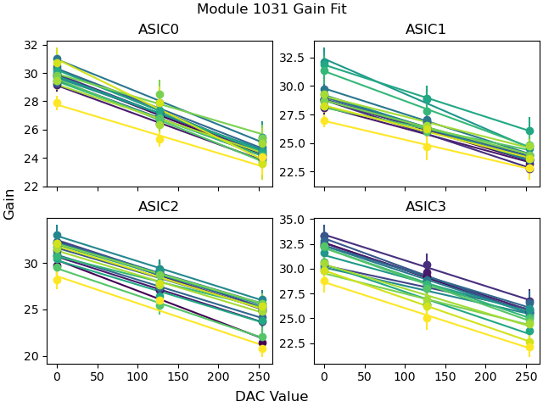
Gain Equalization
Measures the relationship between the gain and the Digital to Analog converter values
Takes about 25 minutes per module
Viviana Rickert - Upgrading the pSCT camera for gamma-ray Astronomy

Slide 25
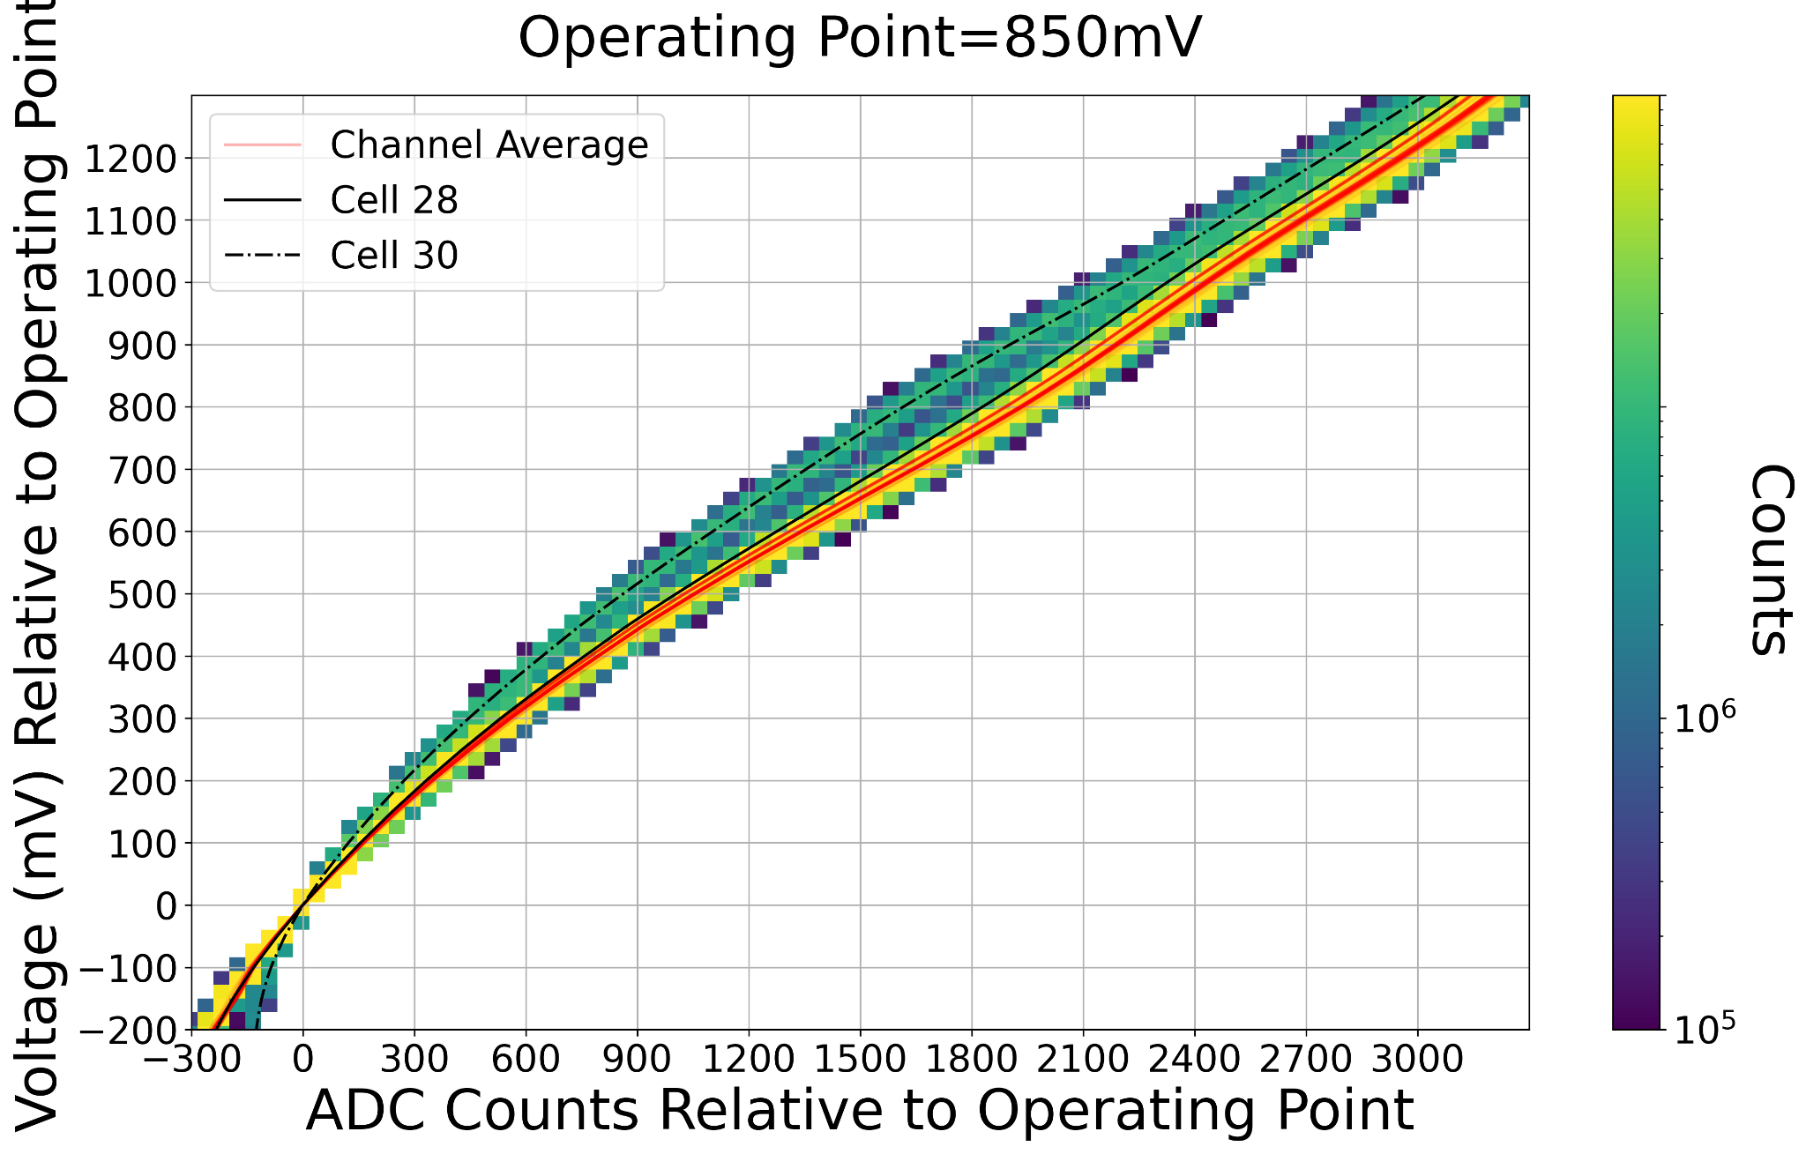
Transfer Function
Creates the transfer function to more clearly distinguish pulses from noise
Takes about 30 minutes per module
Viviana Rickert - Upgrading the pSCT camera for gamma-ray Astronomy

Slide 26
Batch 2 Optimization Specifics
Modules separated into 3 sets (2, 25, 25)
Calibrations have been separated into 3 “bundles” of back to back calibrations, one set would be ran through one bundle before moving to the next
Viviana Rickert - Upgrading the pSCT camera for gamma-ray Astronomy

Slide 27
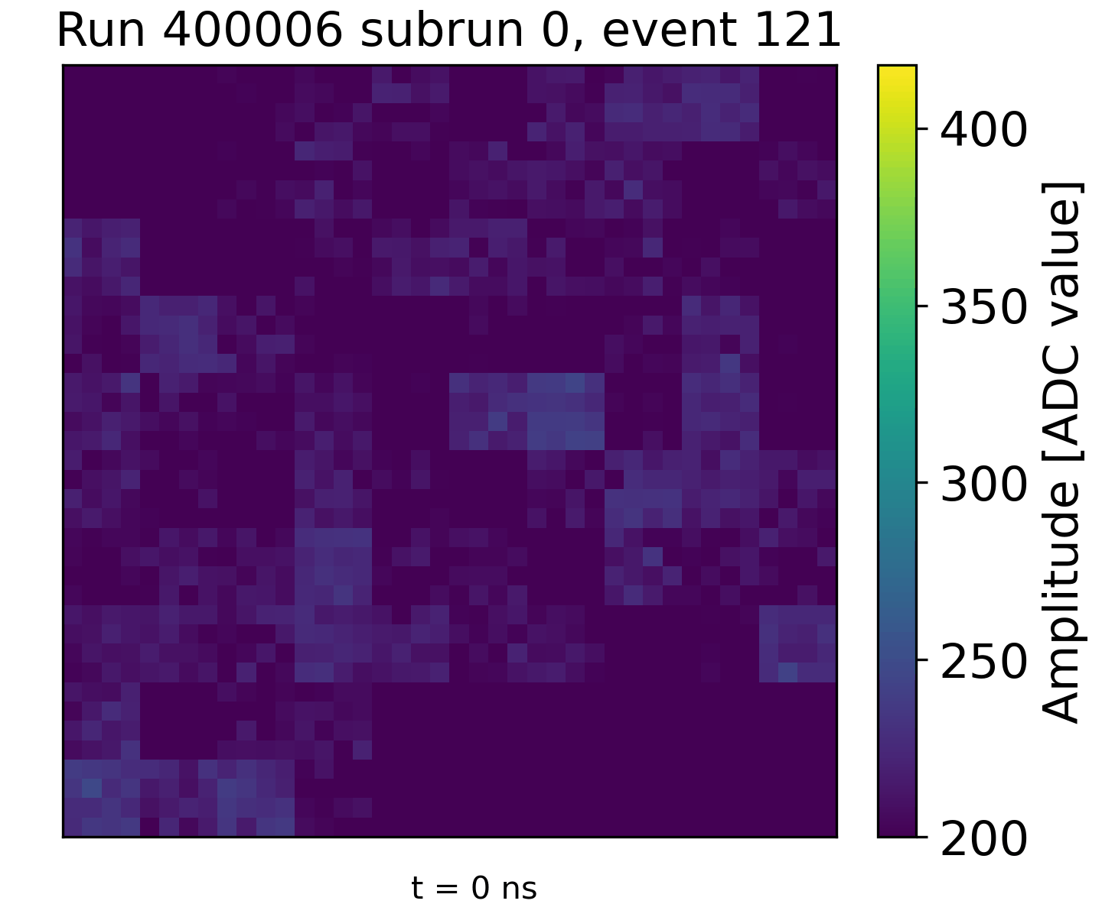
First Light Shower
Viviana Rickert - Upgrading the pSCT camera for gamma-ray Astronomy

Slide 28
Blank
Viviana Rickert - Upgrading the pSCT camera for gamma-ray Astronomy

