Slide 1
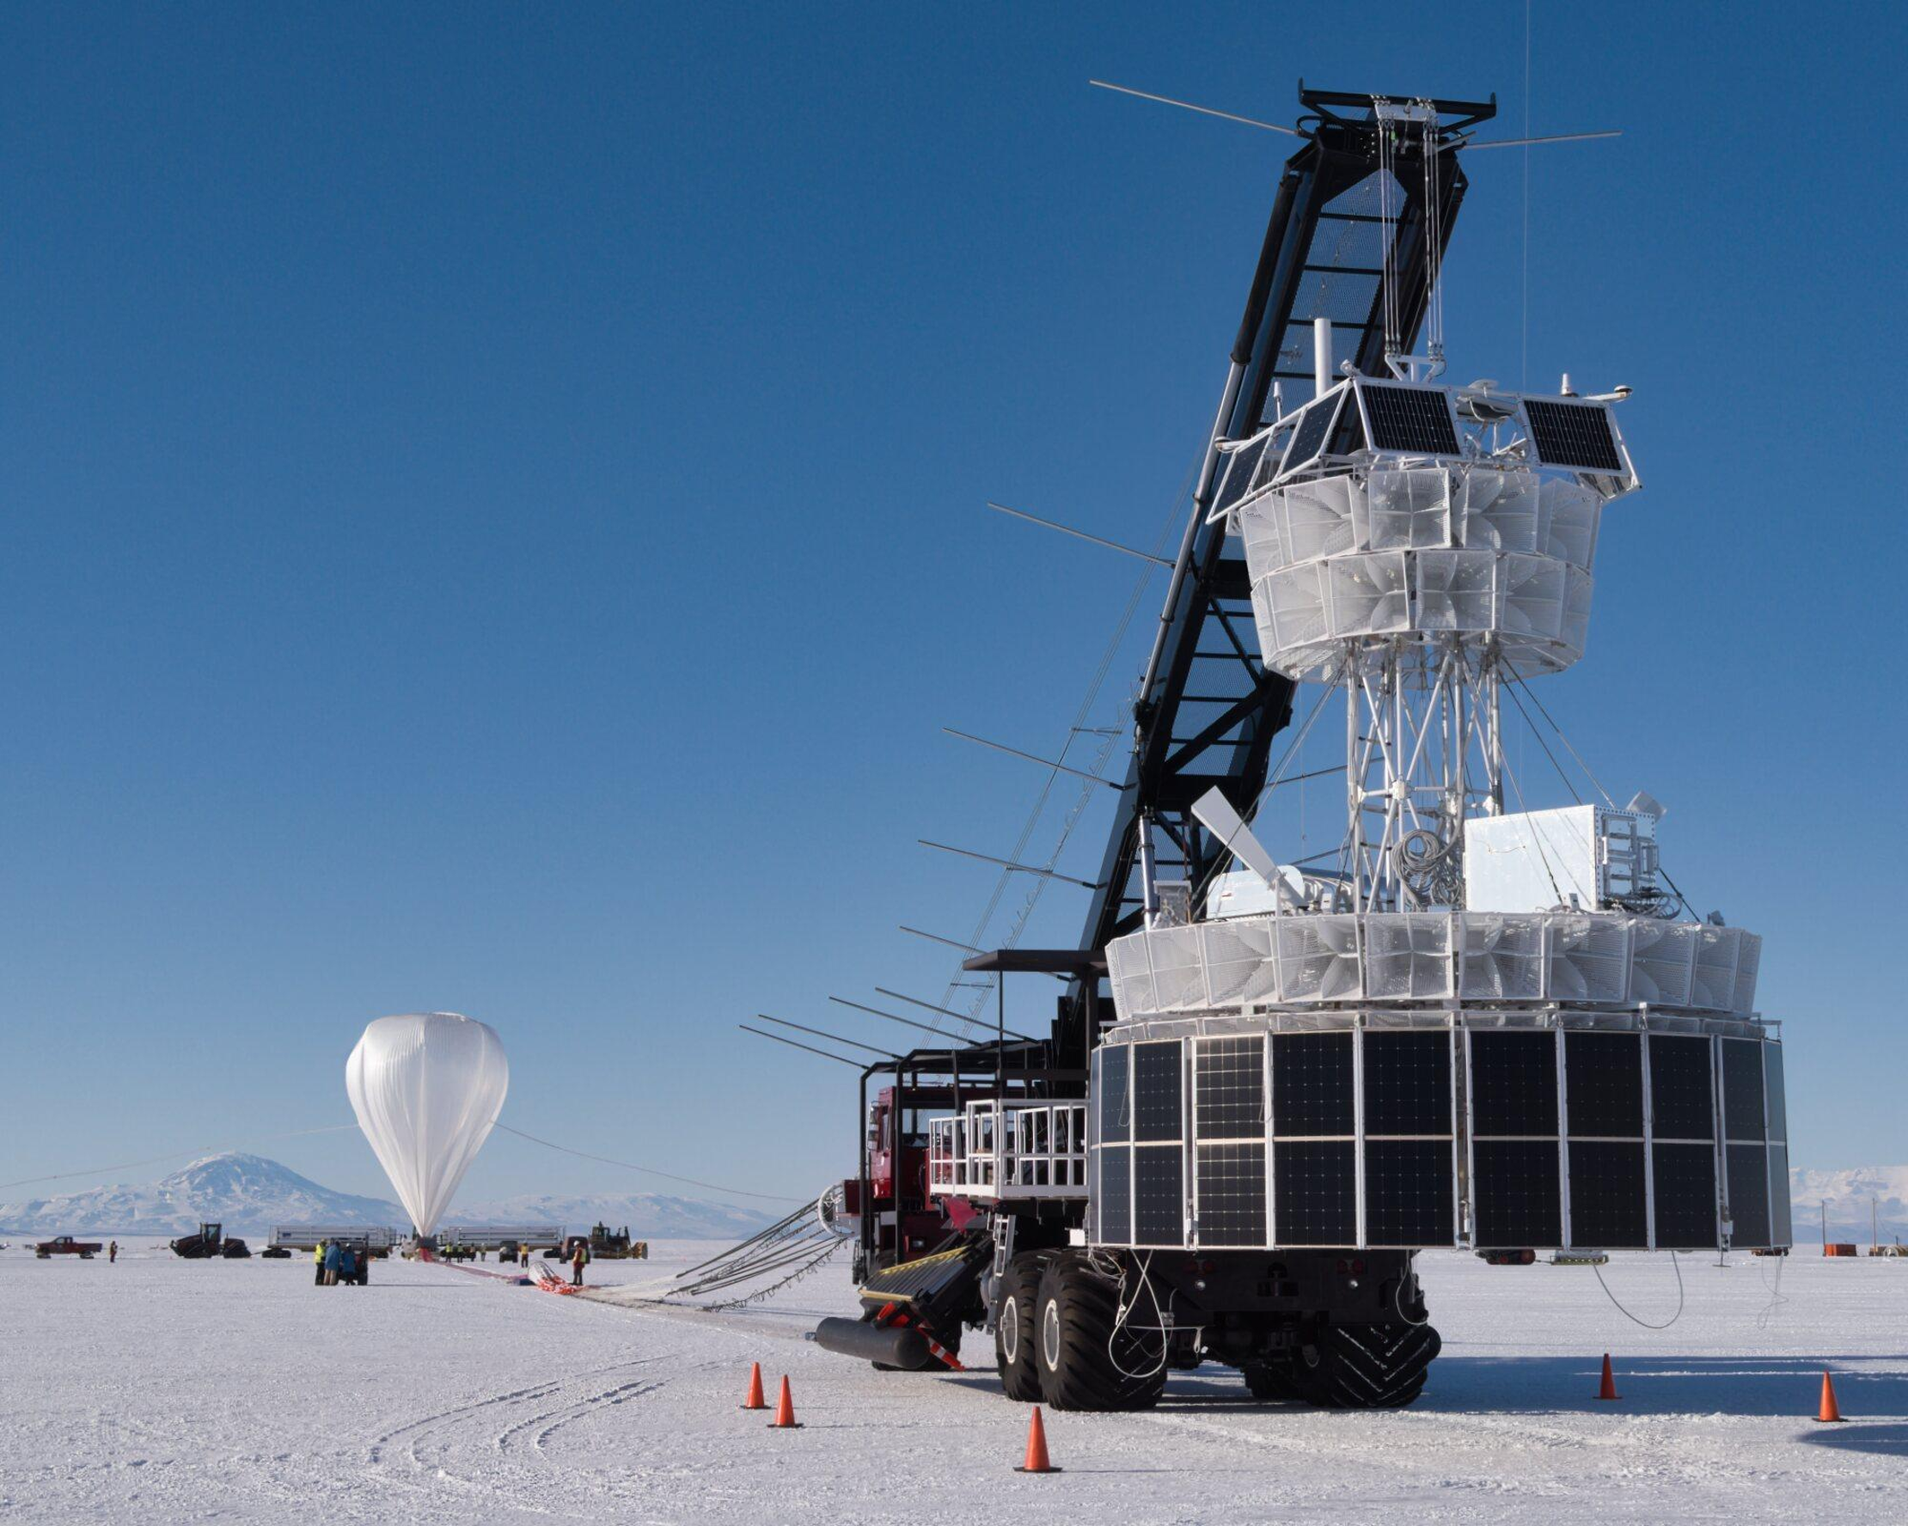
The Payload for Ultrahigh Energy Observations (PUEO)
Flight and Outlook
Notes:
Pleasure to be here and give these lectures. I am going to jump right in today with what astroparticles are, what we understand about them and their role in the cosmos, and move towards convincing us that they can tell us incredible unique

Slide 2
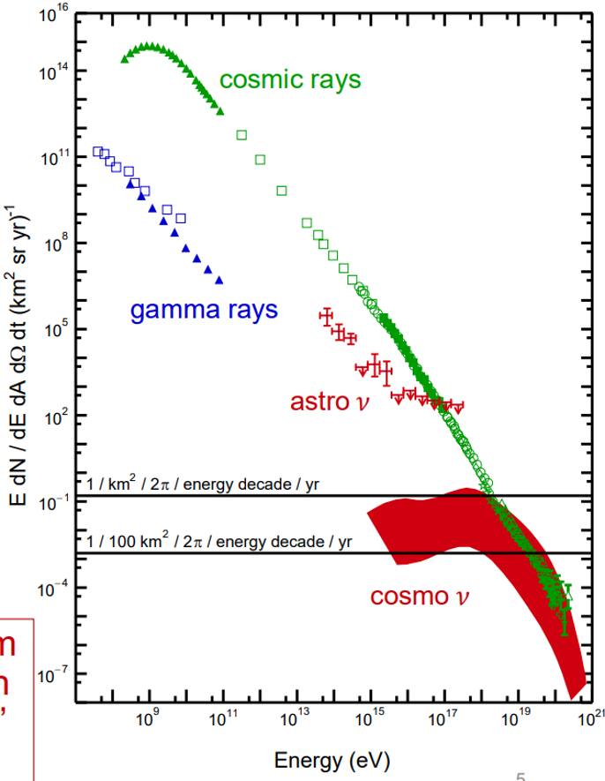
GZK-cosmic rays to BZ-neutrinos
Ultrahigh-energy cosmic rays (UHECR, 1 EeV) have been detected
Interactions of UHECR with CMB photons should produce neutrinos at the highest energies
Predictions
  Emitted at cosmic ray acceleration sites (astrophysical)
  Emitted from cosmic-ray interactions from propagation (cosmogenic)
Adapted from A. Connolly (OSU)

Slide 3
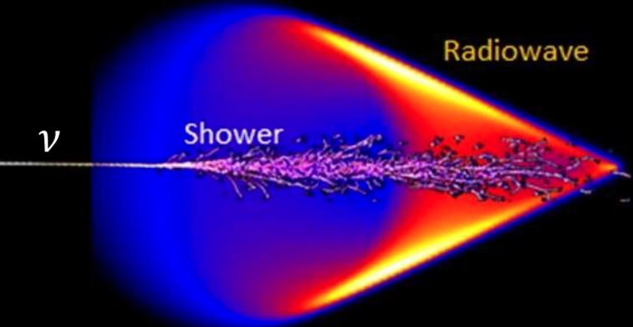
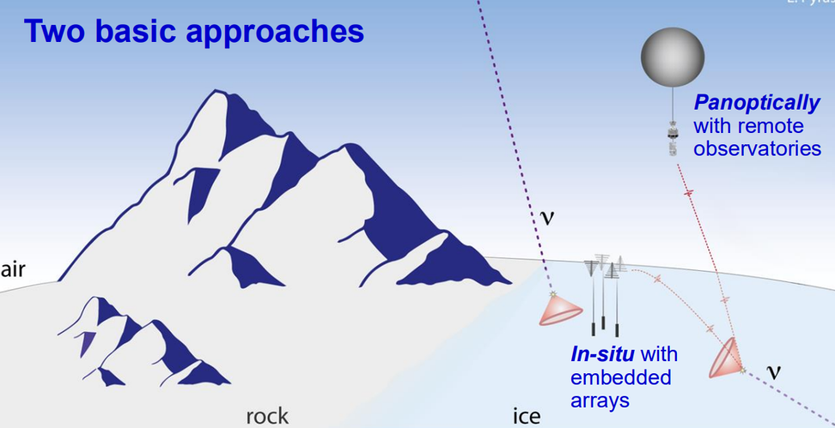
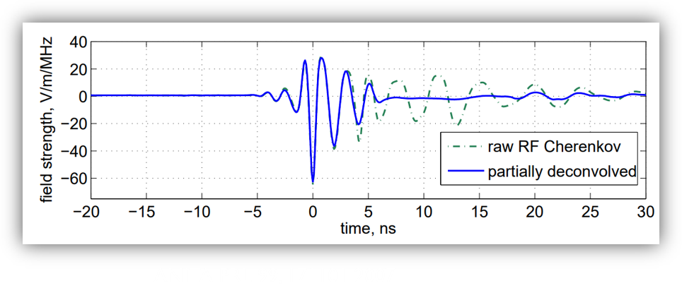
Radio neutrino detector landscape
UHE neutrino interaction → Askaryan signal
Fast/impulsive and broadband radio signal
as measurements in beamline show
Antarctic and Greenland ice (radio transparent)
PUEO has a 700 km horizon -
coverage > 1 million km²

Slide 4
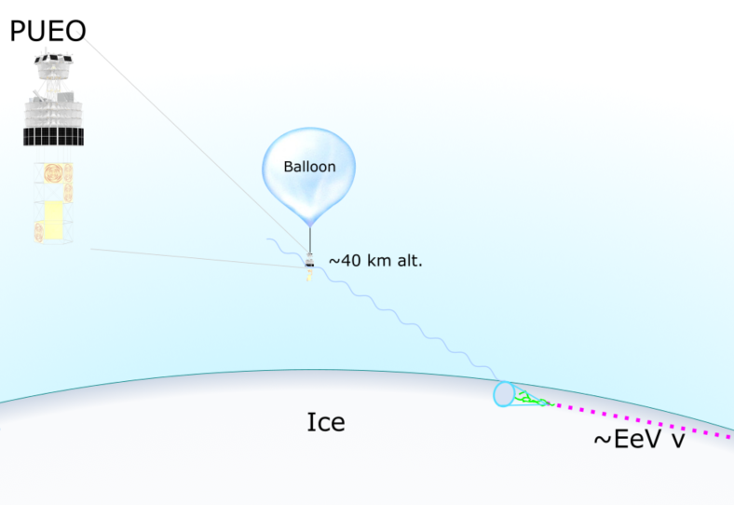
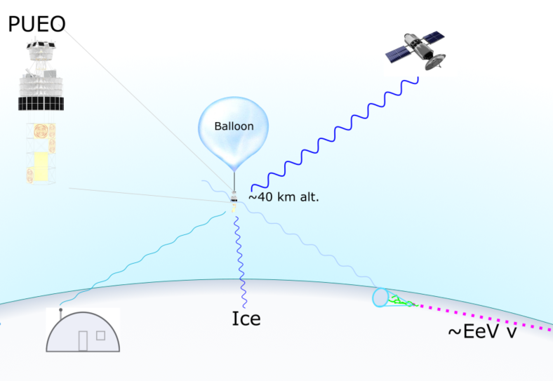
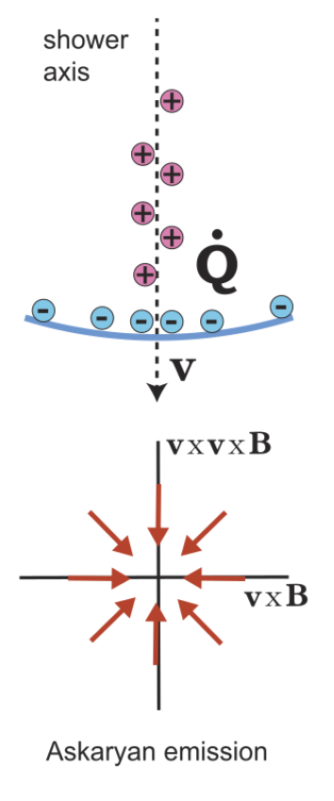
PUEO Design
Reconstruct the Electric field vs time
  -Radially polarized radio signal at emission → linearly polarized at PUEO
Neutrino direction
Mitigate backgrounds
  Thermal, payload, and anthropogenic noise
Image Credit: Stephen Hoover

Slide 5
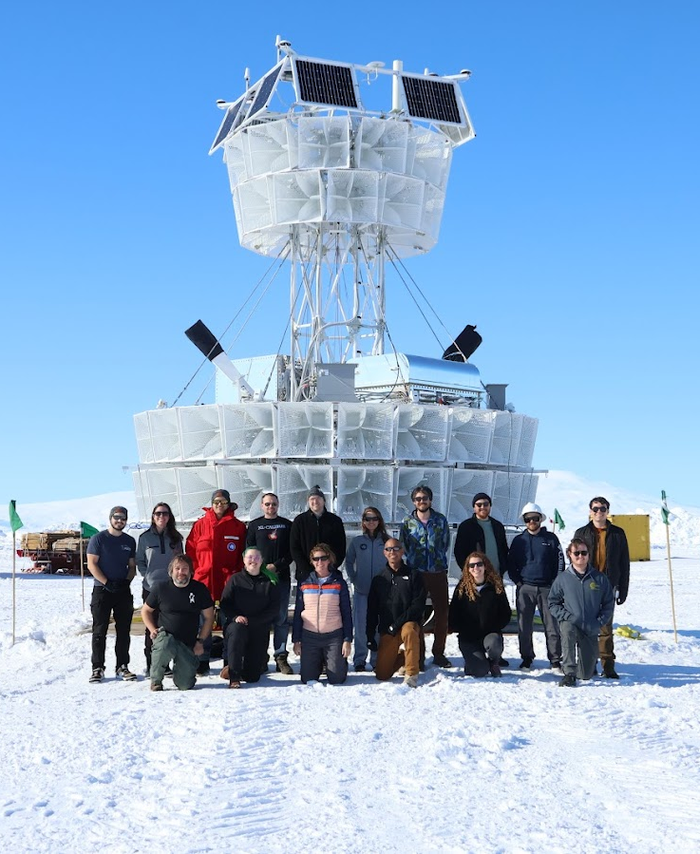
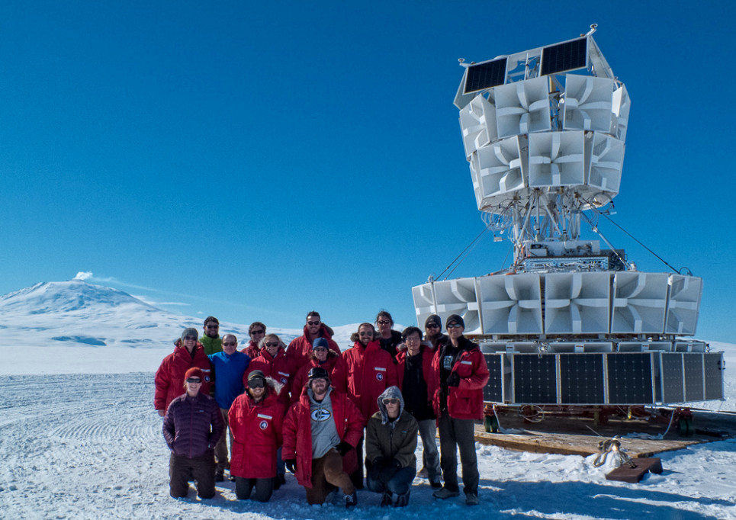
PUEO Builds on ANITA Heritage
ANtarctic Impulsive Transient Antenna (ANITA)
  4 flights from 2006-2016 in Antarctica
PUEO
ANITA-III
More antennas with higher gain
Lower noise figure of Radio Frequencies system
Improved triggering firmware
Low Frequency (LF) instrument

Slide 6
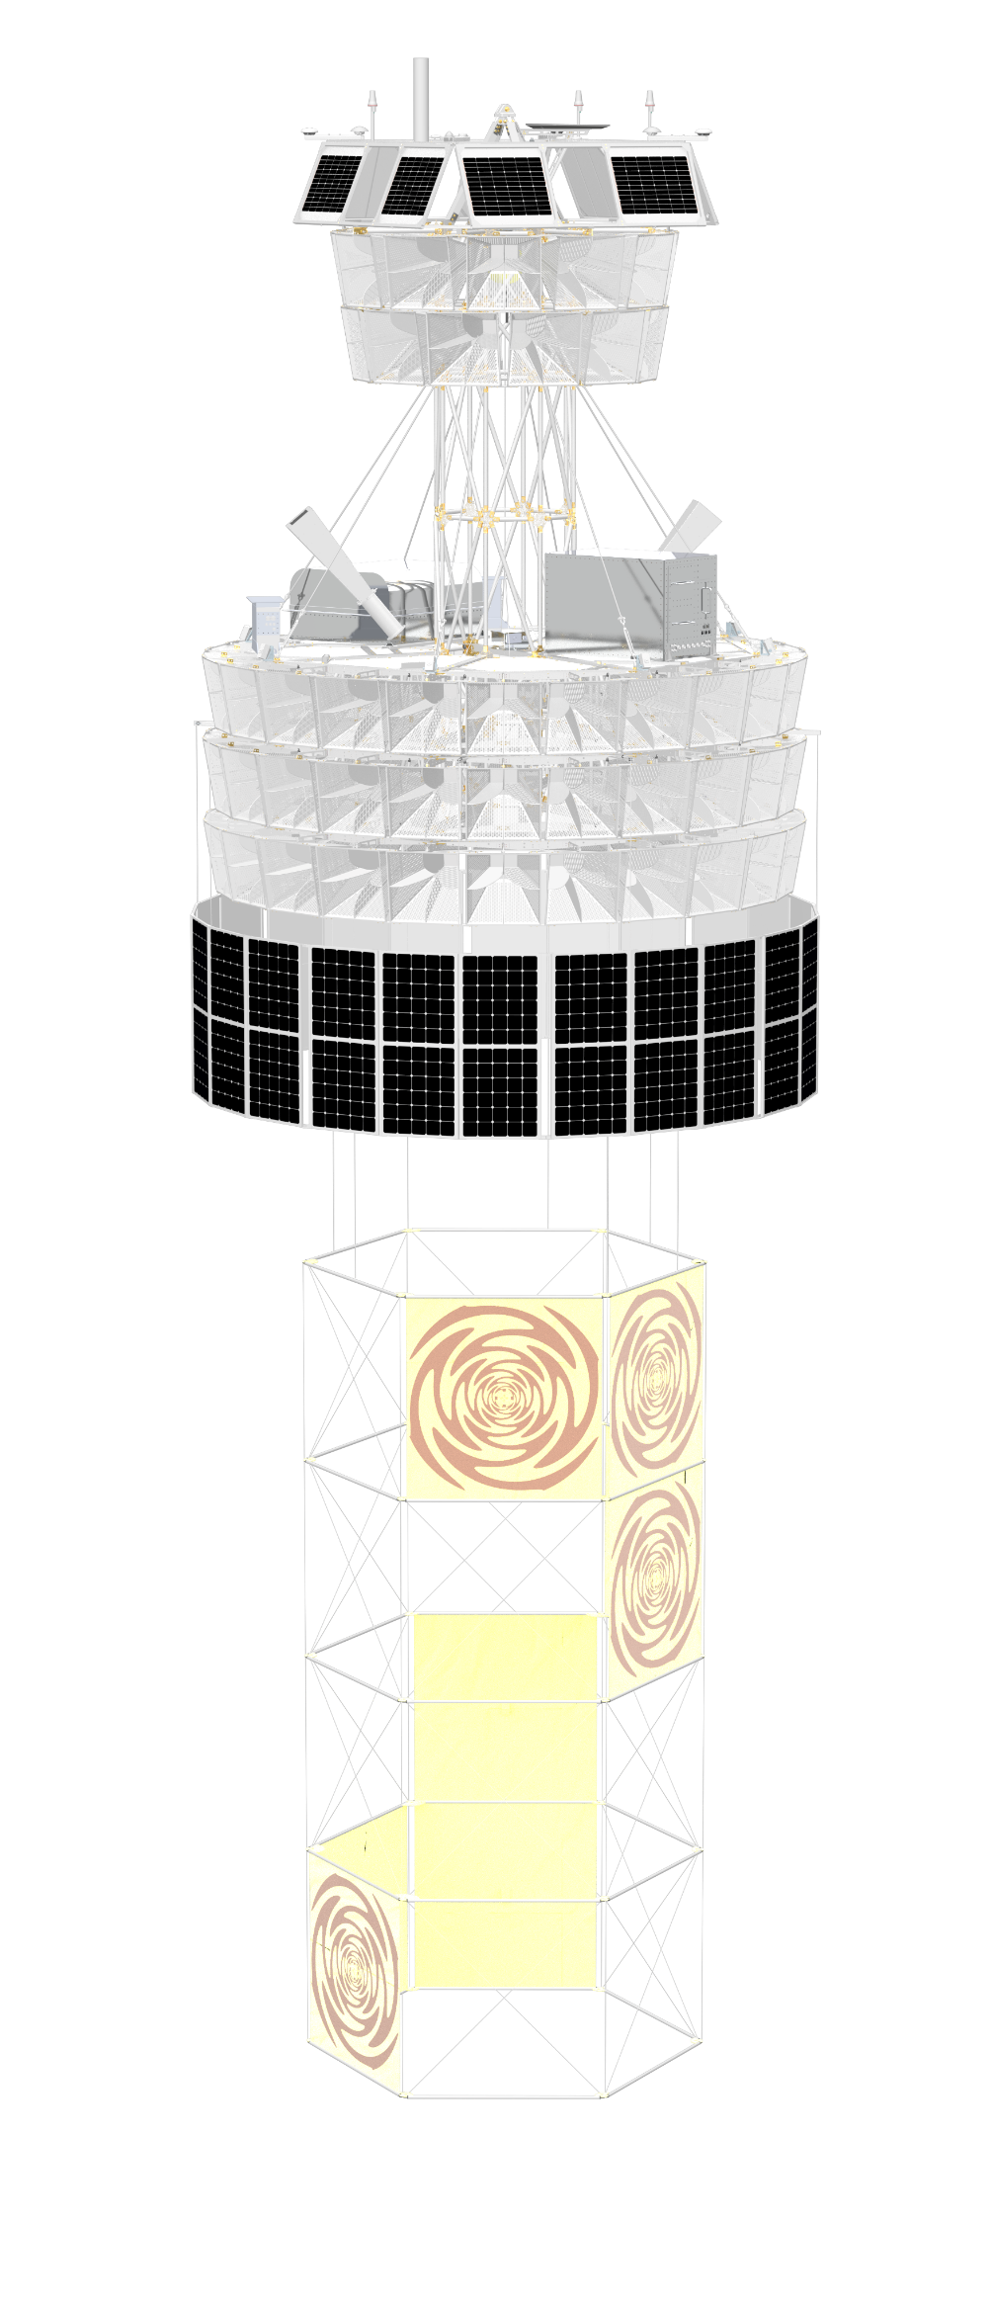

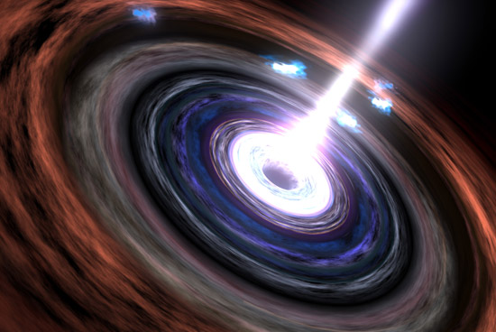
The Payload
Main Instrument (MI) – 96 antennas (192 channels)
  Quad-ridged horn, dual polarized
  Collecting area, 2π acceptance
Deployable Low Frequency (LF) fabric sinuous antennas x8
Deployable solar panels
Telemetry antennas
Navigation suite - localize neutrino direction back to sources

Slide 7
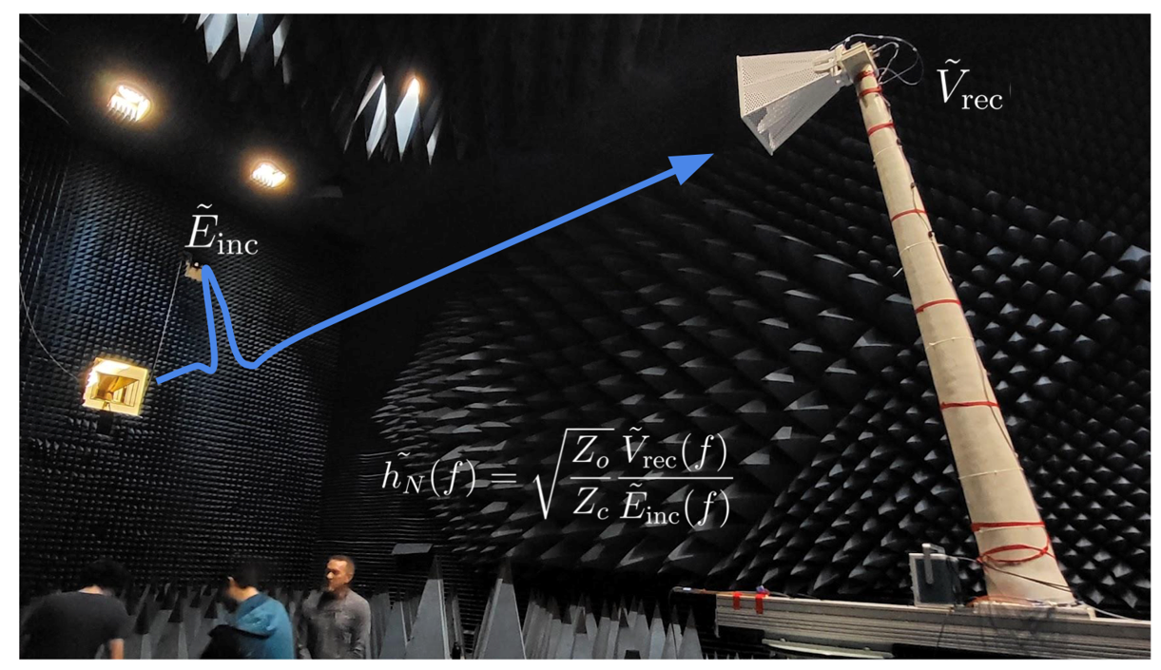
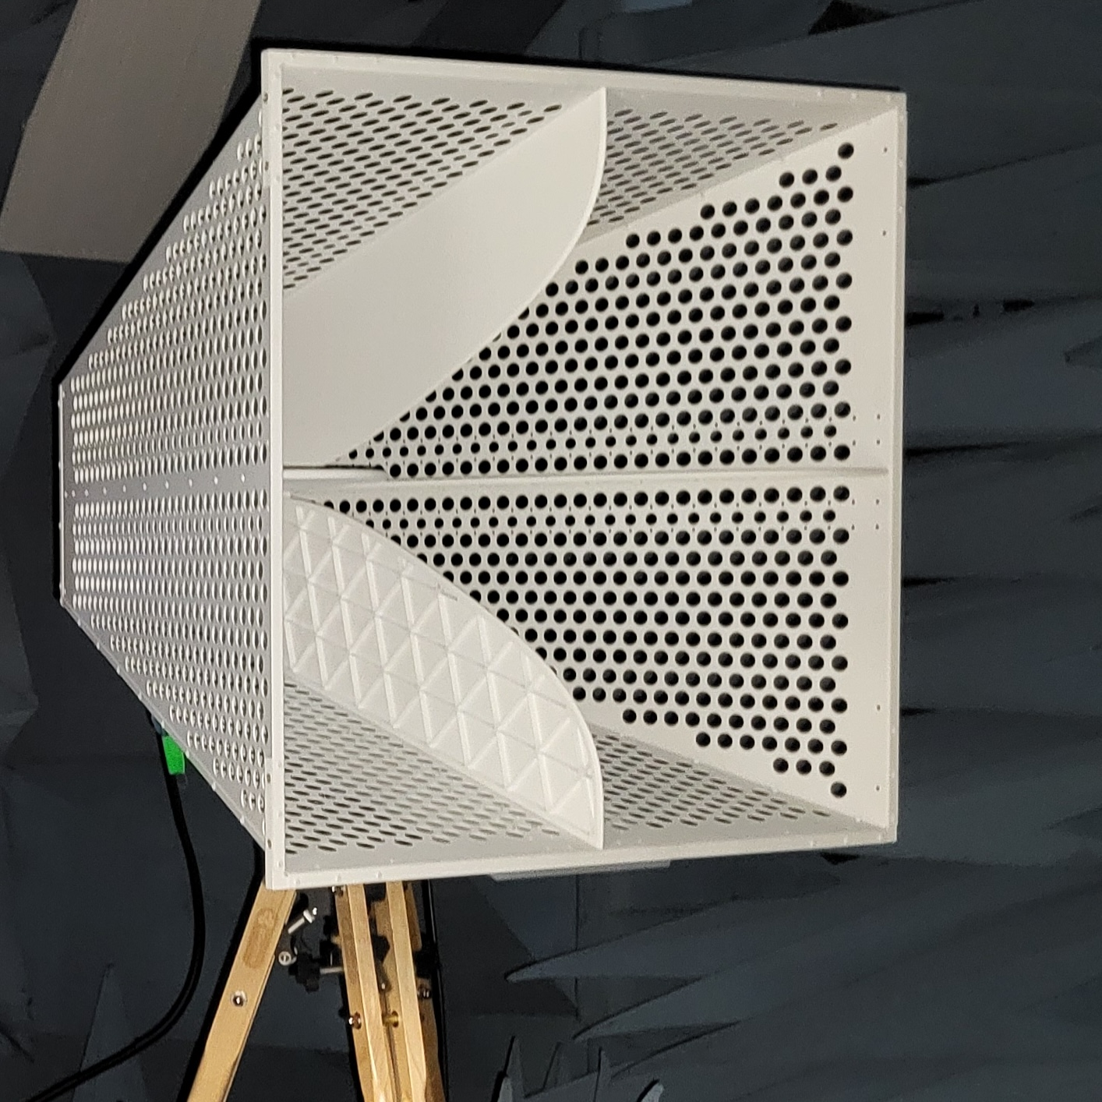
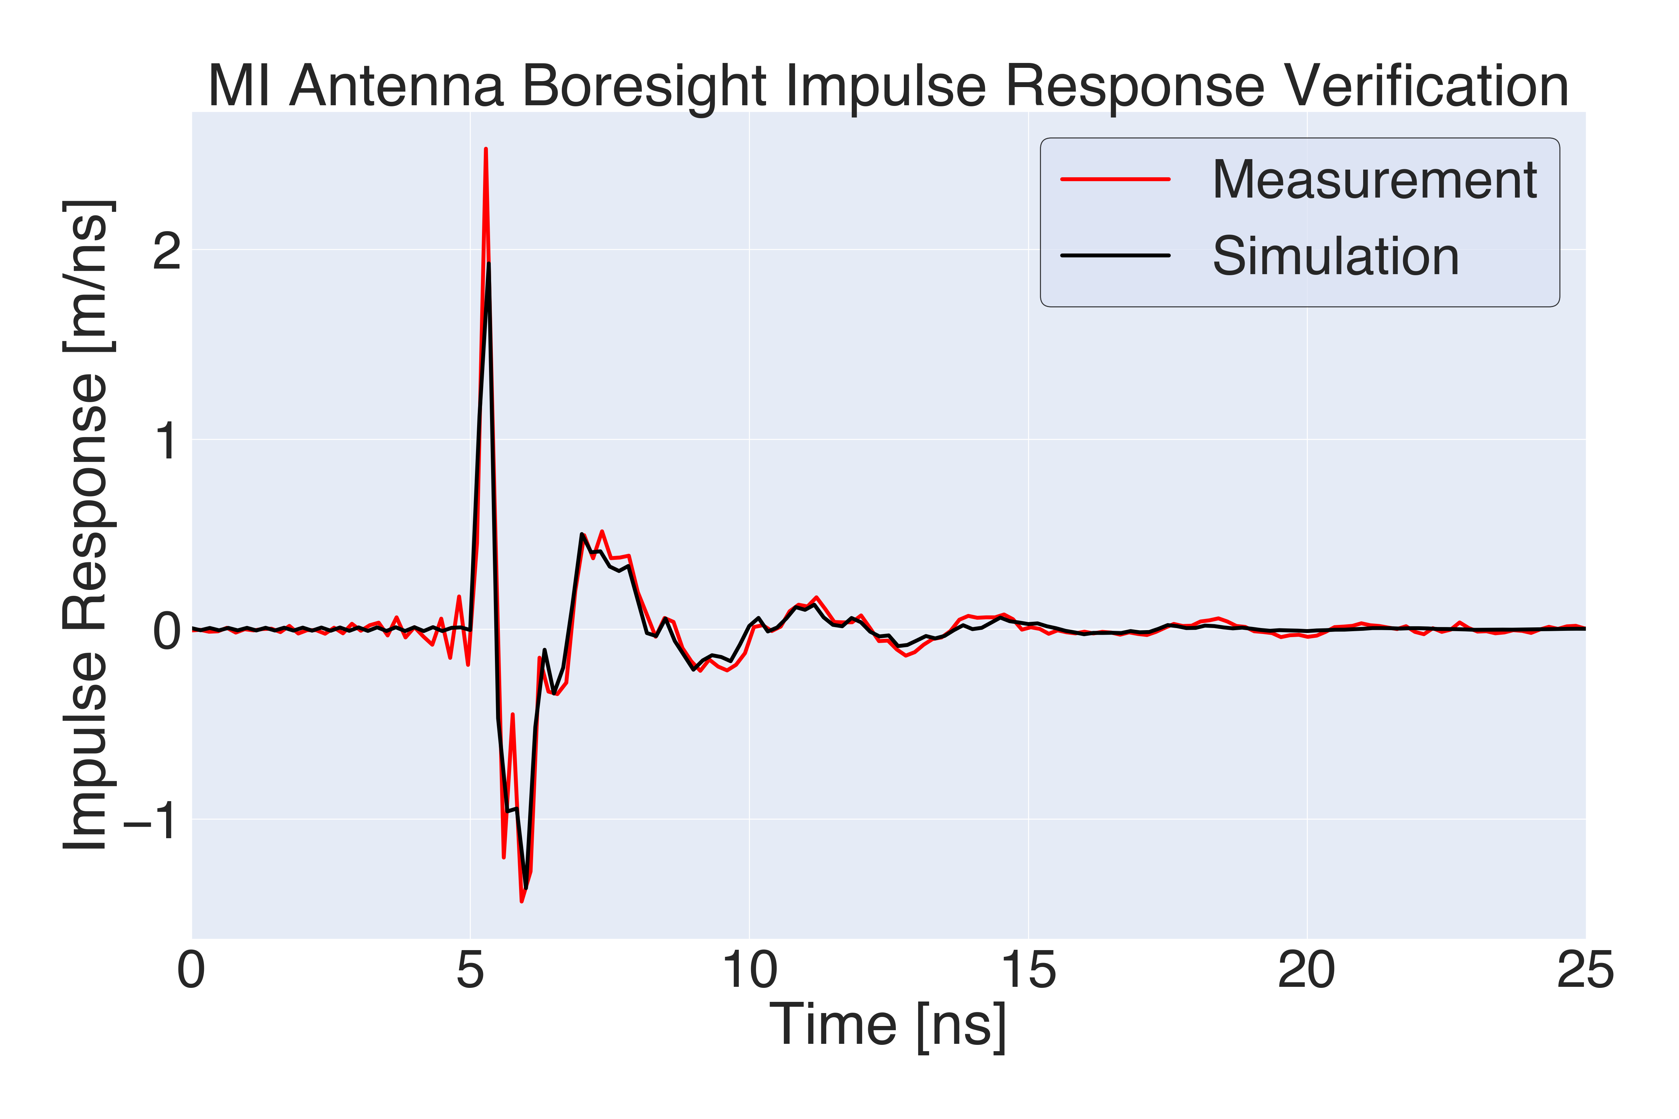
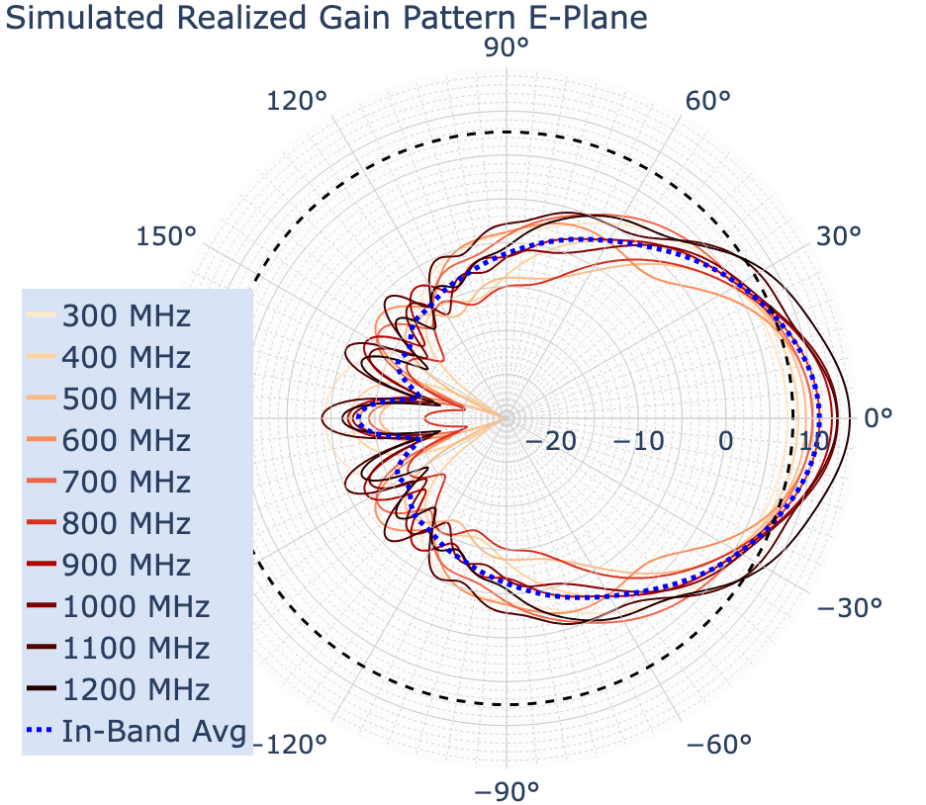
Main Instrument Antennas
Anechoic chamber testing
Bandwidth 300 to 1200 MHz
  ANITA: 200 to 1200 MHz
Custom designed by Toyon
All channels appear to have functioned well during flight

Slide 8
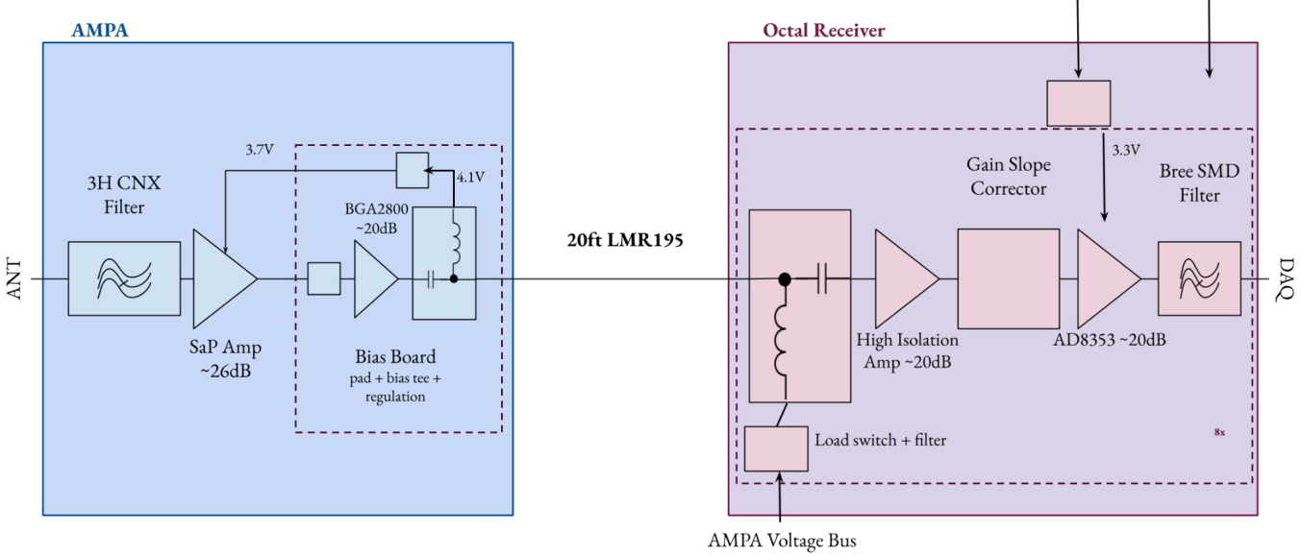
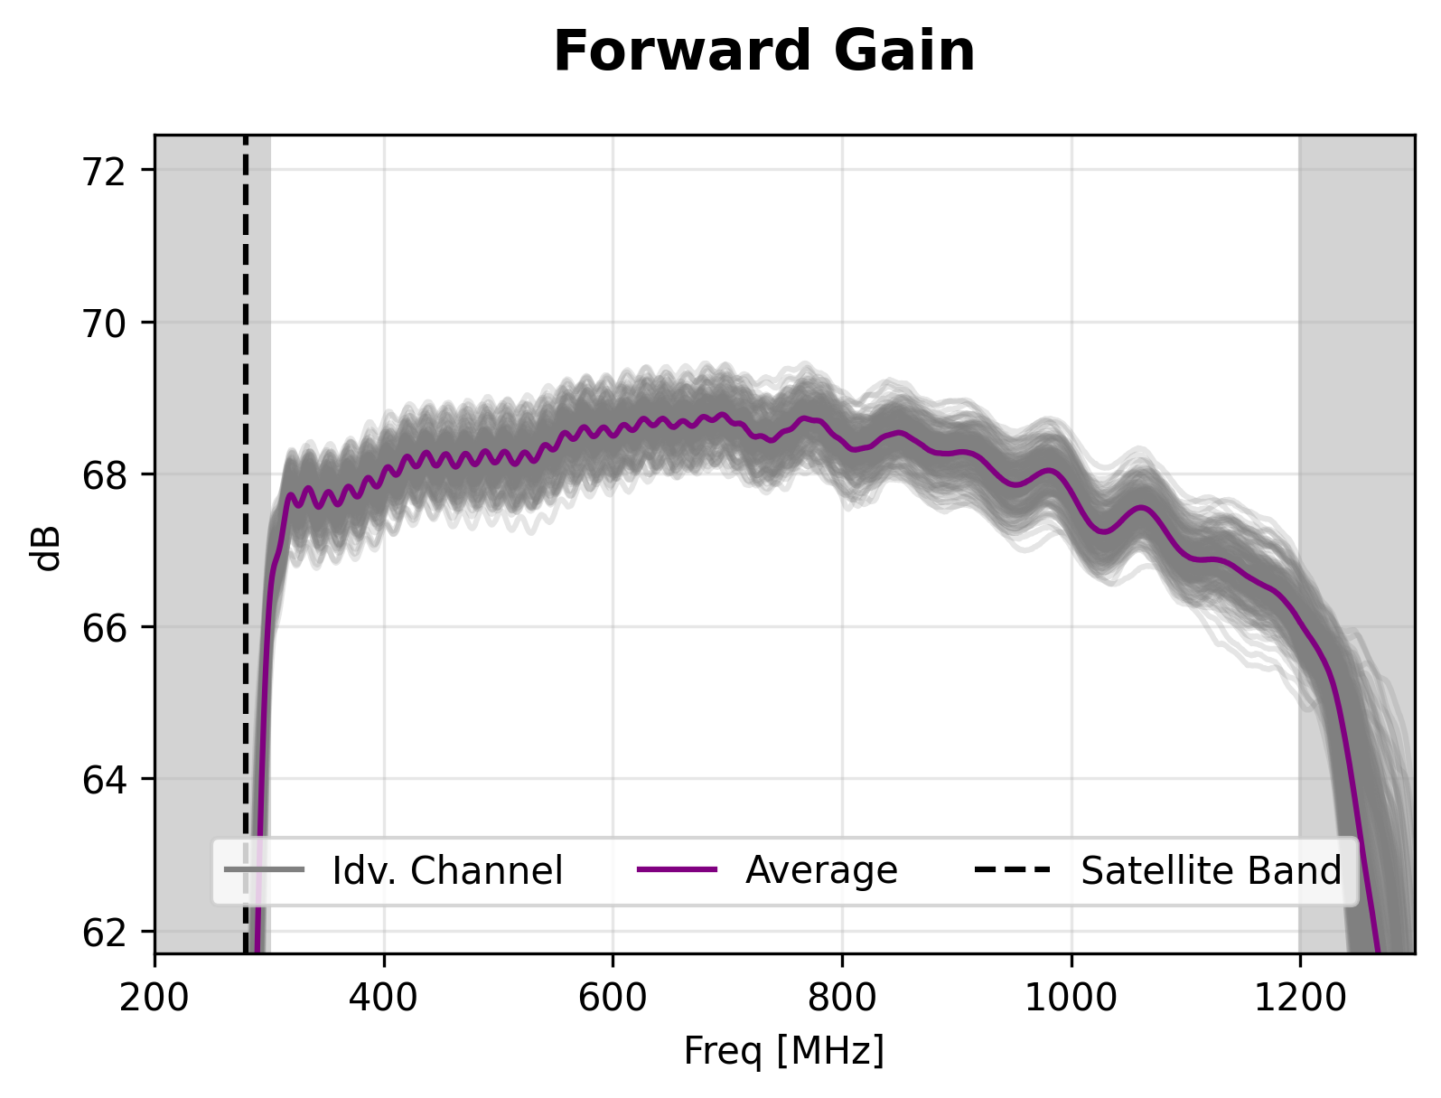
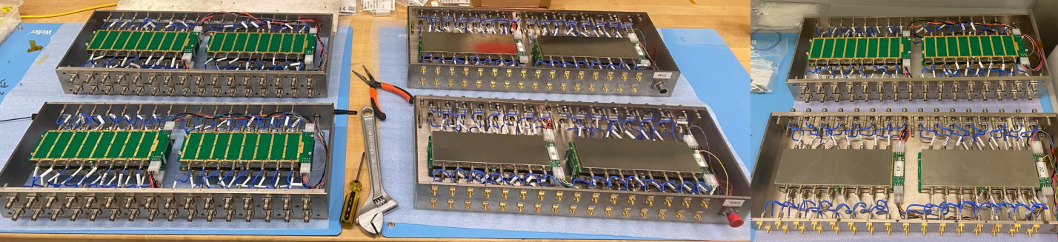
Main Instrument RF front-end
Expected μV scale Askaryan signal at the antennas
Amplification and filtering electronics
  2 stages: at antenna and just before DAQ

Slide 9
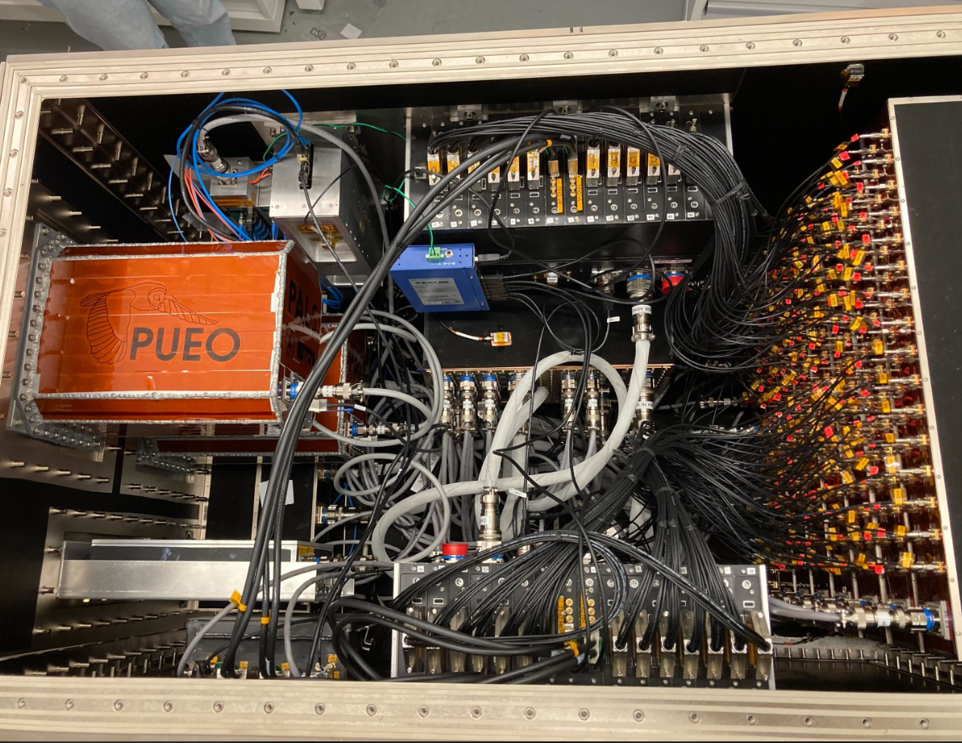
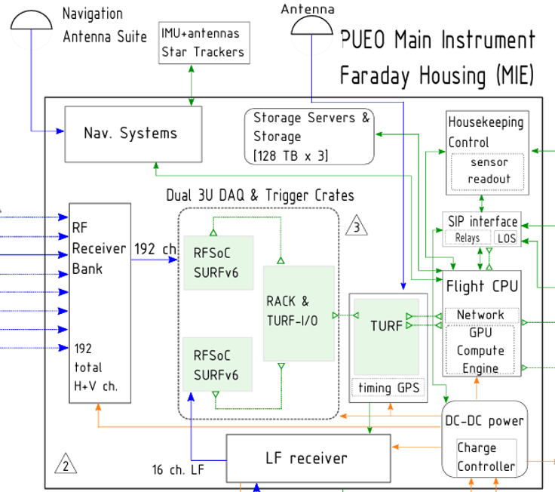
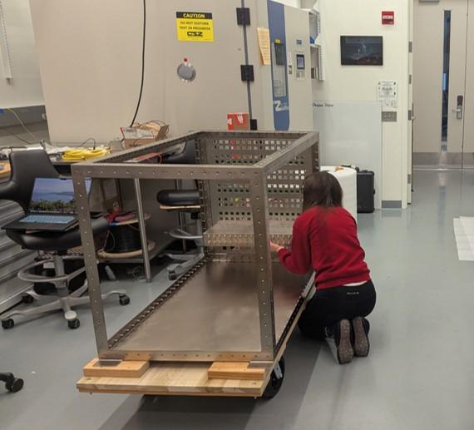
Mitigating Payload Electronics Noise Emission
All electronics for the payload housed inside of radio-tight enclosures
  Reduction of RFI (Radio Frequency Interference) at the level of ~80dB
Main Instrument Enclosure (MIE)
Fully assembled, the MIE weighs nearly 800lbs (360kg)

Slide 10
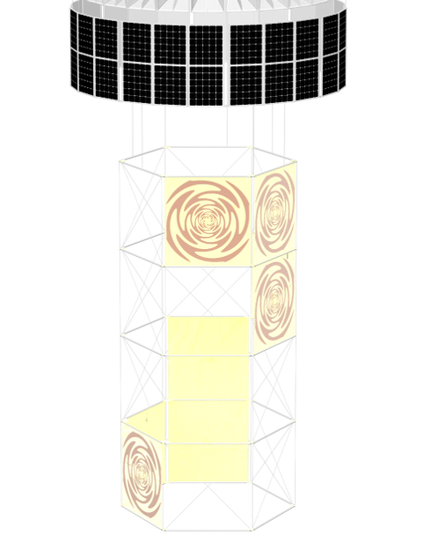
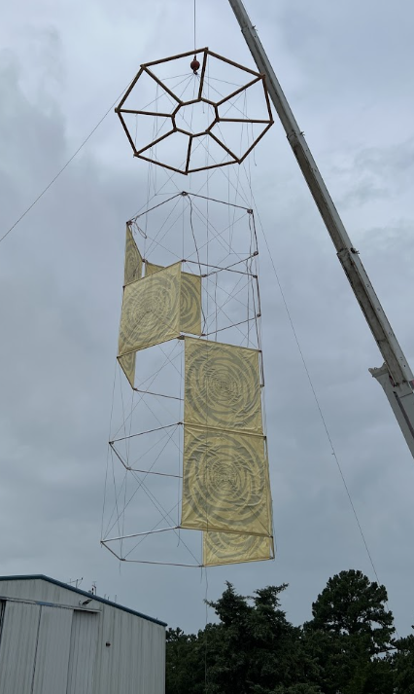
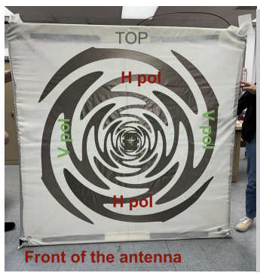
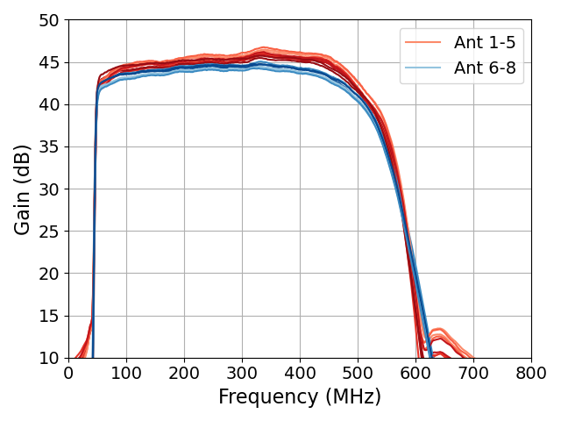
Low Frequency Antennas
8 dual-polarized sinuous antennas deployed after launch
50-500MHz band
Dedicated LF front-end hardware

Slide 11
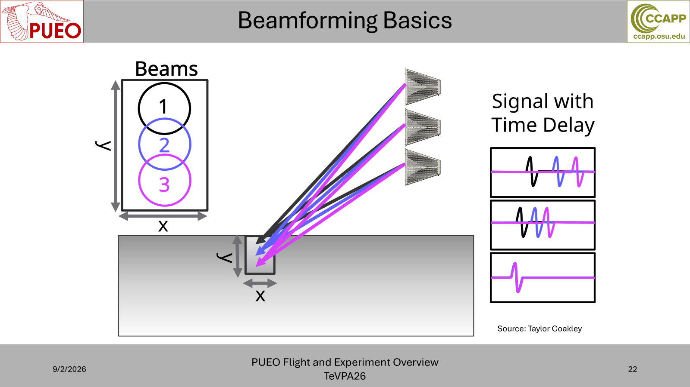
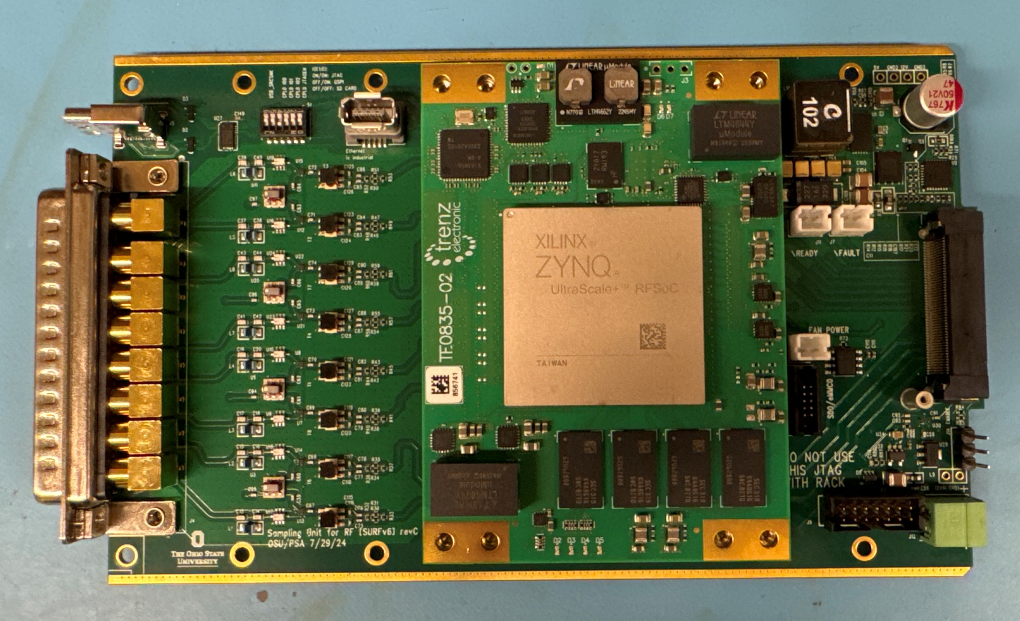
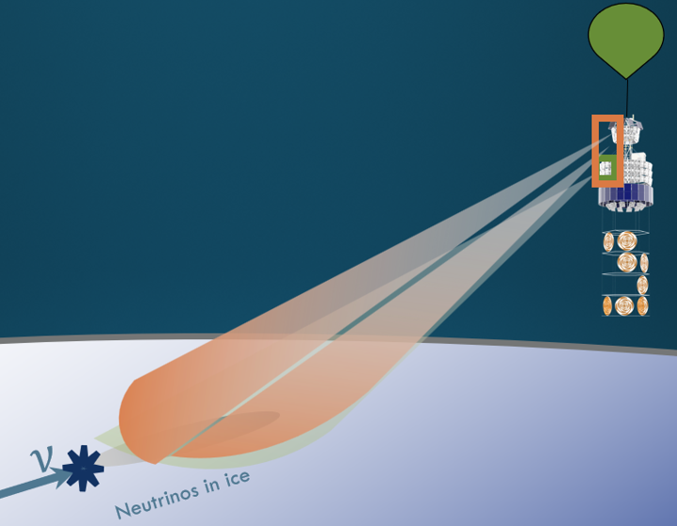
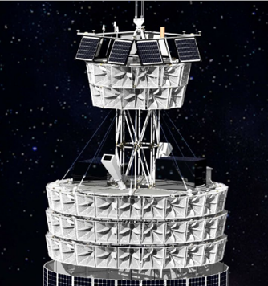
DAQ and Trigger
Sampling Unit for Radio Frequencies
Central component – RFSoC (x8 ADC at 3 Gsps) on SURF units
26 SURFs for MI+LF
  1 SURF covers 2 phi sectors/ 8 channels for each polarization
Precalculated beams using delay-and-sum.
Triggering Units for Radio Frequencies (TURF)
  Trigger threshold with multiple SURFs and coincident above-threshold overlapping beams

Slide 12
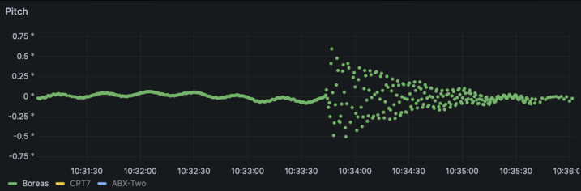
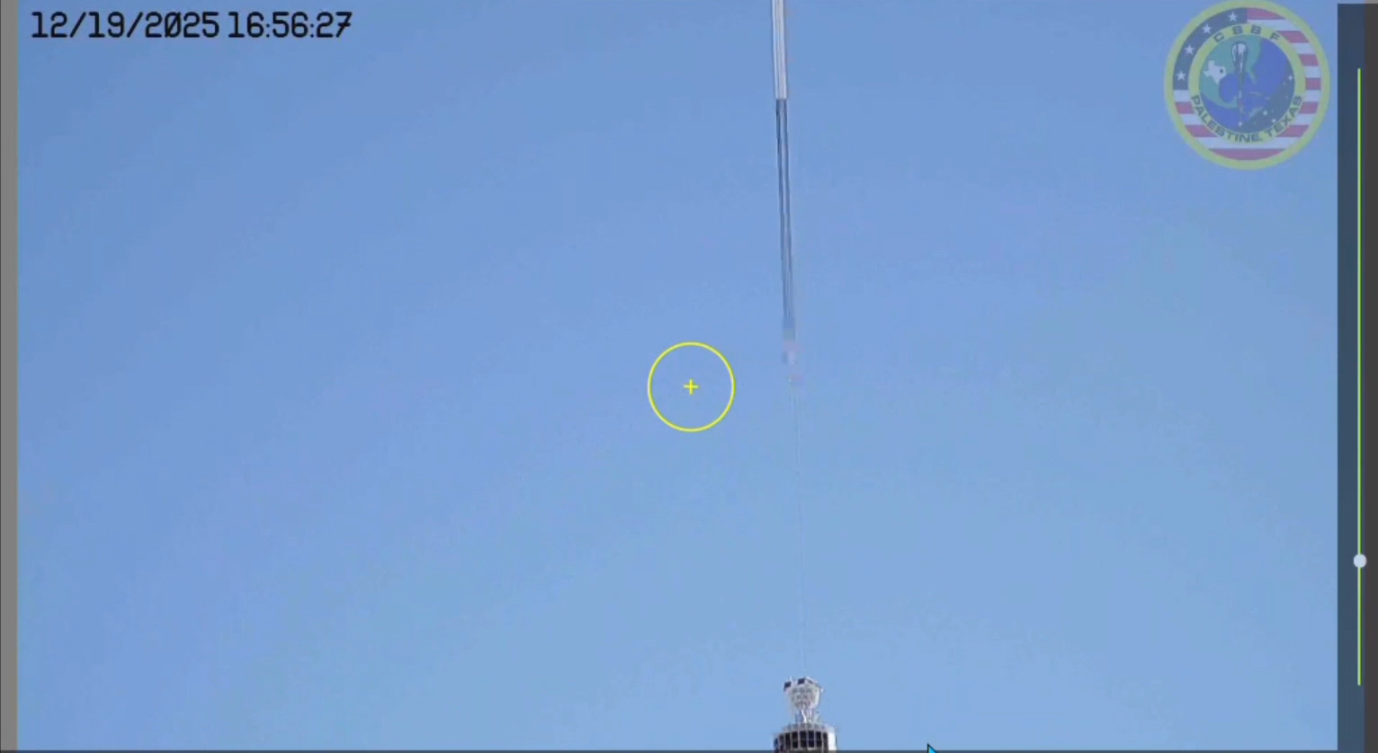
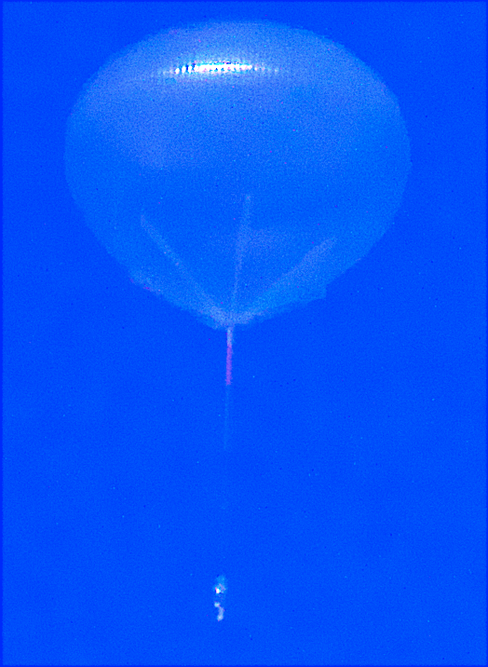
Deployables
The solar panels and sinuous antennas were deployed after launch due to launch envelope constraints (17.5meters)

Slide 13
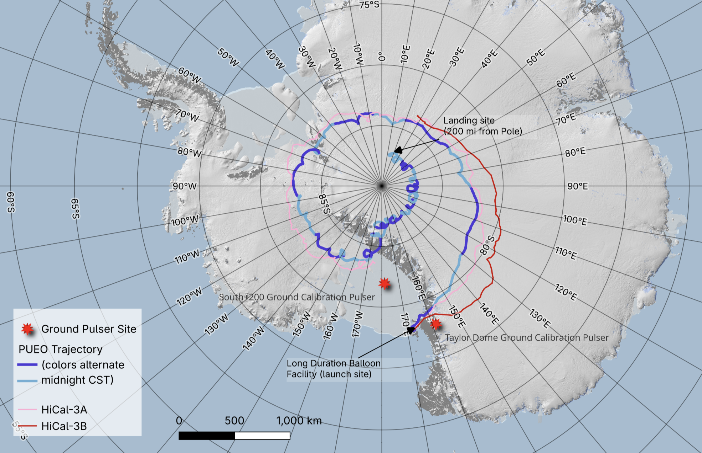
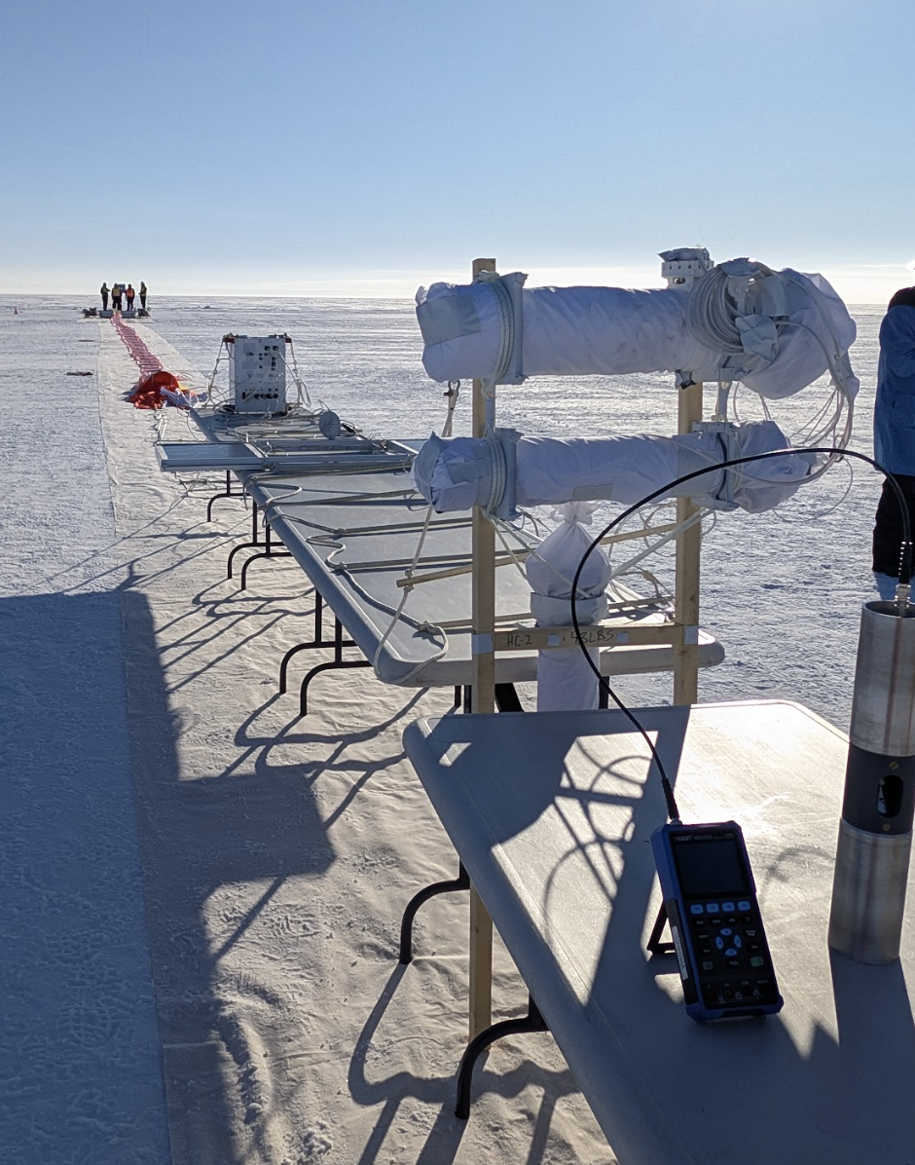
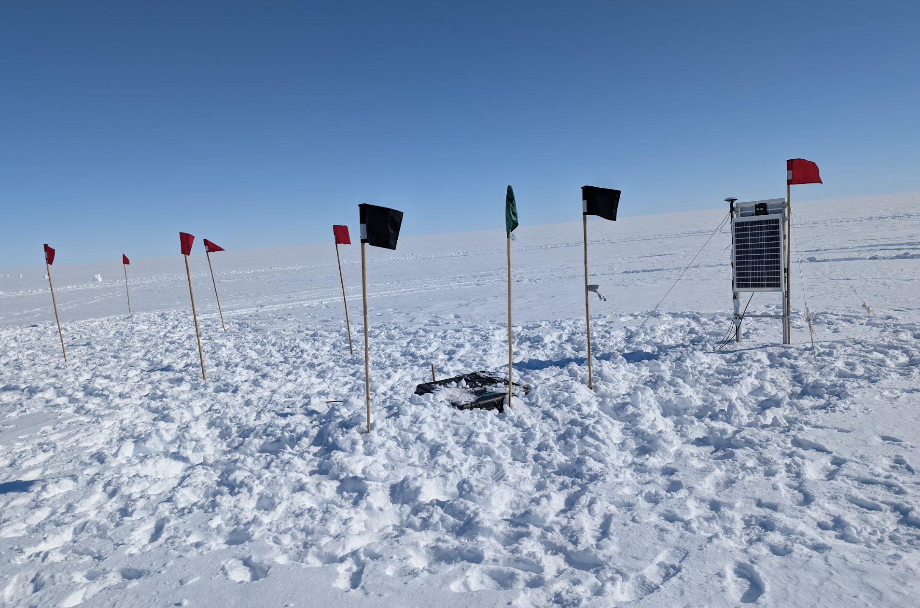
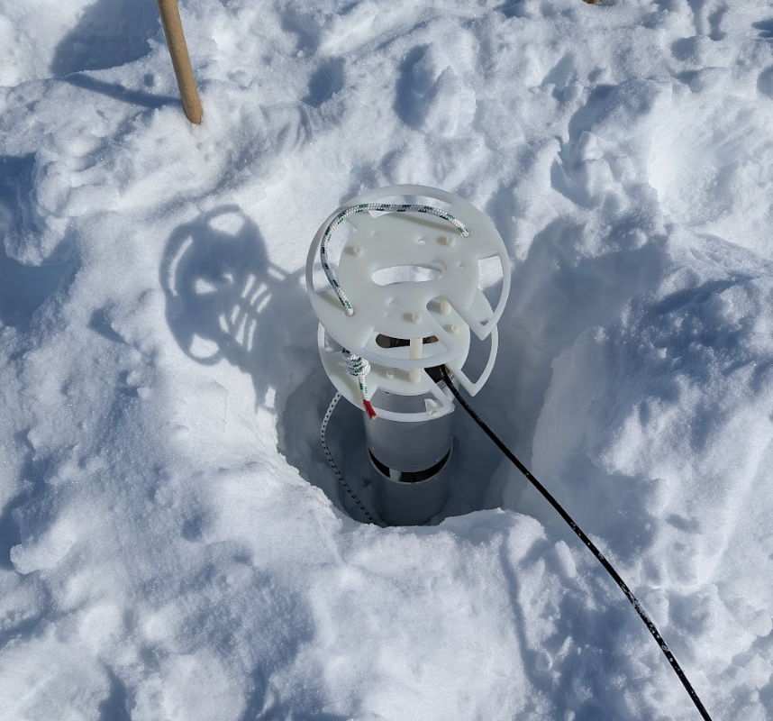
Flight path and ground calibration
Pulsed antennas to mimic neutrino signals
Useful for calibration and triggering studies
Both following, small balloon payloads and ground stations
Launched Dec 20th, 2025, 1st launch attempt!
Terminated January 12th, 2026
23 day flight
HiCal A on Launch Pad
S+200 ground pulsers

Slide 14
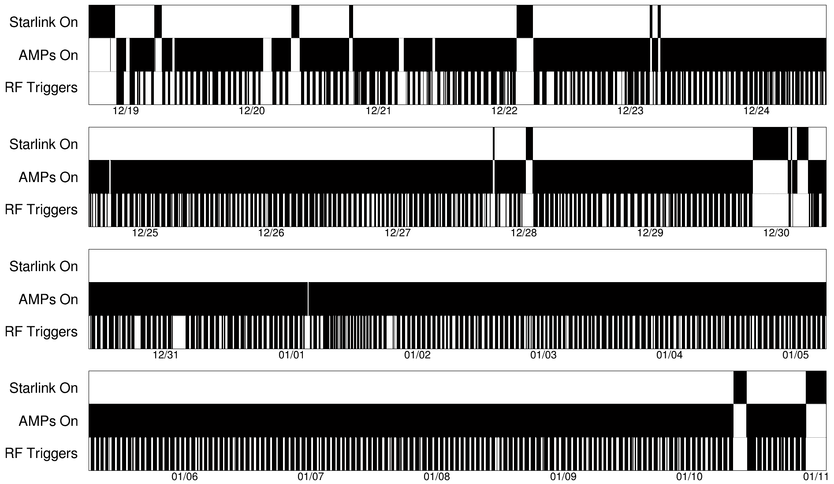
Telemetry and duty cycle
Achieved 10Mbps with LOS for first day after launch
Utilized Starlink Maritime unit
  Only when AMPAs are off
  In-lab testing showed very loud in-band emission
DAQ system much hotter than thermal vacuum testing had shown when at float

Slide 15
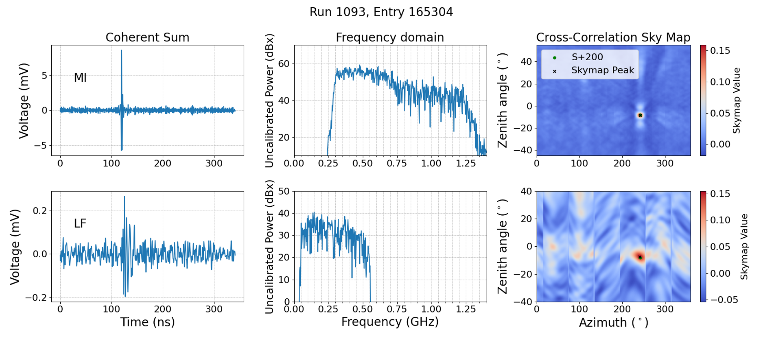
Ground Calibration Event Reconstruction
South+200 event identified by the subsecond (millisecond time offset after GPS pulse-per-second)
Cross-correlation map shows good pointing back to S+200 site!
S+200 ground calibration event

Slide 16
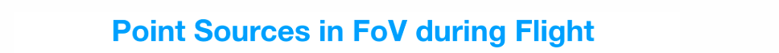
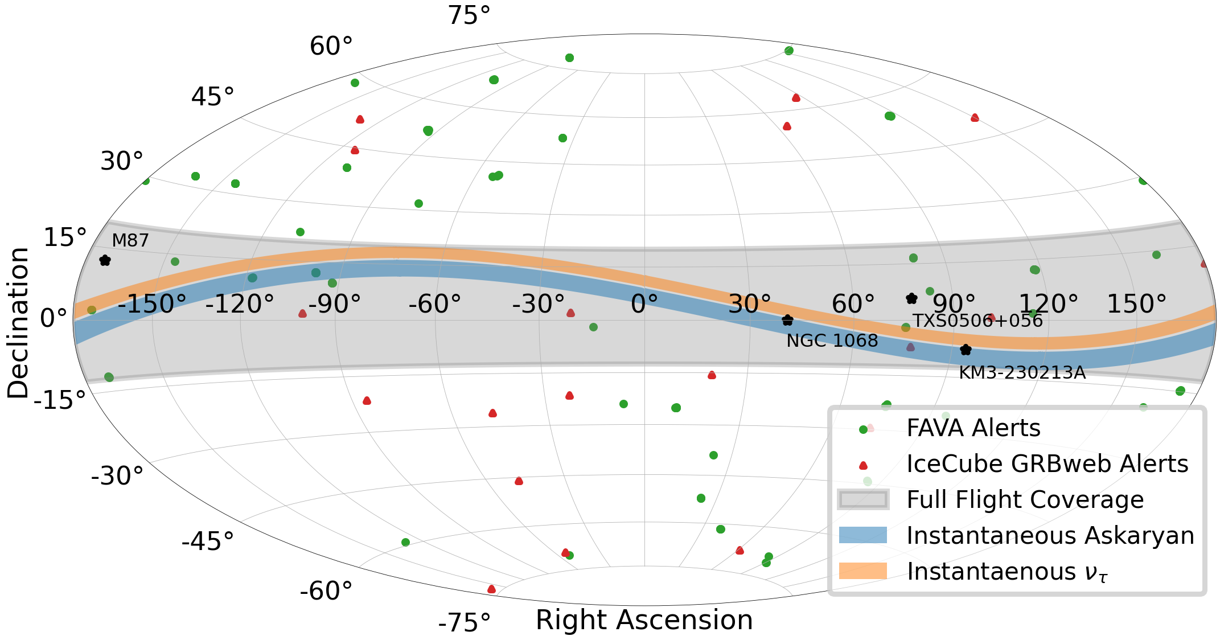
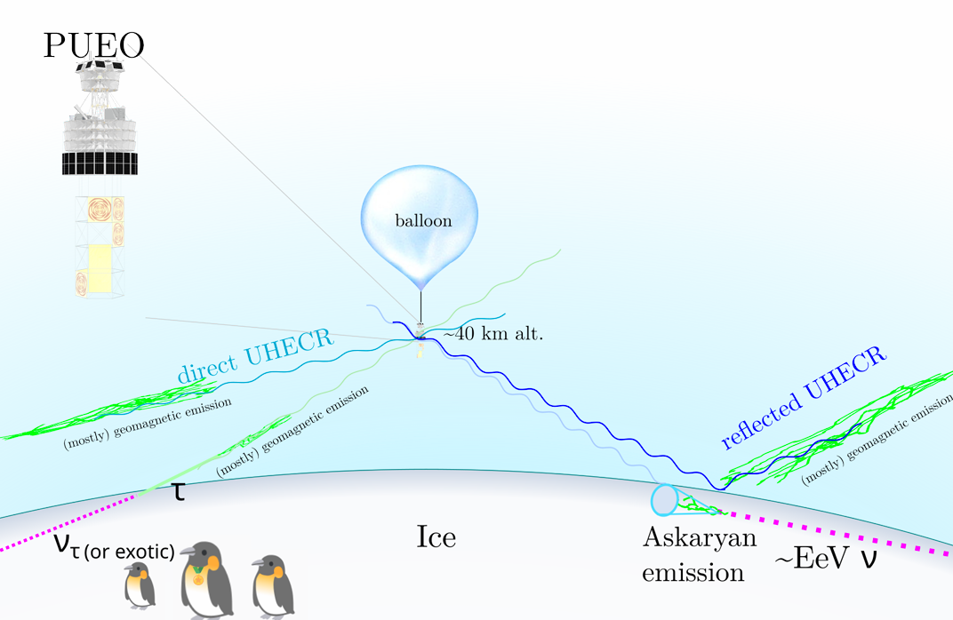
Outlook
Credit J. Flaherty
More than 110 million RF triggered events
  > 55TB of data
Point source searches
Diffuse neutrino search
  Early next year
Extensive Air Showers
Ice radio-reflectivity measurements with HiCal
→ Stay tuned!

Slide 17
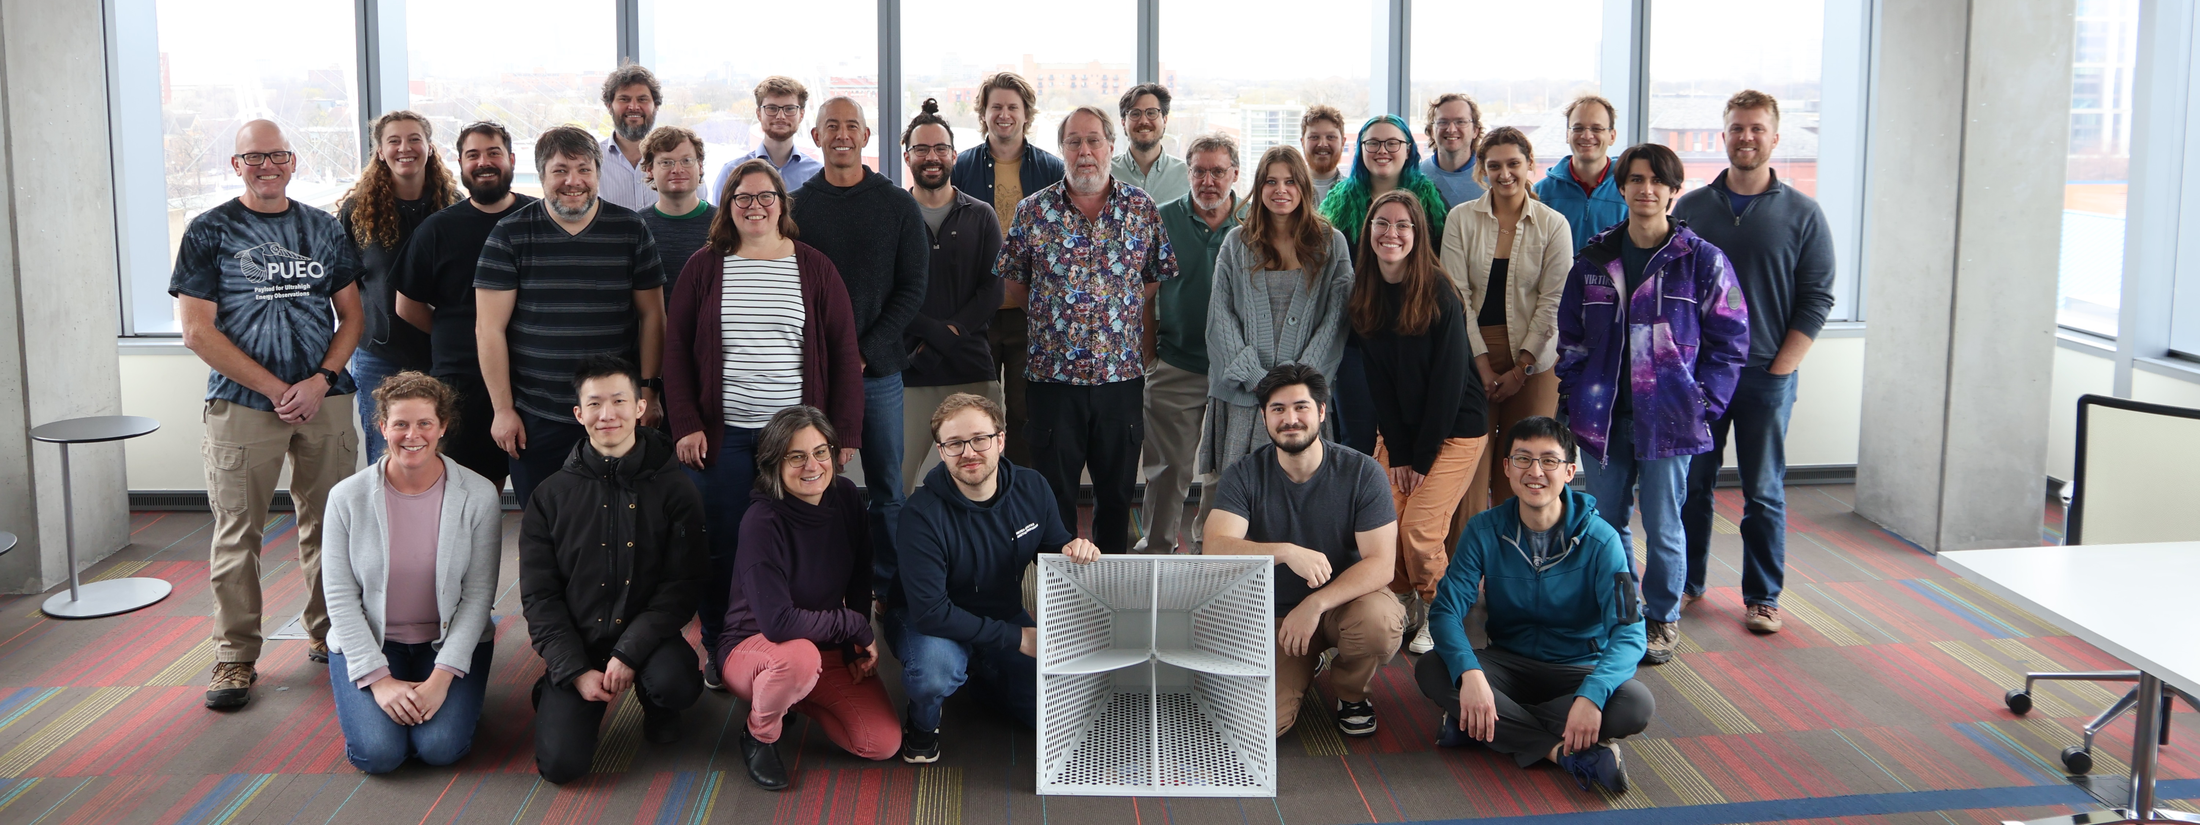

Thank you!
We gratefully acknowledge NASA Awards
#80NSSC20K0775 and #80NSSC20K0925

Slide 18
Backup

Slide 19
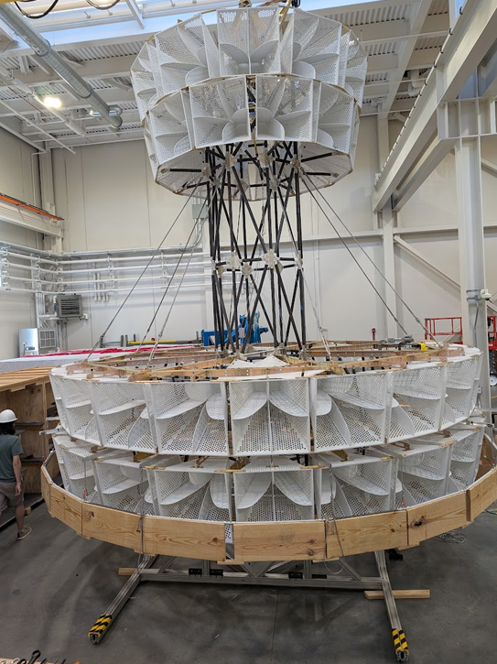
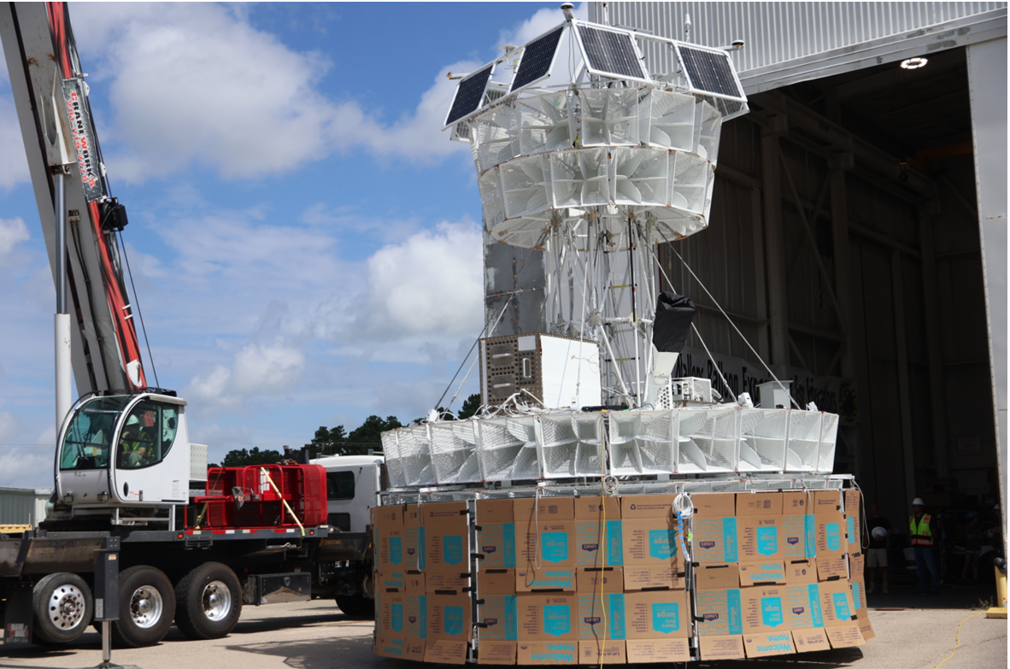
Assembling (and Disassembling) PUEO
U. Chicago high bay
  Construct the full gondola and attach antennas
Take it apart and build it again in Palestine, TX for hang test with CSBF+NASA
Take it apart and build it again on the Ross Ice Shelf in Antarctica
  Then launch it

Slide 20
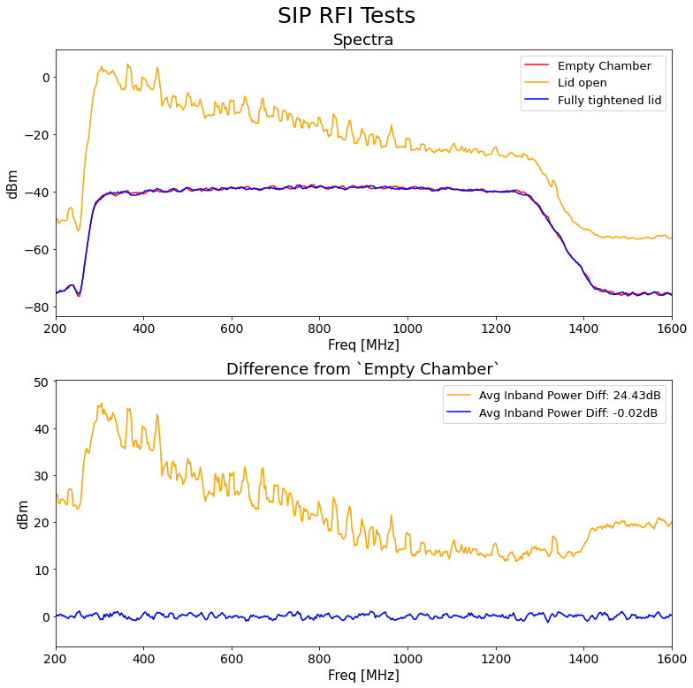
On Ice Testing Preflight
RF-sealed tent to qualify electronic enclosures
Custom-designed Beamforming Test System (BTS)
Delay-tunable 16-channel “Askaryan-like” radio pulses

Slide 21
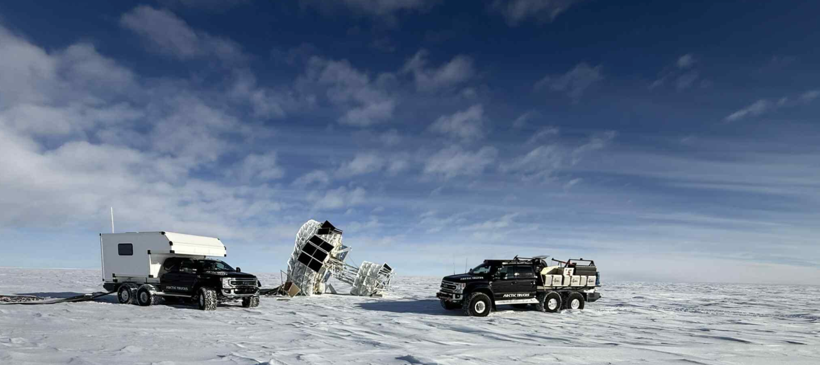
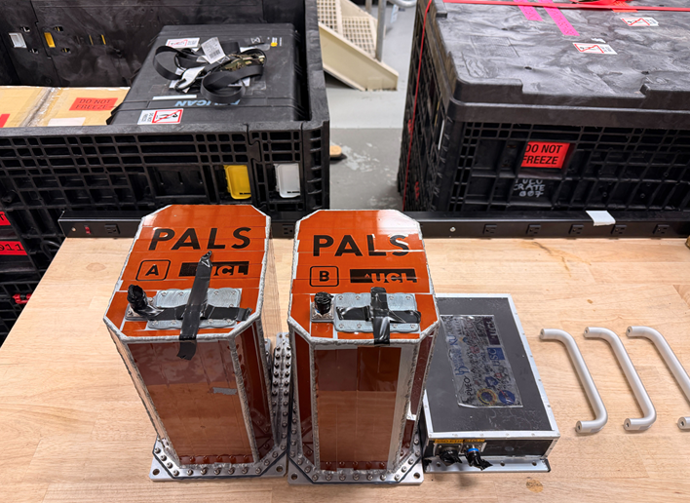
Termination and recovery
A significant amount of time epicycling near Pole
Opted for termination to have same-season recovery
  Arctic trucks made recovery very smooth
Over 55TB of data collected
  Triply redundant storage
  Over 120 Million RF-triggered events
Data storage vaults

Slide 22
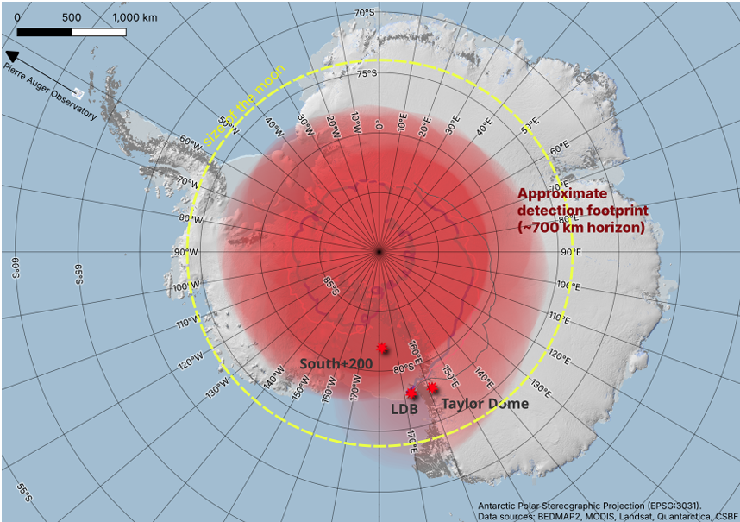

Slide 23
