Slide 1
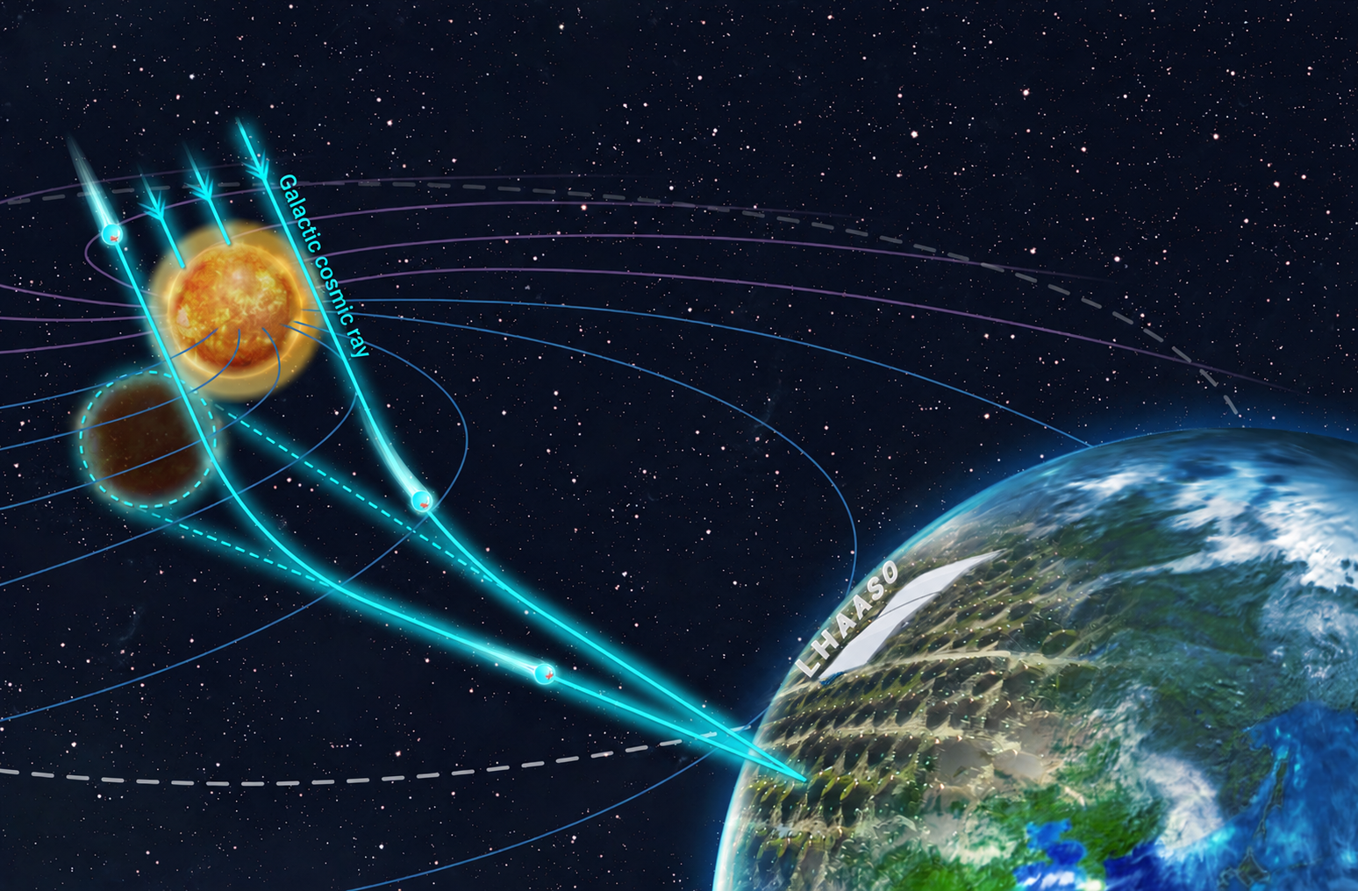


Time-Dependent Modeling of the TeV Cosmic-Ray Solar Shadow
Dylan M.H. Leung, John Beacom, Jung Tsung Li, Annika Peter
The Ohio State University
Center for Cosmology and AstroParticle Physics (CCAPP)
https://doi.org/10.1016/j.xinn.2024.100695 (AI-Edited)

Slide 2
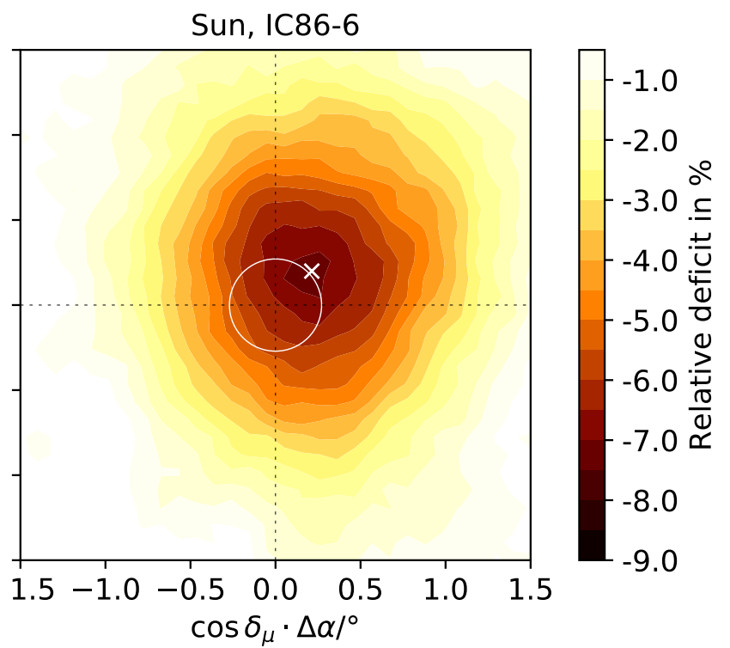
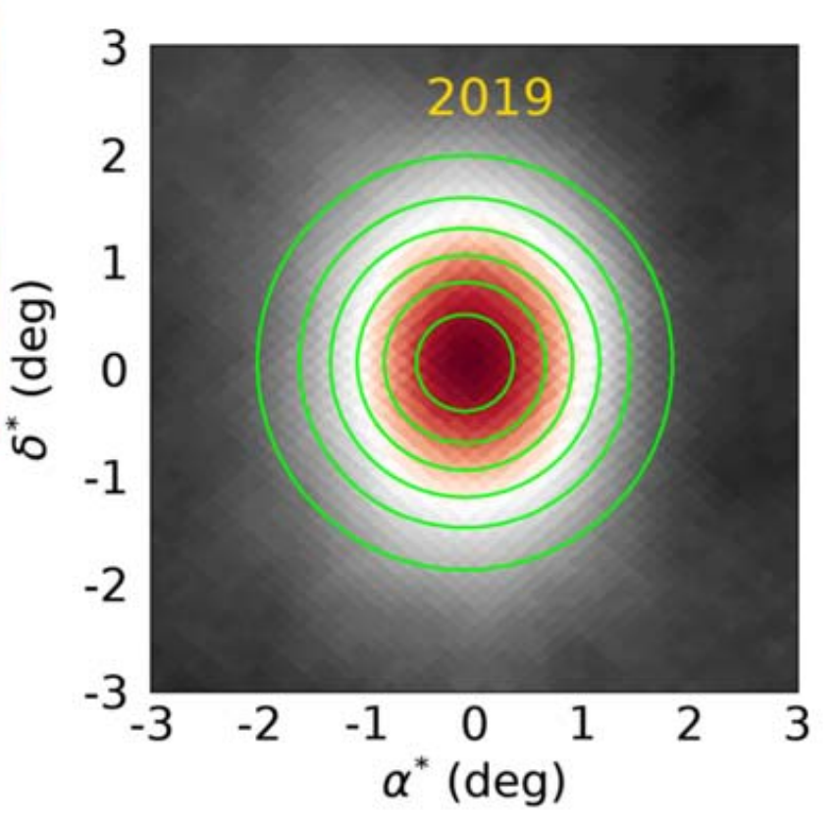
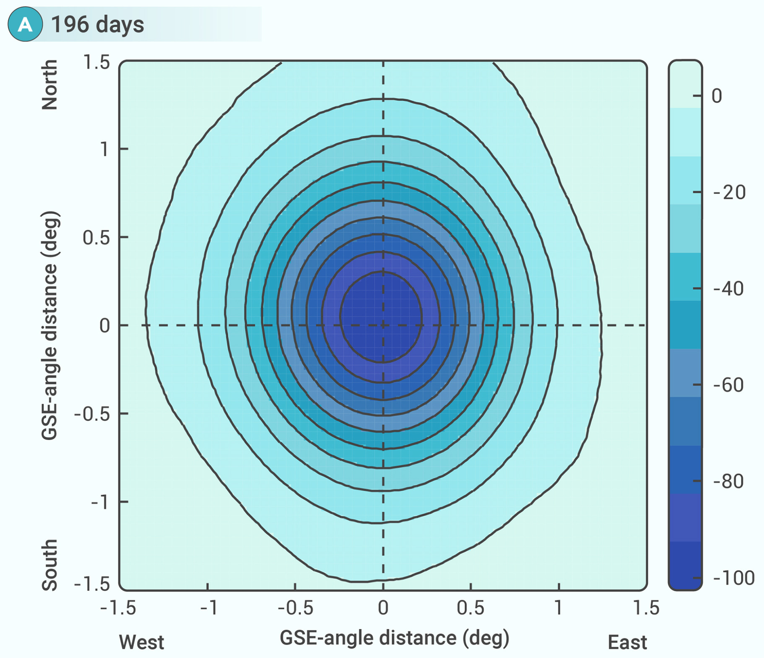
Solar shadow observations
IceCube 2016 (4 months)
HAWC 2019 (1 year)
LHAASO 2021 (196 days)
2006.16298
DOI 10.3847/1538-4357/ad3208
DOI: 10.1016/j.xinn.2024.100695

Slide 3
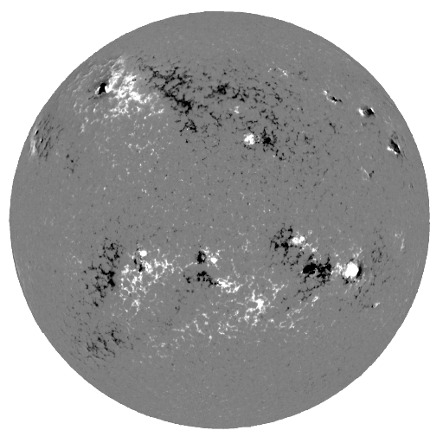
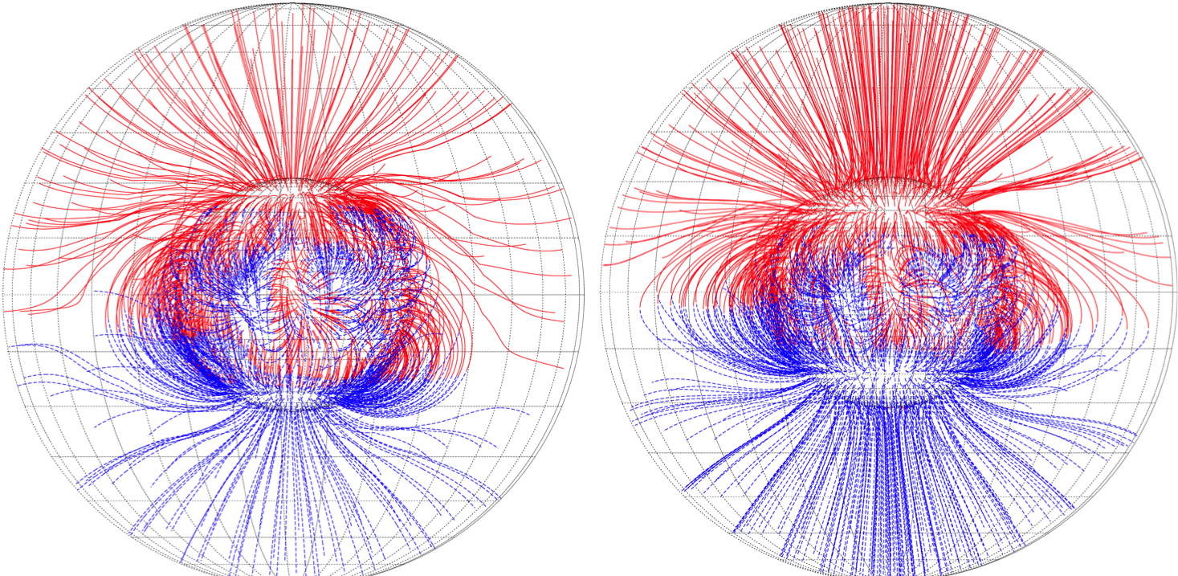
Coronal field modeling
Observation
Model
J ≠ 0
(current included)
J = 0
(current free)
CSSS
PFSS
Physics calculation
jhelioviewer.org
1306.3009​
Photospheric magnetogram
(Observed through Zeeman effect)
Coronal field
(Extrapolate with different physics assumption)
No direct way to measure the coronal field

Slide 4
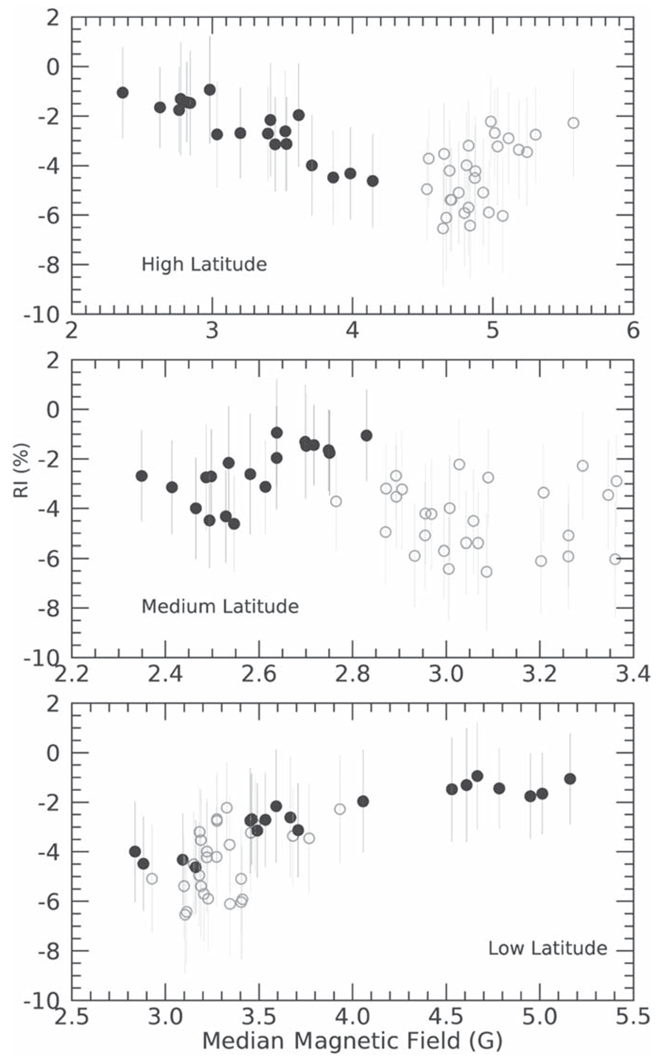
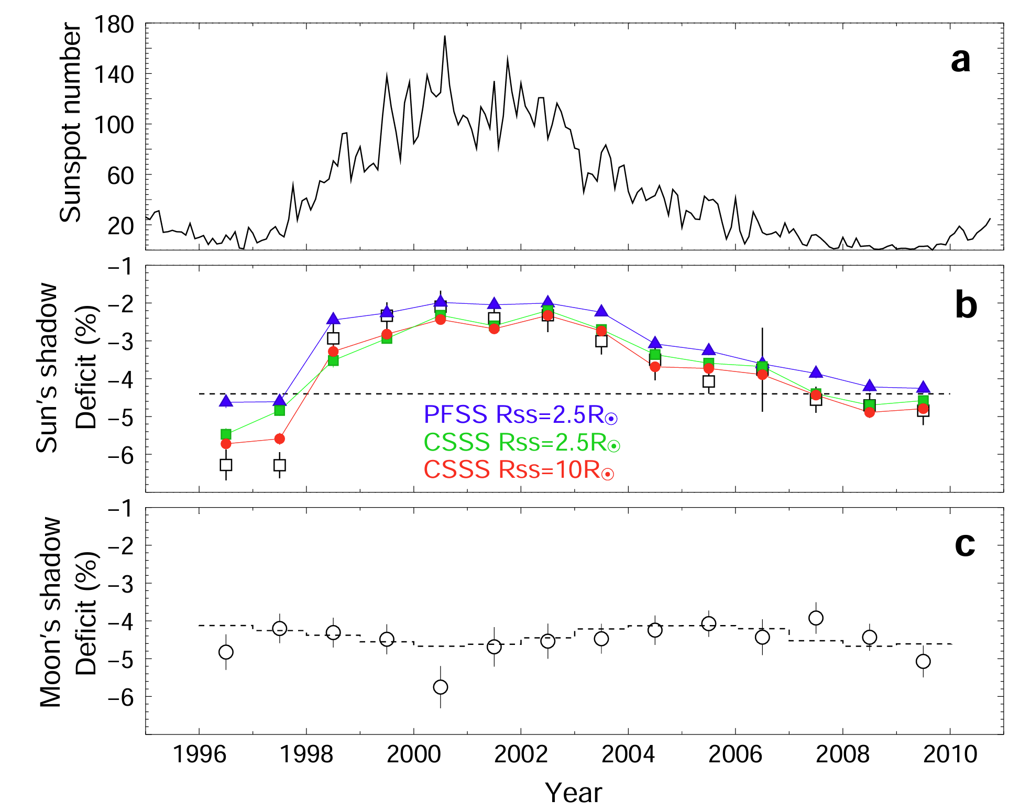

Correlation of coronal field and shadow depth
1306.3009
DOI 10.3847/1538-4357/ad3208
Anticorrelation of solar activity (Sunspot number) and central depth
CSSS model better produce the central depth variation than PFSS
Deficit and photospheric field magnitude correlation is latitude dependent

Slide 5
Make use of shadow morphology instead of depth

Slide 6
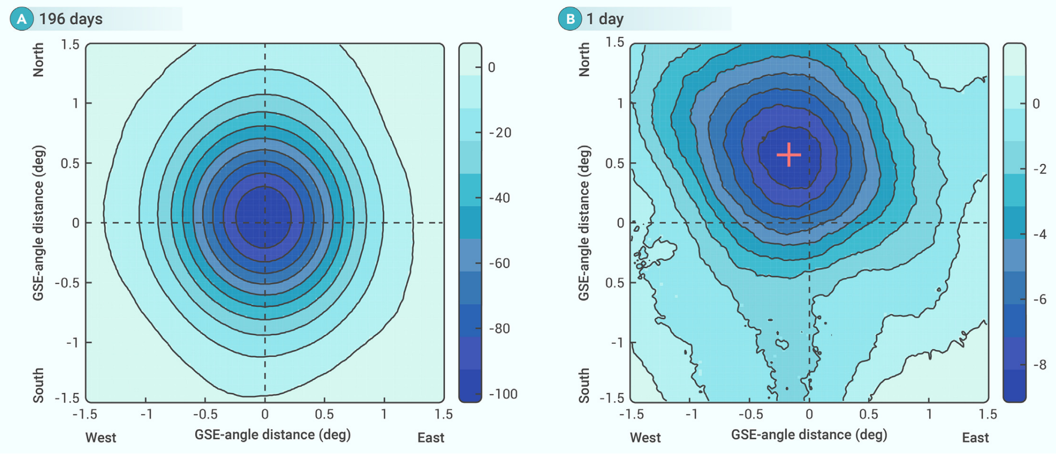
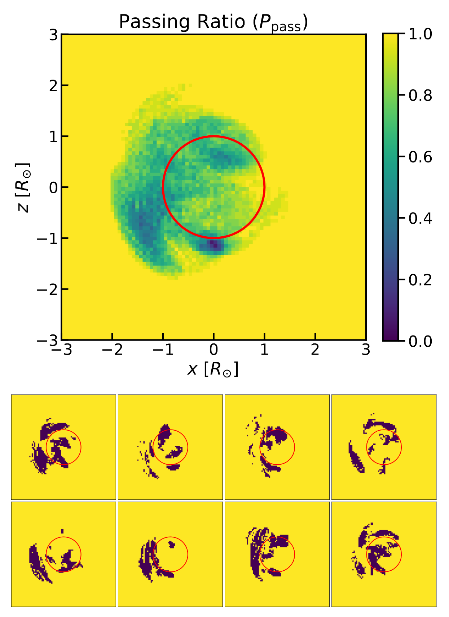
We need to focus on short exposure time
Shadow morphology
Daily shadow first reported by LHAASO
Month averaged shadow
Daily shadow
(LHAASO 2024)
More irregular, less symmetric,
shape evolve with the rotation of the Sun
Might contain useful information of the underlying B field

Slide 7
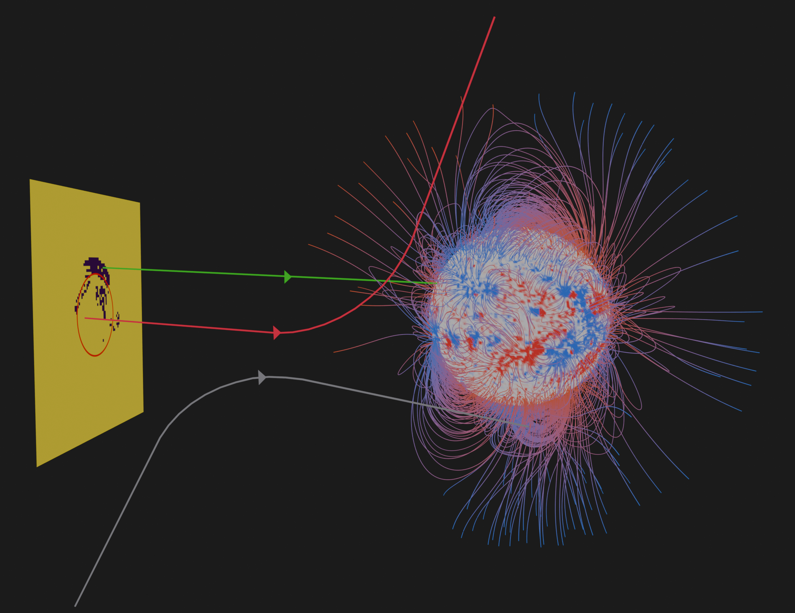

Back tracing simulation
Off trajectory registered as shadow off region
Negative proton shoot horizontally from the plane
The Sun do not rotate during the simulation
Hit trajectory registered as shadow on region
Observer plane
Backward time​
All trajectories that never reach the plane was not simulated

Slide 8
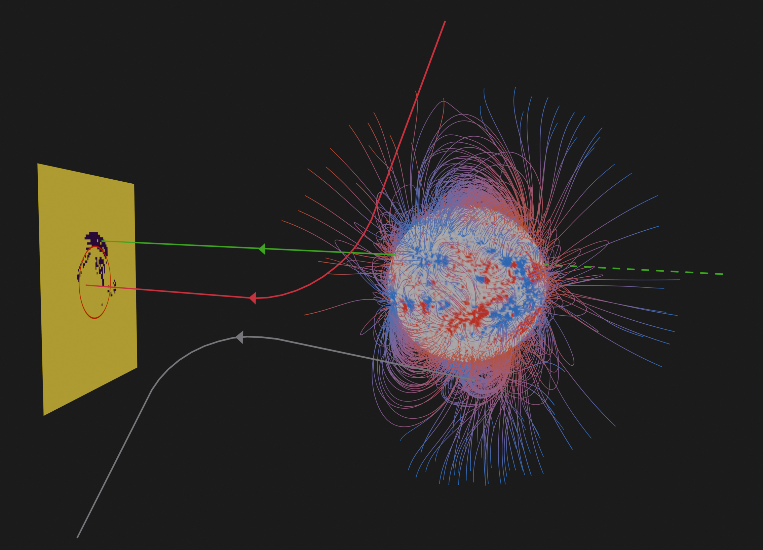
Back tracing simulation
Proton coming from infinity bend and reach the observer plane (shadow off)
Proton that reach the plane from every possible directions
Proton coming from the sun mean it is being blocked (shadow on)
Observer plane
Forward time​
All trajectories that never reach the plane was not simulated

Slide 9
Shadow of multipole expansion field

Slide 10
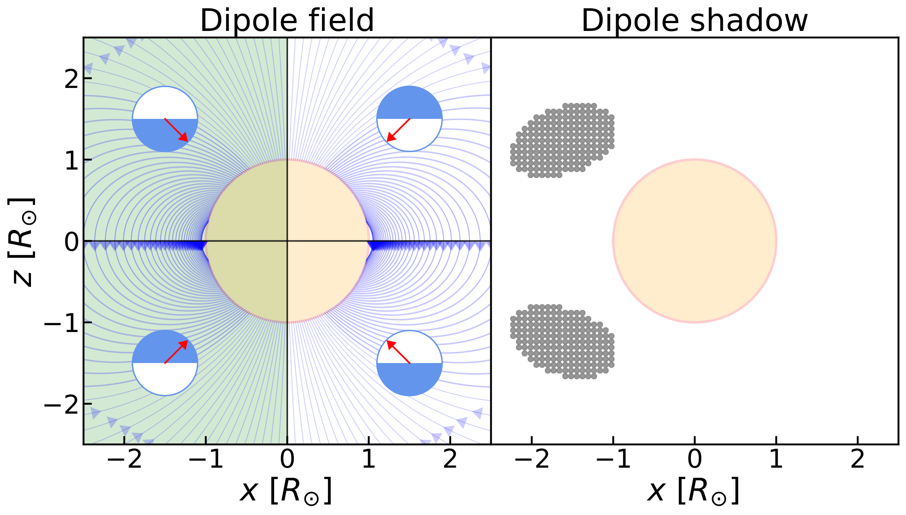
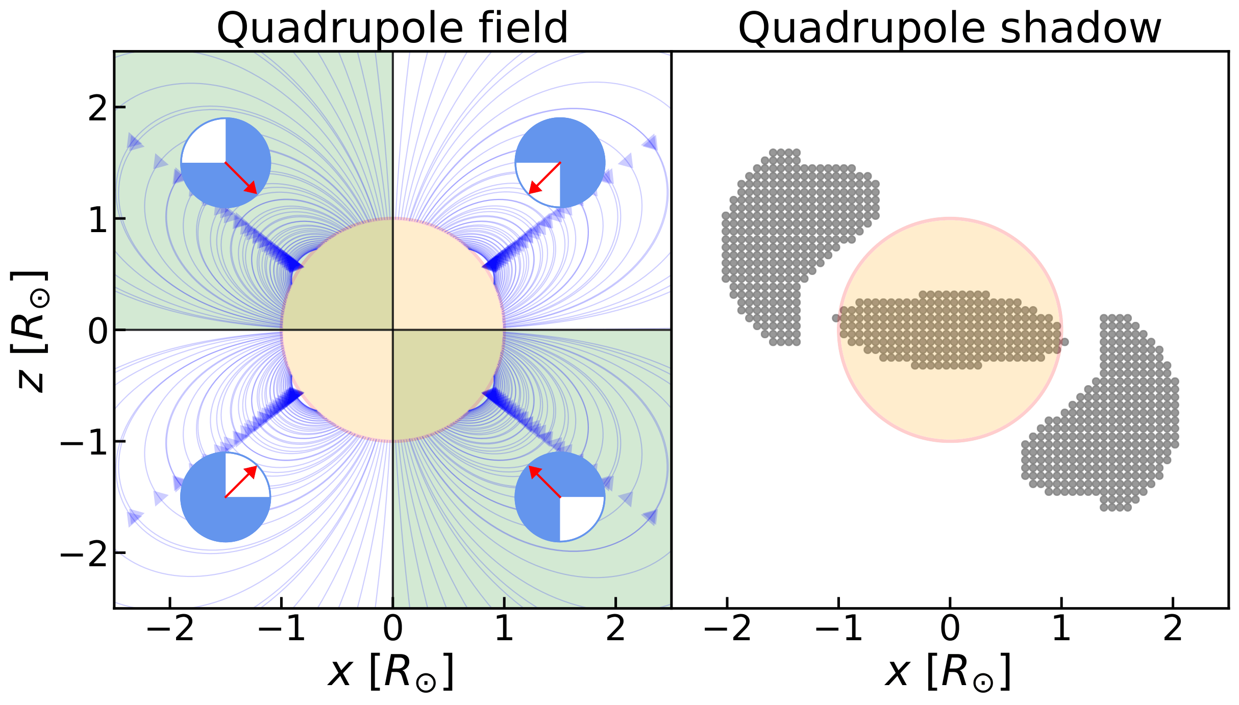
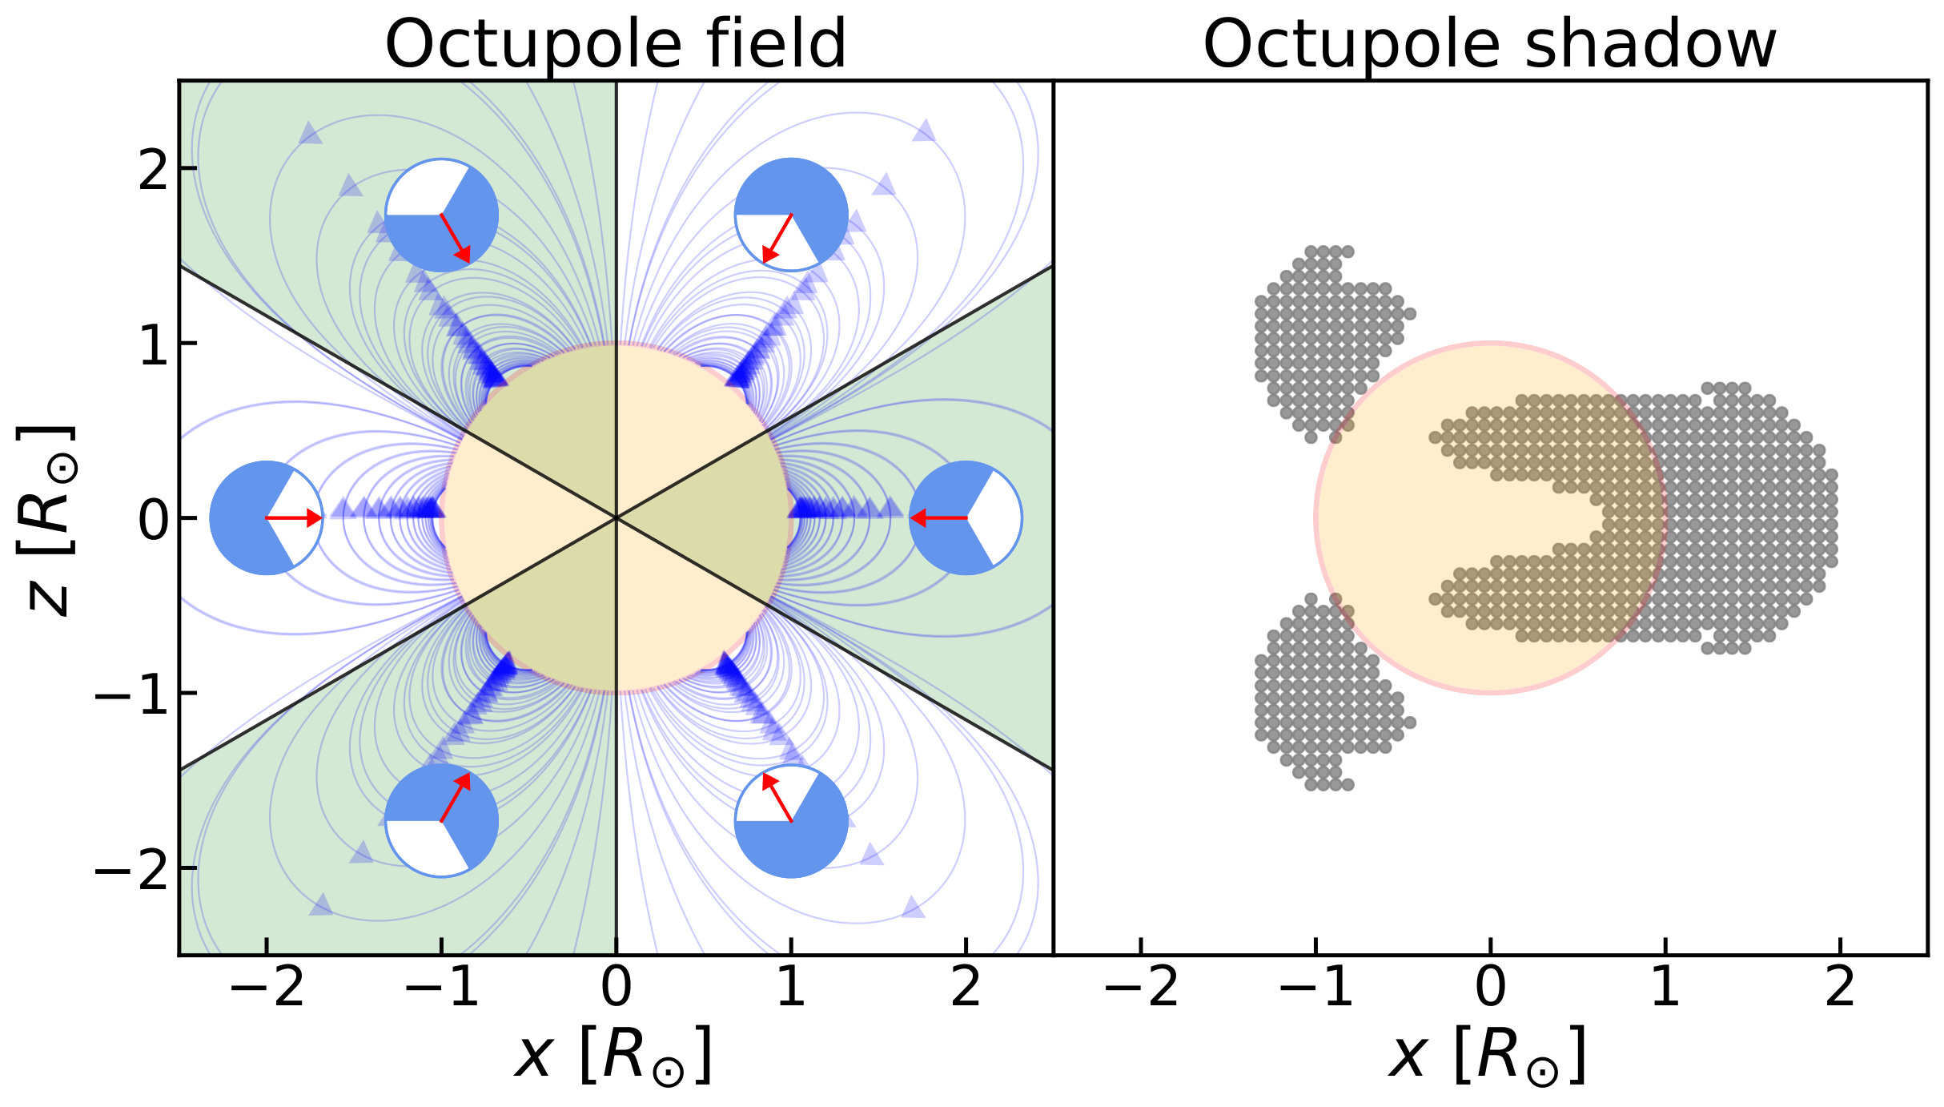
Multipole expansion field
In each sector:
Overlap → Shadow On
Set of Lorentz force direction in the sector
Force pointing to the center​
​
Shadow shape have to do with the coronal field topology !

Slide 11
Shadow of PFSS field

Slide 12
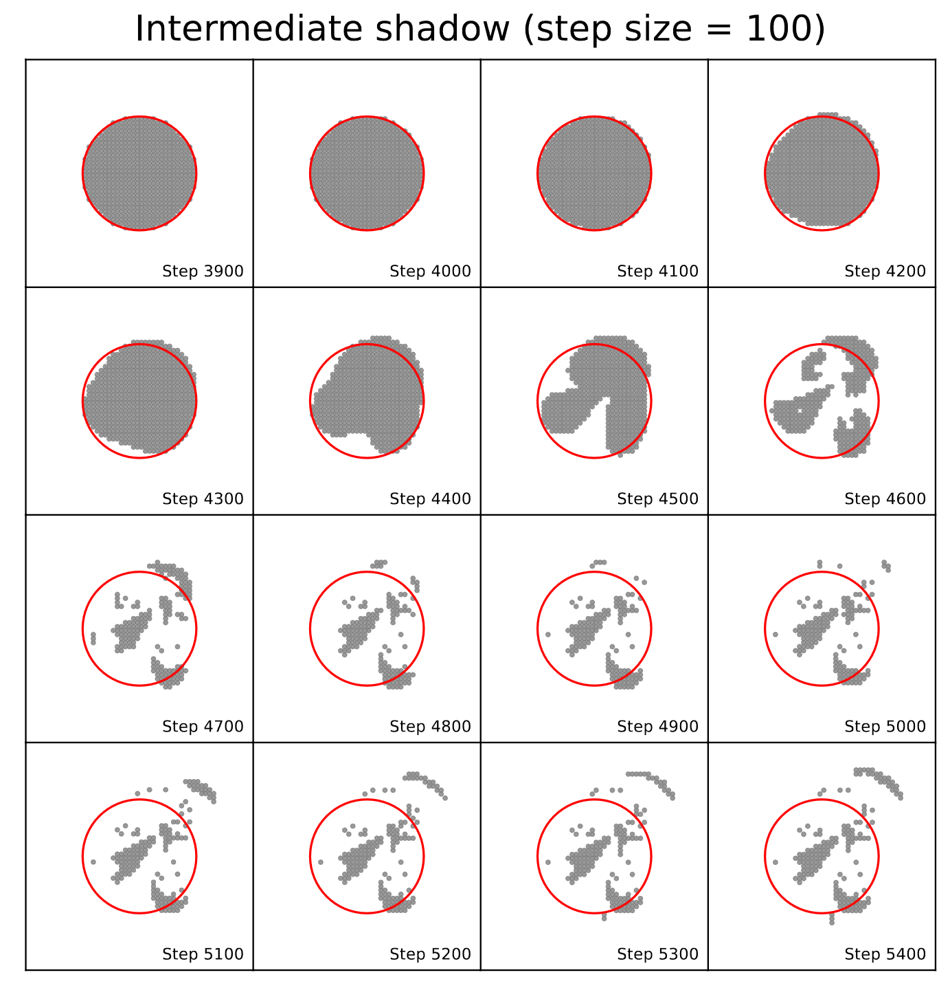
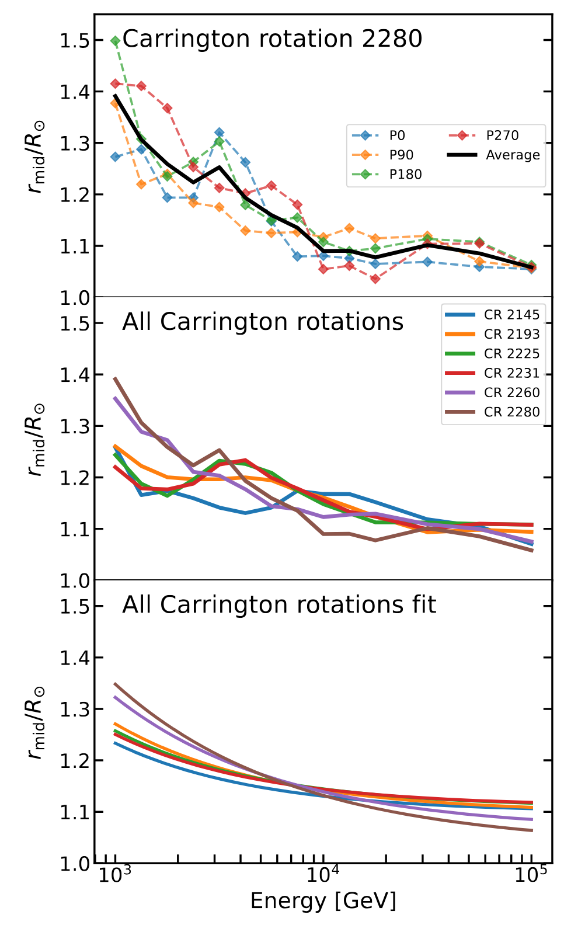
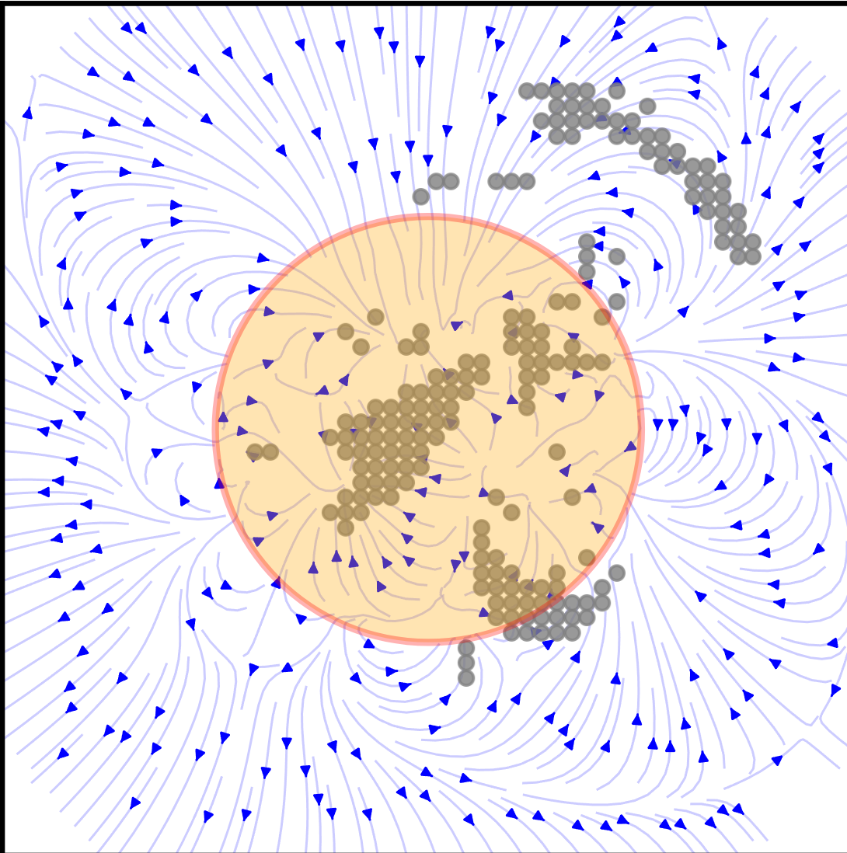
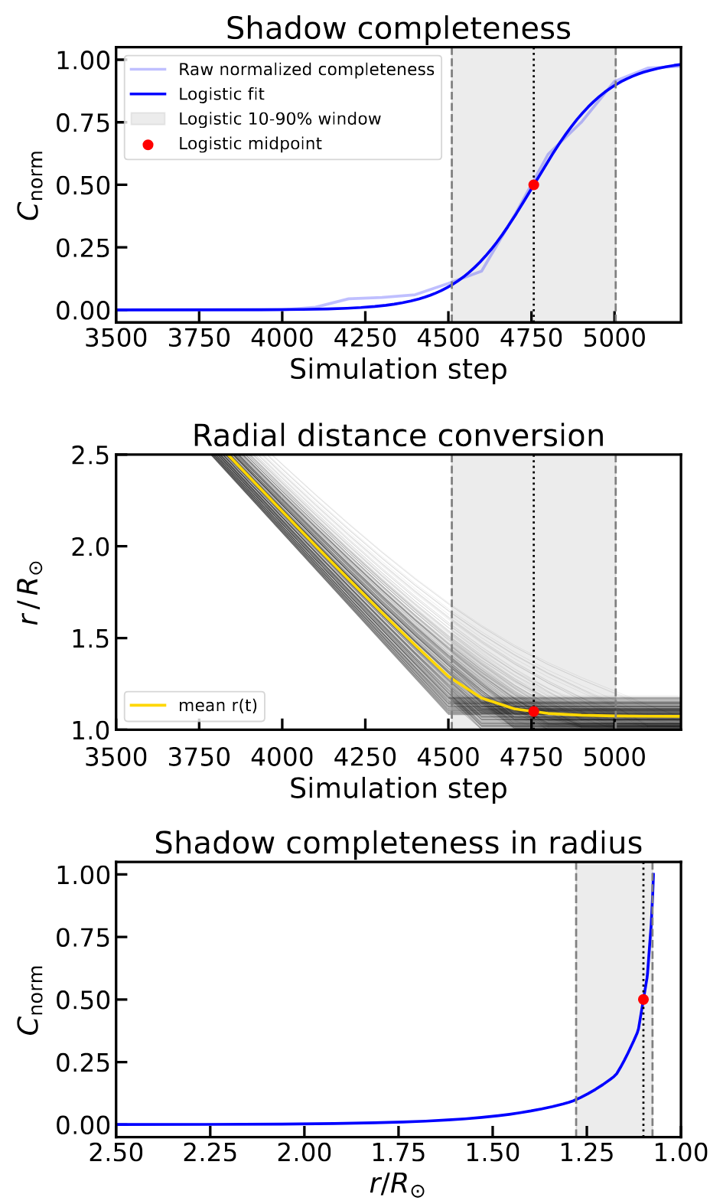

Where the shadow is formed
Carrington rotation 2280, 7.5 TeV
Carrington rotation 2145 – 2280, 1 – 100 TeV
Trak the shadow evolution during the simulation
Repeat for all energy and Carrington rotation
Intermediate
Final
Determine the characteristic distance of shadow formation
$$r_{mid}$$
Shadow forming distance
>TeV shadow mainly form within the 1.05 - 1.35 R☉ region

Slide 13
Correlation of the PFSS field and the shadow shape?

Slide 14
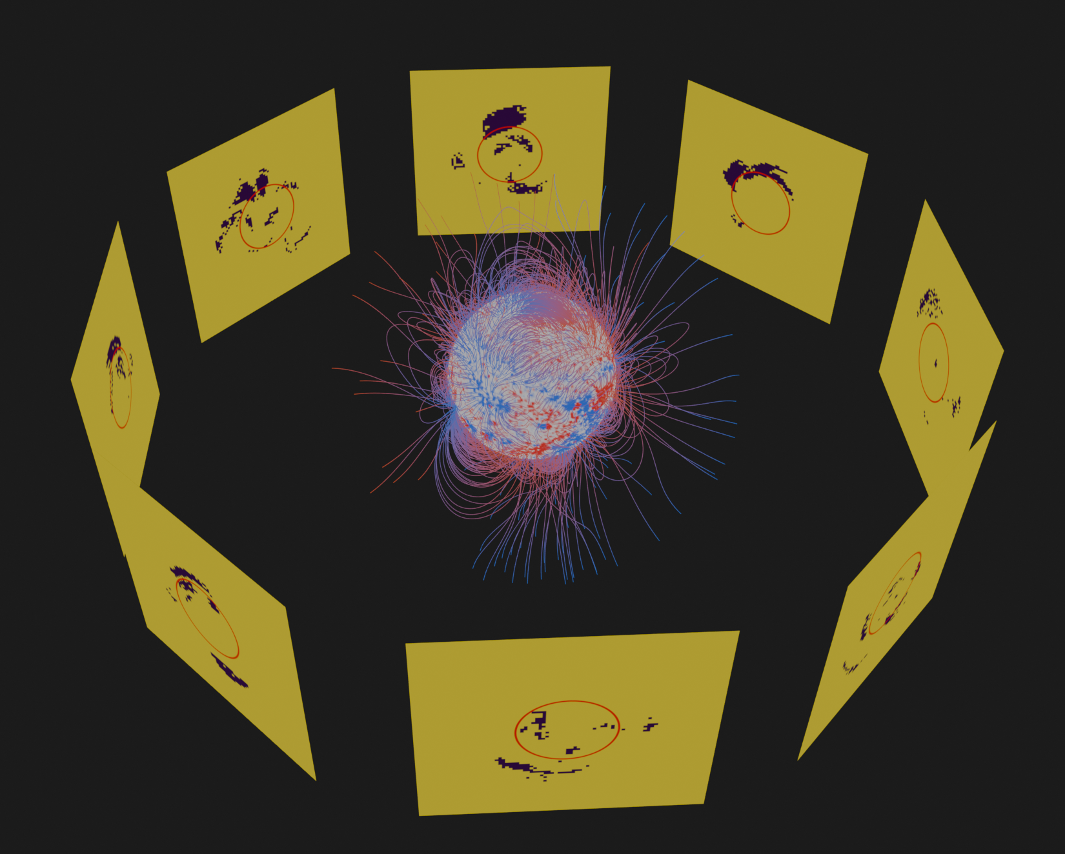
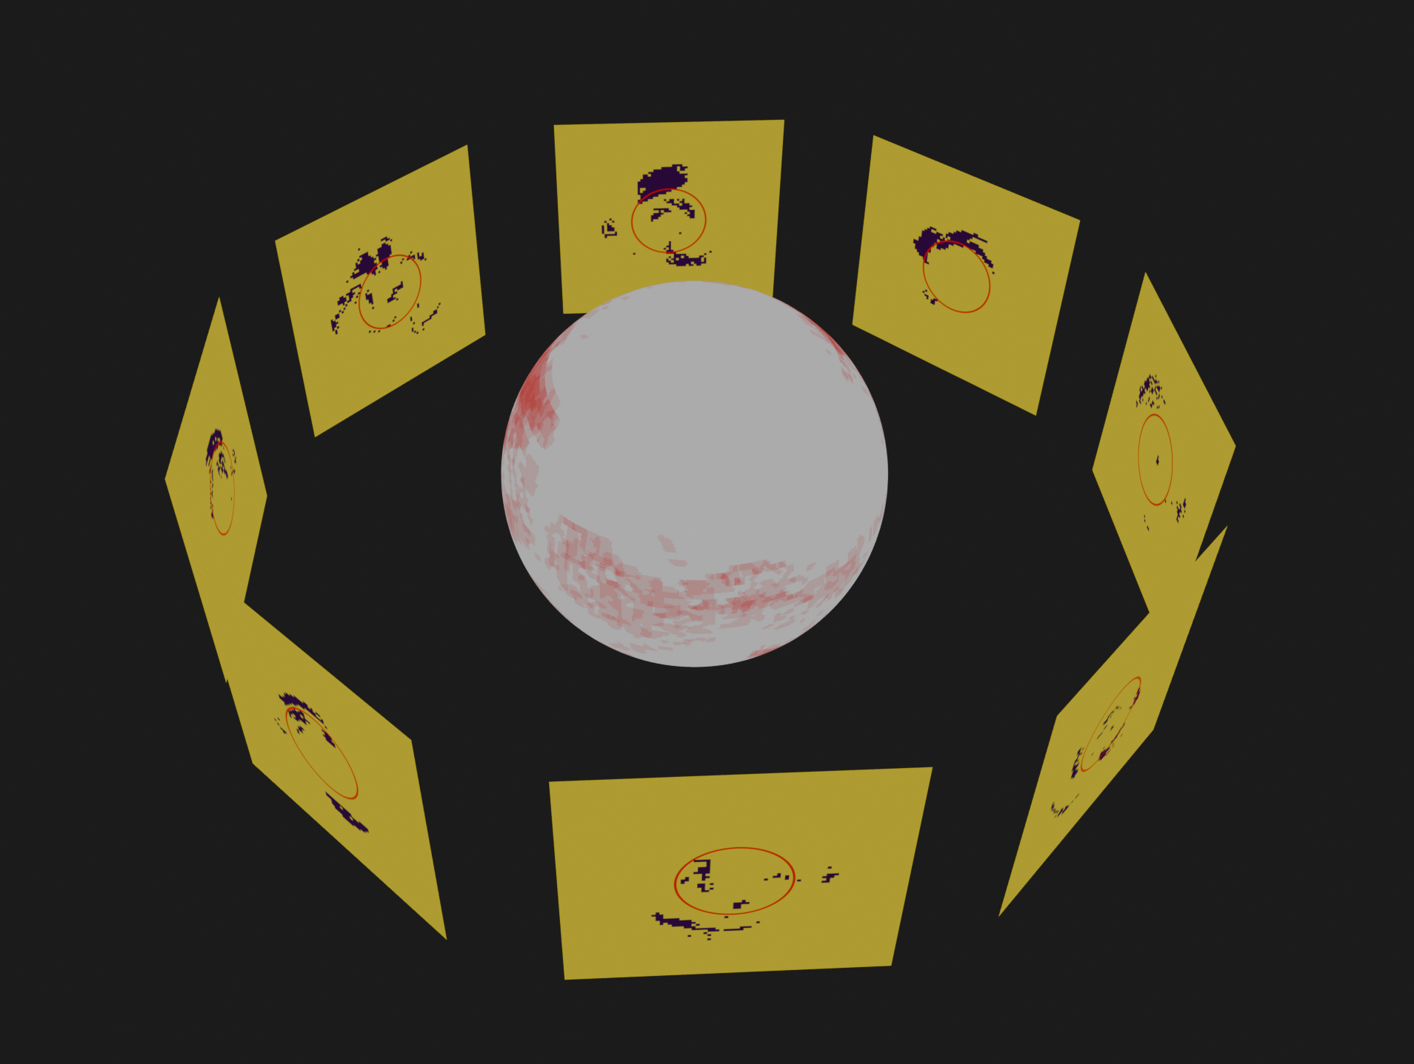
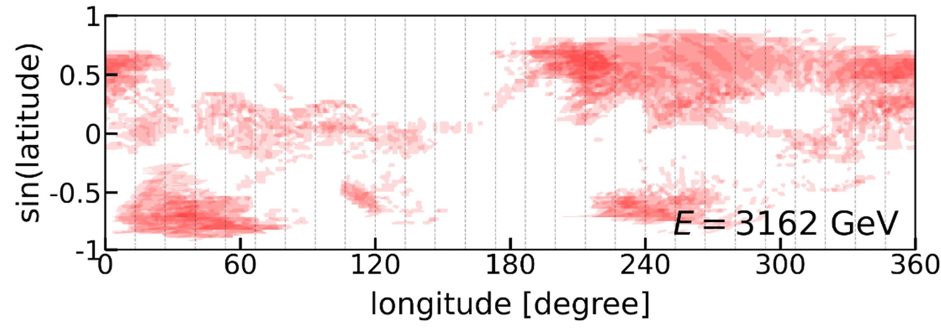
Global shadow map
Individual shadow is projected on the same sphere surface to form a global shadow map
Individual shadow is collected at different facing angle of the Sun
Assuming coronal field is static in a single Carrington rotation (27 days)

Slide 15
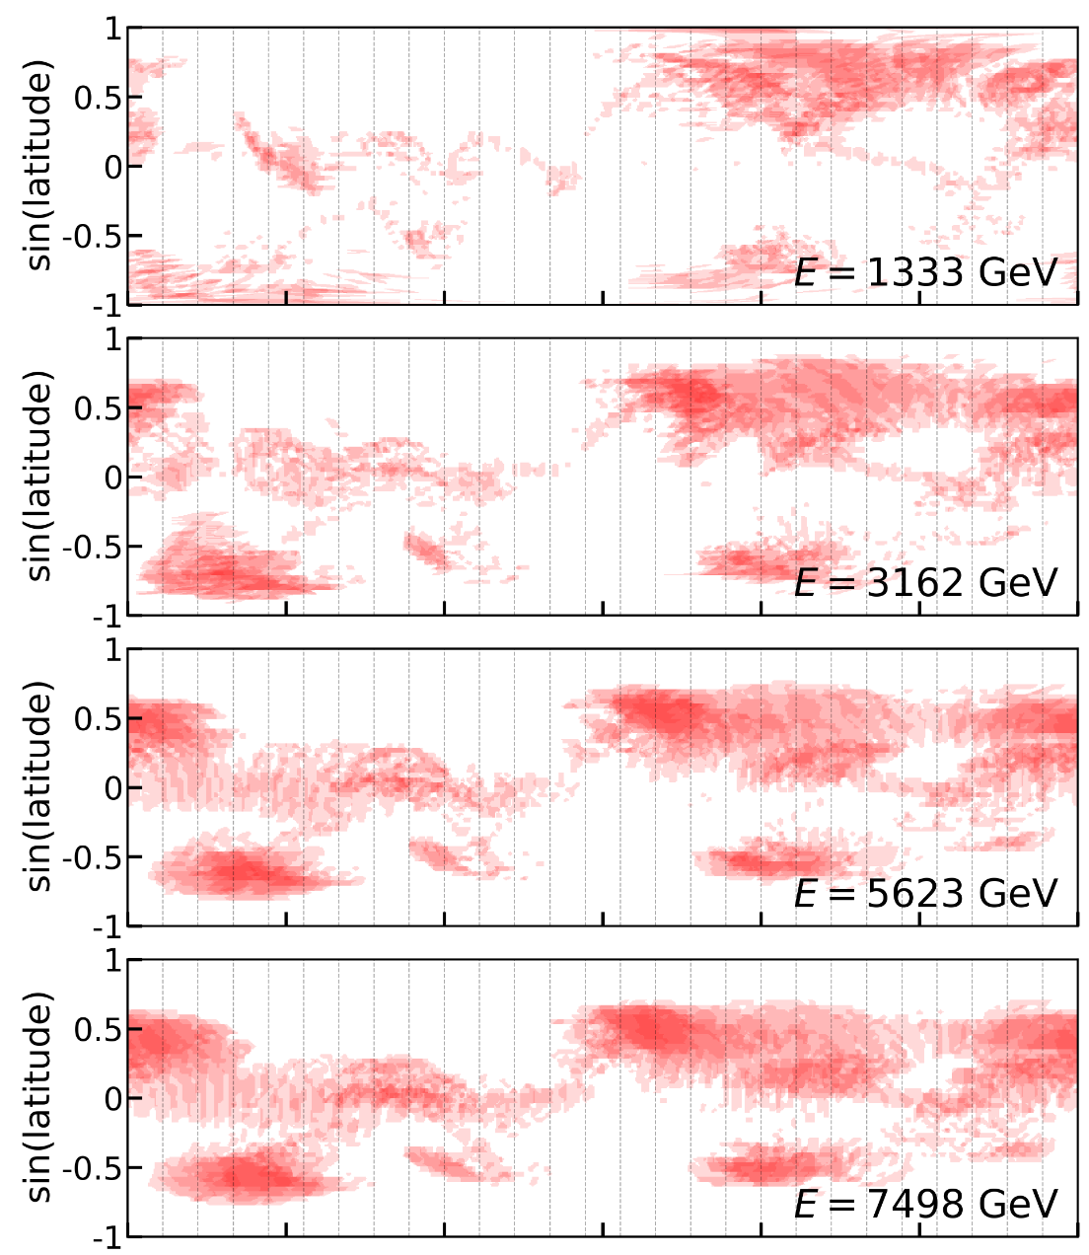
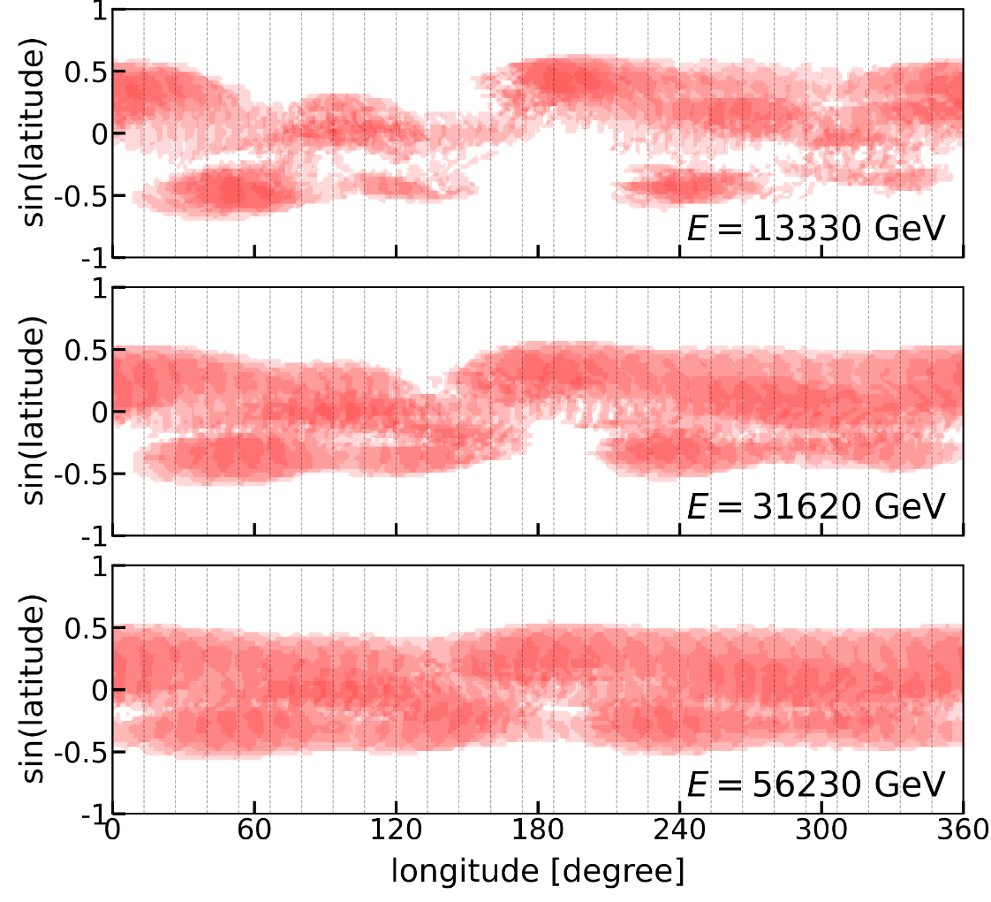
Global shadow map (CarRot 2145)
Sun

Slide 16
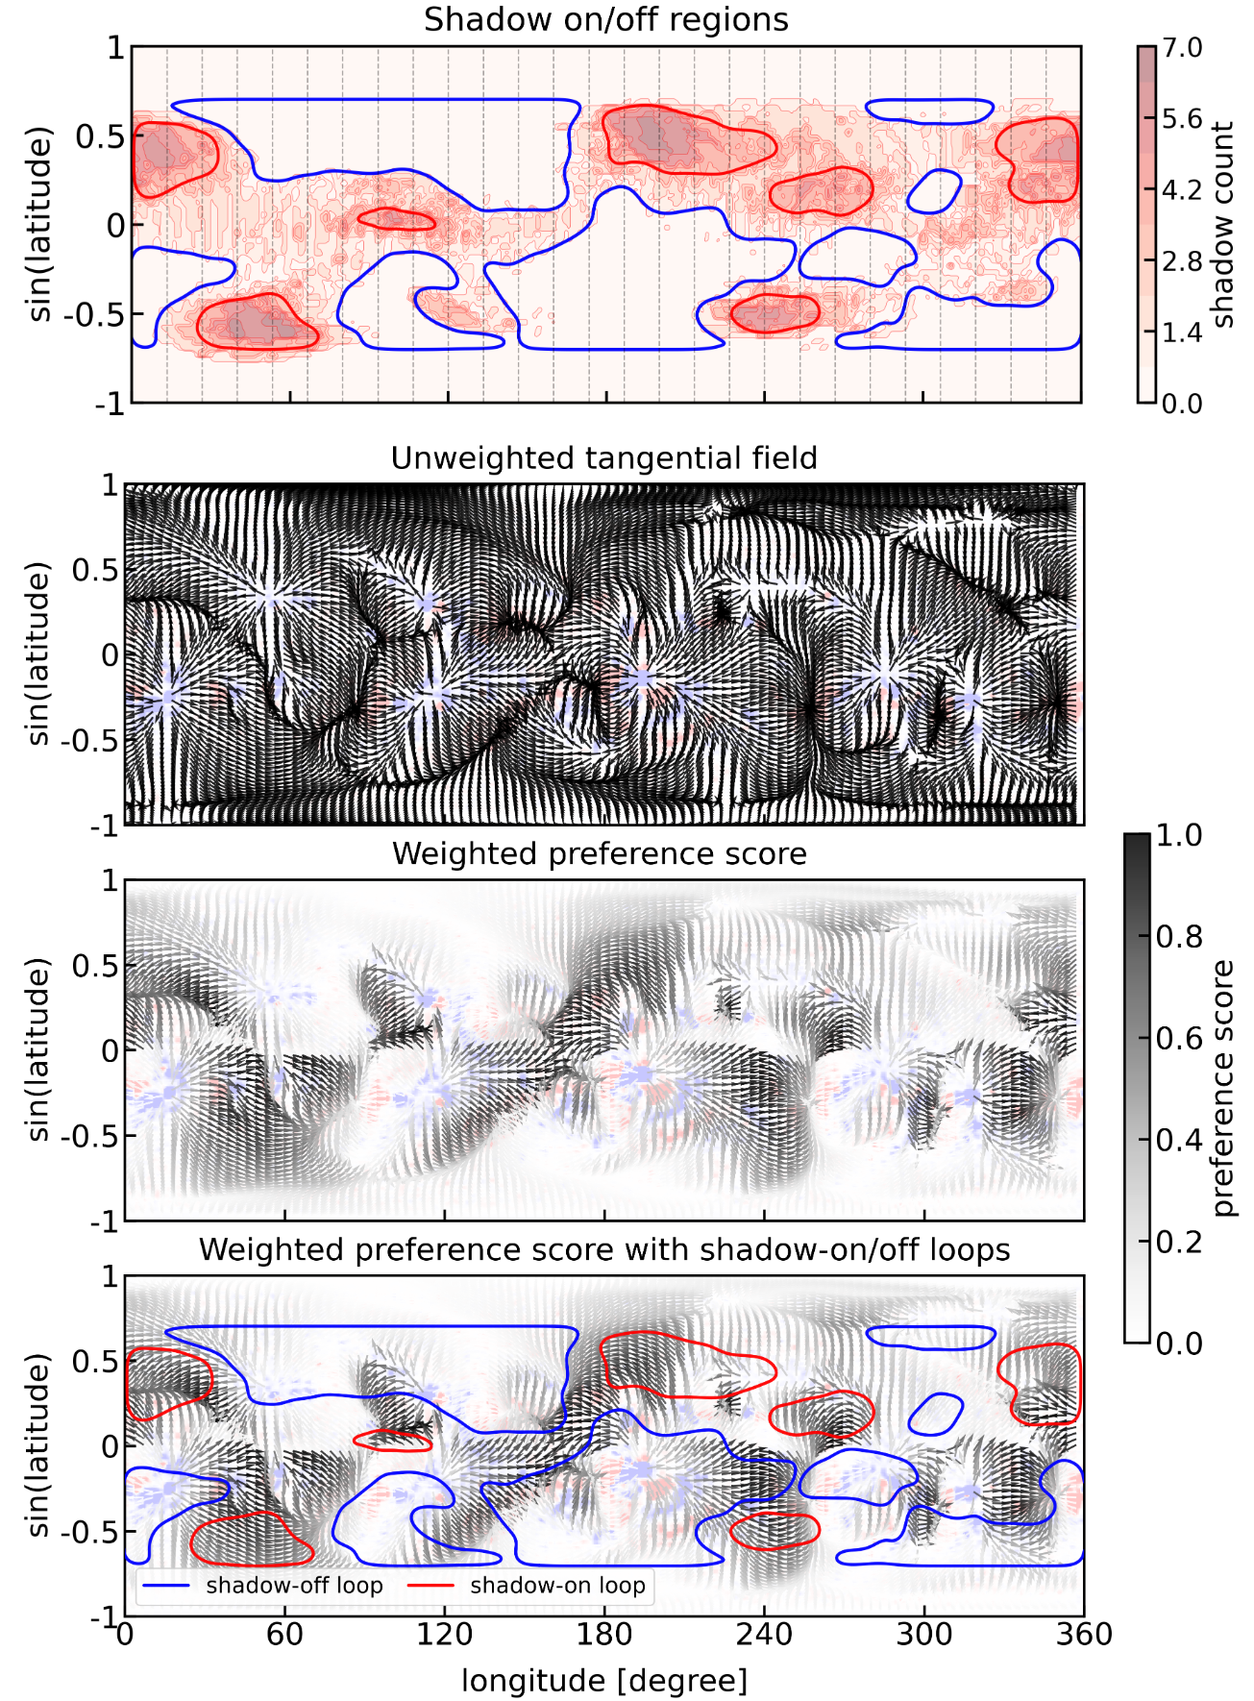

Global shadow and tangential field
7500 GeV, CarRot 2145
Tangential field at the $r_{mid}$ shell

Slide 17

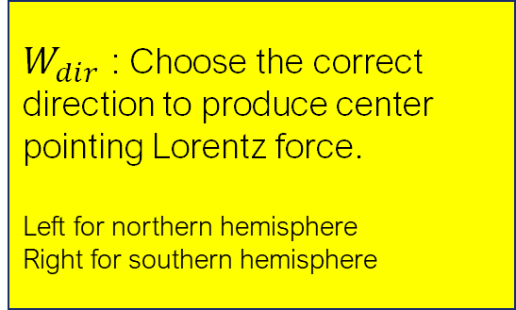
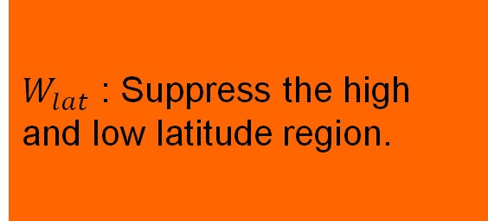
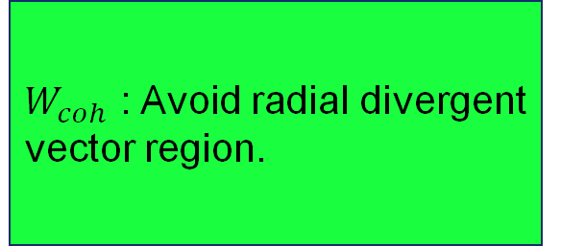
Global shadow and tangential field
7500 GeV, CarRot 2145
$$S=W_{dir} W_{coh} W_{lat}$$
$W_{dir}$ : Choose the correct direction to produce center pointing Lorentz force.
Left for northern hemisphere
Right for southern hemisphere
$W_{coh}$ : Avoid radial divergent vector region.
$W_{lat}$ : Suppress the high and low latitude region.

Slide 18
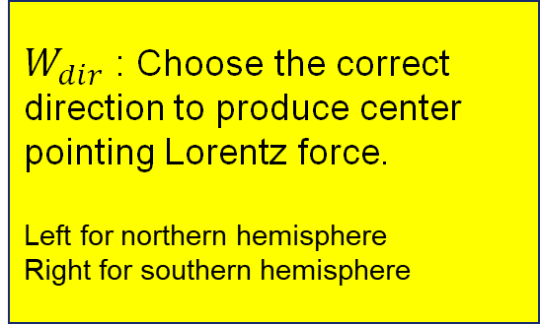
Global shadow and tangential field
7500 GeV, CarRot 2145
$$S=W_{dir} W_{coh} W_{lat}$$
$W_{dir}$ : Choose the correct direction to produce center pointing Lorentz force.
Left for northern hemisphere
Right for southern hemisphere
$W_{coh}$ : Avoid radial divergent vector region.
$W_{lat}$ : Suppress the high and low latitude region.

Slide 19
Global shadow and tangential field
7500 GeV, CarRot 2145
$$S=W_{dir} W_{coh} W_{lat}$$
Clear correlation of field topology and shadow morphology!
These can be done in all energy and each will correspond to different layer of the coronal field.
High score region: Shadow on
Low score region: Shadow off

Slide 20
Conclusion
The daily shadow has been observed for the first time by LHAASO.
The daily shadow shape is irregular and contain information of the coronal field.
1 – 100 TeV shadow is mainly formed in low coronal region (1.05 – 1.35 R☉).
We show the correlation of coronal field topology and the shadow morphology.
This study might point to a new method to probe the structure of 3D coronal field using the shadow:
Determine the local magnetic loop size and height
Constraint the coronal field extrapolation model
Future work

Slide 21
Appendix

Slide 23
