Slide 1



IceCube Upgrade:
Status and Prospects
Delaney Butterfield on behalf of the IceCube Collaboration
University of Wisconsin-Madison
IceCube Particle Astrophysics Symposium, Madison, WI
October 16, 2026

Slide 2
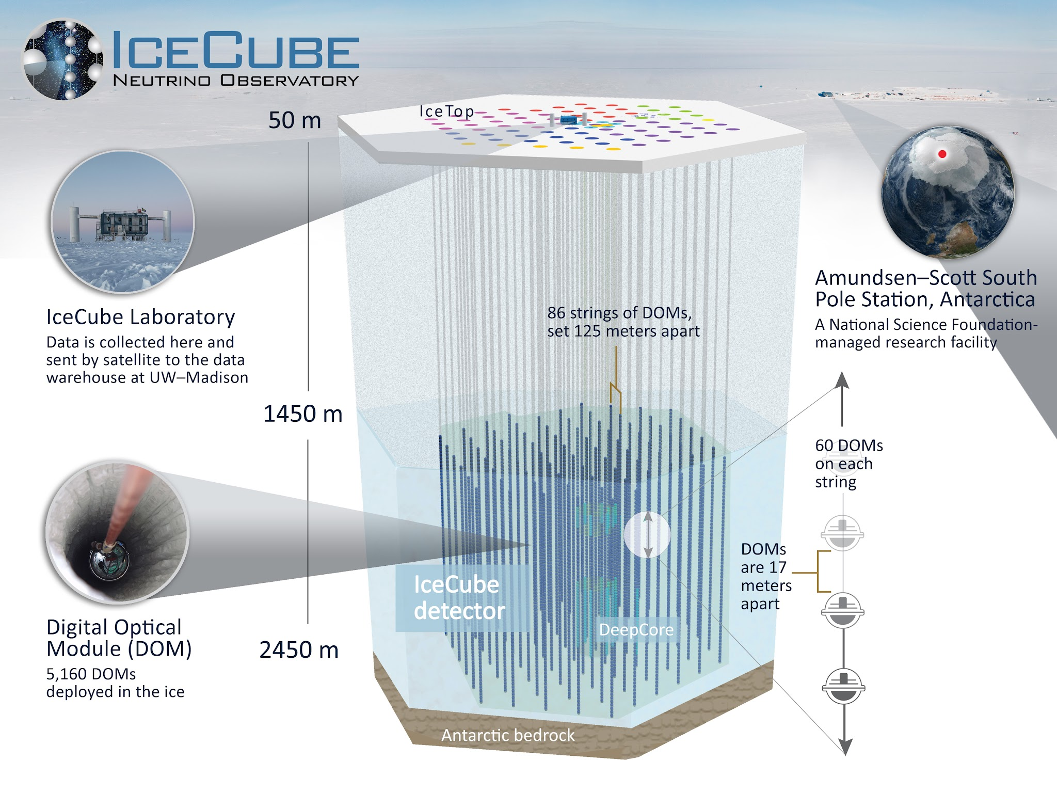

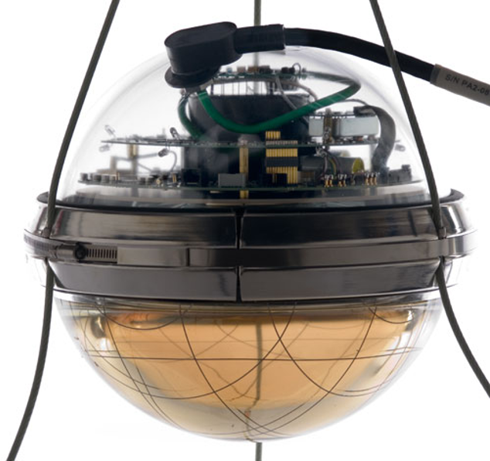
IceCube
Taking data with the full 86 string configuration since 2011
  15 years of data taking!
Geared towards energies > TeV
Dense infill comprised of 8 strings: DeepCore
  Targets energies between ~10 GeV to 10 Tev

Slide 3


Slide 4
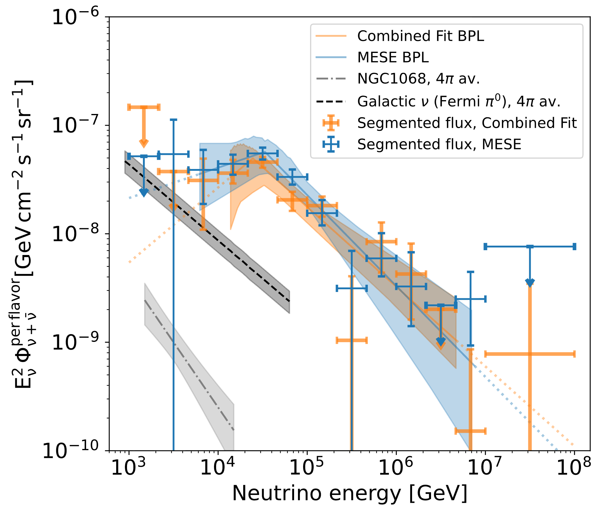
IceCube’s Achievements
https://doi.org/10.1103/2gh9-d4q7

Slide 5
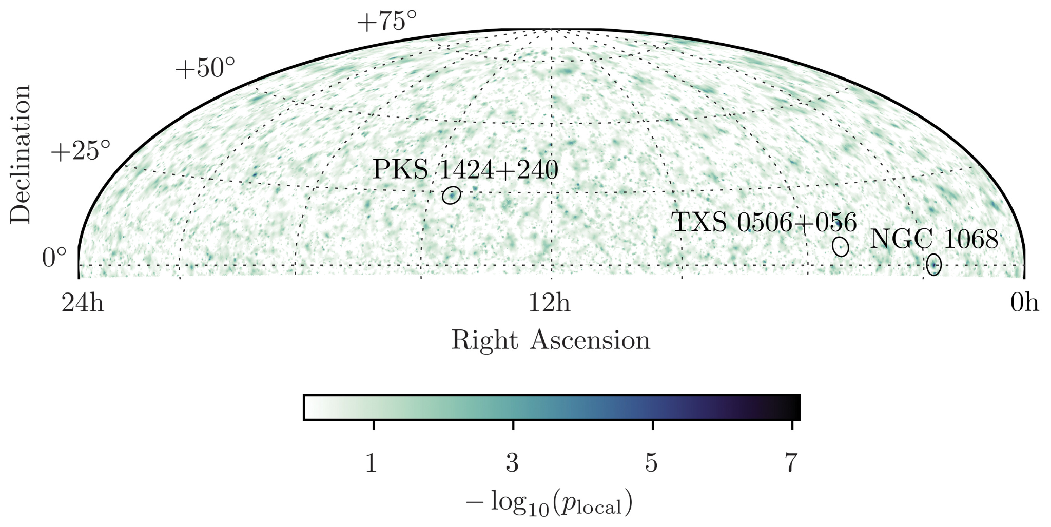
IceCube’s Achievements
DOI: 10.1126/science.abg3395

Slide 6
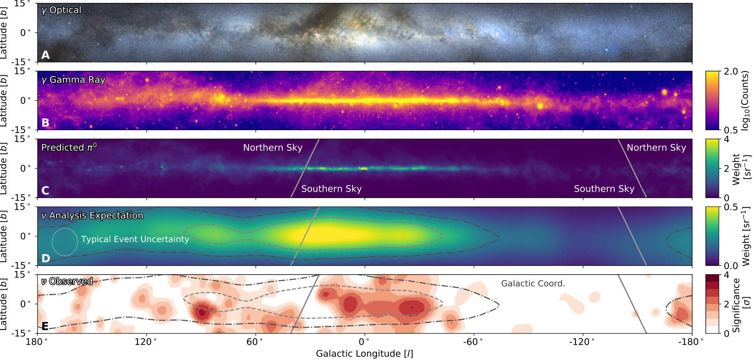
IceCube’s Achievements
https://doi.org/10.1103/2gh9-d4q7
See V. Basu’s talk from Wednesday for more on astrophysical neutrinos!
https://doi.org/10.1126/science.adc9818

Slide 7
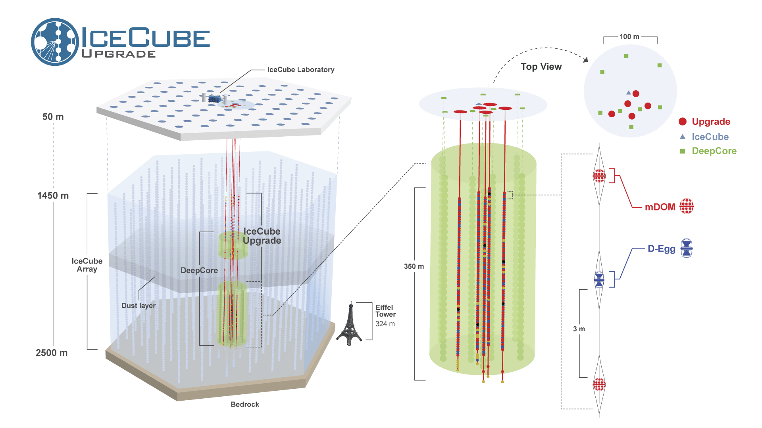
5 new strings deployed with a total of 505 optical modules
Denser spacing with multi-PMT optical modules
Targeting neutrino energies below 10 GeV

Slide 8
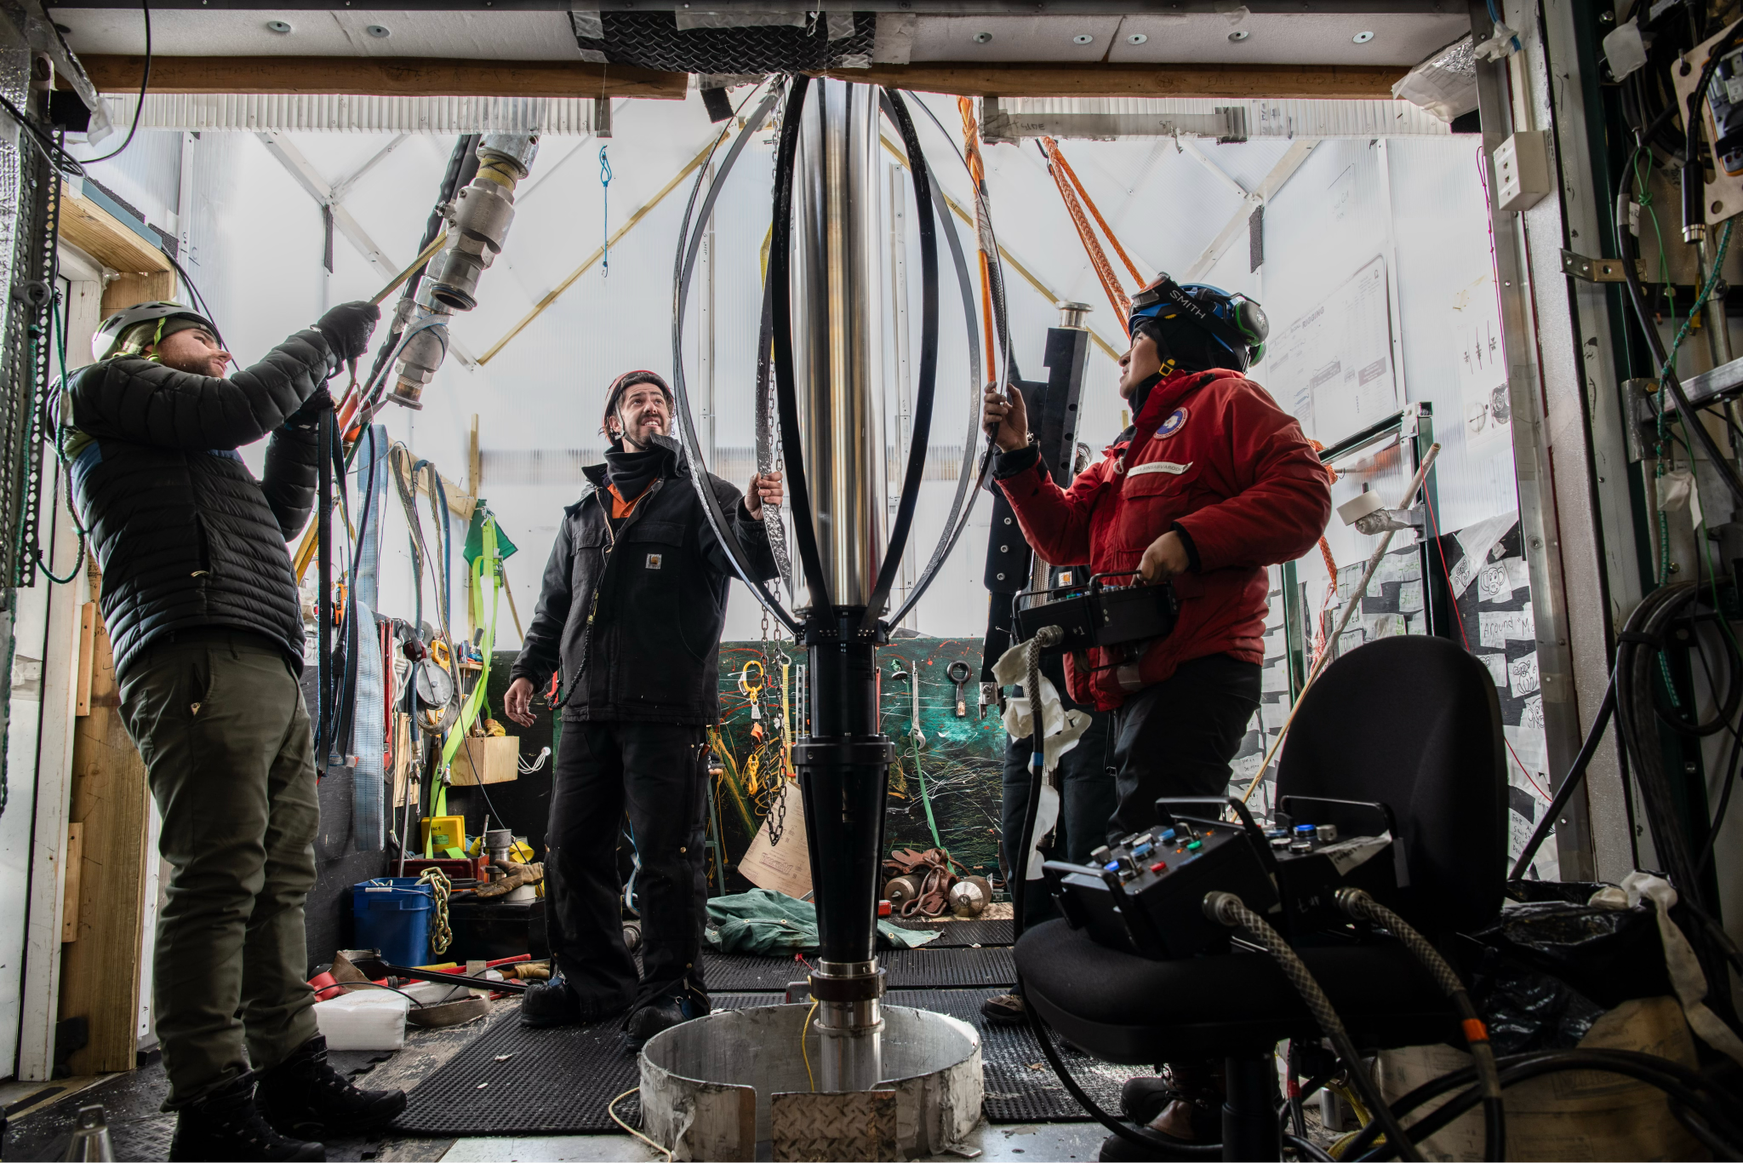
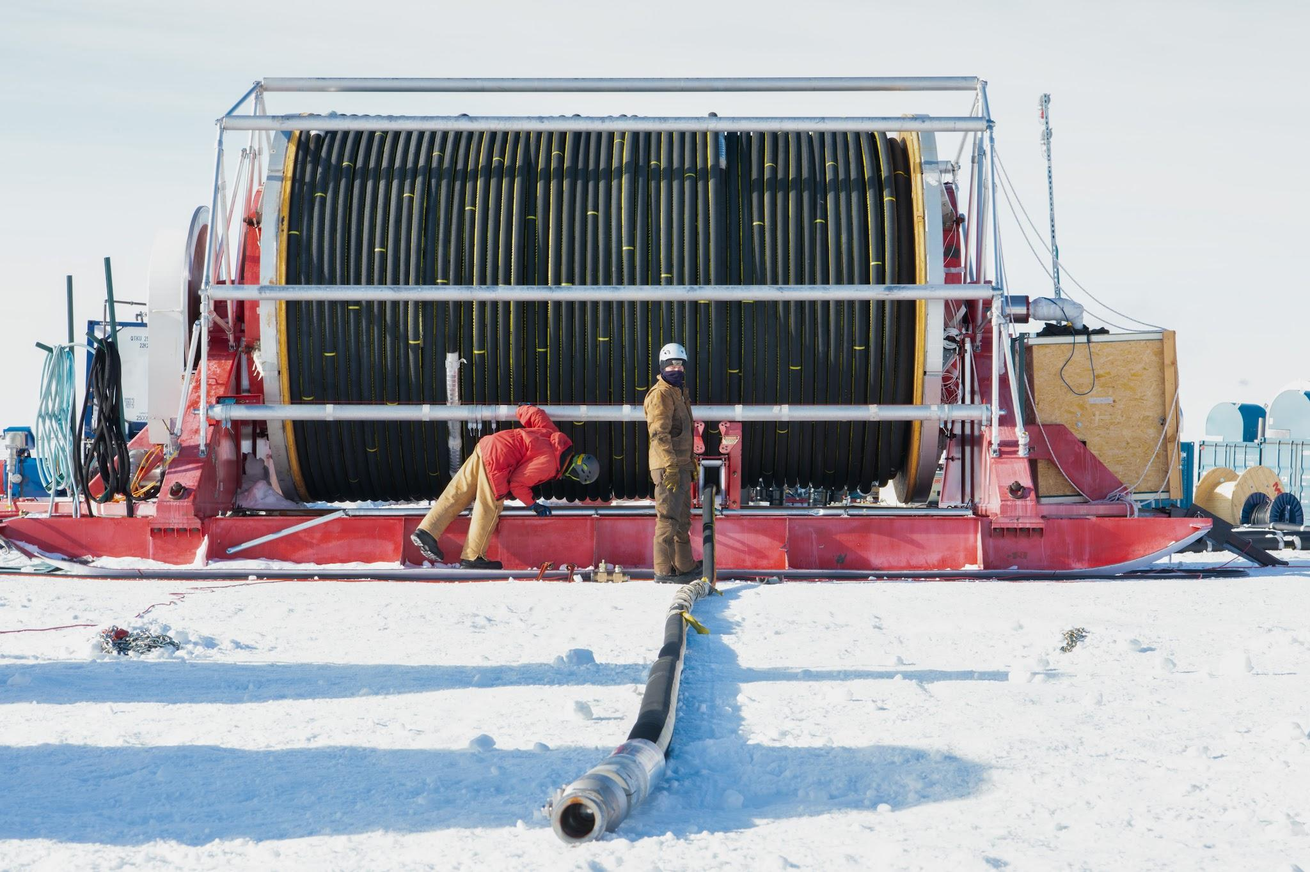
Drilling
Team of ~50 drillers refurbished Enhanced Hot Water Drill from IceCube deployment
First drilling operation since
2010/11 field season!
Photo credits: Yuya Makino
10/16/2026

Slide 9
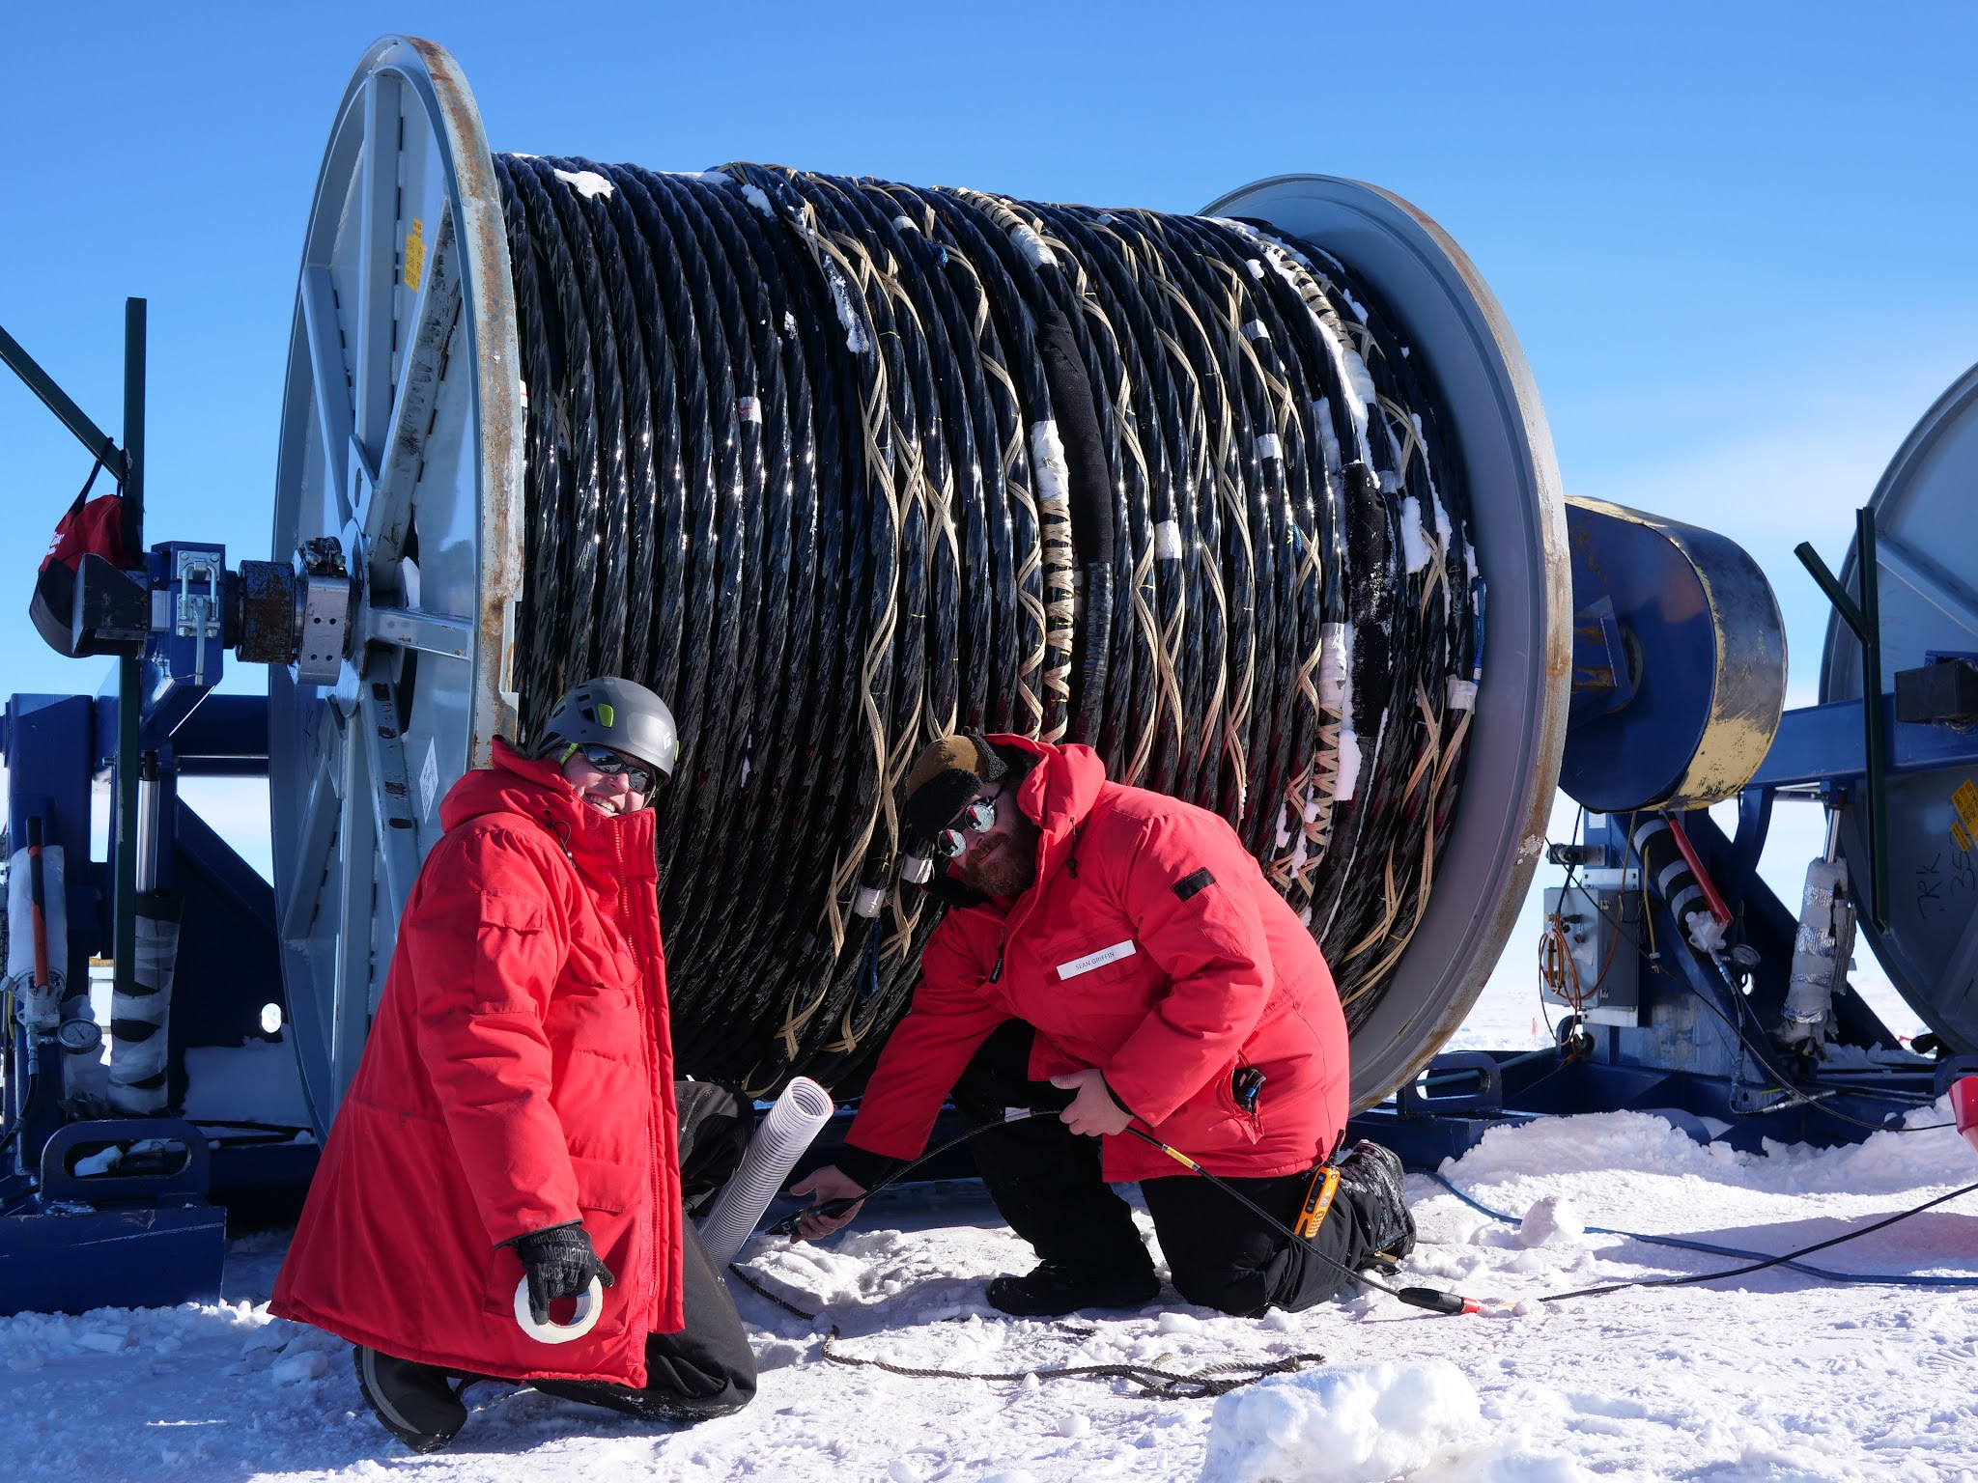
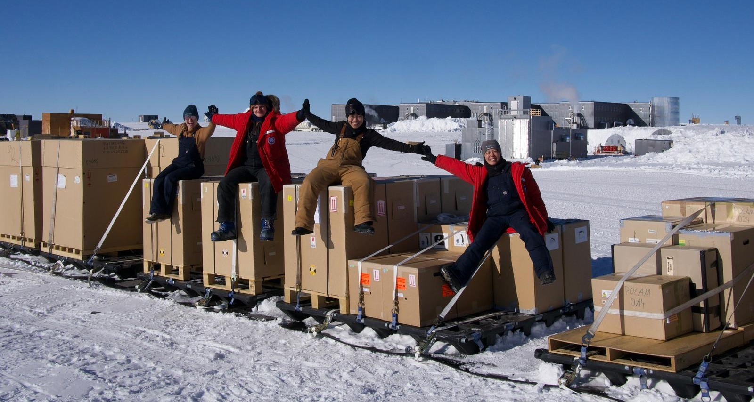
Device & Main Cable Testing
South Pole Acceptance Testing (SPAT) performed on over 800 devices!
Communications testing done on Main Cable Assembly before installation
Photo credits: Colton Hill
10/16/2026

Slide 10
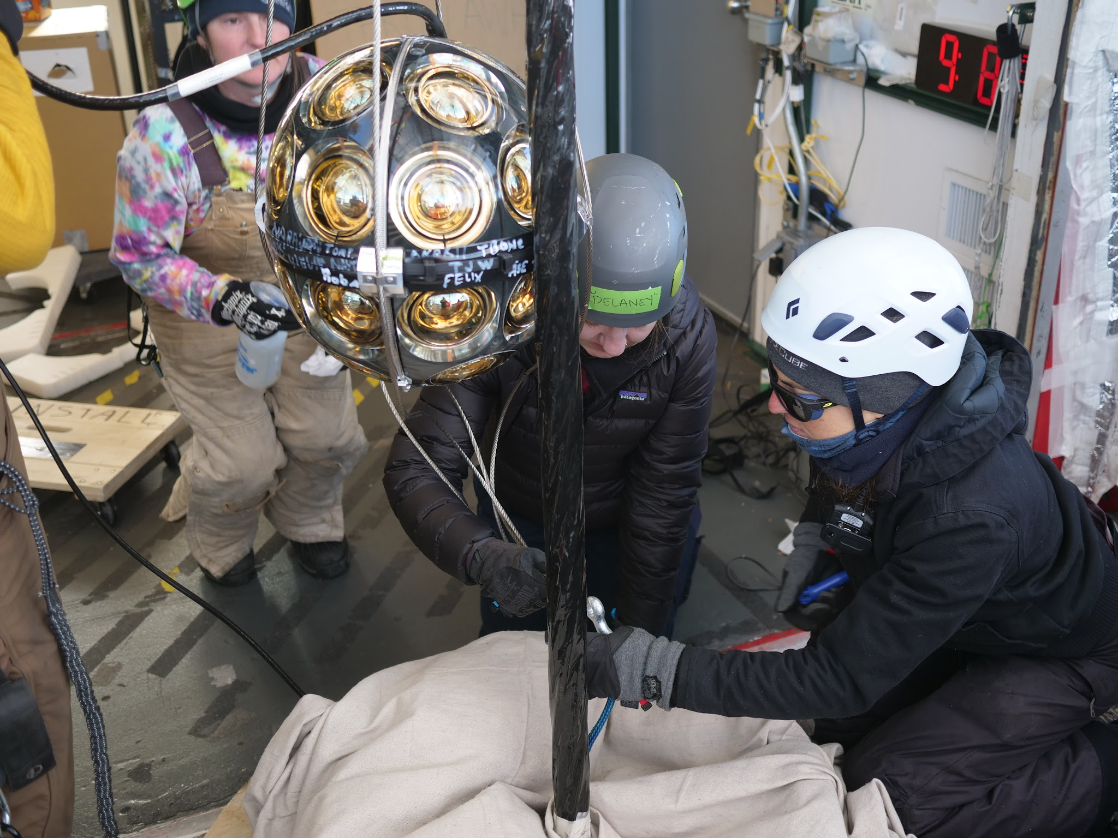
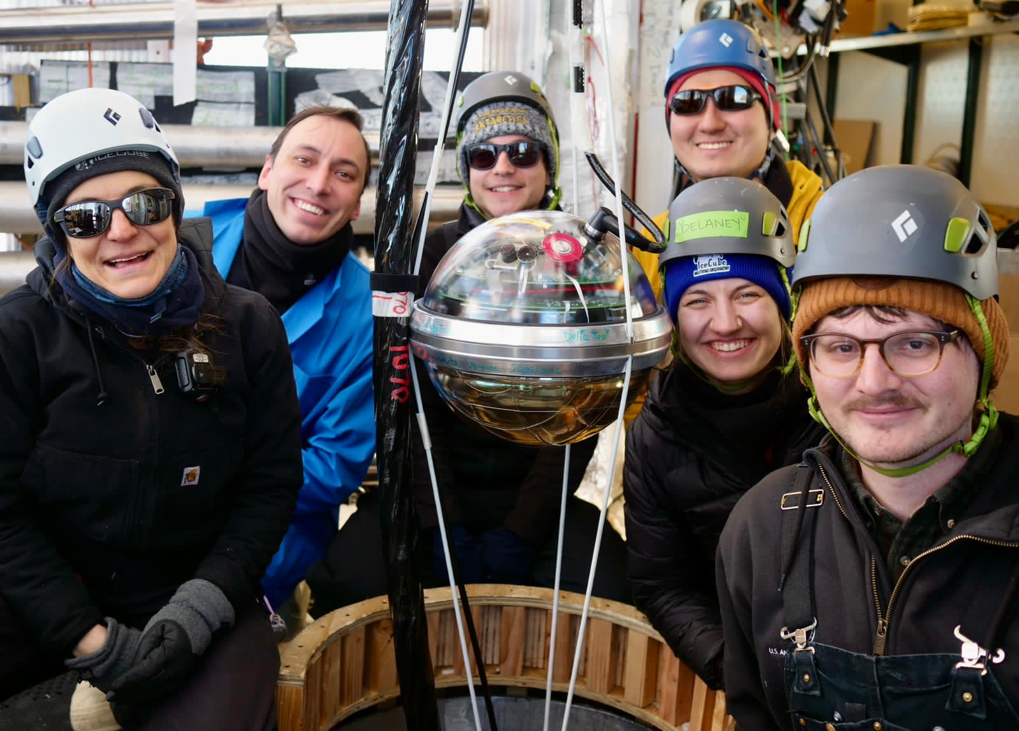
Installation
Two teams of installers working two shifts
~24 hours to fully install one string
Photo credits: Colton Hill
10/16/2026

Slide 11
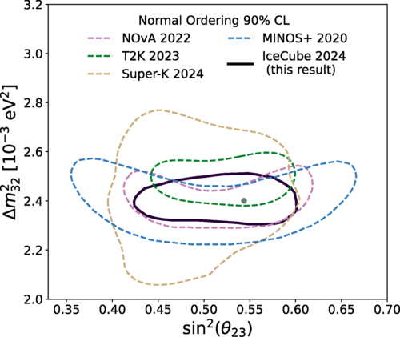
Why add more strings?
DOI: https://doi.org/10.1103/PhysRevLett.134.091801
DeepCore has produced atmospheric neutrino oscillation measurements comparable to accelerator experiments
Denser instrumentation and very clear ice improve low energy event reconstruction
  Improves sensitivity to neutrino oscillation parameters and low energy neutrino astronomy

Slide 12
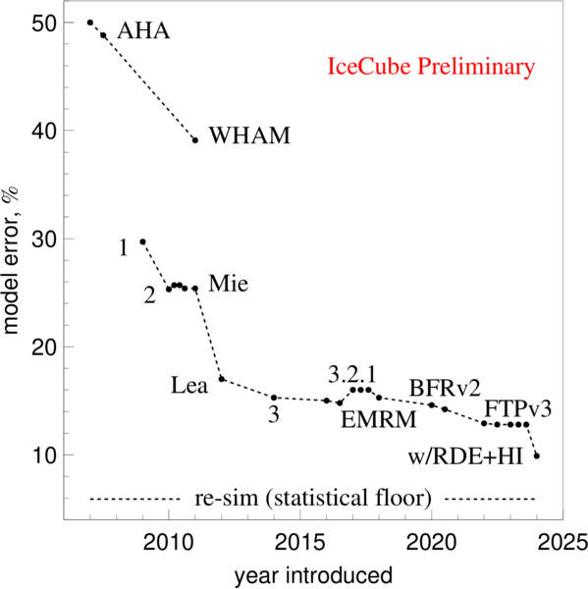
Why add more strings?
DOI: https://doi.org/10.22323/1.501.1013
Ice modelling is IceCube’s biggest systematic
  Absorption length is high
  Mostly affected by light scattering and birefringence
  Used calibrated flashers to study the ice
  Room for improvement in current ice model
New calibration devices deployed
  New ice model can be applied to archival data
    Recalibration of all IceCube data
Testing R&D sensors for IceCube-Gen2

Slide 13
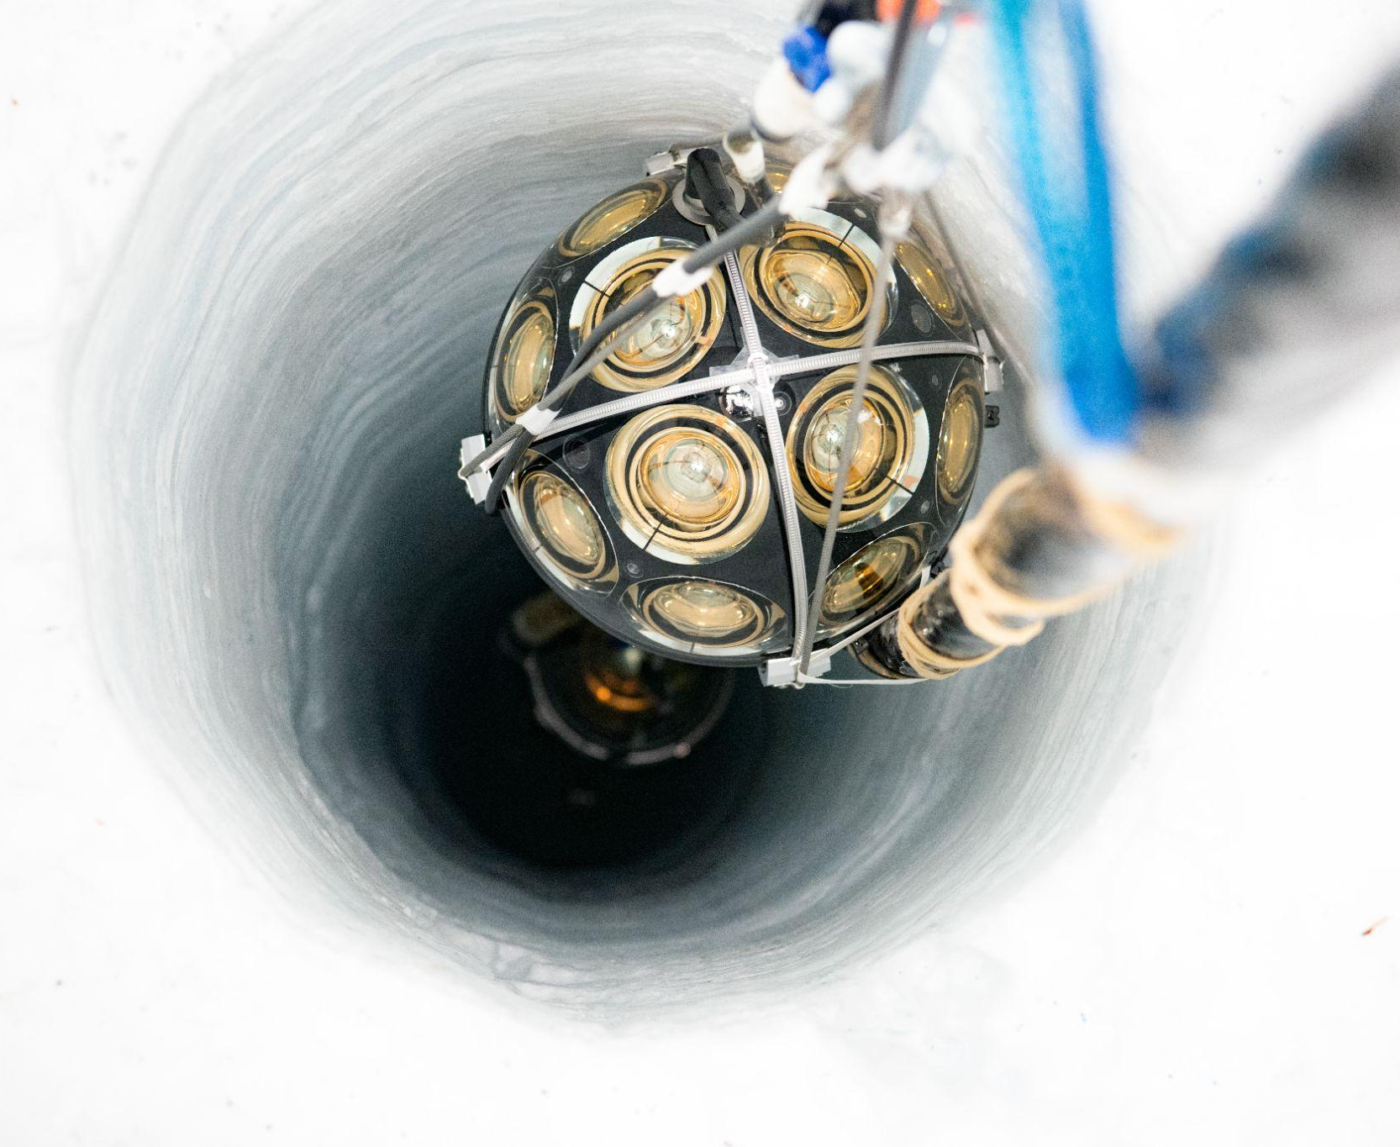
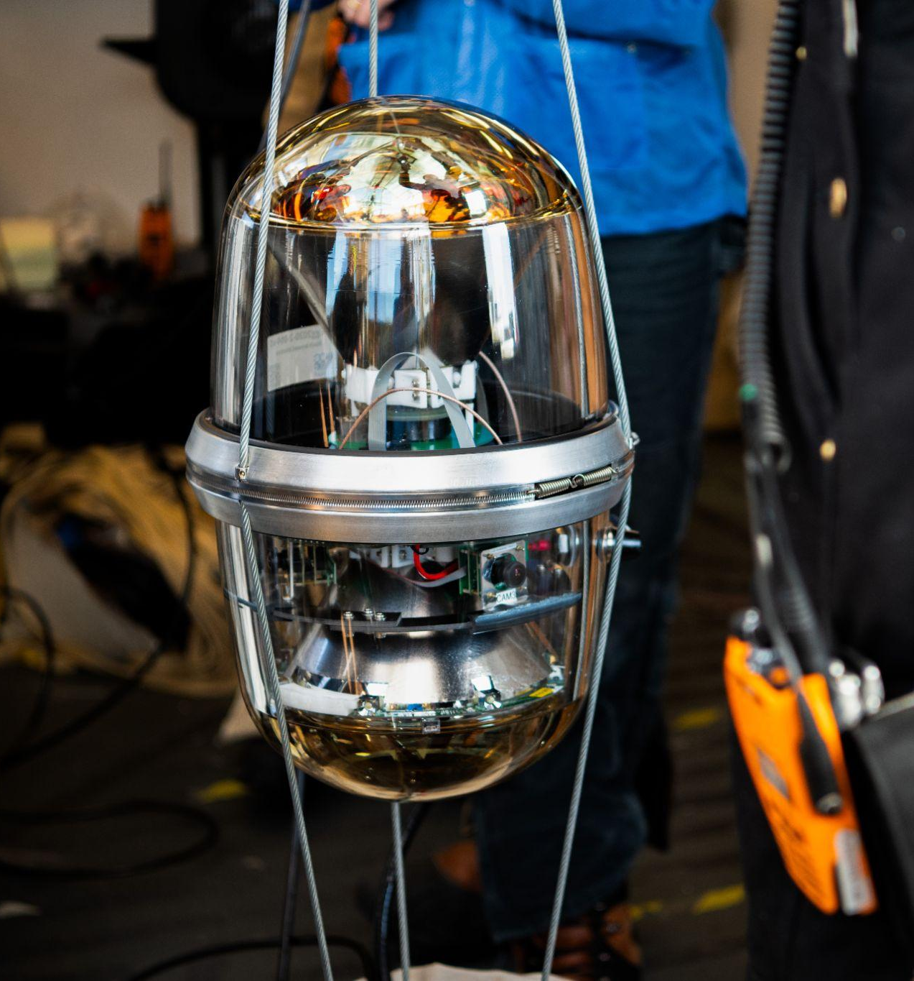
New Devices in the Upgrade
mDOMs - multi PMT digital optical modules
  24 3” PMTs
DEggs - dual optical sensor in ellipsoid glass for Gen2
  2 8” PMTs
~3x the photocathode area as IceCube
mDOM
DEgg
photo credits: Yuya Makino

Slide 14
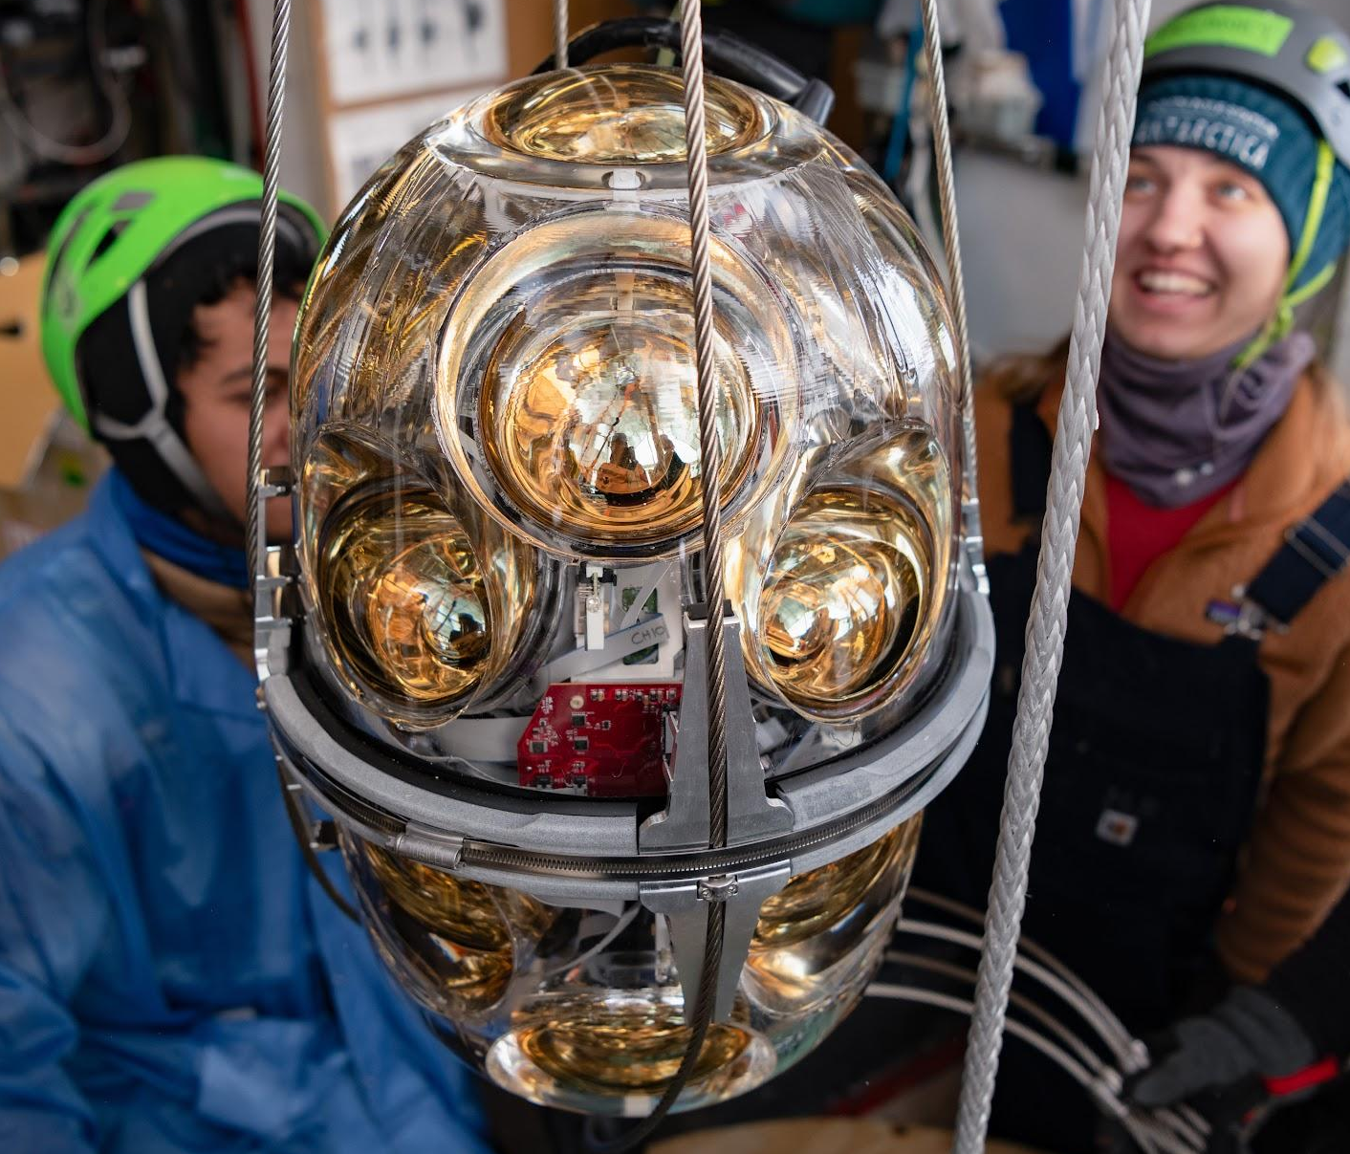
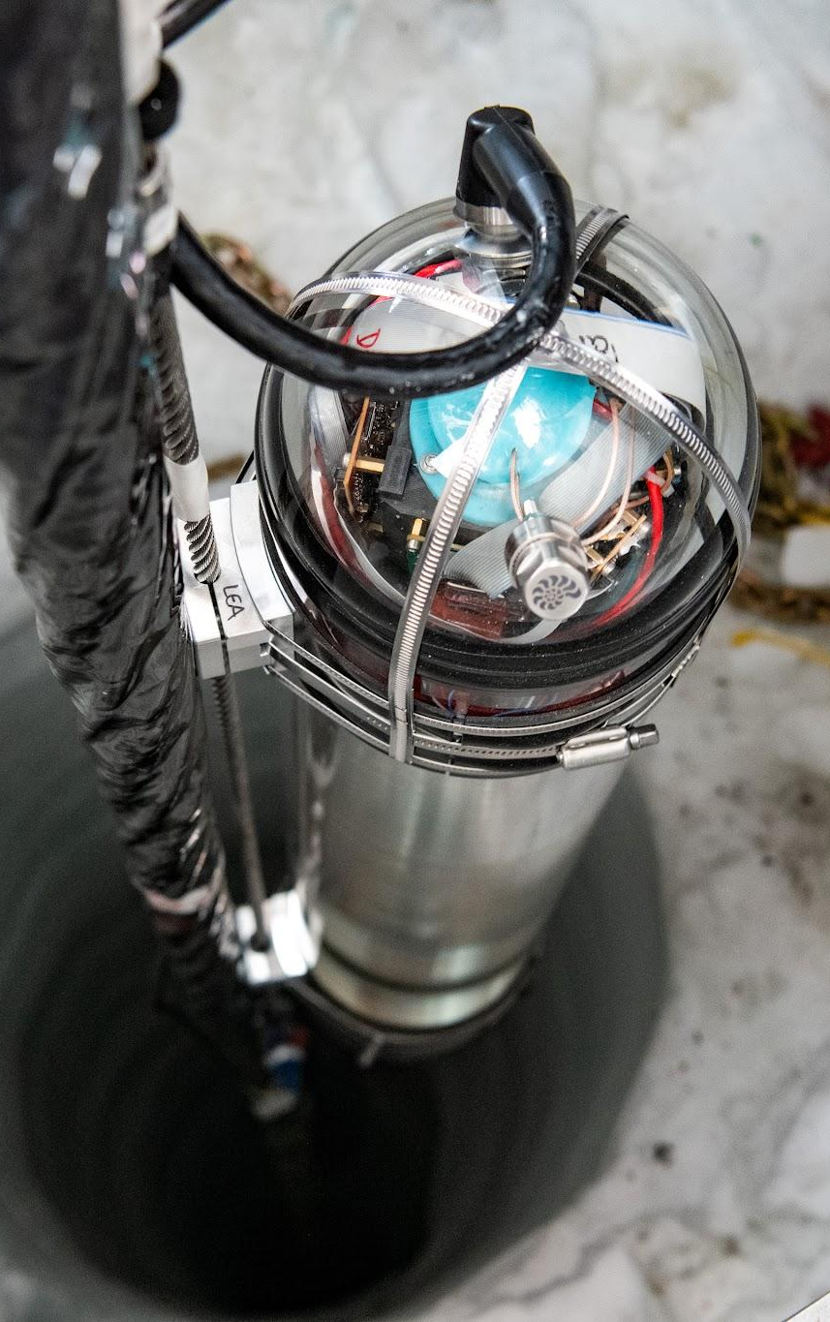
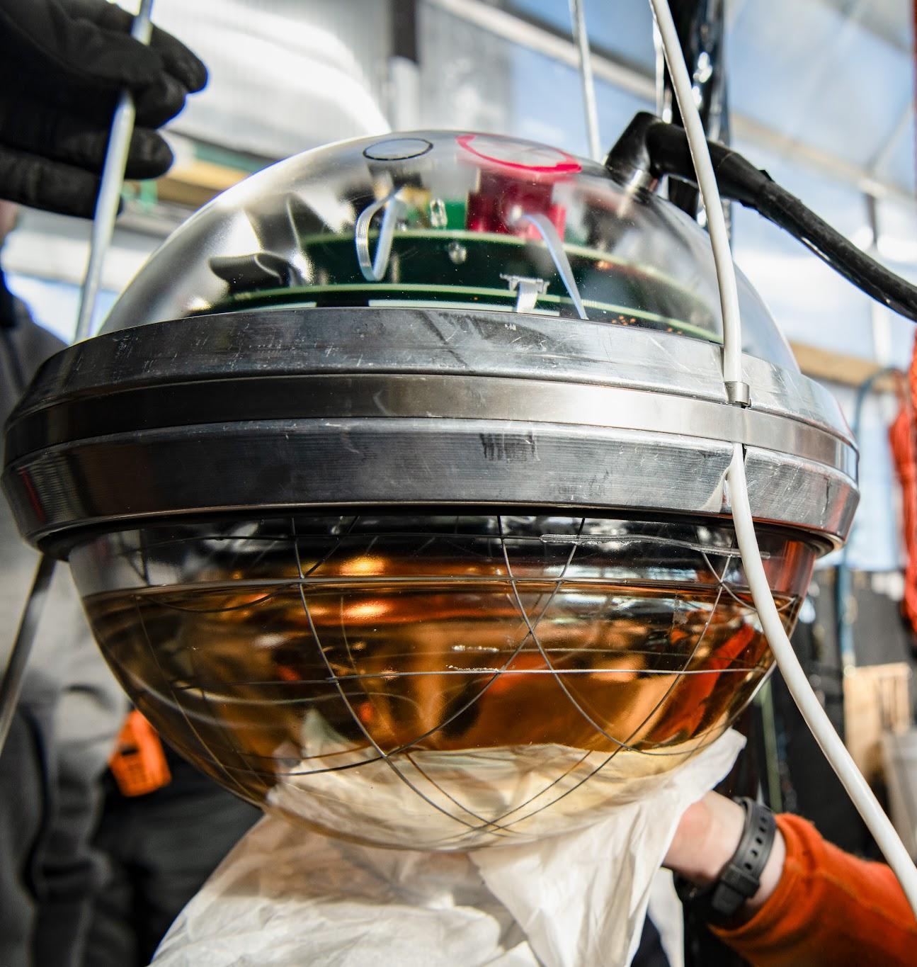
New Devices in the Upgrade
Prototype Gen2-DOM
  16 or 18 4” PMTs
WOM - wavelength shifting optical module
  One PMT with wavelength shifting fluid in pressure vessel
pDOM - retrofitted IceCube DOM with updated electronics
  Some have wavelength shifting fibers attached to the vessel - “fiber optical module” (FOM)
Prototype Gen2-DOM
pDOM
WOM
photo credit: Yuya Makino

Slide 15
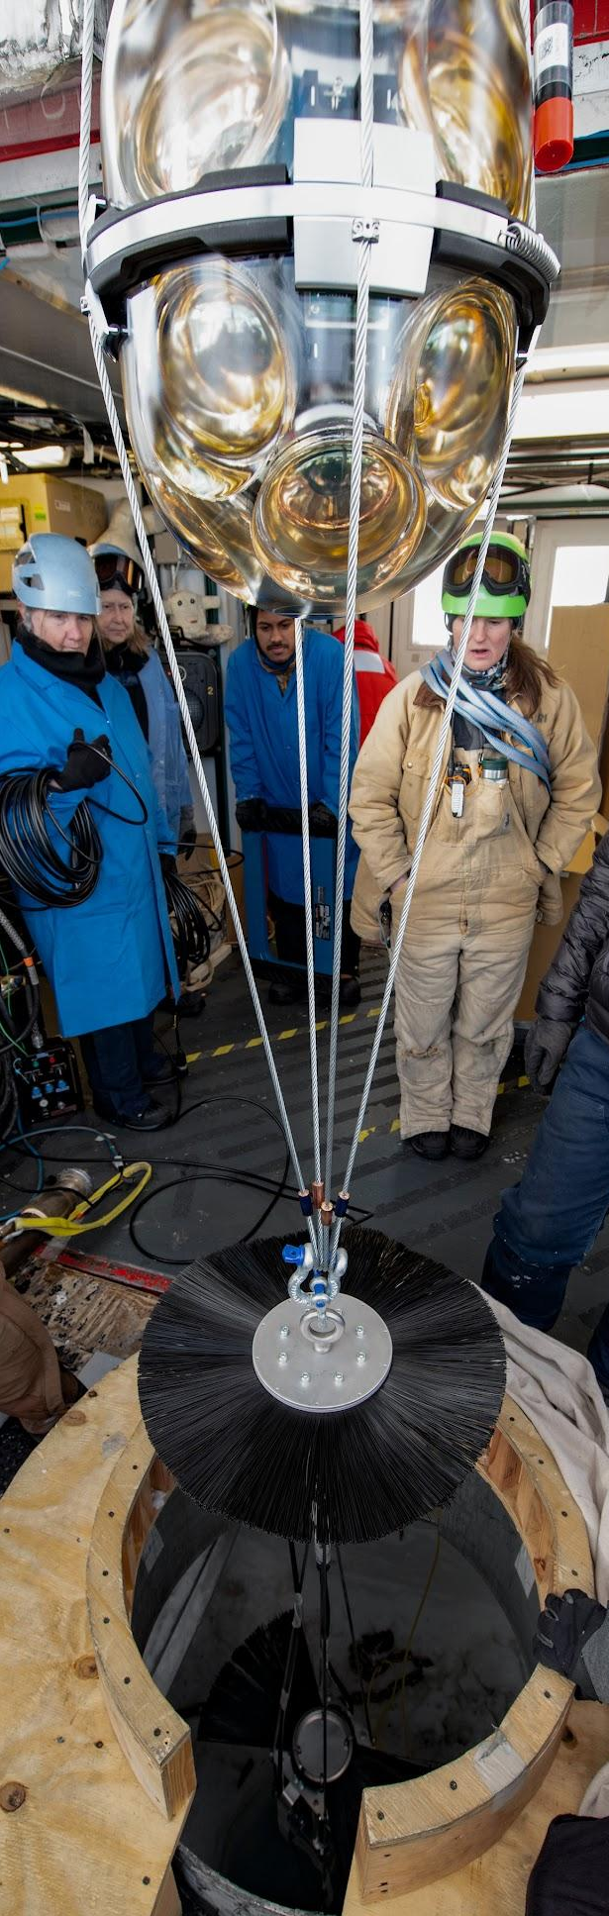
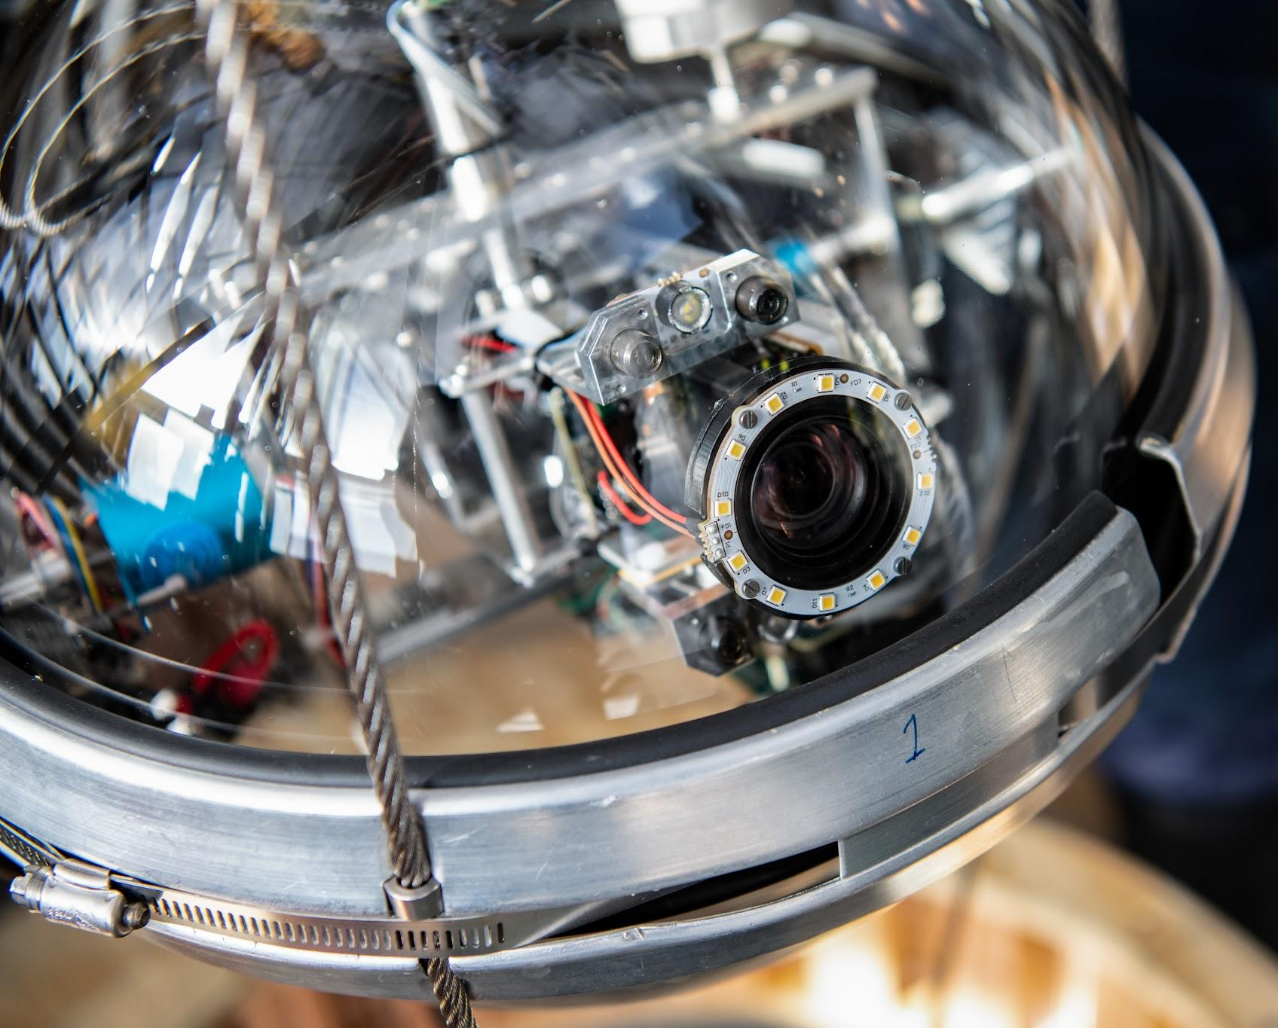
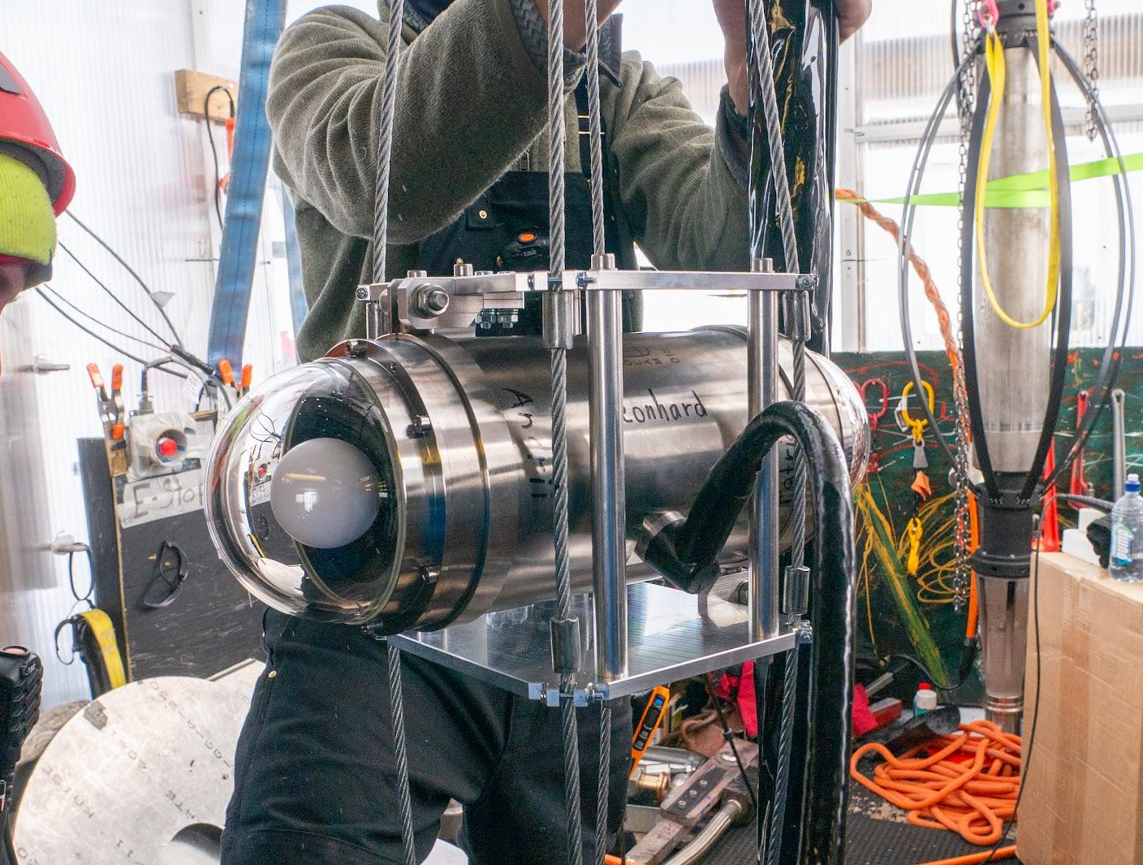
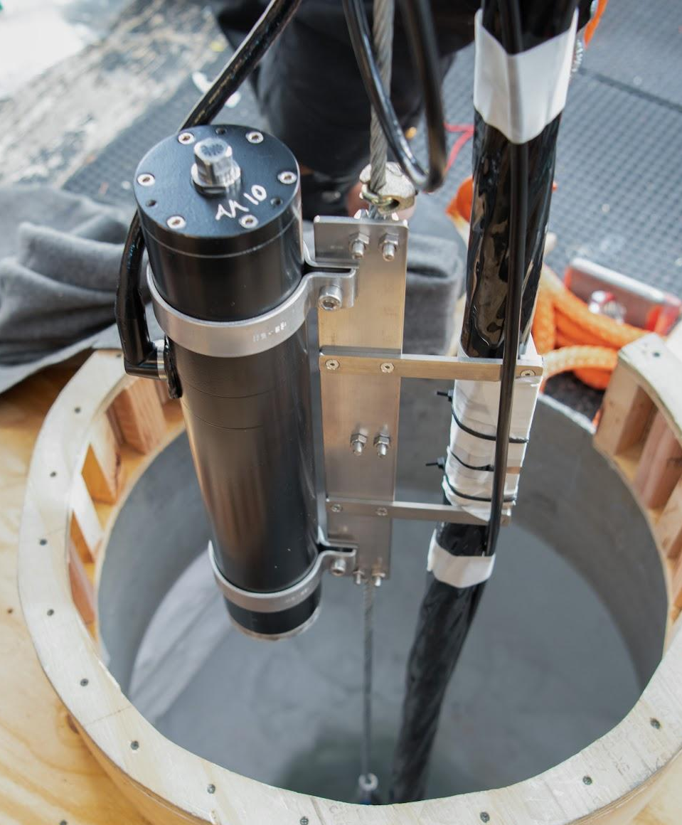
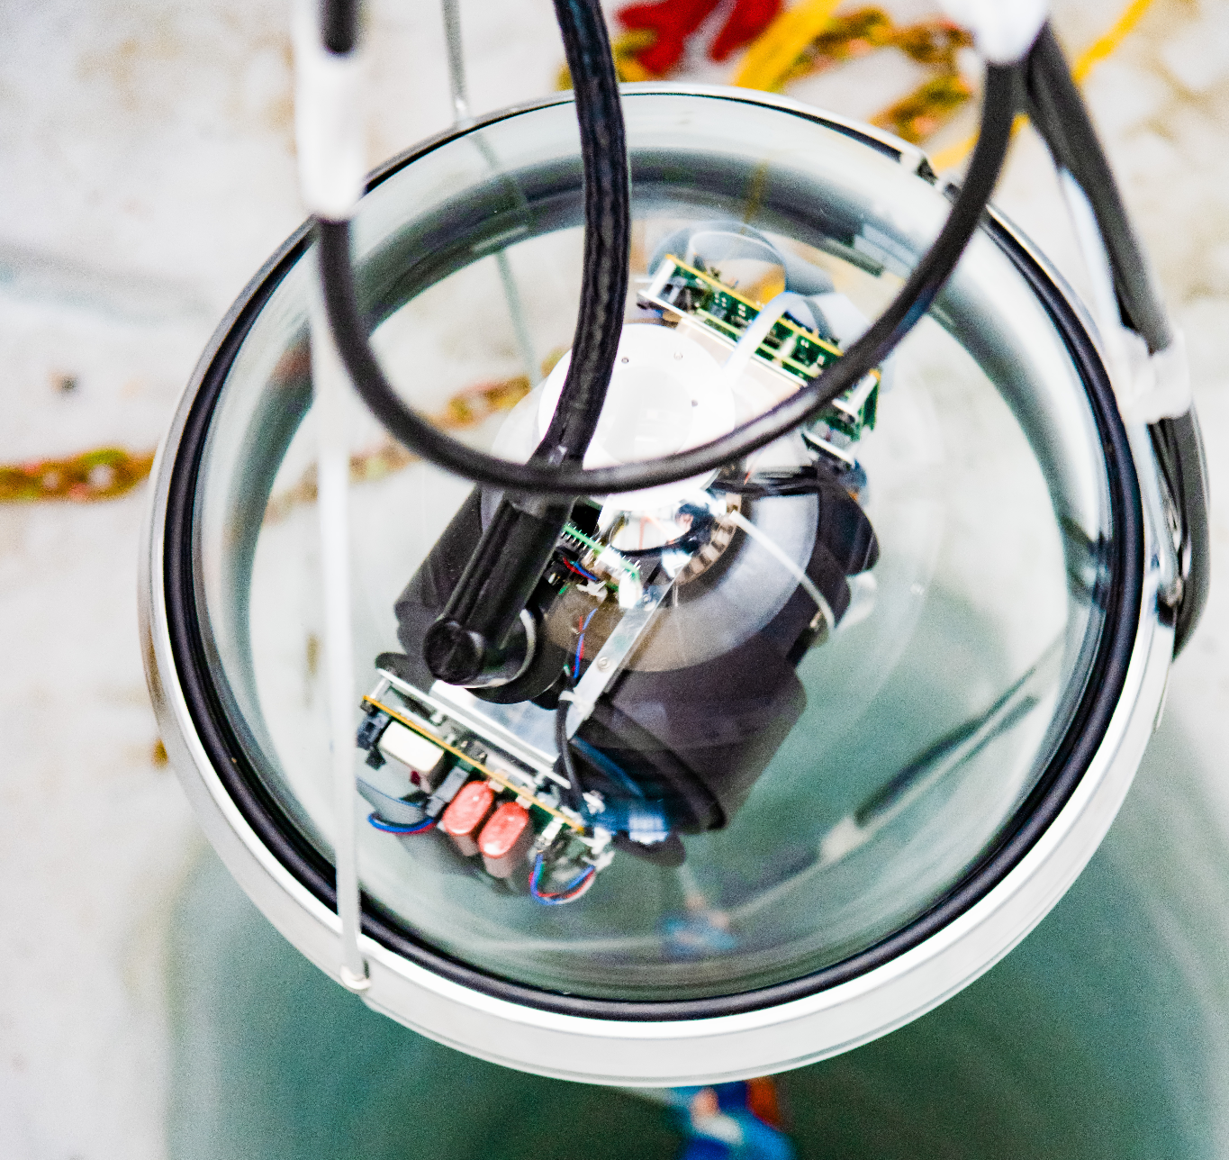
New Devices in the Upgrade
Sweden Camera - free rotating camera
  Records surrounding hole ice and refreeze process
POCAM - precision optical calibration module
  Diffuse multi-wavelength light source to measure hole ice properties, angular acceptance, and DOM efficiency
Pencil Beam - collimated light source
  Measures light scattering in the ice
Acoustic Module
  Measures acoustic properties of ice
LOM Logger
  Measures ice stratigraphy and depth dependent dust concentration
Photo credits: Yuya Makino, Aya Ishihara
Sweden Camera
POCAM
Acoustic Module
Pencil Beam
LOM Logger

Slide 16
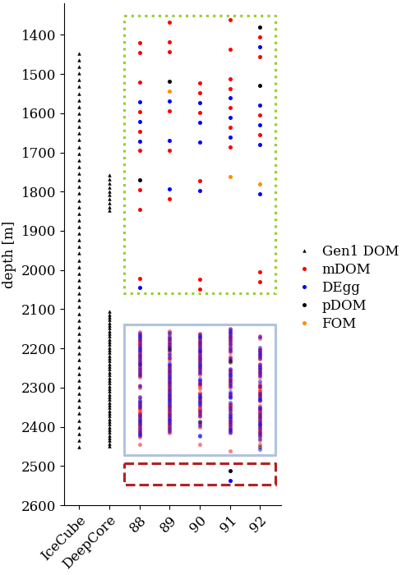
Current Status of New Detector
Added 505 Upgrade OMs and 64 special/calibration devices on 5 strings to the IceCube array
89% of deployed OMs are successfully commissioned and taking data
Working towards fully integrating the 5 new strings into the standard data taking stream
Initial studies using test data are ongoing to prepare for first physics data taking run
Notes:
Add trigger plot too

Slide 17
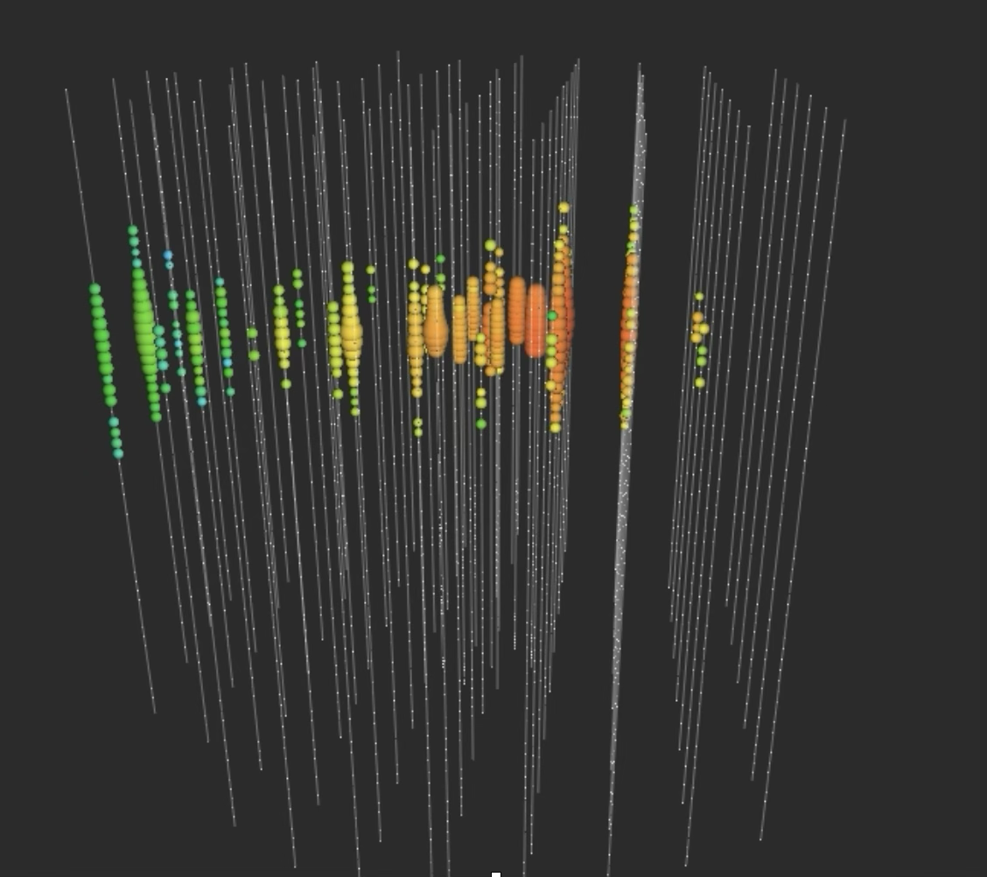
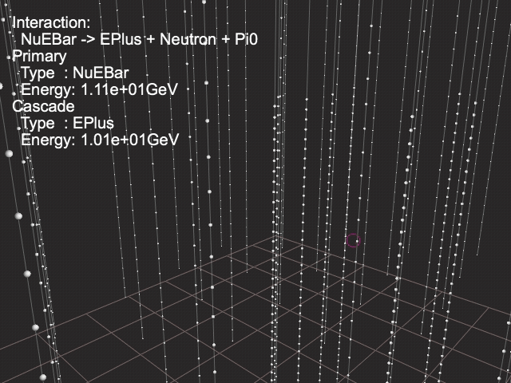
Events in IceCube & DeepCore
~70 TeV event in IceCube spans almost the entire 1km length of the detector
11 GeV event in DeepCore is much smaller with significantly less hits in the detector

Slide 18
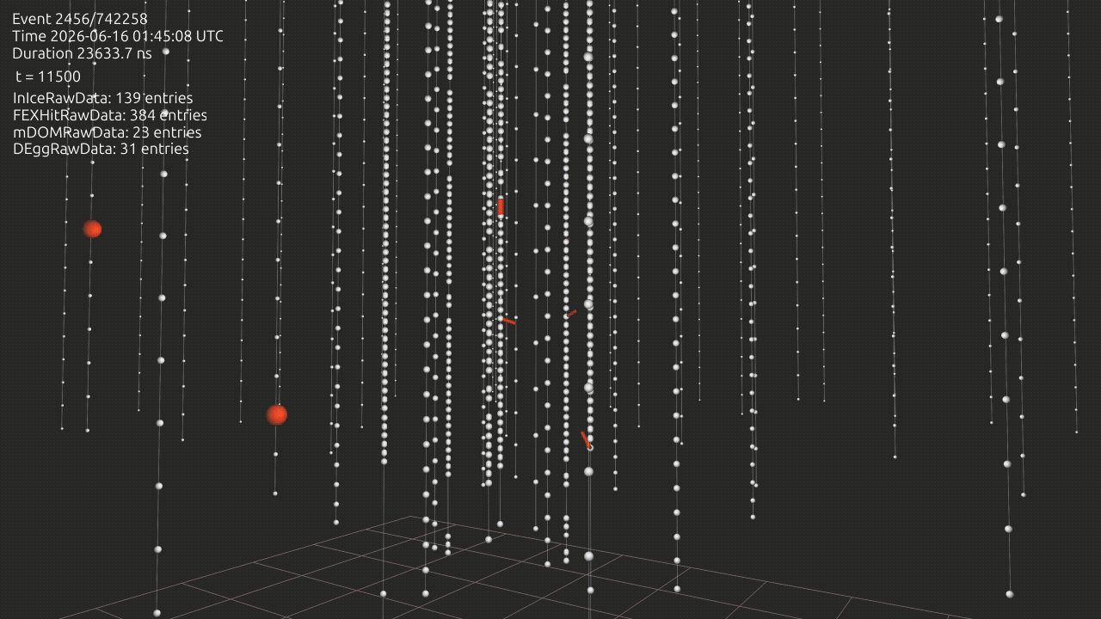
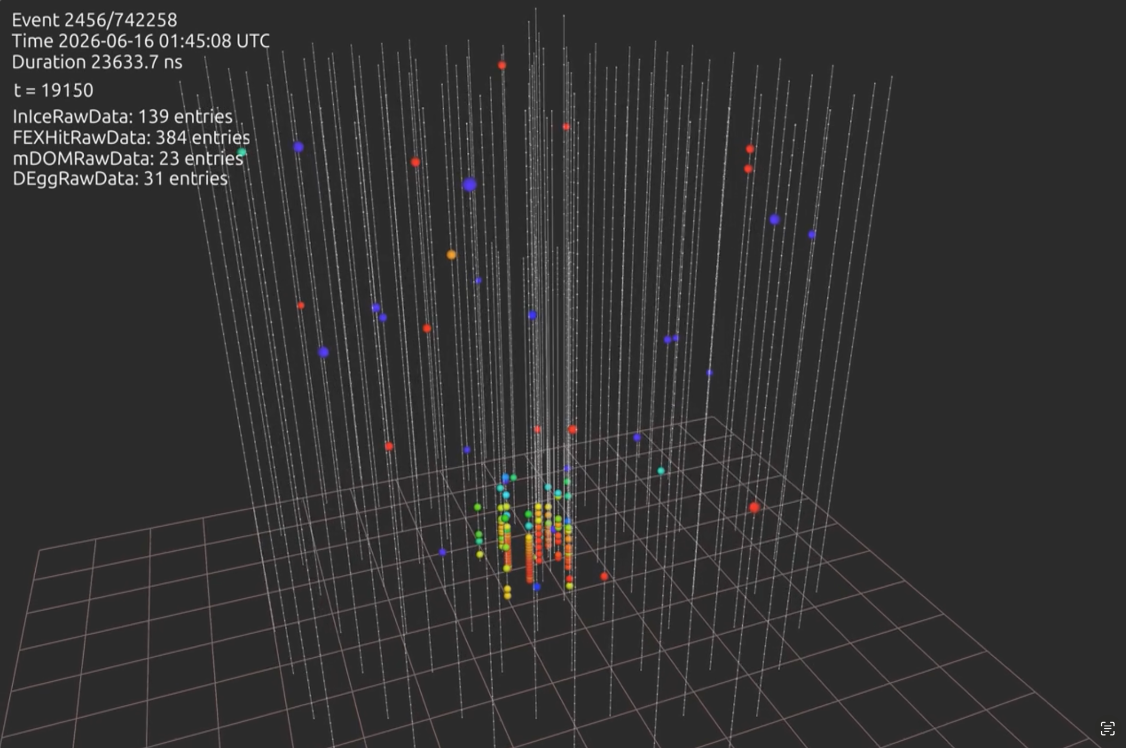
Event in the Upgrade
~1000 x lower energy than in IceCube!
Over 400 photon hits in the Upgrade compared to 140 in IceCube
Notes:
Add trigger plot too

Slide 19
Current Status of New Detector
Lower noise rates in ice than in lab measurements by a factor of ~2
  mDOMs: ~300 Hz / channel
  DEggs: ~250 Hz / channel
Total event readout is 20us
  Expect ~25 noise hits in IceCube
  ~35 noise hits in the Upgrade
Reoptimizing triggers and filters to push to lower thresholds
  Can use IceCube strings to help filter muons
Notes:
Add trigger plot too

Slide 20
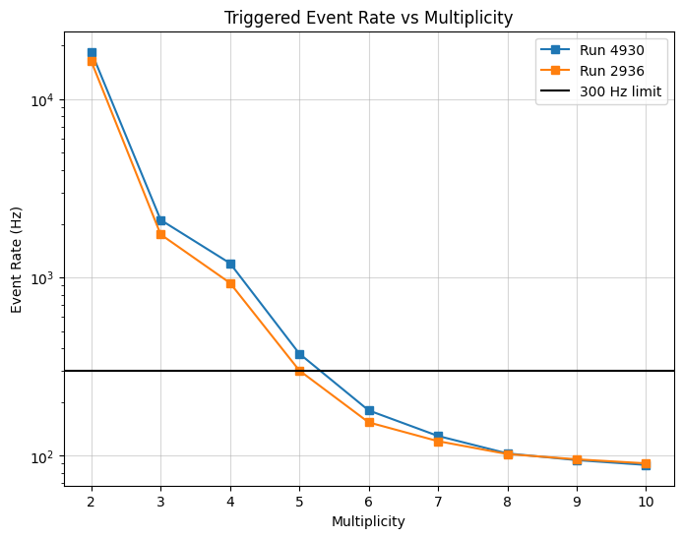
Trigger Reoptimization
10 minutes of test data
Reoptimizing triggers and filters to push to lower thresholds
Simple Multiplicity Trigger (SMT) counts coincident hits in the Upgrade
Can lower SMT multiplicity threshold to 5 before event trigger rate is completely dominated by noise
Noise dominated region
Cosmic ray dominated region
Notes:
Add trigger plot too

Slide 21
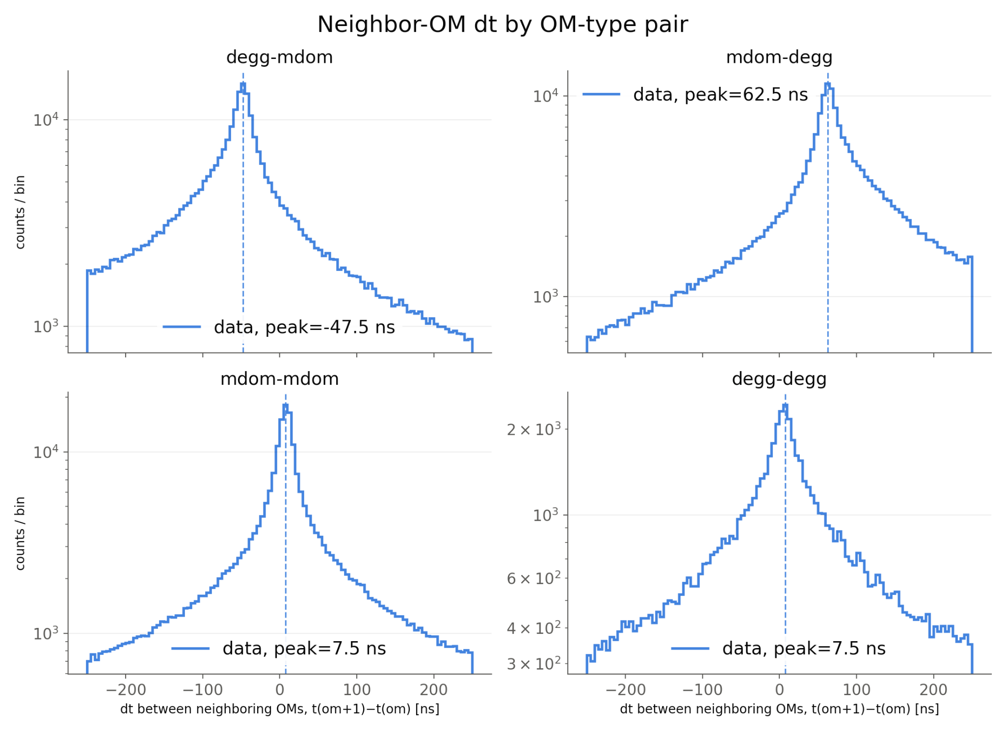
Early Data Analysis
10 minutes of test data
Looking at timing distributions of early test data to characterize detector
  Calibrating timing offsets between devices
  Width of distributions can show information about in ice scattering
  Distribution peaks are consistent with time of flight of a muon between the OMs
Notes:
Add trigger plot too

Slide 22
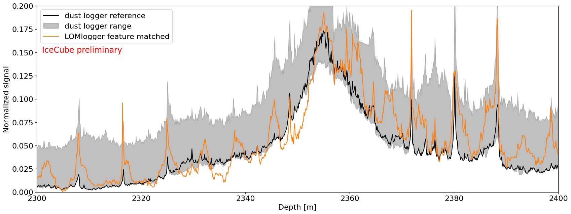
Early Calibration Results - LOM Logger
Prototype dust logger with Gen2DOM
Realtime calibration probe to measure the depth dependence dust layers in every Gen2 string

Slide 23
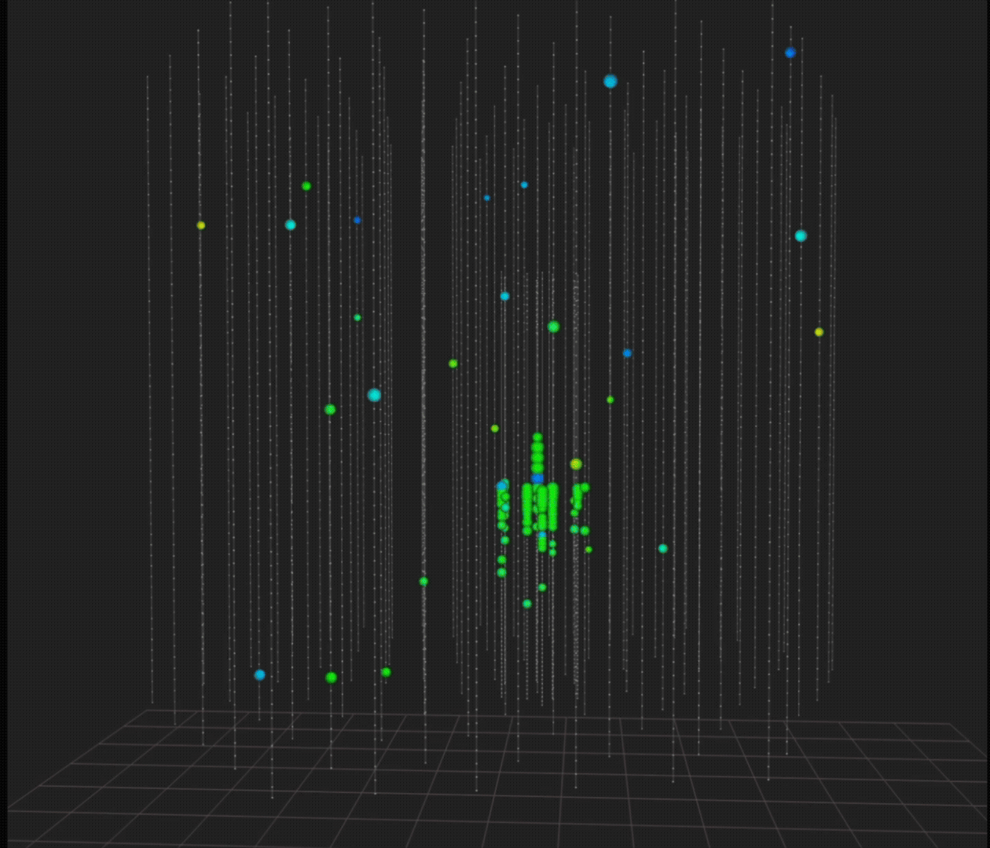
Early Calibration Results - POCAM
During deployment of Precision Optical Calibration Module, 405nm LED was flashed at a 1 Hz interval
Goal is to study ice properties and calibrate detector geometry
Video shows the POCAM dropped over several hours during deployment

Slide 24
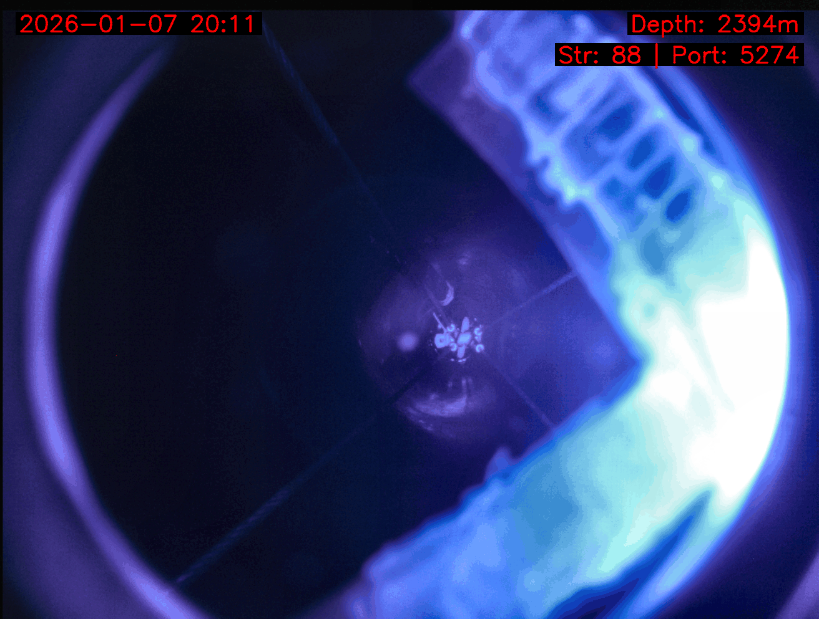
Early Calibration Results - Cameras
Sweden Cameras and fixed focus cameras on mDOMs and DEggs being used to monitor hole ice properties during the freeze in process
Helps us understand the position and size of the bubble columns

Slide 25
Science Prospects
Physics potential of the IceCube Upgrade for atmospheric neutrino oscillations
  https://arxiv.org/abs/2509.13066
Astrophysical Sensitivity Projections for the IceCube Upgrade
  https://arxiv.org/abs/2608.28395
Sensitivity Projections for Low-Mass Dark Matter Annihilation with the IceCube Upgrade
  https://arxiv.org/abs/2605.06600

Slide 26
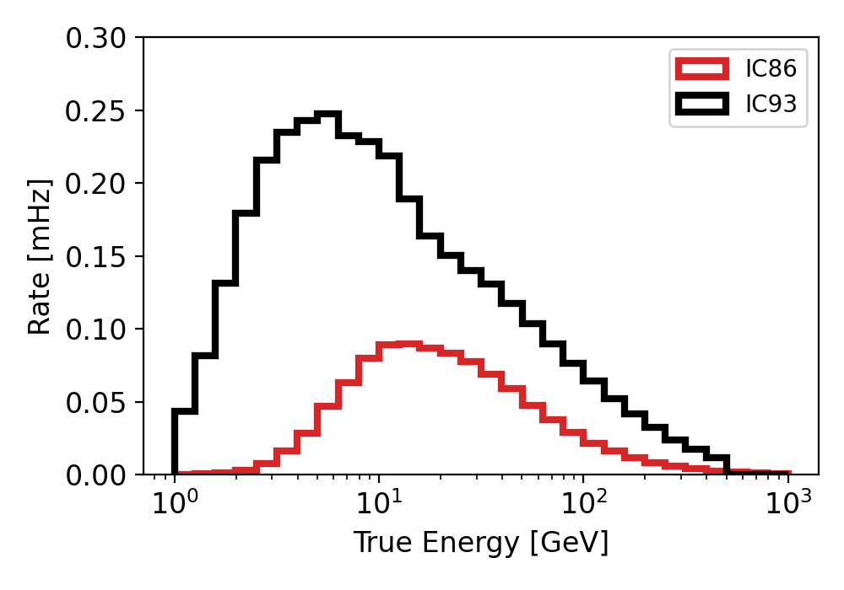
Expected Detector Performance
Expect to observe ~300,000 atmospheric neutrino events in the first 3 years of data taking
Atmospheric neutrino event rate in the Upgrade increases by a factor of 5 and shifts to lower energies compared to IceCube+DeepCore
Upgrade
~5x increase in event rate
IceCube
https://doi.org/10.48550/arXiv.2509.13066

Slide 27
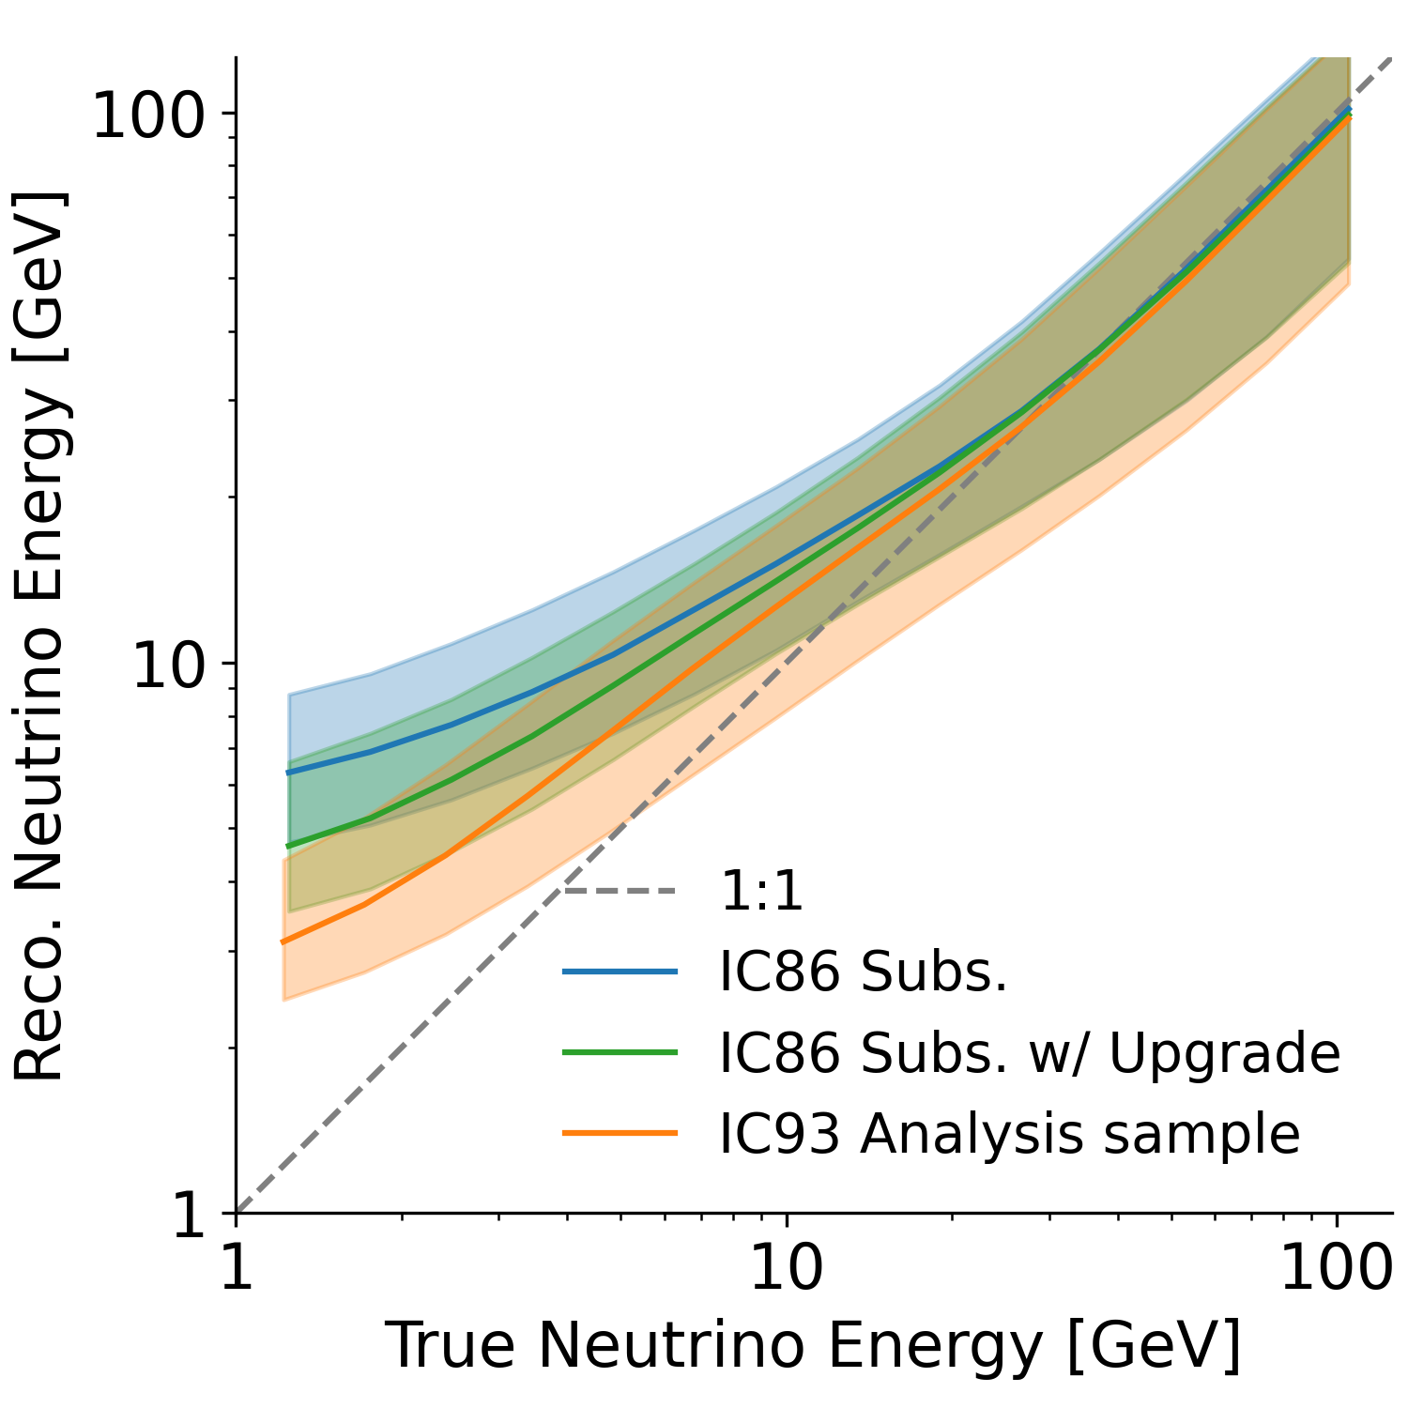
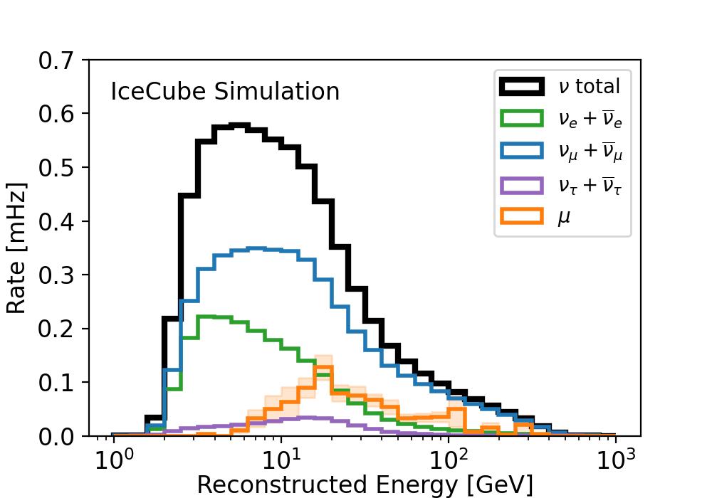
Expected Detector Performance
Energy resolution improves compared to IceCube+DeepCore
Reconstruction falls off at low energies, but new low energy reco methods are being developed
https://doi.org/10.48550/arXiv.2509.13066

Slide 28
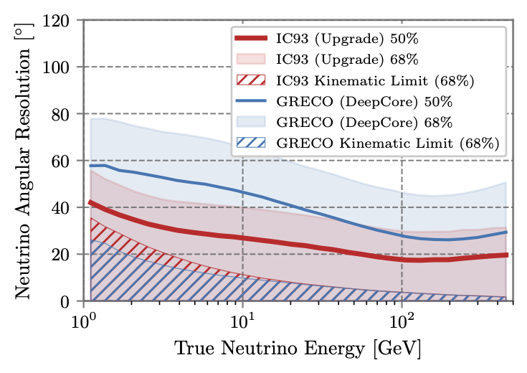
Expected Detector Performance
IceCube Upgrade is expected to significantly improve signal acceptance and angular resolution in the GeV energy range
At 10 GeV, DeepCore’s angular resolution is ~50°
Upgrade’s angular resolution is ~30° at 10 GeV
https://doi.org/10.48550/arXiv.2608.28395

Slide 29
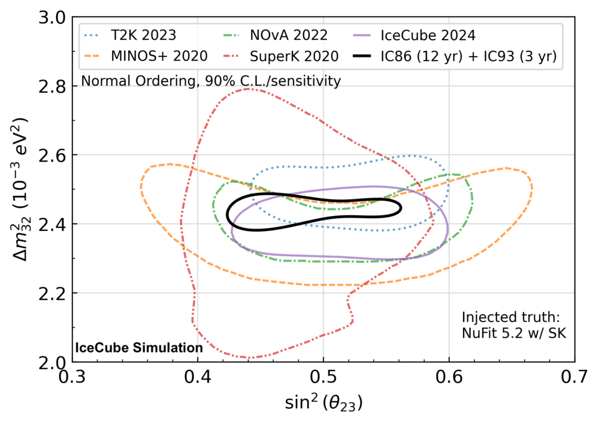
Science Prospects - Neutrino Oscillations
Expect to observe ~300,000 atmospheric neutrino events in the first 3 years of data taking
Unprecedented design sensitivity to fundamental neutrino properties
Improvement of 55-70% in area enclosed by 90% C.L. contour depending on injected truth
https://doi.org/10.48550/arXiv.2509.13066

Slide 30
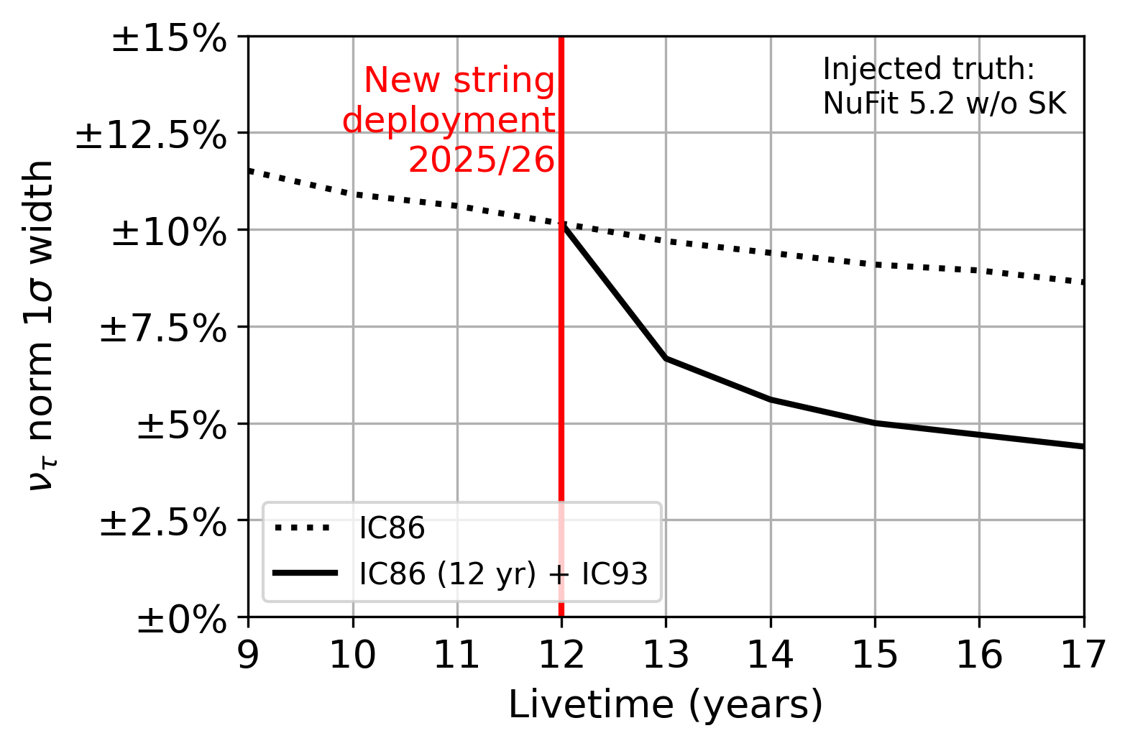
Science Prospects - Tau Neutrino Normalization
Improvement of ~40% of the 1𝜎 width
Without the Upgrade, 𝜈_{𝜏} normalization 1𝜎 width is ~9% after 15 years of livetime
With the addition of the new strings, 𝜈_{𝜏} normalization 1𝜎 width is ~5% after 3 years of Upgrade data taking
https://doi.org/10.48550/arXiv.2509.13066

Slide 31
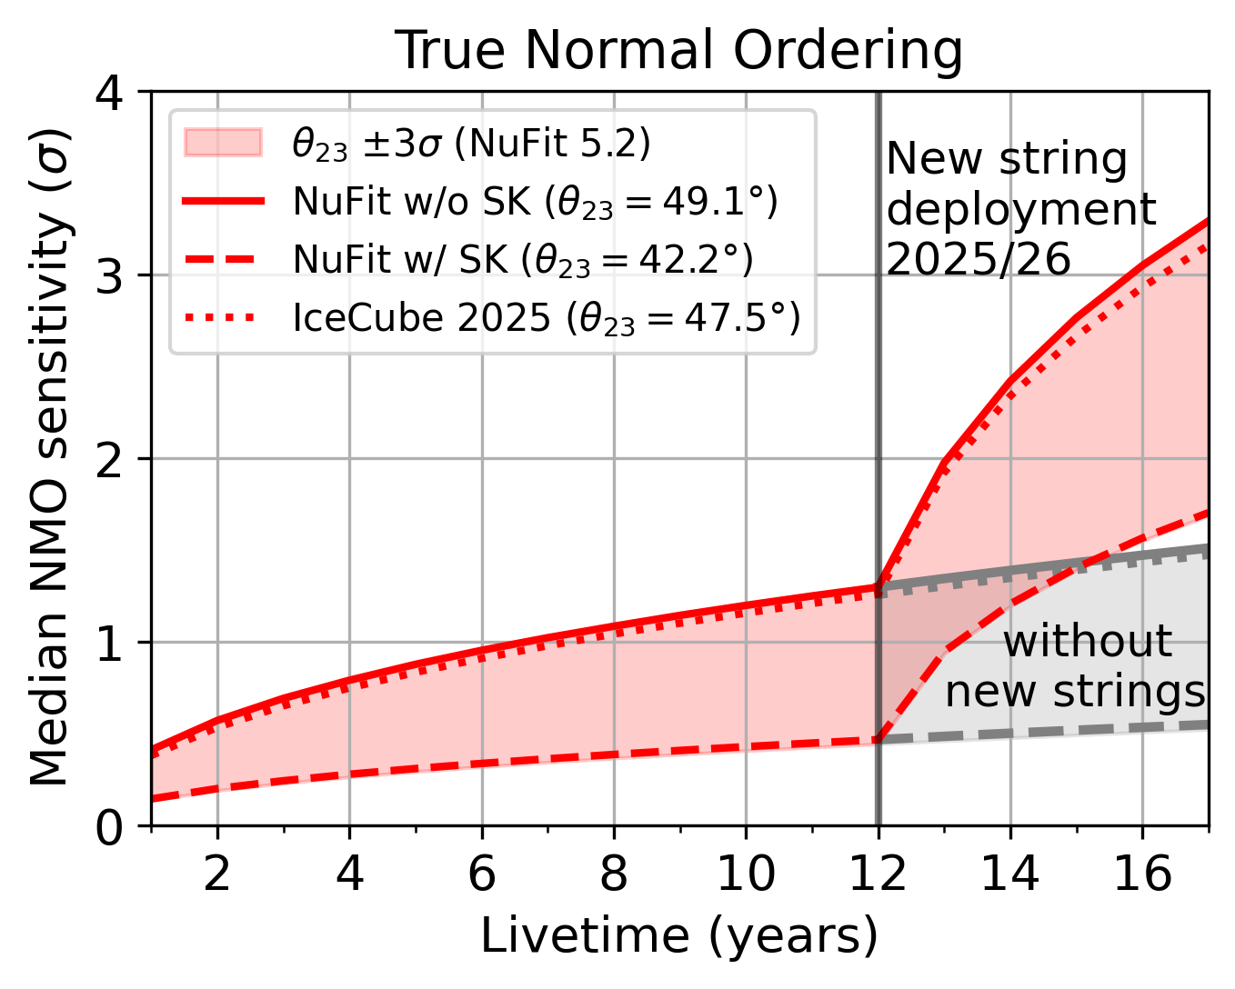
Science Prospects - Neutrino Mass Ordering
2-3 x improvement in the median Neutrino Mass Ordering sensitivity
Without the Upgrade, NMO sensitivity is ~1.5𝞼 after 15 years of livetime
With the addition of the new strings, NMO sensitivity is ~2.5𝞼 after 3 years of Upgrade data taking
https://doi.org/10.48550/arXiv.2509.13066

Slide 32
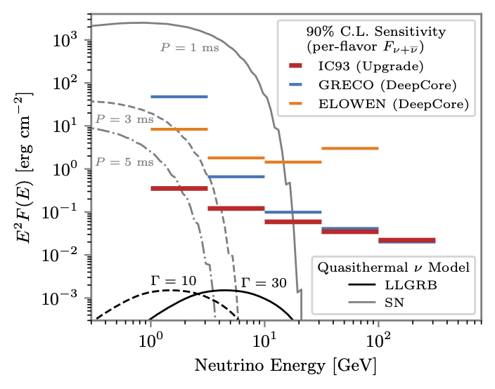
Science Prospects - Transient Neutrino Astronomy
Distinct GeV signature expected in quasithermal neutrinos from GRBs/SNe
Transient sensitivity expected to increase by an order of magnitude from DeepCore with ΔT = 1000s
Expect to see < 1 atmospheric neutrino in that time window
  Any excess in events, paired with resolving the direction, can result in higher significance
https://doi.org/10.48550/arXiv.2608.28395

Slide 33
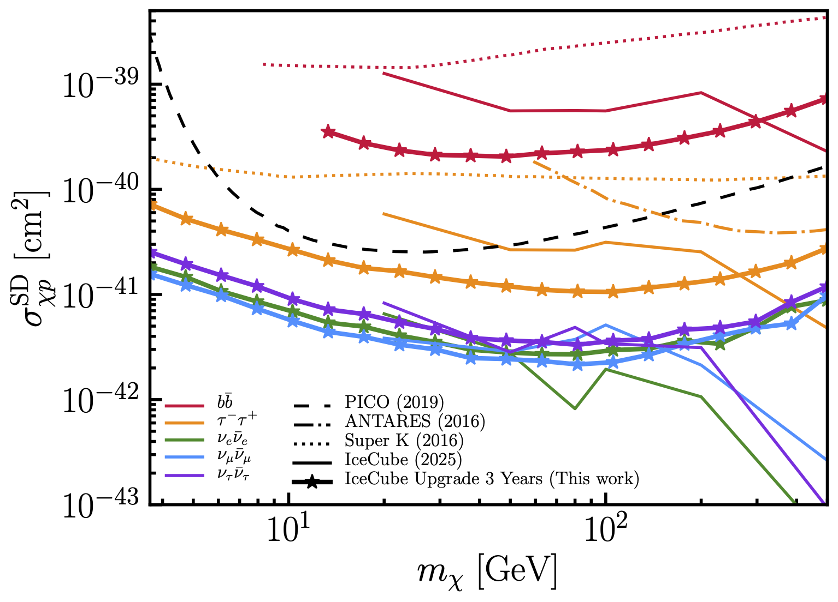
Science Prospects - Dark Matter
IceCube Upgrade is projected to become the most sensitive experiment to low-mass DM annihilation for masses up to approximately 200 GeV
Order of magnitude improvement for dark matter masses below 20 GeV when compared to DeepCore results
Upgrade substantially extends sensitivity to lower dark matter masses
https://doi.org/10.48550/arXiv.2605.06600

Slide 34
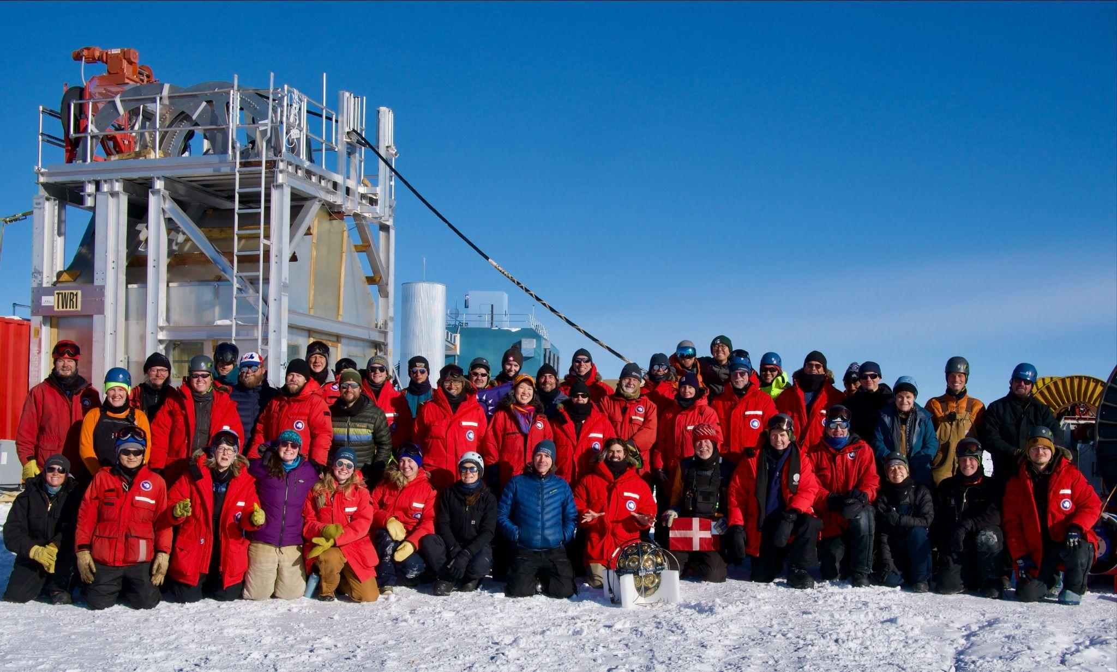
Current Status
Successfully installed and commissioned 5 strings in the IceCube Upgrade in 2025/26 Antarctic field season!
Early calibration and commissioning studies are ongoing
  Ice modeling, geometry calibration, hit timing
Expecting to fully integrate the Upgrade into the IceCube DAQ and begin taking physics data by the end of the year
Photo credit: Colton Hill

Slide 35
Outlook
Expecting to meet or exceed all projected science goals in neutrino oscillations, astronomy studies, and dark matter sensitivity
Important milestone for IceCube-Gen2!
Photo credit: Colton Hill

Slide 36
Backup Slides

Slide 37
Trigger Data Flow
Upgrade readout
IceCube readout
Event Builder
Global Trigger
Hitspool 88-92
All hits from Upgrade strings
Upgrade Trigger
IceCube Trigger
StringHubs 1-86
All hits from IceCube strings
ULC Flagged Hits
Leaving Pre-Trigger
No longer string scoped
StringHubs 88-92
PreTrigger flags string-scoped Upgrade LC hits
88
89
90
91
92
All Upgrade Hits
All IceCube + IceTop Hits

Slide 38
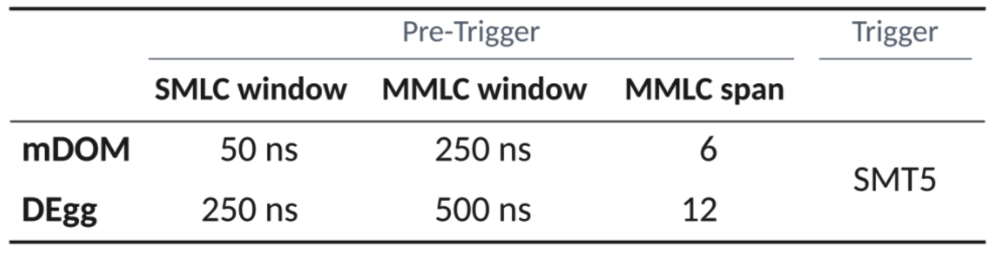
String Level Pre-Trigger
Pre-Trigger identifies hits on single strings which meet “Upgrade Local Coincidence” (ULC) conditions
  Single Module LC (SMLC) = 2 hits on different channels (pmts) on the same module
    Within some module window 𝚫t_{SMLC}
  Multi Module LC (MMLC) = 2 hits on different modules on the same string
    Within some MMLC window 𝚫t_{MMLC} and vertical span
𝜇

Slide 39
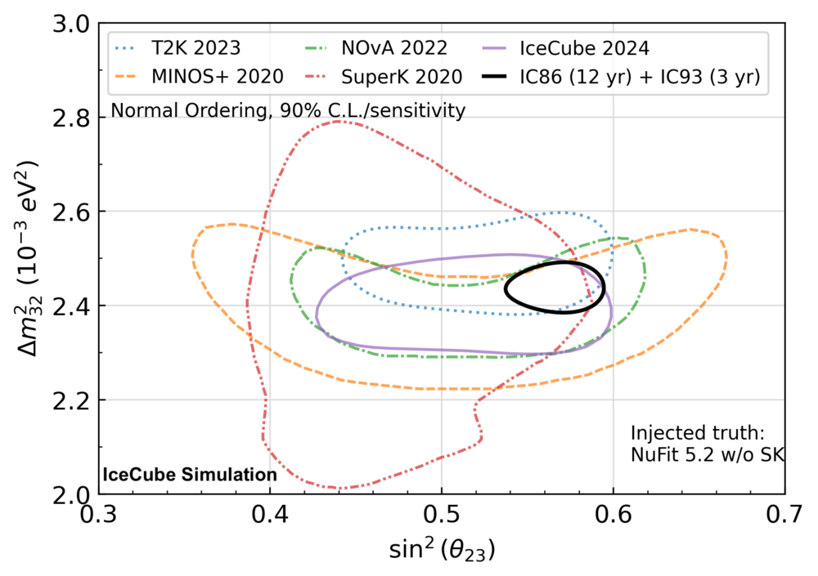
Science Prospects - Neutrino Oscillations
Expect to observe ~300,000 atmospheric neutrino events in the first 3 years of data taking
Unprecedented design sensitivity to fundamental neutrino properties
Improvement of 55-70% in area enclosed by 90% C.L. contour depending on injected truth
https://doi.org/10.48550/arXiv.2509.13066

Slide 40
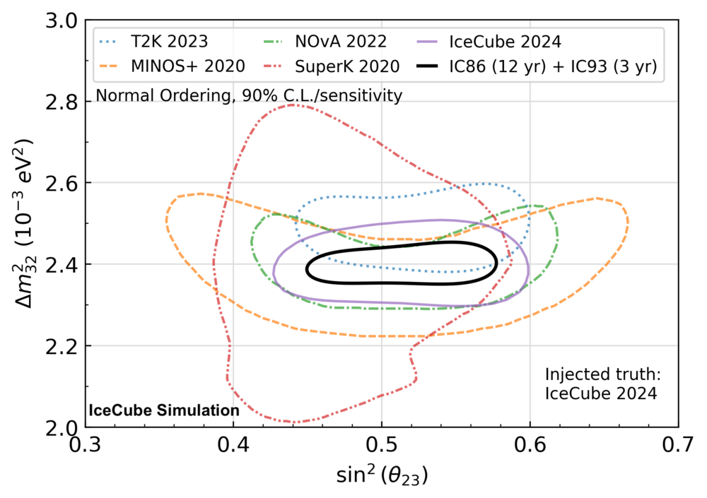
Science Prospects - Neutrino Oscillations
Expect to observe ~300,000 atmospheric neutrino events in the first 3 years of data taking
Unprecedented design sensitivity to fundamental neutrino properties
Improvement of 55-70% in area enclosed by 90% C.L. contour depending on injected truth
https://doi.org/10.48550/arXiv.2509.13066

Slide 41
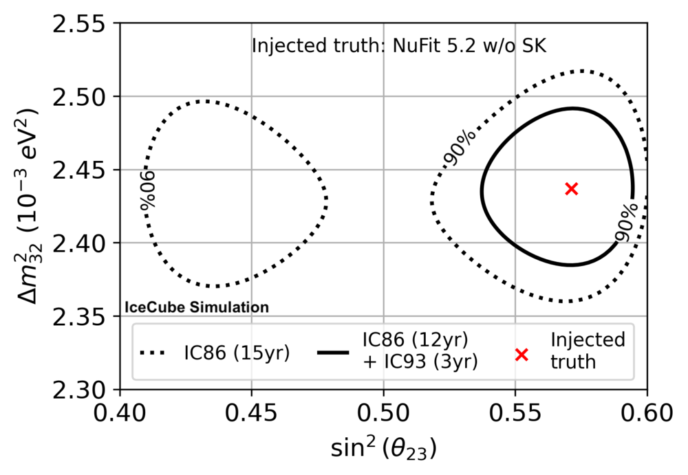
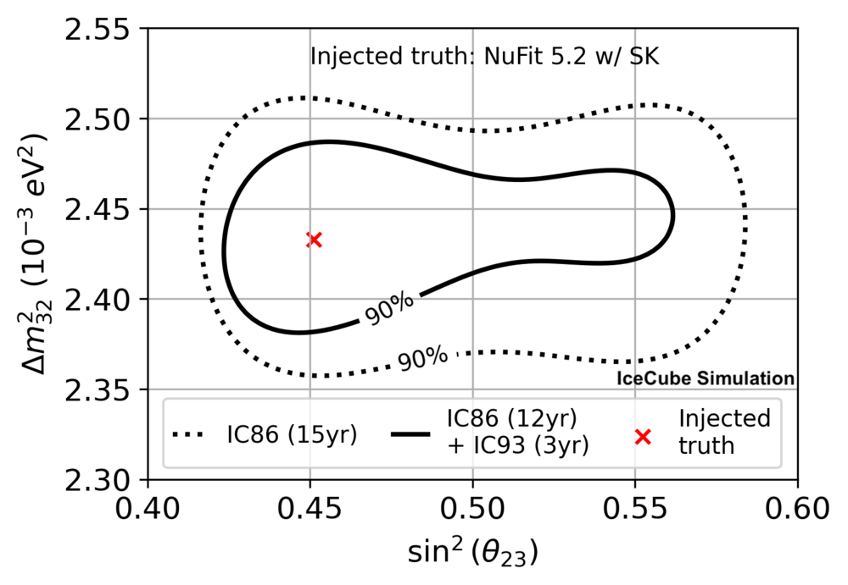
Science Prospects - NuMu Disappearance
Comparing to IceCube+DeepCore with comparable livetime

Slide 42
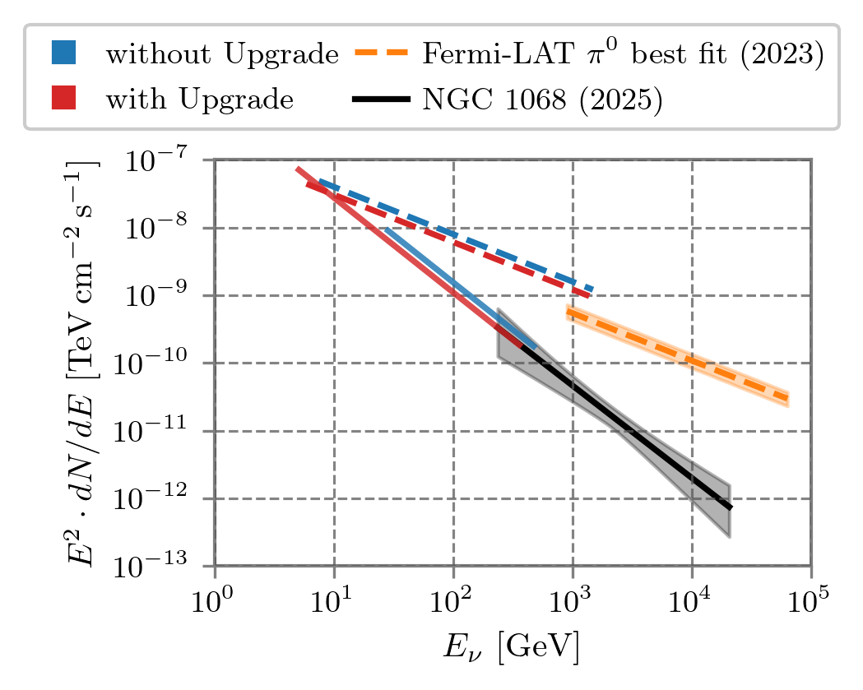
Science Prospects - Steady State Neutrino Astronomy
Improvement for steady state sources comes from accumulation of data livetime
Most significant improvements for soft-spectrum sources and those located in the southern sky
Lowering energy threshold will extend observation window down to lower energies
https://doi.org/10.48550/arXiv.2608.28395

Slide 43

Science Prospects - Neutrino Mass Ordering
2-3 x boost in median Neutrino Mass Ordering sensitivity
https://doi.org/10.48550/arXiv.2509.13066

