Slide 1



What Makes IceCube-Selected Blazars So Extreme?
alexander@plav.in · https://plav.in
Sasha (Alexander) Plavin
National Radio Astronomy Observatory · Jansky Fellow
member of

Slide 2
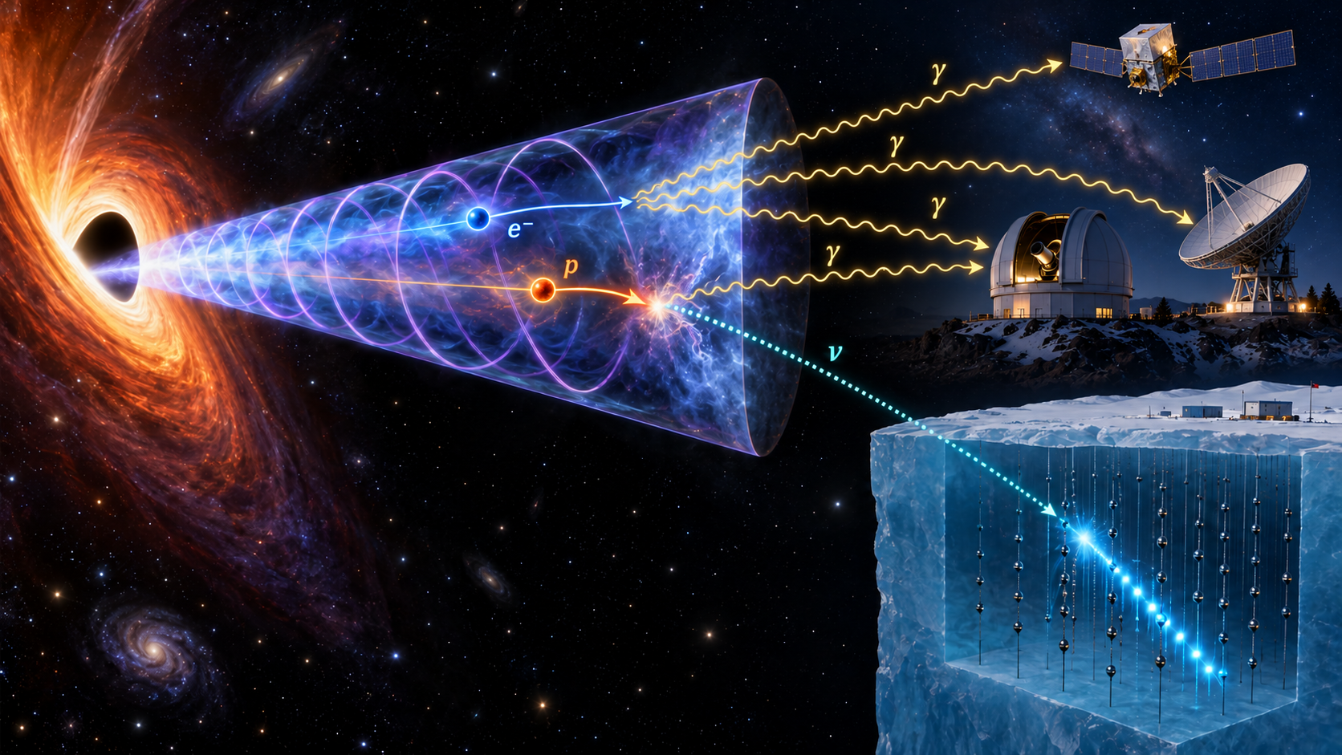
Neutrinos: the most direct
tracers of accelerated protons
(but see Justin’s talk next)

Slide 3
Population studies · what I typically talk about
IceCube+23
Reproduces our calculations
(disagree on interpretation)
Plavin+24
Hard X-rays from neutrino blazars
Plavin+20
Neutrinos come from bright radio blazars
Plavin+23
Same analysis, 3 yr more data
Plavin+25
Neutrinos come from the most strongly beamed jets
3.1σ
3.6σ
3.0σ

Slide 4
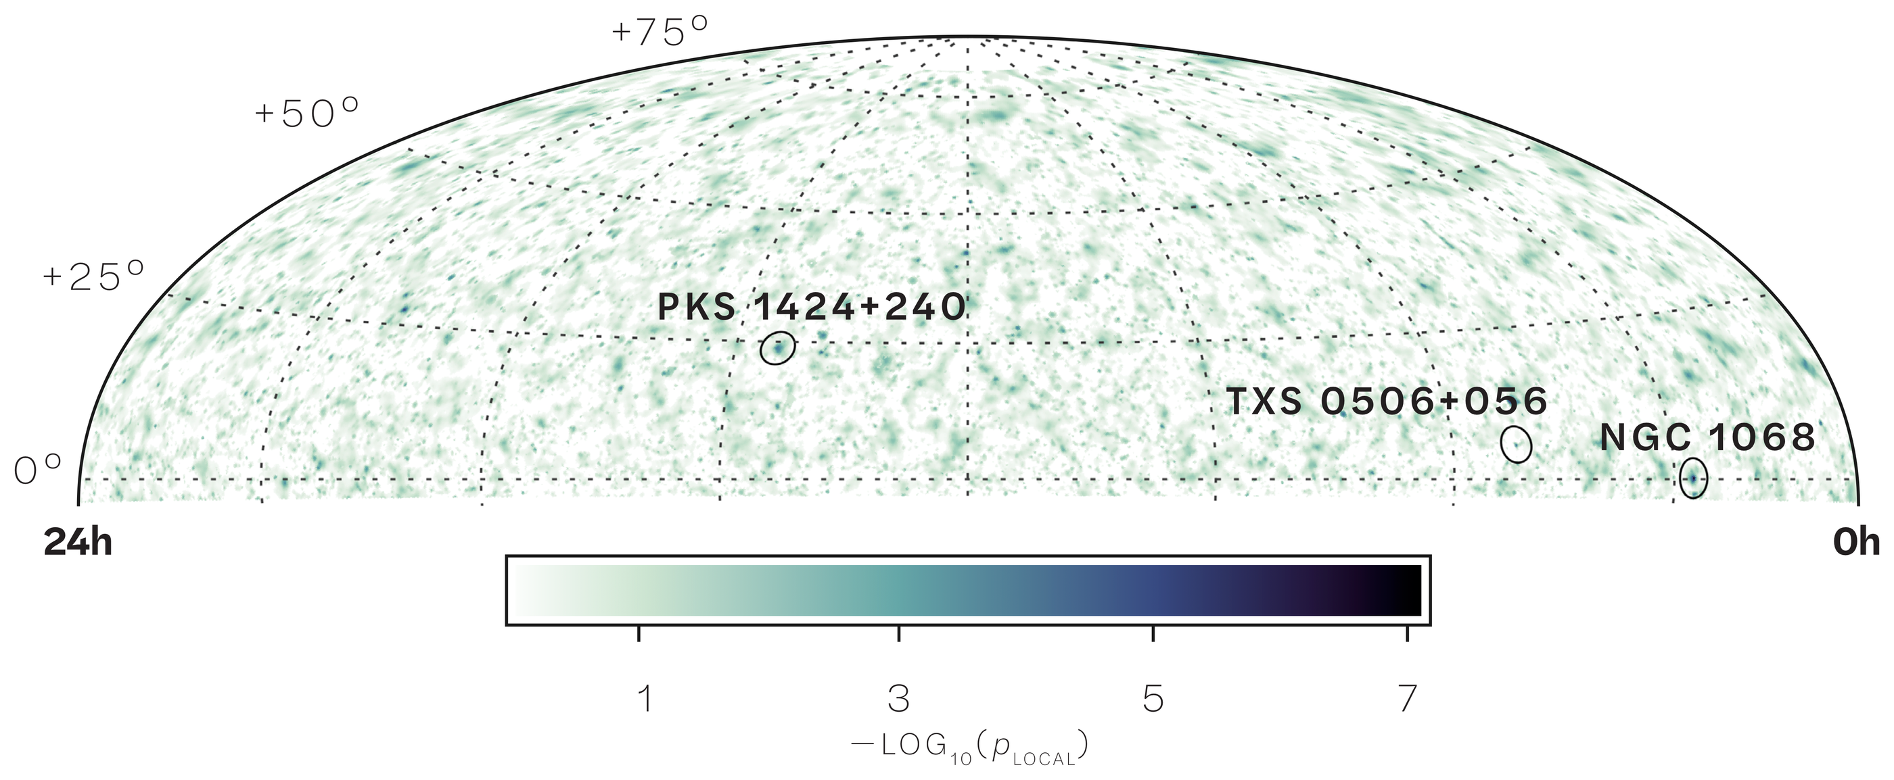
Top-3 neutrino sources from IceCube map
IceCube+22

Slide 5
Top-3 neutrino sources from IceCube map
Two of the three are known blazars
IceCube+22

Slide 6
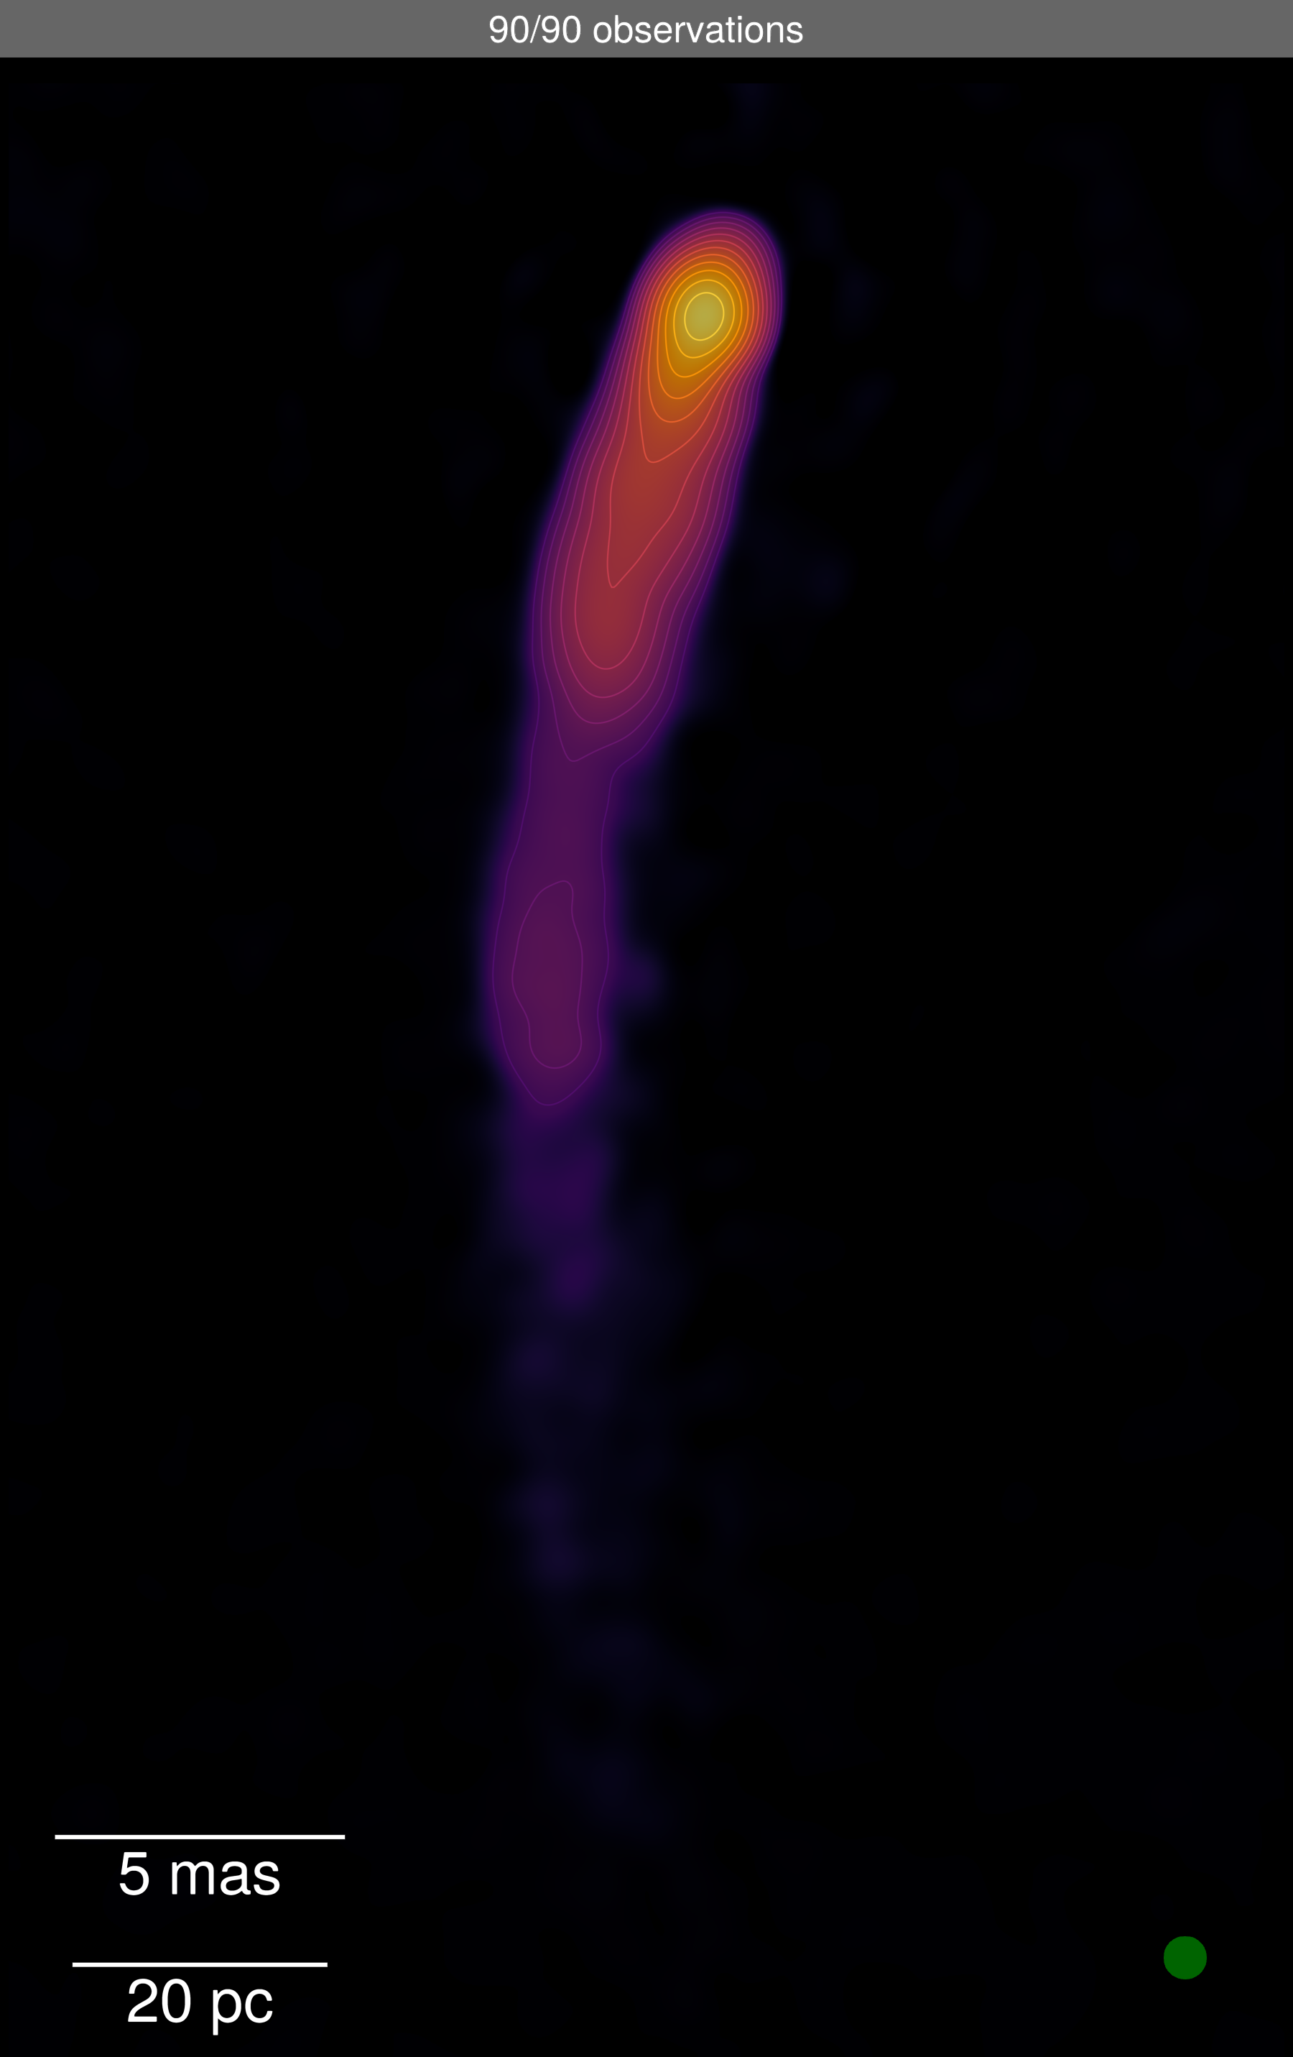
Blazar: AGN with a jet pointing closely towards us
J1927+7358
Plavin+25

Slide 7
PKS 1424+240
The most extreme blazar known?
(with the most closely Earth-aligned jet)

Slide 8
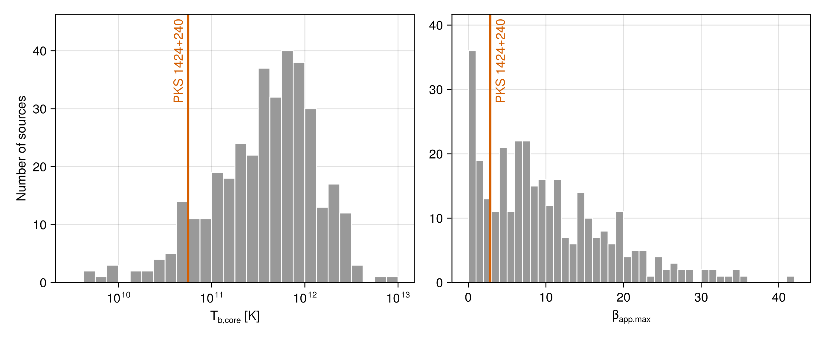
PKS 1424+240 never stood out in blazar population studies
Homan+21

Slide 9
PKS 1424+240 never stood out in blazar population studies
…until IceCube prompted us to look closer
Homan+21

Slide 10
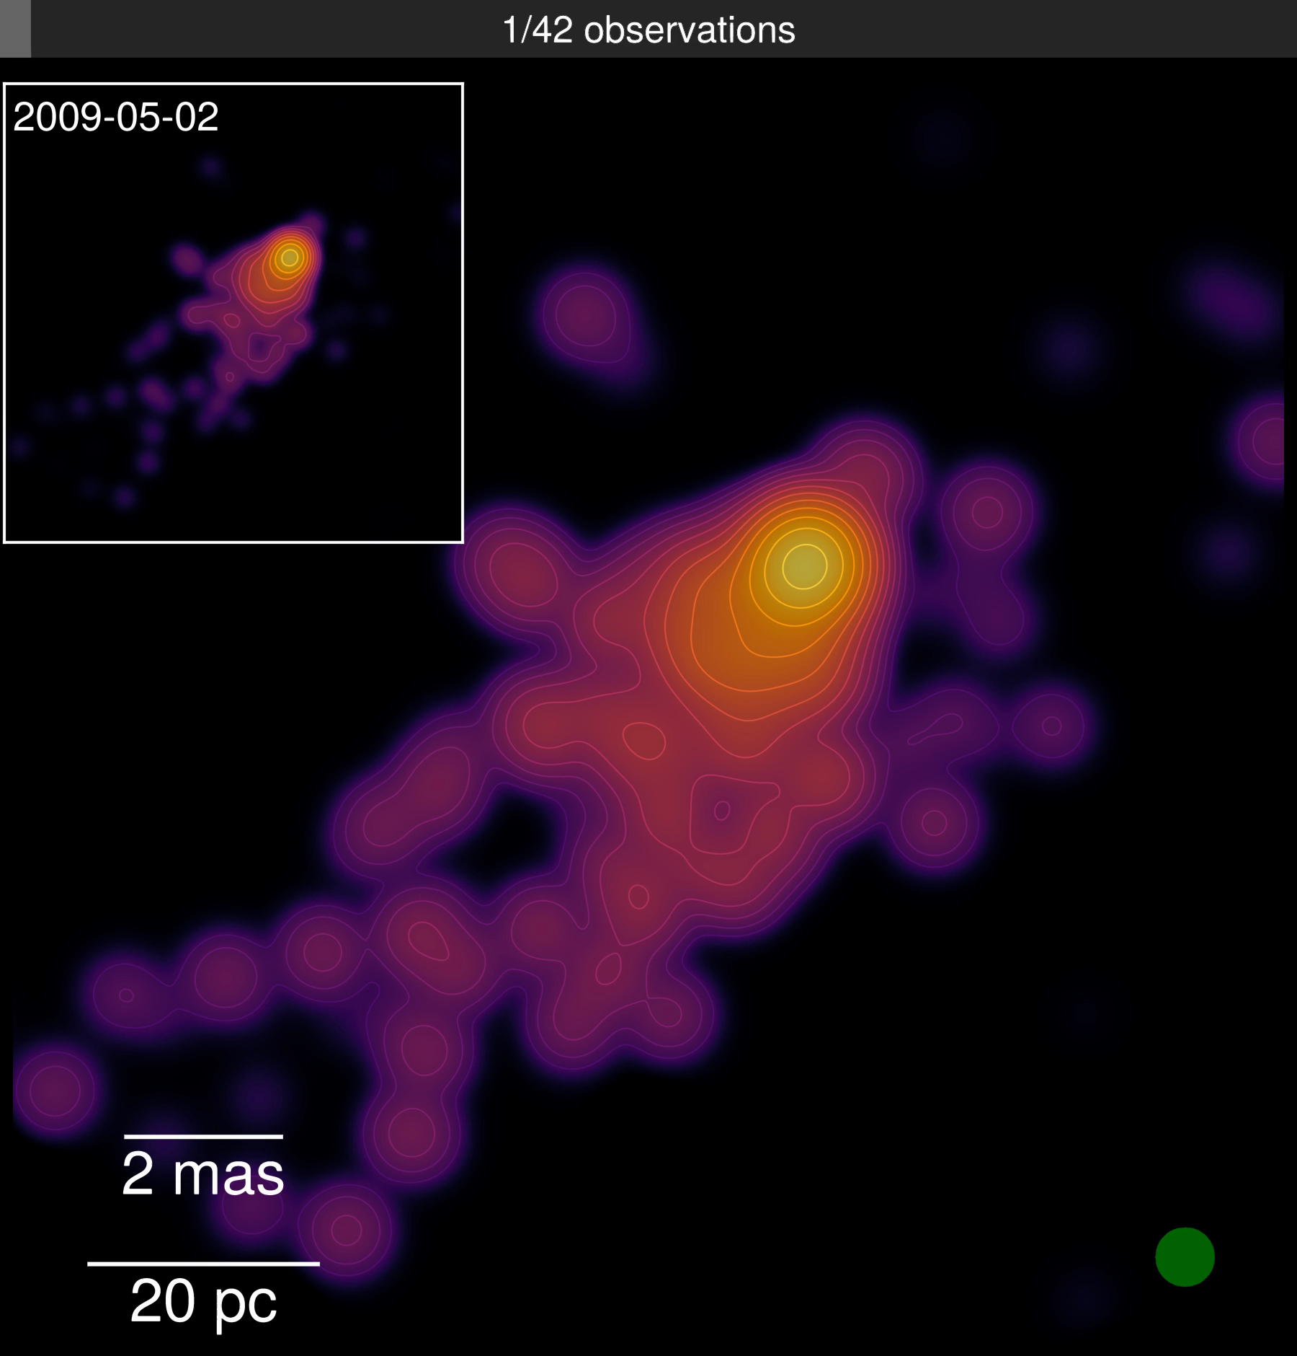
Extreme jet alignment?
PKS 1424+240

Slide 11
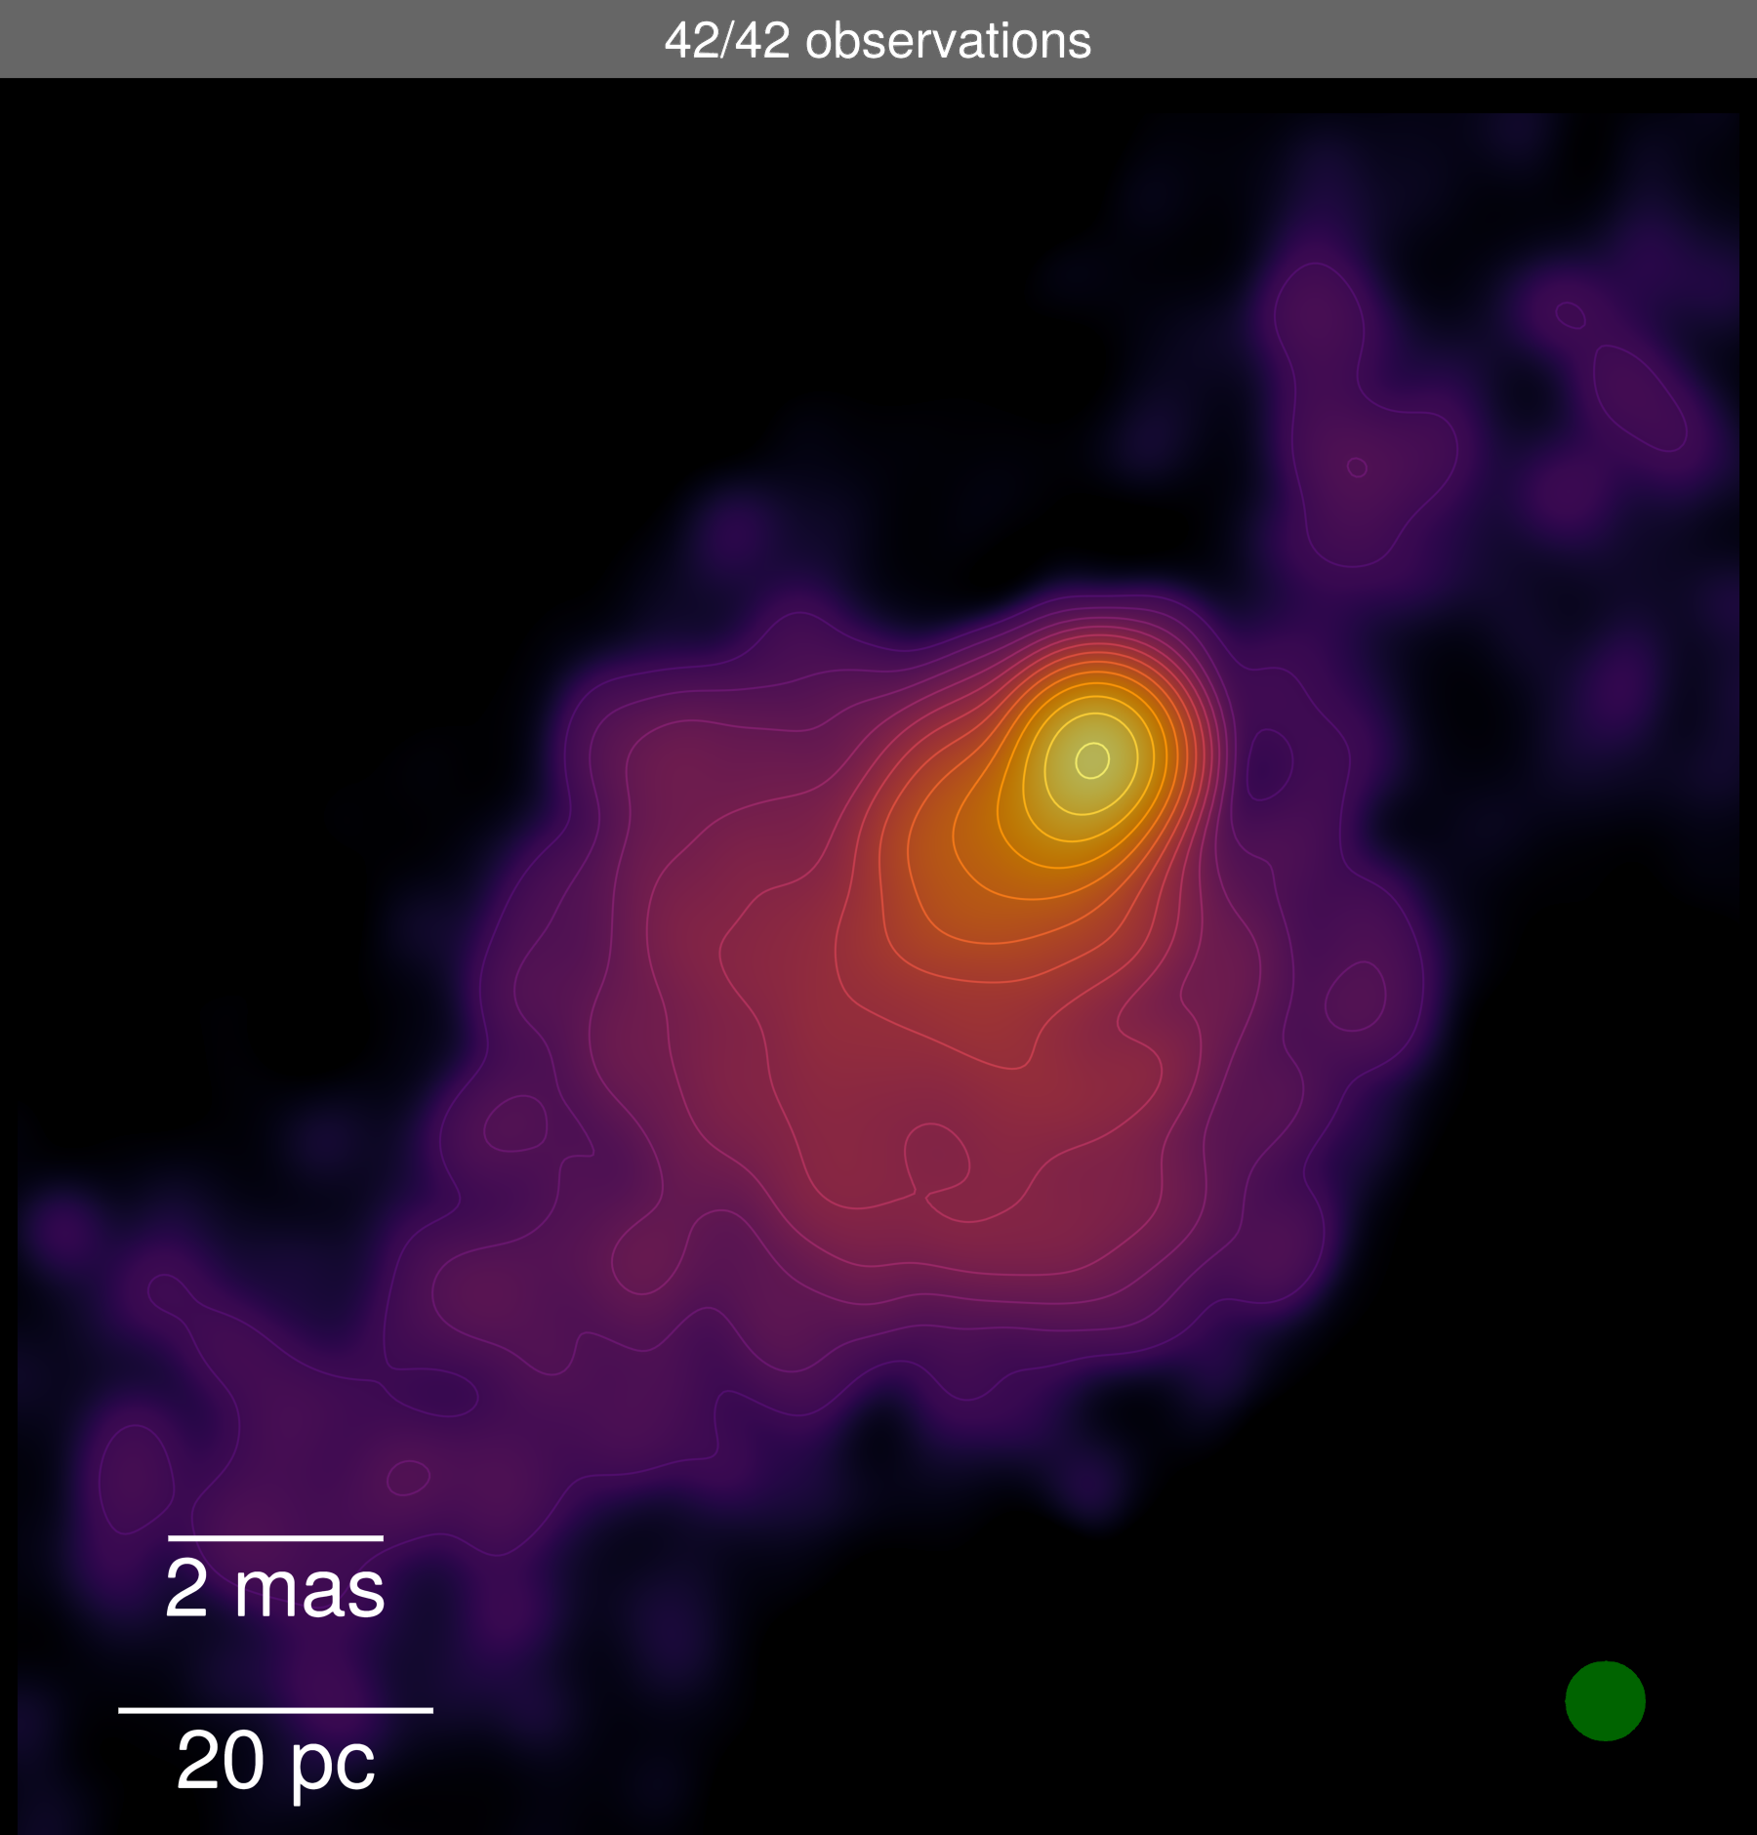
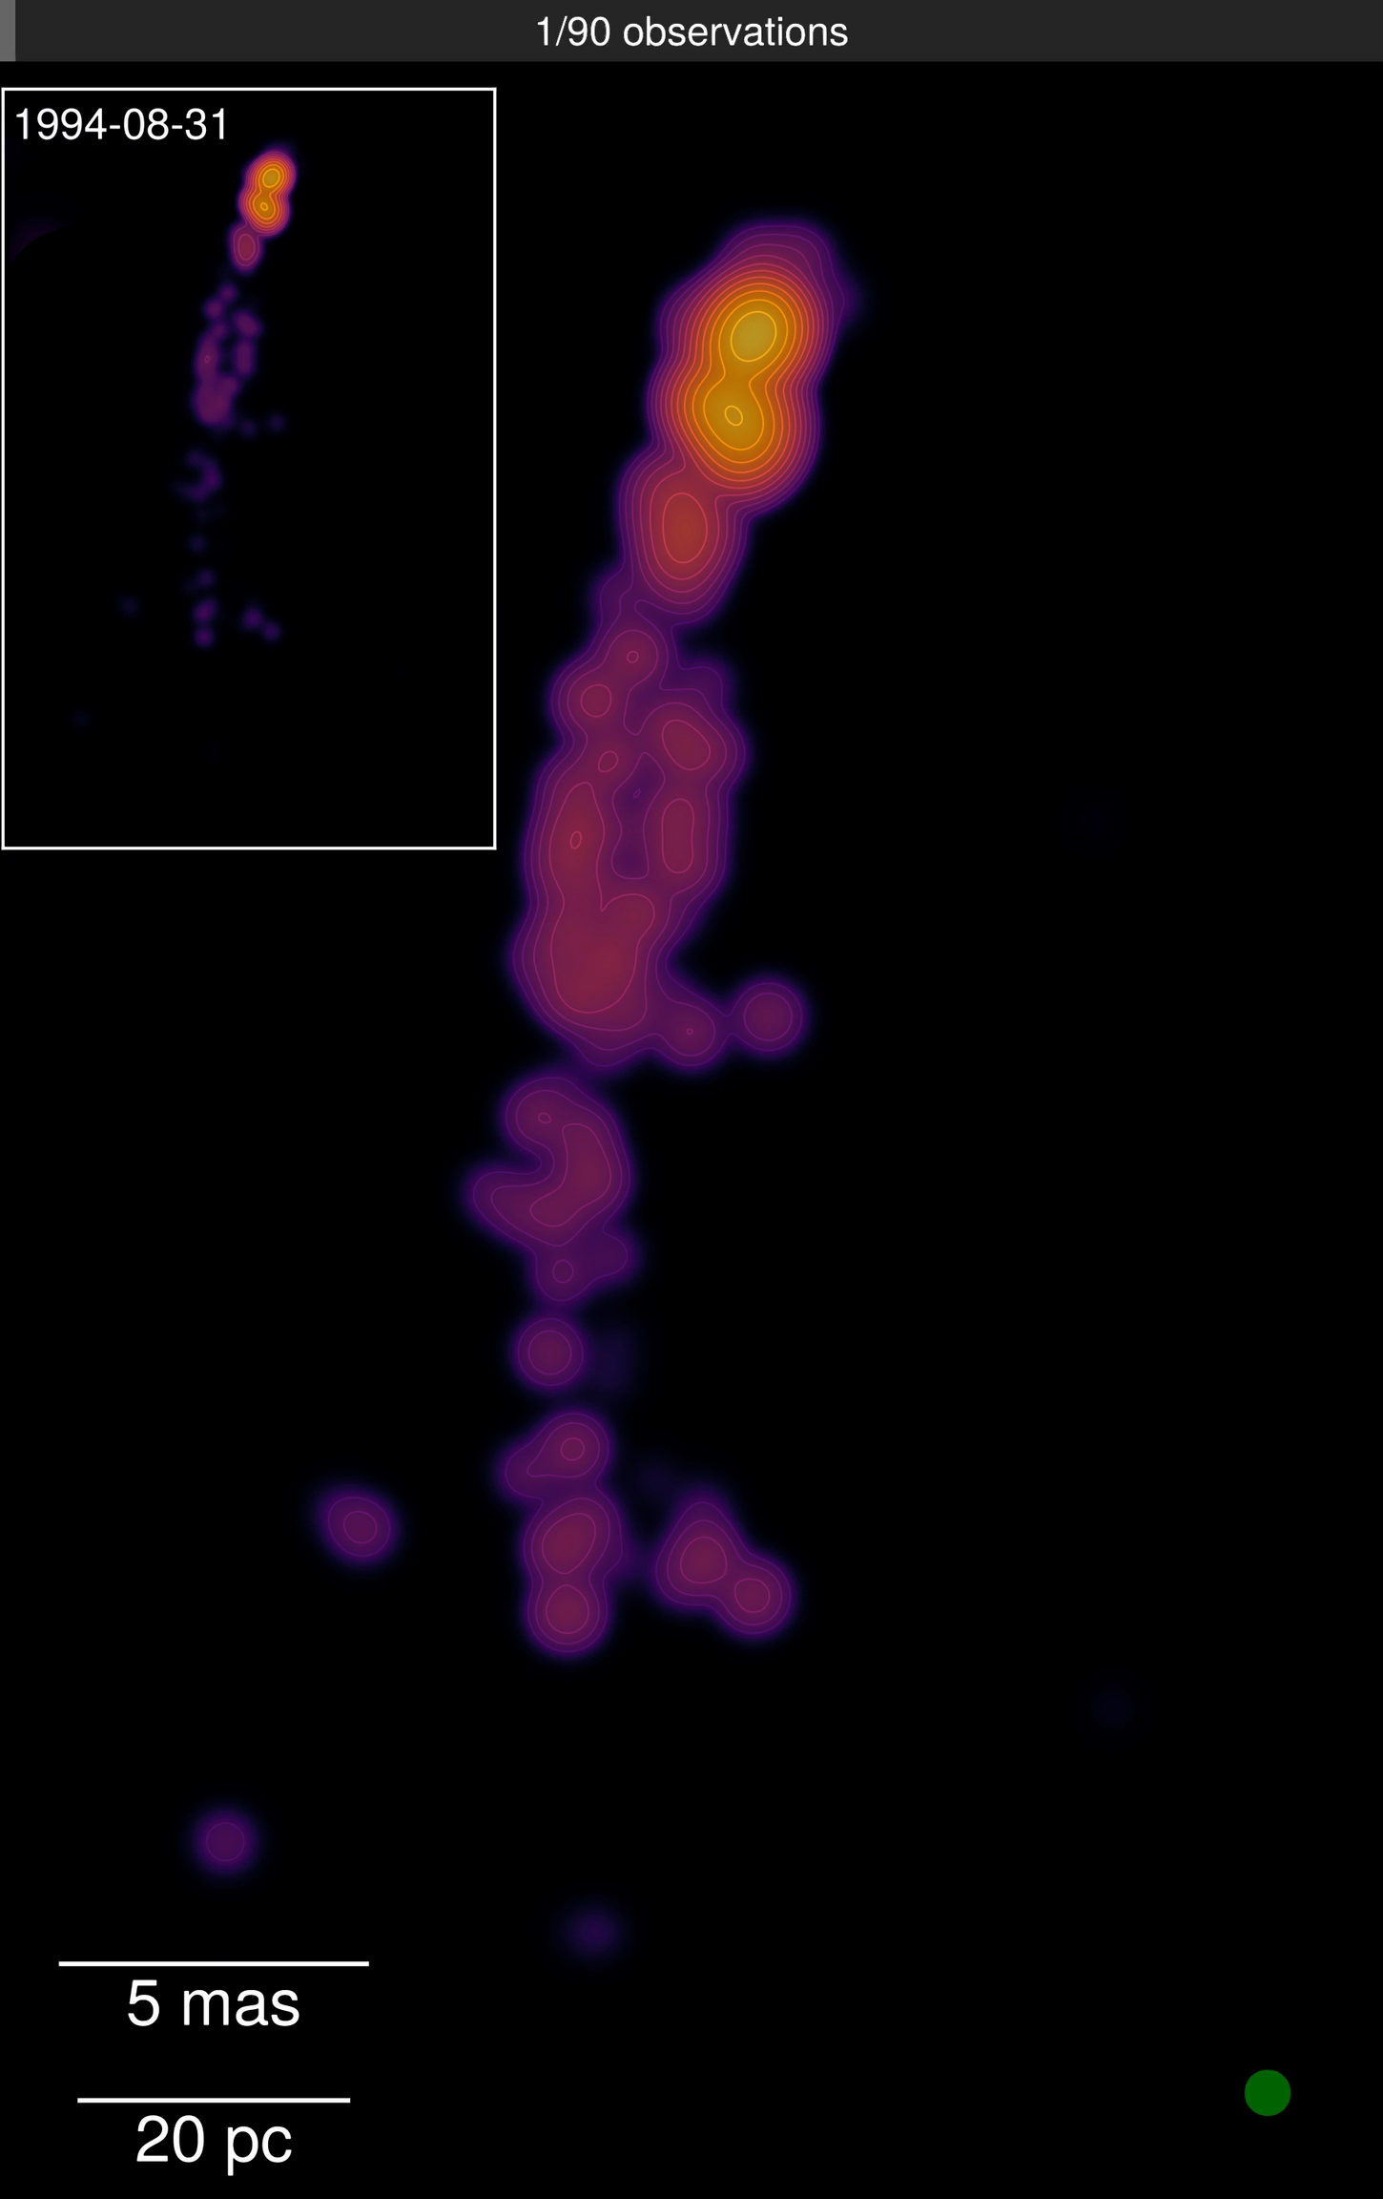
Extreme jet alignment
PKS 1424+240
J1927+7358

Slide 12
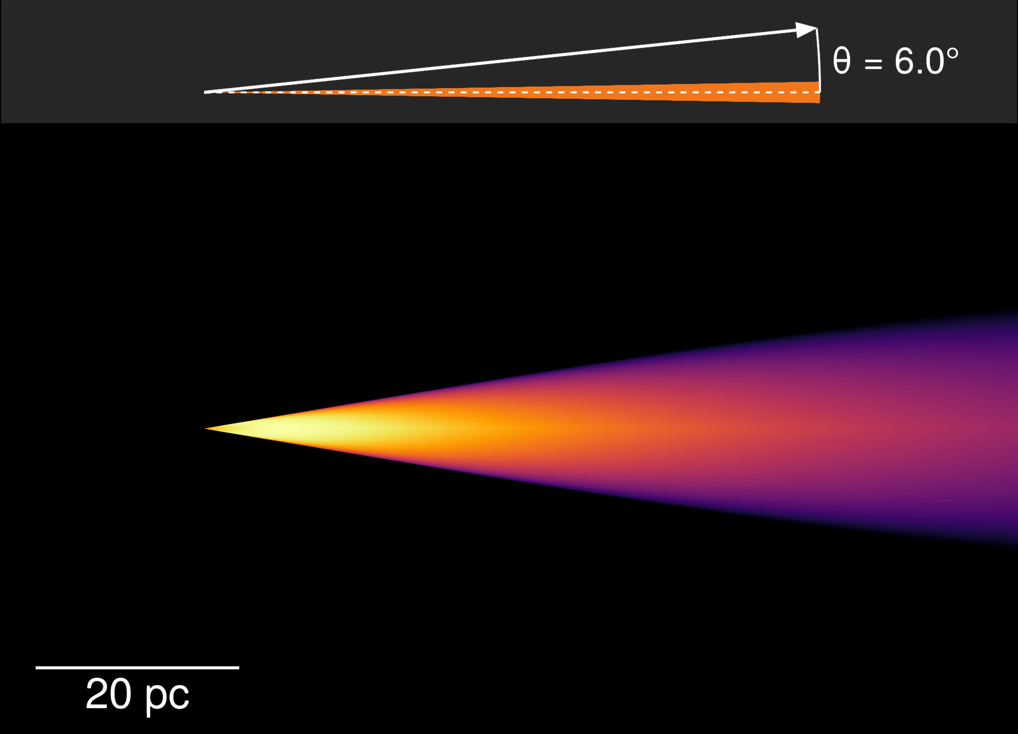
Extreme jet alignment
PKS 1424+240
J1927+7358
Simulations with Synchray.jl

Slide 13
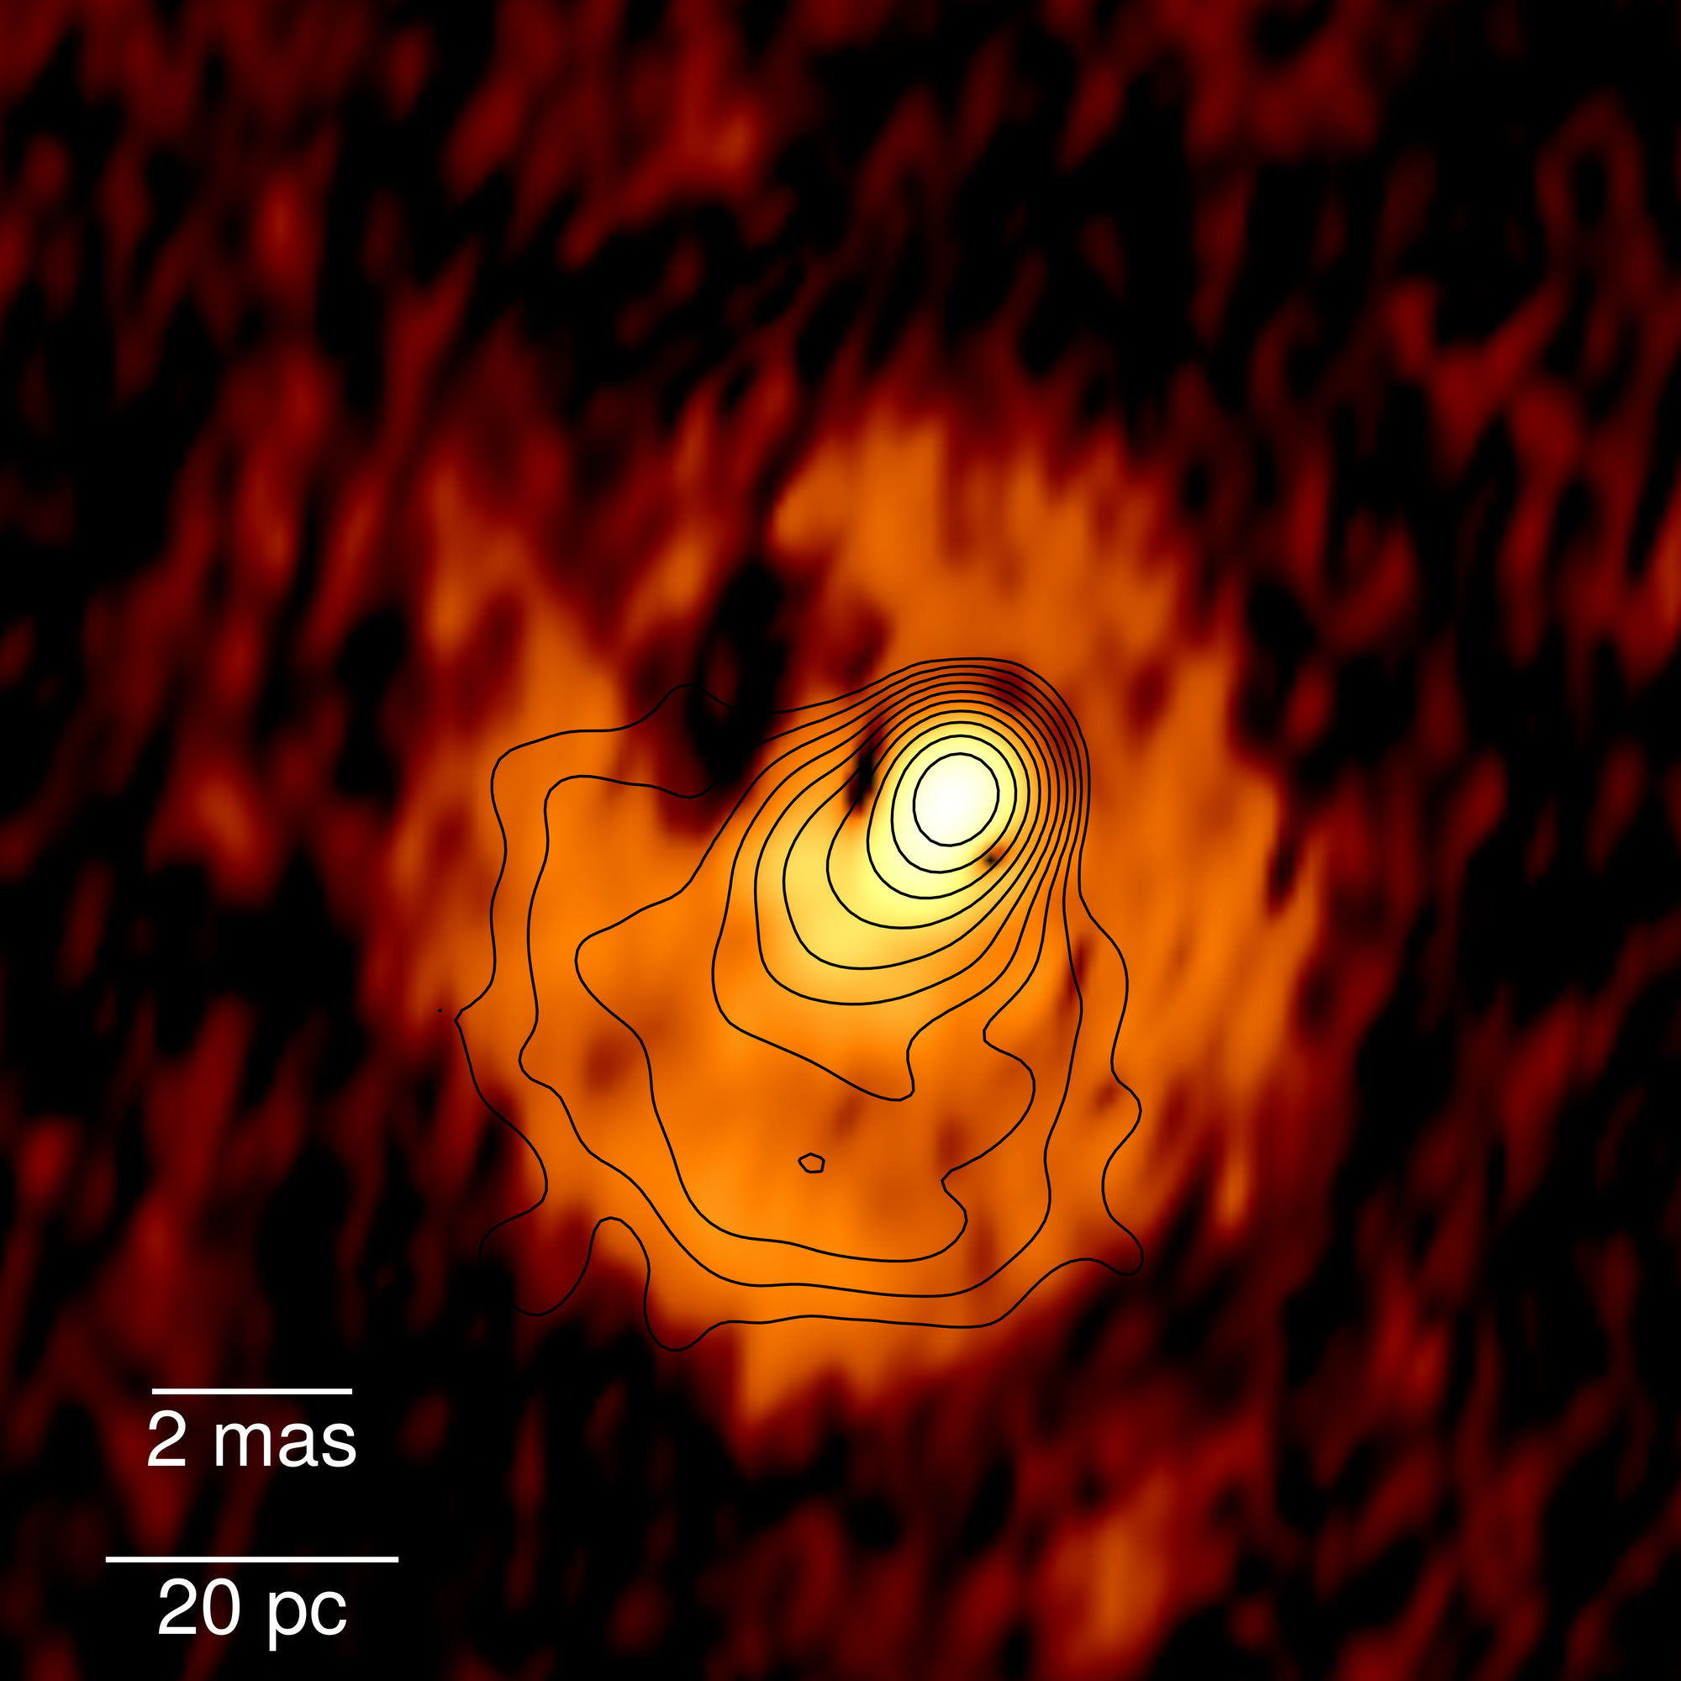
Extreme jet alignment
PKS 1424+240 · polarization

Slide 14
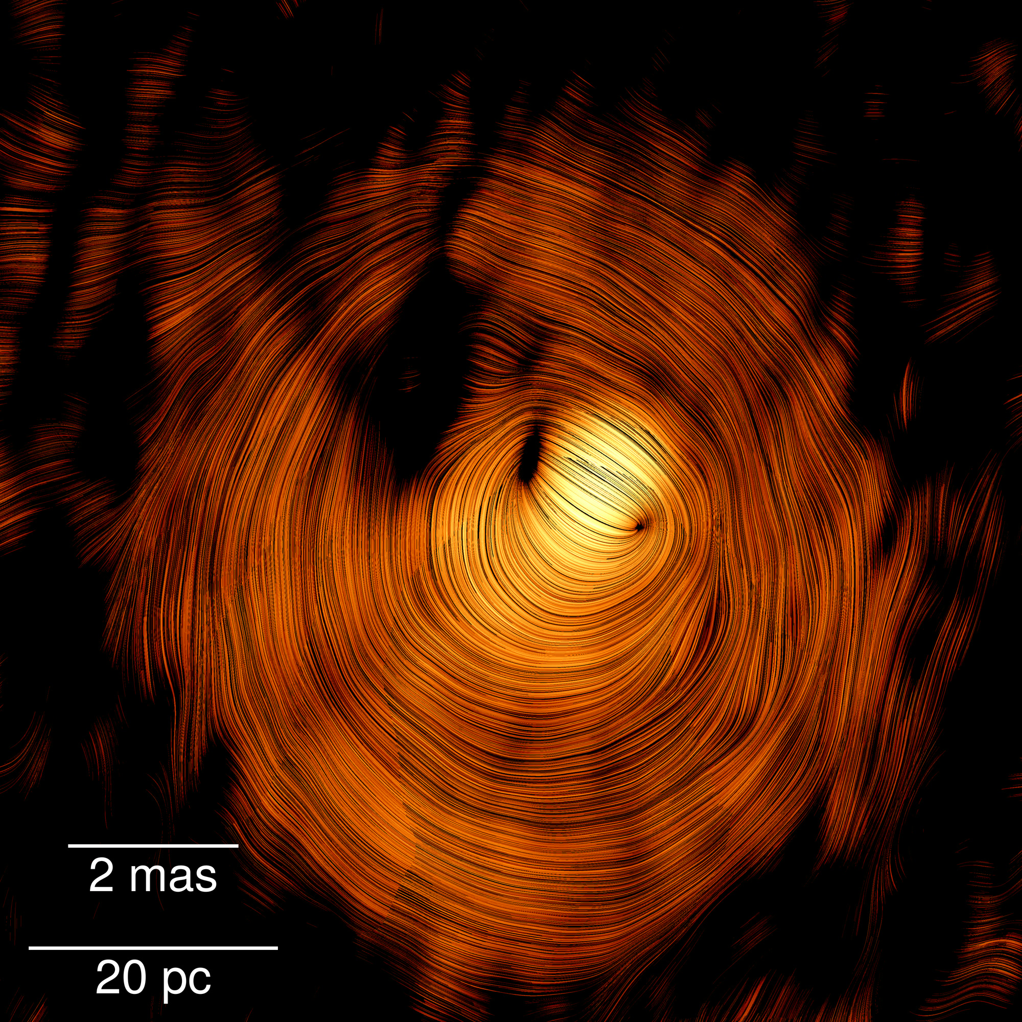
Extreme jet alignment
PKS 1424+240 · polarization
+ magnetic field direction

Slide 15
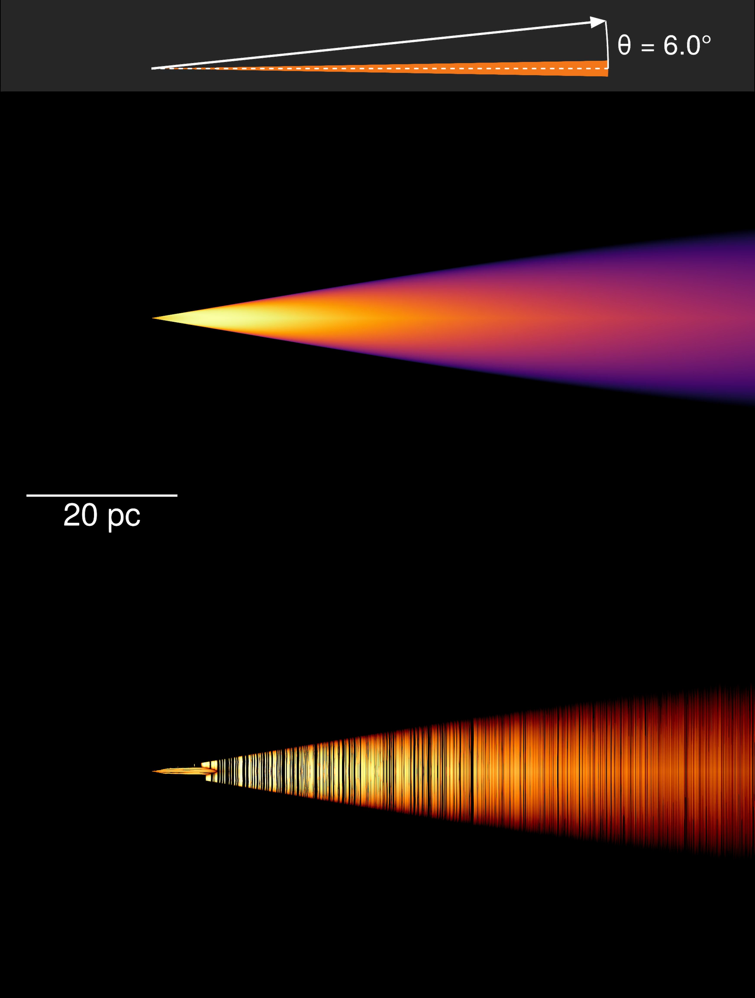
Extreme jet alignment
PKS 1424+240
polarization
Simulations with Synchray.jl

Slide 16
TXS 0506+056
Understanding the OG

Slide 17
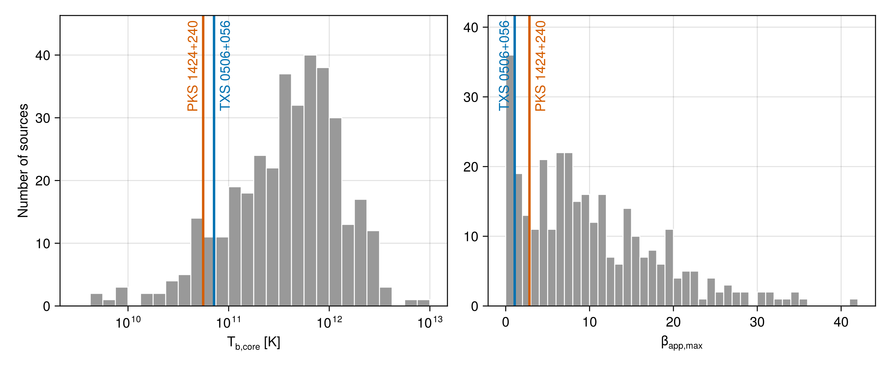
Our regular blazar, one of many hundreds
Homan+21

Slide 18
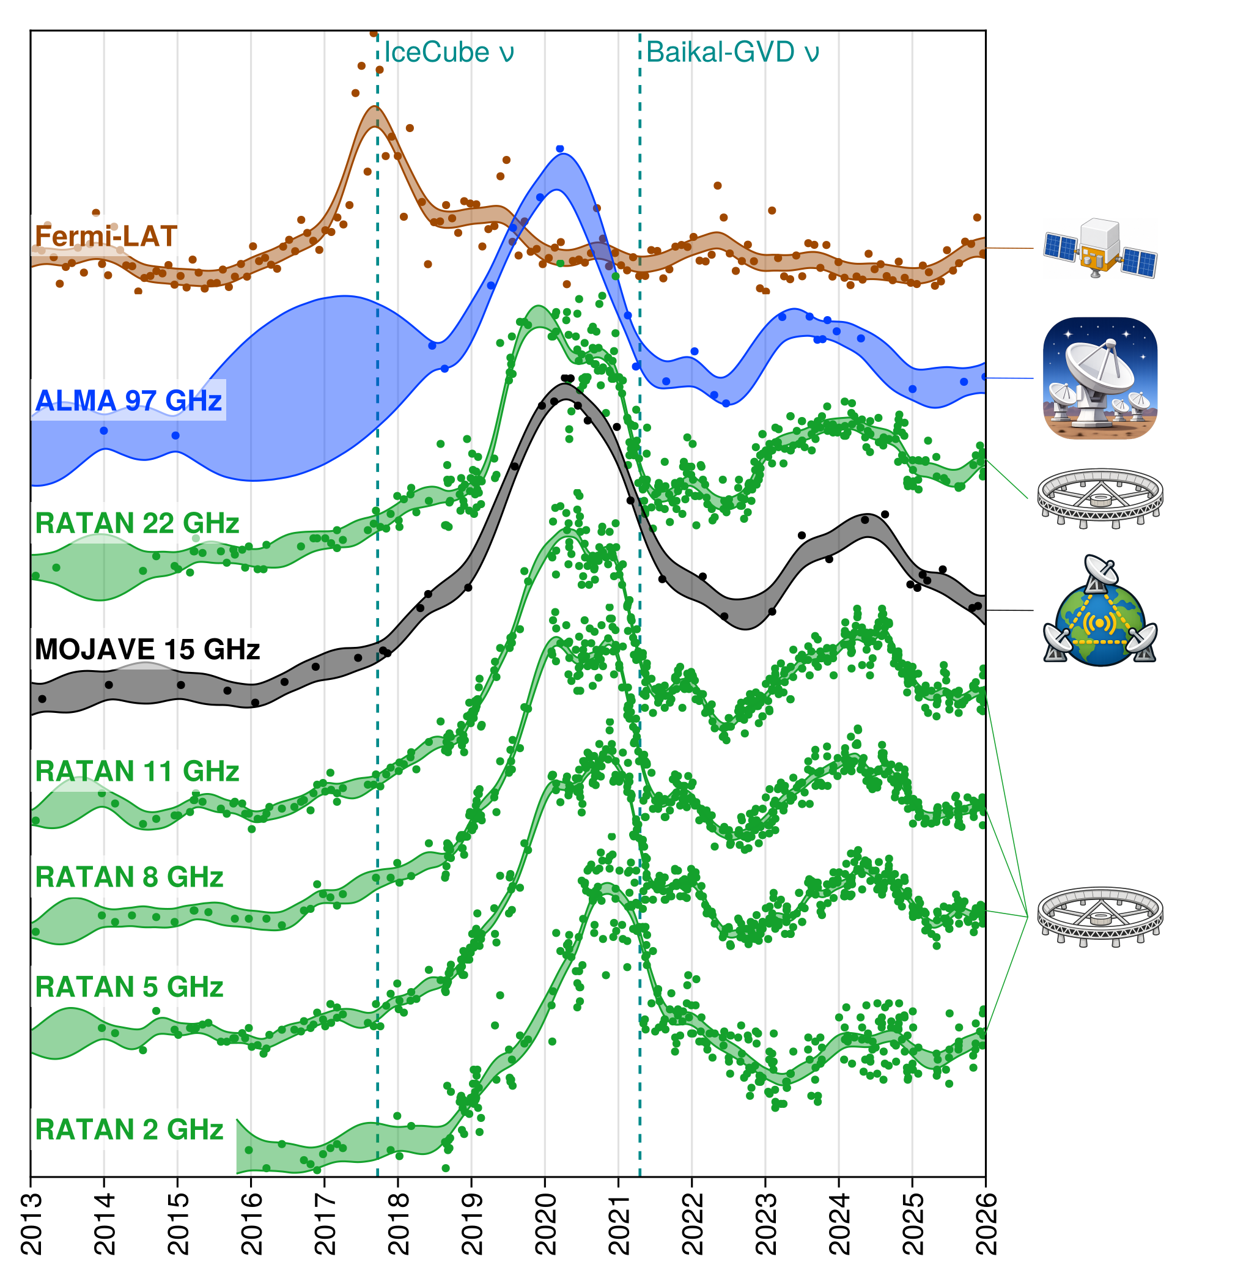
Our regular blazar, one of many hundreds
…until it flared

Slide 19
Best case to study multiband flares?
Very unusual:
Slow apparent pattern speed vs major flare & γ-ray flux — the “Doppler crisis”
Long γ→radio delay (typically a few months: Liodakis+18, Kramarenko+22)

Slide 20
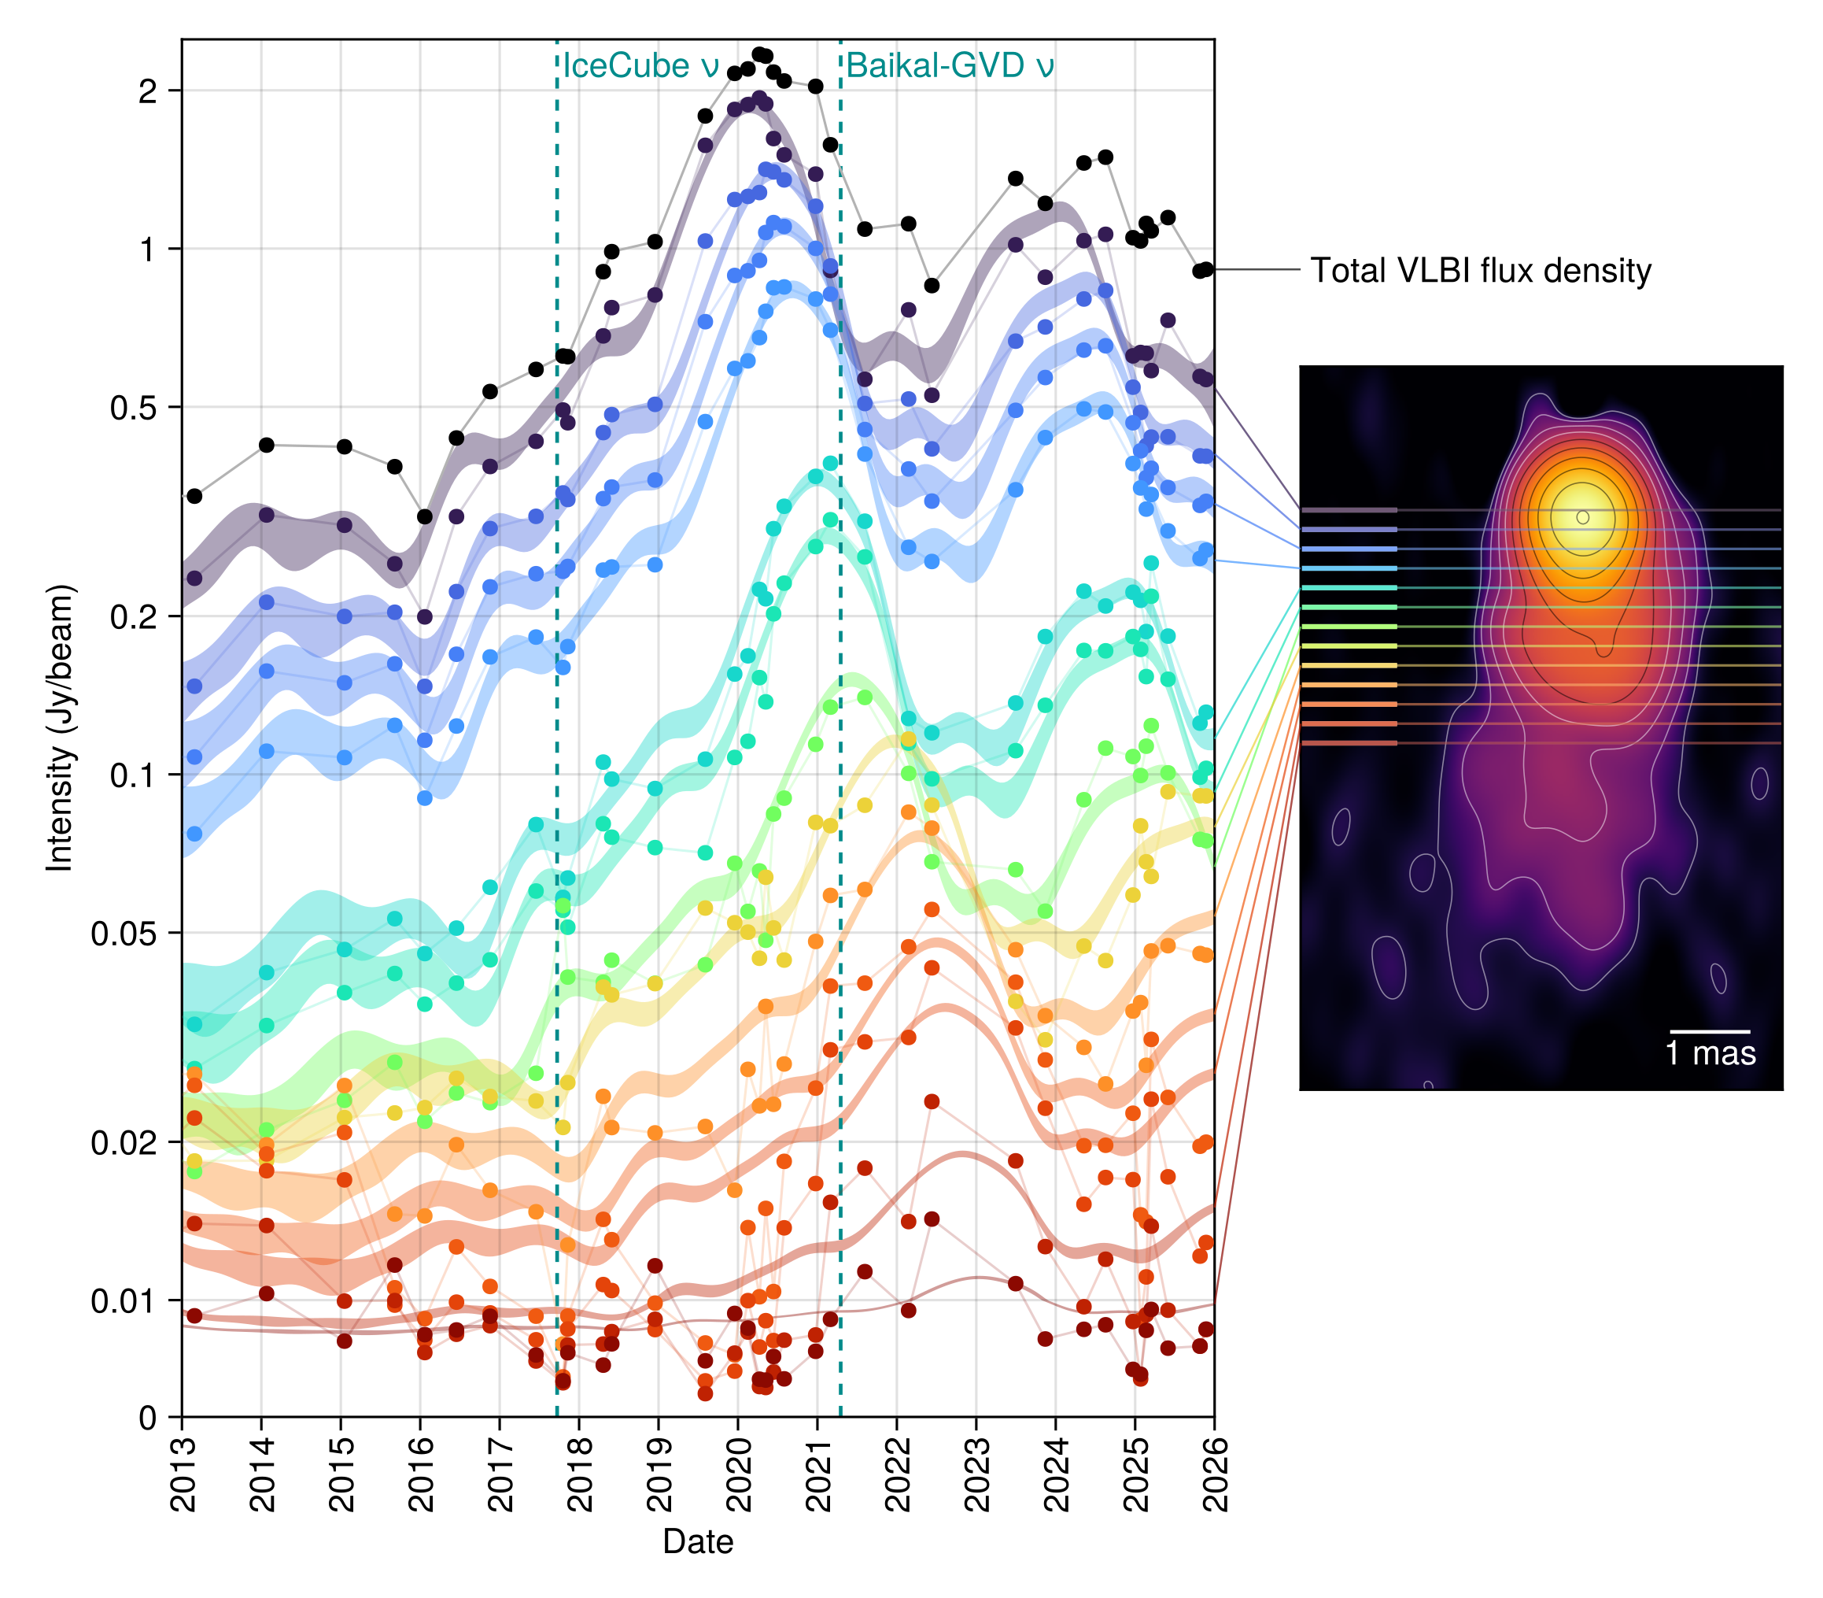
Resolving the slow pattern speed
Kovalev+26; Eppel+26

Slide 21
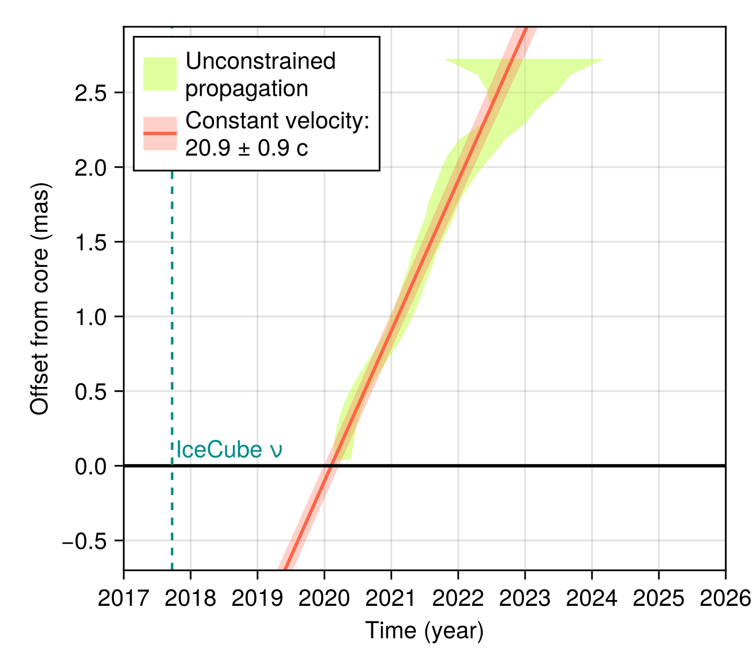
Resolving the slow pattern speed
Motion: fast —
we just didn’t catch it before
Kovalev+26; Eppel+26

Slide 22
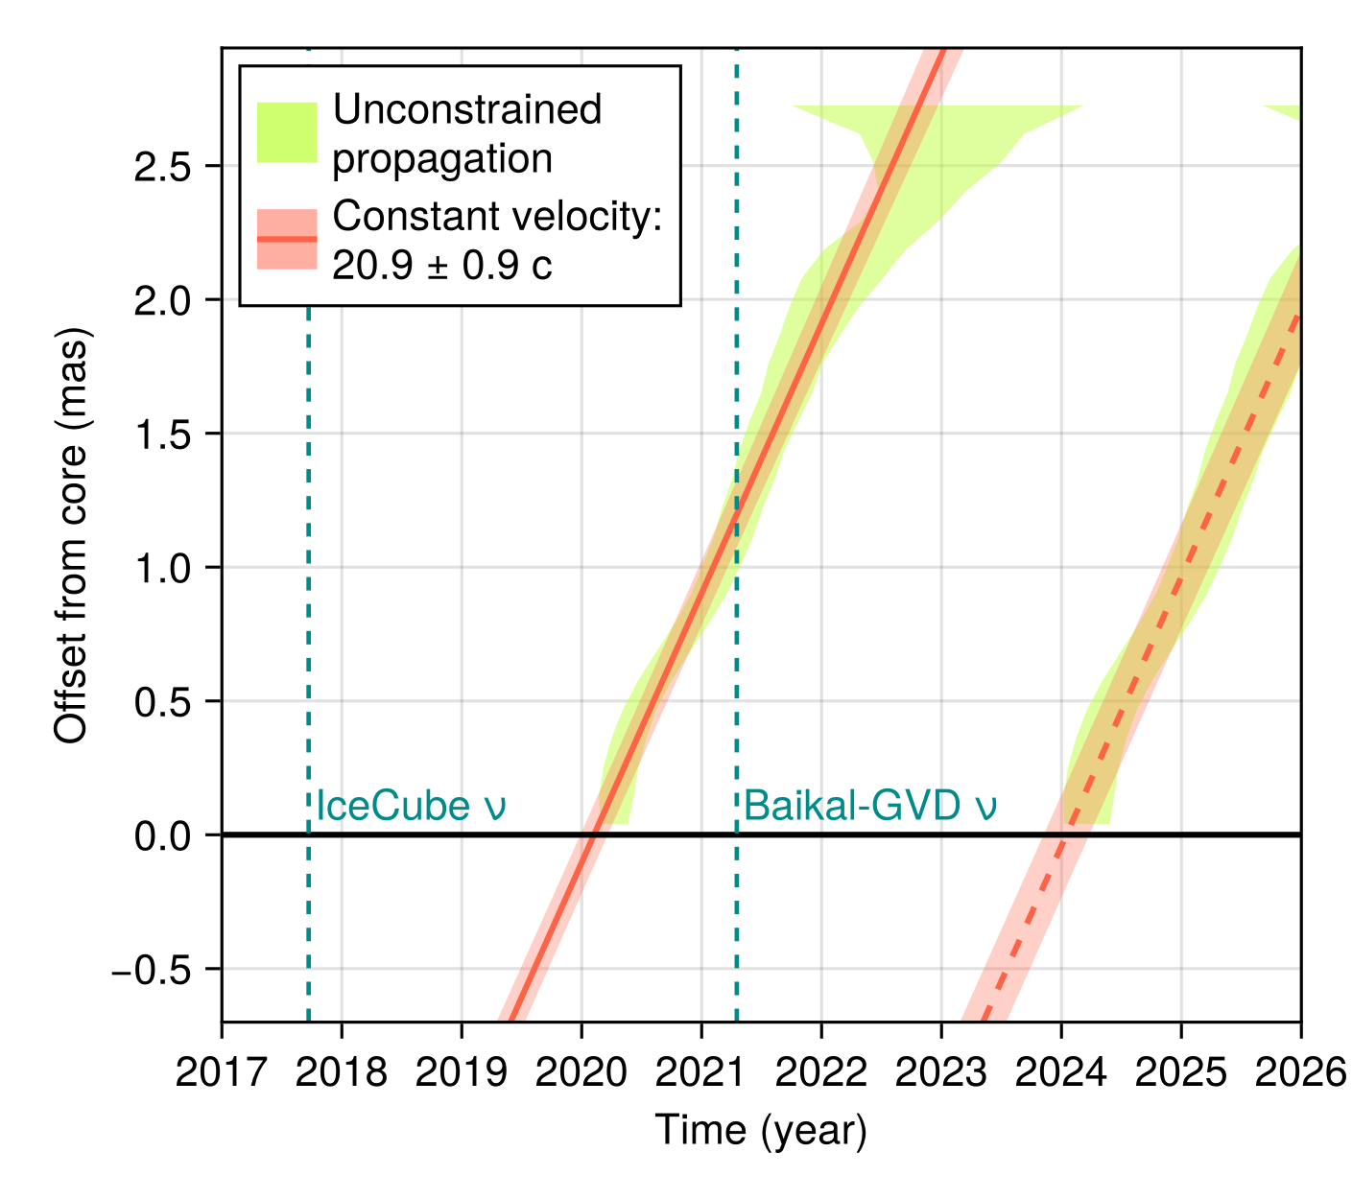
Resolving the slow pattern speed
Motion: fast —
we just didn’t catch it before
Kovalev+26; Eppel+26

Slide 23
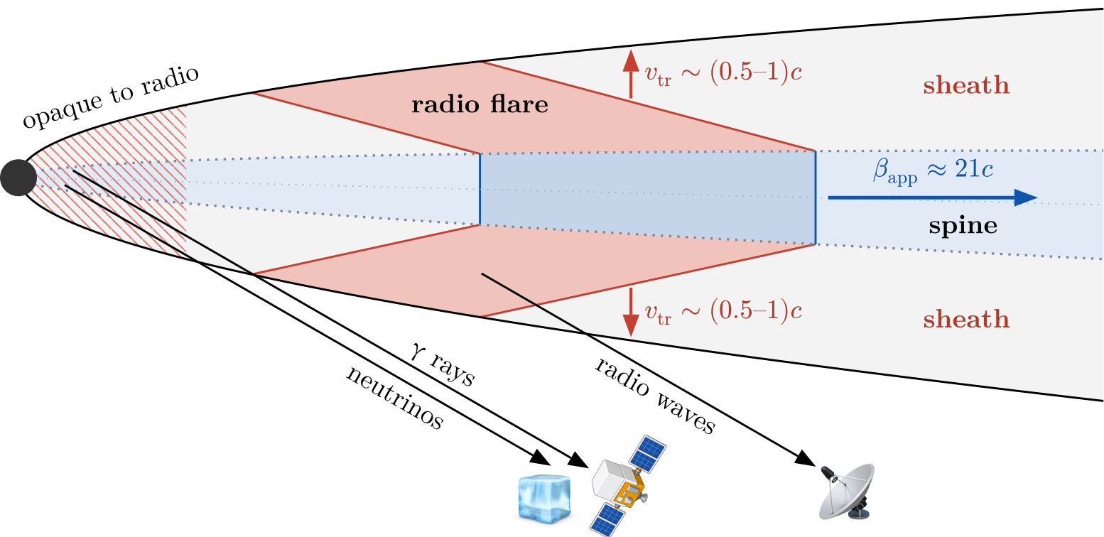
TXS 0506+056: what’s going on?
Detailed investigation ongoing
Best simple model: stratified spine–sheath jet
Kovalev+26; Eppel+26

Slide 24
Most direct way to study inner regions of AGNs: radio VLBI

Slide 25
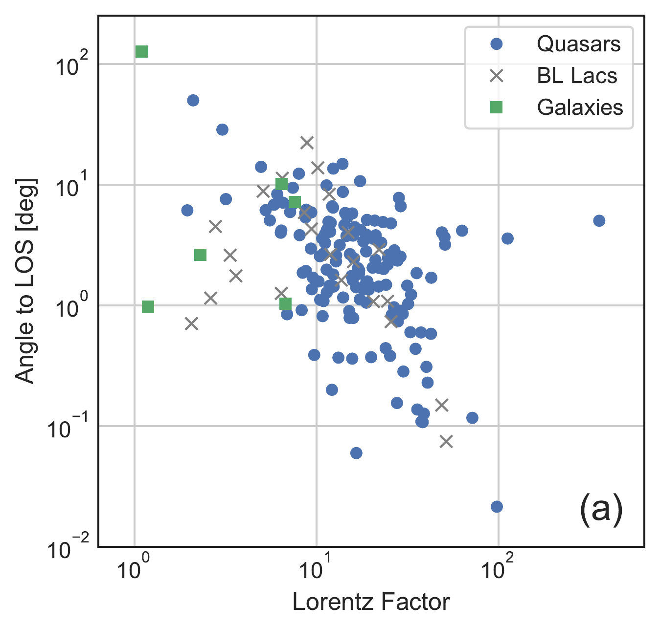
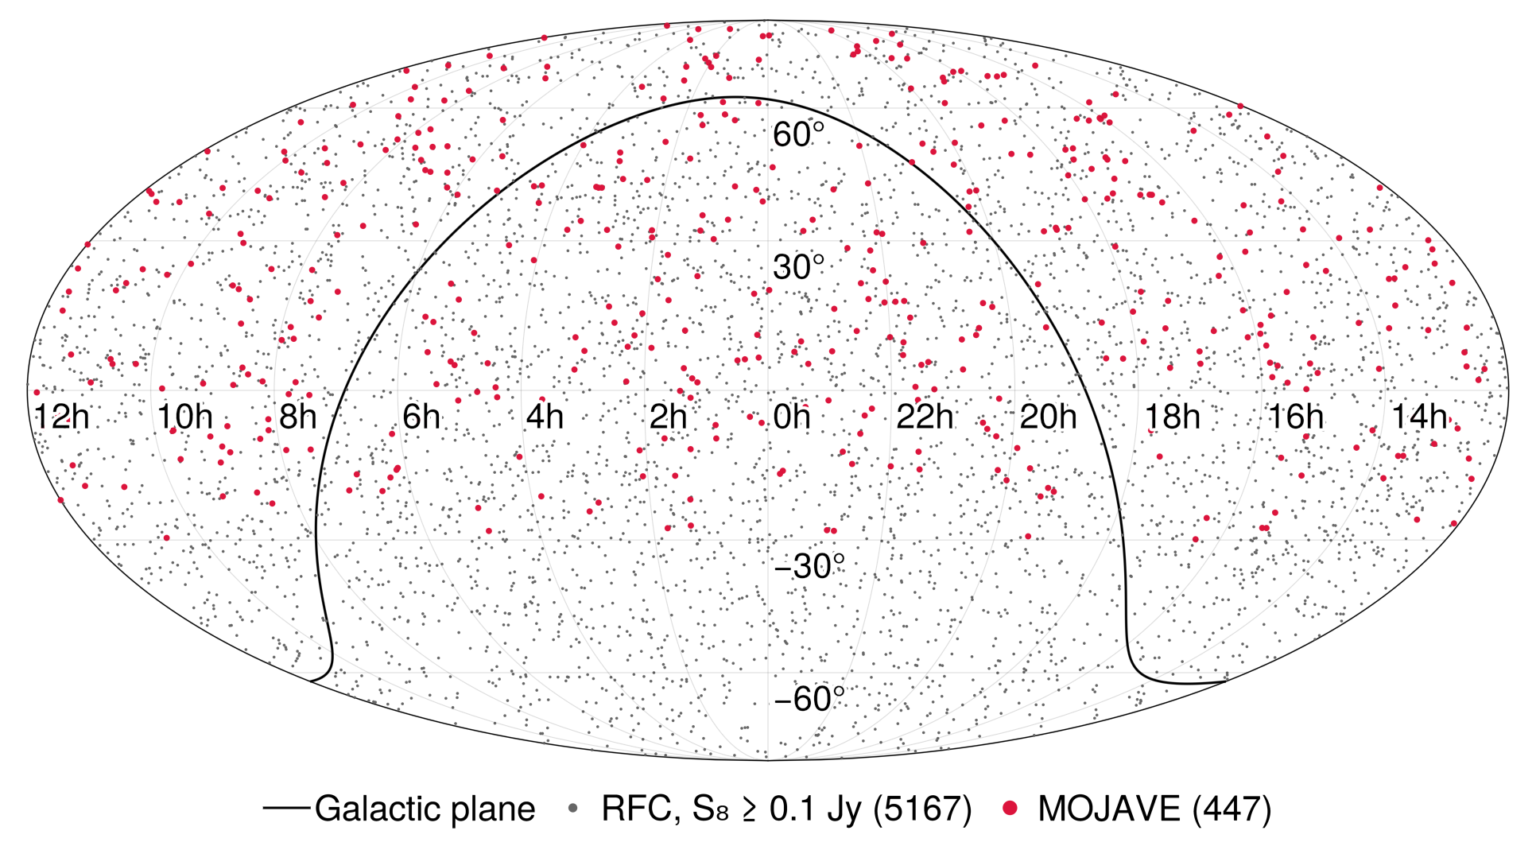
Most direct way to study inner regions of AGNs: radio VLBI
Best way to select fast jets pointing at Earth: also VLBI!
Cannot yet tell if physically related mechanisms, or common effects such as geometry
Lister & Marscher 97; Lister+19; Homan+21

Slide 26
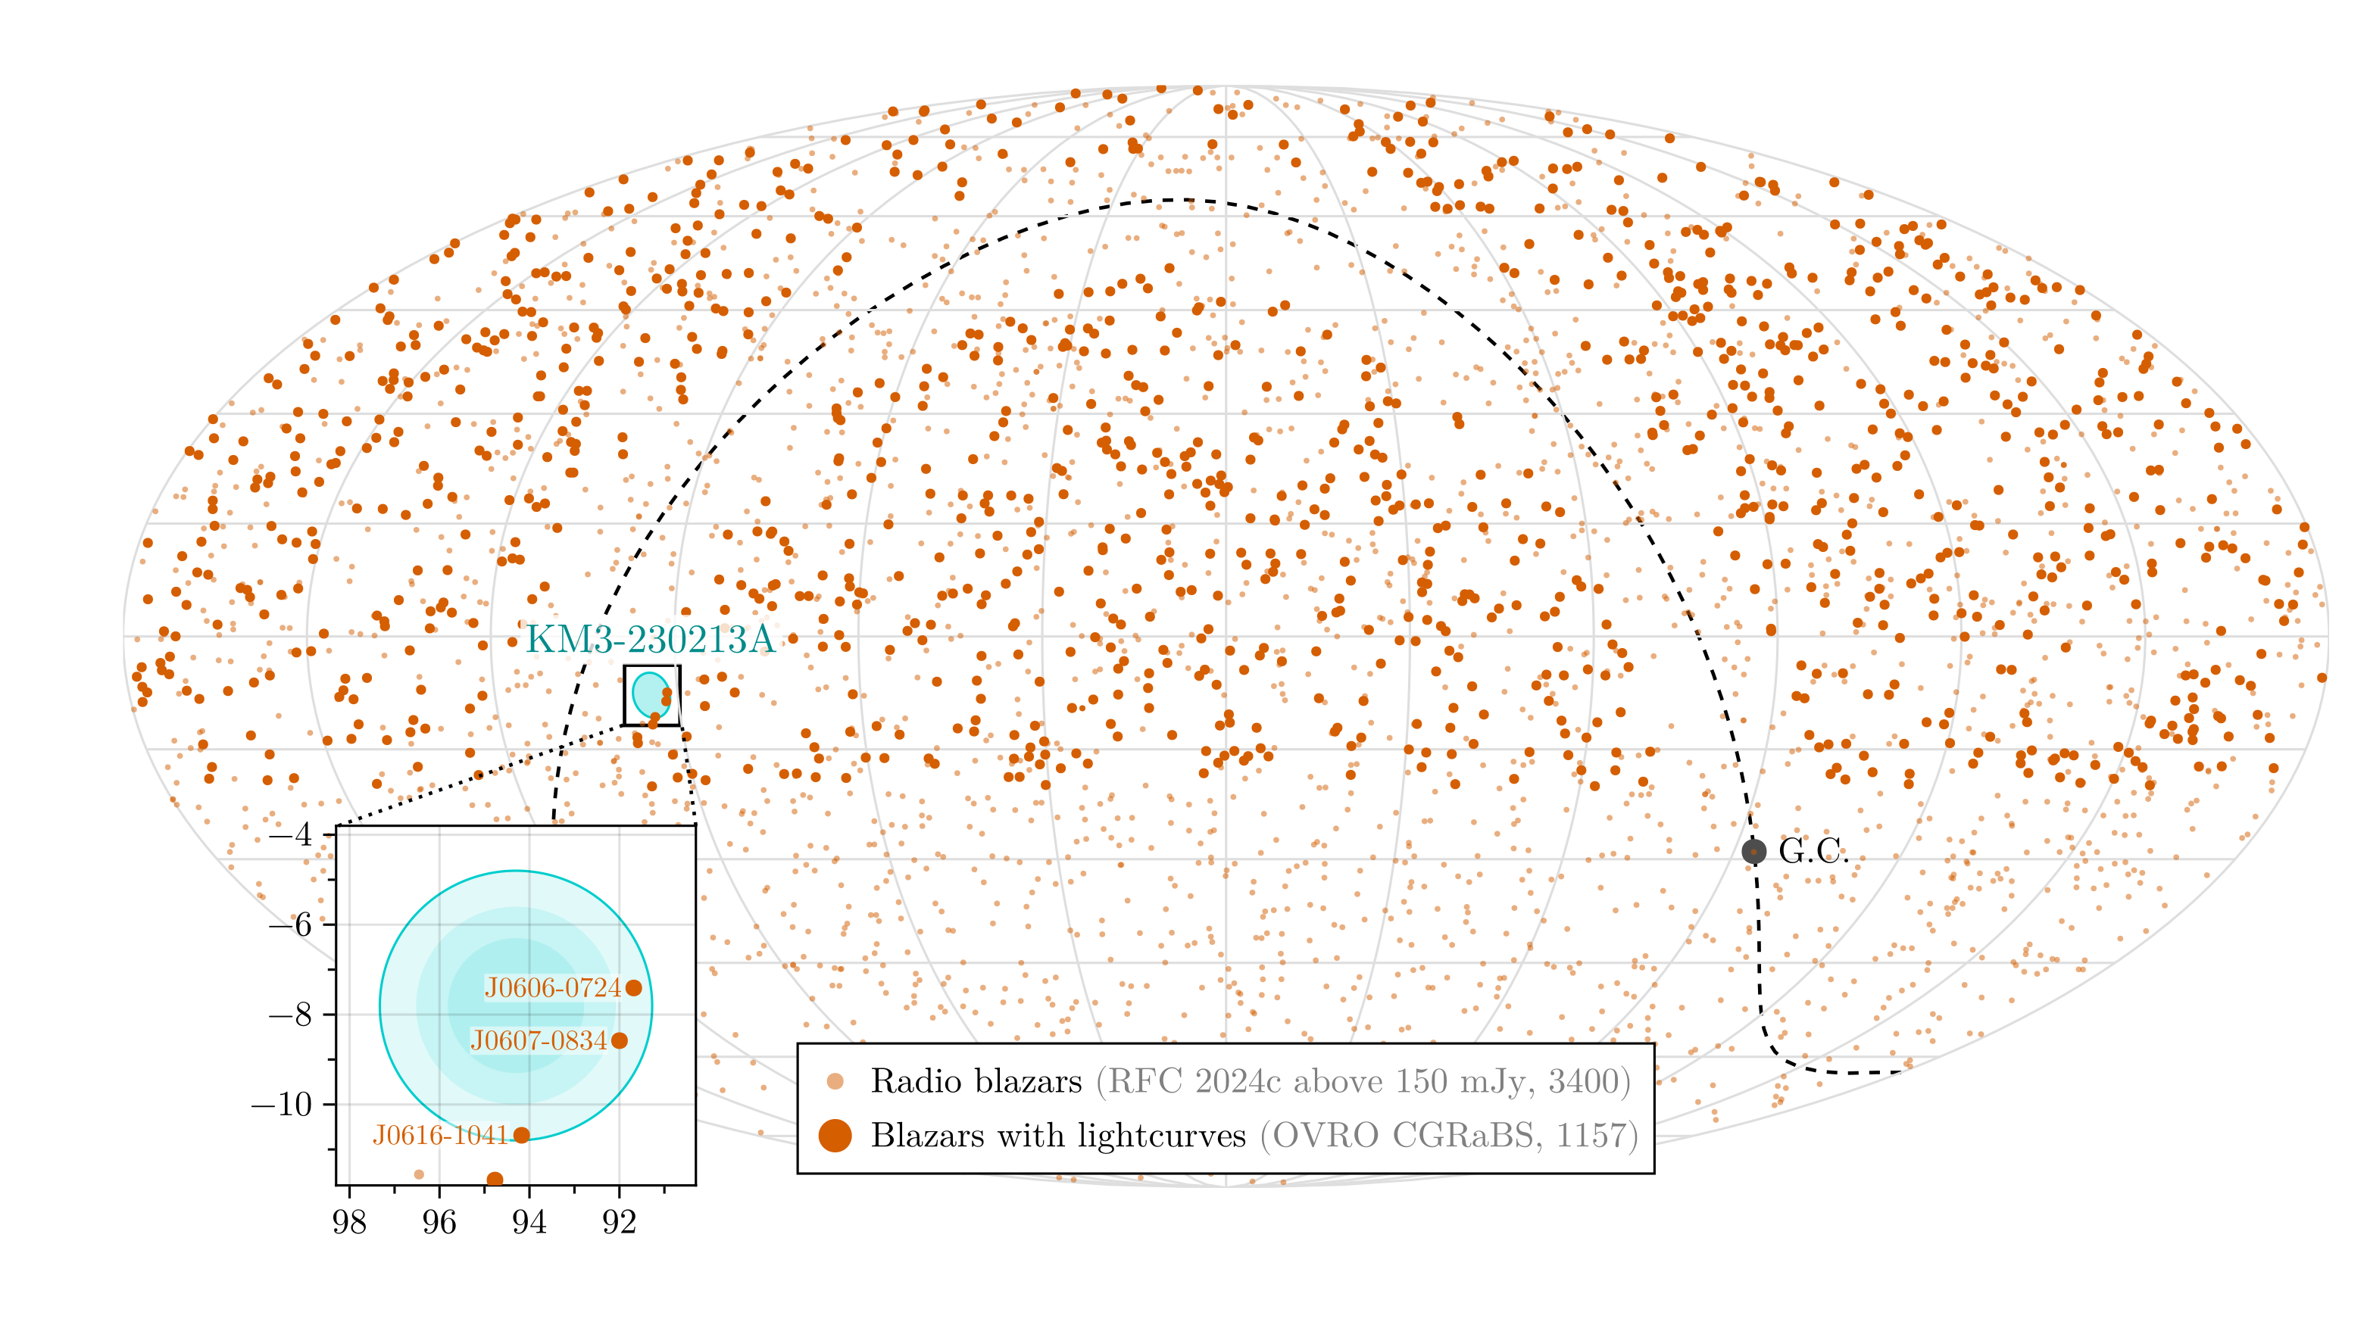
Example: KM3NeT’s highest-energy event (KM3-230213A)
VLBI used to narrow down candidates
still too many within 3°
KM3NeT+25; KM3NeT+26 (incl A. Plavin as a corr author)

Slide 27
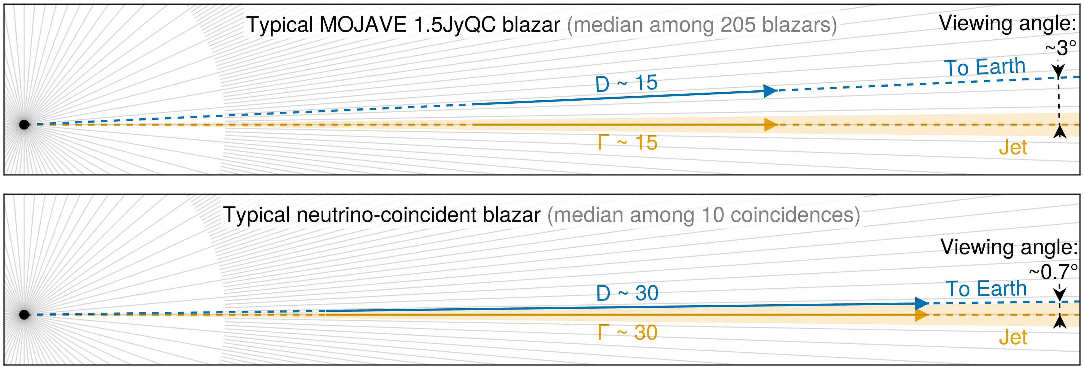
What Makes IceCube-Selected Blazars So Extreme?
IceCube selects fast,
Earth-aligned jets
Neutrinos are beamed along the jet, like photons
Plavin+25

Slide 28

What Makes IceCube-Selected Blazars So Extreme?
IceCube selects fast,
Earth-aligned jets
Neutrinos are beamed along the jet, like photons
VLBI: uniform samples for populations, detailed studies of individual jets
Open: are protons accelerated along the jet, or carried by its bulk motion?
NGC 1068: a distinct population?
alexander@plav.in · https://plav.in

