Slide 1
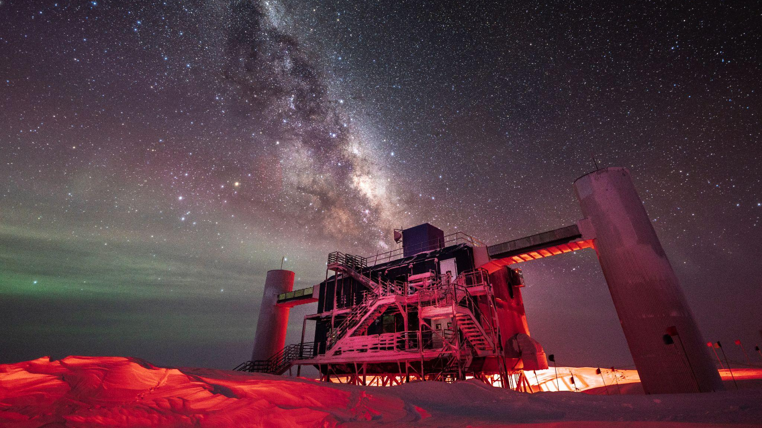
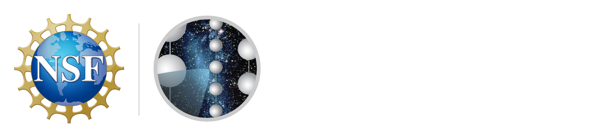

Neutrino and multi-messenger astrophysics with IceCube
Vedant Basu
On behalf of
the IceCube Collaboration
PC: Martin Wolf, IceCube/NSF
Notes:
Hey everyone, thank you for coming
Present my work on the astrophysical neutrino spectrum with IceCube
Done under Albrecht’s guidance

Slide 2
Outline
Multimessenger Astronomy at IceCube
Event Reconstructions with IceCube
Measurements of the Diffuse Neutrino Spectrum
Studies of Neutrino Sources
Outlook

Slide 3
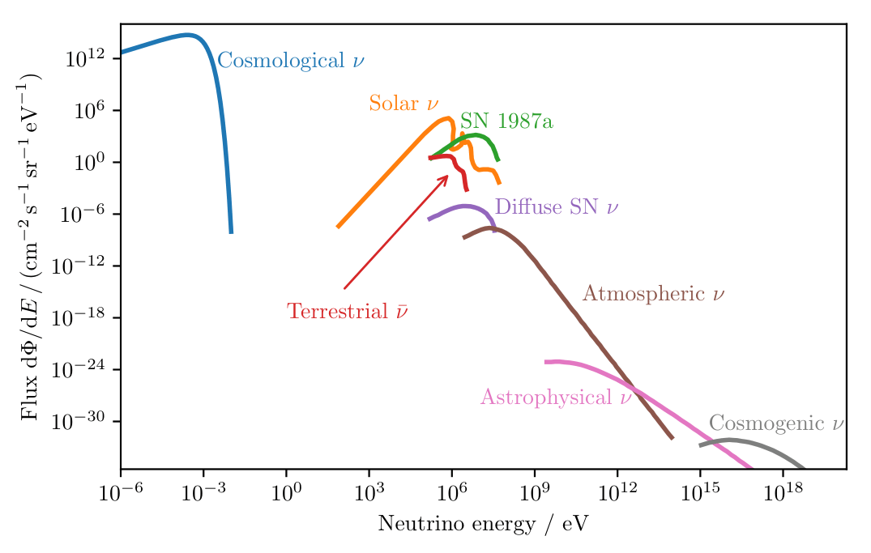
Neutrino Sources
Neutrino spectra cover multiple orders of magnitude, from a plethora of sources
Diffuse cosmic neutrino analyses focus on characteristics of astrophysical neutrino flux in the TeV-PeV range
Isotropic nature indicates extragalactic origin, from sites of cosmic ray acceleration
Neutrino Spectrum
M. Meier
Notes:
Cosmological: relic neutrinos from ~1s after Big Bang
Solar: P-P fusion in sun
Supernova neutrinos:Produced by core-collapse supernovae
Terrestrial (anti)neutrinos: all the radionuclides in the Earth
Atmospheric neutrinos are created when cosmic rays bombard our atmosphere
Astrophysical neutrinos are created near cosmic accelarator sites along with cosmic rays
GZK neutrinos are created when UHE protons interact with the cosmic microwave background, the highest energy neutrinos in the universe!

Slide 4
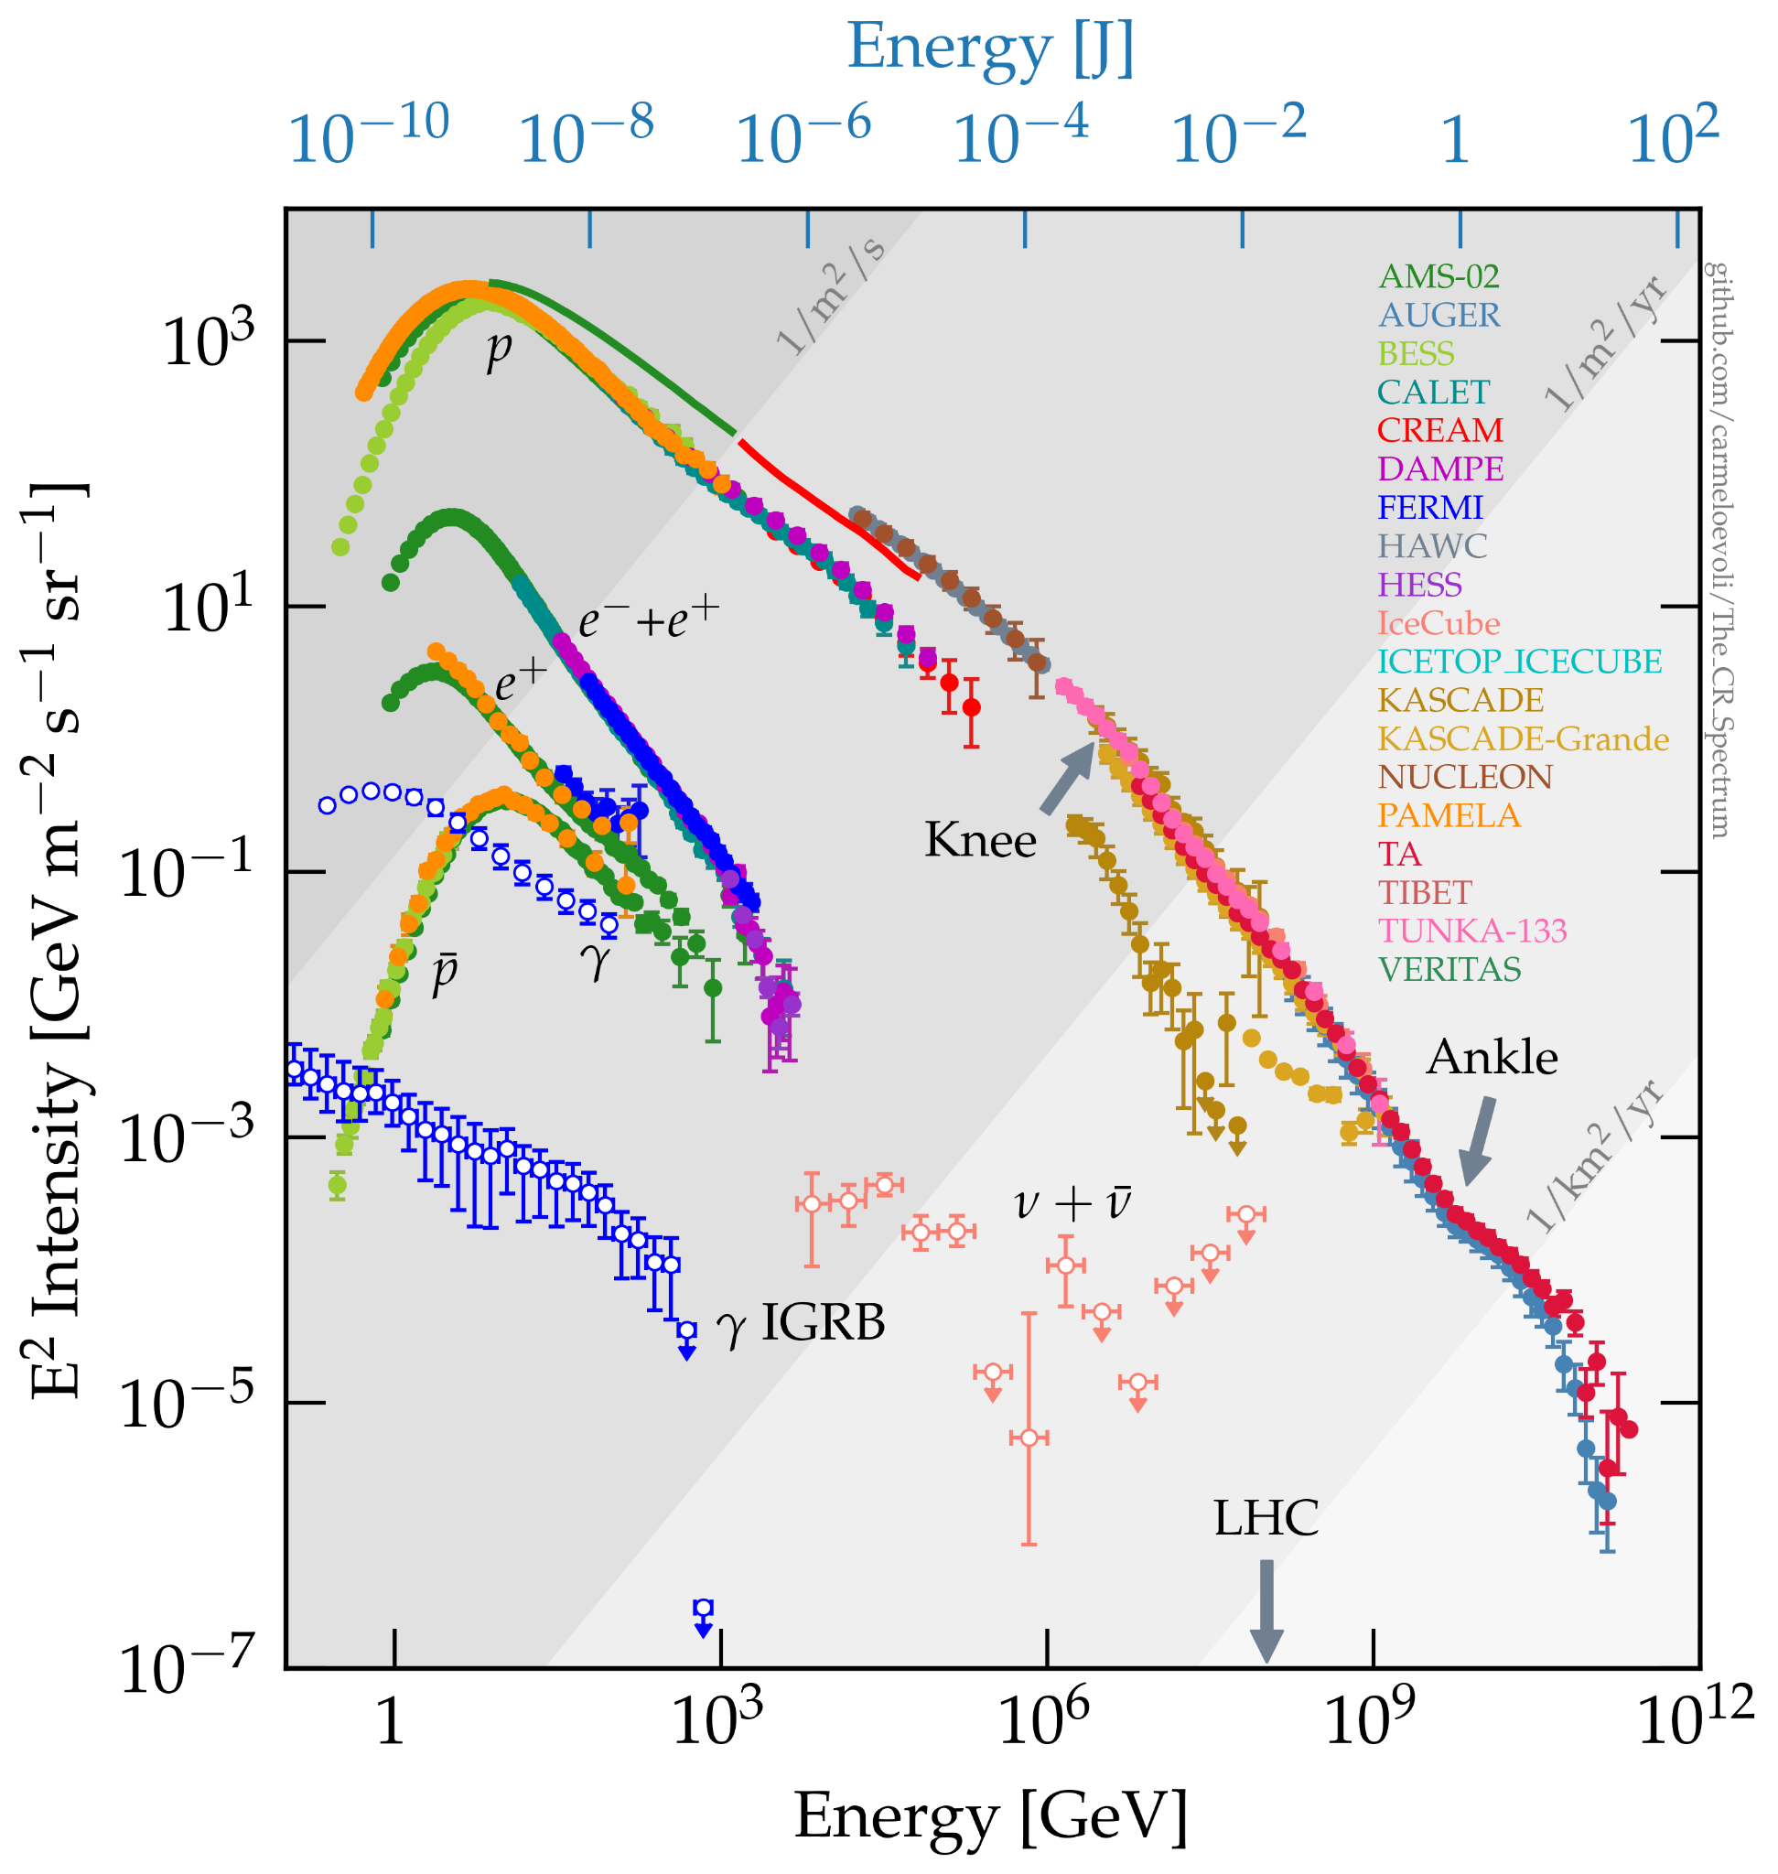
How are neutrinos produced from cosmic rays?
Accelerated cosmic rays interact with photons in the ambient radiation field (p-γ interaction), or with protons in a gaseous environment (p-p interaction)
In p-p interactions, pions are produced even at GeV proton energies, and inherit the power law spectrum of their parents.
When the p-γ interaction is considered, the production of pions has a sharp resonance at the Δ+ mass of 1232 MeV.
Swordy Plot
Evoli, C. 2020
Notes:
Other non-resonant processes also contribute, but the steep target photon spectrum generally means that the Δ resonance is relevant even at very high primary energies, and leads to a ‘bump’-like feature in the daughter neutrino spectrum

Slide 5
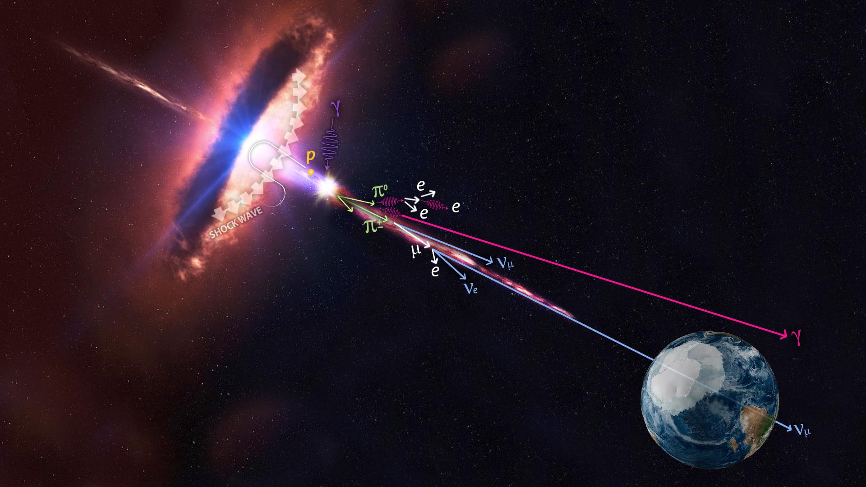
Astrophysical Neutrinos
Cosmic rays accelerated in presence of strong magnetic fields at source
Accelerated cosmic rays interact with protons/photons at source
Interactions create pions and kaons, which decay into neutrinos and gamma rays
Notes:
Produced by hadronic interactions → smoking gun for CR sources
simplify the discussion to be about fermi acceleration

Slide 6
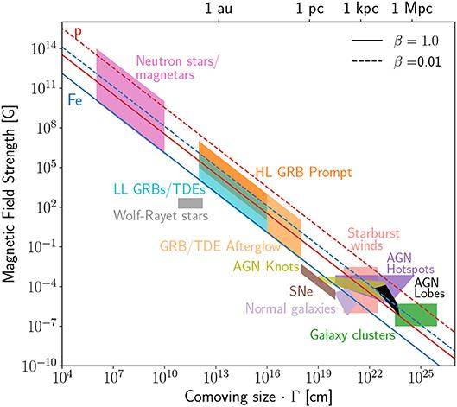
Characteristics of cosmic accelerators
A Hillas Plot
If we define the escape probability in terms of the characteristic periods of the acceleration and escape phenomena, T_{acc} and T_{esc} , we may define P_{esc} = T_{acc}/T_{esc}
An accelerator with a certain characteristic T_{acc} must have an upper bound on the energy to which it can accelerate particles
This also imposes a bound on the confinement volume of an accelerator. If the gyroradius of a particle exceeds the radius of the accelerator, it is no longer confined (Hillas criterion)
Alves Batista, R., et al,, 2019. Open questions in cosmic-ray research at ultrahigh energies. Frontiers in Astronomy and Space Sciences, 6, p.23.

Slide 7
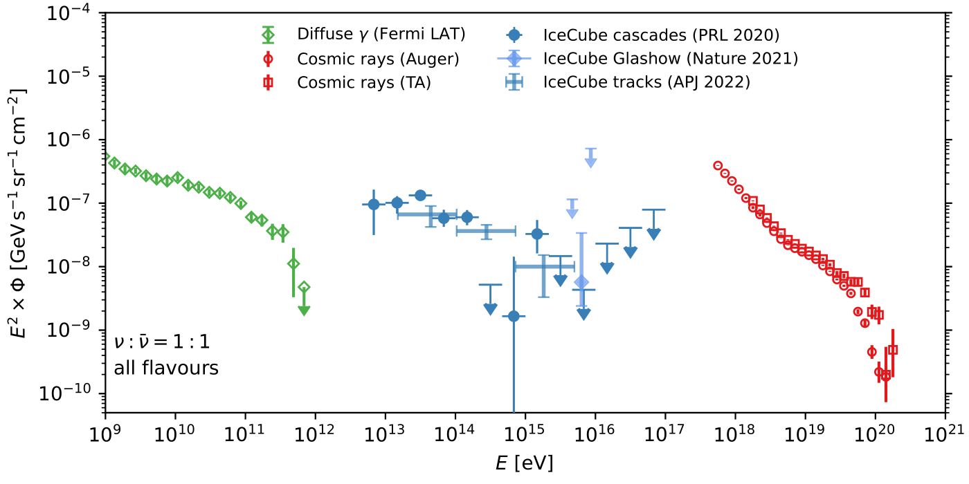
Multimessenger Astronomy
Energy density of high energy neutrinos similar to γ-ray flux, and Ultra High Energy Cosmic Rays (UHECRs)
Ackermann, M., et al. Journal of high energy astrophysics 36 (2022)
Notes:
. For extragalactic scenarios, this gamma-ray emission is not directly observed because of strong absorption of photons by e +e − pair production in the extragalactic background light (EBL) and CMB. The leptons initiate electromagnetic showers of repeated inverse-Compton scattering and pair production in the CMB that eventually yield photons that contribute to the Fermi γ-ray observations in the GeV-TeV range
focus on mismatch in fluxes as we extend to 1 TeV in energy. HESE will technically surpass the calorimetric limit if you extrapolate but the numu analysis doesn’t and unfortunately doesn’t have sensitivity to lower energies. this is why mese is so important.
Calorimetric limit: UHE CR sources can be embedded in environments that act as “storage rooms” for cosmic rays with energies far below the
“ankle” (ECR 1EeV). This energy-dependent trapping can be achieved via cosmic ray diffusion in magnetic fields. While these cosmic rays are trapped, they can produce γ-rays and neutrinos via collisions with gas. If the conditions are right, this mechanism can be so efficient that the
total energy stored in low-energy cosmic rays is converted to that of γ-rays and neutrinos
The same cosmic ray model predicts the emission of cosmogenic neutrinos from the collision with cosmic background photons (GZK mechanism)
Talk about production mechanisms, see if this measurement has resulted in a model re-evaluation:
https://arxiv.org/pdf/2007.12706.pdf
Revisiting AGN as the Source of IceCube’s Diffuse Neutrino Flux
Waxmann, ahlers papers
two complementary measurements were performed, don’t say HESE and diffuse NuMu
Start with UHECRs, need to be accelerated. Similar energy density to gamma rays and neutrinos

Slide 8
Outline
Multimessenger Astronomy at IceCube
Event Reconstructions with IceCube
Measurements of the Diffuse Neutrino Spectrum
Studies of Neutrino Sources
Outlook

Slide 9
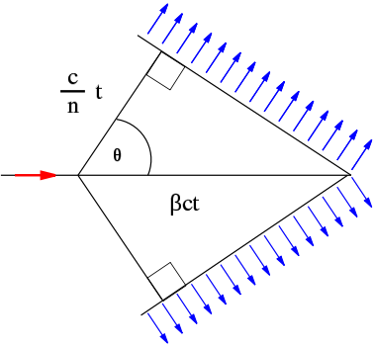
Observing neutrino interactions via the Cherenkov effect
Charged particles deposit energy as they travel through matter
When charged particles travel faster than the speed of light in a medium, they emit Cherenkov radiation
A cone of light is formed determined by Cherenkov angle, θ_{C}
Cherenkov light collected by DOM photomultiplier tubes (PMTs), which convert the optical signal to an amplified electrical signal
In ice: θ_{C} = 40.2°
Wikimedia Commons

Slide 10
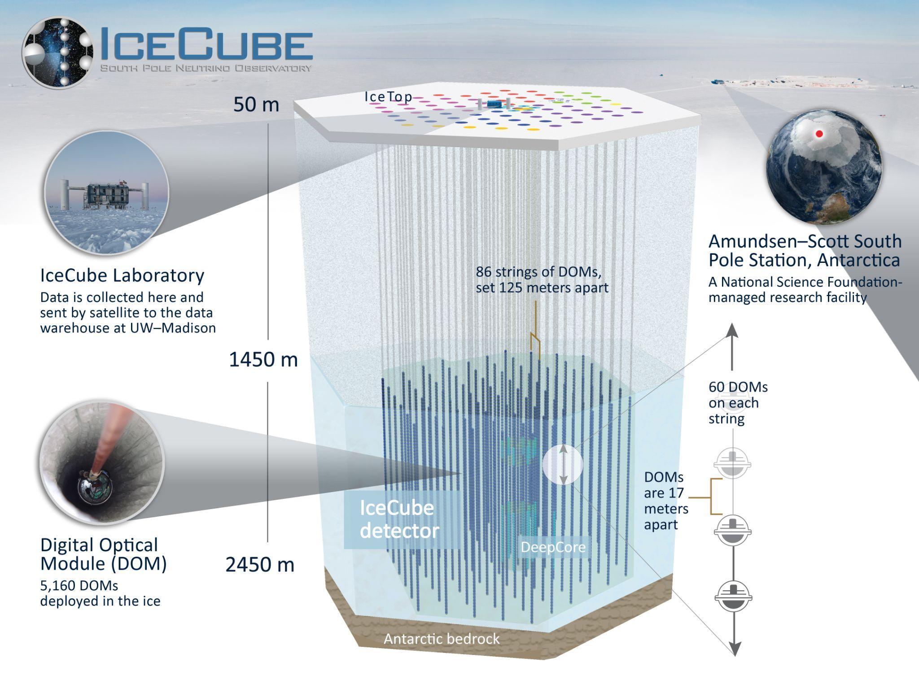
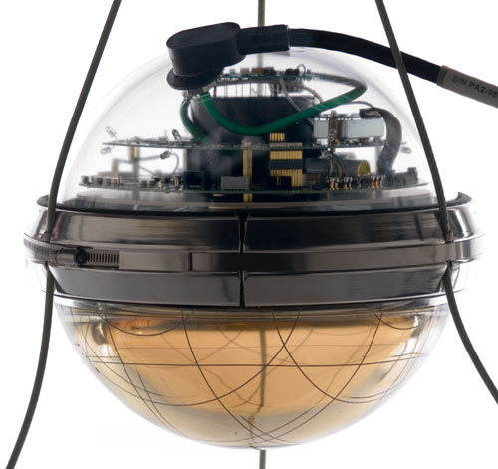
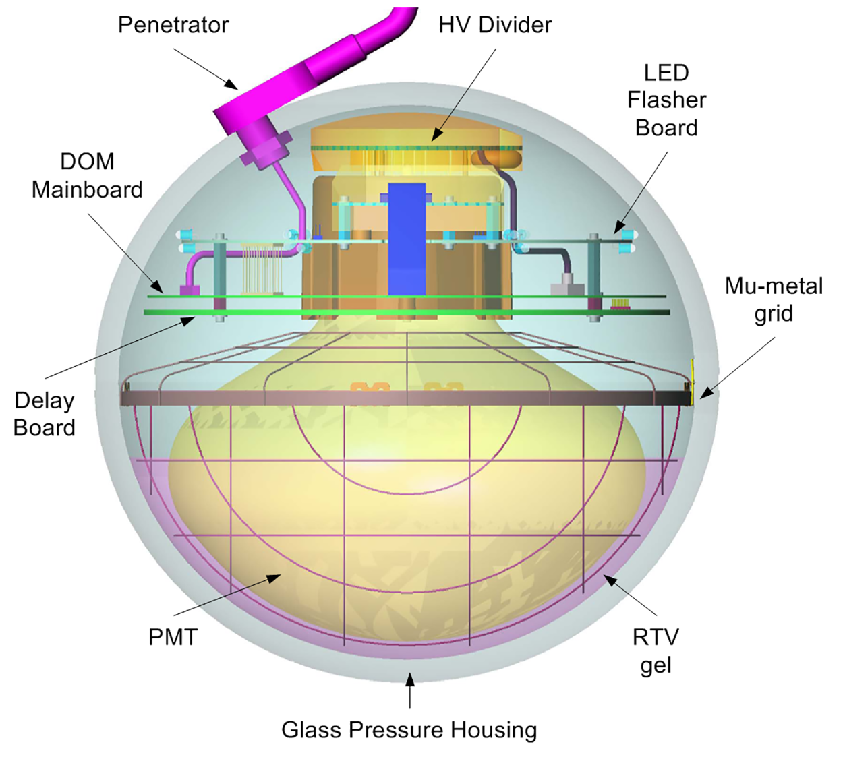
Digital Optical Module
Notes:
Dust Layer: depths between 1970 m and 2100 m

Slide 11
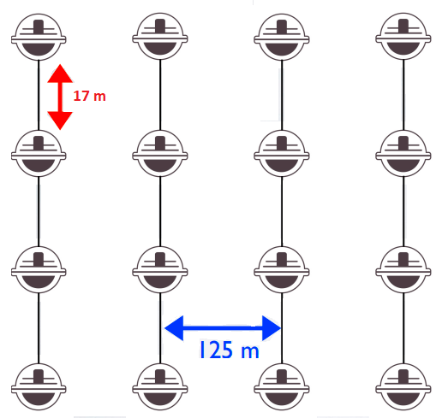
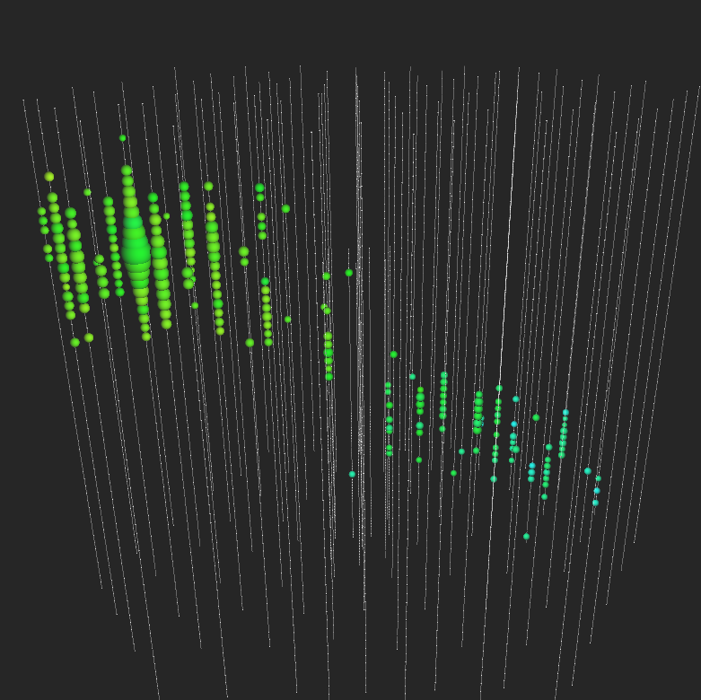
Event Reconstruction
Number of Cherenkov photons captured ∝ deposited energy.
Photon arrival times at DOMs helps reconstruct particle trajectory.
Charged particle trajectory
Notes:
Hits from DOM are classified as HLC/SLC
Look for image with waveforms

Slide 12

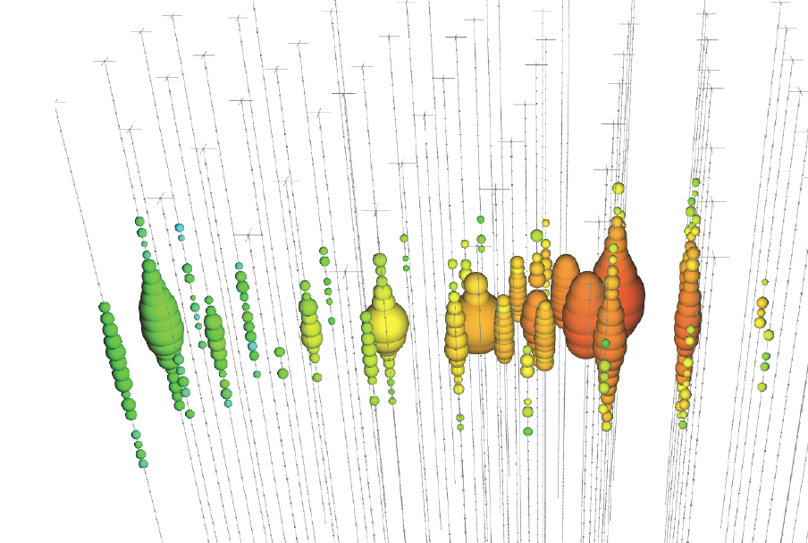
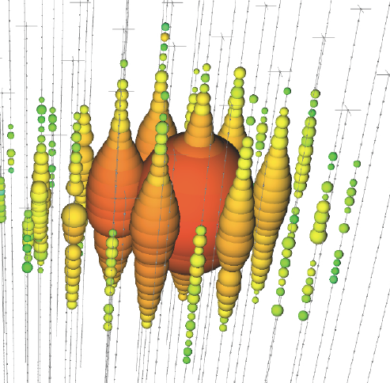
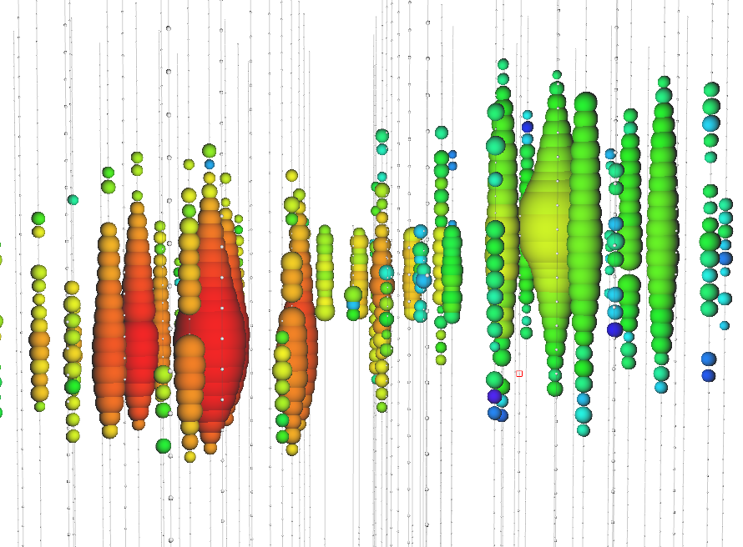

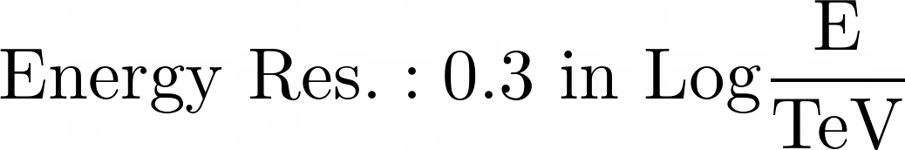


IceCube Event Morphologies
Tracks (Data)
Cascades (Data)
Double Cascade (Simulated)
Ref.
Notes:
Size of circle is proportional to charge deposited
SPEND MORE TIME
You have different fonts here. Keep it the same —Aswathi
Find out how energy resolutions are measured . Be specific about resolutions
Tracks:Due to the relatively long muon lifetime, cherenkov emission along the outgoing
muon path shows up as a linear track
Cascades: in a NC interaction the out-going products are a neutrino and a recoiling hadron.
We don't see the daughter neutrino, and the hadronic recoil is what becomes the cascade,
because hadronic products tend to feature short lifetimes and short interaction lengths.
They also readily produce electrons in the shower, which don't decay but also have short
interaction lengths
Double Cascades: Secondary signal from Tau decay product. A second cascade is resolvable starting at Tau energies of around 1 PeV, when the decay length is ~50m (comparable to 0.5*string spacing 125m). Depending on the Tau decay channel, other topologies such as a ‘lollipop’ (where tau decays to a muon) may also occur

Slide 13
Outline
Multimessenger Astronomy at IceCube
Event Reconstructions with IceCube
Measurements of the Diffuse Neutrino Spectrum
Studies of Neutrino Sources
Outlook

Slide 14
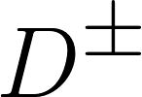
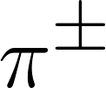
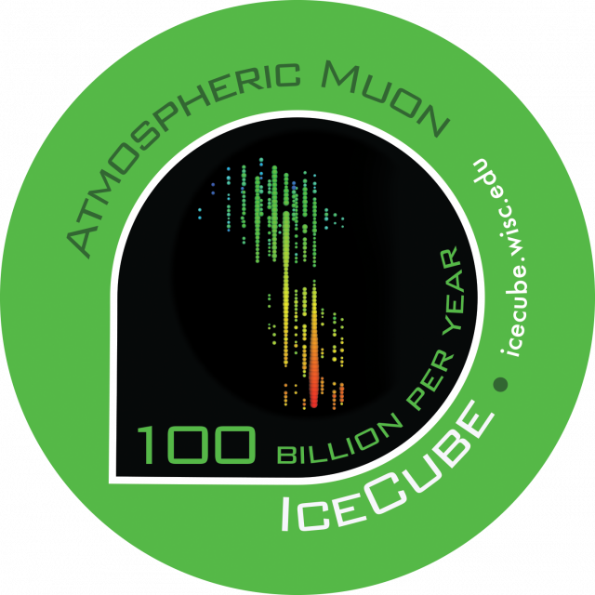
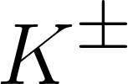

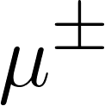




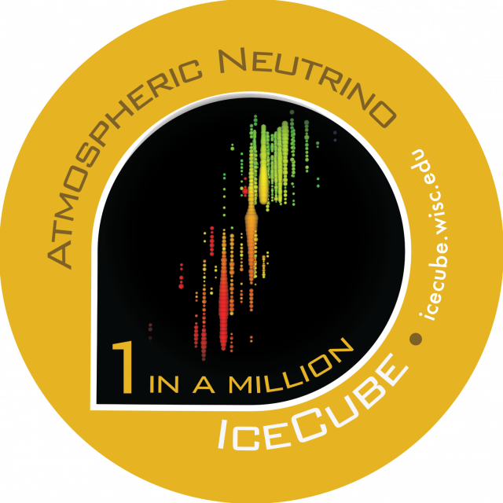
Atmospheric Background
Primary Cosmic Ray
Main background from atmospheric muons
Neutrinos also produced in atmospheric cosmic rays interactions. Flux from pion/kaon decay follows ~E^{-3.7}
Prompt contribution from charmed meson decay- follows ~E^{-2.7}
Prompt Atmospheric Flux
Conventional Atmospheric Flux
Notes:
Atmospheric showers are also responsible for a large background flux of muons (3kHz at IceCube): 100B a year
Atmospheric Neutrino rate: 100k a year
Astrophysical neutrino rate: 100 a year
D-meson production is not confirmed. if you do decide to say “prompt neutrinos” be ready to defend why we haven’t seen them if theory models expect them to be there.
Do you have background slides on what to expect for charm? I think you might get questions about this
Modify image to better represent MESE background

Slide 15
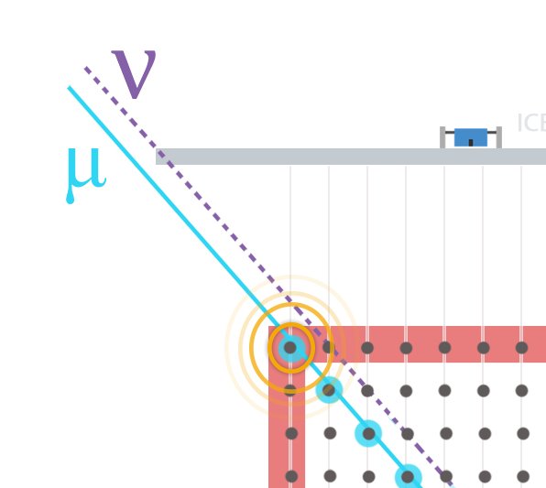

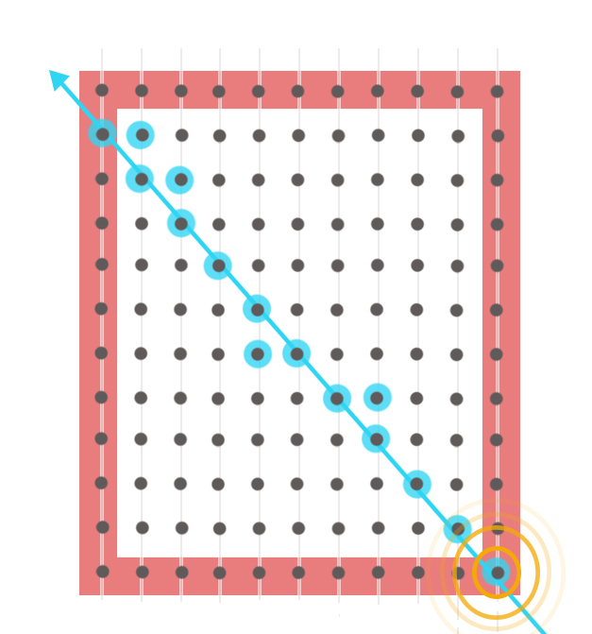
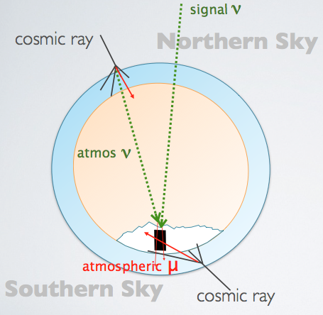

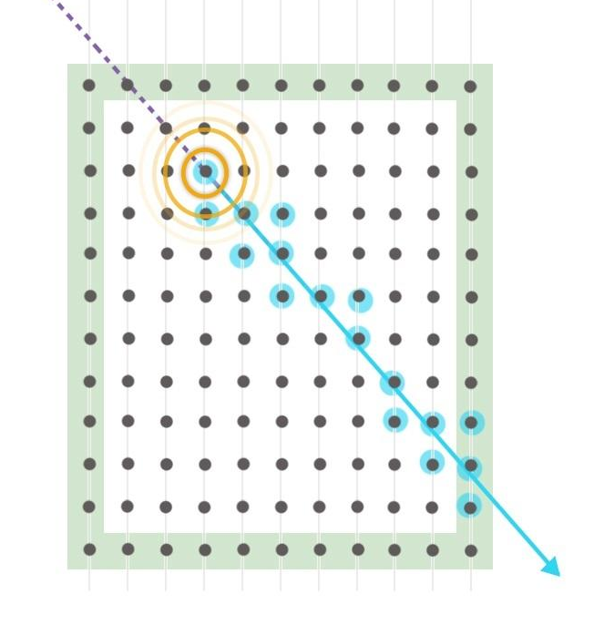

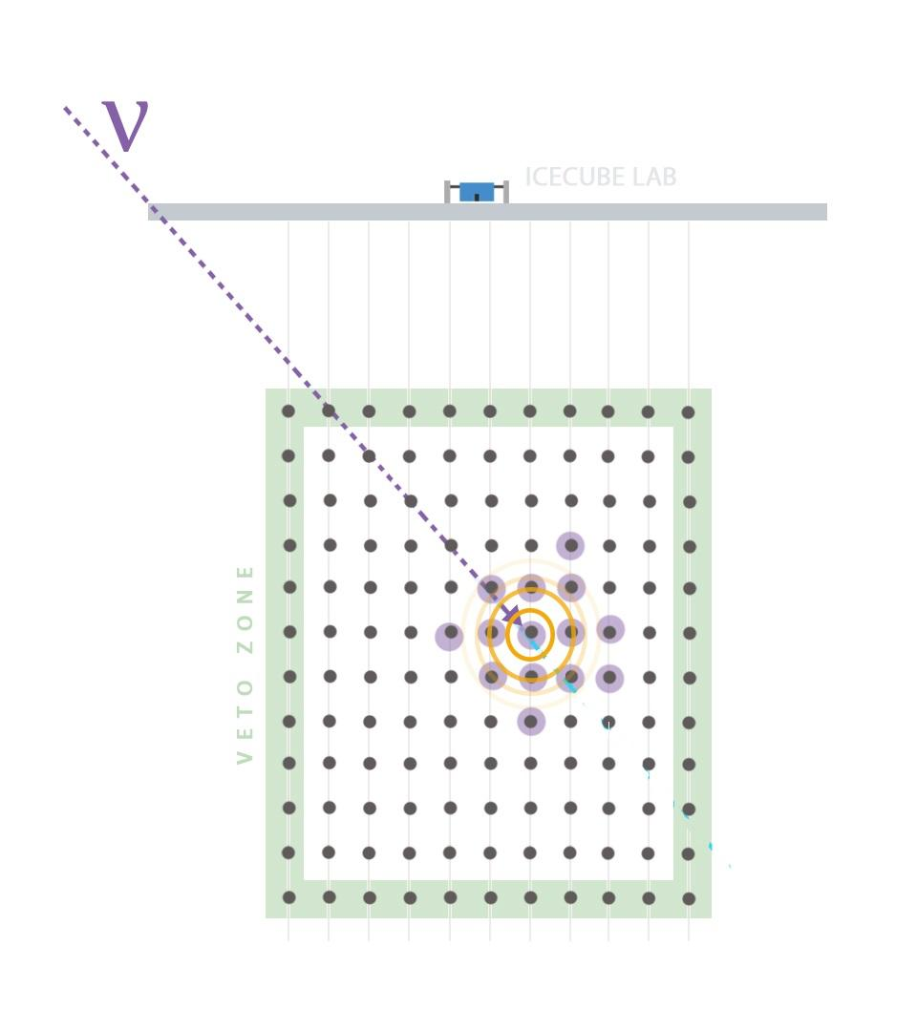
Identifying Cosmic Neutrinos
Atmospheric Background
Upgoing Tracks
Up
going
Starting Tracks
Cascades
Starting Events
θ
Downgoing
Notes:
An advantage of this approach is that we accept neutrinos from all directions in the sky, and are sensitive to different neutrino flavours
Upgoing Tracks: a 300 GeV muon has a most probable path length of ∼1 km in ice. The most probable path length is ∼2 km for a 1 TeV muon, and the length rises only logarithmically with Eµ, reaching 20 km for a 1 PeV muon

Slide 16
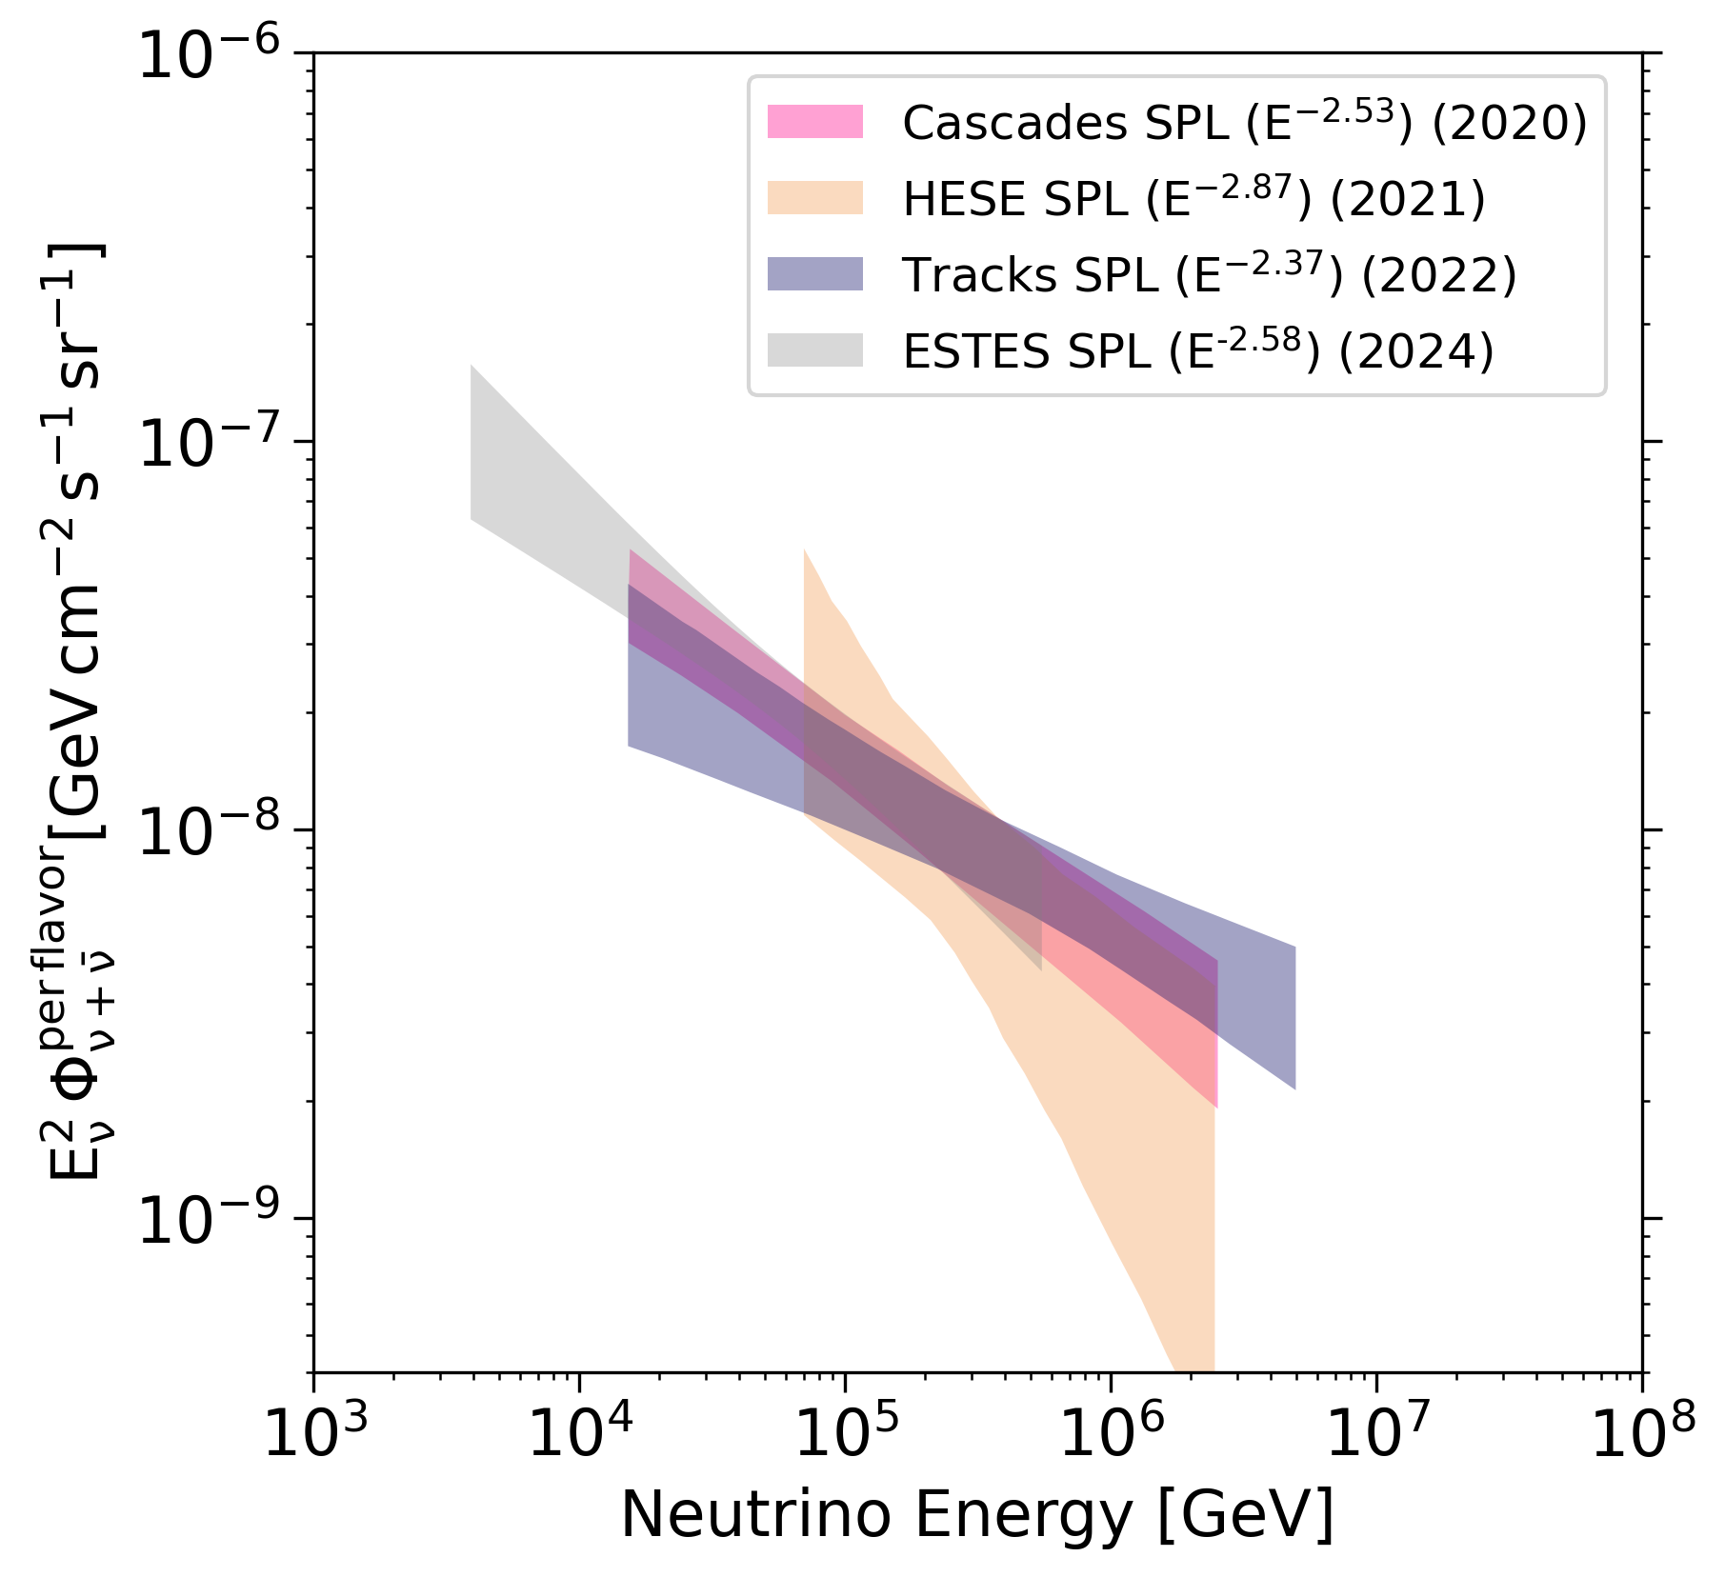
Diffuse Cosmic Neutrino Flux
Previous IceCube measurements of the diffuse spectrum follow a single power law (E^{-𝝲}).
  High Energy Starting Event (HESE):
  all flavours & all sky, above 60 TeV
  Through-going tracks:
  muon neutrinos from the Northern sky
  Cascades:
  All sky electron and tau neutrinos, and muon neutrino NC interactions
  Enhanced Starting Track Event Selection (ESTES):
  All sky muon neutrinos
Notes:
To date, the precise origin and production mechanism of astrophysical neutrinos remains unknown. As a simplifying assumption in this work we assume that the incident astrophysical neutrino flux is isotropic, equal between neutrino flavors, and equal between neutrinos and antineutrinos. These assumptions are reasonable given that, due to the finite energy resolution of the experiment and unknown source distance, neutrino oscillations are expected to yield very close to equal amounts of each flavor

Slide 17
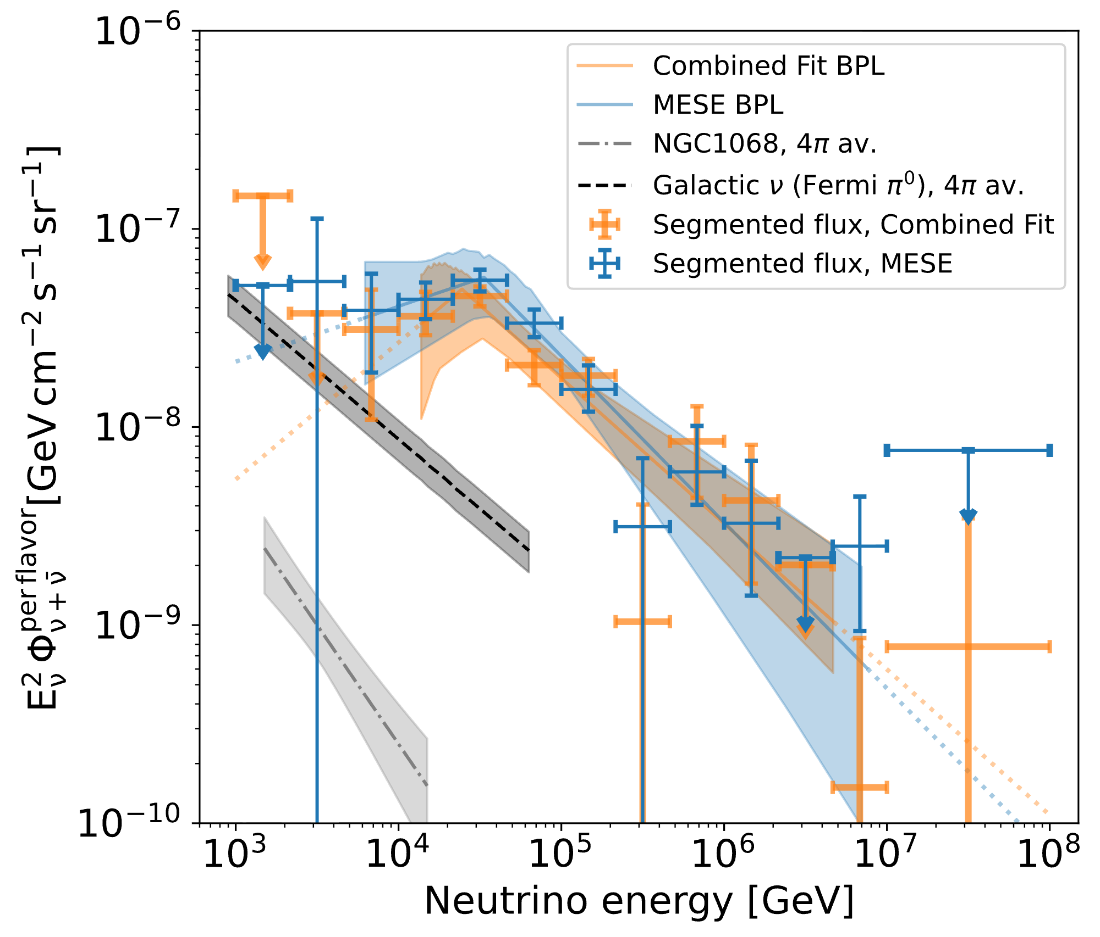
Evidence of spectral curvature
Two analyses using both cascades and tracks reject SPL model for first time by >4𝜎
“Combined Fit” analysis combining Cascades and Northern Tracks dataset
“Medium Energy Starting Events (MESE)” selection using cascades and starting tracks
Jointly published in Phys. Rev. Lett. and Phys. Rev. D
Notes:
Both are softer than the diffuse neutrino spectrum below E_{break}
Harder unresolved sources?

Slide 18
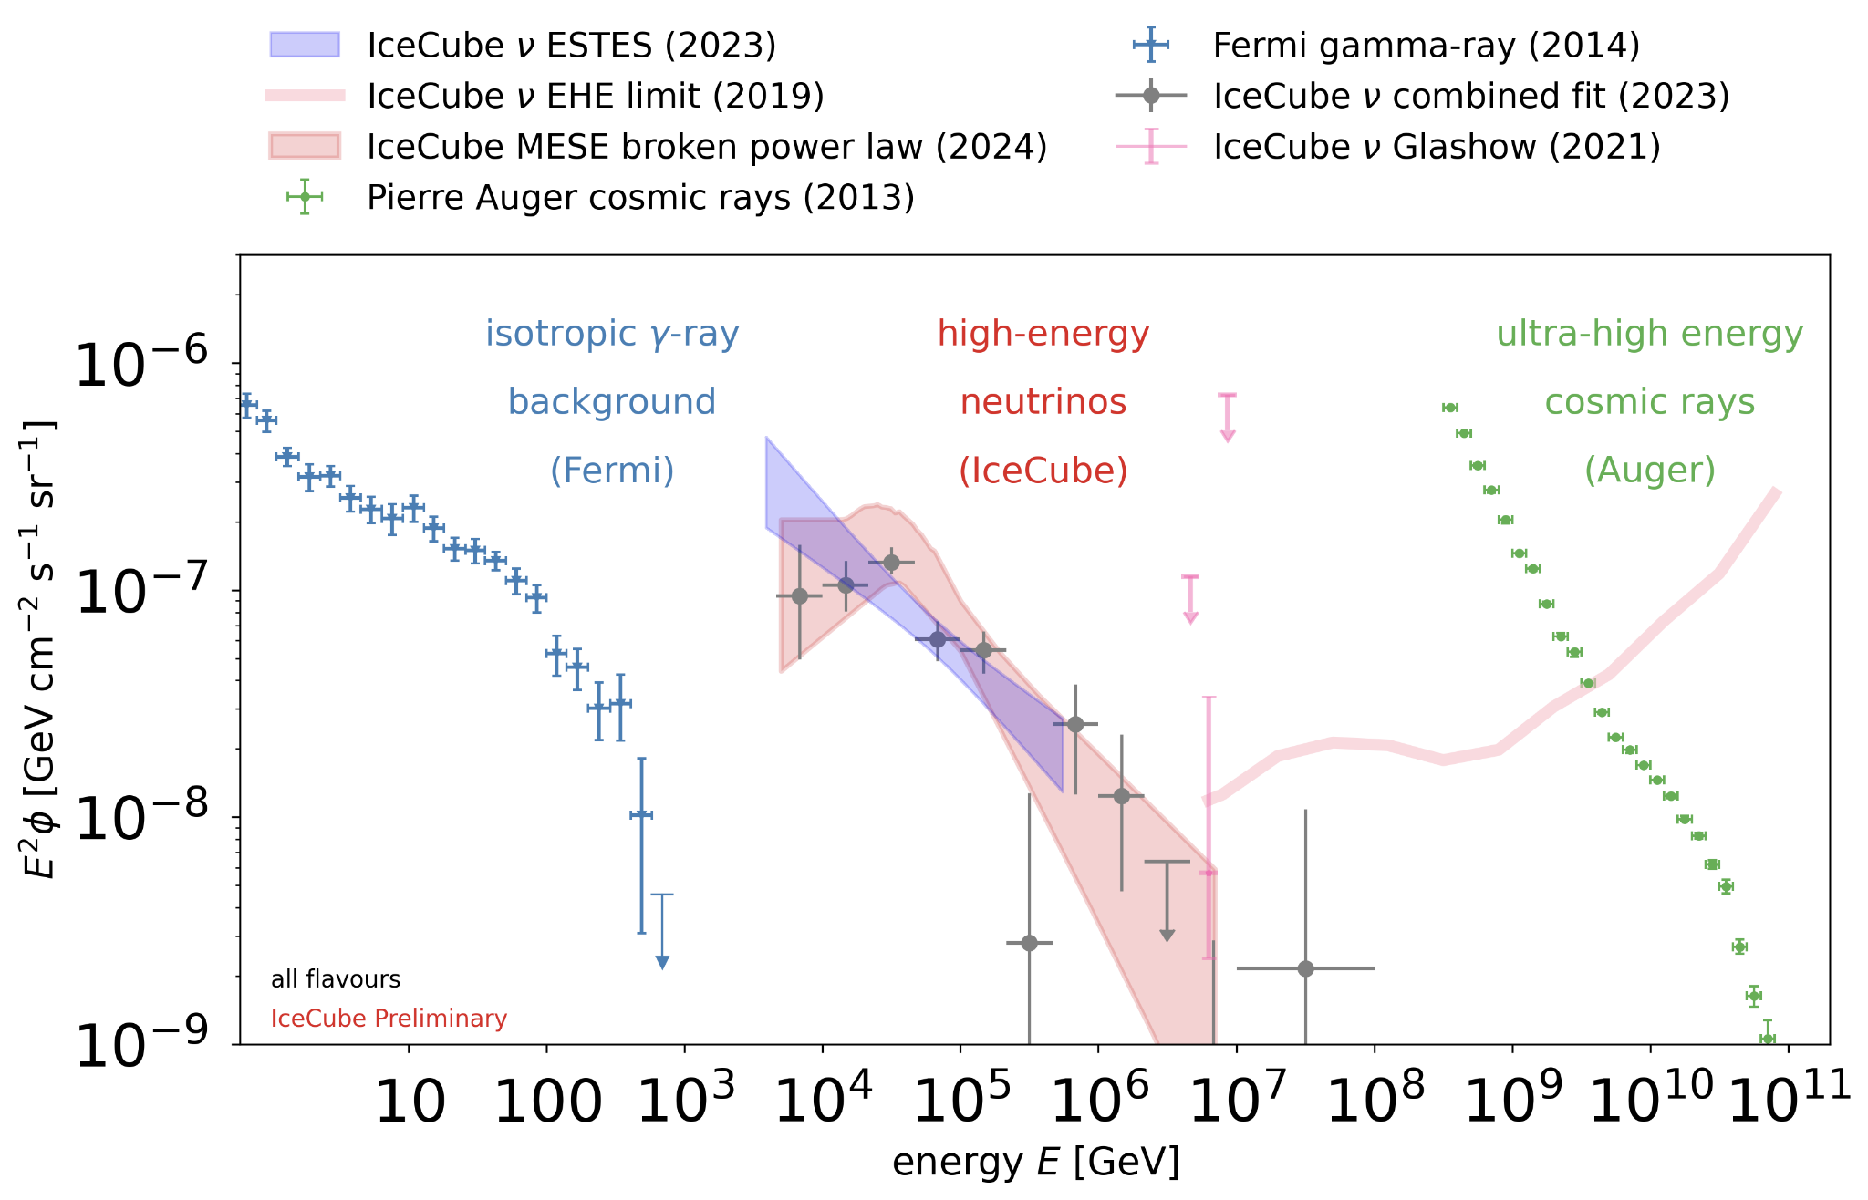
The multi-messenger sky
Extrapolation of SPL model overestimates 𝛾-ray flux
Spectral curvature reduces potential tension with extragalactic 𝛾-ray spectrum
Courtesy L. Lu
Notes:
If neutrinos produced by p-p interactions in gamma transparent sources, spectral index constrained to be <2.1-2.2, in violation with icecube data
Also saturates expected flux of gamma rays
The emission of neutrinos from TXS 0506+056 was accompanied by a GeV gamma ray
flare observed by the Fermi-LAT and MAGIC telescopes. The detection of NGC 1068,
however, did not coincide with significant TeV gamma ray emission, implying that neutrinos
could originate in environments opaque to VHE gamma rays.

Slide 19
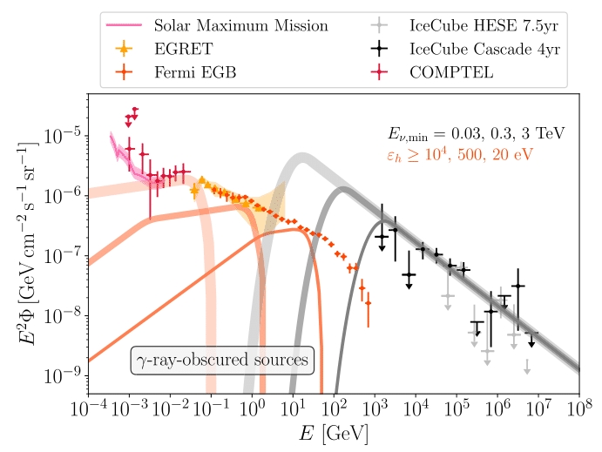
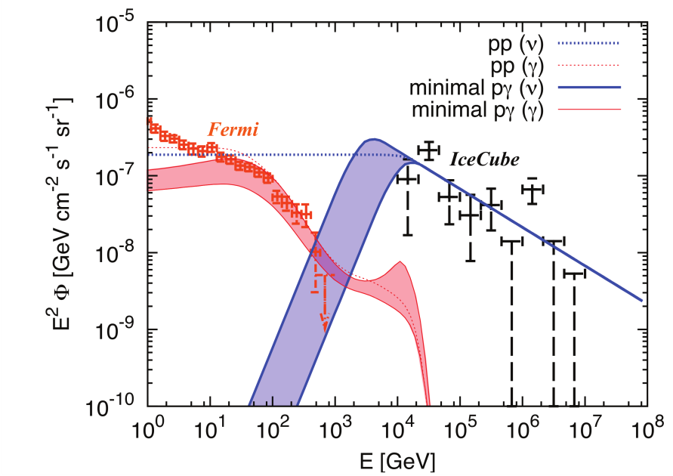
Cosmic ray accelerator dynamics
Low-energy cutoff may indicate sensitivity to p-p vs p-𝛾 neutrino emission
Neutrino energy constrains photon field at source, could indicate correlation with MeV/X-ray bright objects
Murase et al Phys. Rev. Lett. 116, 071101
Fang et al 2022 ApJ 933 190
Notes:
P-p emission assuming CR reservoirs with spectral break saturates IGRB measurement. But bulk of EGB >100GeV believed to be from unresolved blazars (https://iopscience.iop.org/article/10.1088/2041-8205/800/2/L27) which are variable and not necessarily p-p
P-gamma emission: do not saturate the IGRB measurement, but from Murase et al 2013, there is disagreement with high energy IGRB if the sources are gamma ray transparent. Assuming they are gamma opaque reprocesses these down to MeV/Xray
As the lower energy threshold for
neutrinos decreases, the emitted neutrinos
and γ-rays carry more power. Consequently,
a higher energy radiation field is required in
the source environment to cascade down
the hadronically produced γ-ray photons
to match Fermi’s measurements
of the diffuse extragalactic gamma background
(EGB)
Upon comparing Fermi’s measurement of the isotropic gamma-ray background to the flux
of cascades in the EBL, current IceCube measurements suggest that most high-energy
neutrino sources are opaque to GeV gamma rays, but may emit detectable MeV
photons. As illustrated in Fig. 2, the relation between the neutrino and gamma ray spectra
from such sources implies that measuring the MeV γ-ray flux can validate models
of the source’s radiation field, while constraining the total power of the source when
combined with neutrino spectral observations.

Slide 20
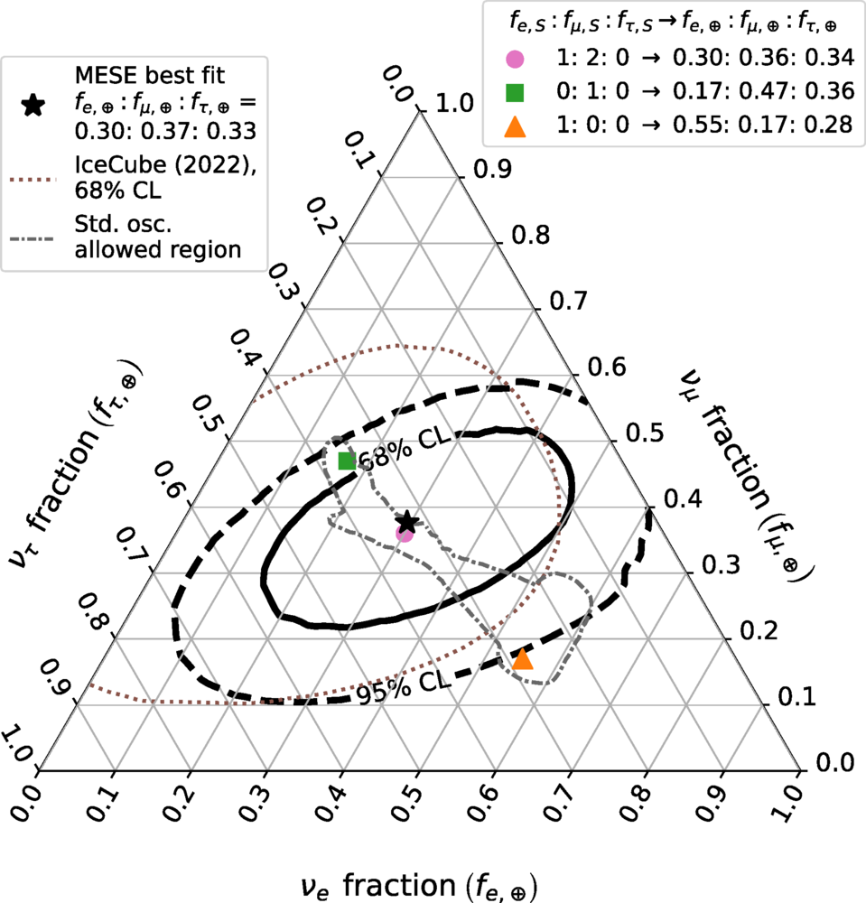
Neutrino flavor measurements
Discovery of astrophysical tau neutrino flux, with 7 candidate events in PRL132, 151001, (2024).
MESE dataset used to study ratio of neutrino flavors at Earth
Consistent with models assuming neutrino production via pion decay, and oscillation over cosmic distances
No evidence for interactions beyond Standard Model predictions
Phys. Rev. Lett. 137, 081002
Notes:
assuming no prompt muons from air showers, and assuming no shower fluctuations in the longitudinal profile of single hadronic and EM showers.

Slide 21
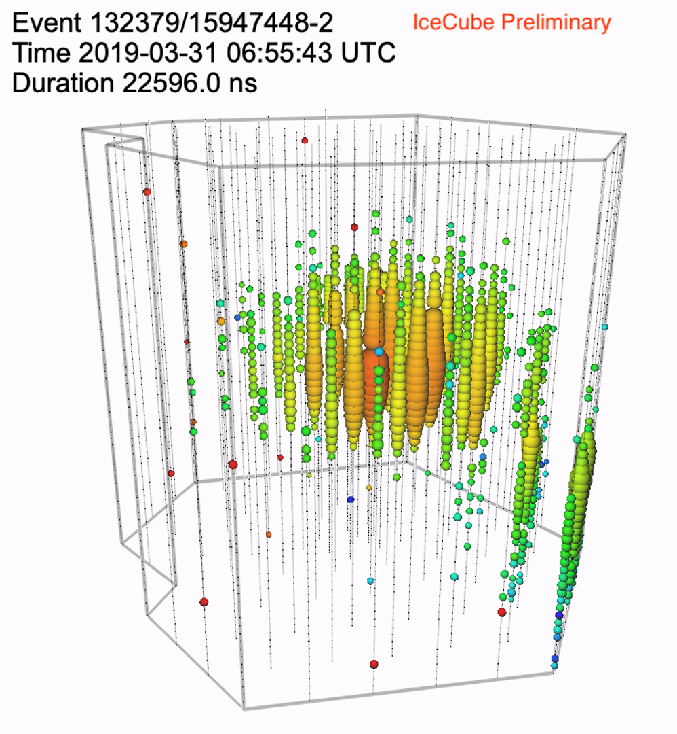
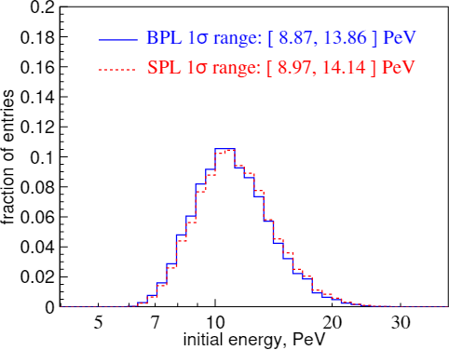
IceCube’s Highest Energy Event
IC190331A: Starting Track in HESE sample, reconstructed energy 4.8 PeV
Primary neutrino energy*:11.4 PeV
PoS ICRC2023, 1030 (2023)
*Most probable neutrino energy when assuming a BPL spectrum (𝛄₁ ,𝛄₂)=(1.72,2.84) [Data Release]
Notes:
GCN alert https://gcn.nasa.gov/circulars/24028
List of alerts : https://gcn.gsfc.nasa.gov/gcn/other/icecube_190331A.gcn3
Agile found a gamma ray source in vicinity
Swift later found 4 X-ray candidates
Counterparts

Slide 22
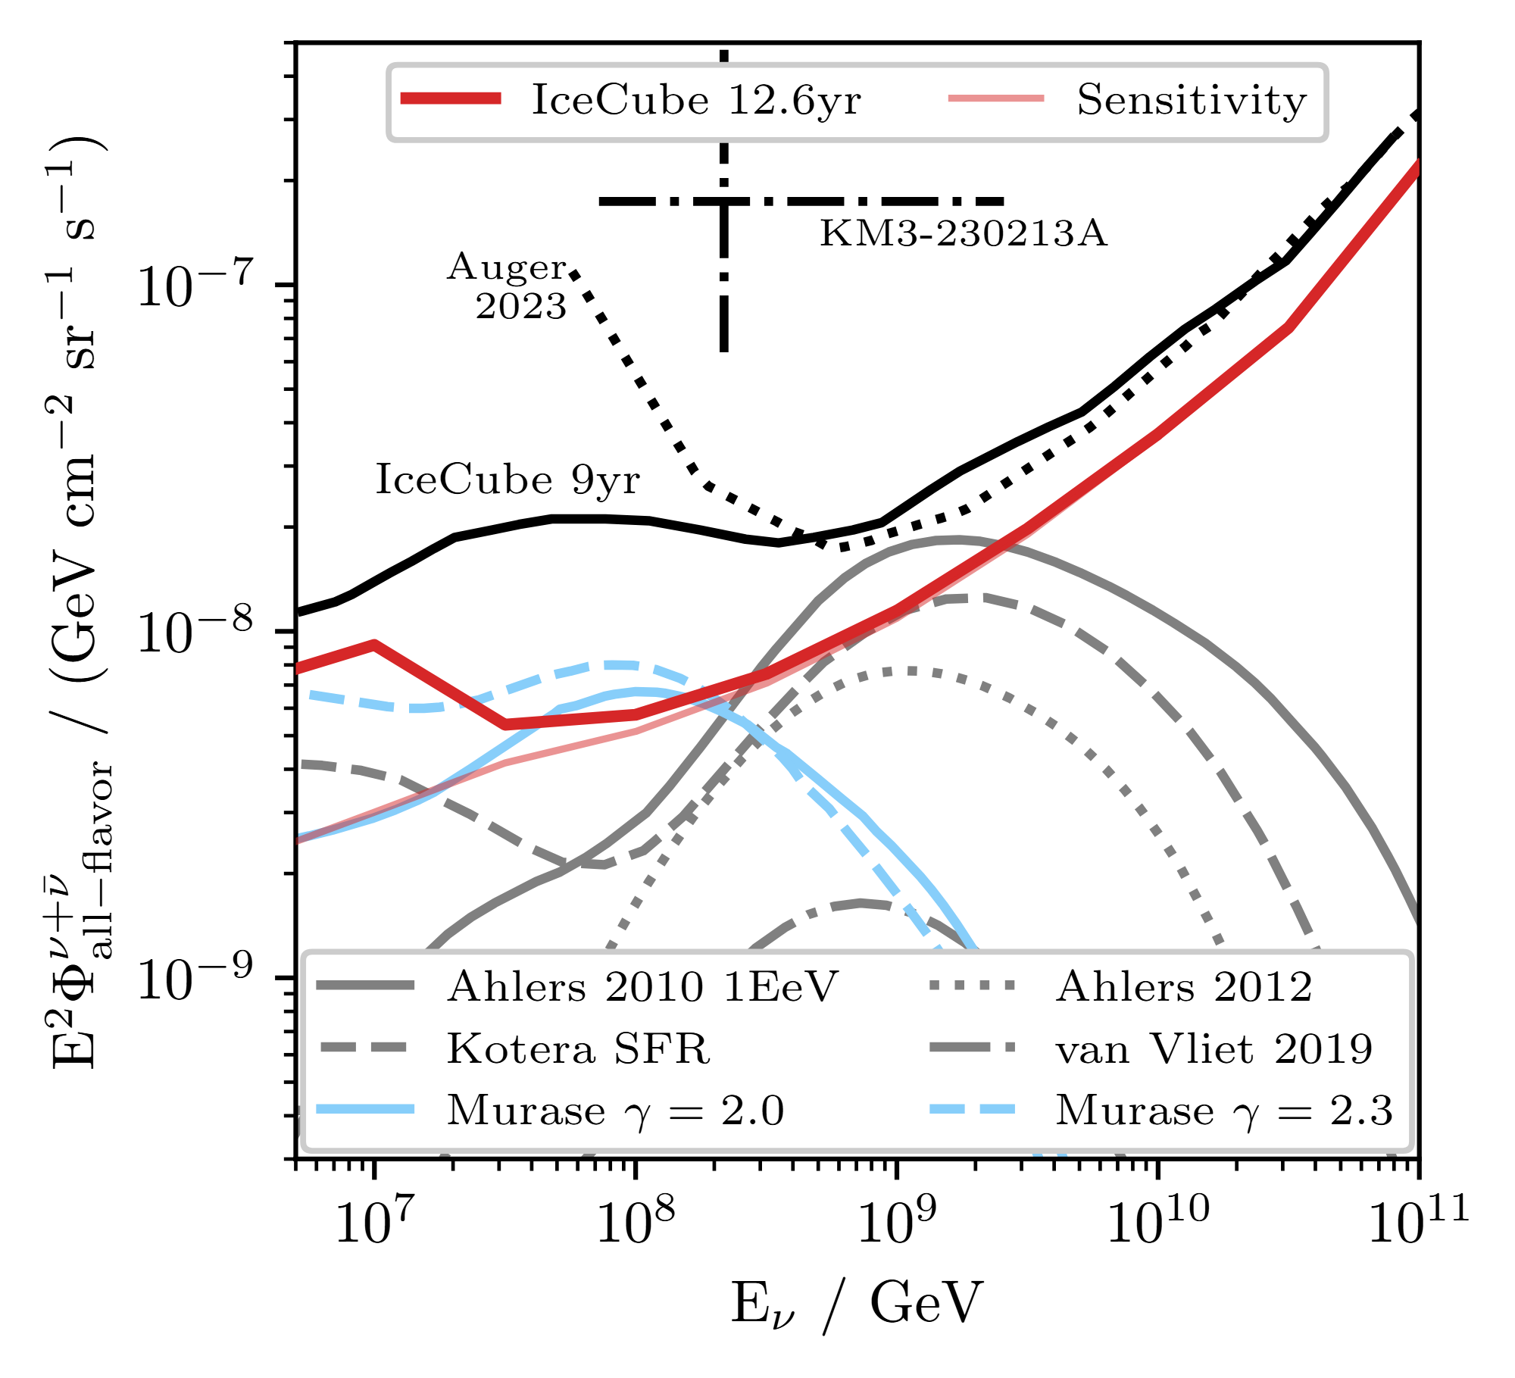
Spectral measurements at PeV energies and beyond
Gap between 1-10 PeV also probed with downgoing muon neutrino sample, finding no significant preference for a cutoff.
EHE neutrino flux measured at 1 EeV E²ɸ_{all-flavor} ~ 10⁻⁸ GeV s⁻¹ sr⁻¹ cm⁻²
Constraints on UHECR source conditions, disfavoring 100% proton fraction from CR measurements, in agreement with Auger, TA
KM3NeT observation of 220 PeV neutrino at 2.9σ tension with IceCube EHE measurements
Phys. Rev. Lett. 135, 031001 (2025)
Notes:
2x improvement via added livetime (+50%) and new selection techniques (e.g. stochasticity of muon bundle energy deposition)

Slide 23
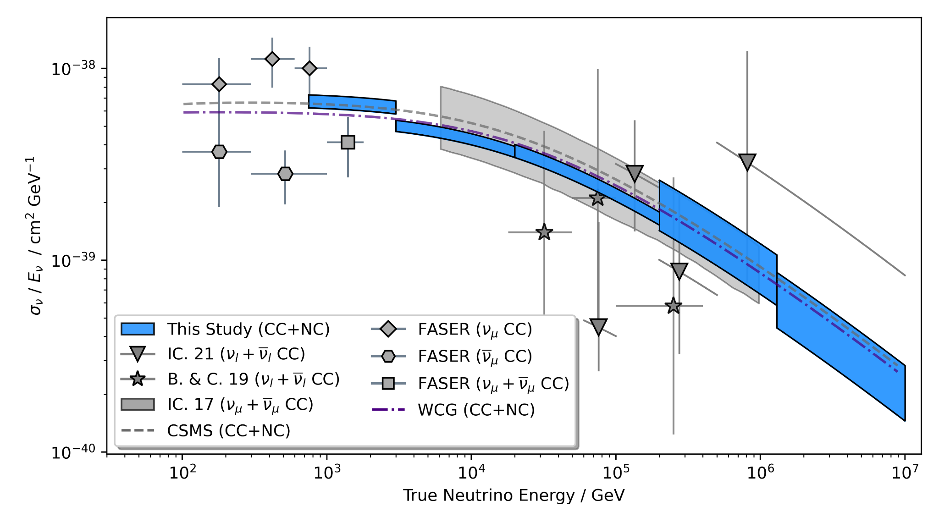
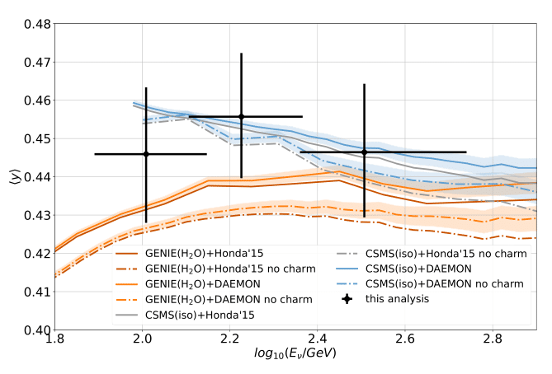
Deep Inelastic Scattering Inelasticity measurements
Inelasticity measurements from energy ranges linking accelerator measurements to natural sources
IceCube Upgrade expected to extend threshold below 80 GeV
IceCube Preliminary
IceCube Preliminary
C. Hill, TEVPA 2026
DOI

Slide 24
Outline
Multimessenger Astronomy at IceCube
Event Reconstructions with IceCube
Measurements of the Diffuse Neutrino Spectrum
Studies of Neutrino Sources
Outlook

Slide 25
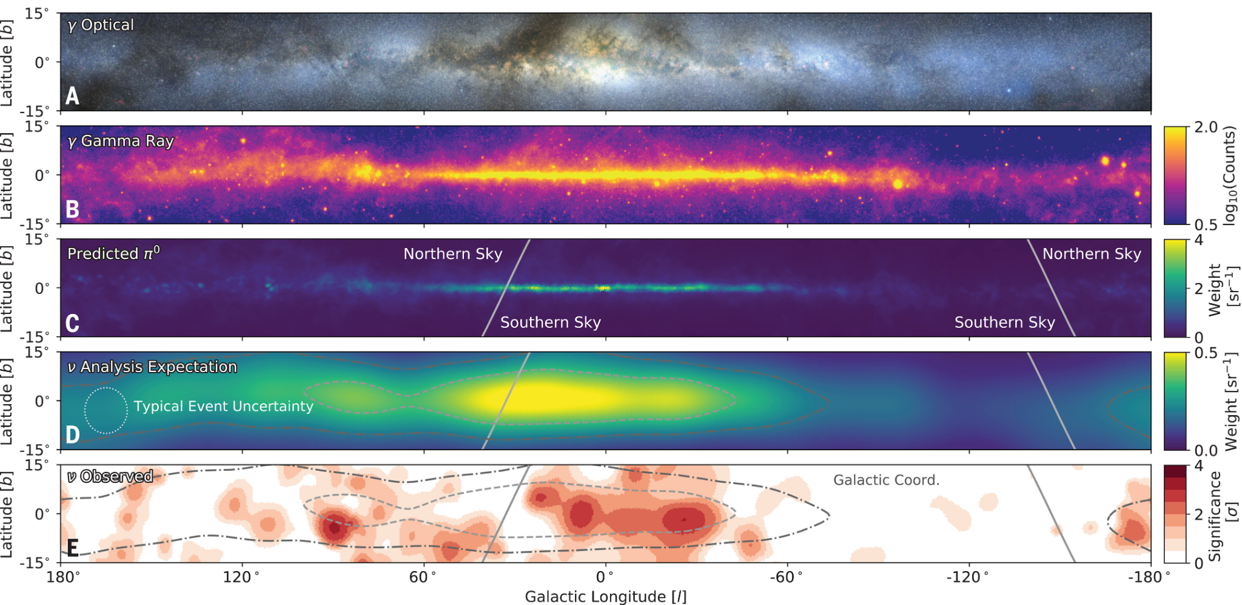
The Milky Way as a neutrino source
A novel cascade event selection, created using deep learning techniques, was able to find evidence for galactic neutrino emission at 4.5σ
Incorporation of track signatures and improved ice modelling leads to 5.7σ post trial significance: Link
Science 380, 1338 (2023)
Notes:
2x improvement via added livetime (+50%) and new selection techniques (e.g. stochasticity of muon bundle energy deposition)

Slide 26
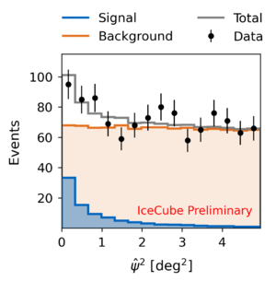
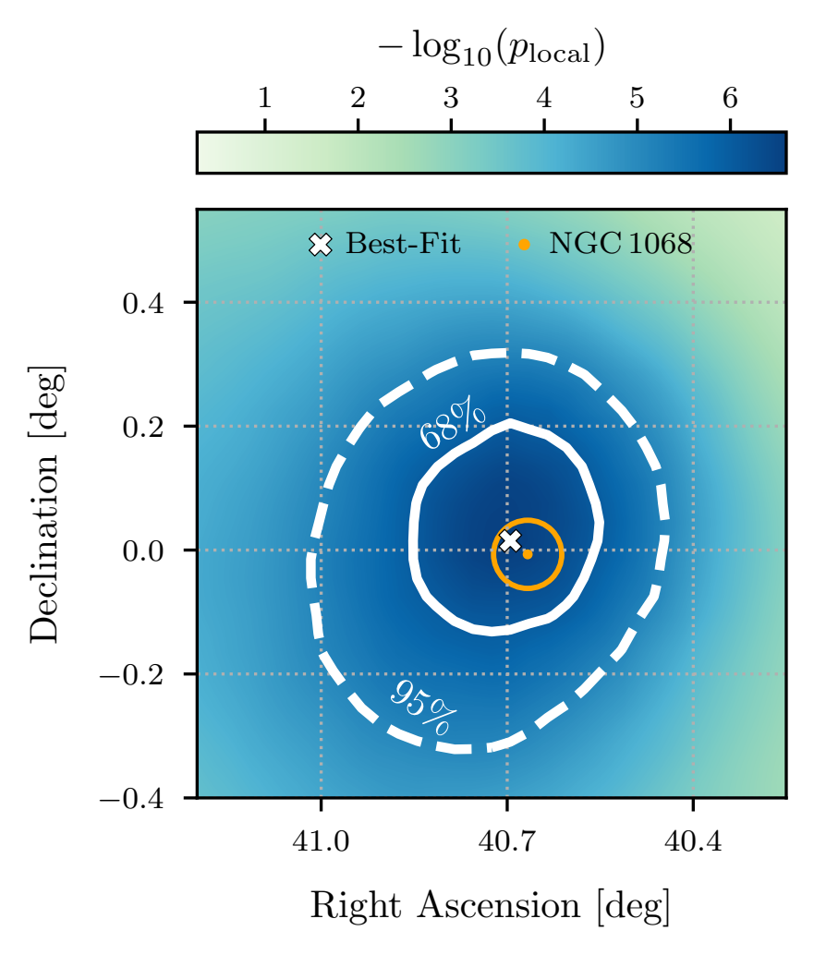
Neutrino emission from NGC 1068
Neutrinos are observed from sources where ambient matter may occlude GeV gamma rays, but which may be bright in the MeV or X-ray regime.
IceCube observed neutrinos from the Seyfert galaxy NGC 1068 with a significance of 4.2σ, with the observed flux exceeding gamma-ray predictions by at least two orders of magnitude.
R. Abbasi et al 2026 ApJL 1000 L26
Notes:
IceCube recently reported the observation of TeV neutrinos from the nearby Seyfert galaxy NGC 1068, and the corresponding neutrino flux is significantly higher than the upper limit implied by observations of GeV–TeV gamma rays. This suggests that neutrinos are produced near the supermassive black hole, where the radiation density is high enough to obscure gamma rays

Slide 27
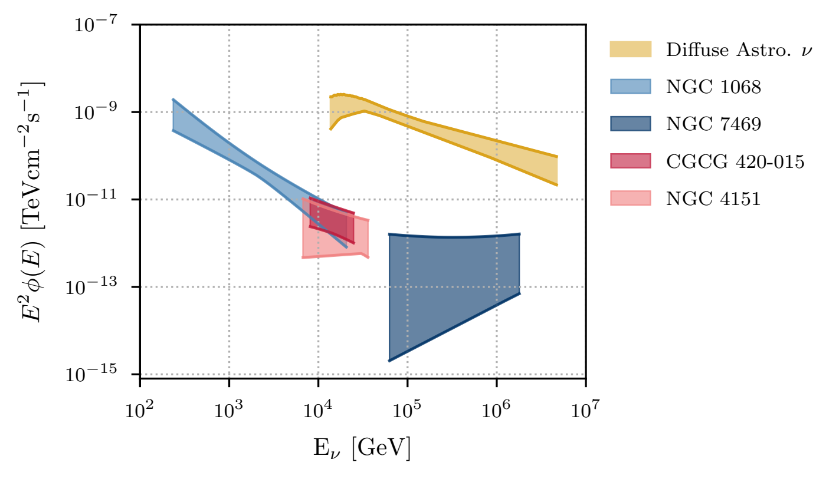
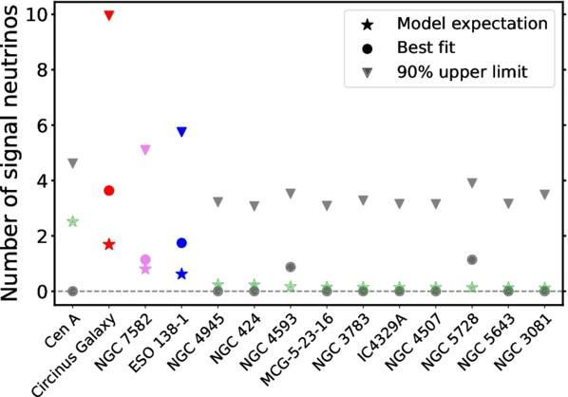
Neutrinos from X-ray bright Seyfert Galaxies
Evidence for neutrino emission from X-ray bright AGN cores in northern sky, correlated with the intrinsic X-ray flux
Study performed with sample of Seyfert galaxies in the Southern sky also finds an excess of events incompatible with background-only hypothesis at 3.0 σ
R. Abbasi et al 2026 ApJL 1000 L26
R. Abbasi et al 2026 ApJL 1000 L37
Notes:
2x improvement via added livetime (+50%) and new selection techniques (e.g. stochasticity of muon bundle energy deposition)

Slide 28
Outline
Multimessenger Astronomy at IceCube
Event Reconstructions with IceCube
Measurements of the Diffuse Neutrino Spectrum
Studies of Neutrino Sources
Outlook

Slide 29
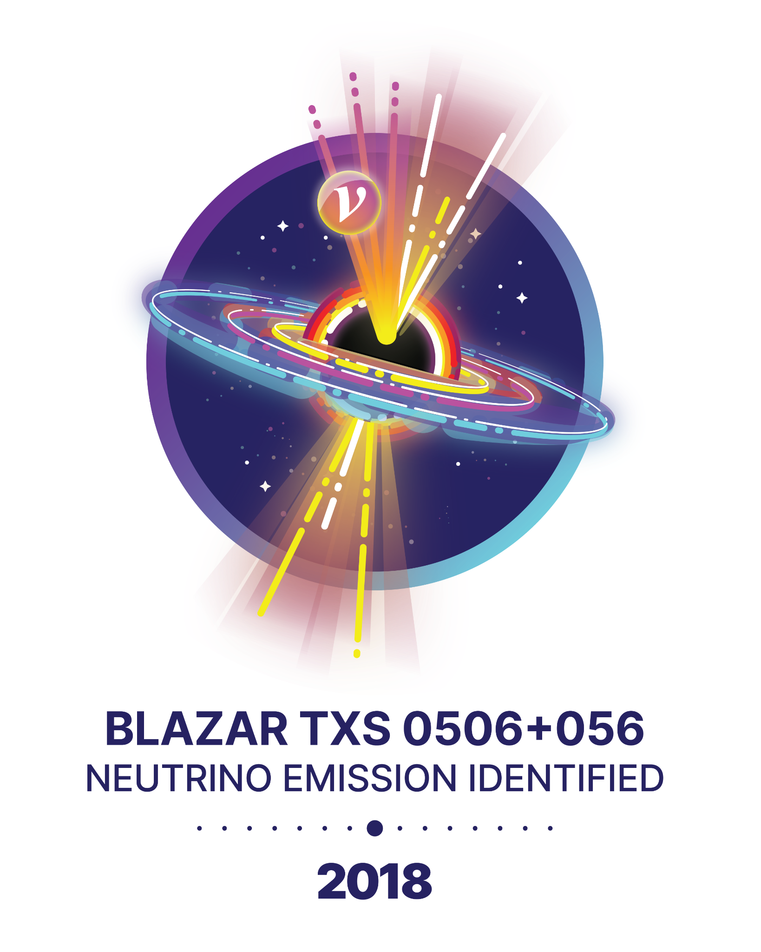
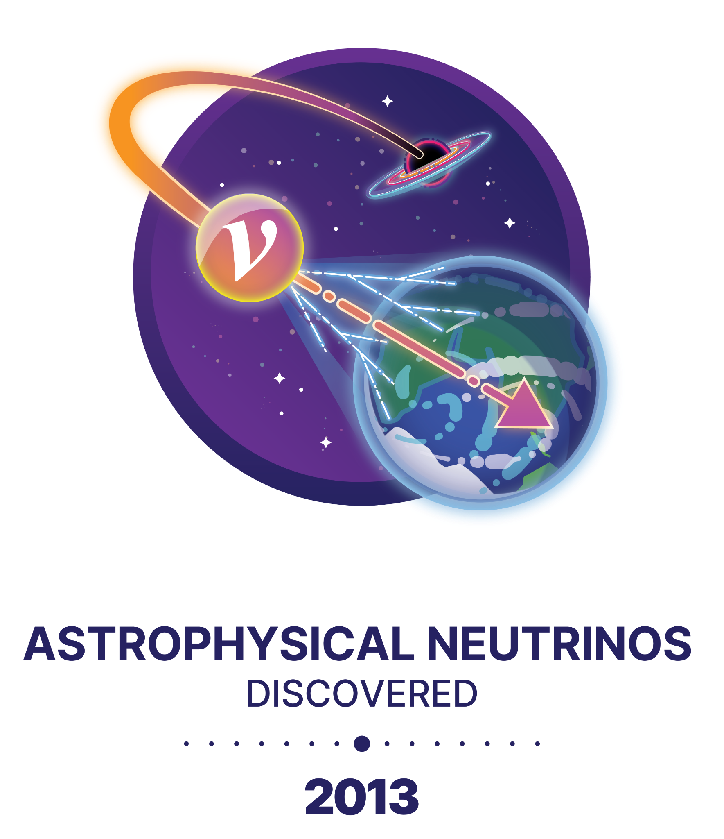
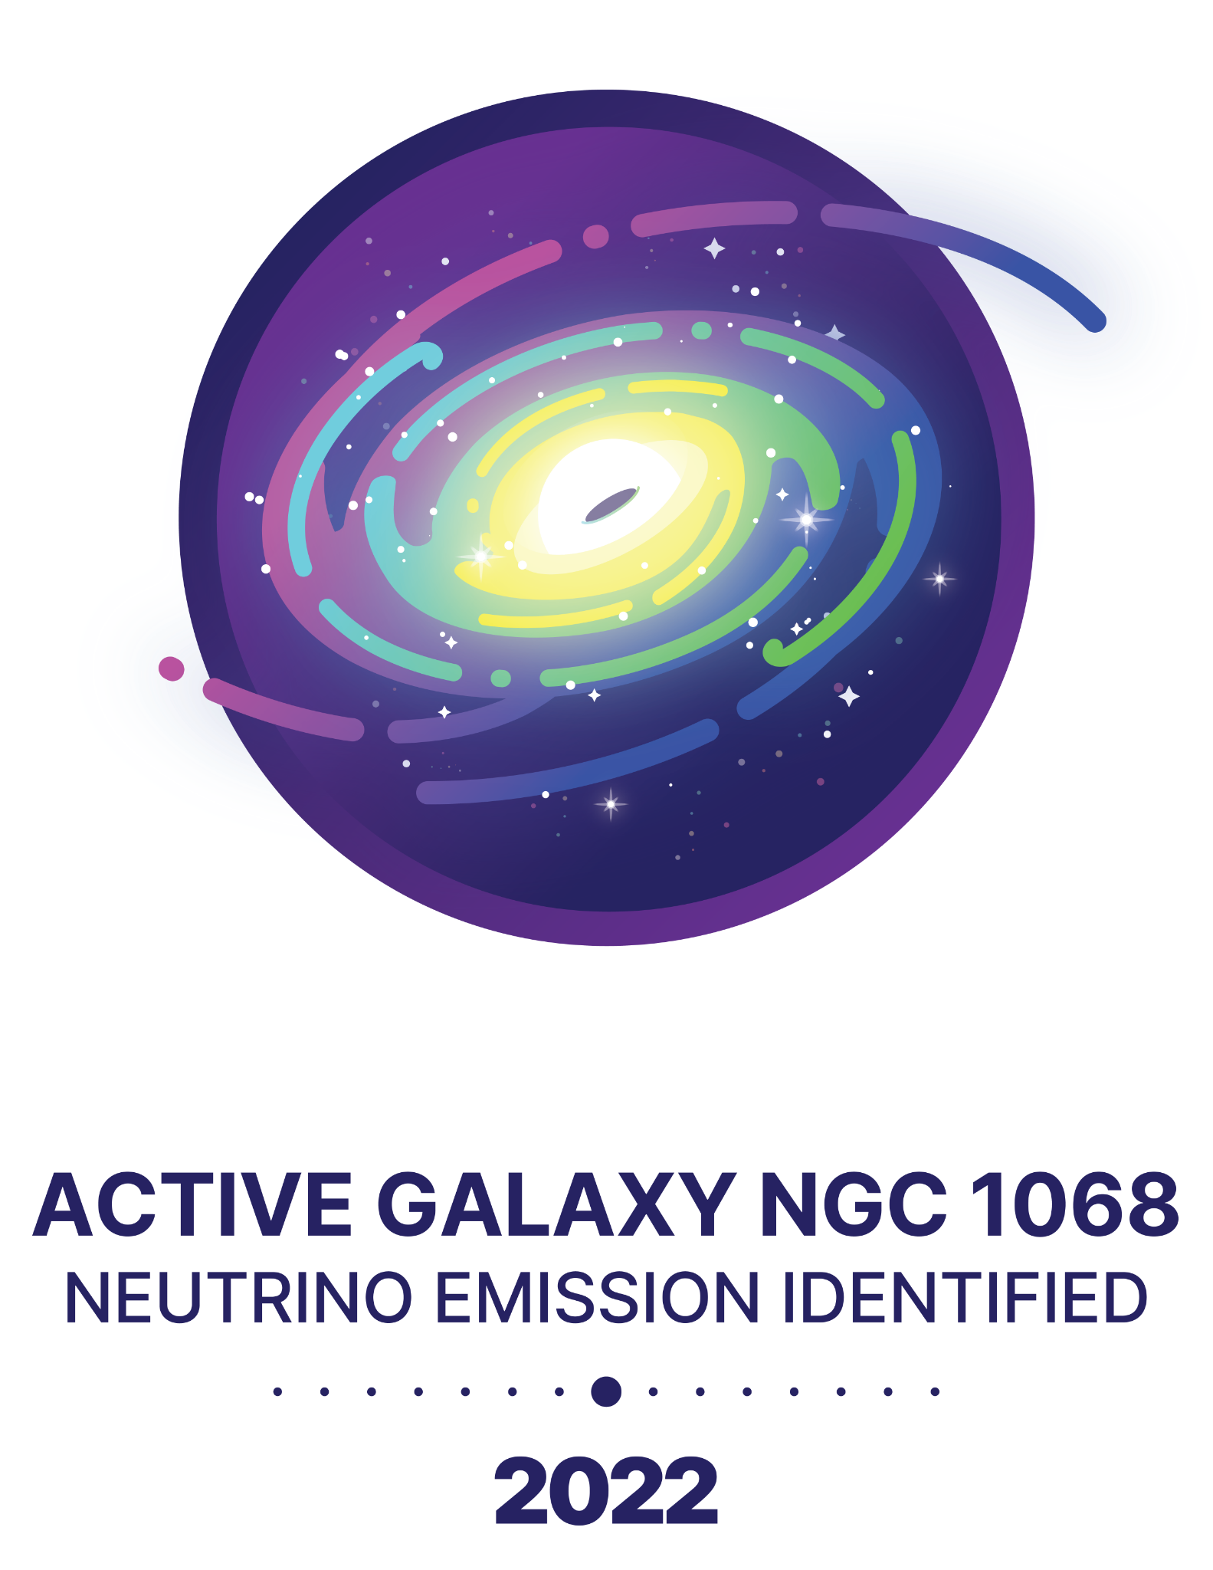
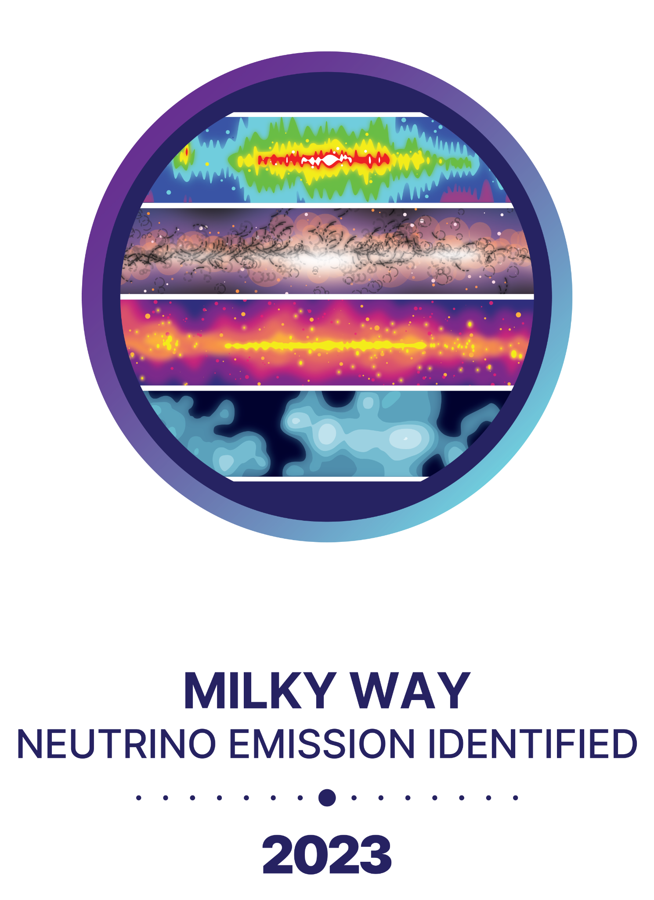
Observations of astrophysical neutrinos

Slide 30
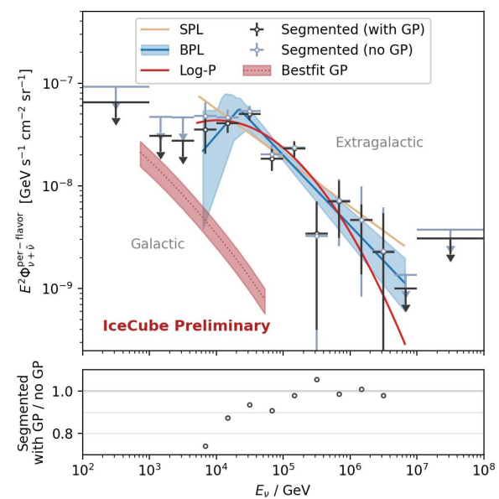
Combined picture
Flux of neutrinos at Earth greater than contribution from Milky Way alone -> unresolved extragalactic sources account for the bulk of the TeV neutrino flux
Extragalactic sources may be opaque to GeV gamma rays, but may show up in the MeV or keV range
Sites of galactic neutrino emission are still unresolved, and need careful study to identify
CRIS-MAC 2026
Notes:
2x improvement via added livetime (+50%) and new selection techniques (e.g. stochasticity of muon bundle energy deposition)

Slide 31
Outlook
IceCube has been able to identify neutrino emission both from within our galaxy and from extragalactic sources
Improvements in calibration, ice modelling, and machine-learning analysis techniques will push cosmic neutrino sensitivity lower into the TeV regime, enabling the testing of more detailed spectral models.
Future analyses to study the dynamics and populations of neutrino emitters are underway. Expansions such as the IceCube Upgrade (see talk by D. Butterfield) and the planned IceCube-Gen2 aim to greatly boost the sensitivity of searches for neutrino sources across many decades in energy
Notes:
2x improvement via added livetime (+50%) and new selection techniques (e.g. stochasticity of muon bundle energy deposition)

Slide 32
Backup

Slide 33

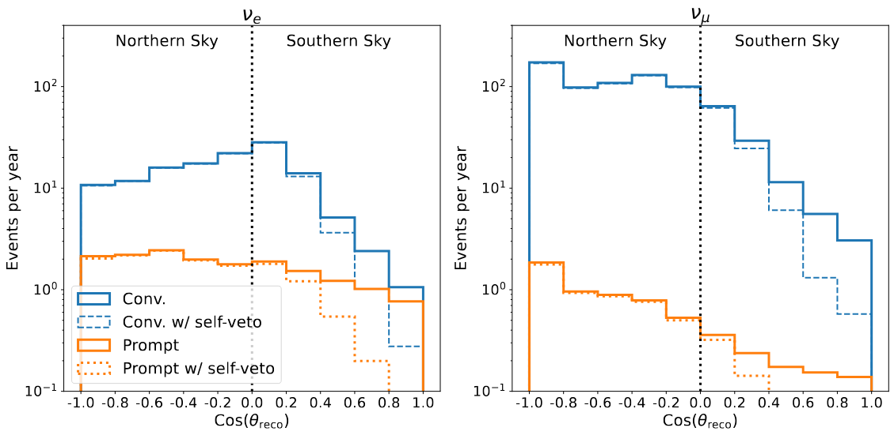
Neutrino self-veto
Neutrinos from CR showers often accompanied by muons.
Vetoing these muons suppresses atm. neutrino background
Accurate modeling of the self-veto suppression via
muon bundle injection.
Notes:
https://www.hawc-observatory.org/science/cosmicrays.php
Check on use of ‘systematics’ vs ‘systematic uncertainties’

Slide 34



Neutrino Interaction Channels
Charged current interactions yield an outgoing charged lepton and a hadronic shower
Neutral current interactions have an outgoing scattered hadron and neutrino
Glashow Resonance interactions yield an on-shell W⁻ boson, which subsequently decays
Notes:
CC and NC Deep Inelastic Scattering
Glashow Resonance:https://www.nature.com/articles/s41586-021-03256-1

Slide 35

Atmospheric Neutrino Spectrum
As conventional neutrinos are produced by the decay of pions produced in cosmic ray air showers, they follow a spectrum one unit steeper than the parent cosmic ray spectrum ~E^{-3.7}
The neutrino spectrum at Earth is therefore dominated by atmospheric neutrinos upto ~100 TeV, at which point astrophysical neutrinos predominate
The energy distribution of upgoing tracks for the period 2010-18
The Astrophysical Journal 928.1 (2022): 50
Notes:
Spend time, explain axes!
We will be extending the HESE analysis to lower energies, may have improved fitting
including the prompt neutrinos produced by charmed meson decays in the atmosphere.
Look up diff spectrum, look up muon spectrum
Get different results when you assume a single power law-> we can test like a broken power law or other.
Improved track energy resolution should be able to resolve spectral features
Higher statistics too

Slide 36

Tau neutrino identification
Selection strategy focused on double-cascade identification
Perform likelihood-based reconstruction
Additional cuts to select double cascades based on reconstructed energy in both cascades and their relative magnitudes
Retain events that pass the cuts with tau-decay length > 10 m and energy > 30 TeV as double cascades
Remaining events are cascades or tracks (based on a DNN)

