Slide 1
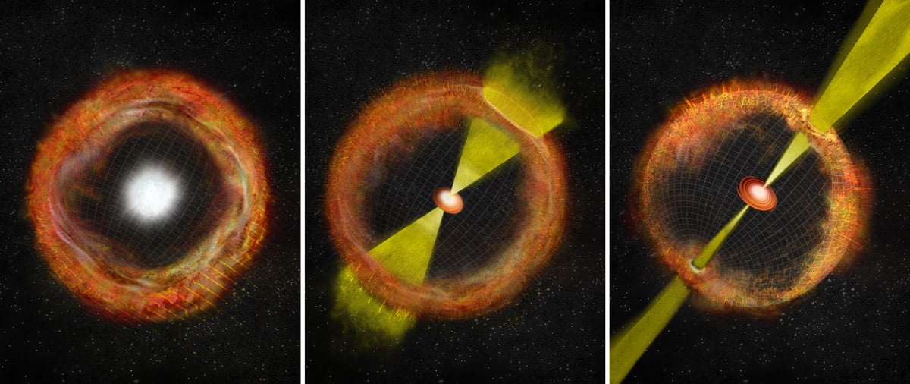
Supernovae progenitors as
sources of GeV-PeV neutrinos
Credit: Smithsonian Institution
Mukul Bhattacharya
Simons Collaboration (SCEECS) Postdoctoral Fellow
WIPAC, University of Wisconsin-Madison
IceCube Summer School 2025

Slide 2
Why should we study neutrinos?
Astrophysical production and detection
ProtoNS are multi-energy neutrino transients
GeV neutrinos from Galactic SNe (IceCube, KM3NeT, +)
TeV-PeV neutrinos from relativistic jets (IceCube-Gen2)

Slide 3
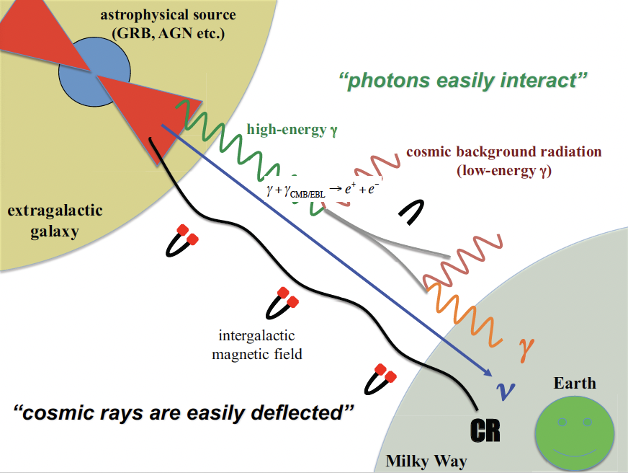
Why study neutrinos?
Neutrinos as cosmic messengers
Hold no charge $⟶$ point back to their source
Retain information from deep with the source
Undergo weak interaction
escape the source unimpeded
not absorbed by dust, CMB, EBL
Some drawbacks:
Low statistics
Large atmospheric neutrino background at GeV
Require very large detectors

Slide 4
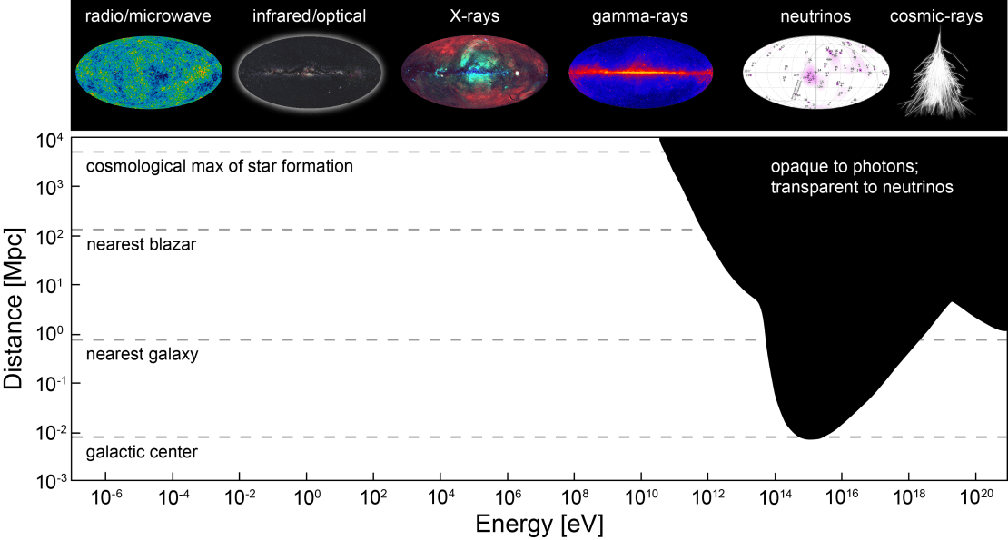
Neutrinos: Unique messenger at high energies
See Angelina’s talk for multi-messenger emission
Galactic magnetic fields deflect cosmic rays, gamma rays with E > 10 TeV attenuated
Astrophysical sources with very high energies are opaque to EM radiation but can be directly probed using neutrinos

Slide 5
Why should we study neutrinos?
Astrophysical production and detection
ProtoNS are multi-energy neutrino transients
GeV neutrinos from Galactic SNe (IceCube, KM3NeT, +)
TeV-PeV neutrinos from relativistic jets (IceCube-Gen2)

Slide 6
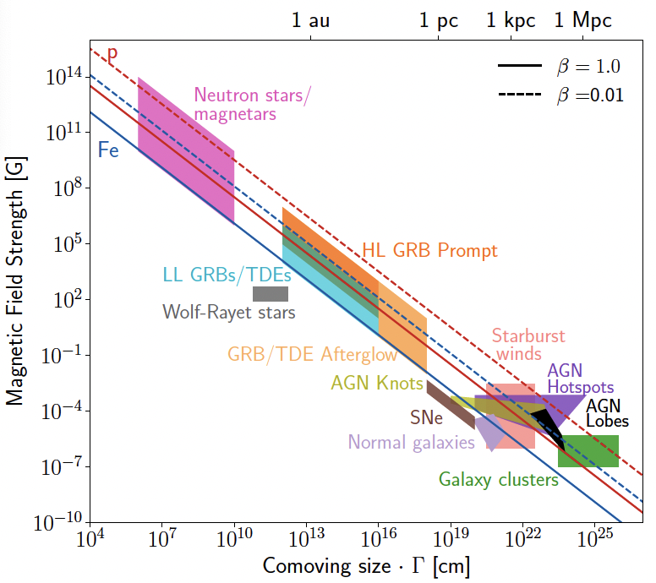
Astrophysical neutrino production
$$p,γ$$
$$ν_{μ}$$
p
$$π^{±}$$
$$ν_{μ}$$
$$μ$$
$$e$$
$$X$$
$$ν_{e}$$
Cosmic accelerator
Target
(beam dump)
Neutrinos are generated from $π$ decay, the latter being created in hadronic interactions
How are protons accelerated in astrophysical environments?
Diffusive shock acceleration
Occurs in collisionless shocks
Predicts $E_{p}^{-2}$ spectra
Magnetic reconnection
Efficient at dissipating magnetically-dominated outflows
Predicts spectra harder than $E_{p}^{-2}$ in relativistic outflows (e.g., Hoshino 2012, Guo et al. 2016)

Slide 7
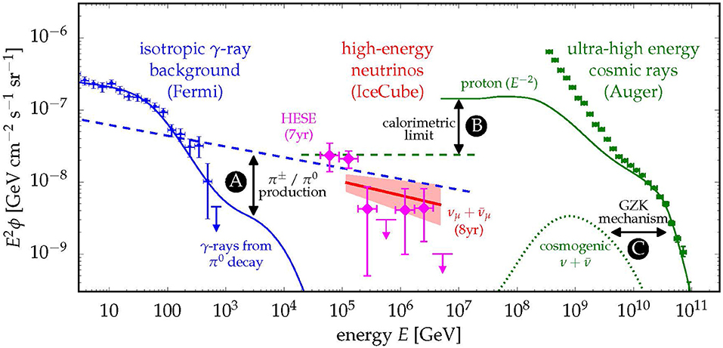
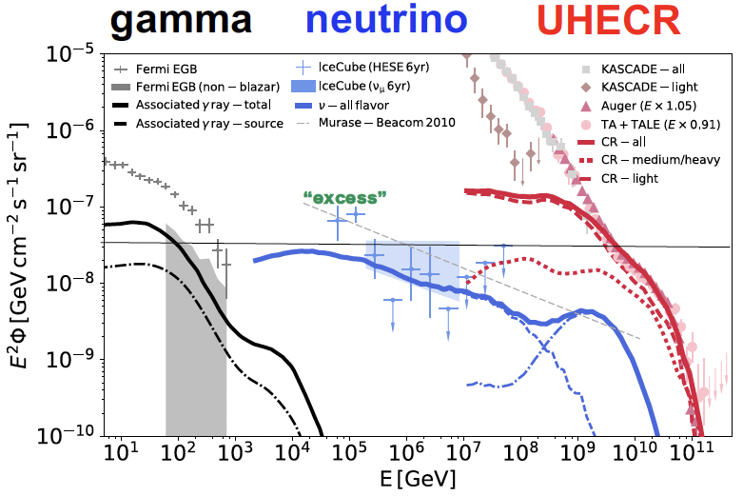
Flux correlation with other messengers
Similar scales for energy densities of Fermi EGB, IceCube neutrinos and Auger UHECRs
Production of charged pions and neutral pions via CR interactions leads to the emission of neutrinos (dashed blue) and gamma rays (solid blue), respectively
CR emission models (solid green) of UHECRs imply a maximal flux (calorimetric limit) of neutrinos from the same sources (green dashed)
Predictions of emission of cosmogenic neutrinos from the collision of UHECRs with CMB photons (GZK mechanism)
Notes:
High-energy neutrino production, at its core, functions just like making neutrinos from an accelerator

Slide 8
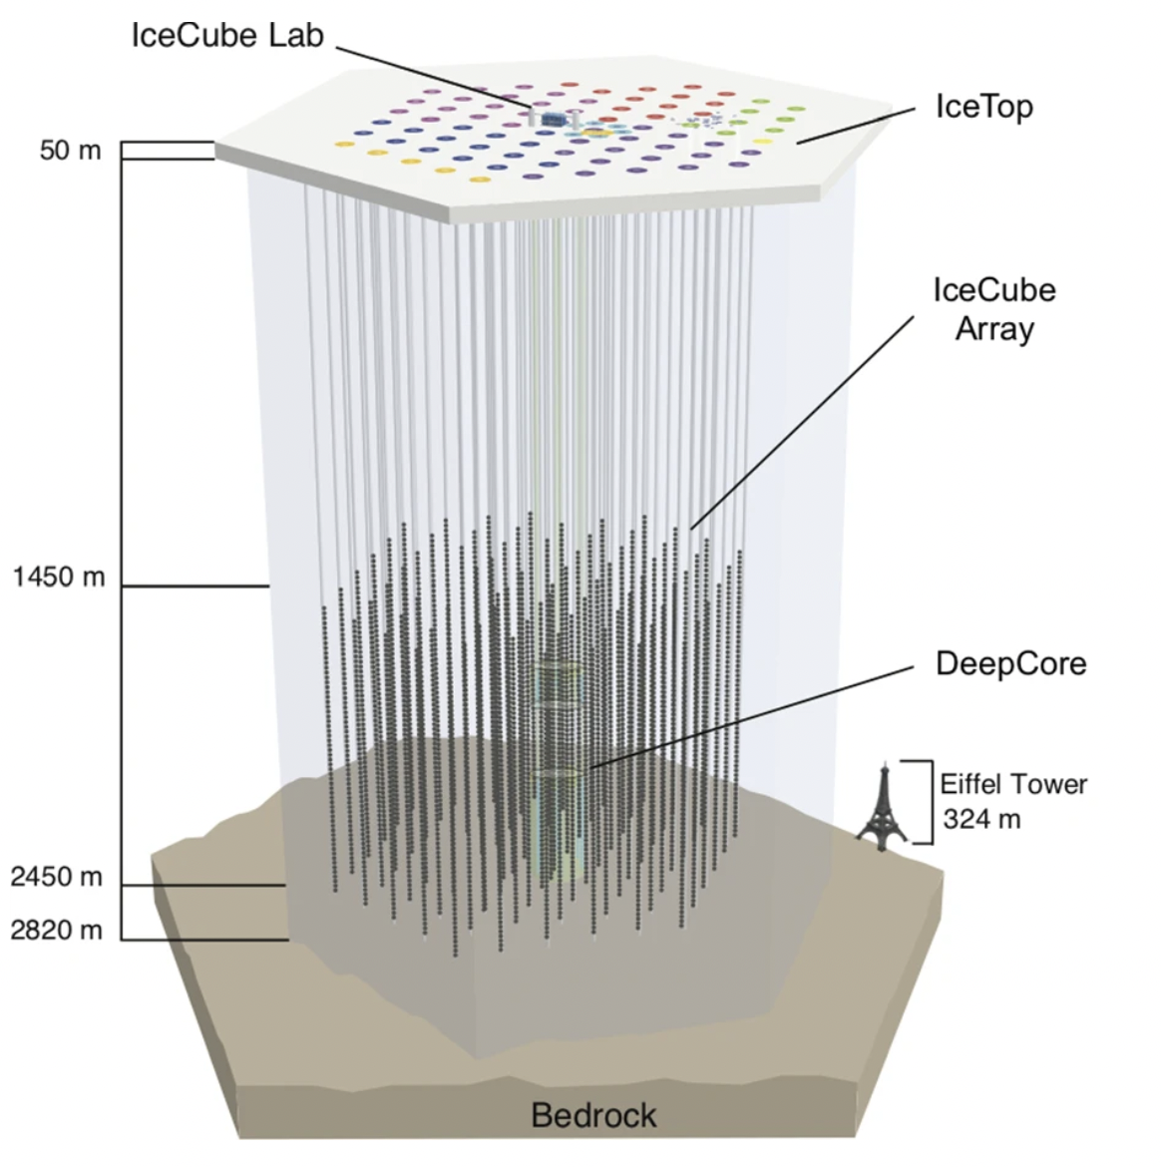
How to detect these neutrinos?
Low cross sections require large detectors
Detection via Cherenkov radiation
Energy range
Current detectors
Next-generation
GeV-100 GeV
TeV - PeV
IceCube-Deepcore
Super-Kamiokande
IceCube
IceCube-Upgrade
KM3NeT-ORCA
Hyper-Kamiokande
IceCube-Gen2
Notes:
High-energy neutrino production, at its core, functions just like making neutrinos from an accelerator

Slide 9
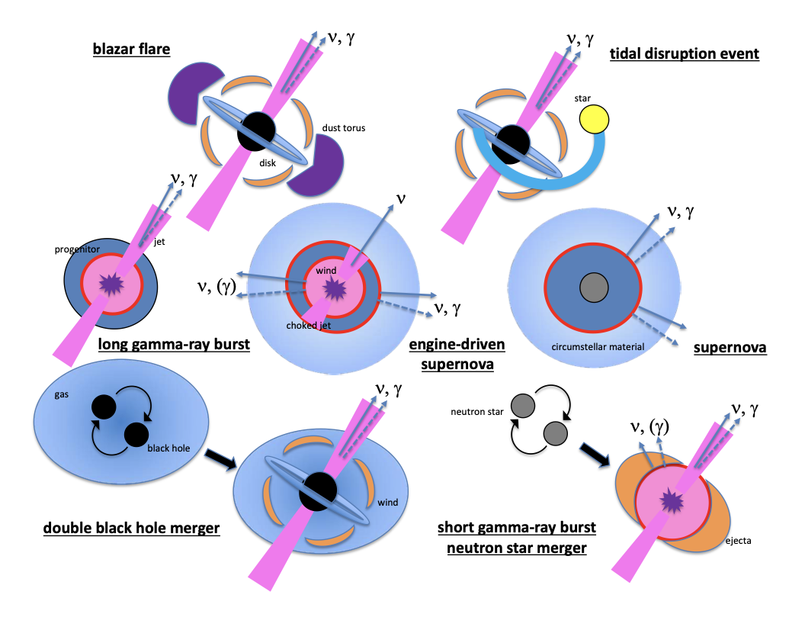
Astrophysical neutrino transients
Neutrino transient candidates can also be:
Gamma-ray emitters
Cosmic-ray accelerators
Accompanied by GWs
Multi messenger signatures
TXS 0506+056 (Aartsen et al. 2018)
NGC 1068 (Abbasi et al. 2022)
Neutrino coincidences with TDEs (R. Stein et al. 2021, S. Reusch et al. 2022, van Velzen et al. 2024)
See Angelina’s talk for multi-messenger signatures
Several theoretical studies on neutrinos from TDEs
(e.g., Liu et al. 2020, Walter & Lunardini 2022, Mukhopadhyay et al. 2023, Yuan et al. 2024)
Bartos & Murase 2019
See Nick’s talk for neutrinos from AGNs and TDEs

Slide 10
Why should we study neutrinos?
Astrophysical production and detection
ProtoNS are multi-energy neutrino transients
GeV neutrinos from Galactic SNe (IceCube, KM3NeT, +)
TeV-PeV neutrinos from relativistic jets (IceCube-Gen2)

Slide 11
Protoneutron stars (PNSs)
Neutron stars formed after core-collapse supernovae start out as PNSs.
If PNS is highly magnetized ($B≳{10}^{14}G$), we call it a protomagnetar
What makes them interesting
Can be central engines for gamma-ray bursts
(e.g., Zhang & Mészáros 2001, Thompson et al. 2004, Metzger et al. 2011)
Are sites for heavy element nucleosynthesis
(e.g., Horiuchi et al. 2012, Bhattacharya et al. 2022, Ekanger et al. 2023)
Credit: Dafne Guetta

Slide 12
How are PNSs formed?
Infalling material bounces off core, powers shock wave outwards
Neutrinos revive shock in the surface of NS
Fe fused in core of $8M_{⊙}$ progenitor, radiation
pressure decreases
$$ν$$
$∼1.4M_{⊙}$ core collapses, $p+e^{-}→n+ν_{e}$ ,
neutron degeneracy
$$ν$$
NS
$$ν$$
$$ν$$

Slide 13
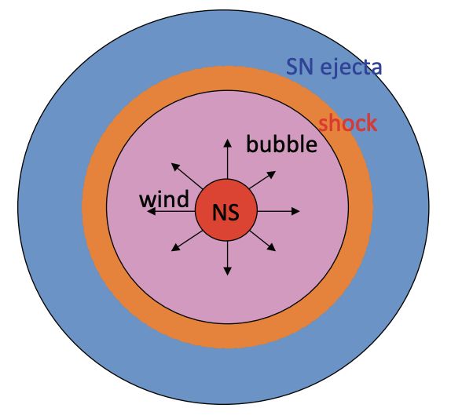
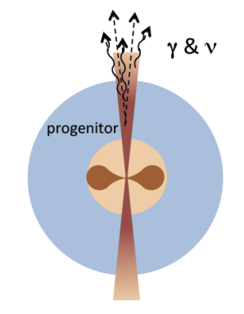
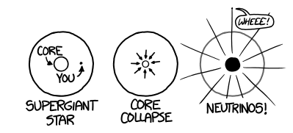
PNSs are multi-energy neutrino transients
Murase et al. 2015
Credit: https://neutrino.physics.iastate.edu/project/dune
Produced in neutron-rich winds
Created from neutron-proton interactions
$$∼0.1GeVto∼10GeV$$
Quasi-thermal
Supernova neutrinos
Lasts $∼10$ seconds
$$∼1MeVto∼50MeV$$
Thermal
Franckowiak 2017
From SNe hosting relativistic jets
Result from $pγ$ interactions
Non-thermal
MeV $ν$s
GeV $ν$s
TeV - PeV $ν$s
$$E_{ν}$$

Slide 14
Why should we study neutrinos?
Astrophysical production and detection
ProtoNS are multi-energy neutrino transients
GeV neutrinos from Galactic SNe (IceCube, KM3NeT, +)
TeV-PeV neutrinos from relativistic jets (IceCube-Gen2)

Slide 15
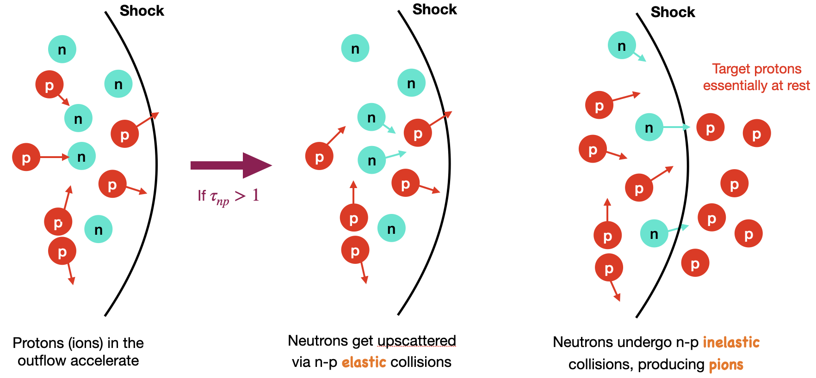
Neutrons in PNS wind
Assumption: Spherical neutrino-driven wind (no jets! no beaming!)
Outflow is naturally neutron-rich from neutrino heating.
More neutrons from photodisintegration of heavy nuclei (depends on electron fraction $Y_{e}$).

Slide 16
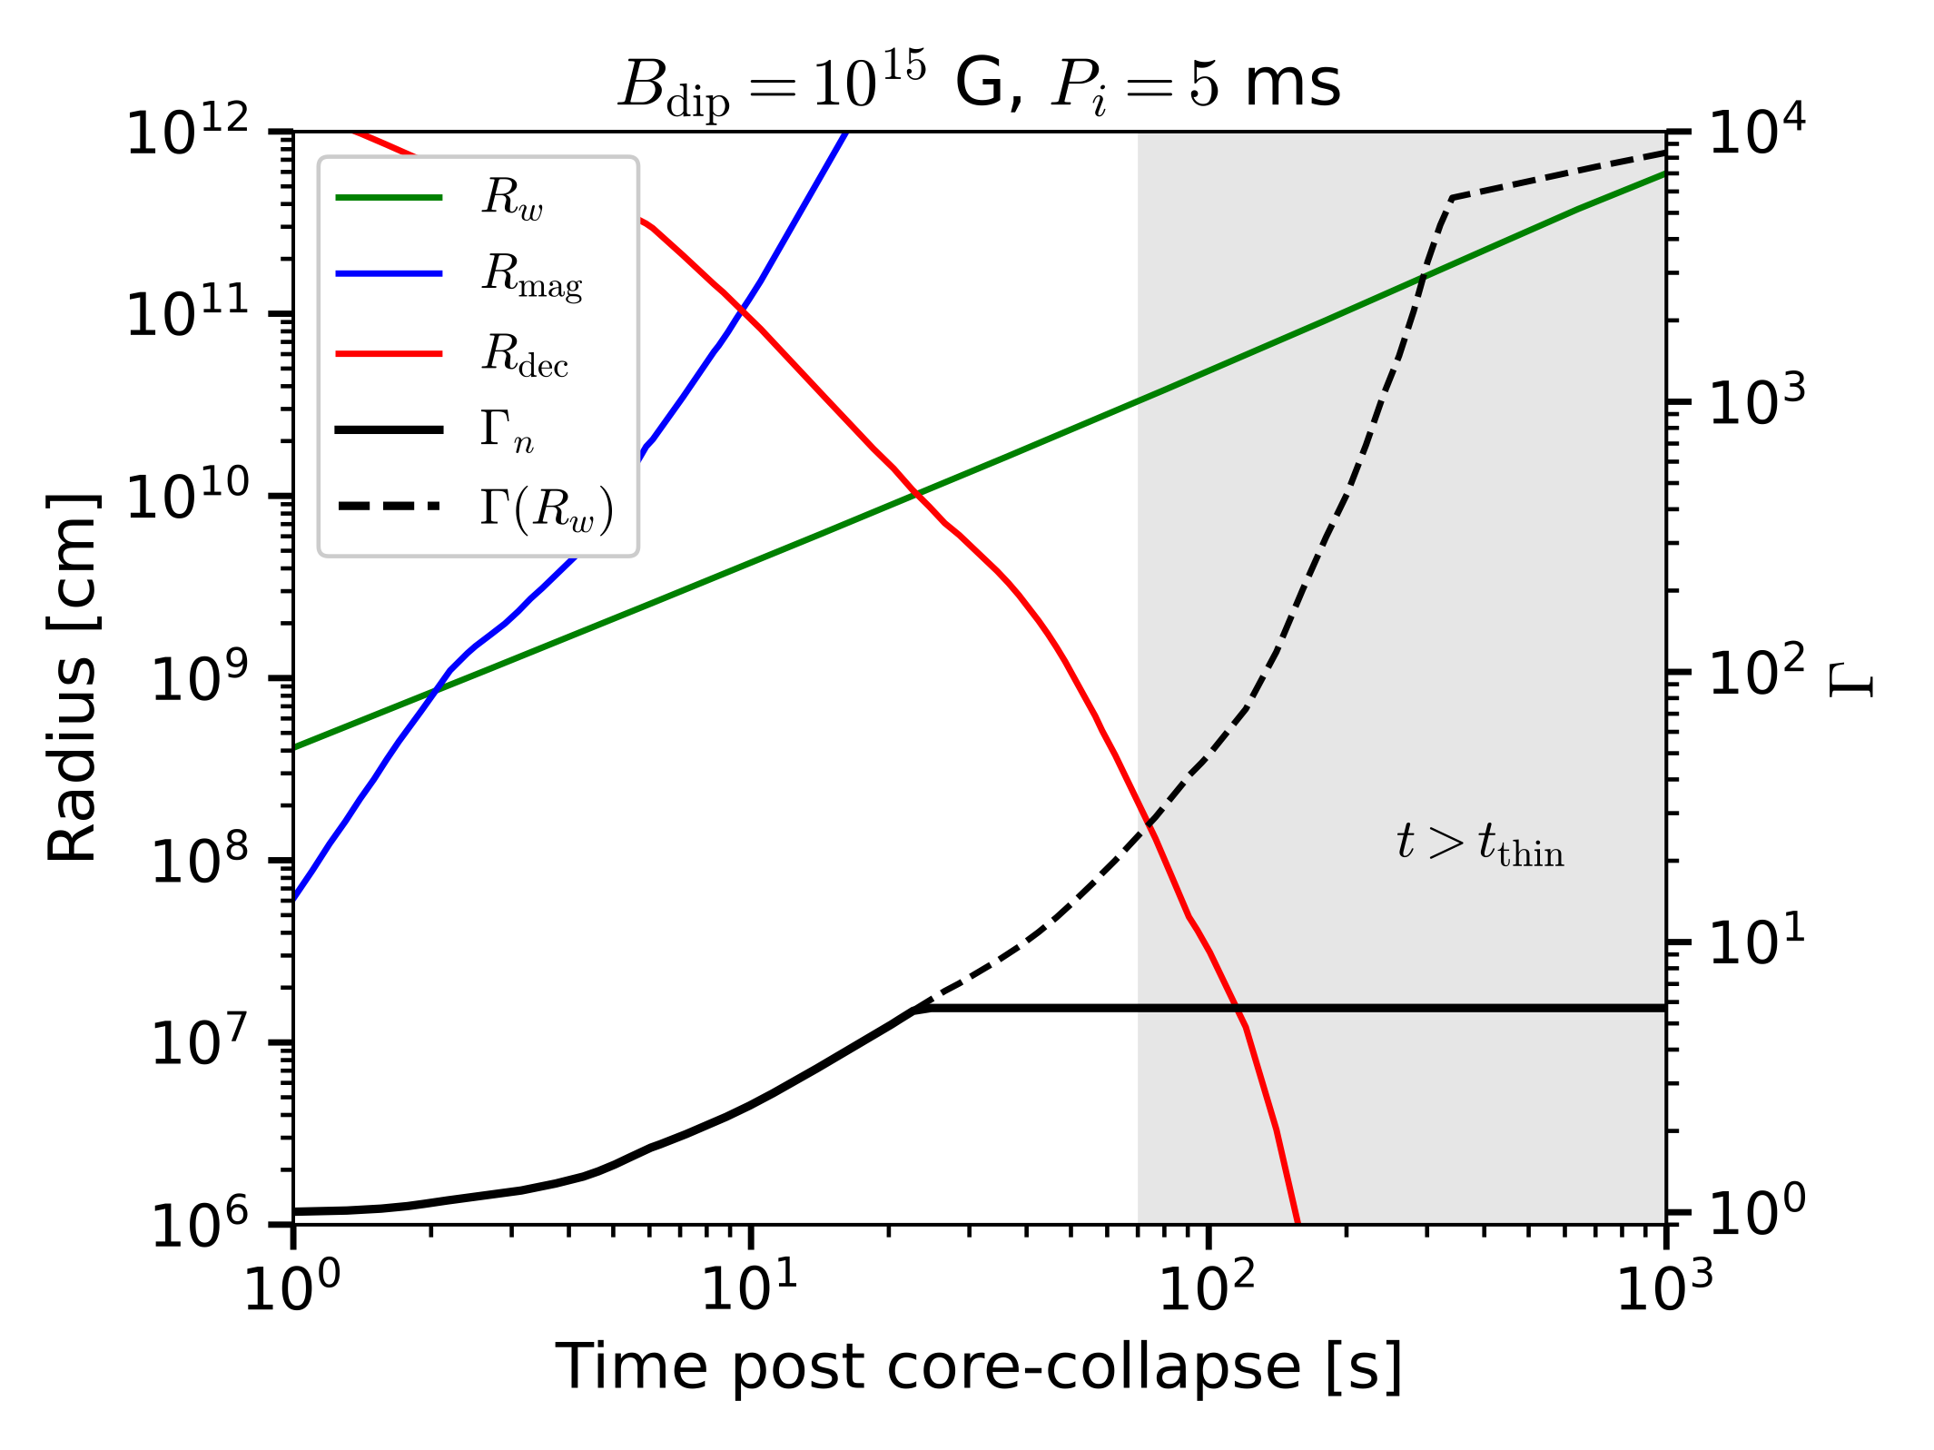
Neutron bulk acceleration
$π$ production via $np$ inelastic collisions $Γ≳1.4$.
(e.g., Bahcall & Mészáros 2000, Murase et al. 2013)
$R_{dec}$ is the radius where $τ_{np}=1$
If $R_{w}>R_{dec}$, neutrons stop accelerating
Neutrons now decouple behind the wind radius
Does not involve particle acceleration mechanisms (only use $\overset{·}{M}$)
$π$ production is guaranteed if relativistic neutrons are present
$\overset{·}{M}$ drops drastically

Slide 17
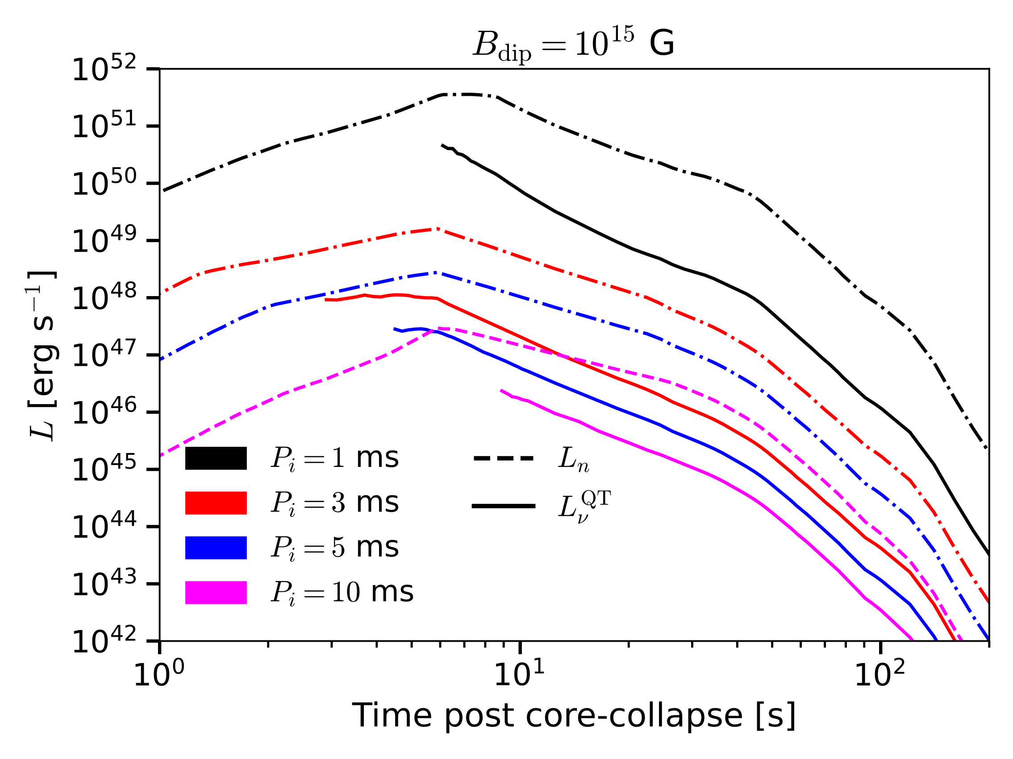
Quasi-thermal neutrino production
Neutrinos carry a smaller neutron energy fraction
Neutron kinetic luminosity: $L_{n}=Y_{n}(Γ_{n}-1)\overset{·}{M}c^{2}$
(assume $Y_{n}=0.5$)
$\overset{·}{M}$ (and $L_{n}$) drops quickly after $≈70$ s
PNS contraction
Wind becomes
relativistic
For weaker $B$ fields, the wind takes $∼20$ s to become relativistic
$∼10\%$of the neutron energy goes to neutrinos for neutrons close to production threshold

Slide 18
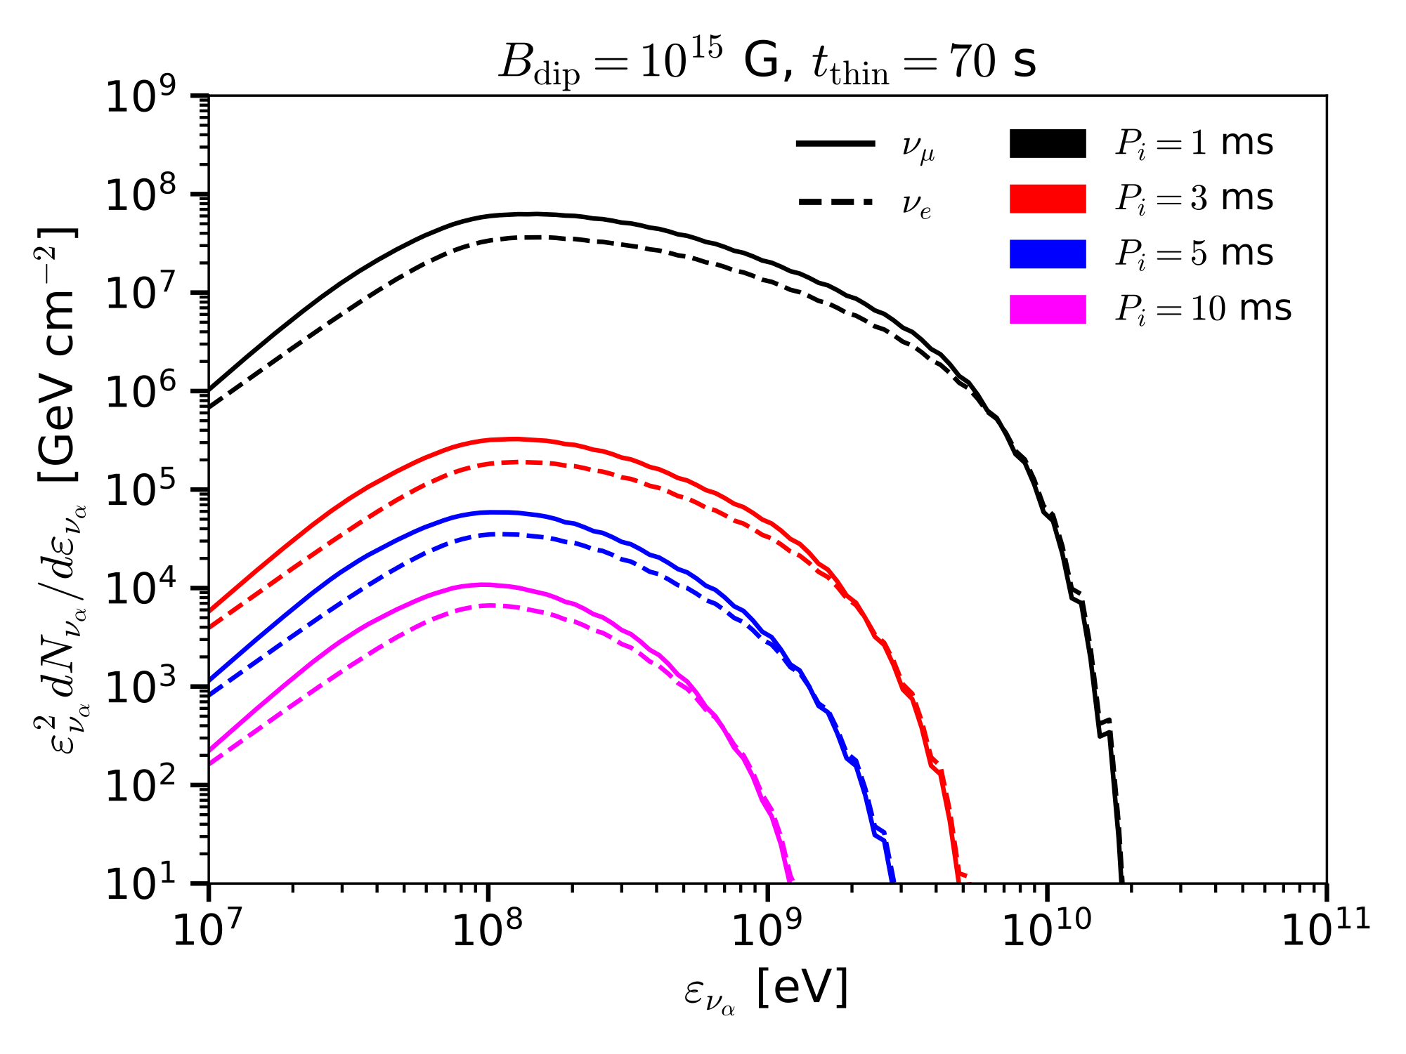
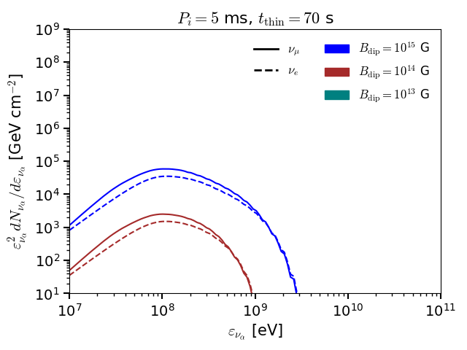
Quasi-thermal neutrinos ($D=10$ kpc)
Higher energy than (thermal) MeV SNe neutrinos, but less energetic than TeV-PeV non-thermal neutrinos.
Neutrons do not reach pion production threshold for $P_{i}=5$ ms and $B_{dip}={10}^{13}$ G
More energetic configurations achieve a larger maximum energy
Carpio, MB, Murase et al. (2023)

Slide 19
Quasithermal neutrinos ($D=10$ kpc)
Higher energy than (thermal) MeV SNe neutrinos, but less energetic than TeV-PeV non-thermal neutrinos.
Luminosities
Neutrino fluence
PNS contraction
More energetic configurations achieve a larger maximum energy

Slide 20
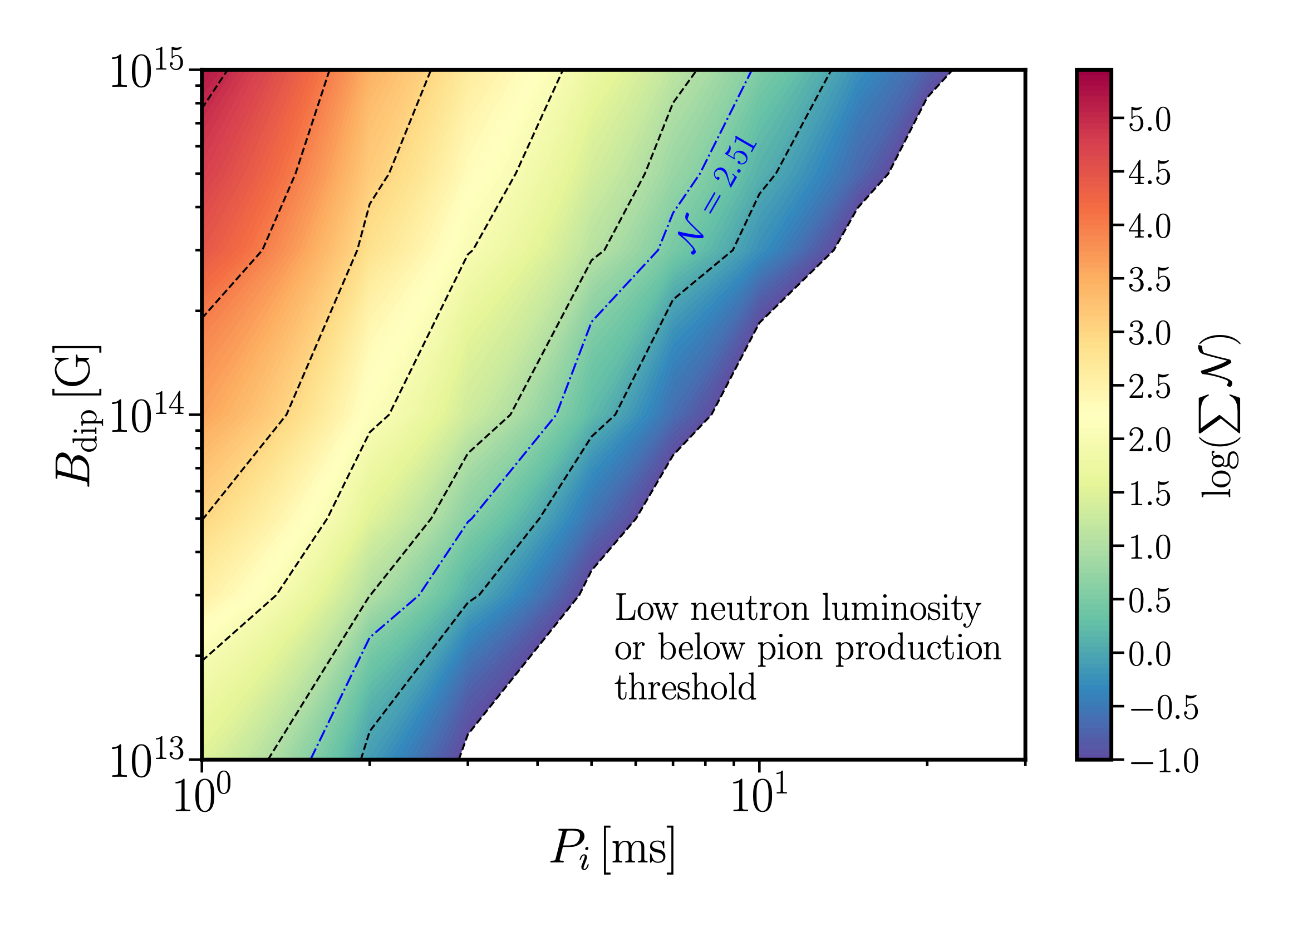
Detection prospects for SNe at $D=10$ kpc
Number of events in Hyper-K
Three detectors for GeV neutrinos:
Hyper-Kamiokande
IceCube-Upgrade
KM3NeT-ORCA
We calculate the number of >100 MeV neutrino events $N$ within a 70 seconds time window for Hyper-K.
Main background is atmospheric $ν$s
$$log(N)$$
$N=2.51$ is the Feldman-Cousins upper limit for the expected 0.27 background atmospheric neutrino events
Carpio, MB, Murase et al. (2023)

Slide 21
Why should we study neutrinos?
Astrophysical production and detection
ProtoNS are multi-energy neutrino transients
GeV neutrinos from Galactic SNe (IceCube, KM3NeT, +)
TeV-PeV neutrinos from relativistic jets (IceCube-Gen2)

Slide 22
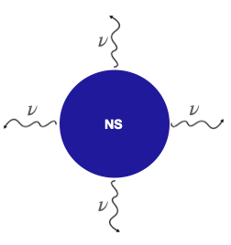
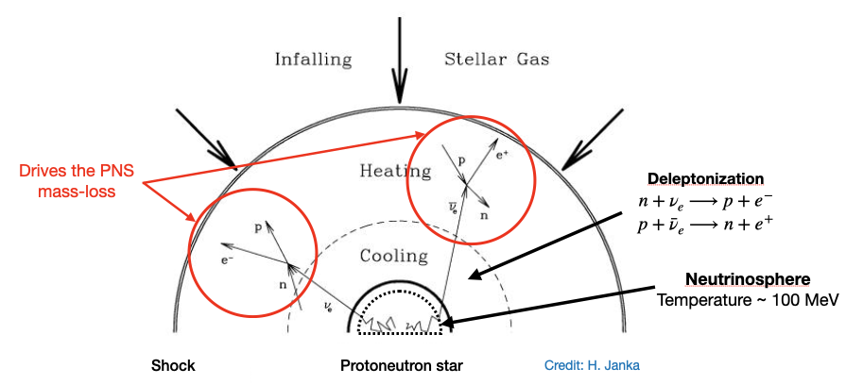
After the PNS forms

Slide 23
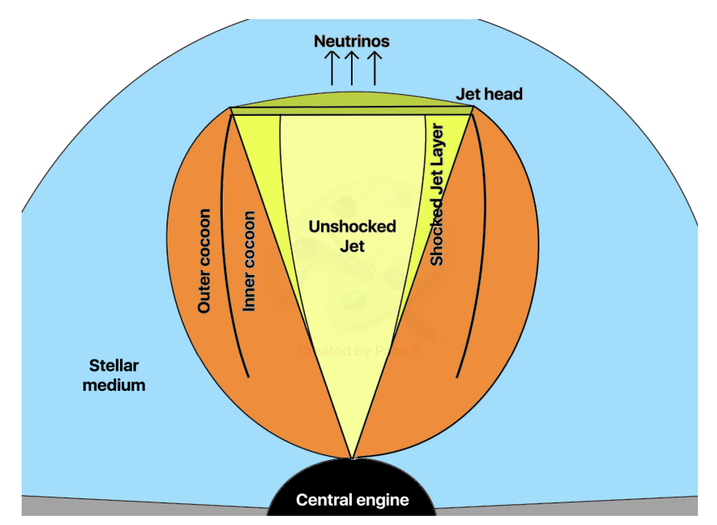
Jet structure and propagation
Relativistic jet carries rotation and magnetic energy outward as Poynting flux
Pressurized cocoon can collimate the jet
Particles accelerated via magnetic reconnection
PNS Parameters
Dipole field strength: ${10}^{15}G≤B_{dip}≤{10}^{16}G$
Rotation period: $1ms≤P_{i}≤2ms$
Distance: $D=100$ Mpc
Stellar progenitors
Wolf Rayet (WR) stars with tbo ~ 10 s
Blue supergiants (BSG) with tbo ~ 100 s
Red supergiants (RSG) with tbo ~ 1000 s
$$\}$$
PNS launches a relativistic collimated outflow (jet) which emits in EM radiation (gamma rays, X-ray, radio) as well as neutrinos
Extended progenitors

Slide 24
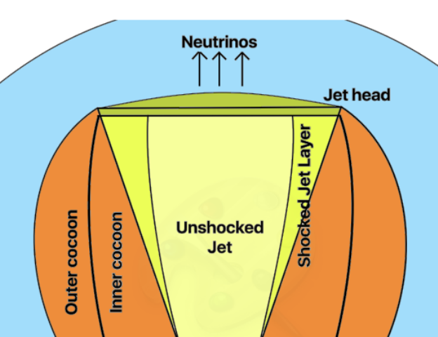
Cosmic-ray acceleration and neutrino production
Jet head
$$γ$$
p
Photons leak into unshocked jet
p
p
p
Unshocked jet
p
Protons
Accelerated close to the jet head
Highly magnetized jets lead to hard spectra $E_{p}^{-s}$ with $1≤s≤2$ (e.g., Guo et al. 2016)
Photons
Optically thick jet head $⟶$ thermal photons
(small leakage fraction)
Optically thin $⟶$ non-thermal (broken PL) photons

Slide 25
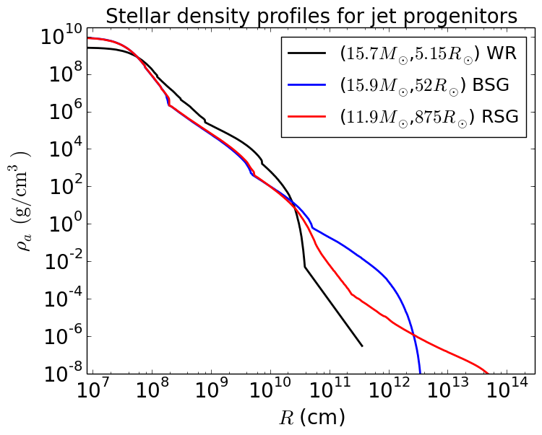
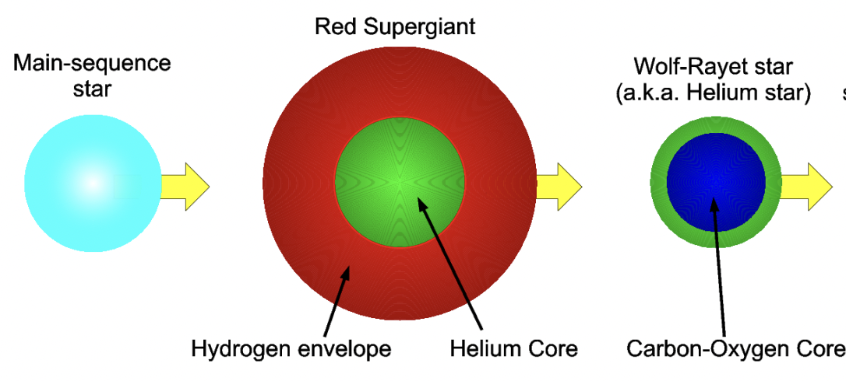
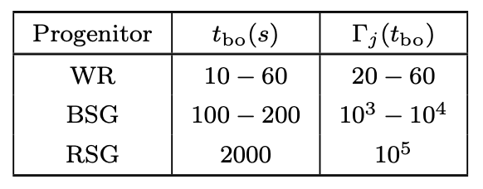
PNS progenitors
Progenitor density profile affects the jet's evolution
Wolf-Rayet (WR) stars
Blue supergiants (BSG)
Red supergiants (RSG)
$$\}$$
Extended progenitors
We compute the breakout time $t_{bo}$ when the jet escapes the progenitor and its Lorentz factor $Γ_{j}$

Slide 26
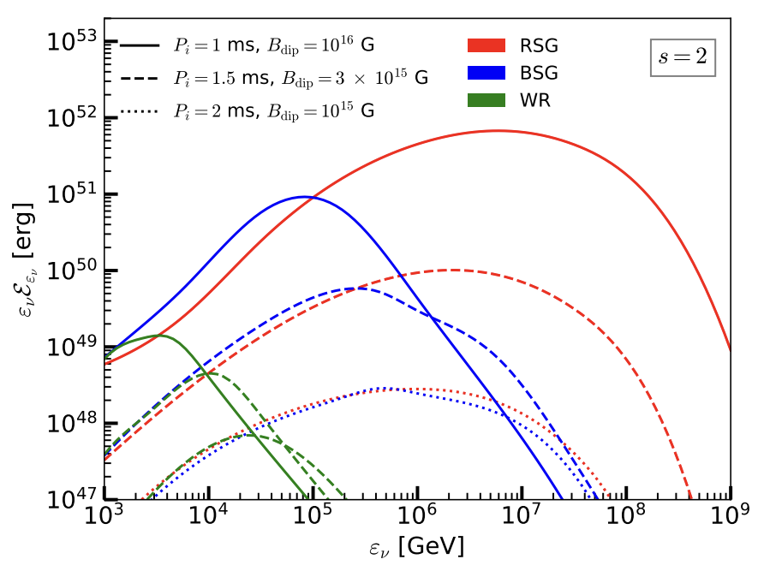
Detection prospects for source at 100 Mpc
$ν_{μ}$ events in IceCube-Gen2
$$E_{p}^{-2}$$
$$(B_{dip}[G],P_{i}[ms])$$
BSG
RSG
$$({10}^{15},2)$$
$$4.3×{10}^{-2}$$
$$4.8×{10}^{-2}$$
$$(3×{10}^{15},1.5)$$
$$8.9×{10}^{-1}$$
$$1.1$$
$$({10}^{16},1)$$
$$14$$
$$43$$
Time-integrated $E_{ν}^{2}dN/dE_{ν}$ [erg]
Neutrino spectrum integrated until $t_{bo}$
~ 30 s for WRs, ~ 200 s for BSGs, $≈$ 2000 s for RSGs
Neutrinos from extended progenitors have larger Lorentz factors
High-energy tail from meson cooling
WR stars unlikely to yield neutrino events
Strong $π,μ$ cooling
$E_{ν}$ [GeV]

Slide 27
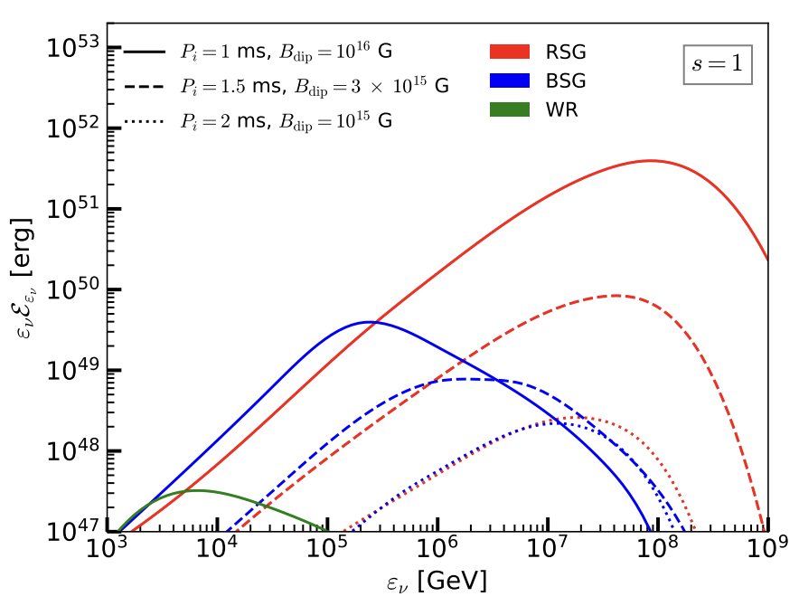
Neutrino emission ($E_{p}^{-1}$ case)
$$E_{p}^{-1}$$
More high-energy protons
Less $ν$s at low energies
More high-energy $π$
Time-integrated $E_{ν}^{2}dN/dE_{ν}$ [erg]
Spectrum peaks at higher energies
High-energy tails are more pronounced
$E_{ν}$ [GeV]
MB, Carpio, Murase, et al. (2023)

Slide 28
Detection prospects for source at 100 Mpc
WR stars are unlikely to yield neutrino events
WR fluxes well below GRB 221009A, GRB 180720B and GRB 130427A limits
We look at $ν_{μ}$ detection in IceCube-Gen2
No neutrinos from GRB 221009A
IceCube limit $E_{ν}^{2}Φ_{ν}<3×{10}^{-4}{ergcm}^{-2}$
WR model: $E_{ν}^{2}Φ_{ν}≲{10}^{-7}{ergcm}^{-2}$
Expected number of $ν_{μ}$ events in IceCube-Gen2
$E_{p}^{-2}$ Injection spectrum
$E_{p}^{-1}$ Injection spectrum
$$(B_{dip}[G],P_{i}[ms])$$
BSG
RSG
$$(B_{dip}[G],P_{i}[ms])$$
BSG
RSG
$$({10}^{15},2)$$
$$4.3×{10}^{-2}$$
$$4.8×{10}^{-2}$$
$$({10}^{15},2)$$
$$5.9×{10}^{-3}$$
$$6.3×{10}^{-3}$$
$$(3×{10}^{15},1.5)$$
$$8.9×{10}^{-1}$$
$$1.1$$
$$(3×{10}^{15},1.5)$$
$$5.9×{10}^{-2}$$
$$1.2×{10}^{-1}$$
$$({10}^{16},1)$$
$$14$$
$$43$$
$$({10}^{16},1)$$
$$4.7×{10}^{-1}$$
$$3.2$$

Slide 29
Future prospects look promising

Slide 30
Main takeaways
Neutrinos, being weakly interacting, are difficult to detect but provide an accurate probe of source physics and particle acceleration in astrophysical systems.
Winds and relativistic outflows from PNS (i.e. SNe progenitors) are promising sites for the production of GeV and TeV-PeV neutrinos, respectively, in addition to thermal MeV neutrinos.
Neutrinos from PNS outflows can be useful probes to understand GRB-SNe connection.
TeV neutrinos already detected from AGNs (potentially TDEs) harboring SMBHs. Need more sensitive detectors to probe the relative contribution from source classes.
Future prospects
With IceCube-Gen2, KM3NeT, Hyper-K and other advanced detectors, strategic real time multi-messenger searches will be crucial for transient sources.
Can perform EM-triggered searches for low-energy neutrinos from nearby (Galactic) SNe.
Establishing multi-messenger and multi-zone picture is crucial with next-generation facilities e.g. IceCube-Gen2 which will improve IceCube’s current sensitivity by ~1-2 orders of magnitude.

Slide 31
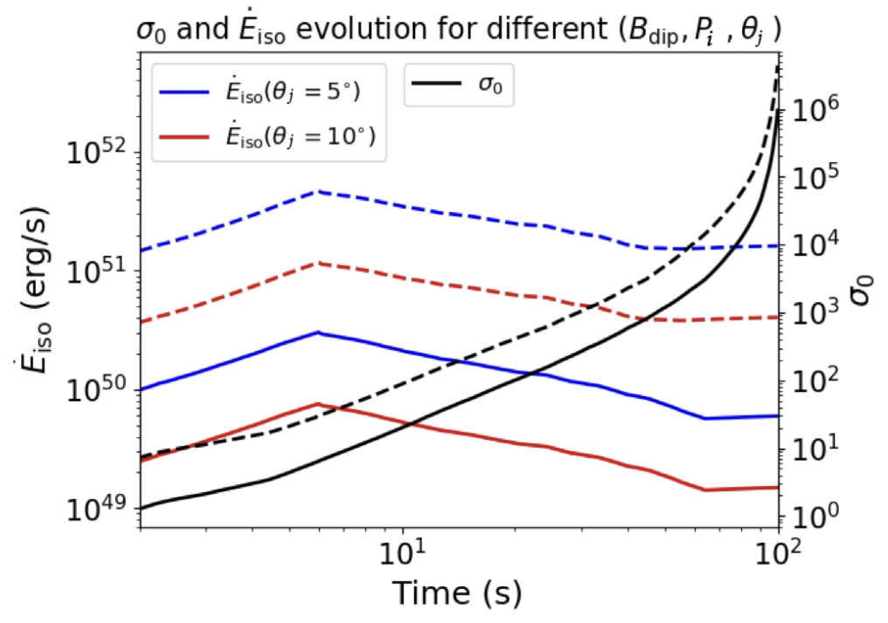
Backup slides
PNS Parameters
Dipole field strength: ${10}^{15}G≤B_{dip}≤{10}^{16}G$
Rotation period: $1ms≤P_{i}≤2ms$
Distance: $D=100$ Mpc
Solid lines: $B_{dip}={10}^{15}G,P_{i}=2ms$
Dashed lines: $B_{dip}=3×{10}^{15}G,P_{i}=1.5ms$
We follow the approach in Metzger et al 2011
$${\overset{·}{E}}_{iso}(erg/s)$$
PNS loses mass $\overset{·}{M}∼{10}^{-5}-{10}^{-4}M_{⊙}s^{-1}$ via neutrino-driven wind
Magnetization $σ_{0}=ϕ_{B}^{2}Ω^{2}/\overset{·}{M}c^{3}$
Transition from non-relativistic to relativistic at $σ≳1$
Bhattacharya, JC et al. 2023

Slide 32
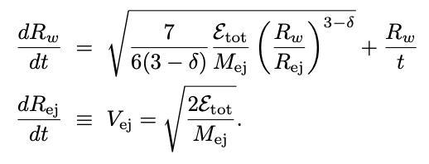
Backup slides
Mass-loss rate
$R=10$ km
$$M_{NS}=1.4M_{⊙}$$
Evolution of wind and ejecta radii (pulsar wind)
Density profile $1/R$

