Slide 1
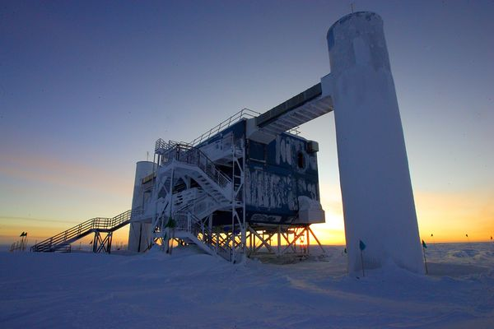
Detector physics relevant to IceCube and similar detectors
Justin Vandenbroucke, June 3, 2025
IceCube Summer School, WIPAC, UW–Madison
Notes:
Time allocation: 40 min including questions
Eva request for this year: add more on current and future detectors and their complementarity

Slide 2
Outline
Neutrino interactions and cross sections
Muon lifetime
Charged particles losing energy in matter
  Ionization
  Radiative loss (pair production, bremsstrahlung, photonuclear)
Electromagnetic and hadronic showers/cascades
Cherenkov radiation
Photomultiplier tubes
Energy reconstruction
Notes:
Tavernier:
1 introduction
1.6.3 gamma decay
1.6.4 electron capture and internal conversion
1.6.5 radioactive decay law
1.6.6 nuclear level diagram
2 interactions of particles in matter
2.1 cross section and mean free path
2.2 energy loss of a charged particle due to its interaction with the electrons
2.3 other electromagnetic interactions of charged particles (multiple scattering, Cherenkov effect, transition radiation, bremsstrahlung
2.4 interactions of x-rays and gamma rays in matter
2.5 interactions of particles in matter due to the strong force
2.6 neutrino interactions
2.7 illustrations of the interactions of particles
3 natural and man-made sources of radiation
3.1 natural sources of radiation
3.2 units of radiation and radiation protection
3.3 electrostatic accelerators
3.4 cyclotrons
3.5 the quest for the highest energy, synchrotrons and colliders
3.6 linear accelerators
3.7 secondary beams
3.8 applications of accelerators
3.9 outlook

Slide 3
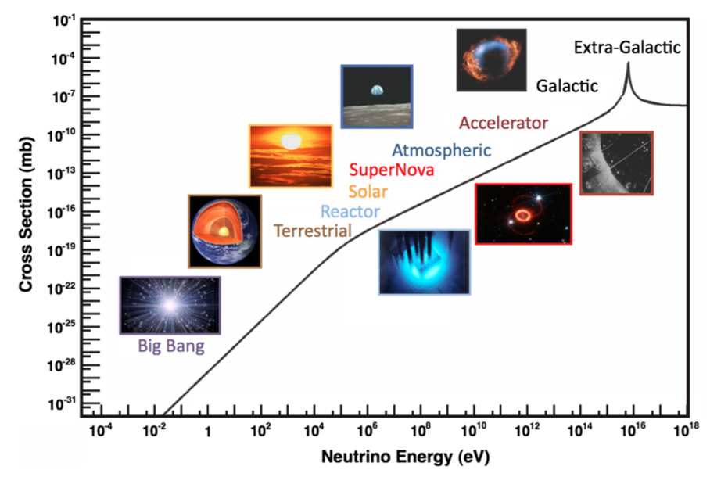
Neutrino cross section
IceCube science
Formaggio & Zeller Rev. Mod. Phys. 2012
Notes:
CMB: 412 photons per cubic cm
CNB: 336 neutrinos per cubic cm
Note: this cross section is for nuebar on e [not NC, CC DIS]
Formaggio & Zeller Fig 28:
CC cross sections at 50-350 GeV:
Neutrinos: sigma = (Enu/GeV) * (0.7e-38 cm^2)
Antineutrinos: sigma = (Enu/GeV) * (0.3e-38 cm^2)
Above 0.5 TeV
Estimating scaling from above plot:
High energy regime (>> 100 keV)
two points (x, y) = (10^8, 10^-16), (10^14, 10^-10)
Slope = 6/6 = 1.0
Low energy regime (<< 100 keV)
two points (x, y) = (10^-1, 10^-31), (10^5, 10^-19)
Slope = 12/6 = 2.0

Slide 4
(Weak) neutrino interactions in matter: high energy (>30 GeV)
charged current
neutral current
In the high-energy regime (above ~30 GeV), interactions are dominated by deep inelastic scattering (neutrinos interact with quarks in nuclei)
Charged-current (CC) and neutral-current (NC) interactions
Cross section increases with energy
CC products: charged lepton (e.g. muon track) and hadronic shower/cascade
NC products: neutrino and hadronic shower/cascade
Notes:
Additional neutrino interactions: QECC, DIS vs. low energy alternative
What dominates below inverse beta decay threshold?
ES elastic scattering
QE: nu_mu n -> mu- p
Example: u (+2/3) input -> tau+ and down (-1/3) output, obeys charge conservation
Why are they called “currents”?
DIS
https://en.wikipedia.org/wiki/Deep_inelastic_scattering
Henry Kendall, Jerome Friedman, Richard Taylor 1990 Nobel for "for their pioneering investigations concerning deep inelastic scattering of electrons on protons and bound neutrons, which have been of essential importance for the development of the quark model in particle physics.”
1968 at SLAC: electrons on protons and neutrons in nuclei; later with muons and neutrinos
W±, Z detected in early 80s (same for gluons)
W and Z discovered by UA1 and UA2, CERN 1983
To do: add e and mu channels to CC

Slide 5
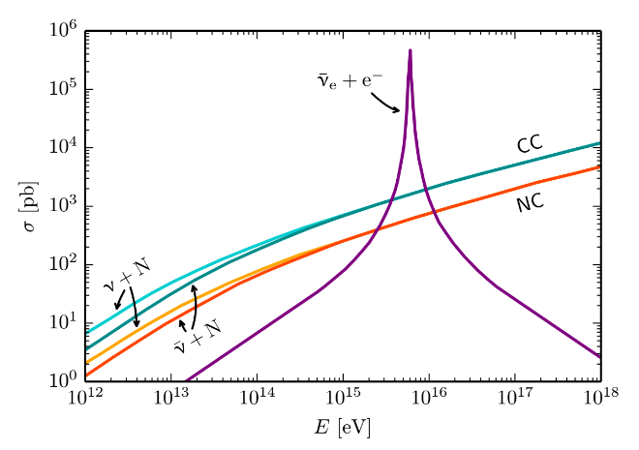
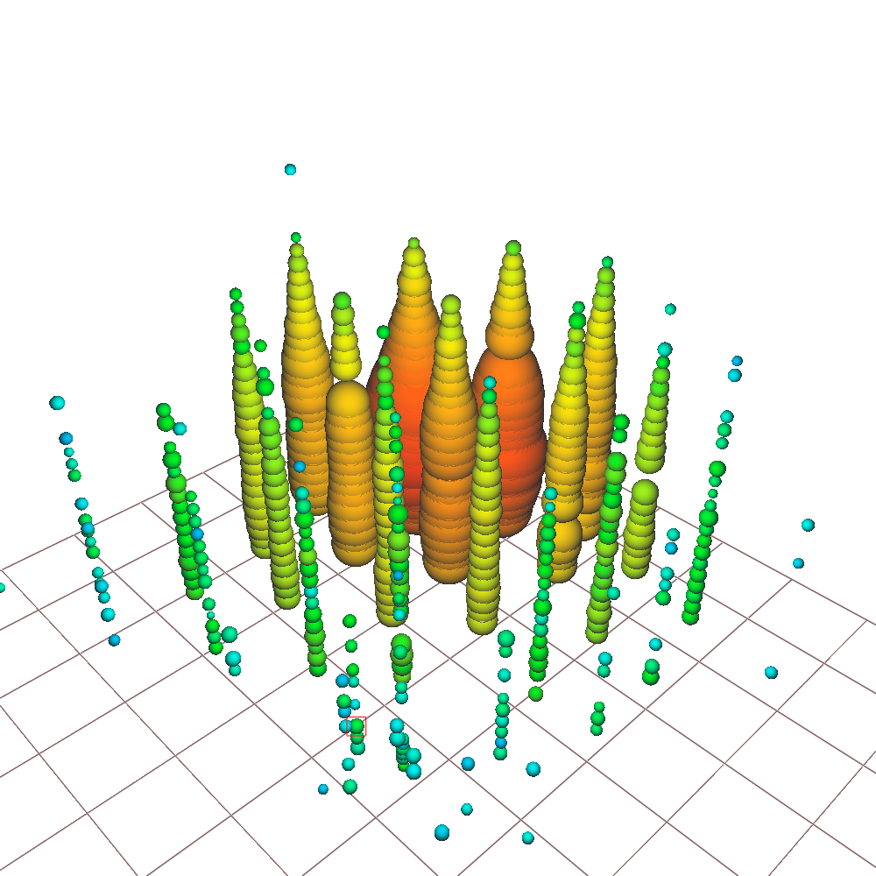
Interaction with atomic electrons:
Glashow resonance
Resonance:
E_{ν} = 6.3 PeV
IceCube, Nature 591, 220-224 (2021)
6.05 ± 0.72 PeV visible energy
Notes:
Low energy muons produced in hadronic shower
Astrophysical origin: 5 sigma
Glashow identity: 2.3 sigma
W decay modes
IceCube, 1710.01191 (ICRC)
Event not contained: identified in partially contained PeV search (PEPE)
Why CC > NC?
Why nu > nubar?
First predicted in 1960, Glashow paper
https://journals.aps.org/pr/abstract/10.1103/PhysRev.118.316
Parameterization of shape of resonance? Breit-Wigner?

Slide 6
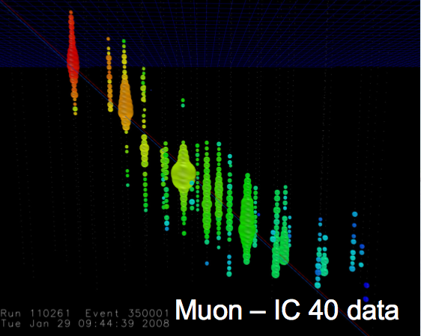
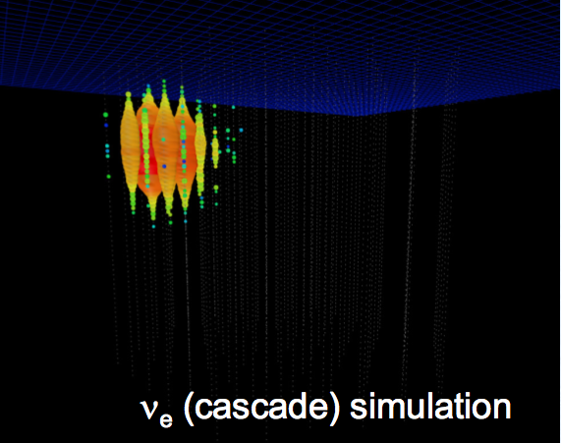
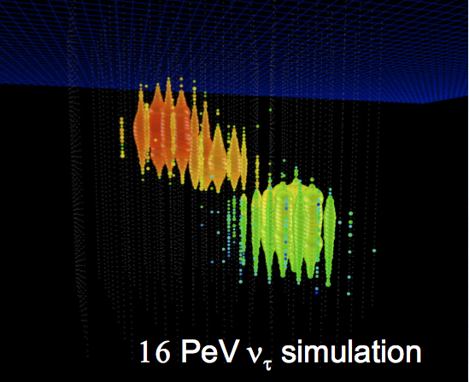
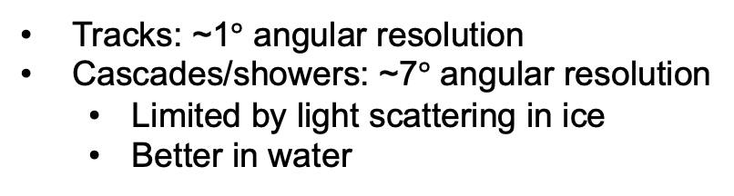
Tracks and showers
(from various flavors & interaction channels)
Muon neutrino
+ Straight track,
points to neutrino source,
angular resolution ~1°
- Cosmic-ray muon background
Electron neutrino
+ Good energy resolution
- Cascade, ideally in detector
- Poor angular resolution
Tau neutrino
+ Double bang signature,
low background
+ Pointing capability
- Low rate
Tracks: ~1$°$ angular resolution
Cascades/showers: ~7$°$ angular resolution
  Limited by light scattering in ice
  Better in water
Notes:
Tau decay length vs. energy
Muon is IC 40 data
Left (muon track) is IC 40 data
Center is nu_e cascade simulation
Right is 16 PeV nu_tau simulation

Slide 7
Muon lifetime and range
Mass m = 0.1 GeV/c²
Decay lifetime 𝜏 = 2.2 µs
Nonrelativistic case: range L = v𝜏
According to relativistic time dilation, the range of a high-energy muon in the lab frame increases by 𝛾
Range L = 𝛾v𝜏 ≈ 𝛾c𝜏
c𝜏 = (3 x 10⁸ m/s)(2.2 x 10⁻⁶ s) = 0.7 km
1 TeV muon (typical IceCube energy)
  𝛾 = (10³ GeV) / (0.1 GeV) = 10⁴
  Travels 𝛾c𝜏 = 0.7 x 10⁴ km = an Earth radius
  ?
In vacuum, yes
In ice, a 1 TeV muon travels “only” ~3 km, due to energy loss!
Notes:
Precise muon mass = 106 MeV
Precise lifetime: tau = 2.20 µs
Precise nonrelativistic range: (3e8 m/s)*(2.20 µs) = 660 m
Gamma = 1/sqrt[1-beta^2]
E = gamma mc^2
Earth radius = 6400 km = 6.4 x 10³ km = 0.64 x 10⁴ km
Linear range parameterization (alpha + beta E)

Slide 8
Ionization of atoms in a material by charged particles traversing it

Slide 9
Ionization energy loss
Ionizing radiation = high energy particles energetic enough (at least a few eV) to ionize atoms in matter
The energy transferred to the ionized electrons is lost by the incident particle
Technically, “ionization” loss includes loss due to merely exciting rather than ionizing atoms
Process is stochastic (random), with large fluctuations
Intuition from classical mechanics and Coulomb interactions
Notes:
What is minimum energy of the E^-2 distribution? If it is zero then the integral of the distribution diverges.
Why distributed as E^-2

Slide 10
Conceptual expectations for ionization loss
(quantified as energy loss per distance traveled)
Which parameters (of incident particle and traversing medium) should it (dE/dx) depend on?
Depends on density (ρ) of matter
Depends on charge (Z) of incident particle
Depends on speed (β) of particle
Proportional to ρ, Z², and β⁻²
Notes:
Depends on Z_nucl, Z_part, A_material, rho, beta, gamma, ionization energy of material
Answers: ionization loss dE/dx is proportional to:
rho
Z^2
1/beta^2
Dependence on atomic mass (A) of matter? 1/A
Dependence on nuclear charge (Z_{nucl}) of matter? Znucl

Slide 11
Full expression for ionization loss:
Bethe-Bloch equation
Notes:
Depends on Z (particle), Z_nucl, A (medium), rho (medium)
JV: plot approximation (rho Z^2/beta^2) overlaid with precise
Is I mean excitation energy including both ionization and excitation as “excitation”?
Use this to derive 2 MeV/cm

Slide 12

Ionization energy loss by muons
Particle Data Book
($p=βγm_{0}c$)
Notes:
Which term in Bethe-Bloch is rising, to compensate the falling overall behavior?
Muon mass: 106 MeV
Ec is the critical energy, where dE/dx from ionization equals dE/dx from radiation (Bremsstrahlung)
Rolls over at low beta as beta decreases to 1% (comparable to velocity of atomic electrons, so approximation that they are stationary relative to incident particle breaks down)
Linear below the peak
Why is there a peak at low E, followed by decrease as E decreases?
Calculate Ec and X0 in copper
Why do mu- deviate from mu+ (atomic capture?)
Given dE/dx, use this to normalize the 1/E^2 distribution for individual ionization events. Given this (b) how many events are excitation not ionization? (c) how many produce an electron with a macroscopic range (delta ray)?

Slide 13
Pair production by energetic particles
Case 1: by photons
Case 2: by charged particles
Energetic charged particles (including muons) can also produce electron-positron pairs

Slide 14
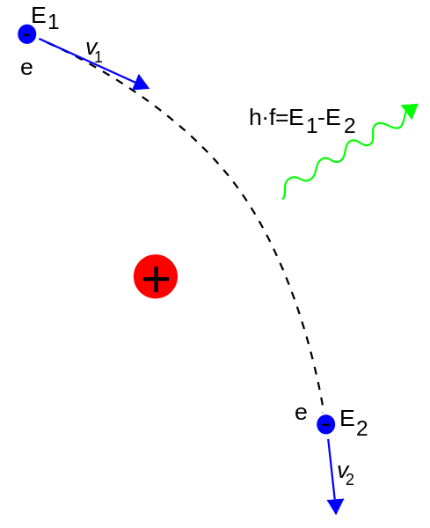
Radiative loss (bremsstrahlung) by charged particles
For high-energy charged particles, radiative energy loss dominates ionization energy loss
Radiative energy loss by an electron (for example) passing through a medium is proportional to the energy of the electron:
This means the energy of electrons passing through a medium decreases exponentially:
X₀ is the characteristic energy loss scale for electrons, the radiation length
  depends on material roughly as Z⁻¹ (1+Z)⁻¹
  Air: 37 g/cm²
  Lead: 6 g/cm²
Notes:
Conservation of momentum (classical approximation):
Sum of momentum of outgoing electron and photon match momentum of incoming electron
Homework: Work out kinematics including angles, for one scatter
Forward beamed? Opening angle?
Radiation length in water is 36 cm

Slide 15
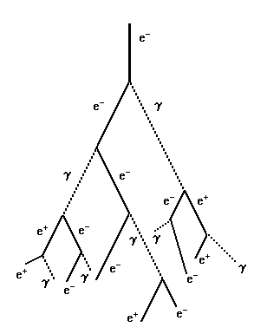
Electromagnetic showers (in air, ice, …)
Initiated by gamma, electron, or positron
Alternation between
  Pair production (must occur at a nucleus to conserve momentum)
  Bremsstrahlung radiation (radiative energy loss caused by deceleration of e± in Coulomb field of nucleus: dominates ionization loss at high energy)
Can occur in any medium with nuclei: ice, atmosphere, plastic, crystal, …

Slide 16
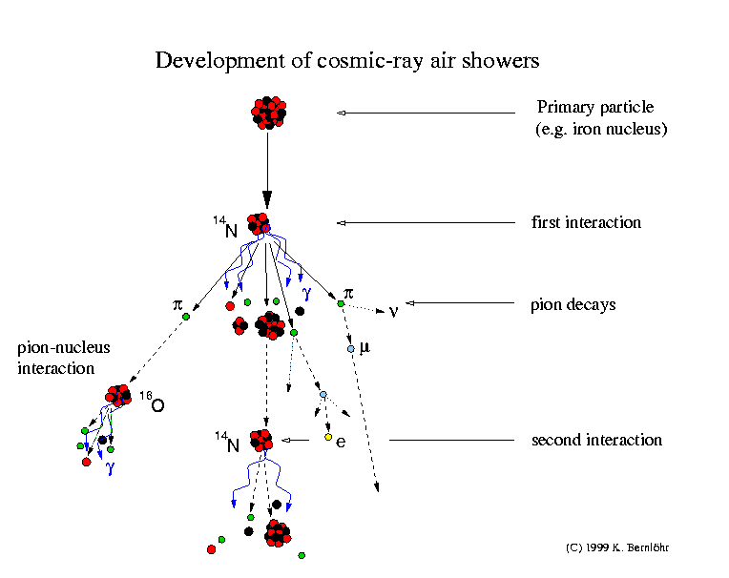
Hadronic showers (in air, ice, …)
In hadronic showers, the hadrons (nuclei) actively participate
Pions (and heavier mesons) are created
Mesons produce muons, neutrinos, and electromagnetic sub-showers
Notes:
Charged pion lifetime: 26 ns
c*tau = 7.8 m
Heavier mesons: kaons
Also charm

Slide 17
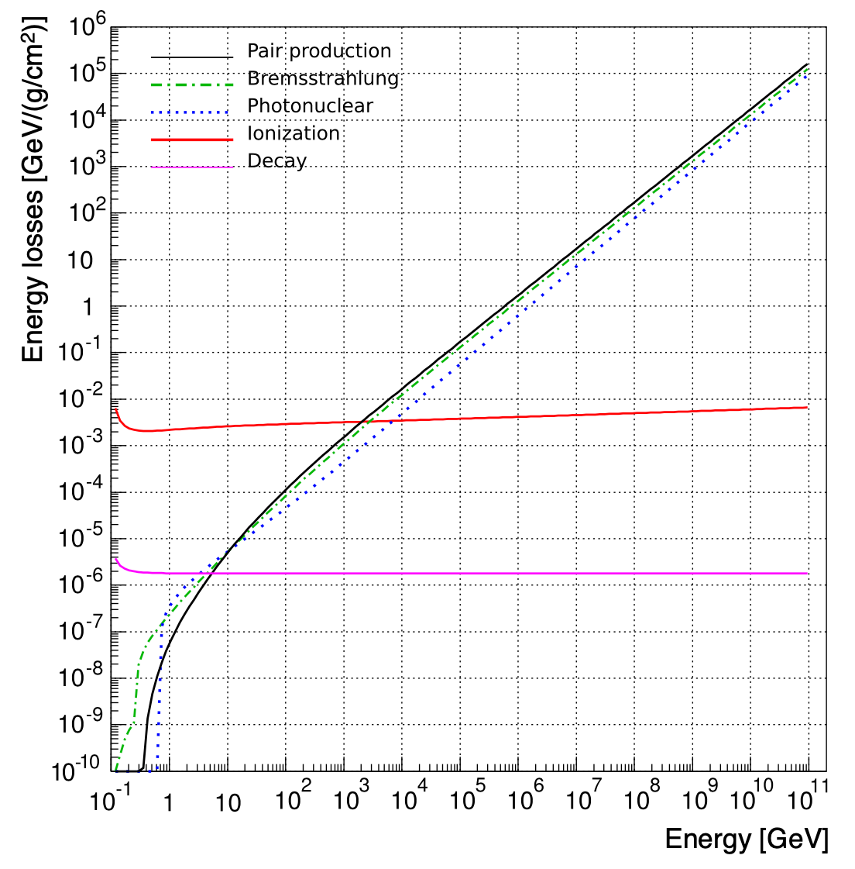
Energy loss of muons per unit distance (in ice)
Above 2 TeV:
proportional to energy
E_{critical} = 2 TeV
Below 2 TeV:
~independent of energy
J.-H. Koehne et al. CPC 184 (2013) 2070
Notes:
“Fig.20. Pair production (upper solid curve for high energies, black), bremsstrahlung (dashed–dotted, green), photonuclear interaction (dotted, blue), ionization (central solid curve for high energies, red) and decay (lower solid curve for high energies, magenta) energy losses in ice.”
probability of decay per unit distance multiplied by the primary particle energy
Good discussion of photonuclear interactions of muons at http://journals.aps.org/prd/pdf/10.1103/PhysRevD.67.034027
Muon: lifetime tau = 2.2 µs, mc^2 = 106 MeV, c tau = 660 m
How is decay included as an effective dE/dx?
Approximate it as “all of particle energy is lost smoothly along one decay length”
Equivalent to: particle always travels its decay length and then decays at exactly one decay length
So we spread its energy over its decay length
Then
dE/dx = E/L = E/gamma c tau = gamma m c^2 / gamma c tau = m c^2 / c tau
Now include 1/rho density factor:
dE/dx = m c^2 / rho c tau = (0.106 GeV) / (1 g/cm^3) / (6.6e4 cm)
Effective dE/dx for decay is 1.6e-6 (GeV/ (g/cm^2))
Then why does decay dE/dx increase for energies comparable to rest mass?
Ah, because we assumed speed was c
If not:
dE/dx = gamma mc^2 / gamma v tau
So at low energy, it grows by a factor of 1/beta
Plot citation: https://arxiv.org/abs/hep-ph/0407075
Photonuclear interactions of muons (or electrons or taus): energy transfer to nucleus via photon, producing energetic hadrons (like a hadronic interaction of a proton)
Homework: plot decay length vs. energy on log/log, including relativistic and nonrelativistic
Exercise: continue to low energy, where ionization stops and decay dominates
2 TeV muon range: several km
Signals from a minimum ionizing muon
Drect Cherenkov emission by the muon
Light from the secondaries - delta rays above 0.8 MeV Cherenkov threshold. What is rate of such delta rays?
Ionization loss: electron Cherenkov threshold is 0.8 MeV
So a bare (minimum ionizing) muon only signature is the high energy (0.8 MeV)
So a bare muon (minimum ionizing): the muon itself emits Cherenkov light, plus a bit from the secondaries
Reconcile with PDG plot

Slide 18

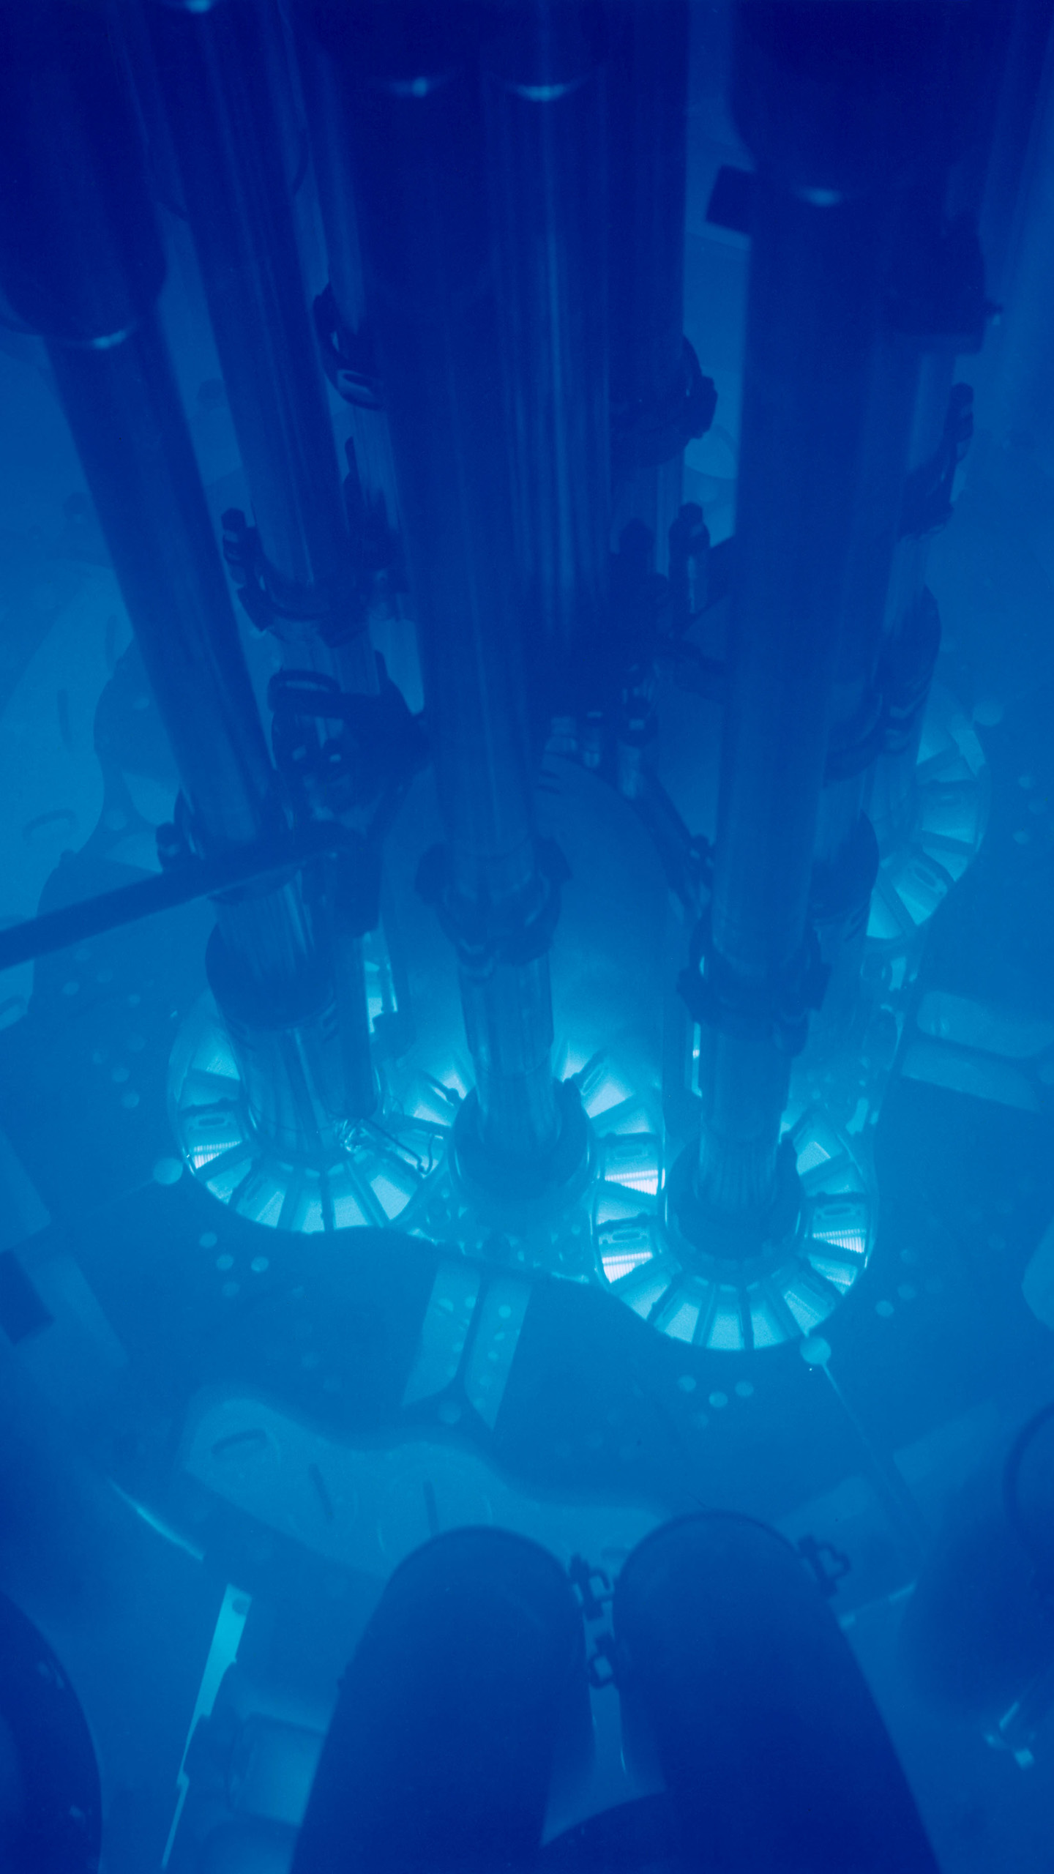
Cherenkov radiation
A wake
produced by a duck
enjoying the Terrace
produced by energetic charged particles
enjoying a nuclear reactor

Slide 19

Cherenkov radiation
Due to polarization of medium, produced when a relativistic charged particle travels through a medium faster than the speed of light in the medium (c/n)
Typically a negligible contribution to particle energy loss
Very useful for detecting particles and measuring their direction, energy, or mass/identity
Radiation emitted along a narrow cone of opening angle θ_{C} (can vary with wavelength):
Radiation intensity scales with particle Z²
Spectrum of Cherenkov light: increases with frequency (Frank-Tamm formula):
~200 photons/cm in ice
Notes:
Homework: calculation the fraction of energy loss (relative to particle energy or ionization dE/dx)
Derivation of Frank-Tamm?
If v < c is there incoherent radiation?
Homework: (1) Cherenkov angle as function of atmosphere density (2) as function of altitude
Does Frank-Tamm work to arbitrarily small wavelengths?
Integrate Frank-Tamm to determine dE/dx
Derive 1/lambda^2 from this
Does integral converge without a small-lambda cutoff?
Back of envelope comparison to ionization loss: Cherenkov is (1 eV/photon) * (200 photons/cm) = 200 eV/cm
Ionization is 1e6 eV/cm so 4 orders of magnitude greater
What happens at small wavelength? Where does it break down (prior to transparency)? Why not more X-ray emission than UV?
Assume each photon is 1 eV
200 eV/cm = 2e2 eV/cm
Minimum ionization is 2 MeV = 2e6 eV/cm
So Cherenkov energy loss is 4 orders of magnitude lower than ionization
Animated gif from
https://en.wikipedia.org/wiki/Cherenkov_radiation
Group vs. phase velocity

Slide 20
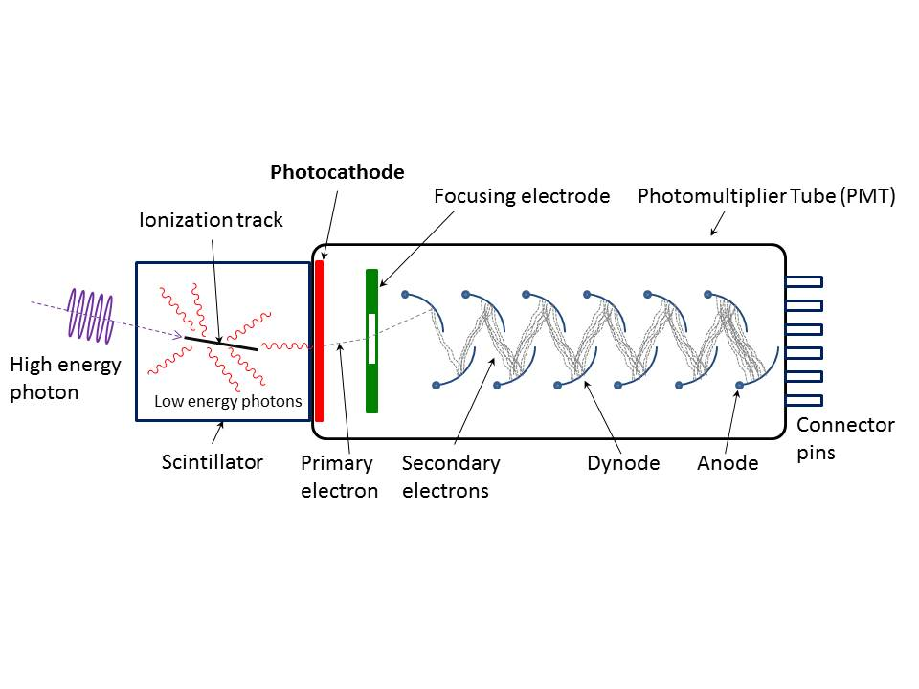
Photomultiplier tube
Each electron incident on a dynode produces d secondary electrons
d typically 3-10
For n dynode stages, gain = d^{n}, typically 10⁶ or greater to detect single photons
“Electron optics” of dynode chain optimized for
  Good gain (favors more dynodes) and collection efficiency
  Good transit time and transit time variation (favors fewer dynodes)

Slide 21
Reconstructing neutrino energy using energy loss physics
Cascades/showers
  If contained within detector, then calorimetric: total emitted Cherenkov light proportional to shower energy, which can be connected to neutrino energy
Tracks
  Low energy (<0.1 TeV): also contained within detector: calorimetric
  High energy (>2 TeV): energy loss per unit track length is proportional to muon energy and can be used to estimate muon energy
  Intermediate energy (0.1-2 TeV): uncontained, and energy loss per unit track length is independent of particle energy (minimum ionizing), therefore harder to measure muon energy
Additional nuisances
  Muon may have lost an unknown amount of energy before entering detector
  Original neutrino shared energy among multiple outgoing products (e.g. a track and a cascade produced outside the detector)
Notes:
Muon energy, range
See muonRange.m implementing parameterization dE/dx = -alpha - beta * E
from https://iopscience.iop.org/article/10.1088/1475-7516/2004/01/002/pdf
(Halzen & Hooper IceCube Plus paper)
1 GeV, 5 m
10 GeV, 50 m
100 GeV, 450 m
250 GeV, 1 km
1 TeV, 3 km
10 TeV, 7 km
100 TeV, 13 km
1 PeV, 18 km
1 EeV, 35 km
Critical energy (ionization loss = radiative loss) at ~2 TeV
Note MMC paper (and probably Proposal) have better parameterizations
Doulbe check 0.1 TeV contained length: at what energy is track length equal to ~1 km?

Slide 22
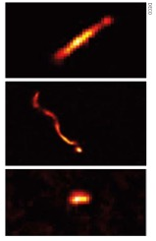
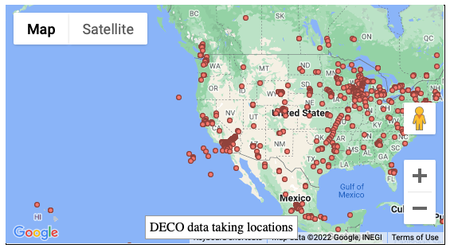
The Distributed Electronic Cosmic-ray Observatory (DECO)
Use your smart phone as a cosmic-ray detector
Users in 80 countries in all 7 continents
App, data, articles, papers: https://wipac.wisc.edu/deco

Slide 23
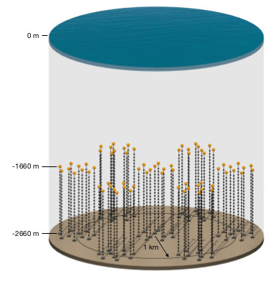
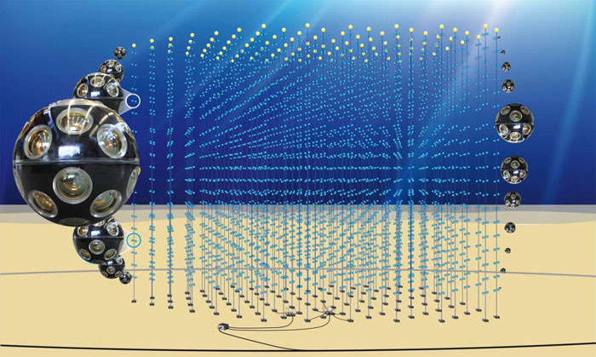
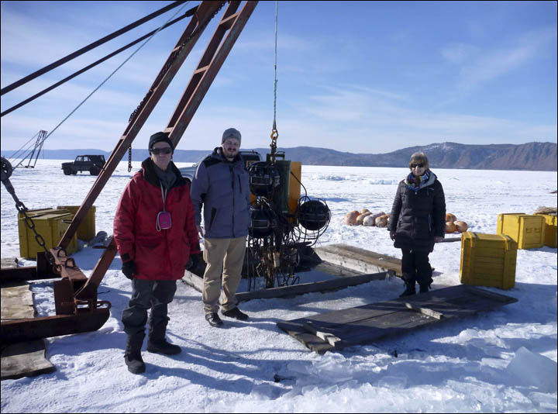
Neutrino telescopes around the world
(using optical Cherenkov technique)
ANTARES
(0.01 km³)
KM3Net
(1.1 km³)
STRAW
P-ONE
IceCube
(1 km³)
Upgrade
Gen 2
(8 km³)
Baikal GVD
(1 km³)
Trident (8 km³)
HUNT (30 km³)
running/completed under construction proposed/planned
Notes:
Gen2 7.9 km³:
https://iopscience.iop.org/article/10.1088/1361-6471/abbd48

Slide 24
Summary and conclusion
Neutrinos have several possible interaction channels when they collide with atoms in ice
Flavor and interaction channel determine product(s) of interaction: track and/or cascade
Secondary particles lose energy as they propagate through the ice
Secondary particles emit Cherenkov light proportional to deposited energy
Deposited energy can be used to estimate original neutrino energy (under some assumptions)
If at UW–Madison: take Physics 772 (High Energy Astrophysics) and 736 (Experimental Methods in Nuclear, Particle, and Astro Physics) for much more on these and related topics

Slide 25
Additional slides

Slide 26
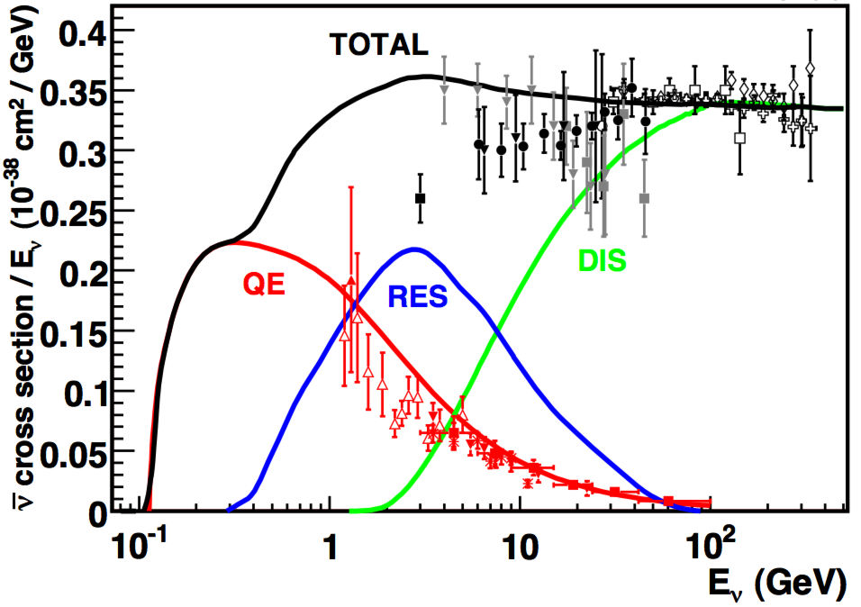
Neutrino interactions in matter: medium (<30 GeV), low (<1 GeV) energy
Formaggio & Zeller Rev. Mod. Phys. 2012
High energy: deep inelastic scattering
Intermediate energy: resonant scattering (pion is produced)
Low energy: (charged-current) “quasi-elastic” (small energy transfer) scattering (CCQE)
$ν_{μ}$ + N $→$ $μ$ + X
$ν_{μ}$ + p $→$ $μ$ + p + $π$
$ν_{μ}$ + n $→$ $μ$ + p
Notes:
“inelastic”: kinetic energy is not conserved

Slide 27
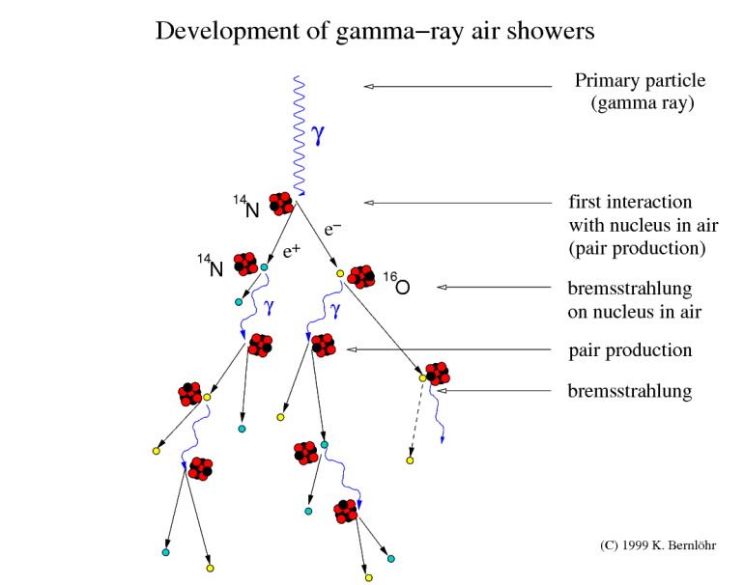
Electromagnetic showers (example in air)
In purely electromagnetic showers (simplified model), the medium nuclei do not actively participate (only as catalysts for electromagnetic interactions)

Slide 28
Stochastic nature of energy loss
dE/dx describes the mean energy loss
Most probable energy loss is substantially different from mean (distribution has long tail)
Most energy loss phenomena are actually discrete and stochastic, not smooth and continuous
Stochastic nature of ionization loss is important for thin absorbers
For thick absorbers, ionization loss is fairly smooth
Stochastic nature of other interactions (bremsstrahlung, pair production, photonuclear interactions) typically important even for thick absorbers
Even ionization loss can have large individual stochastic depositions (e.g. delta rays)
Cherenkov emission is fairly continuous (but of course the photons are quantized)

Slide 29
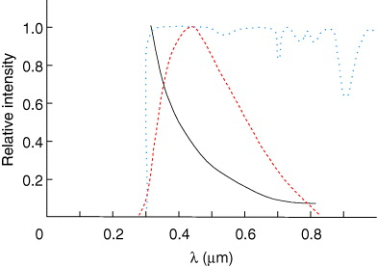
Cherenkov spectrum in practice
Cherenkov spectrum
PMT sensitivity
Medium transmissivity
Example in air
In practice, short wavelength end limited by transmission through medium and by efficiency of photon detector in the ultraviolet
Notes:
Derive 1/lambda^2 from Frank-Tamm

Slide 30
Bremsstrahlung and radiation length
Bremsstrahlung is radiation due to hard Coulomb interactions of a particle with atomic nuclei (“braking radiation”)
More important for light (e±) than heavy particles
Radiation is forward beamed
dE/dx is proportional to energy:
The proportionality constant in bremsstrahlung dE/dx is by definition the radiation length, a property of the material
Over one radiation length, the particle energy is reduced (on average) by one e-folding
In water, radiation length = 36 cm (worth memorizing that it is ~1/3 m)
Notes:
Derive that dE/dx is proportional to energy? From cross section from QED…
Why does particle mass affect Ec but not X0? Overlay radiative dE/dx vs. E for both protons and electrons on same plot, compare Ec directly
(rho * N_A / A_r) = (Z/A) ? Perkins Particle Astophysics
Brem: charged particle -> charged particle and photon
Pair production: photon -> two charged particles

Slide 31
Ionization loss
Slower particles ionize more
At intermediate energies, heavier particles ionize more (because they travel more slowly)
Higher-charge particles ionize more
Once β increases to be close to 1, minimum is reached: “minimum ionizing particle” (MIP)
Above a few GeV most particles are MIPs
MIP energy loss depends only on particle charge and material density (not on particle mass)
For fixed KE below MIP: higher mass means lower speed so greater dE/dx
Notes:
Pion (±) mass: 140 MeV
Muon mass: 106 MeV
Why the gradual increase at high energy? Radiative effcts?

Slide 32
Bremsstrahlung and radiation length
Bremsstrahlung is radiation due to hard Coulomb interactions of a particle with atomic nuclei (“braking radiation”)
More important for light (e±) than heavy particles
Radiation is forward beamed
dE/dx is proportional to energy:
The proportionality constant in bremsstrahlung dE/dx is by definition the radiation length, a property of the material
Over one radiation length, the particle energy is reduced (on average) by one e-folding
In water, radiation length = 36 cm (worth memorizing that it is ~1/3 m)
Notes:
Derive that dE/dx is proportional to energy? From cross section from QED…
Why does particle mass affect Ec but not X0? Overlay radiative dE/dx vs. E for both protons and electrons on same plot, compare Ec directly
(rho * N_A / A_r) = (Z/A) ? Perkins Particle Astophysics
Brem: charged particle -> charged particle and photon
Pair production: photon -> two charged particles

Slide 33
Photonuclear interactions
Counter-intuitively, photons can undergo strong interactions with nuclei
Gamma-ray produces virtual quark-antiquark pair that interacts with nucleus
Excitation of nucleus can cause dipole (excess protons on one side) which results in resonant absorption (“giant dipole resonance”, GDR)
Other non-hadrons (e.g. muons) can also undergo photo-nuclear interactions

Slide 34
Glashow resonance event
Resonance:
E_{ν} = 6.3 PeV
IceCube, Nature 591, 220-224 (2021)
IceCube, 1710.01191 (ICRC)
6.05 ± 0.72 PeV visible energy
Event not contained: identified in partially contained PeV search (PEPE)
Notes:
Low energy muons produced in hadronic shower
Astrophysical origin: 5 sigma
Glashow identity: 2.3 sigma
W and Z discovered by UA1 and UA2, CERN 1983
W decay modes

Slide 35
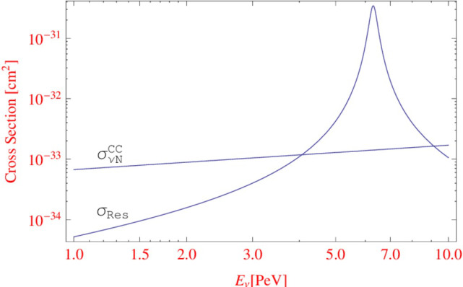
The Glashow resonance
An alternative interaction to DIS, for neutrinos incident on matter (atoms)
Only possible for electron anti-neutrinos, due to presence of atomic electrons in matter
Resonant production of W⁻, which decays
Resonance is at neutrino energy of 6 PeV
W⁻ branching ratios:
  68% quark + antiquark (hadronic shower)
  11% tau + tau antineutrino (tau track)
  11% mu + mu antineutrino (mu track)
  10% electron + electron antineutrino (electromagnetic shower)
Notes:
W mass: 80 GeV

Slide 36
Strong interactions
So far we have focused on electromagnetic interactions: ionization loss, Cherenkov radiation, bremsstrahlung, transition radiation, photoelectric, Compton, pair production
High energy hadrons (protons, neutrons, pions, …) can also undergo strong interactions in matter
Elastic: simple scattering without exciting or changing identity of particles
Inelastic: produces quarks which hadronize to mesons or baryons
Non-hadrons (electrons, muons, neutrinos, …) do not undergo strong interactions
Because strong force has a very short range, strong cross section at high energy (above 1 GeV) is roughly equal to geometric cross section of nucleus
1 barn = 10⁻²⁴ cm²
Proton radius ~ 1 fm: area = ~3 x 10⁻²⁶ cm² = ~30 millibarn
Nucleus of atomic number A has cross section given approximately by
Notes:
Muons can in extreme cases undergo strong interactions: how?
pi ( 1e-15)^2 = 3.14e-30 m^2 = 3.14e-26 cm^2 = 0.0314e-24 barn = 31.4 millibarn

Slide 37
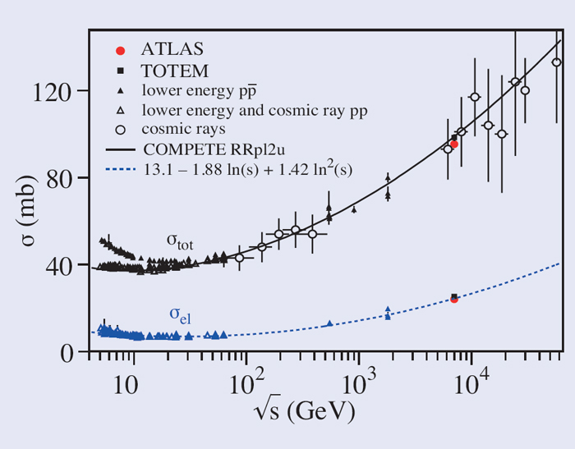
Strong interaction cross section grows slowly with energy
Simple estimate surprisingly accurate
Small rise at high energy, but only by a factor of ~2 for LHC energy and ~3 for ultra-high-energy-cosmic-ray energy (10¹⁷ eV)
Notes:
Why does it increase with energy?
Review sqrt(s)
Image source? Looks like Physics Today?
How to derive ratio of elastic to total?
Image from http://cerncourier.com/cws/article/cern/58525
“using the Absolute Luminosity For ATLAS (ALFA) Roman Pot sub-detector system located 240 m from the interaction point”
“To measure the total cross-section, the optical theorem is used, which states that the total cross-section is proportional to the imaginary part of the forward elastic-scattering amplitude, extrapolated to momentum transfer, t = 0.”
“Measuring elastic scattering is a challenge because elastically scattered protons escape the interaction at very small angles of tens of micro-radians or less. To detect these protons, dedicated detectors are installed, such as ALFA.”
Sqrt(s) = Ecm? 2 Ecm?

Slide 38
Integrated charge distribution
Example from IceCube
PMT is current source
Integral of waveform is integrated charge collected from PMT in some time window
Primary peak in charge distribution is from single photo-electrons
Lower amplitude peak (pedestal) is from noise
Can be used to measure/monitor PMT gain
Gain = ~2 pC per pe / (1.6e-19 C per electron) = ~1 x 10⁷ electrons per pe

Slide 39
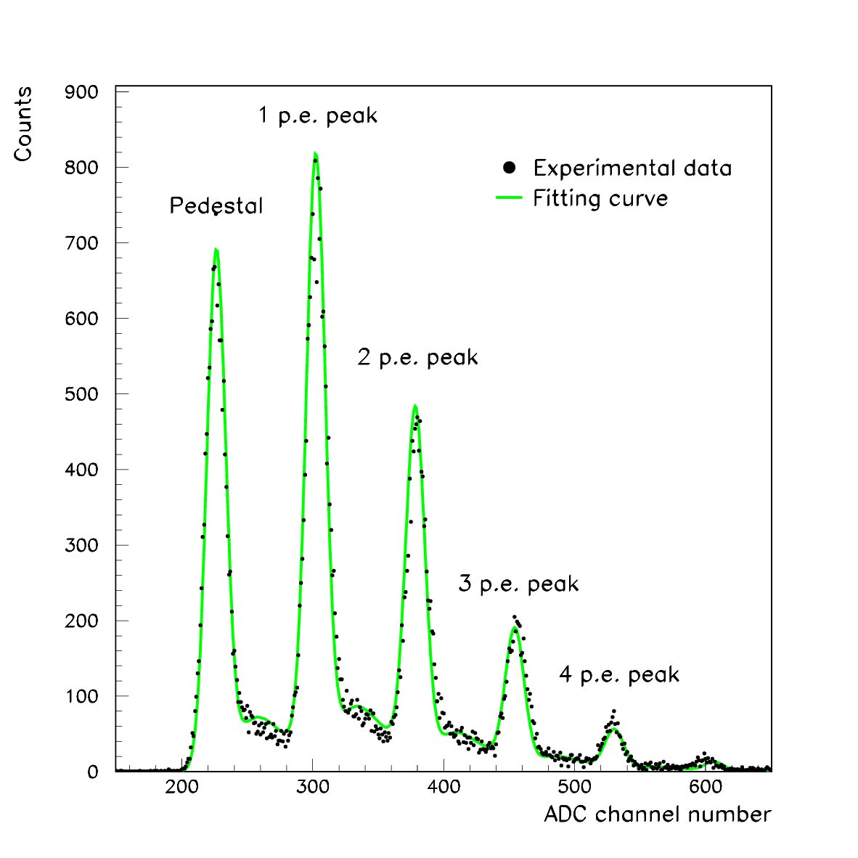
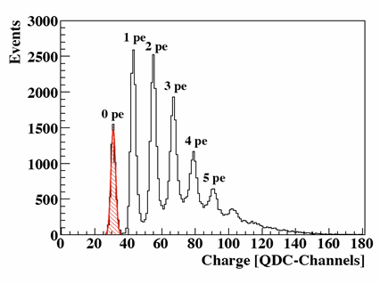
Pulse height (or integrated charge) spectra
Pulse amplitude
Pulse integral (charge)
Example from Hamamatsu
multi-pixel photon counter
Example from LHCb RICH
“Pedestal” (0 pe signal) is the noise floor

Slide 40
Nuisance pulses in PMTs
Late pulses: pe backscatters elastically off first dynode, then accelerated back to it
  Delayed arrival time
  Standard amplitude
After-pulses: pe scatters off residual gas atom inside PMT, ionizing it
  Original pe proceeds almost as usual
  Ion drifts backward (slowly) to photocathode, where it ejects many (~10) photoelectrons
  Delayed arrival time
  Large amplitude
Pre-pulses: photons bypass photocathode and produce photo-electron on first dynode
  Earlier arrival time
  Lower amplitude
Notes:
IceCube pre-pulses: 1/15 charge and 30 ns early
IceCube late pulses: 25-160 ns late
Numbers from C. Weaver thesis
Late pulses: pe backscatters elastically off first dynode, then accelerated back to it
After-pulses: pe scatters off residual gas atom inside PMT, ionizing it
Pre-pulses: photons bypass photocathode and produce photo-electron on first dynode

Slide 41
Excess noise factor
If gain is constant, statistical variation is simply Poisson statistics of photo-electrons
But gain varies from event to event, resulting in excess noise
ENF = factor by which noise is larger than expected from Poisson distribution
ENF = 1 for zero gain variation, typically up to 2 for actual detectors with gain variation

Slide 42
Waveforms of photo-electrons from PMTs
Example from IceCube
Waveform recording is powerful (for single-photon counting and timing) and increasingly common
Waveform-recording electronics are more expensive than alternatives
Alternatives with less expensive electronics, computing, data storage: record only the peak amplitude, integrated charge, or time of threshold crossings (time to digital converter)

Slide 43
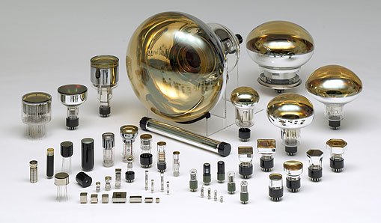
Wide variety of PMT shapes and sizes

Slide 44
Photomultiplier glass materials
Glass often has trace radioactivity (potassium-40)
For low-background experiments, special low-activity PMTs or silicon photodetectors can be used
PMT window transmissivity typically cuts off in UV
Difficult/expensive to achieve good UV response
Borosilicate glass passband: near IR to 300 nm
Example challenge: xenon (for double beta decay and dark matter experiments) scintillation light is 175 nm

Slide 45
Example: calculation of shower max altitude in air for 10 TeV gamma ray
Critical energy in air: E_{crit} = 0.1 GeV
Radiation length in air: X₀ = 37 g/cm²
H = scale height of atmosphere = 6.5 km
h = height above sea level
X(h) = total column depth along shower, integrated from space to a height of h above sea level
X(0) = total column depth of atmosphere (1030 g/cm²)
Atmosphere density model -> column depth model: X(h) = X(0)exp(-h/H)
Shower max occurs at t_{max} = ln(E₀/E_{crit}) / ln2 = 16.6 radiation lengths; X_{max} = 16.6*37 g/cm² = 615 g/cm²
Plugging in to atmosphere model, solve for altitude of shower max: ln(X_{max}/X(0)) = -h/H -> h = -H * ln(X_{max}/X(0)) = 3.4 km = 11kft
Notes:
See Perkins Particle Astrophysics p161 (2003 ed.)
Homework: calculate critical energy in air

Slide 46
Electromagnetic shower development
For a primary particle of energy E₀, after t radiation lengths (generations), the energy of each e± or gamma will be approximately E(t) = E₀/2^{t}
Continues until E = E_{crit}
So shower maximum is at t_{max}, when E_{crit} = E₀/2^{tmax}
Depth of shower max increases logarithmically with primary energy: t_{max} = ln(E₀/E_{crit}) / ln2
Total track length of charged particles (number of radiation lengths) scales with E₀/E_{crit}

Slide 47
Lateral distribution of hadronic shower components
e± Coulomb scatter and spread out
Notes:
Why is EM component from pi0 far off axis? pi0 have very short lifetime (26 ns pi+- and 10^ -16 s pi0)

Slide 48
Minimum ionization loss is ~2 MeV cm²/g times the material density (useful number to memorize)
(spatial dE/dx divided by density)
Notes:
PDG 2015
Figure 33.3: Mass stopping power at minimum ionization for the chemical elements. The straight line is fitted for Z > 6. A simple functional dependence on Z is not to be expected, since ⟨−dE/dx⟩ also depends on other variables.
Derive the slope (and offset) of the trend line
Is slope simply from Z/A decreasing with increasing A?
Why hydrogen off the chart?
dE/dx = 2 MeV cm^2/g * density
Plotted is
“Stopping power” [?] = dE/dx / density
MeV/cm / (g/cm^3) = MeV cm^2 / g
Hydrogen: 1/1 = 1 electron per nucleon
Helium: 2/4 = 0.5 electrons per nucleon
Lithium: 3/7 ~0.5 electrons per nucleon
Typical: 0.5 electrons per nucleon
Hydrogen has more electrons per mass than others

Slide 49
Energy loss of muons: ionization, bremsstrahlung, pair production, photonuclear
(in ice)
(MMC paper)
Chirkin & Rhode, hep-ph/0407075
Photonuclear interactions of muons (or electrons or taus): energy transfer to nucleus via photon, producing energetic hadrons (like a hadronic interaction of a proton)
Notes:
Cross sections for different mechanisms of energy loss by muons in ice as a function of muon energy from [15]. At high energies, stochastic losses (particularly Bremsstrahlung and pair production of secondary particles) dominate over continuous losses from ionizing the medium. Decay is not actually an energy-loss process, but has been included for comparison by multiplying the decay probability by the particle energy.
Good discussion of photonuclear interactions of muons at http://journals.aps.org/prd/pdf/10.1103/PhysRevD.67.034027
Muon: tau = 2.2 µs, mc^2 = 106 MeV, c tau = 6.6e4 cm
How is decay included as an effective dE/dx?
Approximate it as “all of particle energy is lost smoothly along one decay length”
Then
dE/dx = E/L = E/gamma c tau = gamma m c^2 / gamma c tau = m c^2 / c tau
Now include 1/rho density factor:
dE/dx = m c^2 / rho c tau = (0.106 GeV) / (1 g/cm^3) / (6.6e4 cm)
Effective dE/dx for decay is 1.6e-6 (GeV/ (g/cm^2))
Plot citation: https://arxiv.org/abs/hep-ph/0407075
See also PROPOSAL paper
https://reader.elsevier.com/reader/sd/pii/S0010465513001355?token=40B636A433882678A9D68D6DC97F80078C7D1449F9B978CA012A933140FABFB933D5EF3886C35543EAD8A001EEFCBB42&originRegion=us-east-1&originCreation=20210609204736

Slide 50
Quantum efficiency
Quantum efficiency = Fraction of photon absorption events that result in photo-electron emission by metal surface
Function of wavelength for each material
Choice of photocathode material determines QE as function of wavelength
Typically peaks ~25%
High quantum efficiency devices now available up to ~35-40% (more expensive)
Notes:
Slope of lines? Why?

Slide 51
IceCube PMT inside
Digital Optical Module
10 inch diameter PMT (compare 20 inch SuperK diameter)
Mu metal cage: nickel-iron alloy (77% nickel, 16% iron, 5% copper, 2% chromium)
  High magnetic permeability (µ)
  Shield’s Earth’s magnetic field to reduce deflection in electron optics
Notes:
Magnetic permeability

Slide 52
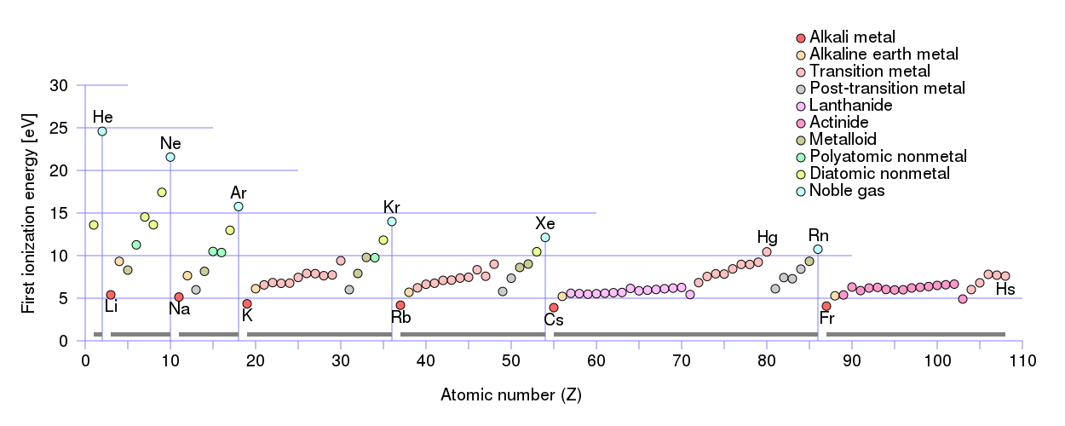
(first) ionization energy of each element
~10 eV for each element
Full range: 4-25 eV
If atom is already missing one election, “second ionization energy” and so on
Energetic particle (“ionizing radiation”) traveling through matter can cause ionization if it has at least this much energy
If it has much more energy, can cause many ionization events

Slide 53
Cherenkov radiation
Due to polarization of medium, produced when a relativistic charged particle travels through a medium faster than the speed of light in the medium (c/n)
Typically a negligible contribution to particle energy loss
Very useful for detecting particles and measuring their direction, energy, or mass/identity
Radiation emitted along a narrow cone of opening angle θ_{C} (can vary with wavelength):
Radiation intensity scales with particle Z²
Spectrum of Cherenkov light: increases with frequency (Frank-Tamm formula):
~200 photons/cm in ice
Notes:
Homework: calculation the fraction of energy loss (relative to particle energy or ionization dE/dx)
Derivation of Frank-Tamm?
If v < c is there incoherent radiation?
Homework: (1) Cherenkov angle as function of atmosphere density (2) as function of altitude
Does Frank-Tamm work to arbitrarily small wavelengths?
Integrate Frank-Tamm to determine dE/dx
Derive 1/lambda^2 from this
Does integral converge without a small-lambda cutoff?
Back of envelope comparison to ionization loss: Cherenkov is (1 eV/photon) * (200 photons/cm) = 200 eV/cm
Ionization is 1e6 eV/cm so 4 orders of magnitude greater
What happens at small wavelength? Where does it break down (prior to transparency)? Why not more X-ray emission than UV?
Assume each photon is 1 eV
200 eV/cm = 2e2 eV/cm
Minimum ionization is 2 MeV = 2e6 eV/cm
So Cherenkov energy loss is 4 orders of magnitude lower than ionization

