Slide 1
Neutrino Physics: A brief survey
A. Baha Balantekin

Slide 2
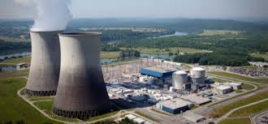
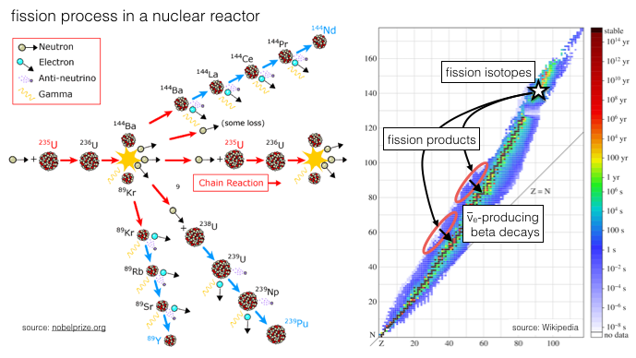
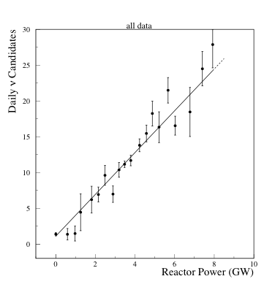
Sources of neutrinos: Nuclear Reactors
If you can get close enough by far the most abundant source of neutrinos on Earth are commercial fission reactors.

Slide 3
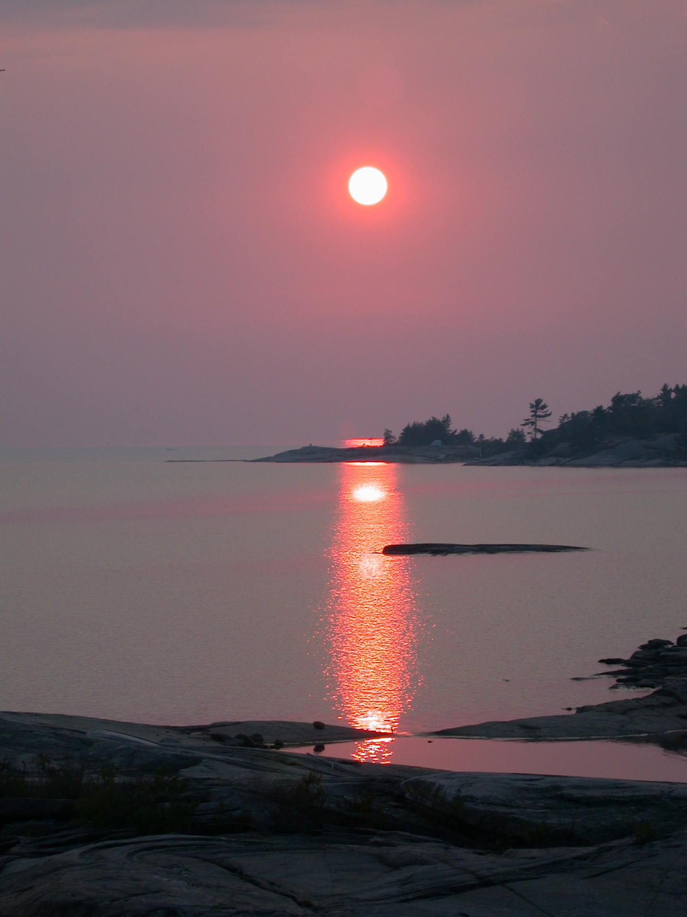
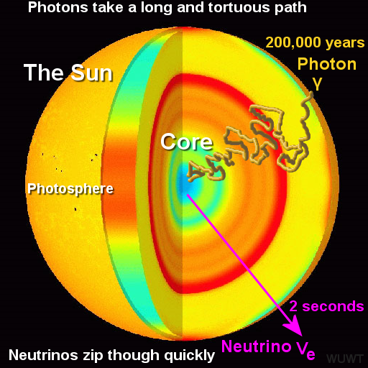
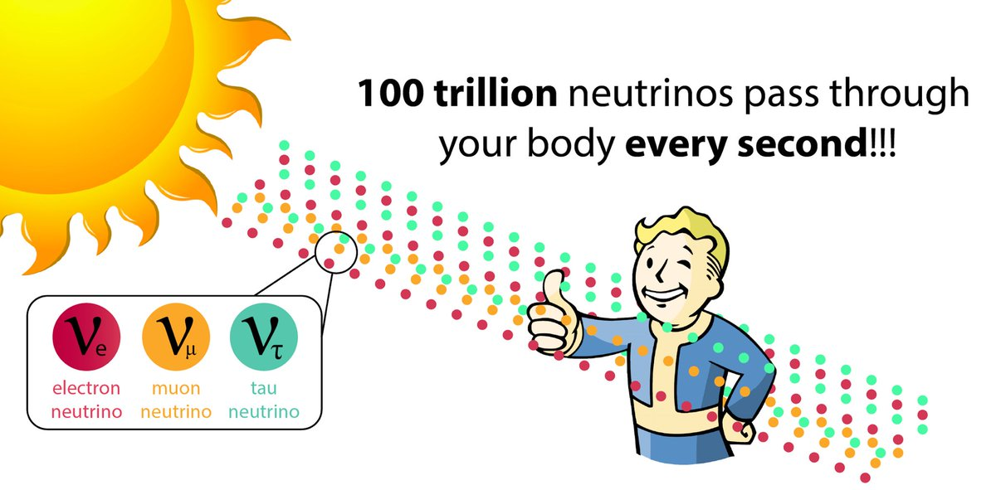

Sources of neutrinos: Sun
A minor league star (such as our Sun) produces neutrinos mainly through the reaction
$$p+p→d+e^{+}+ν_{e}$$
Adopted from Lux Science

Slide 4
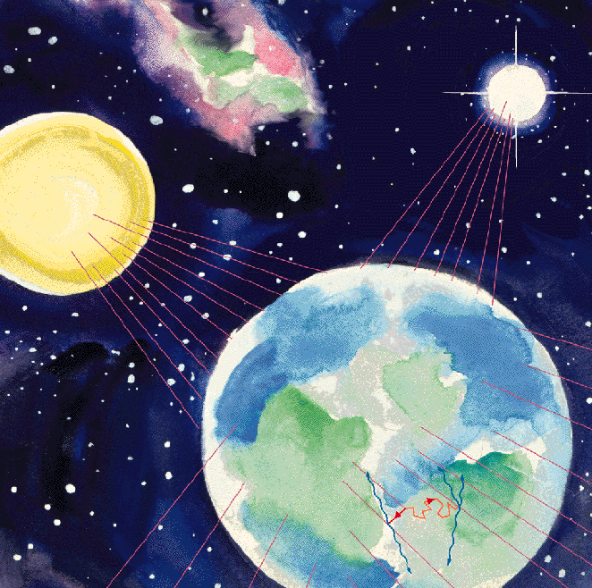
Sources of neutrinos: Supernovae
A (hopefully distant enough) core-collapse supernova produces approximately 10⁵⁸ neutrinos in about twenty seconds via
$$\text{Gravitational} \text{binding} \text{energy} →ν_{x}+{\overline{ν}}_{x}$$
Those neutrinos produced in supernova explosions since the beginning of the Universe still stick around, forming the “Diffuse Supernova Background”

Slide 5
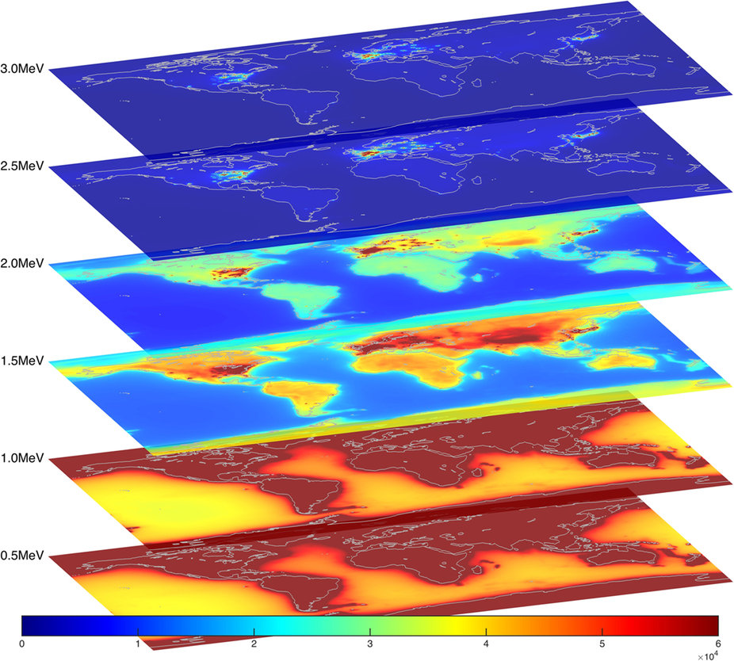
Sources of neutrinos: Earth
Geoneutrinos are antineutrinos coming from the decay of ²³⁸U, ²³⁸Th, and ⁴⁰K inside the Earth. Picture on the right shows the sum of reactor neutrinos and geoneutrinos.

Slide 6
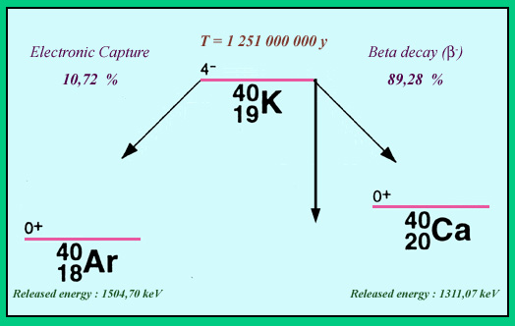


Sources of neutrinos: Fruits and Vegetables
Many fruits and vegetables absorb ⁴⁰K in addition to the stable potassium isotope. ⁴⁰K decays by emitting either neutrinos or antineutrinos:
$${}_{}^{40}{K→{}_{}^{40}{Ca+e^{−}+{\overline{ν}}_{e}}}$$
$${}_{}^{40}{K+e^{−} →{}_{}^{40}{Ar+ν_{e}}}$$
About one million neutrinos and antineutrinos are emitted per day from one banana due to ⁴⁰K decay

Slide 7
Sources of neutrinos: Humans
We also ingest ⁴⁰K when we eat potassium rich foods such as bananas, kidney beans, nuts, etc. Our bodies deposit ⁴⁰K in our bones.
A 70 kg (154 pounds) person emits about 530 electron neutrinos and 4460 electron antineutrinos per second.

Slide 8
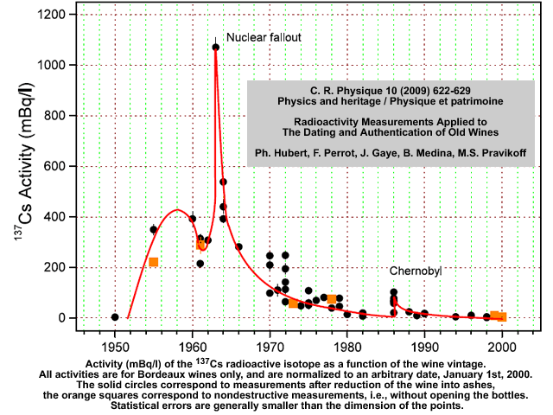
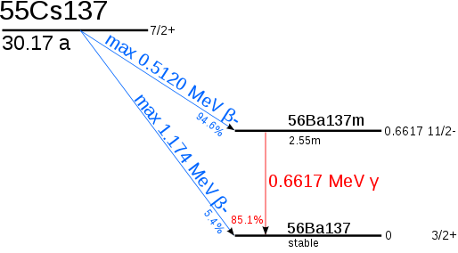
Sources of neutrinos: Wine

Slide 9
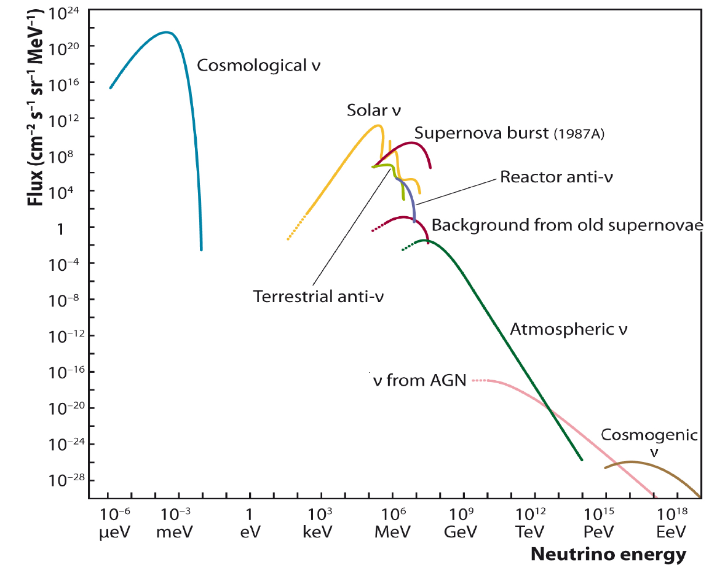

Slide 10
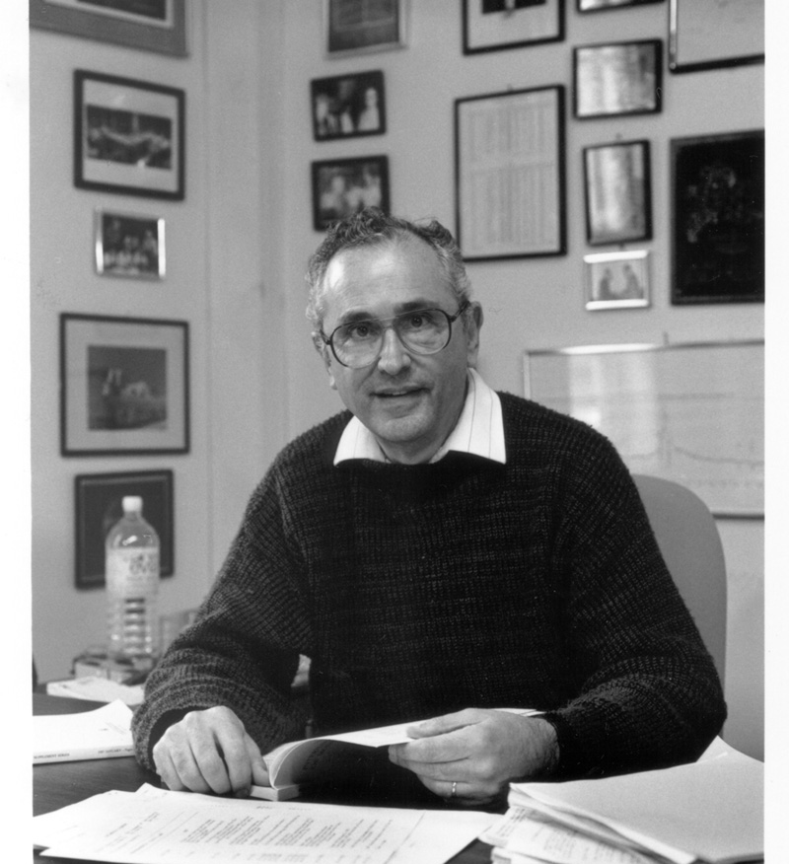
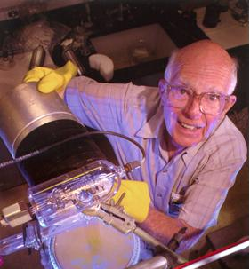
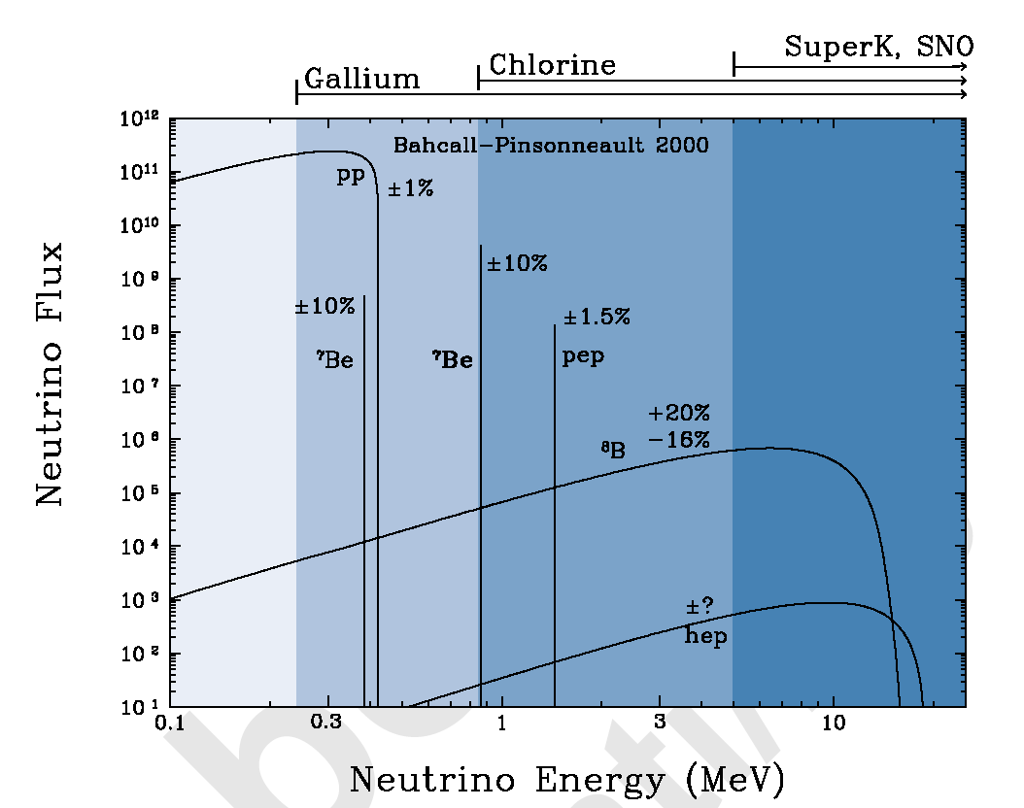
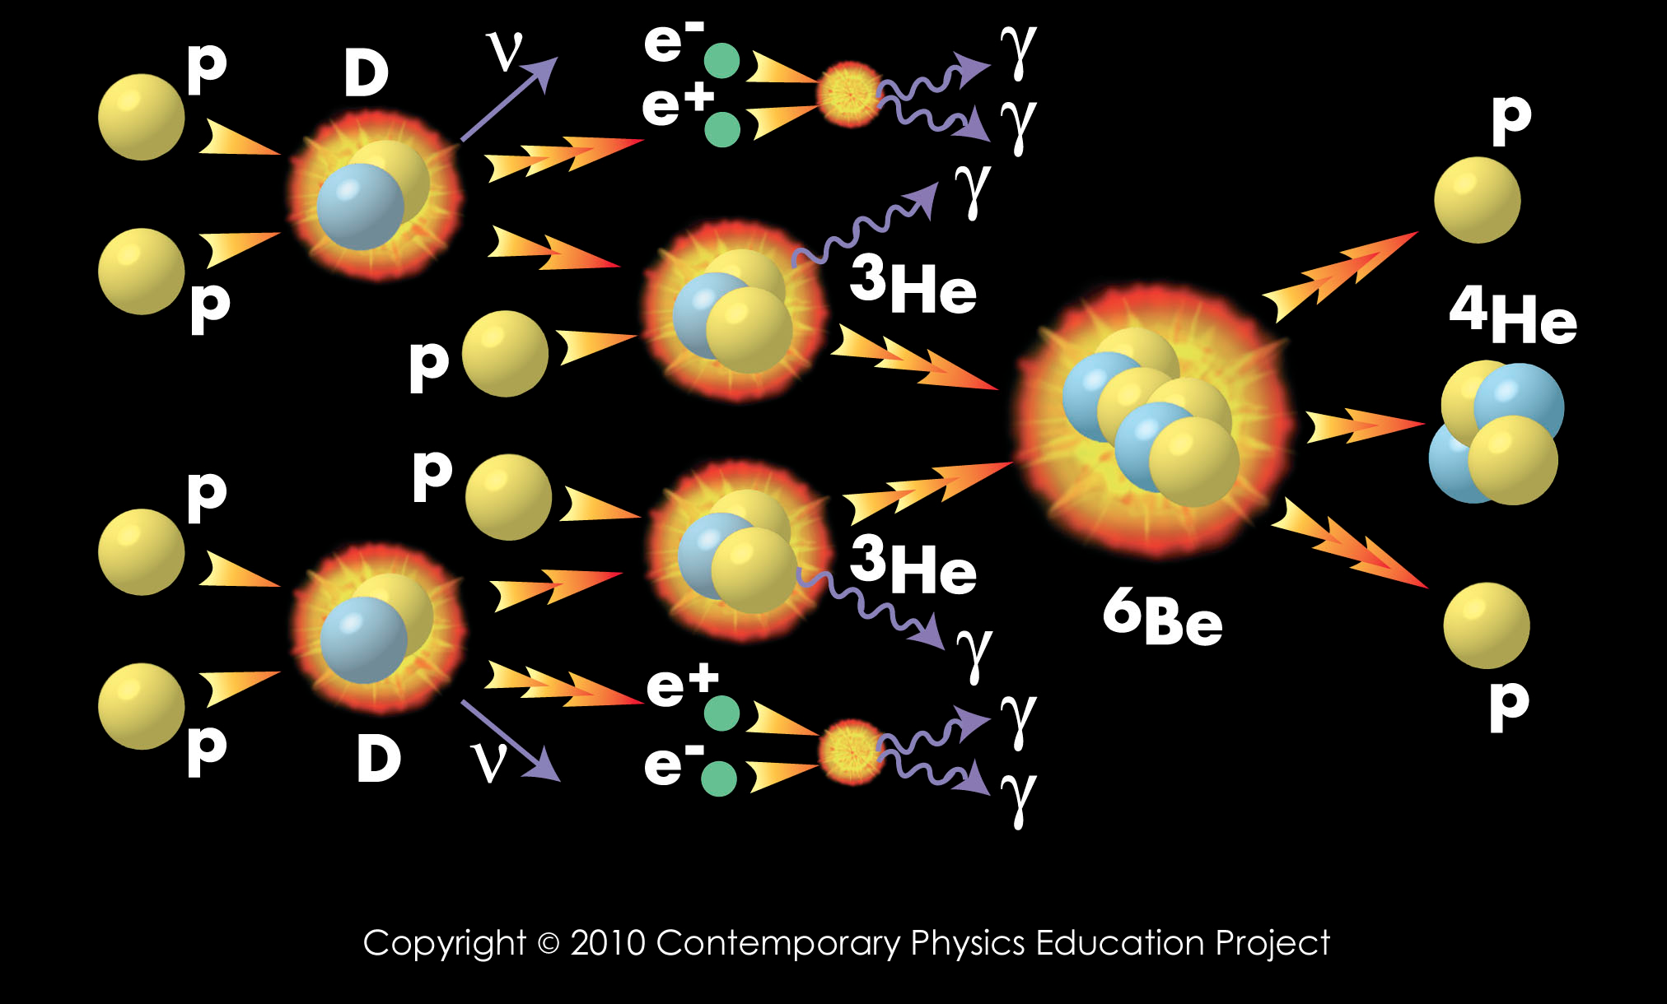
“...to see into the interior of a star and thus verify directly the hypothesis of nuclear energy generation..”
Bahcall and Davis, 1964
Solar Neutrinos

Slide 11
Nuclear reaction network in the Sun
99.77%
p + p → d+ e⁺ + ν_{e}
0.23%
p + e ⁻ + p → d + ν_{e}
84.7%
d + p → ³He +γ
~2×10⁻⁵ %
13.8%
³He + ⁴He →⁷Be + γ
13.78%
0.02%
⁷Be + e⁻ → ⁷Li + ν_{e}
⁷Be + p → ⁸B + γ
³He+³He→α+2p
⁷Li + p ->α+α
⁸B → ⁸Be*+ e⁺ +ν_{e}
2α
³He+p→α+e⁺+ν_{e}
Three paths leading to neutrinos are called pp-I, pp-II and pp-III chains, respectively.

Slide 12
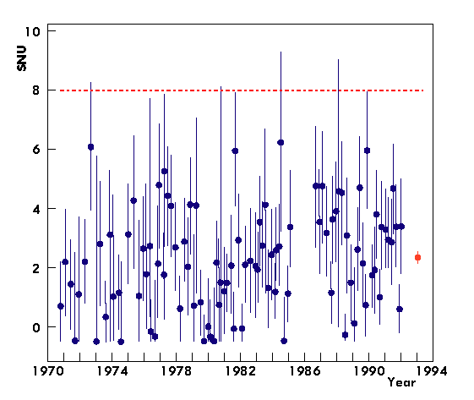
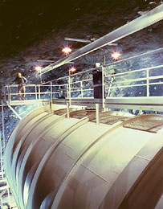
The pioneer
Homestake Experiment
Solar model prediction
At the time there were many skeptics that said neutrino signatures of the element formation in the Sun cannot be measured with the needed precision . Nevertheless Davis persisted and eventually received the Nobel Prize for his work.

Slide 13
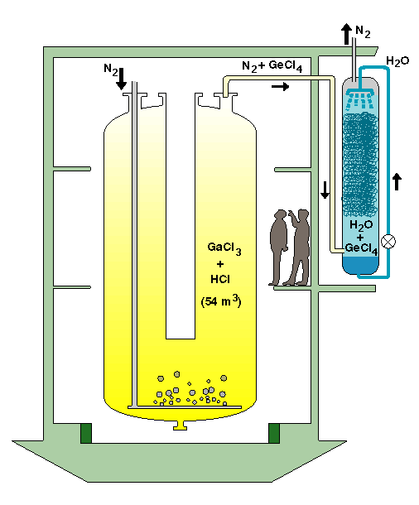
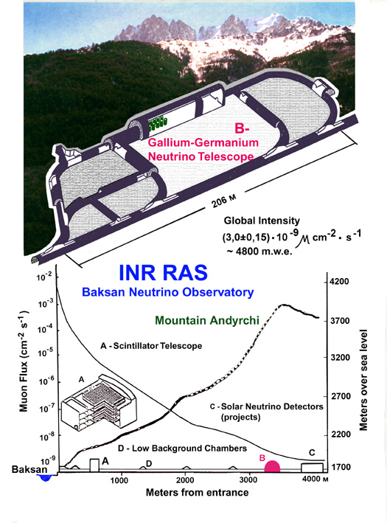
SAGE
Gallex and GNO
The Gallium Experiments

Slide 14
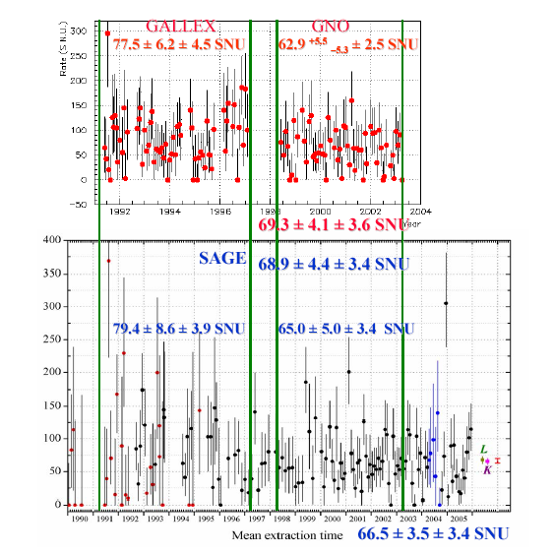
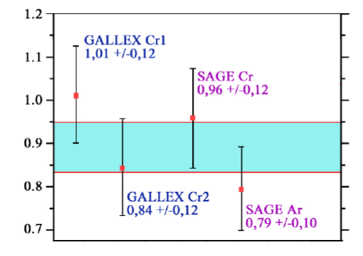
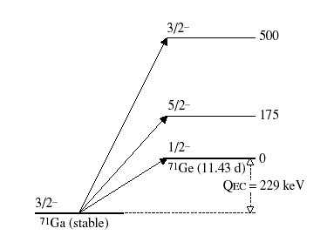
Adopted from Gavrin

Slide 15
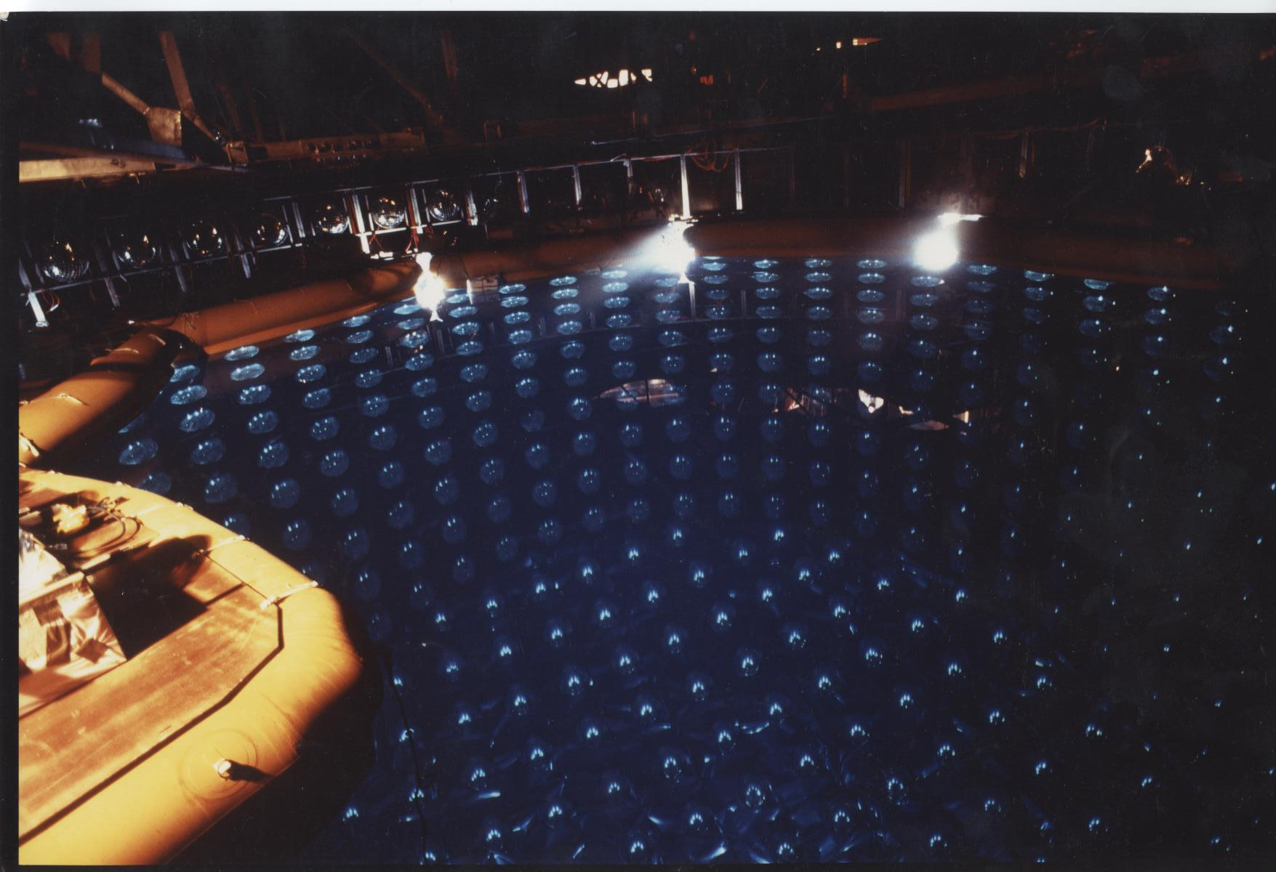
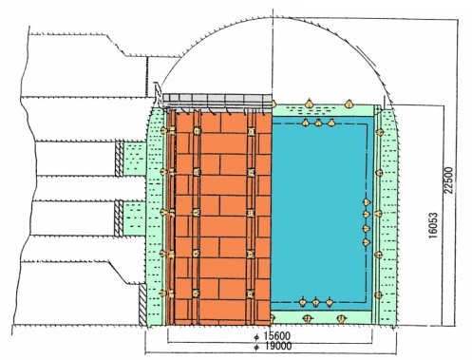
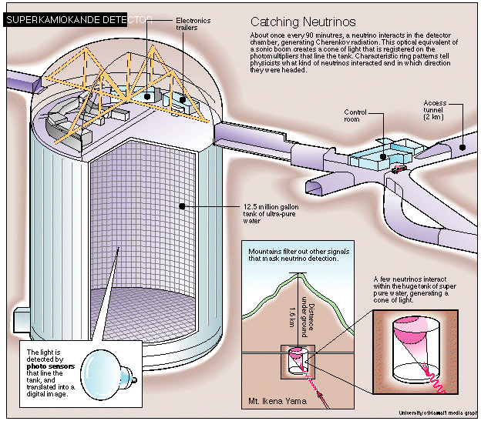
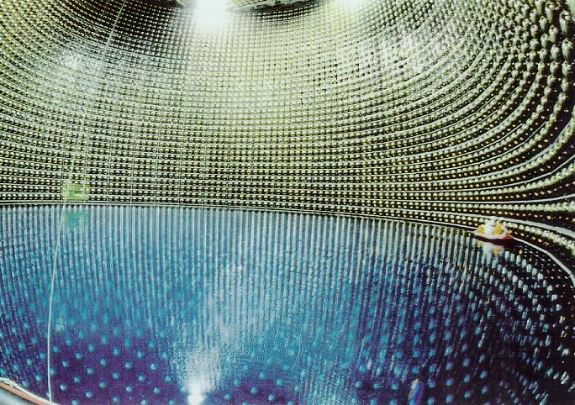
Kamiokande
SuperKamiokande

Slide 16
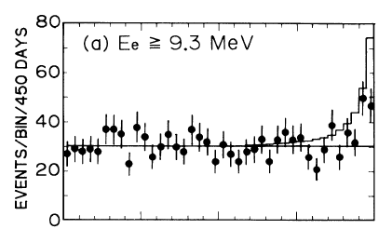

A historic plot: Kamiokande (1987-1988)

Slide 17
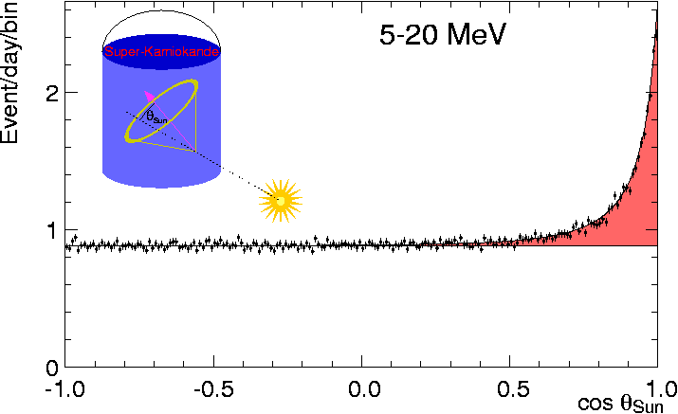
SuperKamiokande-I ⁸B solar ν’s

Slide 18
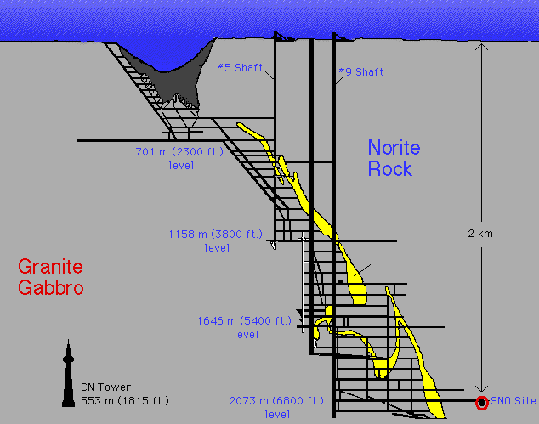
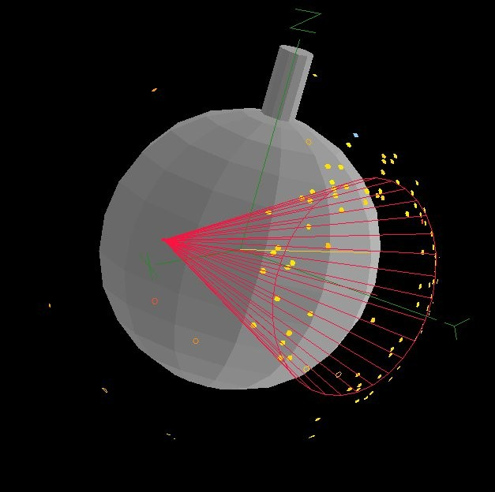
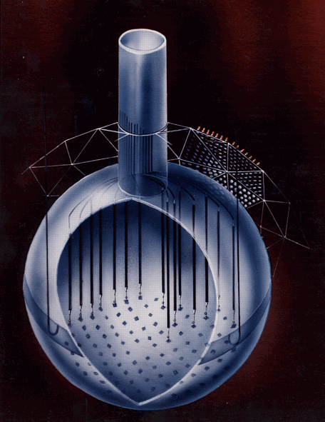
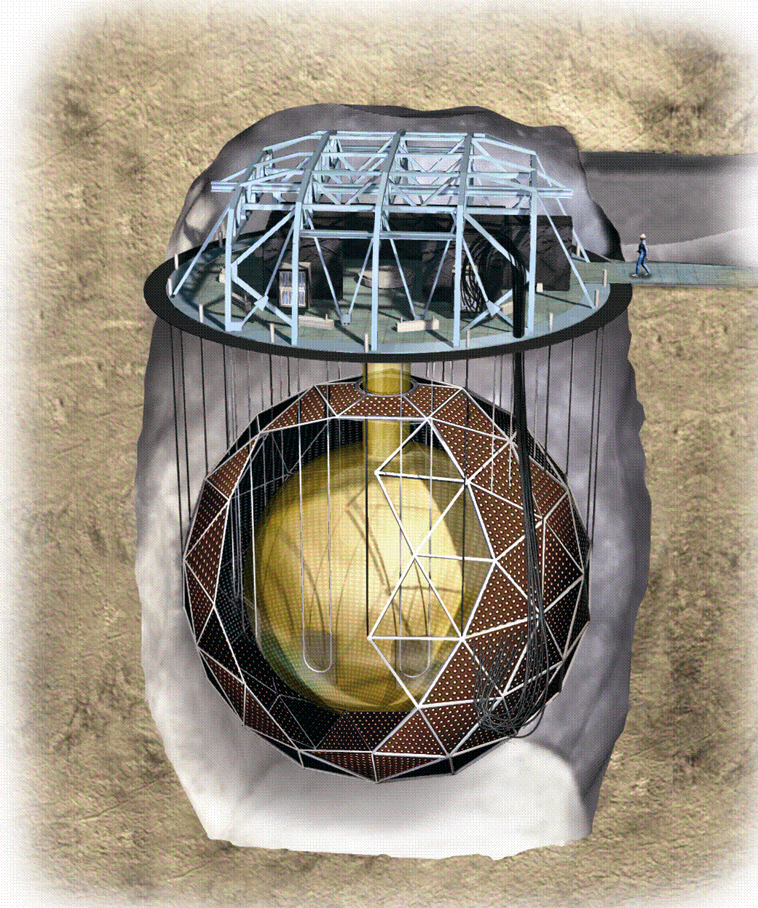
Sudbury Neutrino Observatory (SNO)
ν_{e} + d → p + p + e⁻ CC
ν_{e} + e → ν_{e} + e ES
ν_{x} + d → ν_{x} + p + n NC

Slide 19
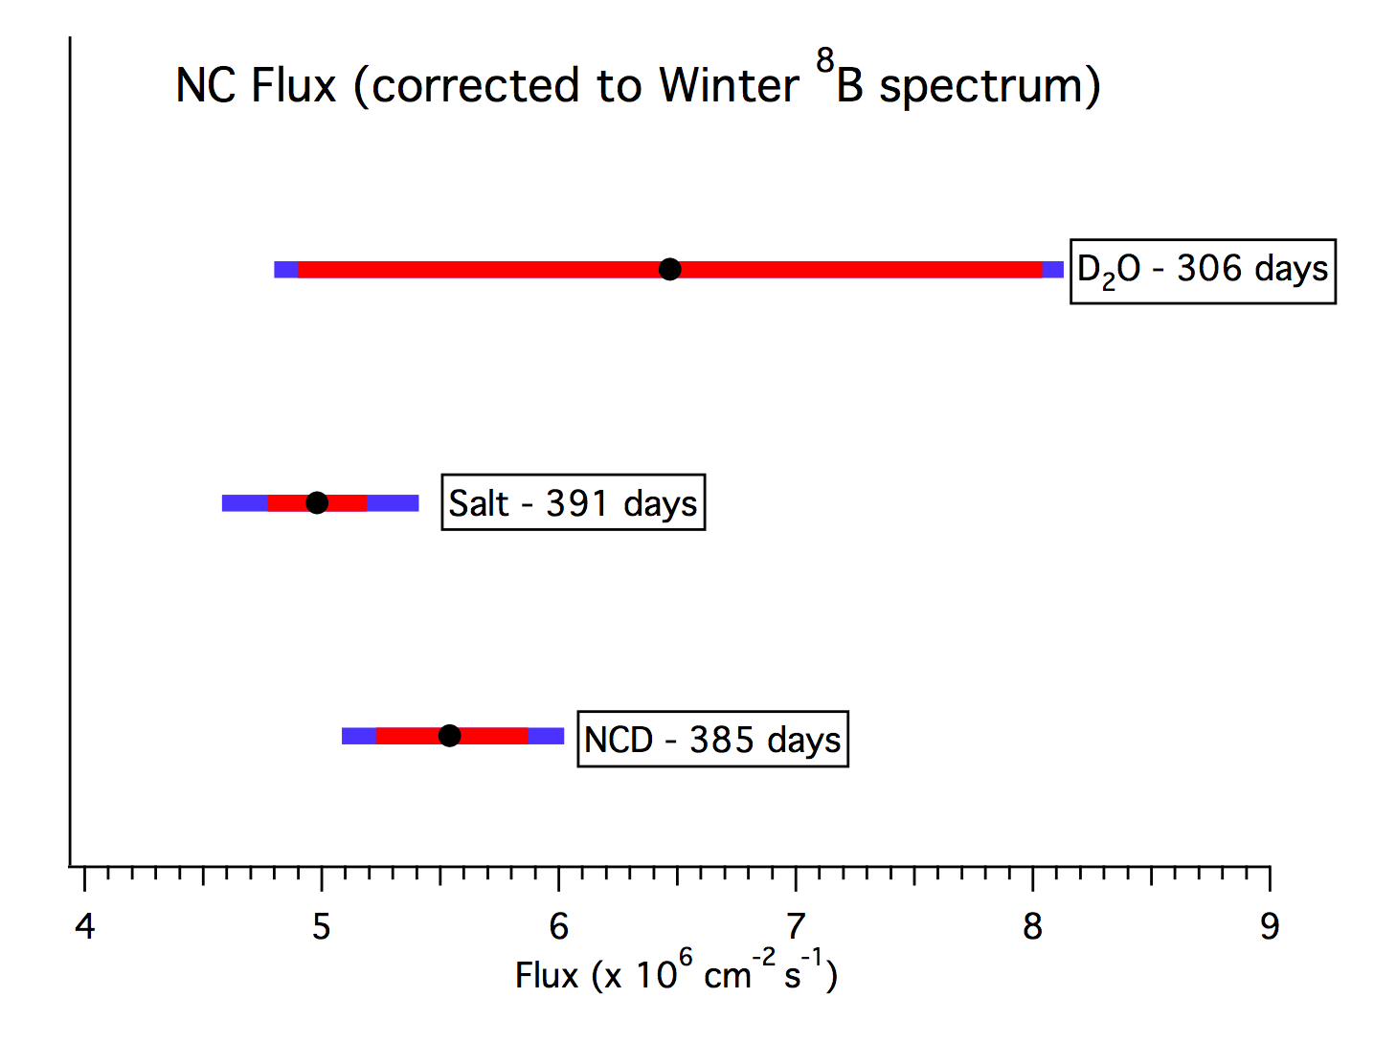
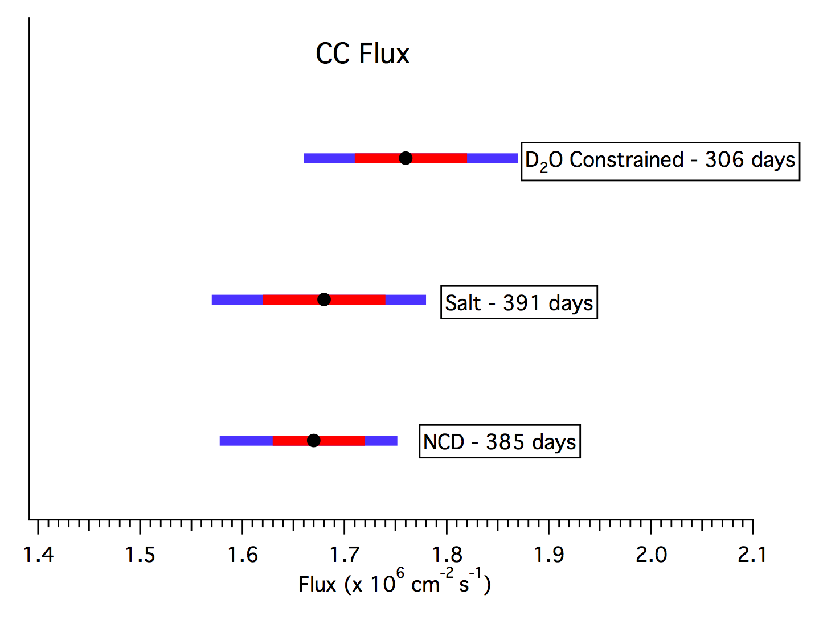
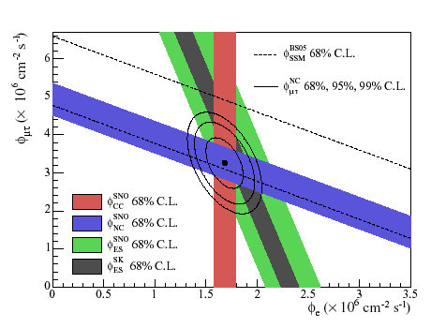
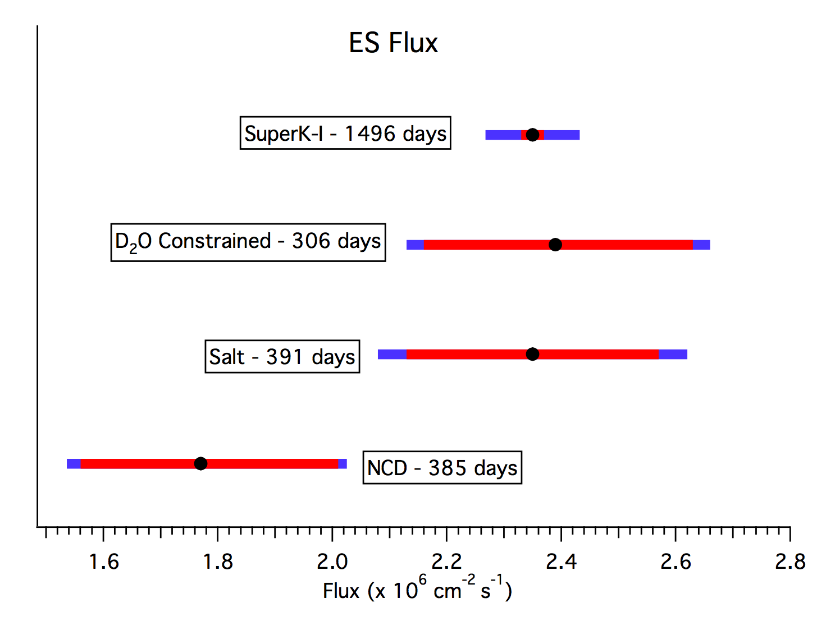
Three phases of SNO
stat
stat + syst

Slide 20
Other neutrino sources we talk about
Particle and Nuclear Accelerators
Big Bang
The atmosphere
Extra Galactic Sources
Point sources
Neutron-star mergers.
…..

Slide 21
Mixing matrix for three flavors

Slide 22
Example: Oscillations in the two-flavor case

Slide 24

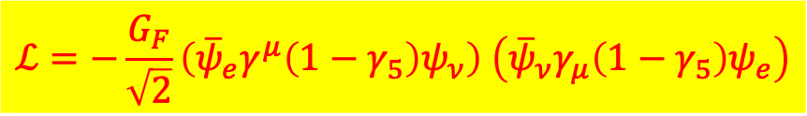

Inside the Sun neutrinos travel through dense matter and interact with a “mean-field” created by the background
$$ℒ=−\frac{G_{F}}{\sqrt{2}}\left({\overline{ψ}}_{e}γ^{μ}\left(1−γ_{5}\right)ψ_{ν}\right) \left({\overline{ψ}}_{ν}γ_{μ}\left(1−γ_{5}\right)ψ_{e}\right)$$
Recall
Rewrite as
$$ℒ=−\sqrt{2}G_{F}\left({\overline{ψ}}_{eL}γ^{μ}ψ_{ν,L}\right) \left({\overline{ψ}}_{ν,L}γ_{μ}ψ_{e,L}\right)$$
Apply Fierz transformation
$$ℒ=−2\sqrt{2}G_{F}\left({\overline{ψ}}_{ν,L}γ^{μ}ψ_{ν,L}\right) \left({\overline{ψ}}_{e,L}γ_{μ}ψ_{e,L}\right)$$

Slide 25



Inside the Sun neutrinos travel through dense matter and interact with a “mean-field” created by the background
$$ℒ=−\frac{G_{F}}{\sqrt{2}}\left({\overline{ψ}}_{e}γ^{μ}\left(1−γ_{5}\right)ψ_{ν}\right) \left({\overline{ψ}}_{ν}γ_{μ}\left(1−γ_{5}\right)ψ_{e}\right)$$
Recall
Rewrite as
$$ℒ=−\sqrt{2}G_{F}\left({\overline{ψ}}_{eL}γ^{μ}ψ_{ν,L}\right) \left({\overline{ψ}}_{ν,L}γ_{μ}ψ_{e,L}\right)$$
Apply Fierz transformation
$$ℒ=−2\sqrt{2}G_{F}\left({\overline{ψ}}_{ν,L}γ^{μ}ψ_{ν,L}\right) \left({\overline{ψ}}_{e,L}γ_{μ}ψ_{e,L}\right)$$
Average over the background
$$ℒ=−2\sqrt{2}G_{F}\left({\overline{ψ}}_{ν,L}γ^{μ}ψ_{ν,L}\right)\left\langle {\overline{ψ}}_{e,L}γ_{μ}ψ_{e,L}\right\rangle$$
$$\left\langle {\overline{ψ}}_{e,L}γ_{0}ψ_{e,L}\right\rangle$$
A scalar describing the background
$$\left\langle {\overline{ψ}}_{e,L}γ_{i}ψ_{e,L}\right\rangle$$
A vector describing the background

Slide 26
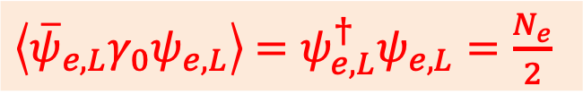

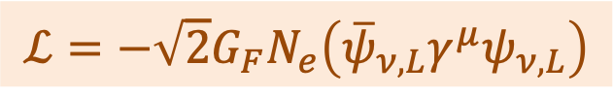
$$\left\langle {\overline{ψ}}_{e,L}γ_{i}ψ_{e,L}\right\rangle$$
A three-vector describing the background in bulk
If the background is static, i.e. no net velocity or currents (both vectors) or there is no strong magnetic field causing a net polarization (also a vector), this term must vanish upon averaging!
$\left\langle {\overline{ψ}}_{e,L}γ_{0}ψ_{e,L}\right\rangle$ $=ψ_{e,L}^{†}ψ_{e,L}=\frac{N_{e}}{2}$
Only left-handed electrons participate
Hence effective neutrino Lagrangian becomes
$$ℒ=−\sqrt{2}G_{F}N_{e}\left({\overline{ψ}}_{ν,L}γ^{μ}ψ_{ν,L}\right)$$
Note: protons and neutrons contribute too. Proton contribution is small. In a more careful derivation considering W-boson, for a charge-neutral medium this result holds. Z-boson contributes the same amount for all three flavors and becomes proportional to neutron density for such a medium.

Slide 27
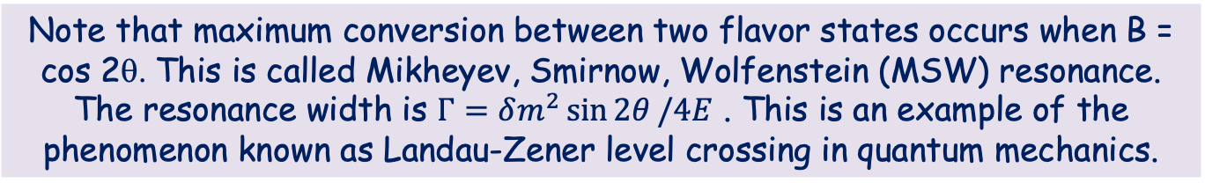

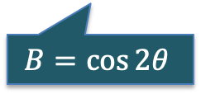

$i\frac{∂}{∂L}\left(\begin{matrix}ν_{e} \\ ν_{μ}\end{matrix}\right)=\frac{δm^{2}}{4E}\left(\begin{matrix}B−\cos{2θ} & \sin{2θ} \\ \sin{2θ} & −B+\cos{2θ}\end{matrix}\right)$ $\left(\begin{matrix}ν_{e} \\ ν_{μ}\end{matrix}\right), B=\frac{2\sqrt{2}G_{F}EN_{e}(L)}{δm^{2}}$
Note that maximum conversion between two flavor states occurs when B = cos 2θ. This is called Mikheyev, Smirnow, Wolfenstein (MSW) resonance. The resonance width is $Γ=δm^{2}\sin{2θ}/4E$ . This is an example of the phenomenon known as Landau-Zener level crossing in quantum mechanics.
$$P\left(ν_{e}→ν_{e}\right)$$
Γ/2
$$B=\cos{2θ}$$
$$N_{e}$$

Slide 28
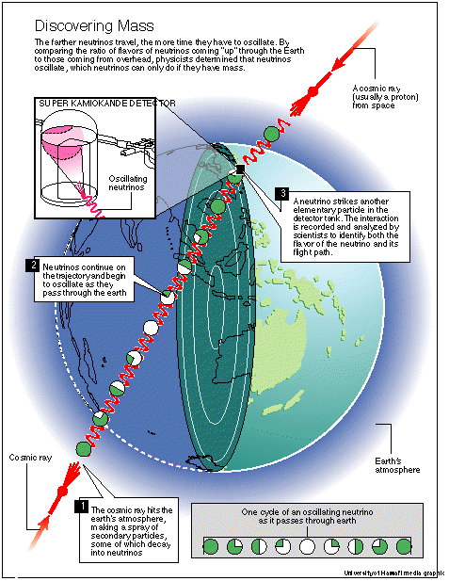
Atmospheric Neutrinos

Slide 29
Measuring θ₁₃ with Reactor Antineutrinos
Double Chooz Daya Bay RENO
Small-amplitude oscillation due to θ₁₃ integrated over E
Large-amplitude
oscillation due to θ₁₂
Reactor neutrino energies are too low to produce muons. Hence this is an antineutrino disappearance experiment (also no matter effects).
Measure ratio(s) of interaction rates in two or more detectors to cancel systematic errors.
Those detectors will never be identical, hence one should try to control mass differences, detection efficiencies, etc.
θ₁₃
Δm²₁₃≈ Δm²₂₃
~1-1.8 km
detector 1
detector 2
> 0.1 km

Slide 30
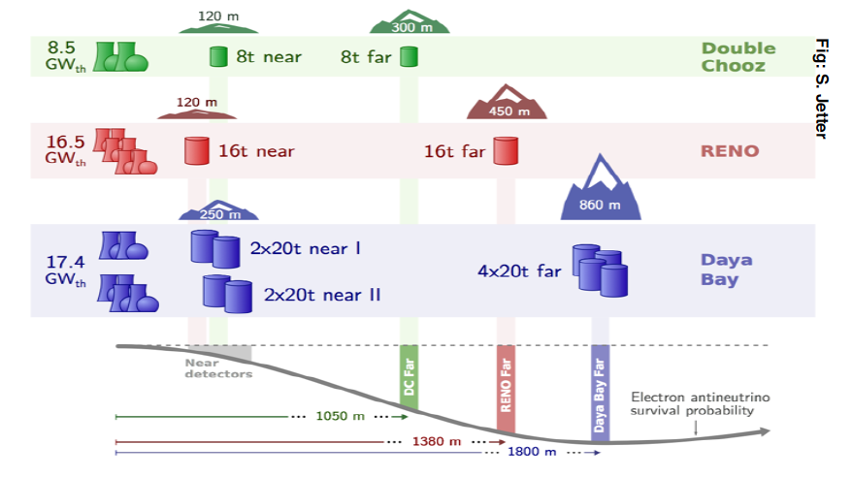

Slide 31
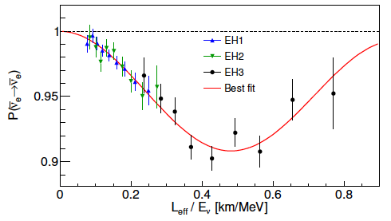

PRL 112 (2014) 061801

Slide 32
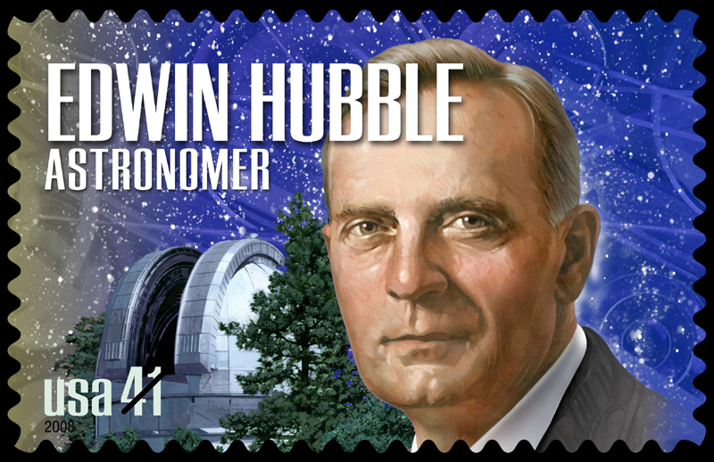
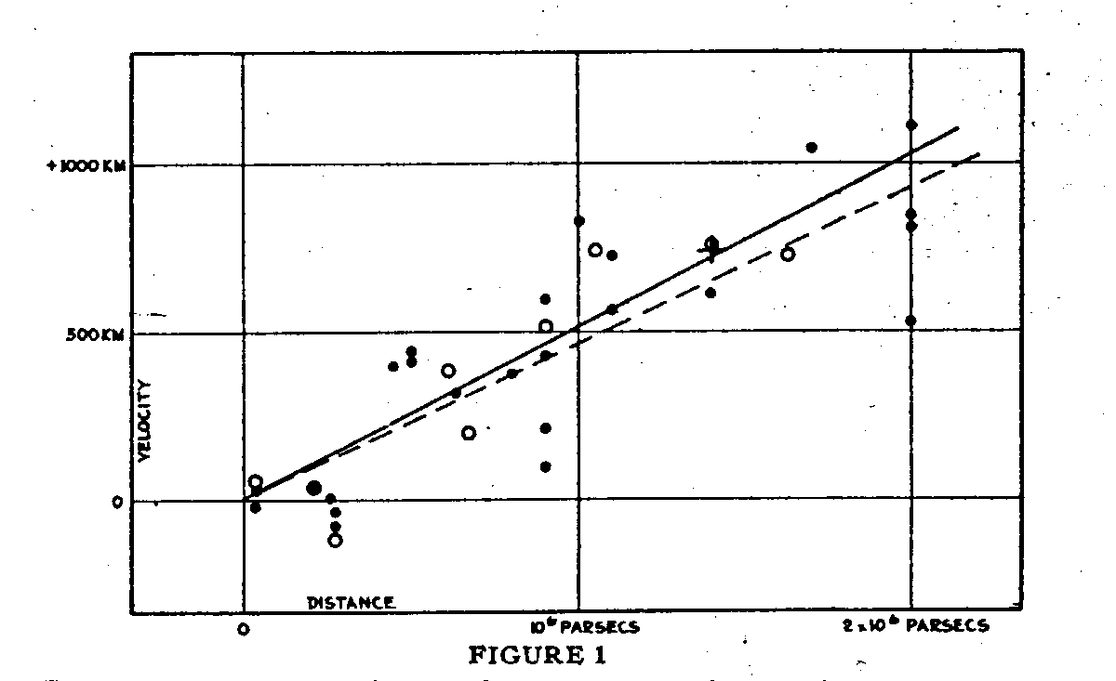
Expansion of the Universe: Hubble’s original graph

Slide 33
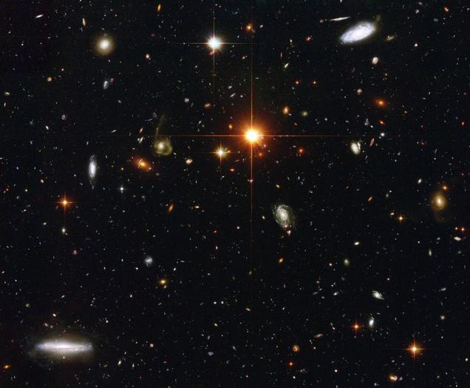
Expansion of the Universe
Universe remains homogeneous and isotropic during expansion
For any length scale

Slide 34
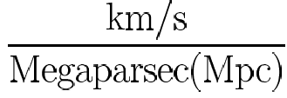
Hubble’s constant
1 pc = 3.09×10¹³ km ≈ 3.26 light years
Observations
H⁻¹ ≈ 9.78×10⁹ years
Planck Mass:
m_{p} = 2.17×10⁻⁵ g m_{p}c² = 1.2×10¹⁹ GeV
Planck time

Slide 35
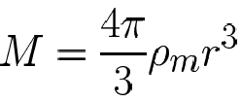



Enclosed mass:
m
r
H²
E < 0 ⇒ the mass m is bound and cannot escape to infinity E > 0 ⇒ expansion can continue
E = 0 ⇒ critical density, ρ_{c}
Even though this derivation was carried out in Newtonian gravity, it is also valid general relativistically because of the symmetries!

Slide 36
ρ_{c}c² = 9.45×10⁻⁹ ergs/cm³ = 5900 eV/cm³
Ω = ρ/ρ_{c} = Ω_{ν} + Ω_{γ} + Ω_{baryon} + Ω_{dark-matter} + Ω_{vacuum} ≈ 1
≈ 0.24
≈ 0.73

Slide 37
Elementary Statistical Mechanics
Particle Number
Energy
E_{p} = ( p² + m²)^{1/2}
: Chemical potential
g: Spin degrees of freedom =2J+1
+ fermions
- bosons

Slide 38



Relativistic Limit ( T>>μ, T>>m)
$$ρ=\frac{E}{V}=\left\{\begin{matrix}g_{s}\left(\frac{π^{2}}{30}\right)T^{4} \\ g_{s}\frac{7}{8}×\left(\frac{π^{2}}{30}\right)T^{4}\end{matrix}\right.$$
bosons
Energy density:
fermions
$$n= \frac{N}{V}=\left\{\begin{matrix}g_{s}\left(\frac{ζ\left(3\right)}{π^{2}}\right)T^{3} \\ g_{s}\frac{3}{4}×\left(\frac{ζ\left(3\right)}{π^{2}}\right)T^{3}\end{matrix}\right.$$
Number density:
ζ(3) = 1.202
$$g_{eff}\left(\frac{π^{2}}{30}\right)T^{4}$$
$$g_{eff}=\sum_{bosons}{g_{b}+\frac{7}{8}}\sum_{fermions}{g_{f}}$$
Effective energy density:

Slide 39

Species will remain in thermal equilibrium as long as their interaction rate exceeds the expansion rate

Slide 40
Planck Collaboration, 2021

Slide 41






$$ρ=\left(g_{\text{boson}s}+\frac{7}{8}g_{\text{fermion}s}\right)\frac{π^{2}}{30}T^{4}$$
$$T_{\text{after}\text{ (}\text{photons}\text{)}}={\left(\frac{11}{4}\right)}^{1/3}T_{\text{before}\text{ (}\text{neutrinos}\text{)}}$$
$$ρ=\frac{π^{2}}{30}T_{γ}^{4}\left[g_{γ}+ \frac{7}{8}g_{``ν”}{\left(\frac{4}{11}\right)}^{1/3}\right]$$
$$g_{γ}=2, g_{``ν”}=2 ×N_{eff}$$
Relativistic energy density
$$ρ=\frac{π^{2}}{15}T_{γ}^{4}{\left(1+z\right)}^{4}\left[1+ \frac{7}{8}N_{eff}{\left(\frac{4}{11}\right)}^{1/3}\right]$$
$$N_{eff}=3.046$$
Standard Model (including QED, QCD, and plasma corrections)

Slide 42
Cosmological Implications
Atmospheric neutrinos: Δ m₂₃² ≈ 2.0 × 10⁻³ eV²
  ∴ One neutrino mass > 0.04 eV
SNO + KamLAND: Δ m₁₂² ≈ 7.1 x 10⁻⁵ eV²
  ∴ One neutrino mass > 0.008 eV
Limits on “ν_{e} mass” give: m(ν_{1,2,3}) < 2.2 eV
Σ neutrino masses: 0.048 < m₁+m₂+m₃ < 6.6 eV
0.001 < Ω_{ν} < 0.13
Stay tuned…

Slide 43
2203.07638
Contributions of a single massless particle, which decoupled from the Standard
Model at temperature T_{F}, to the effective number of relativistic species, N_{eff} = N_{SM} + ∆N_{eff}, with the SM expectation N_{SM} = 3.045 from neutrinos.

Slide 44
Neutrinos from core-collapse supernovae
M_{prog} ≥ 8 M_{Sun}
ΔE ≈ 10⁵³ ergs ≈ 10⁵⁹ MeV
99% of the energy is carried away by neutrinos and antineutrinos with 10 ≤ E_{ν} ≤ 30 MeV
10⁵⁸ Neutrinos!

Slide 45




ORNL/UT
Development of 2D and 3D models for core-collapse supernovae: Complex interplay between turbulence, neutrino physics and thermonuclear reactions.
3D
2D
Princeton
Munich

Slide 46
ν
Energy released in a core-collapse SN: ΔE ≈ 10⁵³ ergs ≈ 10⁵⁹ MeV
99% of this energy is carried away by neutrinos and antineutrinos!
~ 10⁵⁸ Neutrinos!
This necessitates including the effects of νν interactions!
ν
ν
Proto neutron star
ν
ν
The second term makes the physics of a neutrino gas in a core-collapse supernova a very interesting many-body problem, driven by weak interactions.
Neutrino-neutrino interactions lead to novel collective and emergent effects, such as conserved quantities and interesting features in the neutrino energy spectra (spectral “swaps” or “splits”).

Slide 47
MSW oscillations
(low neutrino density)
Collective oscillations (high neutrino density)
Proto-neutron star
Neutrinos forward scatter from each other
Neutrinos forward scatter from background particles

Slide 50

How do you cook elements around us?

Slide 51

How do you cook elements around us?
BIG BANG
He
H
Li
D

Slide 52

How do you cook elements around us?
BIG BANG
Pop III stars (very big and very metal poor)
He
H
Li
D

Slide 53

How do you cook elements around us?
They go supernovae
He
H
Li

Slide 54
How do you cook elements around us?
Ti
O
Mg
C
He
H
Li
Sr
N
D
Ca
Fe
Si

Slide 55
How do you cook elements around us?
BIG BANG
Pop II stars (metal poor)
He
H
Li
D

Slide 56
How do you cook elements around us?
BIG BANG
Some go supernova,
producing U, Eu,Th… via the r-process
Pop II stars (metal poor)
He
H
Li
AGB stars produce
Ba, La, Y,…. via the s-process
D

Slide 57


How much does the CNO cycle contribute in the Sun?
In SSM CNO cycle contribute about 0.8% of the neutrino flux. Data are consistent with this. A more precise measurement of the CNO contribution will provide a test of SSM.

Slide 58
Borexino Collaboration
2006.15115 [hep-ex]

Slide 59

BOREXINO, PRL 129, 252701 (2022)

Slide 60
Abazajian and Heeck, PRD 100, 075027 (2019

Slide 61
Neutrino decoupling
dS = dE/T ⇒ entropy per unit volume ~ g_{s} T³
Before e⁺e⁻ annihilation:
g_{s}^{(b)} = 2 + (7/8) x 4 = 11/2
After e⁺e⁻ annihilation:
g_{s}^{(a)} = 2
Entropy conservation:
g_{before} T³_{before} = g_{after} T³_{after}
T_{after} = (11/4)^{1/3} T_{before}
T_{γ} = 2.7 ºK
T_{ν} = 1.9 ºK

Slide 62
Temperature: T=2.7ºK
g=2, two polarization components
Cosmic microwave background photons
Number density: N/V = (2/π²) 1.202 T³ ~ 398 photons/cm³
Energy density: E/V = 2 (π²/30) T⁴ ~ 5 x 10⁻¹³ ergs/cm³
Ω_{γ} = (ρ_{γ} /ρ_{c}) ~ 10⁻⁴ , does not close the universe
Cosmic background neutrinos
Temperature: T=1.9ºK
Number density: ~ 112 neutrinos/flavor-cm³
To close the universe one needs Σm_{ν} ∼ 100 eV

Slide 63

H = 1.66 (g_{s})^{1/2} T²/m_{p}
σ_{ν} ~ G_{F}² E² ~ G_{F}² T² n_{ν} ~ T³
Rate, Γ ~ G_{F}² T⁵
Freeze-out when Γ = H

Slide 64
Planck Collaboration, 2021

Slide 65
⁴He equilibrium abundance
4 (N_{n}/2)
Y_{α} =
N_{n} + N_{p}
He mass fraction
(N_{n}/N_{p}) = exp(-∆m/T)
neutron-proton mass difference
freeze-out temperature T~ 0.8 MeV

Slide 66
Recall that
Y_{α} depends on T_{freeze-out} which in turn depends on g_{s}
Neutrino counting !
δY_{α} ∝ δg_{s} ∝ δN_{ν}

Slide 67

3.4
3.2
3.0
Schramm et al.

Slide 68

Big-bang nucleosynthesis

Slide 69
Planck Collaboration, 2021

Slide 70
Planck Collaboration, 2021

Slide 72


Most of the primordial abundances are consistent with the baryon density inferred from CMB.
CMB probes universe at
t≈4×10⁵ yrs; z≈10³ T≈0.3 eV
⁴He production probes t≈1s; z≈10⁹ T≈1 MeV
D production probes t≈100 s z≈10⁸ T≈0.1 MeV

Slide 73



Slide 74

Iron peak
to produce these nuclei another process besides fusion is needed

Slide 75


Slide 76


One way to produce most of the elements heavier than iron is via rapid neutron capture (r-process)
[Fe/H] ≈ -3.1
A > 100 abundance pattern fits
the solar abundances well
r-process abundances should depend very strongly on electron fraction Meyer

Slide 77

Cowan & Sneden, Nature 440, 1151 (2006)

Slide 78

From H. Schatz

Slide 79
Where in the Cosmos
does the r-process
take place?
From H. Schatz

Slide 80
Neutrinos dominate the energetics of core-collapse SN
Explosion only 1% of total energy
Total optical and kinetic energy = 10⁵¹ ergs
Total energy carried by neutrinos = 10⁵³ ergs
10% of star’s rest mass
Neutrino diffusion time, τ_{ν} ~ 2-10 s

Slide 81


Understanding a core-collapse supernova requires answers to a variety of questions some of which need to be answered by nuclear physics, both theoretically and experimentally.
Balantekin and Fuller, Prog. Part. Nucl. Phys. 71 162 (2013)
Arcones and Montes

Slide 82


Slide 83
Bethe ansatz method has numerical instabilities for larger values of N. However, it is very valuable since it leads to the identification of conserved quantities.
Patwardhan et. al., PRD 99, 123013 (2019); Cervia et al., PRD 100, 083001 (2019)
Runge Kutta method (RK4)
Patwardhan et. al., PRD 104, 123035 (2021), Siwach et. al. PRD 107, 023019 (2023)
Tensor network techniques
Cervia et al., PRD 105, 123025 (2022)
Noisy quantum computers
Siwach et. al., PRD 108, 083039 (2023)

Slide 84
A system of N particles each of which can occupy k states (k = number of flavors)
Exact Solution
Mean-field approximation
Entangled and unentangled states
Only unentangled states
Dimension of Hilbert space: k^{N}
Dimension of the diagonalizing space: kN
von Neumann entropy
S = - Tr (ρ log ρ)
 | Pure State | Mixed State
Density matrix | ρ² = ρ | ρ² ≠ ρ
Entropy | S = 0 | S ≠ 0

Slide 85
We find that the presence of spectral splits is a good proxy for deviations from the mean-field results
Probability of observing the first mass eigenstate
Entanglement entropy
mean field
many body
ω
Split frequency

Slide 86


Although mapping two neutrino flavors onto qubits is reasonable for exploratory work, neutrinos do come in three flavors. First calculations with qutrits showed that entanglement is larger with qutrits (Pooja Siwach, Anna Suliga, A.B. Balantekin
PRD 107 (2023) 2, 023019)
Density matrix for a single qutrit
$$ρ=\frac{1}{3}\left(1+ λ_{i}P_{i}\right)$$
$$P_{i}P_{i }≤3$$
$$Q=d_{ijk}P_{i}P_{j}P_{k}$$
Positive semi-definite condition
Pure state only if
$$P^{2}=P_{i}P_{i}=3 \text{and} P_{i}=d_{ijk}P_{j}P_{k}$$
In the above equations d_{ijk} is the completely symmetric tensor of SU(3). Note the duality between SU(3) Casimir operators and invariants of the density matrix.
A.B. Balantekin and A. Suliga, 2405.13862 [quant-ph]

Slide 87

The impact of two different treatments of collective neutrino oscillations (with and without entanglement)
Many-body
$$ω_{i}=\frac{δm^{2}}{2E_{i}}$$
$ω_{1}:{\overline{ν}}_{e},$ $ω_{2}:{\overline{ν}}_{x}{, ω}_{3}:ν_{x},ω_{4}:ν_{e}$
Mean-field
Balantekin, Cervia, Patwardhan, Surman, Wang; 2311.02562 [astro-ph.HE], Astrophys. J. , in pres
Considerations of collective effects unveiled a new kind of nucleosynthesis: ”The νi process”.

Slide 88
Where does the r-process nucleosynthesis take place?
Core-collapse supernovae?
Neutron-star mergers?

Slide 89


Slide 90
Backup slides

Slide 91
BETHE ANSATZ
Bethe ansatz equations
Pehlivan, ABB, Kajino, & Yoshida
Phys. Rev. D 84, 065008 (2011)

Slide 92

observations
Model calculations for neutron-star mergers
Coalescence timescale = 1 Myr
Average merger rate = 20/Myr
Average merger rate = 2/Myr
Star formation rate?
Argast et al., A&A, 416, 997 (2003)

Slide 93

Yield of neutron star mergers
SDSS Data from Aoki et al., arXiv: 1210.1946 [astro-ph.SR]

Slide 94

Neutrino came out of a puzzle about the radioactive decay in the early 1920’s:
Mother nucleus
Daughter nucleus
electron
Energy-momentum conservation says that data should look like this
..instead it looks like this

Slide 95

Niels Bohr
In radioactive decays energy-momentum conservation no longer holds!
Mother nucleus
Daughter nucleus
electron
Energy-momentum conservation says that data should look like this
..instead it looks like this

Slide 96

Wolfgang Pauli
In this reaction there is a third particle produced that you cannot (yet) see!
Mother nucleus
Daughter nucleus
electron
Energy-momentum conservation says that data should look like this
..instead it looks like this

Slide 97


Physicist goes to a ball
or
Mystery of Missing Energy
Wolfgang Pauli, father of the neutrino and Pauli exclusion principle

Slide 98
Physicist goes to a ball
or
Mystery of Missing Energy
Wolfgang Pauli, father of the neutrino and Pauli exclusion principle

Slide 99


Note that these experiments did not observe
$$n→p+e^{−}+{\overline{ν}}_{e}$$
Because neutron was not discovered yet. Instead, they observed
$${}_{}^{A}Z→{}_{}^{A}{(Z+1)}+e^{−}+{\overline{ν}}_{e}$$

Slide 100




Probing the Cosmic Microwave Background Radiation (CMBR)
CMBR is anisotropic, its temperature varies slightly at different locations

Slide 101
WMAP results:
Dark Blue = -200 μK Red = +200 μK

Slide 102
Probing the Cosmic Microwave Background Radiation (CMBR)
CMBR is anisotropic, its temperature varies slightly at different locations

Slide 103

Planck

Slide 104

Deuterium
D is produced by p+n→ d+γ and destroyed (mainly) by p+d→ ³He + γ
Relevant temperature ~70 keV

Slide 105
⁷Li
⁷Li is the decay product of ⁷Be
At high η ⁷Be is mainly produced by ³He+⁴He → ⁷Be+γ
It is destroyed by n+⁷Be →⁷Li +p and at later times by electron capture.
Relevant temperature ~60 keV.

Slide 106
Is there a problem with the big-bang nucleosynthesis?
CMB observations of the baryon-to-photon ratio are in good agreement for D and ⁴He with BBN predictions, but nuclear physics predicts a higher ⁷Li abundance (by a factor of 2 or 3) than what is observed. What can we do to reduce the abundance of ⁷Li and ⁷Be while keeping ⁶Li within observational limits?
Molaro, 2007

Slide 107

BBN Prediction
Observed value
⁷Li produced in the Big-Bang Nucleosynthesis dominates the observed ⁷Li abundance.
In 1982 Spite and Spite observed that low-metallicity halo stars exhibit a plateau of ⁷Li abundance indicating its primordial origin.
But WMAP observations imply 2~3 times more ⁷Li than that is observed in halo stars!

Slide 108

⁷Li needed to be consistent with the microwave photon observations
⁷Li observed in old halo stars
⁷Li is made in the Early Universe. But still much work needs to be done!

Slide 109

Big Bang nucleosynthesis
Observation
Nuclear physics
Coc
4 ν’s

