Slide 1
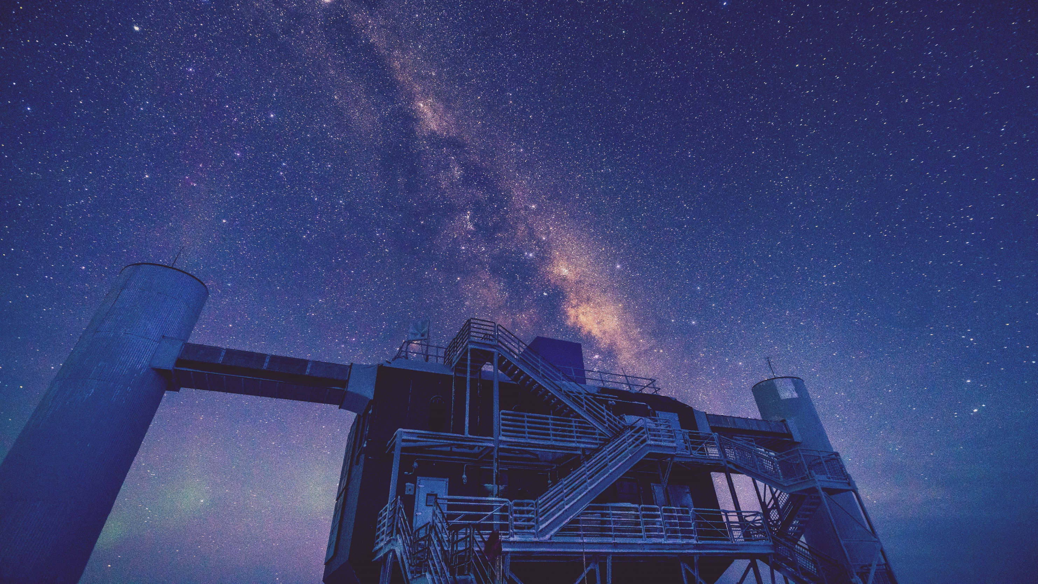
Computing – Upgrade and Beyond
Benedikt Riedel
UW-Madison
SCAP 2025
31 March 2025

Slide 2
Upgrade and Beyond – Landscape
Upgrade will double the photon collection area
Software and analyses will need to adjust to multi-PMT modules, varying readout electronics, etc. – Breaks basic assumptions in software
AI/ML becoming more popular

Slide 3
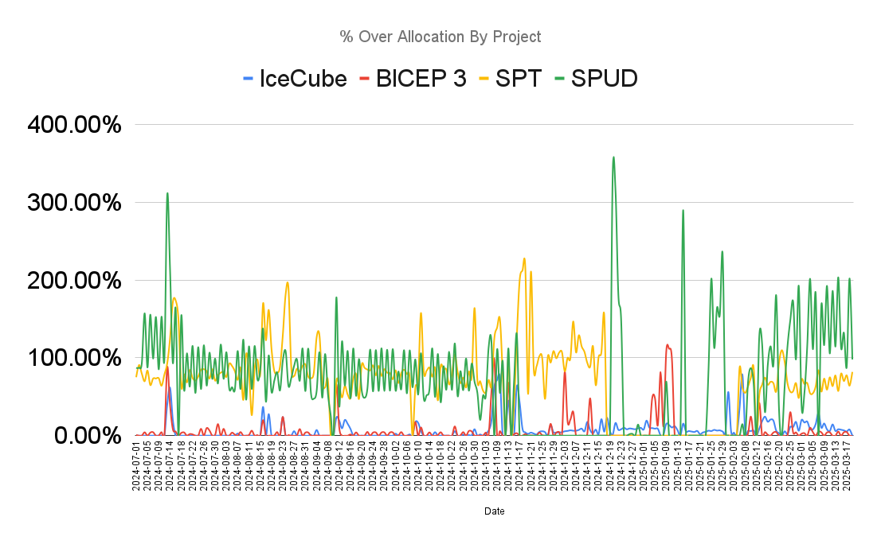
Upgrade Data Rate
2025-2, -3, -4
Biggest hurdle to get data from South Pole is the satellite bandwidth
There is extra bandwidth that is not officially allocated – Used by other experiments
Starlink has been tested – Concerns from CMB experiments with EM inference
Alternative locations for Starlink terminal TBD

Slide 4
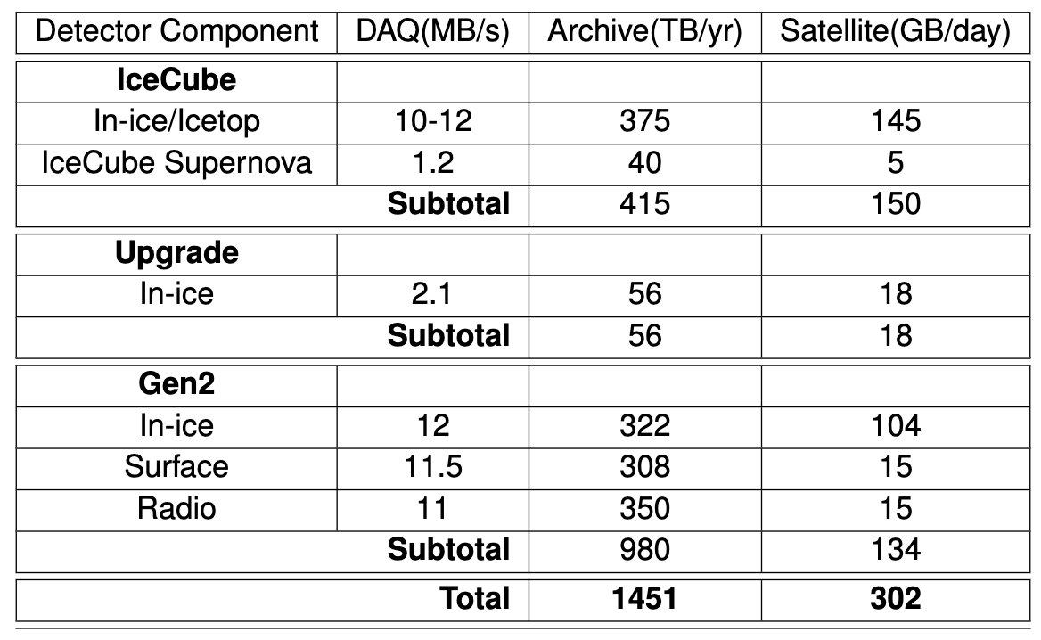
Upgrade Storage
2025-2, -3, -4
For 2023 storage replacement we assumed a 30% increase in data rate
Today 30% is the lower end of the increase
New Offline Processing/Pass3 designed with Upgrade (and beyond) storage uncertainty in mind
Lower on-disk footprint of data and storage – Trading CPU/GPU cycles for storage

Slide 5
Upgrade Computing
2025-2, -3, -4
Computing requirements for Upgrade are somewhat unclear, particularly on the simulation side
Memory usage for calibration constants, etc. – Development in progress
New Triggers and data processing – Will there be AI? Most likely
Leveraging in module computing to reduce computing and storage needs
Upgrade data processing, triggers, etc. will evolve significantly throughout 2026 and 2027 – Plan is to reprocess data (Pass4) in 2027
AI Training and Inference demand is biggest question
AI training resources are mostly contributed – Limited easily accessible collaboration-wide resources
AI Inference will need to be optimized in light of GPU needs for simulation
ML-Inference-as-a-Service/SONIC is the most resource efficient option, requires more development

Slide 6
IceCube Gen2 Storage
2021-8
2025-2, -3, -4
200 TB storage in 2023 storage purchase are planned for Gen2 simulation
At current stage of project (R&D, ~8 years out) this will be sufficient

Slide 7
IceCube Gen2 Computing
2021-8
2025-2, -3, -4
Similar concerns as Upgrade
Increased PMT count and corresponding calibration constants, etc. – Increased RAM usage
Number of photons simulated that will not be detected increases considerably – Wasted computing
Longer run times for simulation
AI Training for Gen2 is limited by GRAM – Over 80 GB
Multi-GPU training?
Inefficiency in ML code?

Slide 8
Summary
Upgrade computing needs are crystalizing
Satellite bandwidth a potential roadblock
New offline processing meant to reduce storage footprint
AI/ML appears the way forward for Upgrade analyses
Gen2 requirements are still being worked on
R&D computing requirements are manageable but may require specialized resources

