Slide 1






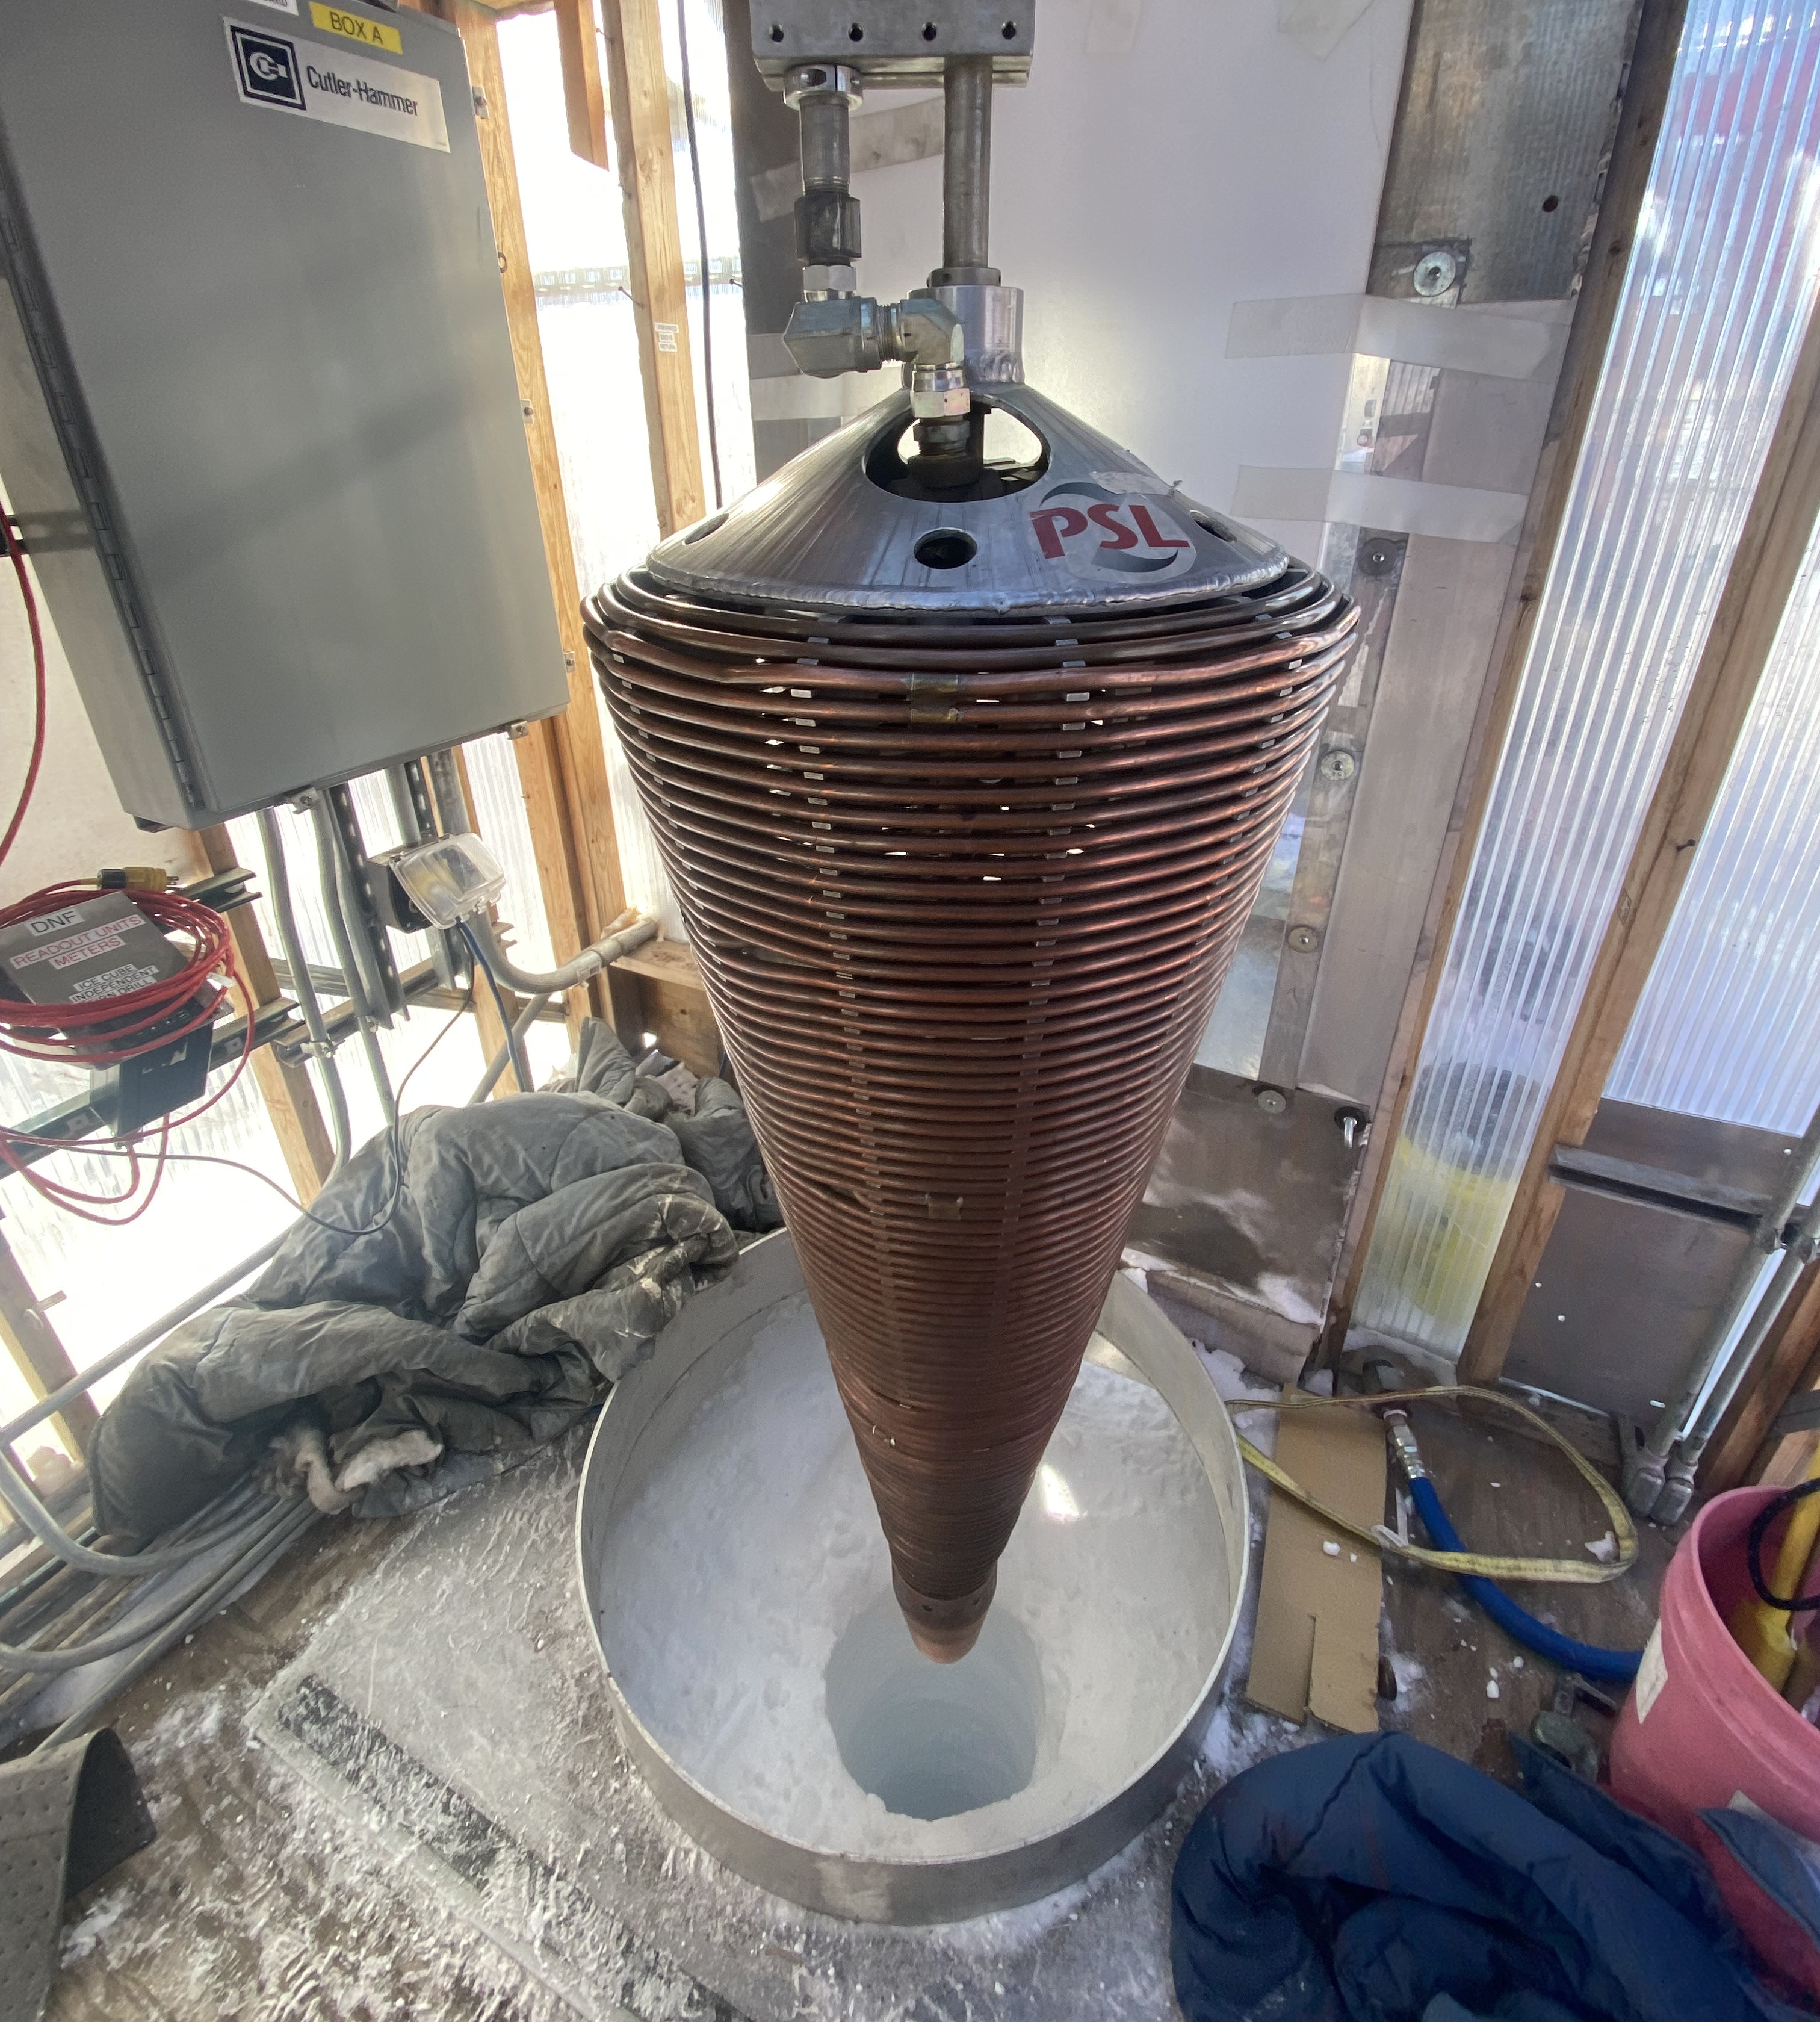
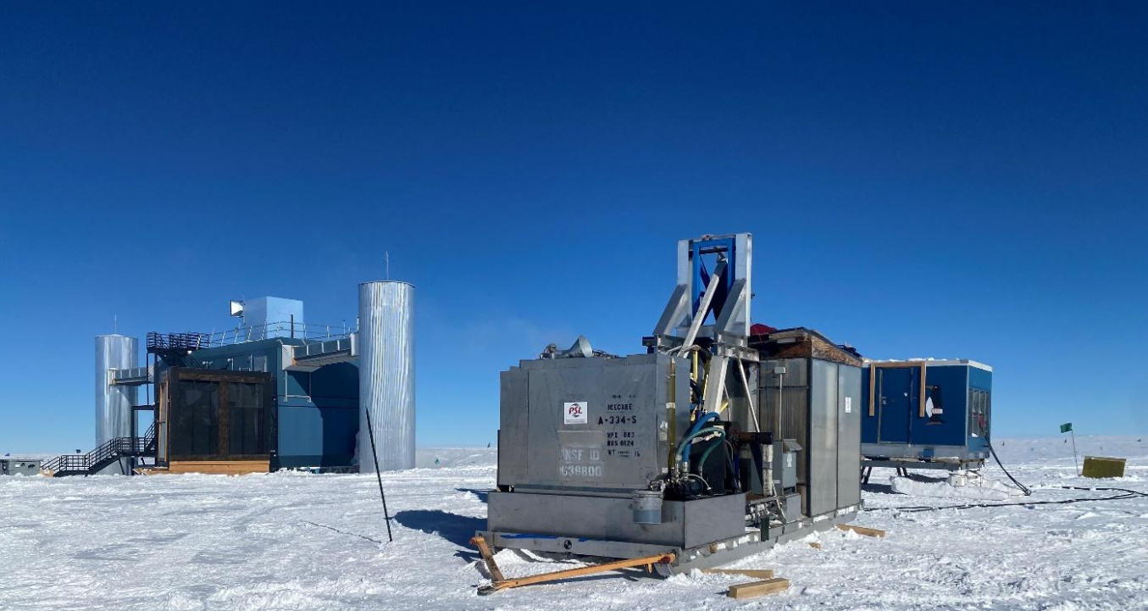
Investigating Ice Drilling Performance in Firn Layer at the South Pole

Slide 2
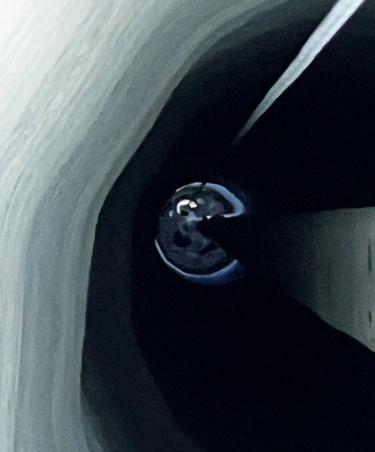
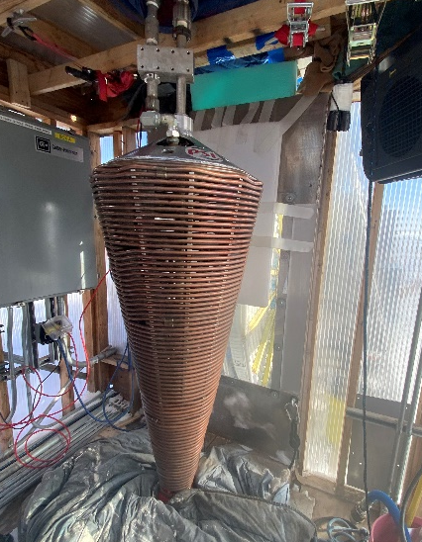
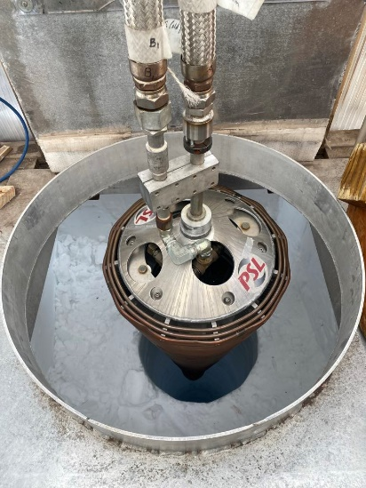
Outline
- Introduction
- Equipment
- Theory Application
- Result and Discussions
- Conclusion

Slide 3
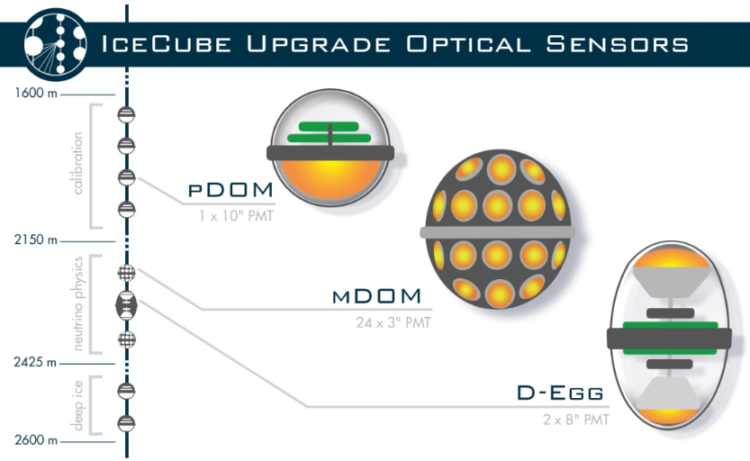
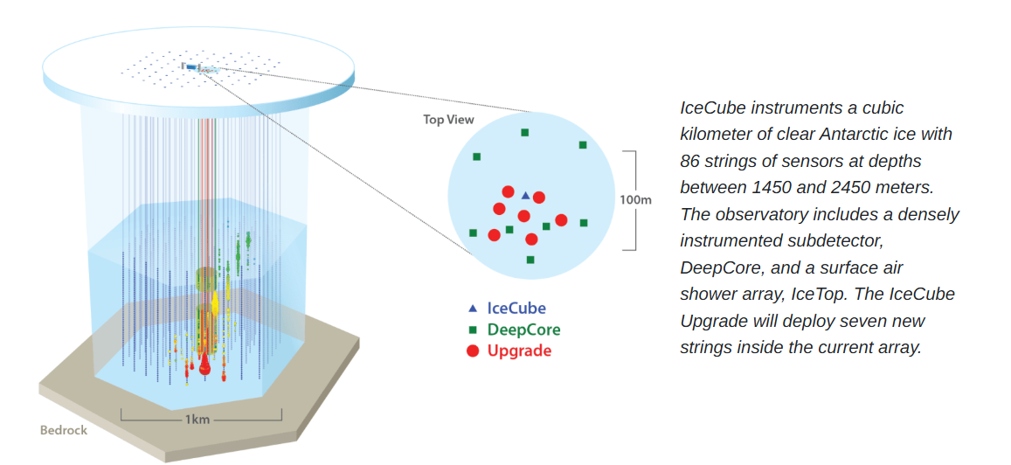
Introduction

Slide 4
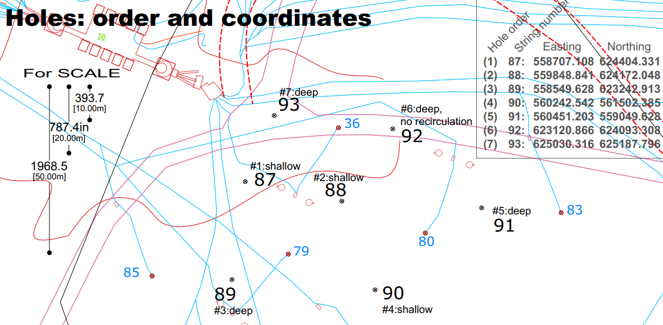

Slide 5
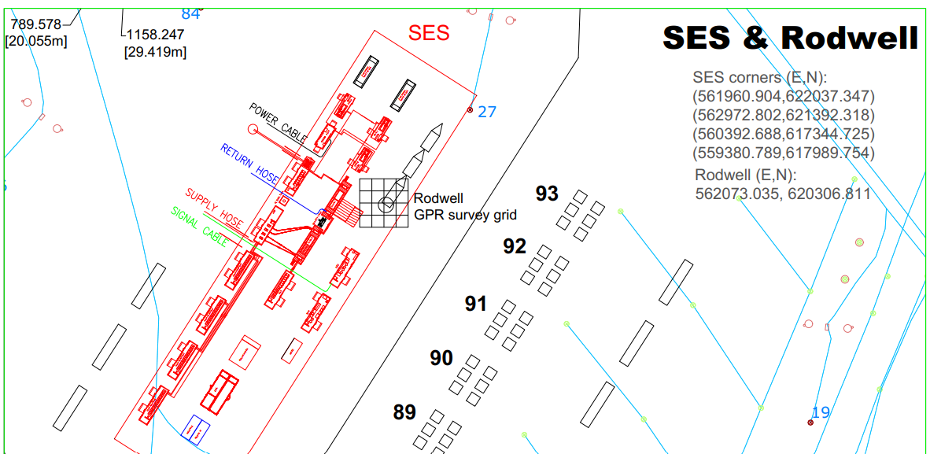

Slide 6
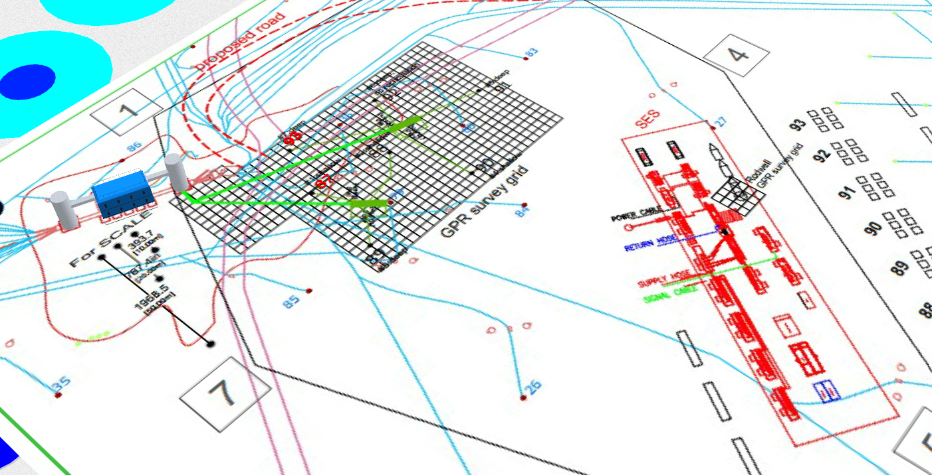

91
92
97
88
90
RodWell Hole
87
89
Condensate Hole

Slide 7
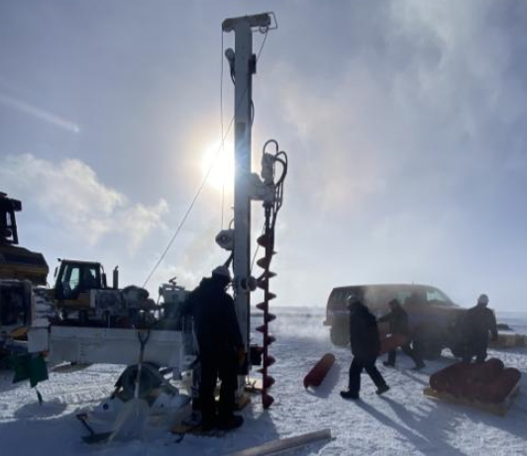
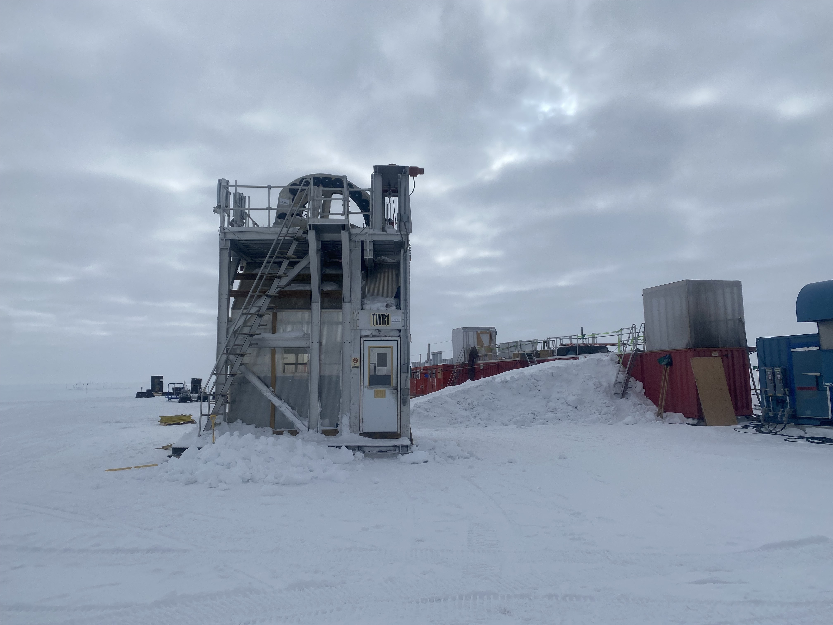
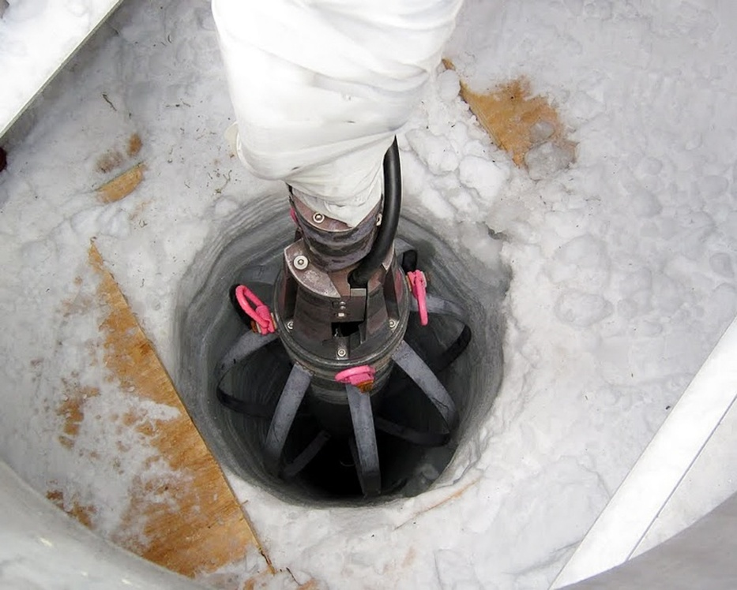
Ice Drilling
Ice drilling is a process that involves engineering complexity, as it relates to transmitting energy into the ice medium to remove material from the borehole efficiently. This process can be achieved using mechanical energy, thermal energy, or a combination of both methods.
The choice of drilling technique depends on the type of ice, the target depth, the required core integrity, and the environmental conditions at the field site.
In general, ice drilling can be categorized into three main types:
Mechanical Drilling
Thermal Drilling
Hot Water Drilling

Slide 9
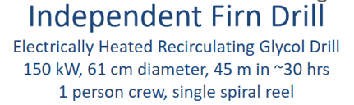
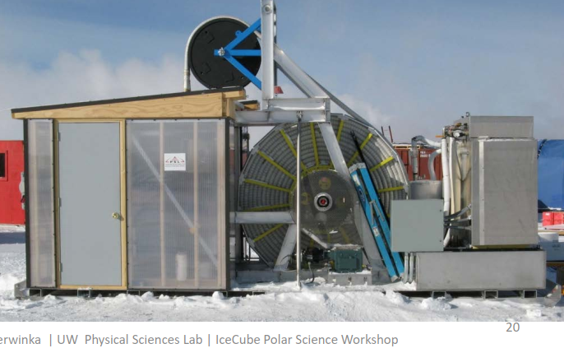
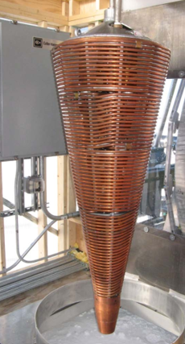
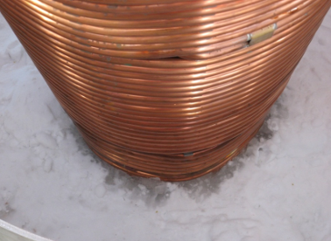

Slide 10
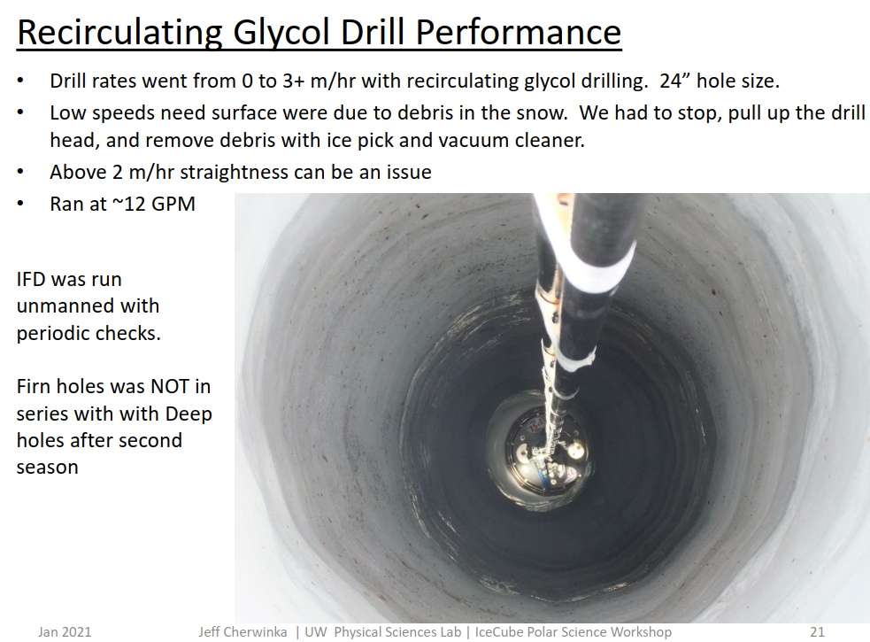

Slide 12
91
92
97
88
90
RodWell Hole
87
89
Condensate Hole

Slide 13


Slide 14
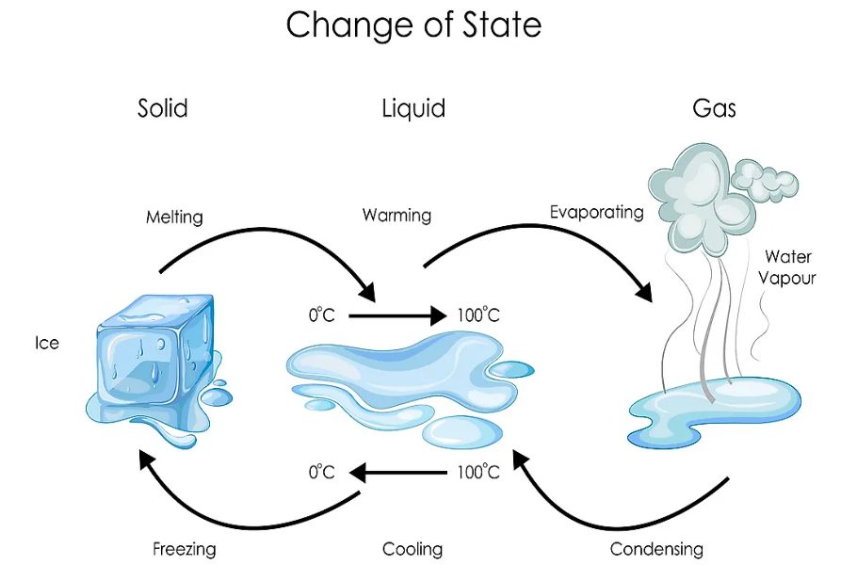

Slide 15
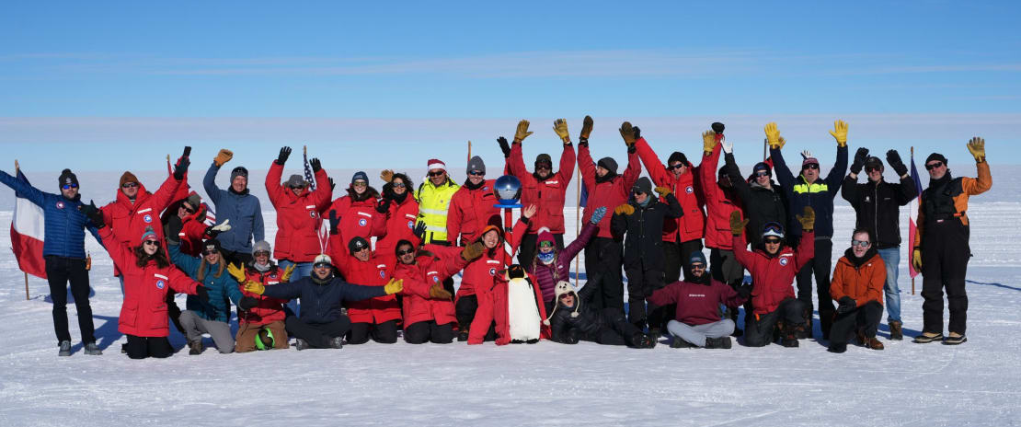
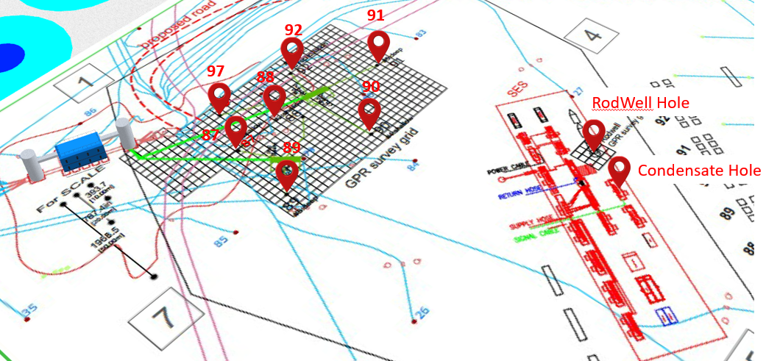

Slide 16
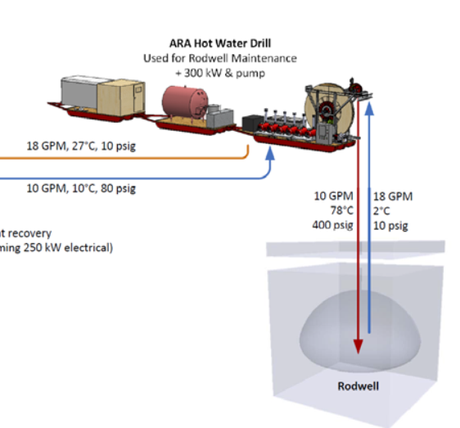
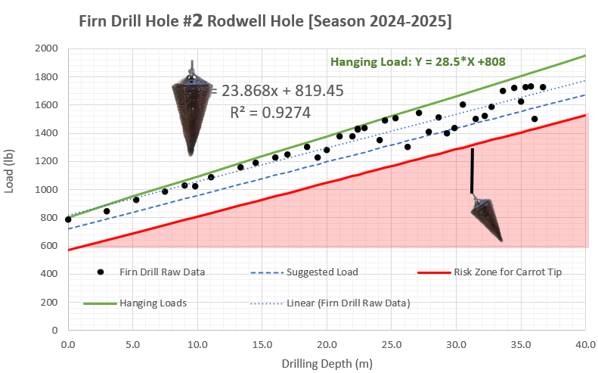
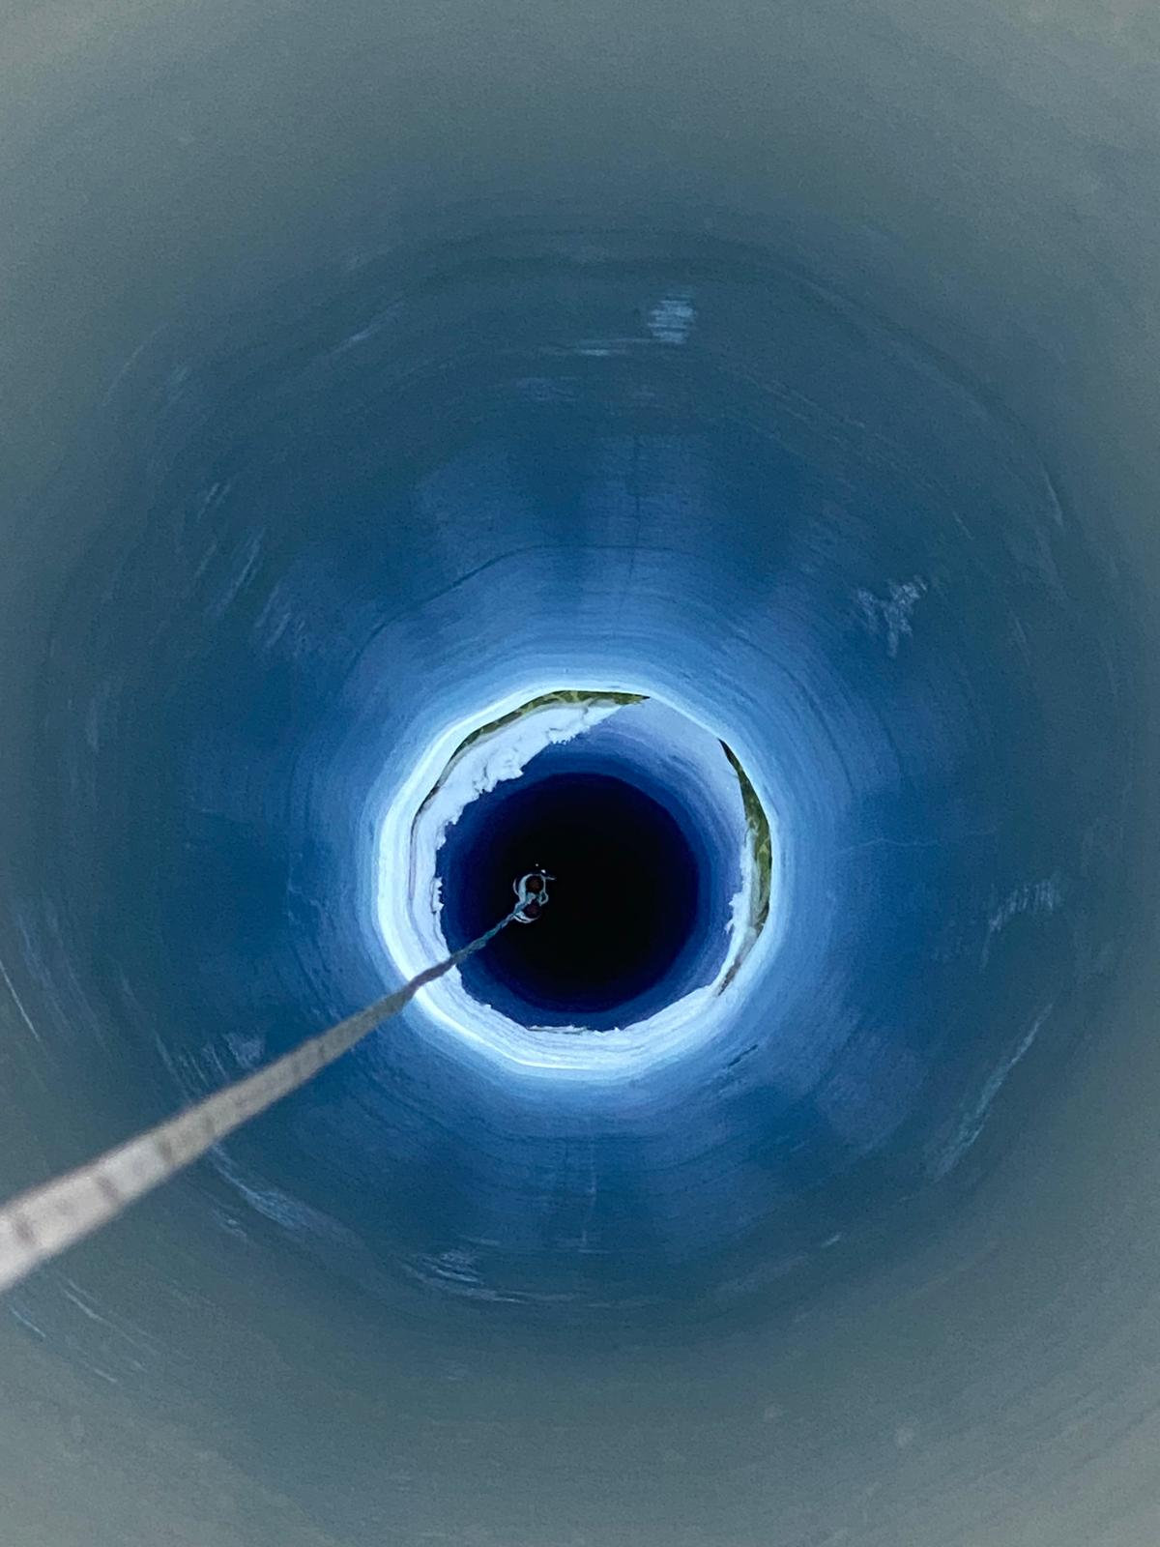

Slide 17
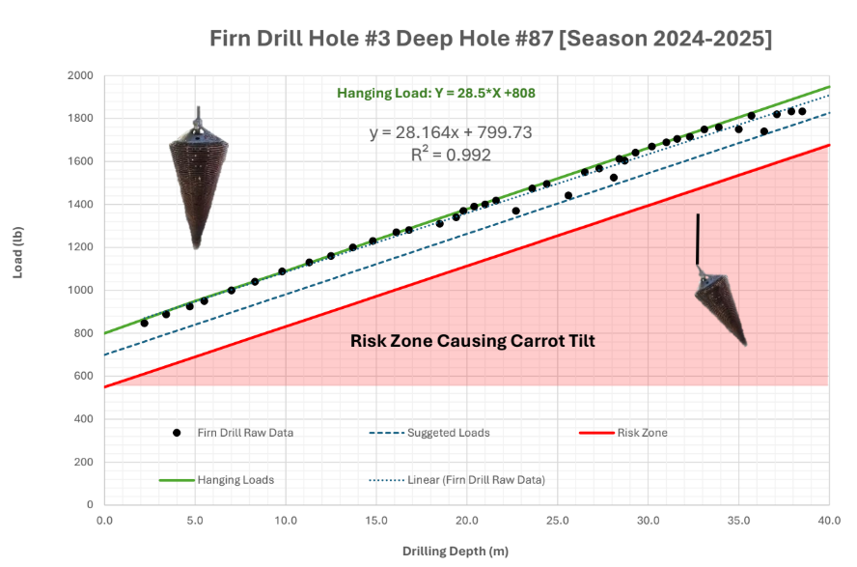

Slide 18
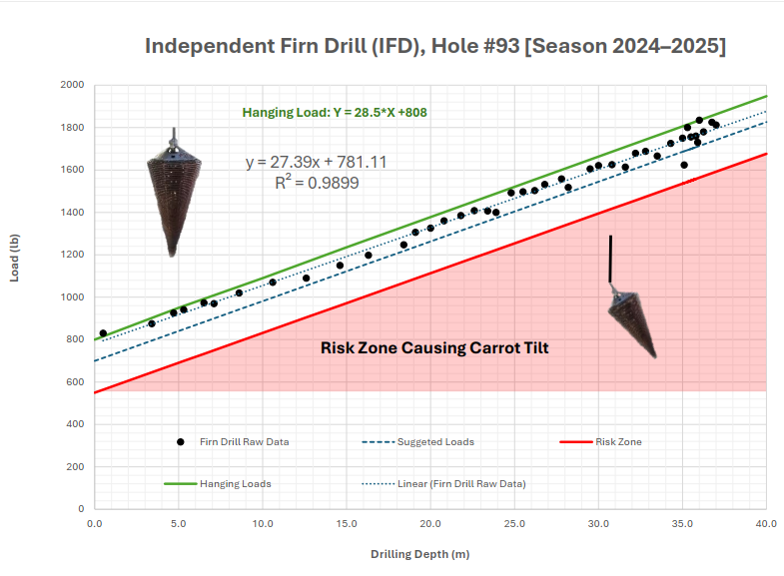

Slide 19
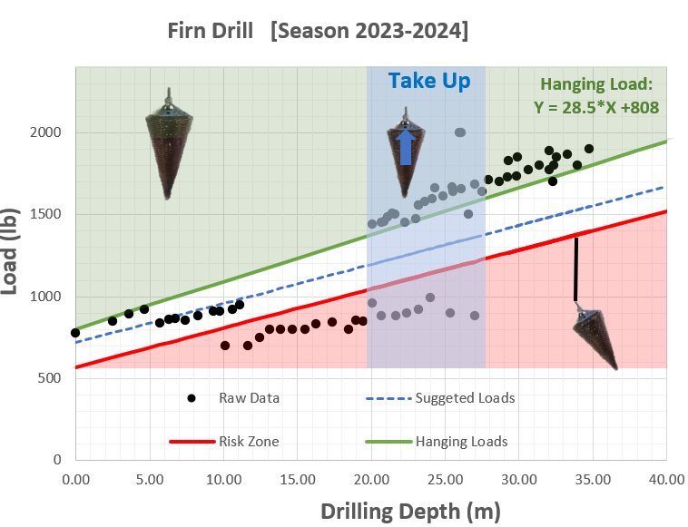

Slide 20
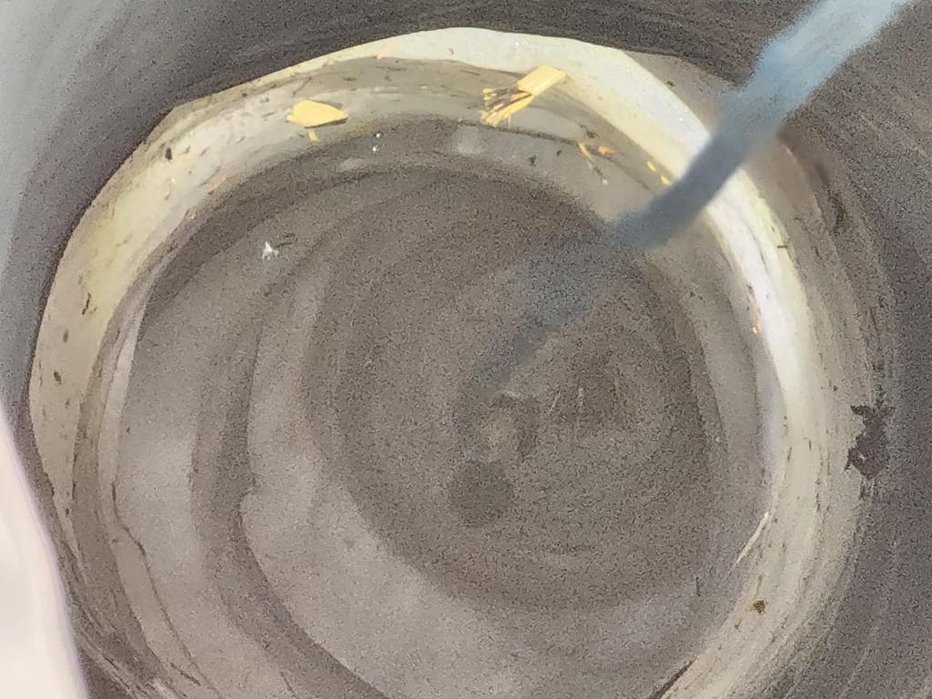
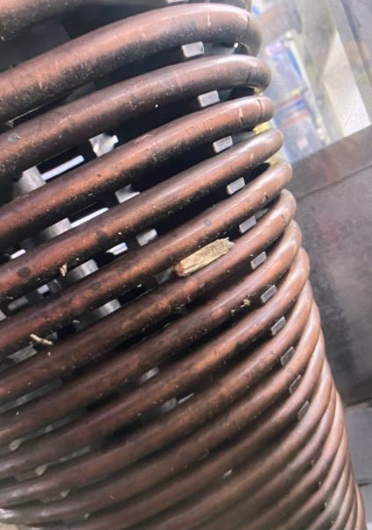

Slide 21
Conclusion
Ice drilling in the IceCube Upgrade Project is a challenging process.
It requires balancing between load and depth to prevent tilting of the drill head.
Controlling key factors :
  The load applied during drilling,
  The vertical speed, and
  The temperature of the drill head
is essential for efficiency and safety in drilling.
The study results indicate that the tensile load of the drill head is related to the drilling depth. The movement speed of the drill head still depends largely on the experience of field engineers.
In the future, Artificial Intelligence (AI) systems can be applied to accurately and efficiently control and adjust various parameters.

