Slide 1
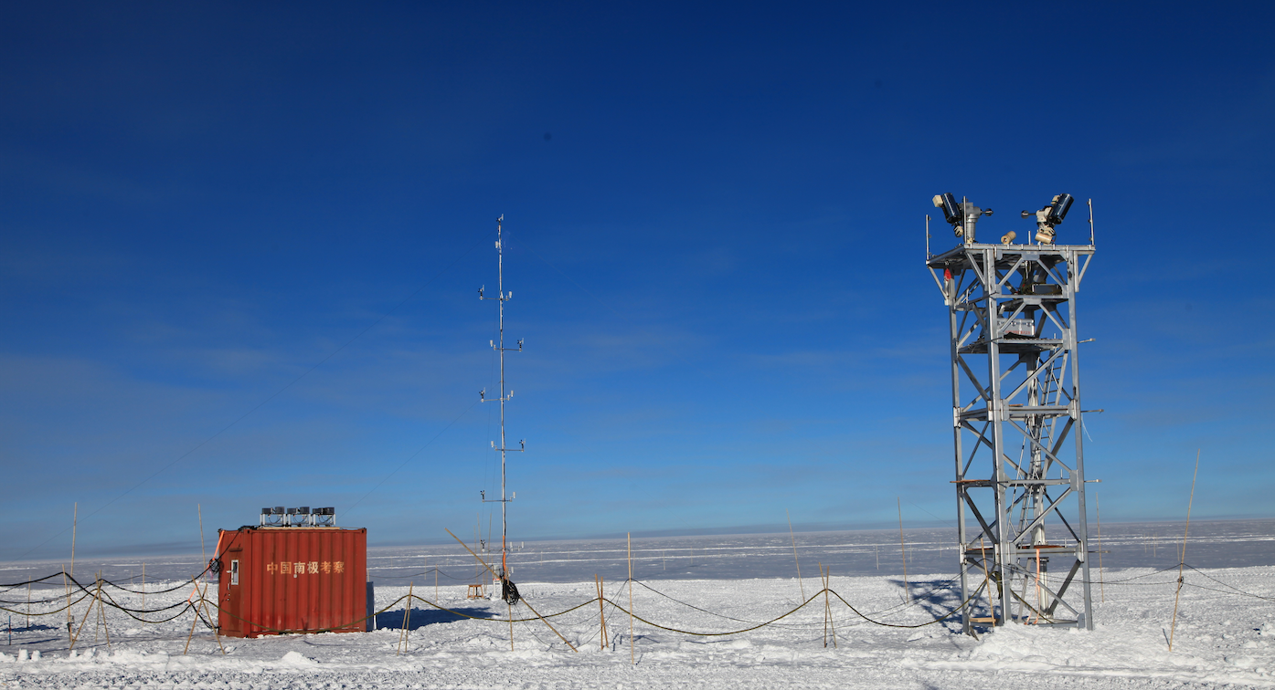
Measure the vertical profile of atmospheric turbulence at Dome A with KLTP
Zhaohui Shang
(NAOC)
8m-DIMM
Collaborators:
Yi Hu (NAOC)
Xu Yang (NAOC)
Ji Ouyang (NAOC)
Bin Ma (SYSU)
Paul Hickson (UBC)
Michael Ashley (UNSW)
CHINARE
15m-AWS
20250917@Phuket

Slide 2


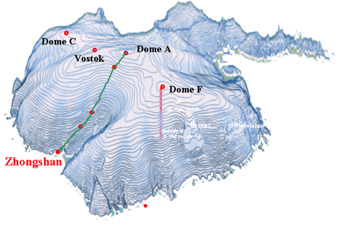
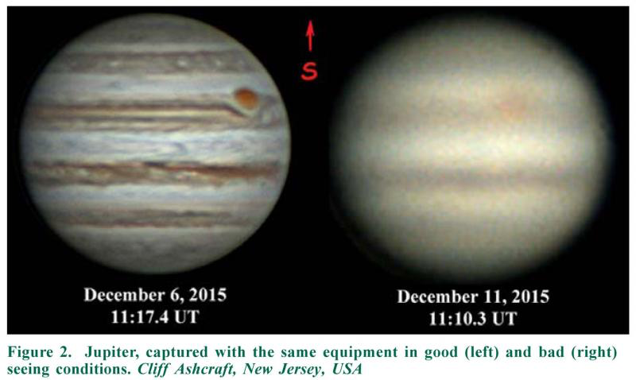
Good seeing is preferred in observations
Atmosphere turbulence causes seeing, which limits the resolution of telescopes;
Seeing at the best mid-latitude sites: ~ 0.6 – 0.8″;
Less turbulent areas: e.g., Dome A, Dome C…
seeing
good
bad
Jupiter

Slide 3
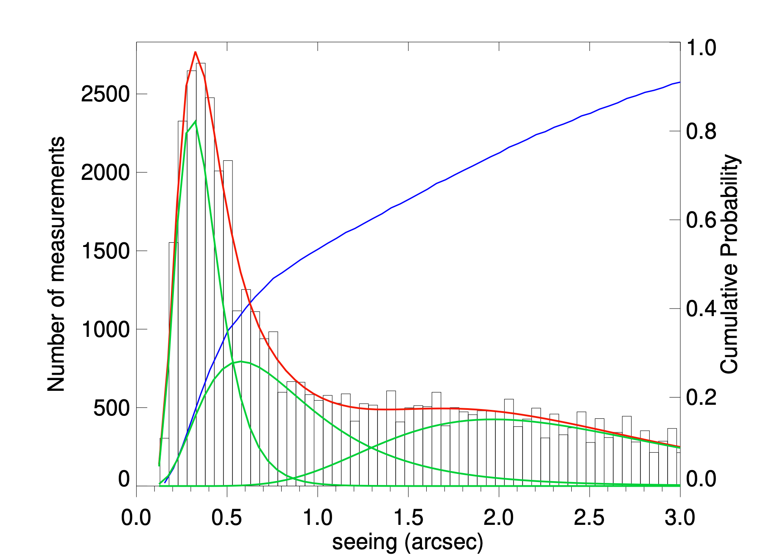
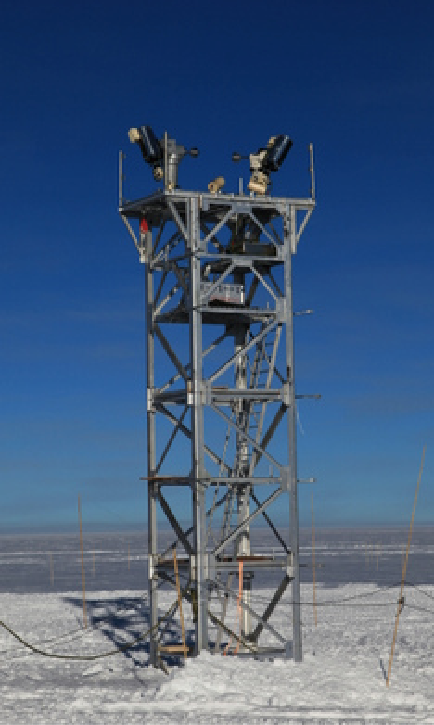
Night-time seeing measurements
Ma et al. 2020
Three components:
Free-atmosphere （FA)
Intermediate
Boundary-layer
The median FA seeing is 0.31″;
Chance of FA/good seeing:
31% at 8m (measured)
Best seeing ~0.1″；
Most turbulence from the boundary/surface/ground layer.
Seeing distribution
boundary layer
8m
boundary layer

Slide 4
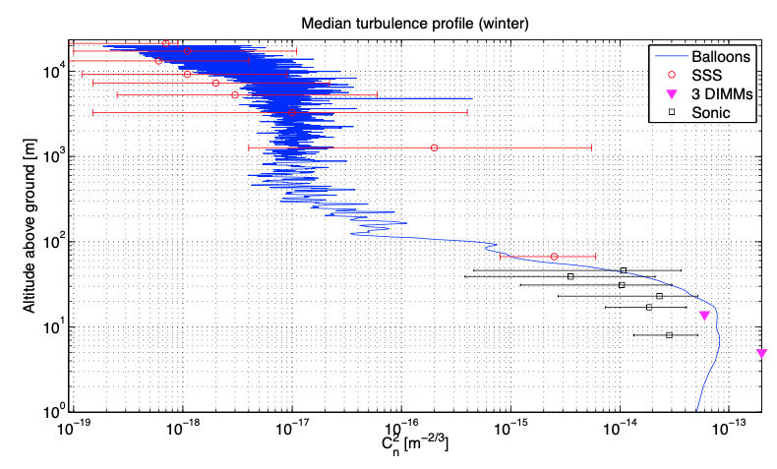
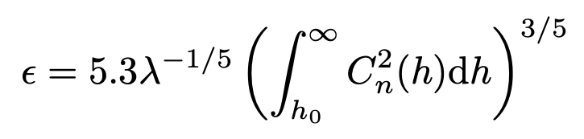
The need for the vertical turbulence profile (C_{n}²)
DIMM-seeing reflects the smearing effect from the total atmosphere.
Adaptive Optics (AO) needs to know the contribution from different layers/heights.
Dome C
Aristidi et al. 2018
Altitude
seeing
C_{n}²
Surface/ground layer (SL/GL) dominates the overall seeing at Dome C, Dome A, etc.
C_{n}² is the atmospheric structure constant of refractive index.

Slide 5
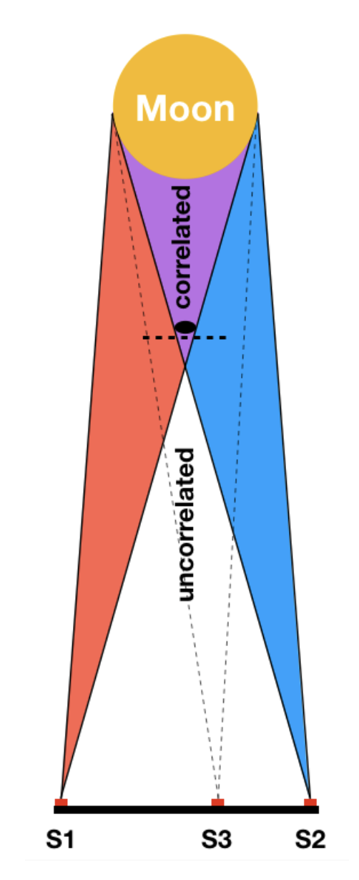
Using solar/lunar scintillation to measure C_{n}²
Instrument: solar/lunar scintillometer
SHABAR (Beckers 2002)
Turbulence Profiler (TP) (Hickson & Lanzetta 2004)
LuSci (Tokovini et al. 2010)
…
Several sensors record scintillation (turbulence) in ms.
Light paths to S1 and S2 overlap, resulting in correlations between the scintillation recorded by S1 and S2.
Dimensionless measurement, so no calibration is required.
Vertical resolution can be achieved with many baselines.
3 sensors (photodiodes)
=> Vertical Profile of C_{n}²

Slide 6
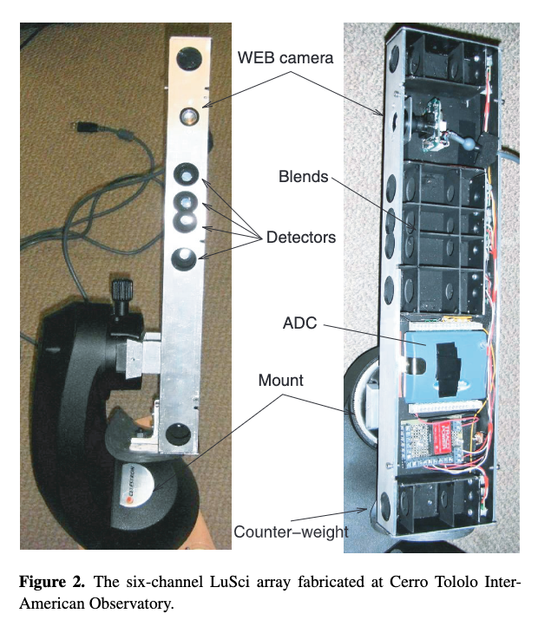
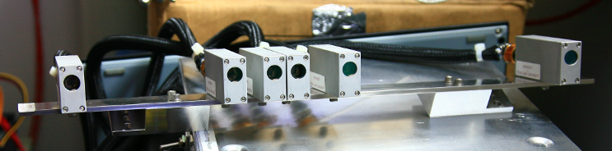
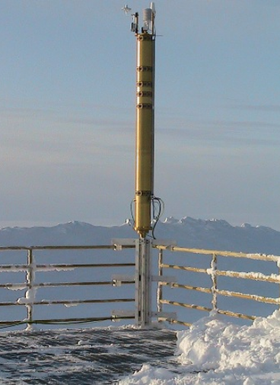
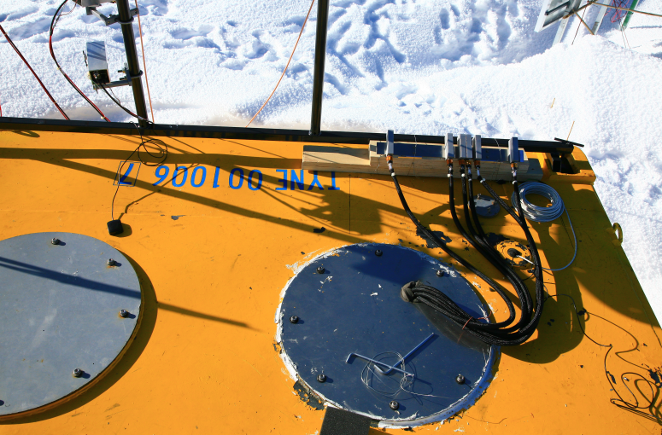
Using solar/lunar scintillation to measure C_{n}²
The Arctic Turbulence Profiler (ATP) at PEARL, Canada (Hickson et al. 2010)
A 6-channel LuSci at CTIO (Tokovinin et al. 2010)
A SHABAR on the roof of PLATO at Dome A (2009), but it didn’t work.

Slide 7
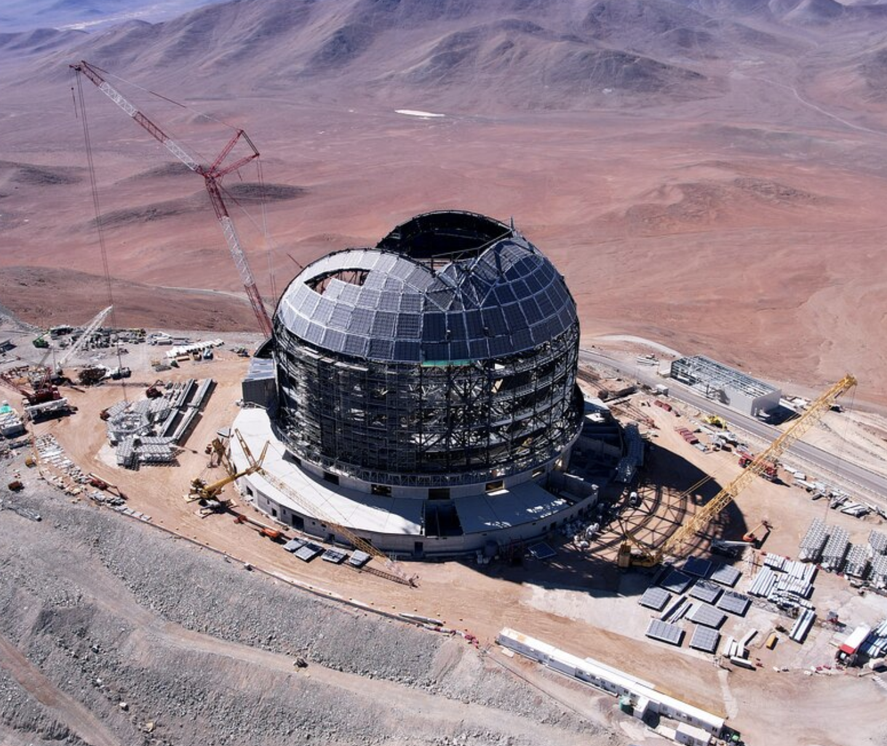
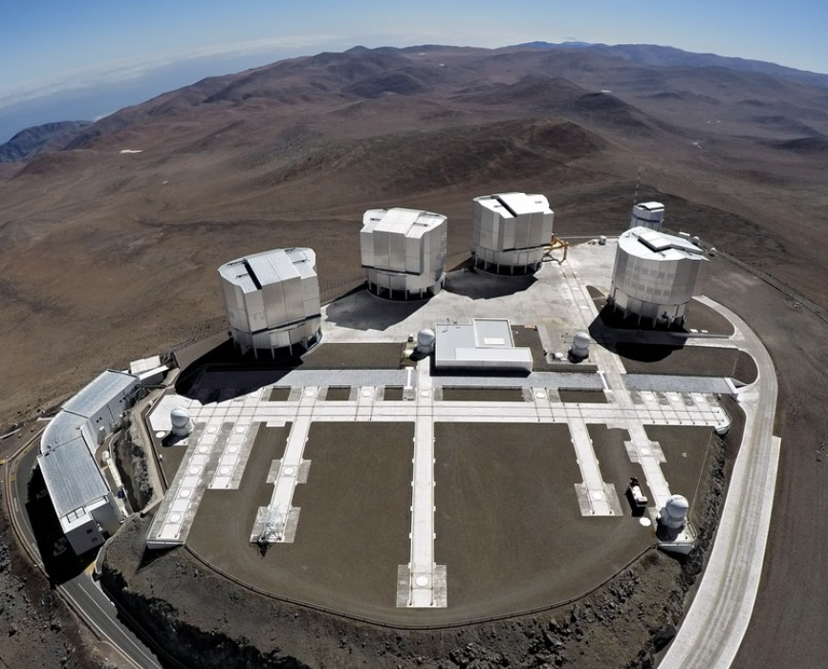
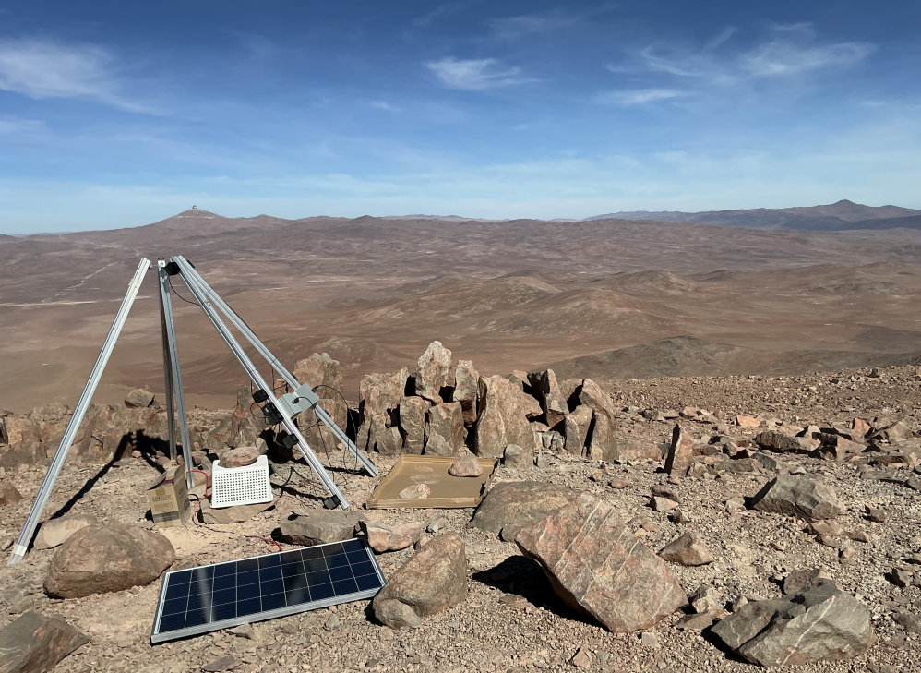
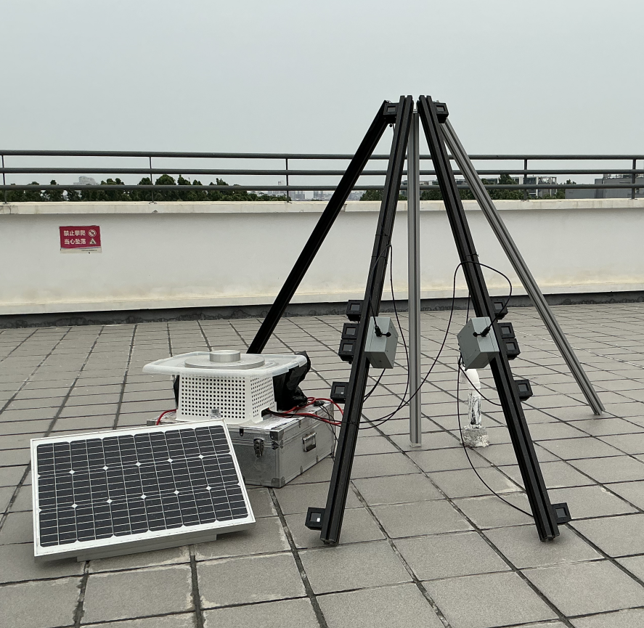
Our Turbulence Profilers (TP)
Self-contained Turbulence Profiler (STP) – a collaboration with Chilean astronomers.
E-ELT
VLT
6 channels, 2 sectors;
Tested in June 2025 @CVO.
NAOC, Beijing
Cerro Ventarrones Observatory (CVO)

Slide 8
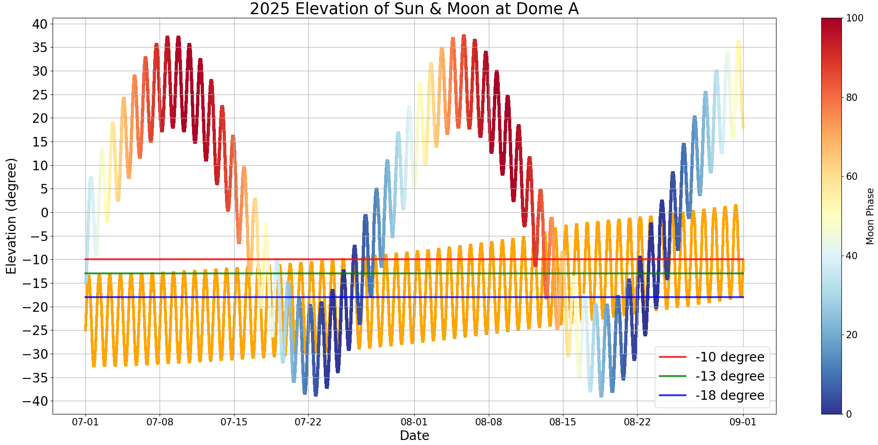
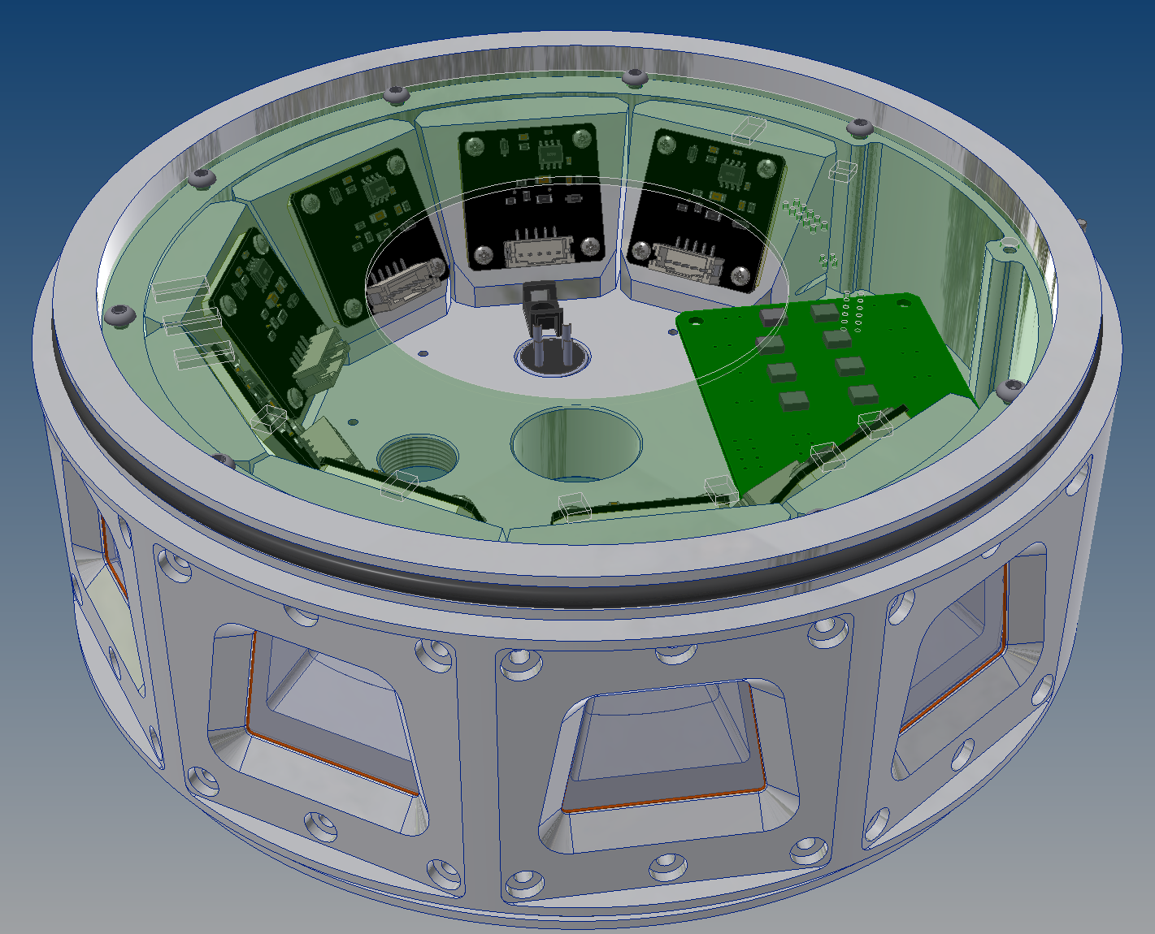
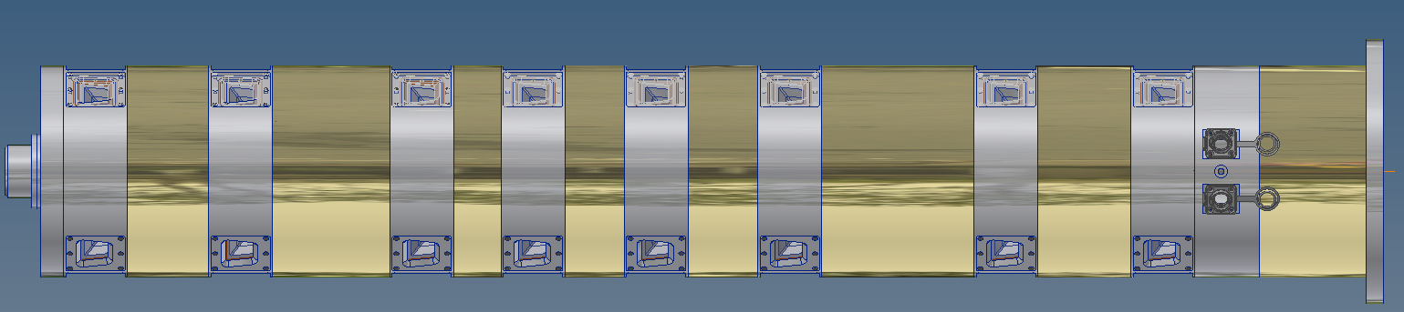
Our Turbulence Profilers (TP)
KunLun Turbulence Profiler (KLTP)
Following ATP design (Paul Hickson)；
No moving parts
8 channels(layers) for more baselines；
7 sectors covering 252°in Azimuth ;
Moon
20°
8
The Arctic Turbulence Profiler (ATP) at PEARL, Canada (Hickson et al. 2010)
Sun
Elevation of Sun and Moon
2025.07-09

Slide 9
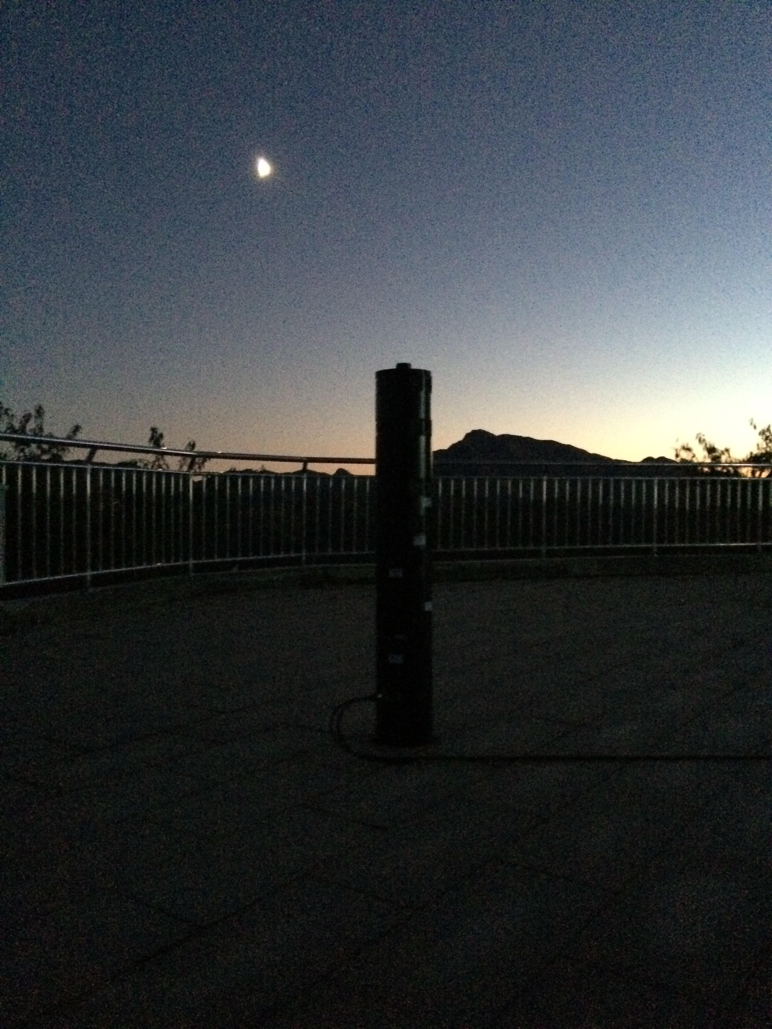
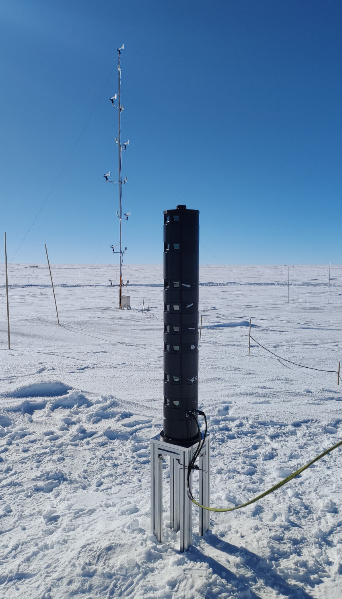
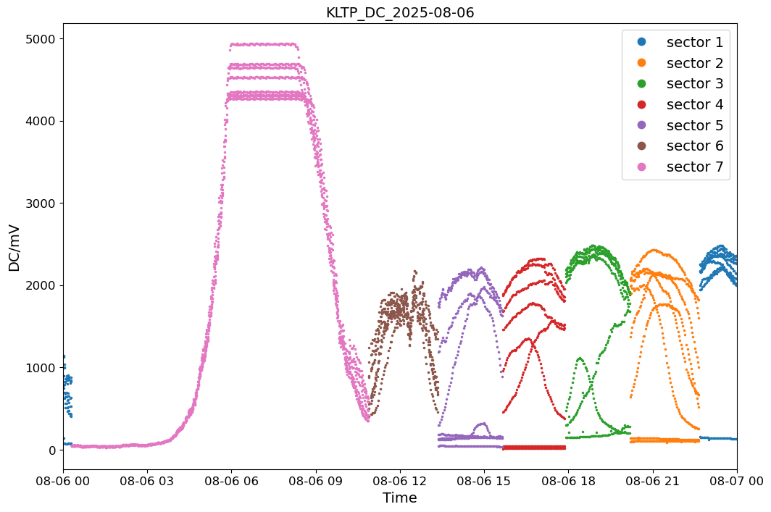
Our Turbulence Profilers (TP)
KunLun Turbulence Profiler (KLTP)
Tested at NAOC;
Deployed to Dome A in Jan. 2025;
Problems with frosting, etc.
Dome A
twilight
7 sectors
Xinglong Station,
NAOC
Frosting?
KLTP raw data

Slide 10
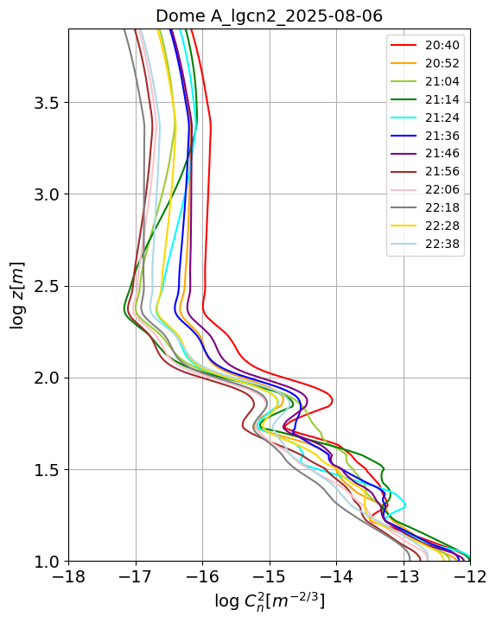
Preliminary Results: KLTP
C_{n}² from Dome A;
Each curve is a C_{n}² profile from one dataset of 2 minutes. (total: ~2 hours for each sector)
height

Slide 11
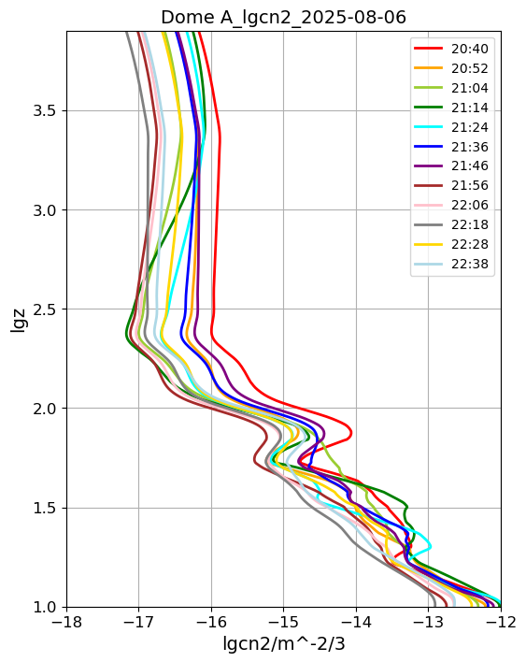
Preliminary Results: KLTP
C_{n}² from Dome A;
Comparing with Dome C;
same z range
Dome A
Dome C

Slide 12
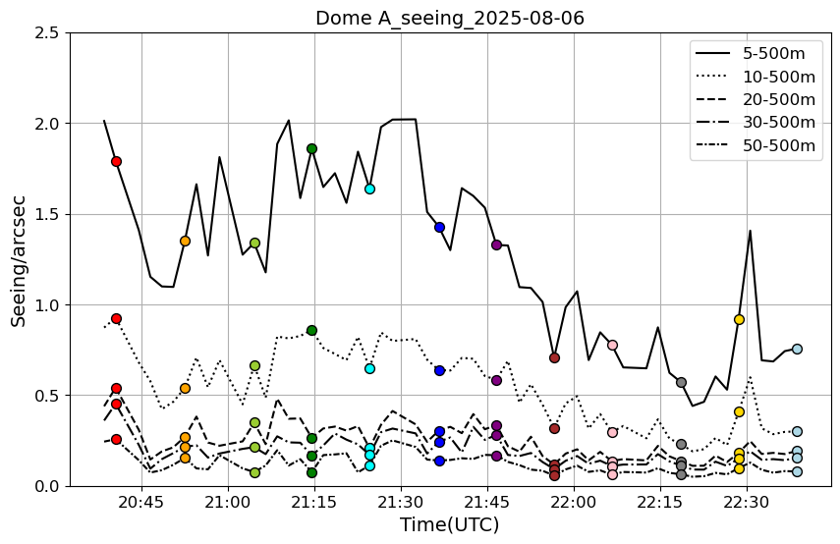
Preliminary Results: KLTP
First check: integrating C_{n}² to get seeing;
Seems reasonable, but not sure.
Good seeing
5m
10m
20m

Slide 13
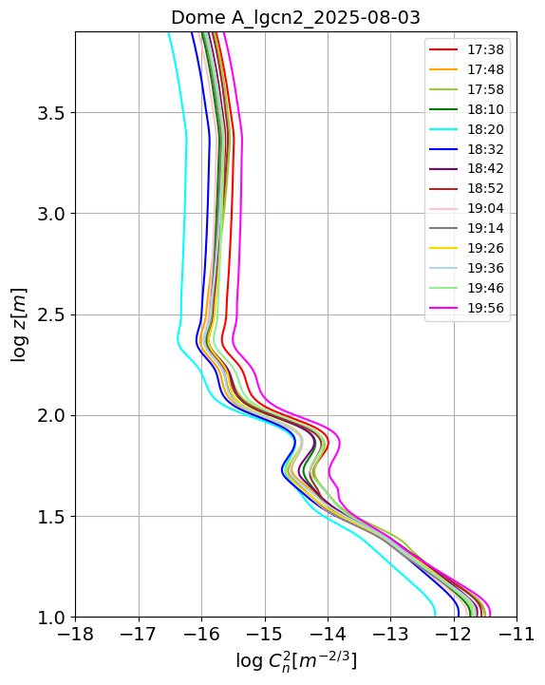
Preliminary Results: KLTP
Integrating C_{n}² to get seeing;
Seems reasonable, but not sure.

Slide 14
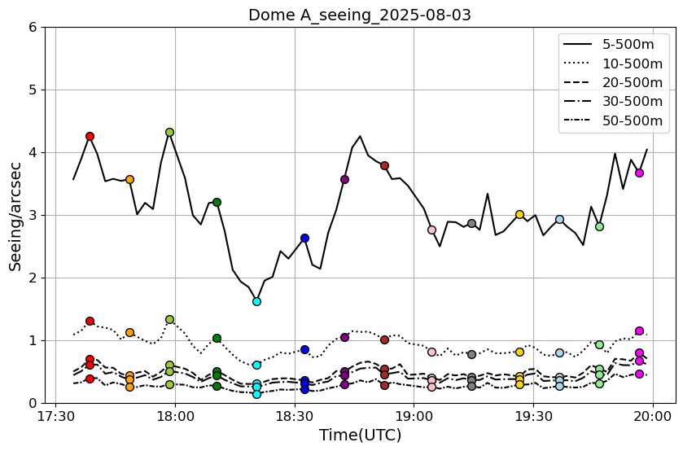
Preliminary Results: KLTP
Integrating C_{n}² to get seeing;
Seems reasonable, but not sure.
Bad seeing
5m
10m

Slide 15
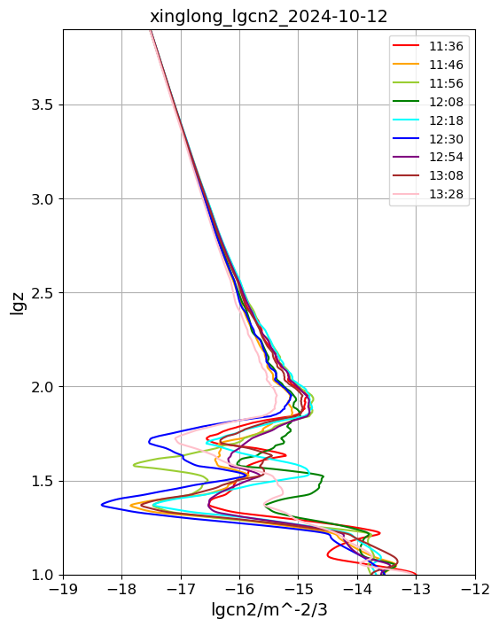
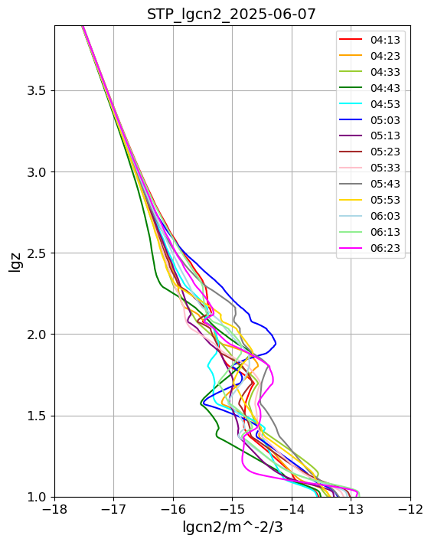
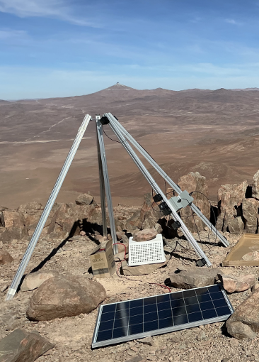
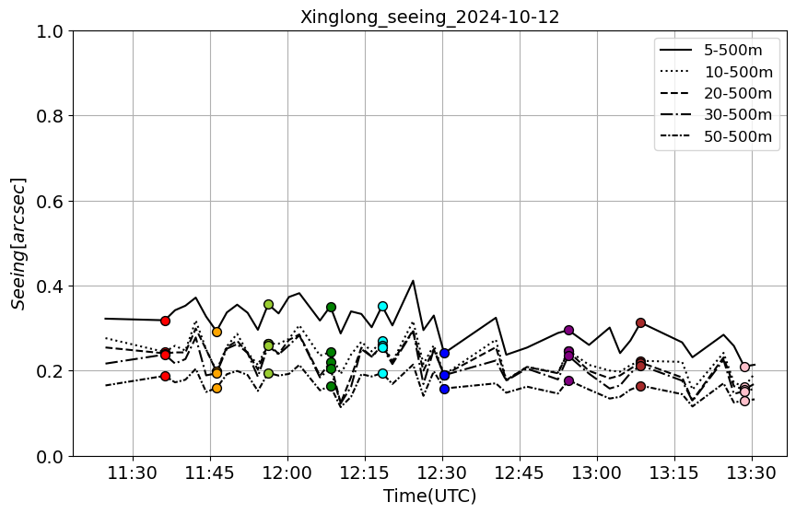
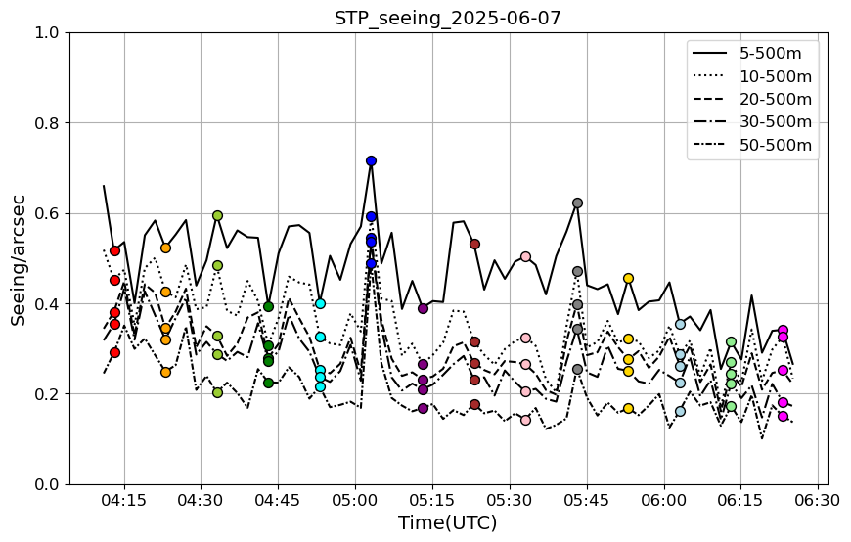
Preliminary Results: KLTP, STP
KLTP @Dome A
KLTP @Xinglong,
NAOC
STP @CVO,
Chile
2"
1"
1"
Probably wrong
seeing
Time

Slide 16
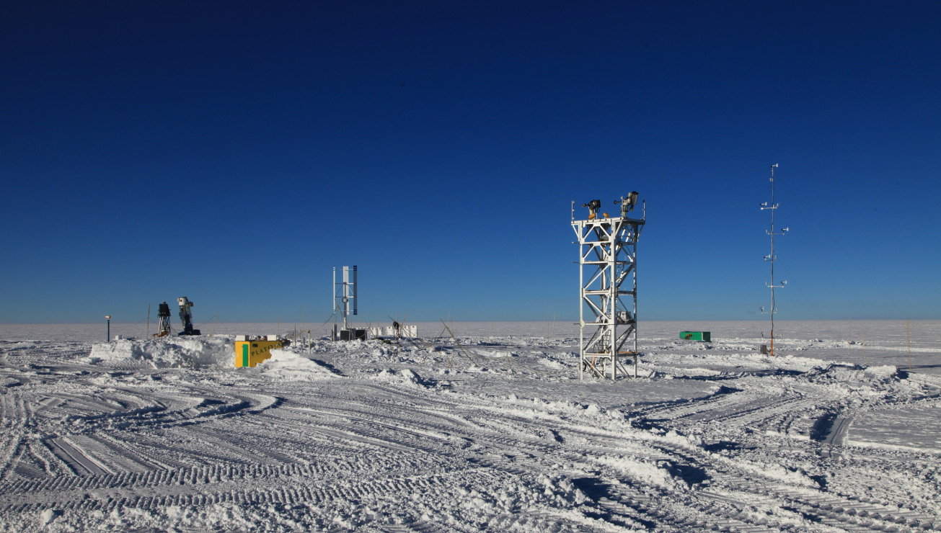
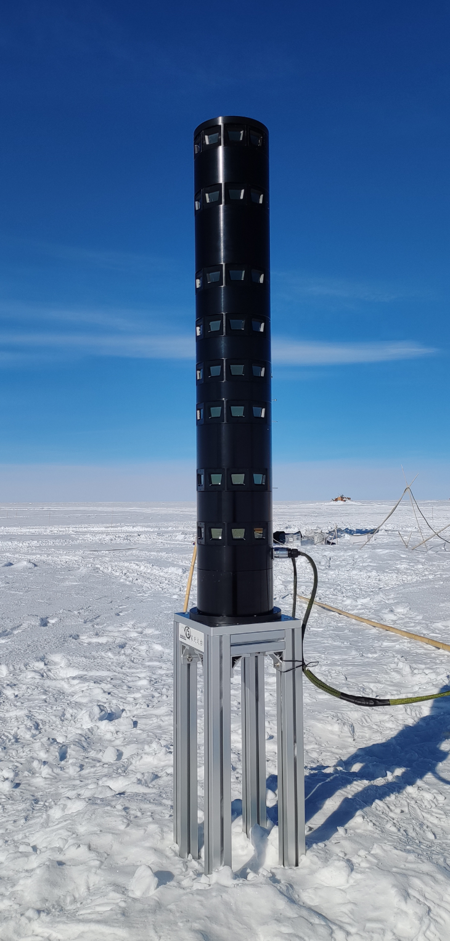
Summary:
KLTP can obtain the turbulence profile at Dome A.
Data analysis needs to be checked and refined.
Thanks!

Slide 17
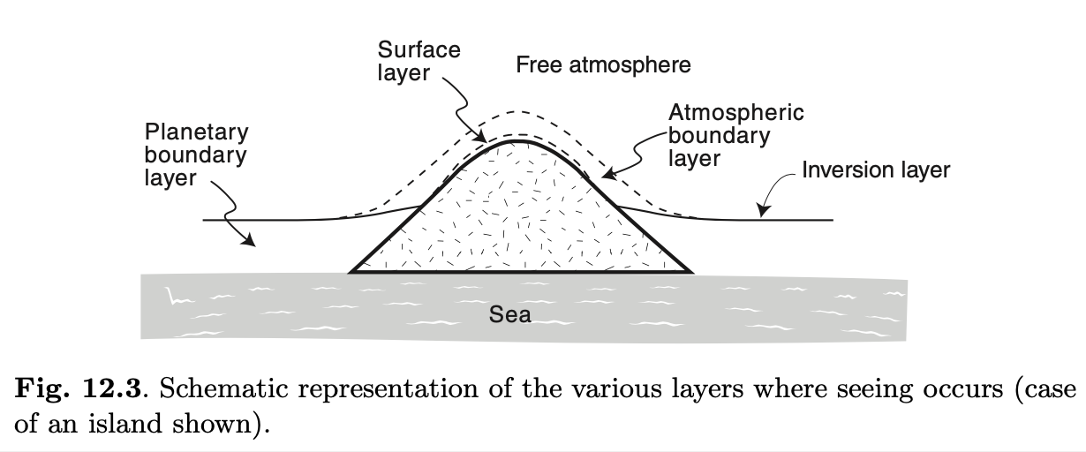
Simplified atmospheric layers: ABL+Free atmosphere
Free atmosphere (FA）
Atmospheric boundary layer (ABL)
Inversion layer
Planetary boundary layer (PBL)
Surface/ground layer (GL)
credit: Bely 2015
Only 2 layers at Dome A/Dome C…:
Stable free-atmosphere (FA) on top;
Near ground turbulence layers: Atmospheric boundary layer（ABL）

