Slide 1
Optimization Design of the telescope tower structure for weak snow foundation in Dome A, Antarctica
Wen Haikun
Nanjing Institute of Astronomical Optics & Technology
National Astronomical Observatories ,CAS
2025.9.17 Thailand
Notes:
Hello! I'm Wen Haikun from NIAOT. Today I want to share with you a talk about the Optimization Design of the telescope tower structure for weak snow foundation in Dome A.
Dome A offers ideal conditions for astronomical observations, but it also faces challenges in telescope foundation building due to soft snow layers and insufficient structural support. This study optimizes a 2-meter-class telescope tower based on snow strength data, aiming to provide a reference model for constructing high resolution telescopes in Antarctica's inland regions.
Next, I'll go into more detail about that.

Slide 2
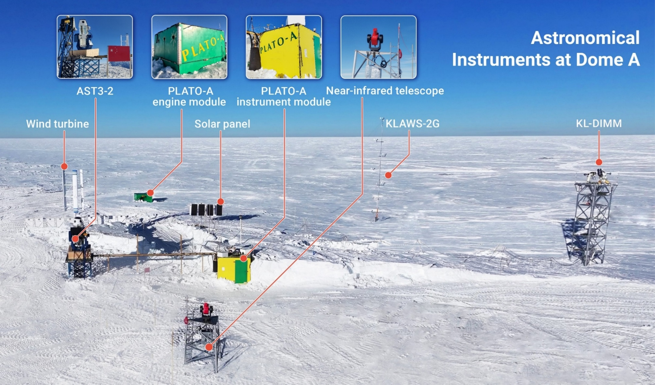
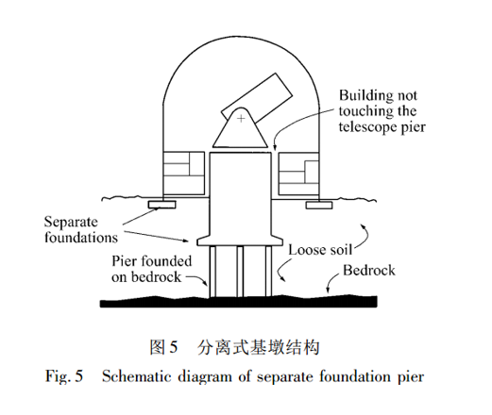
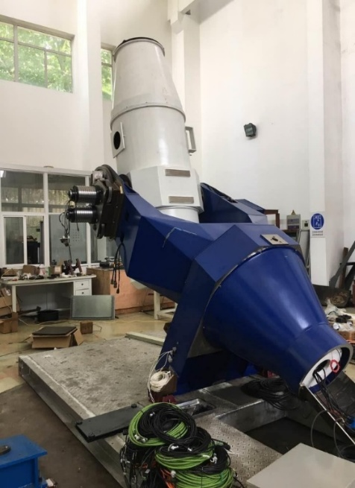
The Bird-eye View of the Astronomical Instruments on Dome A
Advantages of Dome A:low temperature,dry,low wind speed,three months of polar night sky,with excellent atmospheric seeing (median 0.31"and minimum 0.13"）(Bin Ma,Zhaohui Shang.etc.Nature).
One of the difficulties in building a telescope in Dome A is that the snow depth is about 3100 meters,and the surface is soft snow.
5' offsetper year (CSTAR astronomical observation data),which has a serious impact on the high-resolution observation.
How to make the soft snow strong to give the sufficient support to the large high resolution telescopes?
Notes:
This picture is a bird-eye view of the astronomical instruments on Dome A in 2024. The main telescopes currently operating at Dome A include the AST3-2 Sky Survey Telescope and the Near-Infrared Telescope. In the future, we plan to install the AST3-3 telescope there.
While Dome A have favorable conditions such as low temperatures, dry climate, low wind speeds, three-month-long polar night, and excellent seeing conditions, telescope installationalso have some significant challenges. One of them is the snow depth can reach to about 3,100 meters. According to the data of CSTAR, it has 5 arcminute offset per year. This will impact a high-resolution telescope’s Image quality. Unlike some other areas, where telescopes are mounted directly on bedrock, this method remains unfeasible in Dome A. The critical challenge lies in strengthening the soft snow foundation to provide adequate support for large high-resolution instruments

Slide 3
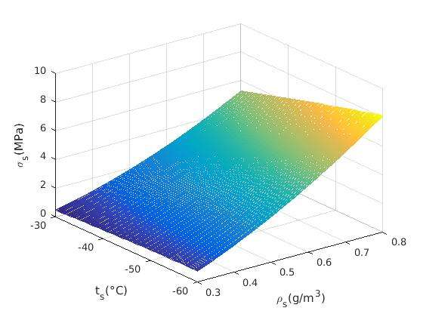
Study and analysis of snow strength in Dome A
Dome A Snow Density-Depth Curve
Mathematical model of snow strength and temperature-density relationship
2014 Dome A monthly average temperature-depth curve
Snow Strength Estimation
0.6Mpa-2.5Mpa (0-10m )
Notes:
Frankly speaking, studying the mechanical properties of snow particles solely is very difficult. Subsequent research revealed that snow's strength has some certain relationship to temperature and density. Malcom Mellor ,an American scientist collected extensive snow samples in Antarctica, conducted compressive strength tests, and compiled a comprehensive table of snow strength data for different temperature and density conditions.
Because the test's minimum temperature was approximately-40°C and the collected snow samples were natural snow with lower density than Dome A's snow, we expanded the original table to establish a relationship curve between snow strength, density, and temperature applicable to Dome A. Additionally, by combining Dome A's temperature and snow density data, we estimated the mechanical properties of snow within the surface layer (0-10 meters deep).
The two images on the left show the measured snow density at 0-10 meters depth of Dome A and the average temperature of the moon.
Estimates indicate that snow accumulation at depths of 0-10 meters ranges between 0.6MPa and 2.5MPa, providing fundamental data for subsequent construction projects,and also can be given to some other projects in Dome A as a reference.

Slide 4
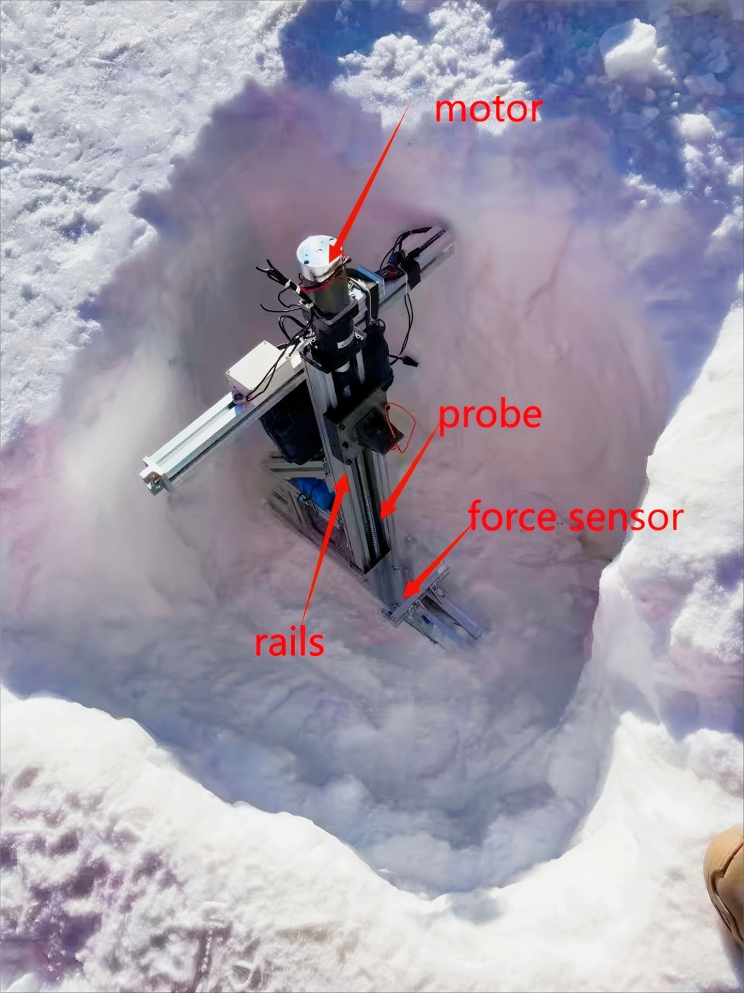
The introduction of the Snow strength tester
Power supply mode | lithium battery
Power | 30W
Weight | 10Kg
Working temperature： | -40℃- 40℃
Force sensor range | 0-5000N
Length range | 0-500mm
Technical parameters of the tester
Notes:
To verify the accuracy of our estimates, we developed a snow strength tester. This device consists of a motor, guide rails, probes, and a force sensor. The motor drives the probes to penetrate the snow layer along the rails, while the force sensor measures the snow strength. The technical Parameter on the right side indicate that this instrument can measure up to 5000N of force, which is sufficient to meet the snow strength testing requirements for Dome A.

Slide 5
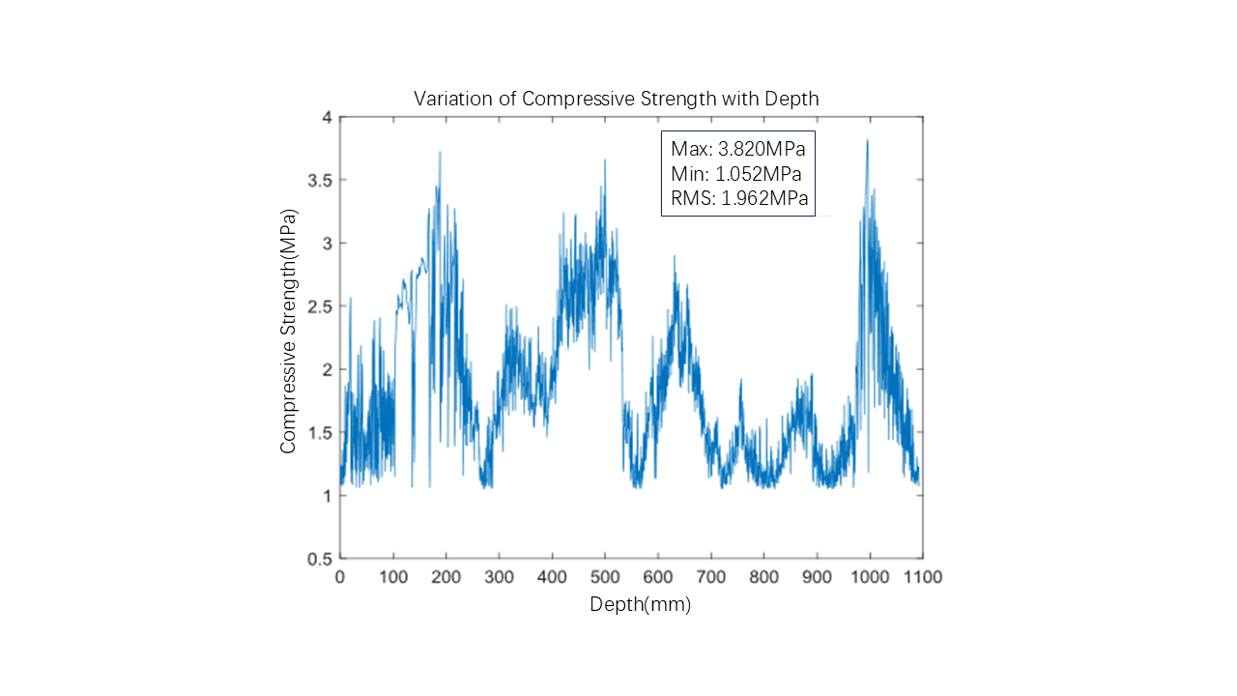
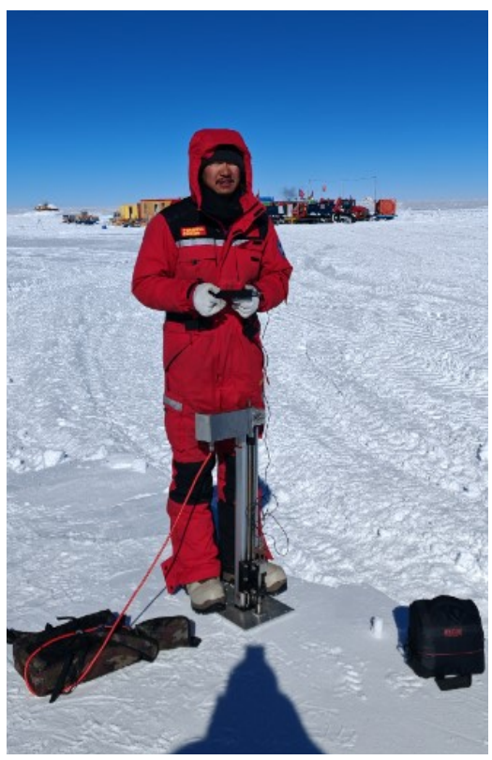
Field experimental verification of snow strength Dome A
The field of the AST3-2, which has a simple foundation treatment, was tested to obtain the depth-pressure curve. The maximum value was 3.820MPa, the minimum value was 1.052MPa, and the root mean square value was 1.962MPa.
The field test results show that our estimation method(value 0.6-2.5MPa) has a high credibility.
Notes:
In order to verify the accurance of the estimation, we have a field experiment in Dome A.The field of the AST3-2, which has a simple foundation treatment, was tested to obtain the depth-pressure curve. The maximum value was 3.820MPa, the minimum value was 1.052MPa, and the root mean square value was 1.962MPa.
The field test results show that our estimation method(value 0.6-2.5MPa) has a high credibility.

Slide 6
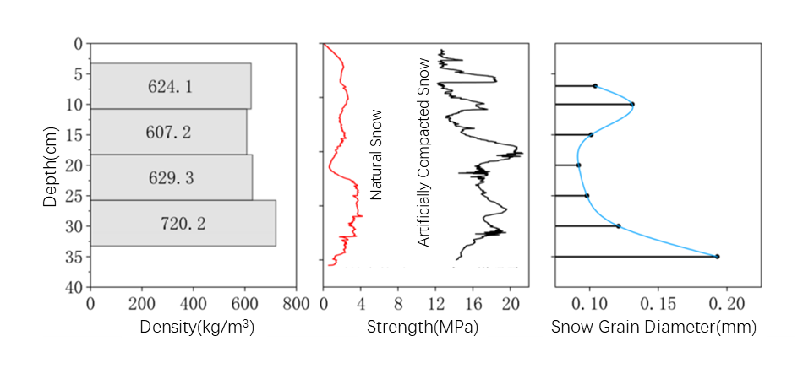
Artificial Reinforcement for the Snow Strength
This project developed an artificial reinforcement plan for the foundation in Dome A area in oreder to have a larger snow strength. The enhanced snow surface foundation achieved a density of 600-750 kg/m³, compared to its original 250-400 kg/m³. The snow strength increased to 12-21 MPa, (SPT telescope requirement 2Mpa)
Notes:
we formulated an artificial reinforcement plan to enhance the snow strength and conducted corresponding tests in northeastern China. After implementation, the density of the snow surface foundation increased from the original 250-400 kg/m³ to 600-750 kg/m³. This significant change substantially improved the foundation's bearing capacity, reaching 12-21 MPa.
The snow strength requirement of SPT telescope base in the United States is more than 2Mpa, and our plan can be improved by about five times to meet the installation requirements of large telescopes in Dome A.

Slide 7
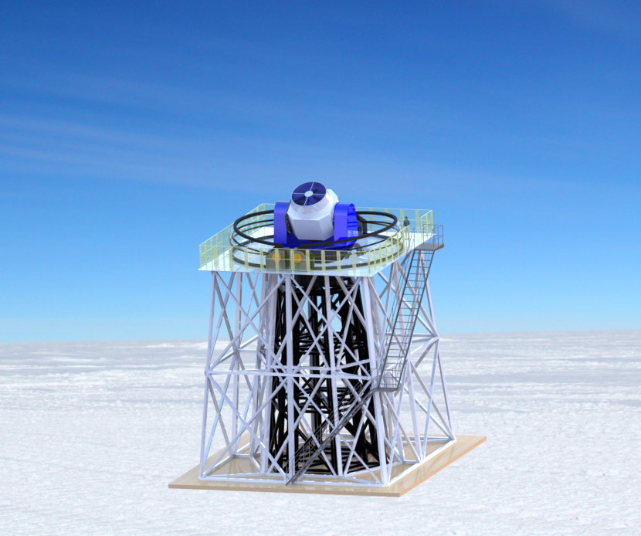
Requirement of the Tower Design
The median boundary layer thickness at Dome A is 13.9 meters, we want to build a tower to place the telescope above the boundary layer for better observations. According to the design experience of large telescope towers, the tower should meet the following requirements:
At least 40 t load;
The first natural frequency is at least 15 Hz;
The displacement at the top should be less than 0.1″ at 10m/s wind speed,.
Notes:
The median boundary layer thickness at Dome A is 13.9 meters, we wanted to build a tower to place the telescope above the boundary layer for better observations.
Therefore, we designed a steel structure tower suitable for 2m class telescope and put forward the corresponding indicators.
In terms of load capacity, the structure must withstand 40-ton operational loads to ensure stable operation of the telescope and associated equipment. The first-order modal frequency should reach at least 15Hz, which guarantees optimal rigidity during operation. When wind speeds reach 10 m/s, the tower's top displacement must remain below 0.1″ to maintain observation accuracy.

Slide 8
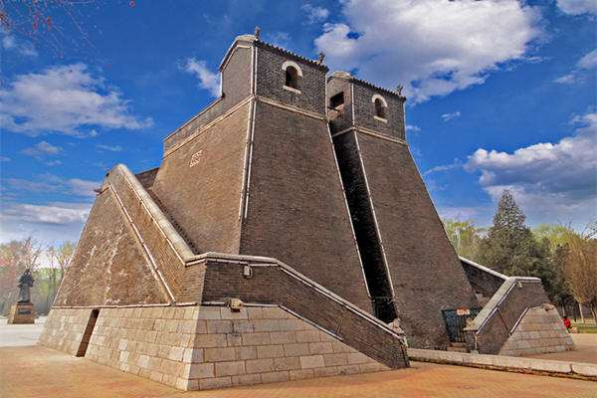
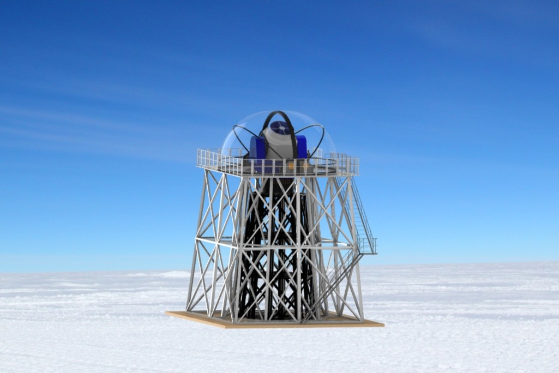
Telescope and Dome Tower design
Deng Feng observatory
1500years ago
Rendering image of the truss tower
with a dome
Notes:
Our tower was inspired by the ancient observatory in Dengfeng, Henan Province, which is currently known as the oldest observatory in China.
In the 2-meter-class Antarctic Telescope project, we designed the telescope's support tower and corresponding dome structure. We separated the tower frame of the telescope from that of the dome to minimize wind-induced vibrations in the telescope's tower. Meanwhile, we adopted an efficient truss design to ensure the tower has excellent stiffness-to-weight ratio, while utilizing modular design to reduce transportation stress during its journey to Dome A and installation challenges at the site.

Slide 9
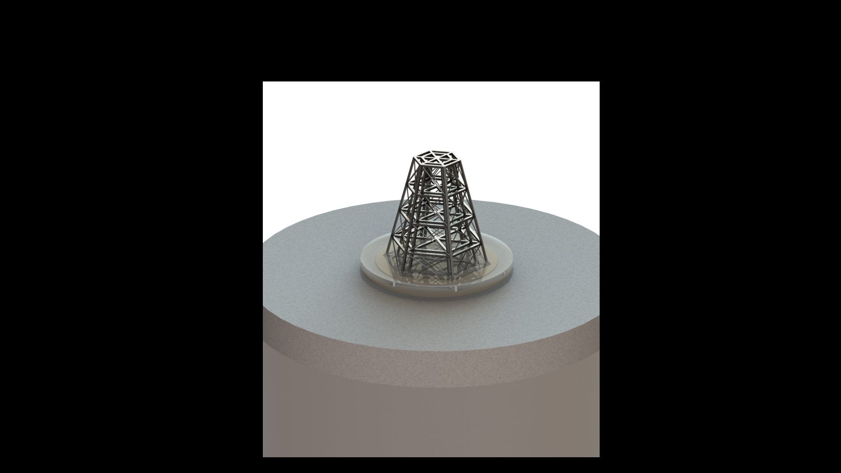
Design of Telescope Tower Mechanical Analysis Model
Tower (stainless steel)
1.Double-layer Nested configuration
2.Height:15m
3.6m diameter at top,15m diameter at bottom
4.Modular design
5.Pre-treated snow depth:4m
cover snow
wood
Pre-treated snow
natural snow
Material | Density (kg·m-3) | Youngs modulus (Pa) | Poisson ratio
Pre-treatment snow | 600 | 2× 10 ⁹ | 0.3
natural snow | 350 | 1× 10 ⁹ | 0.3
cover snow | 250 | 1× 10 ⁹ | 0.3
wood | 487 | 9.3× 10 ⁹ | 0.374
stainless steel | 7900 | 1.98× 10 ¹¹ | 0.27
material parameter table of simulation model
Notes:
Ensure long-term foundation strength stability. And this is the simulation modal parameter table.

Slide 10
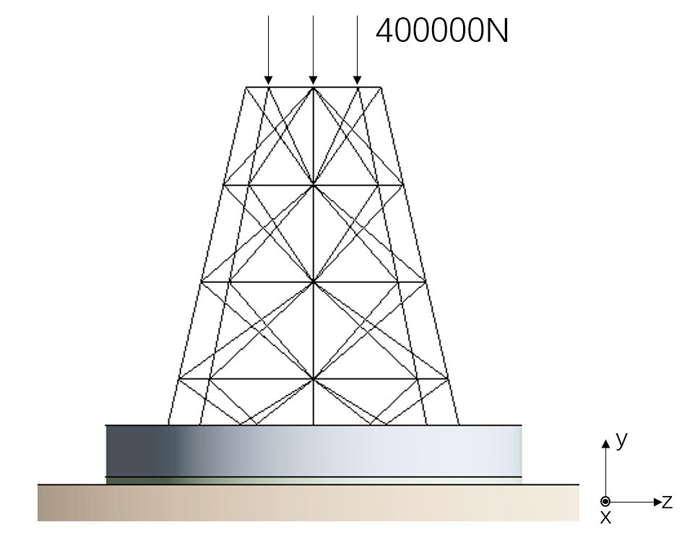
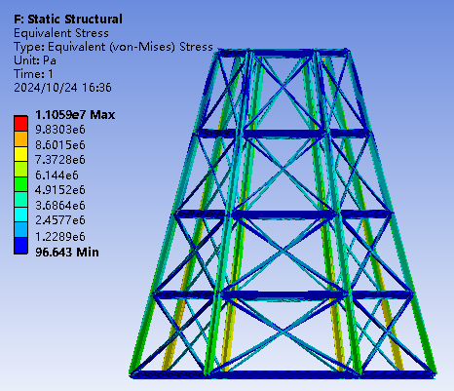
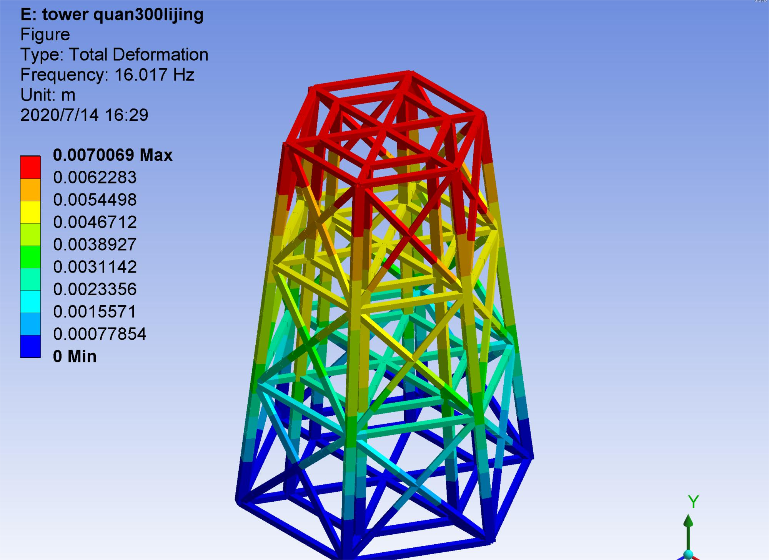
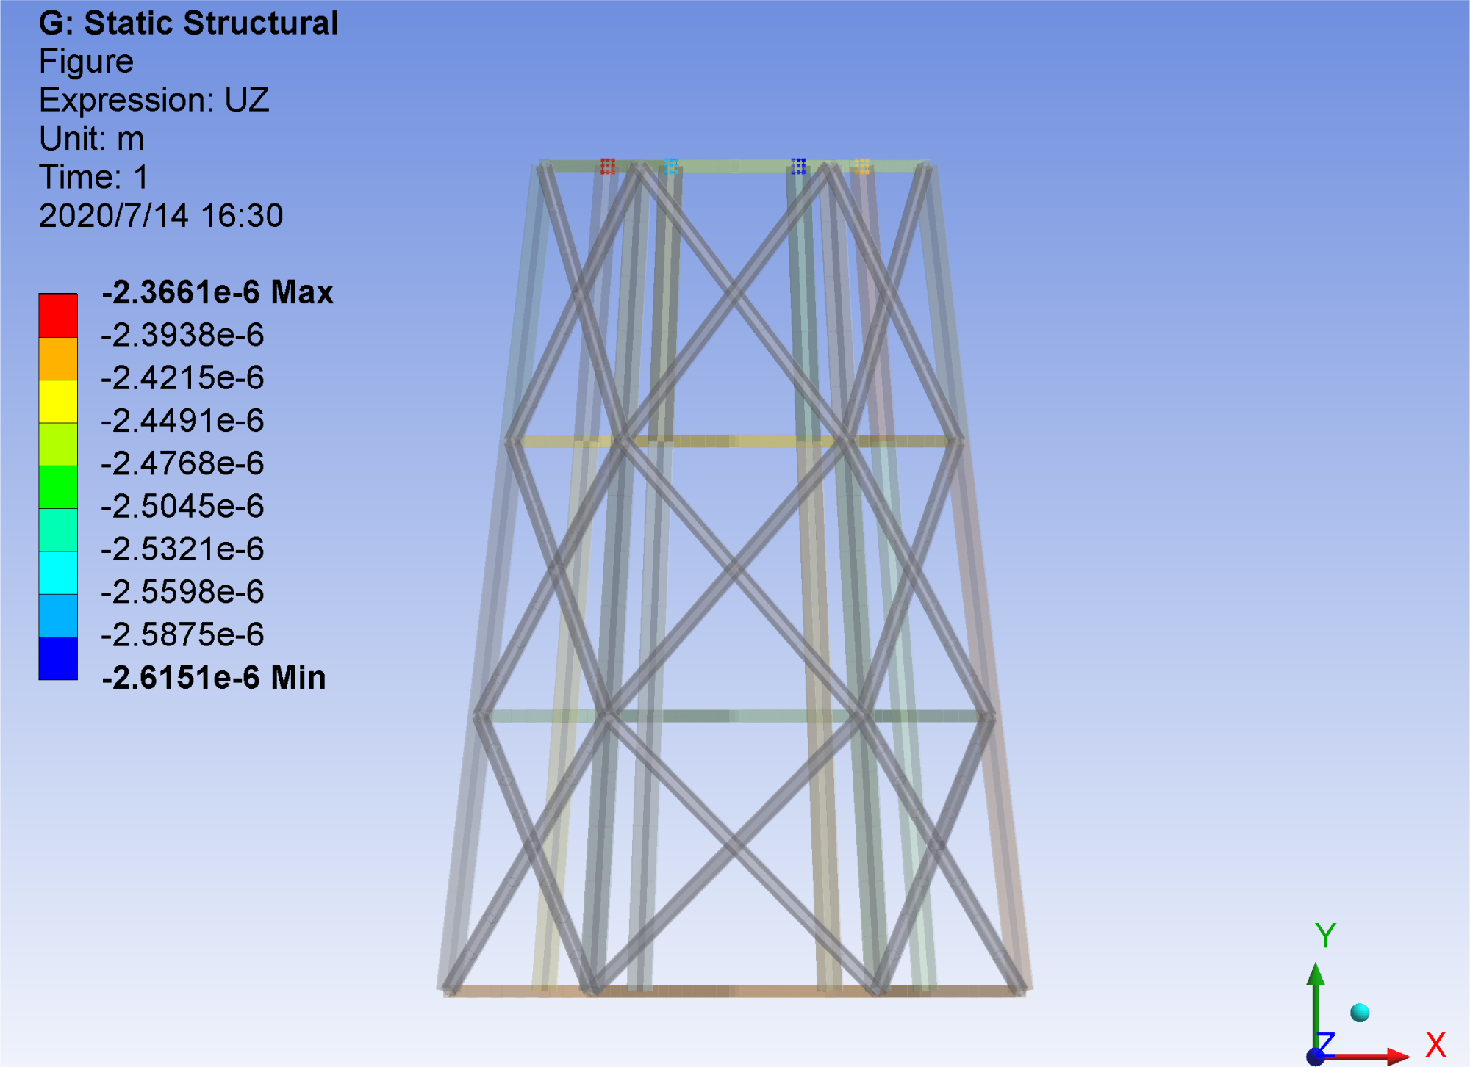
Telescope Tower Static and Dynamic Analysis
Max stress 11.06Mpa (205Mpa)
First natural frequency 16.017Hz of tower(15Hz)
tower displacement 0.08″(0.1″）at10m/s
Notes:
The telescope tower needs to withstand the vertical static load of large telescopes and some other equipment during operation, so it is necessary to verify its structural strength. The specific method is to apply 40 tons of equivalent vertical force at six nodes on the top of the tower to simulate the vertical load of telescopes and related equipment.
Through simulation, we obtained the stress cloud map of the tower. It can be seen that the maximum stress value is 11.059MPa, and the safety factor is about 18, which is concentrated at the bottom of the tower column and meets the requirements.
At the same time, we analyzed the telescope tower erected on the ice and snow foundation. The results showed that the first-order natural frequency of the tower was 16.017Hz, which met our 15Hz requirement
This measurement demonstrates the tower's operational stability, effectively resisting vibration disturbances within a specific frequency range. When wind speeds reach 10 m/s, the deformation at the telescope tower's top measures only 0.08 arcseconds – meeting our 0.1-arc-second threshold. This minimal deformation indicates the tower's exceptional wind resistance, ensuring uninterrupted telescope observations even in windy conditions and establishing a robust foundation for future astronomical research.

Slide 11
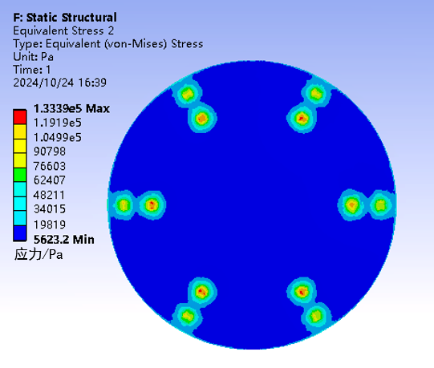
Safety Analysis of Snow Foundation
snow foundation Stress distribution diagram
Max:0.133MPa (SPT:2MPa)
Notes:
Since the tower is constructed on an snow foundation, we must analyze its load-bearing capacity. The total load consists of the tower structure, wooden planks, telescope body, and accumulated snow weight. By examining the stress distribution diagram, we can visualize how the snow-soil mixture withstands pressure. Our analysis shows the maximum load-bearing capacity reaches 0.13 MPa. Given that SPT telescopes require a load-bearing capacity of 2MPa, this ensures a safety factor of at least 15 – fully meeting all strength requirements.

Slide 12
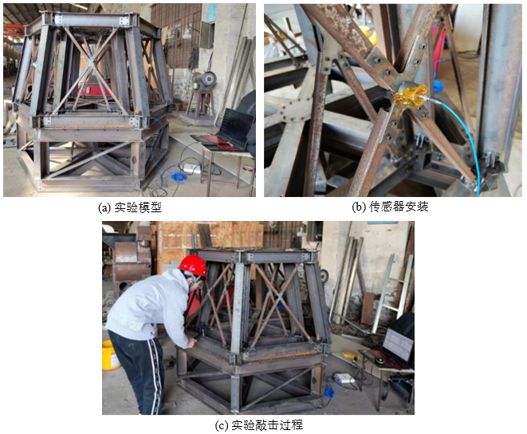
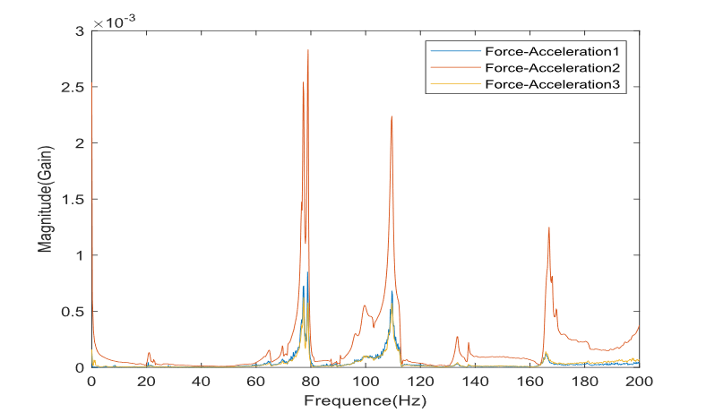
Dynamics Experiment on Scaled-down Tower Models
Moldal Hammer test comparison Table
Notes:
In order to verify the accuracy of our mechanical analysis, we made a scale model and carried out dynamic and static scale tests.
This figure shows the scale test site of static mechanics.
In order to study the influence of cross wind on the top offset of the telescope tower, we loaded the lateral force on the scale model and controlled the loading force size through a force sensor. The deviation between the experimental results and the simulation results is about 10%, which is within the allowable error range, indicating that the simulation results are reliable.

Slide 13
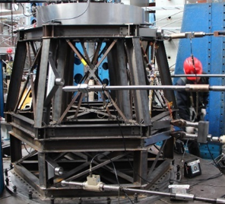
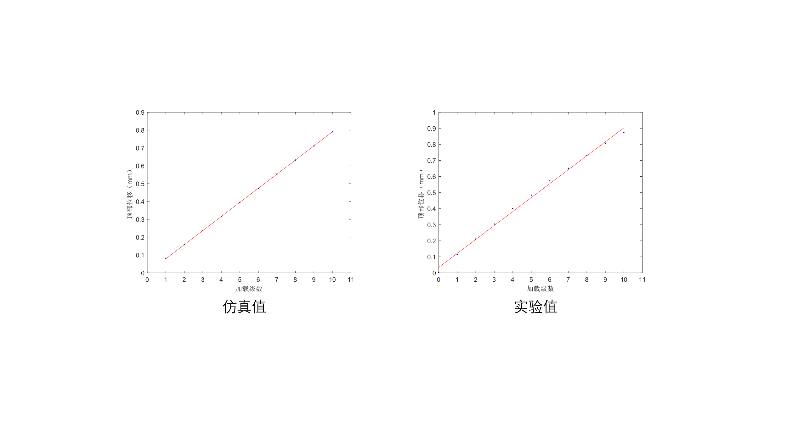
Statistical Experiments on Scaled-down Tower Models
The tower displacement value under the wind is simulated by loading some force on the side of the tower . The deviation between the experimental results and the simulation results is about 10%, which is within the allowable error range.
Notes:
In order to verify the accuracy of our mechanical analysis, we made a scale model and carried out dynamic and static scale tests.
This figure shows the scale test site of static mechanics.
In order to study the influence of cross wind on the top offset of the telescope tower, we loaded the lateral force on the scale model and controlled the loading force size through a force sensor. The deviation between the experimental results and the simulation results is about 10%, which is within the allowable error range, indicating that the simulation results are reliable.

Slide 14
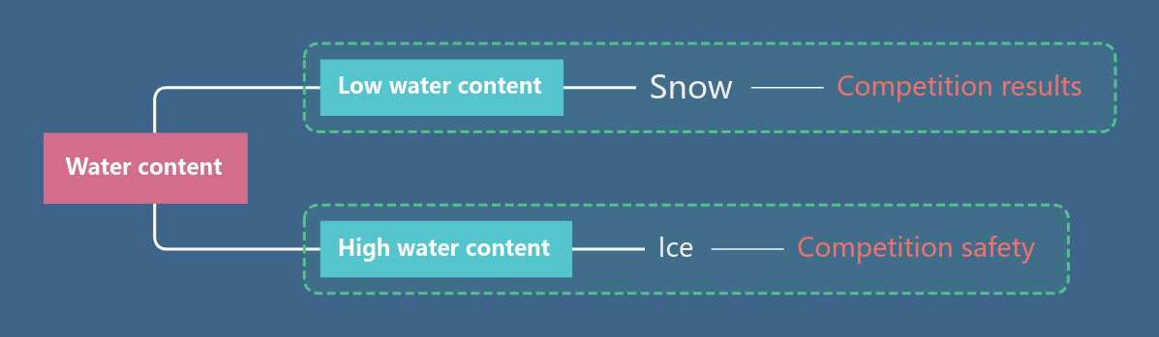
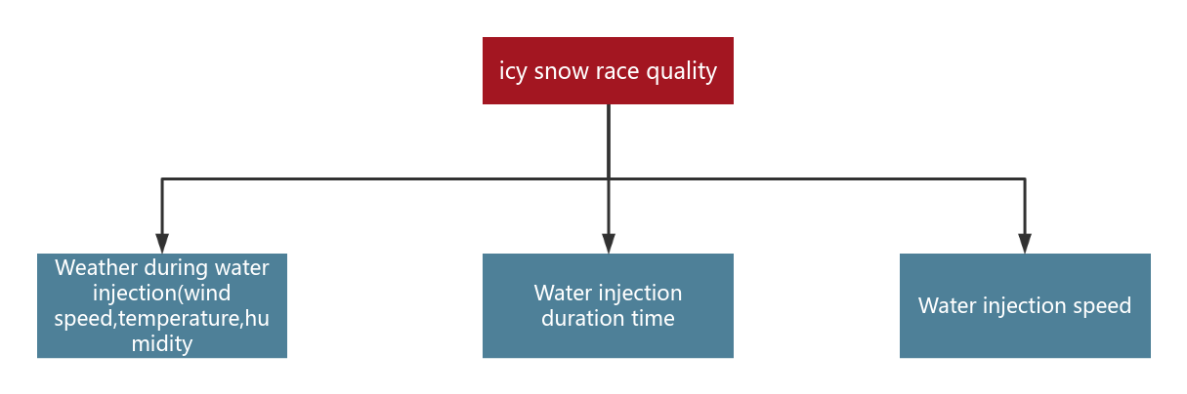
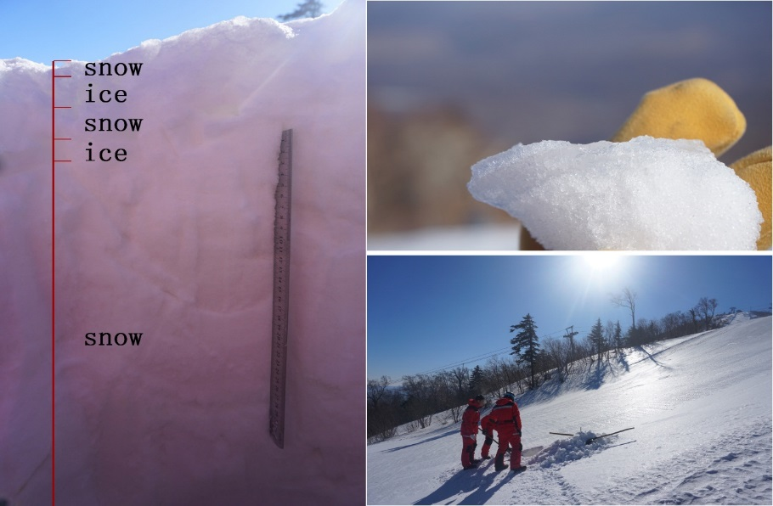
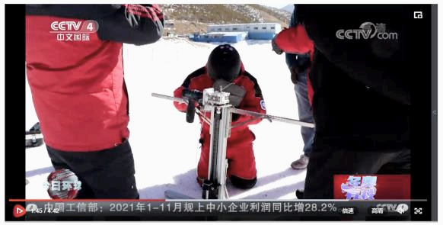
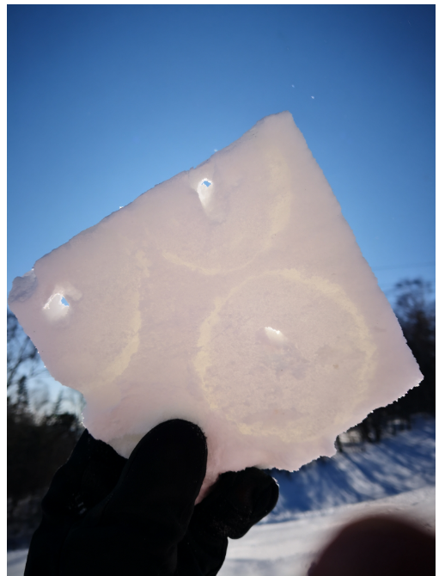
Icy Snow Race Quality Inspection
Expand services for Beijing Winter Olympics:Measuring the quality of icy snow race in Alpine skiing competition
Notes:
In 2022, we applied our snow strength tester on the Beijing Winter Olympics.
The artificial snow used in alpine skiing at the Winter Olympics is a special ice-like snow. It is mainly formed by injecting a certain amount of water on the basis of snow making machine to enhance the density of snow and form a special snow structure similar to ice on the surface.
The water content is very important to the quality of the icy snow.If the content is high,it will convert to the ice,and have the safety problem for the competition. While if it is snow, it is still a snow, and the Soft snow will reduce athletic performance.
The duration time and speed of water injection required for made a qualified icy snow race is different under different weather conditions. We upgraded the snow strength instruments to extract strength parameters of qualified icy snow race. Prior to the Beijing Winter Olympics, extensive field test were conducted at competition field, By reading snow strength data, we can obtain the required duration and speed of water injection for constructing a qualified track under different climatic conditions

Slide 15
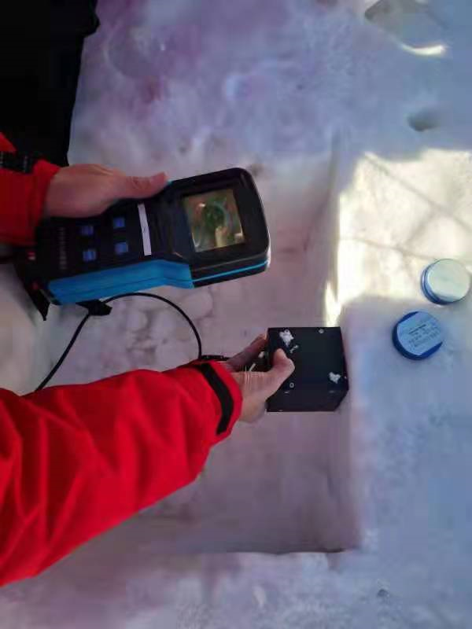
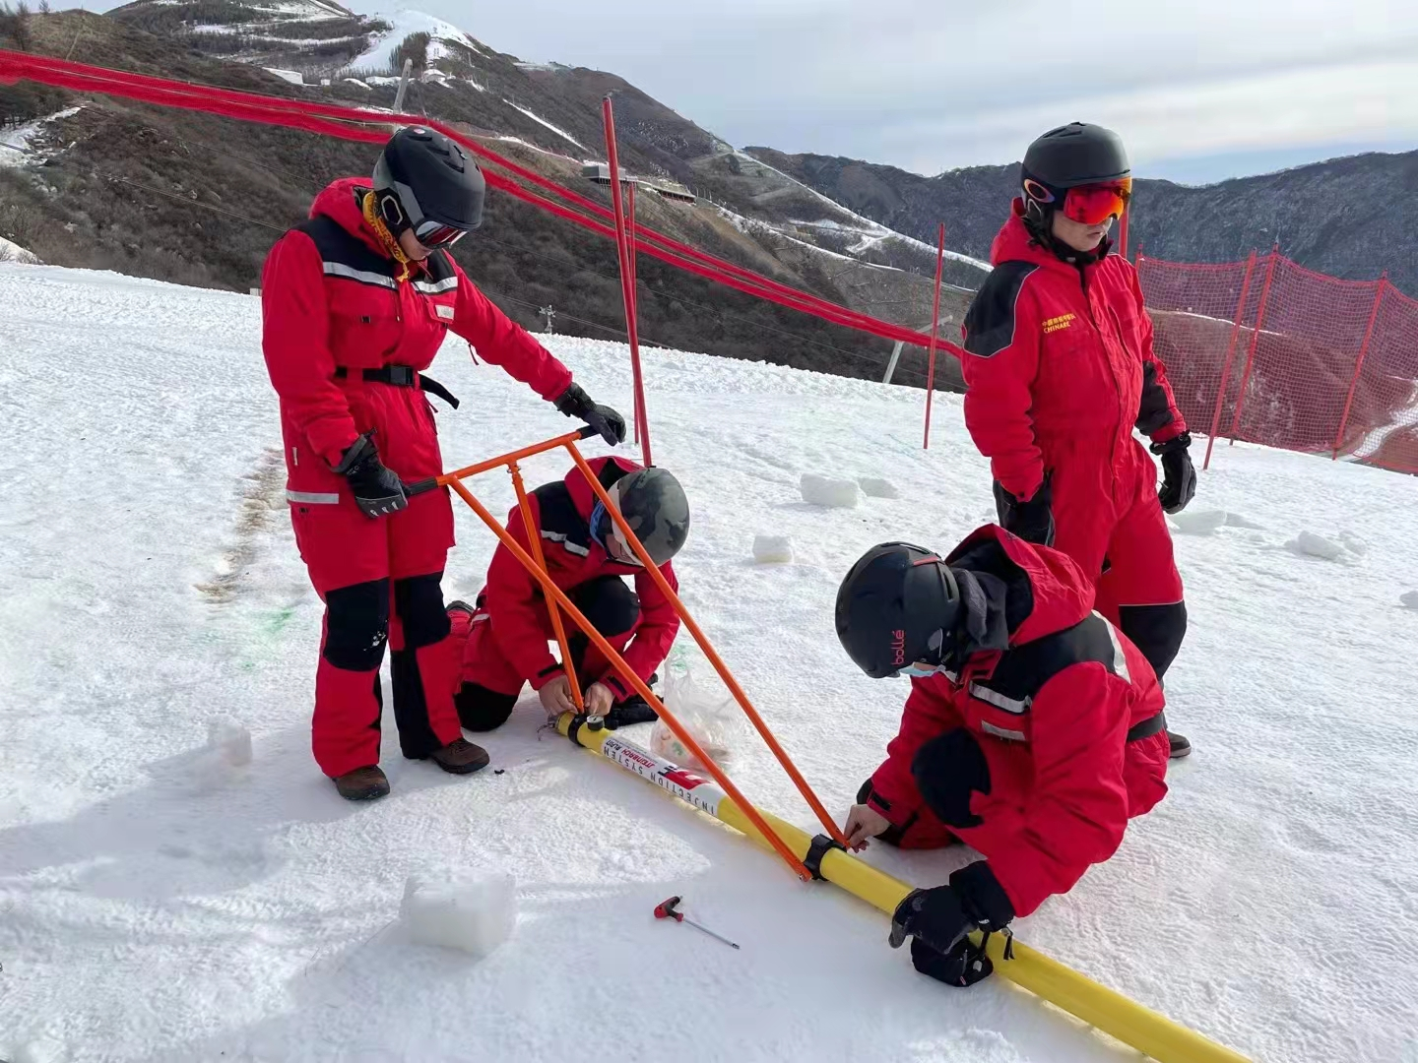
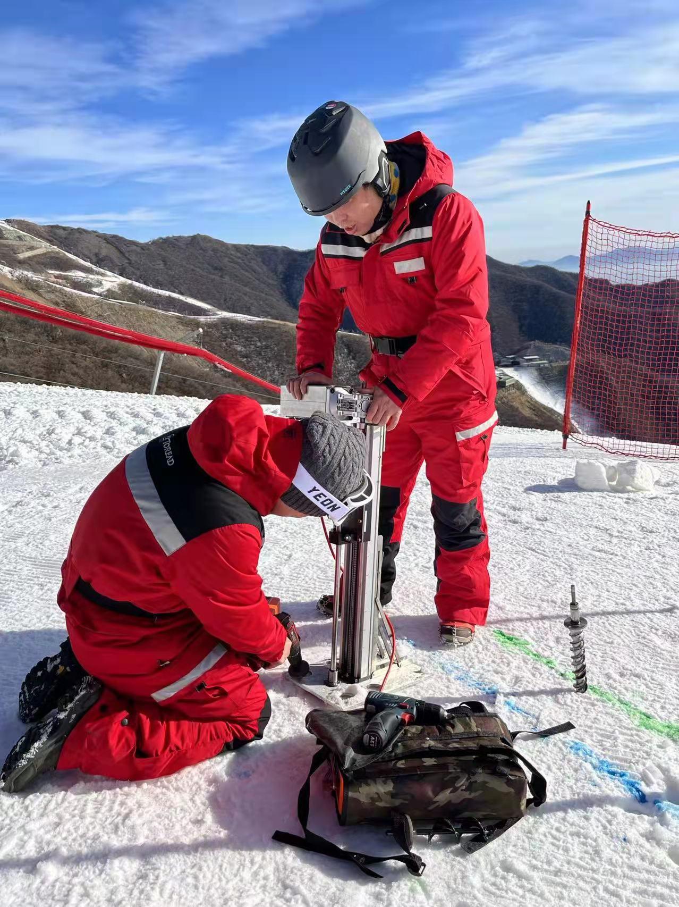
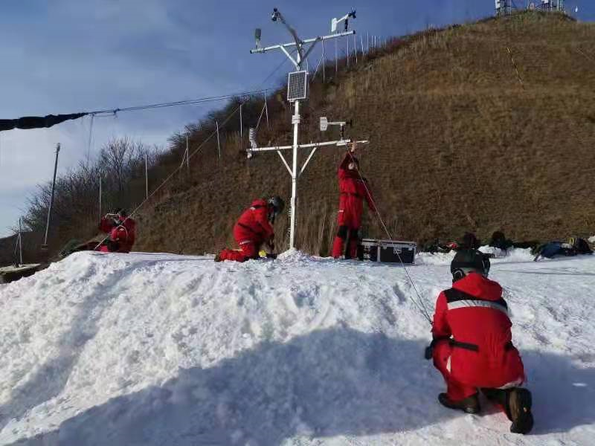
Field Test in the National Alpine Skiing Centre
Notes:
Theictures are the field test in the naitonal alpine skiing centre. and the right one is the water injection tool, this one is the weather station ,this is the strength instrument, the is also what we developed called Snow particle size measure instrument, to measure the Snow particle. Trying to explain the intensity of snow from a microscopic perspective

Slide 16
Future and Outlook
1.Study on the cumulative deformation of snow foundation under long-term working conditions of heavy equipment and its repair method.
2. In the future, we hope to develop opportunities for the wide international cooperation, so that we can apply our snow foundation strength enhancement solutions, snow strength testers, and large telescope tower design solutions to some other Antarctic inland scientific research stations, such as Dome C or Dome F and so on. Furthermore, our snow strength testers can also be applied to other polar scientific research fields, such as the construction of large buildings in the Antarctic inland and the strength testing of runways at Antarctic polar airports.
Notes:
Future research will focus on two key areas. First, we will conduct in-depth studies on cumulative deformation and repair methods for ice-snow foundations under heavy equipment loads. The Antarctic Dome A experiences variable observation conditions where factors like wind speed, direction, sunlight exposure, and temperature can cause displacement and deformation of these foundations, compromising their stability. While current research has only examined short-term strength enhancement of ice-snow foundations, studies and experiments on their long-term stability remain insufficient. This gap is critical for ensuring continuous telescope observations and the long-term operation of observation towers. Subsequent research will address these challenges to strengthen foundational understanding.
Secondly, we aim to establish extensive international collaborations to implement ice foundation reinforcement solutions, strength testing instruments, and telescope tower designs at other Antarctic inland research stations such as Dome C or Dome F. Additionally, these strength testing devices can be applied in polar scientific fields including large-scale construction projects and runway strength assessments in Antarctica.

Slide 17
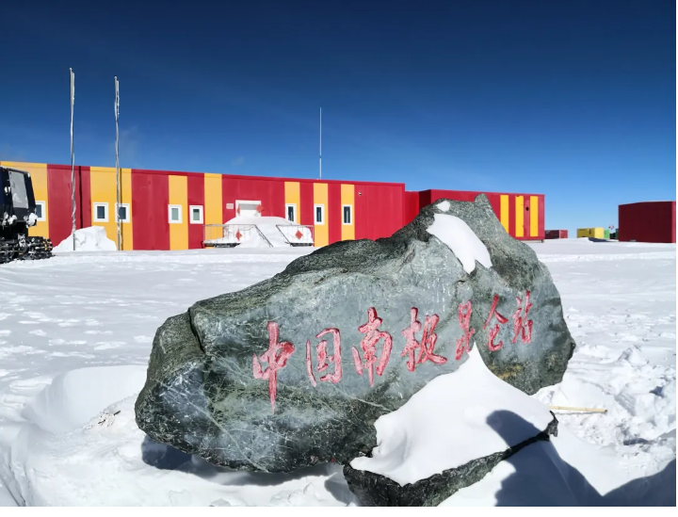
Thank You !
Notes:
Finally, I would like to end with a photo of China's Kunlun Station in Antarctica. Thank you for listening.

