Slide 1
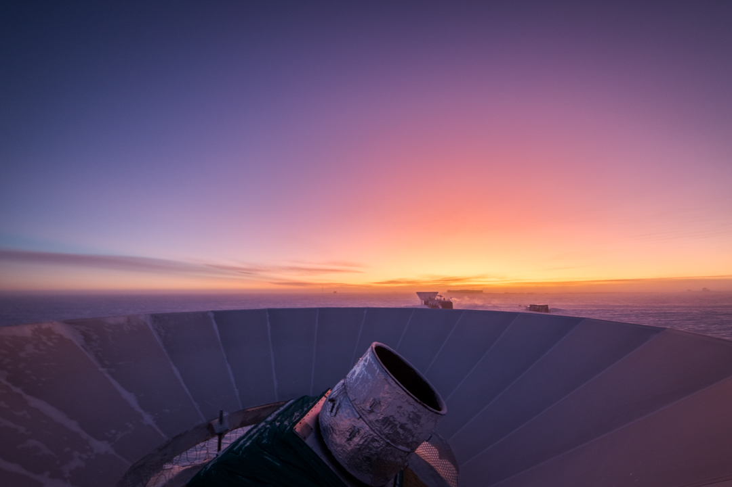




Probing the Early Universe From the South Pole
An Overview of BICEP
Howard Hui
Research Scientist
California Institute of Technology
For the BICEP Collaboration

Slide 2
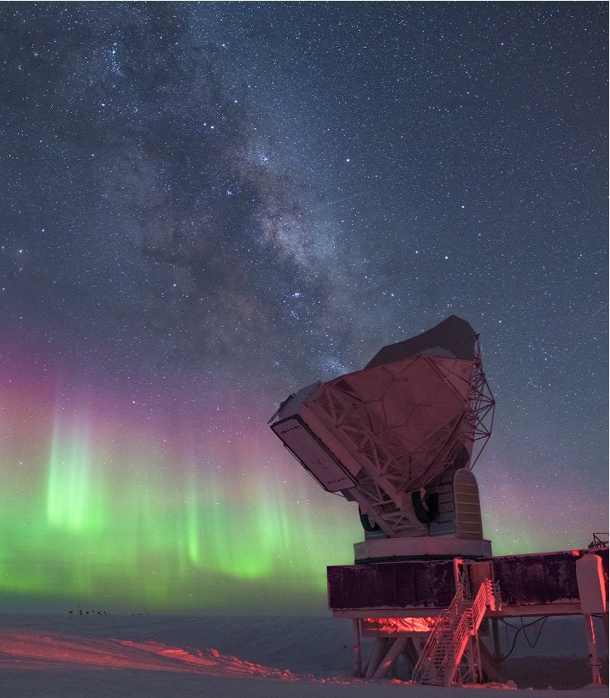
Probing the Early Universe From the South Pole
An Overview of BICEP, SPT, and
The South Pole Observatory
Howard Hui
Research Scientist
California Institute of Technology
For the BICEP, SPT and
The South Pole Observatory Collaboration

Slide 3
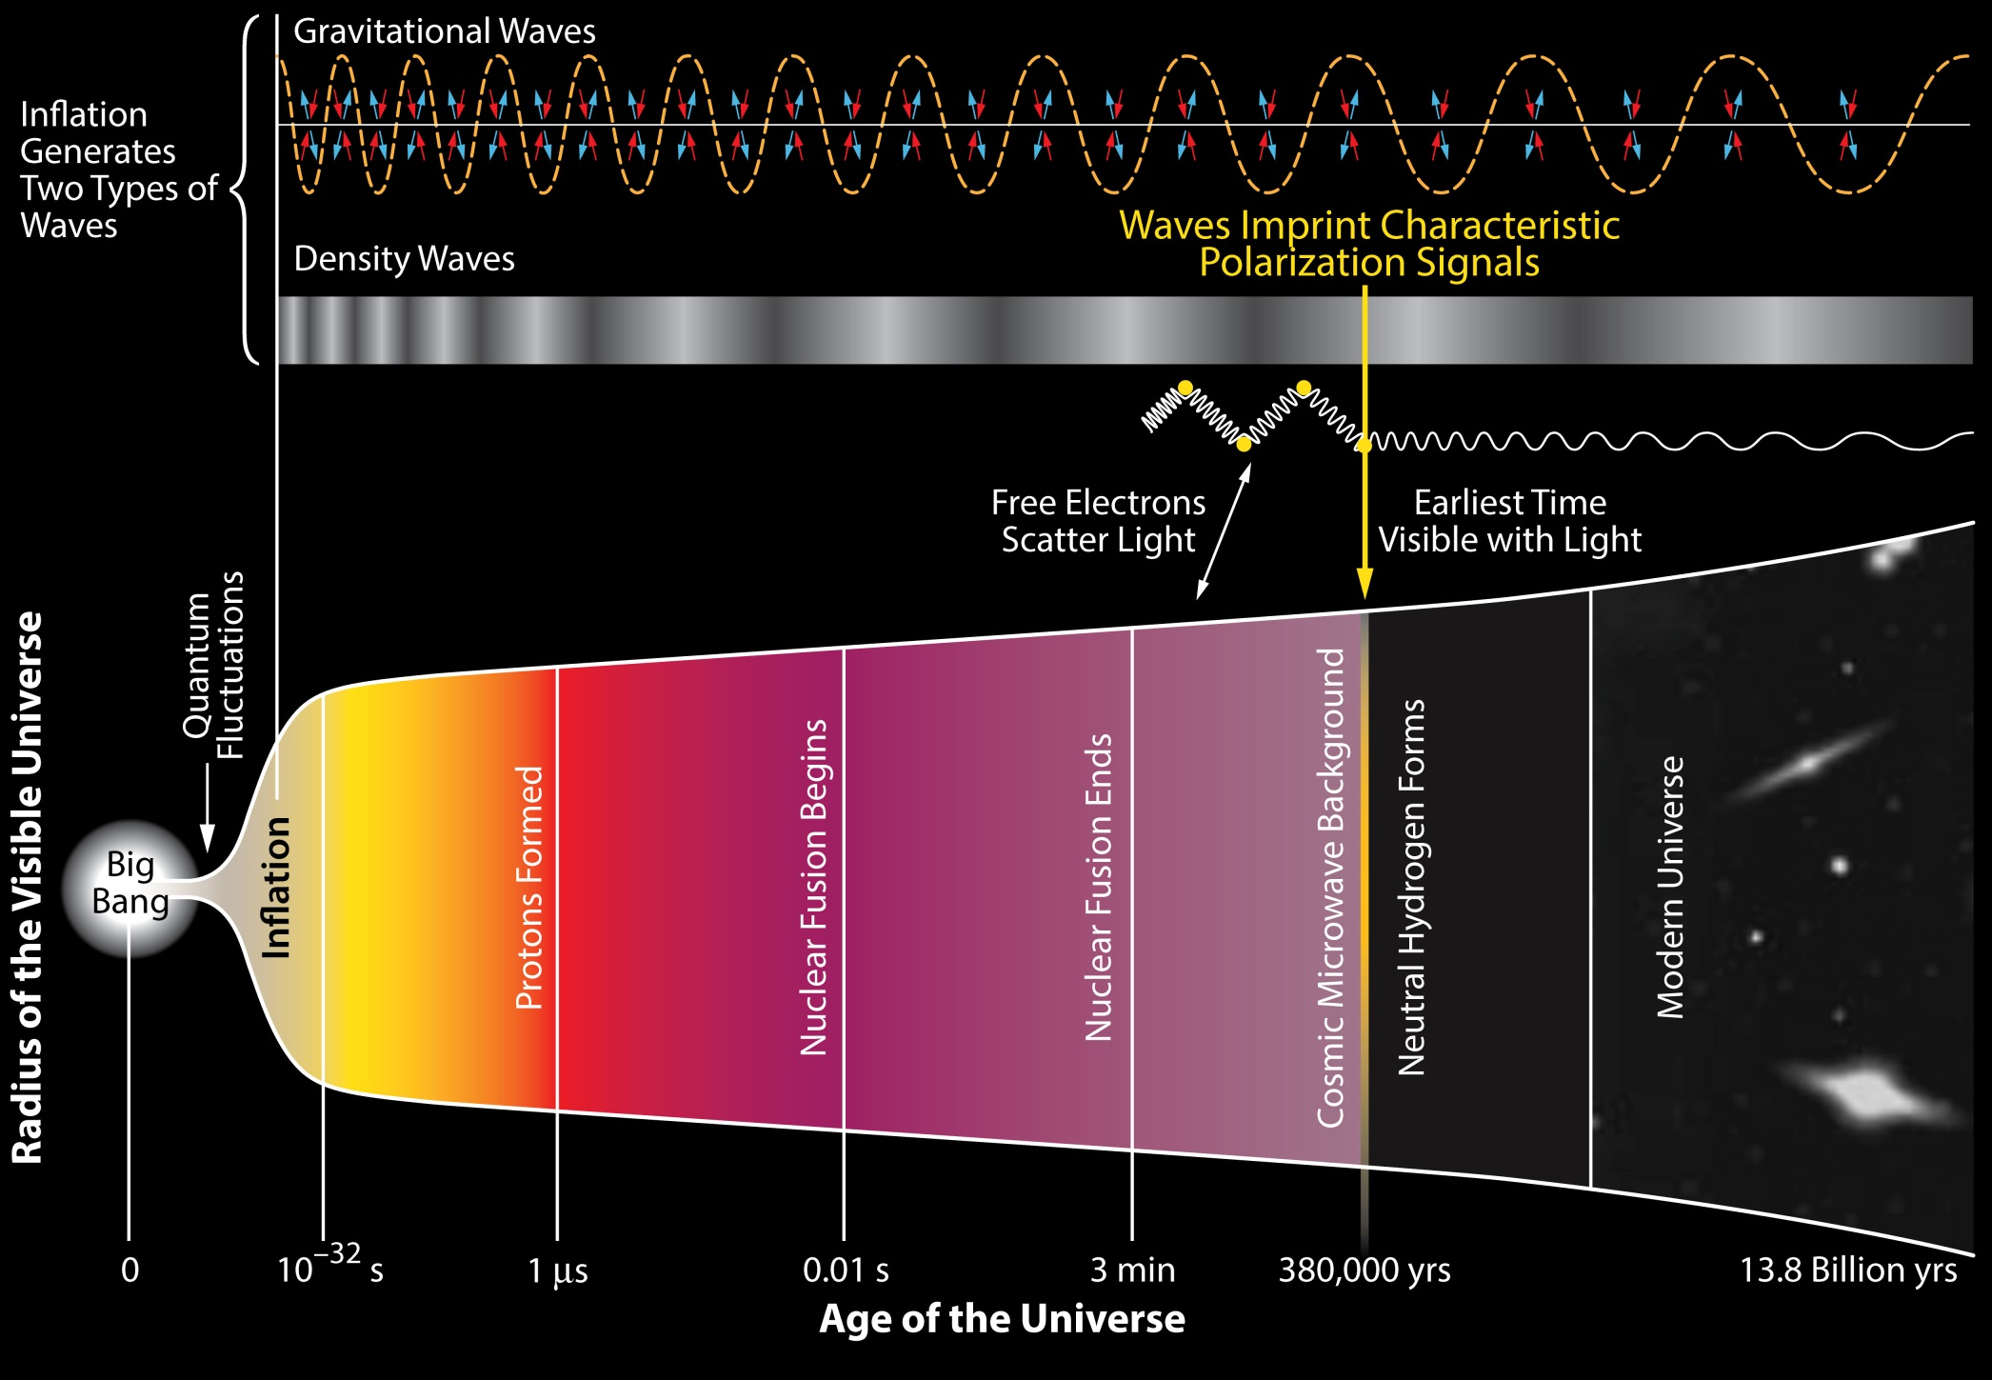
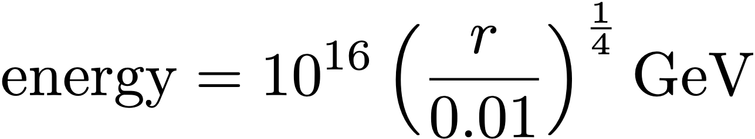
Probing Cosmic Inflation
B
B
B & E
E
E
E
E
E only
A unique key test of inflation and our origins
Tensor-to-scalar ratio, r, can be constrained by CMB B-mode spectrum, and test physics at energy scales a trillion times beyond the reach of the LHC.
Insights into quantum gravity
A relic from 10⁻³⁵ seconds, much earlier than the light elements created at t = 1 second.

Slide 4

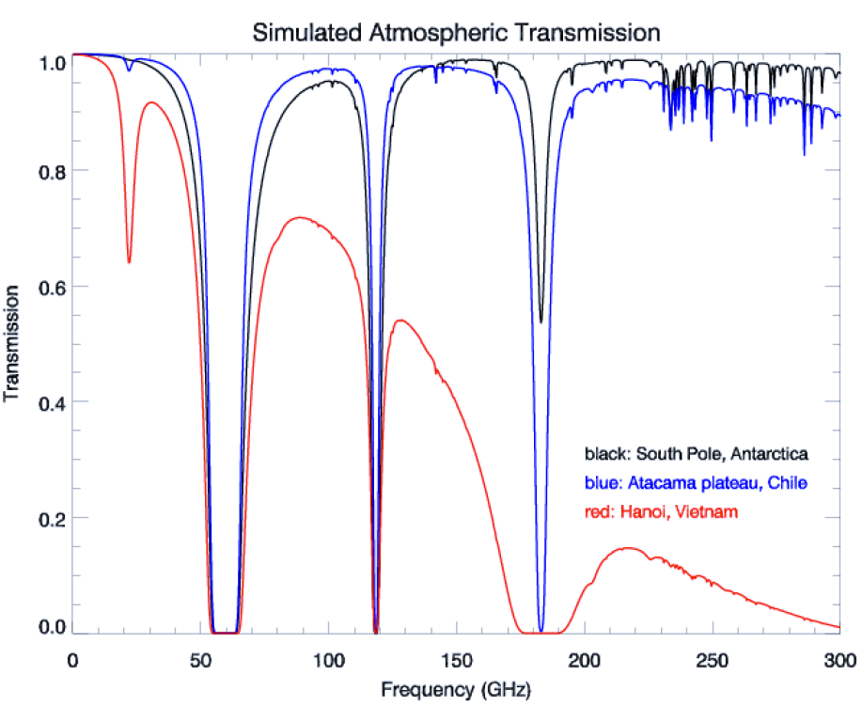
South Pole: Best location on Earth to search for Inflation
High and dry site
1 diurnal cycle per year: low-noise and stable atmosphere
Featureless horizon
24/7 observing access to deep sky regions
Excellent logistics for power, data, & cargo

Slide 5
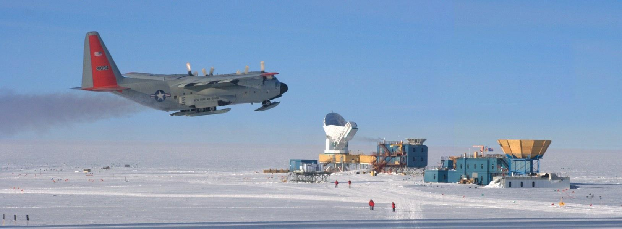
The South Pole Observatory, BICEP + SPT
10m South Pole Telescope
SPT-SZ
SPTpol
SPT-3G
BICEP1
BICEP2
BICEP3
QuAD
Keck Array
BICEP Array

Slide 6
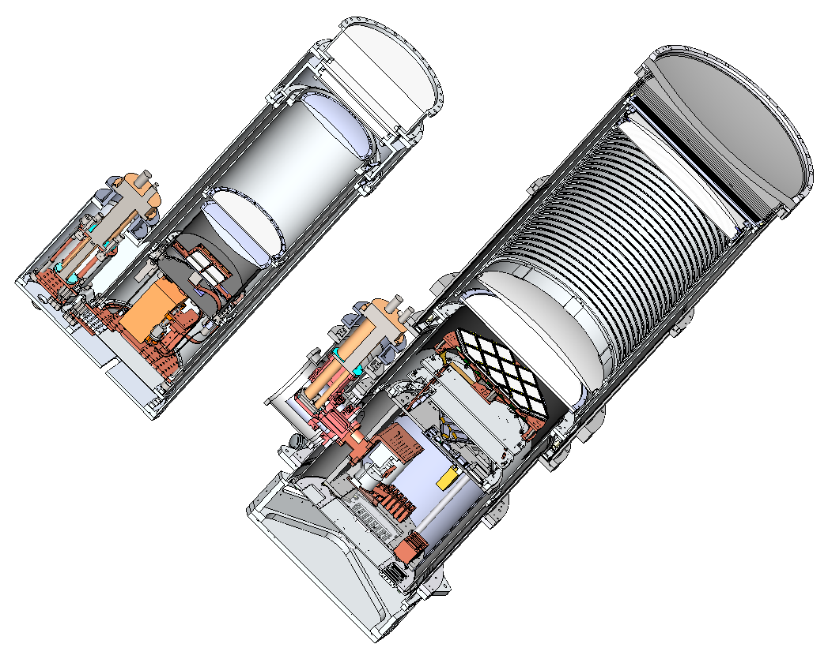
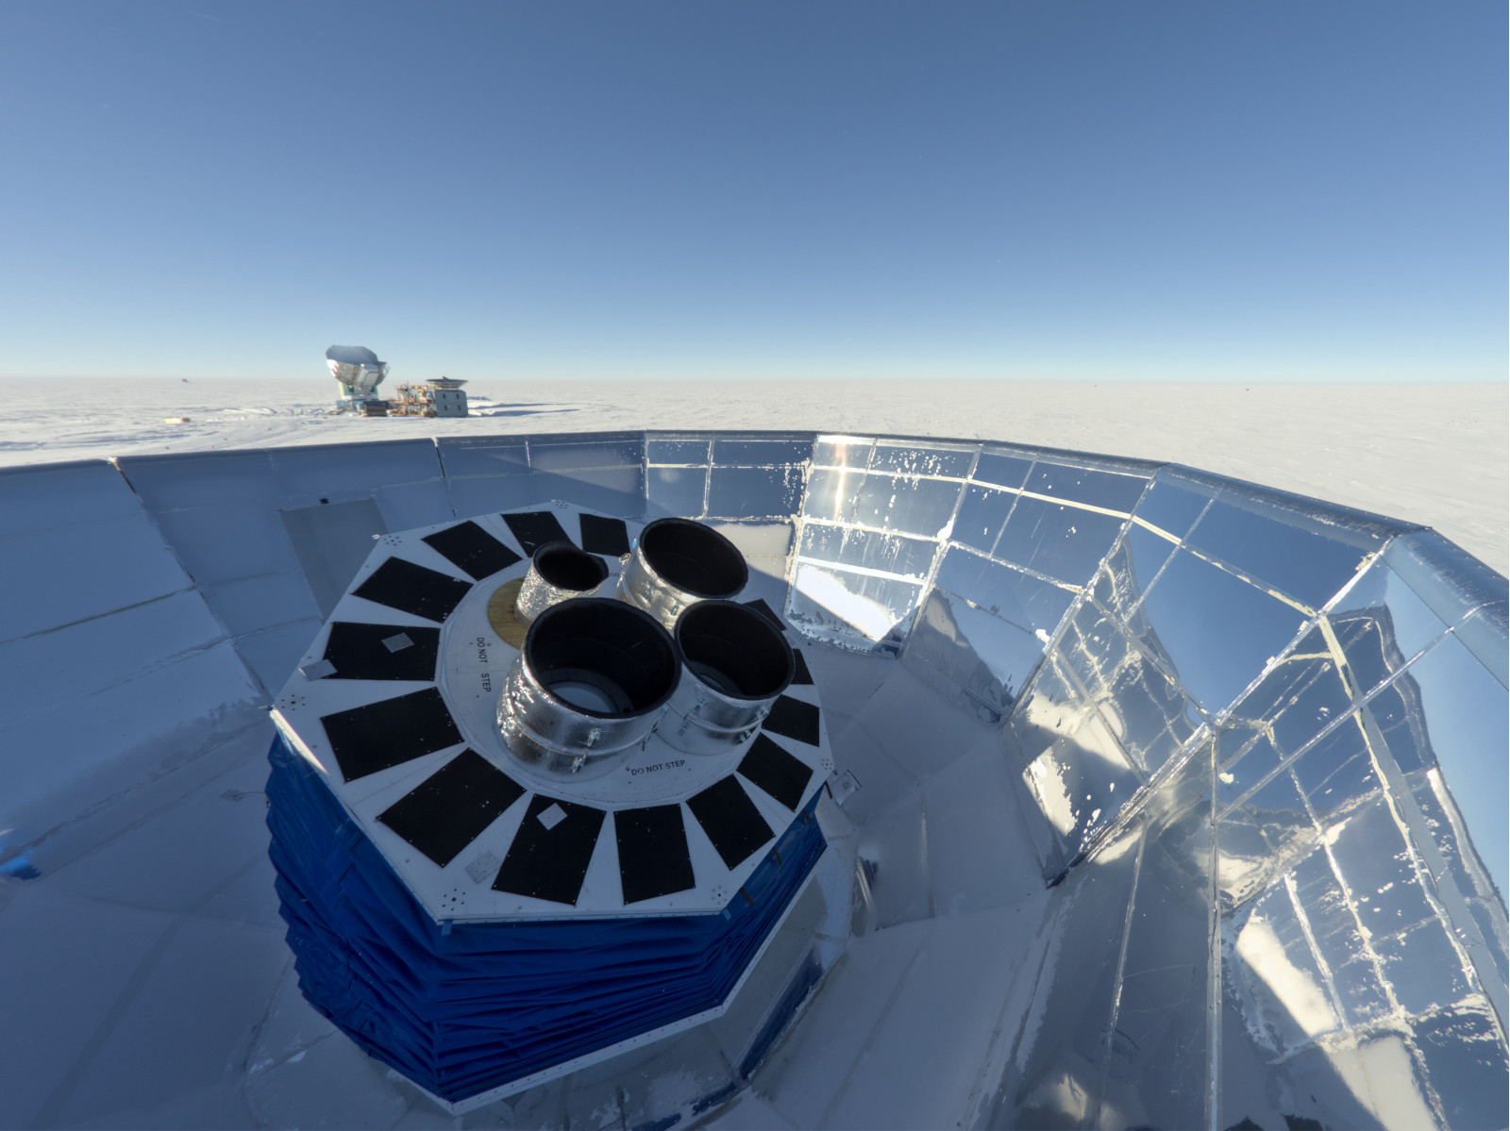
BICEP: Small Aperture Telescopes
Zotefoam Window
26.4 cm Aperture
55 cm Aperture
BICEP Array Telescope Mount
HDPE Lenses
HDPE
Window
PT-410
Pulse
Tube
PT-415
Pulse
Tube
Zotefoam
Thermal
Filters
Boresight
BICEP2
Keck Array
Receiver
4He-3He
Fridge
Alumina or
HDPE Lenses
Elevation
Alumina Thermal
Filter
BICEP3
BICEP Array
Receiver
Azimuth
Small aperture enables boresight rotation
Co-rotating absorbing forebaffle
Reflecting ground shield
Small aperture, large field of view
Refracting 4K optics with low sidelobes
55-cm design increases mapping speed by ~15x

Slide 7
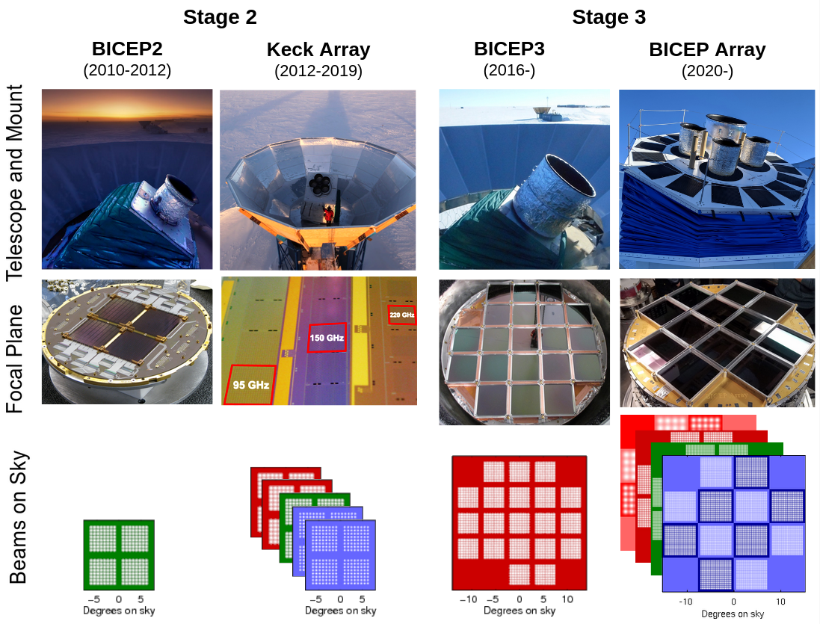
BICEP: Mapping the polarization of the CMB since 2010

Slide 8
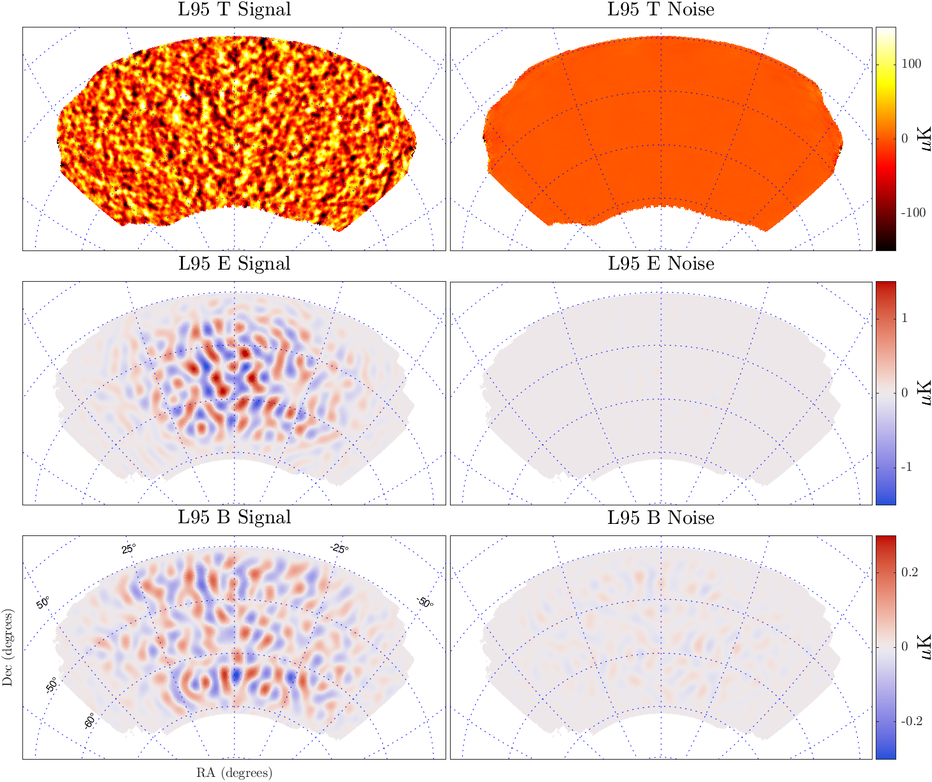
Data through 2024: BK24 Maps
BICEP3 95 GHz 9-year temperature and polarization
Note change in color scale
Effective polarized depth
1.65 𝜇K-arcmin
→ Deepest maps of CMB polarization made to date
*B maps prior to matrix purification

Slide 9
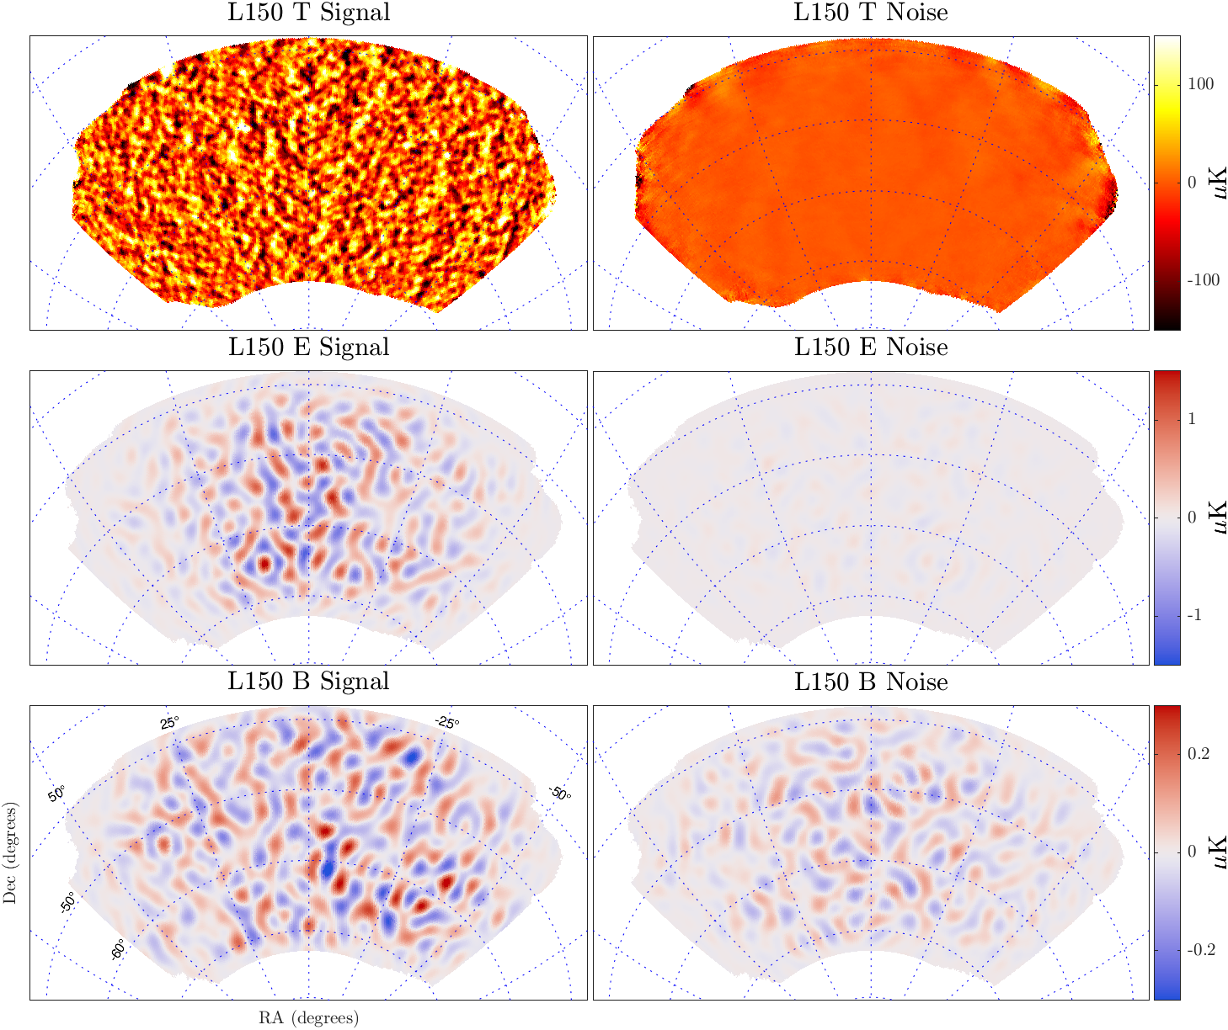
Data through 2024: BK24 Maps
BICEP Array 150 GHz 2-year temperature and polarization
→ Overlaps existing deep 150 GHz maps from BICEP2 & Keck Array in a smaller survey area
*B maps prior to matrix purification

Slide 10
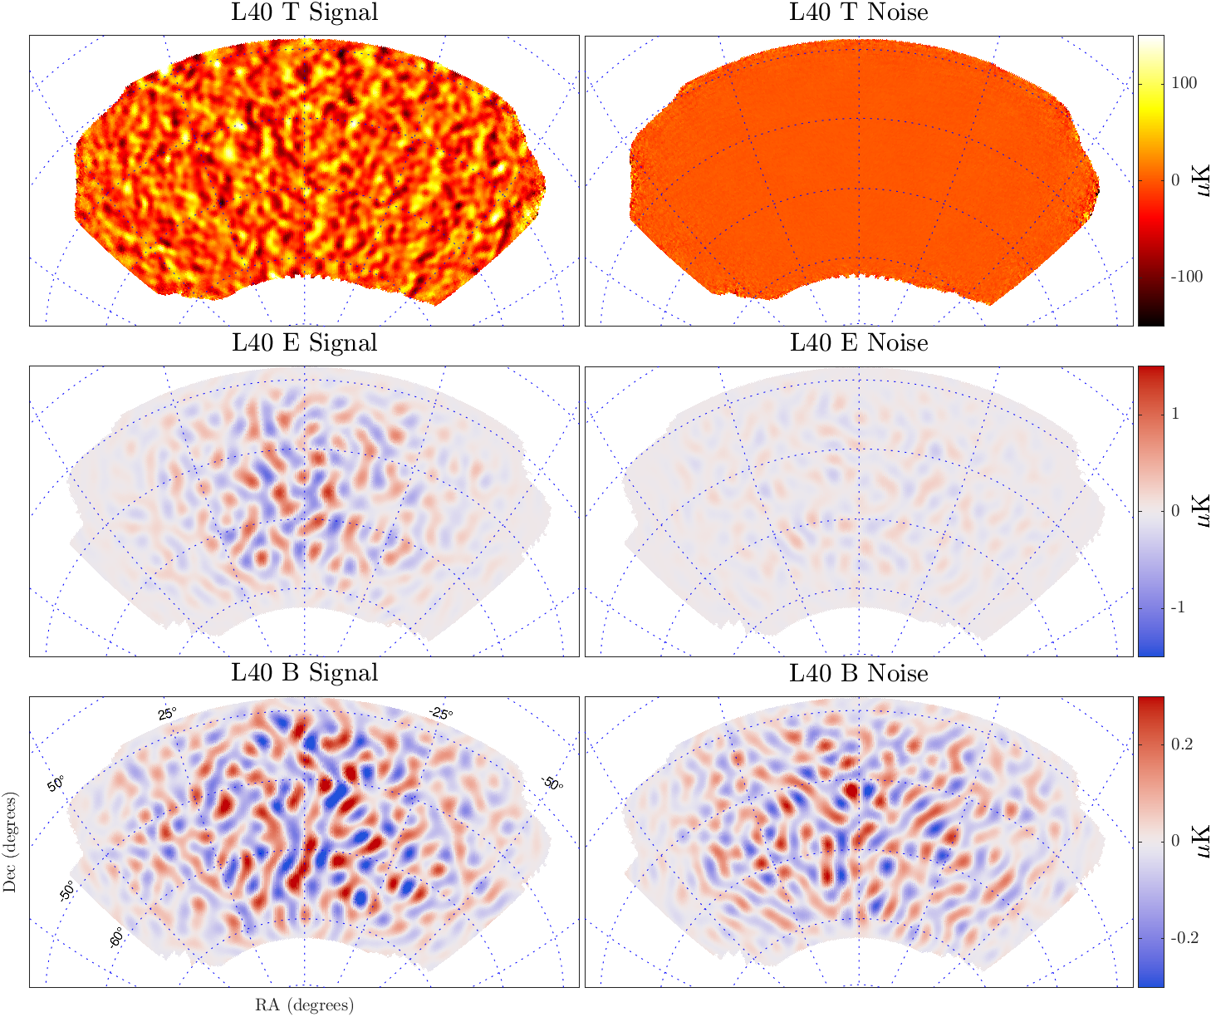
Data through 2024: BK24 Maps
BICEP Array 40 GHz 5-year temperature and polarization
→ New low-frequency bands added for control of synchrotron emission
*B maps prior to matrix purification

Slide 11
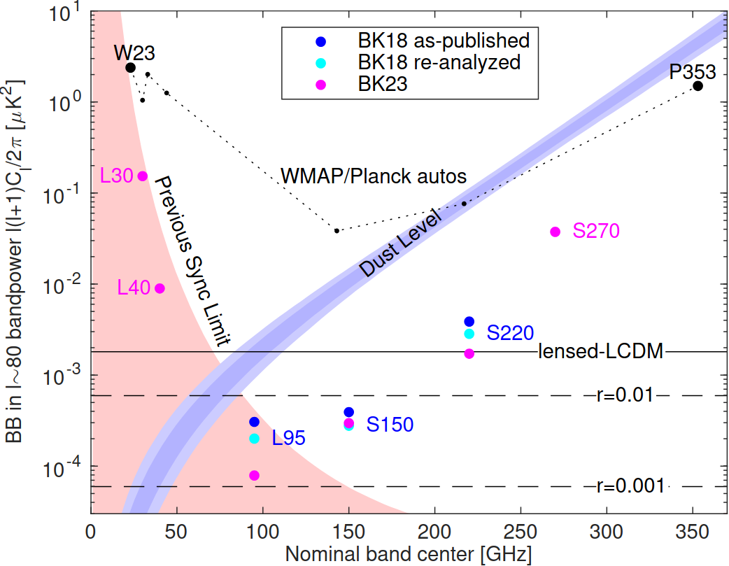
BK23 sensitivity
Progression of noise level in science-driving ℓ~80 bandpower
Multi-frequency observations have dramatically improved understanding of foregrounds
BK23 in analysis
- New data at 30, 40 & 270 GHz
- 4x improved sensitivity at 95 GHz
→ Gravitational lensing is now the dominant error source
- Delensing demonstrated using SPT
and BK data in 2021 paper

Slide 12
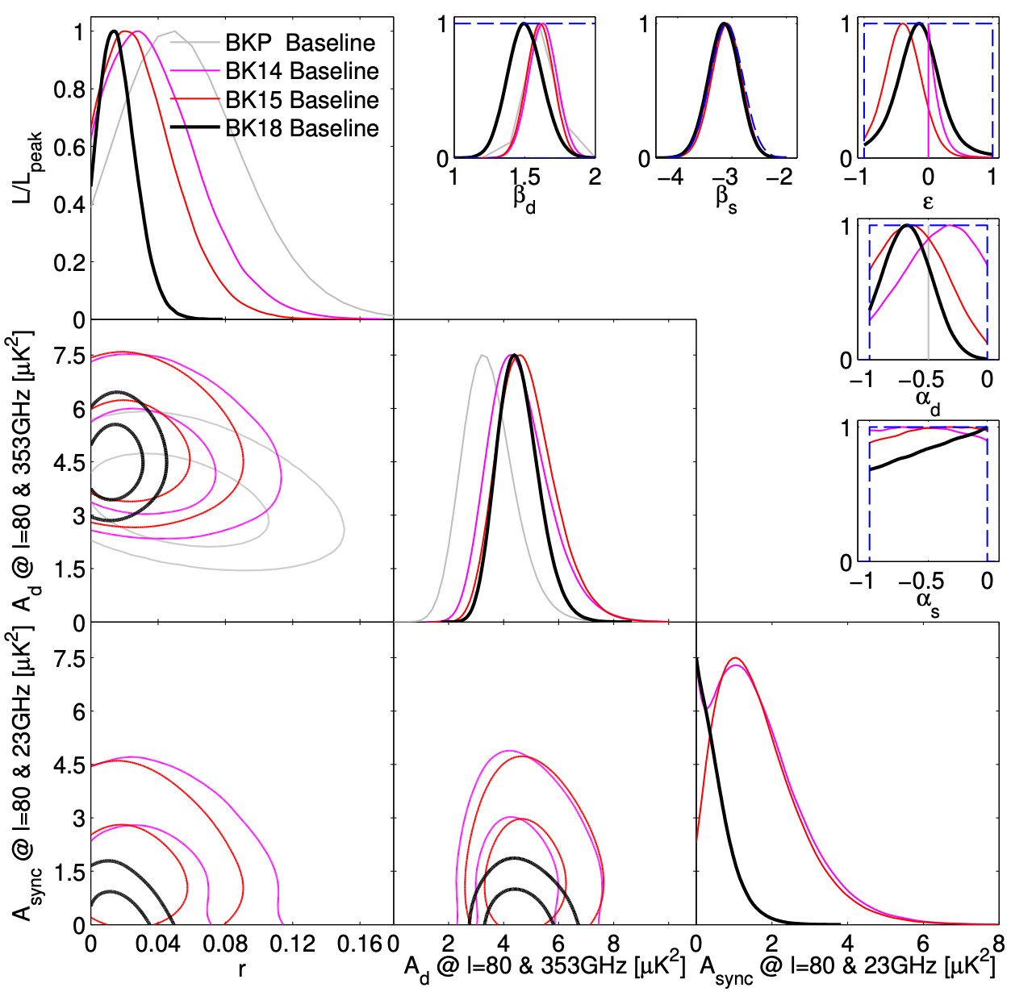
From BKP to BK18
BKP: BICEP2+Keck to 2012 BK14: BICEP2+Keck to 2014 BK15: BICEP2+Keck to 2015 BK18: BICEP2+Keck+BICEP3 to 2018
more data, more foreground parameters, less priors, and a tighter $r$ constraint
BK18 experimental uncertainty $σ(r)=0.009$ — the strongest constraint to date!

Slide 13
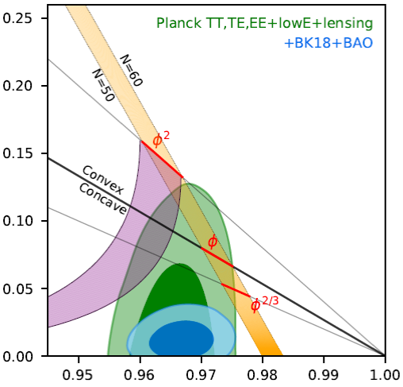
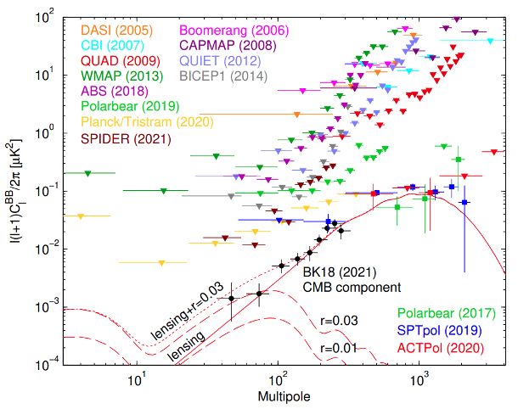
CMB constraints on Inflation from BK18
m²φ² Inflation
Tensor-to-scalar ratio r
Axion
monodromy
models
Inflation with
monomial
potentials φ^{p}
Planck
Natural
Inflation
BICEP-Keck
2018 data
Spatial Index n_{s}
BK18+Planck2018+BAO: $r<0.035$
Monomial Inflation and Natural Inflation are strongly disfavored
The progress is entirely driven by B-modes!
Strong detection of lensing B-modes by SPT and ACT

Slide 14
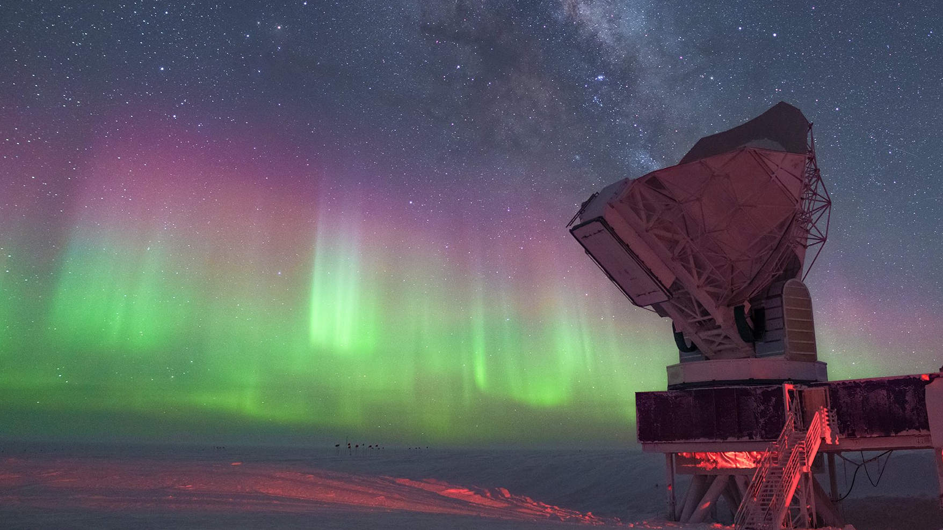

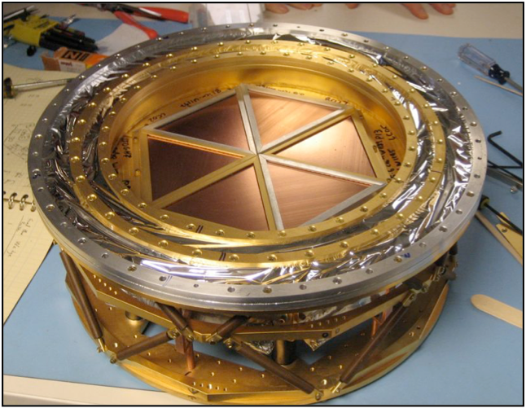
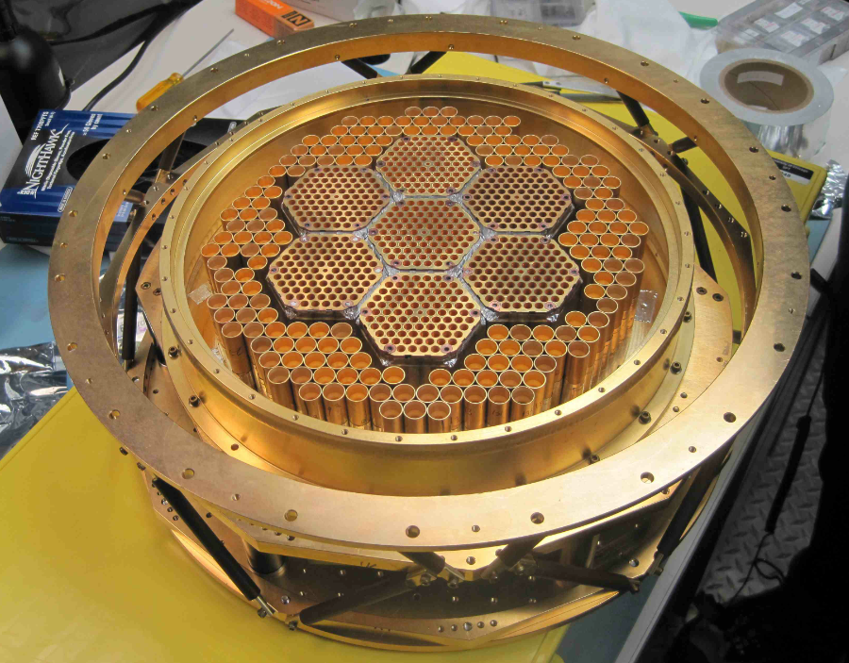
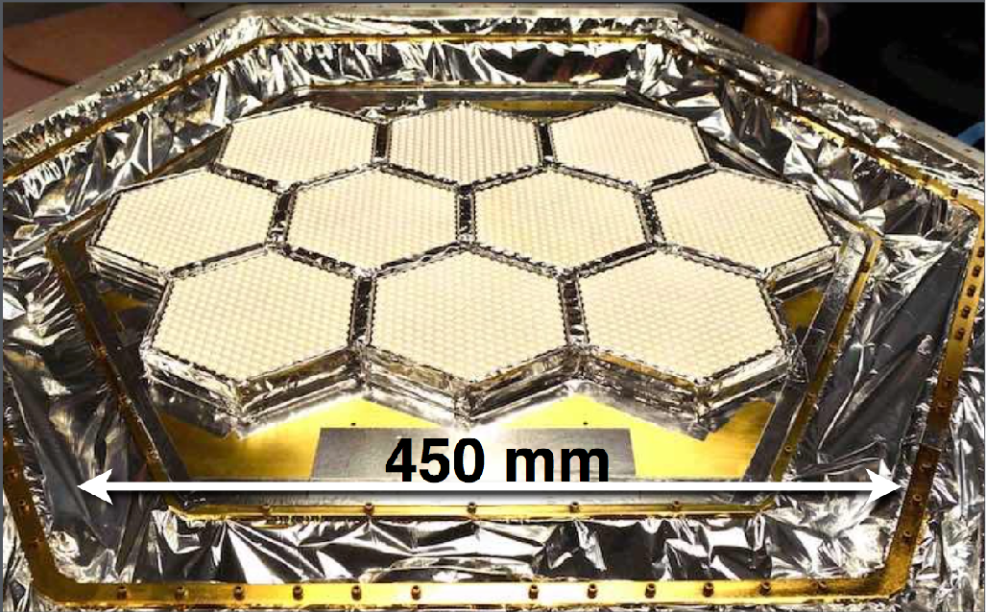


The South Pole Telescope (SPT)
    10-meter diameter telescope
    95, 150, 220 GHz frequency
    1.6, 1.2, 1.0 arcmin resolution
2007: SPT-SZ
960 detectors
100,150,220 GHz
2012: SPTpol
1600 detectors
100,150 GHz
+Polarization
2017: SPT-3G
~16,200 detectors
100,150,220 GHz
+Polarization
SPT-3G has 7x
larger mapping
speed relative to
Planck!
Funded by:

Slide 15
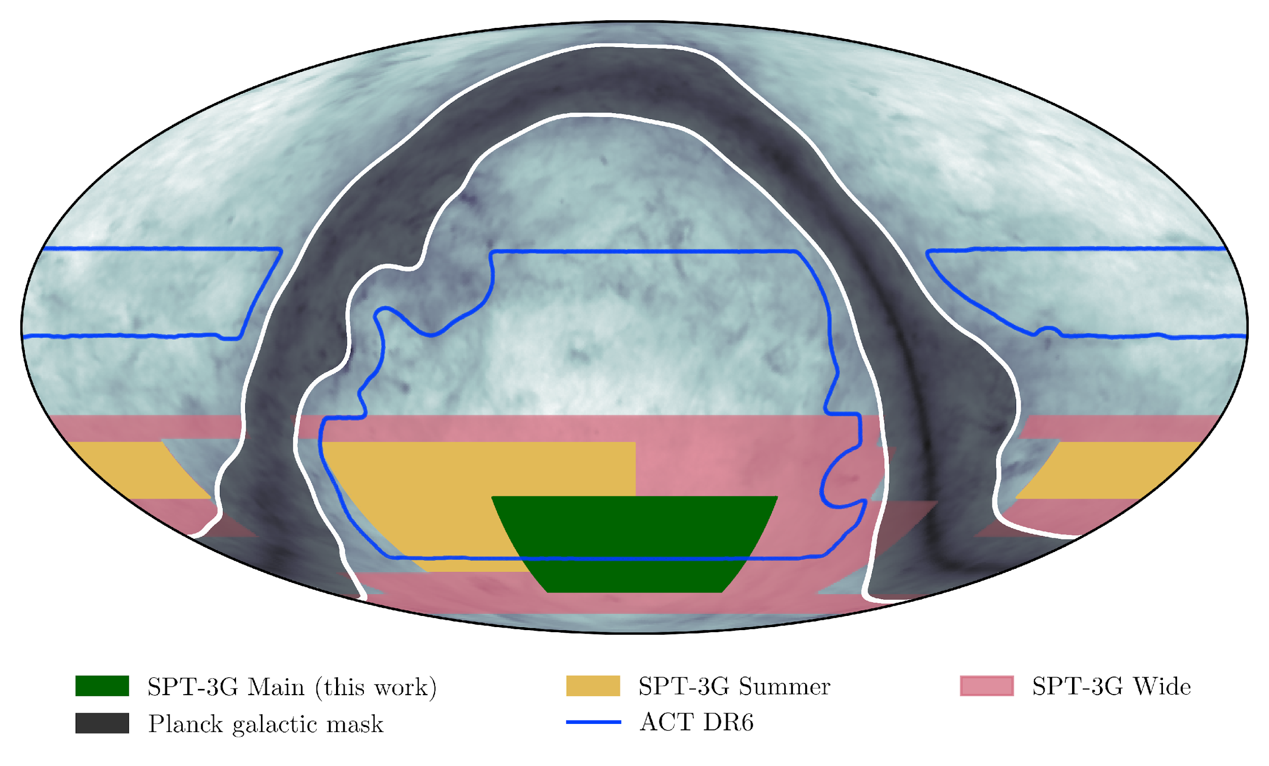
SPT-3G Surveys
In 2019, SPT-3G started a 1500 deg² Main survey, funded to continue observations thru 2028.
  Most-sensitive measurement of gravitational lensing of CMB yet made (~20x deeper than Planck)
SPT-3G also has Summer and Wide surveys totaling 10,000 deg² (~25% of the sky)
Large area (25-50% of sky) surveys from SPT-3G and Simons Observatory (SO) will soon significantly improve 𝚲CDM cosmological constraints over Planck
(SPT-3G) Camphuis et al. (2025), arXiv: 2506.20707
Adapted from Brad Benson

Slide 16
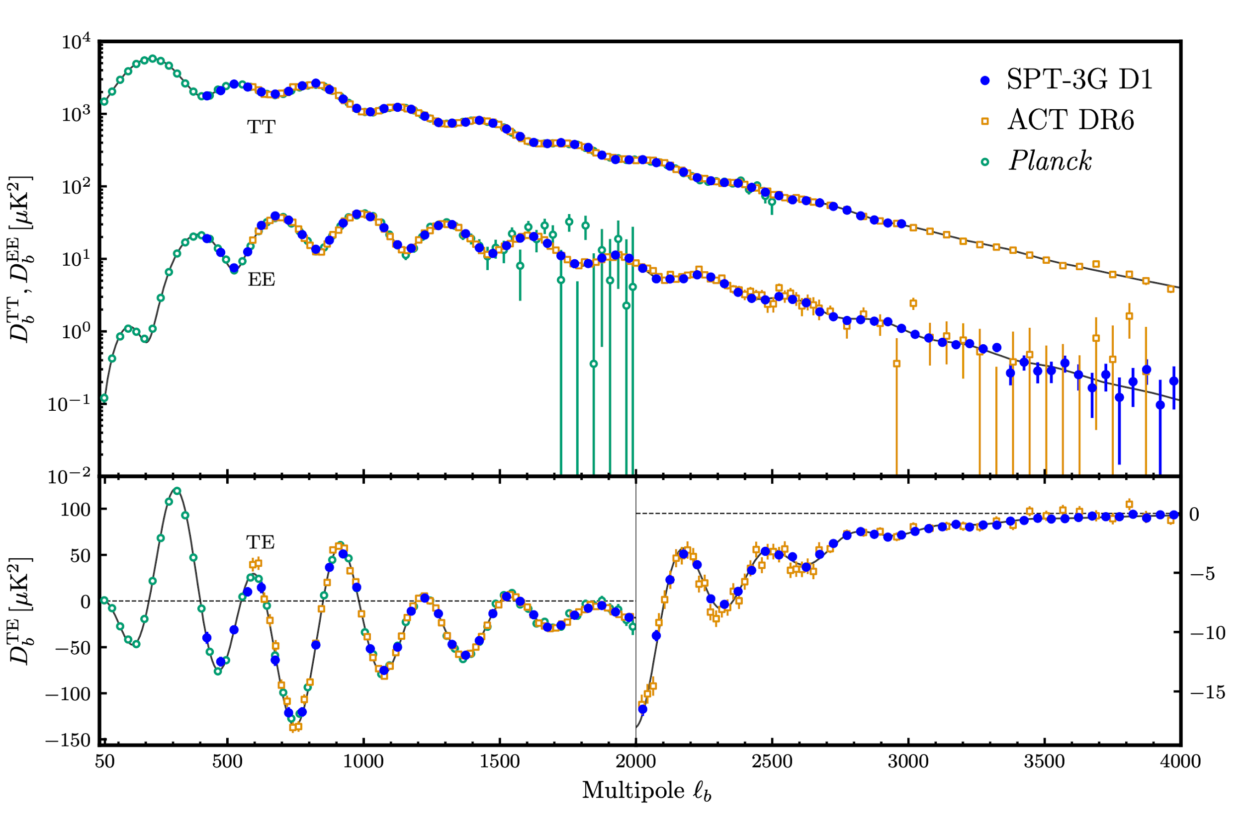
SPT-3G CMB Power Spectra
SPT-3G: CMB Power Spectra
SPT-3G provides the most precise measurement of polarization power spectra at multipoles, ℓ > ~1800
For the first time, the combined constraining power of SPT & ACT exceeds the precision from the Planck on many cosmo parameters
Temperature
Temperature
E-mode
Polarization
TE Correlation
(SPT-3G) Camphuis et al. (2025), arXiv: 2506.20707
Adapted from Brad Benson

Slide 17
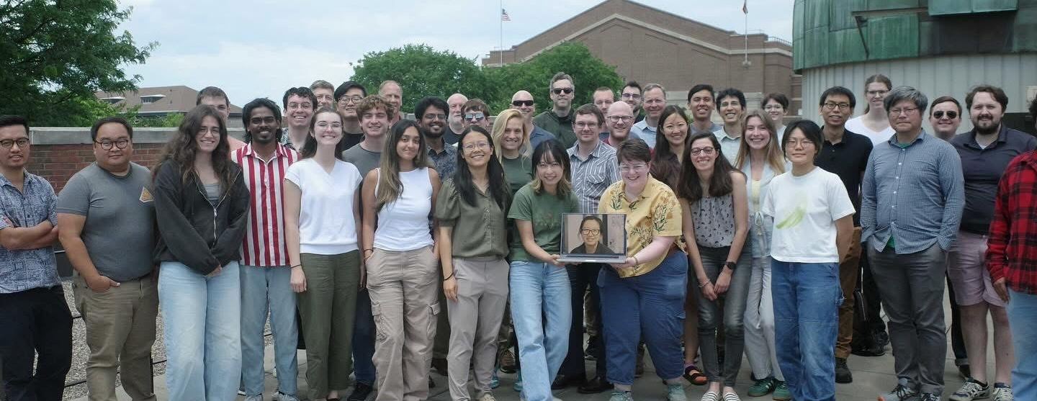








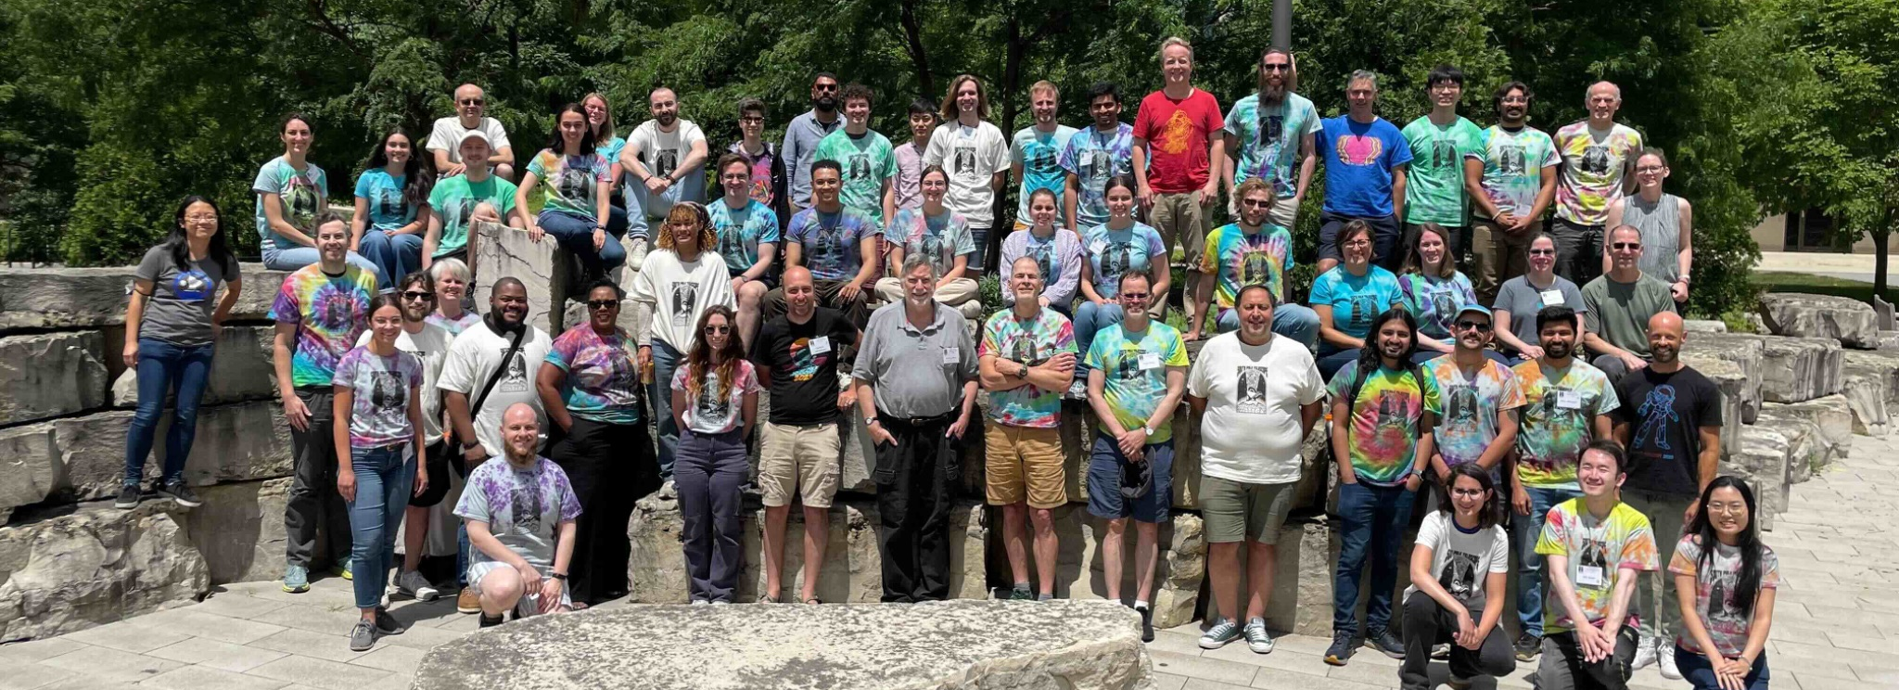











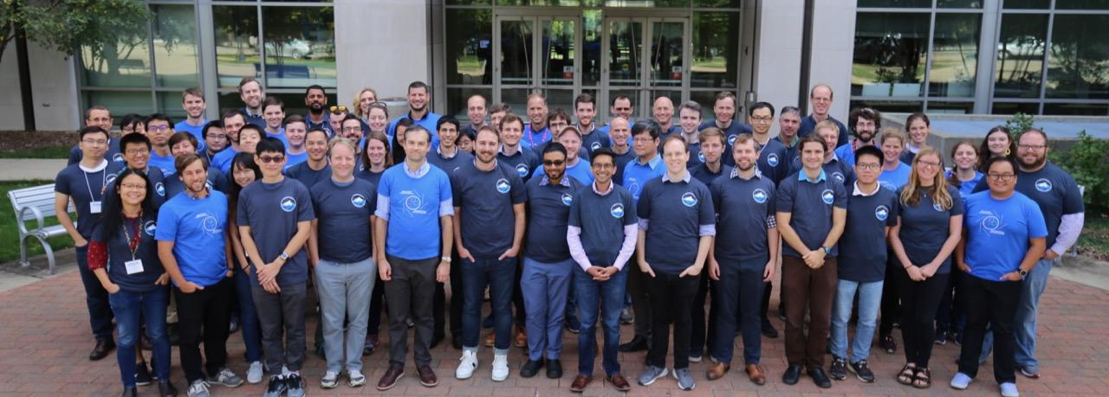






SPO Collaboration
SPO Collaboration consists of over 150 members across 25 institutions
The BICEP Collaboration
The SPT Collaboration
The SPO Collaboration

Slide 18
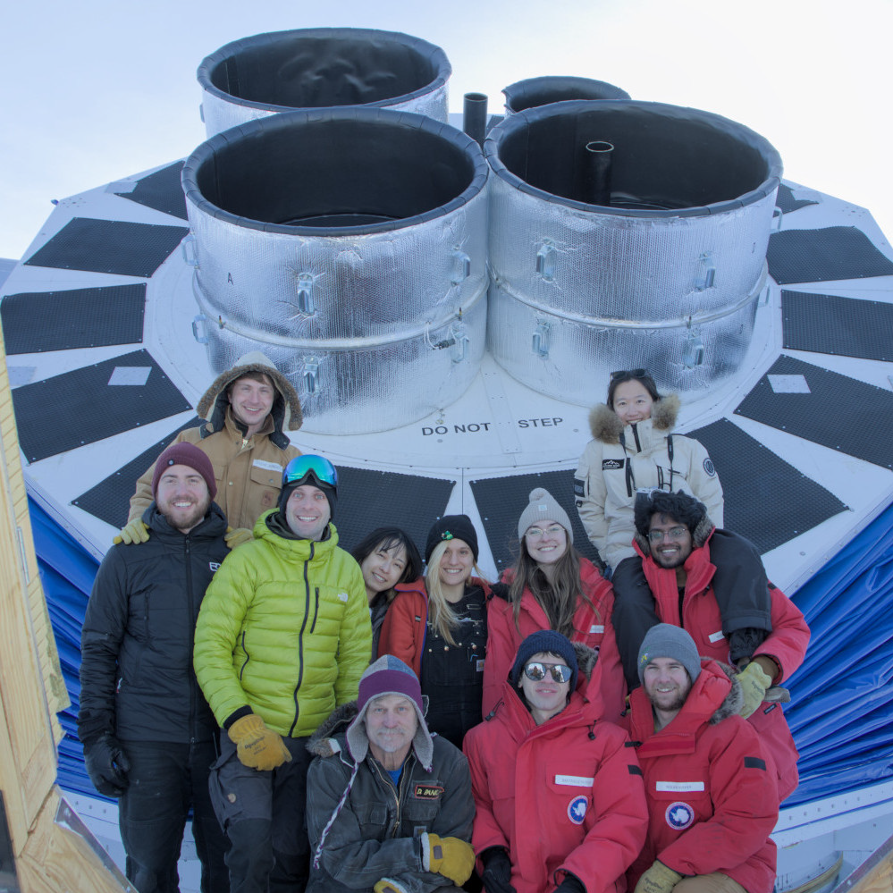
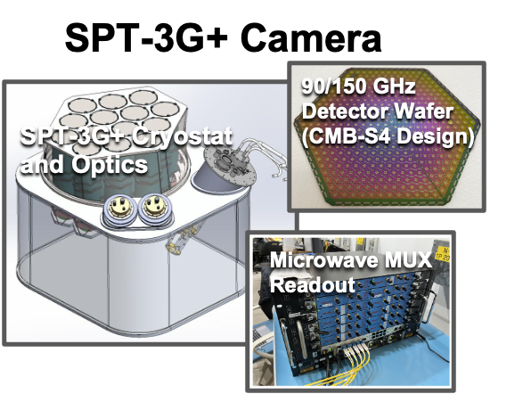
South Pole Observatory (SPO)
BICEP Array
Fig. from Brad Benson
BICEP Array in 2025
South Pole Telescope
Collaboration of the BICEP Experiment and the South Pole Telescope (SPT)
Make the most of existing facilities at the South Pole
Conducting a coordinated program to search for the imprint of Inflationary Gravitational Waves on the Cosmic Microwave Background.

Slide 19
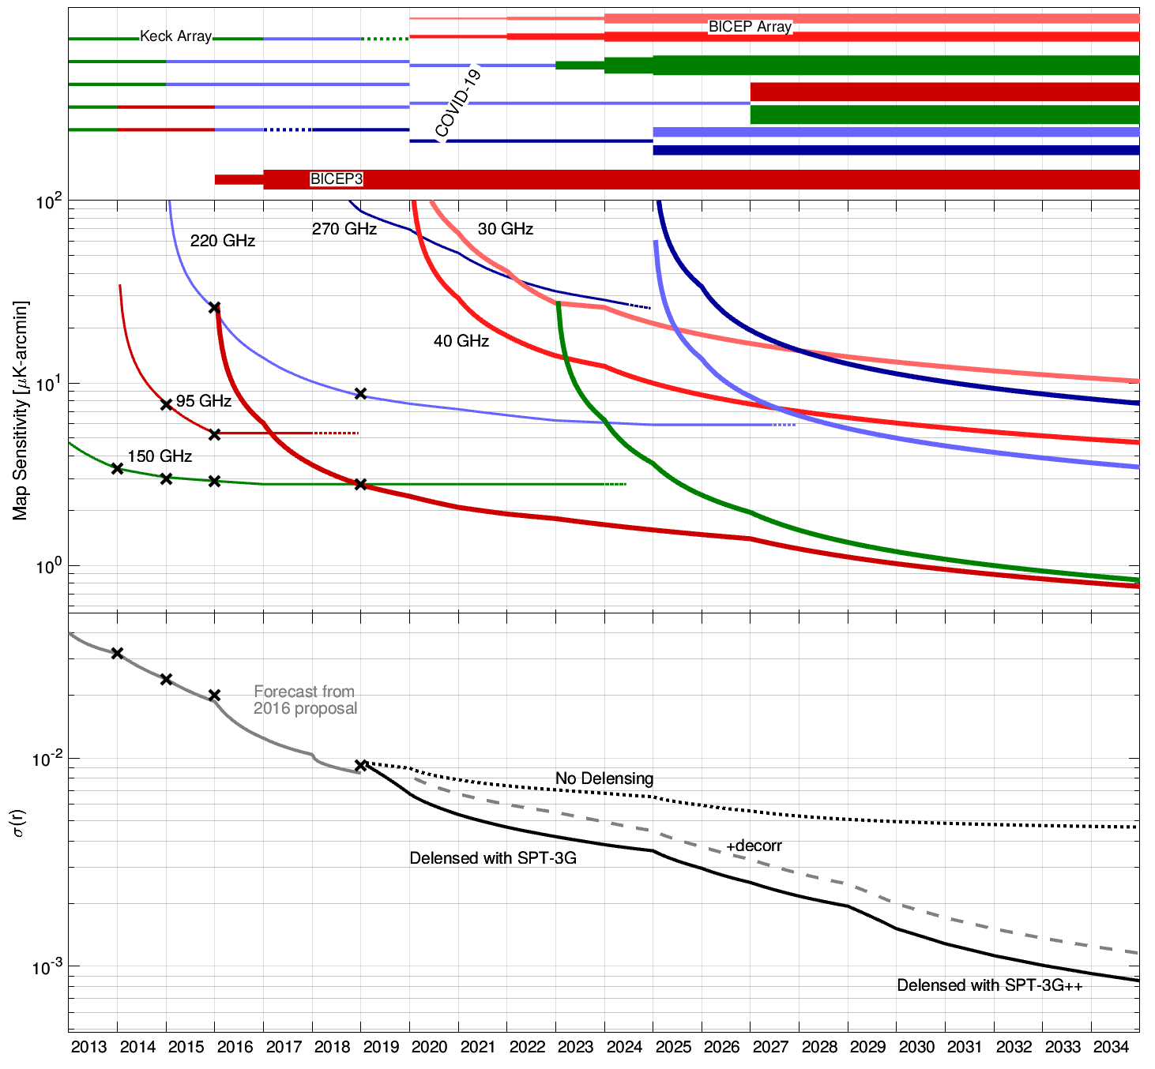
What is next at the South Pole? Forecast based on achieved performances
Three BICEP Array receivers have now been installed:
30/40 GHz (2019)
150 GHz (2022)
220/270 GHz (2024)
Plan for a new 4th 95/150 GHz receiver (2026)
SPT is observing with SPT-3G focal plane now
Opportunity for upgraded delensing capability with a new SPT-3G++ focal plane (2028)
Program achieves
s(r) = 1 x 10⁻³ with an empirically validated sensitivity model and decorrelation in polarized Galactic dust

Slide 20
Summary
CMB measurements from South Pole Telescope have started to surpass the constraining power of Planck, and will significantly improve cosmological constraints in the next few years.
CMB Polarization offers a direct test of inflation.
  BICEP/Keck experiment at the South Pole provide the best constraint on the tensor-to-scalar ratio r, disfavoring some simple inflation models.
  Mutli-frequency observations have dramatically improved understanding of foregrounds.
  Gravitational lensing is now the dominant error source, delensing pipeline demonstrated using South Pole Telescope and BICEP/Keck data in 2021 paper.
  The South Pole Observatory, joining forces of BICEP and SPT with new receivers will improve capability.
  Expected program sensitivity achieves σ(r) = 1 x 10⁻³ by 2034 with an empirically validated sensitivity model and decorrelation in polarized Galactic dust.

