Slide 1
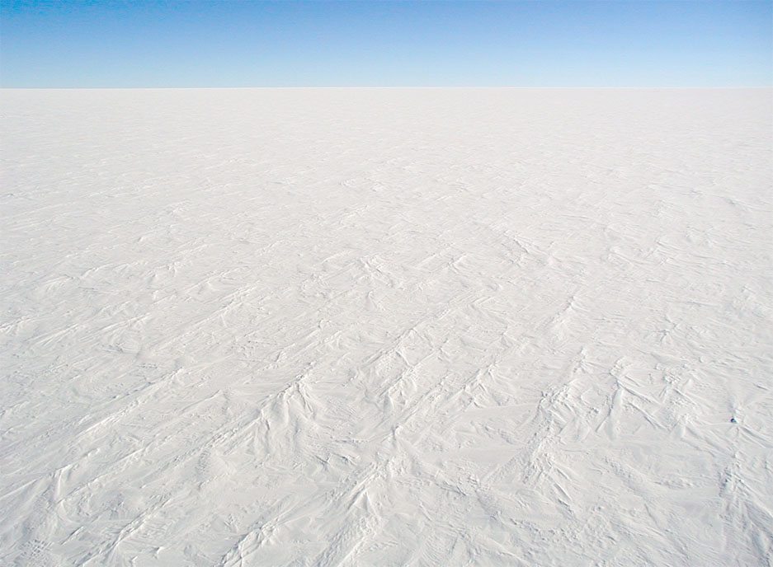
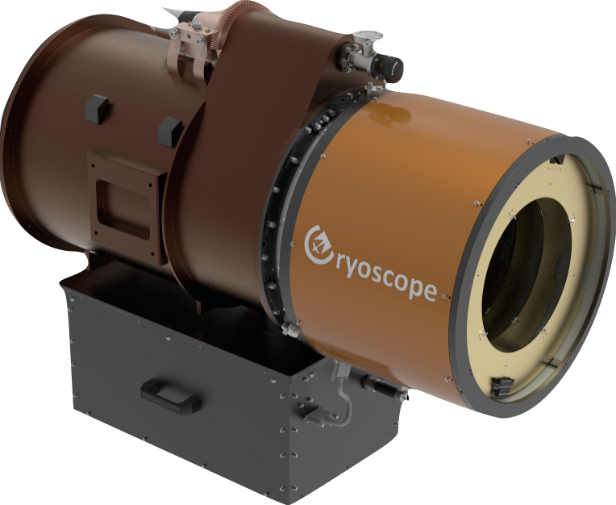
ASTEP to Cryoscope: Expanding Antarctic astronomy at Dome-C with a Wide Field Infrared Telescope
Tony D. Travouillon Antonio de Ugarte Postigo, Tristan Guillot, Mansi M. Kasliwal, Roger M. Smith, Lyu Abe, Karim Agabi, Sarah Antier, Michael C. B. Ashley,
Philippe Bendjoya, Benoit Carry, Luca Casagrande, Ilaria Caiazzo, Cenko Brad,
Matthew Graham, Timothee Greffe, Nicholas Earley, Jason Fucik, David Hale, Elena Pian, Olga Suarez, Amaury Triaud, Bob Weber, and Julien de Wit

Slide 2
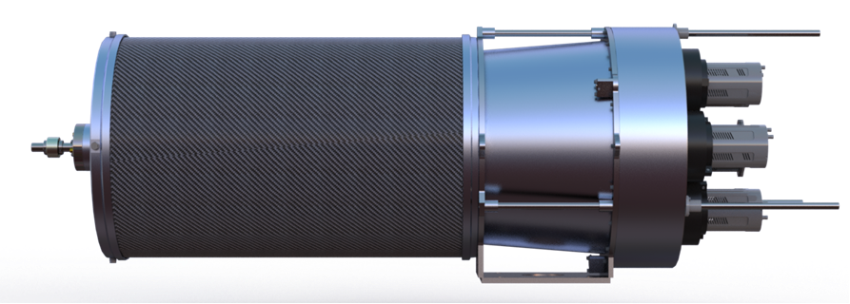
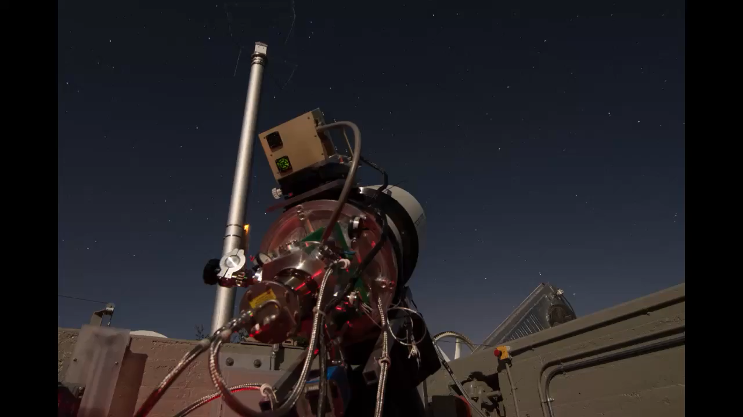
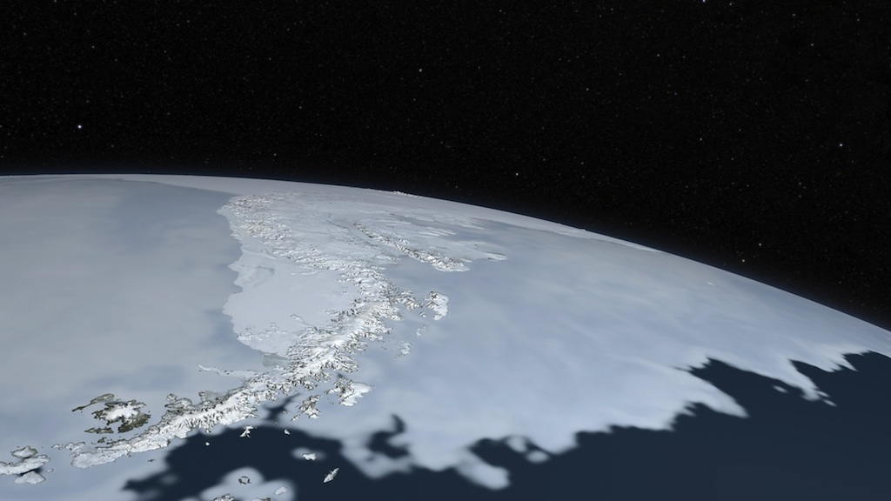
The path towards an Antarctic IR Survey Telescope
Infrared surveyors currently operating or under construction at Palomar (USA) and Siding Spring (Australia).
Cryoscope to be the culmination of this expertise, aiming at a deployment at Dome C before the end of the decade.
WINTER
2030?
1m aperture with 1.2 deg² FOV, 12Mpix, Y/J/H bands
Palomar, California
Cryoscope
1.2m aperture with 50deg² FOV, K-band, 1.2 Gpix
Dome C, Antarctica
Palomar Gattini-IR
2026
30cm Aperture with 25deg² FoV, J-band, 4.2Mpix
Palomar, California
Cryoscope-pathfinder
Quarter-scale technology Demonstrator
2025
DREAMS
50cm aperture with 3.8 deg² FoV, Y/J/H bands, 7.8Mpix
Siding Spring, Australia
2018

Slide 3
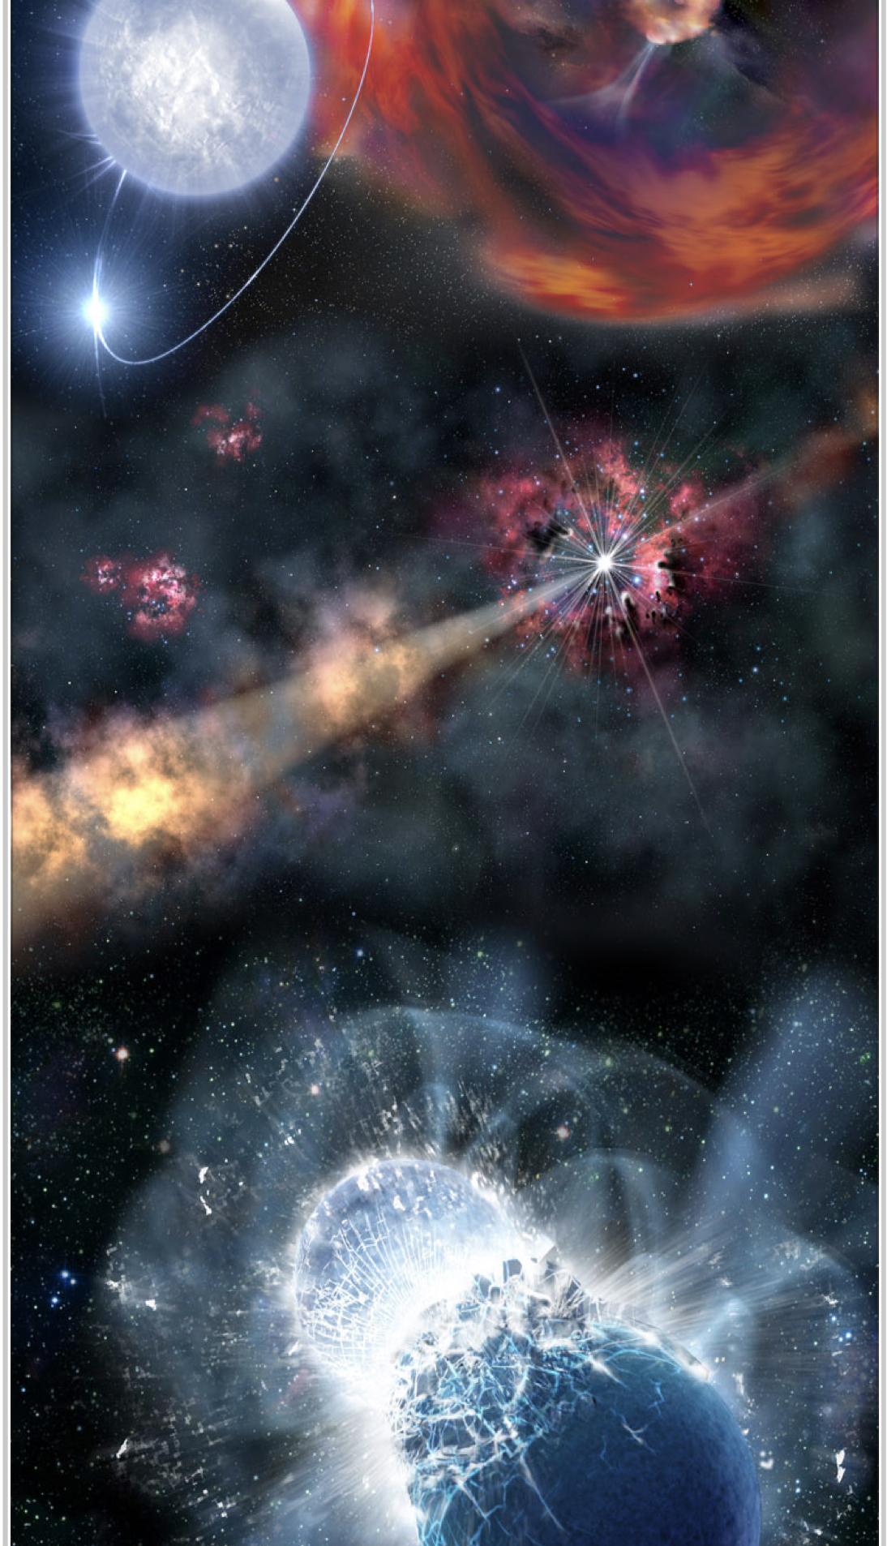
Science drivers for a wide-field IR telescope
At the time of VRO we need a complementing wide field IR survey to study:
  The dusty and obscured Universe
  Cool star forming regions
  Exoplanet transits in cold stars
  Asteroids and comets
  Galactic centers
  Transients with high opacity (KN, TDEs, SN, etc.)
  GW counterparts through wide searches
  Neutrino follow-up
Stephen Hudson, Wikipedia

Slide 4
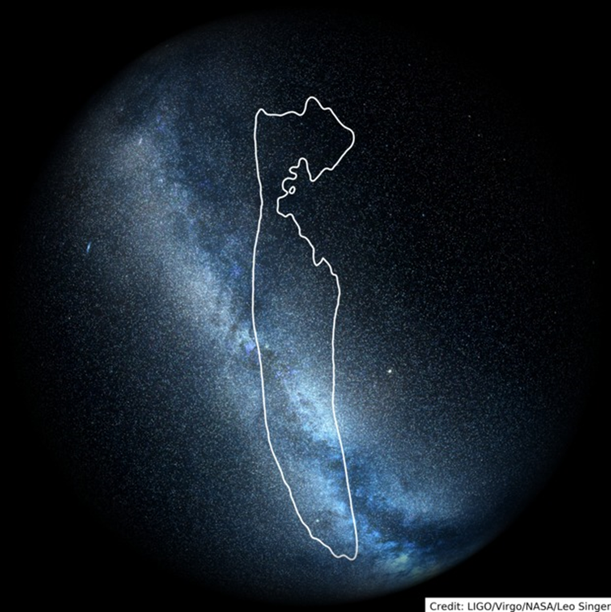
Gravitational wave follow-up
GW observatories deliver large error boxes (100s of deg²) that need rapid monitoring
Neutron star mergers produce heavy elements in high-opacity environments.
The associated kilonovae are better observed in the IR
A sensitive, wide-field K-band observatory is the ideal tool
Stephen Hudson, Wikipedia

Slide 5
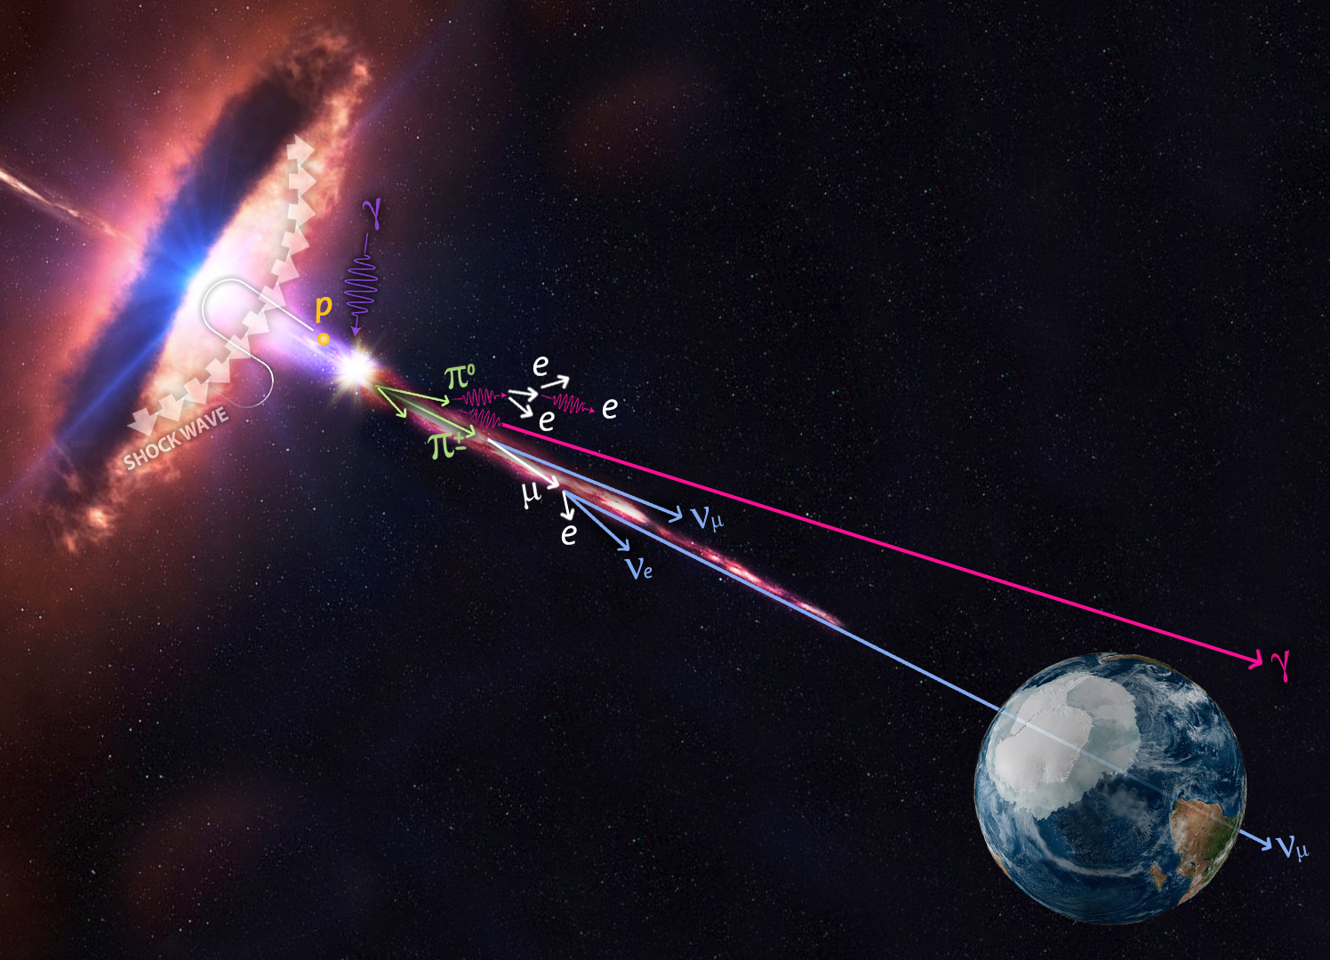
Neutrino counterparts
South location is ideal to search for neutrino sources from the French/Italian KM3NeT
Produced near the supermassive black holes of galaxies, in blazars and tidal disruption events
Follow-up requires large FoV
IR observations allow to search deeper into the dusty core of galaxies
Stephen Hudson, Wikipedia

Slide 6
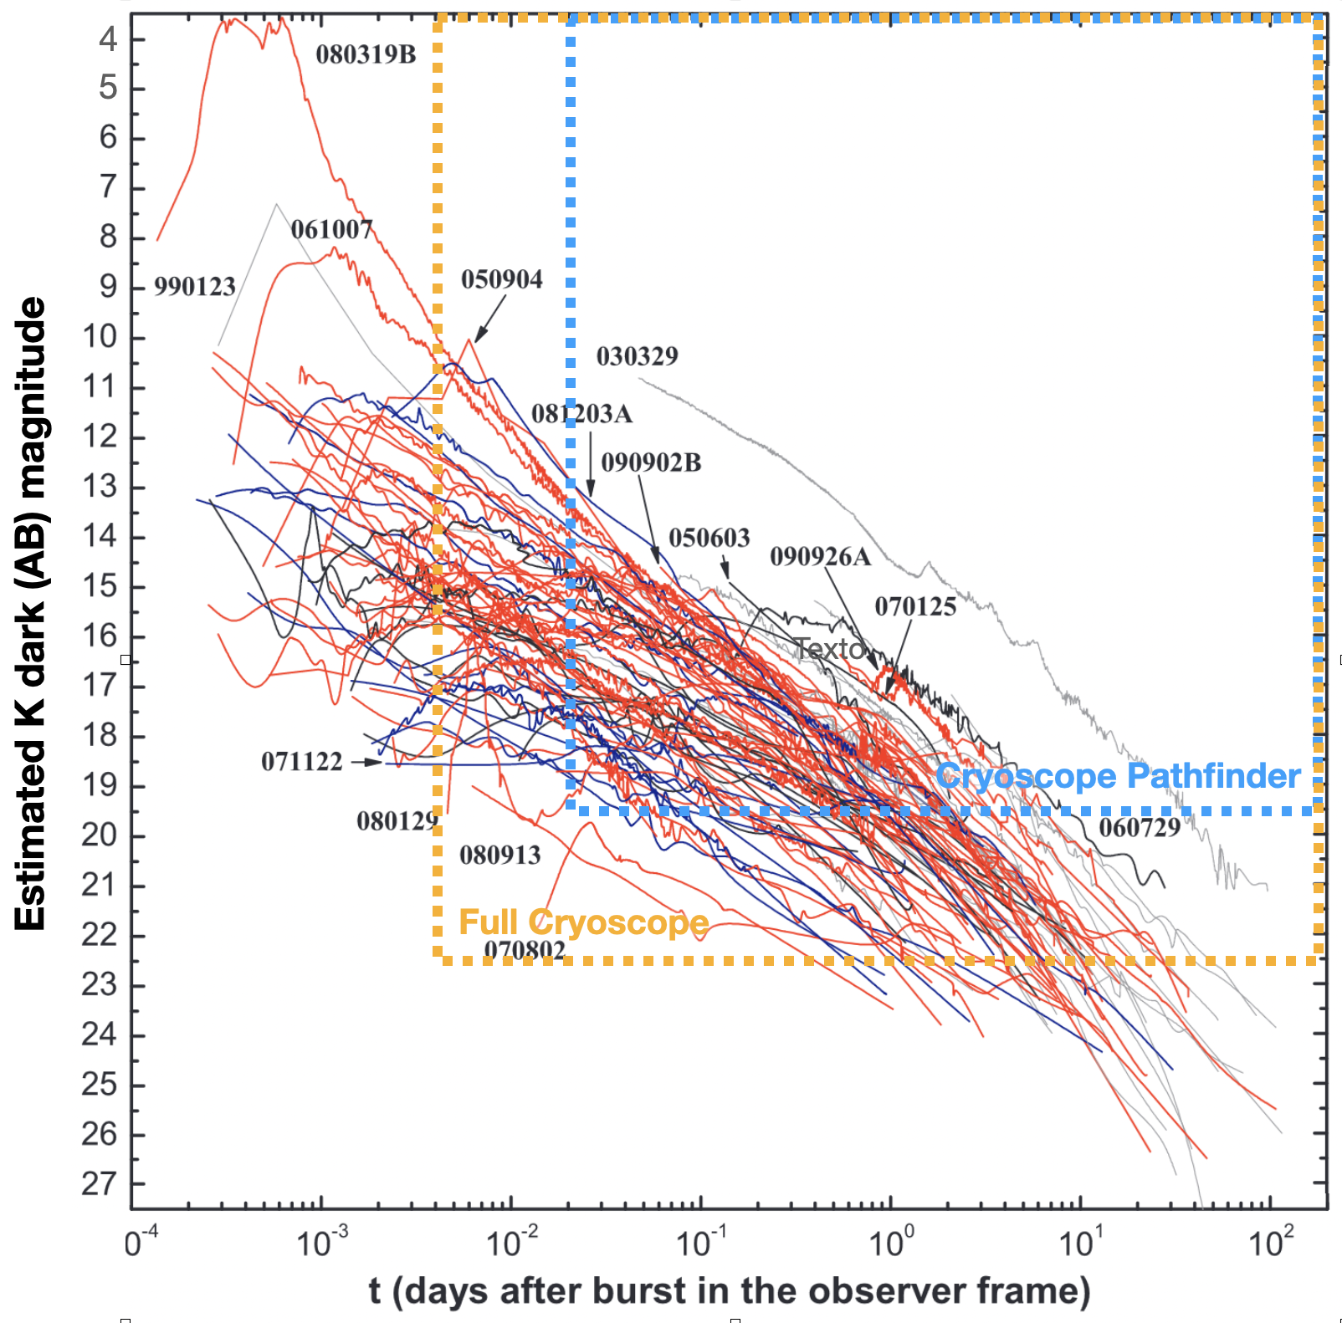
Long gamma-ray bursts
Long GRBs produced by the collapse of very massive stars
Missions like Fermi have error boxes of 10s of deg²
GRBs are brighter in the IR
(easy to detect!)
IR observations will detect:
  Very high redshift events
  Dark GRBs missed in optical searches
  Dust destruction in early light curves
Stephen Hudson, Wikipedia

Slide 7
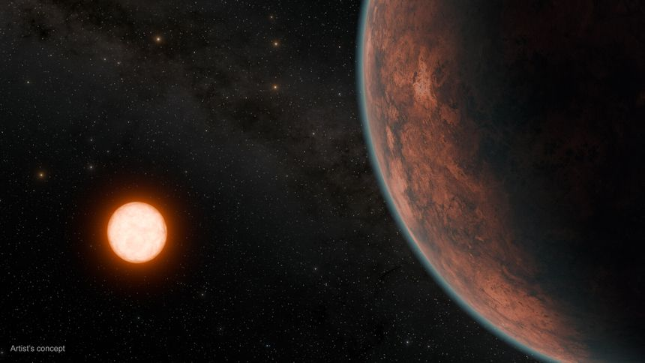
Exoplanet transits
Search for rocky terrestrial planets around < 0.15 M⊙ stars
Highest SNR and contrast in the IR
Less stellar variability in IR
Wide field allows to monitor multiple simultaneous targets
Long Winter nights allow to monitor longer transits
Stephen Hudson, Wikipedia

Slide 8
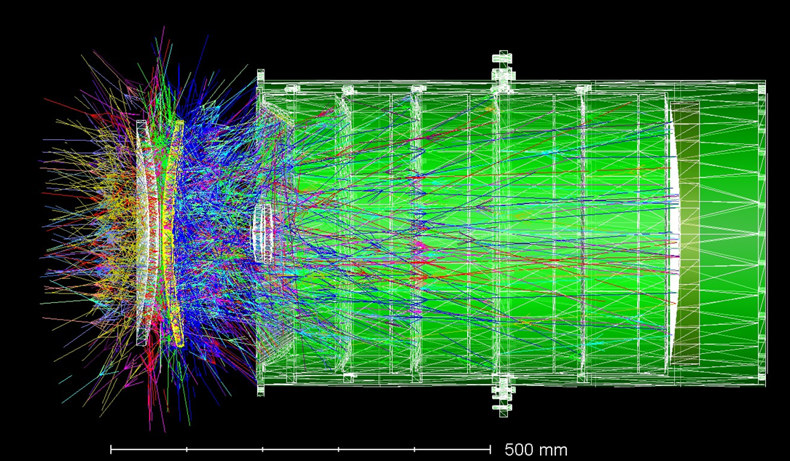
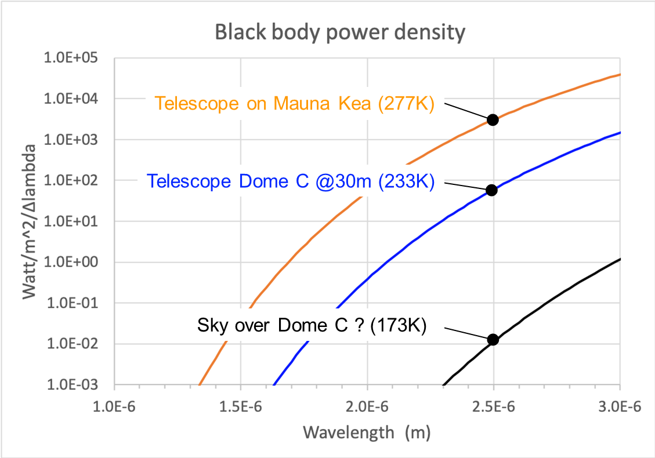
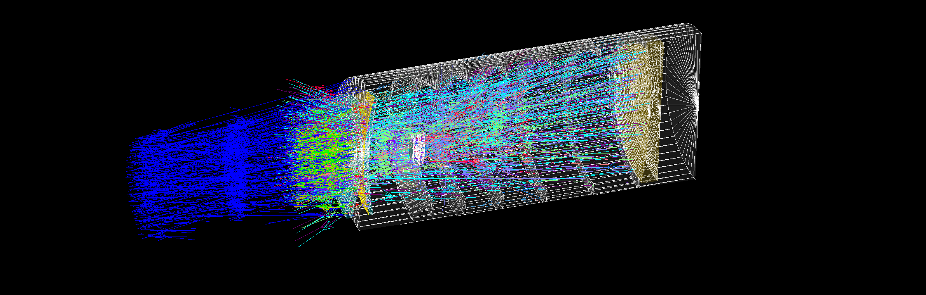
What is Cryoscope?
The 1m class telescope is completely cryogenic. Usual methods to block rays from a warm telescope limit the field of view. A telescope that is colder than the sky is critical to optimize its sensitivity.
Non-sequential ray tracing: >80% of radiation from window is returned to the window +negligible out-of-field light scatter onto the detector

Slide 9
Design choices for an ultrawide telescope in IR
1.2 m aperture is defined by maximum practical meniscus lens. More vendors at 1m.
Reduce K band sky brightness by going to Dome C
Cool entire telescope since reimager (Lyot stop) is impractical. Antarctic (-40C on a warm day) is not cold enough since pixel sees much larger solid angle of telescope than sky.
Stephen Hudson, Wikipedia

Slide 10
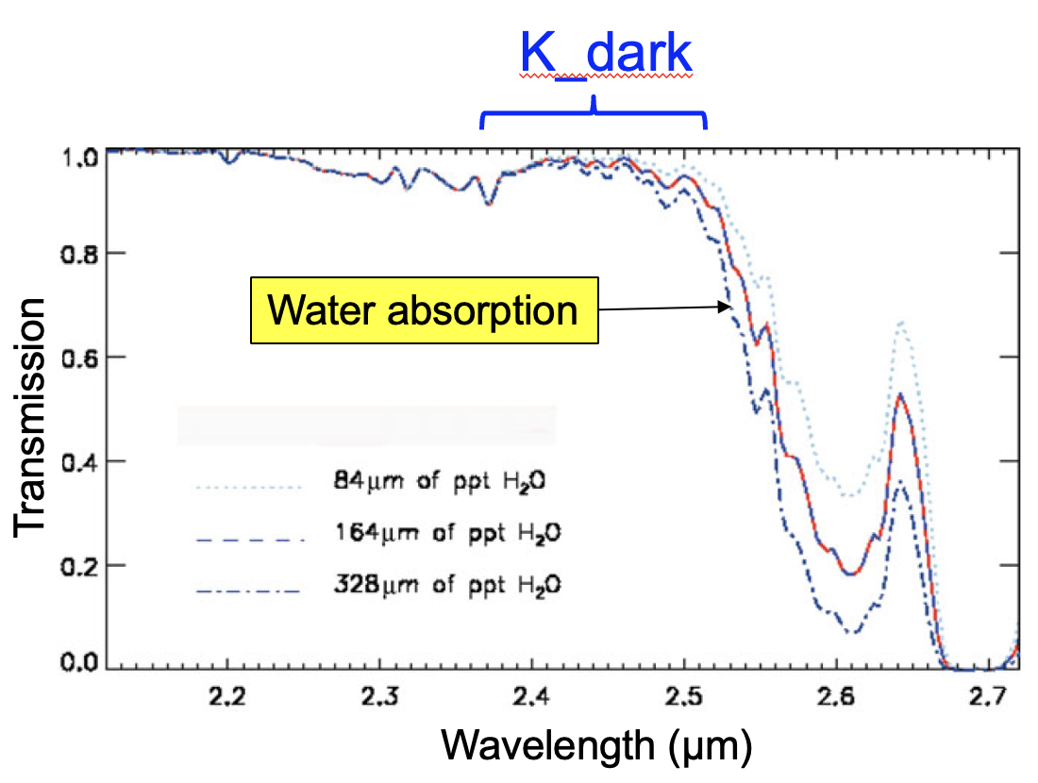
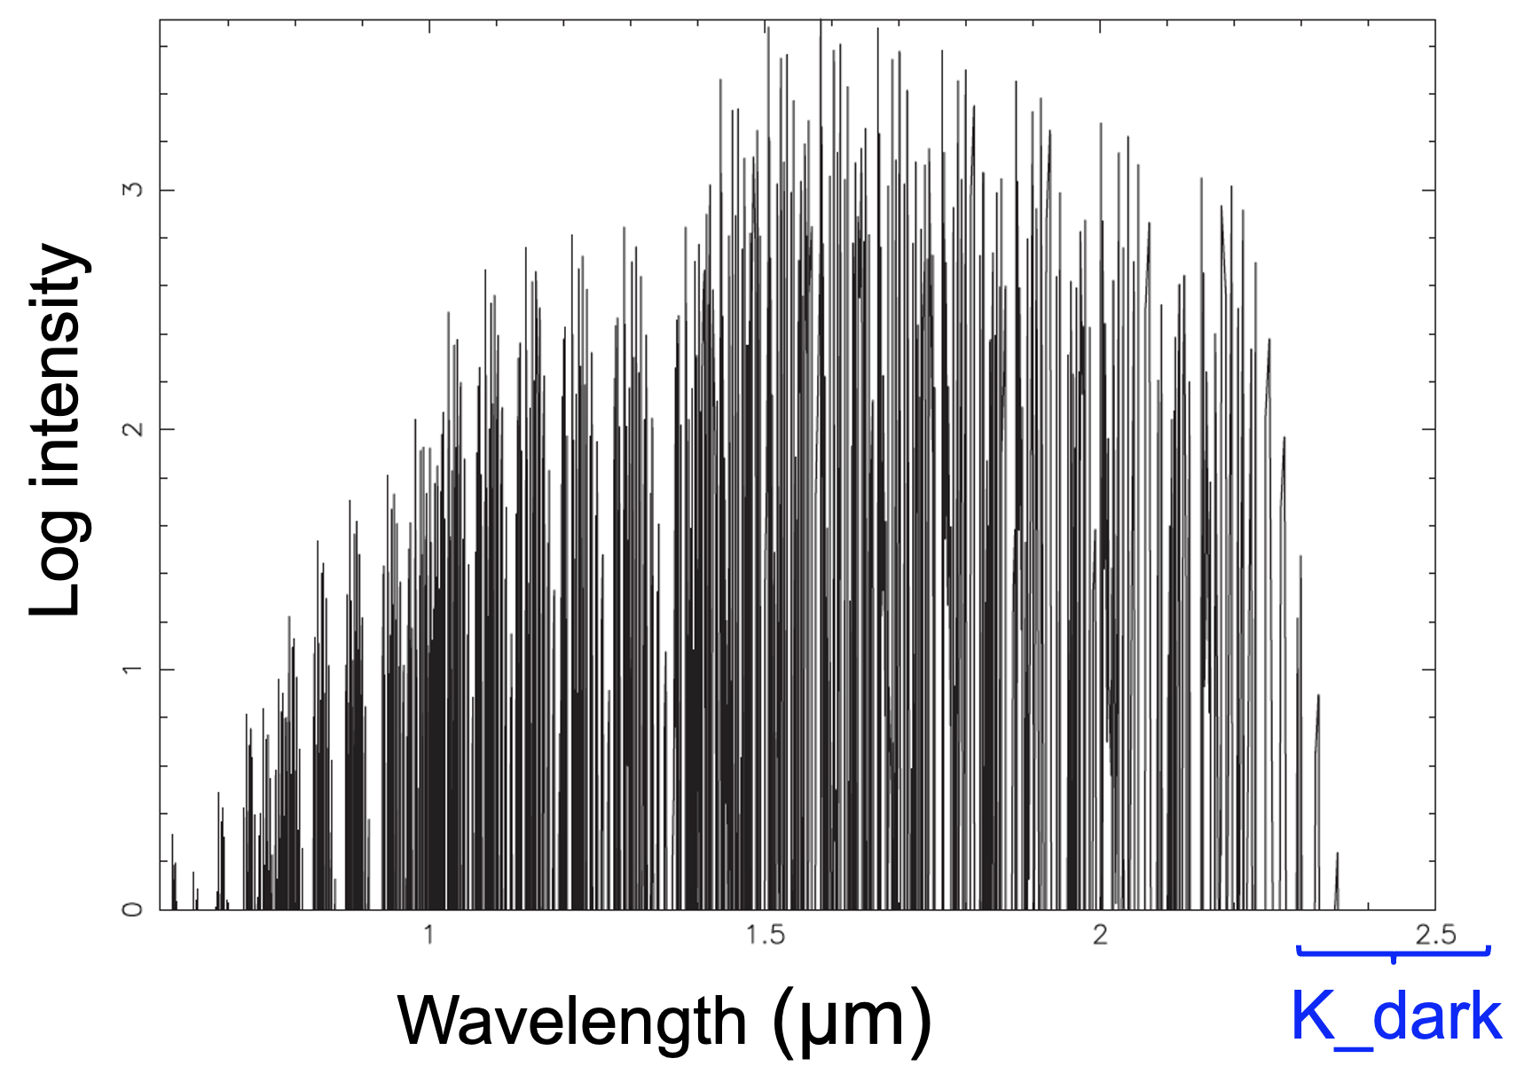
Looking through Dome-C’s K-dark window
Beyond the OH emission
At -40 to -80 C the thermal emission is beyond 2.5 𝜇m
K-dark: 2-2.5 𝜇m
Stephen Hudson, Wikipedia

Slide 11
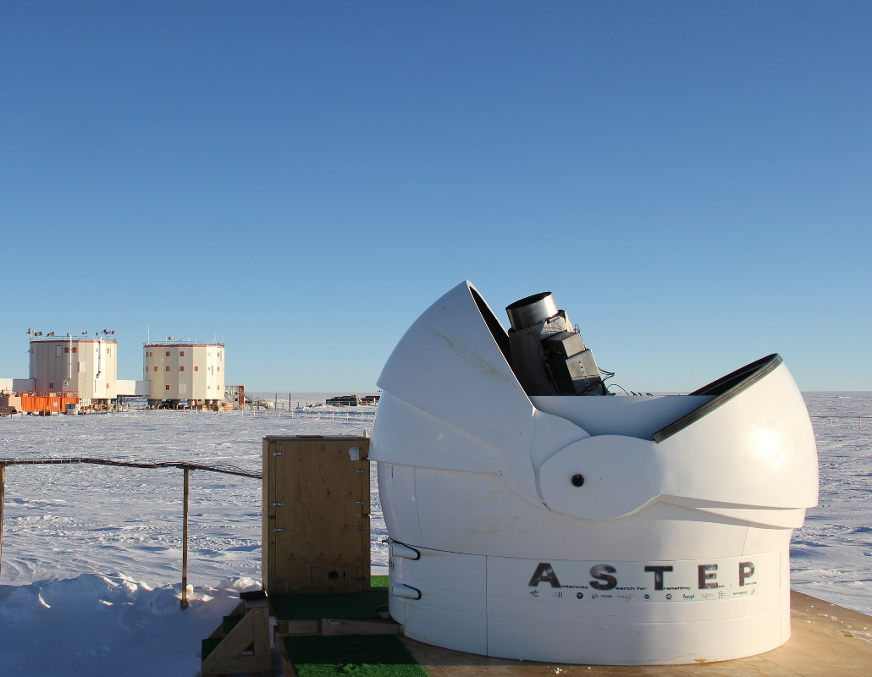
A decade of ASTEP at Concordia
Antarctic Search for Terrestrial Exo-Planets
ASTEP project in Antarctica since 2008
Aims at monitoring transiting exoplanets
ASTEP+ is a 0.4m telescope
Dual band camera for color information
Current selection from TESS, PLATO in the future
Stephen Hudson, Wikipedia

Slide 12
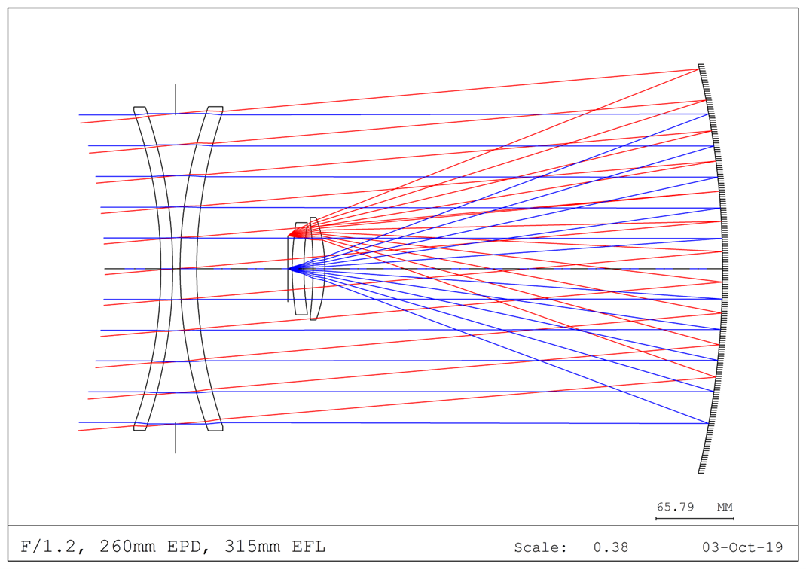
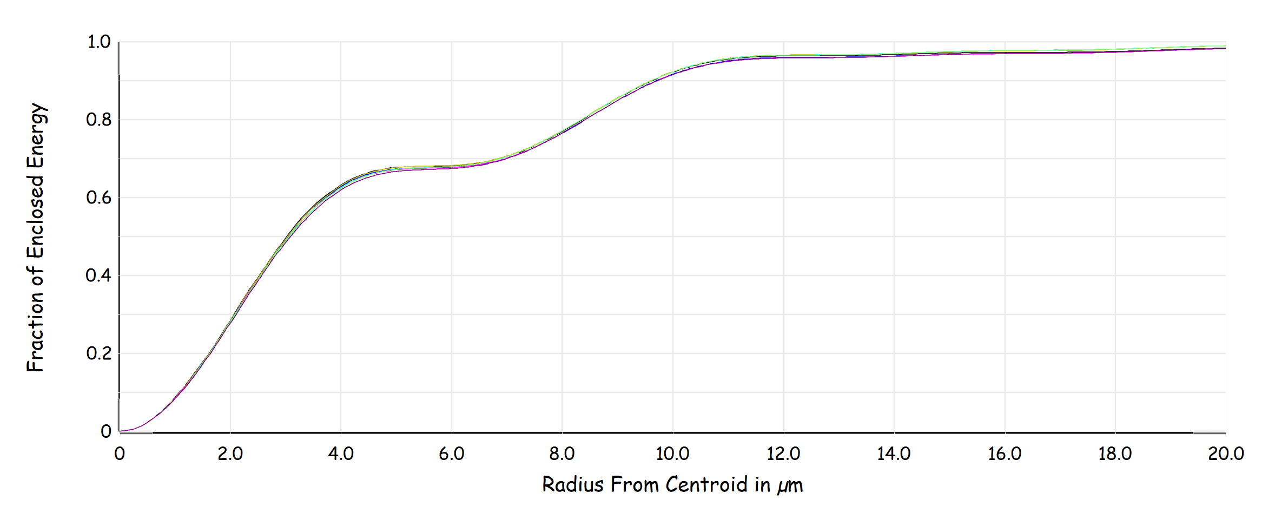
The Optical Design
Double-meniscus design by Jason Fusik (Caltech), complemented by 2 correcting lenses provides near diffraction limit image quality even at f1.2 and 100 sq. deg.

Slide 13
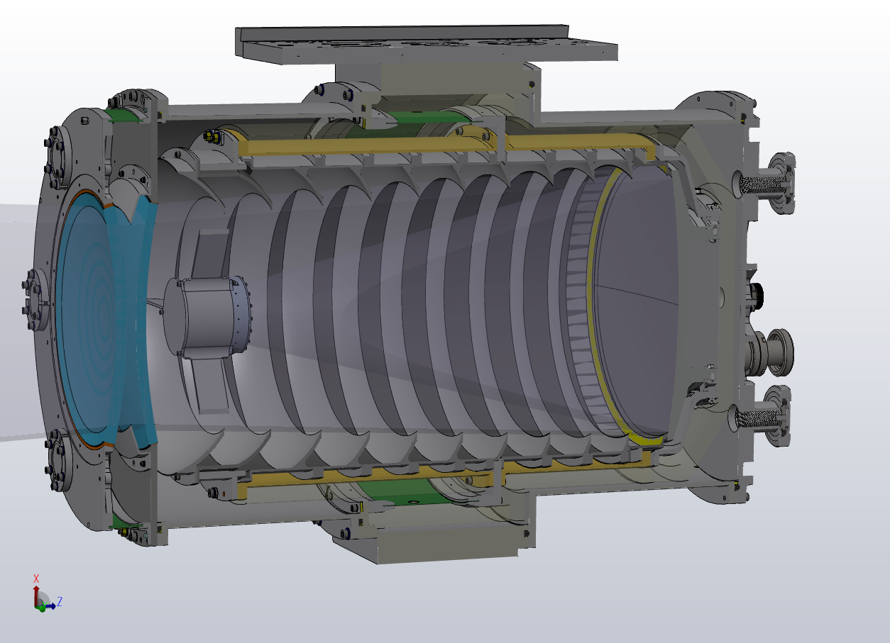
Convex and Concave Windows
Tangential support by silicone gasket to avoid glass compression. Thermal standoff for front baffle.

Slide 14
Detector at prime focus
Flex cable hidden in spider. Multi-color filter in consideration beyond k-band (J, H)

Slide 15
Detector controller
With vacuum interface board

Slide 16
Narcissus baffles
Thermal isolator, G10 cylinder. Precooled with LN2

Slide 17
Diamond turned Al Primary
75% light weighted

Slide 18

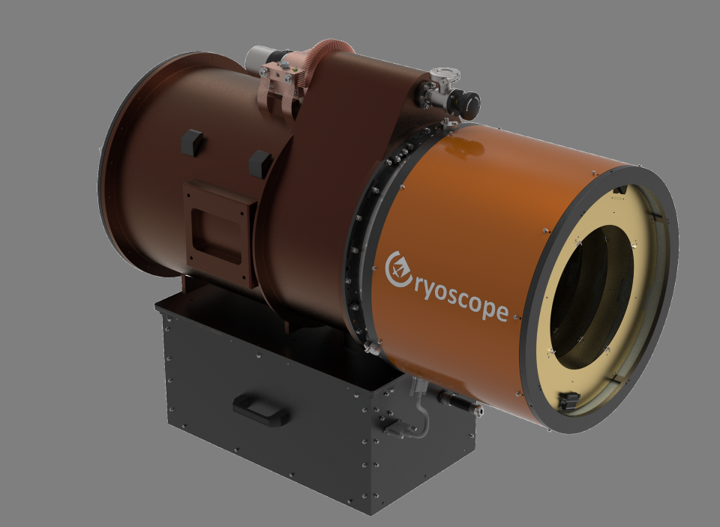
0.26 m aperture prototype
16 sq. deg FoV (limited by 4Mpx available detector)
Construction and testing by October this year
Travelling to Antarctica this southern summer
Operation in Winter 2026
Stephen Hudson, Wikipedia

Slide 19
A wide field, K-dark telescope for Dome-C
Optimized for K-dark
Thermal background less than sky
Very wide field, prime focus camera
Fully cryogenic
Telescope tube in vacuum
Fast telescope with double corrector window + field corrector
Stephen Hudson, Wikipedia

Slide 20
Challenge #1: A window on both sides of vaccum
Stephen Hudson, Wikipedia

Slide 21
Challenge #2: Removing thermal contribution from the instrument
Stephen Hudson, Wikipedia

Slide 22
Critical components installed
Stephen Hudson, Wikipedia

Slide 23
Cryoscope pathfinder is now built
Stephen Hudson, Wikipedia

Slide 24
Optical quality of the instrument
Stephen Hudson, Wikipedia

Slide 25
The current Status of the telescope
Stephen Hudson, Wikipedia

Slide 26
Cryoscope’s future home: The ASTEP mount
Stephen Hudson, Wikipedia

Slide 27
Full scale
~ 1.2 m
5-𝜎 limit K-Dark (AB) ~ 23.4 mag (1h)
FoV = 50 sqr. deg
Camera based on HELLSTAR HgCdTe detectors developed with NSF & NASA funding
6x4 array of (24) 4kx6k detectors with a total of ~ 600 Mpixels
Stephen Hudson, Wikipedia

Slide 28
Comparative specs
Aperture (m) | 1.2 | 0.26
Field of view (deg²) | 50 | 16
5-𝜎 lim AB in 15 s (mag) | 20.6 | 16.9
Focal length (m) | 2.0 | 0.52
Plate scale (”) | 1.0 | 7.1
Survey speed (deg²/hr) | 200 | 65
Detector area (Mpix) | 600 | 4
Stephen Hudson, Wikipedia

Slide 29
Thank you
Cryoscope Pathfinder: testing a new approach to low background, diffraction limited, NIR imaging with exceptionally large field of view
Roger M. Smith et al. Paper 13094-188
Cryoscope Pathfinder: mounting of low temperature optics
Rishi Pahuja et al. Paper 13096-303
Cryoscope Pathfinder: wide-field optical performance validation in the lab
Nicholas Earley et al. Paper 13096-136
Cryoscope Pathfinder: thermal management and electronics in extremely cold environment
Jake Zimmer et al. Paper 13096-389
Advancing large format MCT/Si infrared detectorsfor astrophysics Research
Lasar Bintic Paper 13103-7
Stephen Hudson, Wikipedia

