Slide 1

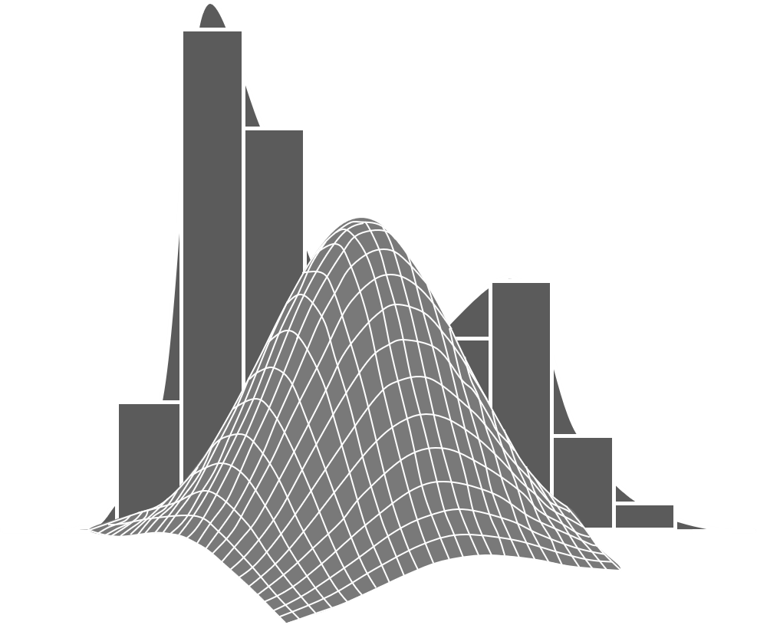
Interpretable deep learning
for event reconstruction in IceCube
Credit: Tobias Hell, https://numerical-analysis.uibk.ac.at/
images/User-Data/Tobias-Hell/StochastikHell.pdf
Mirco Hünnefeld
for the IceCube Collaboration
mhuennefeld@icecube.wisc.edu
ML for High-Energy Cosmic Particles
University of Delaware
January 28, 2025

Slide 2
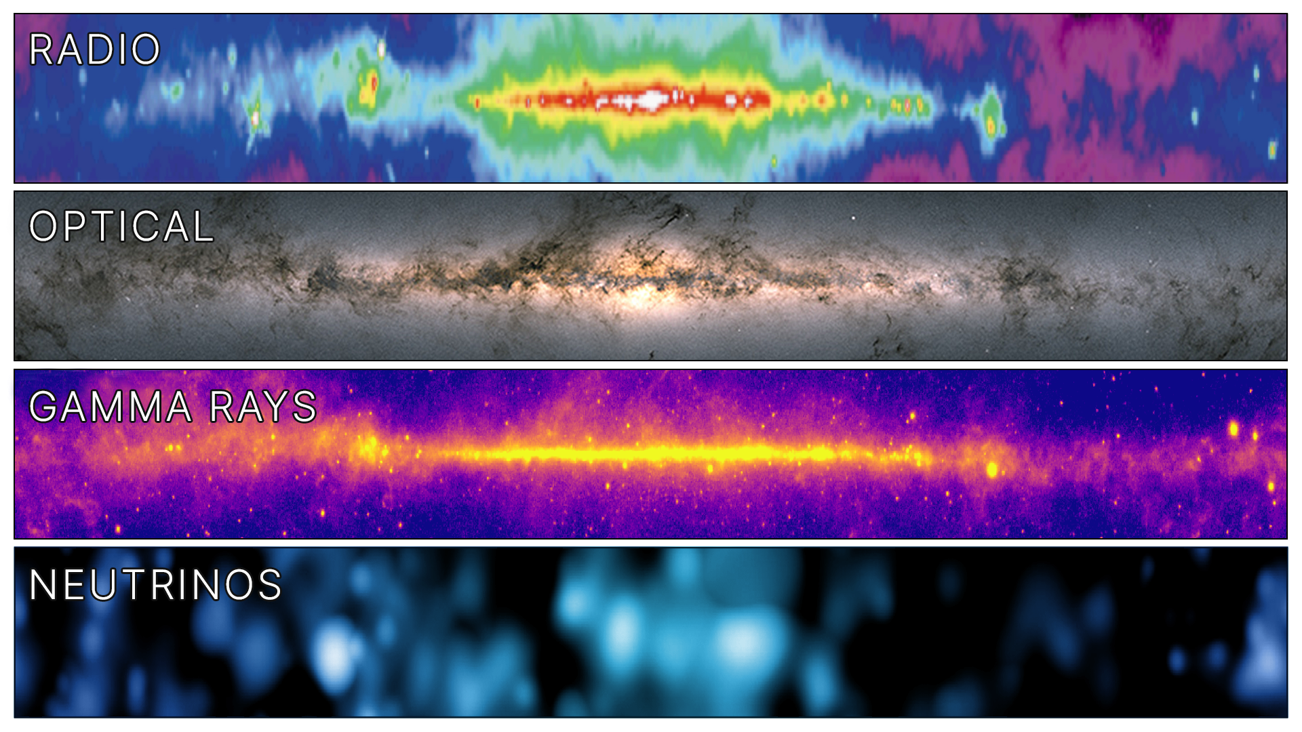
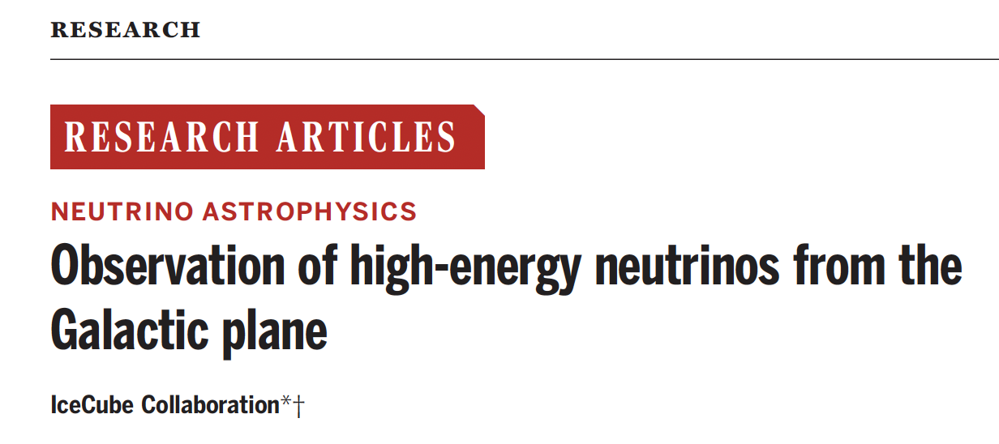

Observation of high-energy neutrinos from the Galactic Plane
Published on June 29th, 2023
DOI: 10.1126/science.adc9818

Slide 3



DOI 10.1088/1748-0221/16/07/P07041
DOI: 10.22323/1.395.1065
$$\sim 2700 / s^{ }$$
$\sim 2 /$ min
$\sim 17 /$ day
3

Slide 4
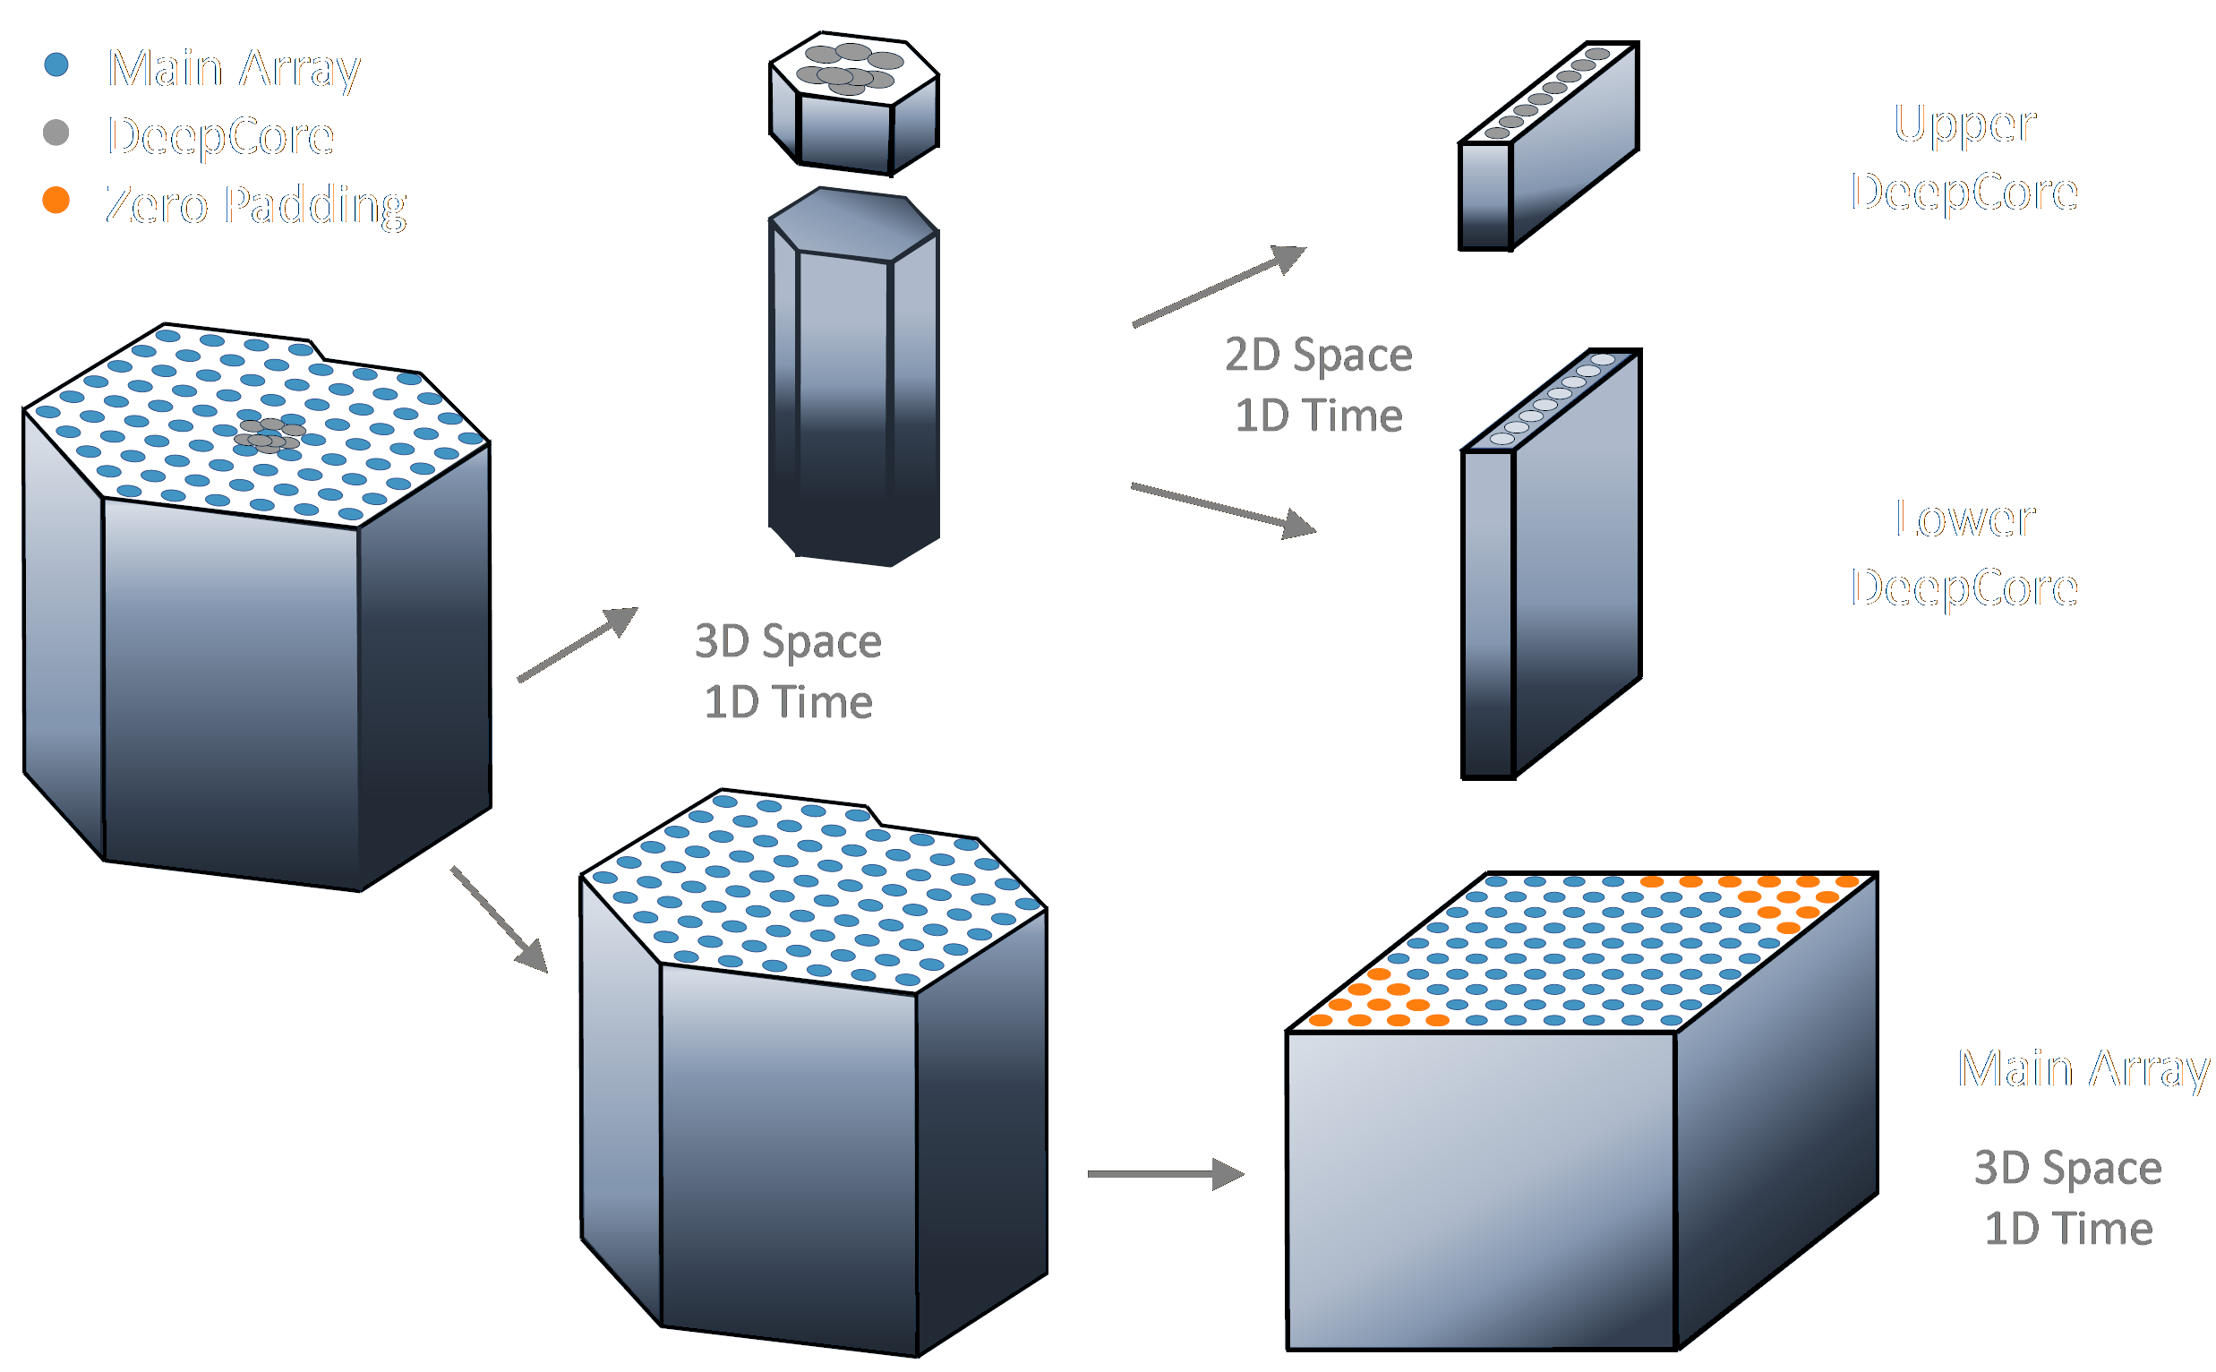
Convolutional Neural Networks
Workhorse of event selection
Classification & regression tasks
Fast and reliable
Hexagonal convolution kernels
Uncertainty quantification
Exploit translational invariance
DOI 10.1088/1748-0221/16/07/P07041
DOI: 10.22323/1.395.1065
$$\sim 2700 / s^{ }$$
$\sim 2 /$ min
$\sim 17 /$ day
Mirco Hünnefeld

Slide 5
Event-Generator
Combining Maximum-Likelihood with Deep Learning
Improved performance
Robust
Interpretable
Uncertainty quantification
Fast simulations
Leverage domain knowledge
Credit: Tobias Hell, https://numerical-analysis.uibk.ac.at/
images/User-Data/Tobias-Hell/StochastikHell.pdf
DOI: 10.22323/1.395.1065
DOI 10.1088/1748-0221/16/07/P07041
DOI: 10.22323/1.395.1065
$$\sim 2700 / s^{ }$$
$\sim 2 /$ min
$\sim 17 /$ day
Mirco Hünnefeld

Slide 6
Talk Outline
Importance of Domain Knowledge and Symmetries
Event Reconstruction in IceCube
  The IceCube Neutrino Observatory
  Data format and challenges
  Convolutional neural networks
Combining Maximum-Likelihood with Deep Learning
  Maximum-Likelihood Estimation
  Exploiting available symmetries and domain knowledge
  Interpretability and Generalization
Ongoing and future work
Conclusions
Mirco Huennefeld
Notes:
15 minutes (30 to go)

Slide 7
Talk Outline
Importance of Domain Knowledge and Symmetries
Event Reconstruction in IceCube
  The IceCube Neutrino Observatory
  Data format and challenges
  Convolutional neural networks
Combining Maximum-Likelihood with Deep Learning
  Maximum-Likelihood Estimation
  Exploiting available symmetries and domain knowledge
  Interpretability and Generalization
Ongoing and future work
Conclusions
Mirco Huennefeld
Credit: Tobias Hell, https://numerical-analysis.uibk.ac.at/
images/User-Data/Tobias-Hell/StochastikHell.pdf
Notes:
15 minutes (30 to go)

Slide 8









Deep Learning (DL) in a Nutshell
1
DL performs a mapping from inputs to outputs
2
Different architectures utilize different symmetries and domain knowledge
$$f:I→O$$
Input $I$
Output $O$
$$x=3$$
$$y=12$$
$$y$$
$$x$$
Can you explain deep learning in one sentence?
Deep learning is a subset of machine learning that uses artificial neural networks to model and understand complex patterns and relationships in data.
Mirco Hünnefeld

Slide 9
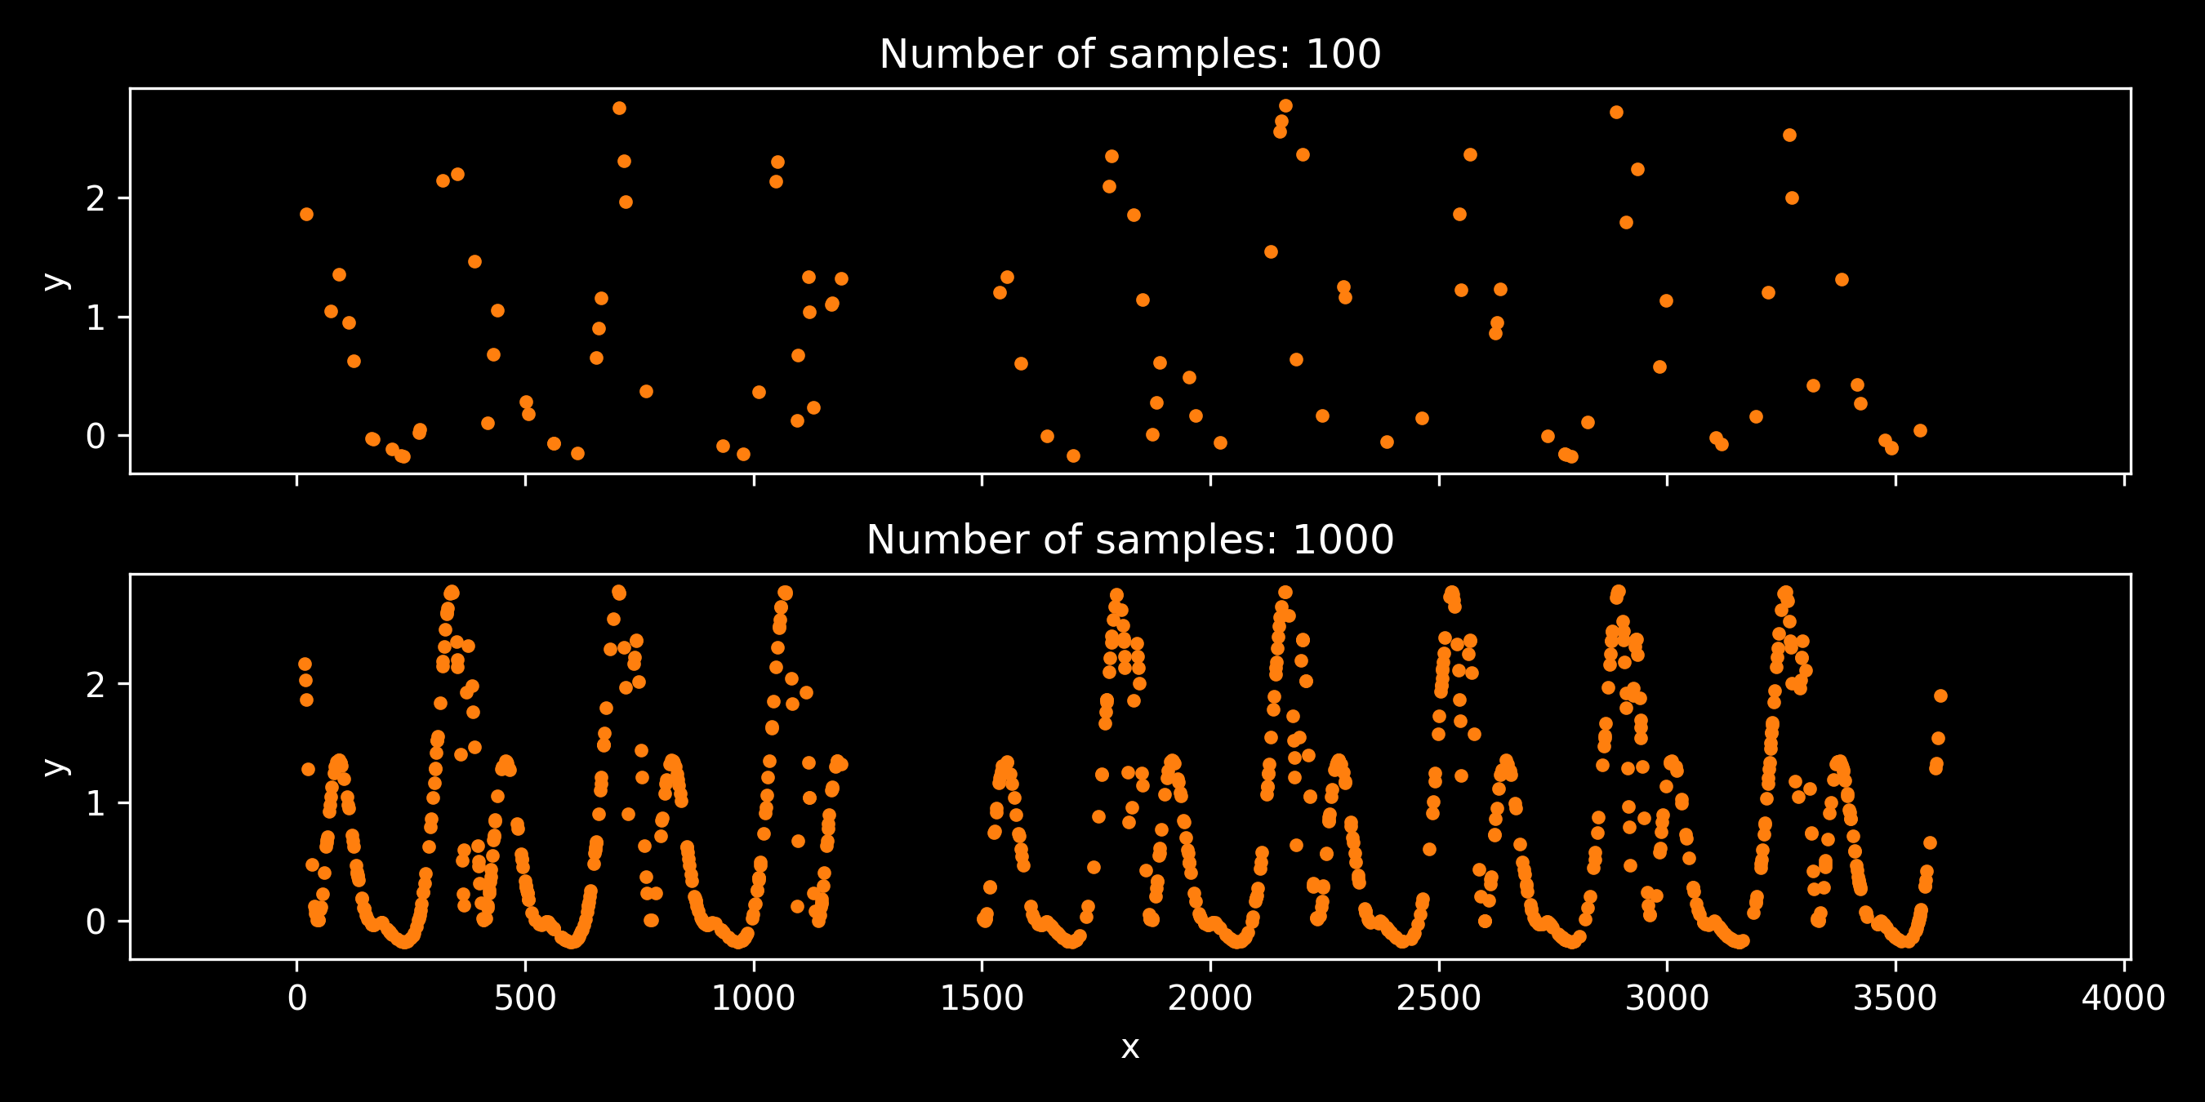
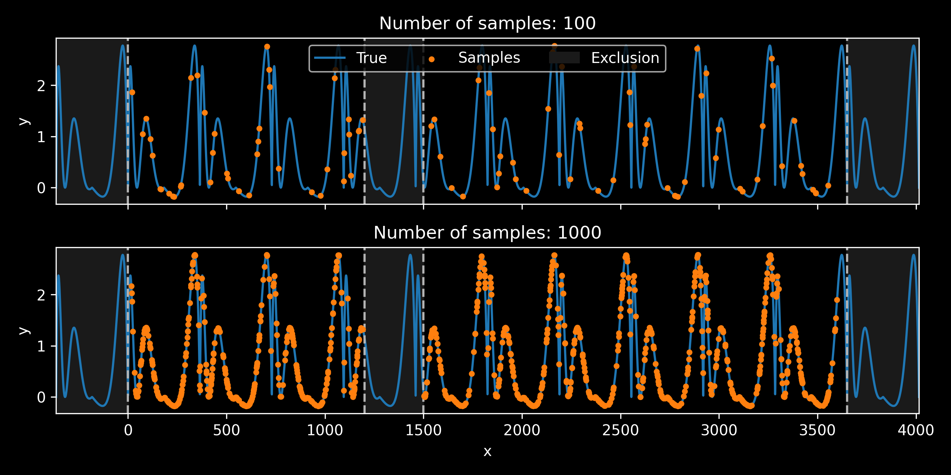
Utilizing Domain Knowledge

Slide 10
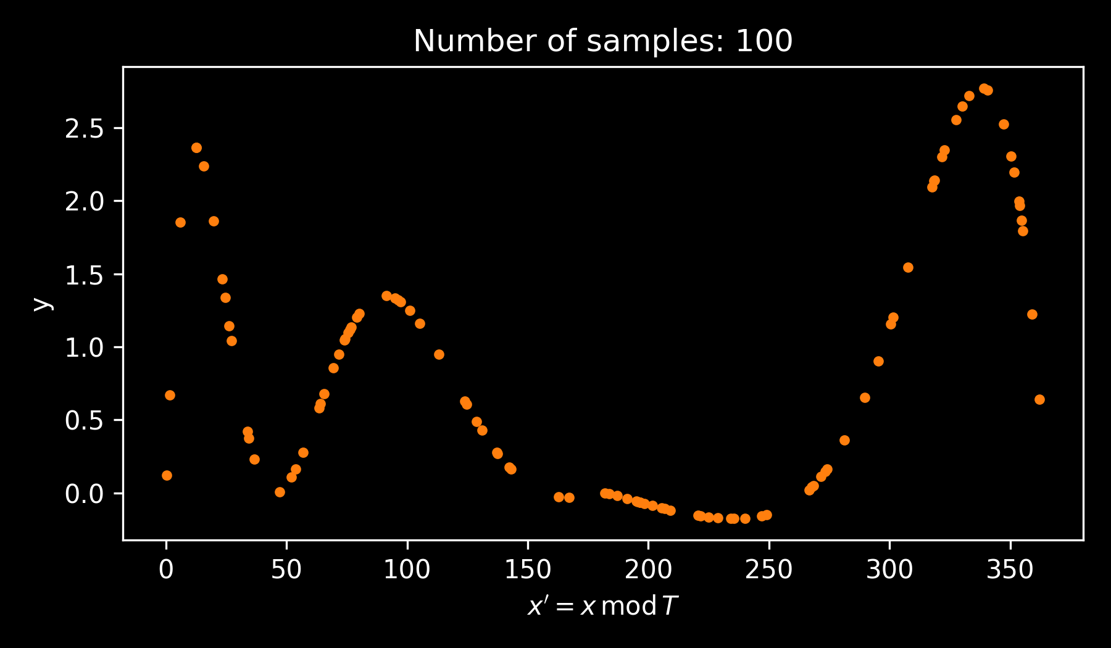

Utilizing Domain Knowledge
Exploit Periodicity:
$$x^{′}=x mod T$$

Slide 11
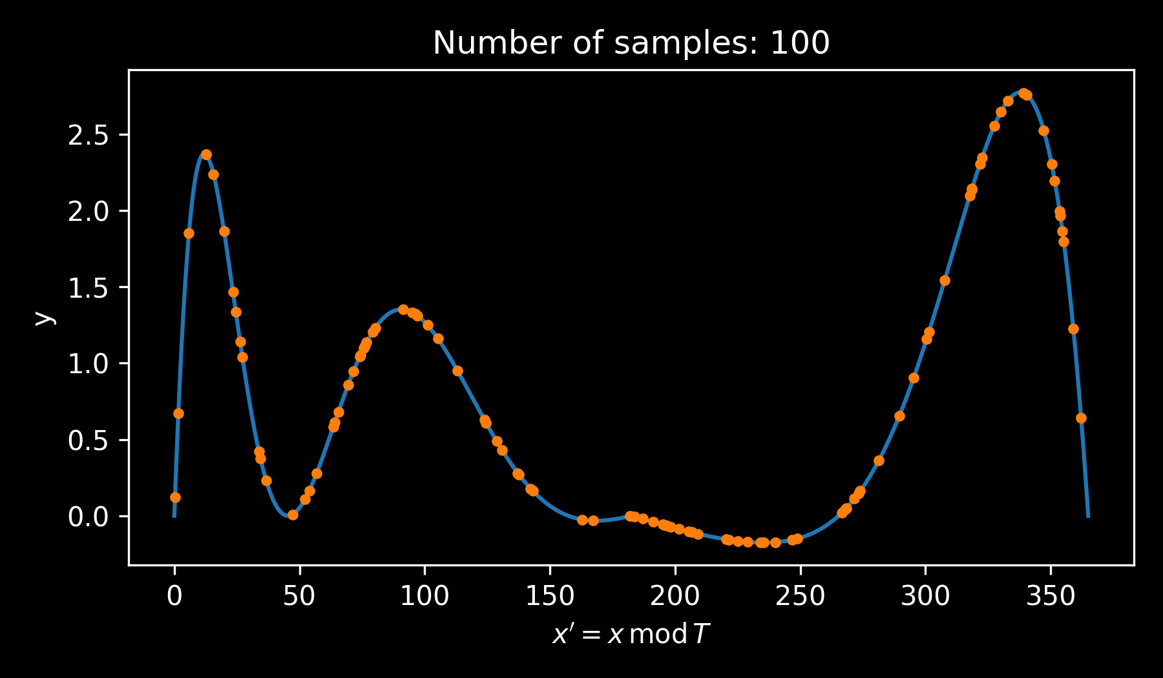
Utilizing Domain Knowledge
Exploit Periodicity:
$$x^{′}=x mod T$$

Slide 12
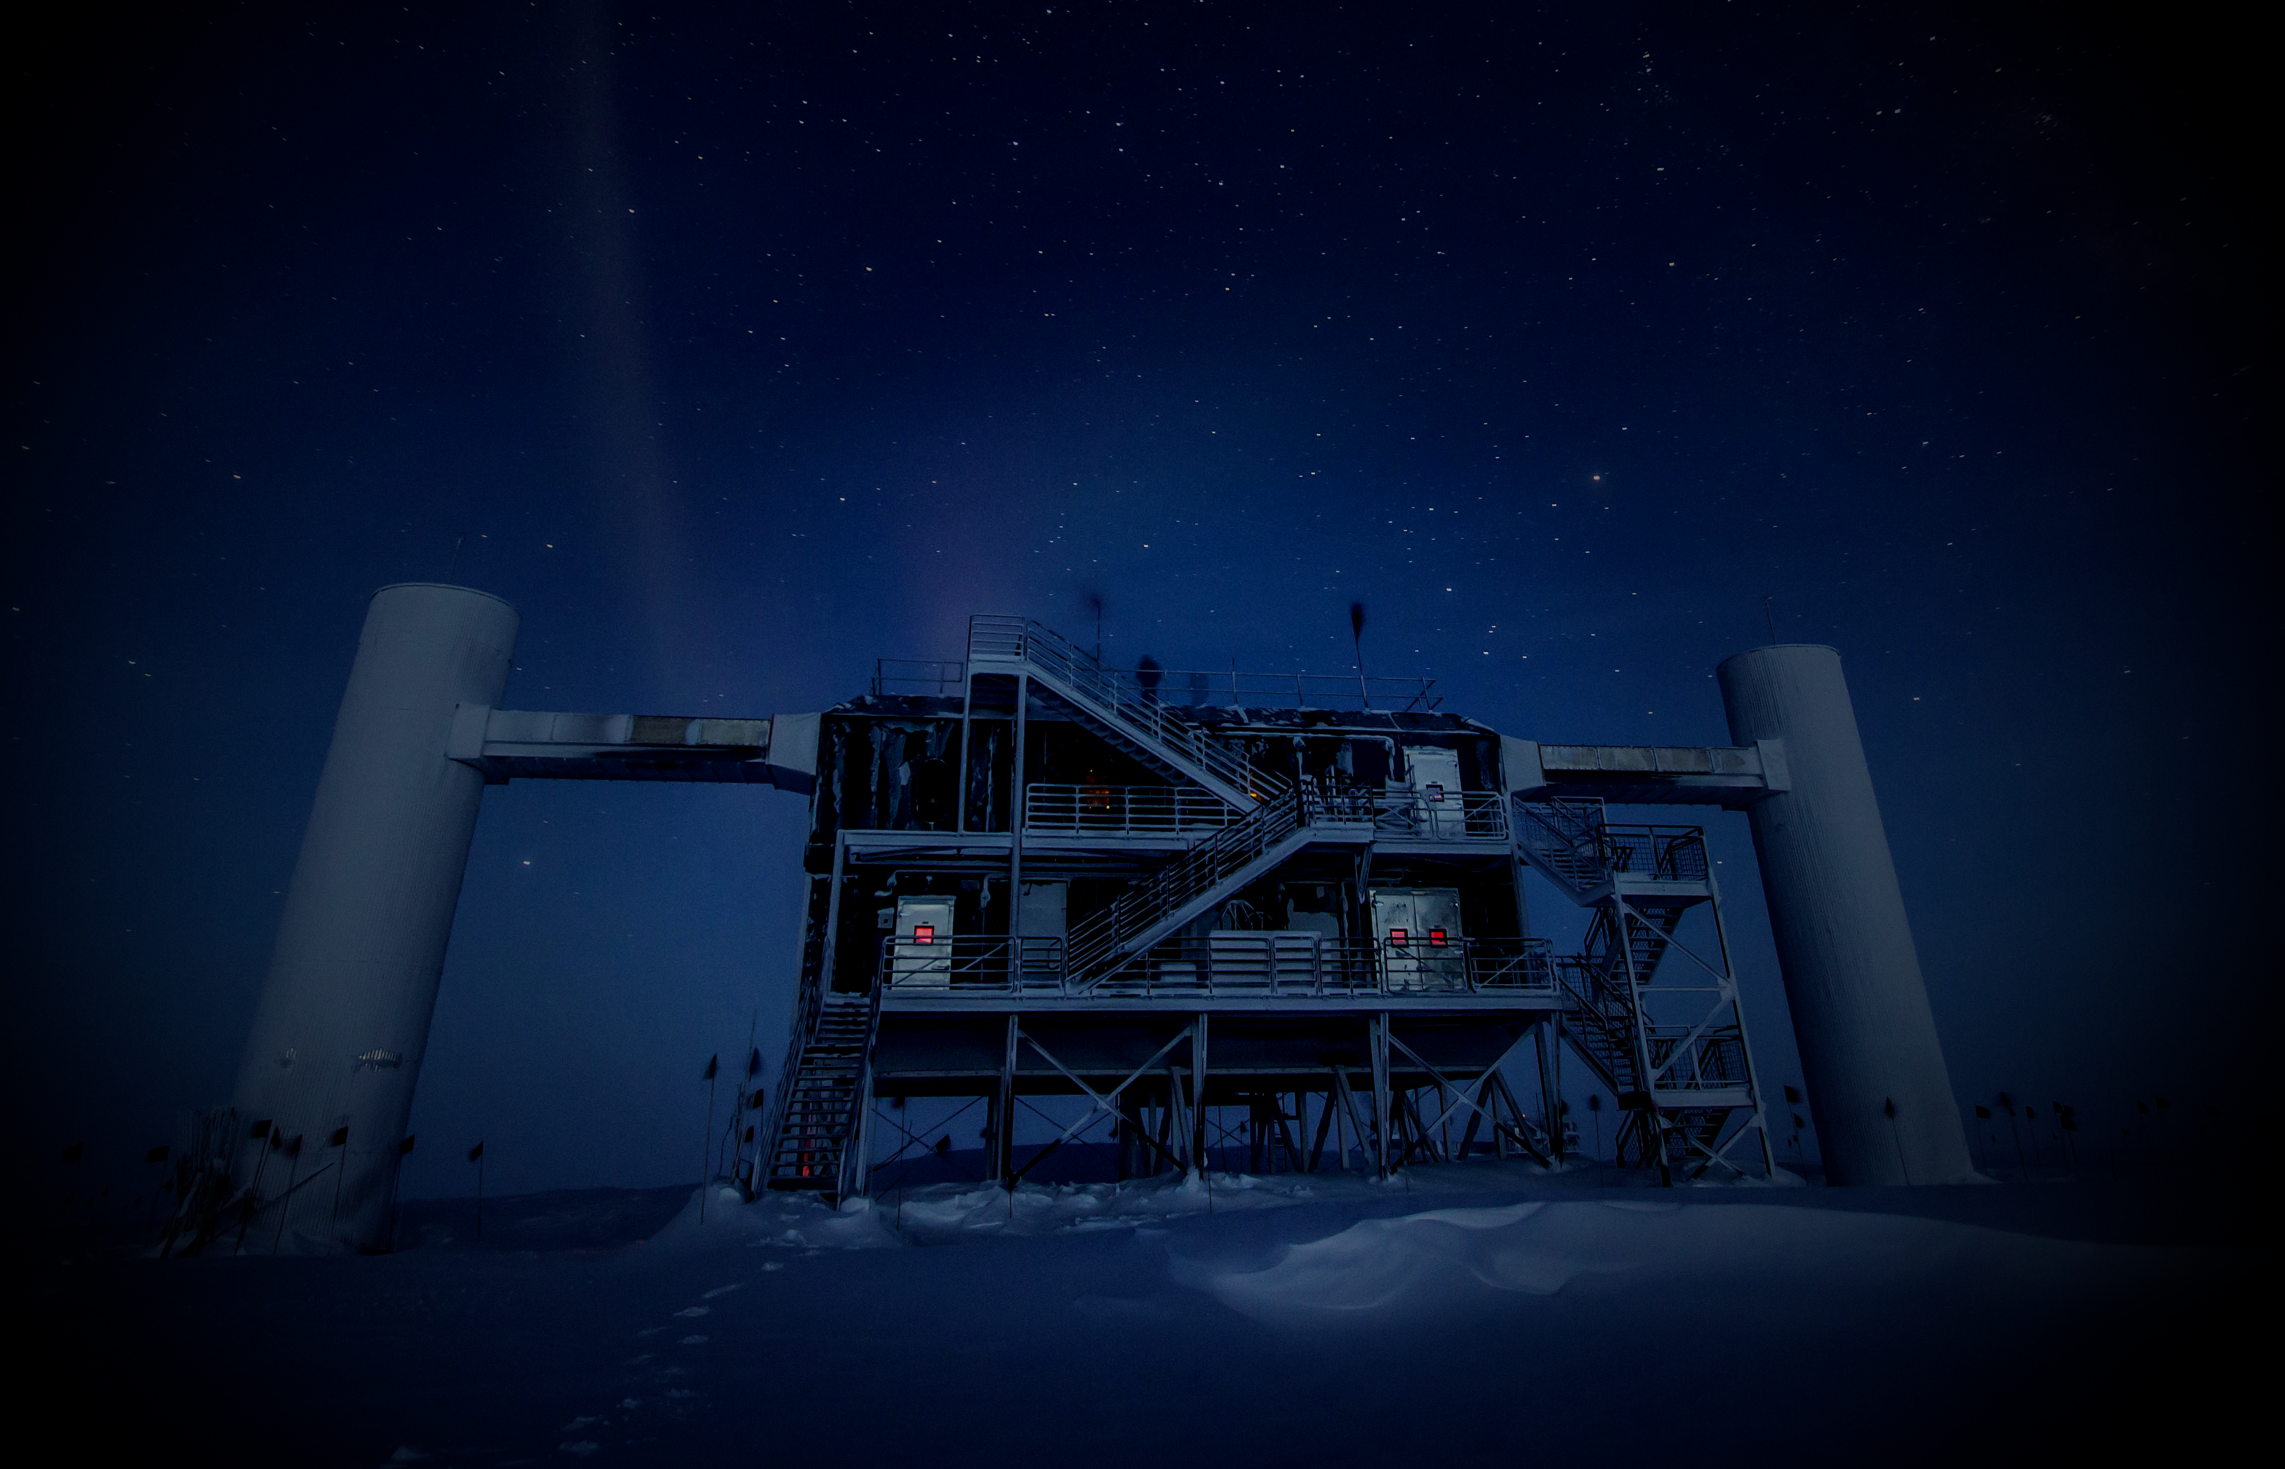
Talk Outline
Importance of Domain Knowledge and Symmetries
Event Reconstruction in IceCube
  The IceCube Neutrino Observatory
  Data format and challenges
  Convolutional neural networks
Combining Maximum-Likelihood with Deep Learning
  Maximum-Likelihood Estimation
  Exploiting available symmetries and domain knowledge
  Interpretability and Generalization
Ongoing and future work
Conclusions
Mirco Huennefeld
Notes:
15 minutes (30 to go)

Slide 13
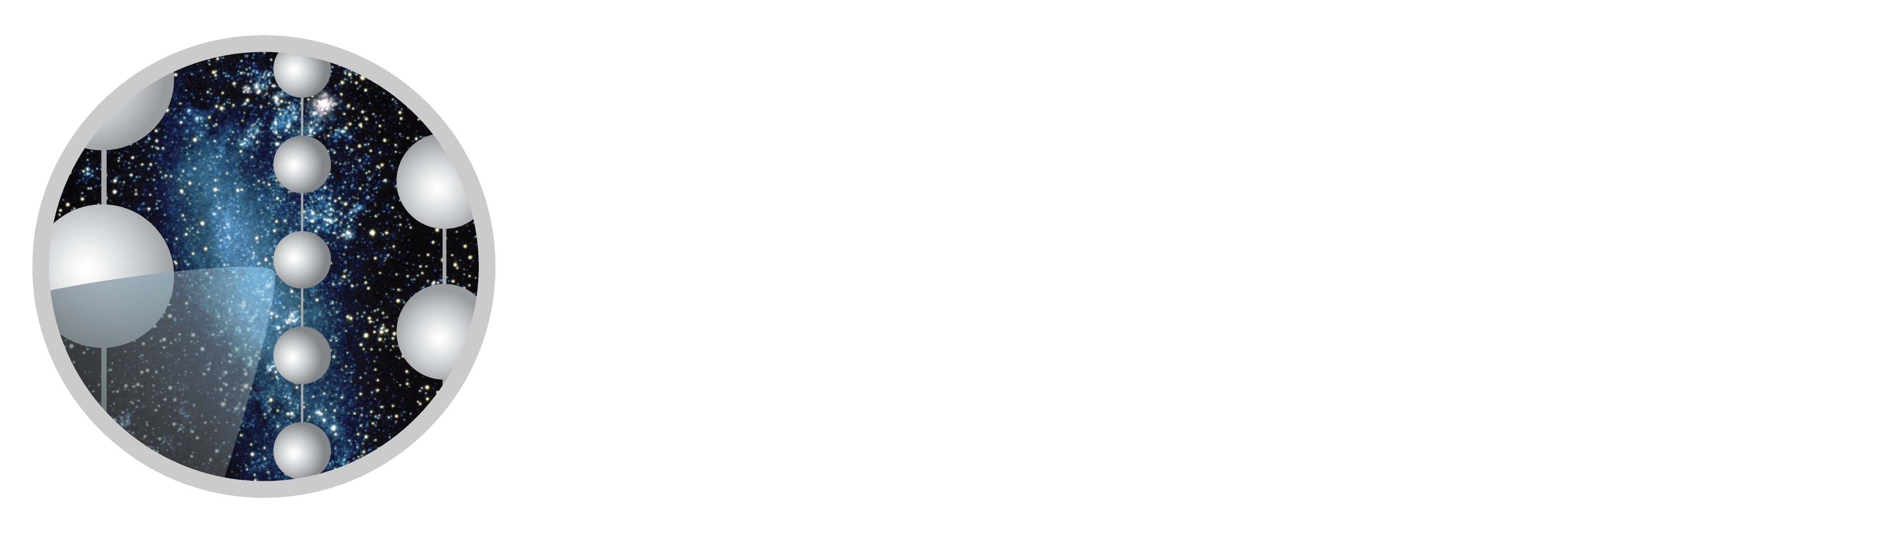
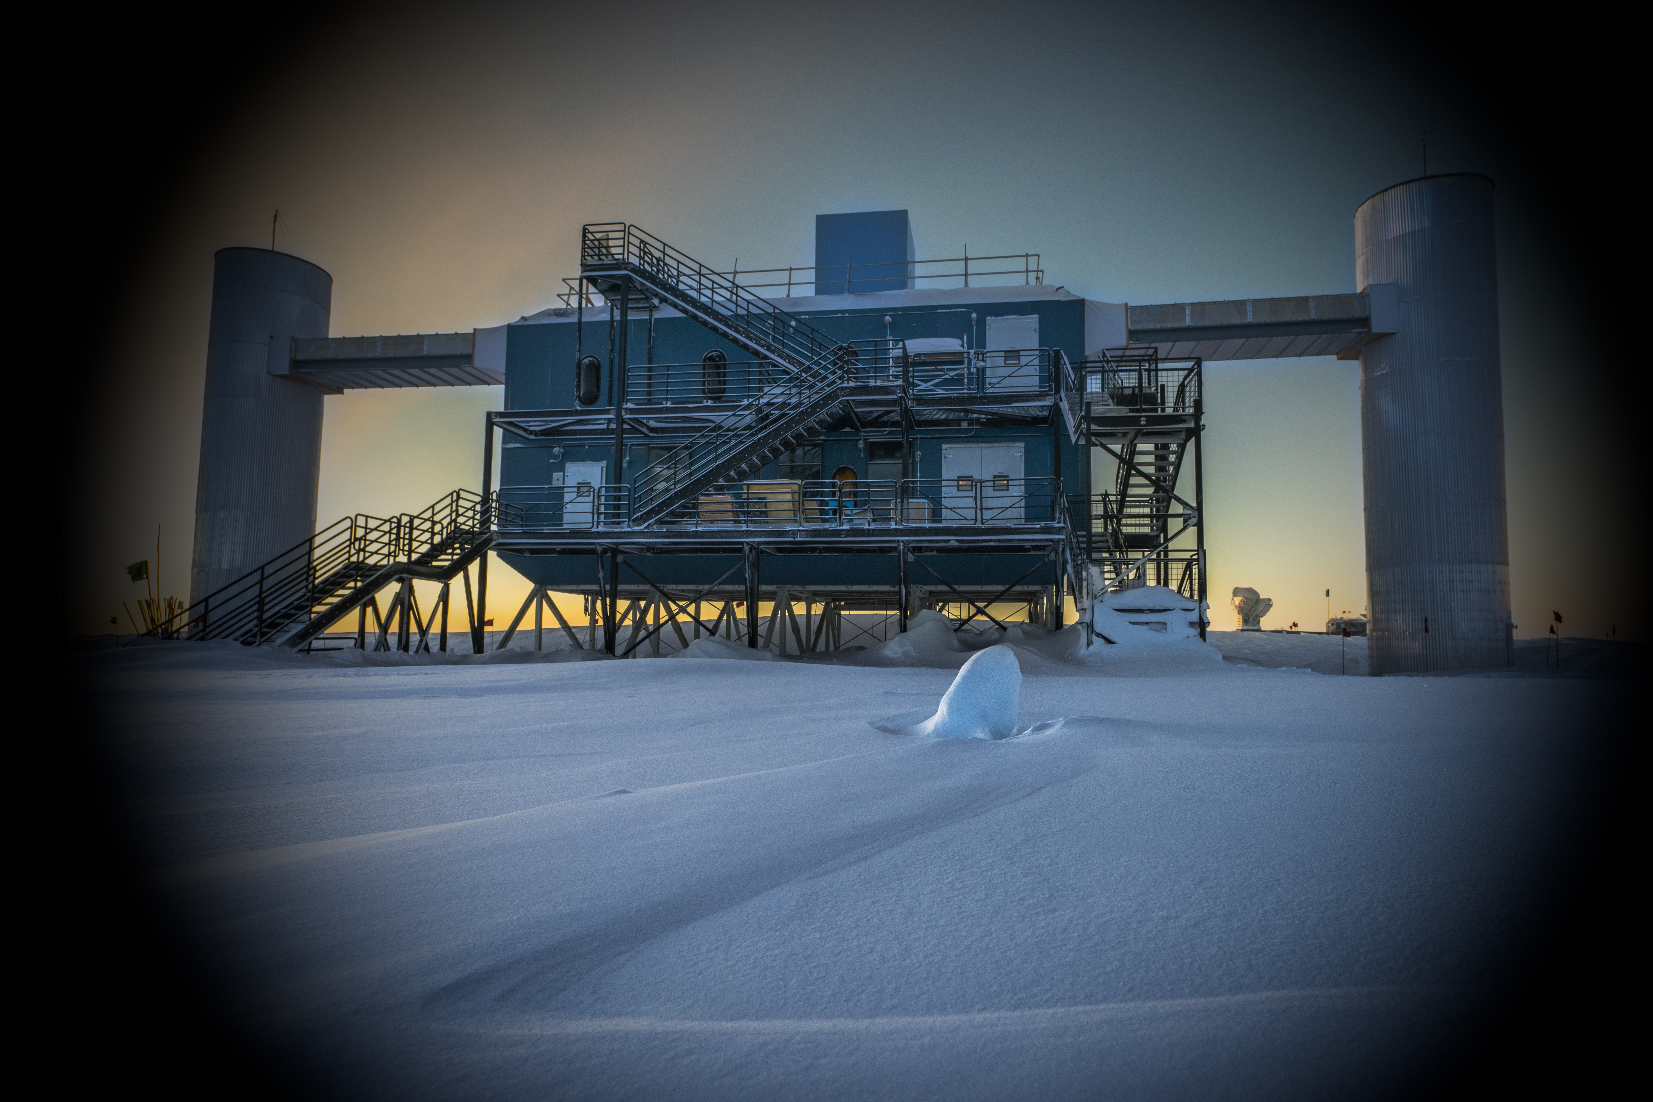
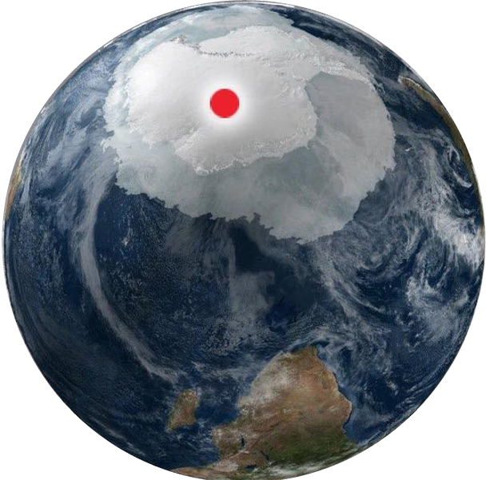
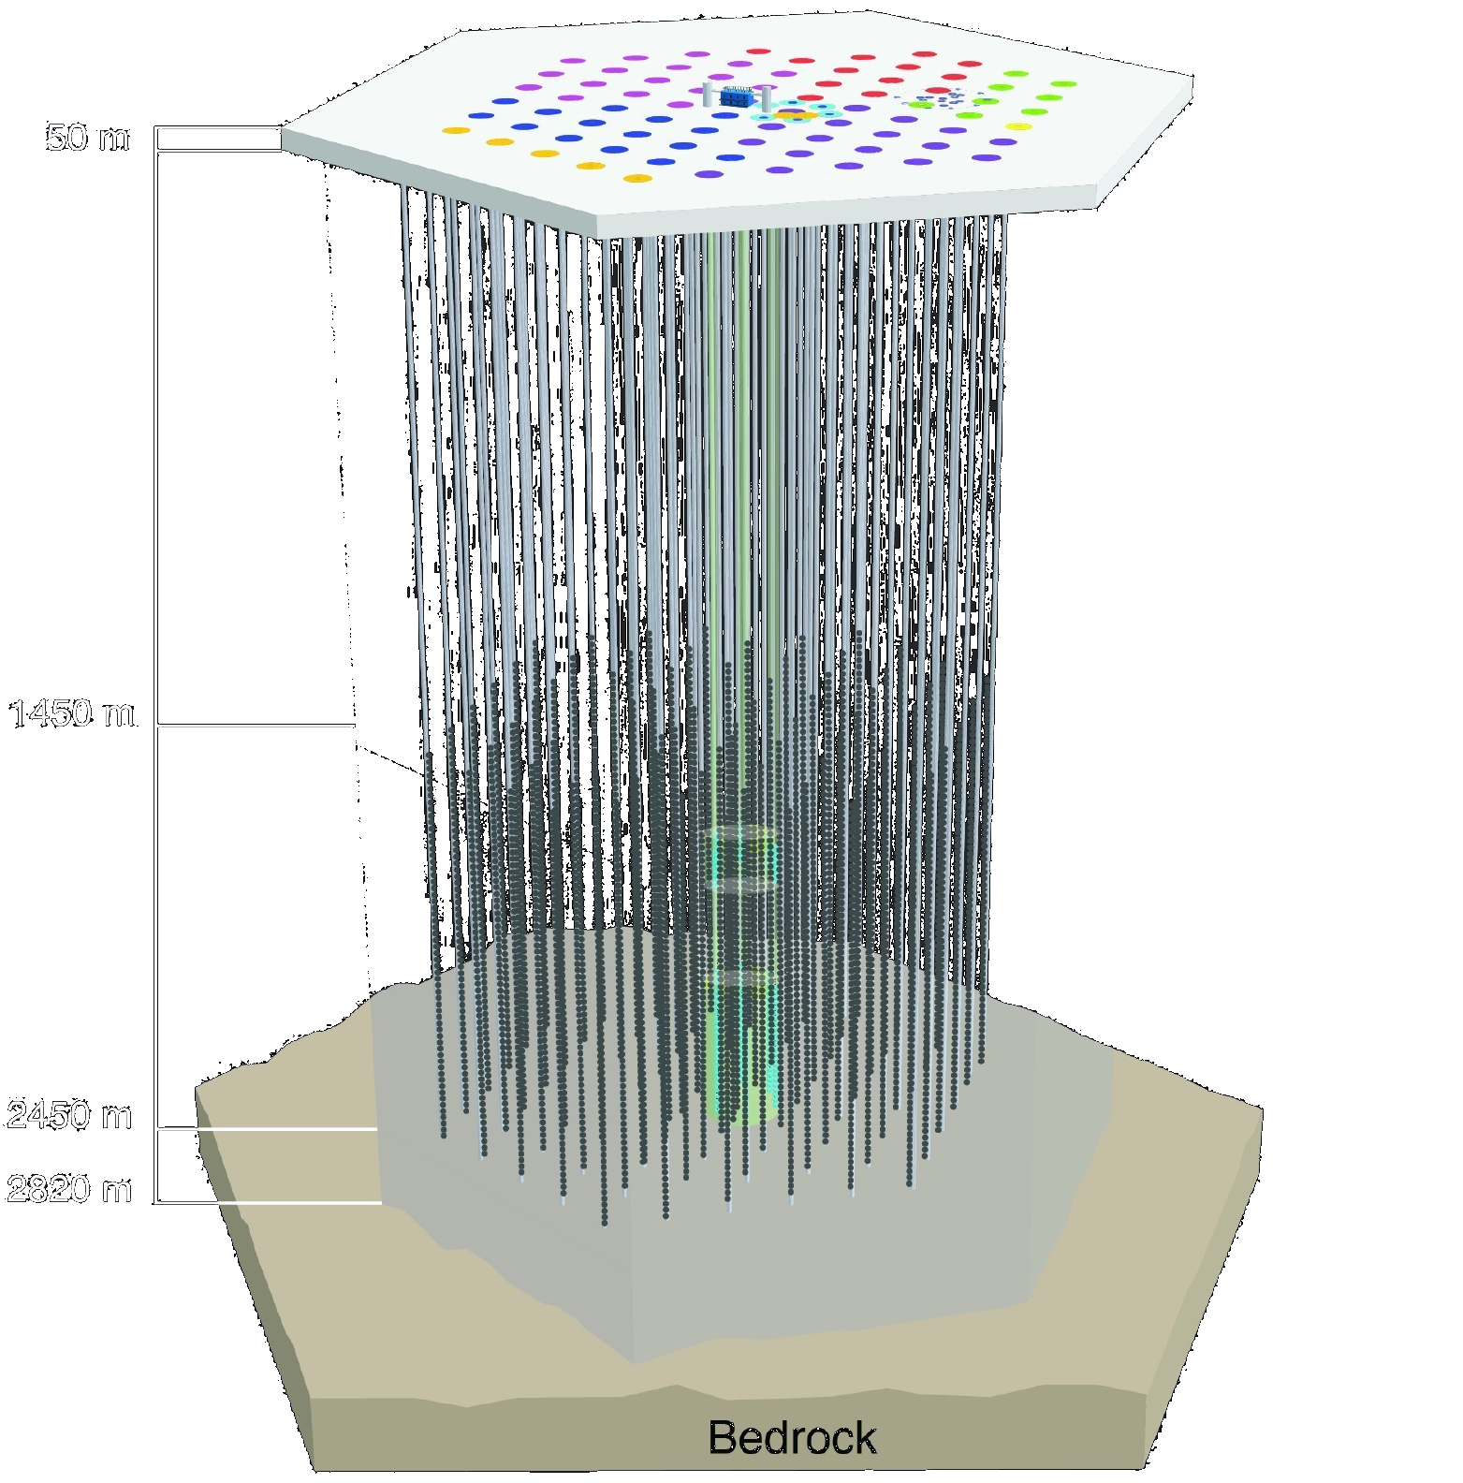
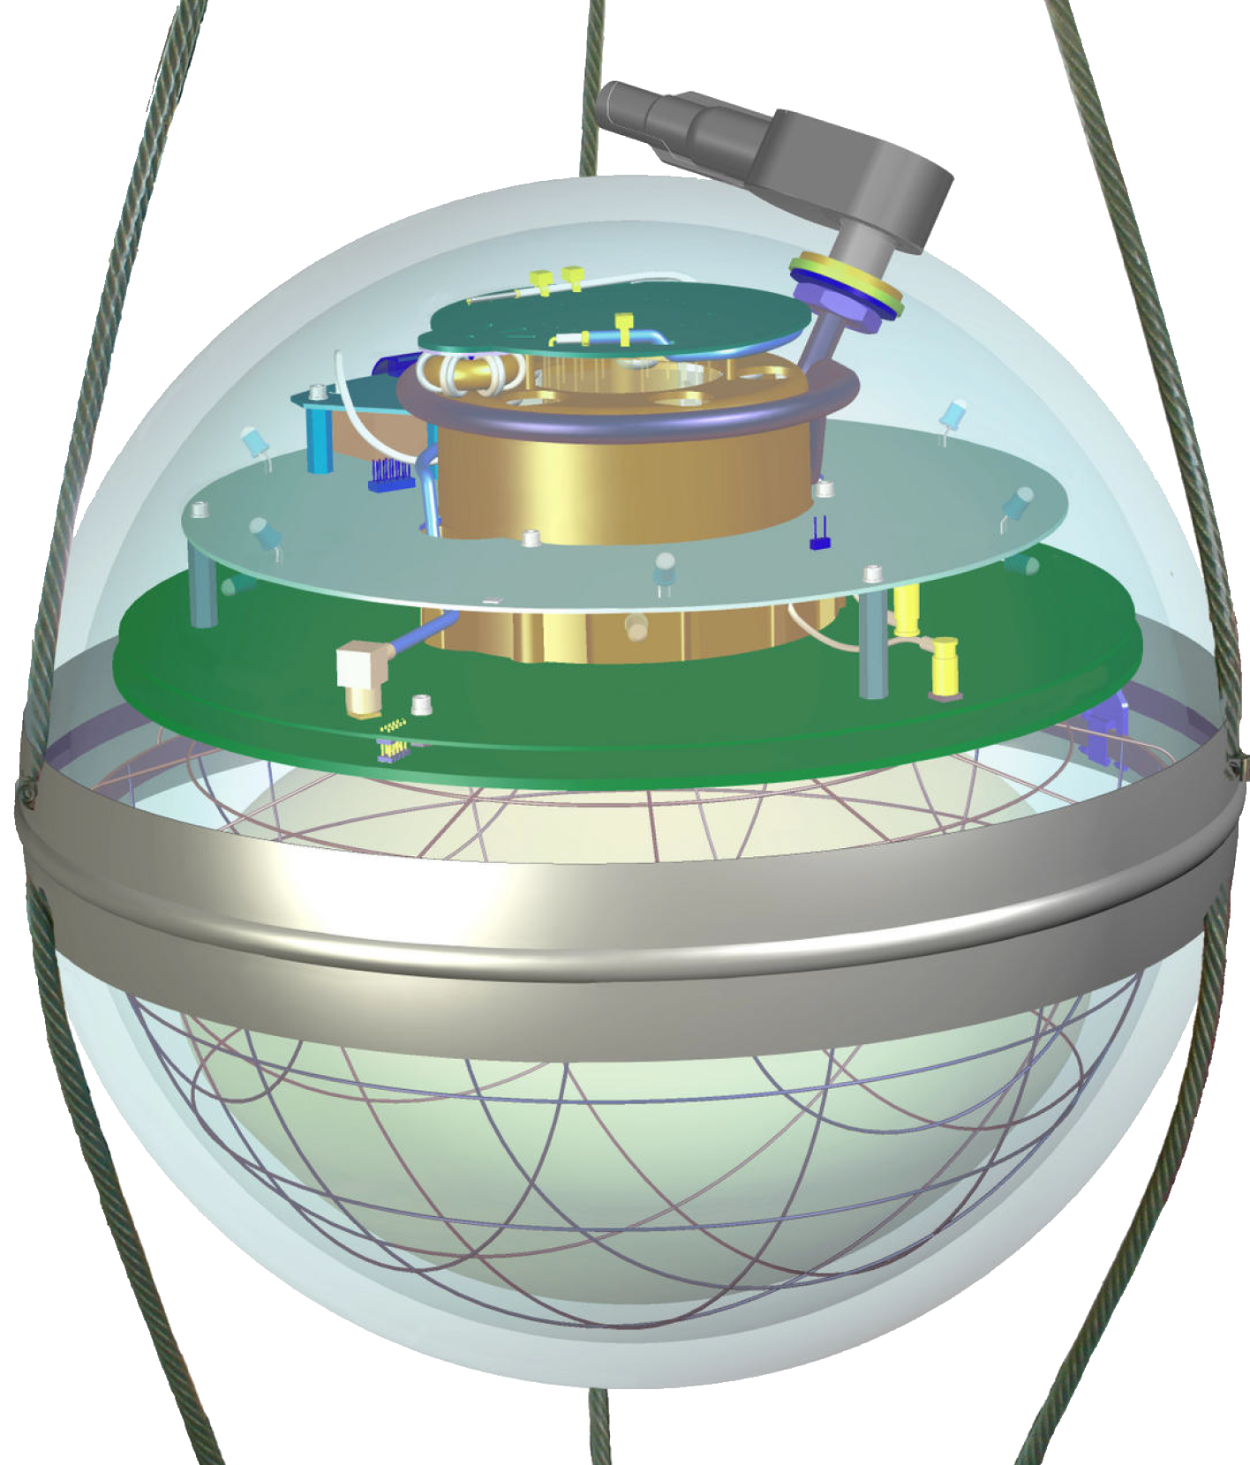

IceTop
Credit: Martin Wolf, IceCube/NSF
Amundsen-Scott South Pole Station, Antarctica
IceCube Laboratory
Main Array
17 m
DeepCore
5160 Digital Optical Modules (DOMs)
86 Strings:
78 Main Array
8 DeepCore
Mirco Hünnefeld

Slide 14



Detection Mechanism
Data rate: $\sim 1$ TB/day
U [mV]
Q [PE]
Pulse Series: ${(t_{i},q}_{i })$
Time [ns]
Cherenkov Radiation
$$ℒ\left(\vec{x} | \vec{θ}\right)=\prod_{i}{p(x_{i}|\vec{θ})}$$
Mirco Hünnefeld
Notes:
60 billion solar neutrinos through 1cm² every second

Slide 15
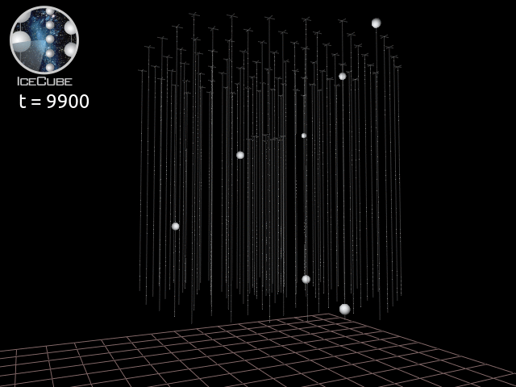
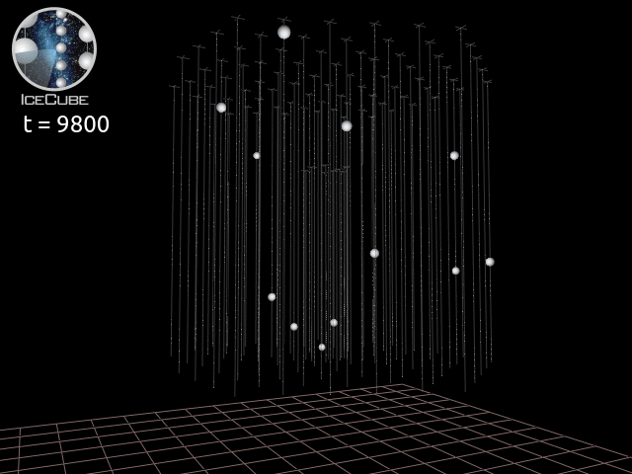

Event Topologies
Track Event
Cascade Event
ns
ns
1
Event Classification
Topology? Neutrino?
2
Event Reconstruction
Direction? Energy? Vertex?
Ratio of signal to background: $\sim 1:100$ million
Mirco Hünnefeld

Slide 16
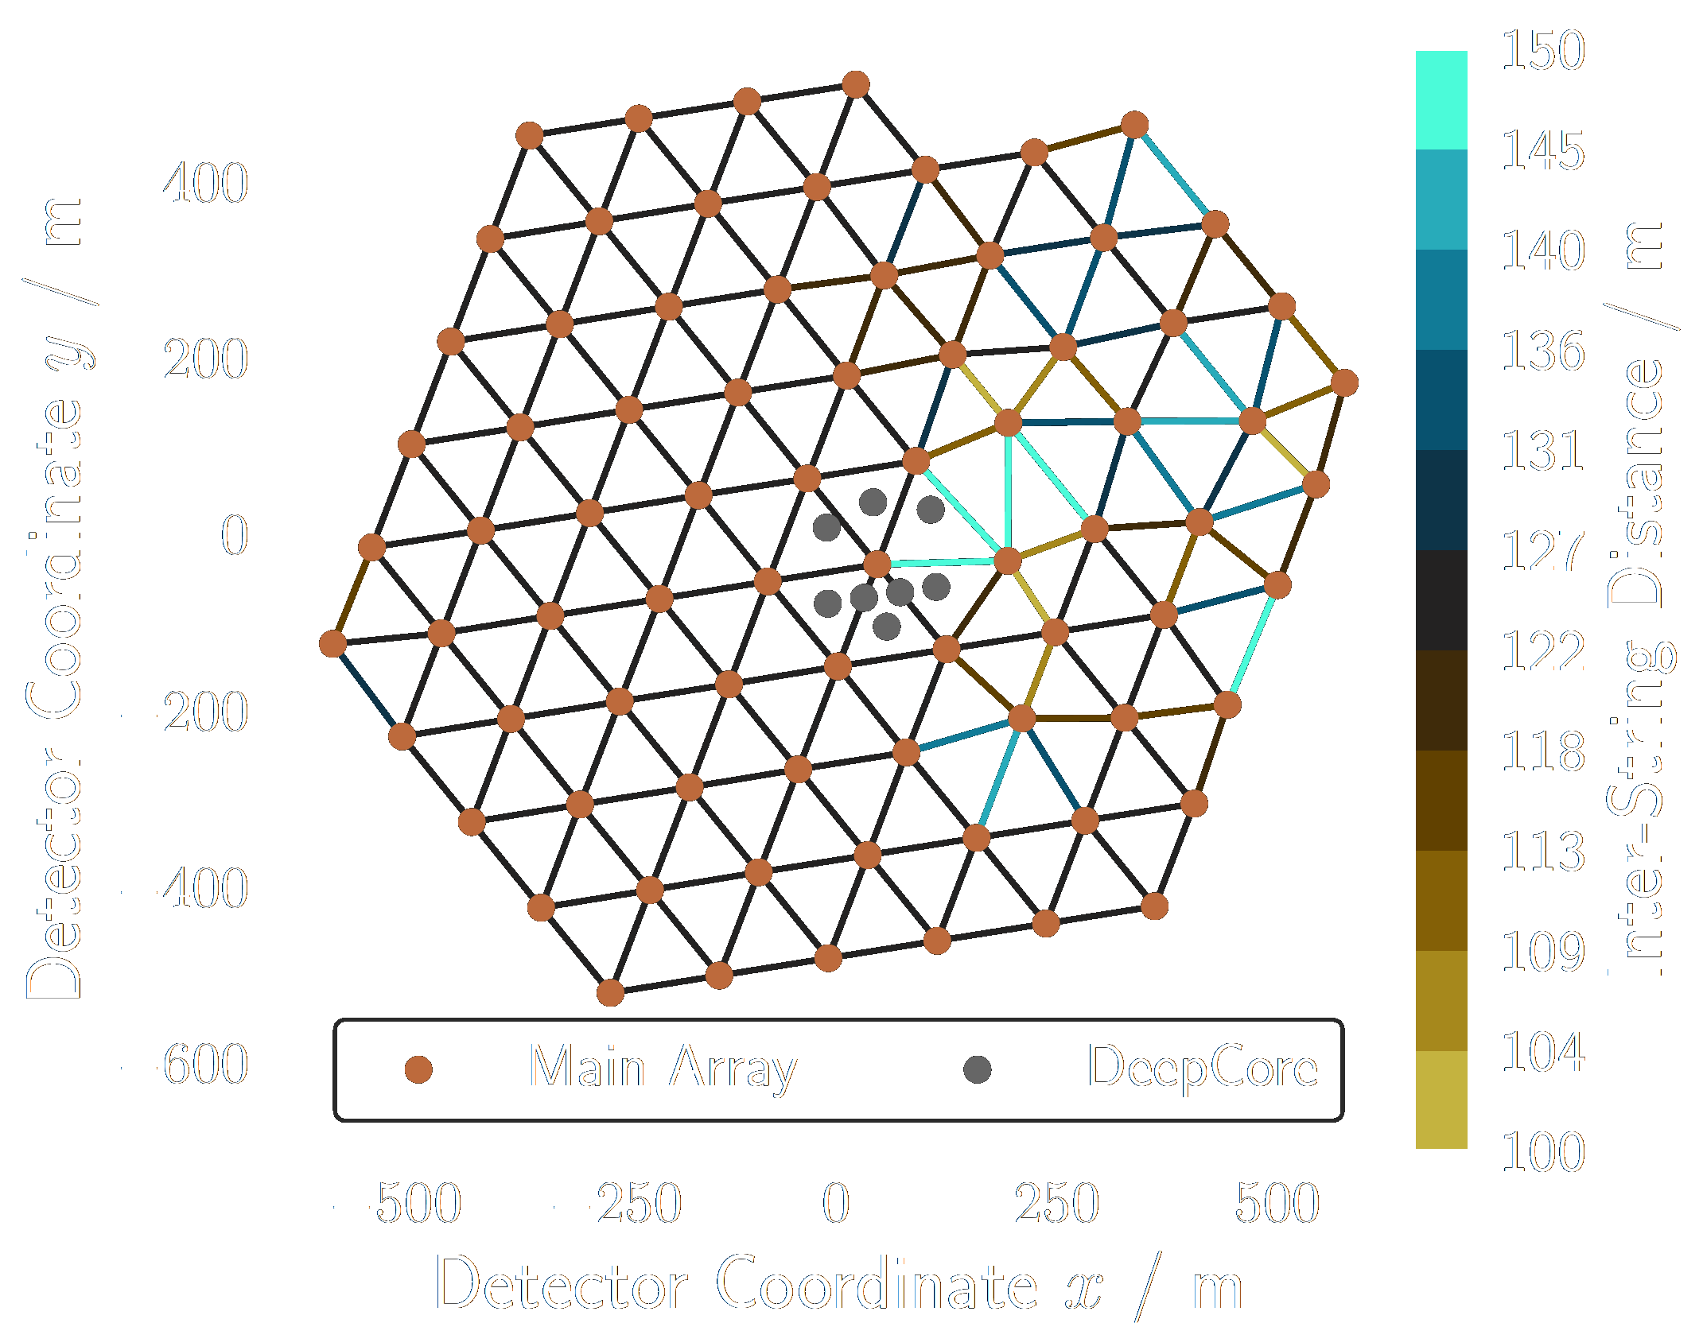
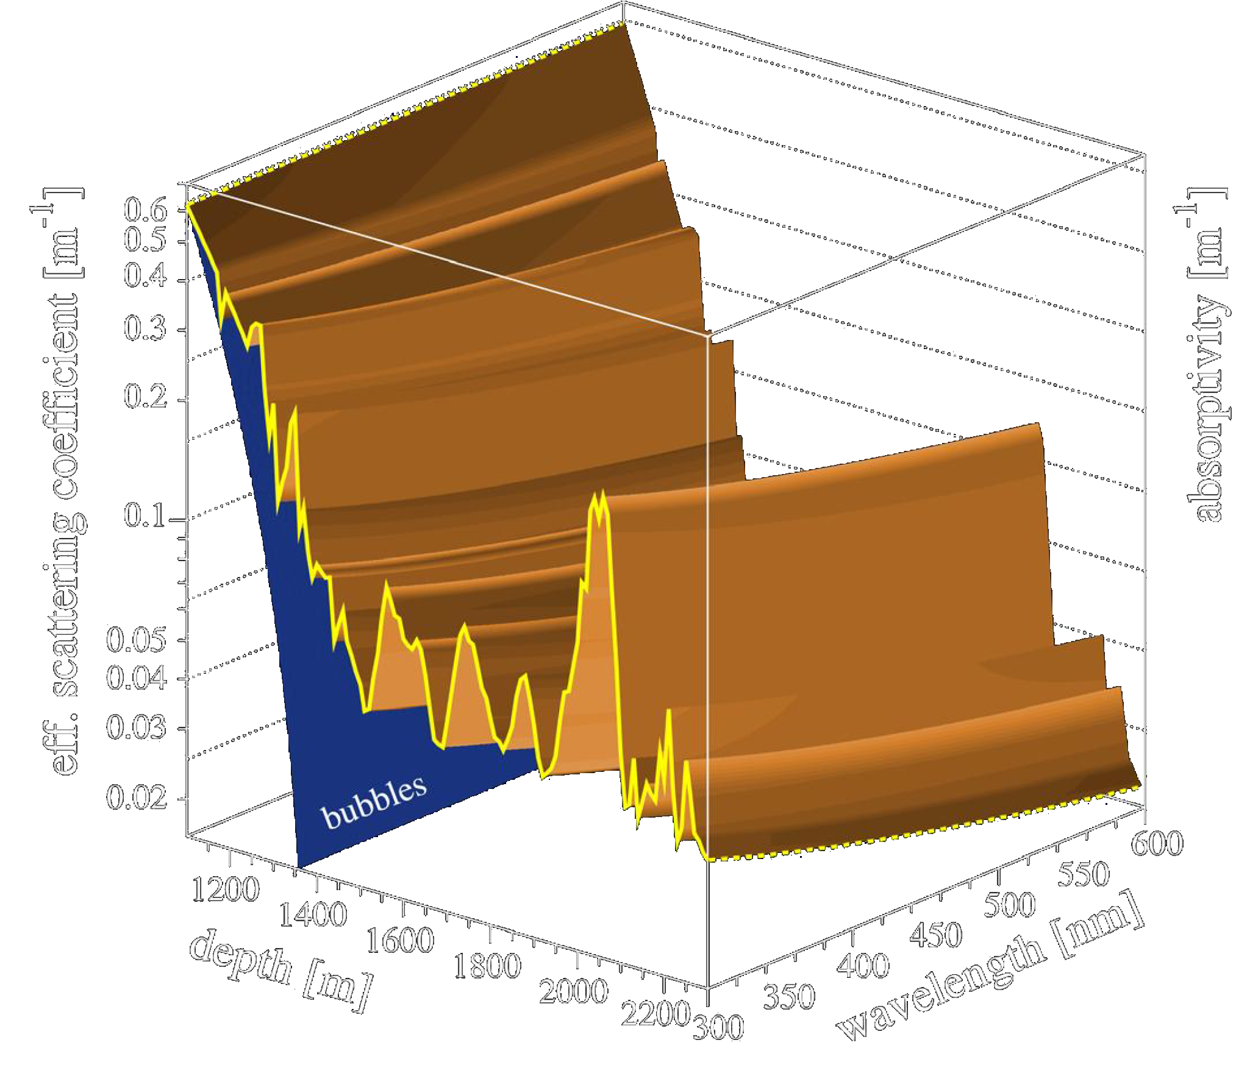
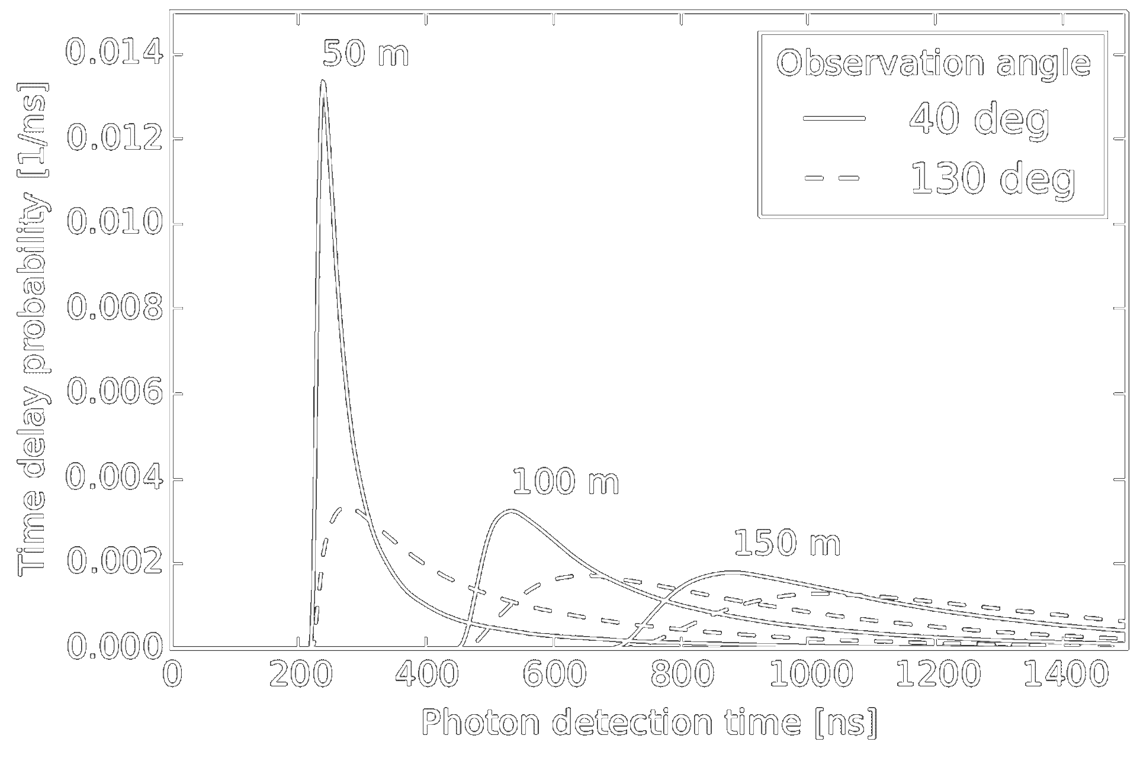
What do we know about our Data?
Detector geometry:
  3 detector parts: main array, upper & lower DeepCore
  Deviations from symmetric detector grid
Underlying physics of neutrino interaction are invariant under translation and rotation
Inhomogeneous photon propagation due to dust impurities and crystal structure of ice
Light yield scales linearly with deposited energy
General shape of photon arrival time PDF
Photons (and in good approximation: the measured pulses) are independent of each other
arXiv: 1311.4767
Mirco Huennefeld
Source: 10.1029/2005JD006687 [4]

Slide 17
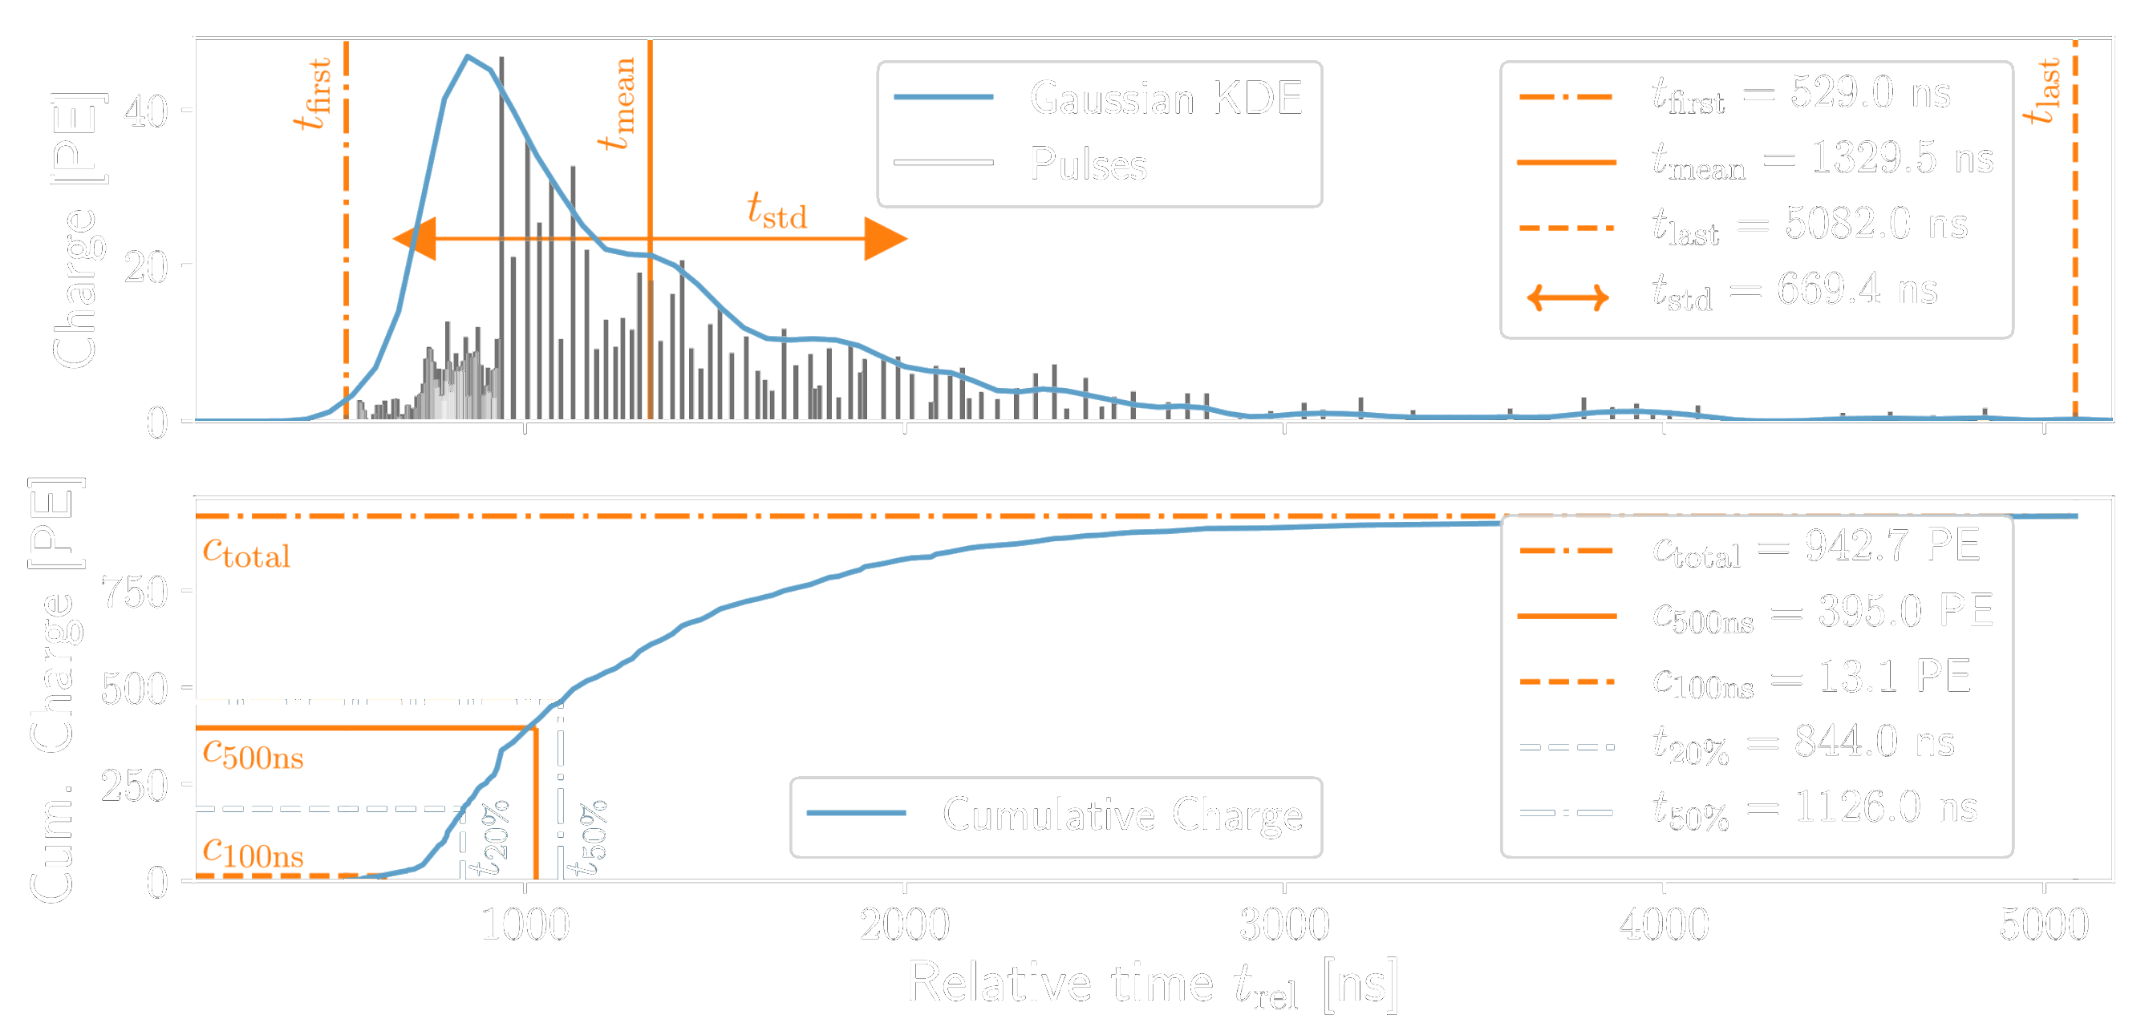
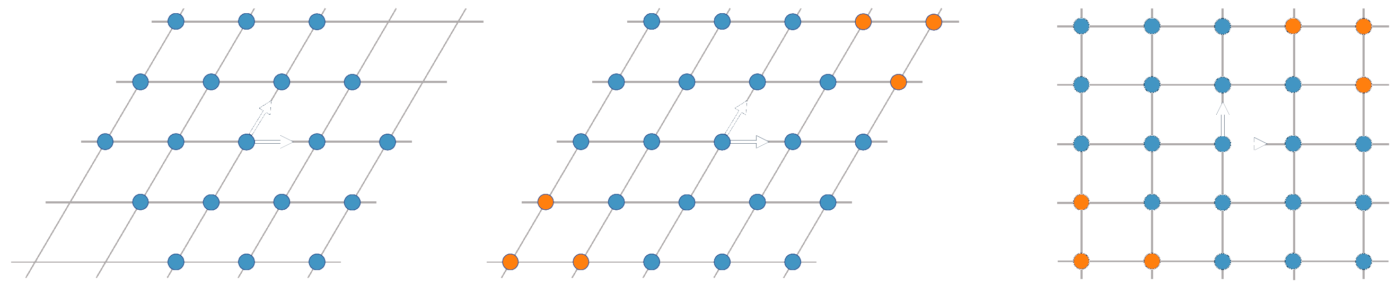
Convolutional Neural Networks
Workhorse of event selection
Classification & regression tasks
Fast and reliable
Hexagonal convolution kernels
Uncertainty quantification
Exploit translational invariance
Hexagonal Convolution Kernels
Mirco Hünnefeld

Slide 18
Talk Outline
Importance of Domain Knowledge and Symmetries
Event Reconstruction in IceCube
  The IceCube Neutrino Observatory
  Data format and challenges
  Convolutional neural networks
Combining Maximum-Likelihood with Deep Learning
  Maximum-Likelihood Estimation
  Exploiting available symmetries and domain knowledge
  Interpretability and Generalization
Ongoing and future work
Conclusions
Credit: Tobias Hell, https://numerical-analysis.uibk.ac.at/
images/User-Data/Tobias-Hell/StochastikHell.pdf
Mirco Huennefeld
Notes:
16 minutes (14 to go)

Slide 19
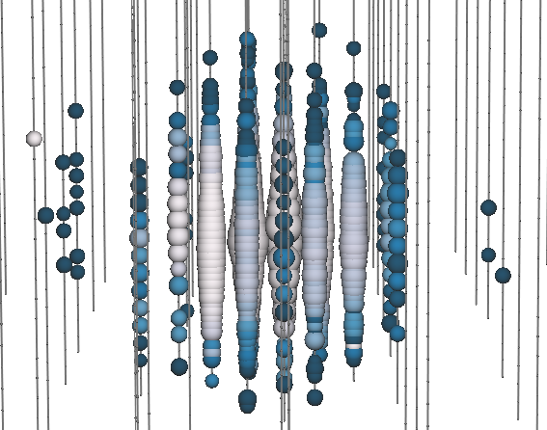




Event-Generator: Combining Maximum-Likelihood with DL
Hybrid reconstruction method:
Combines maximum-likelihood estimation with deep learning
Modeling of high-dimensional PDFs via generative model
Exploits available information and symmetries
Robust and interpretable Deep Learning
Hypothesis
PDF
Expectation $\vec{λ}$
Update hypothesis
Likelihood
Data $\vec{x}$
$$\vec{λ}$$
$$\vec{x}$$
Charge
$$\vec{λ}$$
$$\vec{x}$$
Time
Charge
$$\vec{λ}$$
$$\vec{x}$$
Charge
Time
Time
19

Slide 20
Event-Generator: Combining Maximum-Likelihood with DL
Hybrid reconstruction method:
Combines maximum-likelihood estimation with deep learning
Modeling of high-dimensional PDFs via generative model
Exploits available information and symmetries
Robust and interpretable Deep Learning
Hypothesis
PDF
Expectation $\vec{λ}$
Update hypothesis
Likelihood
Data $\vec{x}$
$$\vec{λ}$$
$$\vec{x}$$
Charge
$$\vec{λ}$$
$$\vec{x}$$
Time
Charge
$$\vec{λ}$$
$$\vec{x}$$
Charge
Time
Time
20

Slide 21
Event-Generator: Combining Maximum-Likelihood with DL
Hybrid reconstruction method:
Combines maximum-likelihood estimation with deep learning
Modeling of high-dimensional PDFs via generative model
Exploits available information and symmetries
Robust and interpretable Deep Learning
Hypothesis
Deep Learning
Expectation $\vec{λ}$
Update hypothesis
Likelihood
Data $\vec{x}$
$$\vec{λ}$$
$$\vec{x}$$
Charge
$$\vec{λ}$$
$$\vec{x}$$
Time
Charge
$$\vec{λ}$$
$$\vec{x}$$
Charge
Time
Time
21

Slide 22
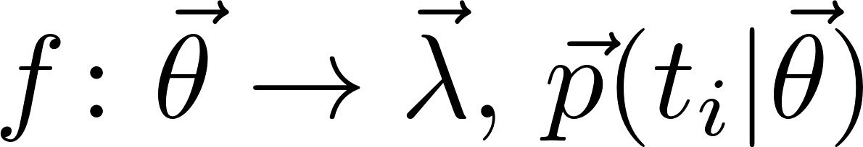
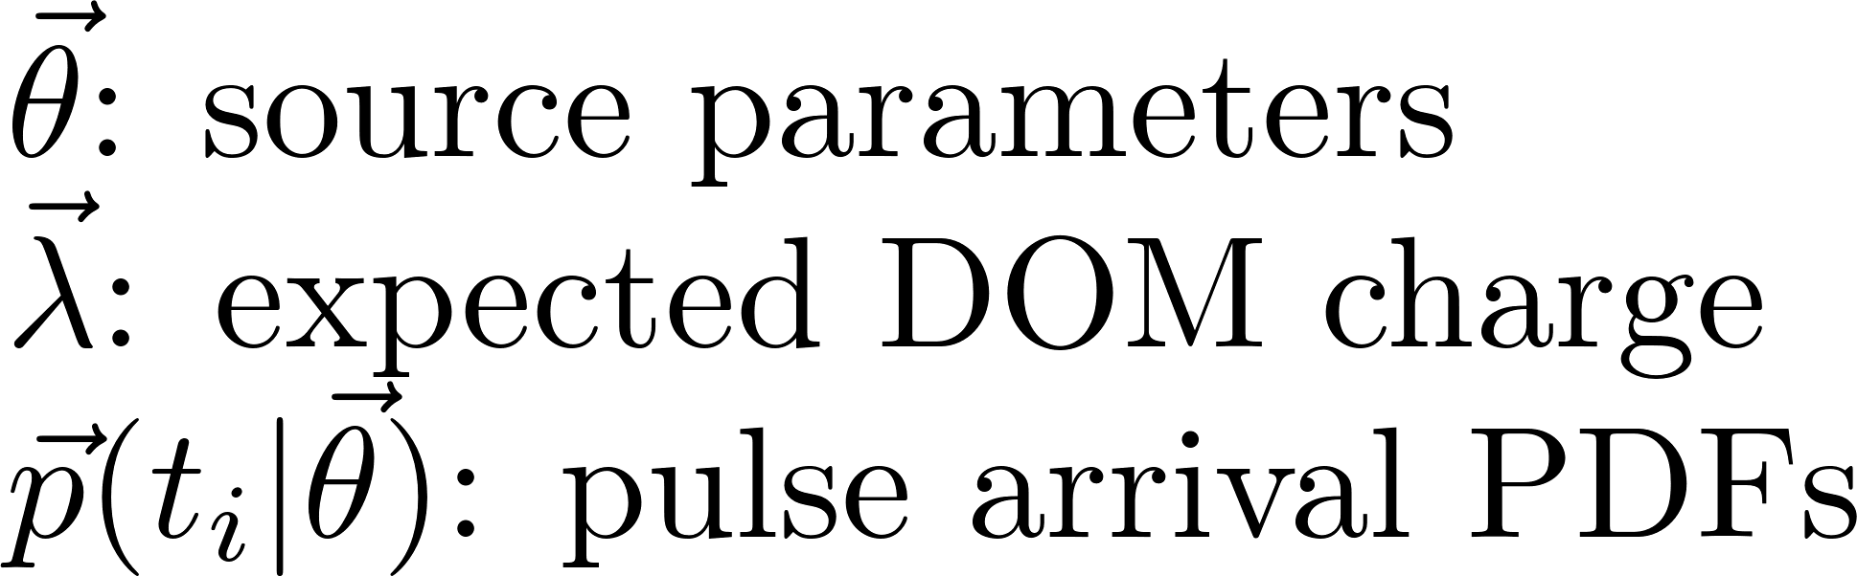
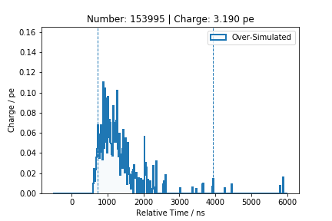
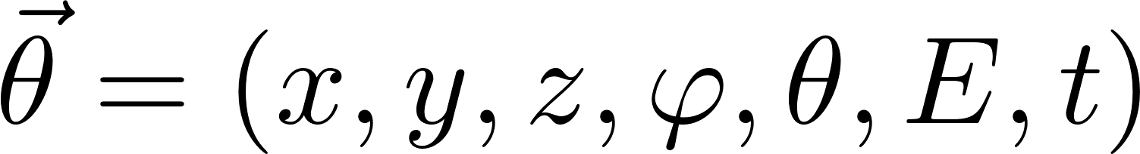
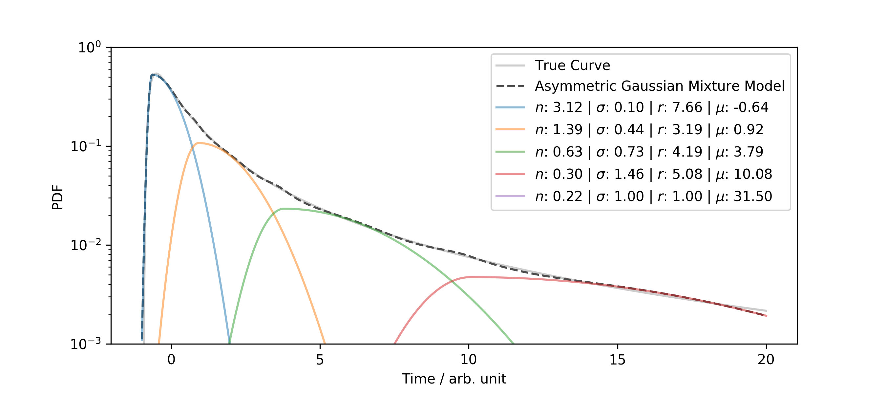
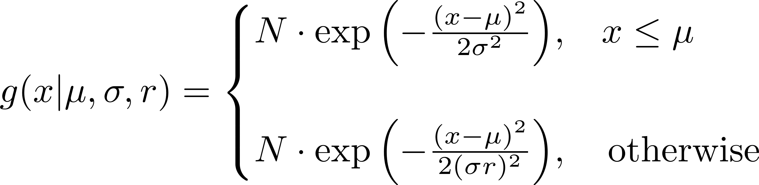
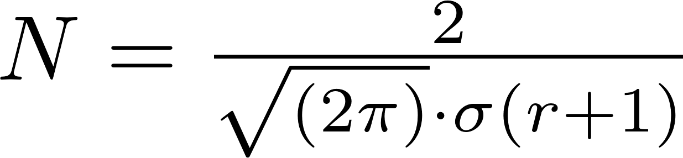
Event-Generator: Architecture
Generator NN learns mapping:
Neural Network that maps
input [?, 7] to output [?, 5160, n]
with number of mixture model components n
5160 PDFs for each of the DOMs
Example: Cascade Hypothesis
Generator
PDF
Relative Time / ns
~200k output variables
Parameterization of pulse arrival time PDF:
DOI: 10.1007/3-540-70659-3_42

Slide 23
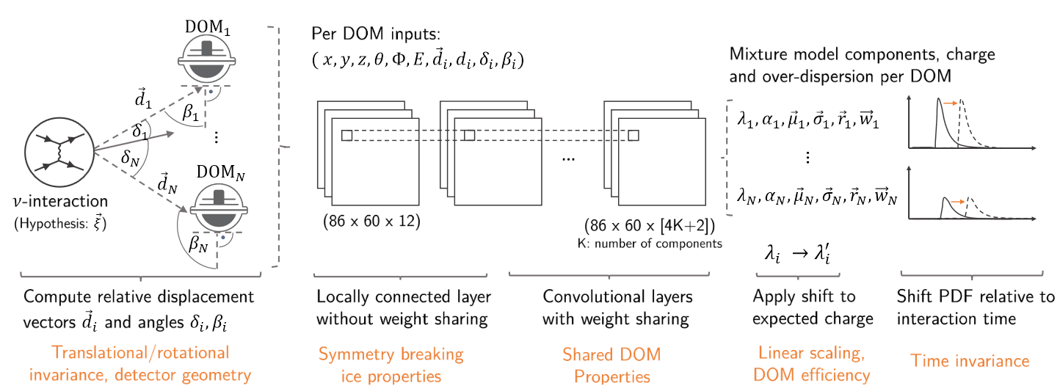
Event-Generator: Example Architecture for Cascades
[Optionally add systematics]
DOI: 10.22323/1.395.1065
Can decouple physics and detector effects
Easier to include information in forward direction when not convolved with detector response yet
We know how to do this – we simulate the data!

Slide 24
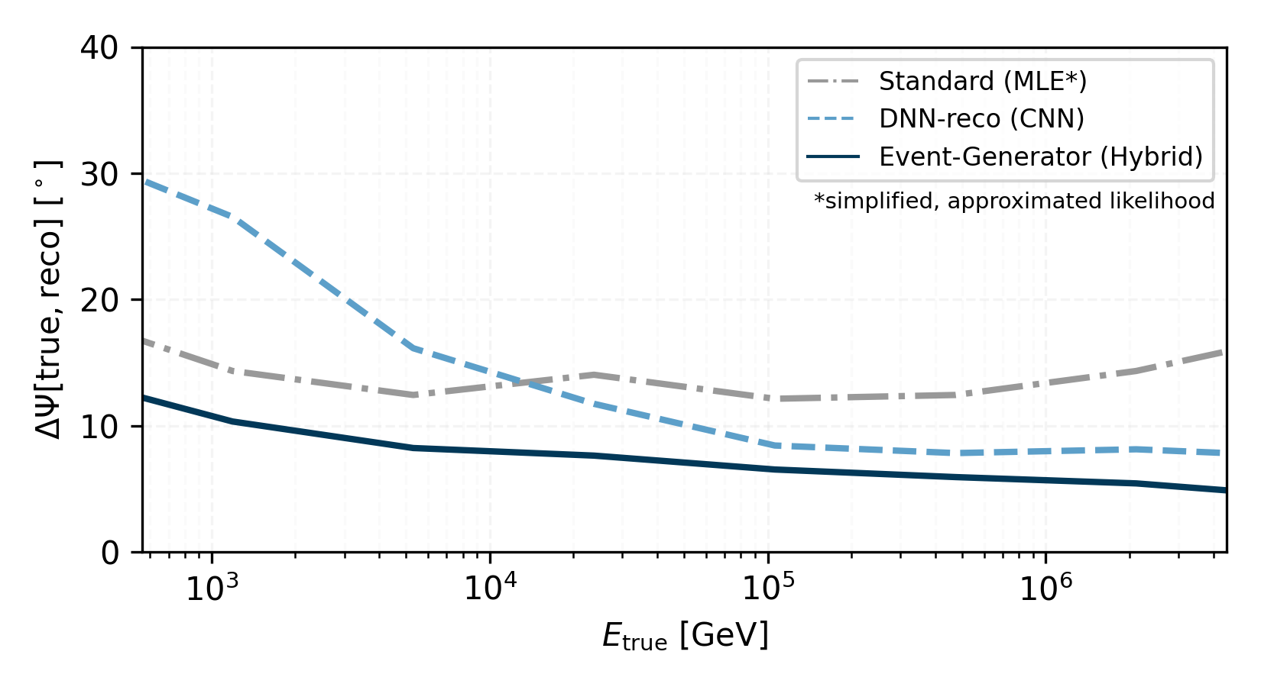
Event-Generator: Improved Performance
Avoid Likelihood Simplifications
Symmetries & Domain Knowledge
DOI: 10.22323/1.395.1065

Slide 25
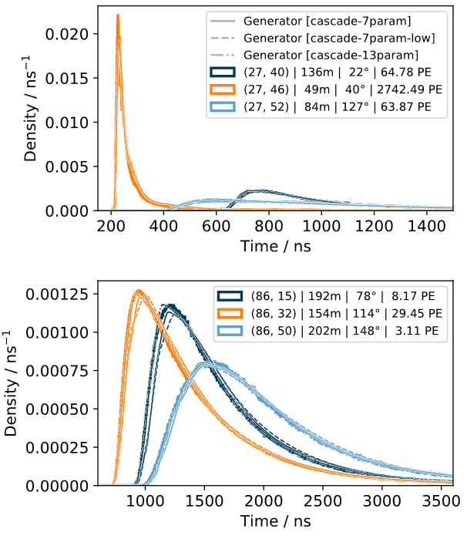
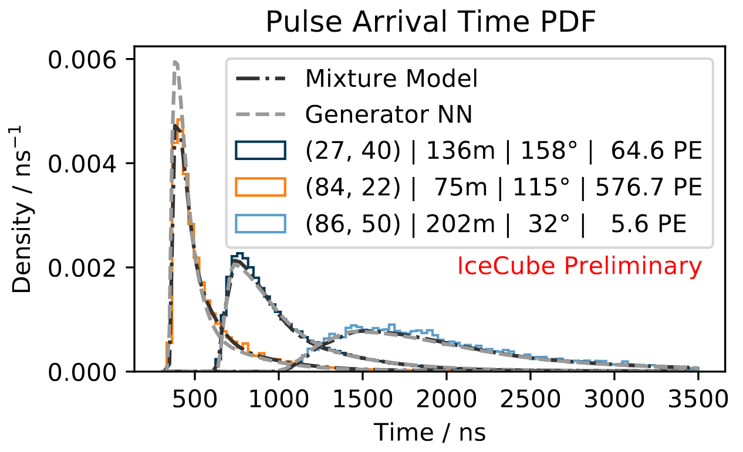
Event-Generator: Interpretability and Generalization
DOI: https://doi.org/10.22323/1.395.1065

Slide 26
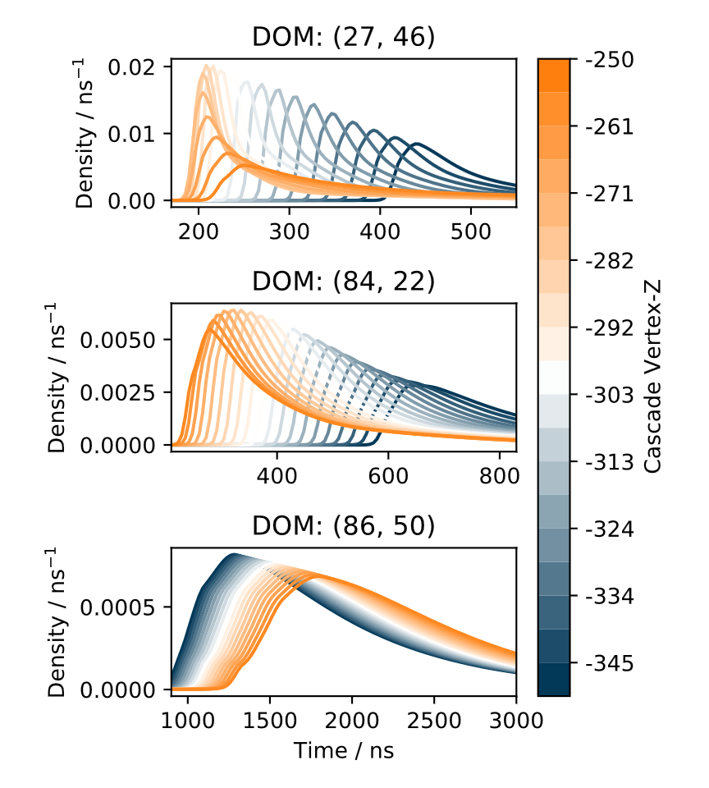
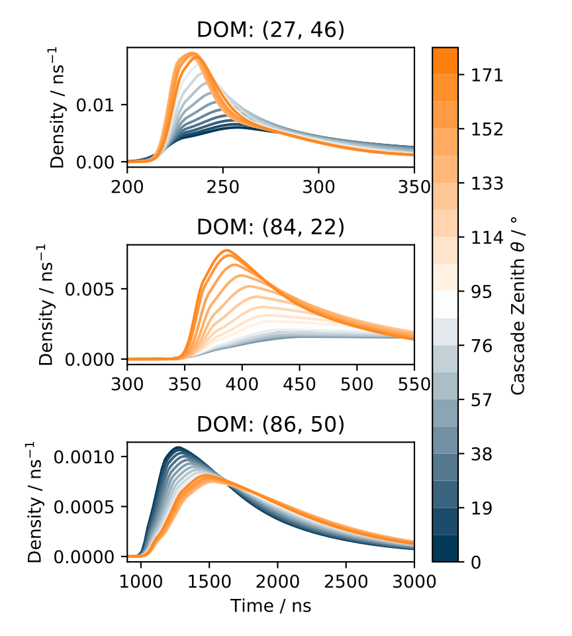
Event-Generator: Interpretability and Generalization

Slide 27
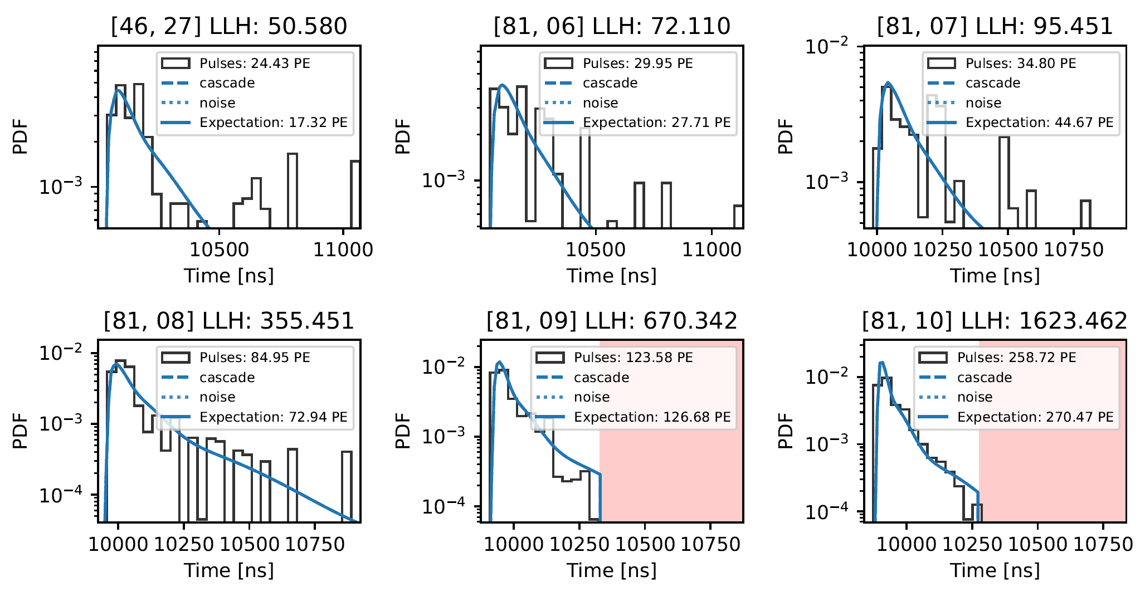
Event-Generator: Interpretability and Generalization

Slide 28
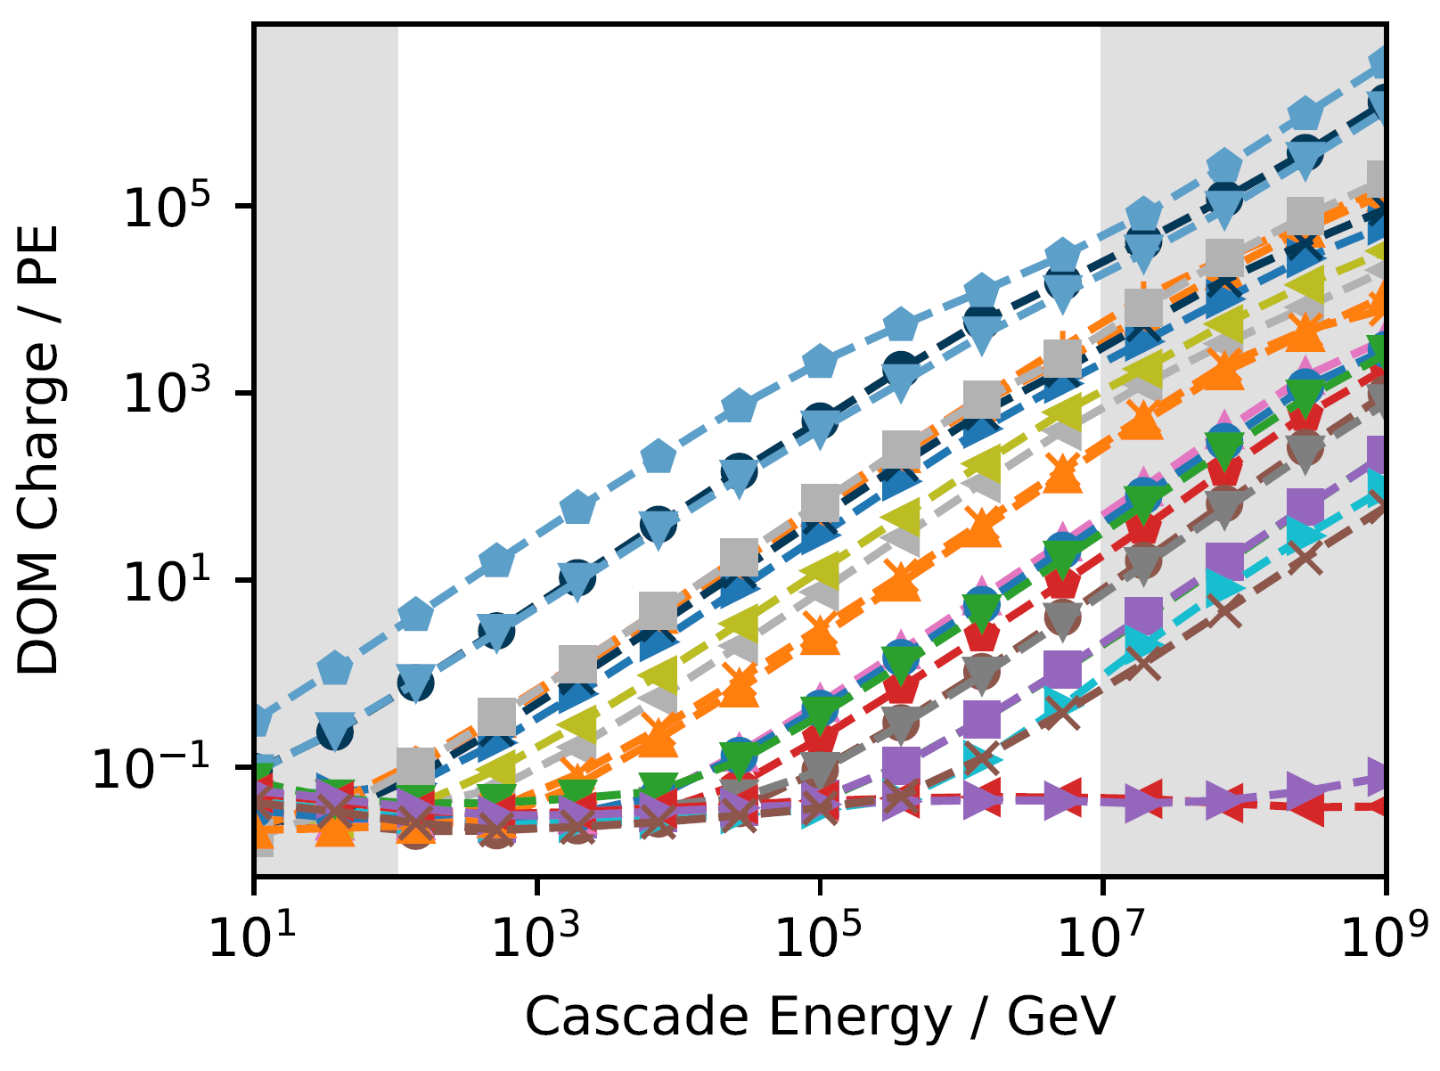
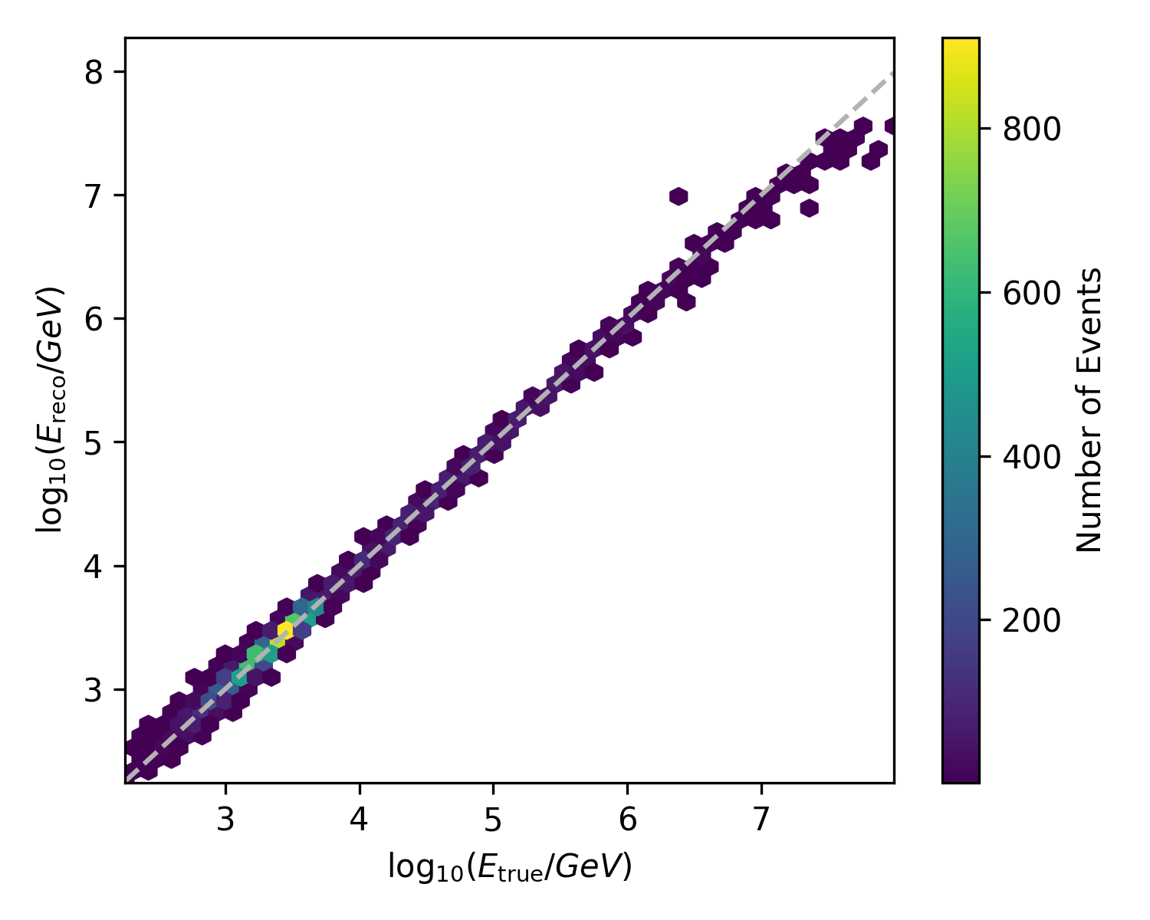
Event-Generator: extrapolating beyond the training data
Colors:
DOMs at different distances from cascade
Near DOMs
Boundary of Training Set
Far DOMs (Noise)

Slide 29
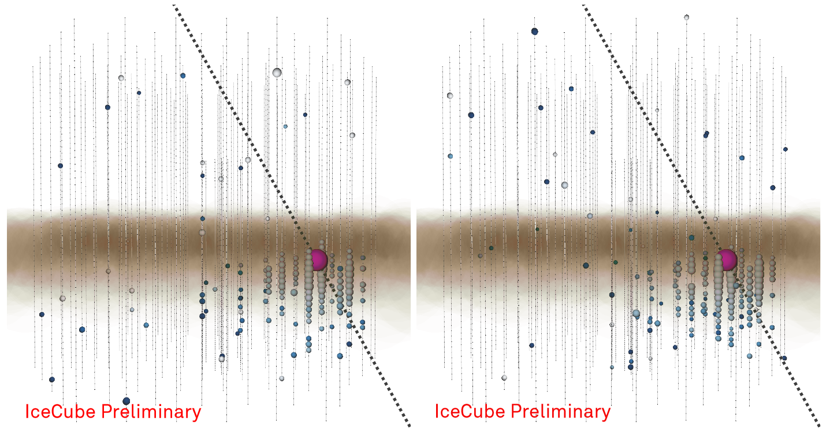
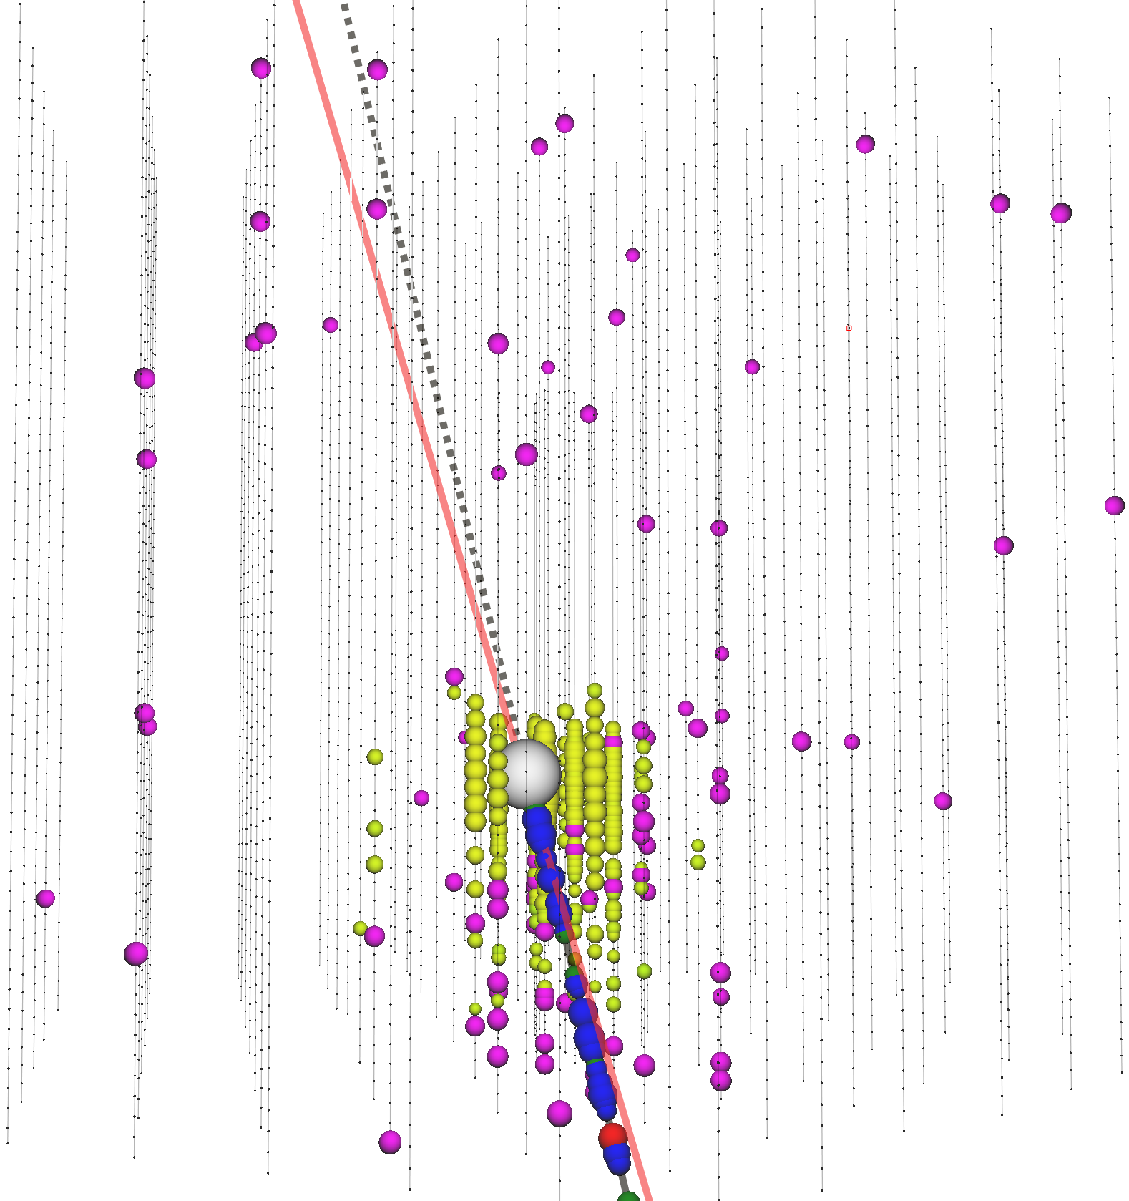
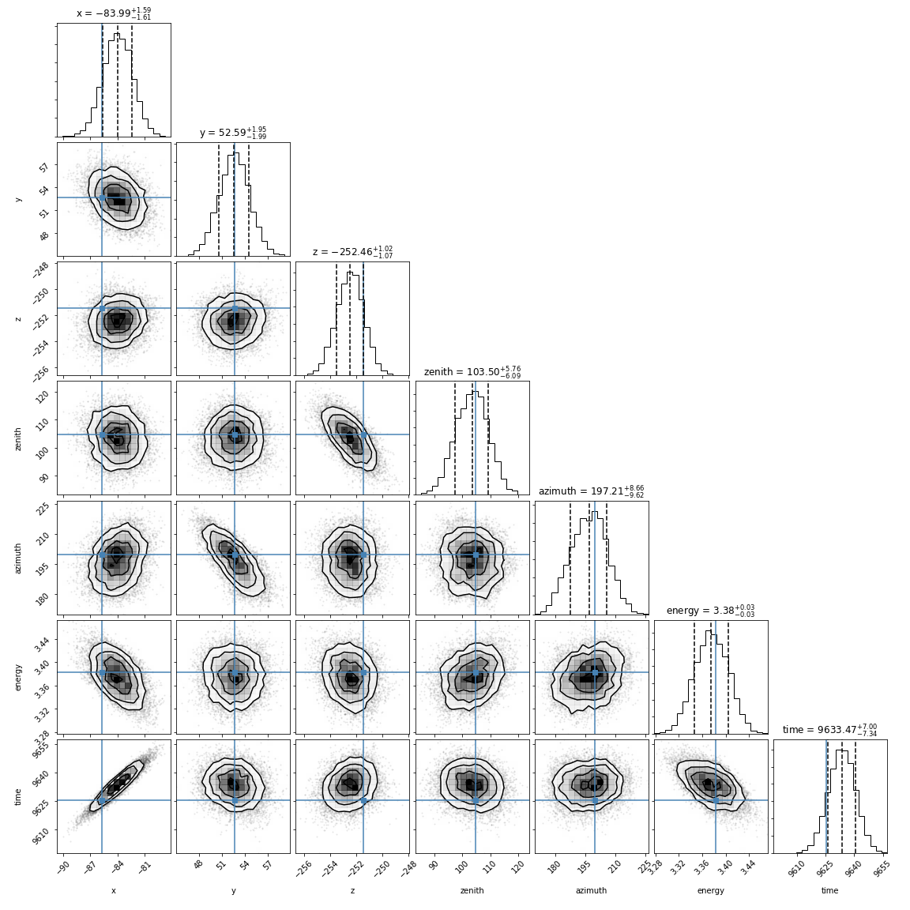
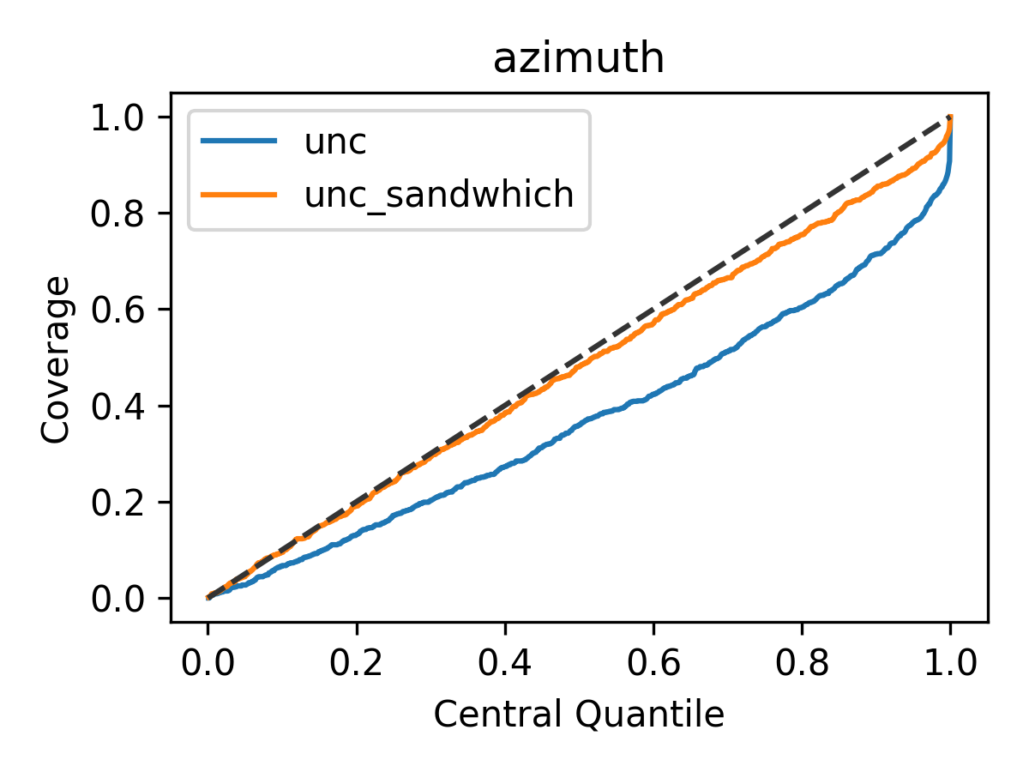
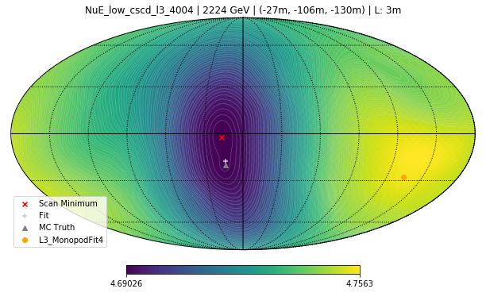
Event-Generator: Additional Applications
Simulation
Goodness-of-fit
DOI: https://doi.org/10.22323/1.395.1065
Uncertainty Estimation
Likelihood Scans
*
*http://www.stat.umn.edu/geyer/5601/notes/sand.pdf

Slide 30
Talk Outline
Importance of Domain Knowledge and Symmetries
Event Reconstruction in IceCube
  The IceCube Neutrino Observatory
  Data format and challenges
  Convolutional neural networks
Combining Maximum-Likelihood with Deep Learning
  Maximum-Likelihood Estimation
  Exploiting available symmetries and domain knowledge
  Interpretability and Generalization
Ongoing and future work
Conclusions
Mirco Huennefeld
Credit: Tobias Hell, https://numerical-analysis.uibk.ac.at/
images/User-Data/Tobias-Hell/StochastikHell.pdf
Notes:
16 minutes (14 to go)

Slide 31
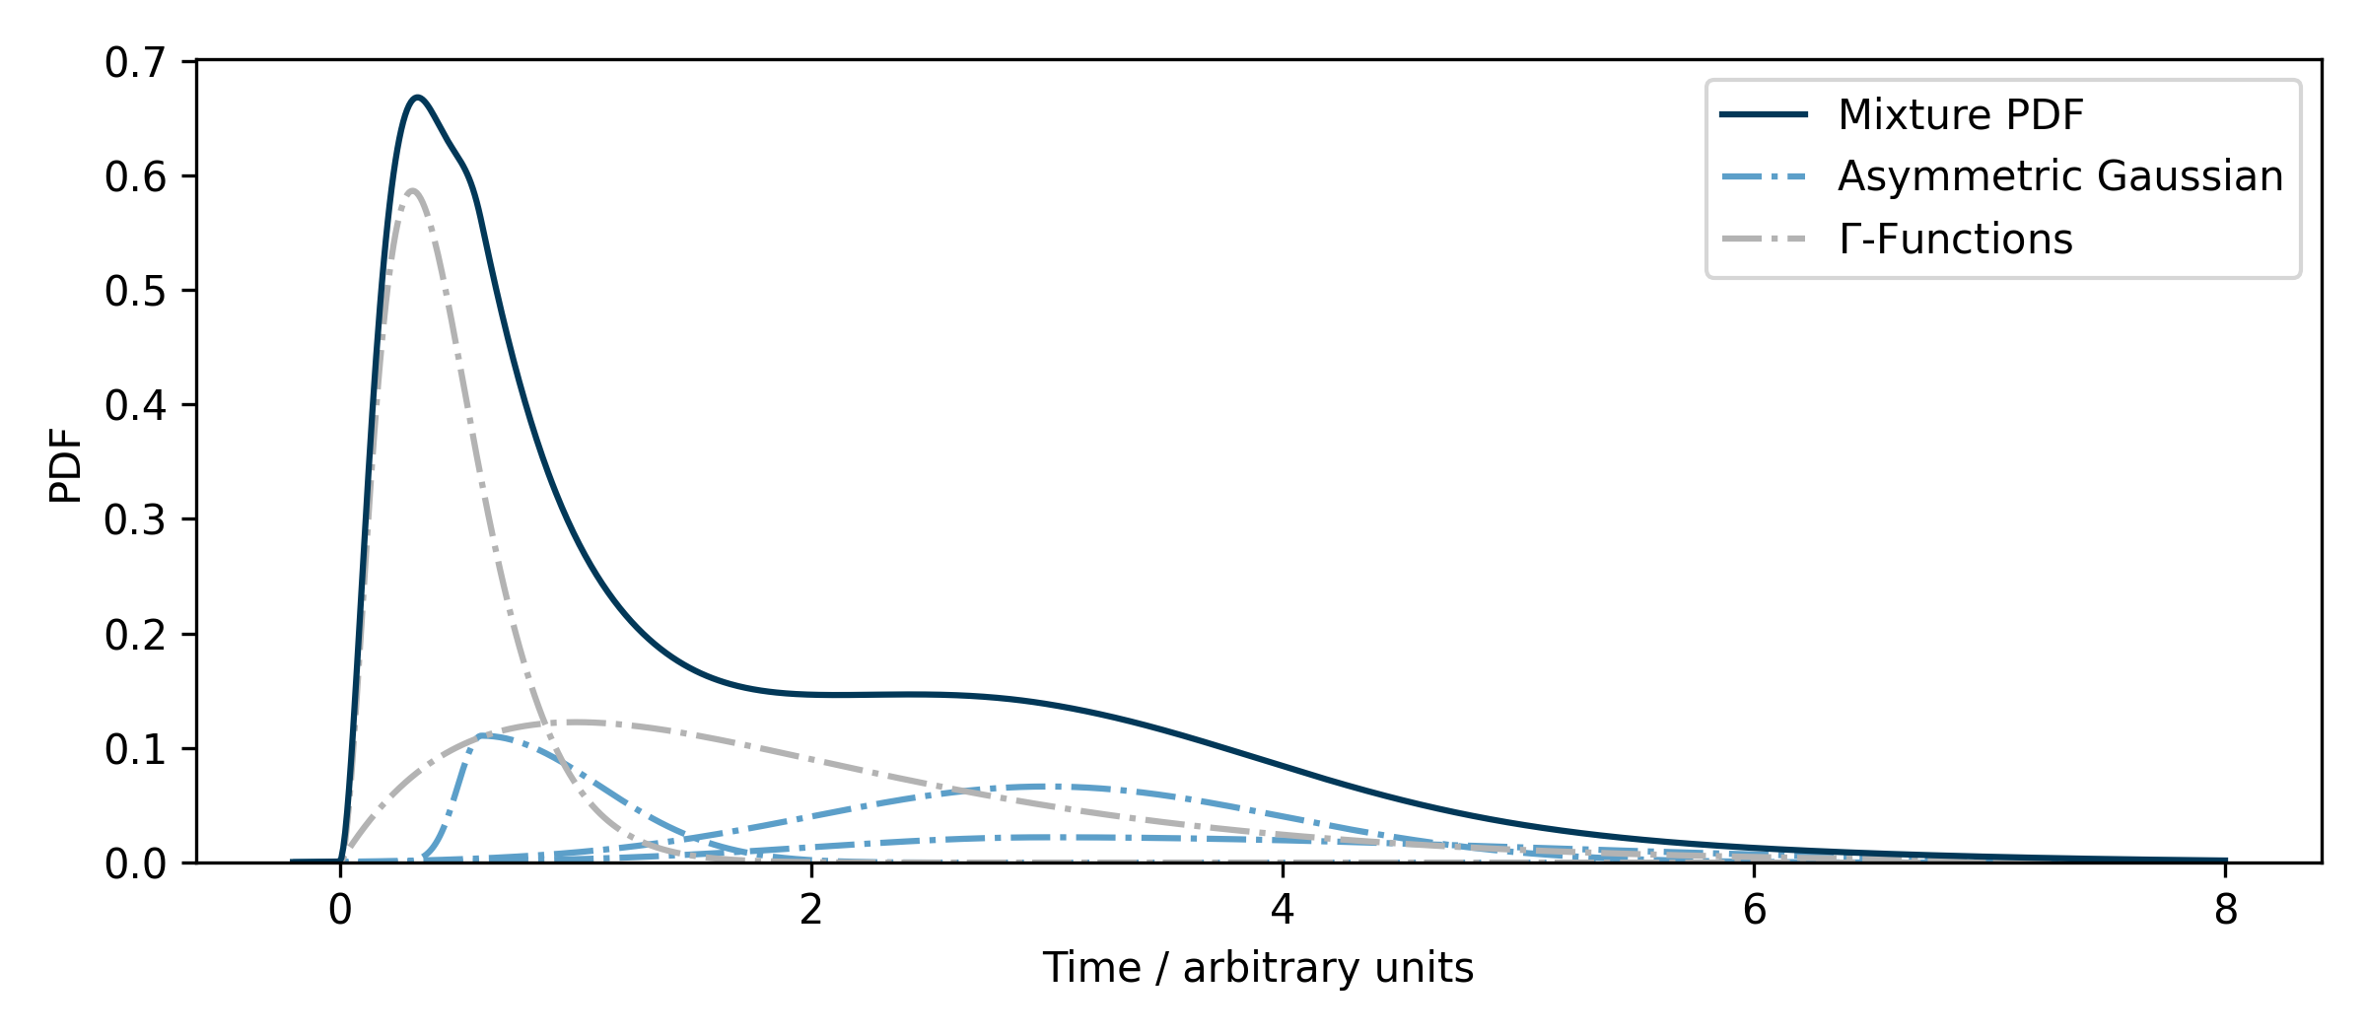
Event-Generator: more flexible time PDFs
Arrival time PDFs:
Previously: mixture model of asymmetric Gaussians
Now: mixture model of any basis PDF
Option to include learnable time PDF parameterizations
  Example: normalizing flow
More accurate modelling of arrival time PDFs

Slide 32
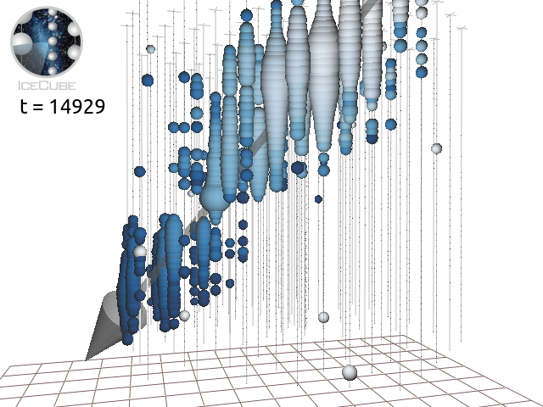
Event-Generator: nested event hypotheses
Source Class
MultiSource Class
Defines an arbitrary light source
Arbitrary collection of light sources defined by (nested) Source and/or MultiSource objects
DOM (13, 37)
DOM (13, 37)
Examples:
Muons (cascades + track segments)
Muon bundle (muons)
Coincident events
Cascade
DOM (13, 37)
Track segment/Muon
Event-Generator:
Framework to compose arbitrary event hypotheses
Framework ensures compatibility of objects, version control, and reproducibility
Provides tools to reconstruct, perform scans, estimate uncertainties, simulate events, interpret and investigate results, create and train new light source models
Double-bang
Flasher
…

Slide 33
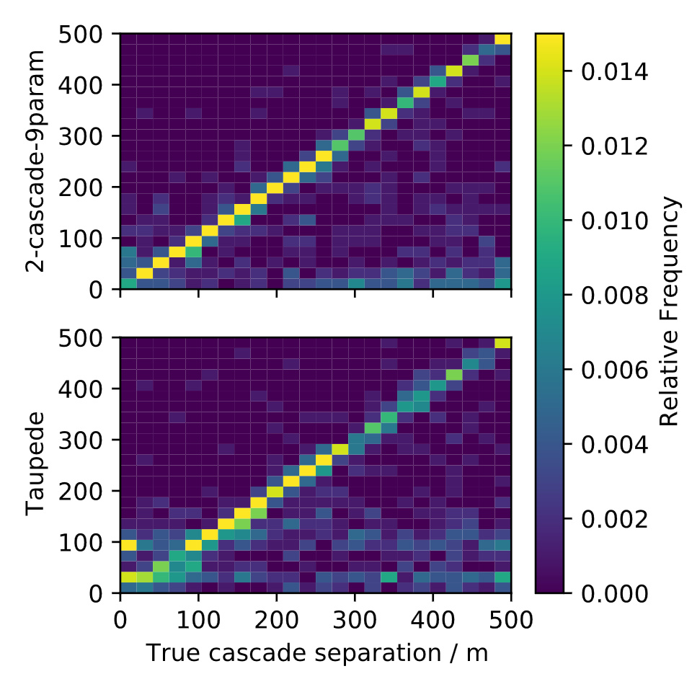
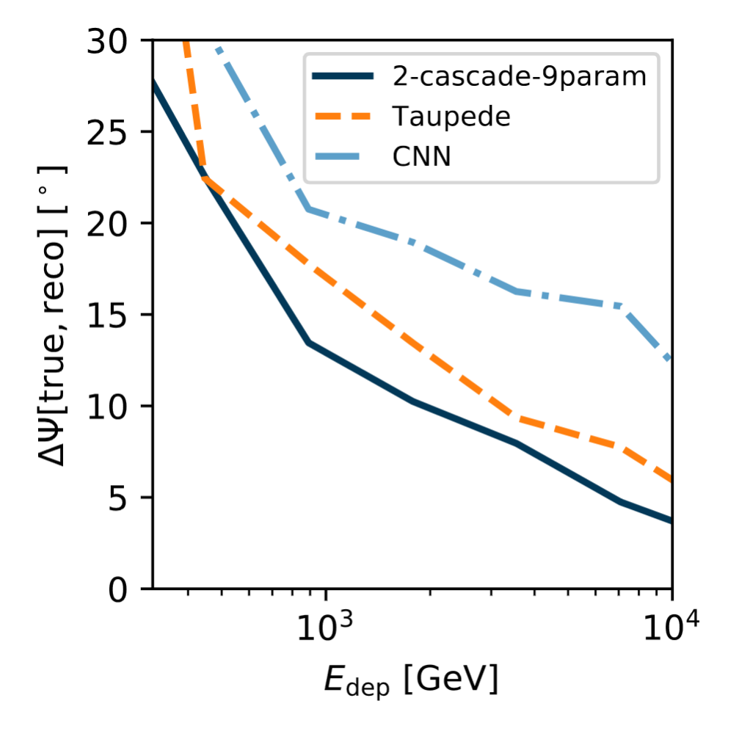
Event-Generator: Double Cascade Reconstruction
Double Cascade Separation
Double Cascade
Separation d
Angular Resolution

Slide 34
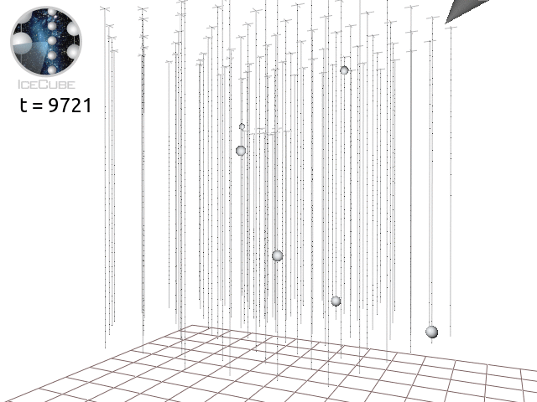
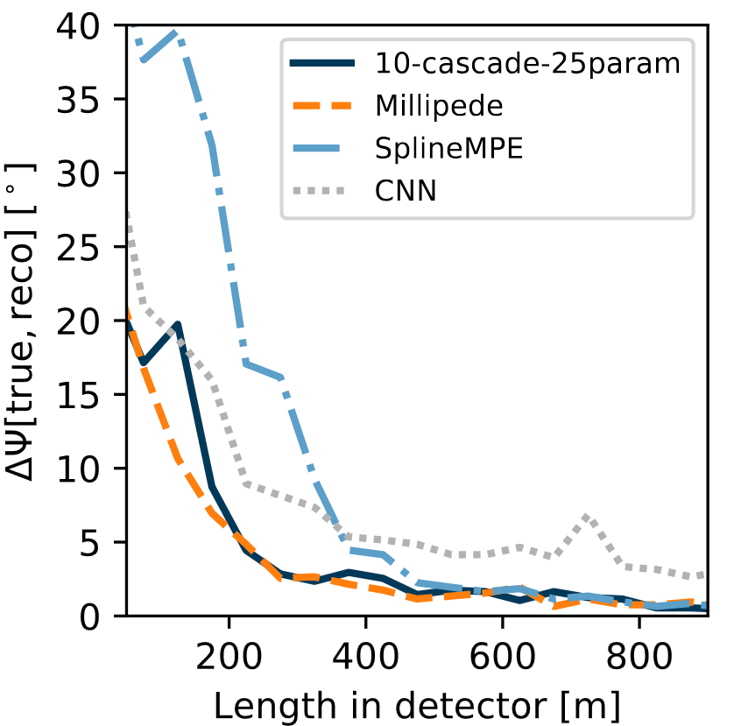


Event-Generator: Track Reconstruction
Track reconstruction:
Hypothesis consists of:
  Track vertex location and time, direction and energy/length
  Energy depositions along track (e.g.: individual cascades)
Challenges:
For accurate description of event O(100) cascades are required!
Current implementation runs into runtime and memory issues
Entering $μ$
ns
High number of parameters: difficult minimization!
10 injected cascades
Track Parameterization
$$μ$$

Slide 35

Talk Outline
Importance of Domain Knowledge and Symmetries
Event Reconstruction in IceCube
  The IceCube Neutrino Observatory
  Data format and challenges
Convolutional Neural Networks
  Exploit approximate translational invariance
Combining Maximum-Likelihood with Deep Learning
  Maximum-Likelihood Estimation
  Exploiting available symmetries and domain knowledge
Ongoing and future work
Conclusions
Mirco Huennefeld
Notes:
16 minutes (14 to go)

Slide 36
Conclusions
Extrapolating beyond training data
Utilization of Domain Knowledge and Symmetries:
Reduces problem complexity
Promotes robustness and generalizability
Enhances interpretability
Event-Generator Framework:
Interpretable and robust DL via utilization of domain knowledge
Support for arbitrary event hypotheses:
  Mostly focused on cascades so far
  Started to look deeper into tracks
Versatile tool: reconstruction, stimulation, uncertainty estimation, sky scans, investigating/interpreting results
Ongoing and future work:
Updates and improvements to Event-Generator framework
Event selection for track-like event topologies
Improved performance
Avoid Likelihood Simplifications
Symmetries & Domain Knowledge
DOI: 10.22323/1.395.1065
Analyses benefit from a combination of different DL methods

