Slide 1
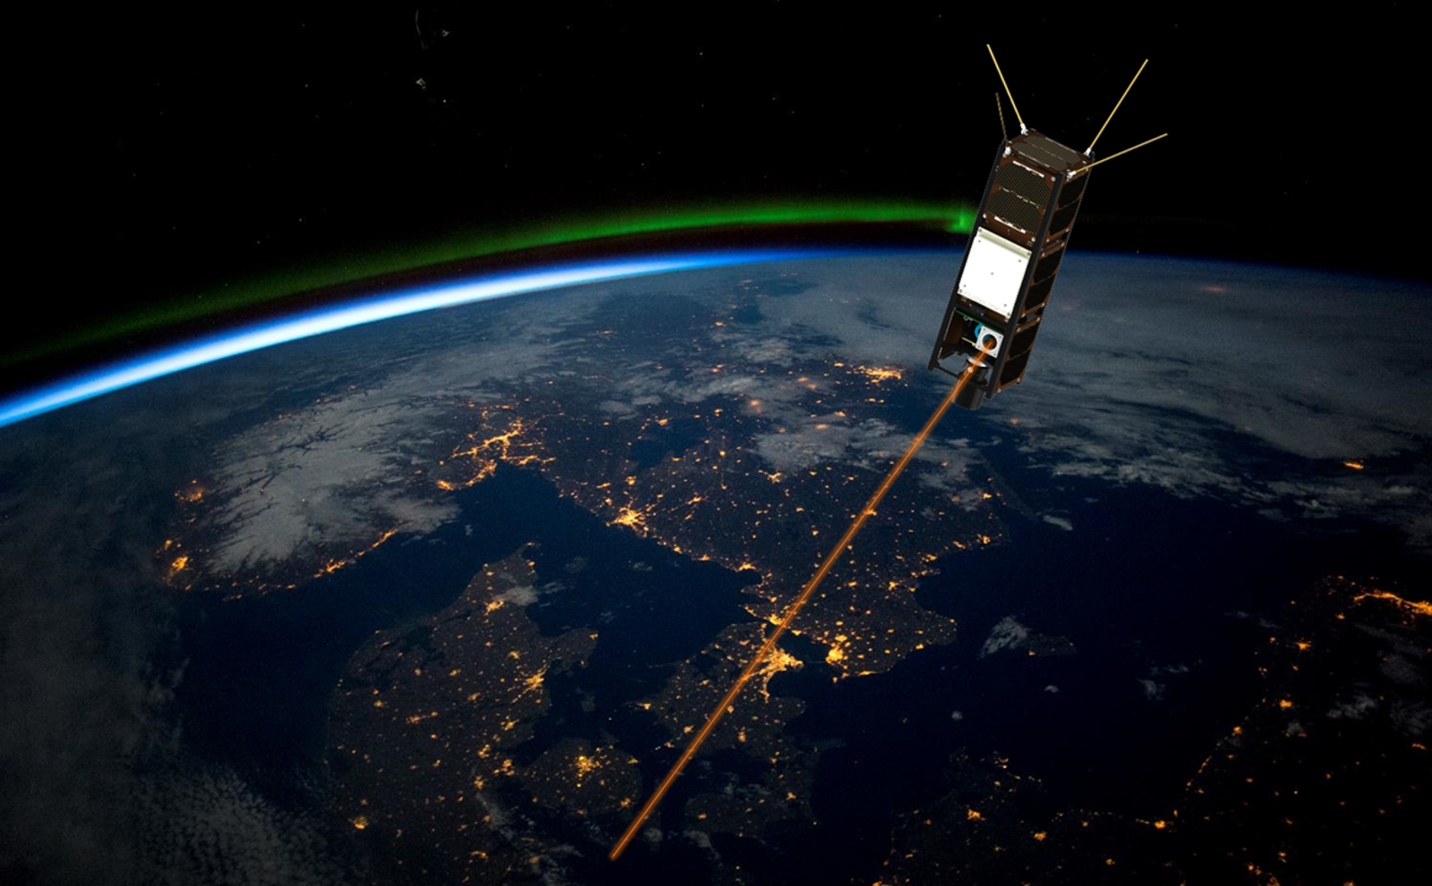
A free-space optical communications data relay for Antarctica
Marcus Birch¹
Francis Bennet¹, Tony Travouillon¹
Simon Alexander², John French²
¹The Australian National University
²Australian Antarctic Division

Slide 2
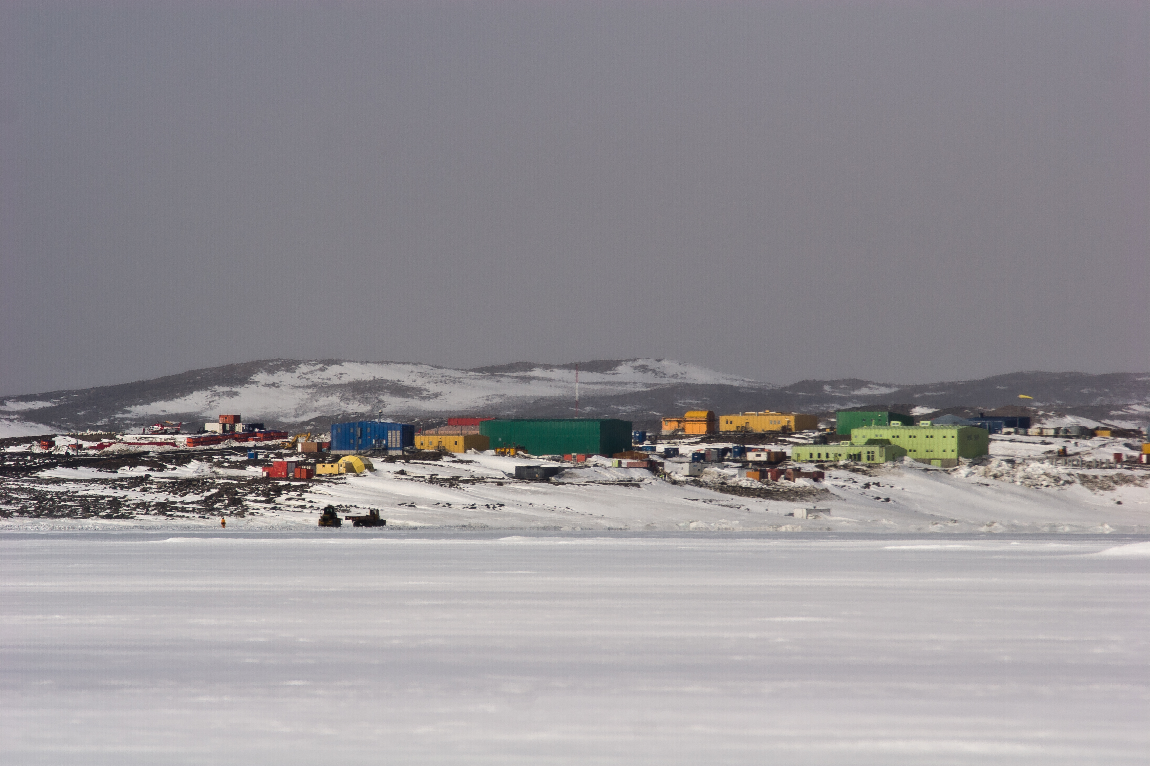
Overview
Modelling laser communications for Antarctica
The RINGSS site-testing instrument
Future options for demonstrations
Telecommunications for Antarctica
Why laser communications could be a solution
What is laser communications

Slide 3
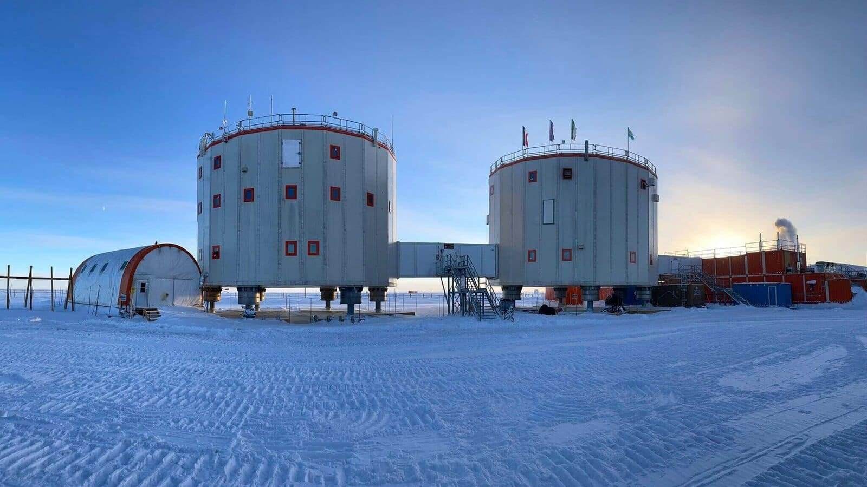
Telecommunications in Antarctica is hard
Without a fibre connection there is typically a reliance on slow Geostationary internet
Starlink offers a way out (<50Mbps uplink persistently)
Science may yet require higher bandwidth connection for offloading data
This could be done with free-space optical relay ( >10Gbps in bursts)
Leverage both excellent optical sites (Dome C) to avoid complexity of adaptive optics and the orbital dynamics at the poles

Slide 4
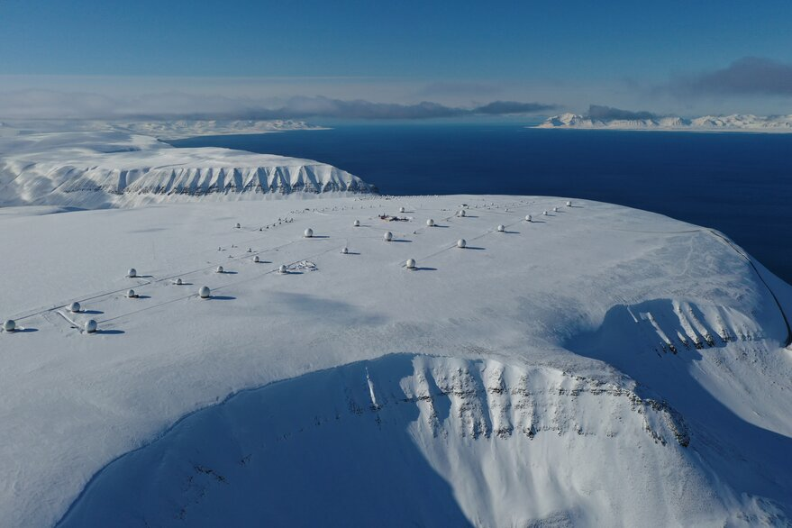
Leveraging Antarctica/Arctic as a service for satellites
Low-Earth orbit satellites rapidly downlink data in bursts to ground stations around the globe
e.g. earth observation satellites
Many satellites are bottle-necked by the data rates they can offload
Reducing data quality/quantity is common
Most Earth-observation satellites are sun-synchronous, making polar locations great for maximizing passes
This has been used effectively by KSAT at SvalSat here and Troll station in Antarctica
Laser communication can provide very high data rate downlinks and take advantage of good optical sites in Antarctica
Can offload effectively from satellites but run into the same relay issues for Antarctica

Slide 5
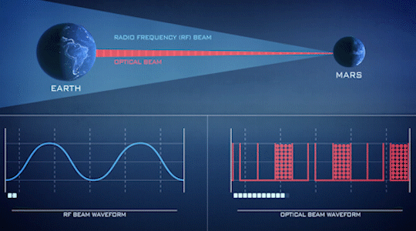
What is free-space optical communication? (FSOC / laser communication)
Taking the same telecommunications done with fiber optics and propagating over free-space (1.55μm)
Faster than radio with far smaller and lower power terminals on board spacecraft
200Gbps downlink was demonstrated this year
The narrow beams require direct line-of-sight with very stable pointing
Many similarities with optical astronomy – and struggles with similar issues
Cloud cover and atmospheric turbulence.

Slide 6
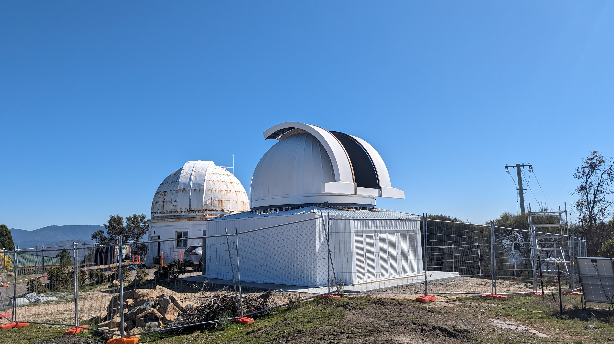
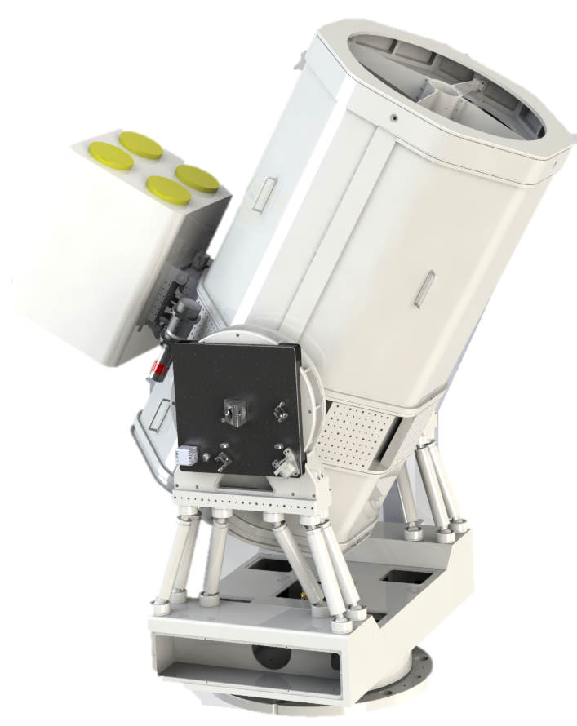
FSOC at the Australian National University
We specialize in adaptive optics for astronomical telescopes (VLT, Suburu, Gemini etc.) and operating Siding Spring Observatory
Lots of ongoing work to leverage this expertise into FSOC
Commissioning is about to begin for our new 70cm OGS at Mount Stromlo Observatory
Upcoming project to support a laser link with the crewed Orion capsule on the Artemis II mission in late-24/early 25

Slide 7
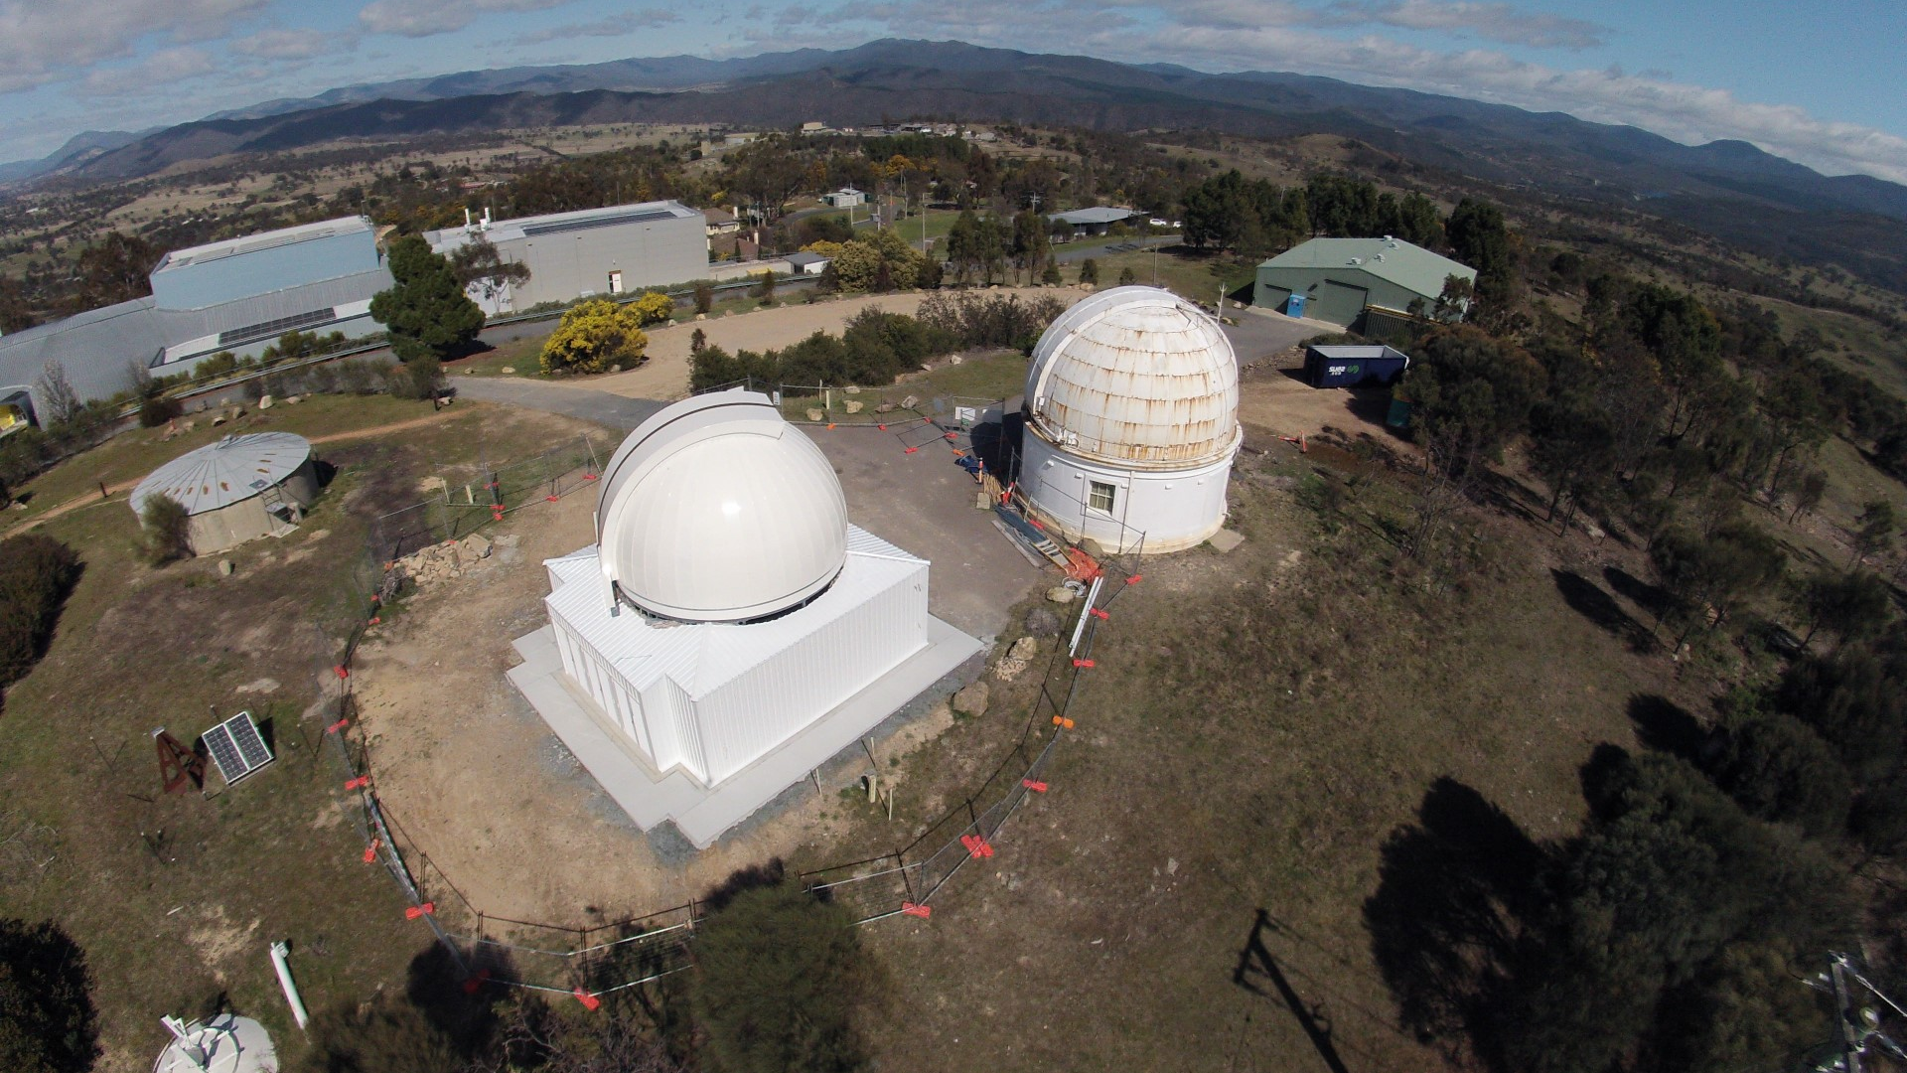

Slide 8
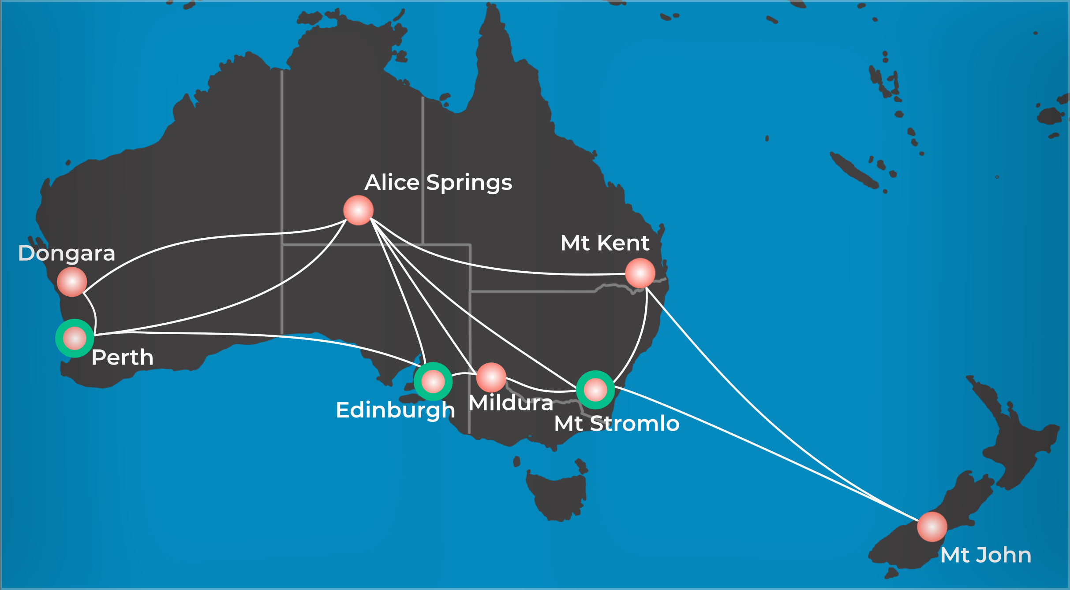
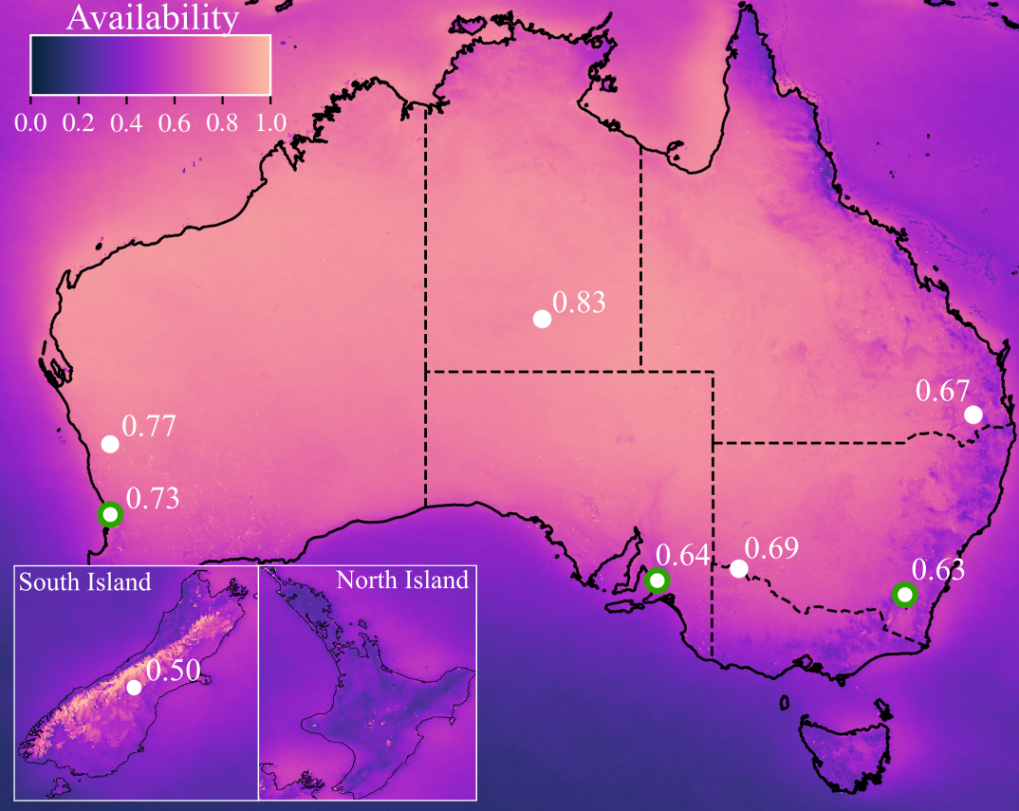
Australasian Optical Ground Station Network
We are working on an extensive Australia/NZ network
Antarctica is the next step

Slide 9
Modelling optical ground station performance for the poles
A basic model:
# of passes x duration of passes x cloud fraction = link durations
To model OGS performance we assume that links can be made in all conditions when it is clear (ignoring outages due to strong turbulence)
Cloud fraction can be measured from satellites
The number of satellite passes, and their duration requires orbital propagation software.
Depends on inclination and orbital height
Assume Links are made above 30°
Simple model can reveal complex dynamics if modelling networked OGS with spatio-temporal correlation of cloud fraction (Birch et al. 2023)

Slide 10
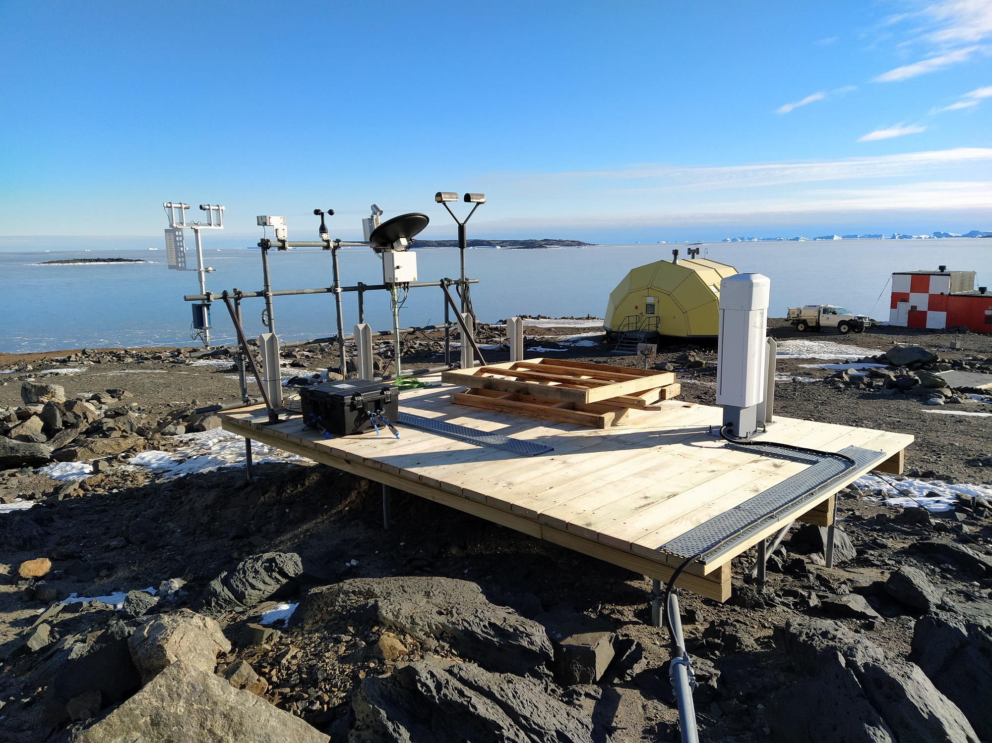
Cloud fraction/Availability
Cloud fraction determines how often an OGS can conduct links
Cloud fraction can be difficult to determine from satellites in the polar regions due to reflectivity of snow and ice
5 different satellite instruments tested but VIIRS/SNPP handles this issue best among optical
A new suite of meteorology instruments installed at Davis station in 2016 for comparison
Image credit: John French, AAD
Image credit: John French, AAD

Slide 11
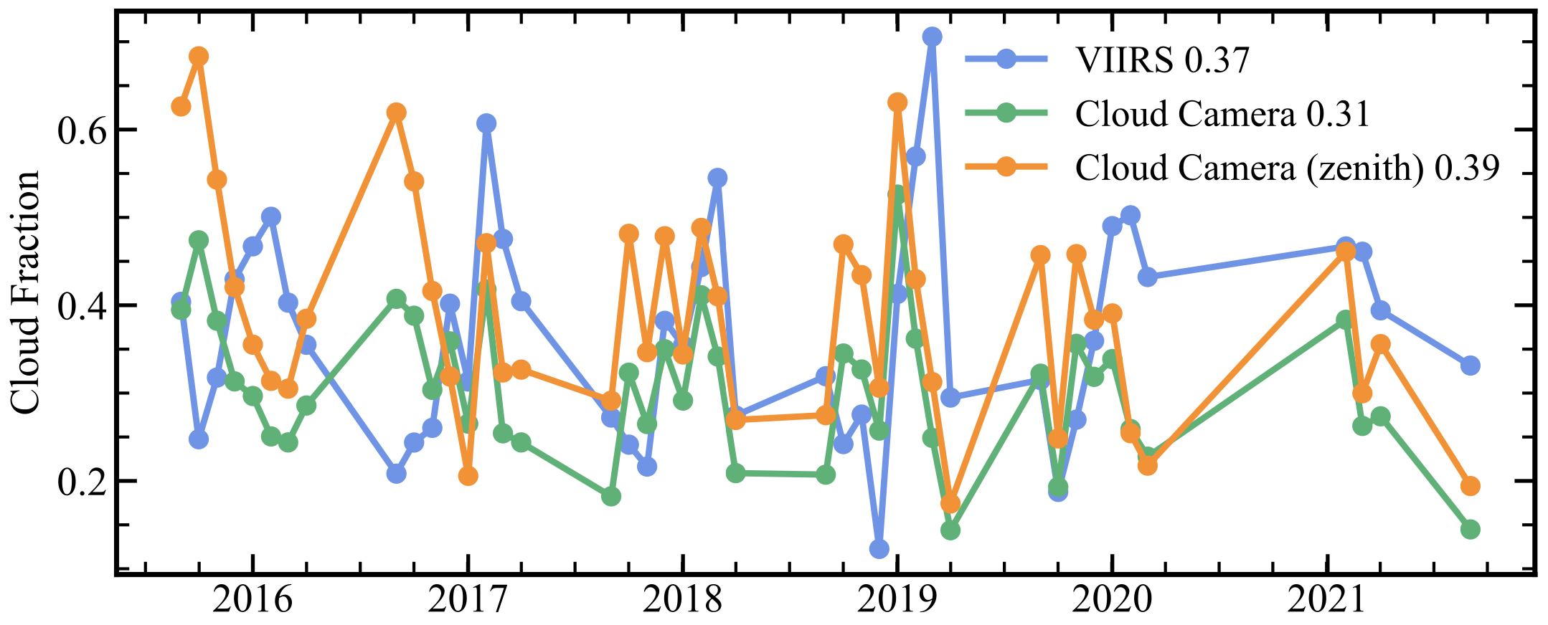
Cloud fraction comparison at Davis Station
Visible all-sky camera uses a simple colour threshold for cloud detection
No data for winter
Image credit: John French, AAD
Seasonal averages from 2016 show good correlation between VIIRS and cloud camera instrument at Davis station.

Slide 12
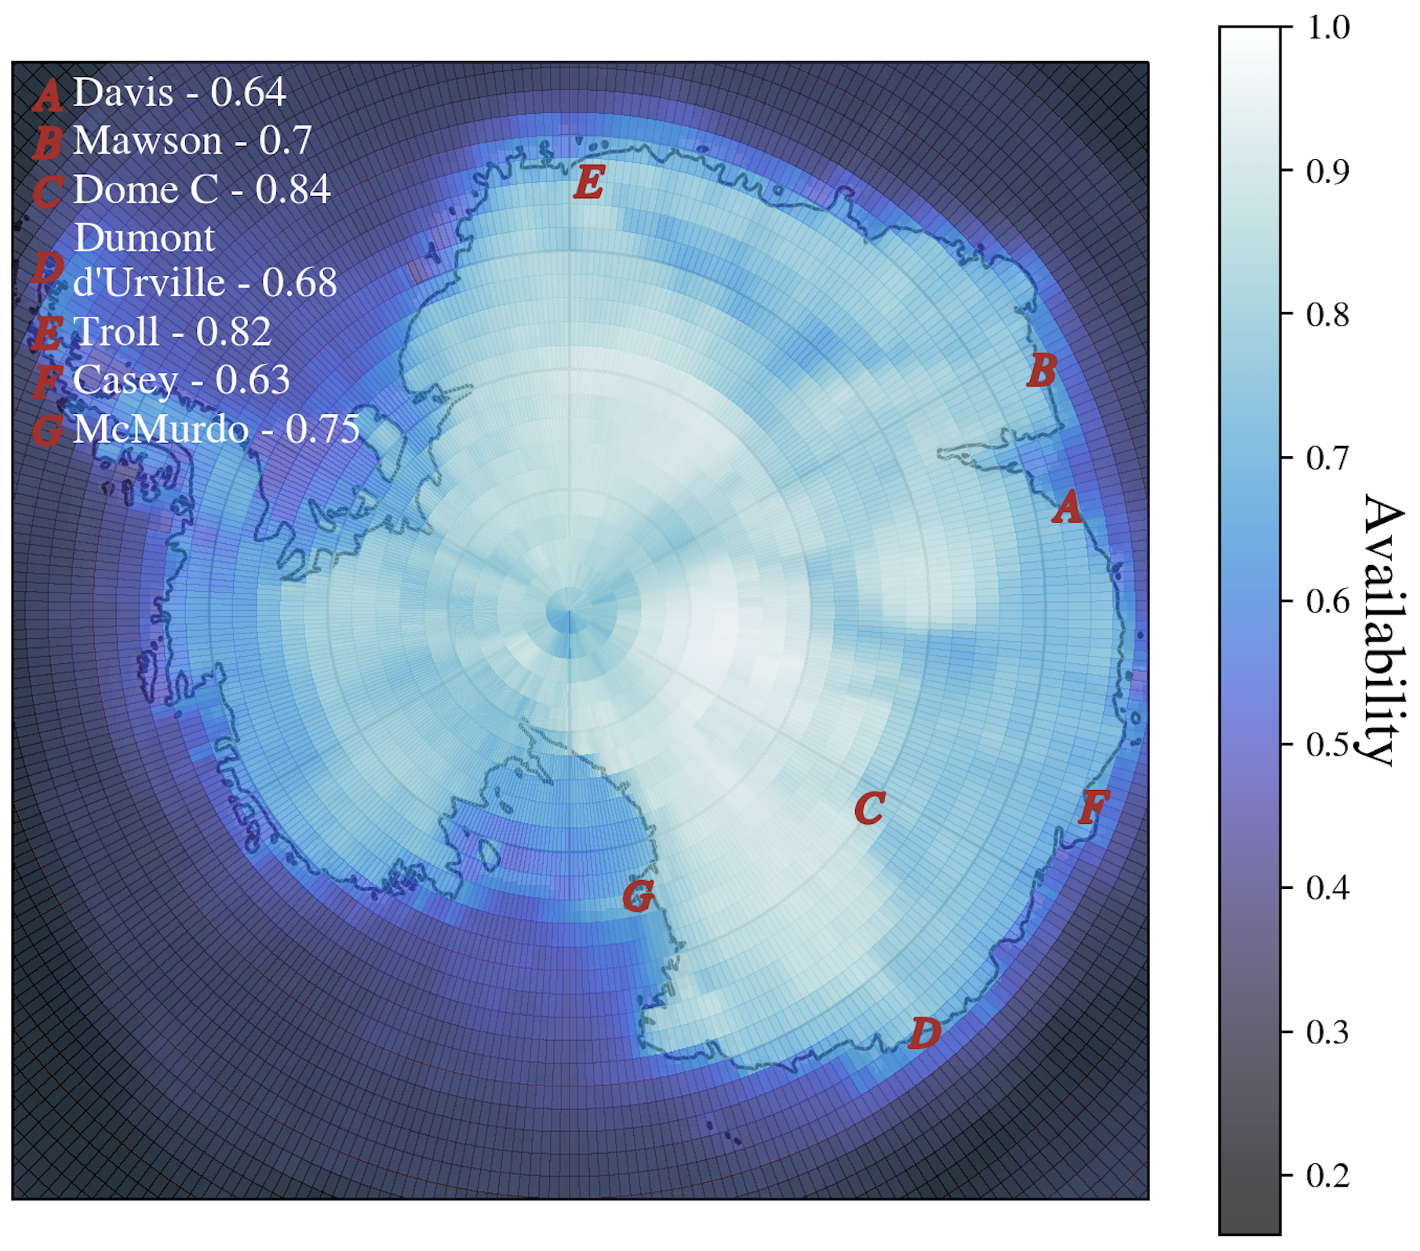
Trusting the VIIRS cloud fraction
FSOC is mostly with 1.55μm and able to penetrate cirrus cloud
Further work to refine this with a liquid cloud fraction from CloudSat/CALIPSO
(Listowski et al. 2019, Guyot et al. 2022)

Slide 14
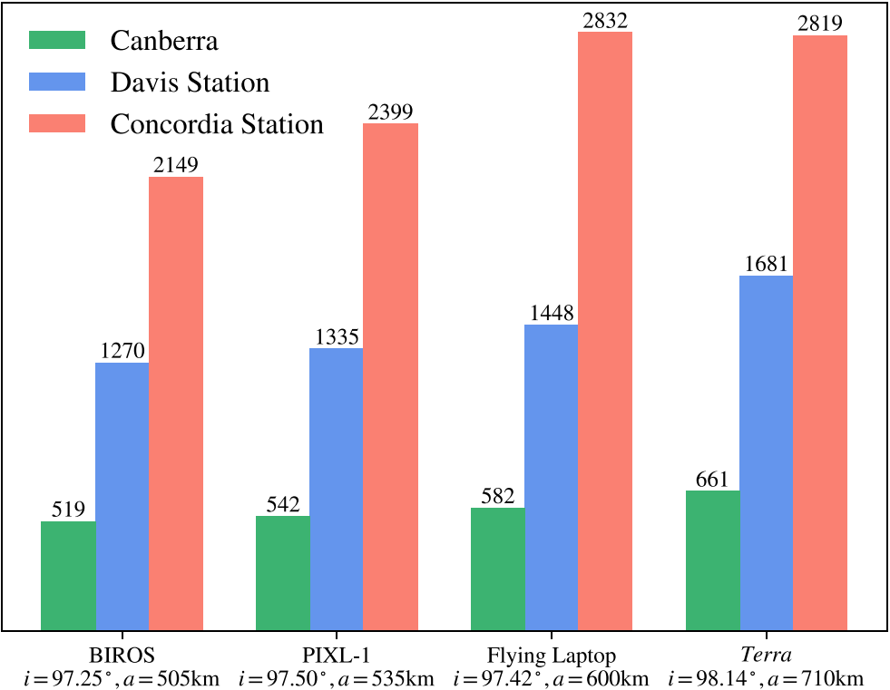
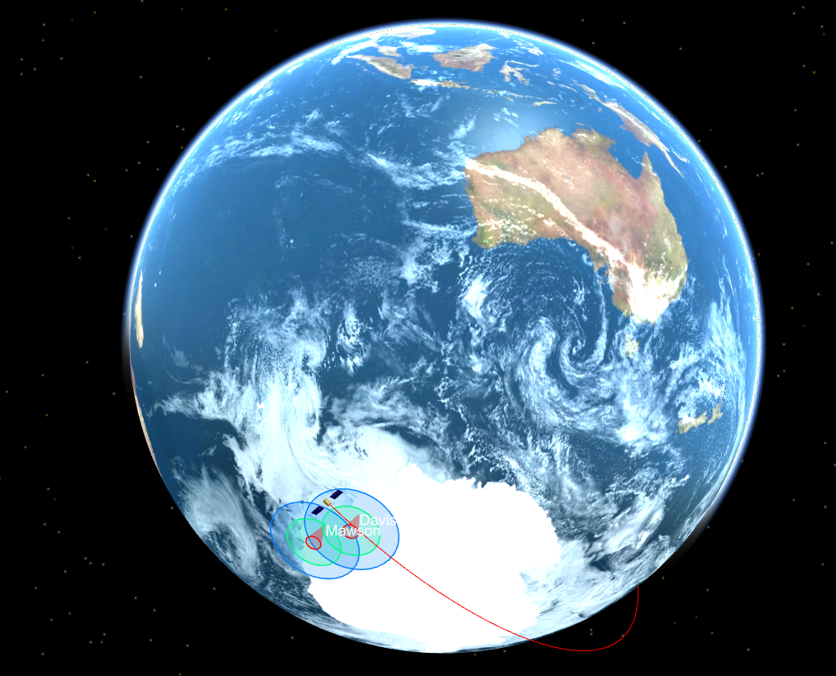
Orbital Simulations
Simulations for different prototypical polar orbiting satellites at example sites
This is the driving reason behind SvalSat/Troll commercial operation
Sun-synchronous satellite yearly passes
Polar-orbiting or Sun-Synchronous orbits are common for SmallSats/CubeSats and many existing laser communication terminals are already in these orbits

Slide 15
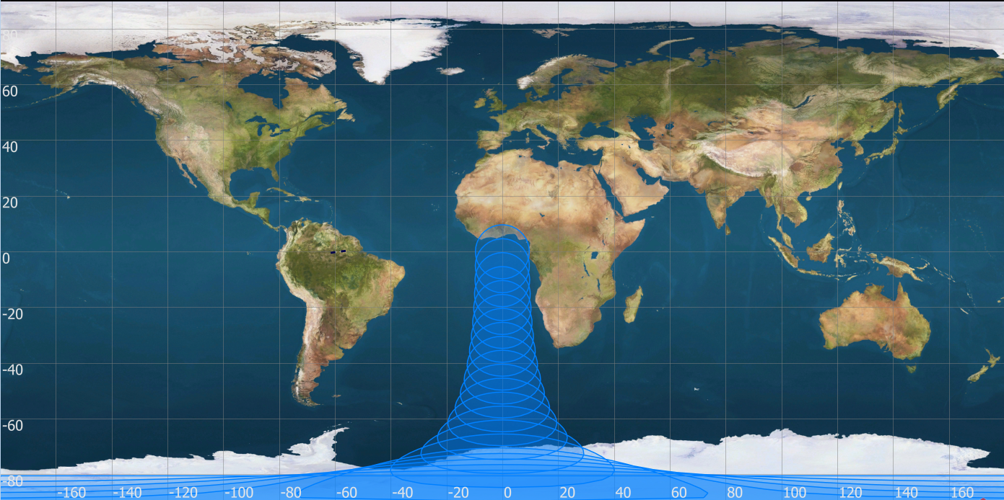
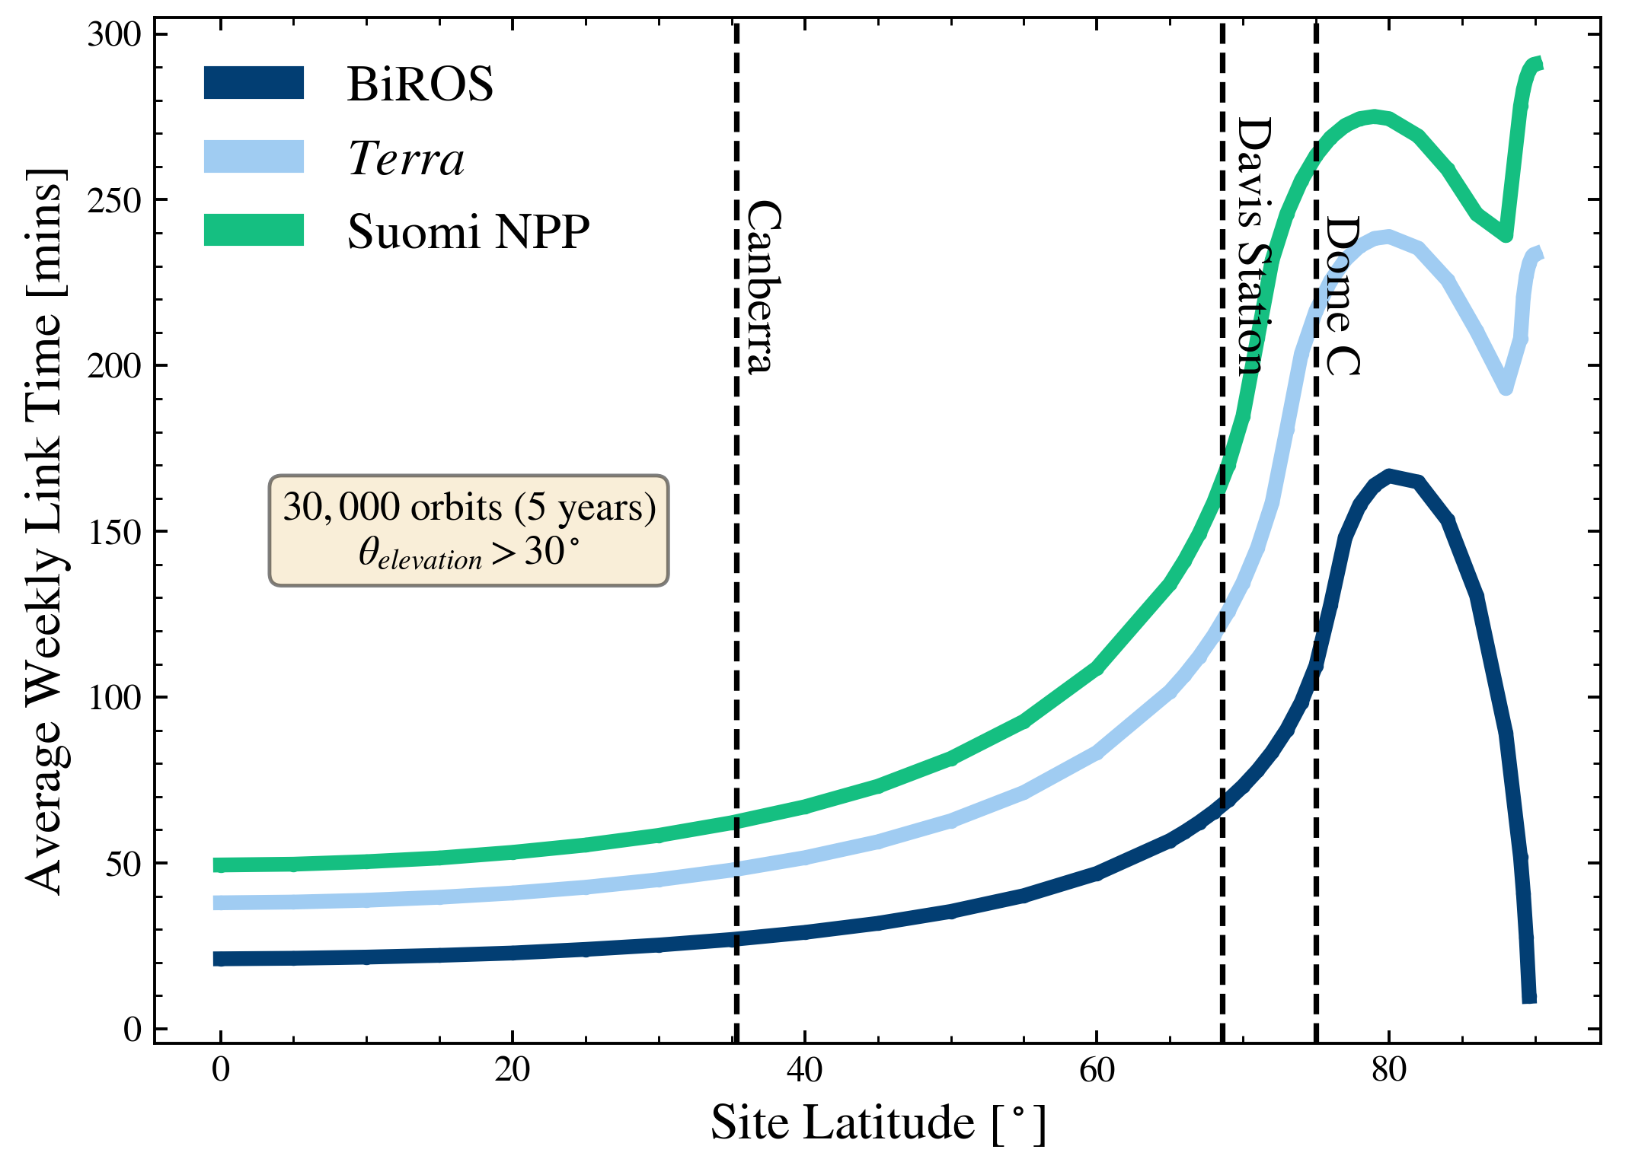
Modelling this as a function of latitude
Dependent on:
Minimum elevation angle for conducting link
Orbital height
Orbital inclincation
Some satellites will never be seen at the south pole

Slide 16
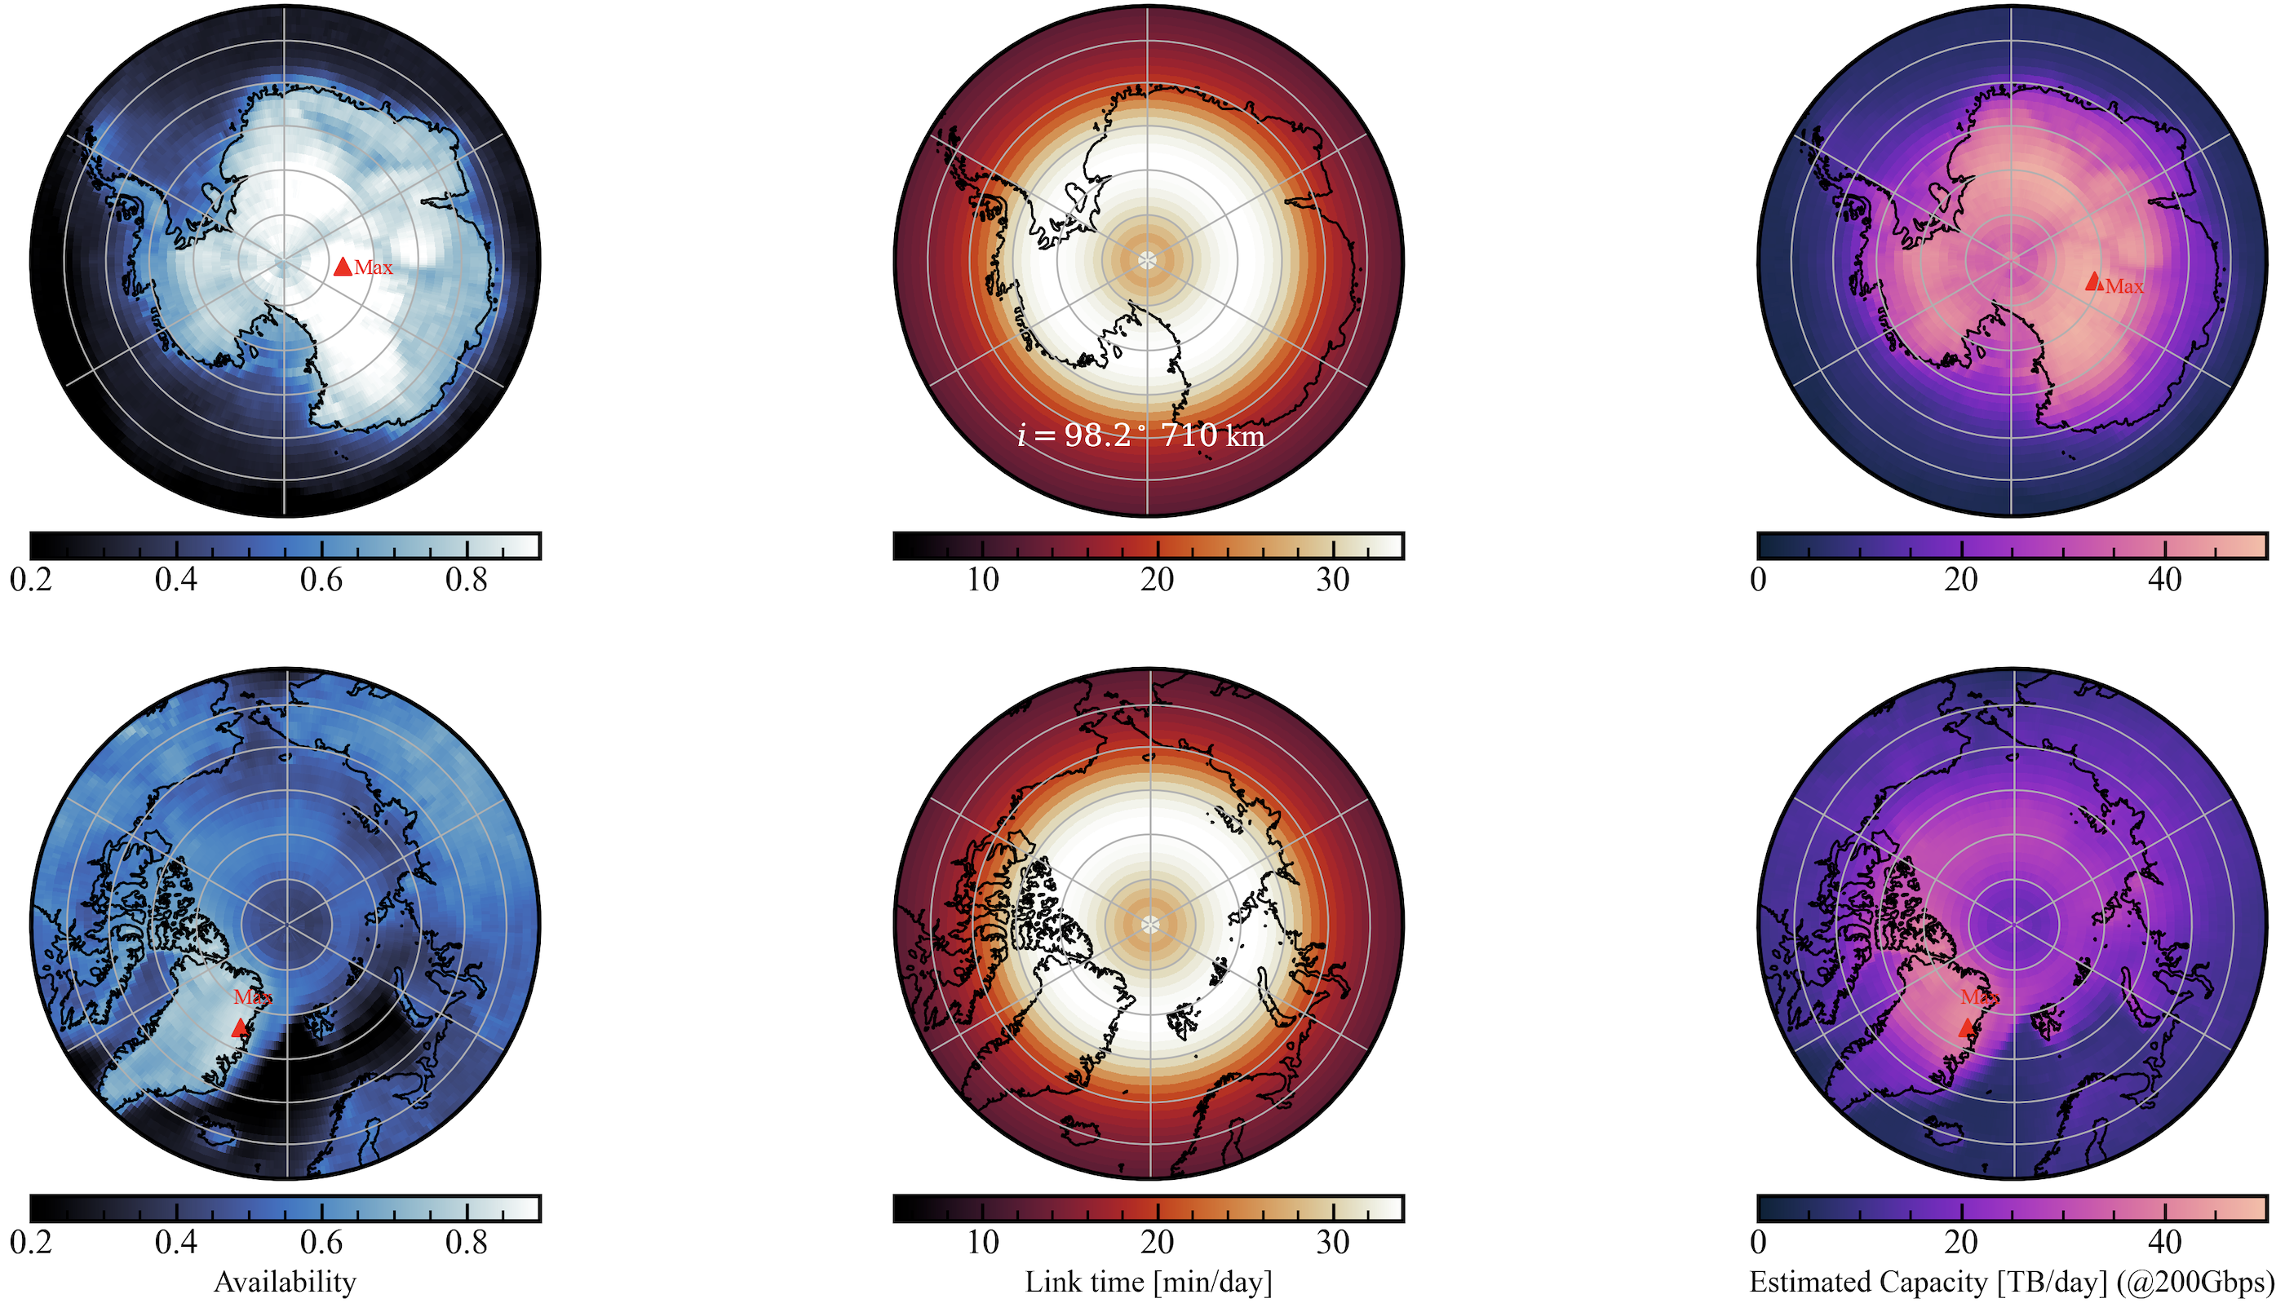
Putting it all together to estimate capacity
Picking a bit-rate is mostly arbitrary
200Gbps was demonstrated with a CubeSat this year *
RF is rarely >500Mbps
A single CubeSat terminal could exceed a persistent Starlink capacity by over 10x**
40TB/day
with current leading-edge technology
at Dome C
*only in downlink
**with caveats (see above)
Reaching these high bit rates and estimates will depend on turbulence (+ Adaptive optics)
FSOC can offer so much downlink capacity that RF relay will bottleneck any advantage

Slide 17
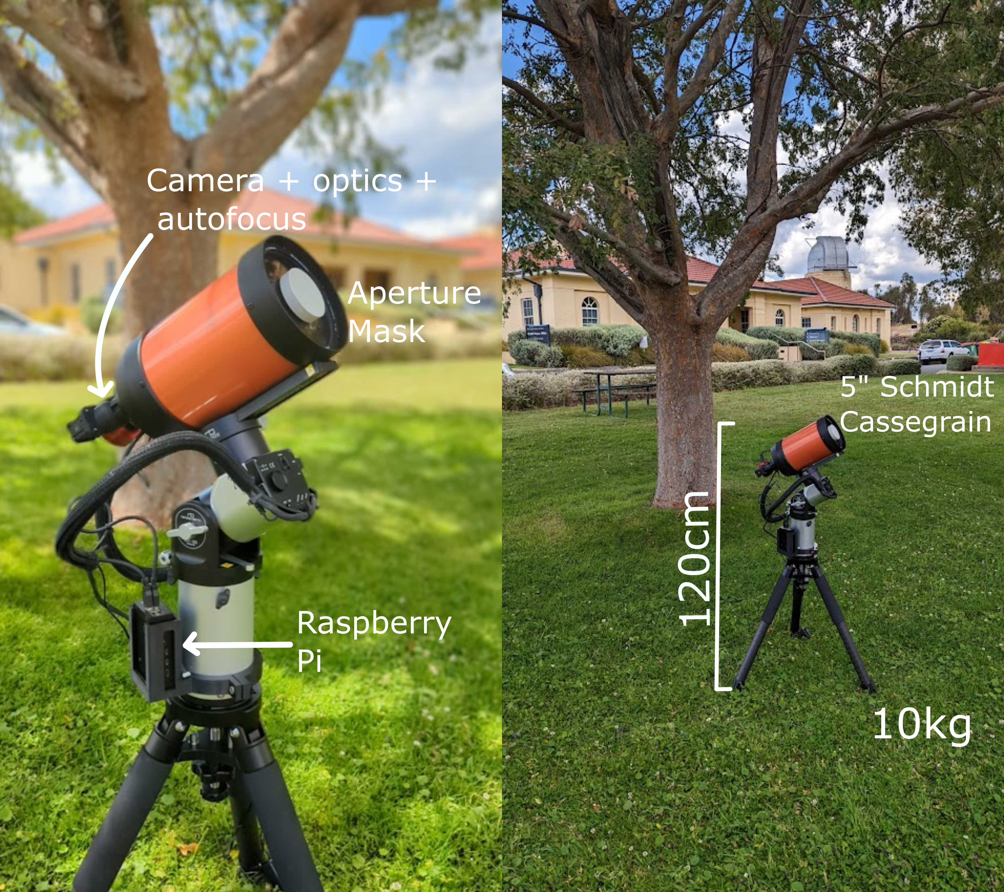
Site-testing with the Ring Image Next Generation Scintillation Sensor (RINGSS)
Turbulence profiling measures the vertical function of turbulence not the integrated seeing (e.g. DIMM)
Infers coherence time and isoplanatic angle
Can see boundary layer and free atmosphere
New type of turbulence profiler proposed by Andrei Tokovinin (2021) which is smaller and cheaper than previous methods
SCIDAR/MASS etc.
Images a defocused ring image from star at high speed to construct azimuthal frequency spectrum and infer profile from prior weighting functions
One is being installed at Siding Spring Observatory
An 8” RINGSS was also installed at NASA JPL Table Mountain Observatory

Slide 18
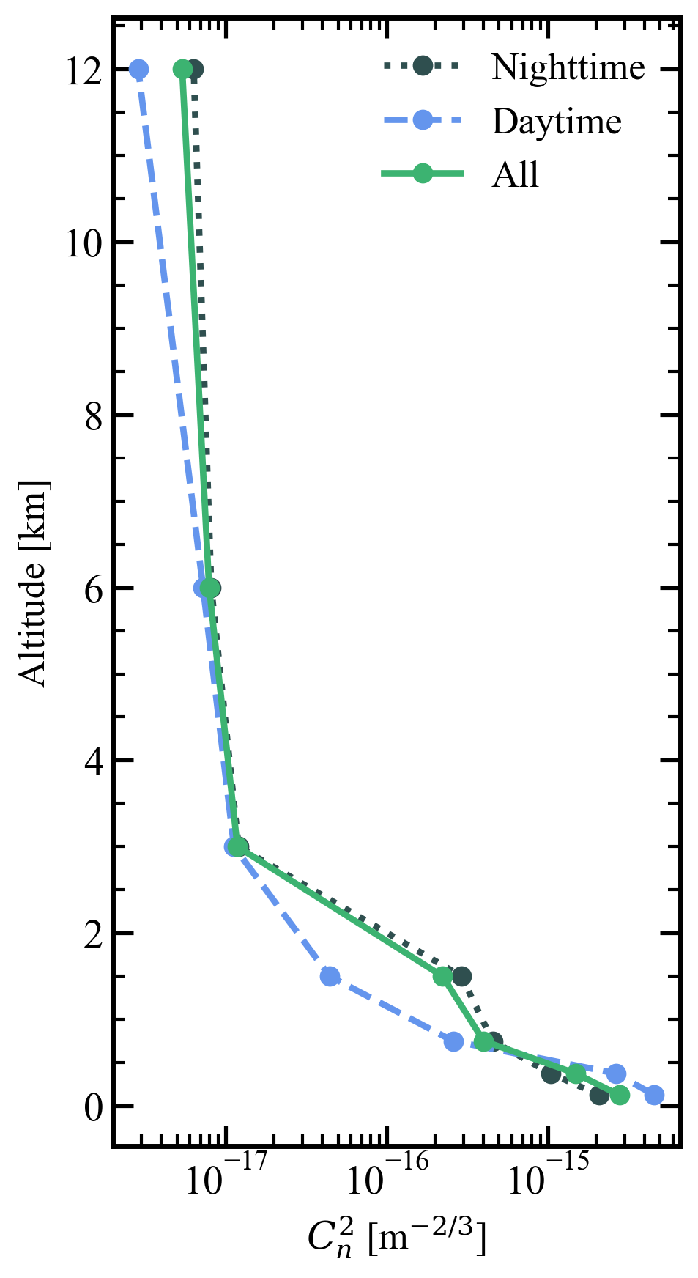
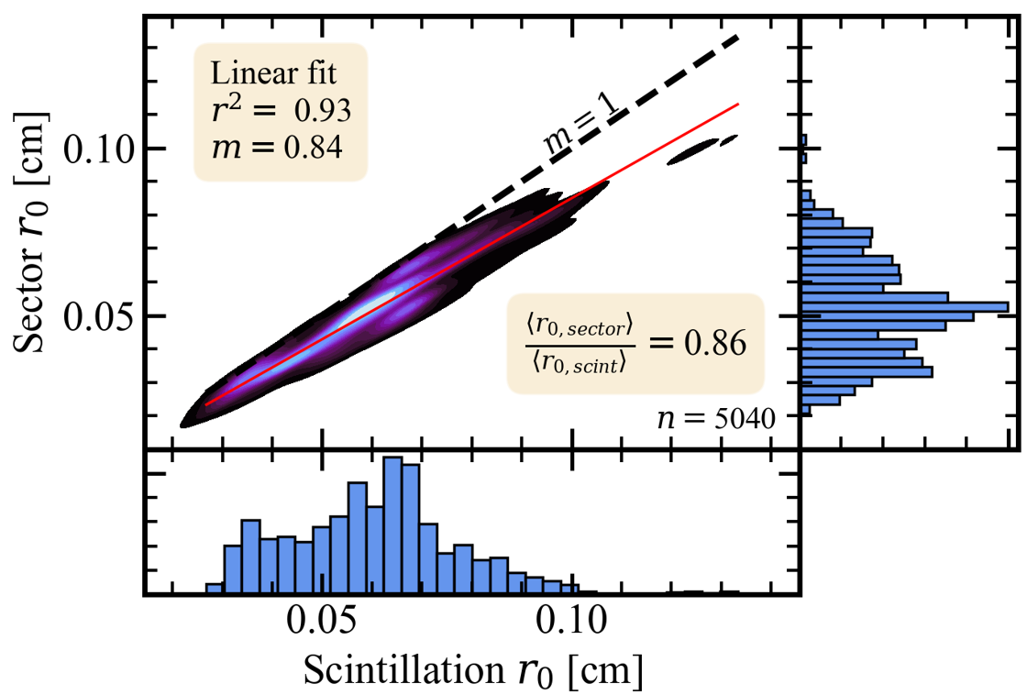
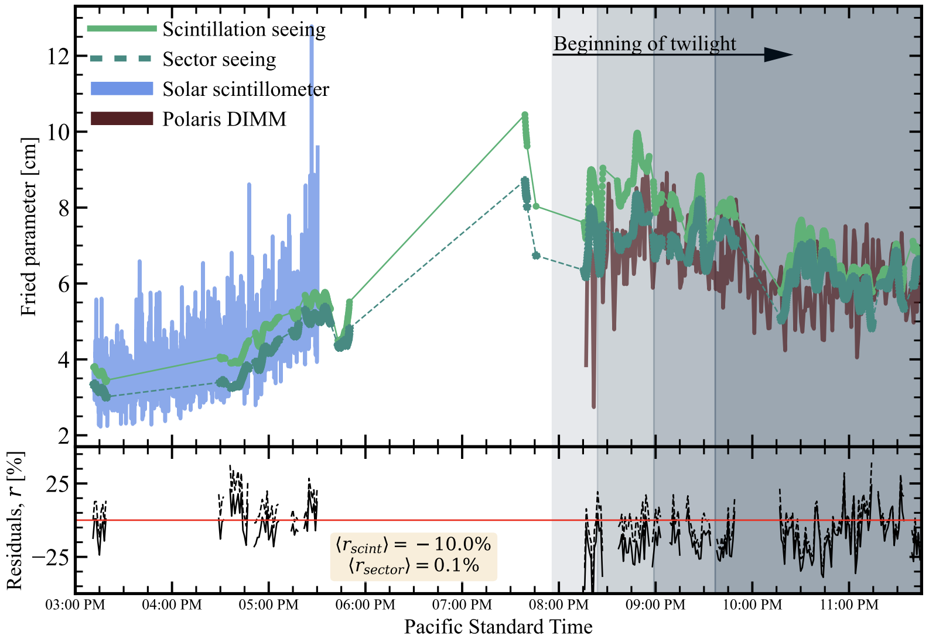
Some data from JPL Table Mountain
RINGSS measures seeing like a DIMM (sector seeing) based on radial motion around the ring while also measuring a profile which can be integrated for the scintillation seeing
Good agreement with two separate integrated seeing monitors!
RINGSS allows us to deploy turbulence profilers cheaply at prospective ground station sites
Mainly targeting low quality sites not typically considered for astronomy

Slide 19
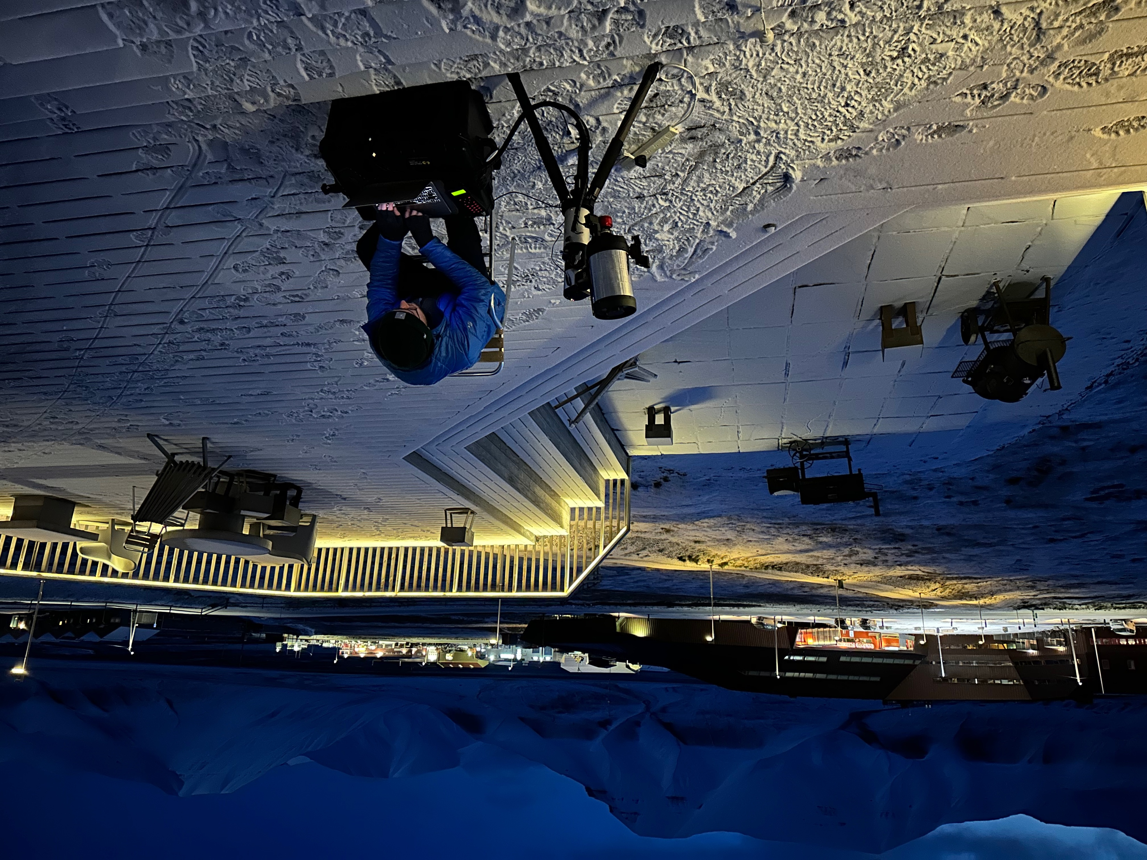
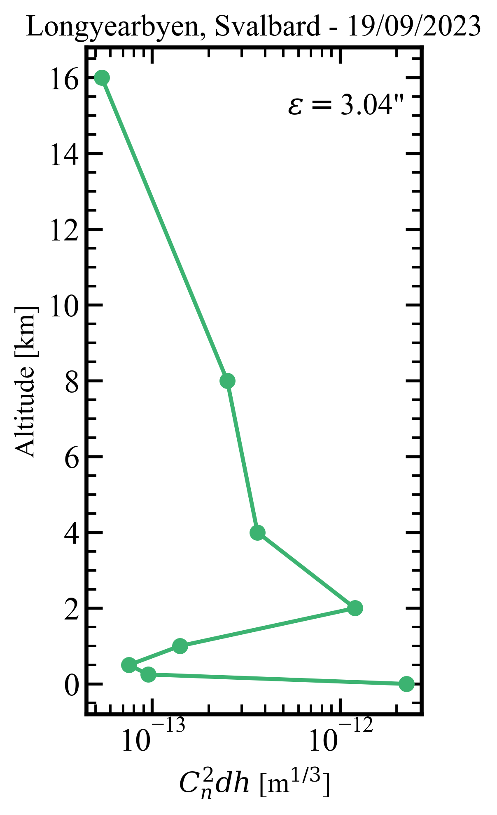
RINGSS on the move
The first profile at Svalbard!
(and maybe the Arctic?)
Demonstrating the capability for size/portability
A more robust MASS/DIMM in a small suitcase

Slide 20
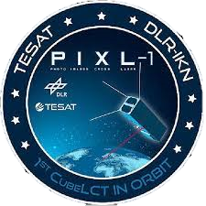
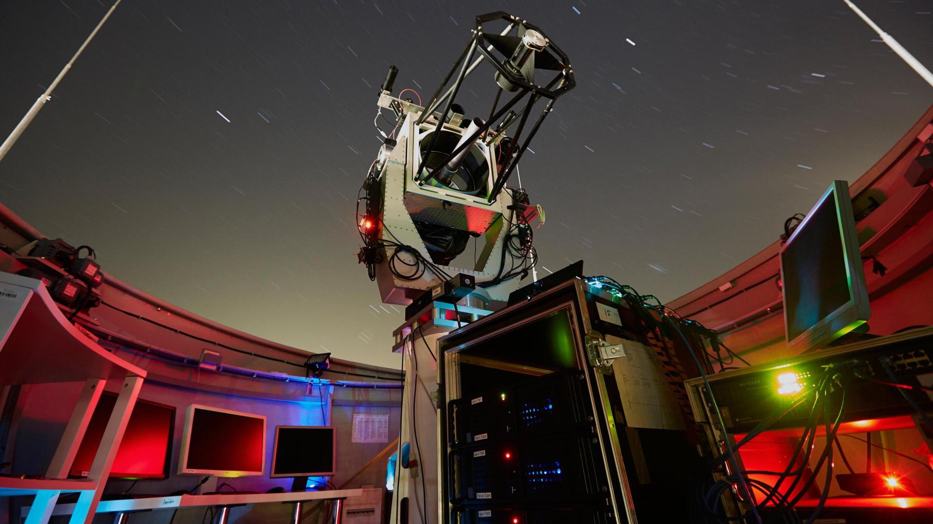
Pathfinder as a next step
Demonstrate a compact ground station (~30cm) at Antarctica to link with existing polar orbiting FSOC satellite and optical downlink to ground station in Canberra
FSOC still requires time to mature before high-speed uplink is broadly offered and there are more ground stations globally for reliable relay.
High quality sites like Dome C could demonstrate non-AO high bit rate uplink to allow Tbit/week off site (RINGSS could piggyback on mission)
Currently looking at McMurdo, Davis, or Dome C
If you have a spare optical telescope at a base – get in touch!
PIXL-1 is a current DLD CubeSat for downlink-only On-off keying

