Slide 1
Extinction and scattering by aggregates composed of submicron particles
Marco Potenza & Llorenç Cremonesi
SCAR AAA 2023
Svalbard, sept 19-21 2023

Slide 2
AIM of the work
We want to characterize dust by measuring light (UV-VIS-NIR-FIR…)
Optical properties of inhomogeneous objects in view of
modelling extinction and radiative transfer processes
L. Cremonesi, et al., Journal of Nanoparticle Research (2020) 22:344 DOI: 10.1007/s11051-020-05075-3
M. A. C. Potenza: Head of the Instrumental Optics Laboratory – University of Milan

Slide 3
AIM of the work
We want to characterize dust by measuring light (UV-VIS-NIR-FIR…)
Optical properties of inhomogeneous objects in view of
modelling extinction and radiative transfer processes
Model systems: fractal aggregates
independent characterization
no free parameters
A good model for porous objects, formed by
collision-dominated accretion processes
L. Cremonesi, et al., Journal of Nanoparticle Research (2020) 22:344 DOI: 10.1007/s11051-020-05075-3
M. A. C. Potenza: Head of the Instrumental Optics Laboratory – University of Milan

Slide 4
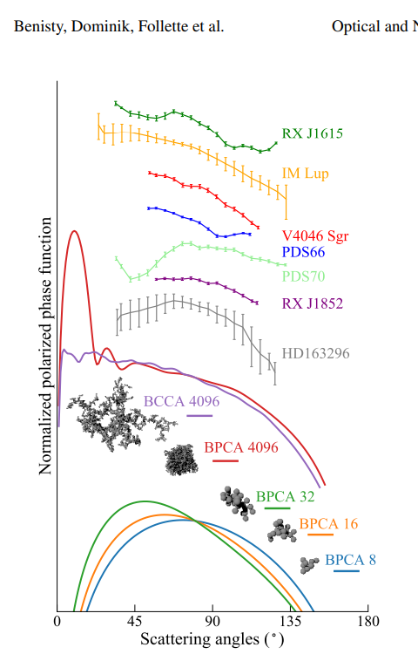
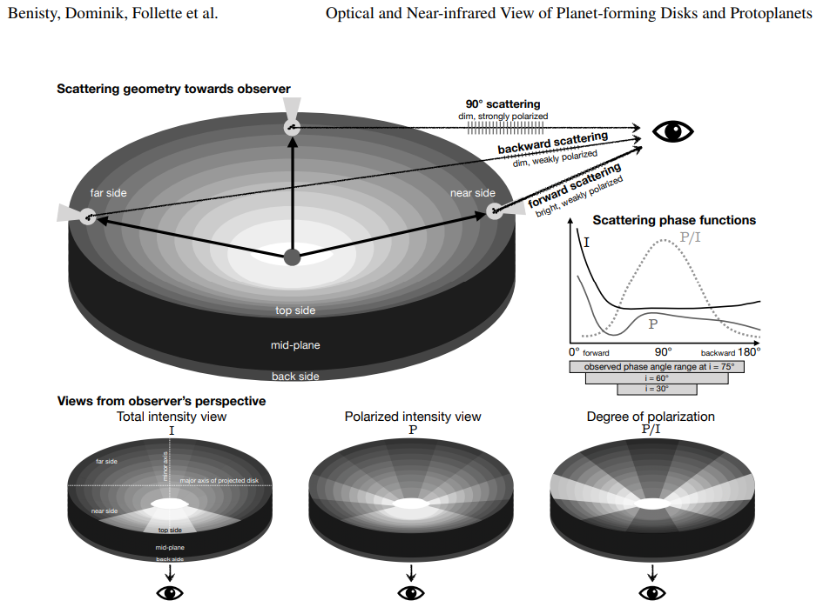
The need to describe scattering
by inhomogenous objects
Benisty et al, Optical and Near-infrared View of Planet-forming Disks and Protoplanets, arXiv 2023.09991
M. A. C. Potenza: Head of the Instrumental Optics Laboratory – University of Milan

Slide 5
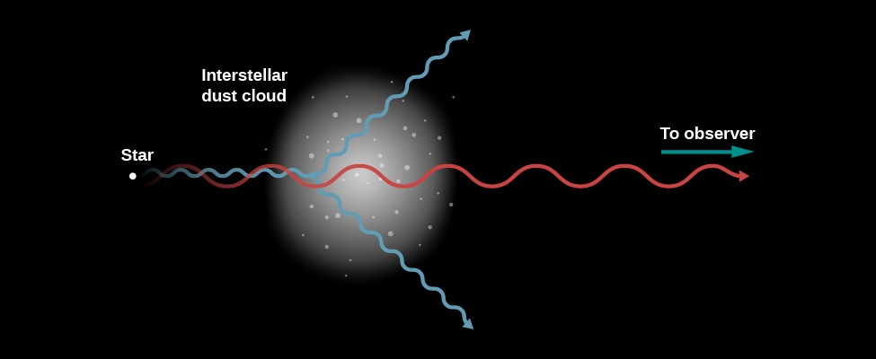
Light Scattering was born in Astronomy
M. A. C. Potenza: Head of the Instrumental Optics Laboratory – University of Milan

Slide 6
Scattering
The incident power is spread
=> scattering cross section
LIGHT
Optical particle sizing
M. A. C. Potenza: Head of the Instrumental Optics Laboratory – University of Milan

Slide 7
Extinction
Scattering
The transmitted power is reduced
=> extinction cross section
LIGHT
SENSOR
Optical particle sizing
M. A. C. Potenza: Head of the Instrumental Optics Laboratory – University of Milan

Slide 8
Absorption + = Extinction
Scattering
LIGHT
SENSOR
Optical particle sizing (?)
M. A. C. Potenza: Head of the Instrumental Optics Laboratory – University of Milan

Slide 9
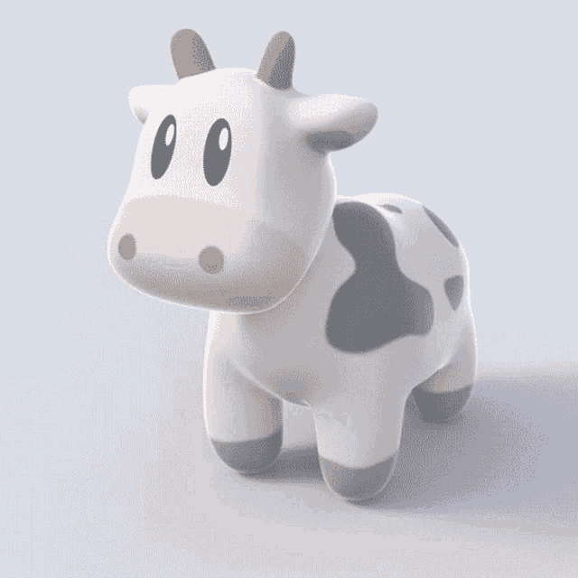
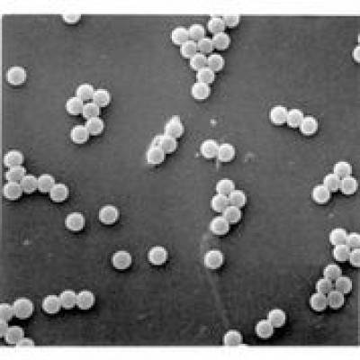
Optical Particle Sizing ?
«Size» is well defined for objects:
spherical
homogeneous
smooth
amorphous
dielectric
In this case we have a one-to-one relation
between geometrical and optical sizes
Mie Scattering: exact solution of the Maxwell’s Eq.s
M. A. C. Potenza: Head of the Instrumental Optics Laboratory – University of Milan

Slide 10
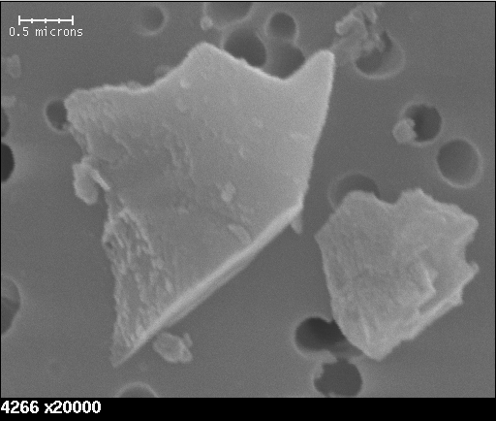
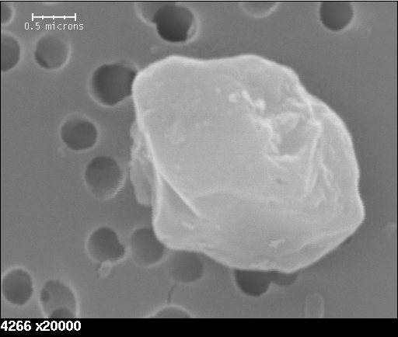
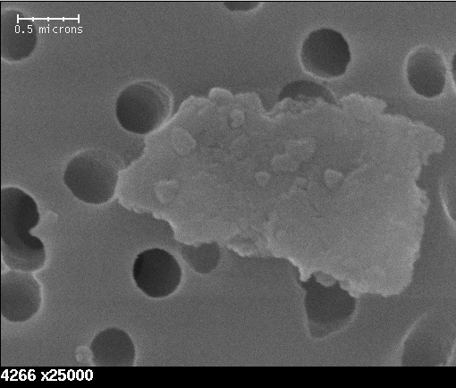
Optical Particle Sizing ?
«Size» is well defined for objects:
spherical
homogeneous
smooth
amorphous
dielectric
In this case we have a one-to-one relation
between geometrical and optical sizes
Mie Scattering: exact solution of the Maxwell’s Eq.s
Dust does not have all these properties…
M. A. C. Potenza: Head of the Instrumental Optics Laboratory – University of Milan

Slide 11
Scattering by inhomogeneous objects
Typically formed by collision-dominated accretion processes
Effective Field Approximation:
Maxwell-Garnett, Bruggemann or other mixing rules:
Maxwell-Garnett
Bruggemann
Others…
M. A. C. Potenza: Head of the Instrumental Optics Laboratory – University of Milan

Slide 12
Scattering by inhomogeneous objects
Typically formed by collision-dominated accretion processes
Effective Field Approximation:
Maxwell-Garnett, Bruggemann or other mixing rules:
correlations
near field are neglected !
multiple scattering
Average polarization of aggregates => equivalent refractive index
M. A. C. Potenza: Head of the Instrumental Optics Laboratory – University of Milan

Slide 13
Single Particle Extinction and Scattering (SPES)
$$E=\frac{1}{kR}S(θ,φ)E_{i}$$
$$I=\frac{1}{k^{2}R^{2}}F(θ,φ)I_{i}$$
signal on sensor
LASER
$${S(0) }^{}$$
A self-reference
interference method
No free
parameters
No need for
any calibration
$$C_{ext}= \frac{4π}{k^{2}}Re S\left(0\right) [μm^{2}]$$
M. Potenza, T. Sanvito, A. Pullia, AIP Advances 5(2015)117222
M. A. C. Potenza: Head of the Instrumental Optics Laboratory – University of Milan

Slide 14
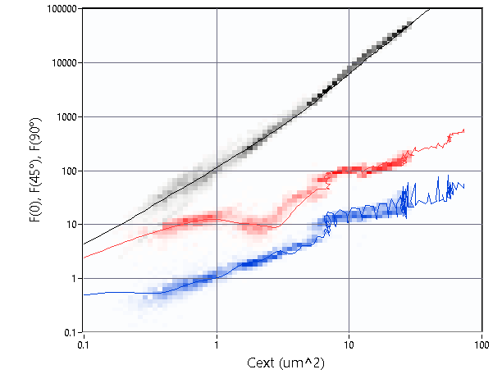
Single Particle Extinction and Scattering (SPES)
$$E=\frac{1}{kR}S(θ,φ)E_{i}$$
$$F(90°)= \int{F(θ,φ)dϖ}$$
$$F(45°)= \int{F(θ,φ)dϖ}$$
$$I=\frac{1}{k^{2}R^{2}}F(θ,φ)I_{i}$$
$${F(0)=\left|\left.S(0\right)\right|}^{2}$$
signal on sensor
LASER
$${S(0) }^{}$$
A self-reference
interference method
No free
parameters
No need for
any calibration
$$C_{ext}= \frac{4π}{k^{2}}Re S\left(0\right) [μm^{2}]$$
M. Potenza, T. Sanvito, A. Pullia, AIP Advances 5(2015)117222
M. A. C. Potenza: Head of the Instrumental Optics Laboratory – University of Milan

Slide 15
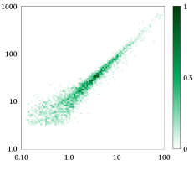
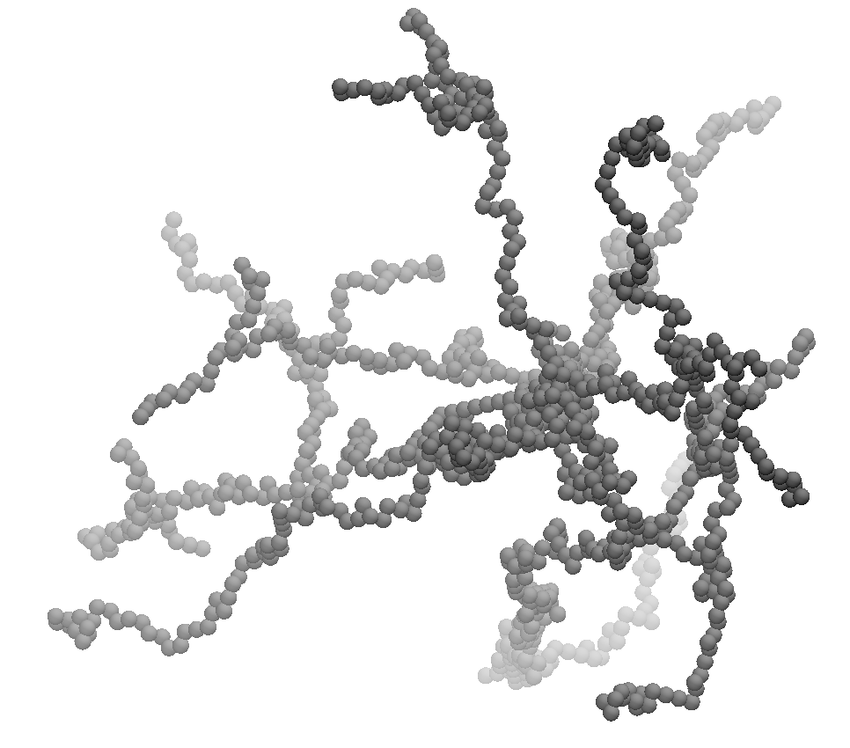
Scattering by model inhomogeneous objects
SPES on colloidal
fractal aggregates
Low Angle Scattering:
Size (gyration radius)
Fractal dimension
Im S(0)
Re S(0)
No free parameters
M. A. C. Potenza: Head of the Instrumental Optics Laboratory – University of Milan

Slide 16
Effective field approximation
Effective field
(Bruggemann)
equivalent sphere
$$ImS\left(0\right) \sim {ReS\left(0\right)}^{d_{f}/\left(2d_{f}−2\right)}$$
Bruggemann
Im S(0)
Re S(0)
No free parameters
M. A. C. Potenza: Head of the Instrumental Optics Laboratory – University of Milan

Slide 17
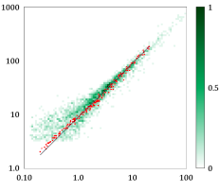
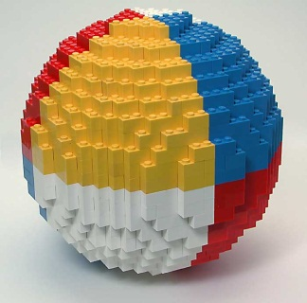
Numerical simulations
Discrete Dipole
Approximation (DDA)
on model colloidal
fractal aggregates
Bruggemann
Im S(0)
Re S(0)
No free parameters
M. A. C. Potenza: Head of the Instrumental Optics Laboratory – University of Milan

Slide 18
Interpreting the results
Model considering
field-field
correlations
(multiple scattering)
Correlations mainly
affect Re S(0):
The scattered amplitude
is (almost) not affected by correlations
Bruggemann
Im S(0)
Re S(0)
No free parameters
M. A. C. Potenza: Head of the Instrumental Optics Laboratory – University of Milan

Slide 19
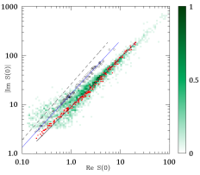
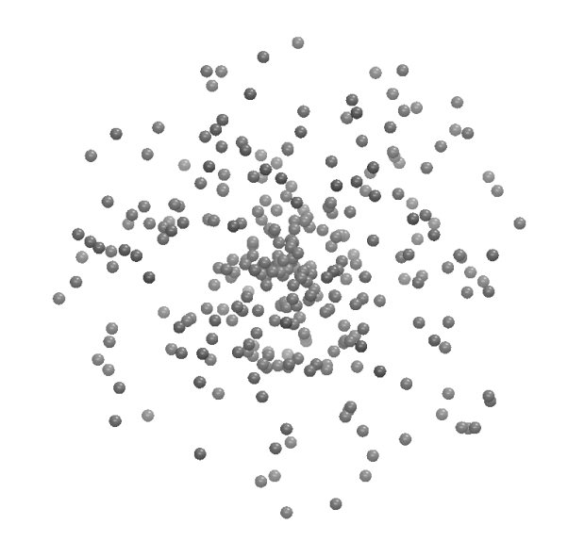
Interpreting the results
Scattering by
granular spheres
Bruggemann
No free parameters
M. A. C. Potenza: Head of the Instrumental Optics Laboratory – University of Milan

Slide 20
Analytical model
$$Im S\left(0\right)=−Nαk^{3}+$$
$$\frac{(N{α)}^{2}}{4π}\int_{0}^{∞}{dq}qF^{2}\left(qa\right){ S}_{s}\left(q\right)\left[…\right]$$
$$Re S\left(0\right)=\frac{N^{2}α^{2}}{4}\int_{0}^{2k}{dq}qF^{2}\left(qa\right){ S}_{s}\left(q\right)\left[…\right]$$
M. A. C. Potenza: Head of the Instrumental Optics Laboratory – University of Milan

Slide 21
Analytical model
$$Im S\left(0\right)=−Nαk^{3}$$
$$Re S\left(0\right)=\frac{N^{2}α^{2}}{4}\int_{0}^{2k}{dq}qF^{2}\left(qa\right){ S}_{s}\left(q\right)\left[…\right]$$
$$F\left(qa\right)=3\frac{\left(sin qa − qa · cos qa\right)}{({qa)}^{3}}$$
Monomer form factor
Structure factor
$$S_{s}\left(q\right)=\frac{1}{N^{2} }〈 {Σ_{ij}e}^{iq⋅\left(R_{i}−R_{j}\right)} 〉 = \frac{1}{N }+\frac{1}{N^{2} }〈 {Σ_{i≠j}e}^{iq⋅\left(R_{i}−R_{j}\right)} 〉$$
M. A. C. Potenza: Head of the Instrumental Optics Laboratory – University of Milan

Slide 22
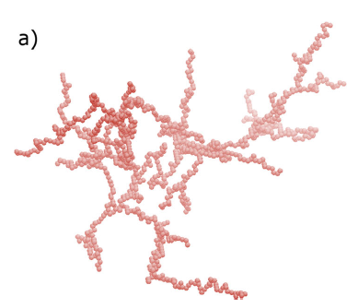
Interpreting the results
Forward scattering by
fractals
(simulations and model)
Bruggemann
Our model - fractals
Implications for phase functions
No free parameters
M. A. C. Potenza: Head of the Instrumental Optics Laboratory – University of Milan

Slide 23
Interpreting the results
Forward scattering by
fractals
(simulations and model)
Our model - granule
Bruggemann
Our model - fractals
Implications for phase functions
No free parameters
M. A. C. Potenza: Head of the Instrumental Optics Laboratory – University of Milan

Slide 24
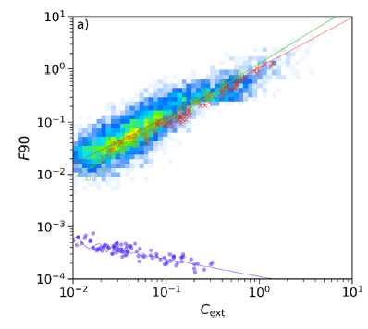
Interpretation of the results
90° scattering by
fractals
(simulations and model)
Our model
Bruggemann
Implications for phase functions
No free parameters
M. A. C. Potenza: Head of the Instrumental Optics Laboratory – University of Milan

Slide 25
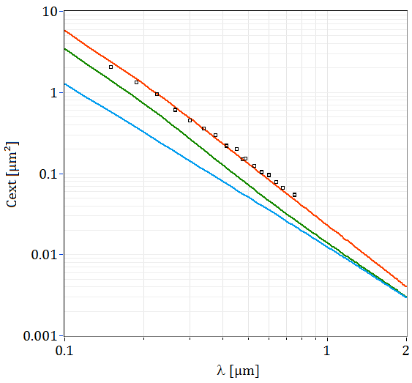
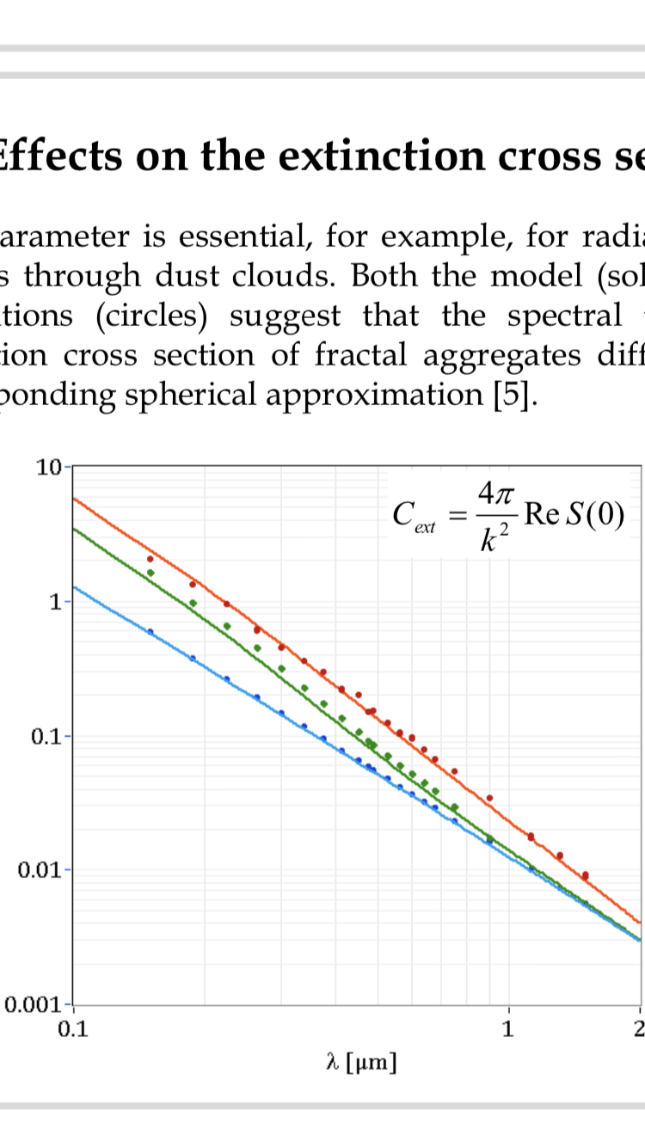
Spectral extinction
Models (lines) and
simulations (dots)
N = 500
Rg = 1.6 µm
df = 1.75
No absorption
No n(λ) dependence
No size distr. effects
Fractal
Granule
Bruggemann
No free parameters
M. A. C. Potenza: Head of the Instrumental Optics Laboratory – University of Milan

Slide 26
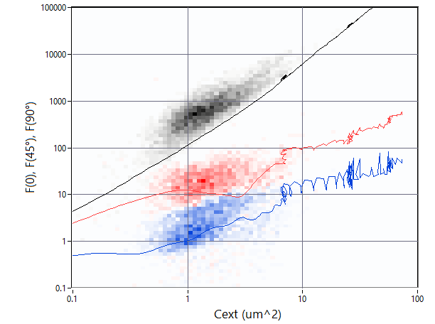
Experimental results in the real environment
Simultaneous 0, 45°and 90°scattering
measurements on single airborne particles
OPTAIR @ DomeC
& Ny Alesund
GAIA – Aosta Valley
Two populations:
factor 5 in F(90) !!
M. A. C. Potenza: Head of the Instrumental Optics Laboratory – University of Milan

Slide 27
Summary
Internal stucture of micron-sized grains influences light scattering and extinction (as expected…)
SPES -> quantitative characterization on model samples
=> validation of the analytical model
M. A. C. Potenza: Head of the Instrumental Optics Laboratory – University of Milan

Slide 28
Summary
Internal stucture of micron-sized grains influences light scattering and extinction (as expected…)
SPES -> quantitative characterization on model samples
=> validation of the analytical model
Impact on extinction and radiative transfer
single scattering albedo
asymmetry parameter
M. A. C. Potenza: Head of the Instrumental Optics Laboratory – University of Milan

Slide 29
Summary
Internal stucture of micron-sized grains influences light scattering and extinction (as expected…)
SPES -> quantitative characterization on model samples
=> validation of the analytical model
Impact on extinction and radiative transfer
Atmospheric optics: OPTAIR@Antarctica; paleoclimate studies
Astrophysics: you may figure out… UV-VIS-NIR-FIR…
L. Cremonesi, et al., Light extinction and scattering from aggregates composed of submicron particles, Journal of Nanoparticle Research (2020) 22:344 DOI: 10.1007/s11051-020-05075-3
M. A. C. Potenza: Head of the Instrumental Optics Laboratory – University of Milan

Slide 30
Thank you Marco Potenza Head Instrumental Optics Laboratory University of Milan marco.potenza@unimi.it

