Slide 1
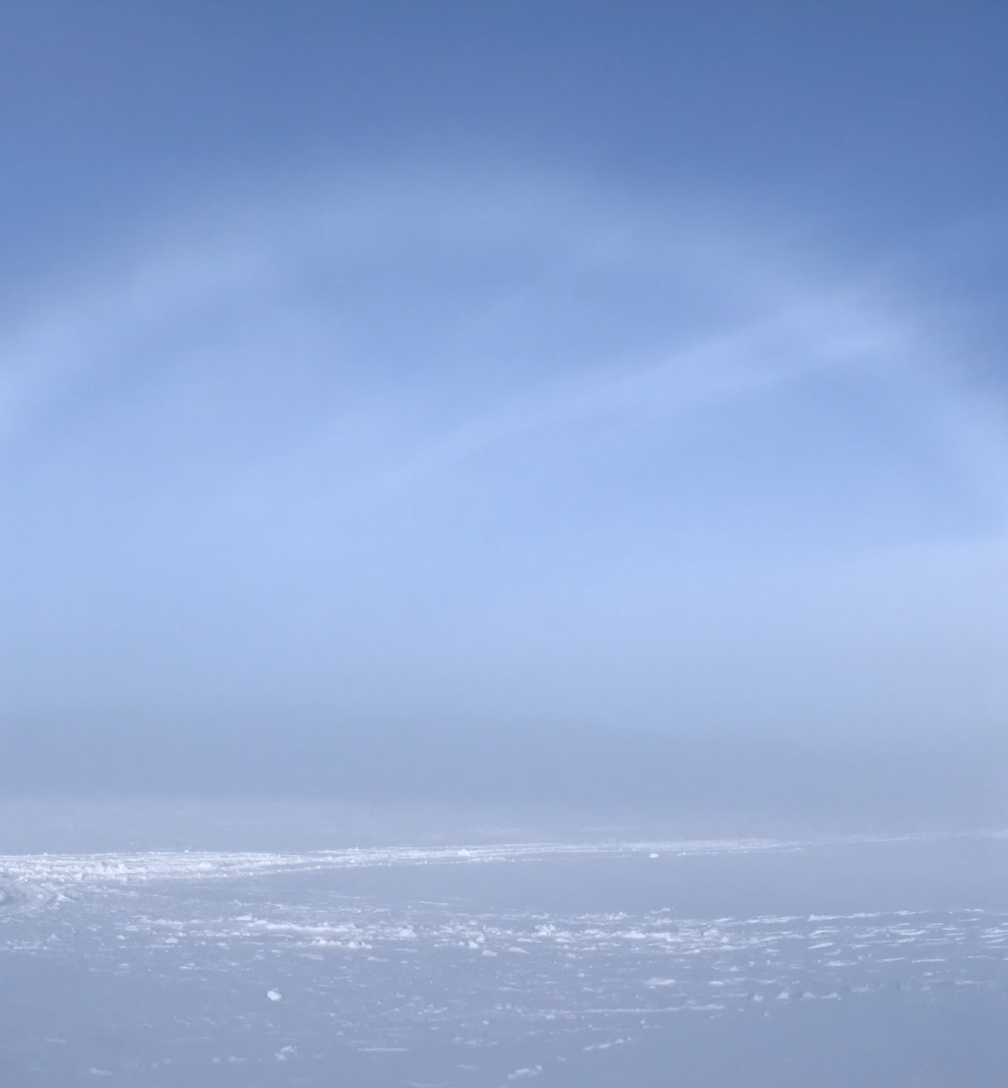
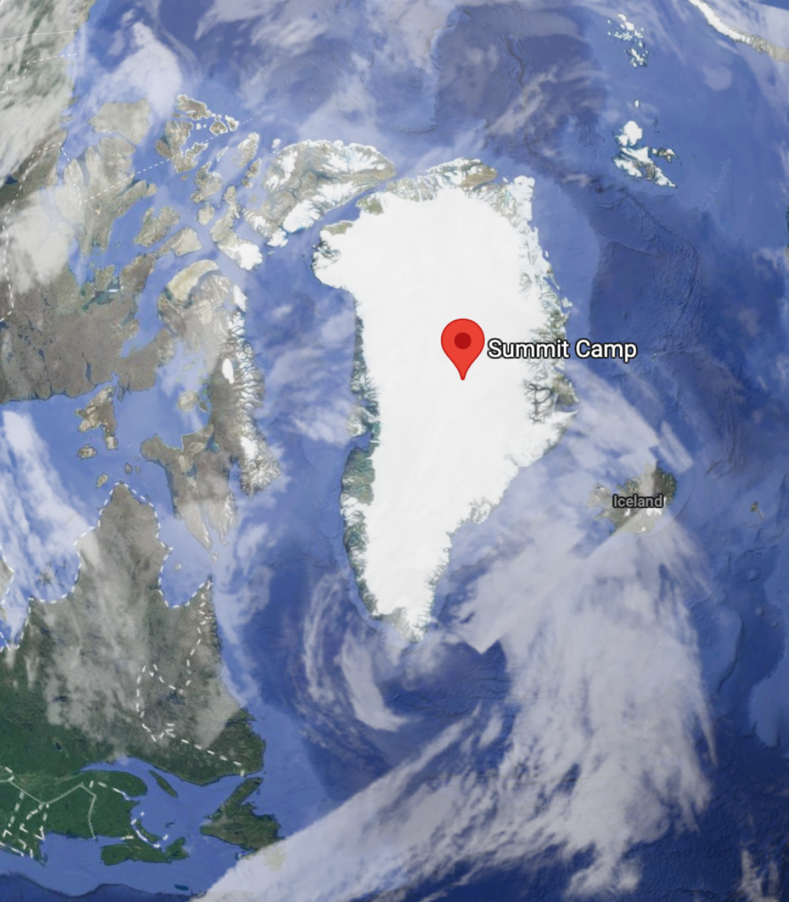
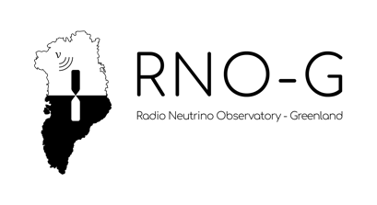
The Radio Neutrino Observatory in Greenland (RNO-G)
Svalbard
Delia Tosi - University of Wisconsin Madison
SCAR-AAA, Longyearbyen - Svalbard - 09/21/2023

Slide 2
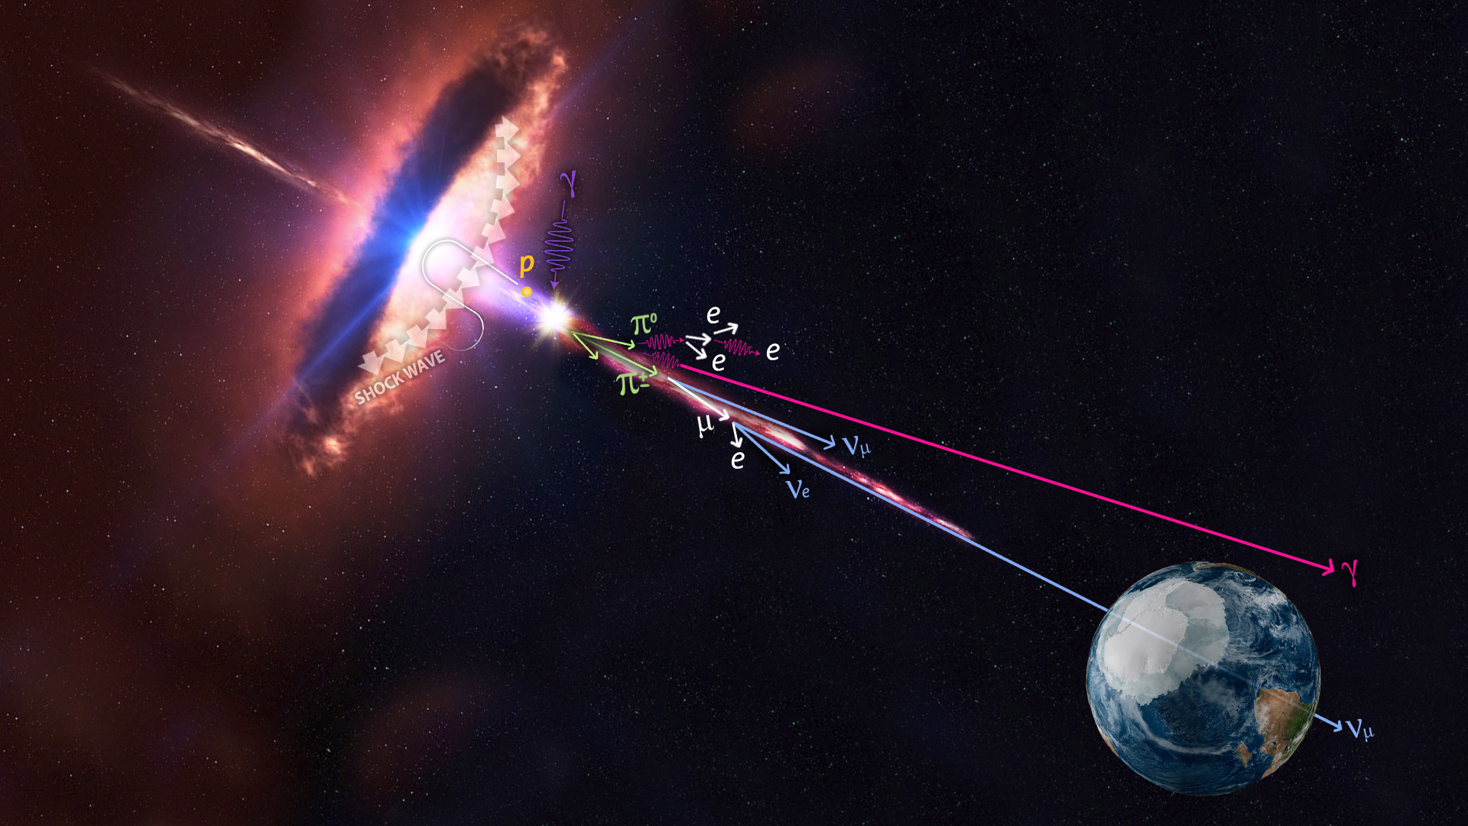
UHE neutrino astrophysics
UHE neutrino astronomy requires large detectors
because the higher the energy, the smaller the flux
Antarctica & Greenland offer large volumes of ice, an ideal, transparent, target material
→ Polar regions and astrophysics go well together!

Slide 3
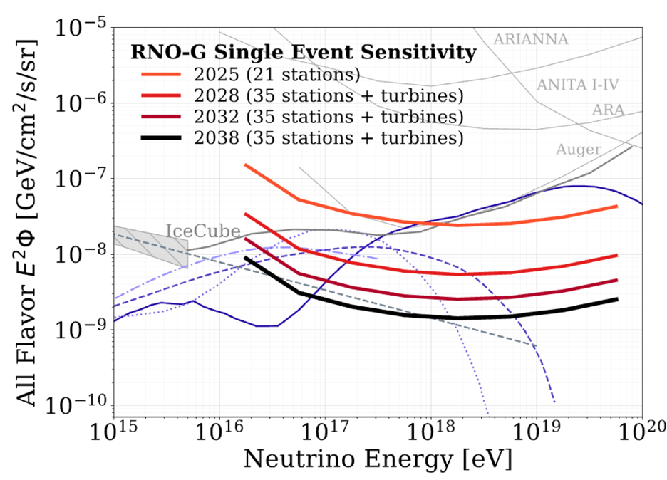
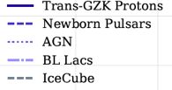
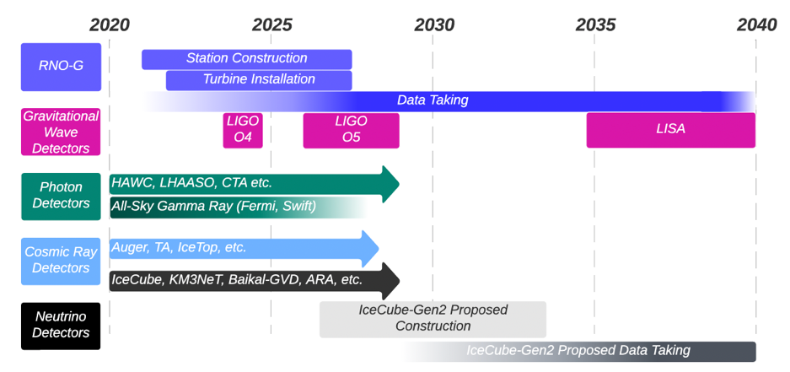
RNO-G
IceCube, though large, has so far not observed neutrinos beyond 10 PeV
RNO-G will extend the energy range of neutrino astrophysics well beyond the IceCube range, to EeV energies and above
RNO-G will provide:
All Flavor Sensitivity for exclusion/validation of various diffuse flux models
Determine if there is a cut off
Point source and transient detection capability
for multi-messenger astronomy
Technology and procedures benchmark
for the much larger radio array of IceCube Gen2
PoS(ICRC2023)1485

Slide 4
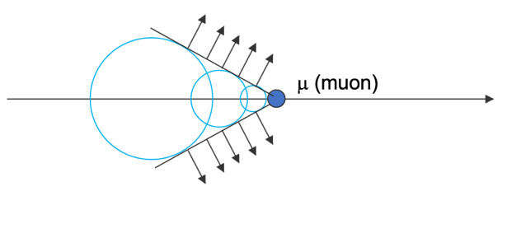
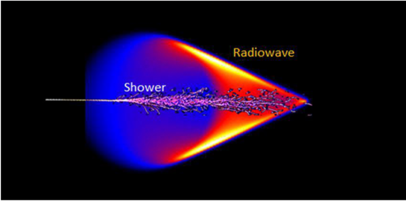
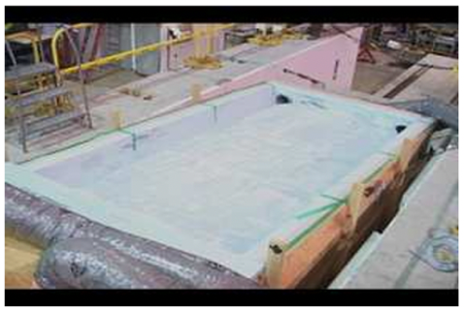
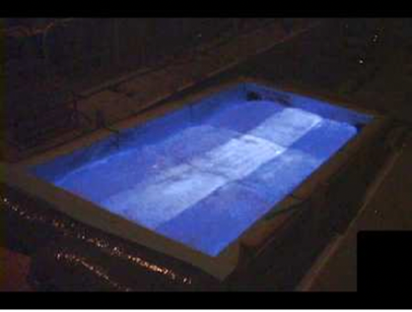
Why ice: Cherenkov radiation
Cherenkov radiation is generated by particles
moving faster than the light speed in medium
Effect commonly used for particle detection and reconstruction
At very high energy, Cherenkov radiation is boosted
Electrons/Positrons are created in the particle shower; the positrons annihilate with matter, creating a charge anisotropy
Charge anisotropy propagates in a dielectric medium creating Cherenkov radiation that sums coherently
in the radio bandwidth (“Askaryan radiation”)
Demonstrated at SLAC national lab in 2006
From J. Kelley’s talk
https://lecospa.ntu.edu.tw/experiment-2/experiment-i-ultra-high-energy-neutrinos-and-cosmic-rays/
https://arxiv.org/pdf/hep-ex/0611008.pdf

Slide 5
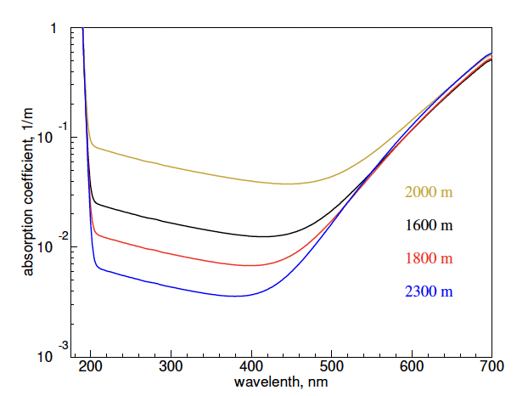
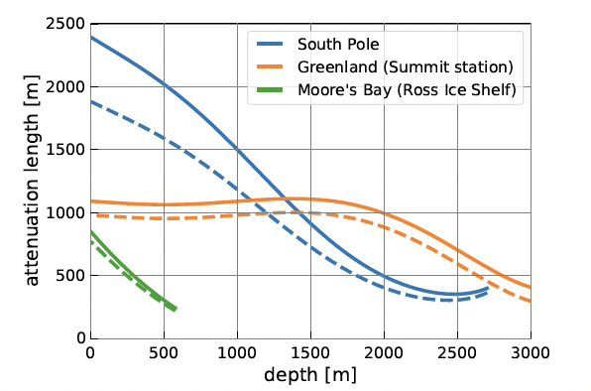
Why ice: absorption
OPTICAL
10 m
Ice is transparent to electromagnetic waves, in the optical and even better in the radio range
The absorption coefficient in the UV is O(100-200m) at 2km depth in South Pole ice
  At shallower depths, bubbles increase scattering/absorption considerably
  An optical detector needs to be deep, and instrumentation needs to be spaced O(100-200m)
In radio, it’s O(1-2 km) at shallow depths in the relevant frequencies, just below the firn (depends on temperature and chemical composition)
  A radio detector can be “shallow” and the instrumentation can be spaced O(1-2km)
dust layer
100 m
200 m
RADIO
arXiv:2208.04971
Solid: 200 MHz
Dashed: 400 MHz

Slide 6
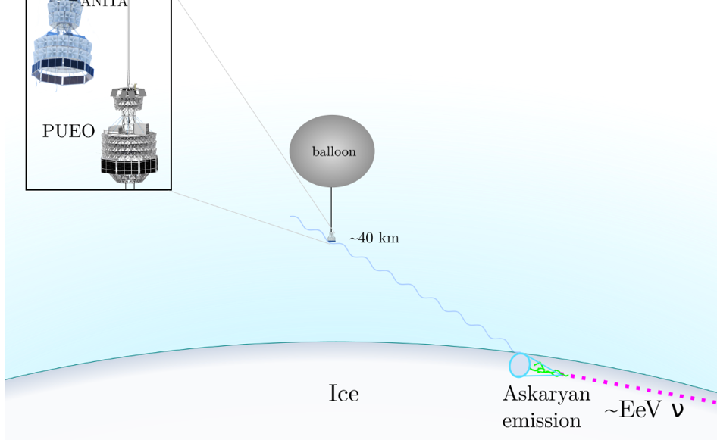
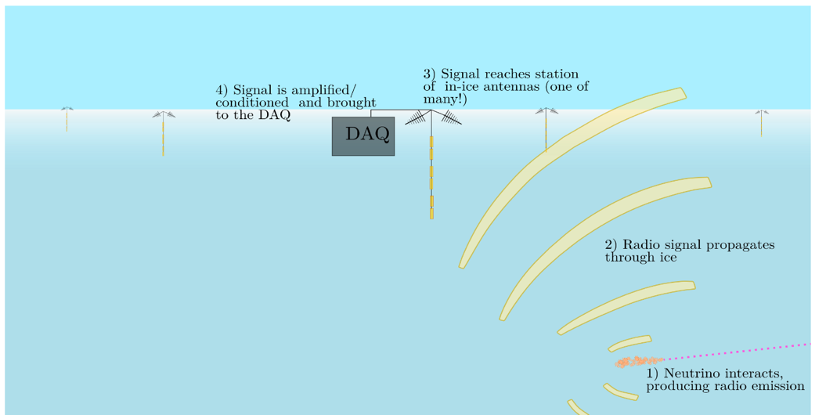
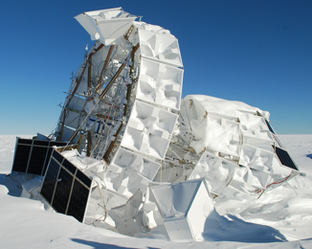
How to use ice for radio neutrino detection
Balloon-borne
Look at the target medium from afar ➔
“balloon borne experiments”
ANITA, PUEIO
ARA, ARIANNA, RNO-G
Illustrations by
C. Deaconu, UChicago
⬅ Embed detectors in the target medium
“in-ice detectors”
In-ice

Slide 7
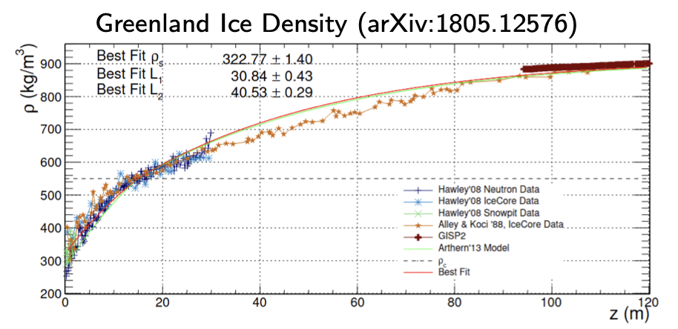
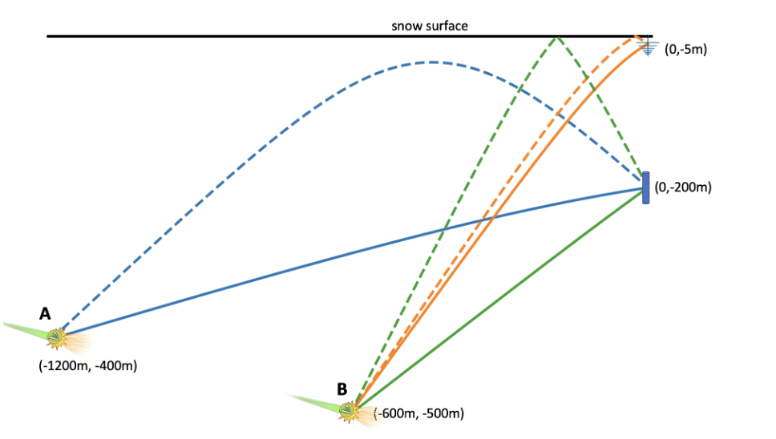
In-ice radio detectors
Index of refraction at large depths approximately constant; near surface, in the “firn” region, it follows the density
Change in index of refraction causes ray bending due to Fresnel refraction
Antennas below the firn layer capture signals from larger volume
  Firn depth: O(100 m) in Greenland, O(200 m) at South Pole
Direct, refracted and reflected signal can be detected to help reconstruction

Slide 8
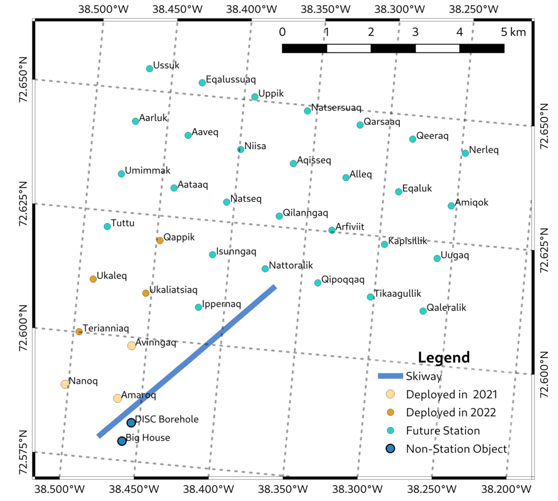
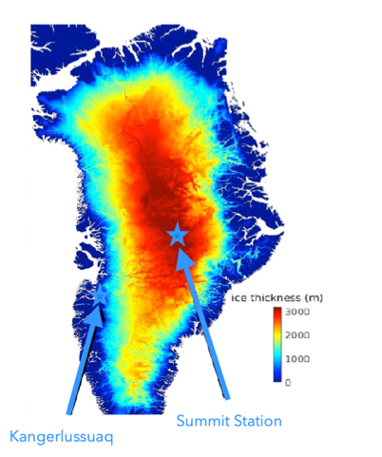
Building RNO-G
Apex of the Greenland ice sheet, at Summit
station (72.5796° N, 38.4592° W)
on 3000 m thick ice
35 stations spaced by 1.25 km
7 installed in 2021 & 2022
Autonomous power: batteries, solar panels,
wind turbines
LTE comms
8

Slide 9
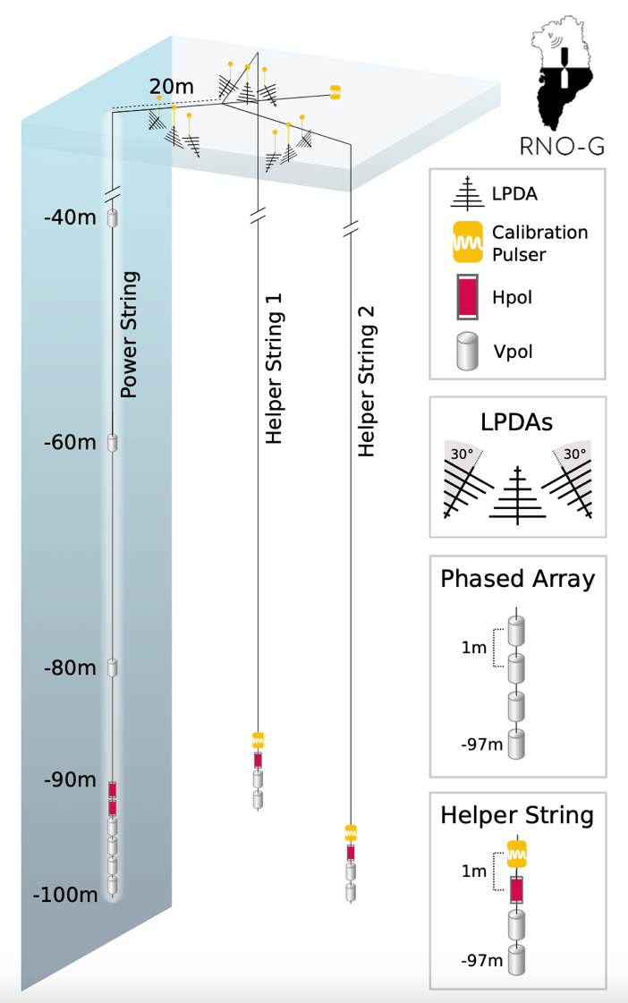
Hybrid station design
Shallow component (~3 m) (ARIANNA)
nine log-periodic dipole antennas (LPDAs) buried in shallow trenches, facing upward and downward
Detect cosmic rays and veto RFI from anthropogenic sources
Deep component (~100 m), 3 strings (ARA)
Eleven Vpol deep antennas sensitive to the vertical polarization
Four Hpol deep antennas sensitive to horizontal polarization
Provide large fraction of the neutrino effective volume
Four of the Vpol antennas are connected back-to-back in phased array configuration to form a low threshold trigger
Hpols (quad slot), constraint by hole size, improve reconstruction

Slide 10
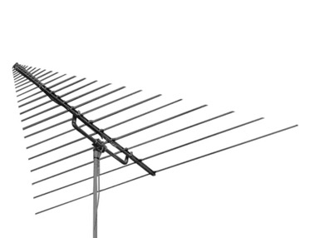
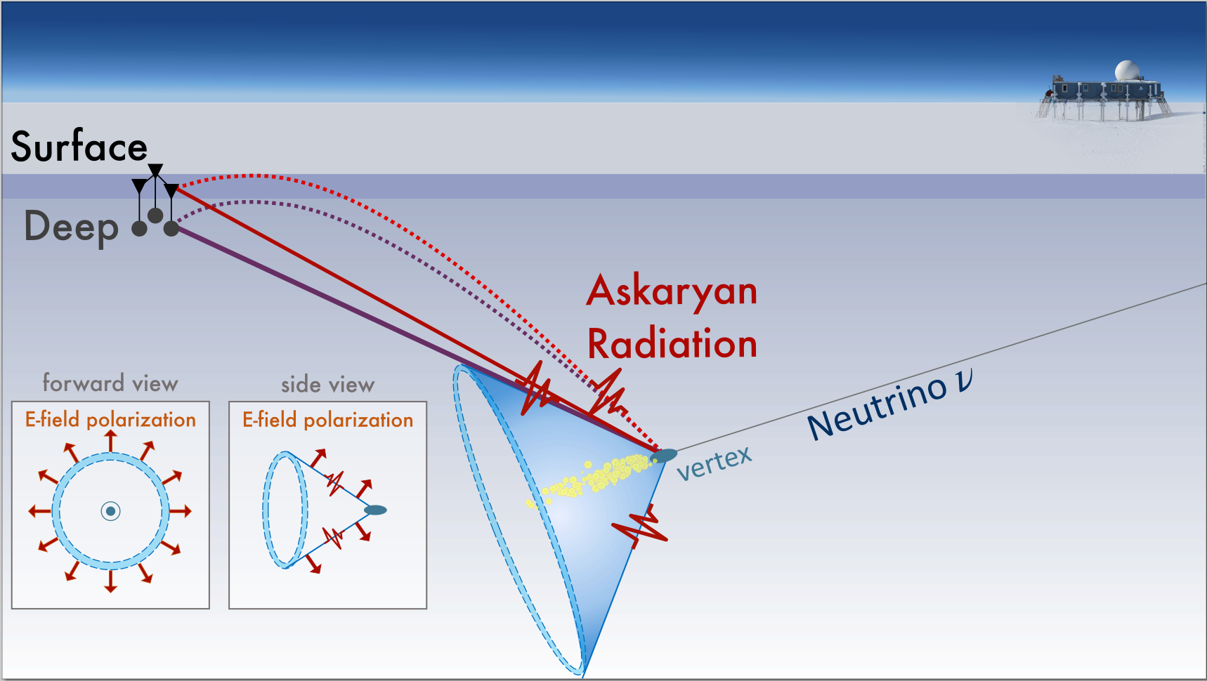
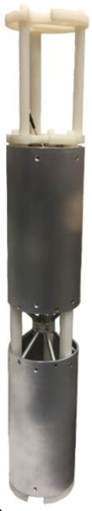
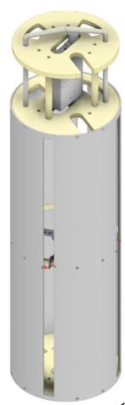
RNO-G at work
LPDA
VPOL HPOL

Slide 11
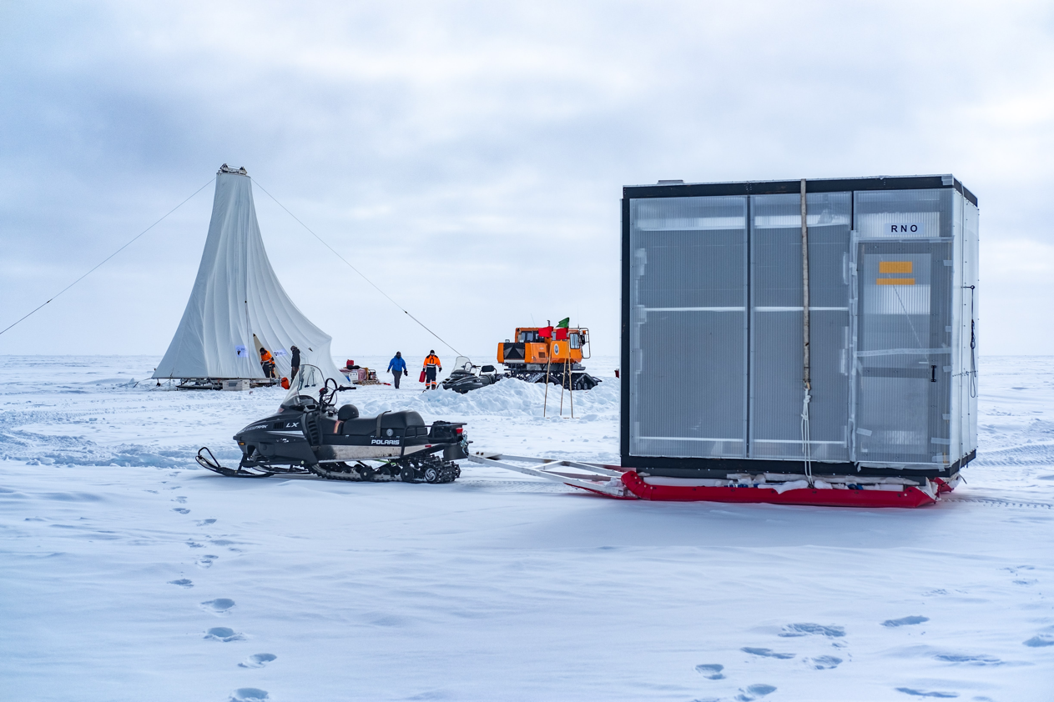
Drilling & Installation

Slide 12
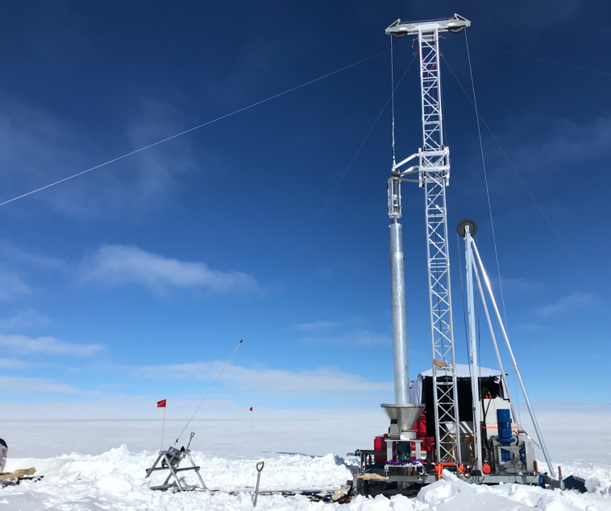
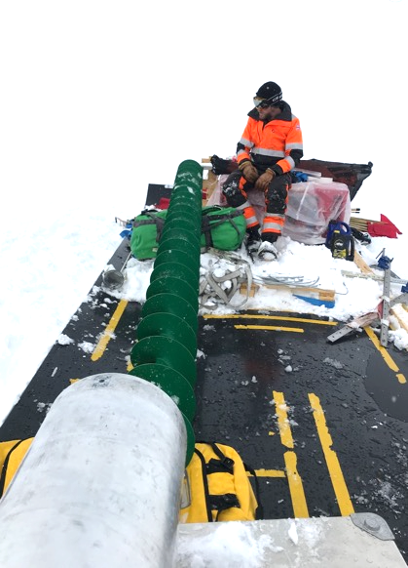
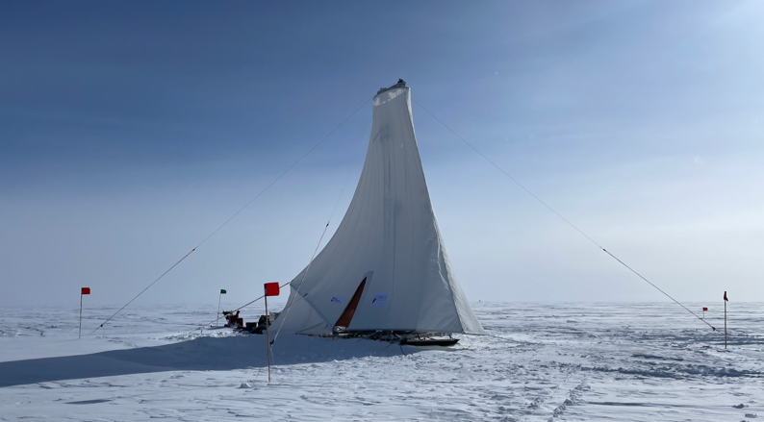
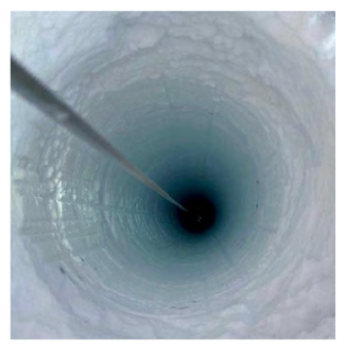
RNO-G drill
BigRAID developed by the British Antarctic Survey drilling group
Auger-type drill, chips are blown and dispersed after every run
~11’ diameter dry hole, 100 m depth
Quick start up, simple system
One operator is sufficient for most operations (two people staffing at any time)
So far 14 holes in a (6-weeks) season
(V1)
(V2)

Slide 13
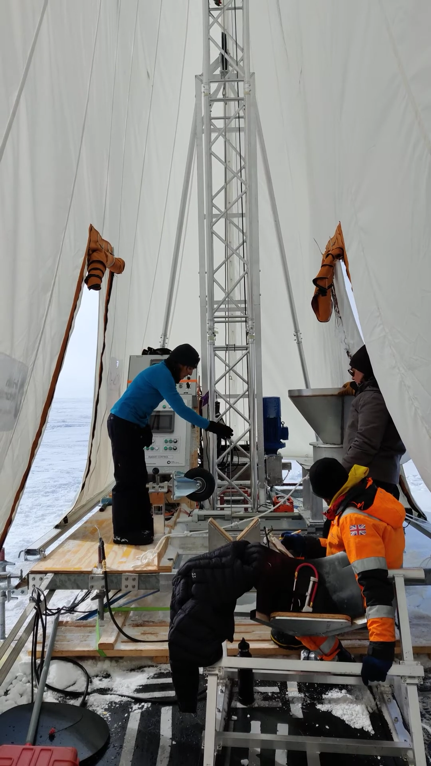
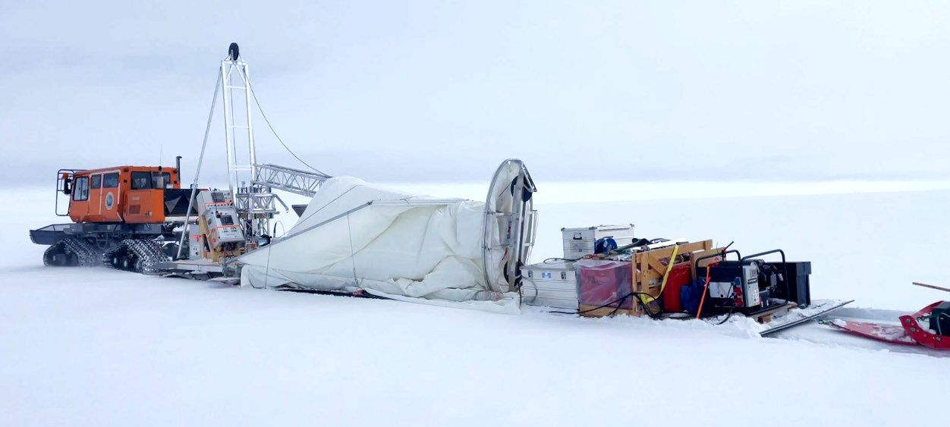
Designed to minimize weight and fuel consumption
Everything is transported on a 45 ft sled pulled by a tracked vehicle
O(35) liters of fuel / hole

Slide 14
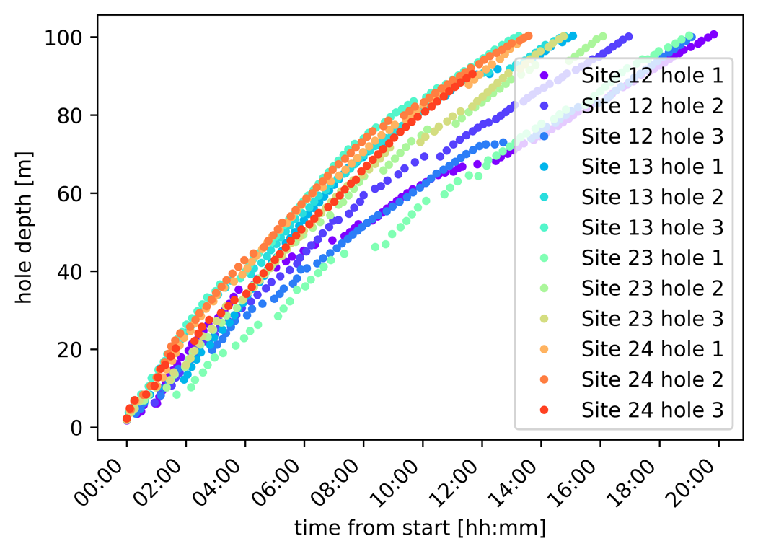
Drilling speed
Improvements from between 2021 and 2022
Tent
General drilling setup (generator in back, controls and wire all accessible to a single operator)
New fuel injected generator
Quick hole-to-hole turn around
Future improvements
Comms issues affecting drilling speed due to reboot
Logbook can be implemented via software
Target is to be able to drill 100 m in one shift

Slide 15
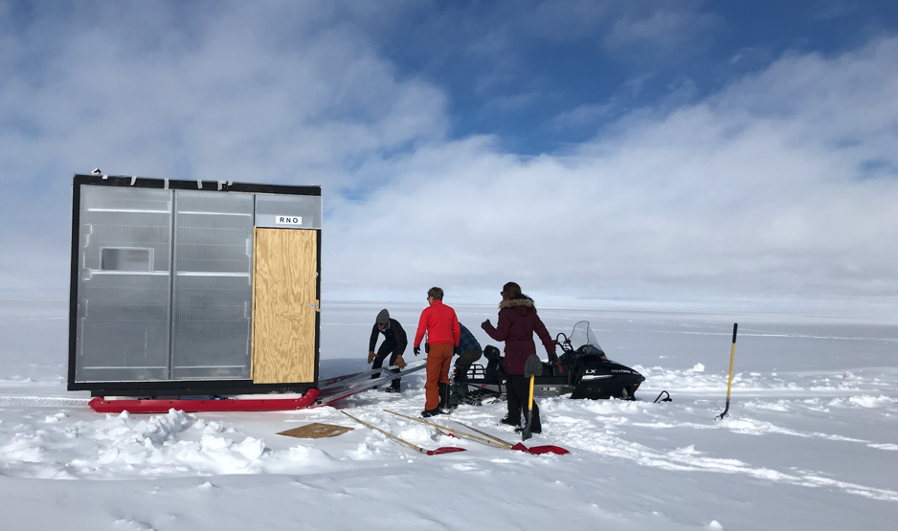
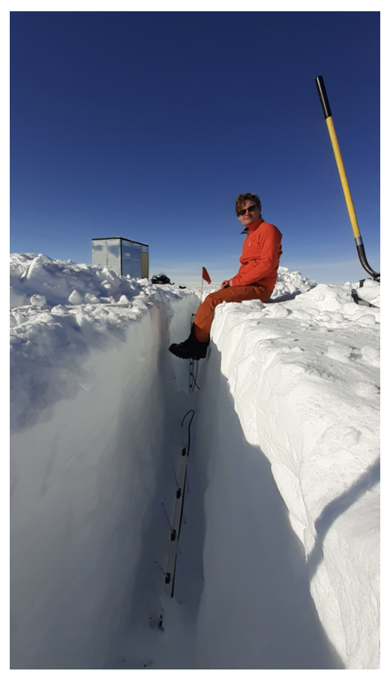
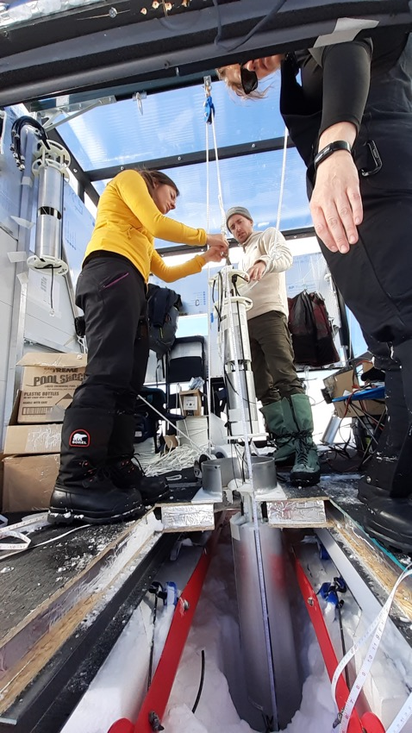
Installation
Straightforward, a full station can be installed in 2.5 days with a team of 4 people
power string: 6 hrs
helper strings 2-3 hrs each
surface instrumentation requires ~0.5 days
can also be reversed easily

Slide 16
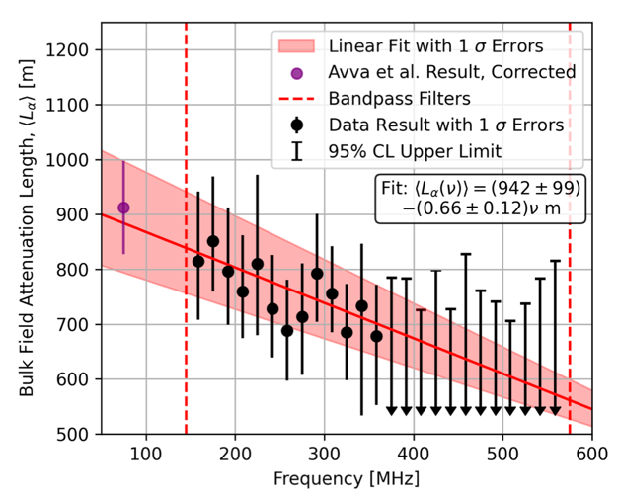
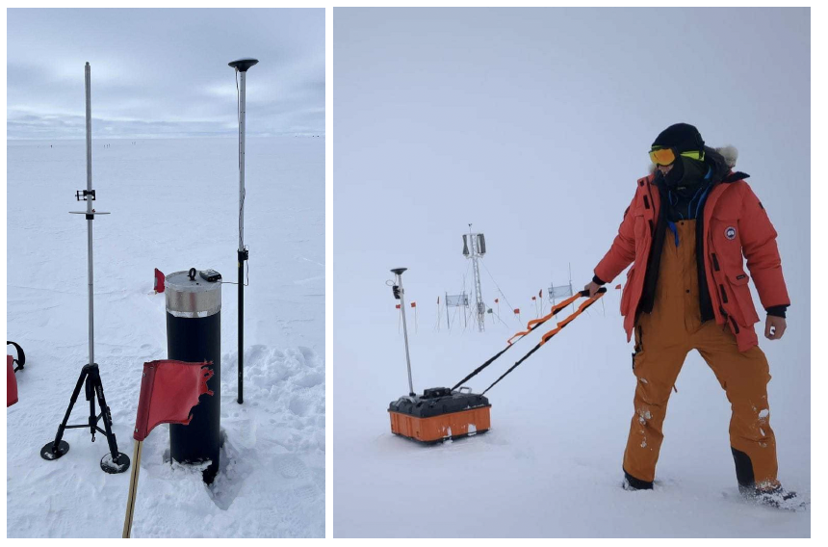
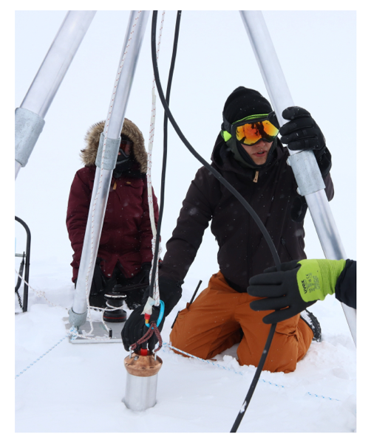
Calibration campaigns
Attenuation length measured and published
Index of refraction measurements underway
Surface pulsing, GPR scans, GPS survey, neutron density probe
Auto-melting probes used for 30 m calibration holes
https://arxiv.org/pdf/2201.07846.pdf

Slide 17
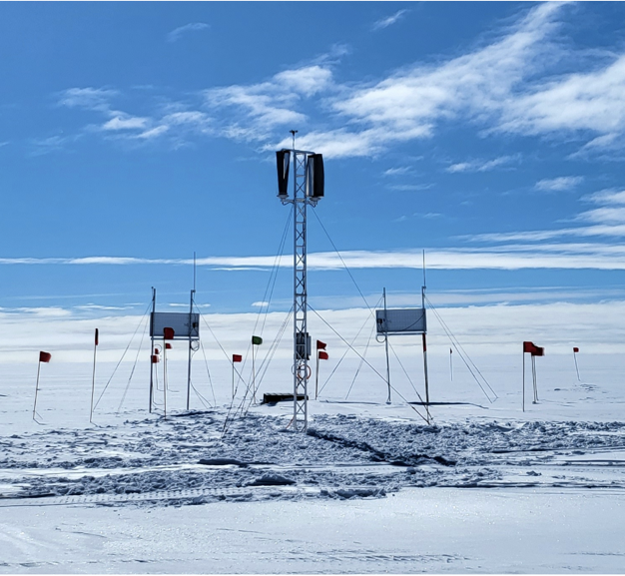
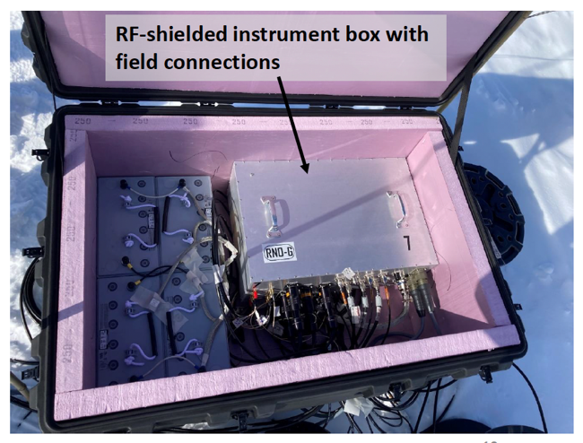
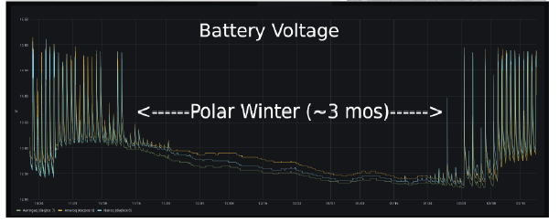
Data taking modes & autonomous power
Stations are un-cabled, rely on solar panels and batteries and wind turbines (development phase)
Data is transferred by LTE and LoRaWAN to Summit
(20GB/day, 10% of which is transferred)
Various data taking modes designed to extend livetime in winter:
  Low/high threshold trigger
  Full/limited LTE data transmission
  Full station/surface only
  Physics mode/Housekeeping

Slide 18
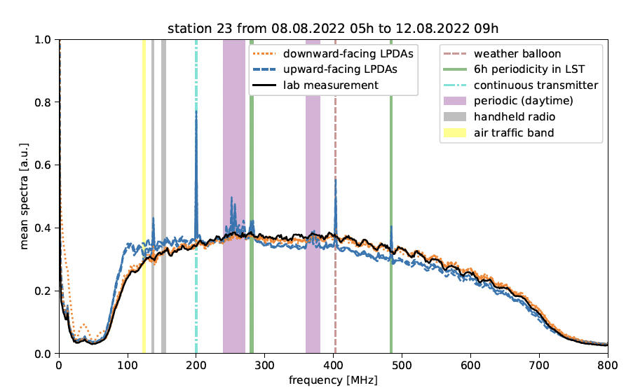
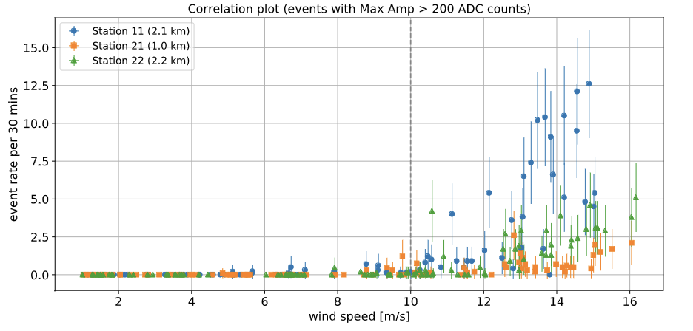

Backgrounds
Spikes in the upward facing LPDAs, indicate above surface activity
weather balloons launched 2/day
handheld radios
Non-anthropogenic:
triboelectric effect
thermal emission by the Galaxy
flares from Sun
cosmic-ray air-showers

Slide 19
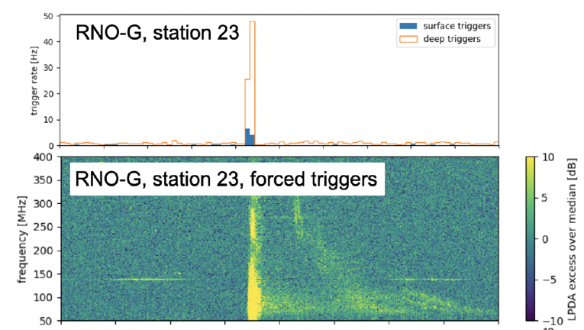
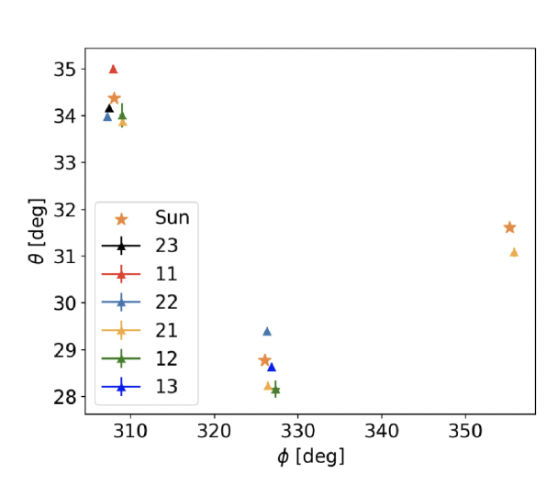
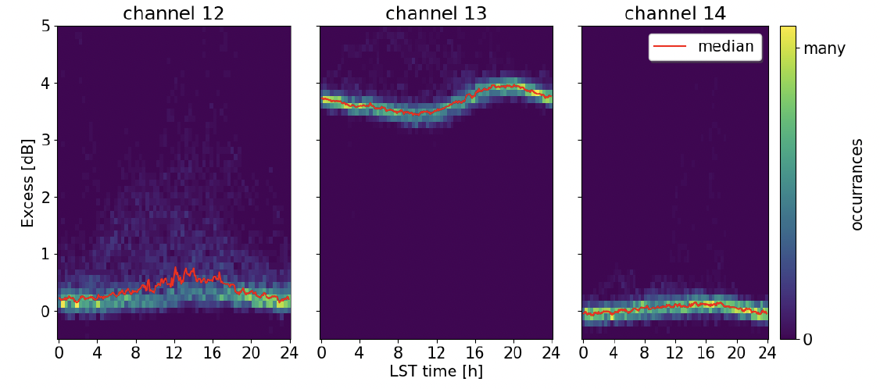
Solar flares, Galactic noise, Cosmic Rays
Solar flares O(1/every few months) detected by RNO-G
Galactic noise as extra noise in the 80-120 MHz band, matching expectation
Cosmic Ray candidates
upward
downward
downward
80-120 MHz

Slide 20
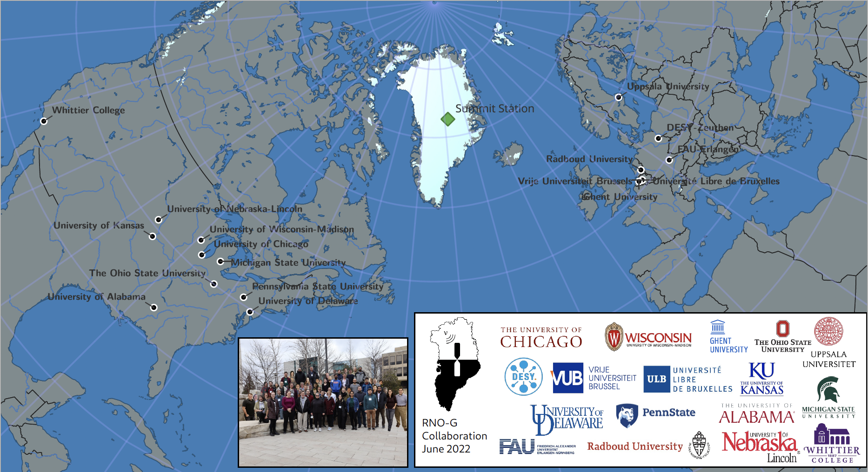
Summary
RNO-G is the only radio neutrino detector in the northern hemisphere
Well funded in Europe and in US
75 members, 18 institutions, 5 countries
Currently in expansion
Drilling + Installing more stations in the next years
Reconstruction and physics analysis methods under development

Slide 21
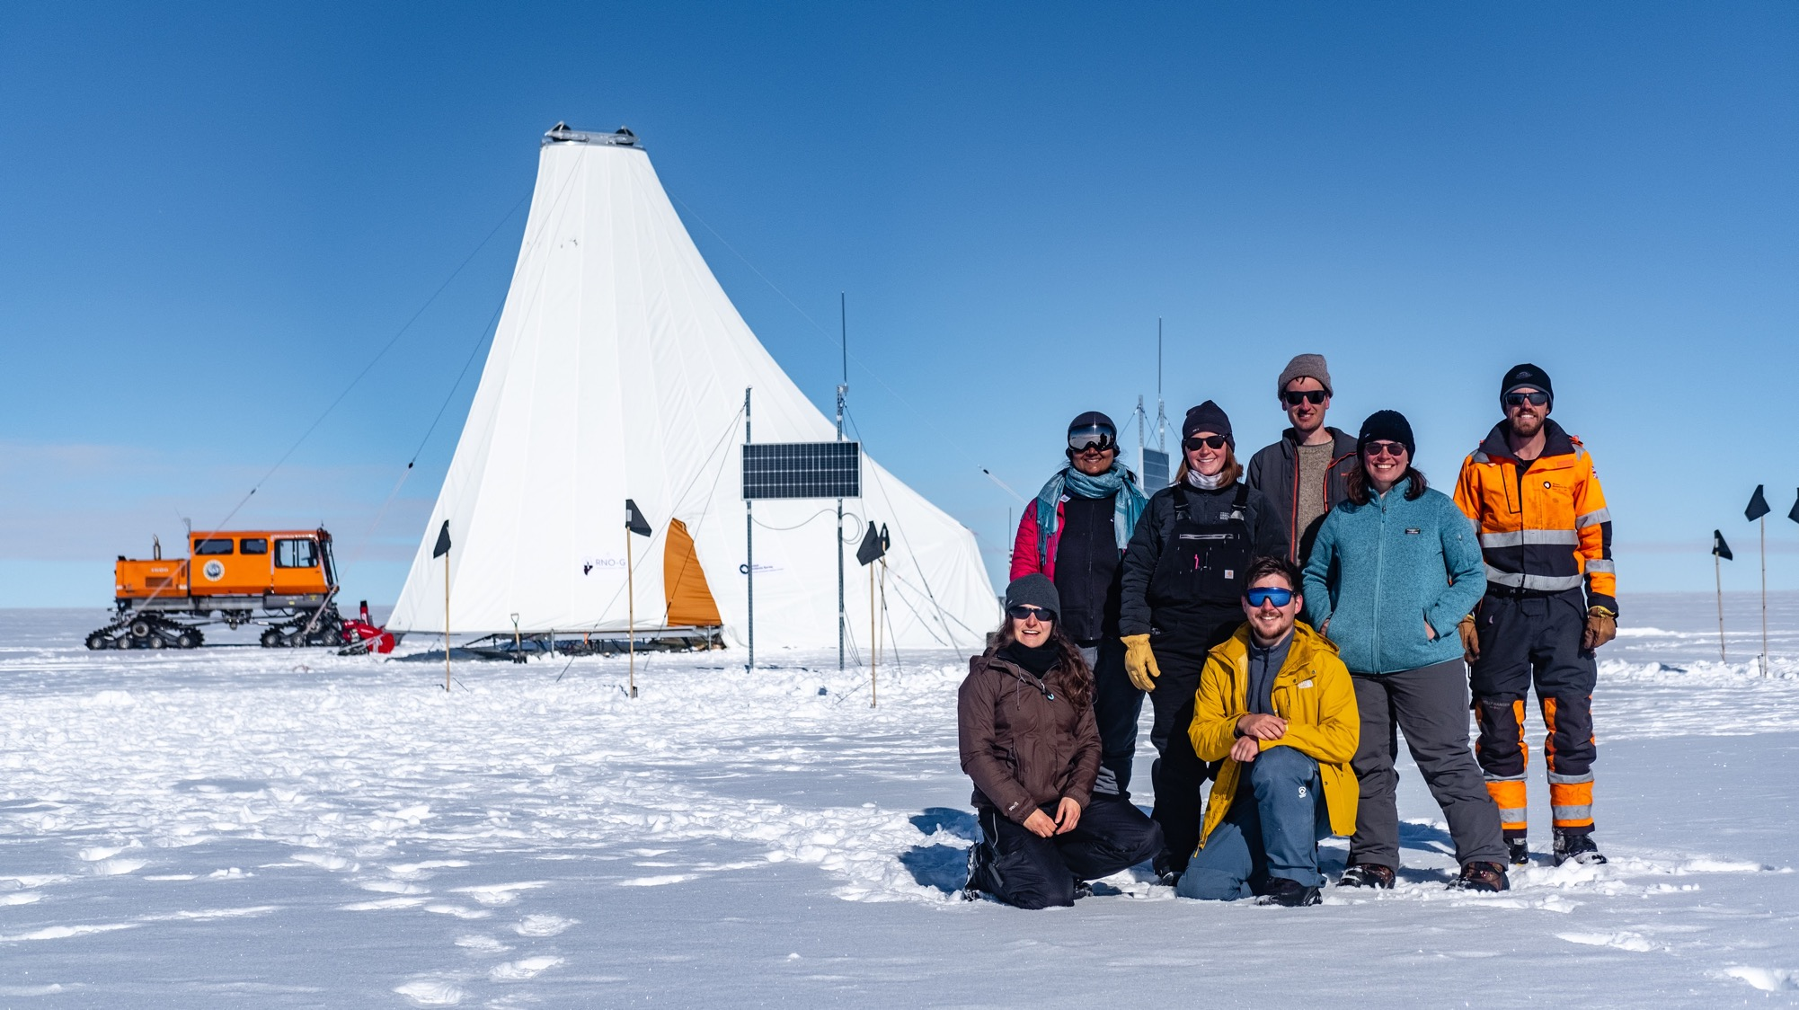
Questions?
RNO-G team 2022

Slide 22
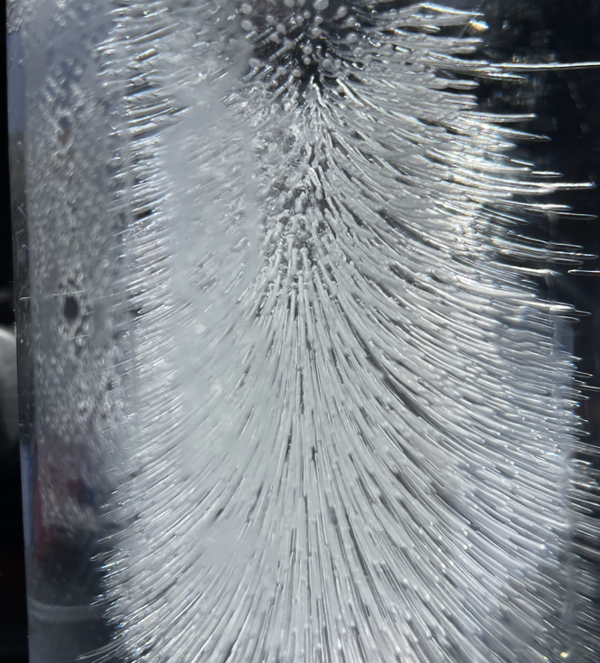



Radiofrequency Ice Dielectric Measurements at Summit Station, Greenland
Triboelectric Backgrounds to Radio-based Polar UHE Neutrino Experiments
In situ, broadband measurement of the radio frequency attenuation length
at Summit Station, Greenland
Reconstructing the neutrino energy for in-ice radio detectors
Design and Sensitivity of the Radio Neutrino Observatory in Greenland (RNO-G)

