Slide 1
CRYOSCOPE Ultra-Wide Field IR Survey Tony Travouillon (ANU) Mansi Kasliwal (Caltech) Roger Smith (Caltech) Tristan Guillot (OCA) Michael Ashley (UNSW) and the Cryoscope consortium

Slide 2
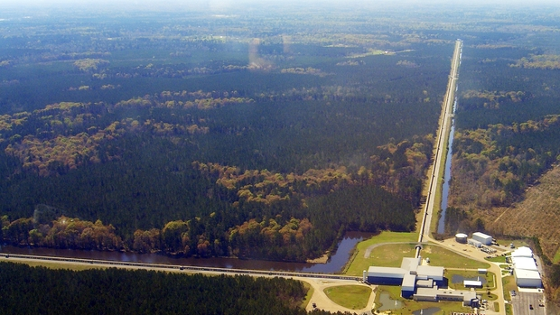
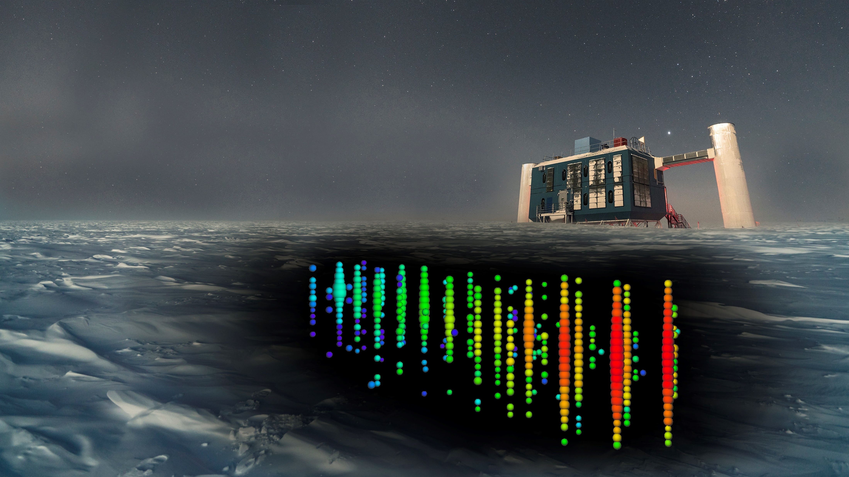
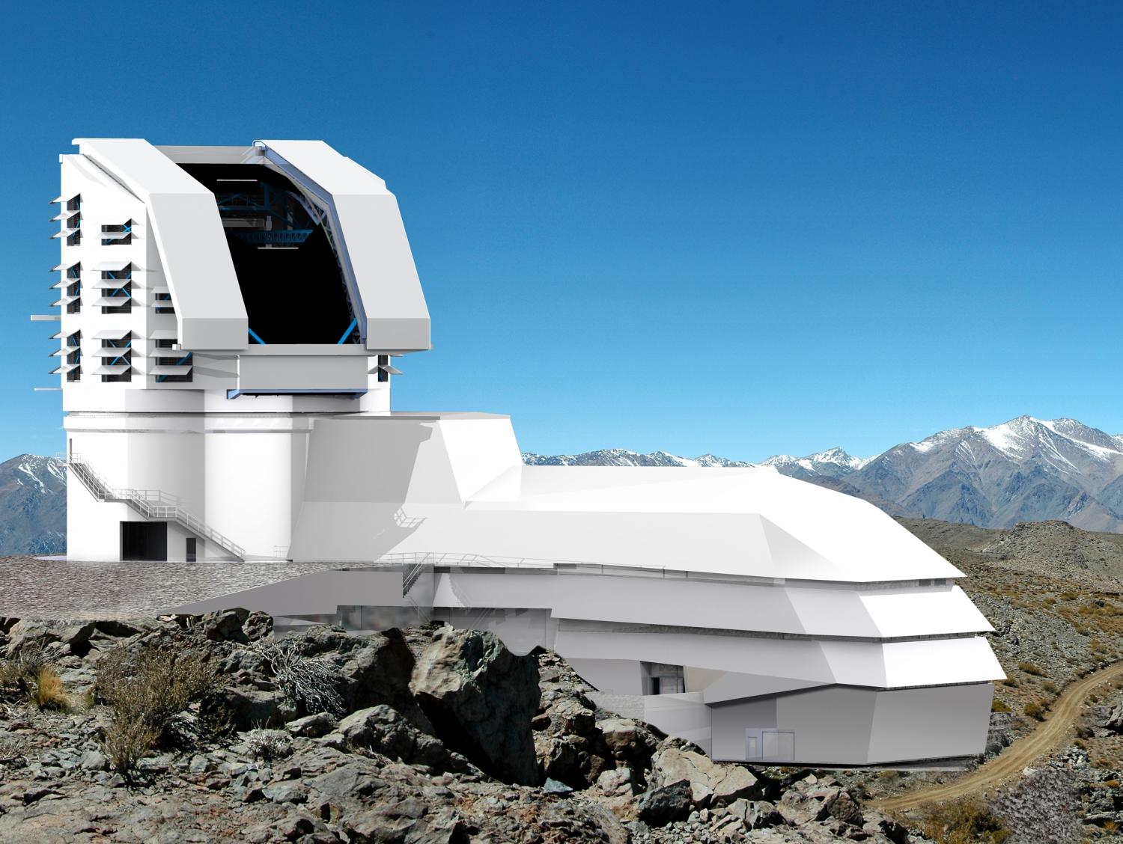
The Dynamic Astronomy Era
Multi-messenger and wide field facilities are finally allowing us to study the universe as a living entity operating on human time scales

Slide 3
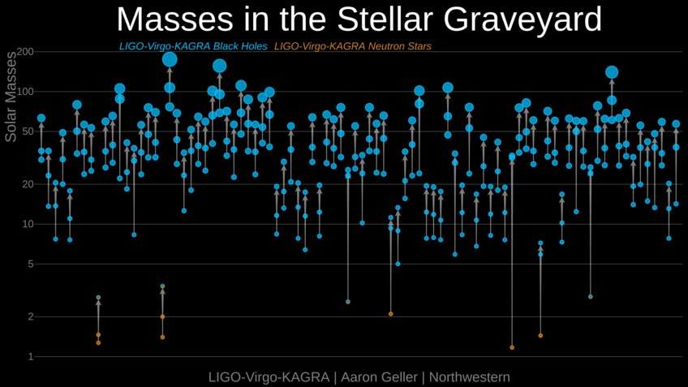
Stellar Mergers
Gravitational Waves open a new way to understand nucleosynthesis and r-process happening in stellar mergers

Slide 4
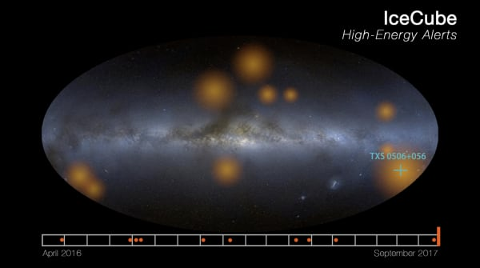
Supernova explosion
Neutrinos can alert observers of where to look for the electromagnetic signatures of supernova as they happen

Slide 5
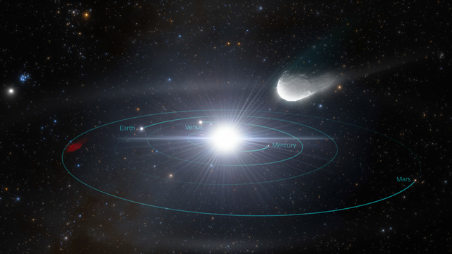
Mapping the Solar System and the Milky Way
Monitoring and understanding the dynamics of the local universe to understand its origins and evolution.

Slide 6
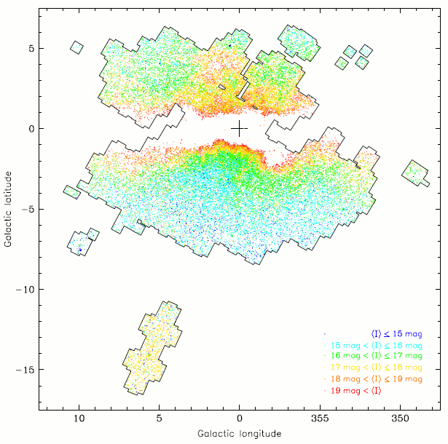
So what tool are we missing?
99% of our galaxy is obstructed by dust. Getting accurate distances and velocities requires access to variable stars near the galactic center.
RR Lyrae are difficult to find along the galactic plane.

Slide 7
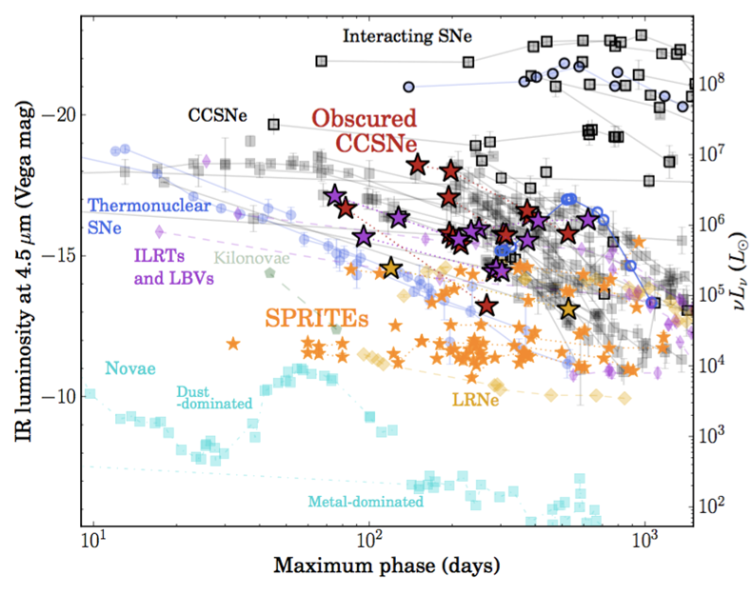
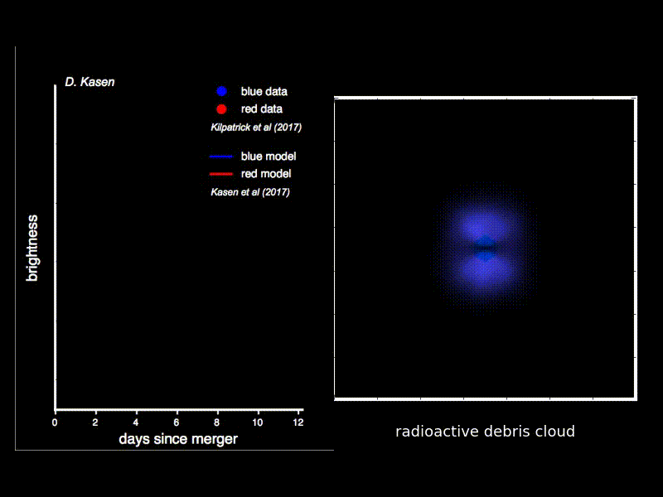
So what tool are we missing?
99% of our galaxy is obstructed by dust. Increasing the number of potential sources a hundred-fold is crucial for rare dynamic events

Slide 8
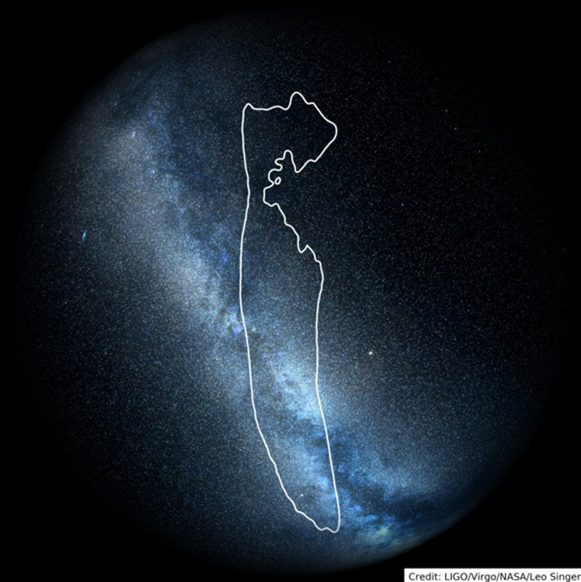
What we are proposing: Ultra-Wide Field Infrared Imaging
Tens of degrees are still needed for fast discovery and high-cadence imaging of the infrared sky.
A good metric: Neutron star- black hole merger at 400Mpc
Another good metric: Volumetric speed of LSST in the k-band
Large Field-of-View: 50 deg²
+
Dense Focal Plane: ~1Gpixel infrared array
=
Cryoscope

Slide 9
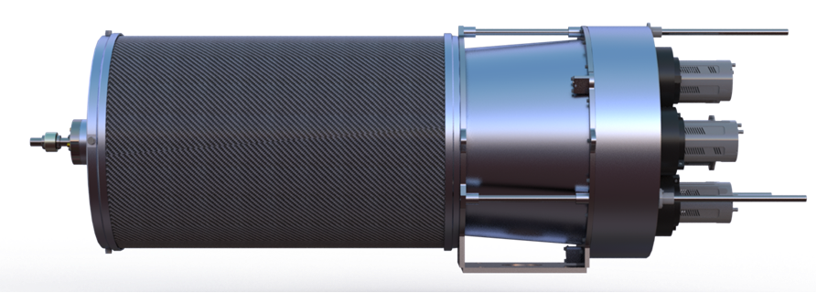
The path towards an Antarctic IR Survey Telescope
Infrared surveyors currently operating or under construction at Palomar (USA) and Siding Spring (Australia).
Cryoscope to be the culmination of this expertise, aiming at a deployment at Dome C before the end of the decade.
WINTER
2030
1m aperture with 1.2 deg² FOV, 12Mpix, Y/J/H bands
Palomar, California
Cryoscope
1.2m aperture with 50deg² FOV, K-band, 1.2 Gpix
Dome C, Antarctica
Palomar Gattini-IR
2025
30cm Aperture with 25deg² FoV, J-band, 4.2Mpix
Palomar, California
Cryoscope-pathfinder
Quarter-scale technology Demonstrator
2023
DREAMS
50cm aperture with 3.8 deg² FoV, Y/J/H bands, 7.8Mpix
Siding Spring, Australia
2018

Slide 10
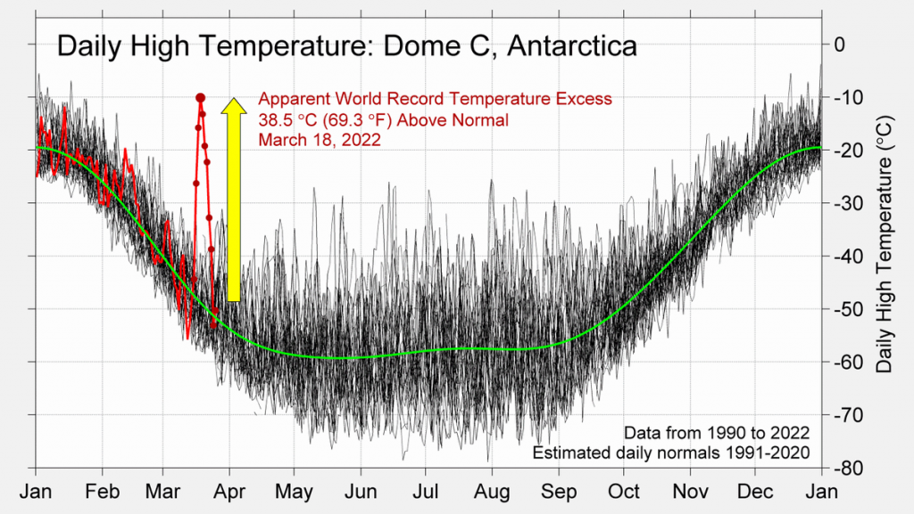
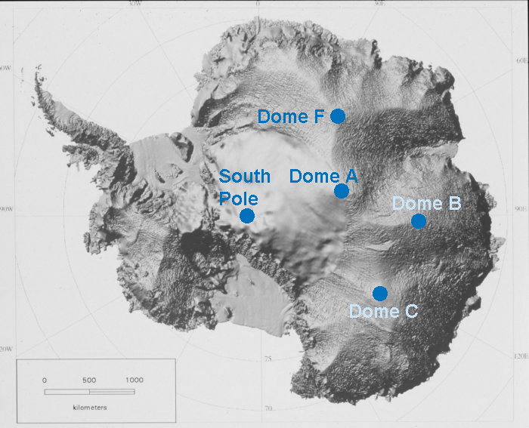
The Site: Dome C
Superb atmospheric conditions married to the necessary logistical support:
>80% cloud free
<0.3” seeing above 25m
Low IR background

Slide 11
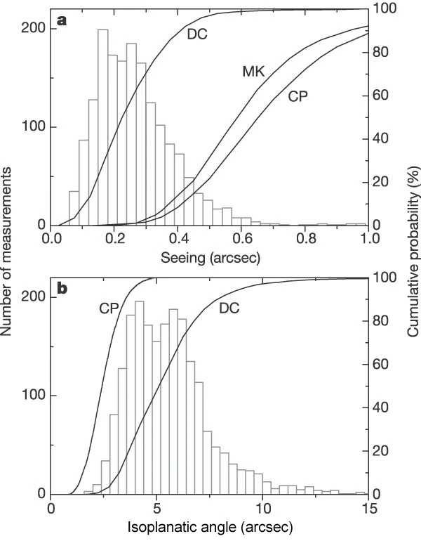
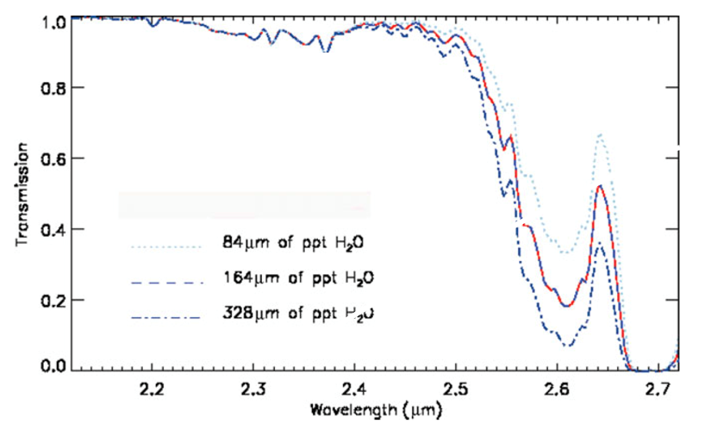
The Site: Dome C
Superb atmospheric conditions married to the necessary logistical support:
>80% cloud free
<0.3” seeing above 25m
Low IR background

Slide 12
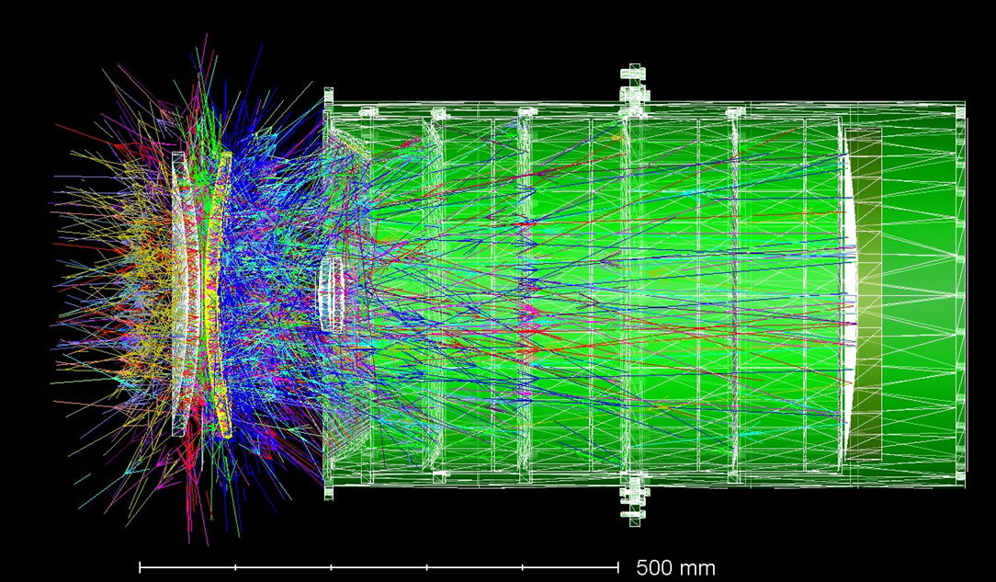
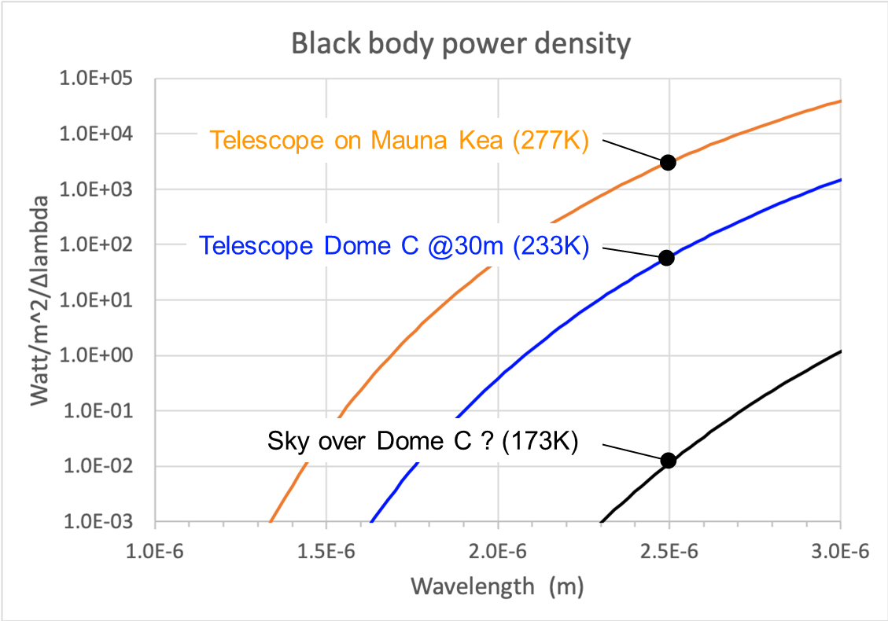
What is Cryoscope?
The 1m class telescope is completely cryogenic. Usual methods to block rays from a warm telescope limit the field of view. A telescope that is colder than the sky is critical to optimize its sensitivity.

Slide 13
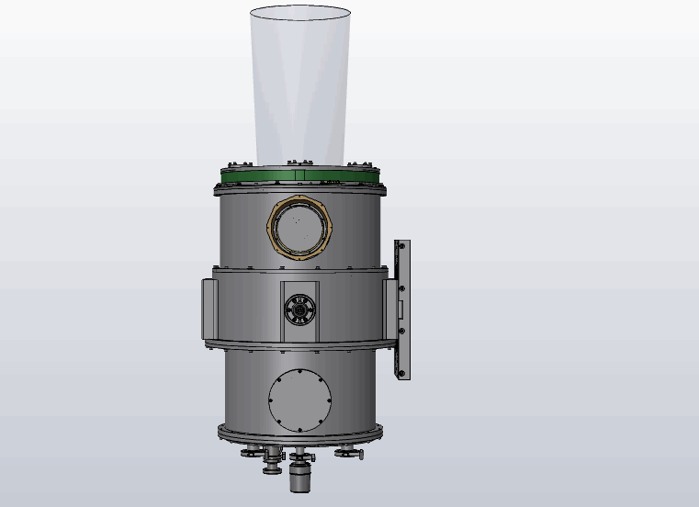
A Unique Telescope Design
The design (Roger Smith, Caltech), relies on some key principles:
2nd corrector element serves as window. The full optical path can be cryogenically cooled, including the detector.
Fused silica for scalable apertures.
No moving part other than the mount.

Slide 14
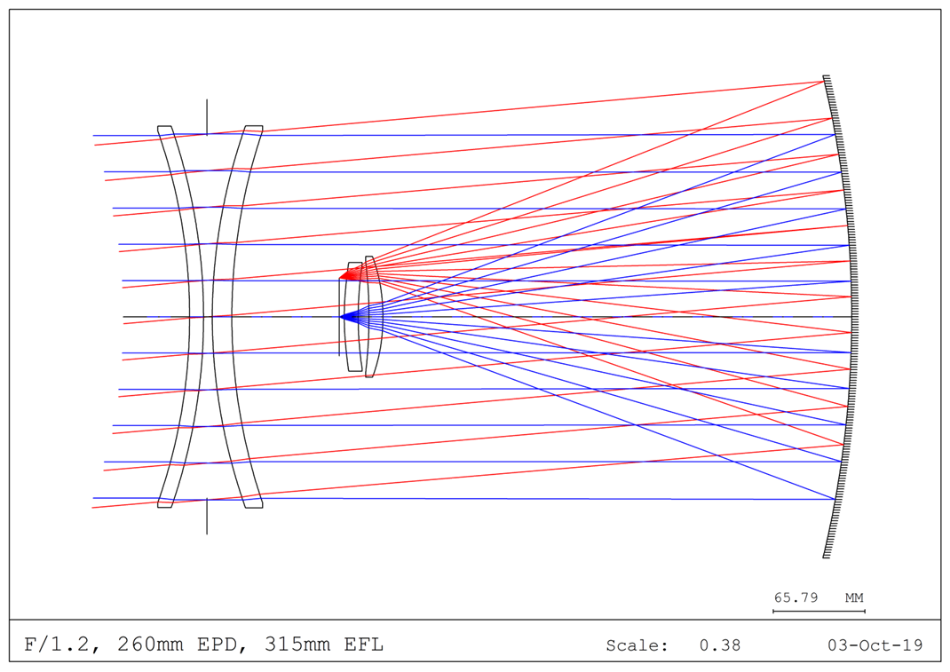
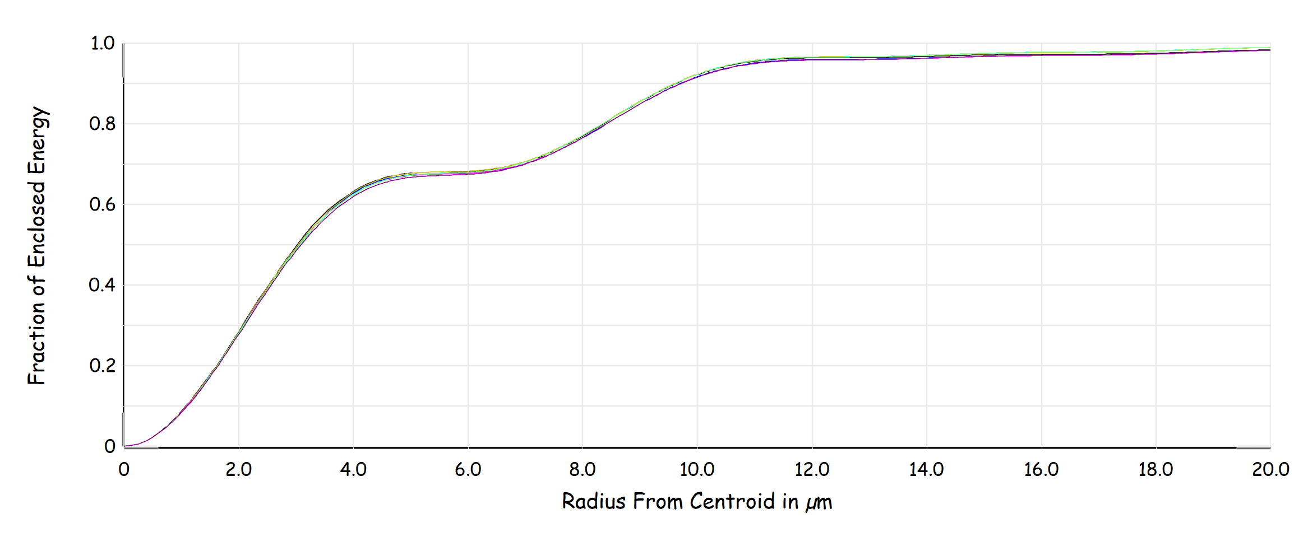
The Optical Design
Double-meniscus design by Jason Fusik (Caltech), complemented by 2 correcting lenses provides near diffraction limit image quality even at f1.2 and 100 sq. deg.

Slide 15
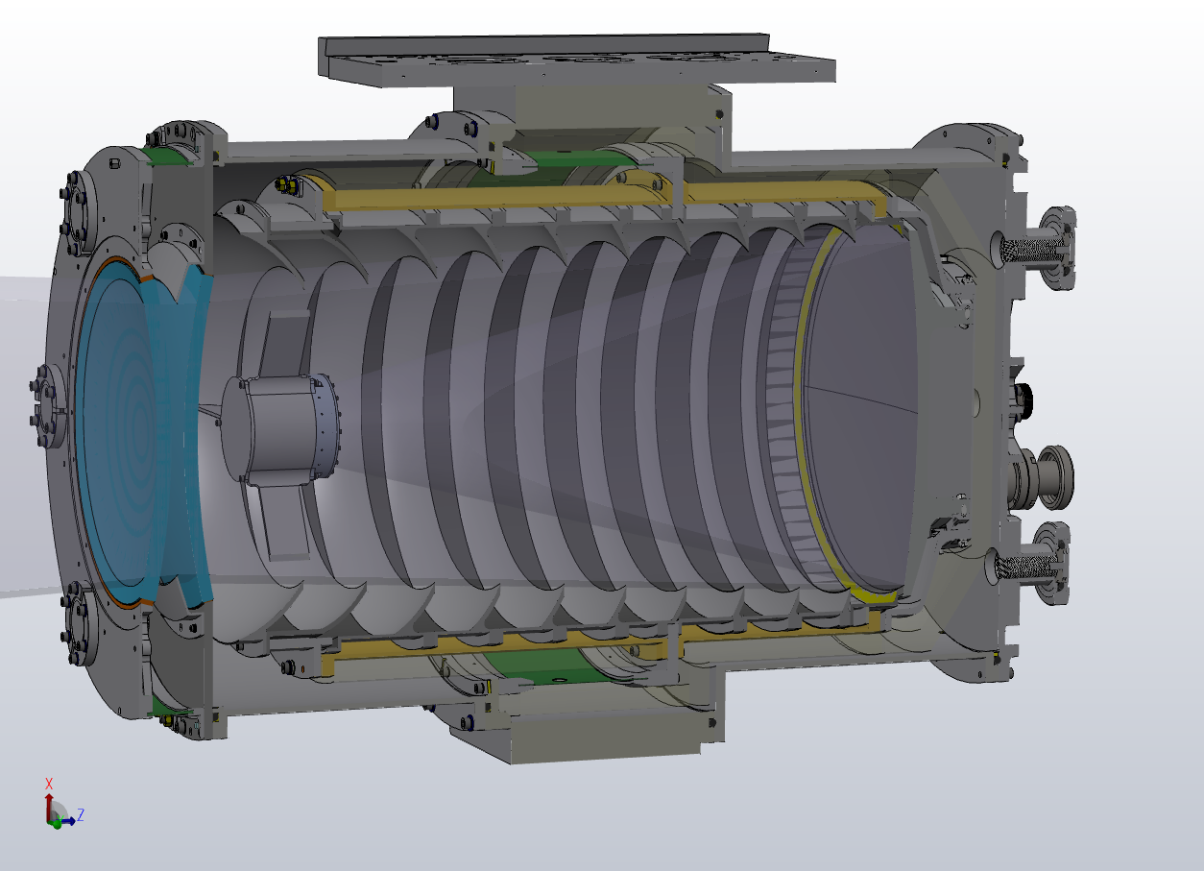
Convex and Concave Windows
Tangential support by silicone gasket to avoid glass compression. Thermal standoff for front baffle.

Slide 16
Detector at prime focus
Multi-color filter in consideration beyond k-band (J, H)

Slide 17
Detector controller
With vacuum interface board

Slide 18
Narcissus baffles
Thermal isolator, G10 cylinder. Precooled with LN2

Slide 19
Diamond turned Al Primary
75% light weighted

Slide 20
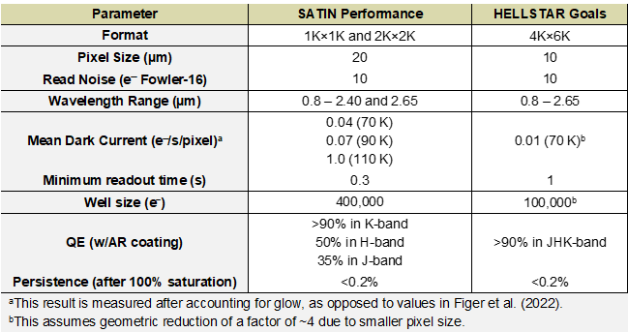
The Focal Plane Array
For our field and pixel scale, a 24K x 24K array is required. A cost-effective solution is required and is currently under development. Raytheon and Rochester partnering to produce 4k x 6k detectors using new epitaxy method.

Slide 21
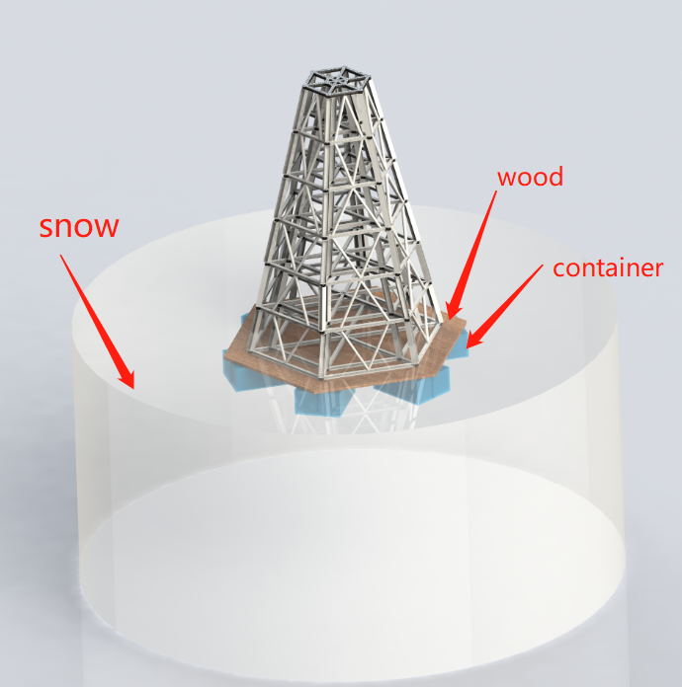
A Tower for Dome C
A 25m tower will be necessary to take advantage of the exceptional seeing and reach our target sensitivity. It also provides us with a method to fight humidity accumulation on the telescope.
Blower
Inlet

Slide 22
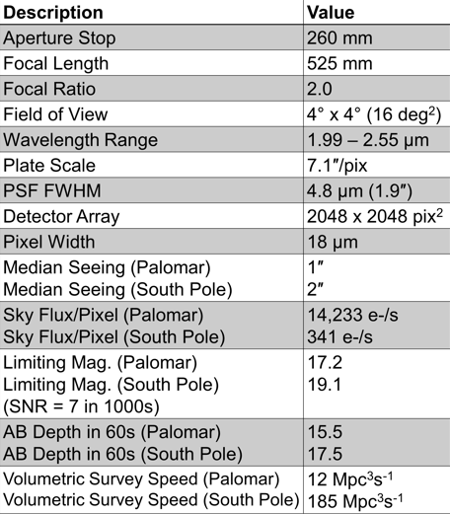
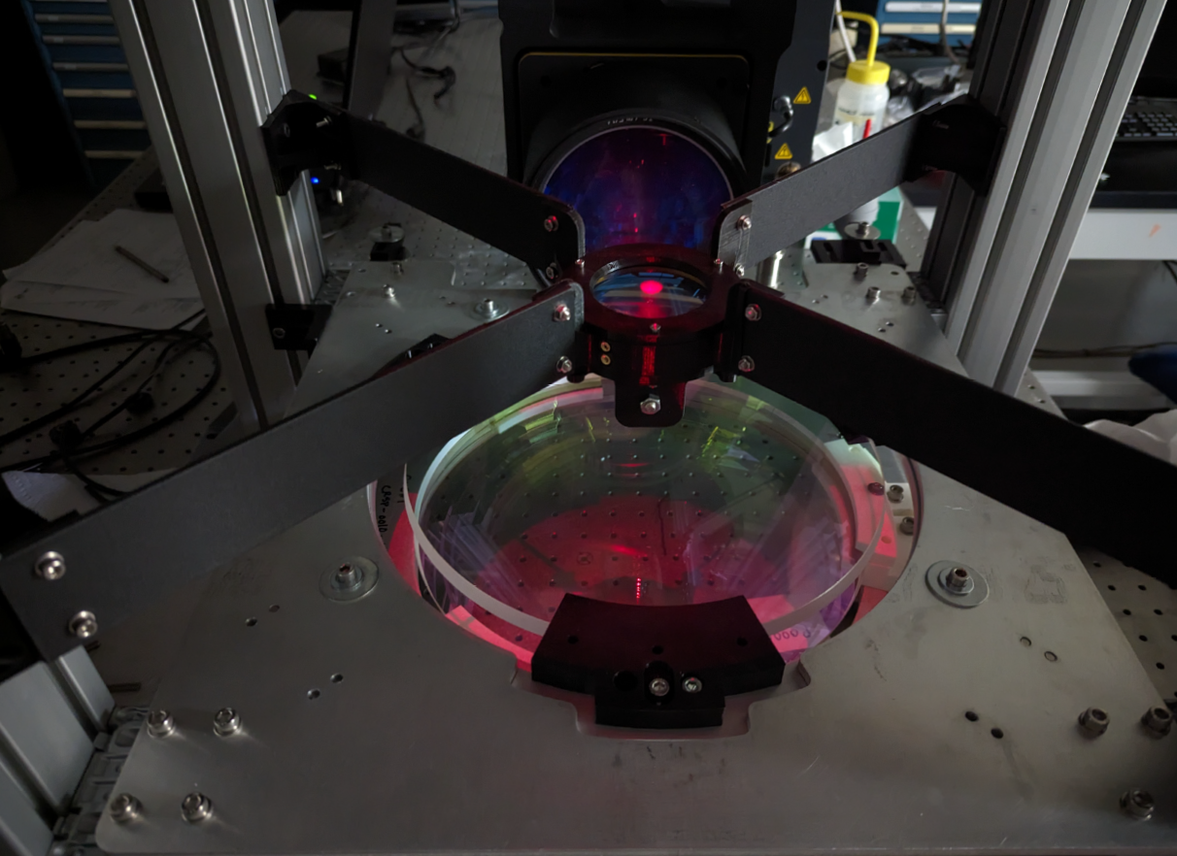
What is Cryoscope-pathfinder?
The quarter-scale version of Cryoscope is currently being built at Caltech. Its objectives are to de-risks the key technologies behind the telescope and also perform a uniquely deep survey in its own right.

Slide 23
Timeline for Cryoscope-pathfinder
2023 Construction
2024 Palomar testing and operation
2025 Deployment at Dome C (Proposal to IPEV pending)
2025-2026 Operation at Dome C

Slide 24
Next steps for the Cryoscope team
Core science contributors working on science case paper to be published by end of 2023. Contributions from the USA, Europe and Australia.
More technical challenges need work: Tower, image stabilization, mount and logistics.
Support critical detector development.
Grow consortium and seek funding for full scale system.
Thank you….

