Slide 1
Exploring the Microwave Sky with CMB-S4
Amy N. Bender, on behalf of the CMB-S4 Collaboration

Slide 2
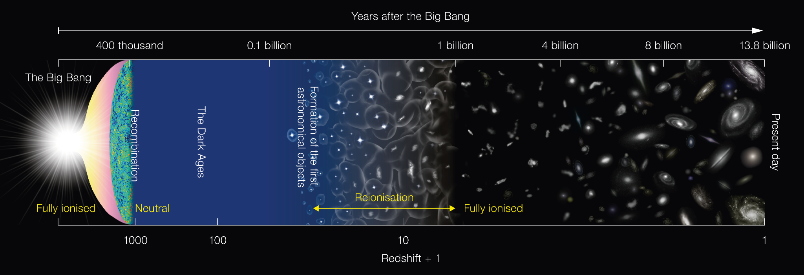
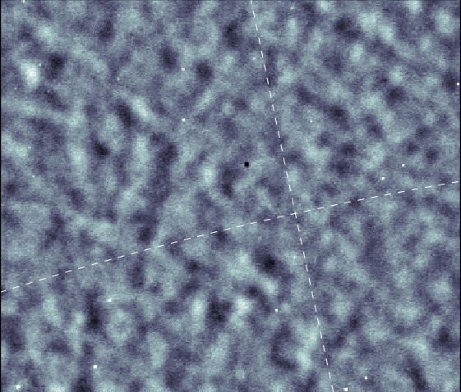
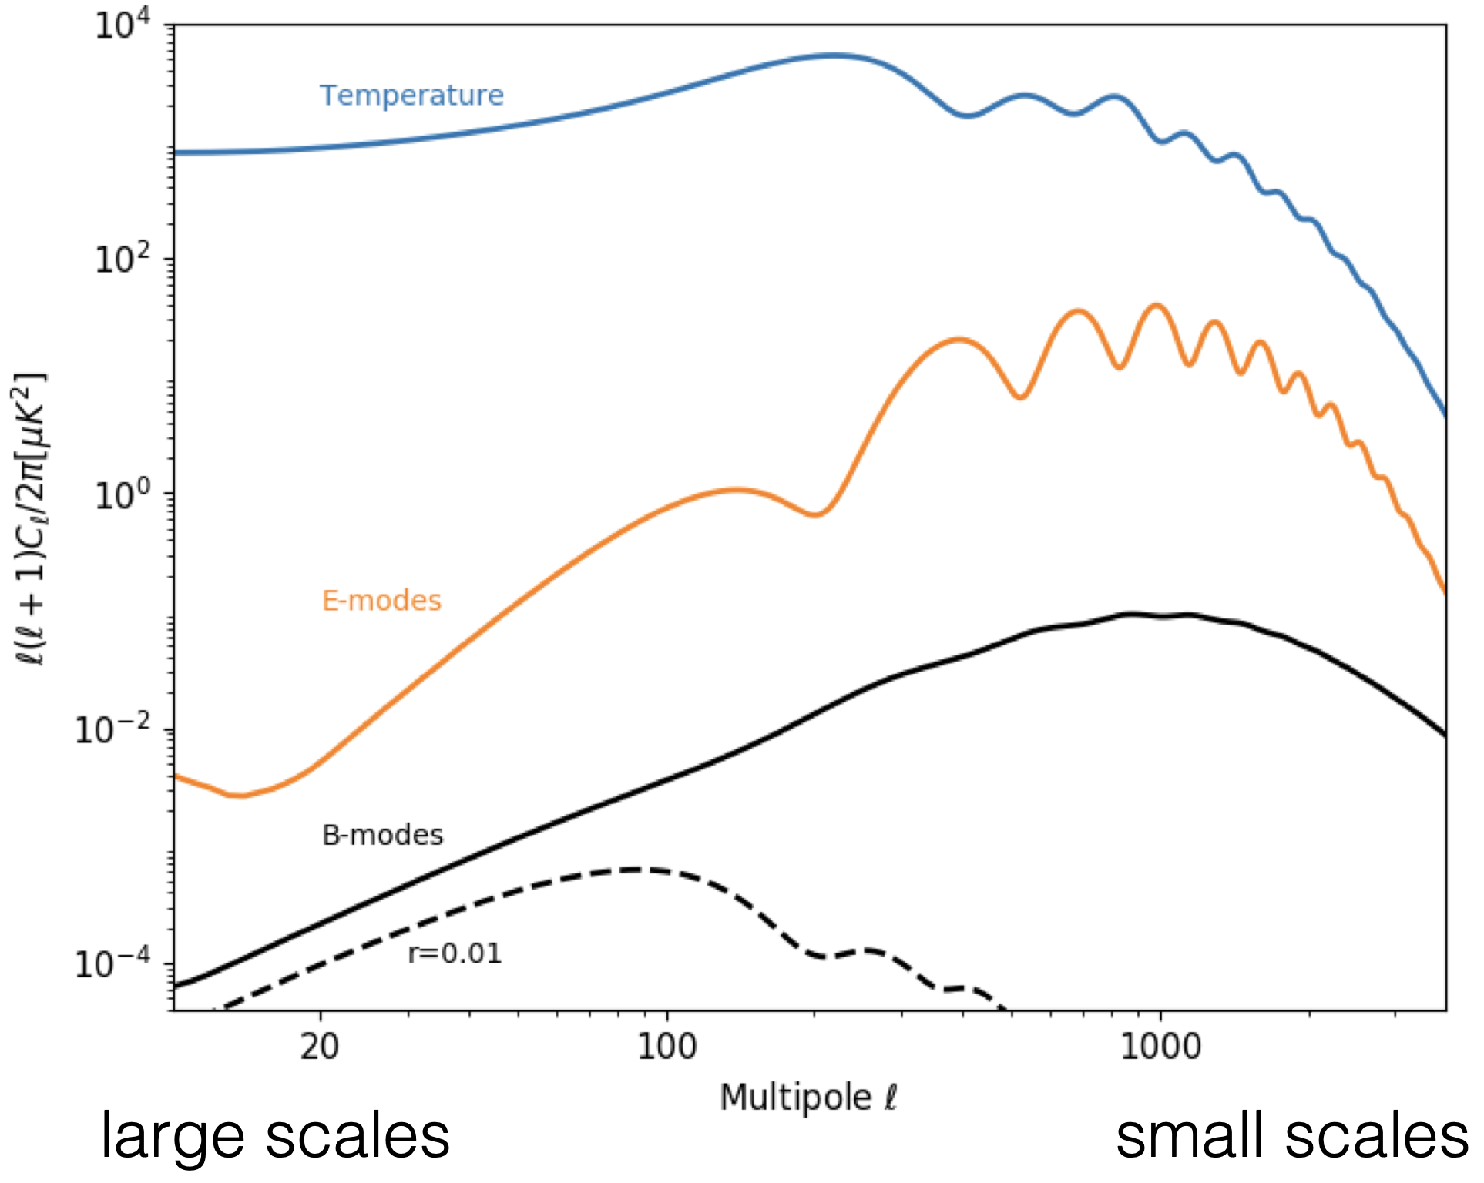
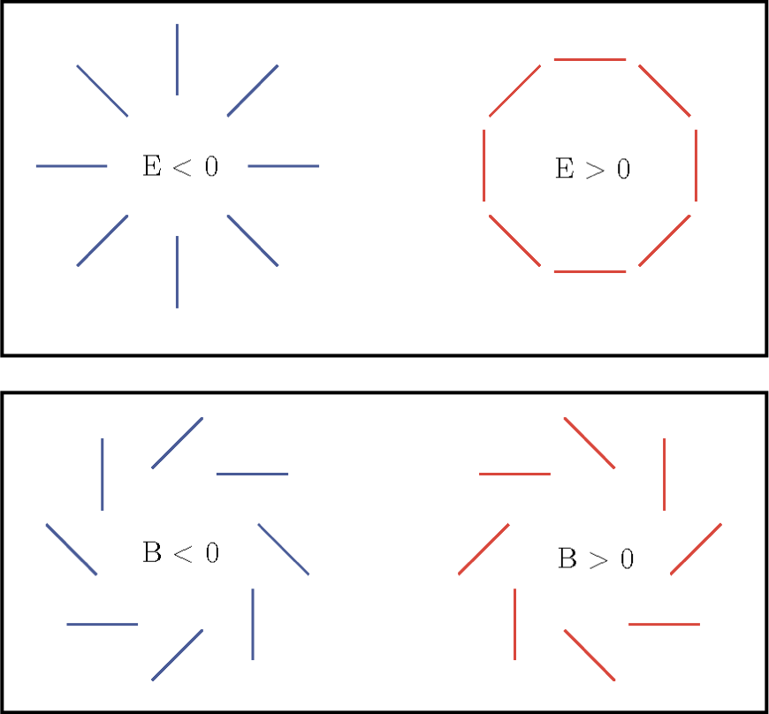
The Cosmic Microwave Background (CMB)
The CMB offers a snapshot of the early universe!
The CMB also contains imprints from structure formation throughout history of the ‘late’ universe
Credit: NAOJ

Slide 3
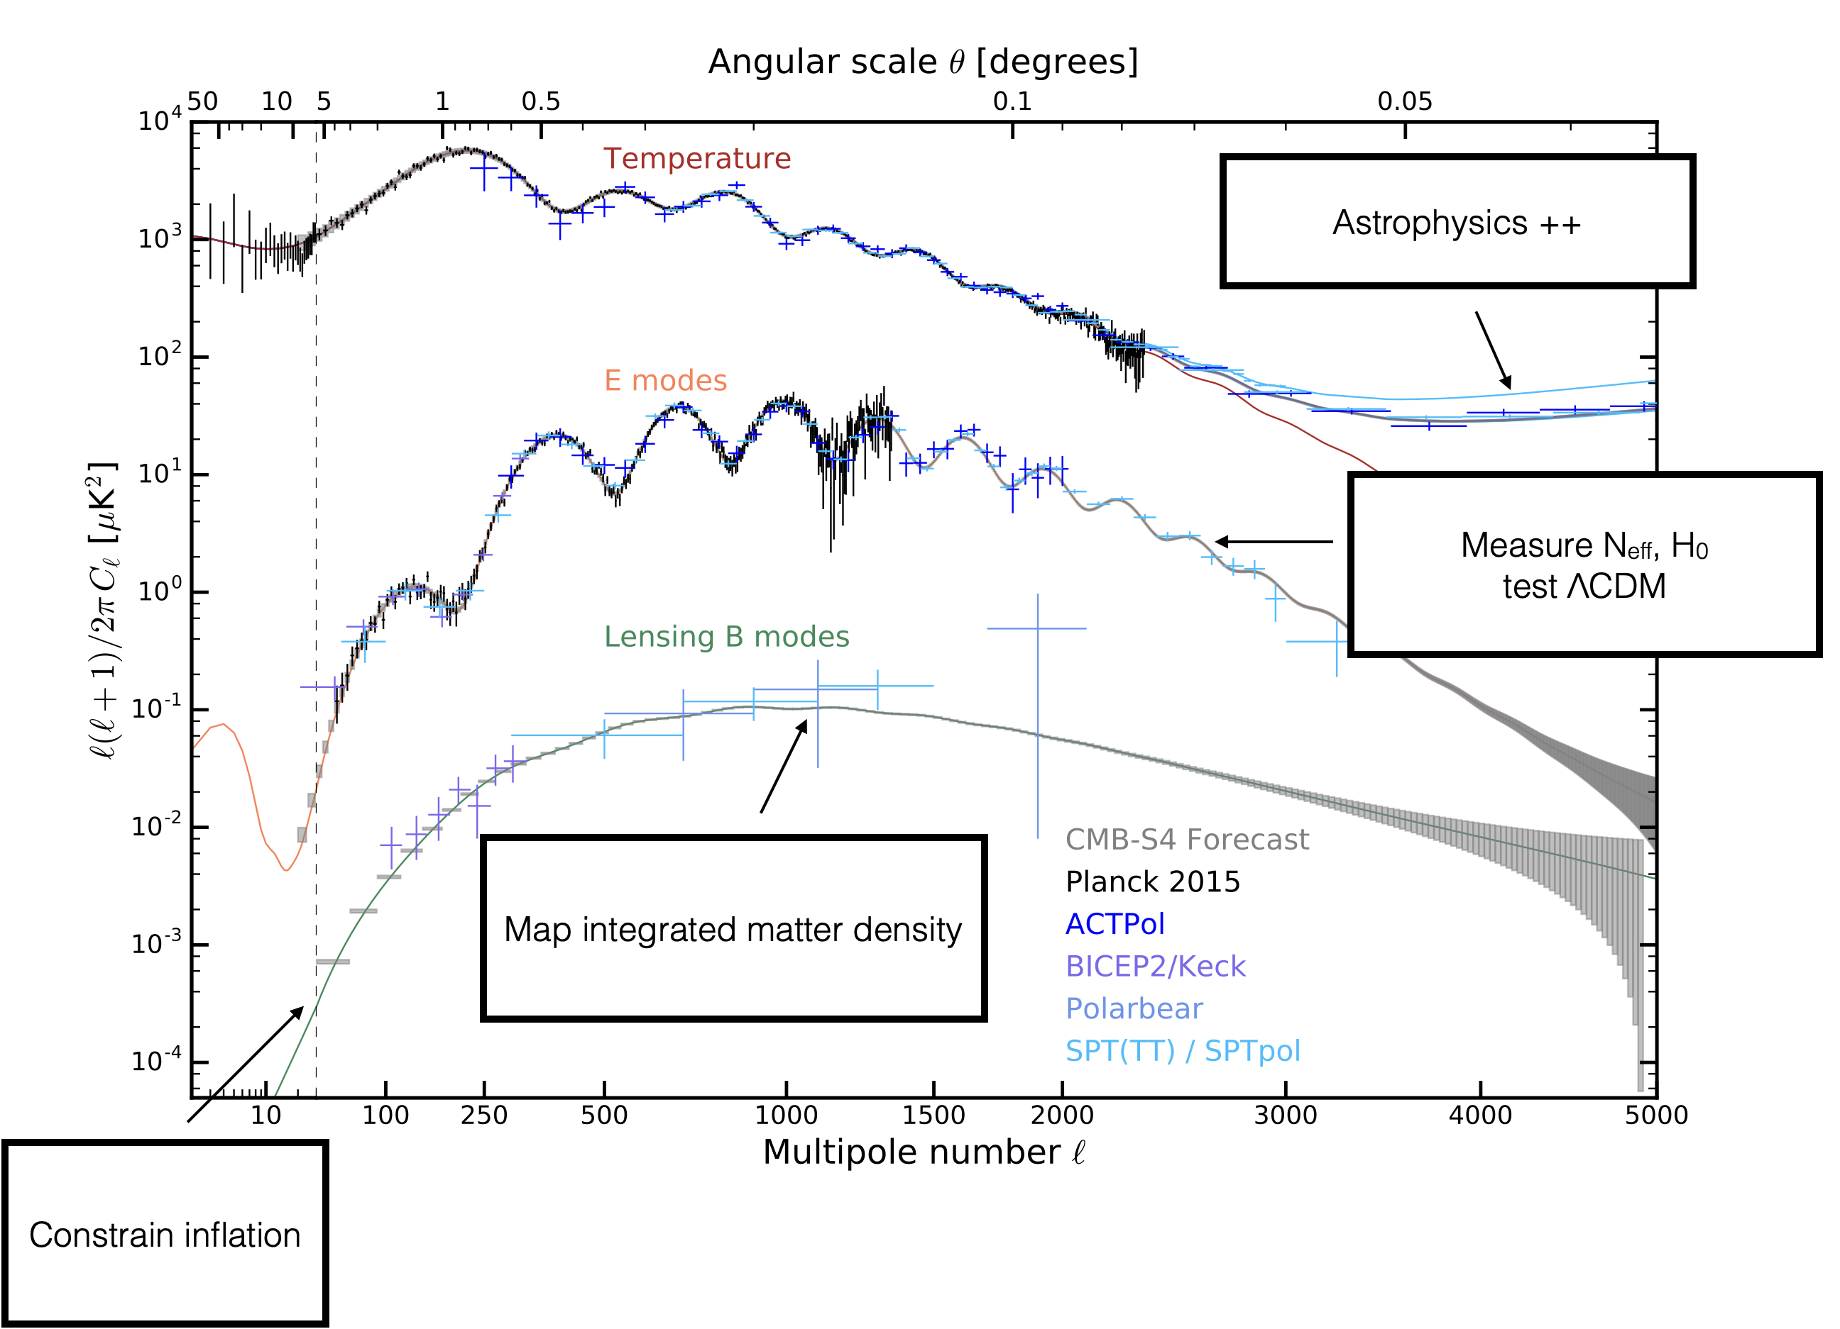
Observing the CMB probes broad science!
CMB observations allow us to study the origin and evolution of the universe, including investigations of inflation, neutrinos, dark energy, and beyond!
CMB-S4 science book: https://arxiv.org/abs/1610.02743

Slide 4
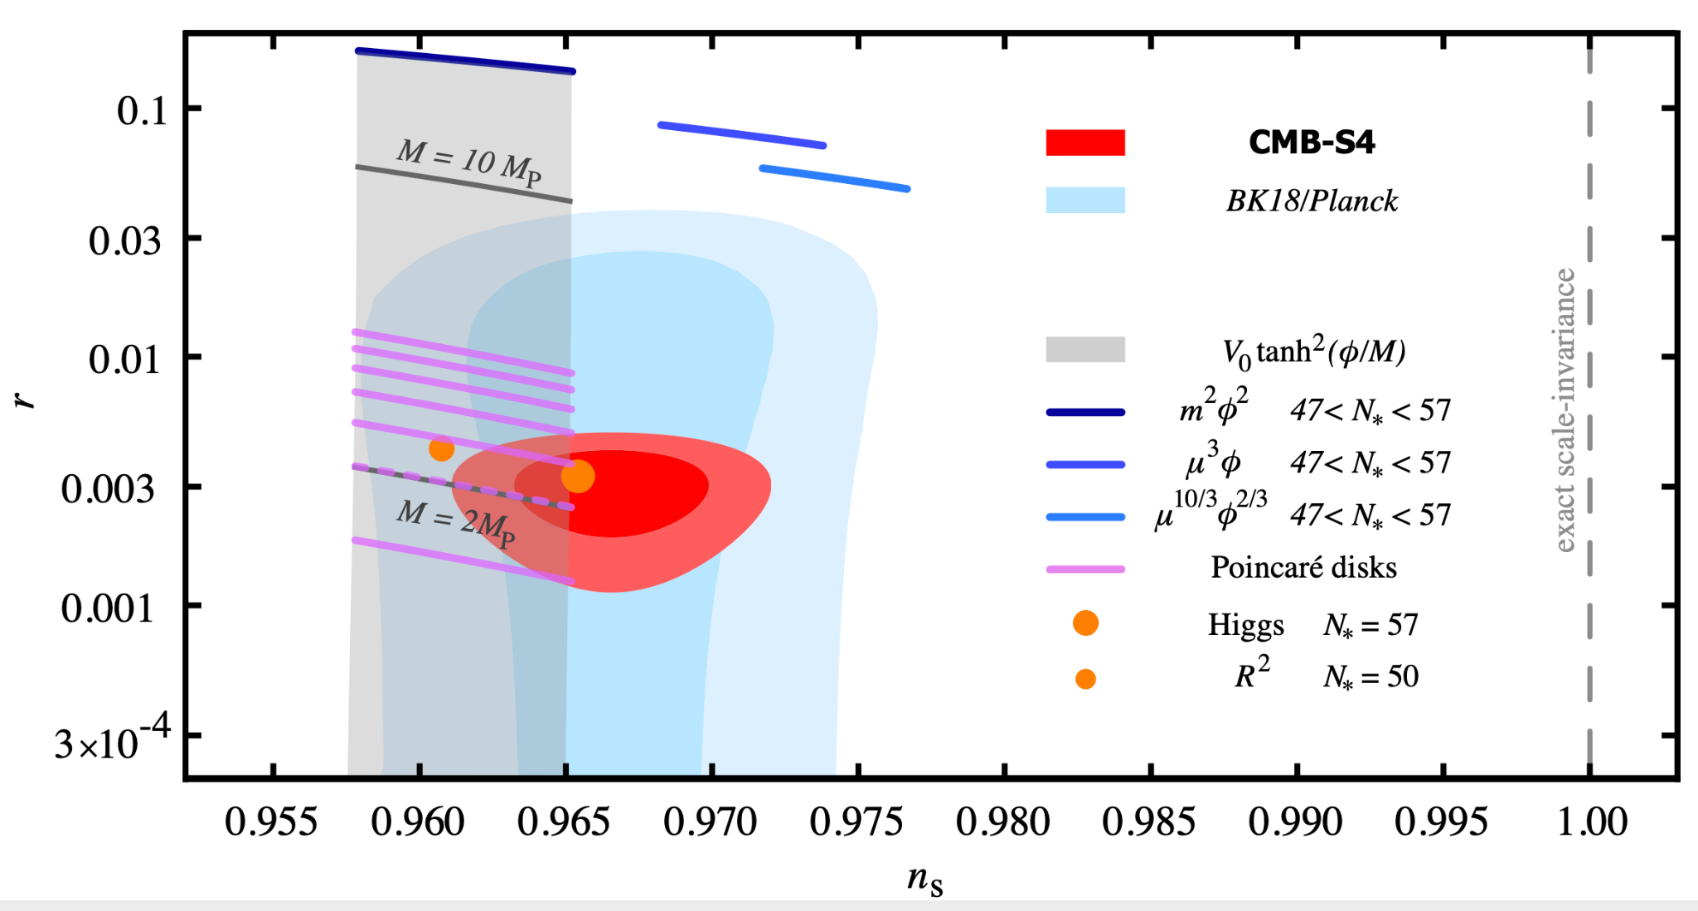
Primordial Gravitational Waves & Inflation
Gravitational waves generated during an epoch of inflation imprint a B-mode polarization signal in the CMB
  Measuring this signal would be a key test of our origins and the earliest moments of the universe!
Requires:
  ~2 orders of magnitude deeper sensitivity than current experiments
  exceptional control of systematics
  disentangling the signal from galactic foregrounds
CMB-S4 is designed to cross a critical threshold: either make a historic detection of this signal, or rule out the entire class of leading models
Inflationary B-modes
~10 nK
r < 10⁻³ @ 95% confidence
Notes:
Probe quantum gravity and fundamental physics ~10⁻³⁶ s after the universe began
Single field, slow roll

Slide 5
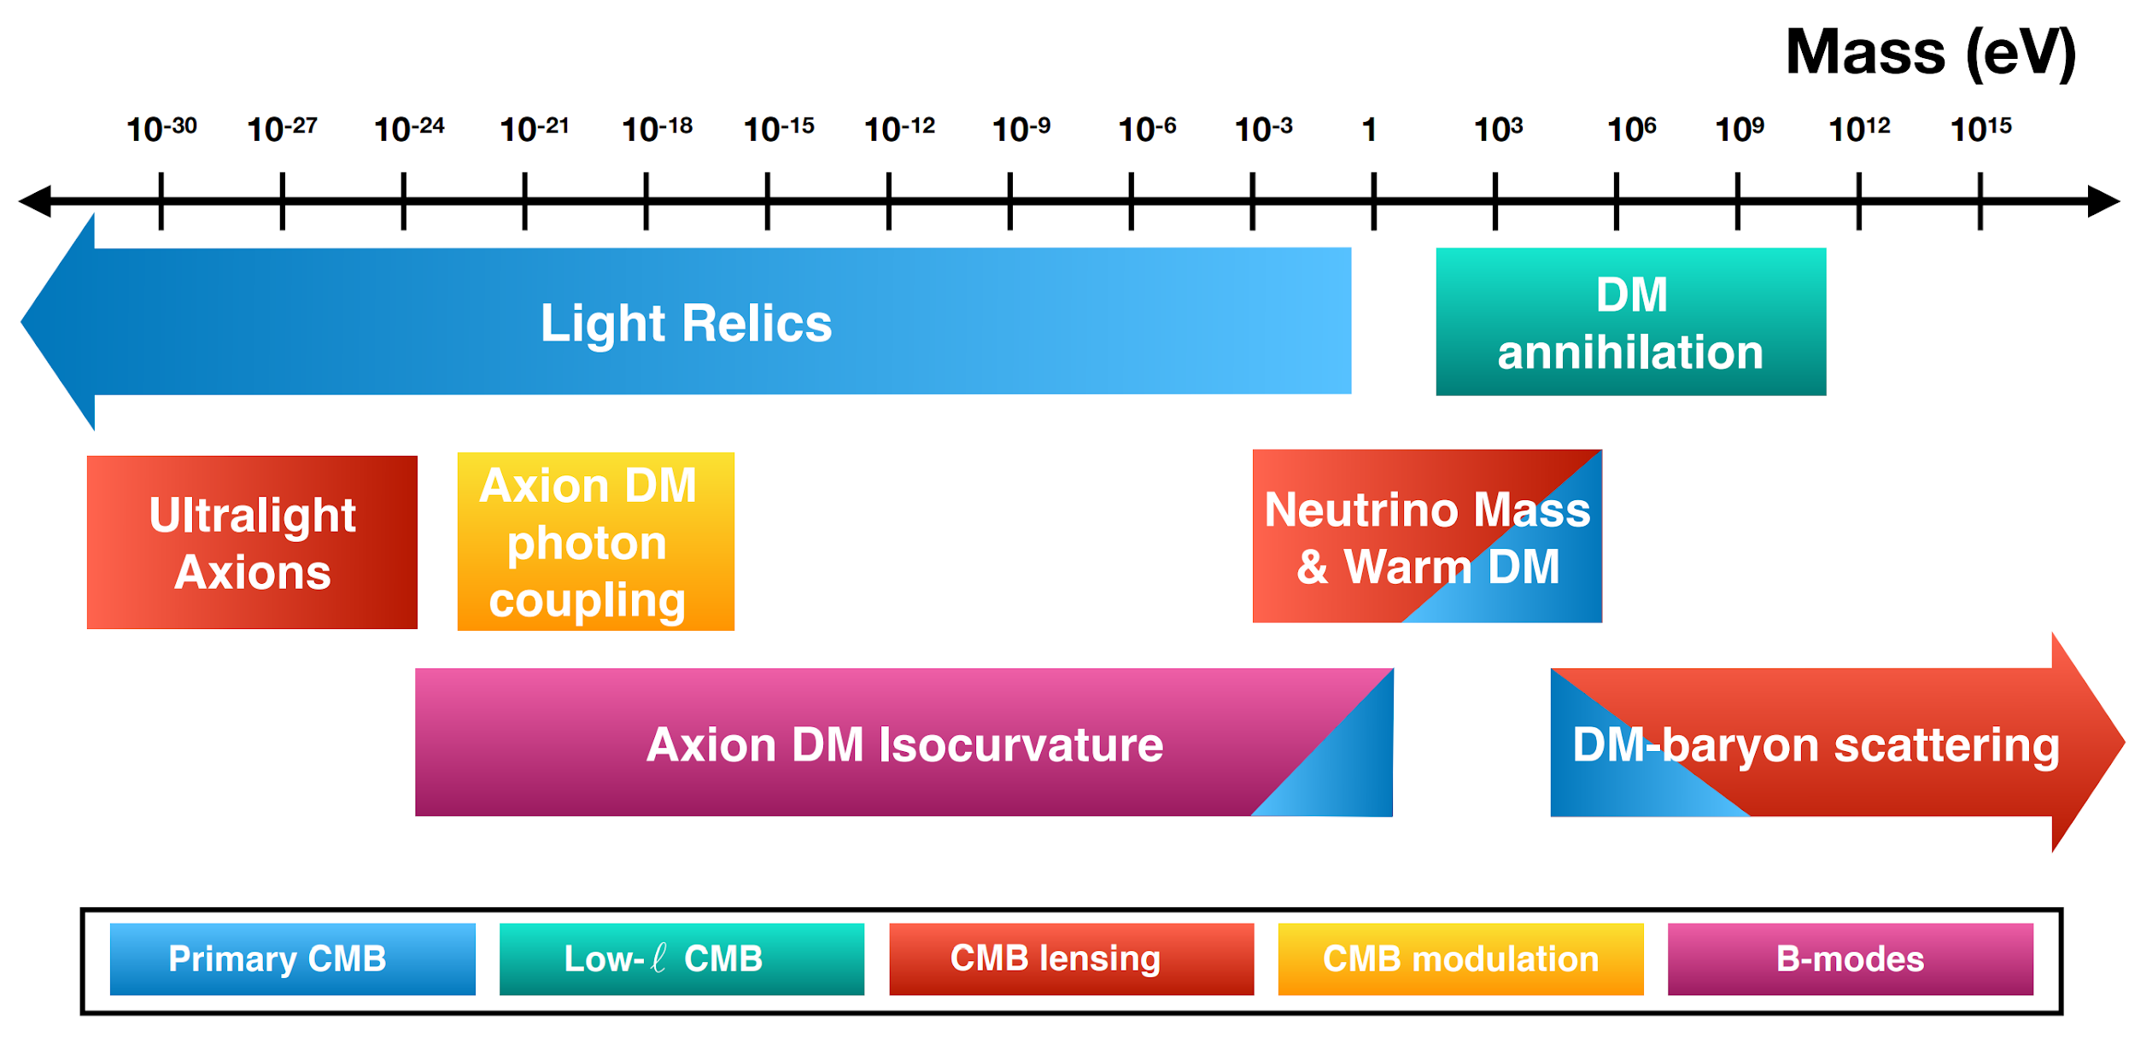
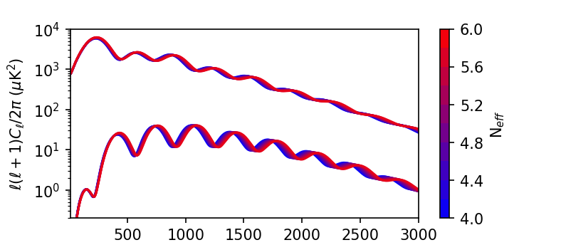
Light Relics
CMB power spectra measure the thermal history of the Universe
  Light relic particles (unknown radiation) beyond the standard model can be measured as a change in energy density at early times
  Quantified through N_{eff}, effective number of relativistic species
CMB-S4 will constrain Δ N_{eff} ≤ 0.06

Slide 6
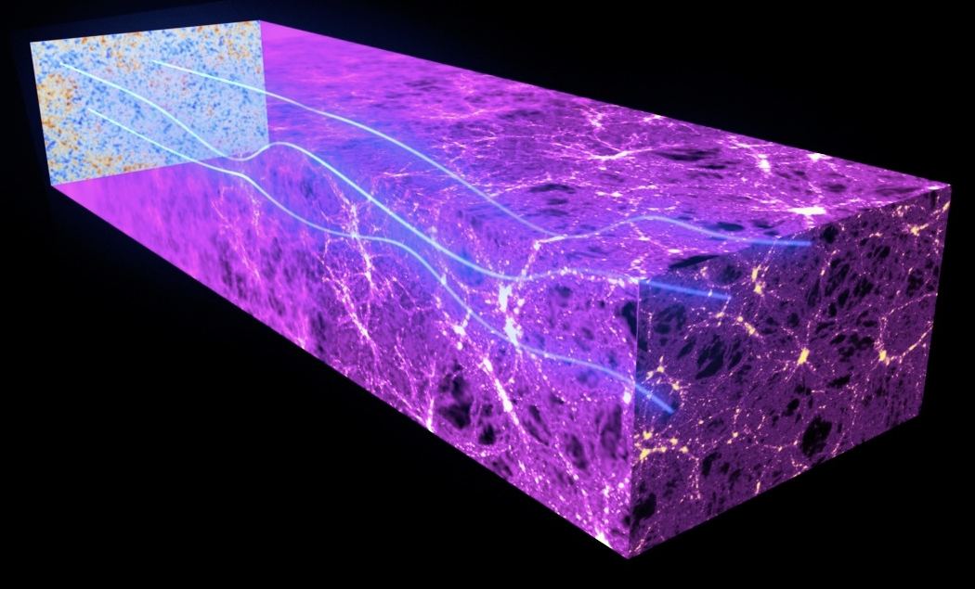
Mapping matter in the Universe
Method 1: CMB lensing
  Matter along the line-of-sight gravitationally lenses the CMB
  Correlates power between scales that are intrinsically uncorrelated
  Probe of physics that impacts the growth of large-scale structure (dark energy, neutrino mass)
  CMB lensing B-modes act as a ‘foreground’ to the inflationary signal, precise cleaning is critical
Method 2: Galaxy clusters
credit: ESA and the Planck Collaboration

Slide 7
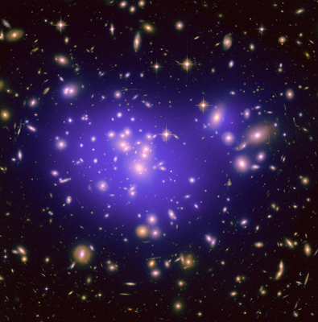
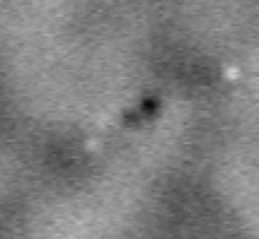
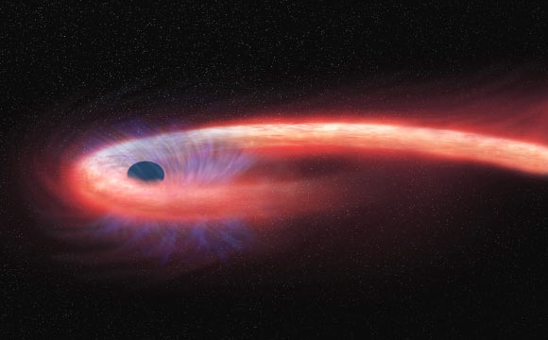
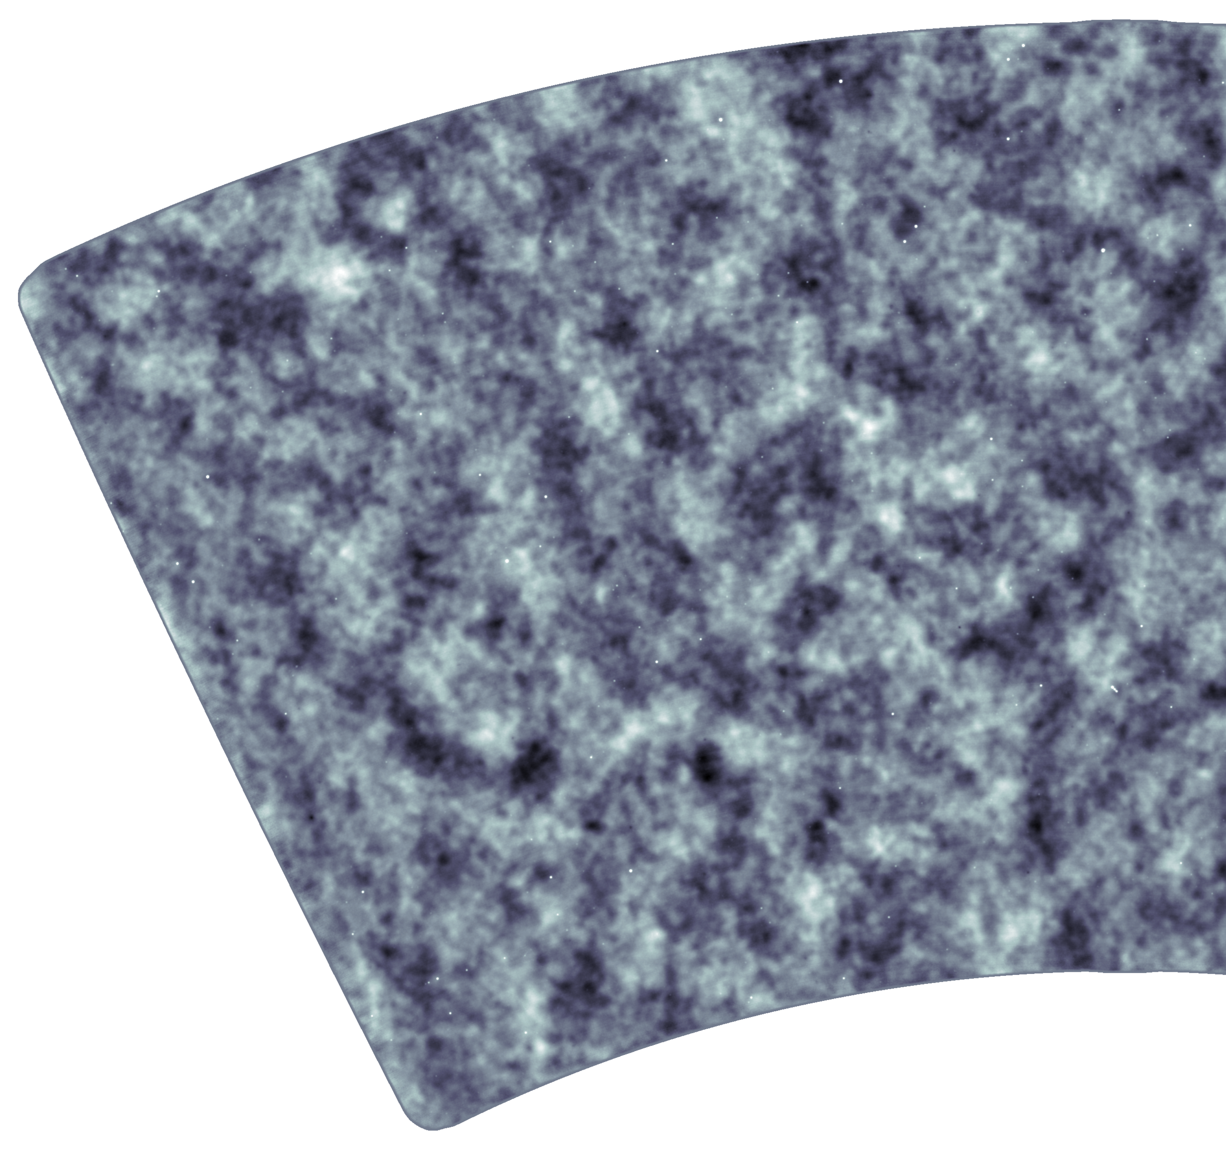
Additional signals in the microwave sky!
Credit: NAOJ
Galaxy clusters
mm-wave sources & transients

Slide 8
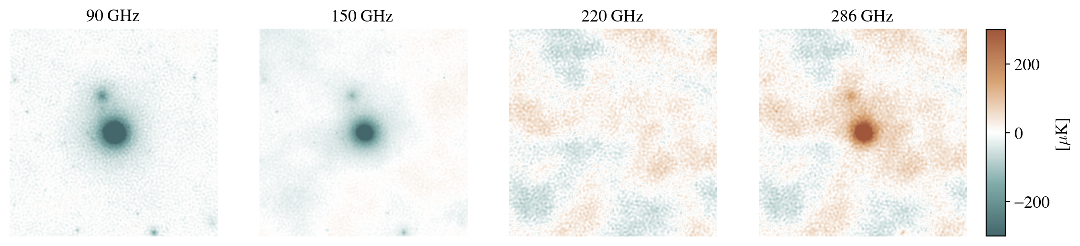
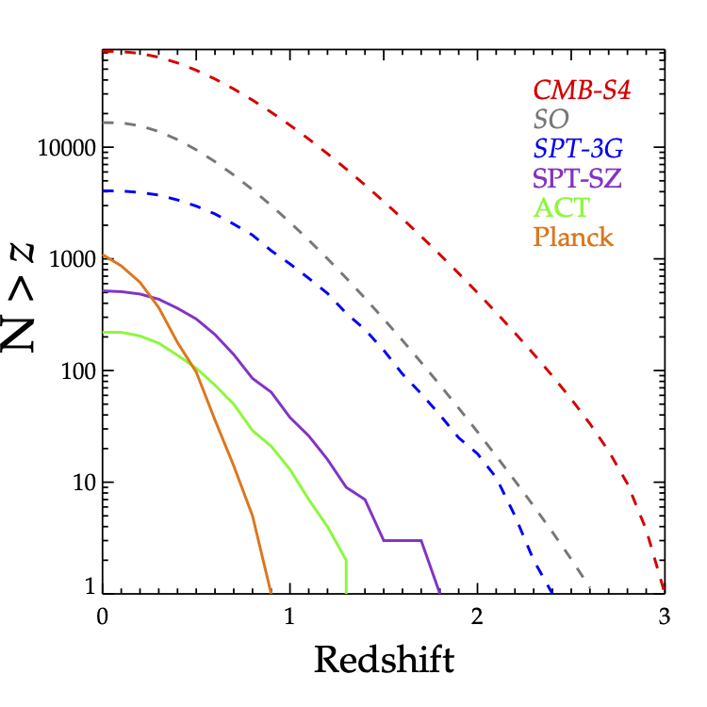
Galaxy Clusters (Matter mapping II & beyond)
CMB photons scatter off the intracluster medium (ICM) creating a spectral distortion at the location of galaxy clusters (Sunyaev-Zel’dovich effect)
  redshift-independent cluster detection
Cluster abundance maps the matter in the universe and the growth of large-scale structure (complementary to CMB lensing)
SZ samples are also powerful tool to probe cluster gastrophysics, feedback, and evolution of the ICM across their cosmic history
CMB-S4 will discover 10x more clusters at high-redshift than any current/upcoming experiment

Slide 9
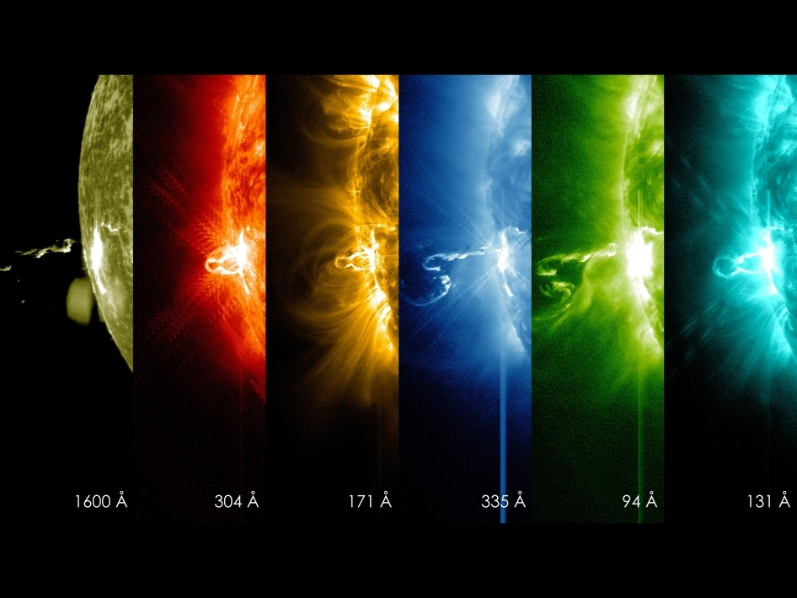
Emissive millimeter sources & the time-variable sky
CMB surveys capture millimeter-wavelength emissive sources, including AGN, dusty star-forming galaxies, solar system objects
Regular re-observation of the same patch of sky enables time-variable measurements
  Emerging discovery space at millimeter wavelengths
CMB-S4 will produce ~hourly maps of the sky for early detection and transient alerts
  Enables follow-up at other wavelengths!
NASA / CXC / M. Weiss.
NASA/SDO

Slide 10
The Four Design Driving Science Goals of CMB-S4
Transformational measurement to detect or rule out many models of inflation
Discover or rule out new ‘light relic particles’ predicted by beyond standard model theories of physics
Map all the matter in the universe (dark and luminous) to learn about structure formation & its underlying physics
Discovery space of millimeter astrophysical transients
Small telescopes to optimally capture degree angular scales
Large telescopes to capture arcminute angular scales
Multi-frequency sensitivity for signal/foreground disentangling (20 GHz – 300 GHz)
~500,000 detectors to provide instantaneous sensitivity
These themes drive the experiment design, but as a result CMB-S4 will test a broad set of fundamental physics and generate a legacy millimeter-wave data set for astronomy, astrophysics, and cosmology.

Slide 11
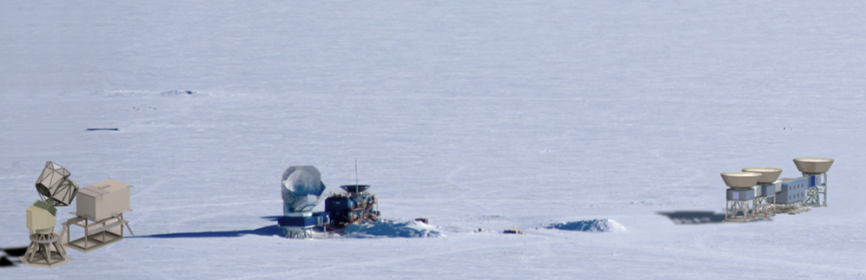
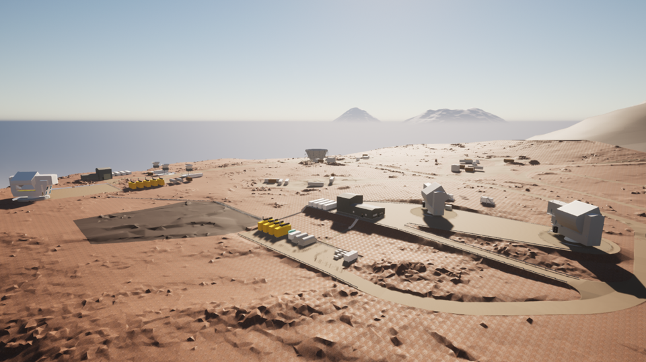
CMB-S4 Experimental Strategy
South Pole
CMB-S4 science goals motivate large & small telescopes sited at the South Pole and large telescopes in the Chilean Atacama desert
  The South Pole site is crucial to the ultradeep survey that will detect gravitational waves from inflation or rule out the most favorable theories for the dawn of the universe
    Builds on the success of and informed by ongoing BICEP & SPT programs (next talks by Marion Dierickx and Sasha Rahlin)
    Added benefit of Dark Sector radio-quiet protected area
Joint project between DOE and NSF
South Pole
Chile
2x large telescopes
3x small telescopes + MAPO
large telescope
Notes:
High dry desert, uniquely transparent and stable atmosphere, only other place where this would be possible would be space.,
Take what SPO is doing and take it to the next level
SPO is the only approach that has worked to make these measurements of inflation

Slide 12
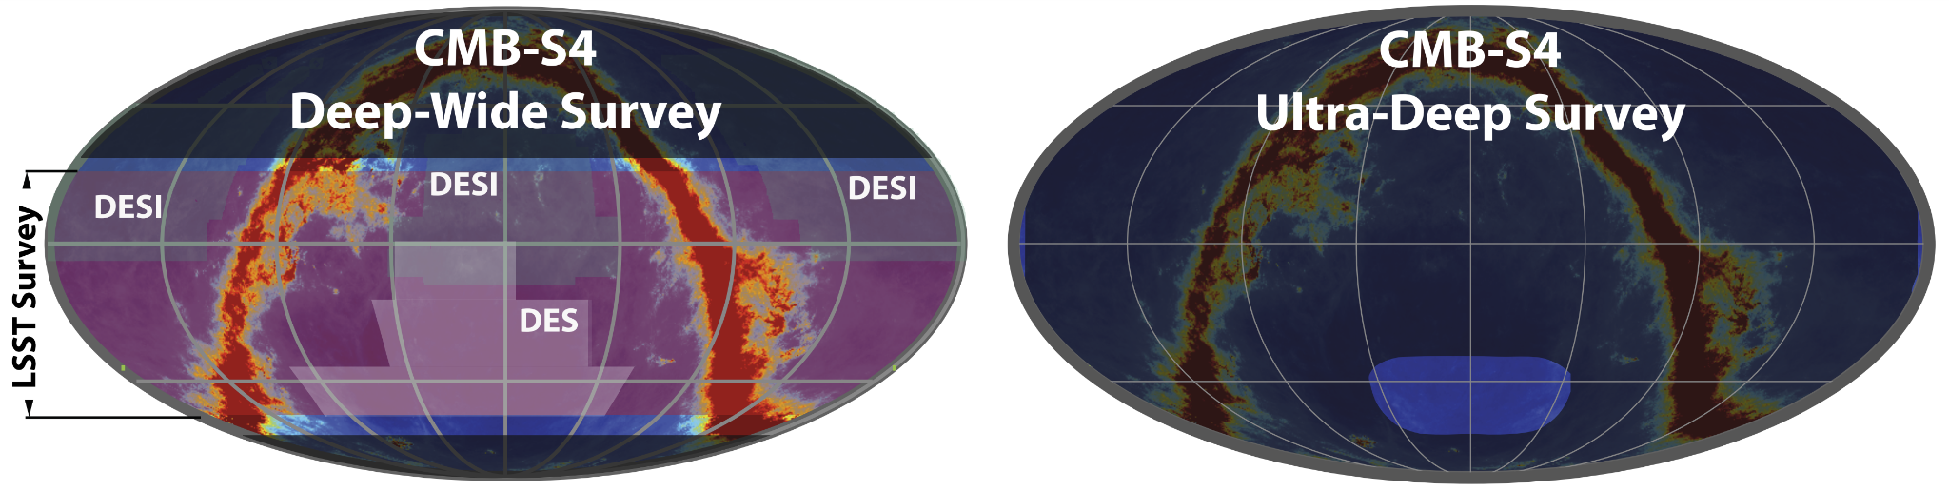
Survey Strategy
South Pole
Small area survey primarily targeting inflationary gravitational waves, enabled by the sky coverage, low horizon blockage, and ultra stable atmosphere of the polar site.
Large area survey motivated by N_{eff}, matter mapping, and time domain science and enabled by the mid-latitude site
Chile

Slide 13
The CMB-S4 Instrument

Slide 14
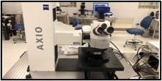
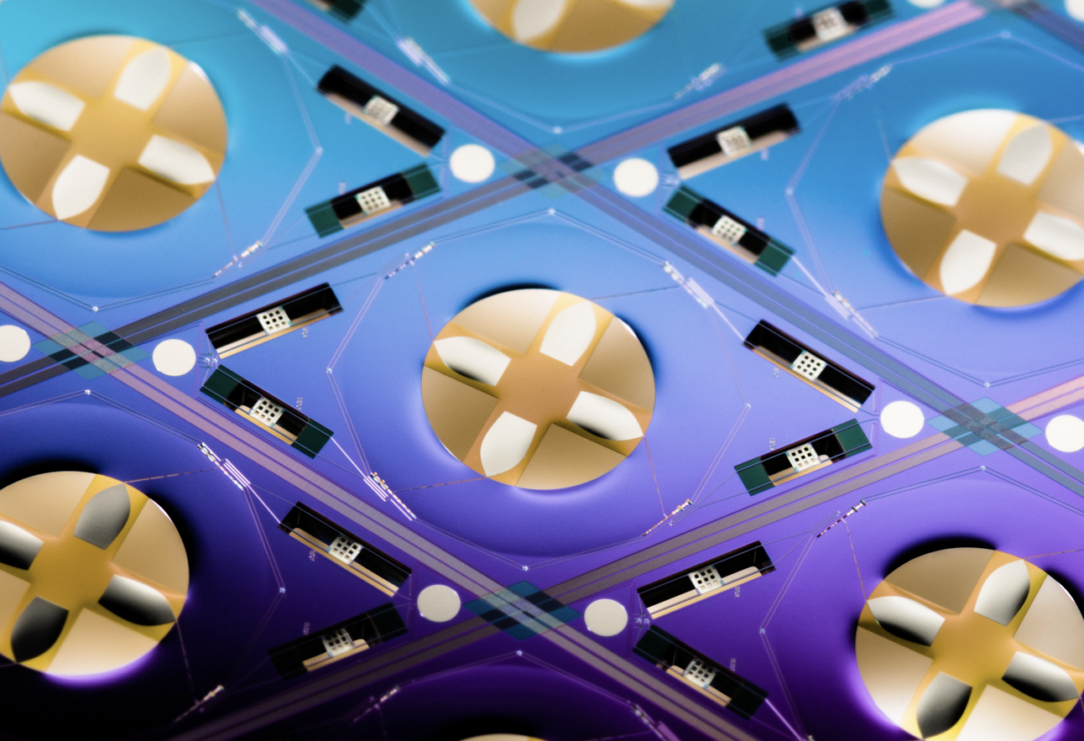
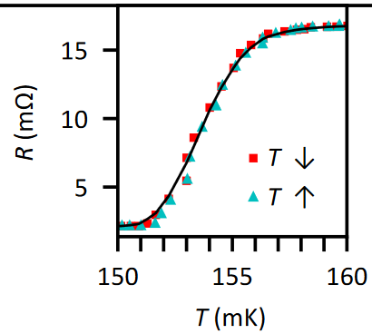
Transition-edge sensors enable background-limited sensitivity
Polarization-sensitive
orthomode transducer absorbs incoming microwave power
Power deposited onto TES island and changes TES resistance
Microstrip lines transmit power to in-line filters and to TES islands
Barron 2022
Readout/bias lines connect TES to off-wafer electronics
~ 4 mm

Slide 15
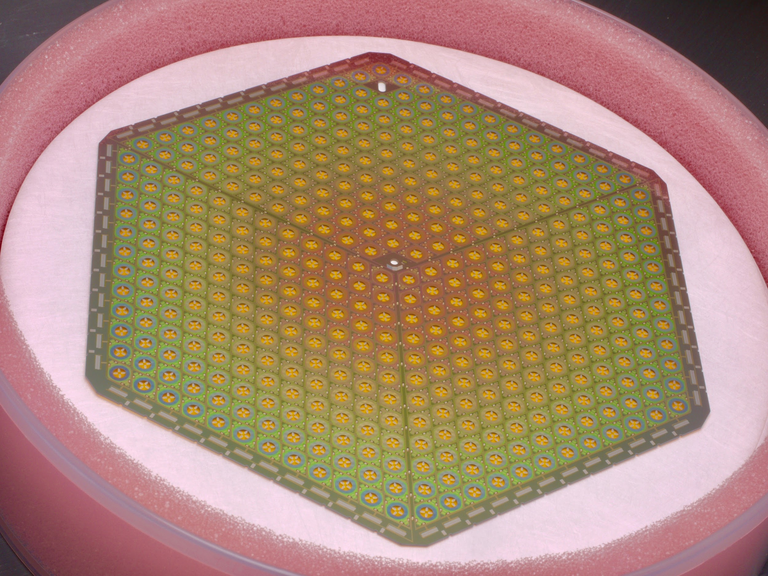
Monolithically-fabricated detector arrays
~500,000 superconducting transition-edge sensor (TES) detectors required to meet experimental sensitivity → ~ 363 wafers across all telescopes
  TESs are established technology and have substantial heritage from successful use in past and current CMB experiments
  ~30x more detectors than any current experiment
CMB-S4 detectors will be:
  Sensitive to frequencies from 20 – 300 GHz
  Polarization-sensitive
~ 4 mm
~ 120 mm

Slide 16
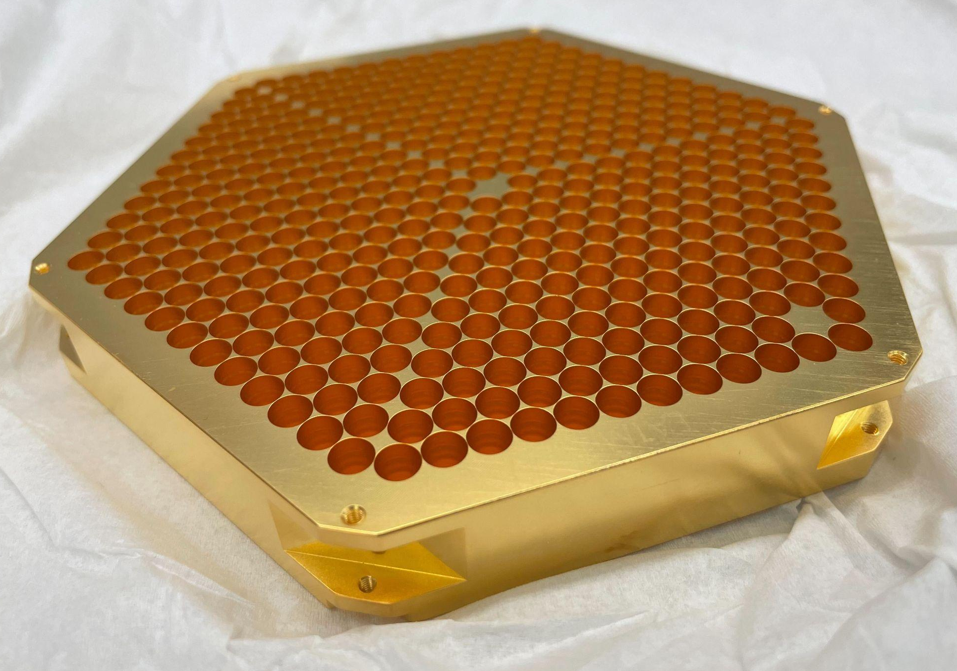
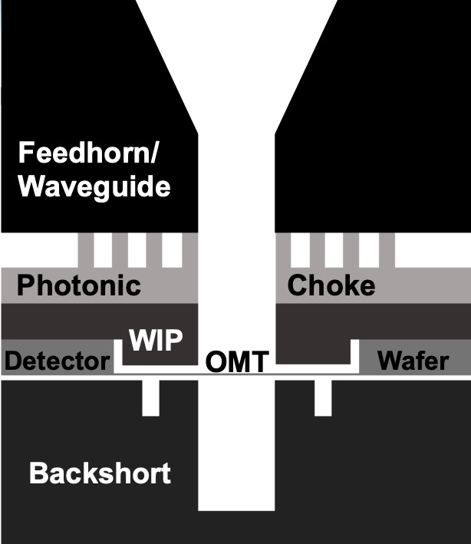
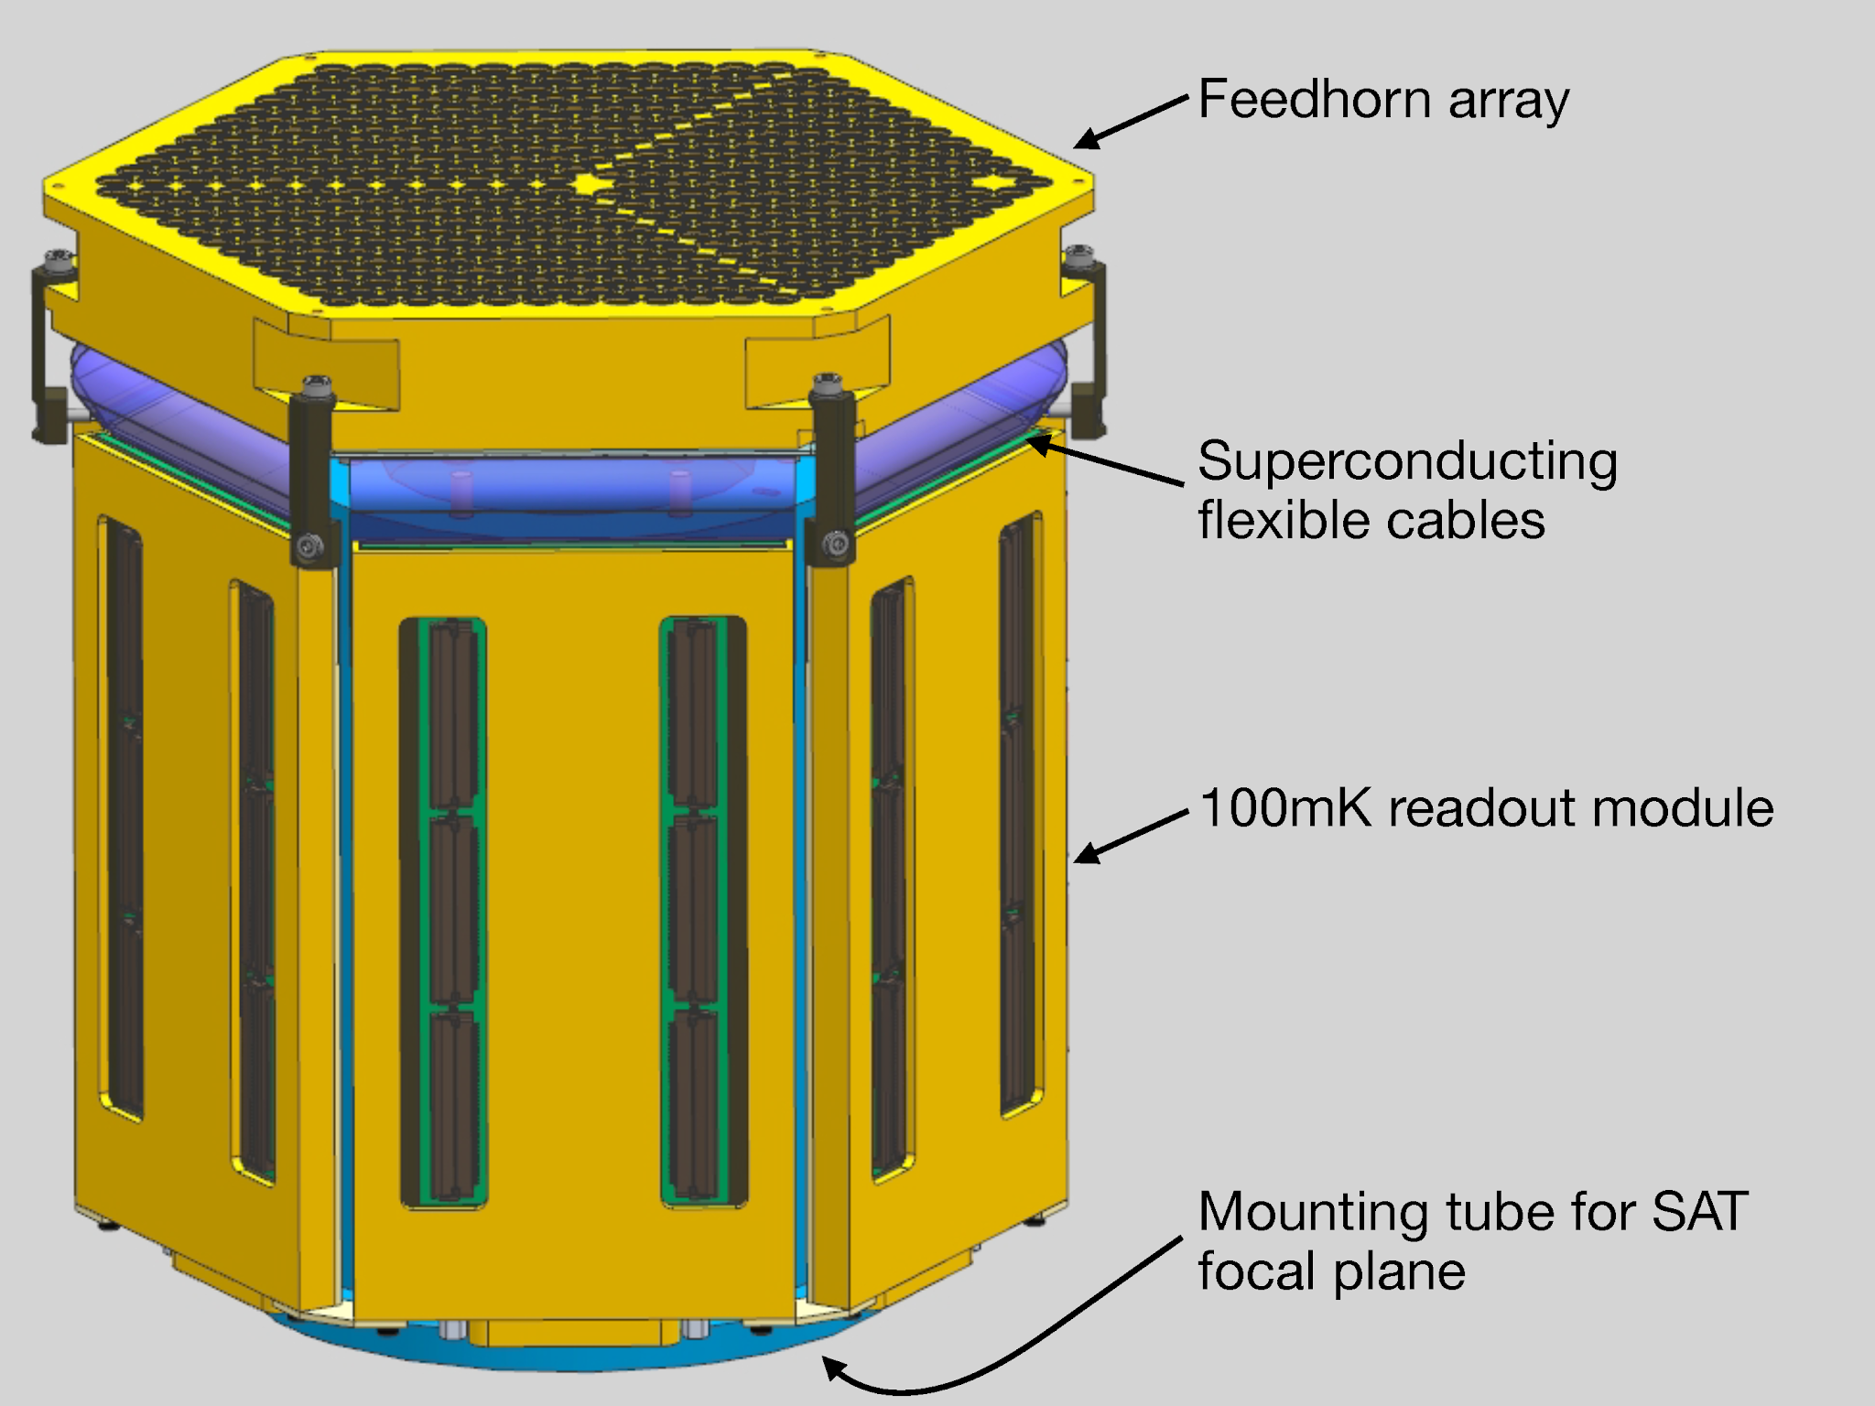
Detector Module
Microwave power is coupled onto the OMTs in the detector wafer using feedhorns and waveguides
Time-division multiplexing readout components (SQUIDs) are also packaged as part of a detector module. Entire module is cooled to T ~100 mK for operation.

Slide 17
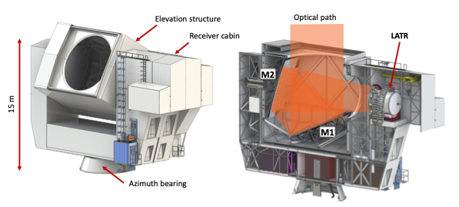
Chile: Large-aperture telescopes
Two 6-meter aperture telescopes in Chile to achieve 1.4’ resolution at 150 GHz
Based on design from Simons Observatory & CCAT
Gallardo et. al. https://arxiv.org/abs/2207.10012
Receiver

Slide 18
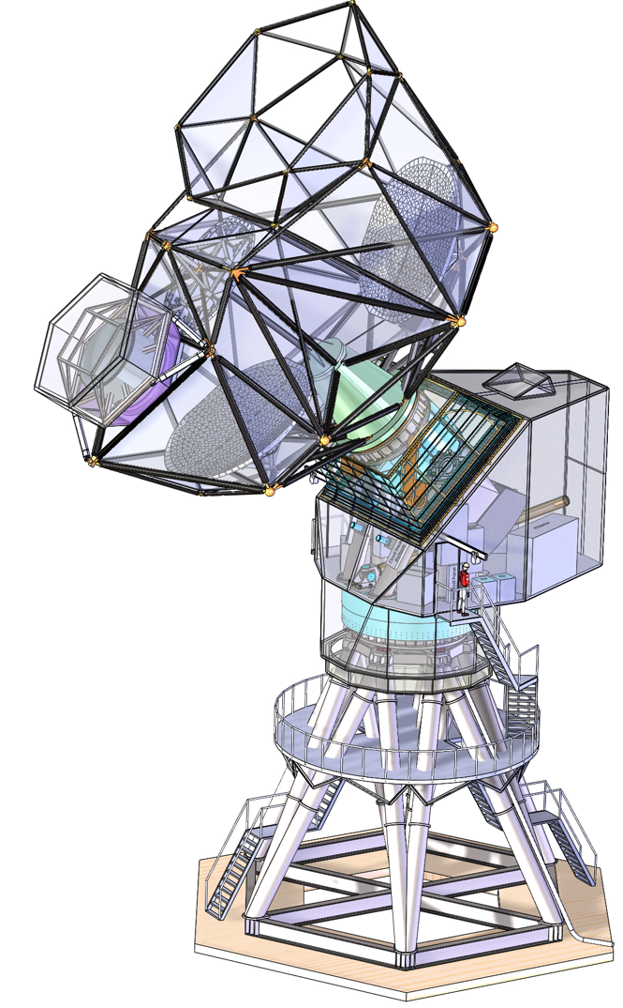
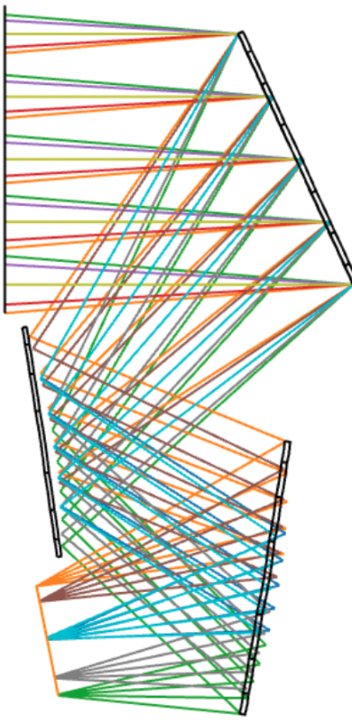
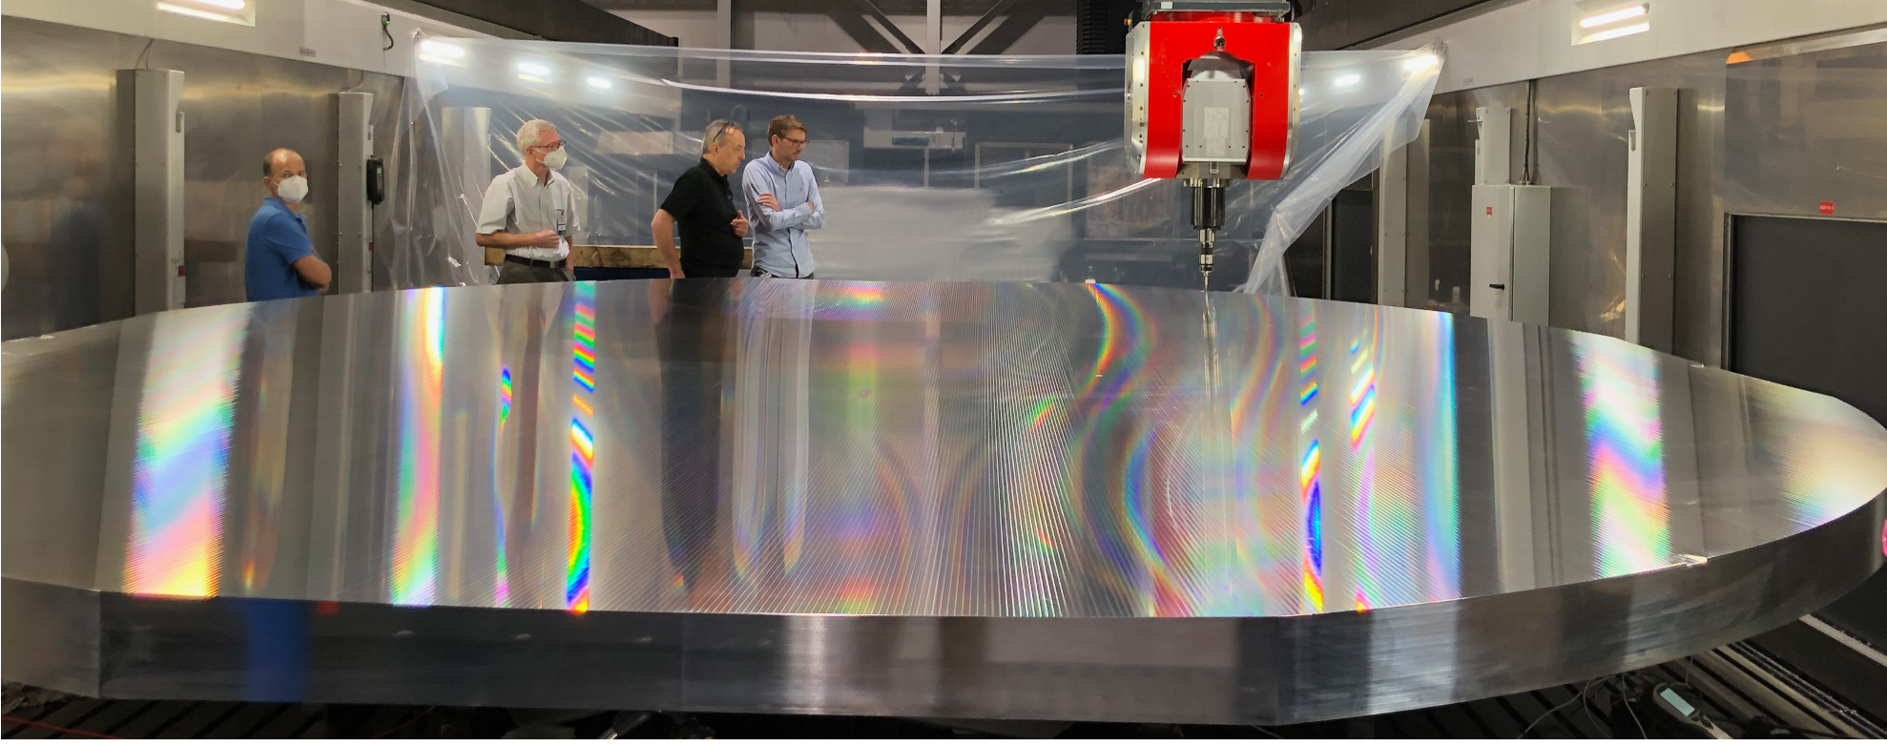
South Pole: Large-aperture telescope
5-meter aperture telescope at South Pole to achieve 1.6’ resolution at 150 GHz
Three-mirror anastigmat optical design with gapless mirrors
Gallardo et al. arXiv:2307.12931
M1
Yoke enclosure
Receiver
M2
Focal plane
M3
Tower

Slide 19
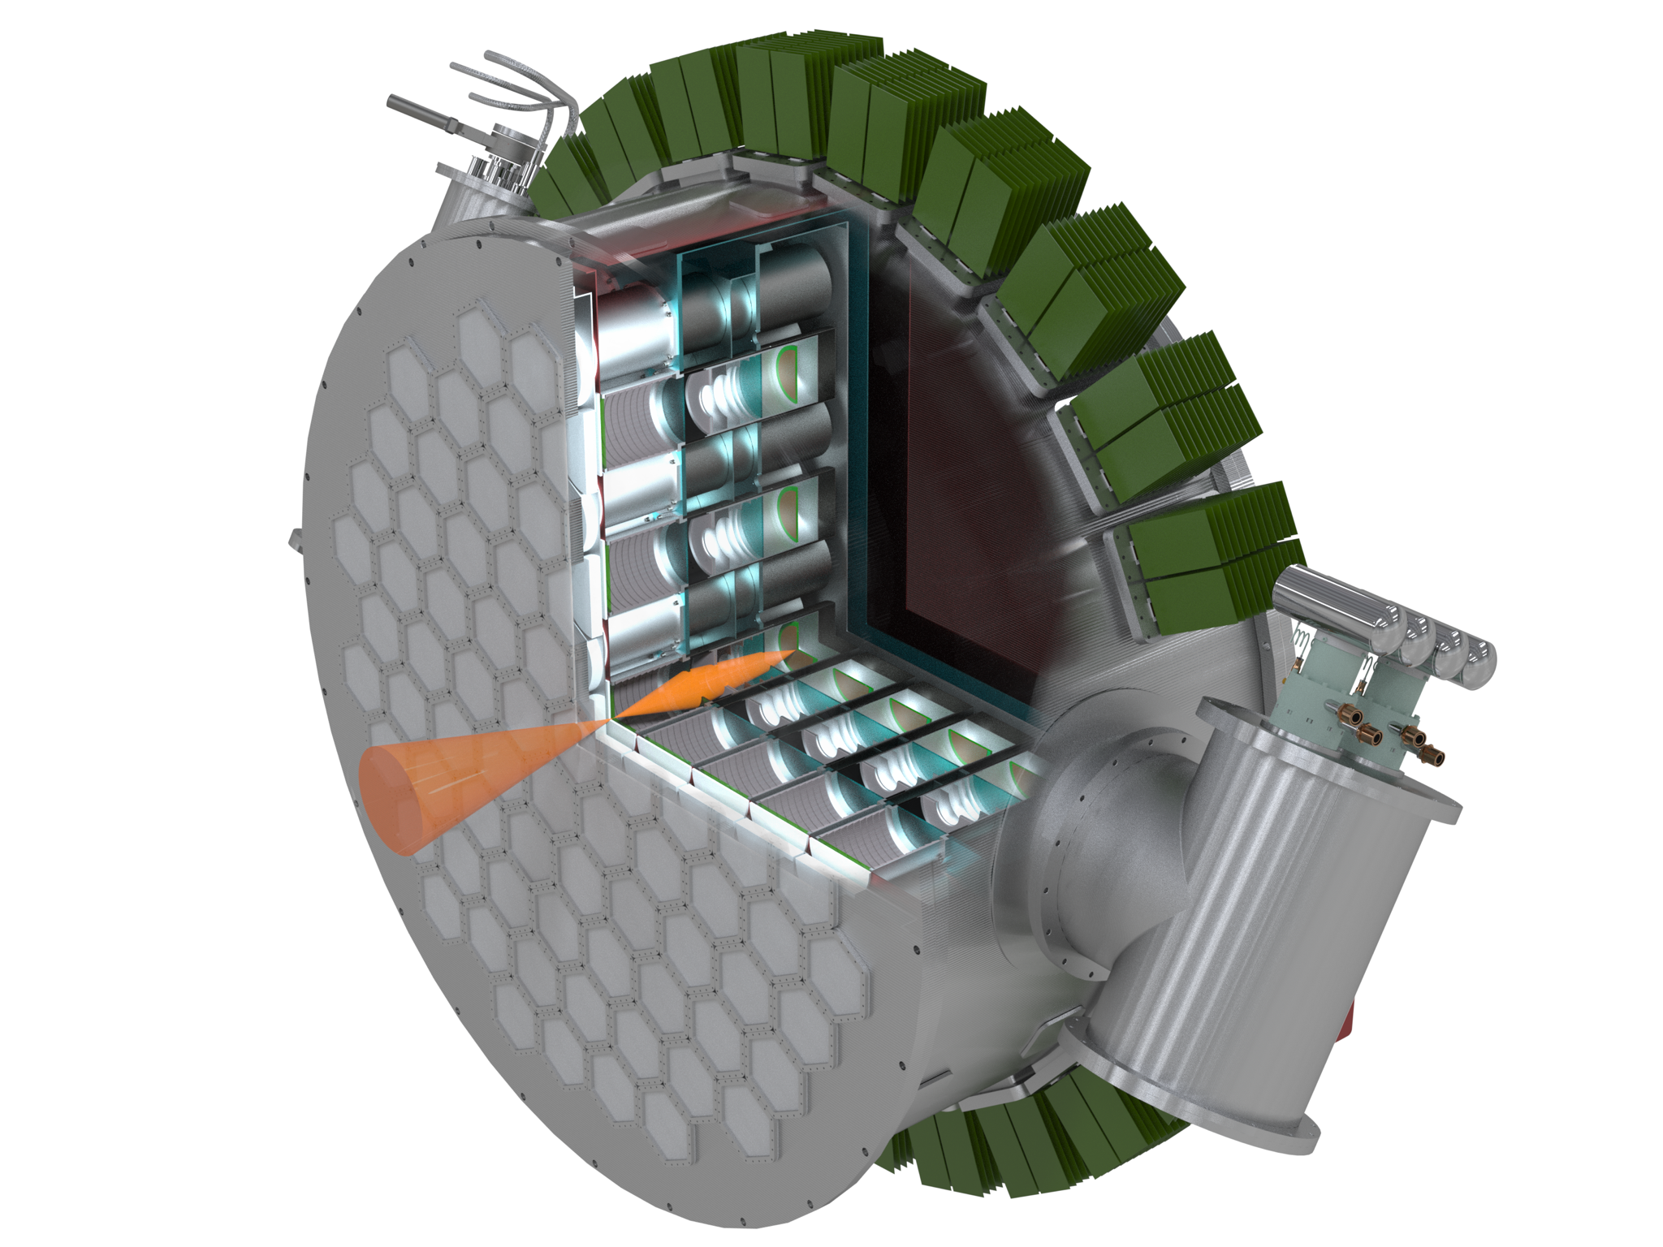
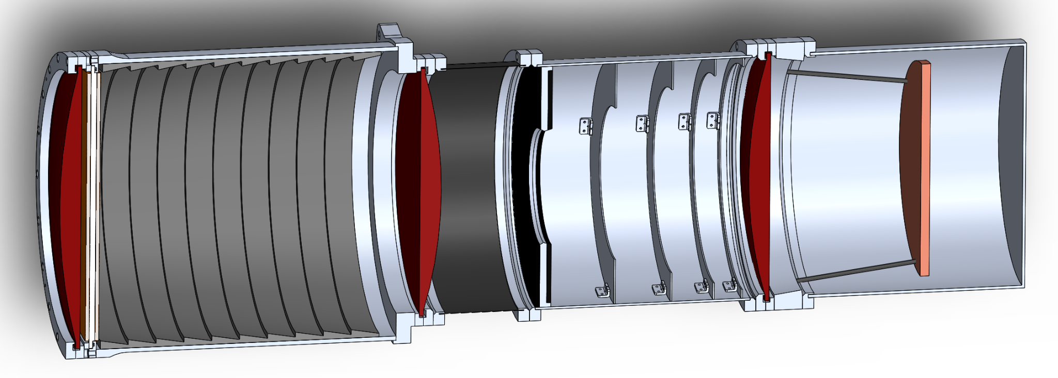
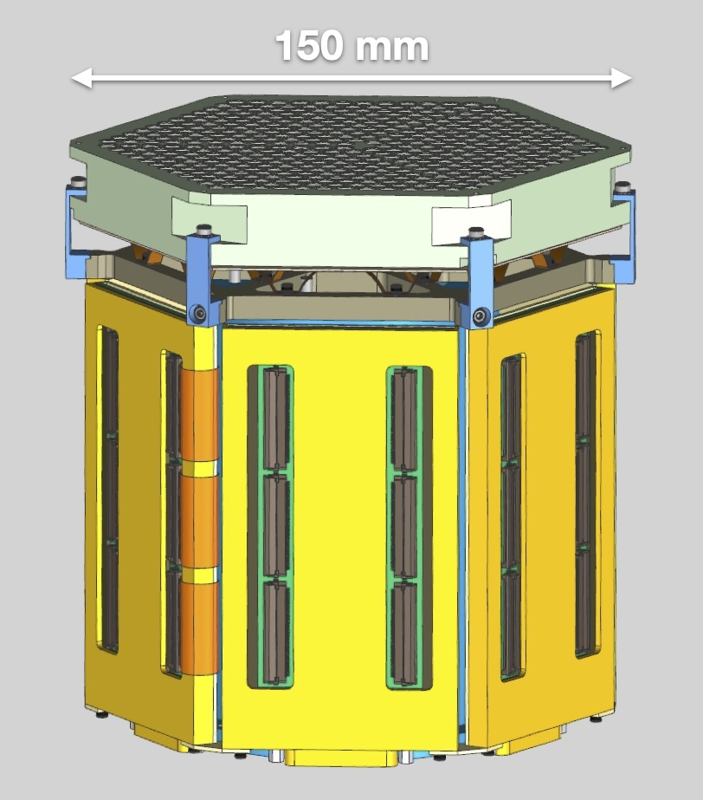
Large-aperture telescope receiver
Optics tube
2.5m
detectormodule
lens
Common cryogenic receiver design for both telescopes
85 optics tubes & detector wafers
Cools detectors to ~100 mK using pulse tube coolers and dilution refrigerator
300K readout electronics

Slide 20
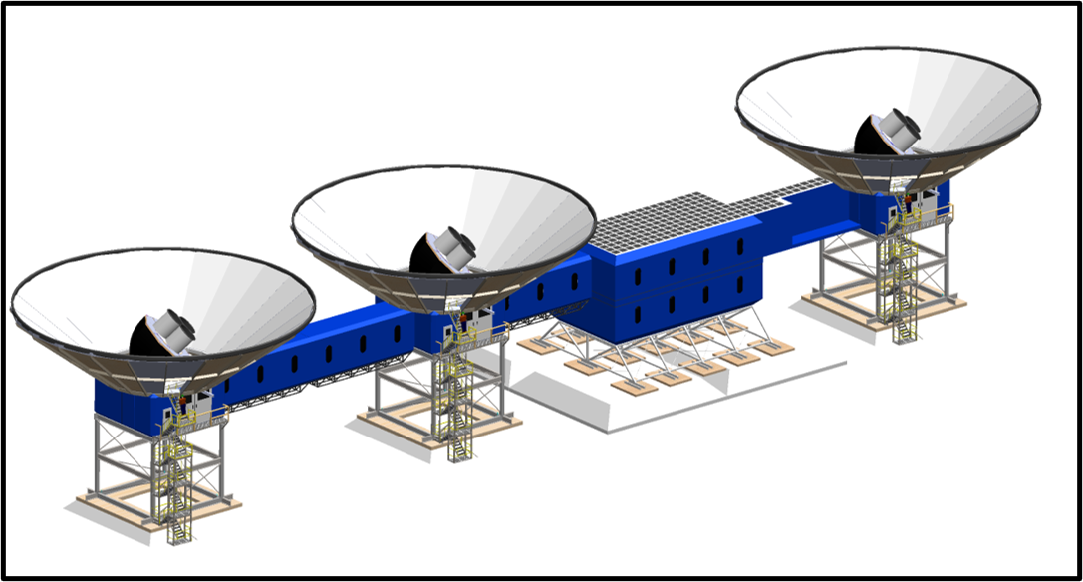
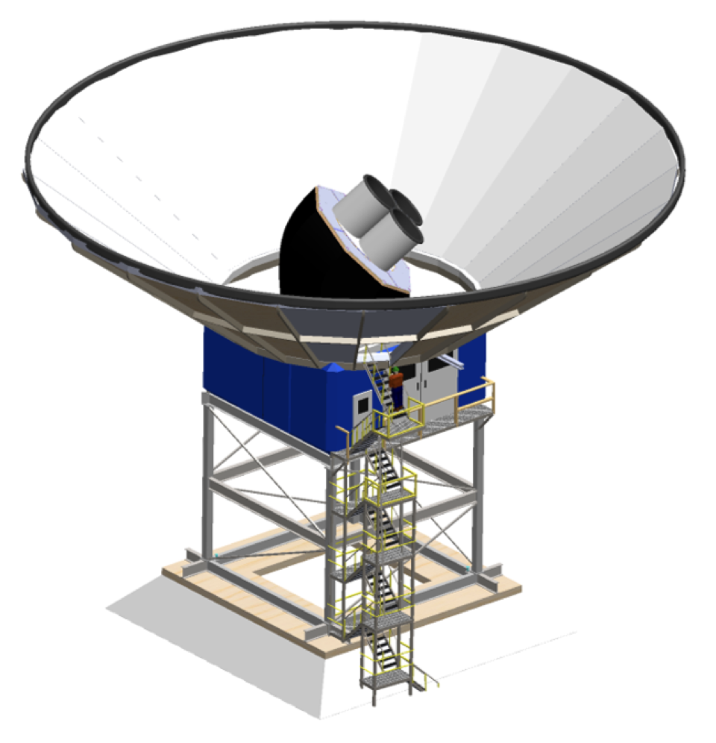
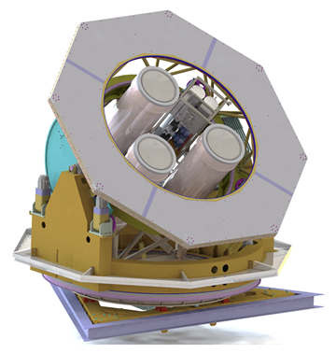
South Pole: Small-aperture telescopes
ground shield
telescope/ receiver
mount
tower
~0.5 m refractive telescopes, 3 grouped onto a single cryobus, mount, & tower
9 total SATs (3 towers)
Design heritage from BICEP/Keck

Slide 21
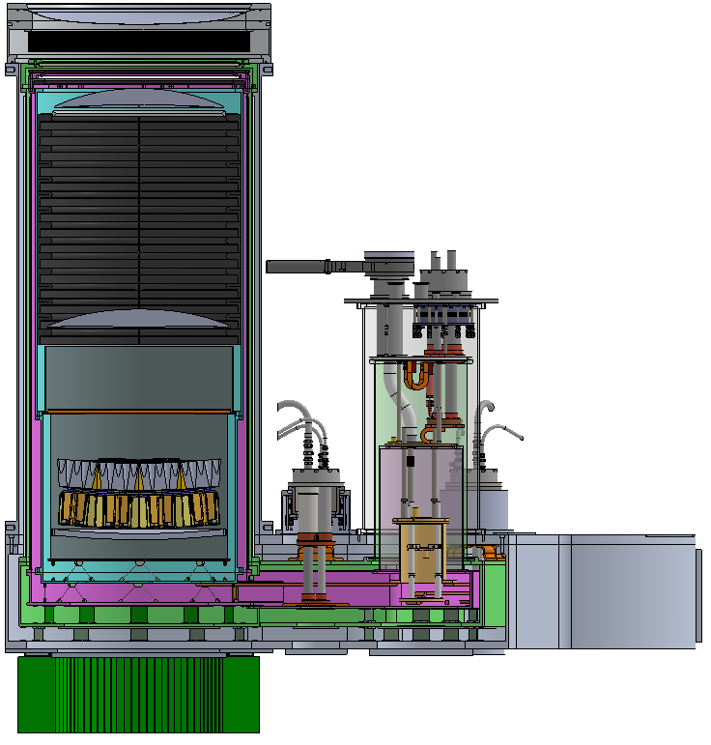
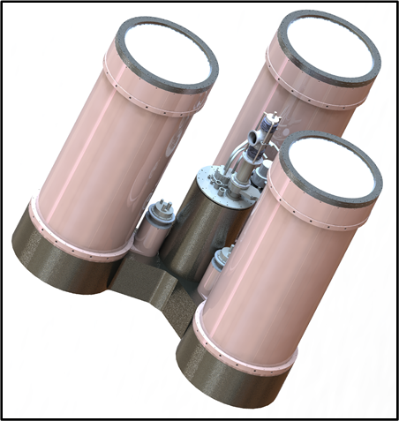
SAT receiver
~0.55 m
dilution fridge
lens
Detector modules
Single cryogenic bus cools 3 sets of optics & detectors using pulse tube coolers and dilution refrigeration
300K readout electronics

Slide 22
(Select) Challenges & Opportunities at the South Pole

Slide 23
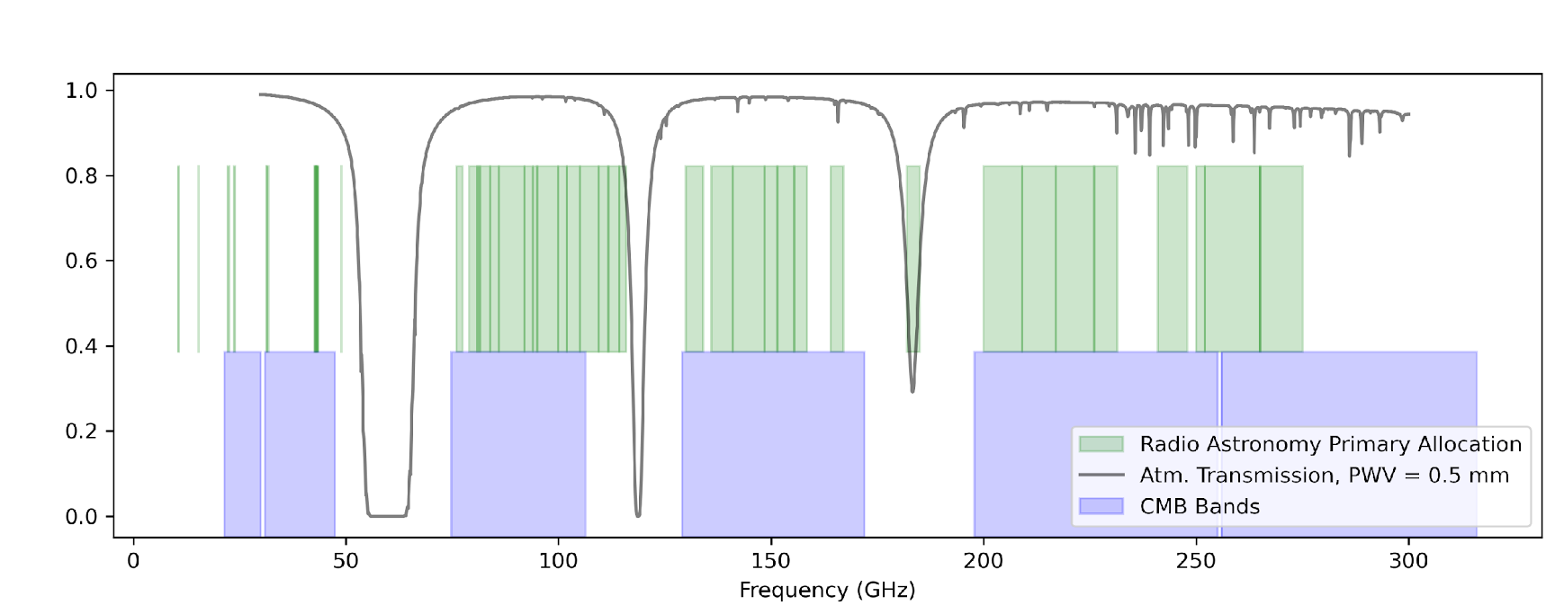
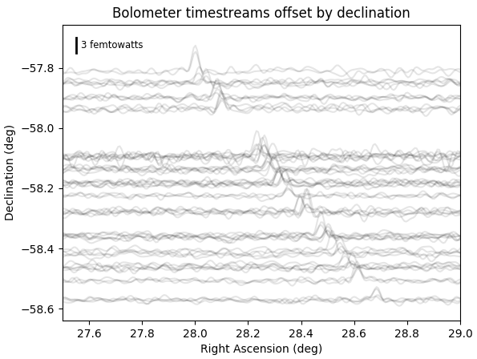
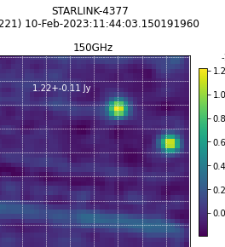
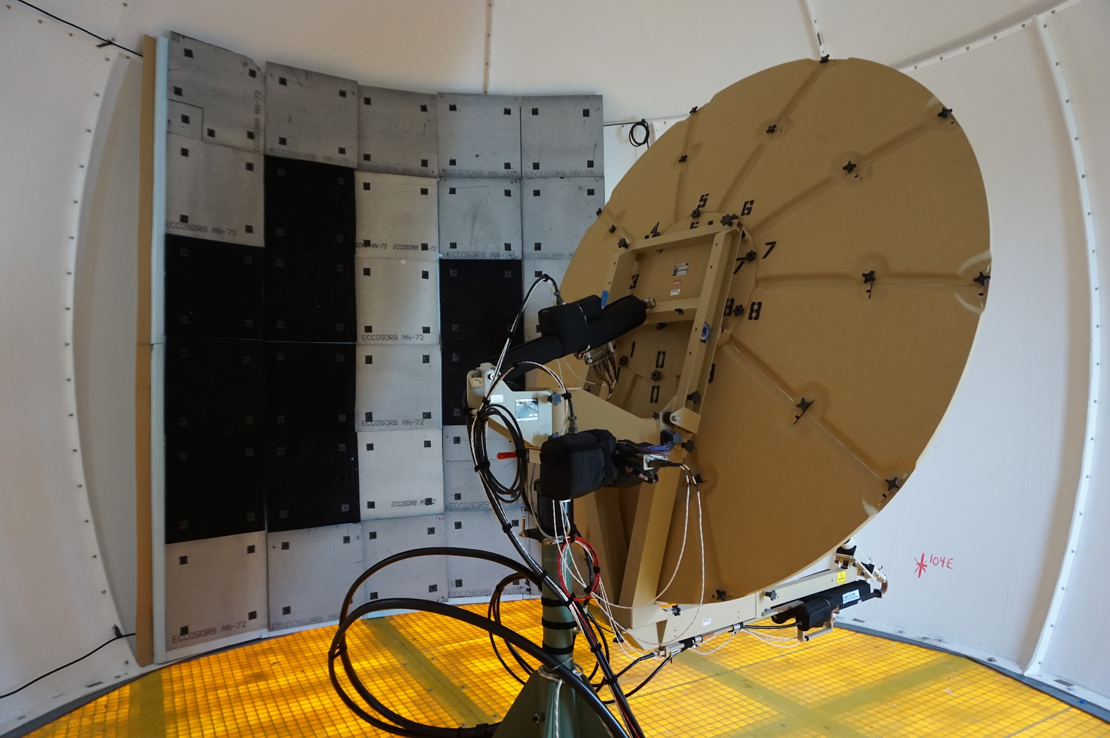
Radio-frequency interference & satellites
CMB-S4 detector saturation powers range from 0.4 – 50 pW
Detector sensitivities are 10-100 aW/√Hz
Field of view for SATs is 29 degrees in diameter
Interference occurs both from satellite and ground sources (radios/terminals/wifi)
Satellites
  Satellites can produce 3-30 pW/m²/MHz for terrestrial observers
    Harmonics are often uncharacterized by manufacturer
  Satellites also produce thermal signatures observable by CMB telescopes
Ground
  Observed sources of contamination include satellite ground terminals, land mobile radios, wifi
  Impacts can be partially mitigated
CMB detectors are broad-band!
Voluntary coordination is the fastest way to mitigate interference and preserve the uniquely exceptional South Pole site properties

Slide 24
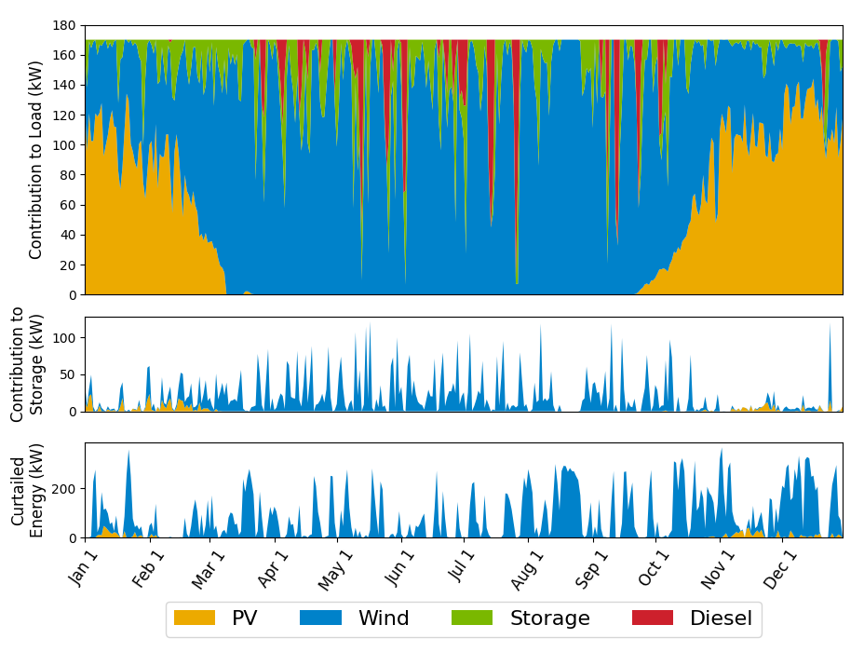
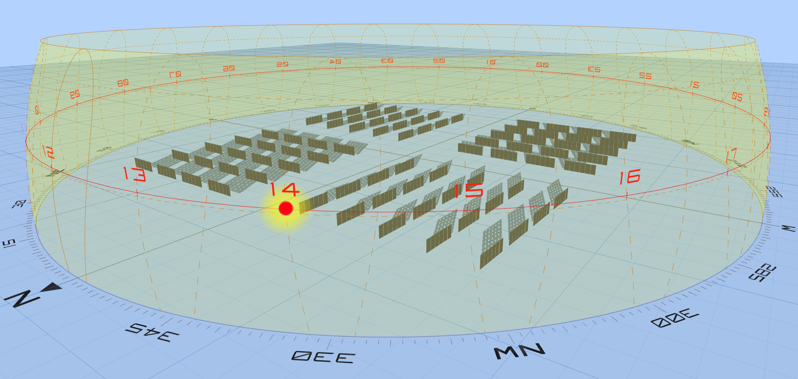
Renewable energy is under consideration by CMB-S4 to supplement South Pole Power
Feasibility study performed by renewables experts indicates that a hybrid system of solar, wind, energy storage (batteries), and diesel would supply year-round power with significant diesel savings
Interested to hear experiences of other polar renewable deployments, what lessons can we learn?
https://arxiv.org/pdf/2306.13552.pdf

Slide 25


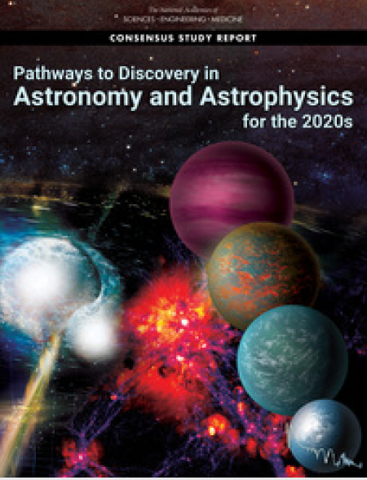
Strong community support
Astro2020: “Recommendation: The National Science Foundation and the Department of Energy should jointly pursue the design and implementation of the next generation ground-based cosmic microwave background experiment (CMB-S4).” Calls out broad science case.
Many community reports (including Astro2020 & NAS Antarctic Vision) endorse CMB-S4 as a U.S. national priority
2014
2015
2021
Notes:
Transient alerts ~hourly (and possible on shorter timescales)
Catalogs ~annually
Single frequency maps (and all of the derived/associated data products) periodically, with each major publication release.

Slide 26
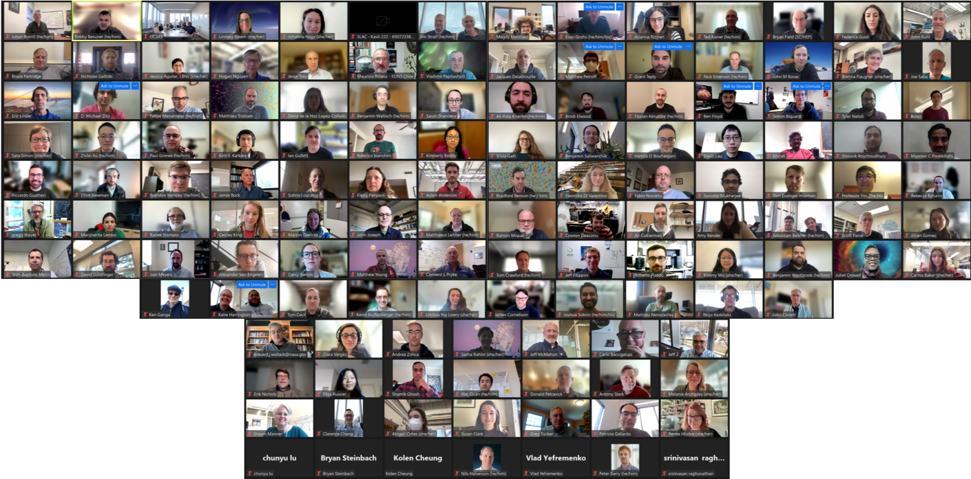


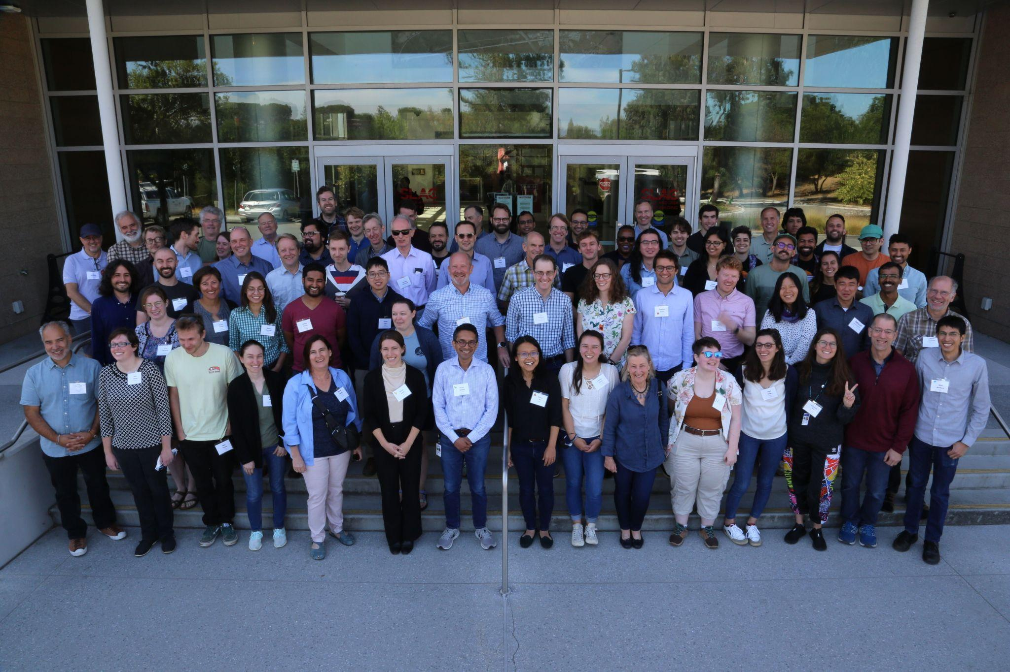
https://cmb-s4.org/
Thank you!
CMB-S4 Collaboration:
>400 members
116 institutions
19 countries
Notes:
Transient alerts ~hourly (and possible on shorter timescales)
Catalogs ~annually
Single frequency maps (and all of the derived/associated data products) periodically, with each major publication release.

Slide 27
Backup

Slide 28
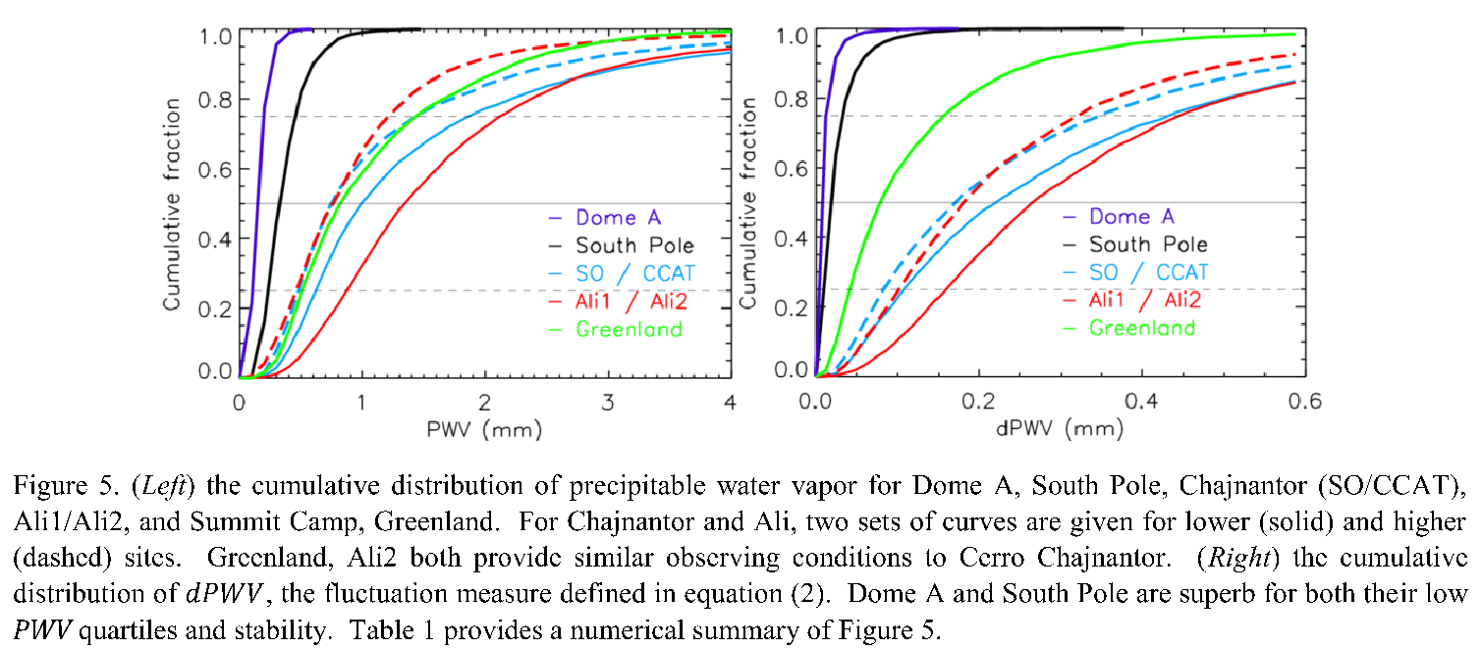
The South Pole is critical to CMB-S4
South Pole has the best atmospheric properties for millimeter-wavelengths of any site with sufficient infrastructure.
Exceptional stability of the atmosphere limits the noise it introduces into the data
South Pole site also allows continuous observation of the ultradeep field that will be used to measure inflation, 2.5x faster mapping to required depth
Reduces atmospheric transmission
Kuo 2017
Chile
Adds noise

Slide 29
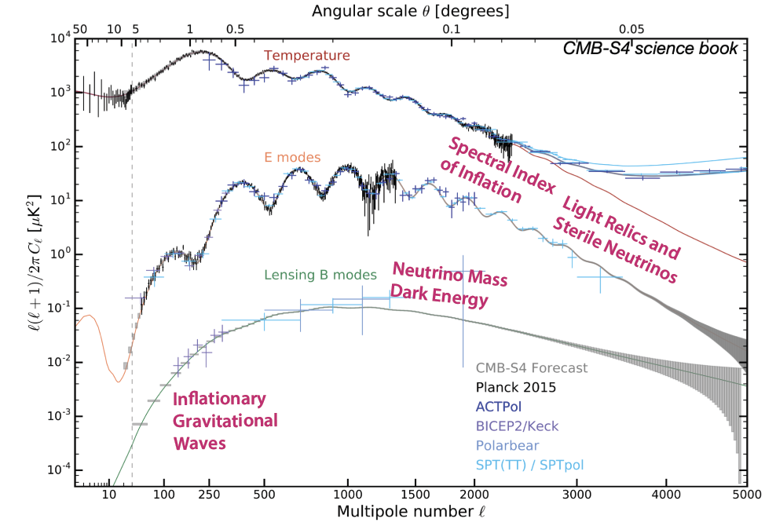
CMB-S4 power spectrum

Slide 30
