Slide 1
Radio Detections of Neutrinos
Abby Bishop
IceCube Summer School 2023
8 June 2022

Slide 2
Quick science behind
UHE Neutrinos and their main progenitor: UHE Cosmic Rays

Slide 3
UHE (Ultra-High Energy) = Energy > 10¹⁷ eV
We think UHE Neutrinos come from
two potential sources:

Slide 4
Astrophysical Sources
(point sources, pp sources)
]
[
UHECR
𝝂s
Other particles in the Source
Other Particles
Basically, a really lively astrophysical source or event emits charged particles that interact with each other and result in neutrinos among other things.
Sadly, there aren’t a ton of frequent ultra high energy cosmic ray + neutrino producers so this isn’t our main source.

Slide 5
Cosmogenic Sources
(aka Cosmic Rays smashing into CMB Photons, p𝝲 sources)
[
]
[
[
𝝂_{𝛍}
Decay
UHECR
π⁺
Decay
𝝂_{e} + 𝝂_{𝛍}
Anti-muon
CMB
𝞬
Neutron
Positron
And then the neutrinos oscillate over millions or billions of parsecs until they reach Earth.
This is our main expected source.

Slide 6
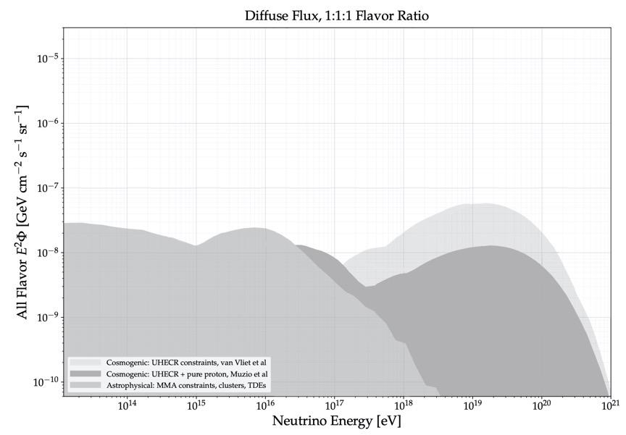
We have models for what neutrino flux we expect
https://arxiv.org/abs/2203.08096

Slide 7
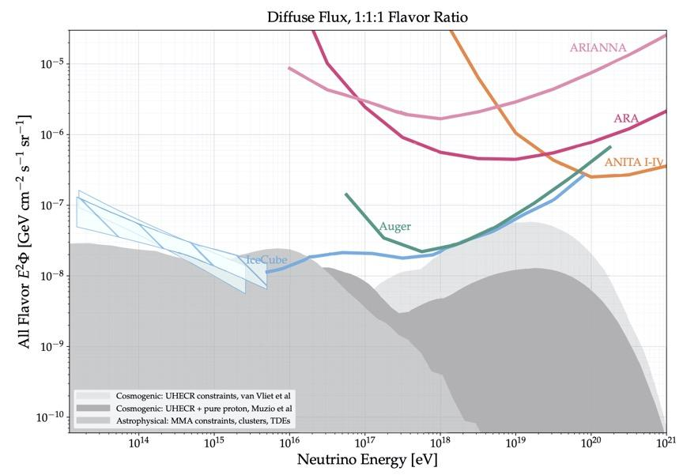
Previous detectors have gotten close
https://arxiv.org/abs/2203.08096

Slide 8
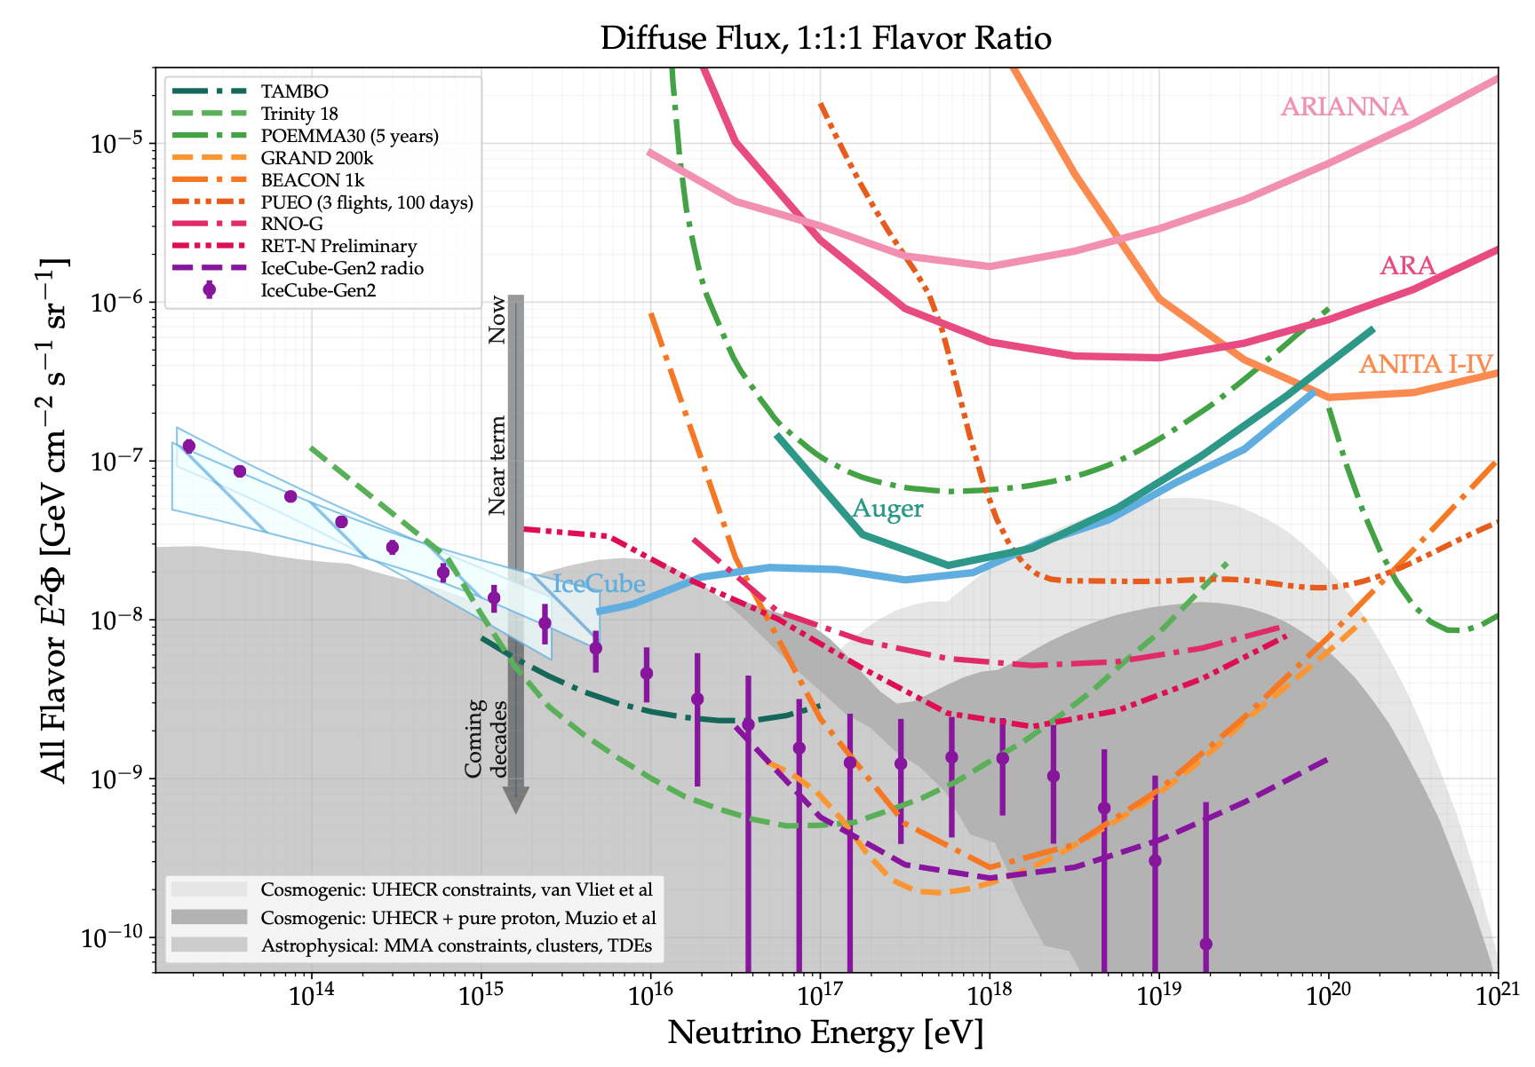
Future detectors are going to probe flux models
https://arxiv.org/abs/2203.08096

Slide 9
How do we observe UHE Neutrinos?

Slide 10
Askaryan Radiation Reveals UHE Neutrino Interactions
https://arxiv.org/abs/2010.12279

Slide 11
Askaryan Radiation Reveals UHE Neutrino Interactions
https://arxiv.org/abs/2010.12279

Slide 12
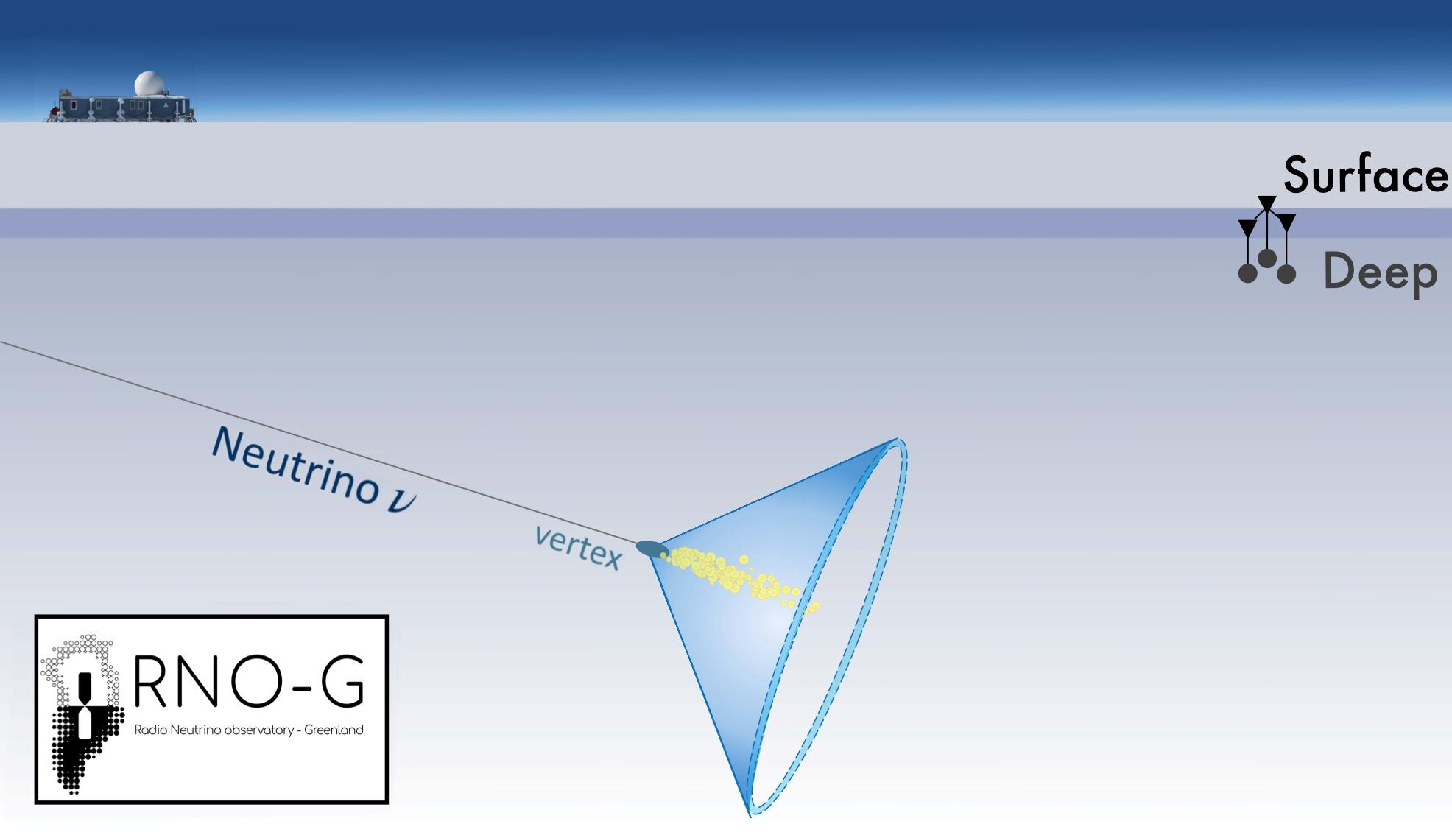
Askaryan Radiation Reveals UHE Neutrino Interactions
Neutrino interactions cause showers of e⁺ and e⁻
Most of the e⁺ cancel with other e⁻ from the shower and stationary e⁻ in nearby atoms
Leaving an excess of 10s of thousands e⁻ moving through the ice, emitting radio waves.
https://arxiv.org/abs/2010.12279

Slide 13
Askaryan Radiation Reveals UHE Neutrino Interactions
Radio waves have wavelengths of centimeters to meters.
The shower that develops is meters long.
Which means… all those e⁻ radio waves destructively interfere everywhere except the Cherenkov Angle
https://arxiv.org/abs/2010.12279

Slide 14
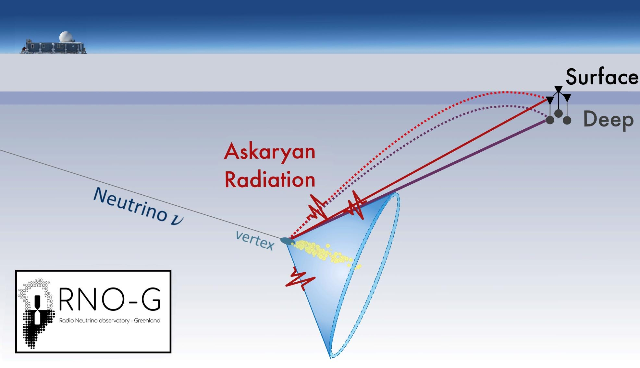
Askaryan Radiation Reveals UHE Neutrino Interactions
https://arxiv.org/abs/2010.12279

Slide 15
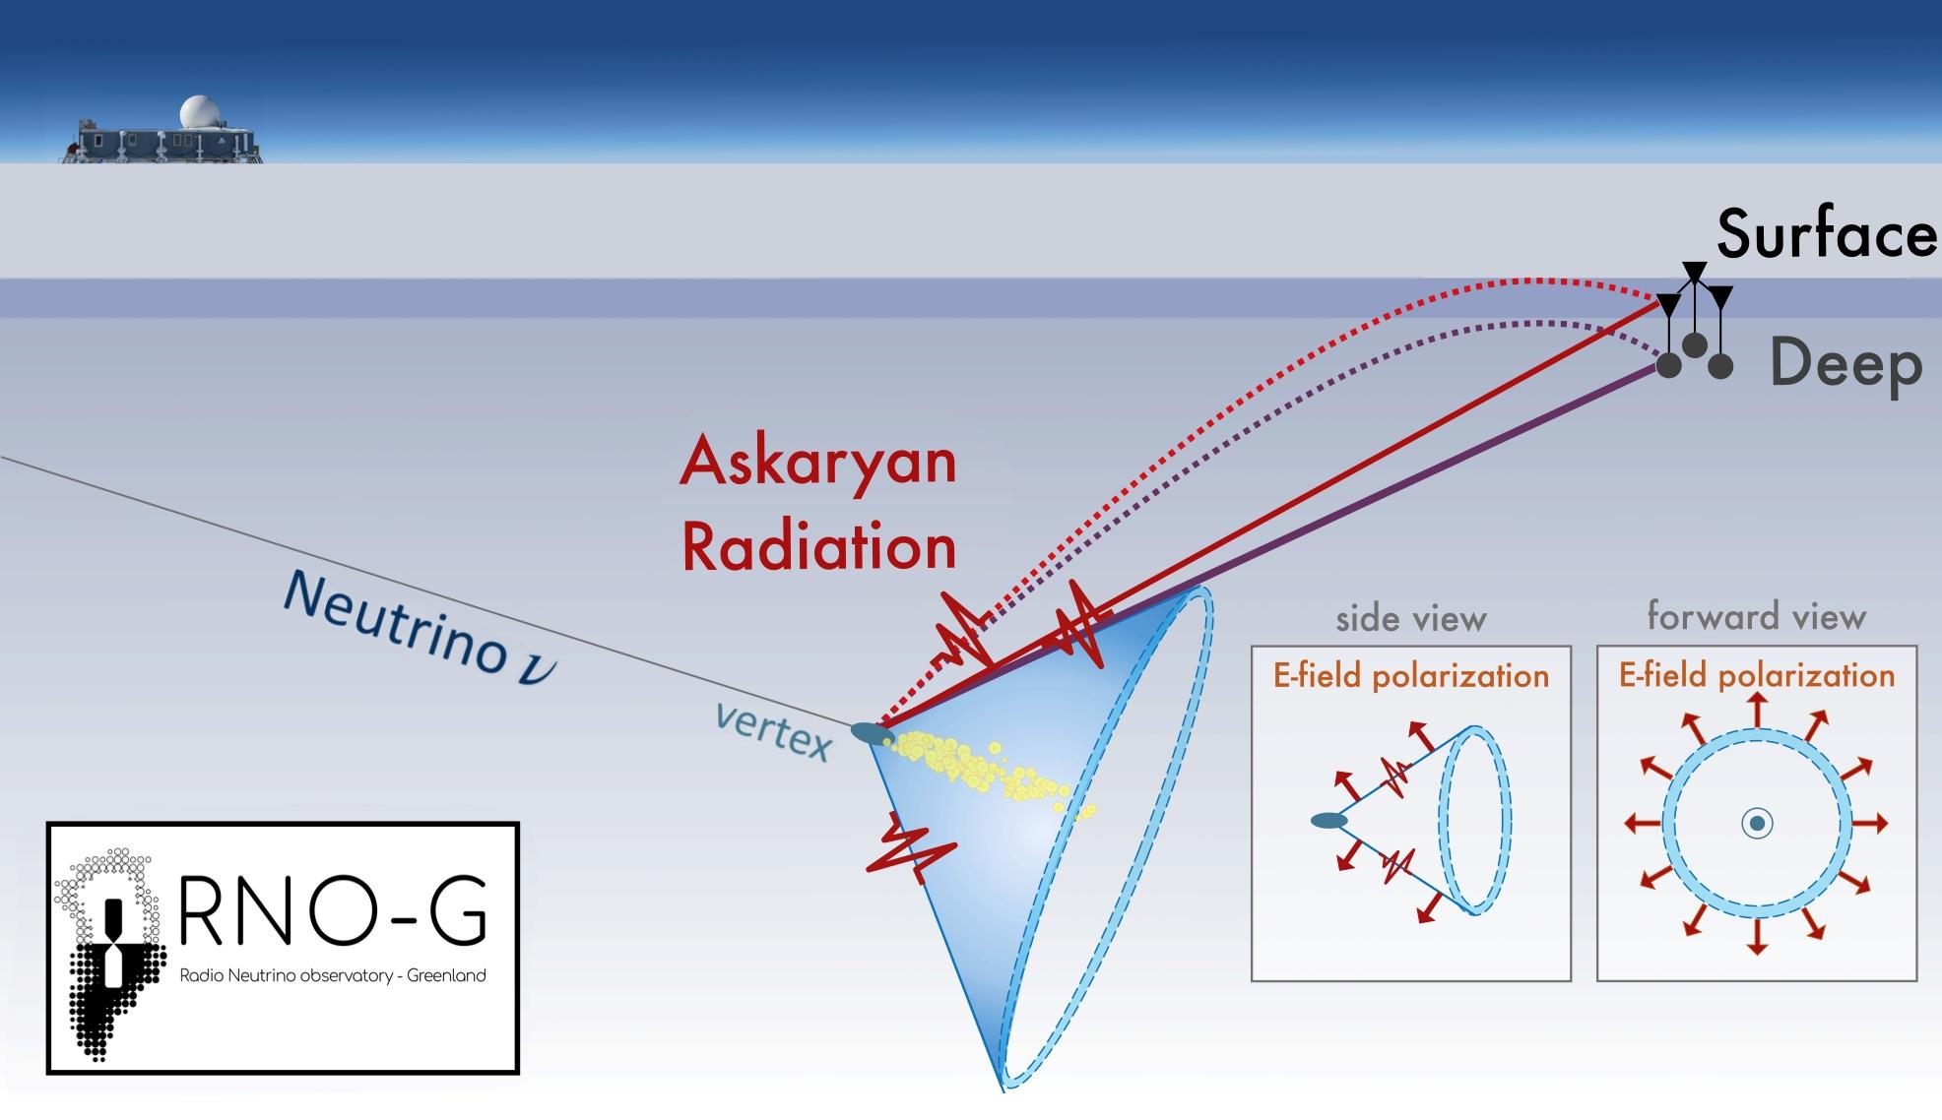
Askaryan Radiation Reveals UHE Neutrino Interactions
https://arxiv.org/abs/2010.12279

Slide 16
What’s the landscape of UHE neutrino observatories?

Slide 17
Observing UHE Neutrinos with the 3 Elements
https://arxiv.org/abs/2203.08096

Slide 18
Observing UHE Neutrinos with the 3 Elements
 | Earth | Ice | The Moon
https://arxiv.org/abs/2203.08096

Slide 19
Observing UHE Neutrinos with the 3 Elements
 | Earth | Ice | The Moon
Experiments
Methods
https://arxiv.org/abs/2203.08096

Slide 20
Neutrino Interactions with Earth
Interaction with mountain or Earth’s Crust
𝝂_{𝛕}
𝛕
The tau lepton leaves the Earth emitting radio radiation.

Slide 21
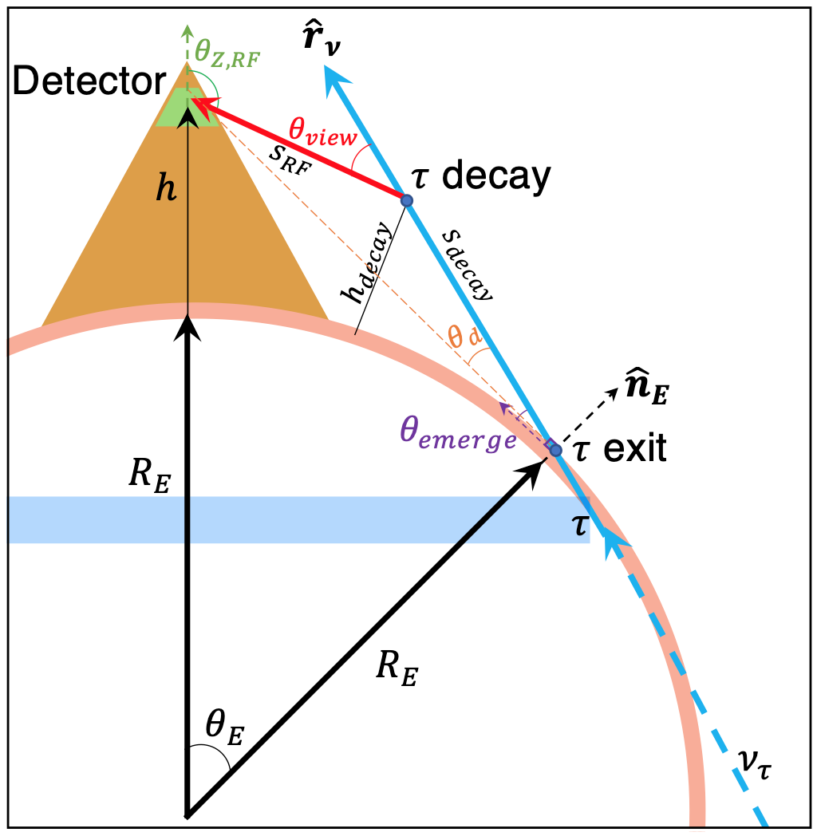
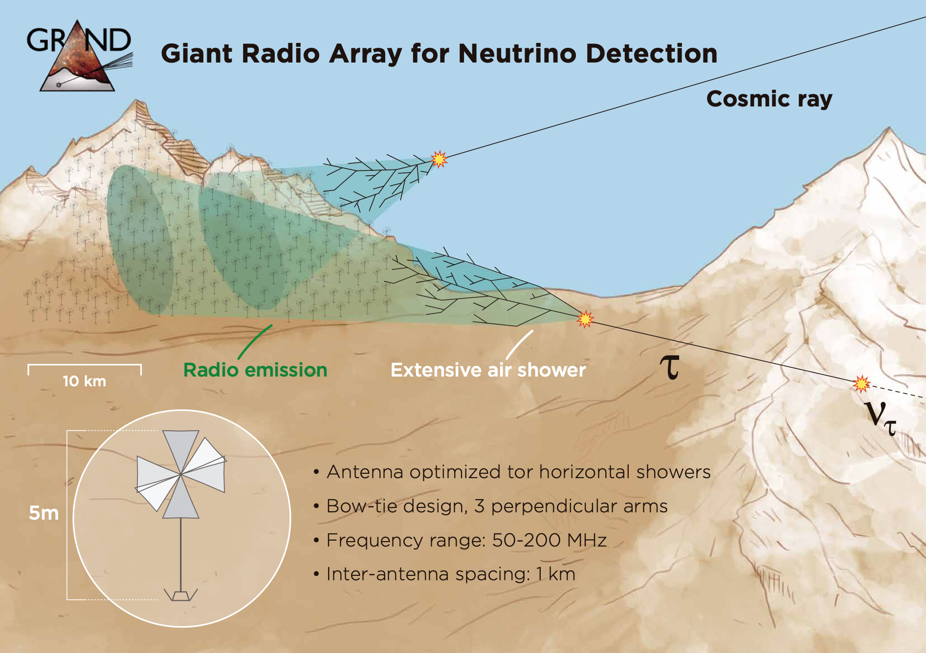
https://arxiv.org/abs/2004.12718
https://arxiv.org/abs/1810.09994
TAROGE
ARIANNA
Notes:
ARIANNA Sees the transantarctic mountains

Slide 22
Observing UHE Neutrinos with the 3 Elements
 | Earth | Ice | The Moon
Experiments | BEACON, TAROGE, GRAND, ARIANNA
Methods | Looking for Earth-skimming UHE Tau Neutrinos in mountains or Earth’s crust
https://arxiv.org/abs/2203.08096

Slide 23
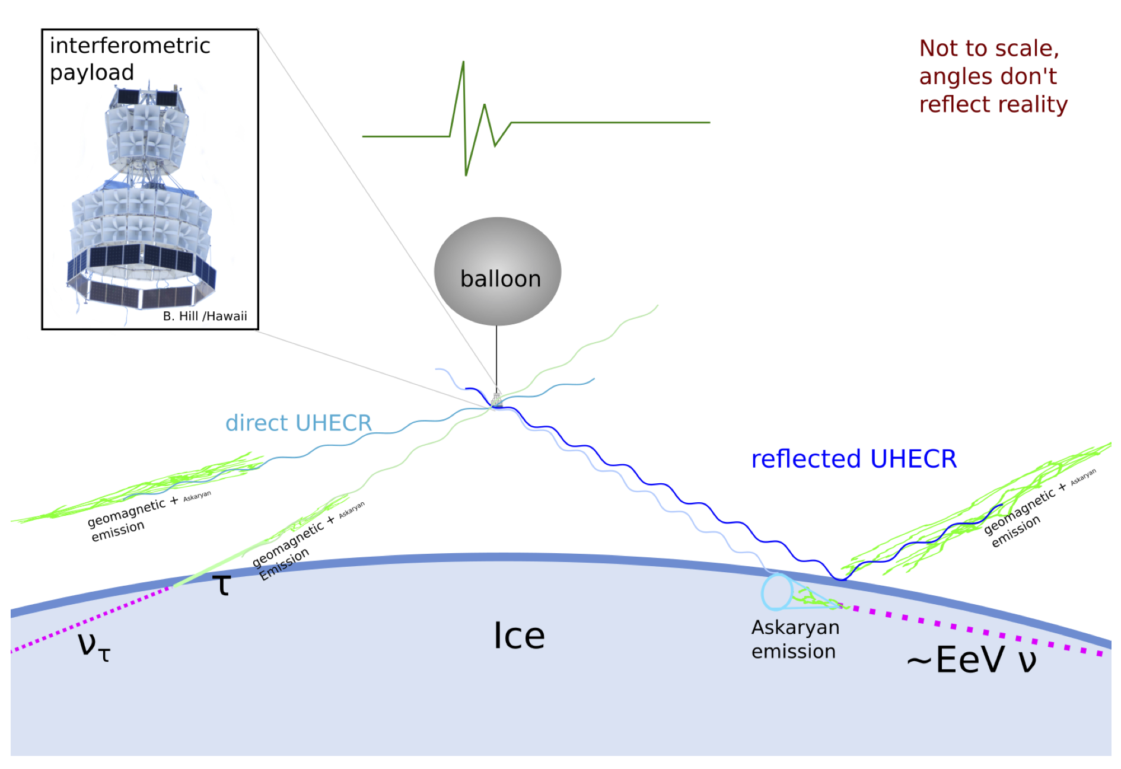
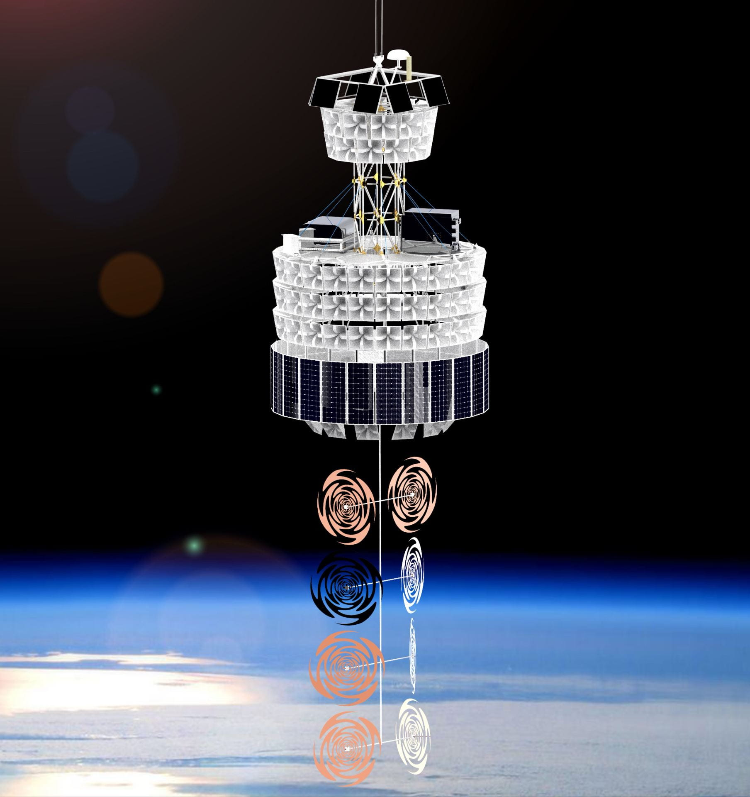
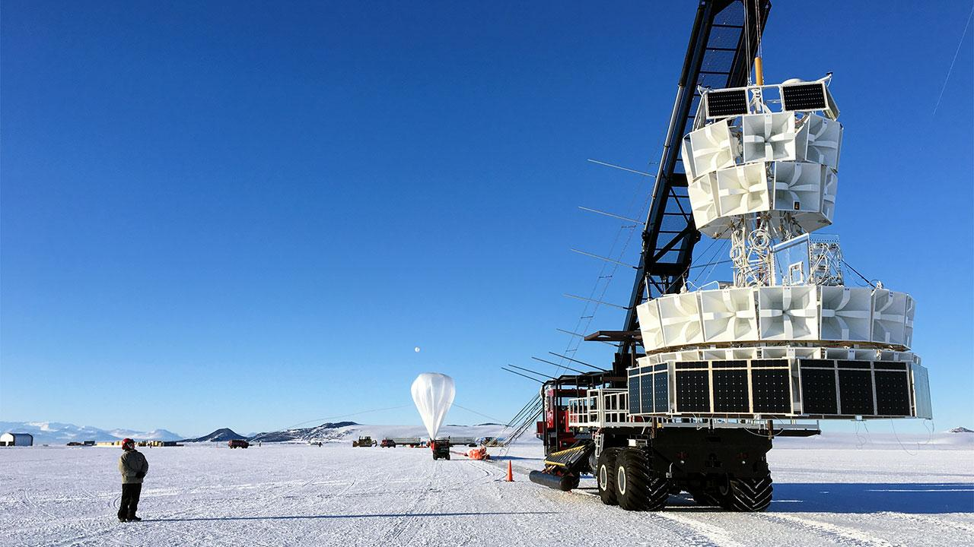
Balloon Detectors
https://www.hep.ucl.ac.uk/uhen/anita/
https://news.uchicago.edu/story/find-energetic-particles-space-new-detector-will-soar-over-antarctic-ice
Christian Miki, University of Hawaii
https://www.science.org/content/article/oddball-particles-tunneling-through-earth-could-point-new-physics NASA
ANITA
PUEO

Slide 24
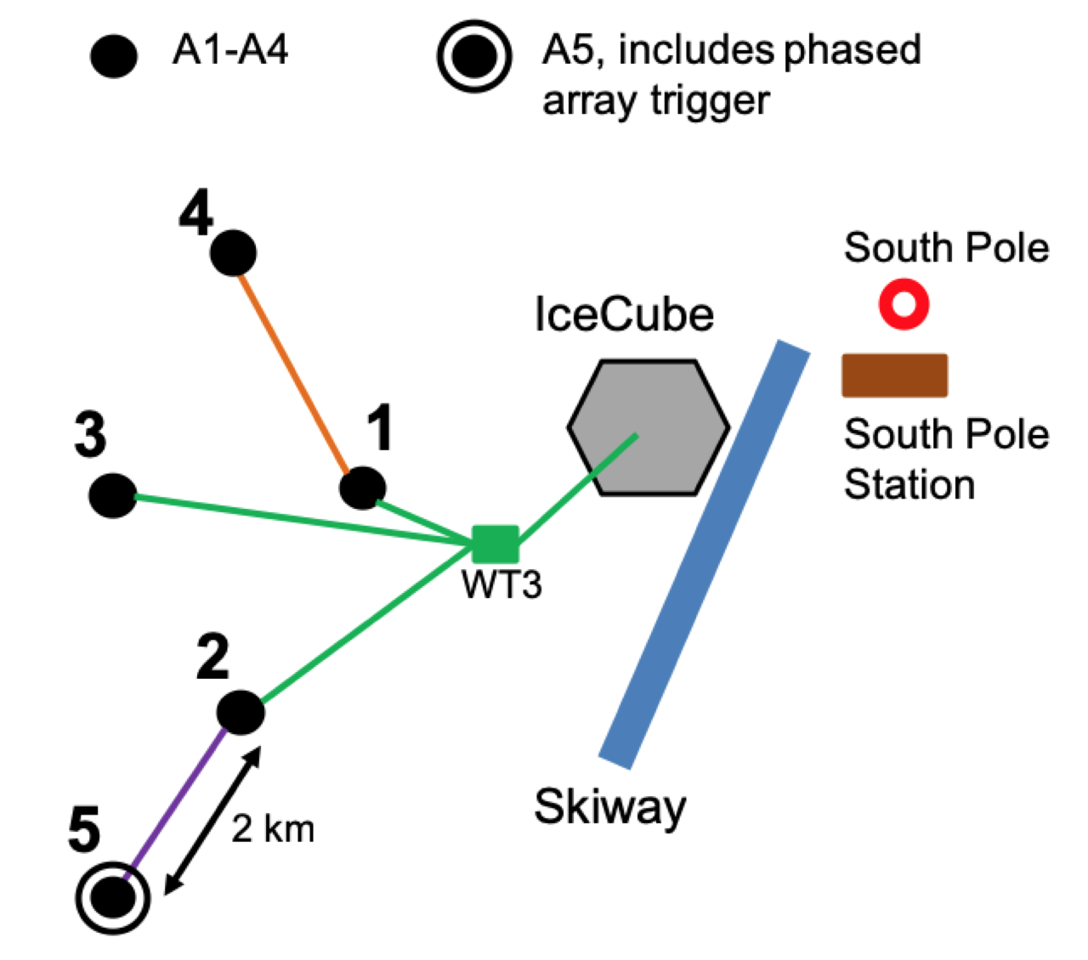
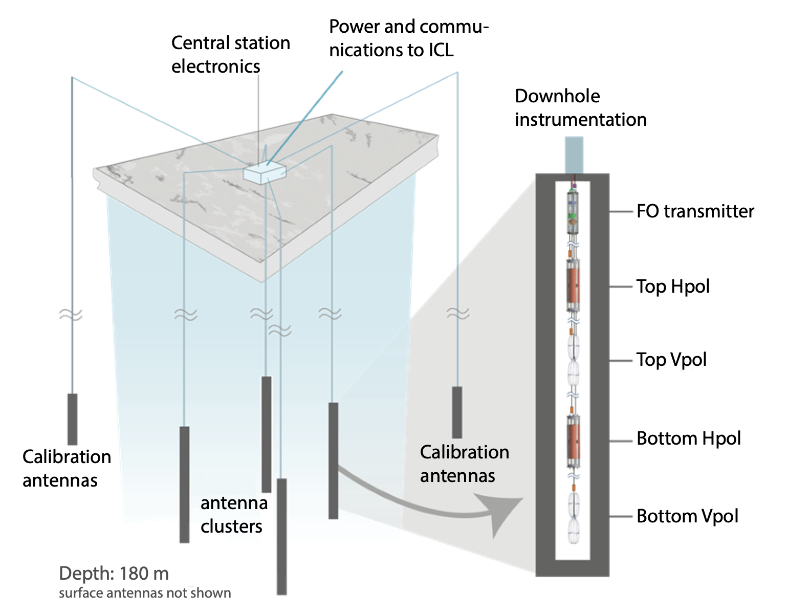
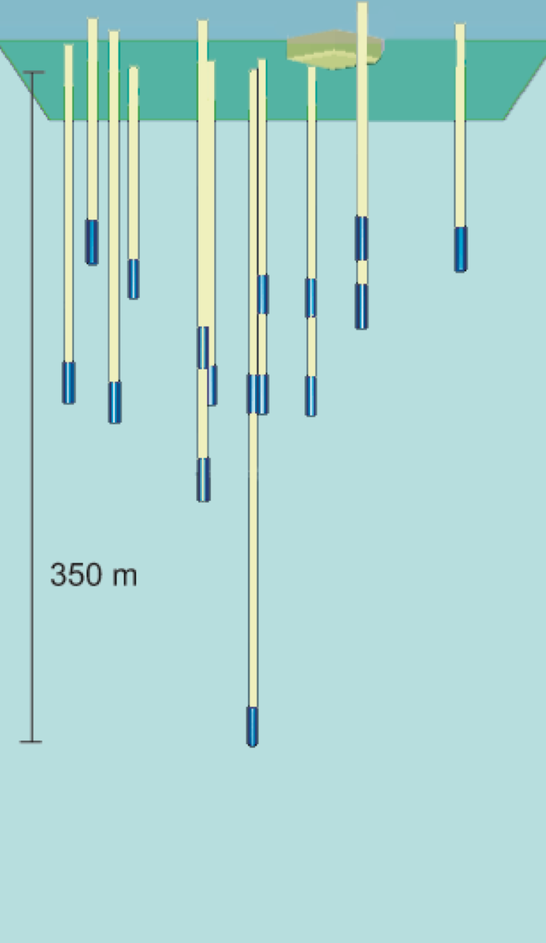
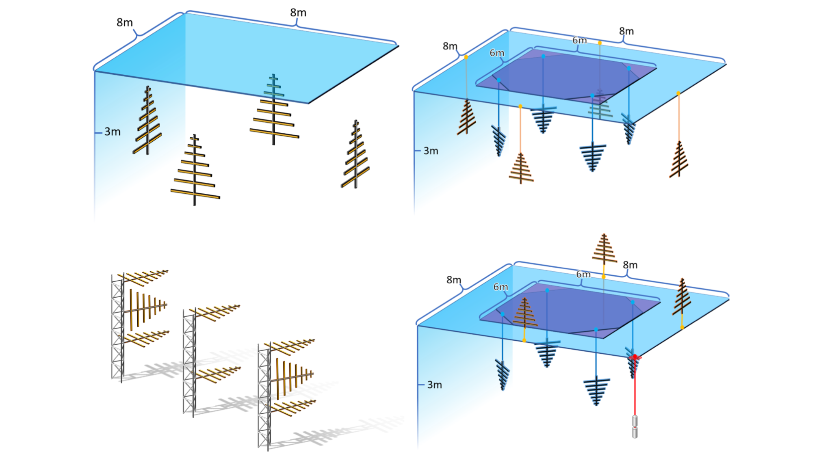
RICE
In-Ice Detectors
https://arxiv.org/abs/1907.11125
https://arxiv.org/abs/1507.08991
ARIANNA
https://arxiv.org/abs/1903.01609
https://arxiv.org/abs/1106.1164

Slide 25
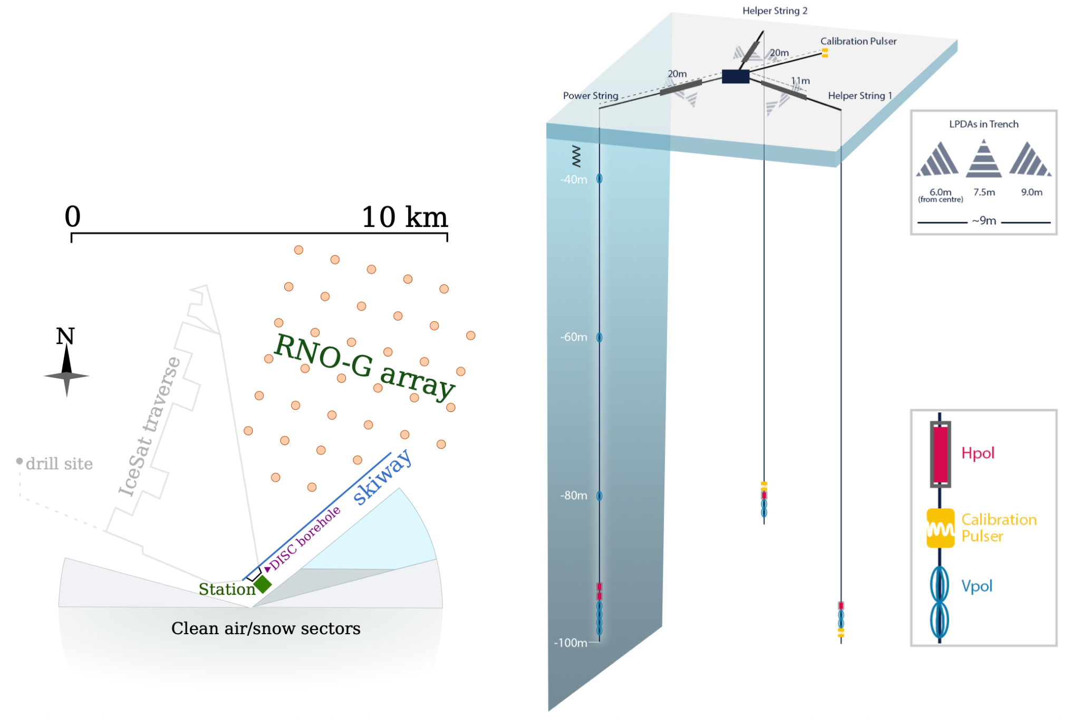
https://arxiv.org/abs/2107.08910
RNO-G
In-Ice Detectors
https://arxiv.org/abs/2107.08910
https://arxiv.org/abs/2010.12279
https://arxiv.org/abs/2008.04323

Slide 26
Observing UHE Neutrinos with the 3 Elements
 | Earth | Ice | The Moon
Experiments | BEACON, TAROGE, GRAND, ARIANNA | ANITA, PUEO, RICE, ARIANNA, ARA, RNOG, IceCube-Gen2-Radio
Methods | Looking for Earth-skimming UHE Tau Neutrinos in mountains or Earth’s crust | Look for UHE neutrino interactions in Ice
https://arxiv.org/abs/2203.08096

Slide 27
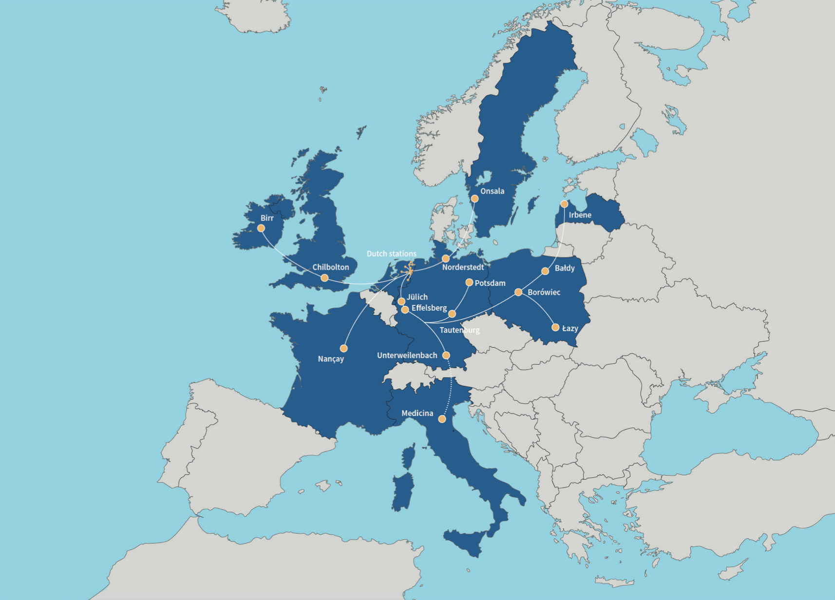
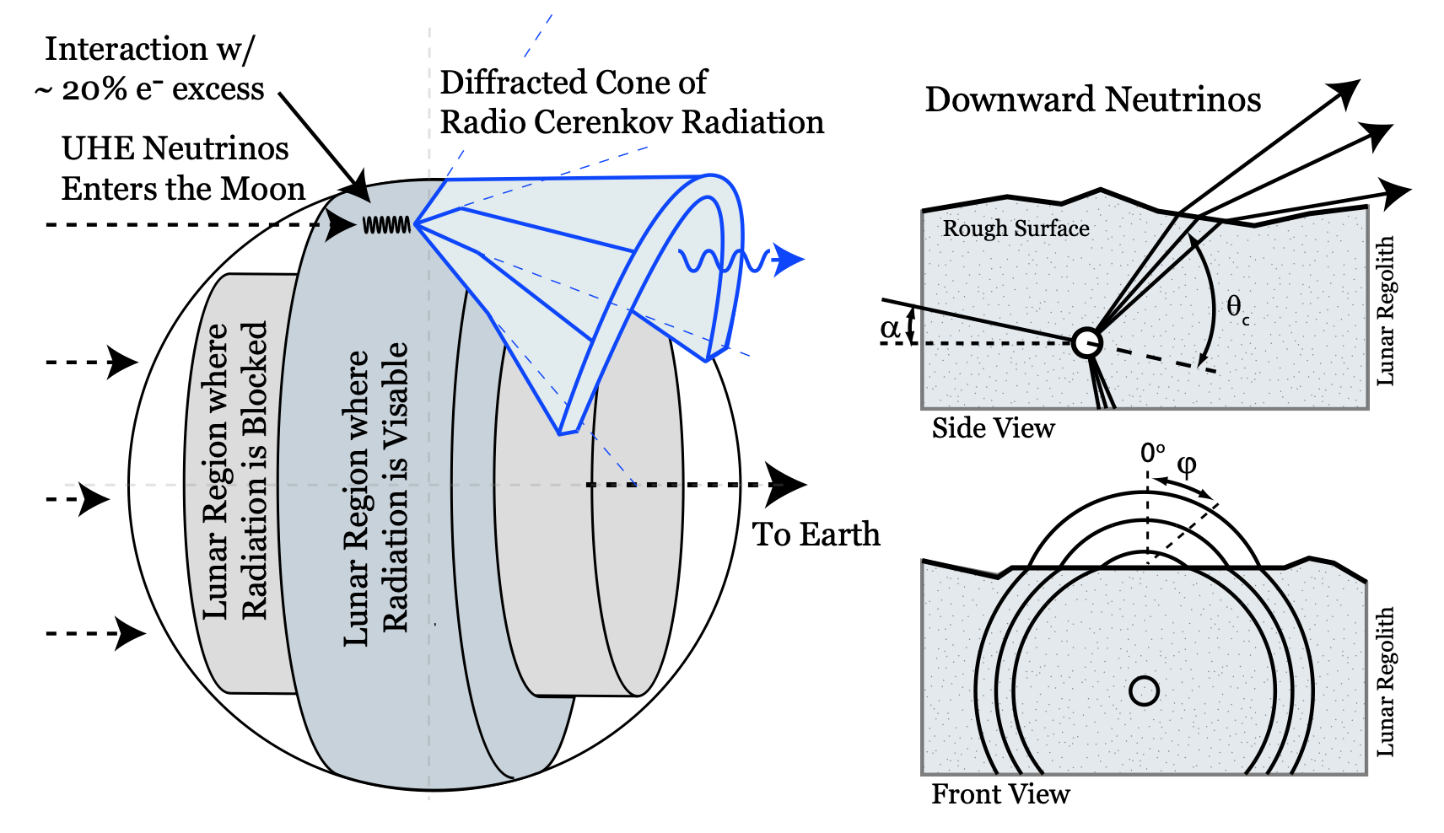
LAROGE & NuMoon
https://arxiv.org/pdf/0910.5949.pdf
https://pos.sissa.it/395/1148/pdf
https://www.astron.nl/telescopes/lofar/

Slide 28
Observing UHE Neutrinos with the 3 Elements
 | Earth | Ice | The Moon
Experiments | BEACON, TAROGE, GRAND, ARIANNA | ANITA, PUEO, RICE, ARIANNA, ARA, RNOG, IceCube-Gen2-Radio | NuMoon
Methods | Looking for Earth-skimming UHE Tau Neutrinos in mountains or Earth’s crust | Look for UHE neutrino interactions in Ice | Look for UHE neutrino interactions in the Moon
https://arxiv.org/abs/2203.08096

Slide 29
A lot of this information came from the HE/UHE Snowmass Paper
Check it out here: https://arxiv.org/abs/2203.08096

Slide 30
Questions?

