Slide 1
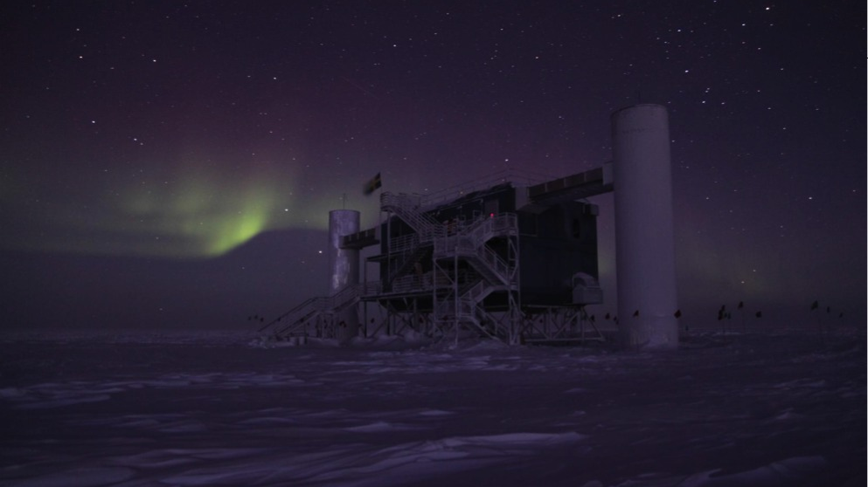
The IceCube Upgrade
Mike DuVernois
IceCube Upgrade (& Gen2) Technical Coordinator
University of Wisconsin-Madison

Slide 7
Upgrade Objectives
Improve science capabilities at low energy, oscillation physics
Improve the scientific capabilities of IceCube at higher energies with improved ice optics and calibrations
Prototype Gen2 IceCube sensors, surface readout, and infrastructure elements
Return to ice drilling at the South Pole
Return to logistics capabilities at the South Pole

Slide 8
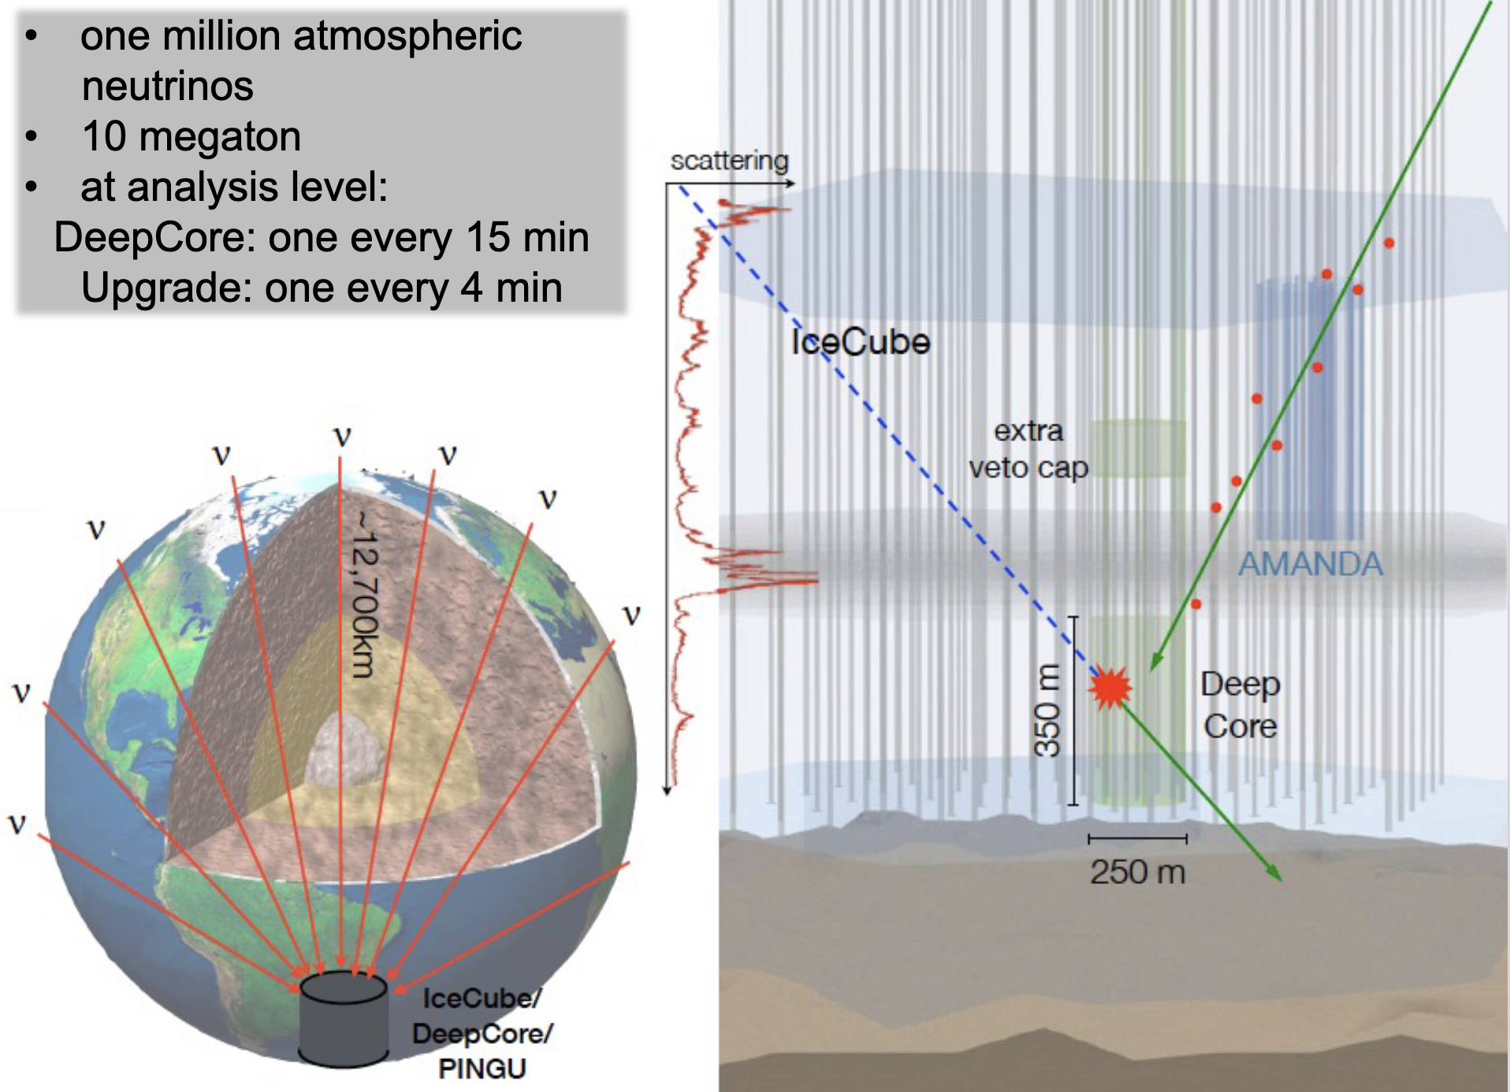

Slide 10
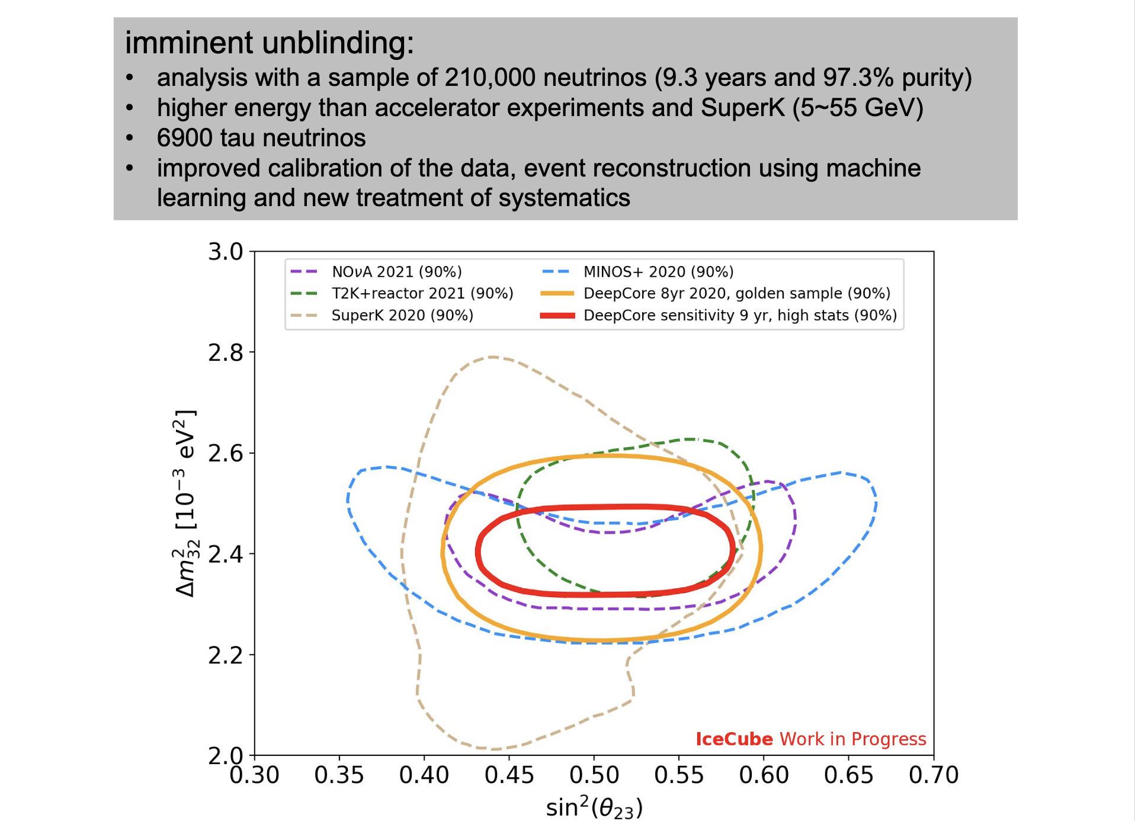

Slide 15
Detector & Installation

Slide 19
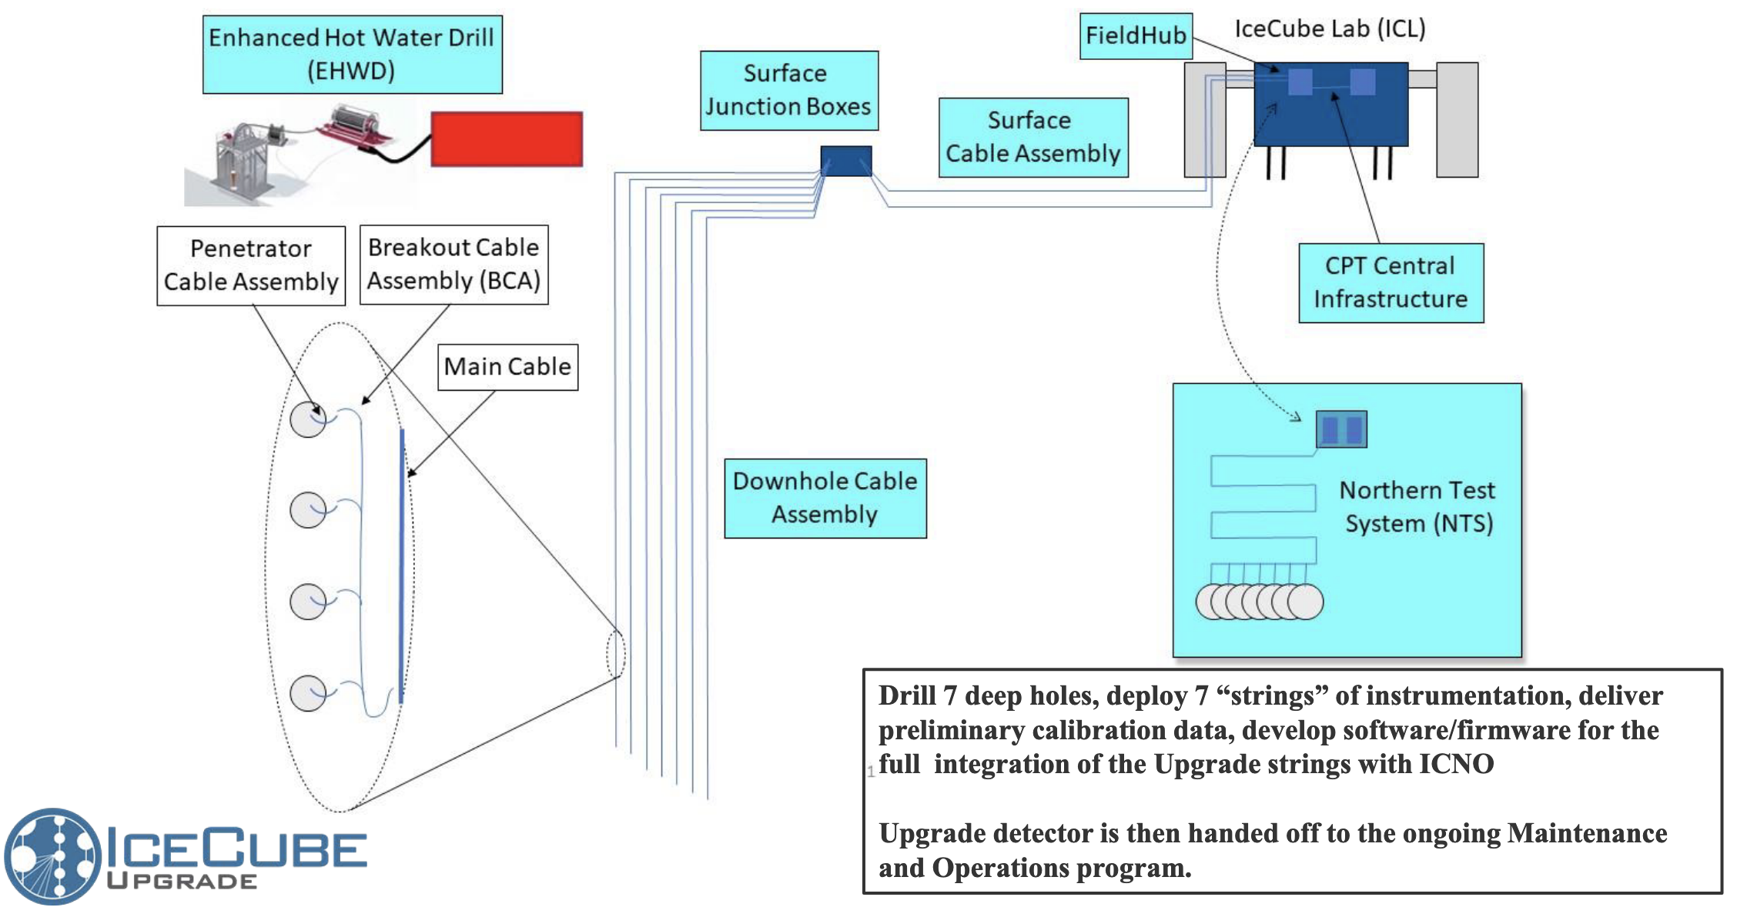

Slide 20
GEN1

Slide 21
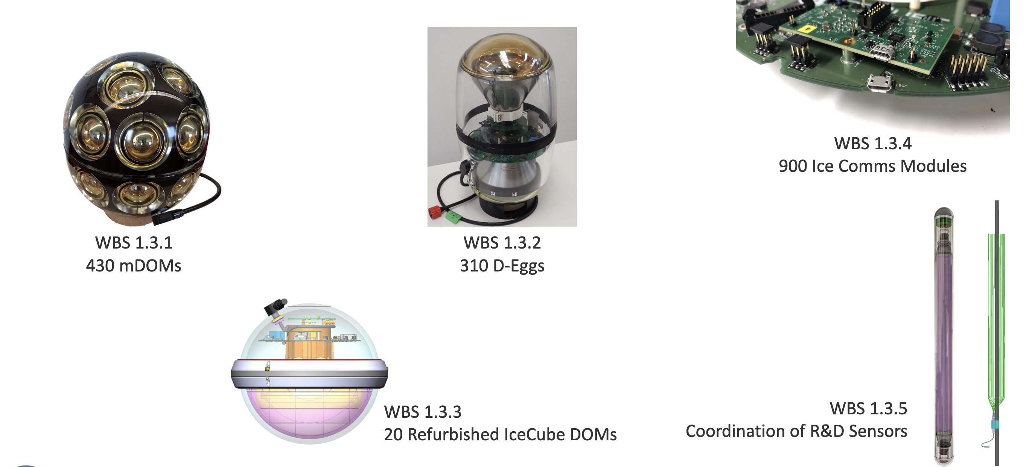

Slide 23
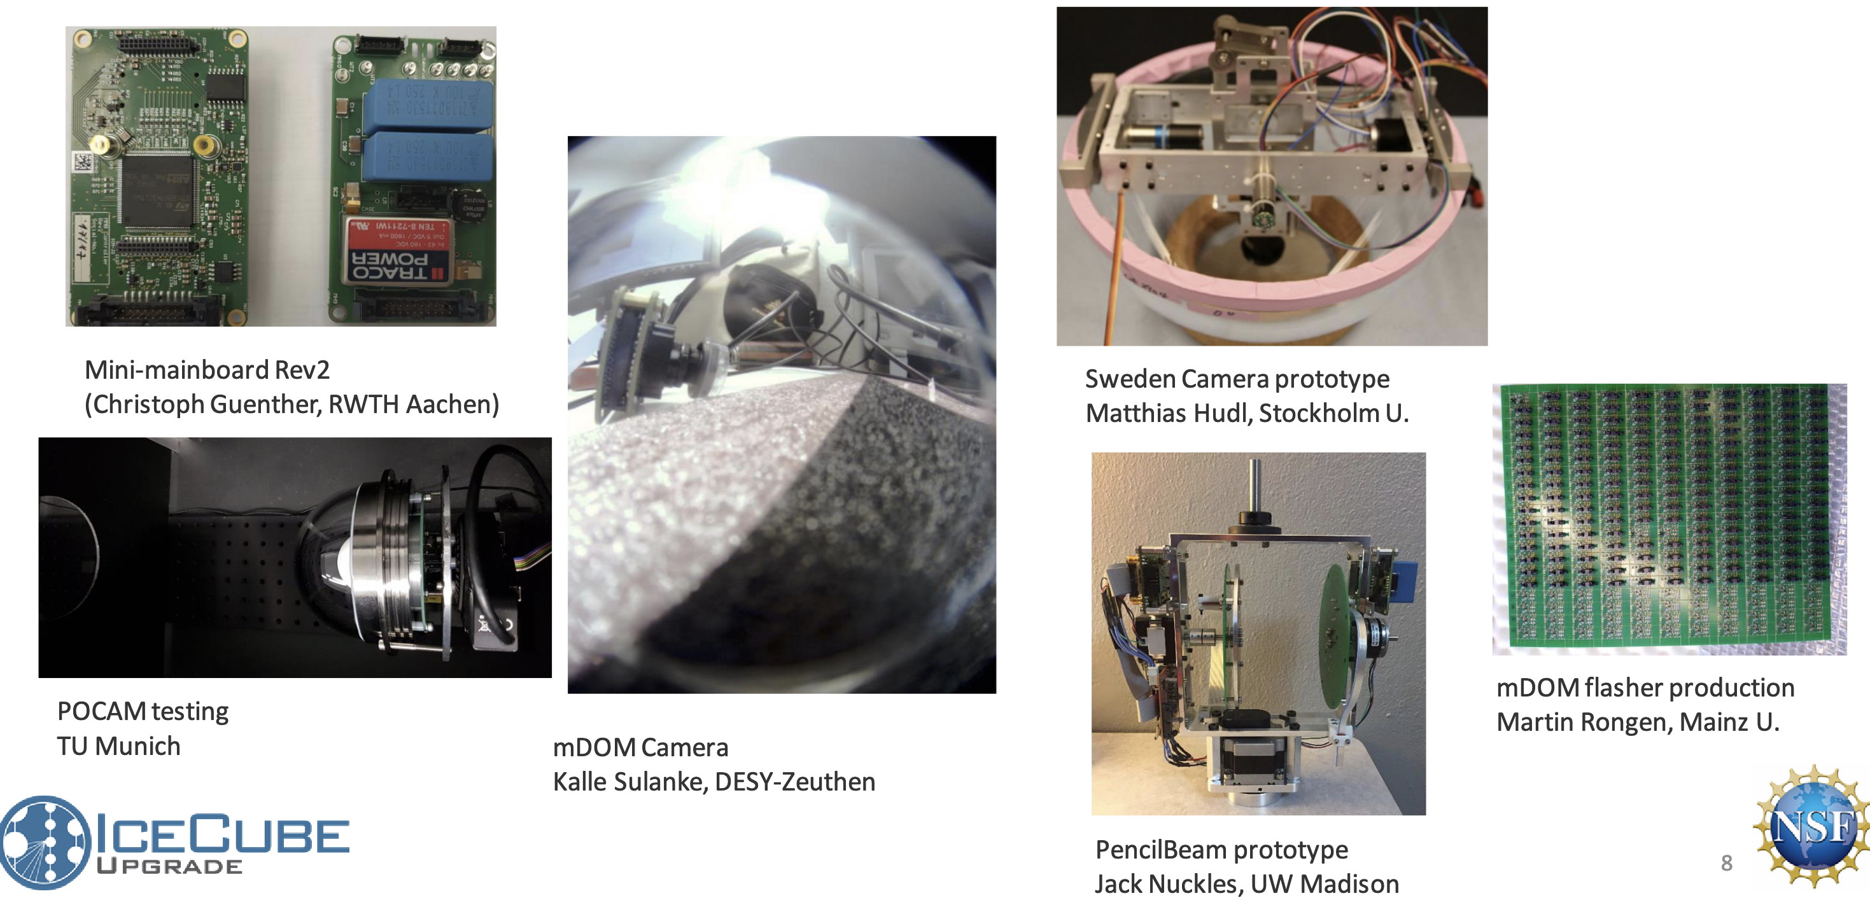

Slide 24
The Drill
ICU = IceCube Upgrade
EHWD = Enhanced Hot Water Drill

Slide 26
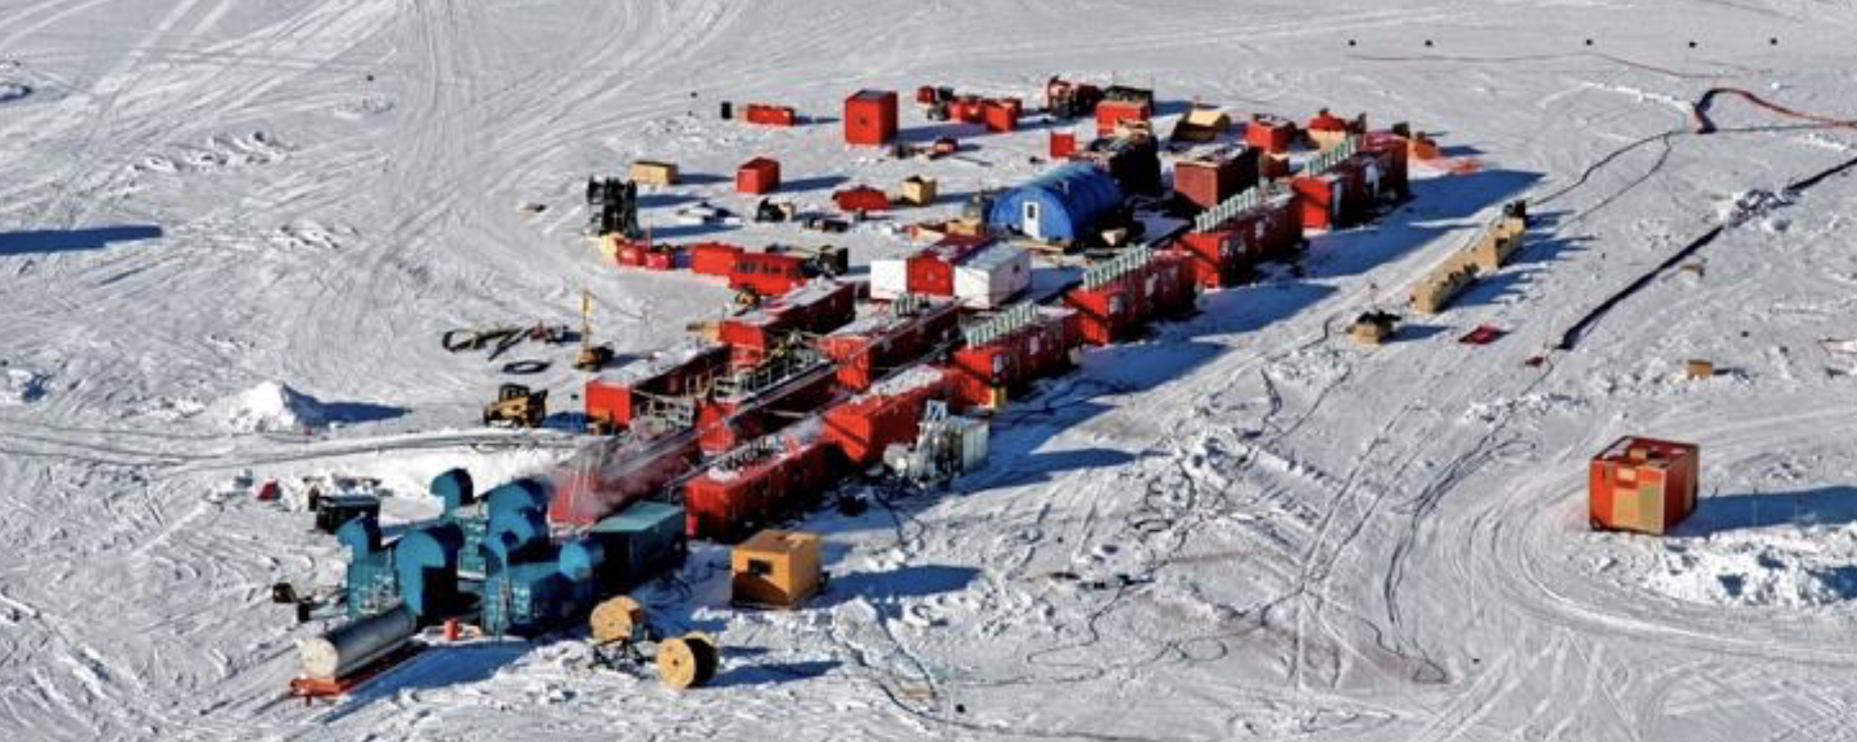

Slide 27
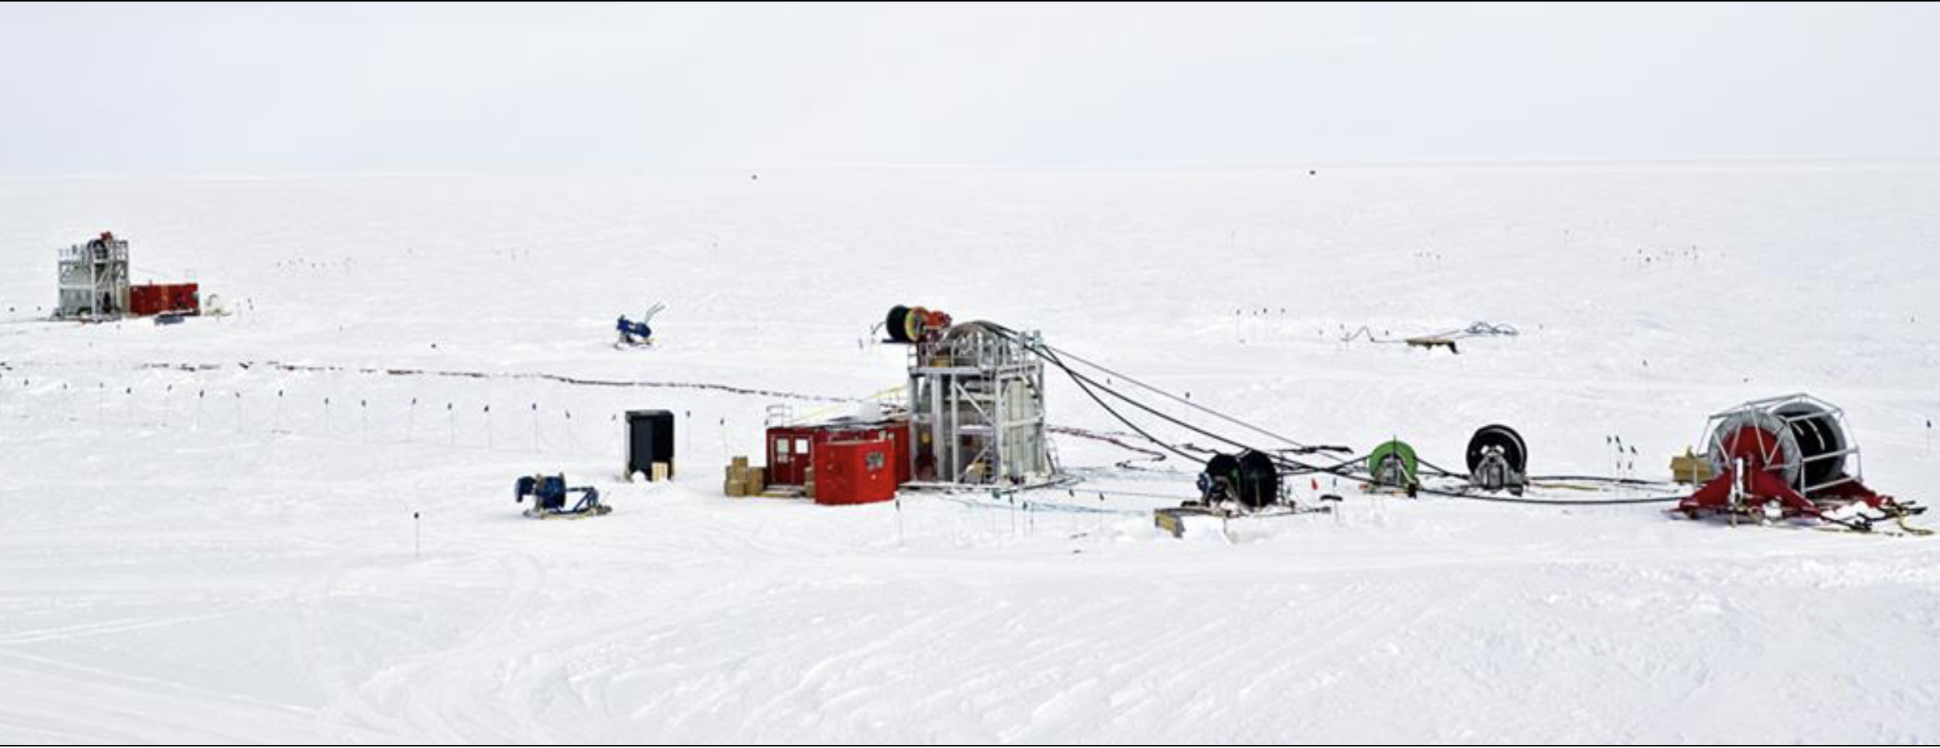

Slide 28
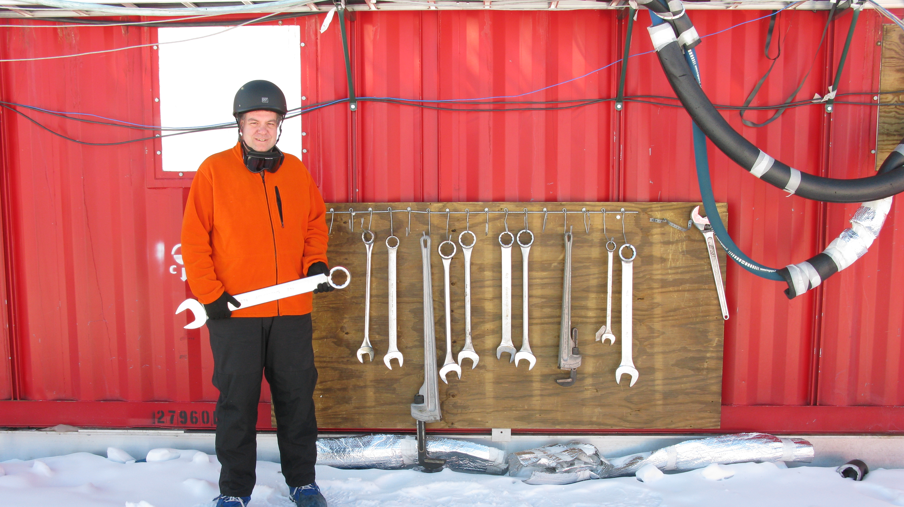

Slide 29
A bit about Logistics

Slide 30
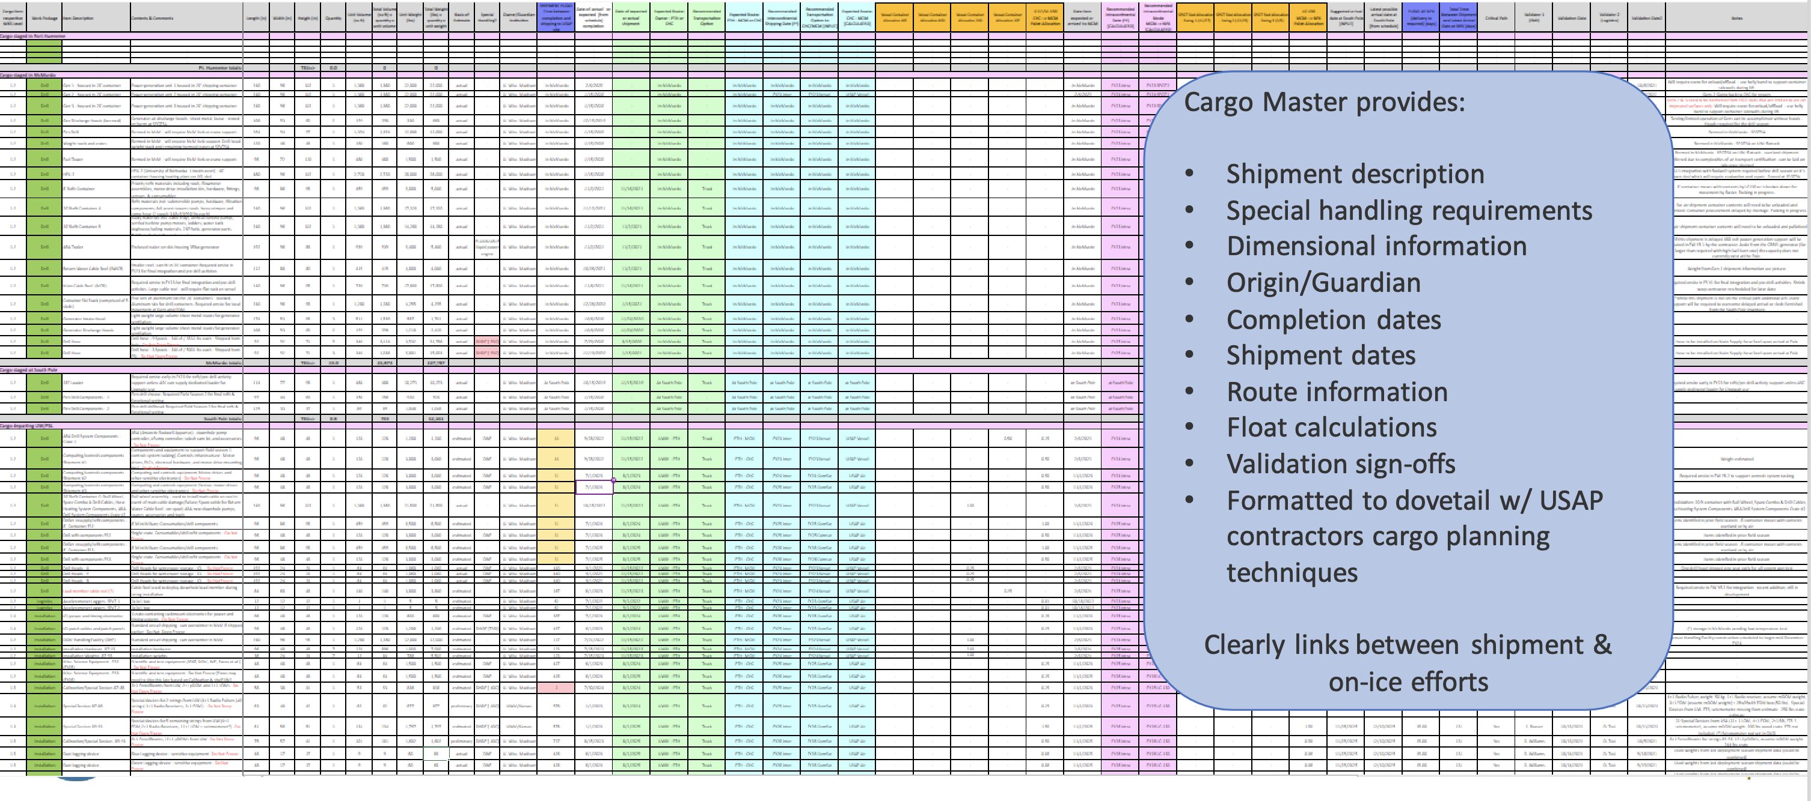

Slide 36
Surface hardware

Slide 38
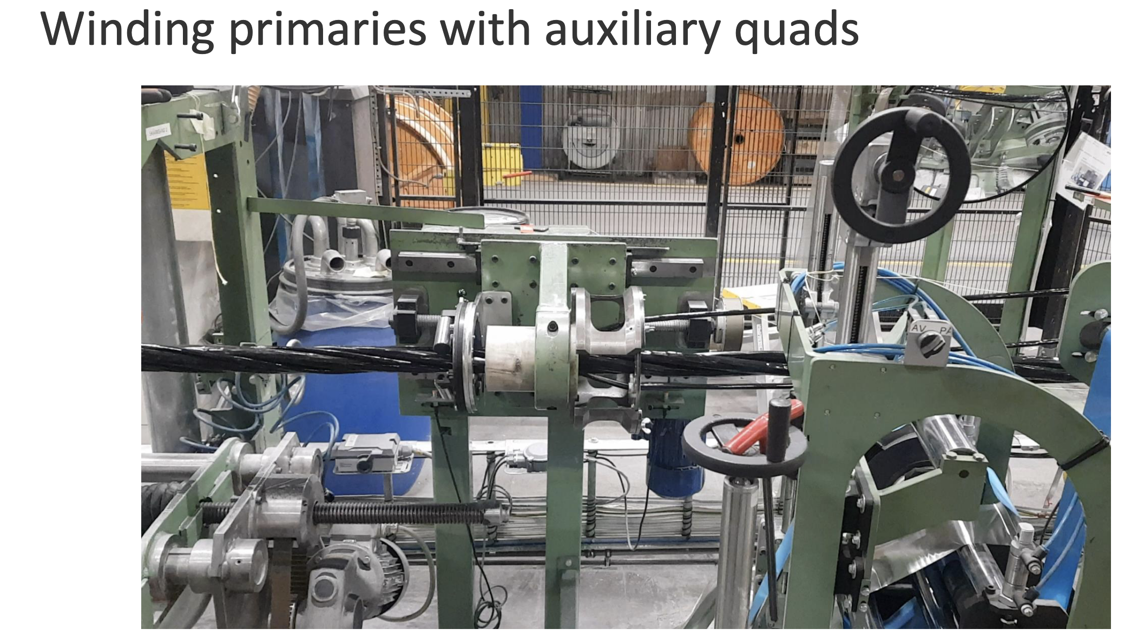

Slide 39
IceCube Upgrade Recap
Science goals of lower energy neutrinos, for oscillation physics, plus a finer look at the ice for re-calibration of existing & future data
Gets us back to the South Pole with a working hot water drill, and detector R&D for Gen2 IceCube
Project/construction effort is spread across a subset of the IceCube Collaboration, distinction between project & experiment
With work at Pole now planned for 2023-24 (drill prep), 2024-25 (firn drilling, full drill test), and 2025-26 (main drill & deploy season)

Slide 40
Backup

Slide 41
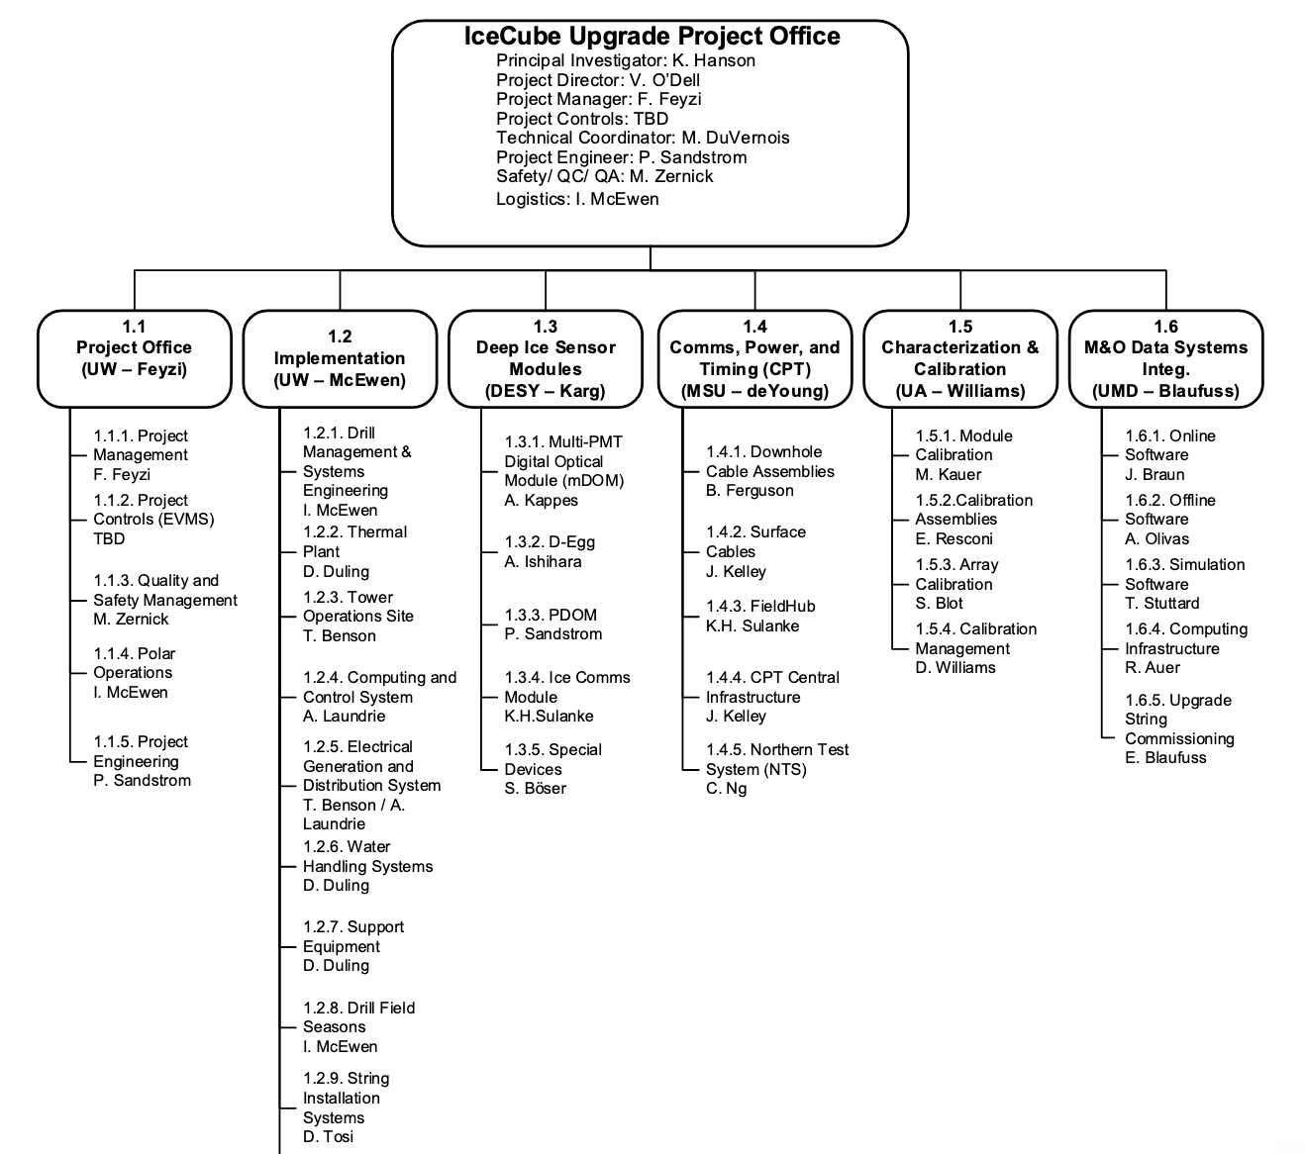

Slide 42
