Slide 1
The anisotropy of TeV cosmic rays in an inhomogeneous interstellar magnetic field
Ming Zhang and Noufel Mallal
Florida Institute of Technology, USA
Nikolai V. Pogorelov
University of Alabama in Huntsville, USA
Cosmic ray anisotropy workshop, Chicago, IL, May 2023

Slide 2
TeV cosmic ray anisotropy observations
Tibet AS @ 5 TeV
IceCube @ 20 TeV
Relative Intensity Map in Equatorial Coordinates
(from Destiati and Lazarian, 2013)

Slide 3
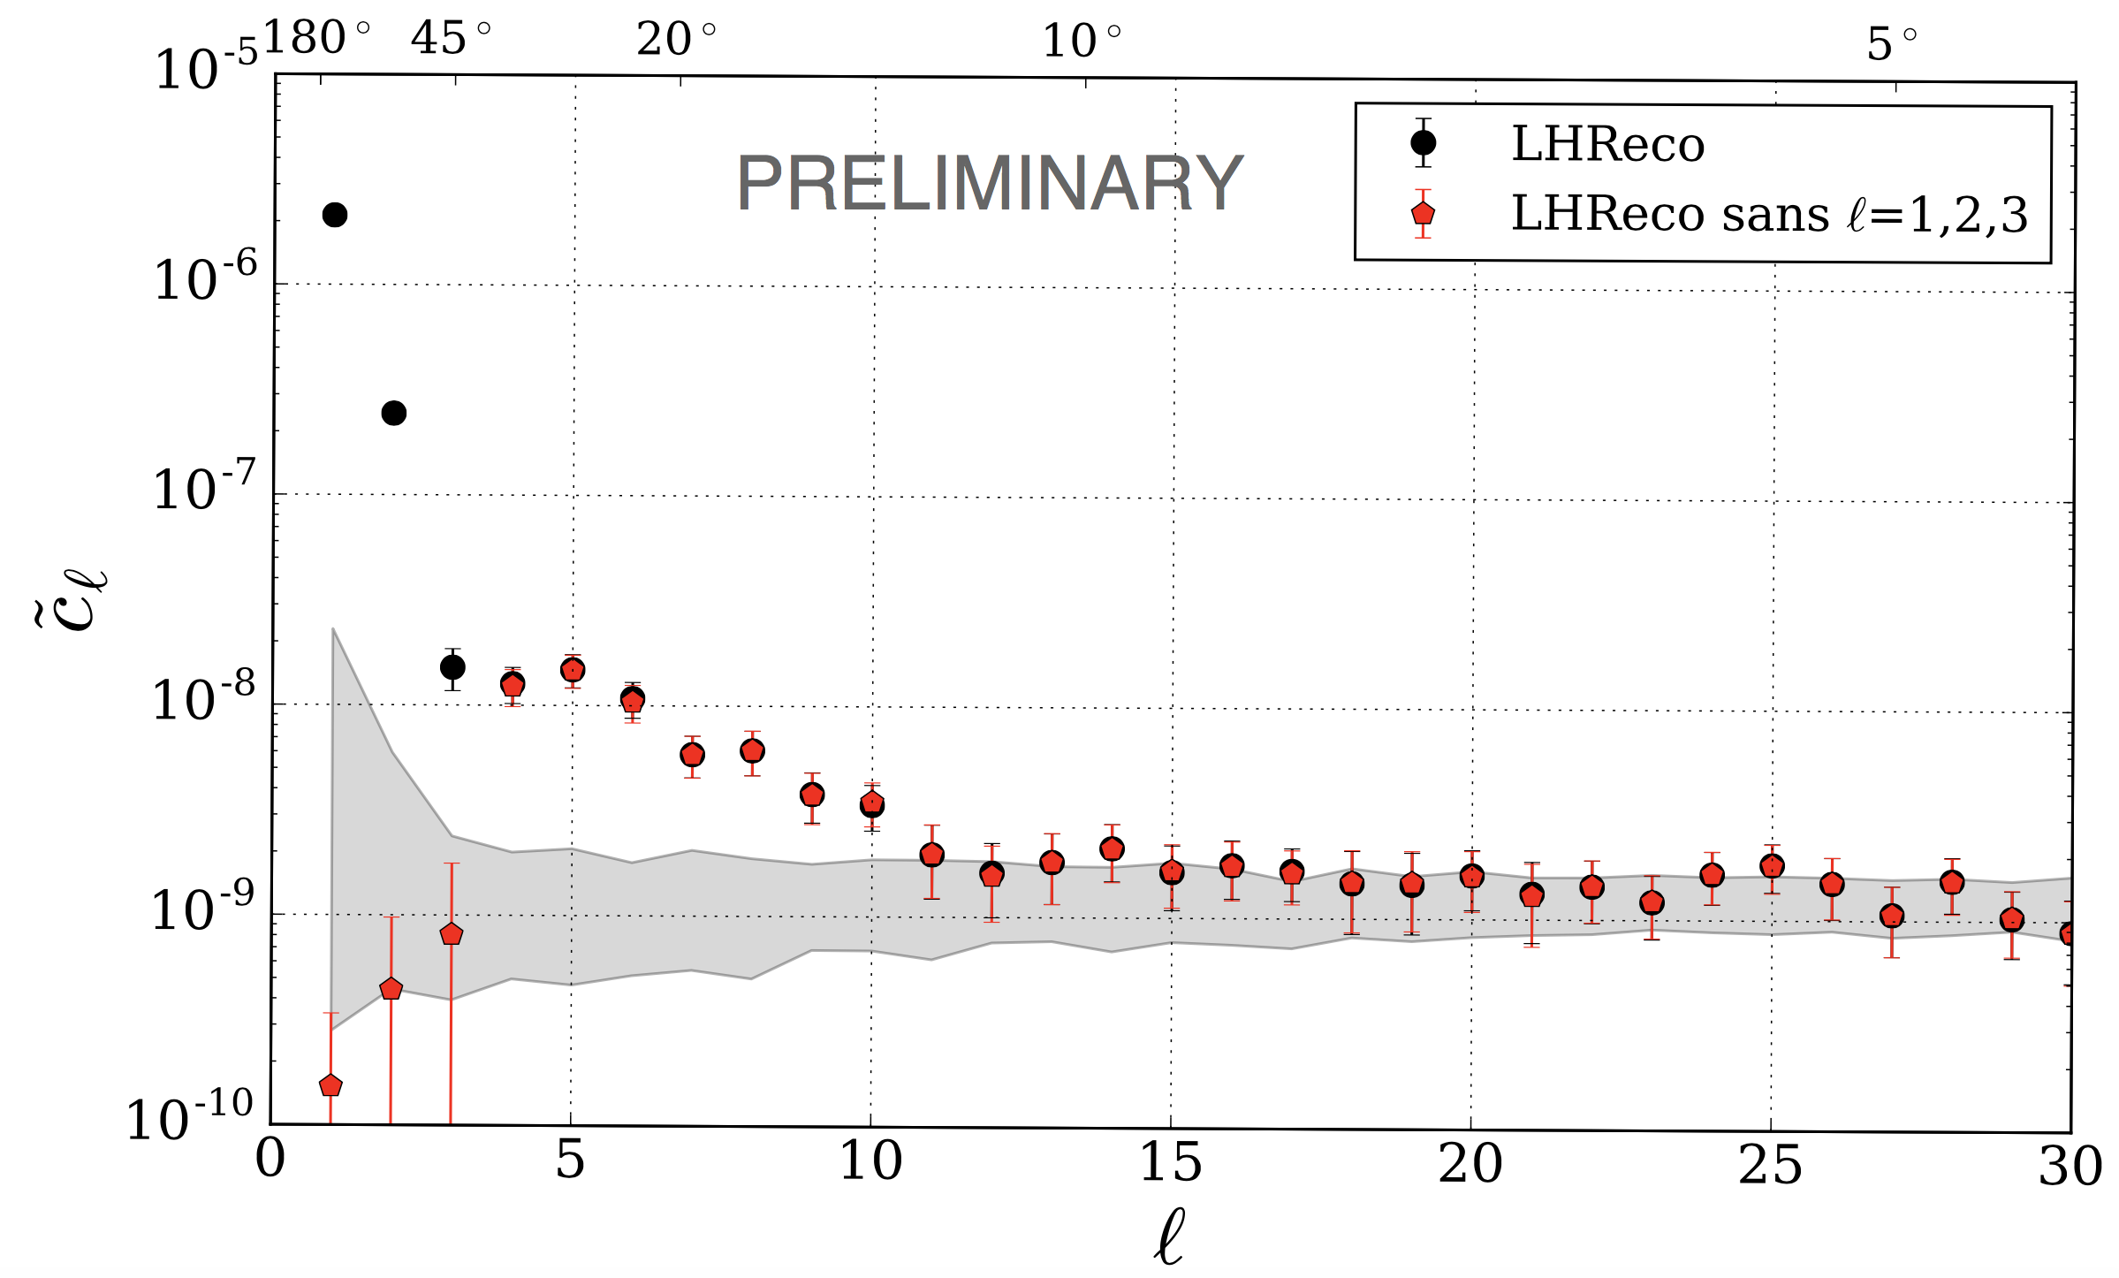
Spherical Harmonic Power Spectrum of TeV CR Anisotropy
IceCube-HAWC construction

Slide 4
Tibet ASγ anisotropy observations
Decomposition into two orthogonal dipoles and one bidirectional anisotropy and plus small features

Slide 5
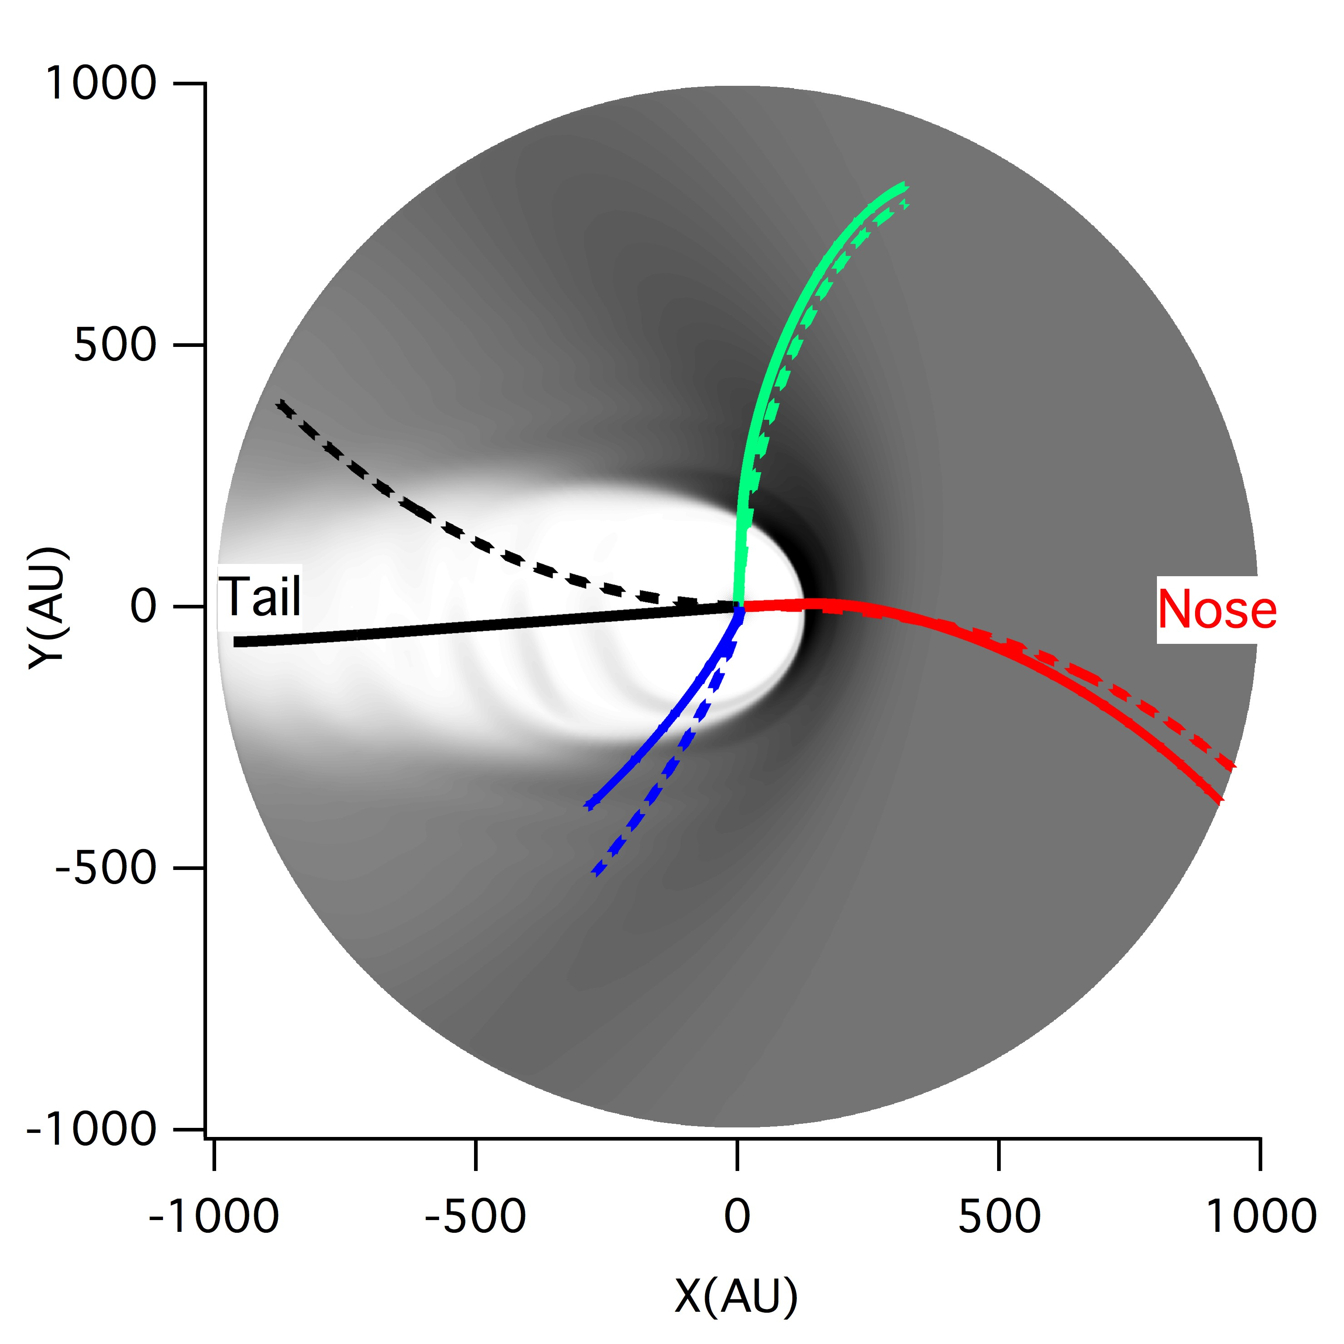
10-TeV proton trajectories
Final arrival directions: Nose, Pole, Flank, Tail
Size of heliosphere (heliopause):
Nose: ~150 AU, Flank ~300 AU
Tail: A few thousand AU
Gyroradius of protons in 3.5 μG LISMF:
1 TeV: 63 AU, 10 TeV: 635 AU
300 TeV: 19 kAU
Heliosphere should affect the anisotropy of TeV cosmic rays
Works investigating heliospheric effects of TeV CR anisotropy
Amenomori et al and Tibet AS team, 2009, 2011
Drury, 2013
Desiati and Lazarian, 2013
Schwadron et al. 2014
Zhang et al. 2014, 2016, 2020

Slide 6
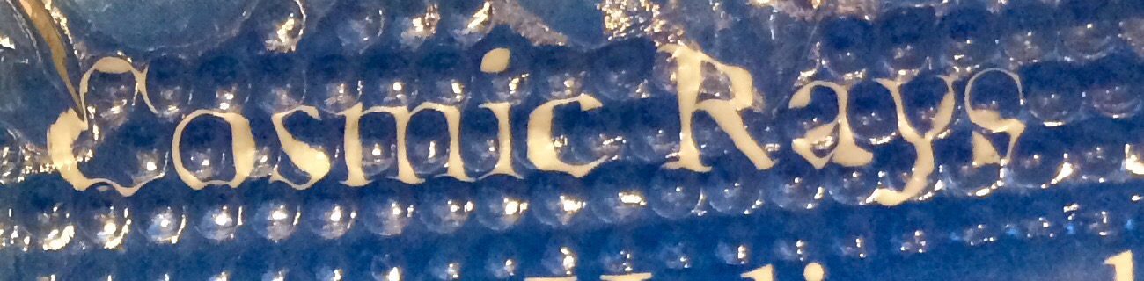
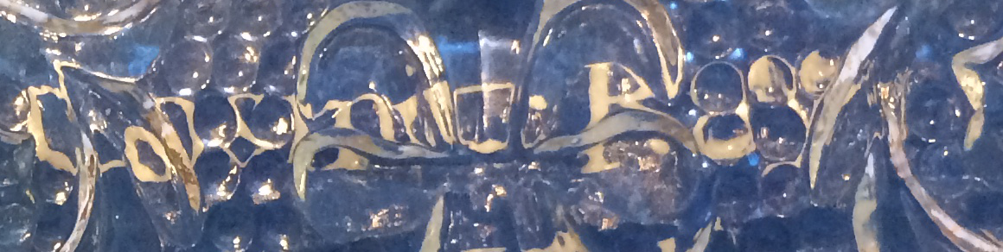
Optical image distortion

Slide 7
Liouville Mapping of Anisotropy
Anisotropy is a measurement of angular dependence of particle distribution in the observer’s reference frame
Liouville’s theorem (solution to Boltzmann-Vlasov Eq)
f is invariant upon transformation of reference frame
Anisotropy at Earth can be mapped of momentum and particle distribution function from the LISM by finding the relation between

Slide 8
Mapping to Earth from ISM distribution through particle trajectory
with ideal MHD Heliosphere Model where
Cosmic ray distribution in LISM as a magnetized charged particle population
Total anisotropy is a linear composition of the above 3 types of anisotropies

Slide 9
B_{ism}=3.5 mG, n_{e}=0.065 cm⁻³, n_{H}=0.184 cm⁻³
Shape of heliosphere and magnetic field environment
Simulation box 12000x8000x10000 AU for cosmic rays of a few TeV
HDP = B-V plane

Slide 10
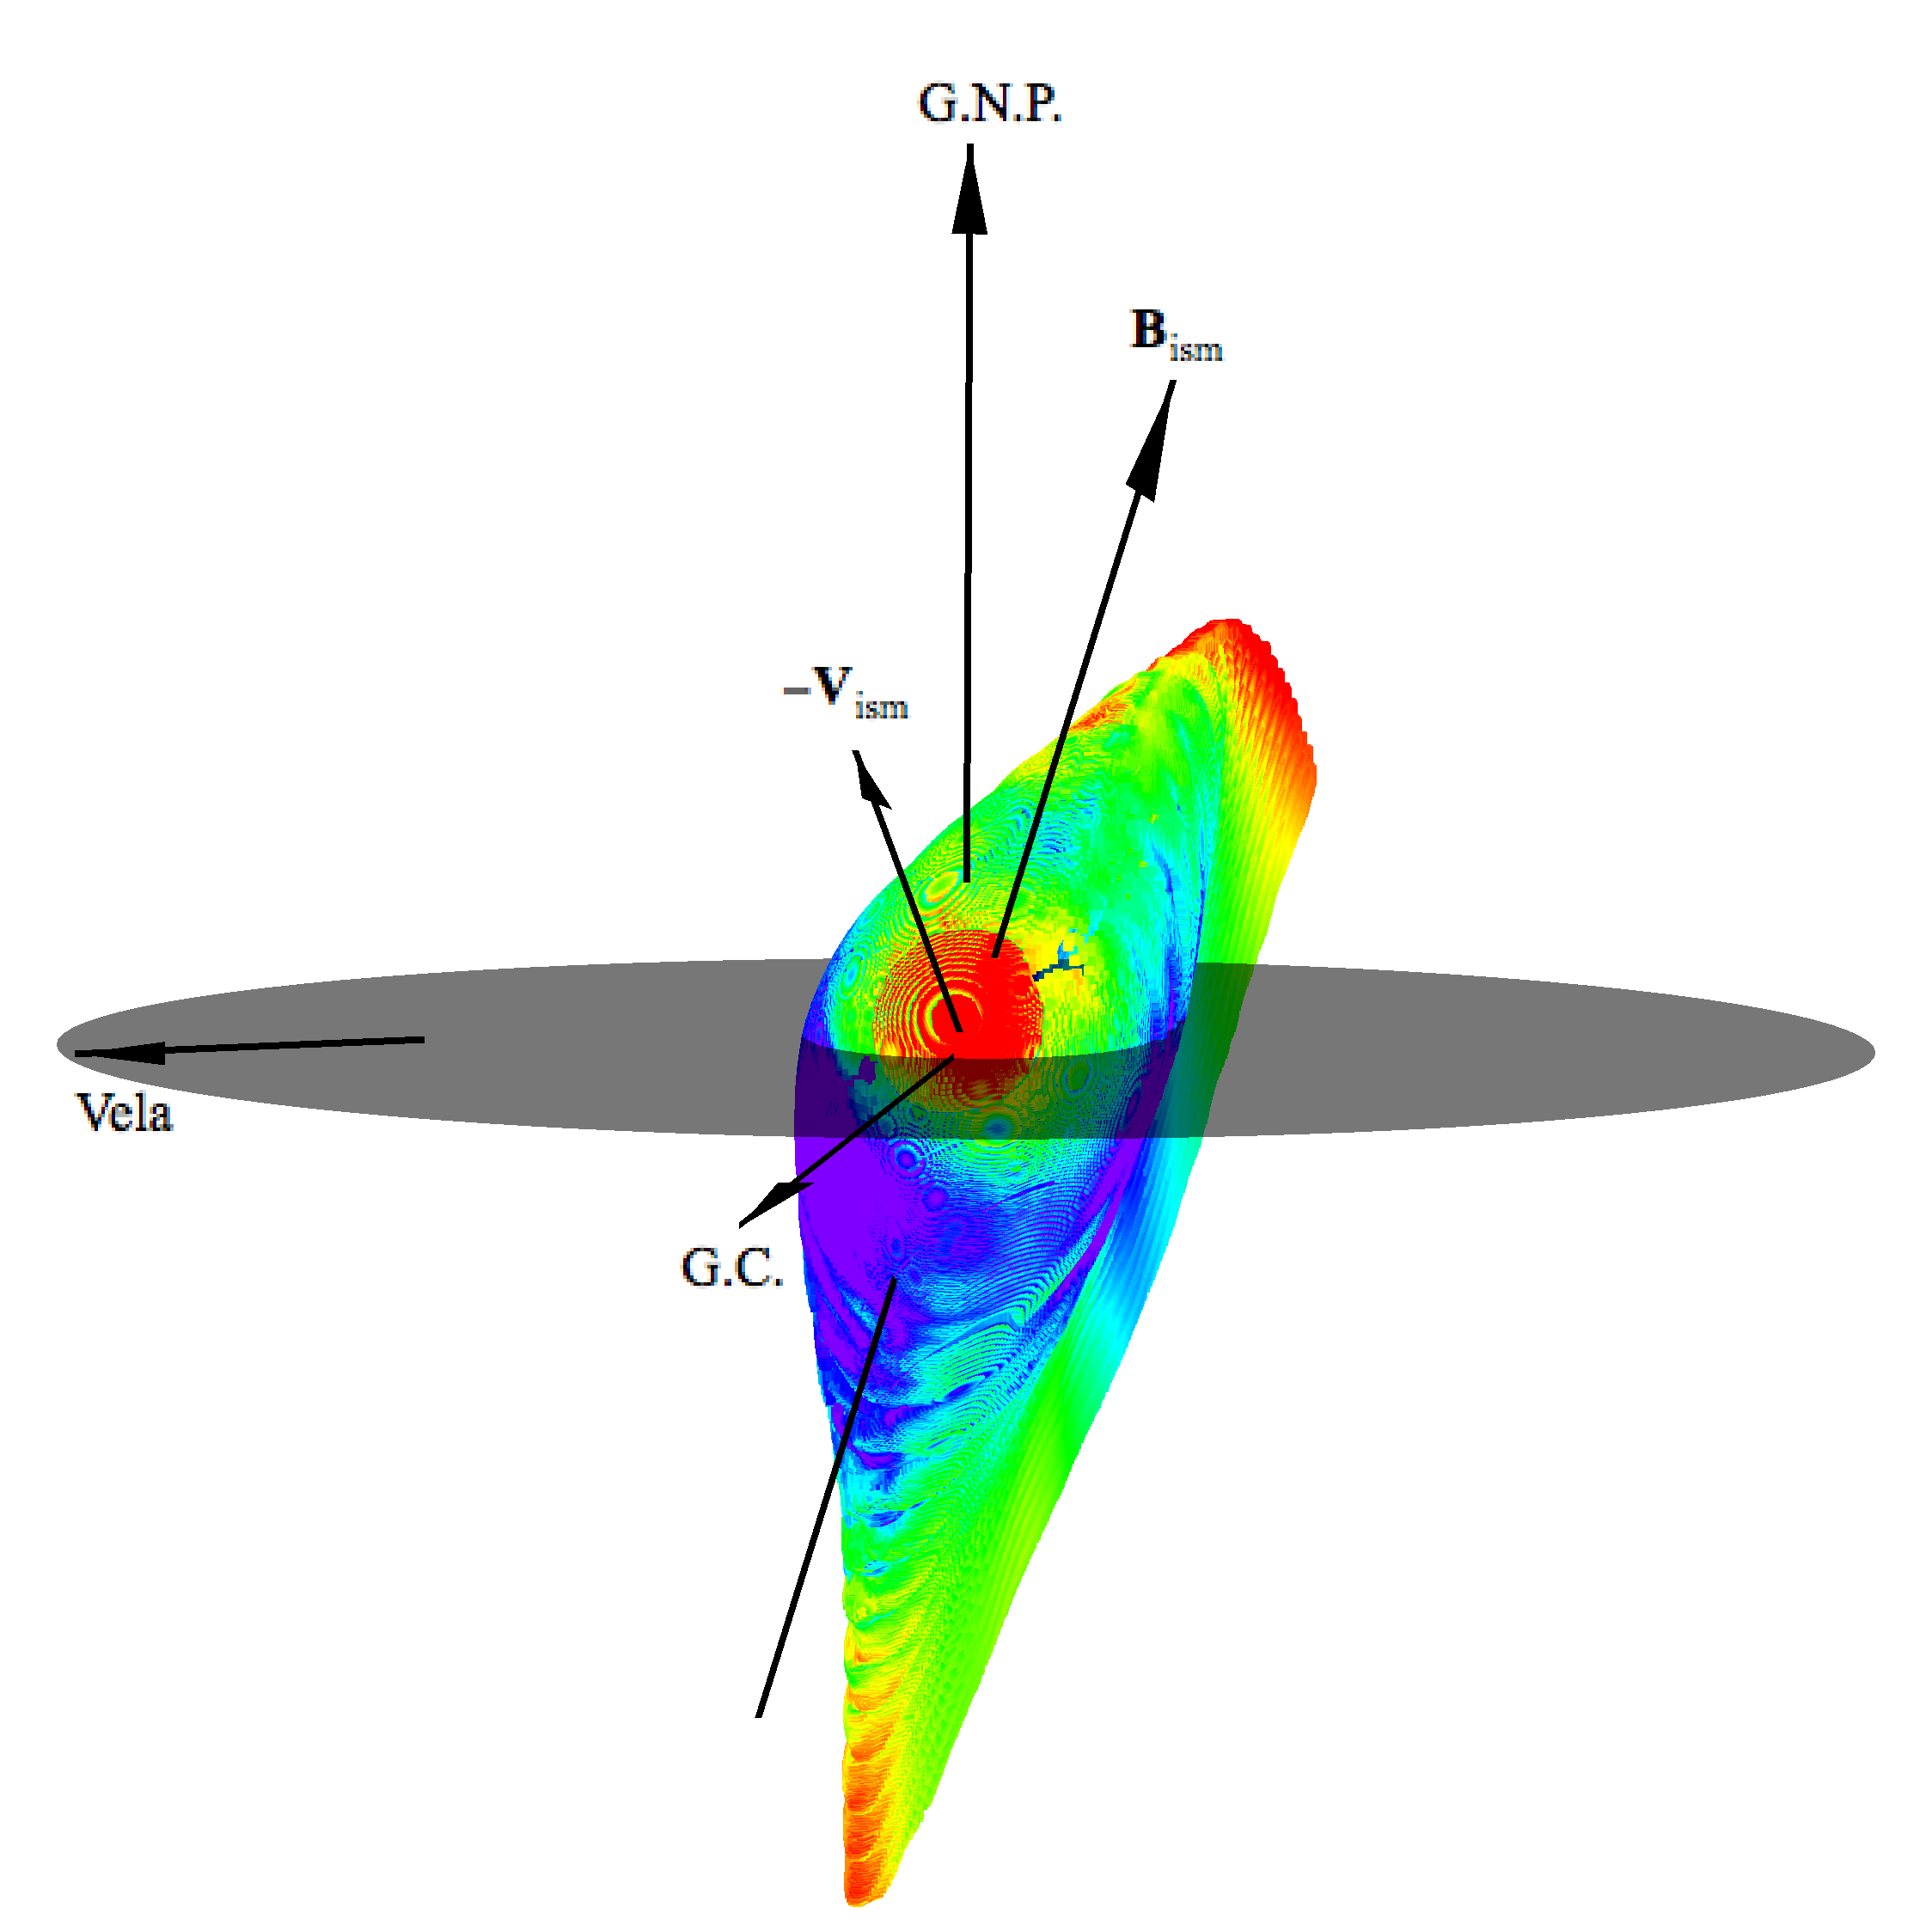
Heliosphere in the Galaxy
(diffusion flux)
TeV CR density gradient
HDP

Slide 11
Anisotropy: comparison between observation and calculation with 2nd order pitch angle anisotropy
Tibet ASγ observationn
Calculation (unsmoothed)
LISM
Calculation (5º smoothing)

Slide 12
TeV CR anisotropy in relation to heliospheric structures
Bow wave
Bow wave
Plane perp to B_{ism}
Plane perp to B_{ism}
HDP
HDP
IBEX ENA Emissions
IBEX image from McComas et al.

Slide 13
Improved model fit with with
(1) higher-order pitch-angle anisotropy
(2) normalized intensity every latitude

Slide 15
Correction to relative intensity map

Slide 16
P2 Linear fit
Calculated
normalized intensity at Earth
Intensity in ISM
Observed
P4 normalized fit

Slide 17
Shape of heliopause and magnetic field environment
Simulation box 12000x8000x10000 AU for cosmic rays of a few TeV
B_{ism}=3.5 mG, n_{e}=0.065 cm⁻³, n_{H}=0.184 cm⁻³
B_{ism}
HDP = B-V plane

Slide 18
Pitch angle diffusion and physical model fit
Pitch angle diffusion with focusing

Slide 19
Angular power spectrum
98% of spectral power is in the dipole
Heliosphere generates the majority of medium-scale anisotropy between l=2, and l=13
Unaccounted power for l >13

Slide 20
TeV cosmic ray transport in LISM
Parameters of cosmic ray distribution inferred to anisotropy
Parallel to magnetic field
Perpendicular to magnetic field
TeV cosmic ray transport in LISM is dominated by parallel diffusion along magnetic field into northern Galactic Halo. The density gradient is mainly perpendicular to the magnetic field. This requires a very anisotropic diffusion of κ_{per}/κ_{par}~10⁻⁴. There is a significant weakening gradient of magnetic field strength, which causes a beam of cosmic ray flux along the field line.

Slide 21
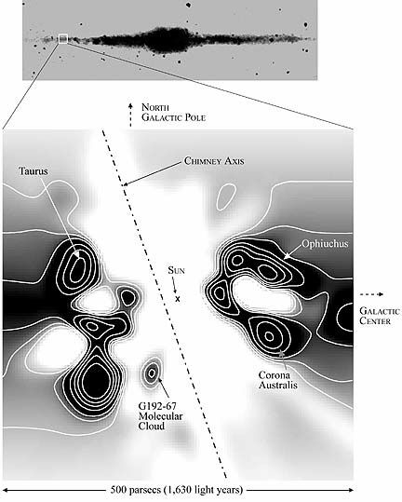
Solar system neighbor environment in the Galactic plane
ISM based on Frisch (2017)
Bism
Galactic plane
© CHIPS, CSE, U.C. Berkeley

Slide 22
Summary
We have theoretical mitigated the latitudinal blindness and obtained true relative intensity map.
The CR anisotropy in the LISM is almost a pure pitch-angle dipole opposite the magnetic field. It indicates that cosmic ray transport is mainly through parallel diffusion into the northern Galactic halo.
Pitch angle anisotropy of TeV cosmic rays is mostly linear, indicating an isotropic particle pitch-angle scattering.
There is a formation of beam along magnetic field through defocusing with L_{B}~6λ||. Tail-in hot spot is explained by this beam.
CR density gradient is perpendicular to the LISM magnetic field. It is large, indicating local SN source is making a special contribution. Its direction is consistent with a source in the local bubble, possibly Vela (250 pc away, 11 kyr old, 0.75% come from it). κ_{per}<<κ_{par}.
The LISM magnetic field and hydrogen ionization ratio are now more tightly constrained. TeV cosmic ray anisotropy images contain features related to (a) Hydrogen deflection plane (HDP) in the heliotail (b) Plane perpendicular to B_{ism}, and (c) Bow wave.
    Heliospheric magnetic field distort LISM dipole anisotropy to form many medium-scale features (l = 2-12) in the anisotropy images seen at Earth. Small-scale (l >13) may be of LISM origin. A part of sky is completely smeared by chaotic CR trajectory.

