Slide 1
Review of the Local ISM
Jeffrey L. Linsky
JILA/University of Colorado, Boulder CO USA
Cosmic Ray Anisotropy Workshop 2023
Loyola University - Chicago
May 16-19, 2023
In collaboration with Seth Redfield (Wesleyan Univ.) and Eberhard Möbius (Univ. New Hampshire)

Slide 2
Outline
What is the LISM (Local Interstellar Medium)?
Why is the LISM important?
How to measure properties of the LISM (in situ and remote)
Kinematic properties of the LISM
Physical properties in the LISM (thermal and non-thermal)
Is the LISM in thermal and pressure equilibrium?
Unanswered questions concerning the LISM

Slide 3
What is the LISM?
A generic term for the gas between the heliopause and the edge of the Local Bubble
Terminology (Disturbed Very Local ISM (VLISM), pristine VLISM, Local Bubble gas)
Structures (heliopause, outer heliosphere, Local Interstellar Cloud (LIC), Cluster of Local Interstellar Clouds (CLIC), Intercloud medium, Local Bubble)

Slide 4
Schematic of the heliosphere showing the inflow of neutrals and plasma from the pristine VLISM
The Sun’s motion through the pristine very local interstellar medium (VLISM) produces inflowing neutral (solid arrows) and ionized gas (dashed arrows).
The plasma flows around the HP.
Neutral He flows through the disturbed VLISM (outer heliosphere) unchanged.
Neutral H mostly charge exchanges with protons in the “hydrogen wall” between HP and BS.

Slide 5
Morphology and kinematics of the Local Interstellar Cloud (LIC). View from the NGP.
62 lines of sight through the LIC allow us to compute a 3D model of the LIC. (Linsky+2019 ApJ 886, 41)
The Sun is at or just beyond the edge of the LIC (covers 45% of the sky).
EUVE, IBEX, and Ulysses have measured neutral He flowing into the heliosphere from the ISM with speed 2 km/s faster and direction 2-3 degrees off from the LIC velocity vector.
Evidence that the heliosphere is not inside of the main part of the LIC, but probably at the edge where the vector velocity is different.

Slide 6
The Cluster of LISM clouds (CLIC) consists of at least 15 partially ionized clouds. View from the NGP.
Each cloud defined by its own velocity vector.
Cloud shapes and sizes from interstellar absorption line column densities for many sightlines.
Assume constant density (n(HI)=0.20 cm⁻³) to calculate pathlength through cloud.
If n(HI)=0.10 cm⁻³ (see later slides), then the clouds are twice as large and fill the entire volume within 4 pc.
Redfield & Linsky (ApJ 673, 282 (2008)).
lism.wesleyan.edu
Redfield & Linsky (2002); Linsky, Redfield, & Tilipman (2019); Frisch, Redfield, & Slavin (2011)
Notes:
do 2-page
left: all LISM clouds are moving roughly in same direction and a speed consistent with simple 3D vector, but significant departures exist
right: find spatial correlations and self-consistent sub-vectors associated with distinct ISM clouds..
gry RL15, website
takeaway: global morphology, richness to structure, but difficult to get small-scale structure

Slide 7
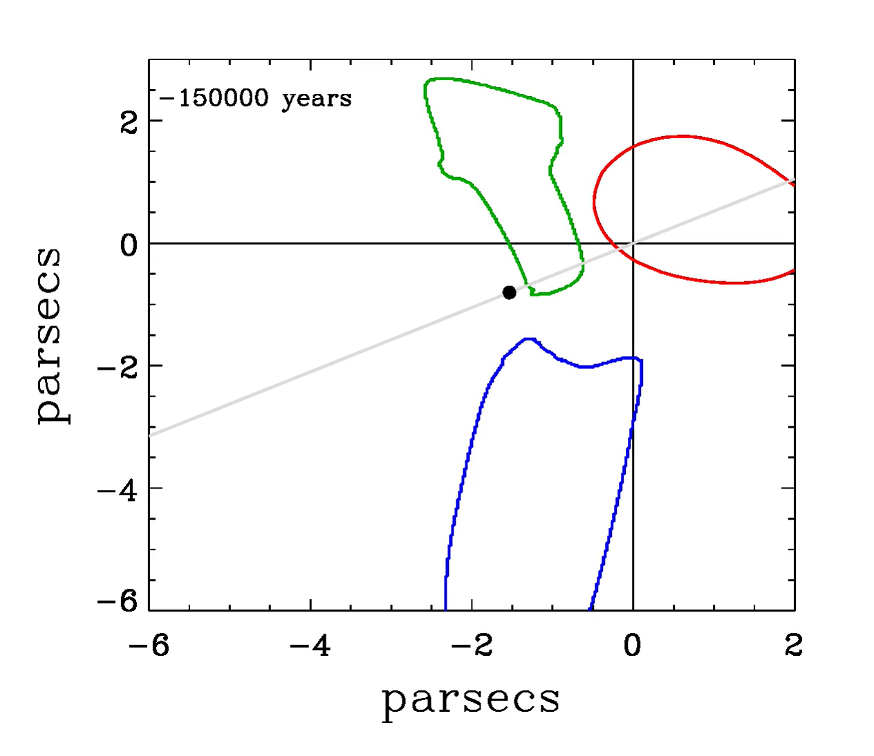
The heliosphere varied in size as it moved among the CLIC clouds, entering the LIC 60,000 years ago
LIC
Aur
Blue
Vannier, Redfield et al. (2023; in prep)
Notes:
The Sun entered the LIC 60,000 years ago

Slide 8
Local Cavity (Bubble) as determined from dust absorption (blue is low dust and red is high dust). Views from NGP and from the Galactic plane. (Pelgrimes et al. A+A 636, A17 (2020))

Slide 9
Why is the LISM important?
Heliosphere: the LISM is more than just the outer boundary condition of the heliosphere determining its size and shape. Inflowing neutral H charge-exchanges with heliospheric protons creating the disturbed VLISM beyond the heliopause.
Astrospheres: environment, measuring stellar winds, models.
Exoplanet Atmospheres: stellar-wind driven atmosphere mass loss occurs inside host star astrospheres.
ISM in the Milky Way Galaxy: properties of the ISM at high spatial resolution, pressure balance, Galactic chemical evolution, deuterium evolution, etc.

Slide 10
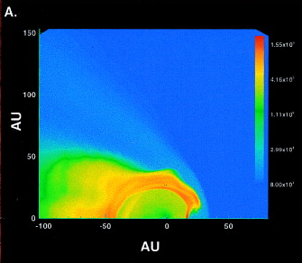
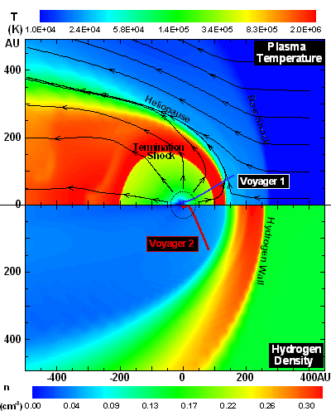
When the Sun sees an increase of LISM density by only a factor of 50, the TS moves inward from 100 AU to 10 AU.
N_{H}(LISM) = 10 cm⁻³
N_{H}(LISM) = 0.2 cm⁻³
Müller (2004)
cf. Opher and Loeb (COSPAR 2022) n(HI)=3,000 cm⁻³
Zank & Frisch (1999) and see Müller et al. (2006)
Notes:
do 2-page: distant ISM optical, complicated by many absorbers, strong, often evaluated at low/medium resolution, physical measurements suffer from blending line of sight averaged
local: only detected in UV (dependent on HST mission lifetime), simple structure, reliable physical measurements possible, line of sight averaged
of 200 some are large surveys by ourselves (one recently accepted), small projects, other purposes

Slide 11
Detecting an astrosphere by blue-shifted absorption in the hydrogen Lyman-α line
Charge exchange between inflowing interstellar HI and protons produces a region of compressed, heated, and decelerated (relative to the ISM inflow) HI Lyman-α absorption.
Hydrogen wall Lyman-α absorption is red-shifted relative to the ISM as seen from inside the heliosphere and blue-shifted relative to the ISM as seen from outside of the astrosphere.

Slide 12
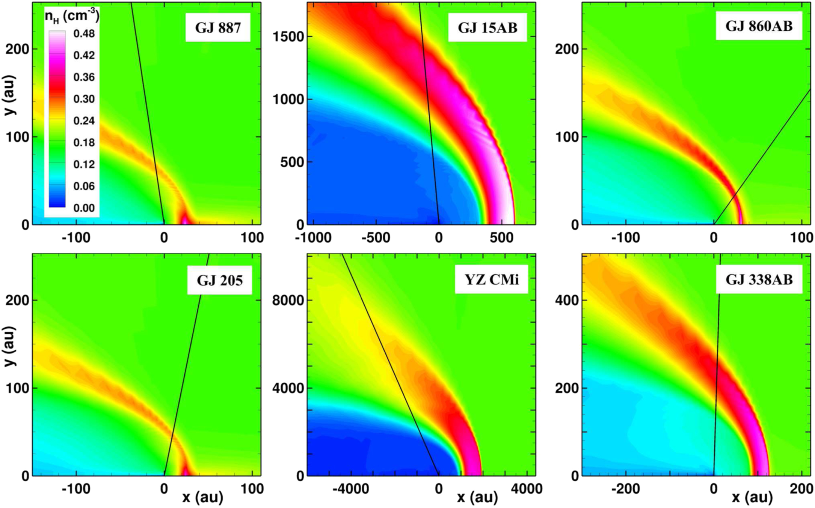
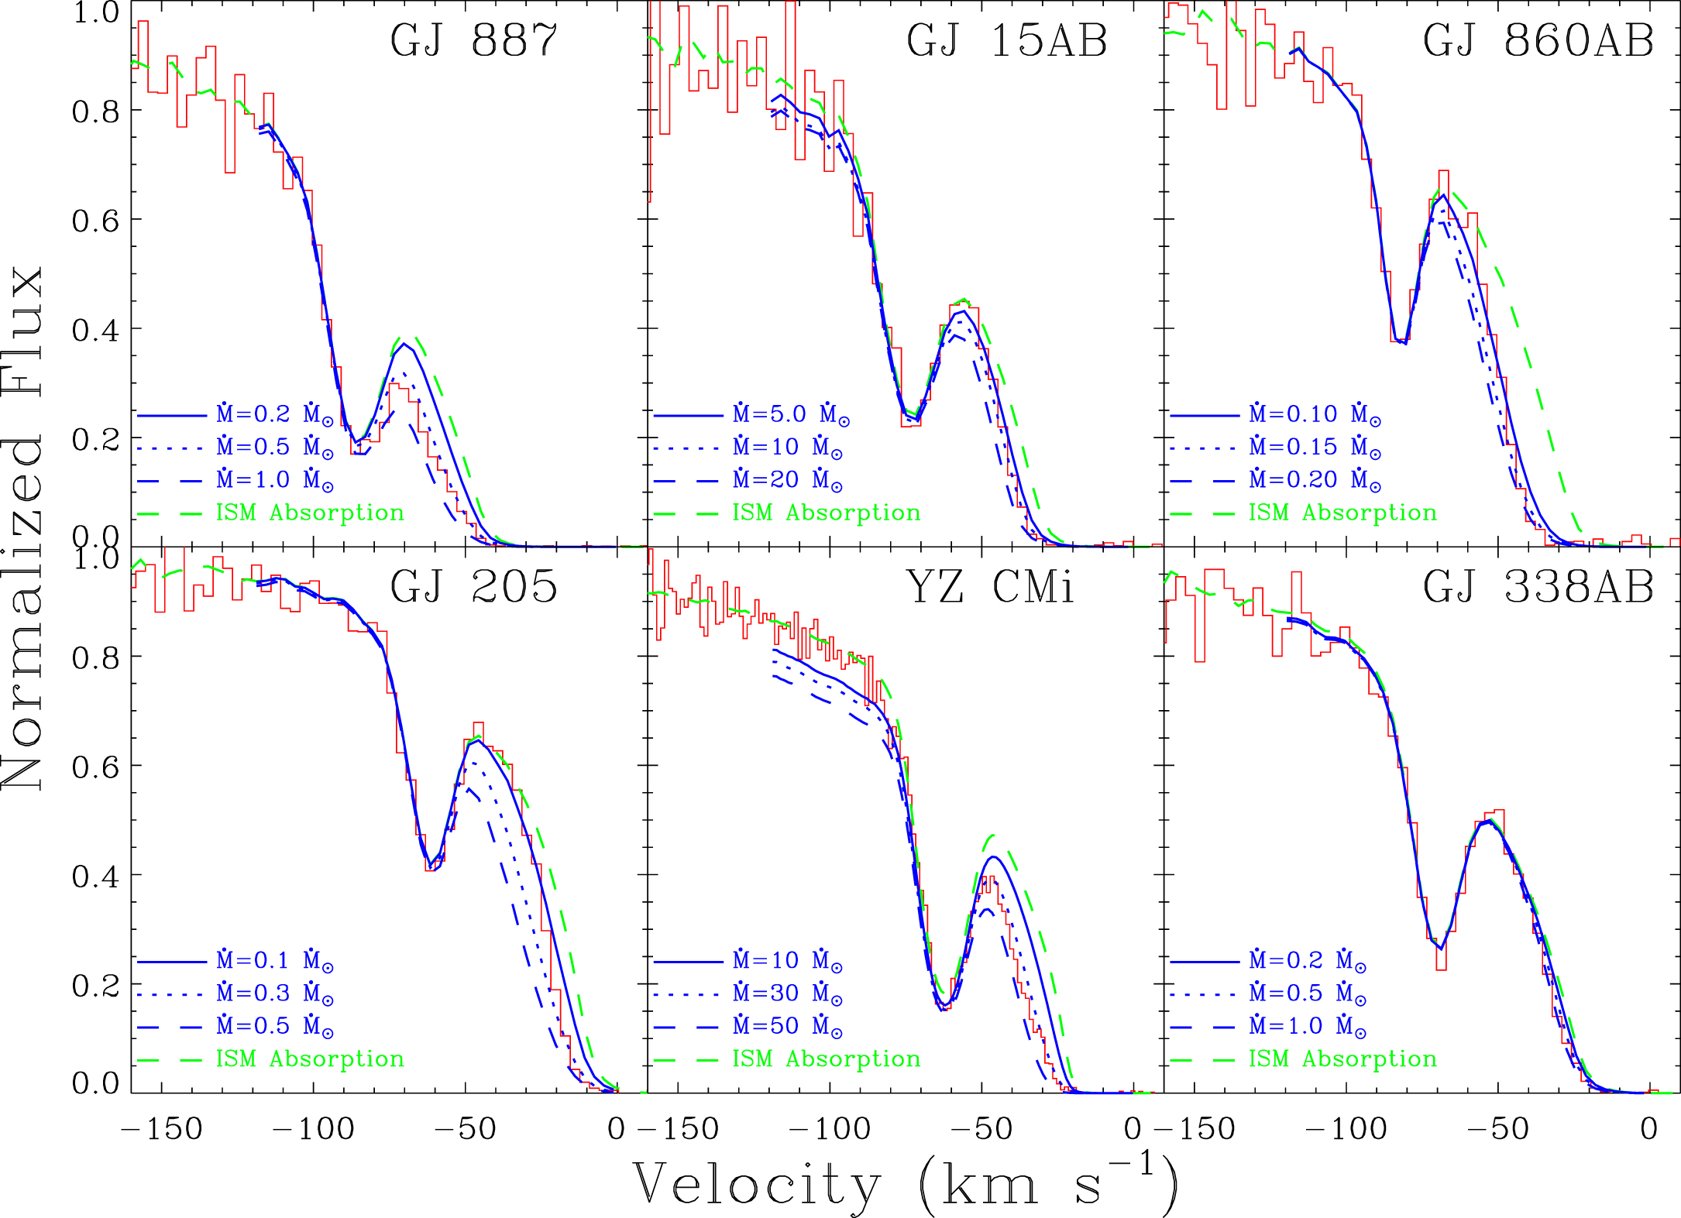
Astrospheres of M dwarfs obtained from high-resolution Lyman-α spectra and hydro-dynamic models (Wood+2021)
Hydrogen walls (red) require that inflowing gas be partly neutral. Stars are located at 0:0. Sight line to HST is black.
Blue side of the ISM Lyman-α absorption. Green line is for only ISM absorption..

Slide 13
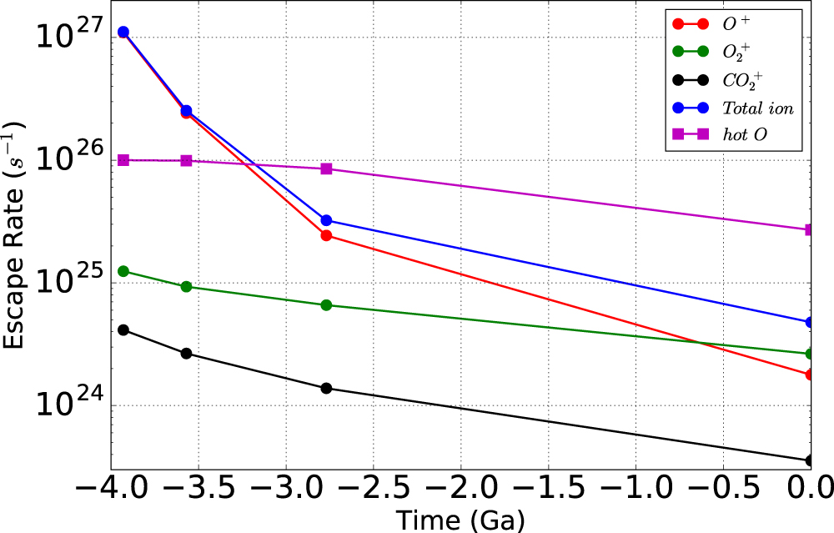
Stellar winds can remove exoplanet atmospheres
For planets with weak or no magnetic fields, magnetic stellar winds can capture ions > escape.
Ions are produced by dissociative-recombination reactions of O₂ and CO₂ > O⁺+, O₂⁺, CO₂⁺, and hot O.
Mars lost its water primarily by photolysis and escape of H (Jeans), and oxygen ions produced in dissociative-recombination reactions and then picked up by the magnetized solar wind.

Slide 14
How to measure the LISM (in situ and remote)?
High-resolution UV spectra (3 km/s desirable) obtained with the STIS instrument on HST.
Weak dust absorption primarily at the outer boundary of the Local Bubble.
In situ measurements by the Voyager spacecraft (V1 now at 159 AU) include magnetic fields, cosmic rays, thermal plasma, pick-up ions.
ENA (energetic neutral atoms) measurements by IBEX.

Slide 15
High-resolution UV spectroscopy is critical for measuring LISM properties. Example of HST spectrum of HD9826 (Edelman et al. 2019)
Most optically allowed transitions from the ground state of abundant species in the ISM are in the UV – e.g., H+D Lyman-α (1216Å), Mg II (2800Å), FeII (2586Å), O I (1304Å) , C II (1335Å).
Interstellar velocity structure shows components separated by only a few km/s.
Best HST resolution is 3 km/s. Consider the effects of 10 km/s or 1 km/s resolution.
Need to separate stellar emission/absorption line from interstellar absorption.
Analysis of the H+D Lyman-α line requires removal of the narrow geocoronal emission.
Will this capability exist after HST/STIS? No

Slide 16
Observational Diagnostics
1 ion, 1 sightline
Velocity, Column Density
Temperature, Turbulence, Volume Density, Abundances, Depletion, Ionization Fraction
multiple ions, 1 sightline
multiple ions, multiple sightlines
Global Morphology, Global Kinematics, Intercloud Variation
Origin and Evolution, Interaction of LISM Phases
b²=2kT/m+ξ² T=temperature ξ=turbulent velocity (km/s)

Slide 17
Kinematic properties of the LISM

Slide 18
The Multi-cloud Model (Redfield & Linsky 2008) – assumptions (because only radial velocities are very accurate and data are limited)
Interstellar radial velocities for more than 4 well separated sightlines that are consistent (within 2 km/s) of a velocity vector define a co-moving interstellar gas structure called a “cloud”.
Clouds are located somewhere within the distance to the nearest star that shows interstellar absorption consistent with the velocity vector.
The gas in a cloud is assumed to be co-moving. (i.e. rigid) with mean physical properties.
Gas motions within a cloud are assumed to be Maxwellian with a “turbulent” component. No shocks or non-thermal velocities are included in the analysis.
Each cloud is assumed to be contiguous (no detached pieces) and homogeneous with no overlap or mixing with other clouds.
Cloud boundaries (in 2 dimensions) are determined by detection of neutral hydrogen or MgII absorption with radial velocities consistent with the vector.
Intercloud gas (if present) must be fully ionized hydrogen (either hot or photoionized) in order to be not detected.

Slide 19
Refinements to the
Multi-cloud Model

Slide 20
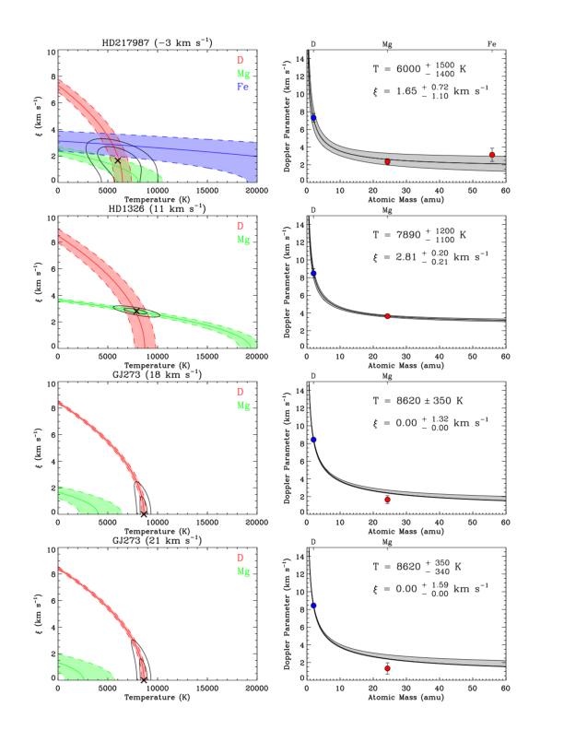
(1) A broad distribution of physical properties within a cloud
Study of 97 sightlines within 100 pc (Linsky et al. AJ 164, 106 (2022)).
STIS data primarily Lyman-α, MgII, and FeII.
Include only data with T≥2error.

Slide 21
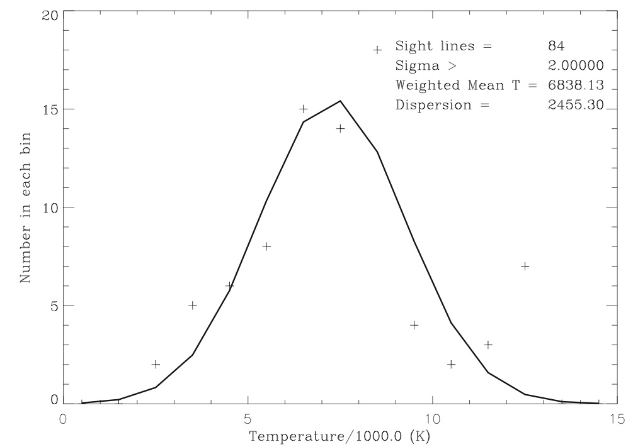
For 84 (≥2σ) sightlines through the LISM and 36 through the LIC. What are the distributions of temperatures? Data are binned. Gaussian fits.
Mean=6,838±2,455 K
Mean=6,510±2,773 K

Slide 22
For 84 (≥3σ) sightlines through the LISM and 36 through the LIC, what are the distributions of turbulent velocities? Data are binned. Gaussian fits.
Mean = 2.54 ± 1.77 km/s
Mean = 2.58 ± 1.34 km/s

Slide 23
Temperature differences ΔT(θ) for sightline pairs through the LIC as a function of angular separation (θ) compared to mean measurement uncertainty
There are 596 sightline pairs through the LIC with ΔT/errors>2.
Most ΔT(θ) far exceed the mean measurement errors (1624 K).
Therefore the temperature distribution in the LIC is definitely not consistent with a constant value.

Slide 24
Temperature differences ΔT(θ) for sightline pairs through the LIC binned in 10 degree intervals
596 sightline pairs through the LIC with ΔT > 2 times errors.
Steady increase in ΔT(θ) above errors.
For the smallest angle separation (Procyon-YZ CMi pair), ΔT(2ᵒ.2)= 2200±695 K.
Center of path length through the LIC toward Procyon is 0.5 pc. Separation of sightlines is 0.5tan(2ᵒ.2)pc=5,100 AU.
Length scale for significant temperature differences in the LIC is probably smaller than 5,100 AU.
NOTE: The heliosphere traverses this length in <5,100 AU/5.1 AU/yr or <1,000 years.

Slide 25
(2) Interstellar n(H I) is inconsistent with n(H I)=0.20 cm⁻³ flowing into the heliosphere
Measurements of n(HeI )and theoretical models of LISM gas flowing into the heliosphere identify n(HI)=0.20 cm⁻³.
For the 37 stars within 10 pc, plot the filling factor (ff) assuming n(HI)=0.20cm⁻³.
Except AD Leo, all sightlines have ff<0.63 and ff decreases with distance.
4 nearby stars with only LIC absorption (red dots) have observed astrospheres, so must be surrounded by neutral hydrogen, so LIC must fill their entire sightlines, and n(HI)≈0.10 cm⁻³ in the LIC.
If the LIC is typical of nearby clouds, then within 4 pc, n(HI)≈0.10 cm⁻³.

Slide 26
(3) Revised Model: n(HI)=0.10 cm⁻³ not 0.20 cm⁻³
Reducing n(HI) by a factor of 2 increases cloud sizes by a factor of 2 in all directions.
As a result, the clouds fill all space out to at least 4 pc.
If n(HI)≈0.10 cm⁻³ in all clouds, then there will be regions of overlap and no inter-cloud medium within 4 pc.
Beyond 4 pc the clouds appear to fill a decreasing fraction of space with distance and inter-cloud ionized gas between the clouds.
n(HI)=0.20 cm⁻³
Redfield & Linsky (2002); Linsky, Redfield, & Tilipman (2019); Frisch, Redfield, & Slavin (2011)
Notes:
do 2-page
left: all LISM clouds are moving roughly in same direction and a speed consistent with simple 3D vector, but significant departures exist
right: find spatial correlations and self-consistent sub-vectors associated with distinct ISM clouds..
gry RL15, website
takeaway: global morphology, richness to structure, but difficult to get small-scale structure

Slide 27
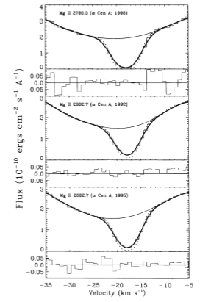
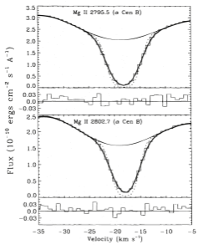
High-resolution interstellar Mg II absorption in spectra of α Cen A and B. G cloud at -18.1 km/s. LIC at -14.5 km/s
The upper limit on the Mg II column density through the LIC and the velocity of the Sun through the LISM imply that the heliosphere will leave the LIC in <2000 years.
LIC
LIC

Slide 28
(4) Very near the heliosphere the LIC and G clouds overlap or do they mix?
Pawel Swaczyna et al. (ApJ 237, L32 (2022)) argued that the heliosphere is now in a region where the LIC and G clouds overlap.
The HeI flowing into the heliosphere from the mixed cloud region has a temperature and flow directions intermediate between the LIC and G clouds.
n(HI)=0.20 cm⁻³ is the sum of n(HI) for the two clouds.
More like a merger than an overlap.

Slide 29
Testing the mixed cloud model
LIC and G are approaching each other with a speed of 7.2 km/s.
Two stars have sightlines that traverse the mixed cloud area along its length – AD Leo and HD 82558.
AD Leo and HD 82558 are the only stars for which we have data that have n(HI)=N(HI)/d≈0.20 cm⁻³.

Slide 30
Physical properties in the LISM
Table from Frisch, Redfield, & Slavin (ARAA 49, 237 (2011)).
Best results are for the LIC.
n(HI)≈0.10 cm⁻³
n(e)/(n(e)+n(HI))≈0.4
Cosmic ray flux measured by Voyagers.
Supra-thermal population in LISM is unknown.

Slide 31
Is the LISM in thermal and pressure equilibrium?
Yes –theoretical models by Wolfire et al. (2003)
No – simulations by de Avillez + Breitschwerdt (2005)
Yes within errors – observations by Linsky et al. (2023)

Slide 32
Theoretical models of CNM (T<300K) and WNM in thermal and pressure equilibrium Wolfire et al. ApJ 587, 278 (2003)
They argue that thermal and pressure equilibrium exists because the gas cools faster than the time between SN shocks.

Slide 33
MHD Simulations by de Avillez + Breitschwardt (2005) including SNe, B, shocks, flows

Slide 34
Is there pressure balance among the heliosphere components, between the disturbed VLISM and the pristine VLISM, and between the pristine VLISM and the Local Cavity and the Galaxy?
Pressure imbalances produce flows and shocks.
Linsky & Moebius (2022) arXiv:2212.00777 to appear in ApJ.

Slide 35
Assess the total pressure in each structure in its rest frame and relative to local standard of rest
Magnetic pressure: P(mag)=B²/8𝜋
Thermal pressure: P(th)=nkT
Cosmic ray pressure: P(cr)
Turbulent pressure: P(turb)=𝜌v²
Supra-thermal and high-energy pressure: P(supra-th)
Ram (dynamic) pressure due to external forces
Total pressure: P(tot) is the sum of the above
Gravitational pressure: P(grav)/k=22,000 Kcm⁻³ due to weight of mater above the Galactic plane

Slide 36
Estimate of pressure terms in the LIC
Magnetic field: 3.0μG from IBEX ribbon (Zirnstein et al. 2016).
Turbulent velocity: 2.20±0.94 km/s (Redfield & Linsky 2008).
Temperature: 7,720±1,907 K (Redfield & Linsky 2008). Other clouds have temperatures in the range 1,000-10,000 K.
Nonthermal (suprathermal) pressure: unknown but Swaczyna et al. 2019 estimate that Kappa is greater than 3.8 for inflowing neutral He. In this case P(suprathermal) ≤ 0.5P(th) ≤ 1015 Kcm⁻³. There could be other nonthermal pressure terms. E/k in photoionizing (504-912Å) flux from ϵ CMa is large (4x10⁷ Kcm⁻³).
Ram pressure: 𝝆v² where v=26 km/s solar motion relative to LIC.

Slide 41
Unanswered questions concerning the LISM
Why are there large temperature variations on short distance scales (<5100 AU)?
Is the CLIC better described by discrete kinematically defined clouds or a single medium with internal velocity gradients?
What interactions exist between cosmic rays and LISM gas?
Is the Local Bubble shock heated and hot (10^6K) or EUV photon ionized and warm (10,000K) or both?
Are the supra-thermal populations large and do they contribute significantly to the total pressure?
Is there important physics missing in the LISM models?

Slide 42
Is T really temperature or something else?
Lines widths of D I (m=2) and Mg II (m=24) are analyzed by one component that depends on 1/√m (called T) and a second component that does not depend on mass (called turbulent velocity).
Similar abundances of D and Mg: D/Mg ≈0.5 (cosmic) but D/Mg≈5 (ISM). Saturation of one line relative to the other is unlikely a problem.
LISM plasma could include a supra-thermal component which would broaden the light D I line measurably but less the heavier Mg II ion.
What appears as variable thermal broadening could be (in part) variable supra-thermal broadening or a bi-directional Maxwellian distribution (Wood et al. ApJ 881, 55 (2019)).

Slide 43
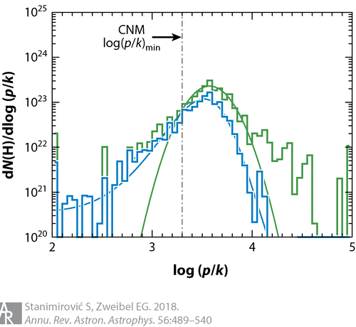
Distribution of thermal pressures of neutrals
Distribution of thermal pressures in the LISM obtained from C I line ratios in CNM and WNM (Jenkins & Tripp 2011).
Blue sample: observed general ISM away from bright stars excluding high pressure regions.
Green sample: Total sample including highly over-pressured regions maybe affected by stellar winds and shocks.
High pressure regions often found close to SNRs.
Alternative possibility: supra-thermal atoms add high pressure to the distribution.

Slide 44
Conclusions
Local interstellar clouds are inhomogeneous with temperature inhomogeneity scale size <5,100 AU.
Typical densities are n(HI)=0.10 cm⁻³ not 0.20 cm⁻³.
Partially ionized clouds completely fill space within 4 pc and partially fill space at larger distances.
Clouds overlap leading to mean properties (example of LIC-G) or overlap without mixing.
Pressure balance within the heliosphere, between the heliosphere and the pristine VLISM, and between the pristine VLISM and Galactic gravity.
Contact: jlinsky@jila.Colorado.edu

Slide 45
Any questions or thoughts?

Slide 46
What comes next? (2) Is there evidence for heating (shocks, turbulence, etc.)?
The largest measured turbulent velocity is about 4.2 km/s, which does not indicate a shock.
But differential velocities between adjacent clouds can be 10-50 km/s, which is supersonic.

Slide 47
What comes next? (3) What physics is missing from the classical 3 component model of the ISM?
Classical 3-component models (cold, warm, hot) of the ISM assume steady state equilibrium (Pressure balance within and between components) and balance of heating and cooling terms.
Wolfire et al. (2003) model predicts for warm gas (neutral or ionized) in the Galactic plane near the Sun, T=5040-8310 K depending on the heating and cooling rates.
In the LIC the observed temperature range is larger 2,450-12,900 K, and in the VLISM there are many sightlines with T≤3,500 K.
Does this indicate that flows are important and/or that the gas is far out of ionization and excitation equilibrium?

Slide 48
(5): Rigid multi-cloud structure is may not be realistic (Gry + Jenkins A+A 567, A58 (2014))
Their simpler picture of the LISM is a single continuous non-rigid cloud surrounding the Sun.
Velocity faster in the direction of motion and slower in opposite direction.
Model fits velocities of most sightlines. Same data set as Redfield & Linsky (ApJ 673, 282 (2008)).
n(HI)= 0.03-0.10 cm⁻³. The cloud fills space out to 9 pc.
Secondary velocity components may indicate a shock going through the main cloud.
Velocity residuals compared to the
mean. MgII (black) and FeII (red).

Slide 49
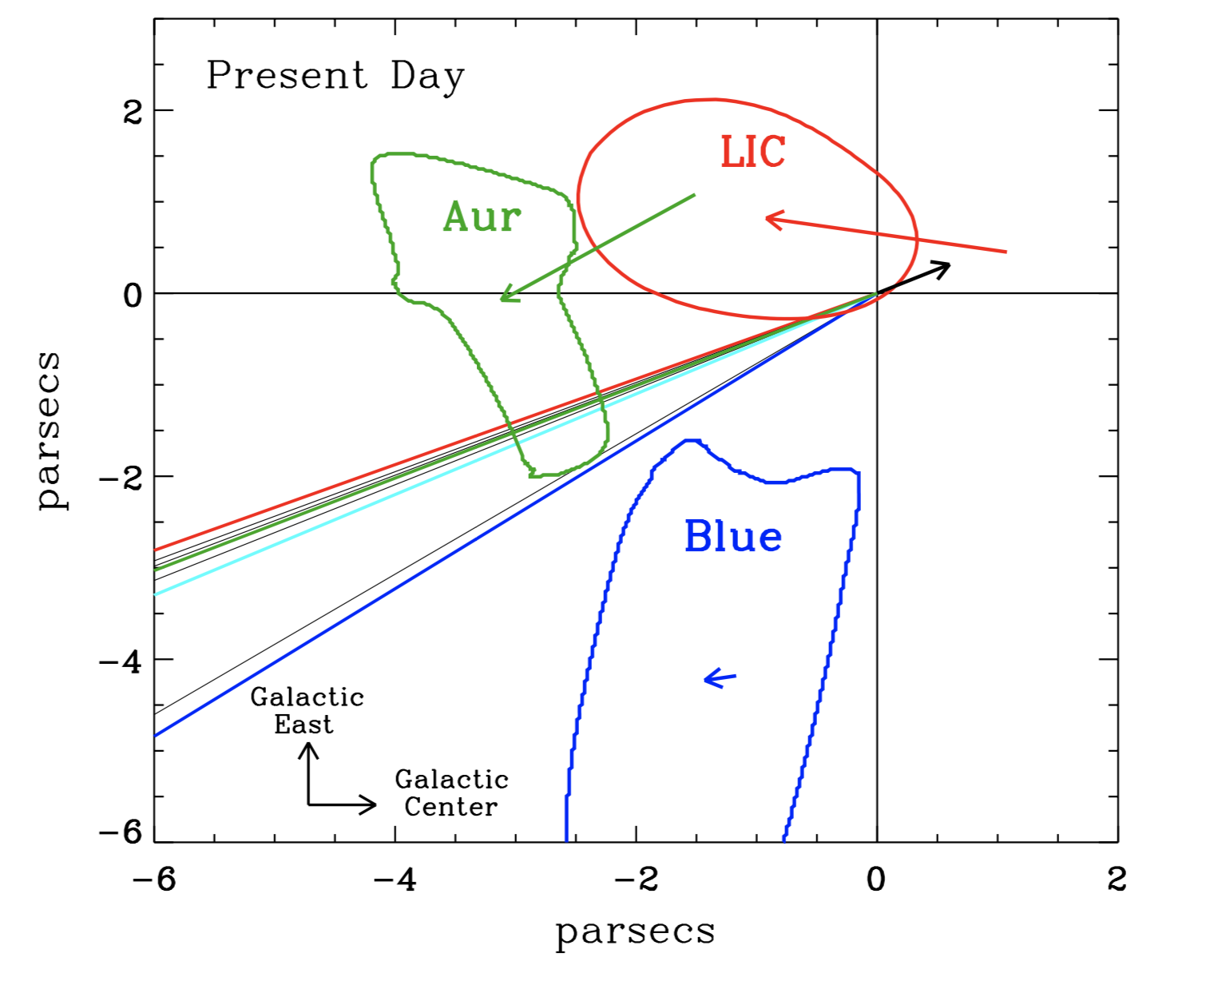
By looking in our rear view mirror we can reconstruct the ISM the Sun encountered in its past
Obtained UV spectra of 8 nearby stars in the backward direction with Hubble.
Analysis is sensitive to distances that correspond to the Sun’s trajectory over the last 4 Myr.
One of the densest LISM surveys
Uncovered significant small scale structure and variation in the small cone of observations.
Cloud sizes assume n(HI)=0.2cm⁻³.
Vannier, Redfield et al. (2023; in prep)
Notes:
do 2-page
left: all LISM clouds are moving roughly in same direction and a speed consistent with simple 3D vector, but significant departures exist
right: find spatial correlations and self-consistent sub-vectors associated with distinct ISM clouds..
gry RL15, website
takeaway: global morphology, richness to structure, but difficult to get small-scale structure

Slide 50
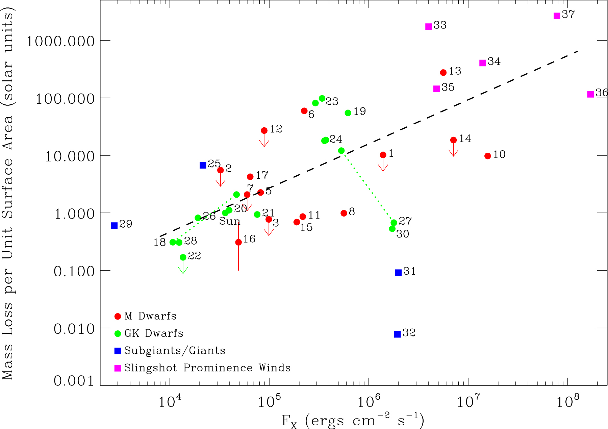
Comparison of stellar winds for stars of different activity and sp. type (Wood+ ApJ 915, 37 (2021))
Mass-loss rates per unit area relative to the Sun (2x10⁻¹⁴ M(Sun)/yr).
Green dots: GK dwarfs (12+Sun)
Red dots: M dwarfs (9)
Red squares: M dwarfs from slingshot technique (5) (Jardine + Collier Cameron MNRAS 482, 2853 (2019))
Blue squares: subgiants/giants (4)
General increase with activity. The young Sun probably had ~100 times the present mass-loss rate.
Most M dwarfs have mass-loss rates similar to G and K stars.

Slide 51
Detection of the astrospheres of α Cen B and Proxima Cen and stellar wind mass-loss
Black line is normalized HI and DI Lyman-α interstellar absorption estimated from MgII.
Extra absorption to the red of interstellar is hydrogen wall absorption in the heliosphere.
Extra absorption to the blue of interstellar is hydrogen wall absorption in the astrosphere.
Astrosphere absorption measures stellar mass-loss rate.

Slide 52
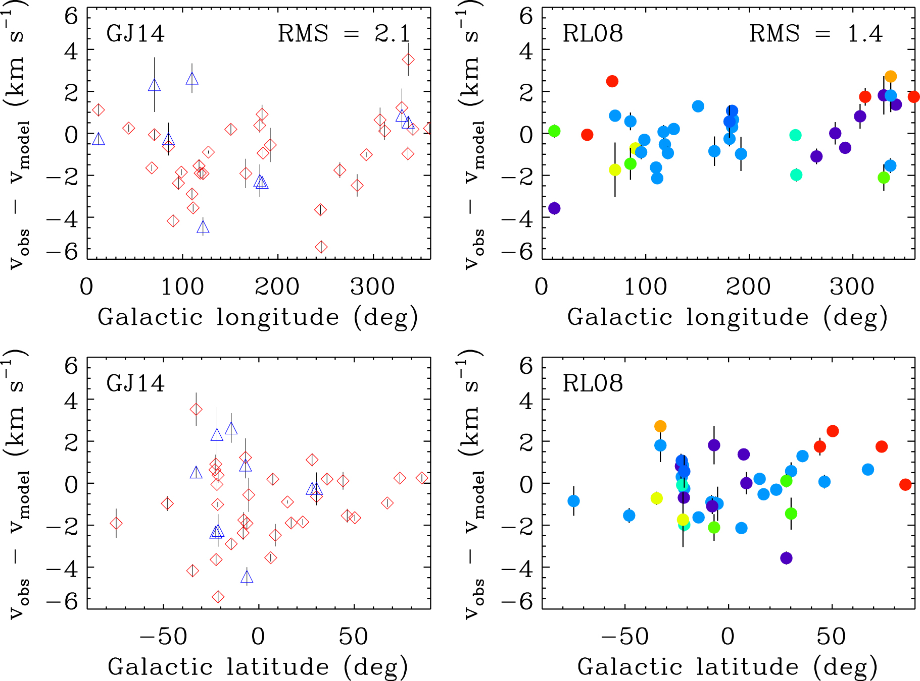
Test of the Gry-Jenkins model using new data
34 new SNAP sightlines selected by HST (Malamut et al. 2014).
Using the new data compare v(obs)-v(model) using the GJ14 model and the RL08 model.
Better fit (lower RMS) using the RL08 (multi-cloud) model.
But the multi-cloud model has many more free parameters, so the question of the best model is open.
All 34 SNAP targets have RVs and Galactic coordinates consistent with clouds previously identified by RL08.

Slide 53
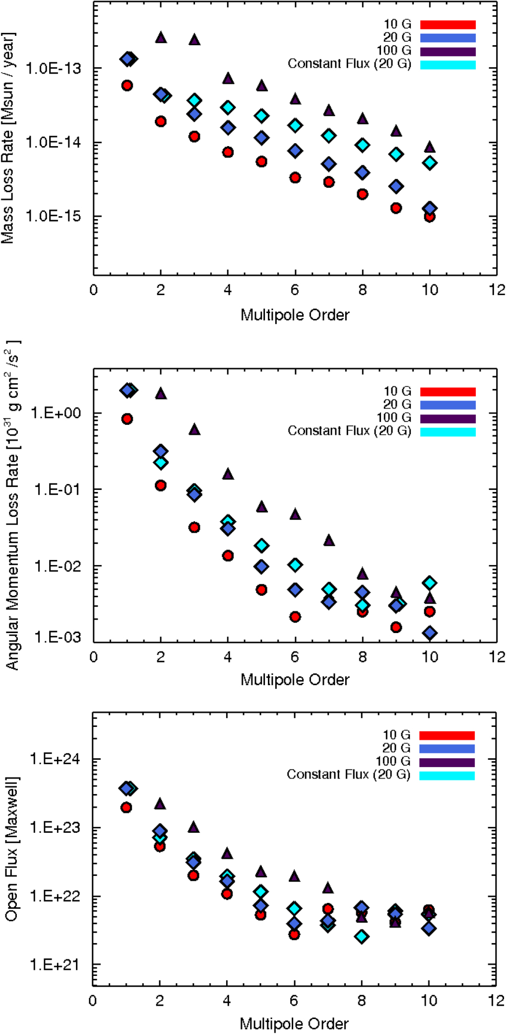
Why is there a large scatter of stellar mass loss rates for stars that are similar?
Magnetic topology: complex fields suppress mass loss (Garraffo+2015). Open fields support. ZDI maps do not measure small scale structure.
Magnetic field strength increases mass loss rate (Garraffo+2015).
Alfven-wave driven wind models have many assumptions.
Coronal mass ejections (CMEs) may account for only 10% of solar mass-loss rate, but could be far more important in stars with many super-flares or suppressed by strong magnetic fields.
Astrosphere technique has many assumptions, especially the assumed wind speed.

Slide 55
Are the total pressures inside the VLISM, CLIC, and Local Cavity in or out of balance?
A major constraint is the weight of overlying gas perpendicular to the Galactic plane: P(grav)=3.0 10⁻¹² dyn/cm² or P(grav)/k=22,000 Kcm⁻³.
The energy density of Galactic cosmic rays measured beyond the heliopause by Voyager 1 is 0.83-1.02 eV/cm³ or P(cr)/k=7,150 Kcm⁻³.
To balance P(grav), the sum of P(mag), P(cr), P(th), P(turb), P(supra-th) and P(hot-ions) must be about 22,000 Kcm⁻³.
What are reasonable estimates of P(mag), P(th), P(turb), P(supra-th), and P(hot-ions) in the VLISM and the LIC? What are the largest uncertainties?

Slide 56
The heliosphere is inside of the CLIC which is inside of the Local Cavity
Very Local ISM (VLISM): the interaction region of outflowing solar wind particles and magnetic fields and inflowing ISM gas and magnetic fields. From the heliopause (~120 AU) to about 700 AU.
Cluster of Local Interstellar Clouds (CLIC): at least 15 partially ionized clouds with temperatures of 1000-12,000 K. The heliosphere is at the edge of the Local Interstellar Cloud (LIC) and will exit soon into an uncertain environment. CLIC extends to about 10 pc (2,000,000 AU).
Local Cavity: An old supernova remnant consisting of a mixture of hot (million degree) gas and ionized warm (10,000-20,000 K) gas. Ionized by the star ϵ CMa. Surrounds the VLISM and CLIC and extends 50-200 pc in all directions

Slide 57
Pressure components in the VLISM
Component | Parameter | Component pressure (Kcm⁻³)
P(cr)/k | 0.83-1.02 eV/cm³ | 7,150±730
P(mag)/k | 4.0 µG | 4,600
P(turb)/k | V(turb)=0.5v(th) km/s | 1,320
P(th)/k | At 300 AU | 2,260
P(supra-th)/k | At 300 AU | 160±20
P(hot-ions)/k | 40-139 keV | 8,000
P(total)/k |  | 23,490
P(total)/k-P(grav)/k |  | 1,490 (7%) OVERPRESSURE 😀

Slide 58
Pressure components in the LIC
Component | Parameter | Component Pressure (Kcm⁻³)
P(cr)/k | 0.83-1.02 eV/cm³ | 7,150±730
P(mag)/k | 3.0µG | 2,600
P(turb)/k | V(turb)=2.20±0.94 km/s | 1,590±30
P(th)/k | T=7,720±1,907 K | 2,090±510
P(supra-th)/k and P(hot-ions)/k |  | unknown
P(ram)/k | V=26 km/s | 18,000?
P(total)/k | Kcm⁻³ | 31,430
P(total)/k – P(grav)/k | Kcm⁻³ | 9,430 (43%) OVERPRESSURE

Slide 59
What is the ram pressure? If there are few collisions, then there is small ram pressure!
Electrons, protons, and ions will be deflected by the magnetic field maintaining most of their forward momentum.
Helium atoms (m=4) proceed through the VLISM plasma with very few interactions and little momentum transfer.
Hydrogen atoms partly interact with the VLISM plasma through charge-exchange reactions, but many have no interactions through the VLISM and impart no momentum to the VLISM.
So, P(ram) < 𝝆v², but how much less? This is critical to the VLISM-LIC pressure balance question.

Slide 60
Two new conclusions concerning the interaction between the outer heliosphere and the LISM
(1) The LIC and by implication other warm clouds in the LISM do NOT have constant properties (temperature and turbulent velocities).
The LIC is highly inhomogeneous with length scales < 4,000 AU.
Higher temperatures at 80ᵒ-160ᵒ from main source of EUV photons.
“Temperature” may have a variable supra-thermal component.
(2) There may be a large pressure imbalance between the outer heliosphere and the LIC.
The VLISM is close to pressure balance with respect to gravity of the Galaxy, although P(hot-ions) is uncertain.
The LIC may be overpressured with respect to the VLISM because of the large P(ram) term. Is this correct?

Slide 61
Outline
Why high-resolution UV spectroscopy is critically important: Uniqueness of the UV spectrum. UV spectroscopy is required for understanding the local interstellar medium (LISM), interactions of the heliosphere with the LISM, ISM as the interface in Galactic chemical evolution, astrospheres, and exoplanet atmospheres and habitability.
Multi-cloud model: Many nearby interstellar clouds are identified by their unique velocity vectors and each with their own mean physical properties. Assumptions of the multi-cloud model. The location of the Sun relative to nearby clouds and the Sun’s trajectory through the CLIC.
Refinements to the Multi-cloud model: (1) Inhomogeneous properties within clouds and their size scale (2) Revised typical value of n(HI) in the clouds? (3) Clouds may completely fill nearby space. (4) Clouds overlap, but do they mix? (5) Clouds may have interior velocity structure.
Astrospheres: (1) How to detect. (2) Stellar wind mass-loss rates. (3) Role of stellar winds in exoplanet atmosphere loss.
Pressure Balance: (1) Within the heliosphere. (1) Between disturbed VLISM and the pristine VLISM. (3) Between the pristine VLISM, Local Cavity, and the Galaxy.

