Slide 1
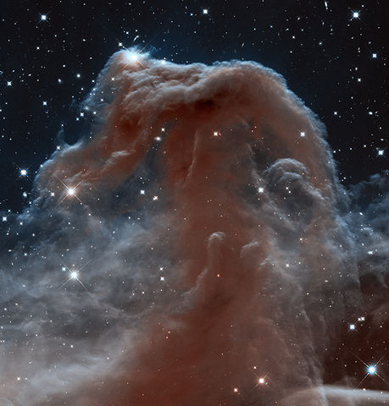
Selected Aspects of Magnetized Turbulence
(with implications for CRs)
Alex Lazarian
Thanks to A. Beresnyak, G. Brunetti, J. Cho, G. Eyink, G. Kowal, E. Vishniac, S. Xu, H. Yan

Slide 2
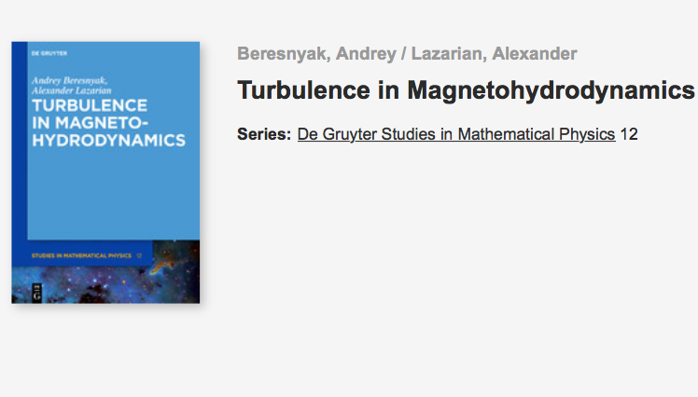
MHD Turbulence is explained in our book, published in 2019

Slide 3

Attention: Turbulence!

Slide 4
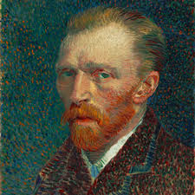

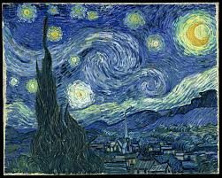

Turbulence is important!
Starry Night
WITH turbulence
WITHOUT turbulence
Van Gogh
Siyao Xu

Slide 5

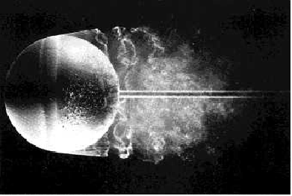
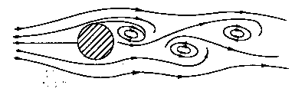
Astrophysical flows are turbulent: Re numbers are huge
L
Re=10000
V
Re ~ 15,000
Re=40
Re numbers from 10⁵ to 10²⁰
Numerical Re<10⁵: this a problem of brute force approach.
Notes:
5

Slide 6
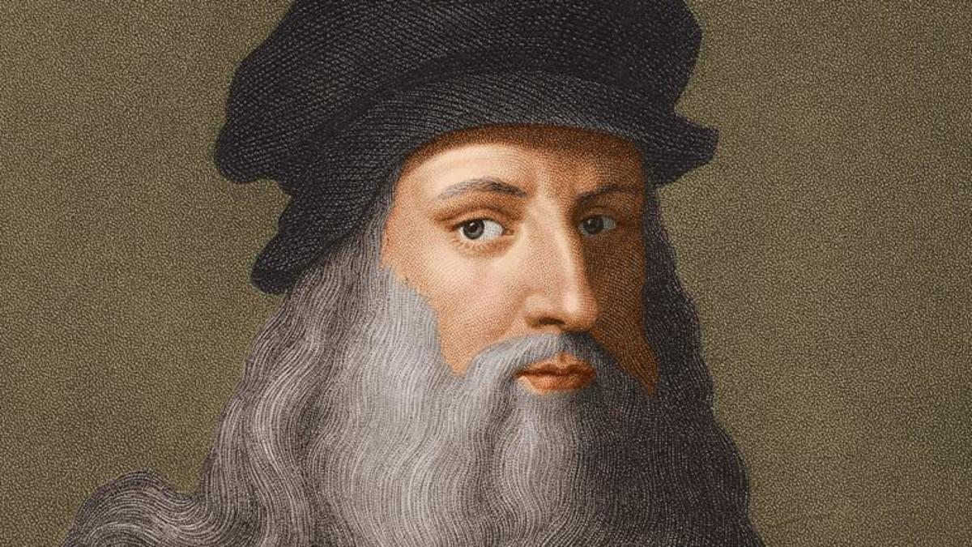
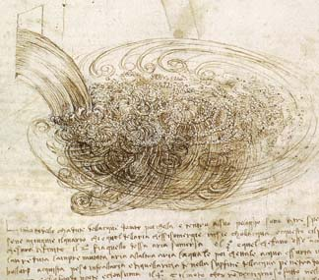
Turbulence is a chaotic order
It is important to know the laws of this order and use them!
L. Da Vinci

Slide 7

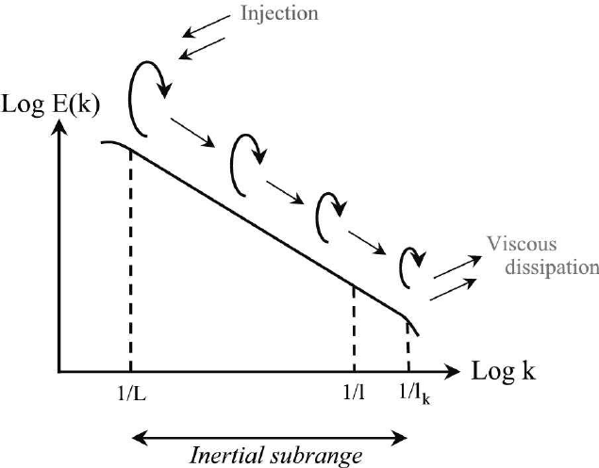
Turbulent energy cascade: self-similar from injection scale to dissipation
Constant turbulent energy transfer rate
https://commons.wikimedia.org/w/index.php?curid=64829708

Slide 8
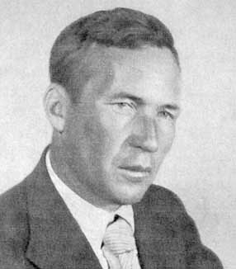
Kolmogorov theory reveals order in chaos for incompressible hydro turbulence
V_{l}²
= const
A. Kolmogorov
t _{cas,l}
V_{l}³
= const, V_{l} ~ l^{1/3}
t _{cas,l} = l/V_{l}
l
Spectrum, E(k)~k^{-5/3}
l
Re>>1
Re~1
Viscosity is not
important
v_{l}
Still not
important
Viscous
dissipation
Notes:
8

Slide 9
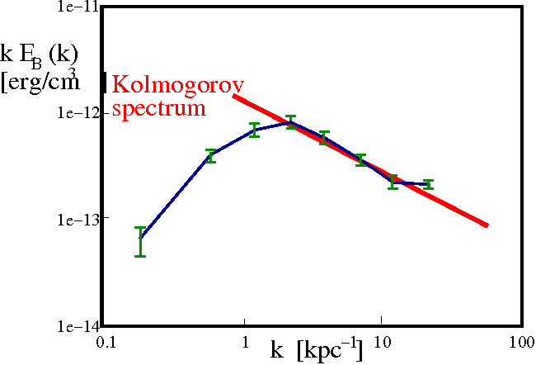
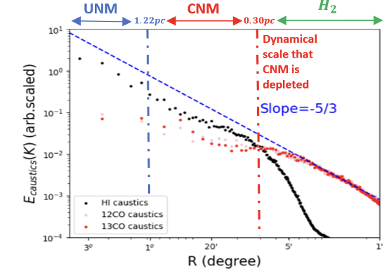
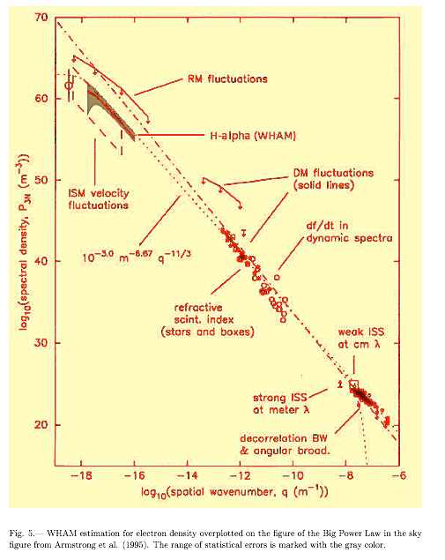
Kolmogorov spectrum is common in Astrophysics
Clusters of Galaxies
Magnetic fluctuations
Interstellar Medium
Velocity fluctuations
Interstellar Medium
Density fluctuations
Vogt & EnBlin 2005
Taurus region
420 pc
140pc
46.7pc
11.7pc
2.3pc
Distance (degrees,pc)
Yuen, Ho & AL 2021
Kolmogorov spectrum
Armstrong+ 95; Chepurnov & AL 09

Slide 10
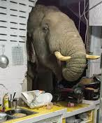
Turbulence is magnetized: The elephant in the room!
The magnetic field is dynamically important
Change in the nature of the motions
Essential for CRs!

Slide 11
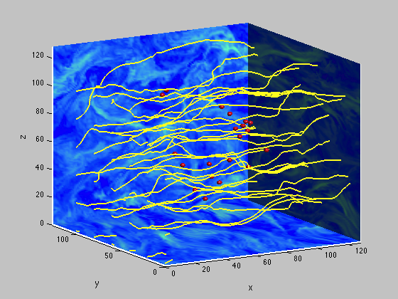
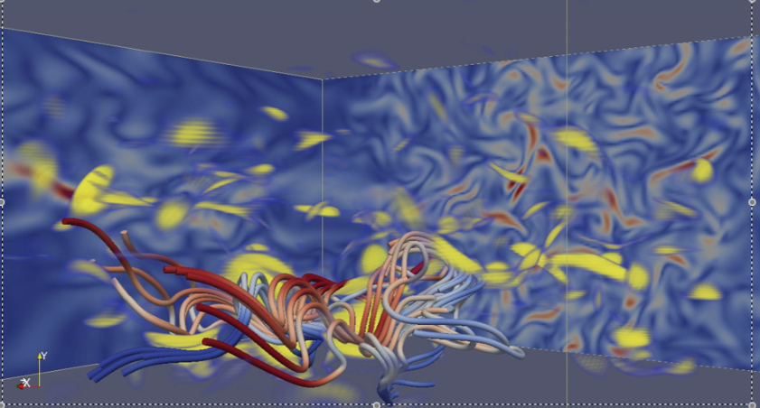
Turbulence radically changes the CRs propagation
Xu & Yan 2013

Slide 12
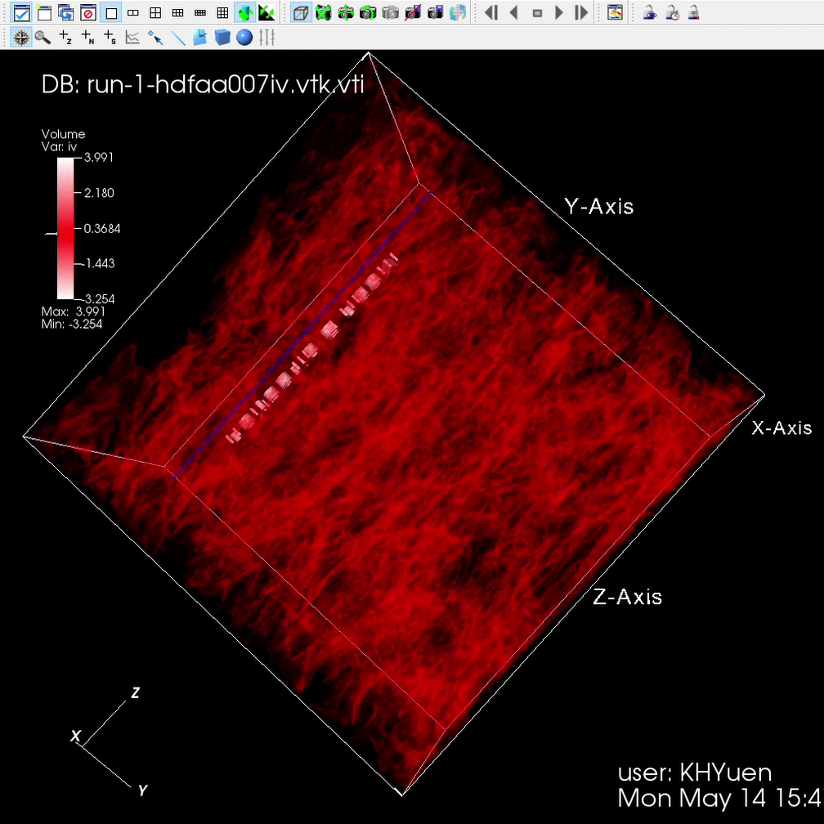
MHD turbulence is anisotropic
W. Matthaeus
In contrast to isotropic Kolmogorov turbulence, MHD is anisotropic (
Shebalin et al. 1983, Matthaeus et al. 1983)
Velocity contours in MHD turbulence (Yuen & Al 2019)
Obvious from modern simulations

Slide 13

Goldreich-Sridhar 1995 turbulent model predicts Kolmogorov spectrum for MHD turbulence
The problem of GS95 is that the scaling relation for anisotropy are obtained in the mean magnetic field reference system.
P. Goldreich
Numerical simulations show that the GS95 relations (Cho & Vishniac 2000, Maron & Goldreich 2001, Cho, AL & Vishniac 2002) are not valid in the mean magnetic field reference system.

Slide 14

Theory of turbulent reconnection (AL & Vishniac 1999) predicts that MHD turbulence consists of turbulent eddies aligned with local magnetic field
Turbulent reconnection predicts that eddies with rotational axis parallel to magnetic field of an eddy are not constrained by magnetic field.
E. Vishniac
MHD turbulence Kolmogorov in terms of spectrum, but the eddies are elongated along the local magnetic field direction. The eddies induce Alfven waves with the period equal to the rotation period of the eddy:

Slide 15
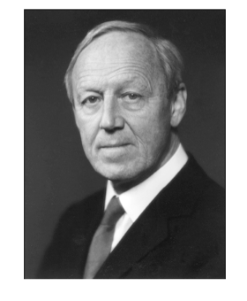
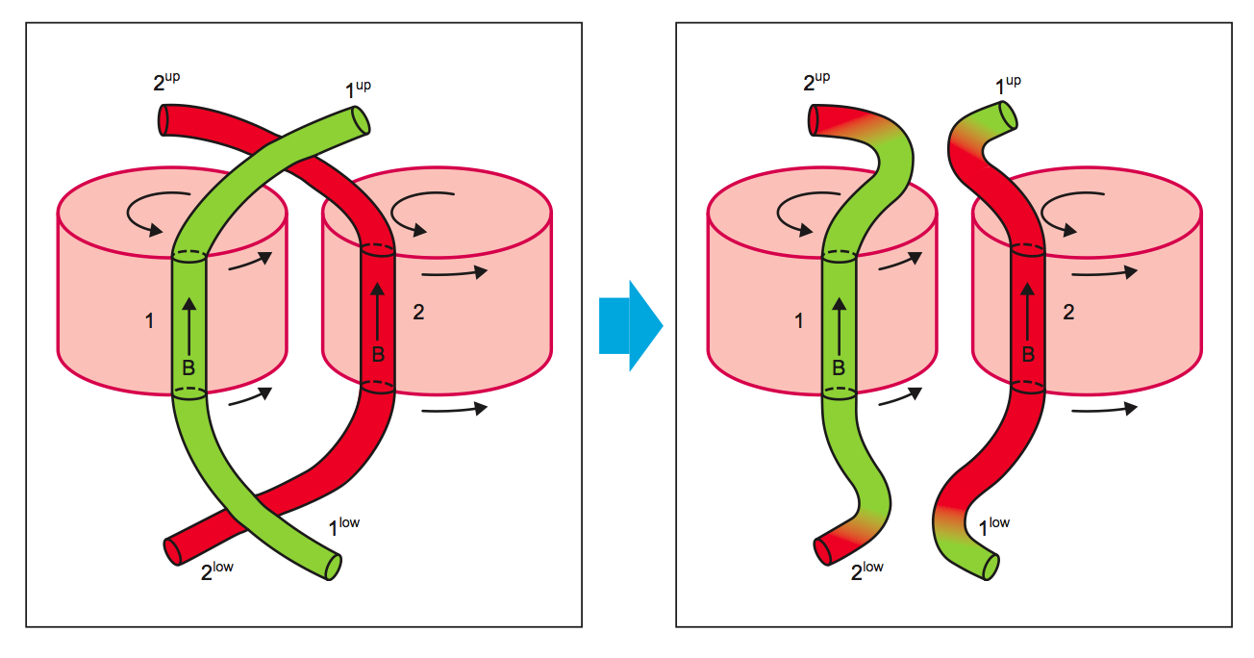
A consequence of turbulent reconnection is the violation of flux freezing via reconnection
Reconnection diffusion illustration
H. Alfven
Alfven theorem is violated in turbulent media!
AL 2007

Slide 16
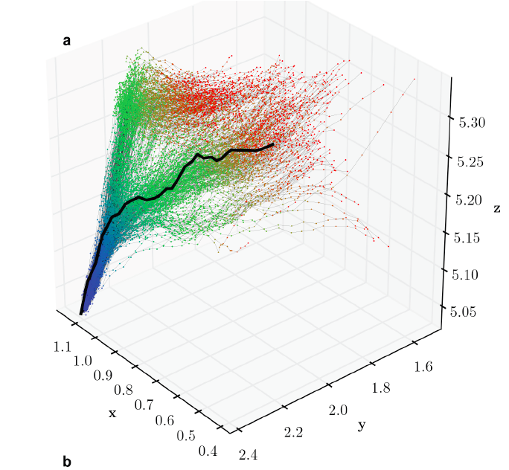
The violation of magnetic flux freezing due to turbulent reconnection is numerically proven
Confirmation of reconnection diffusion in turbulent media
G. Eyink
Magnetic field backtracking shows that many magnetic field lines contributed its parts to any present time magnetic field line
Eyink et al 2013
Diffusion in time

Slide 17
Derivation of MHD turbulence spectrum assuming turbulent reconnection
Critical balance
l⊥ l||
=
v_{⊥l}²
v_{⊥l} V_{A}
= const
(l⊥/v_{⊥l} )
Constancy of energy cascade rate
v_{⊥l}²
v⊥| ~ l⊥^{1/3}
Or, E(k)~k^{-5/3}
= const
t_{cas}
l|| ~l⊥^{2/3}
We obtain Goldreich-Sridhar (1995) scalings but in local system of reference

Slide 18
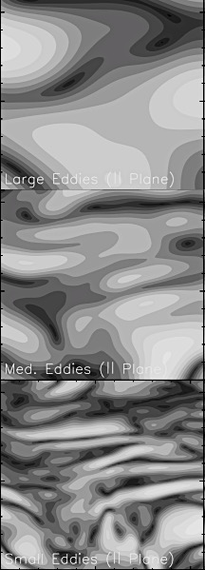
Anisotropy increases with the decrease of scale in MHD turbulence
Scale-dependent anisotropy of MHD turbulence
Turbulent energy cascade
Large scales
Medium scales
Small scales
3D MHD simulations
Cho, AL & Vishniac 2002
l|| ~l⊥^{2/3}

Slide 19
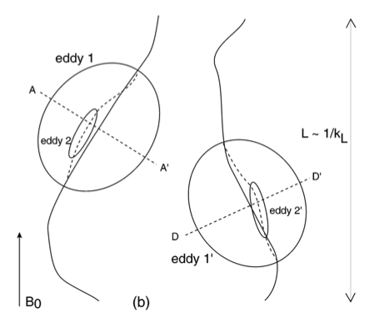
Local system of reference is essential. Scale dependent anisotropy is present only in this system of reference.
In the global system of reference the anisotropy is scale independent
Observations are in global system or reference
Cho, AL & Vishniac 2002

Slide 20
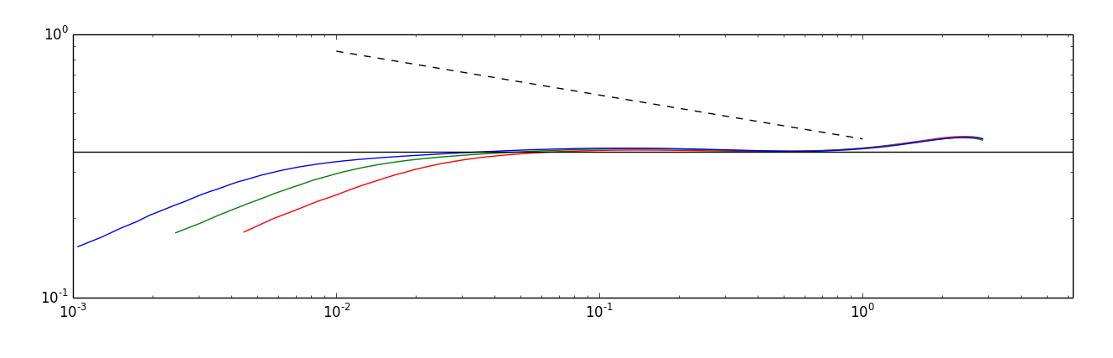
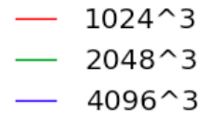
GS95 anisotropy is correct: corresponds to simulations
Boldyrev (2006) predicts
A. Beresnyak
Beresnyak 2016

Slide 21
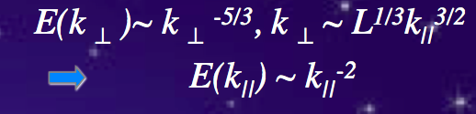
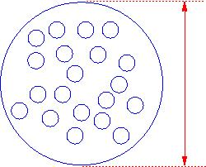
GS95 anisotropy makes resonance scattering inefficient
“random walk interaction”
MHD relations:
B
2r_{L}
Parallel scale is important, while less energy is available
there.
l _{perp}<< l|| ~ r_{L}
l||
Anisotropy of Alfvenic turbulence is a major factor of CR scattering suppression
B
eddies
l⊥
scattering efficiency is reduced
Chandran 2000, Yan & AL 2002

Slide 22
Turbulent reconnection predicts that particles moving along magnetic field lines get separated as s^{3/2}
y₁
Simplified illustration:
y₂
s
AL & Vishniac 1999

Slide 23
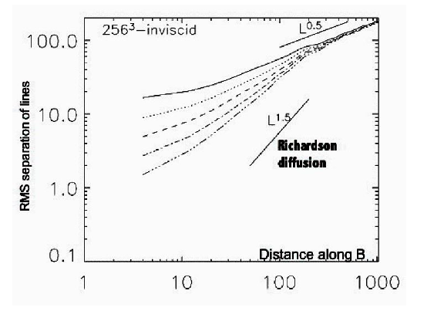
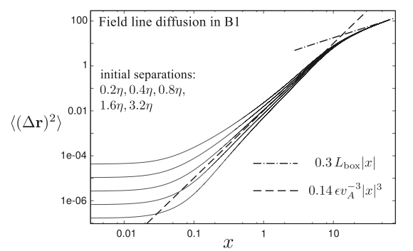
Richardson spatial diffusion law of magnetic fields was confirmed with higher resolutions
AL et al. 2004
1536³
L
More recent simulations
Prediction
Beresnyak 2013

Slide 24
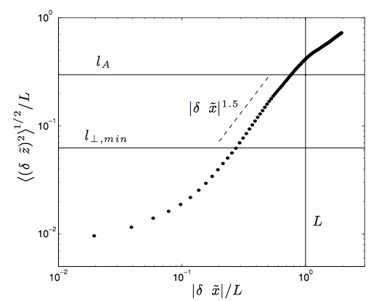
Naturally, particles streaming freely along magnetic field lines show the same superdiffusion as magnetic field lines
M_{A}=1.5
S. Xu
Xu & Yan 2013

Slide 25
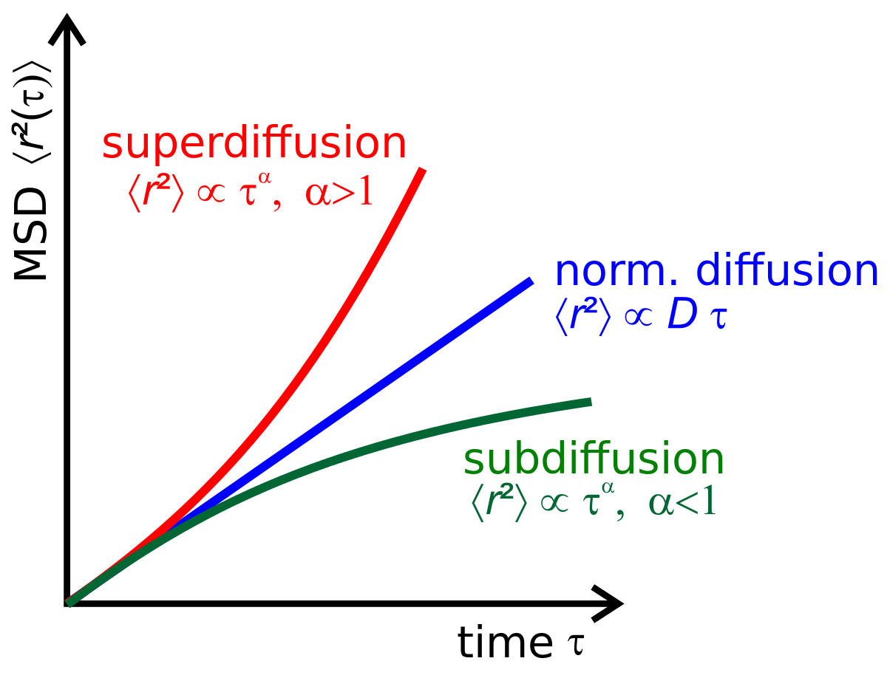
Different regimes of diffusion

Slide 26
For CR diffusing along magnetic field lines the perpendicular displacement is superdiffusive ~ t^{3/4}
Xu & Yan 13
l_{⊥,min}
field lines
Prediction Yan & AL 2007:

Slide 27
Subdiffusion requires particle retracing their way back which is impossible in the presence of B-field superdiffusion
Subdiffusion is discussed in many papers, e.g. Getmantsev 1963, Kota & Jokipii 2000, Qin et al. 2002, Webb et al. 2006 etc.
Usual arguments for subdiffusion: B-field spatial diffusion
Combined with the diffusion along magnetic field lines
Provides the displacement ~t^{1/4}
CAVEAT: Requires retracing of field lines

Slide 28
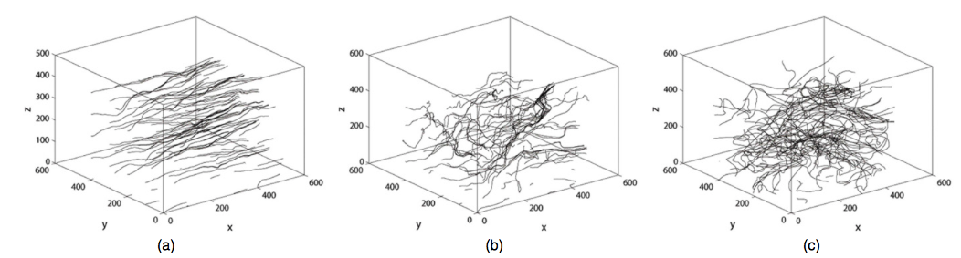
If injection velocity is not equal to Alfven velocity GS95 theory is modified
is Alfven Mach number
corresponds to subAlfvenic turbulence
From l_{trans}=LM_{A}² to the injection scale L the turbulence is weak (AL & Vishniac 1999, Gaultier et al. 2000)
CR trajectories for different M_{A}
M_{A}=0.3
M_{A}=0.7
M_{A}=1.5

Slide 29
Schematic of spectrum of subAlfvenic turbulence
Weak MHD turbulence
Strong MHD Turbulence
Parallel k stays constant for weak turbulence
AL & Vishniac 1999, Gaultier et al. 2000

Slide 30
For strong turbulence regime lines stochastic separate in proportion s³ M_{A}⁴
Moving along magnetic field lines distance one gets the mean squared separation
(1)
For subAlfvenic turbulence magnetic field lines at distance are mixed by turbulent eddies with parallel size (AL & Vishniac 1999):
(2)
Comgining with Eqs. (1) and (2) one gets (AL & Vishniac 1999):

Slide 31
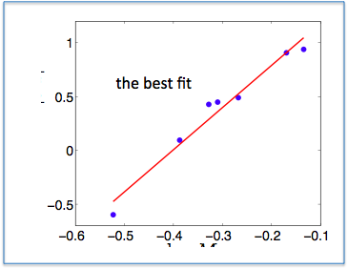
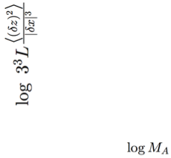


For free streaming along B-field lines the dependence on M_{A}⁴ is confirmed
LV99 prediction
Different from classical M² dependence (Jokipii & Parker 1963)
Xu & Yan 13

Slide 32
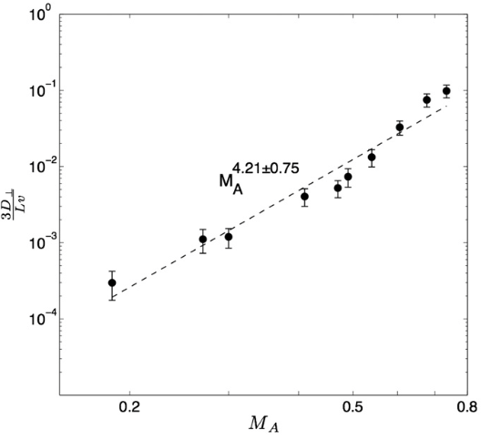

On scales >> L the parallel and perpendicular diffusion are related through M_{A}⁴
Xu & Yan 13
Diffusive regime
To compare with
in AL 2006, Yan & AL 2008

Slide 33
SuperAlvenic Turbulence M_{A}>1
At the injection scale L magnetic field is weak to affect motions. Turbulence is isotropic Kolmogorov-type.
At scale
l_{A}=LM_{A} ⁻³
Magnetic forces get dynamically important and turbulence get anisotropic.
Tangling of magnetic field at scale l_{A} induces diffusion with the mean free path of l_{A} for superalfvenic turbulence in the absence of resonance scattering (Brunetti & AL 2007)

Slide 34
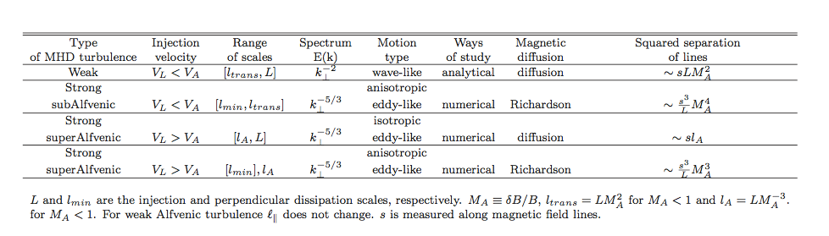
Different regimes of Alfvenic turbulence provide different regimes of B-field line separation
AL & Yan 2014

Slide 35
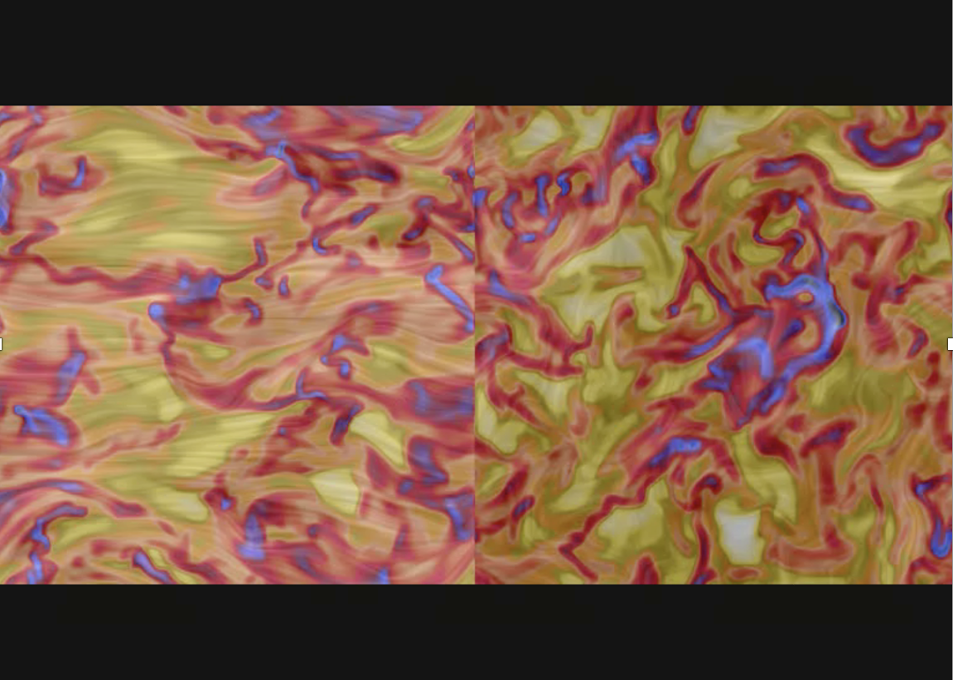
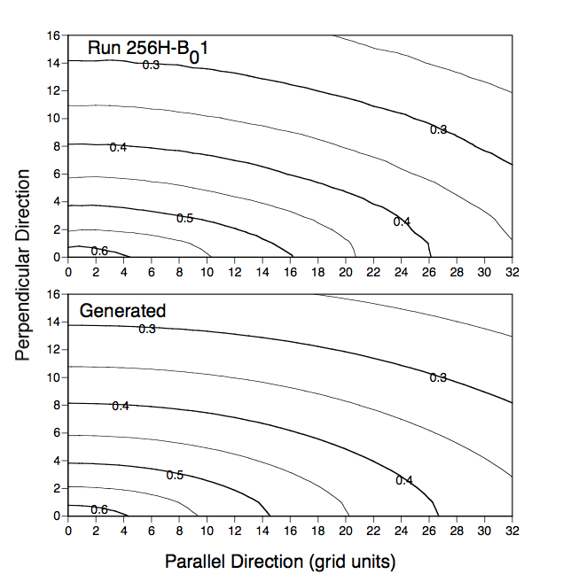

Compressible MHD Turbulence preserves Alfvenic turbulence anisotropy
Cho, AL & Vishniac 2002
Kowal & AL 2010
Energy distribution:

Slide 36
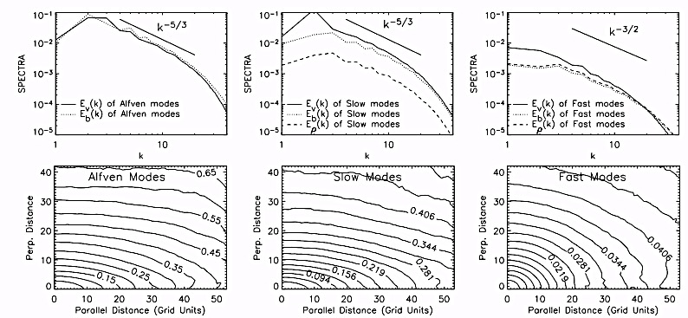


Alfvenic turbulence persists in compressible medium
Mode decomposition of compressible MHD turbulence
Cho & AL 2003
Alfven modes
Slow modes
Fast modes
J. Cho
Isotropic
Lithwick & Goldreich (2001), Cho & AL (2002, 2003), Kowal & AL (2007)
Fast modes are isotropic
Slow modes are slaved by Alfven
Notes:
Decomposition

Slide 37
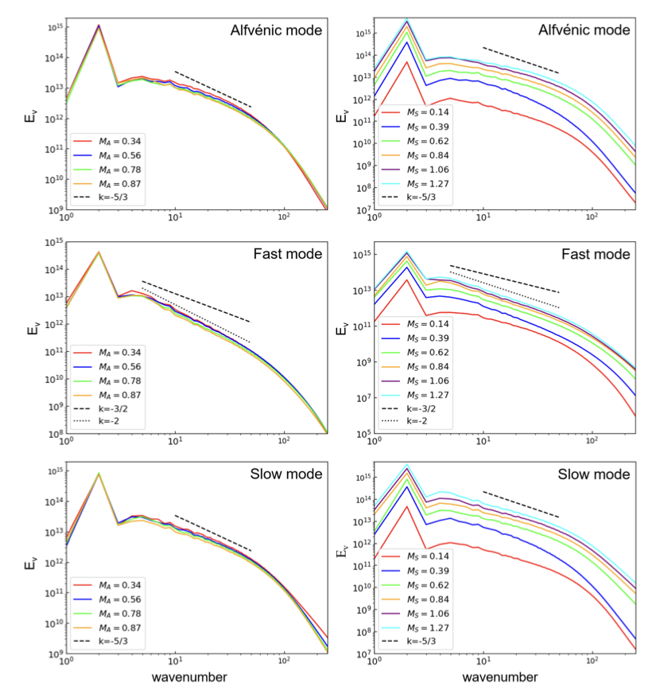
Fast modes steep to k⁻² for supersonic turbulence
Yue Hu
Similar to acoustic turbulence
Hu, AL & Xu 2022
Earlier reported in Kowal & AL 2010

Slide 38
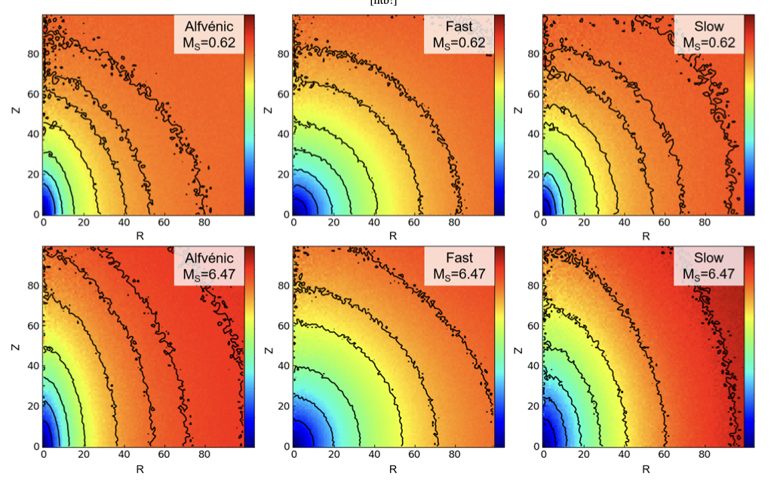
The anisotropy does not change with sonic Mach number
Hu, AL & Xu 2022

Slide 39
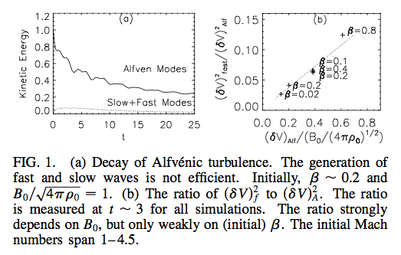
Transfer of energy from Alfven modes to slow and fast modes is rather marginal ~M_{total}= v/(v_{A}²+v_{s}²)^{1/2}
prediction
Cho & AL 02
The coupling of Alfvenic, fast and slow modes is weak for M_{total}<<1 . Thus Alfvenic motions persist.

Slide 40
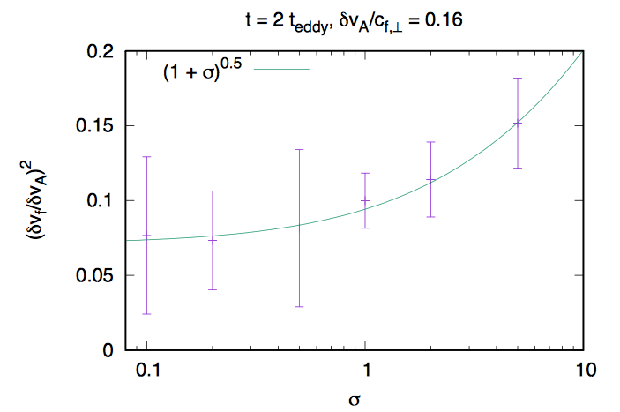
Compressibility in relativistic limit: Coupling of Alfven and fast modes increases in relativistic MHD
Takamoto & AL 2016
=B²/ (plasmas energy)
Fast modes get anisotopic: the interaction with CRs decreases

Slide 41

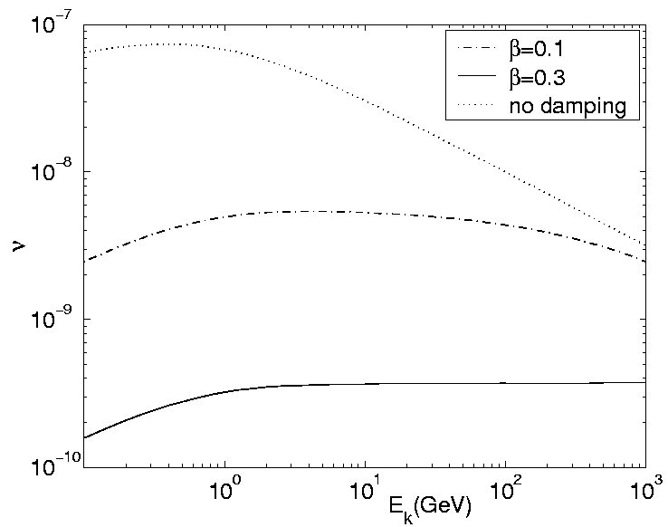
Fast modes efficiently scatter and accelerate cosmic rays
Fast modes
H. Yan
Depends on
damping
Scattering frequency
Yan & AL 2002
Efficient acceleration by fast modes in clusters of galaxies (Brunetti & AL 2007),
Kinetic energy

Slide 42
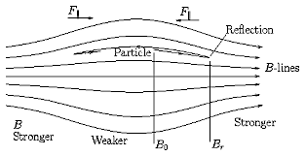
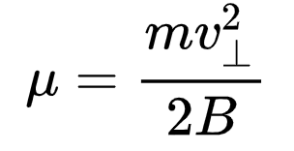
Magnetic mirrors are known to trap particles
How does it change diffusion in the presence of magnetic field wandering?
Notes:
Compressible component created magnetic compressions with converging field lines, a particle that spirals around such MF would feel
a force pointed against the gradient, in the direction of weaker magnetic field. This magnetic mirroring force slows down the particle and eventually reverses it.
IF there are two mirror points, particle moving in between would bounce back and forth and get trapped in the magnetic bottle.

Slide 43
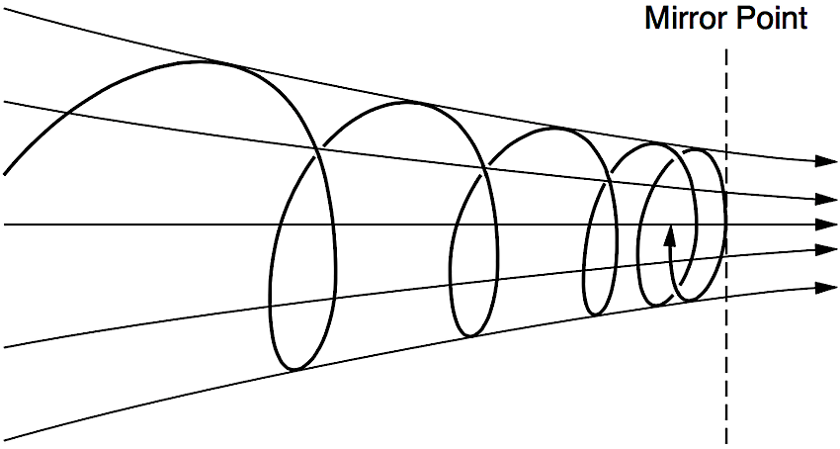
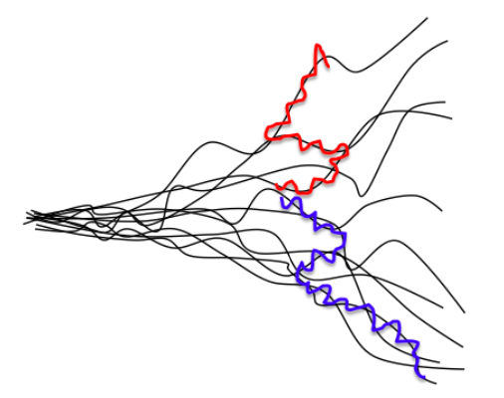
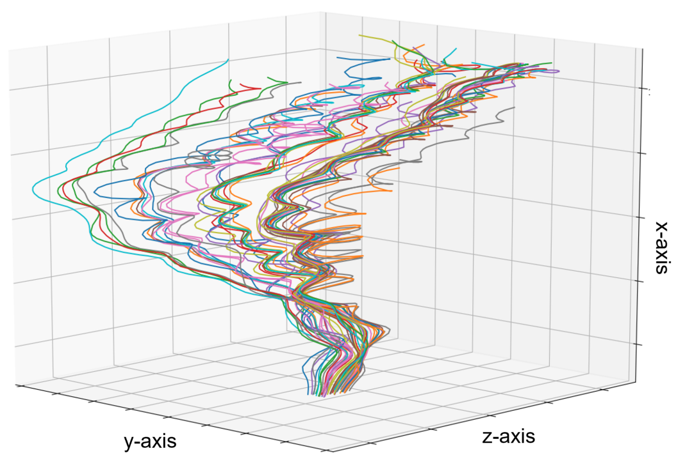

New type of diffusion: mirror diffusion in compressible MHD turbulence
Combine:
mirror diffusion
Mirroring
$\left\langle y^{2}\right\rangle ∝$ x³
AL & Xu 2021;
Superdiffusion
When pitch angle less than the angle for mirror interaction, CRs experience normal diffusion. For large angles, the mirror diffusion acts. Mirror diffusion is slow, but mirror acceleration is efficient (AL& Xu 2023).
Notes:
Turbulence is a game changer. Have their own diffusion, with the increase of the distance along …. Fields lines spread out in perp direction in a fast superdiffusion manner. Similar to the diffusion of smoke particles in turbulent atmosphere…
Intrinsic property, you can observe this kind of superdiffusion of turbulent magnetic fields in solar wind, or MHD turbulence simulations.
In highly compressible MHD turbulence, magnetic compressions can act as magnetic mirrors. The mirroring effect is a well-known mechanism in plasma physics to confine particles and to fusion power. But mirrors in static magnetic fields would lead to trapping of particles back and forth between two mirror points of a magnetic bottle.
Similar to smoke particles in turbulent atomosphere, instead of trapping between two fixed mirror points,
Stochastically interact with different mirror points when they propgate along turbulent magnetic fields. New diffusion mechanism

Slide 44
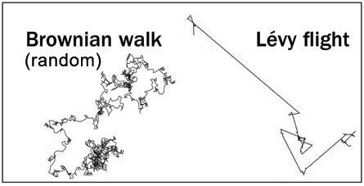
CR diffusion is a Levy flight process (a combination of ordinary diffusion with large mfp and mirror diffusion with a short mfp)
Mirror diffusion region
Levi flight discussed in the literature, e.g. Zimbardo & Perri 2017, 2018
Mirror diffusion is an identified physical process responsible for Levi flights

Slide 45
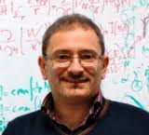

Reconnection in turbulent fluid and acceleration
G. Brunetti
Acceleration via turbulent reconnection in galaxy clusters (Brunetti & AL 2016)
De Gouveia Dal Pino & AL 2005

Slide 46



Theory and simulations of MHD turbulence with localized sinks and sources
Relativistic simulations
Non-relativistic theory: Beresnyak & AL 08
Relativistic simulations
Imbalanced
Turbulence
Cho & AL 14
Beresnyak & AL 08

Slide 47



Driven turbulence
What happens at small scales
Cho & AL 2004
256³
R.J. Leamon et al., JGR (1998)
512³
Cho & AL 09

Slide 48
Summary
Scale-dependent anisotropy of MHD turbulence
Turbulent energy cascade
Large scales
Medium scales
Small scales
Alfvenic turbulence scaling is defined in the local system of reference
Magnetic field lines in turbulence are superdiffusive
MHD turbulence is a sum of Alfven, slow and fast cascades
MHD turbulence and magnetic reconnection are inseparable
MHD turbulence controls processes of CR scattering and acceleration

Slide 49
Simple considerations give hope that compressible MHD turbulence can be understood and described
B
Alfven mode (v=V_{A} cosθ)
incompressible;
restoring force=mag. tension
B
k
slow mode (v=c_{s} cosθ)
restoring force = P_{gas}
B
fast mode (v=V_{A})
k
restoring force = P_{mag} + P_{gas}
Theoretical discussion in Lithwick & Goldreich 01
Cho & AL 02
Notes:
49

Slide 50
Plan of the talk
Different types of superdiffusion
Modern understanding of MHD turbulence
Wandering of magnetic fields and superdiffusion of cosmic rays
Very short: implications of superdiffusion

Slide 51
Plan of the talk
Different types of superdiffusion
Modern understanding of MHD turbulence
Wandering of magnetic fields and superdiffusion of cosmic rays
Very short: implications of superdiffusion

Slide 52

Superdiffusive Levi flights induce mean free path that is infinite
The process of superdiffusion that I discuss arises from the properties of turbulence. It is well tested and it does not involve infinite mean free paths.

Slide 53
I discuss superdiffusion that does not involve Levi flights
No Levi flights!

Slide 54


Diffusion perpendicular to mean magnetic field direction is determined by magnetic field line wandering
Realized by Jokipii & Parker 69, Jokipii 73 but turbulence model and obtained scalings were not right.
This work, however, motivated my work in turbulent magnetic reconnection
The talk uses the modern understanding of MHD turbulence is in AL& Vishniac 99 with the subsequent application to diffusion in AL06, Yan & AL 2008…
Short summary
Strong subAlfvenic turbulence at scales s<L results in superdiffusion:
At scales s>> L results in ordinary diffusion:
Superdiffusive behavior is confirmed numerically in AL et al. 04, Maron & Chandran 04, Beresnyak 15

Slide 55
Plan of the talk
Different types of superdiffusion
Modern understanding of MHD turbulence
Wandering of magnetic fields and superdiffusion of cosmic rays
Very short: implications of superdiffusion

Slide 56
Astrophysical flows are turbulent due to large Reynolds numbers
L
Re=10000
V
Re ~ 15,000
Re=40
Astrophysical flows have Re> 10¹⁰
For reference: Numerical Re<10⁴ and this is a problem of brute force approach.
Notes:
56

Slide 57

“Turbulence is the last great unsolved problem of classical physics”
R. Feynman

Slide 58

Heisenberg believed that turbulence is more mysterious than quantum mechanics

Slide 59


LV99 model extends Sweet-Parker model for turbulent astrophysical plasmas and makes reconnection fast
Outflow is determined by field wandering.
More theoretical works on turbulent reconnection:
AL, Vishniac & Cho 2004
Eynik, AL, Vishniac 2011
Eyink 2015
B dissipates on a small scale λ|| determined by turbulence statistics.
AL & Vishniac (1999)

Slide 60

GS95 model of transAlfvenic turbulence can be extended for sub and super Alfvenic regimes
is Alfven Mach number
corresponds to subAlfvenic turbulence
From l_{trans}=LM_{A}² to the injection scale L the turbulence is weak (AL & Vishniac 1999, Gaultier et al. 2000)
AL & Pogosyan 2004

Slide 61
Plan of the talk
Different types of superdiffusion
Modern understanding of MHD turbulence
Wandering of magnetic fields and superdiffusion of cosmic rays
Very short: implications of superdiffusion

Slide 62
Two regimes are for the perpendicular to B-field propagation are possible:
Cosmic ray stream along the magnetic field lines without scattering
Cosmic ray scatter and diffuse along magnetic field lines
Case a. If no scattering is present the perpendicular propagation obeys the same laws as the magnetic field line diffusion.
Case b. If cosmic rays diffuse along magnetic field lines, both magnetic wandering and diffusion must be accounted for

Slide 63
Two regimes are for the perpendicular to B-field propagation are possible:
Cosmic ray stream along the magnetic field lines without scattering
Cosmic ray scatter and diffuse along magnetic field lines
Case a. If no scattering is present the perpendicular propagation obeys the same laws as the magnetic field line diffusion.
Case b. If cosmic rays diffuse along magnetic field lines, both magnetic wandering and diffusion must be accounted for

Slide 64
In the presence of turbulence dynamically important B-field its lines stochastic separate in proportion s³ M_{A}⁴
Moving along magnetic field lines distance one gets the mean squared separation
(1)
For subAlfvenic turbulence magnetic field lines at distance are mixed by turbulent eddies with parallel size
(2)
Comgining with Eqs. (1) and (2) one gets (AL & Vishniac 1999):

Slide 65
For subAlfvenic regime line separation is superdiffusive for distances s <L and diffusive for s>L
For perpendicular scales from the injection scale L to the transition scale l_{trans}=LM_{A}² the turbulence is weak, E(k)~k⁻² (AL & Vishniac 1999, Gaultier et al. 2000). The random walk with LM_{A}² step and the number of steps is s/L:
Which provides the diffusive CR trasport (AL & Yan 2014):
for
is the distance along magnetic field line

Slide 66
If cosmic rays diffuse along B-field lines, it is still superdiffusion in terms of perpendicular displacement
Substitute parallel displacement
In the expression for the magnetic field perpendicular displacement
One gets
Which means

Slide 67

SubAlfvenic turbulence: forth power of Alfven Mach number
On scales s > L and s>> mfp the ordinary diffusion is present (AL06, Yan & AL08)
On scales < L and s< mfp, CRs trace magnetic field divergence
On scales < L and s >> mfp, CRs trace magnetic field divergence, s is covered in diffusion process
Differs from the textbook (see Jokipii & Parker 69) M_{A}² dependence

Slide 68
Plan of the talk
Different types of superdiffusion
Modern understanding of MHD turbulence
Wandering of magnetic fields and superdiffusion of cosmic rays
Very short: implications of superdiffusion

Slide 69
Subdiffusion requires particle retracing their way back which is impossible in the presence of B-field superdiffusion
Subdiffusion is discussed in many papers, e.g. Getmantsev 1963, Kota & Jokipii 200, Qin et al. 2002, Webb et al. 2006 etc.
Usual arguments for subdiffusion: B-field spatial diffusion
Combined with the diffusion along magnetic field lines
Provides the displacement ~t^{1/4}
But we have superdiffusion!!!

Slide 70
The Lyapunov growth of B-field line separation is only valid at scales comparable with the dissipation scale l_{min}
Max shear is from the minimal size eddies
Minimal eddy
This induces regular exponential Lyapunov growth of the line separation:
cannot be less than the Larmor radius r₀ . Thus after following the distance
magnetic field lines get separated by the scale
For scales larger than the separation is stochastic (AL 2006).

Slide 71


Superdiffusion prevents the particles to return back to a perpendicular shock
Accepted expression
Superdiffusion in a perpendicular shock
Superdiffusion y~x^{3/2}
In reality
AL & Yan 2014

Slide 72


Precursor forms in front of the shock and it gets turbulent as precursor interacts with gas density fluctuation
Much more efficient than Bell’s mechanism
Beresnyak, Jones & AL 2009, de Valle, AL & Santos-Lima 2016, Xu & AL 2018

Slide 73

Numerical simulations support predictions of turbulent dynamo in a precursor
Del Valle, AL, Santos-Lima 2016
First simulations supporting the model are Drury & Downes 2012

Slide 74

Turbulent dynamo makes parallel and perpendicular shocks similar with particles returning to shocks with precursors
AL & Yan 2014
Synthesis: dynamo and magnetic field structure theories

Slide 75
Summary:
MHD turbulence induces superdiffusion of cosmic rays
Richardson diffusion of magnetic field lines makes CRs superdiffusive both for ballistic motion and diffusion along B-field
Subdiffuion is possible only over scales comparable with the dissipation scale
Parallel and perpendicular shock acceleration are similar
Turbulent dynamo may make shock acceleration much more efficient

