Slide 1
IceCube Upgrade
Mike DuVernois
IceCube Upgrade (& Gen2) Technical Coordinator

Slide 2
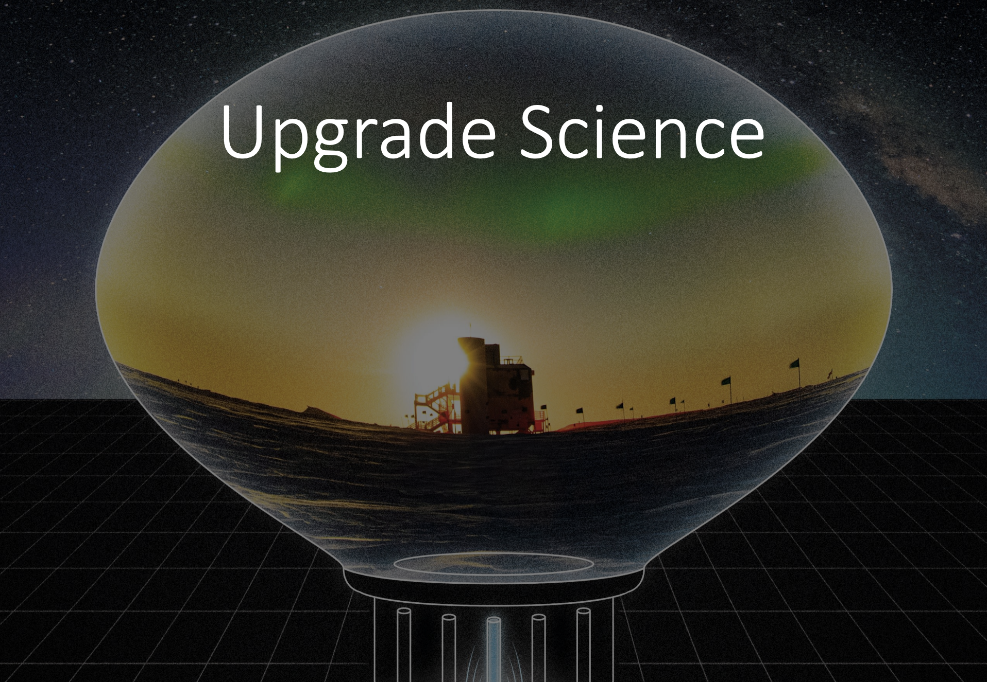
Science

Slide 7
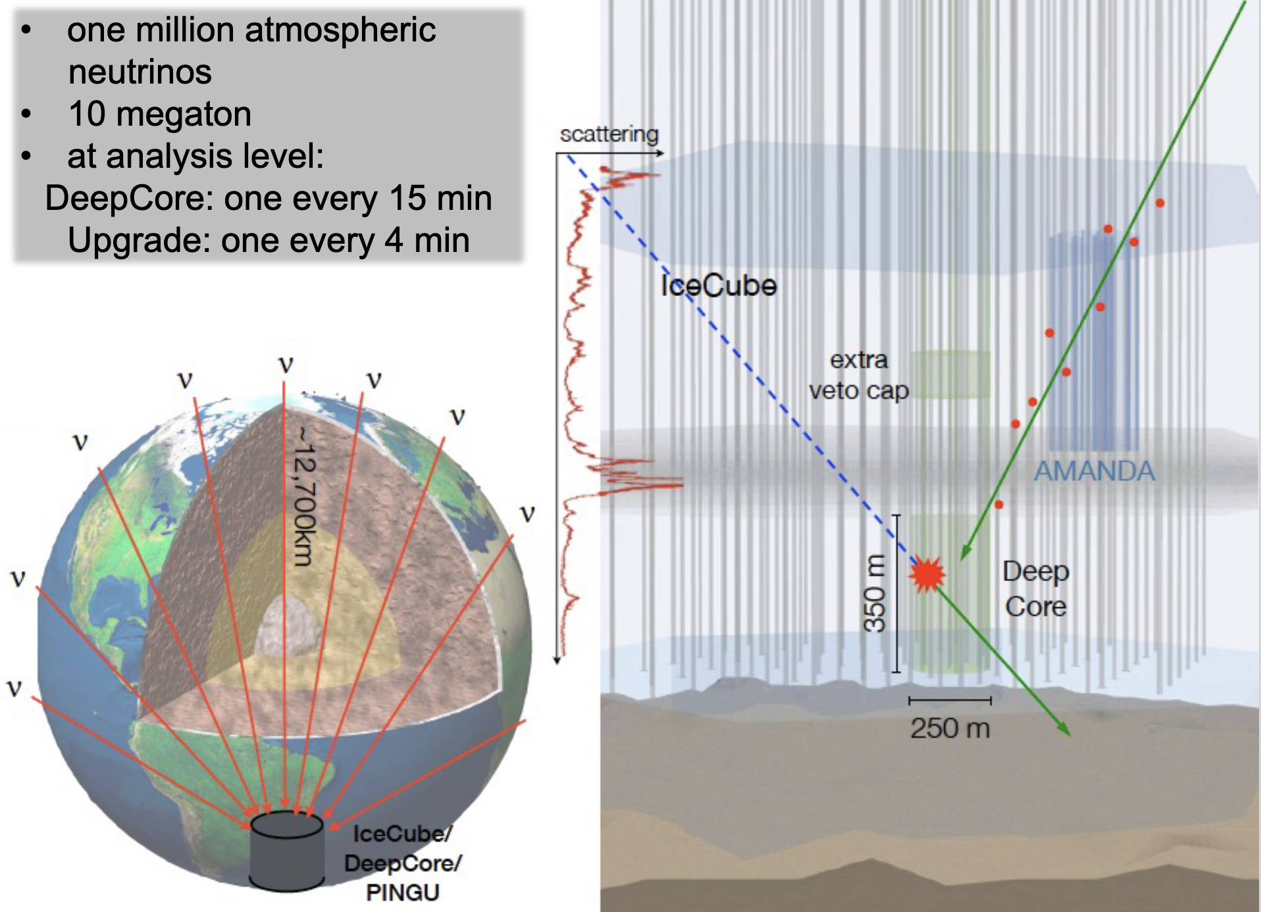

Slide 9
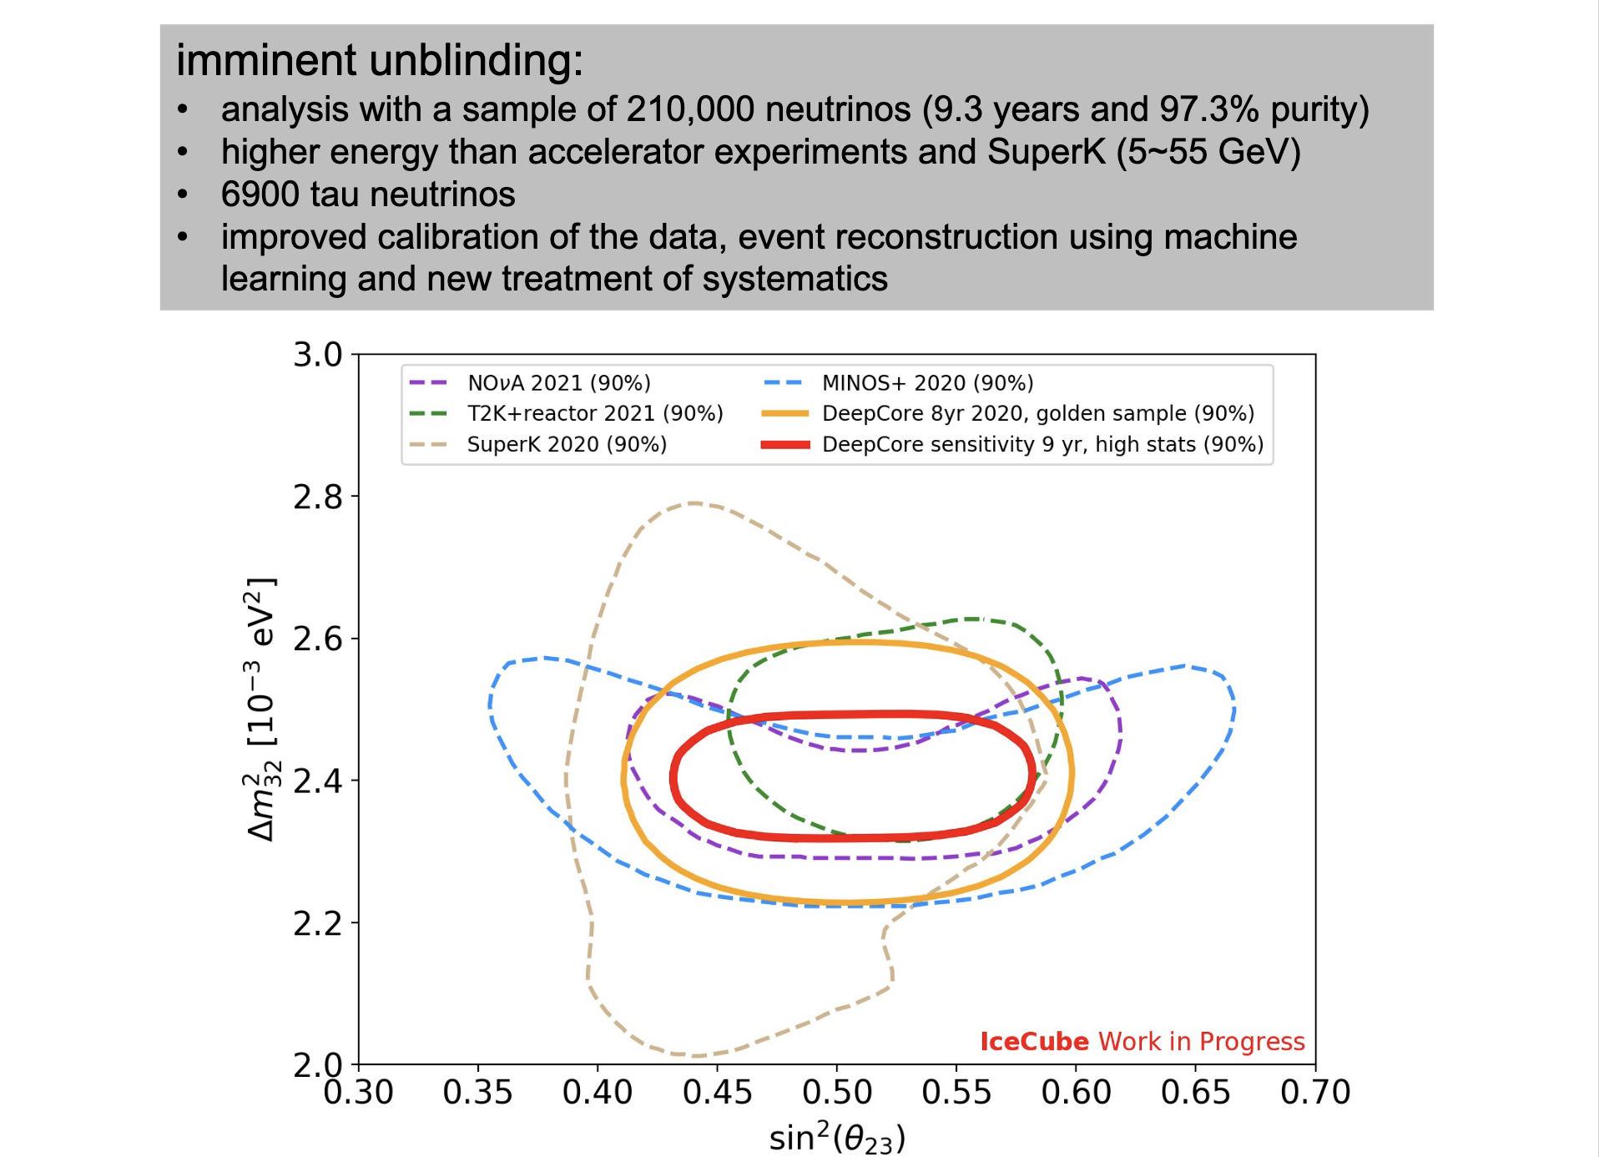

Slide 14
Detector & Installation

Slide 17
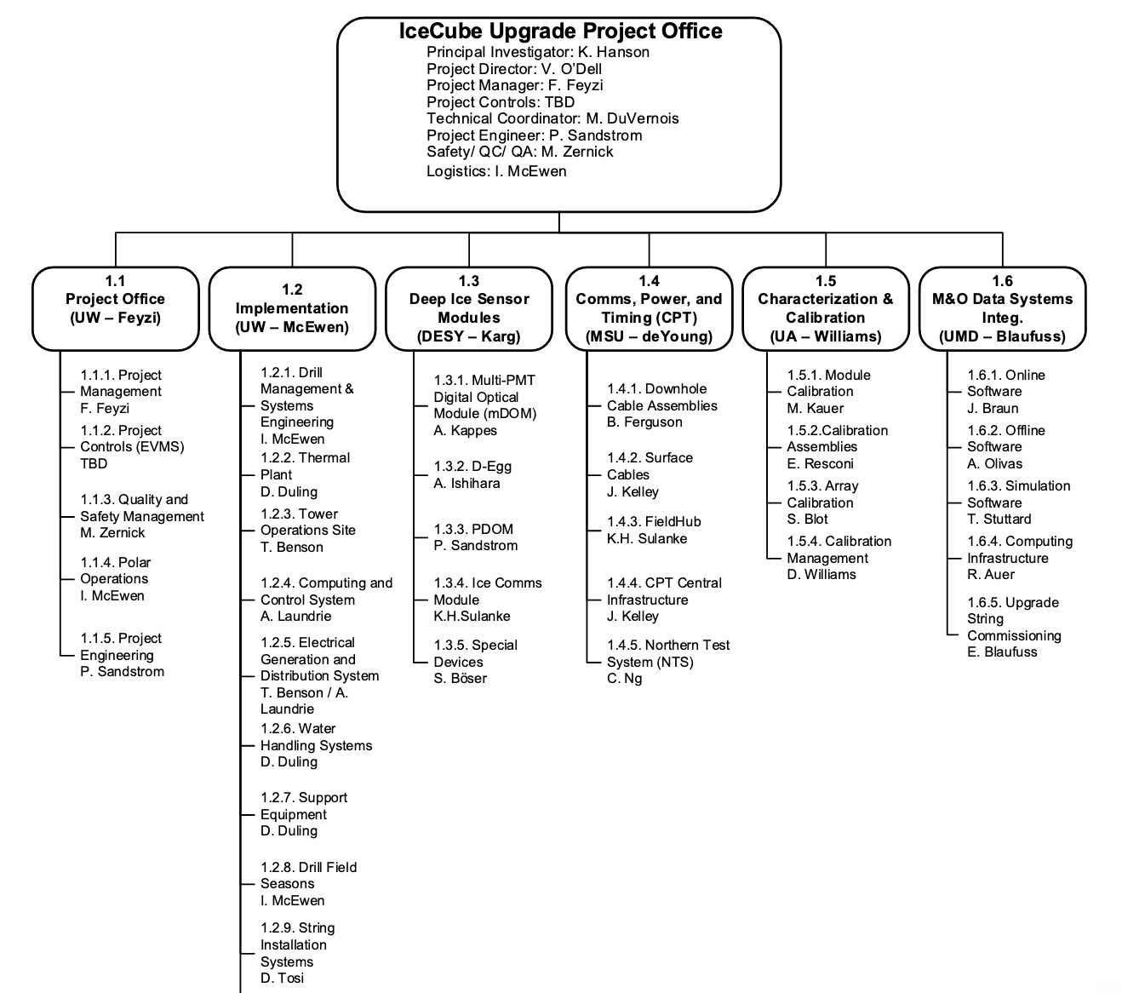

Slide 20
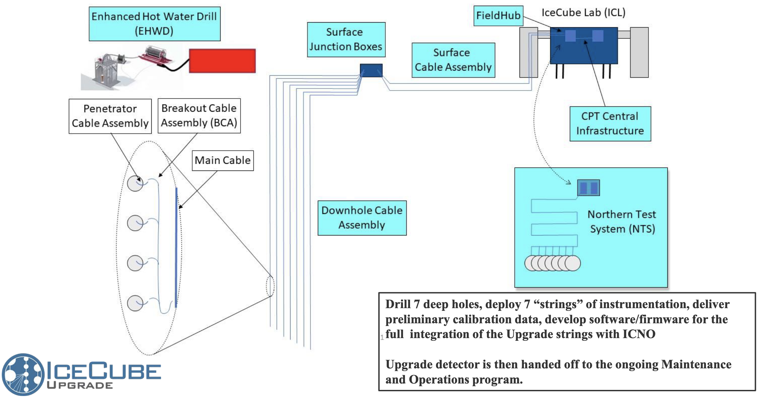

Slide 21
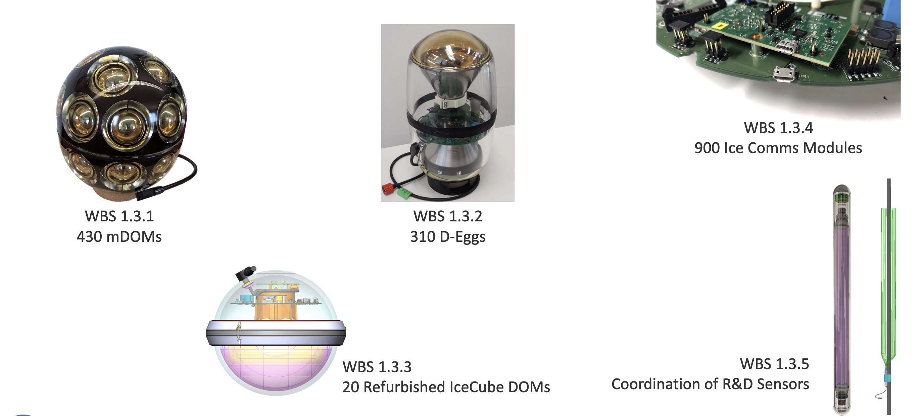

Slide 23
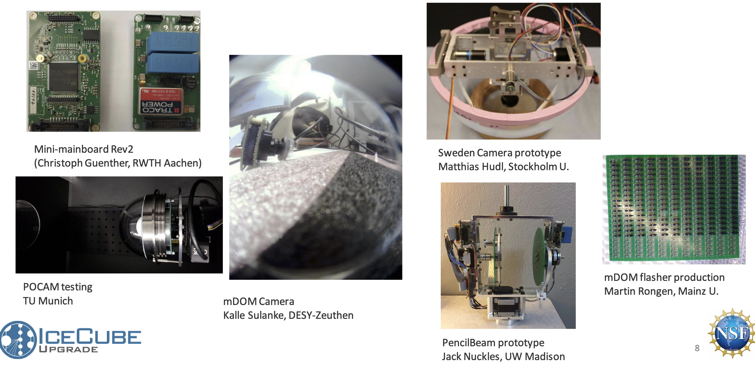

Slide 25
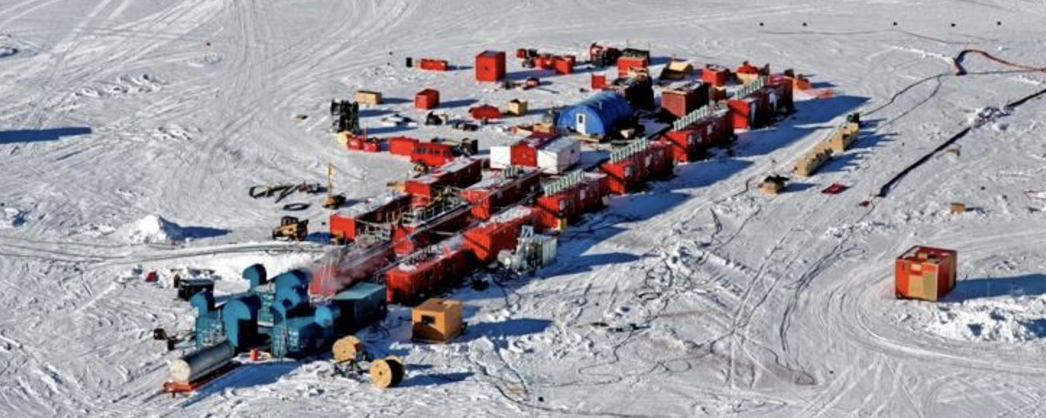

Slide 26
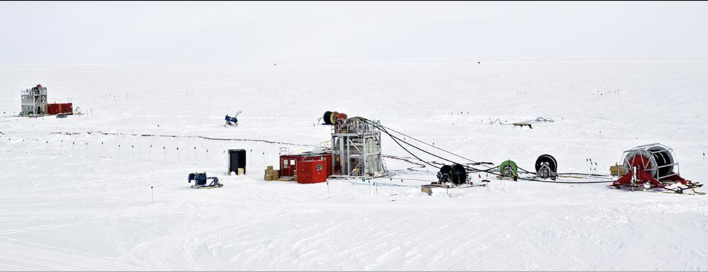

Slide 27
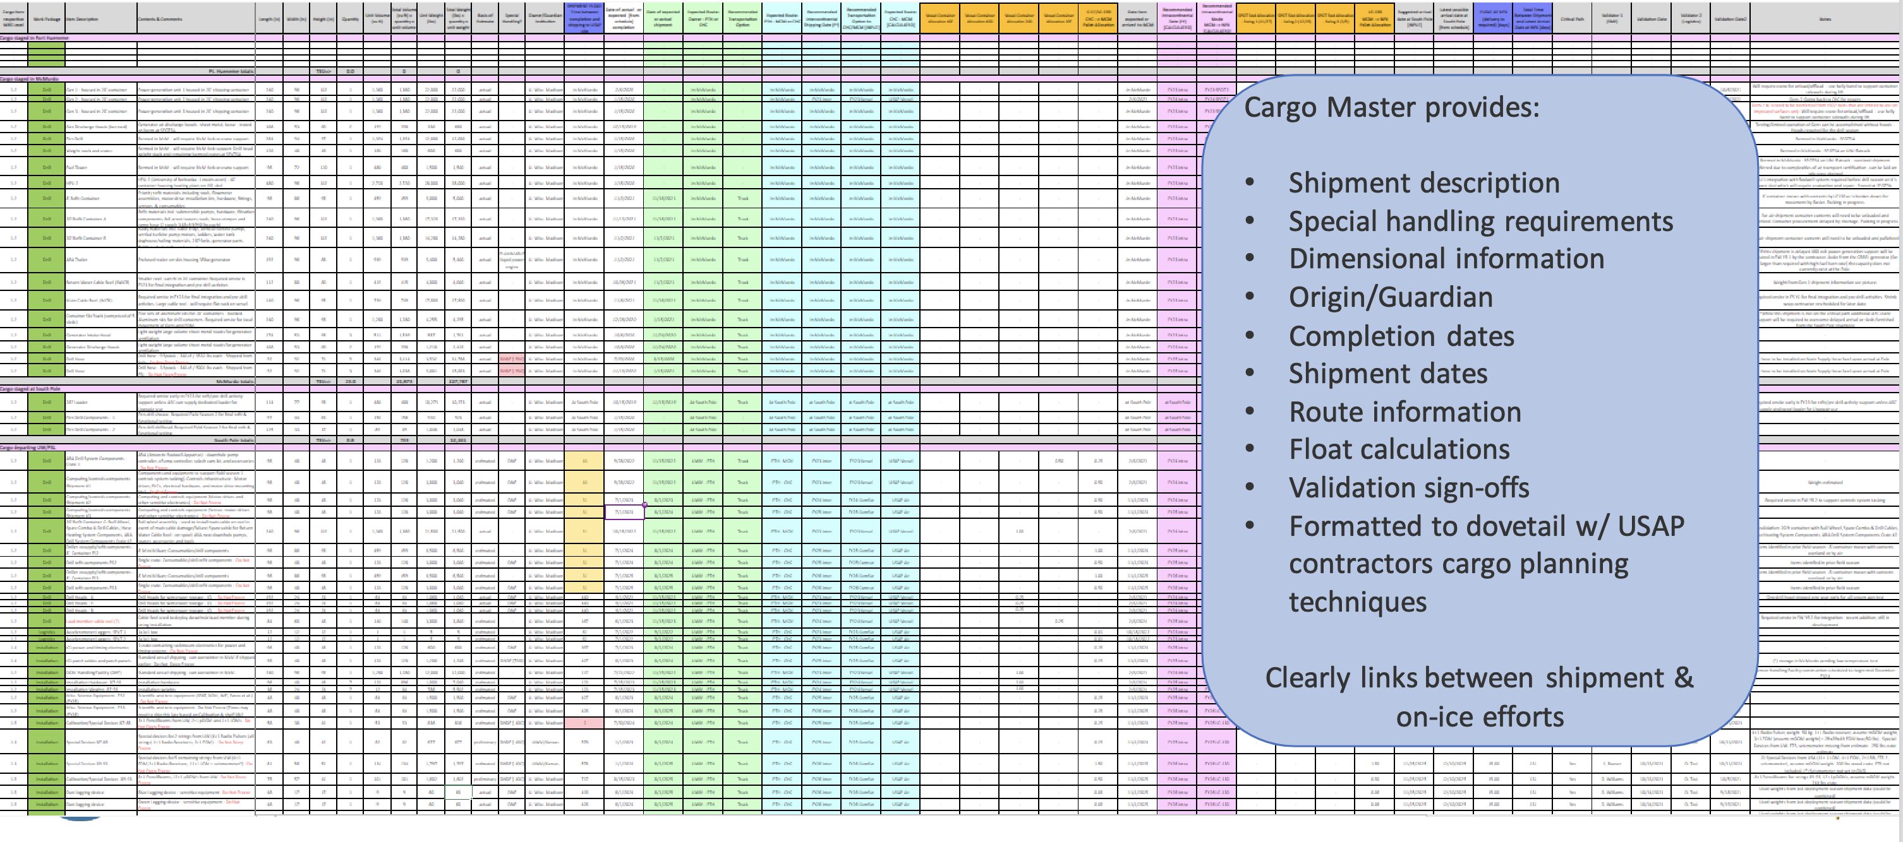

Slide 34
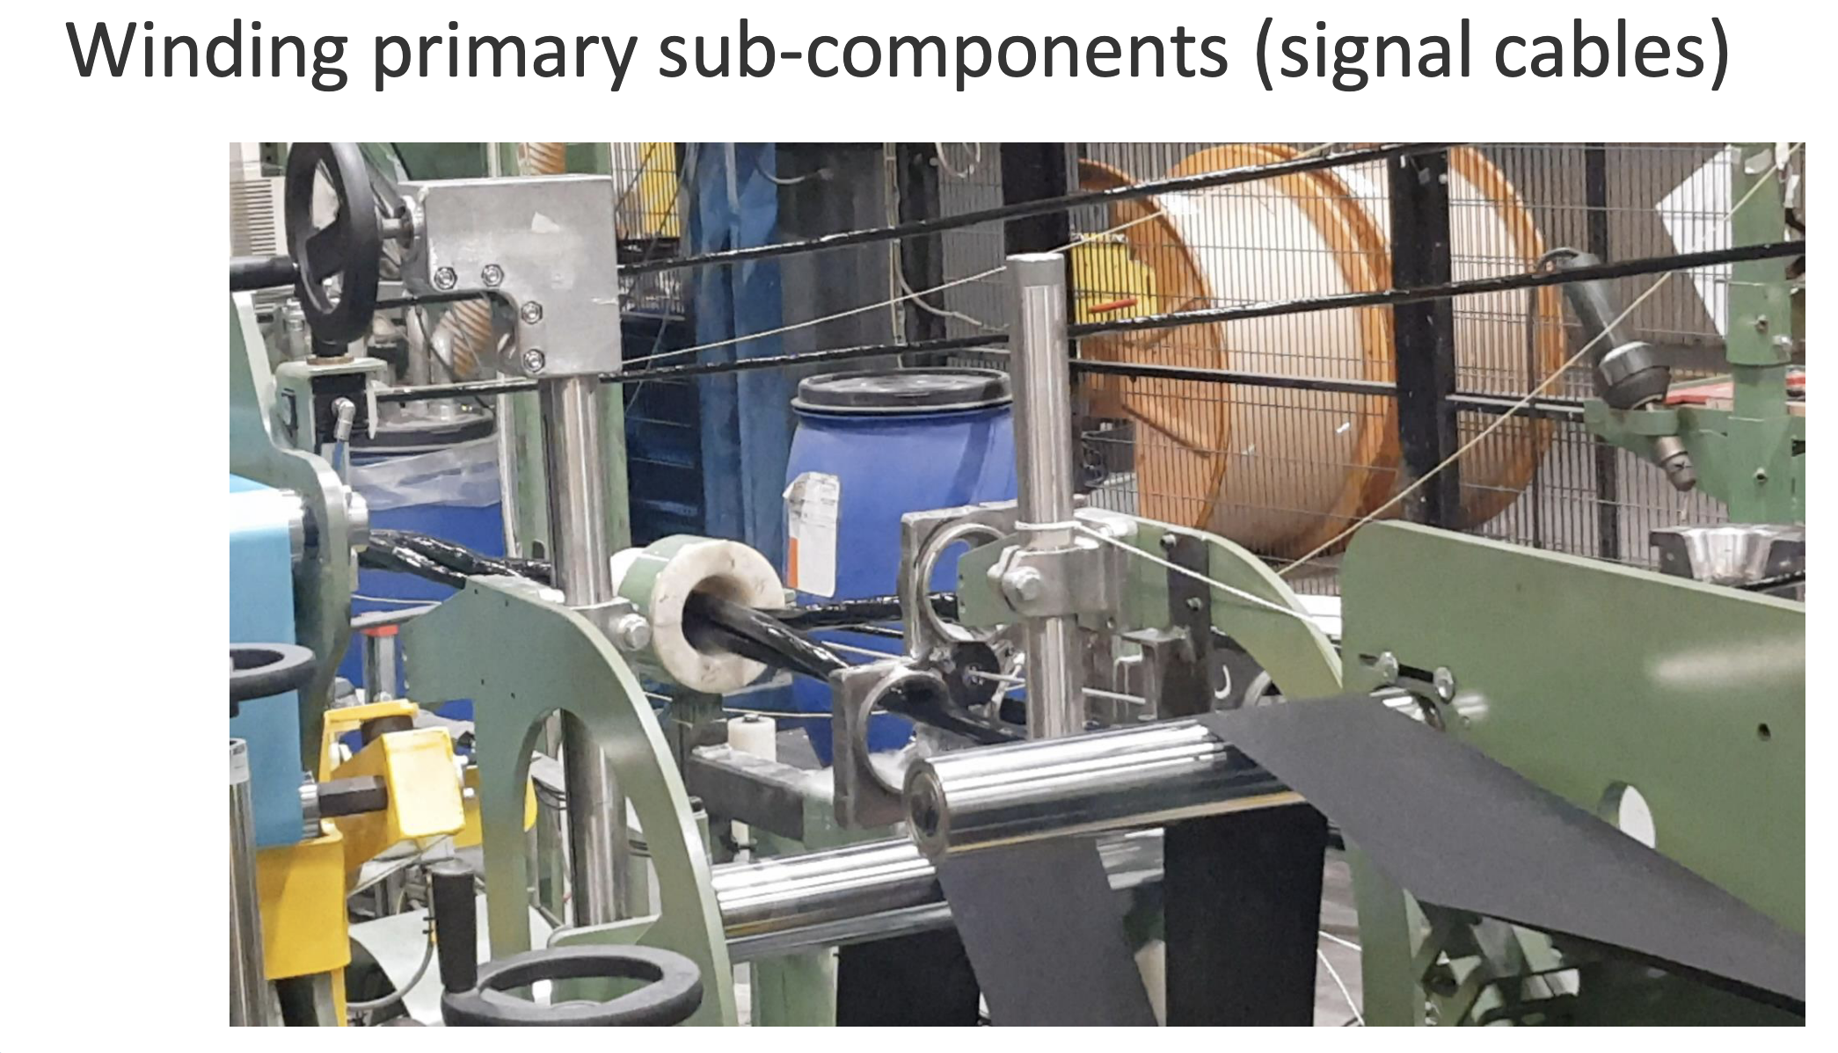

Slide 35
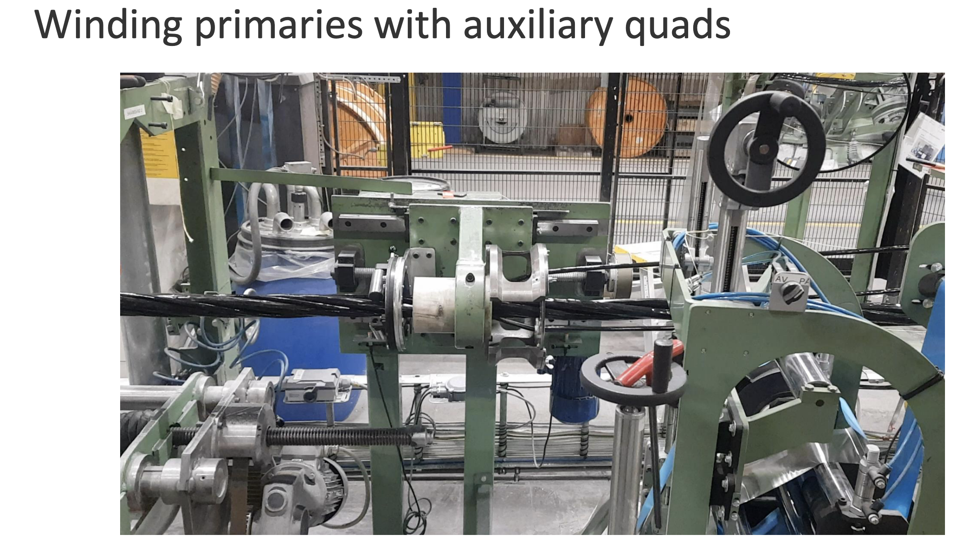

Slide 36
IceCube Upgrade Recap
Science goals of lower energy neutrinos, for oscillation physics, plus a finer look at the ice for re-calibration of existing & future data
Gets us back to the South Pole with a working hot water drill, and detector R&D for Gen2 IceCube
Project/construction effort is spread across a subset of the IceCube Collaboration, distinction between project & experiment
With work at Pole now planned for 2023-24 (drill prep), 2024-25 (firn drilling, full drill test), and 2025-26 (main drill & deploy season)

