Slide 1
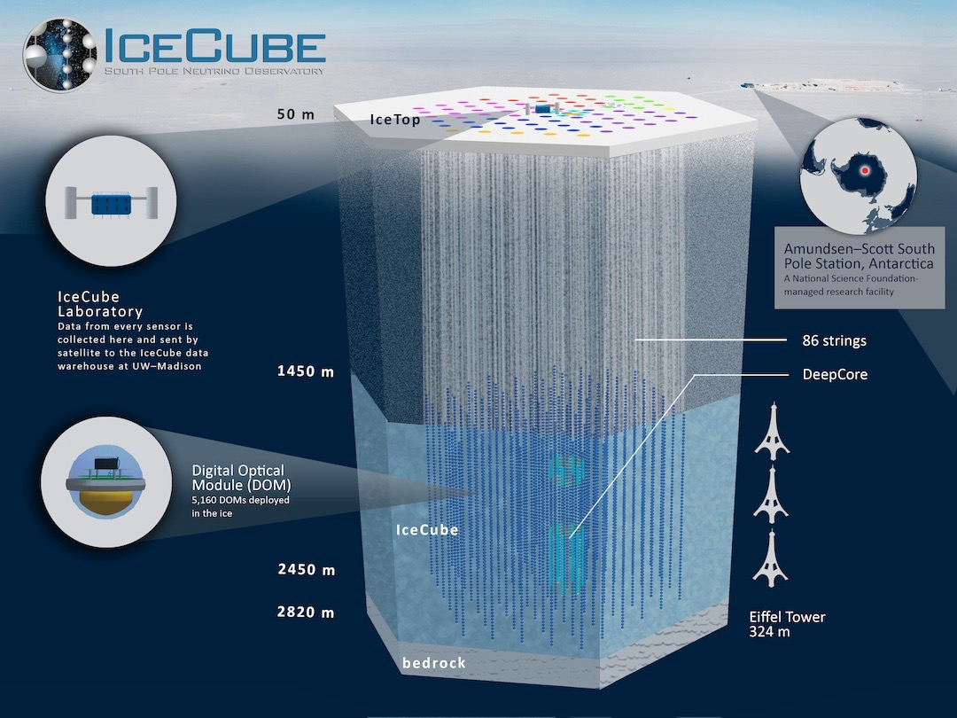
Neutrino and Air Shower Simulations in IceCube
Juan Carlos Díaz-Vélez
IceCube Bootcamp
Madison, WI
June, 2022

Slide 2
The IceCube Observatory

Slide 3
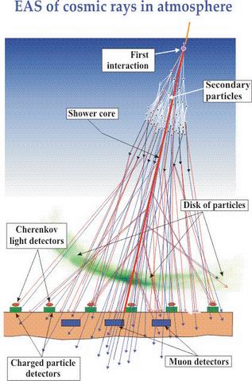
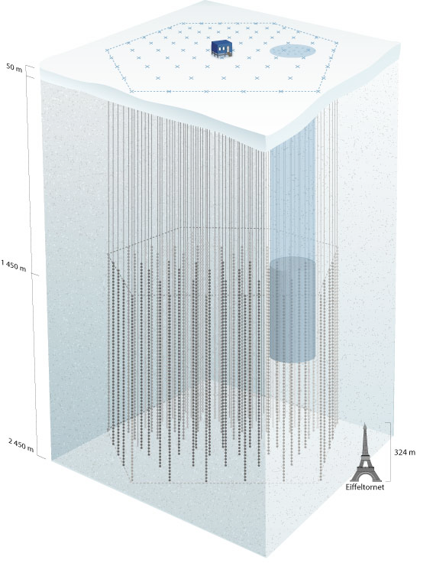
Events in icecube
Air shower detection @ surface
Penetrating muon detection in deep ice
Events dominated by cosmic ray muons : 10⁶ µ for every v that interacts in IceCube
Atmospheric v’s
µ
ν
downgoing ν’s
upgoing ν’s

Slide 4
Simulation
Reconstruction
tree<I3Particle>
(direction, position, energy, type)
I3Particle
(direction, position, energy)
OM, vector<MCPE>
NPEs
OM, vector<MCPulse>
OM, vector<I3RecoPulse>
OM, vector<DOMLaunches>
(digitized, PTM waveforms)
OM, vector<DOMLaunches>
(digitized, PTM waveforms)

Slide 5
Generation
PROPAGATION
CORSIKA
READER
MUONGUN
LeptonInjector
PROPOSAL
Corsika
injector
service
NuGen
GENIE
GEANT4
(CLSim)
PHOTON PROPAGATION
BGND Noise/Muons
PPC
HitMaker
PolyPlopia
(coinc. backgrnd)
Vuvuzela
(noise)
CLSIM
HYBRID
Detector
PMT
DomLauncher
TriggerSim
i³SIM

Slide 6
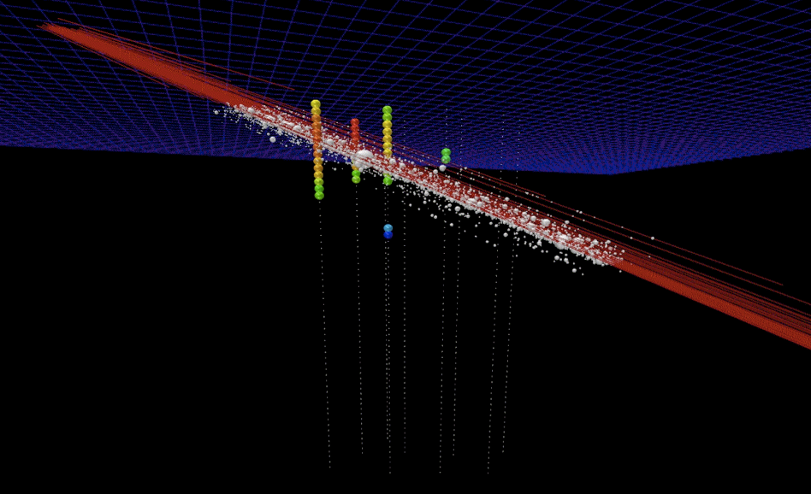
simulaton chain (IT)
Generation
CorsikaKinjector
Service
CORSIKA
CORSIKA
Reader
TankResponse
Service
InIce simulation
TopSimulator
PHOTON PROPAGATION
Detector
PMT
DOM
Trigger

Slide 7
Generators (cont.)
  Other:
    wimpsim-reader: IceTray interface for WimpSim (FORTRAN stand-alone)

Slide 8

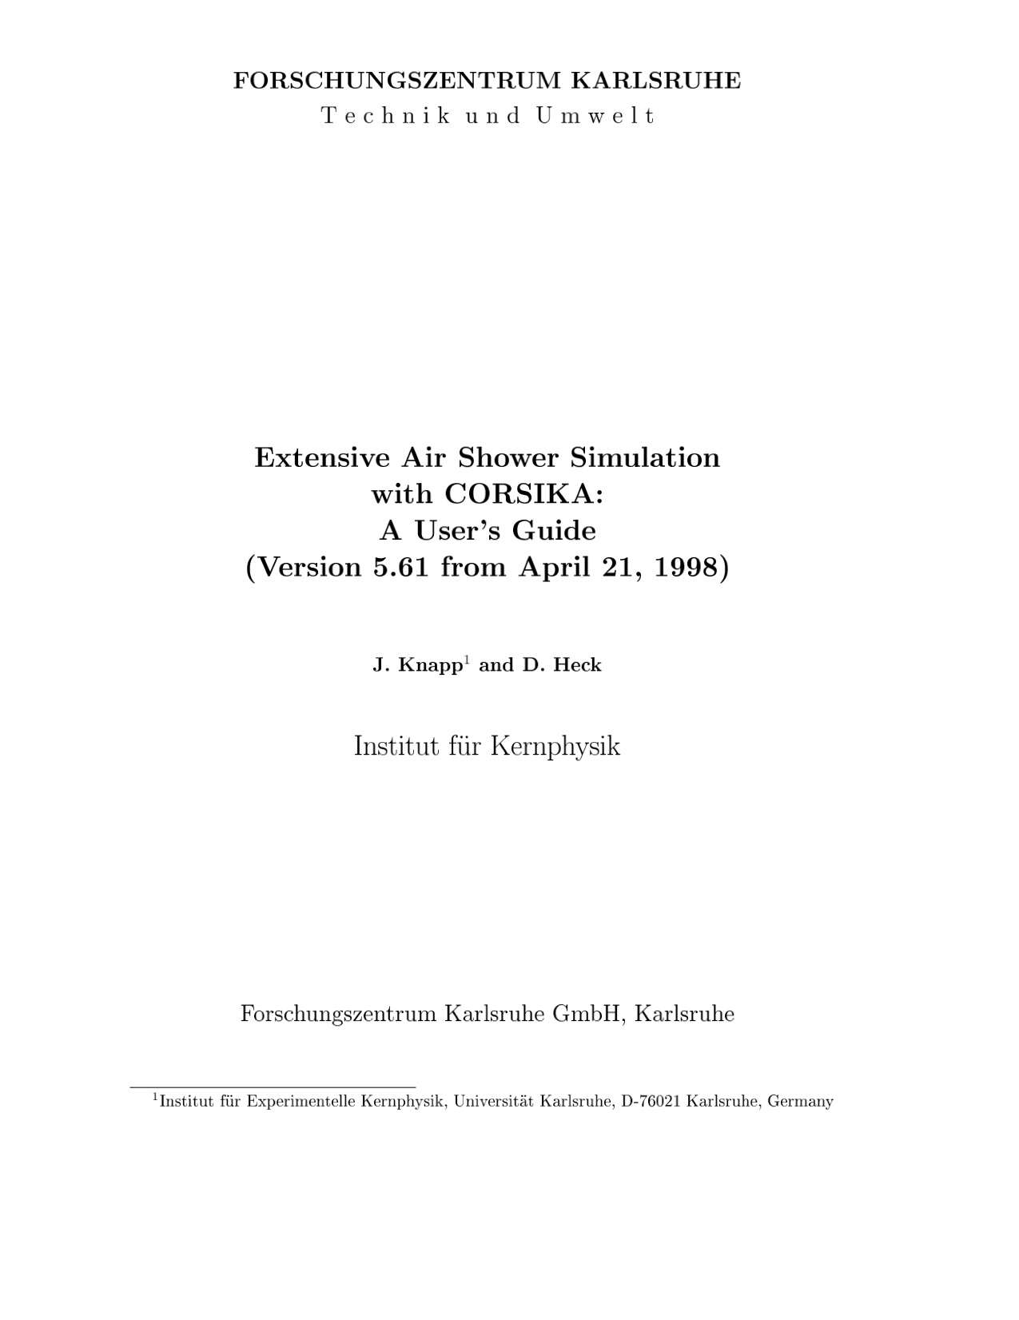
Generators : CORSIKA
(COsmic Ray SImulations for KAscade)
Particles are tracked through the atmosphere until they undergo reactions with the air nuclei or - in the case of instable secondaries - decay.
The hadronic interactions at high energies may be described by several reaction models alternatively:
  VENUS, QGSJET, and DPMJET (Gribov-Regge theory),
  SIBYLL (minijet model).
  neXus, EPOS (combination of QGSJET and VENUS).
  HDPM (Dual Parton Model).
Hadronic interactions at lower energies:
  GHEISHA, FLUKA , or UrQMD models.
For electromagnetic interactions
  Tailored version of EGS4.
  Analytical NKG formulas.
https://web.ikp.kit.edu/corsika/physics_description/corsika_phys.pdf

Slide 9
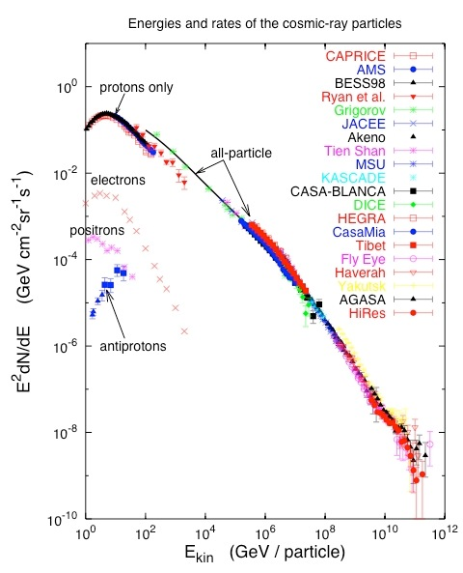
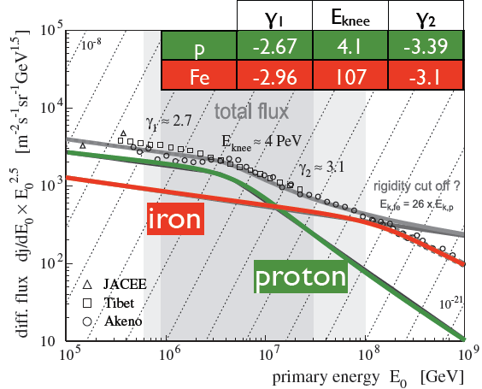
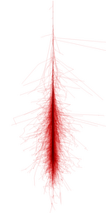
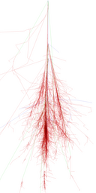
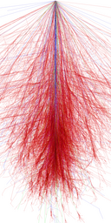
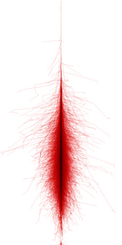
Generators : CORSIKA
(COsmic Ray SImulations for KAscade)
  weighted events : artificially flat spectrum
    better livetime efficiency @ 10 TeV but poor efficiency @ TeV
    energy-targeted generation of (H,He,CNO,Mg,Fe) with E⁻¹⁽²⁾
gamma shower Proton shower Iron shower Muon shower

Slide 10
DYNSTACK in CORSIKA
Kevin Meagher & Jakob van Santen
Replaces CORSIKA’s post-reaction particle stack with a C++11 plugin
General API for doing things like the neutrino kill threshold, plus helpful extras (take configuration from the steering card, manipulate event headers/trailers, etc)
In mainline CORSIKA since 7.56 (modulo typos)
Write plugins in C++11 without touching corsika.F, depend only on the standard library
Build a better CORSIKA for in-ice background simulation.
Reduce memory and disk requirements for high energy simulations.
Analysis-specific, targeted background simulation

Slide 11
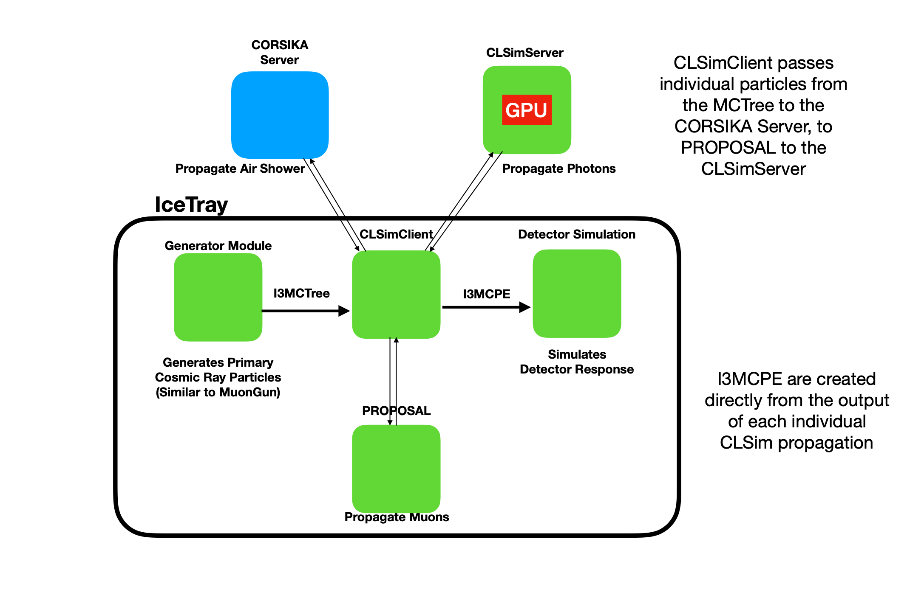
DYNSTACK in CORSIKA
K. Meagher

Slide 12
Generation
PROPAGATION
CORSIKA
PROPOSAL
DYNSTACK
CORSIKA
PHOTON PROPAGATION
CLSIM
BGND Noise/Muons
PolyPlopia
(coinc. backgrnd)
Vuvuzela
(noise)
Detector
PMT
DomLauncher
TriggerSim
i³SIM

Slide 13
MuonGun (IceCube implementation of MUPAGE)
arXiv:0907.5563v1 [astro-ph.IM] 31 Jul 2009

Slide 14
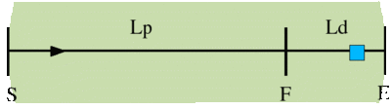
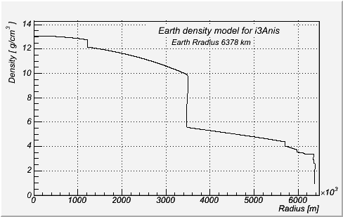
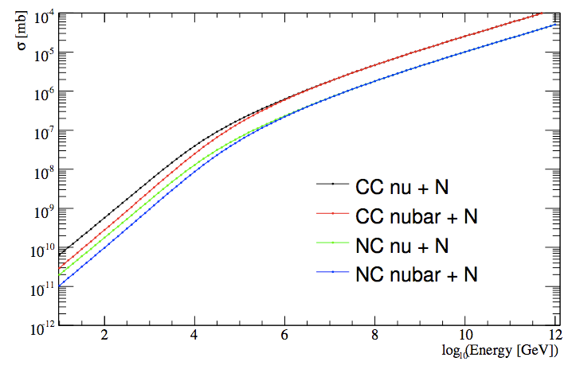
neutrino-generator
Calculate total path length inside the Earth using injected neutrino geometry.
  Separate the total path length into propagation area (SF) and
  detection volume (FE).
Define a step length dx[m] using propagation area and step number.
For each step:
  Calculate a column depth and Earth's density at the step point.
  Calculate a total cross section at the step point.
  Calculate a probability that the injected neutrino interacts within the step. Try Monte-Carlo, and decide whether an interaction happened within the step.
  If interaction occurred: choose interaction randomly.
    If CC-interaction is selected with injection particle NuMu or NuE, break (event is killed).
    else, generate secondaries and continue to next step.
  If nothing happens, continue next step.
Finish propagation when injected neutrino + secondaries reach surface of detection volume (point F), then process a weighted interaction.
produce a E^{-γ} νµ, νe, ντ with
  PRELIM Earth’s density model
    parton distribution functions
    prop & interaction of neutrinos into a weight

Slide 15
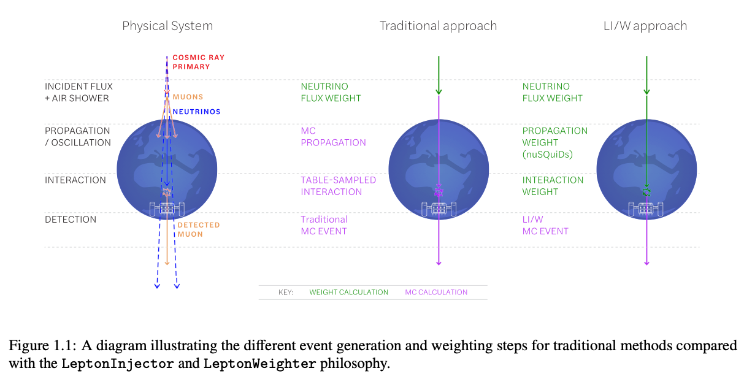
LeptonInjector/LeptonWeighter
LeptonInjector and LeptonWeighter are designed for large-volume Cherenkov neutrino telescopes such as IceCube.
The neutrino event generator allows for quick and flexible simulation of neutrino events within and around the detector volume
Implements the leading Standard Model neutrino interaction processes relevant for neutrino observatories:
  neutrino-nucleon deep-inelastic scattering
  neutrino-electron annihilation.
This is publicly available code.
https://arxiv.org/abs/2012.10449

Slide 16
Generators
  Cosmic-ray Air Showers:
    CORSIKA (FORTRAN stand-alone)
    dynstack-corsika (parallel corsika client/server w clsim)
    corsika-reader: IceTray reader for standard format (deprecated)
    CorsikaInjectorService (IceTop)
  Muons:
    MuonGun: parametrization of flux of atm. muons under the ice.
  Neutrinos:
    neutrino-generator: injects neutrinos, propagates them through Earth, forces interaction in detector volume.
    genie-icetray: detailed simulation of neutrino interactions with GENIE. (Used for low-energy simulations)
    LeptonInjector / NuFSGen (not yet available): weighted leptons+weights to account for flux models, interaction models, in-earth propagation, etc.

Slide 17
Lepton propagation
https://doi.org/10.1016/j.cpc.2013.04.001
  PROPOSAL: parametrized interactions with the medium. Comp. Phys. Com. 184, 9 (2013), p2070-2090
    Stochastic energy losses include:
      ionization
      electron-pair production
      bremsstrahlung
      photo-nuclear interaction
      decay
  GEANT4: Detailed particle propagation in media. https://geant4.web.cern.ch/
    3rd-party G4 library used by CLSim to propagate leptons for low-energy simulations (CPU-intensive).
Notes:
Propagator with optimal precision and optimized speed for all leptons

Slide 18
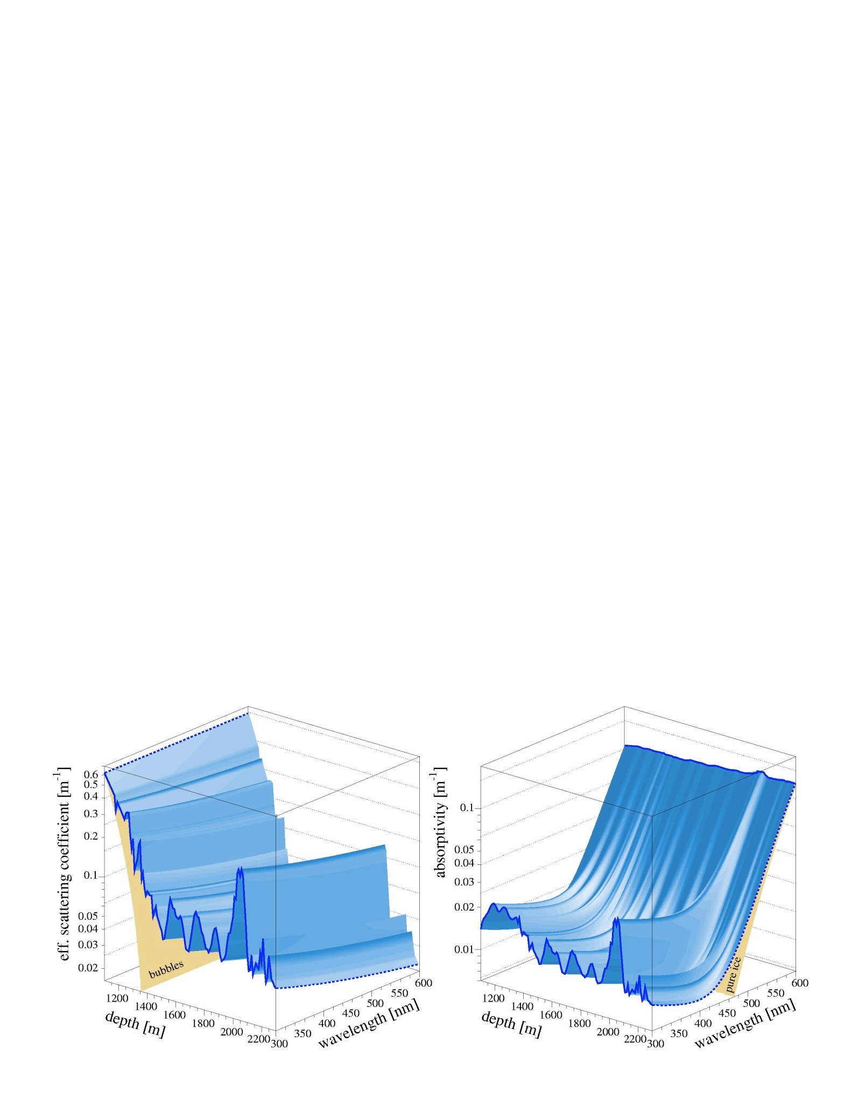
Photon Propagation
µ energy lost + cascades ➙ photons ➙ p.e.
  Photon propagation : ice properties + PMT response + DOM glass/gel
    Pre-generated lookup splined table :
      I3PhotonicsHitMaker
      Amplitude and time distribution
    Direct photon tracking
      CLSim
      PPC
    Hybrid photon tracking
      HitMaker + CLSim

Slide 19
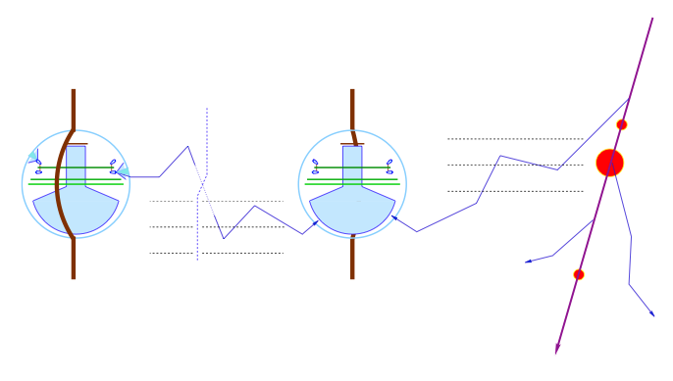
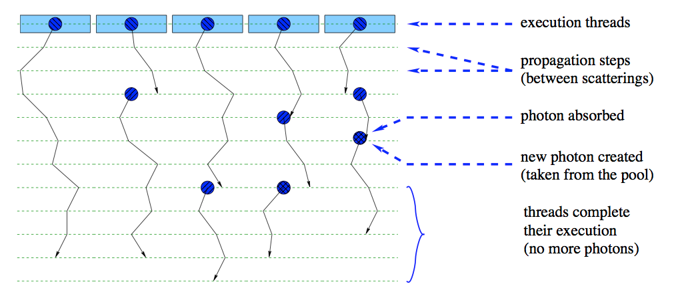
Photon Propagation (PPC, CLSim)
Direct photon propagation on GPU

Slide 20
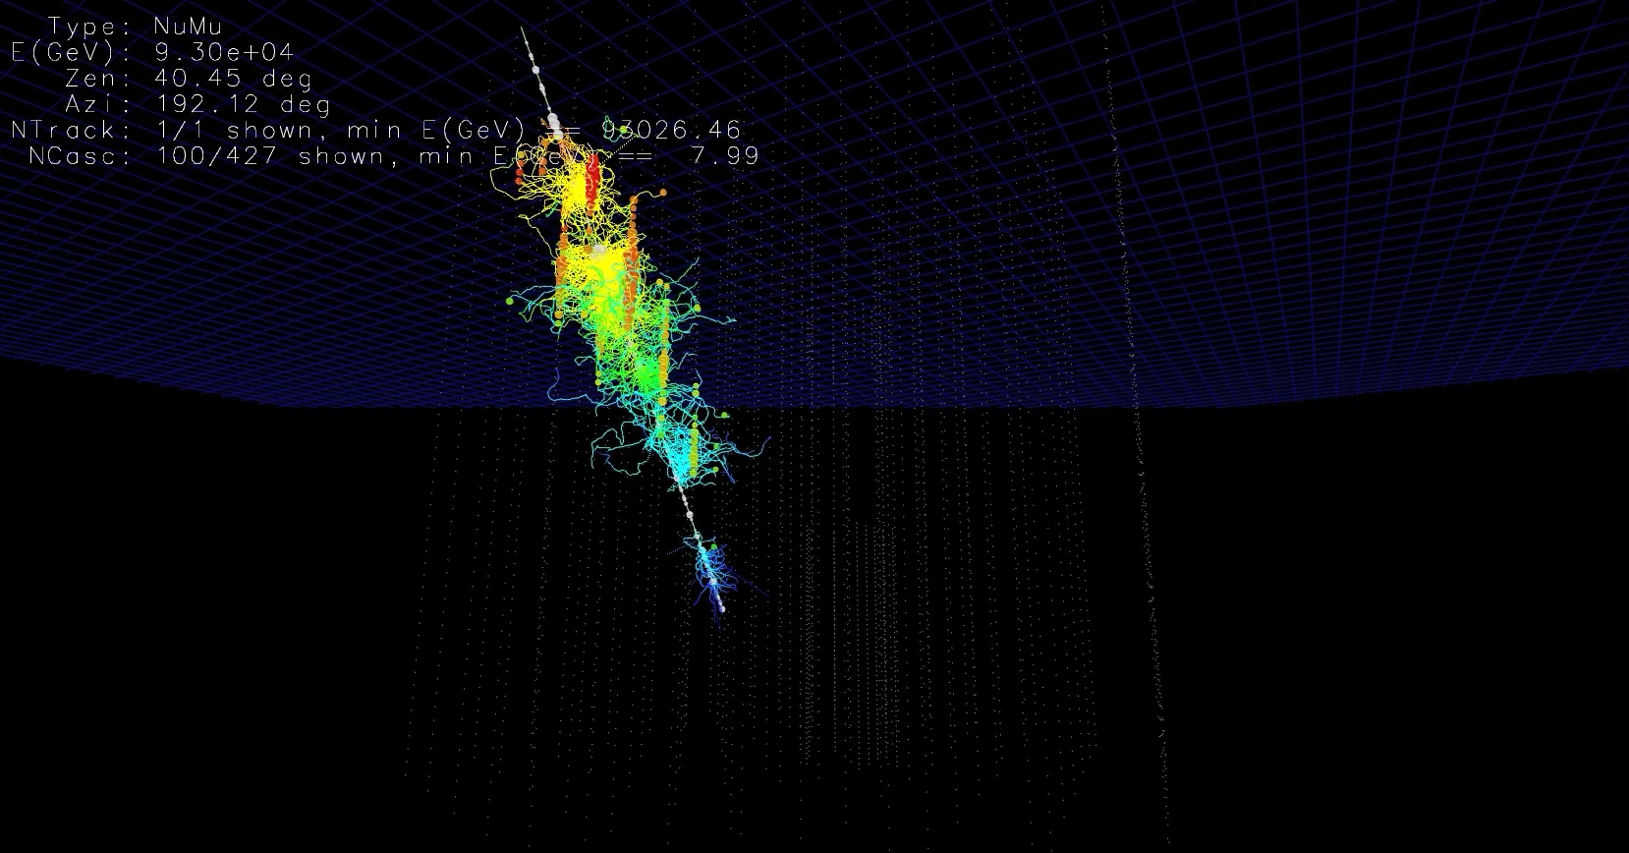
Photon Propagation (PPC, CLSim)
http://icecube.wisc.edu/~ckopper/muon_with_photons.mov

Slide 21
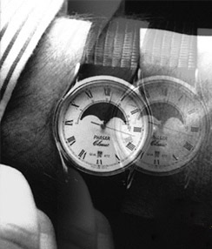
    Polyplopia
    (from gr., πολύς - polús, “many,”, and ὄψ-ops , "vision")
Coincident atmospheric shower events in IceCube
polyplopia::PoissonMerger
  Injects background event read from a separate file on top of primary events in the chain by sampling from a Poisson distribution over a time window ∆t.
  Also makes use of a CoincidentEventService that could be drop-in replaced with other event services such as a MuonGun-based service.
  Writes a separate I3MCTree with background particles.
  Writes a combined I3MCPE map for signal and background.
polyplopia::MPHitFilter
  Removes events that don’t produce light in the detector and removes branches of I3MCTrees whose particles don’t produce enough PEs in the detector,
  Reduces the storage requirements.
It is then up to the trigger-sim to split up Q-frames into P-frames events based on triggers.

Slide 22
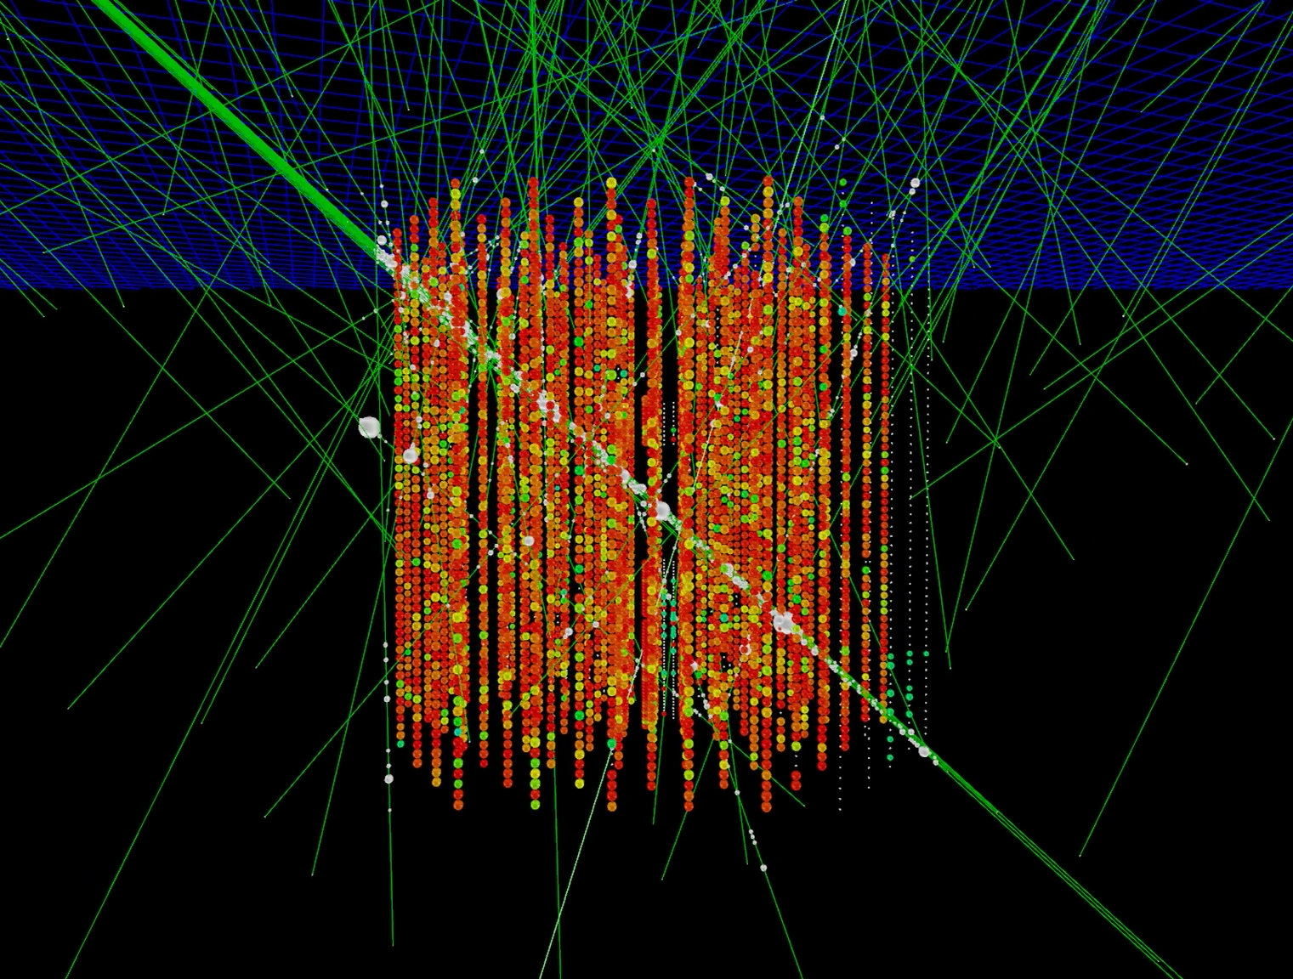
    Polyplopia
    (from gr., πολύς - polús, “many,”, and ὄψ-ops , "vision")
Coincident atmospheric shower events in IceCube
http://icecube.wisc.edu/~juancarlos/video/10msec_w_noise.mp4

Slide 23
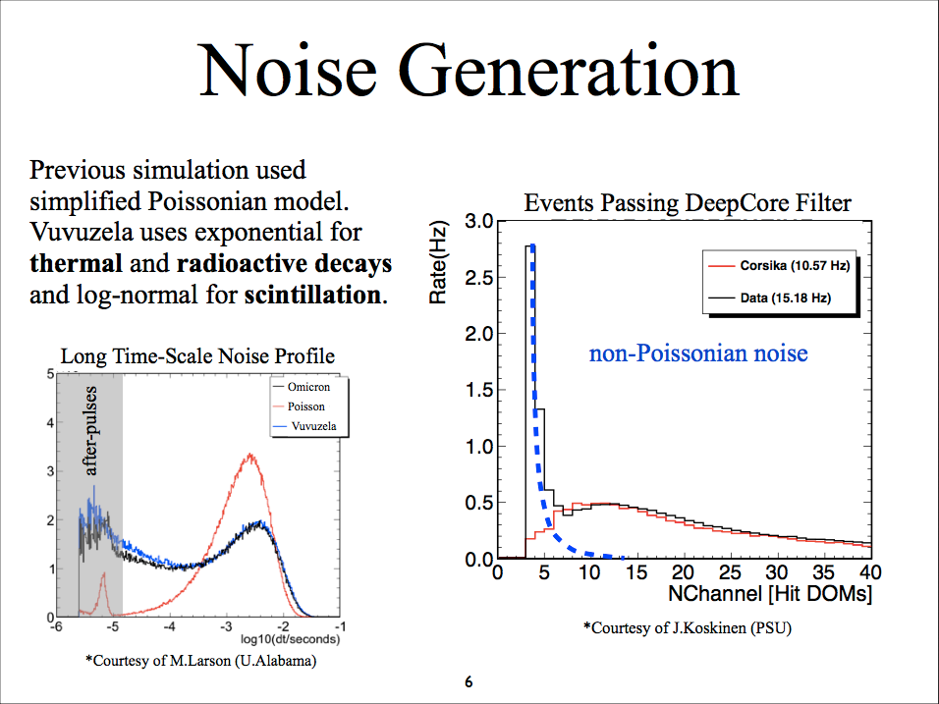
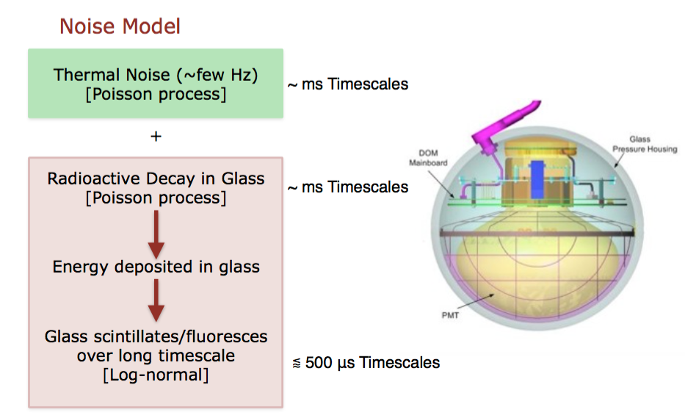
—> (MCPEs)

Slide 25
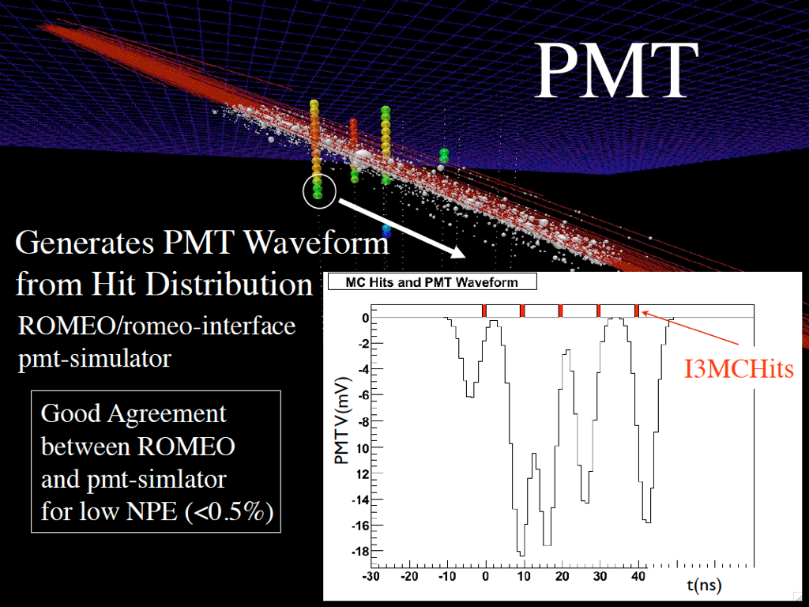
DOMLauncher::
PMTResponseSimulator
From distribution of (combined) MCPEs.
Outputs I3MCPulseSeries for each DOM.
MCPEs
MCPEs

Slide 26
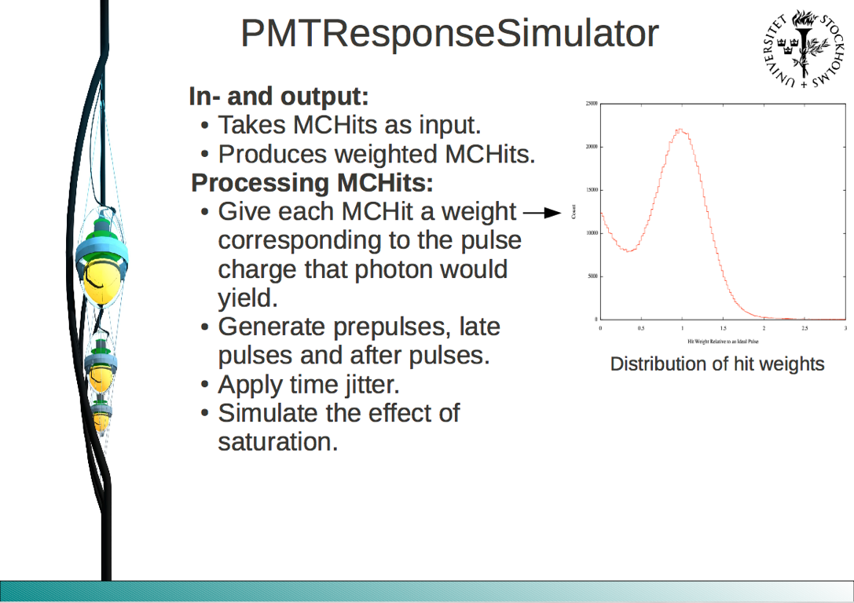
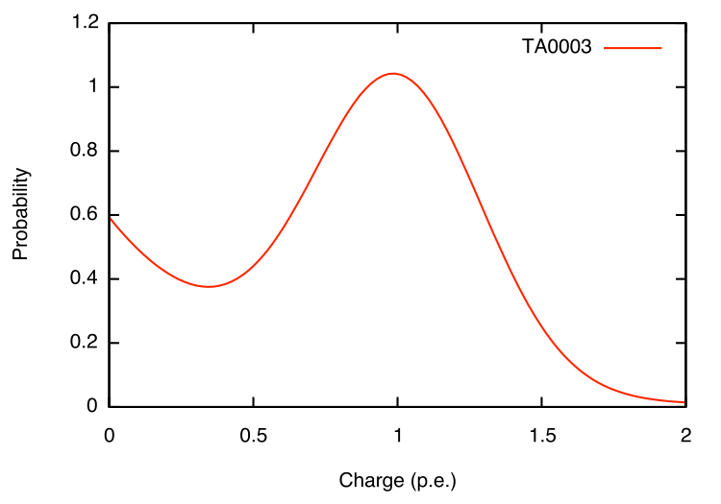
Input: I3MCPEs
Output: I3MCPulses
MCPEs
MCPEs
MCPE
Weights fromSPE Charge Distribution
http://software.icecube.wisc.edu/documentation/projects/DOMLauncher/index.html

Slide 27
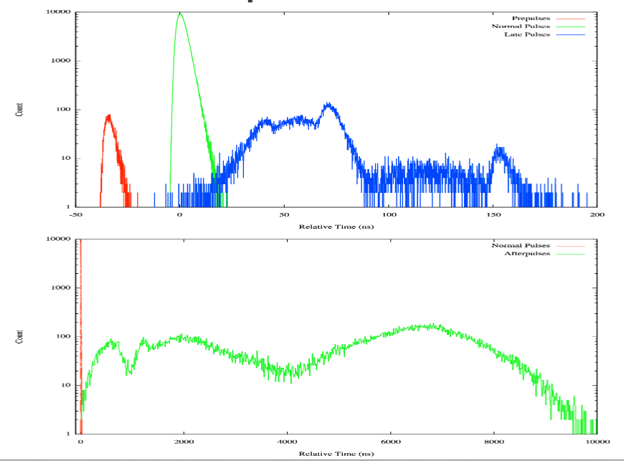
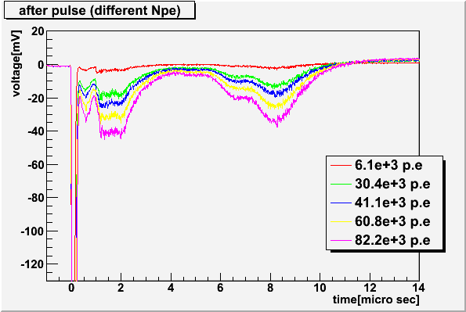
PAL pulses
Pre-pulses: photoelectrons ejected from the first dynode,
Late pulses: electrons backscatter from dynode to cathode.
After-pulses: ionization of residual gases by electrons accelerated in the space between dynode.
Chiba University
-50
0
50
100
150
200
Relative time (ns)
0
2000
6000
8000
10000
Relative time (ns)

Slide 28
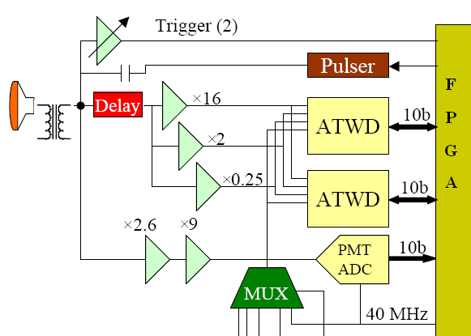
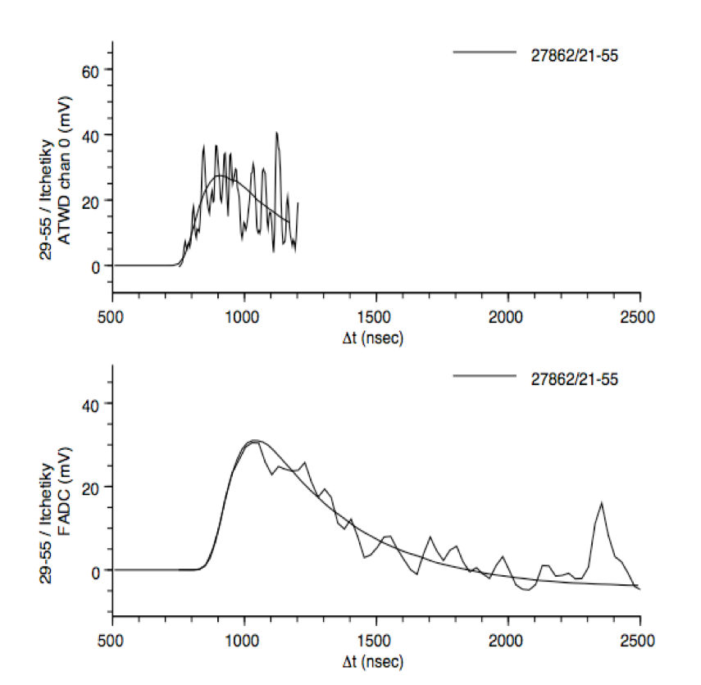
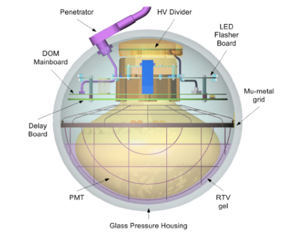
DOMLauncher: DOM electronics simulation
Discriminator
LC-logic
Digitization
Simulated effects
  Electronic noise in the digitizers
  Beacon launches (CPU triggered launches)
  The FPGA Clock phase
  RAPcal time uncertainty
Core of detector simulation
  Digitization & timing @ MB
  Hard local coincidence (HLC) triggers

Slide 29
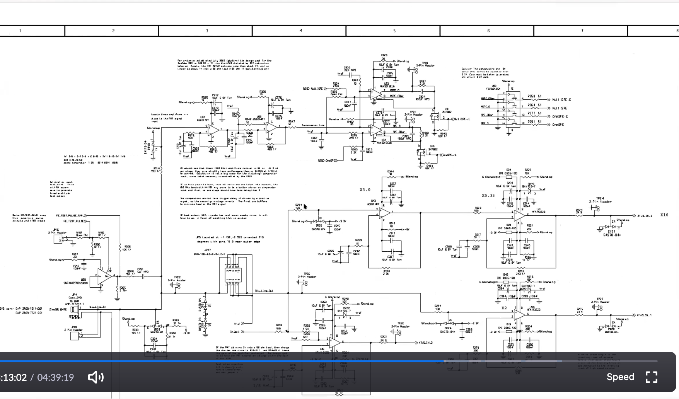
DOMLauncher: DOM electronics simulation

Slide 30
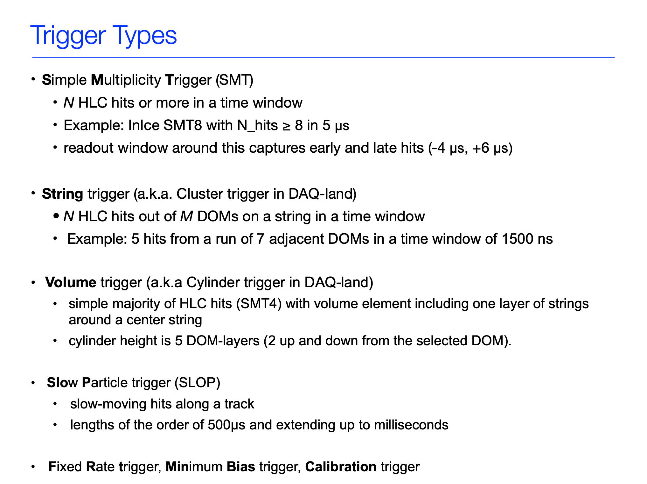
Trigger Simulation

Slide 31
i³SIM
The Shish Kabob
(Computing Resource Optimization)
}
CORSIKA
Optimizing the shish kabob:
  Different parts of the simulation chain have different resource requirements.
    CORSIKA is CPU-intensive and requires little RAM
    Photon propagation run almost exclusively on GPUs
    Detector simulation is CPU bound and requires more memory.
Things to keep in mind:
  Running the whole chain on a GPU node will waste GPU resources and limit your throughput.
  Intermediate storage:
    breaking up chain requires transfering/storing intermediate files.
  Reduce complexity in workflow
CPU
PROPOSAL
}
CLSIM
GPU
PolyPlopia
}
Vuvuzela
(noise)
PMT
CPU
DomLauncher
TriggerSim

Slide 32
Simprod-Scripts
http://software.icecube.wisc.edu/documentation/projects/simprod_scripts/index.html
This project is a collection of scripts, tray segments and IceProd modules used in simulation production. The aim is to provide a central place with standard segments for running simulation in both production and privately.
Tray Segments: IceTray meta-modules that contain several I3Modules with default parameters.
IceProd modules: basic wrappers around tray segments that provide an interface for IceProd.
Scripts: collection of python scripts used in simulation production
Examples: The directory simprod-scripts/resources/examples contains a collection of example scripts for running IPModules
Tests: are run on the build-bots to check that the different parts of the simulation are not broken with each commit to the software repository.

Slide 33
Simprod-Scripts
http://software.icecube.wisc.edu/documentation/projects/simprod_scripts/index.html
IceProd Modules
$I3_SRC/simprod-scripts/python/modules
Corsika
MuonGunGenerator
NuGen
GENIE
CLSim
PPC
Detectors
IceTop

Slide 34
Simprod-Scripts
http://software.icecube.wisc.edu/documentation/projects/simprod_scripts/index.html
Tray Segments
$I3_SRC/simprod-scripts/python/segments
        Calibration
        DetectorSim
        GenerateAirShowers
        GenerateCosmicRayMuons
        GenerateFlashers
        GenerateIceTopShowers
        GenerateIceTopShowers
        GenerateNeutrinos
        GenerateNoiseTriggers
        HybridPhotonicsCLSim
        Polyplopia
        PropagateMuons

Slide 35
simprod-scripts
http://software.icecube.wisc.edu/documentation/projects/simprod_scripts/examples/fullSimulation.html
Examples:
$I3_SRC/simprod-scripts/resources/examples/fullSimulation.py
./fullSimulation.py -n 10 --seed=43682 --datasetnumber=1 --runnumber=1 --no-hybrid --icemodel=SpiceLea \
            --detector=IC86 --unshadowed-fraction=0.99 --flavor=NuTau --outfile=taus.i3 --skip-calibration \
            --from-energy=1000 --to-energy=10000000 --include-gcd-in-outfile
-n 10 Simulate 10 events (the output file might contain fewer events because not everything will trigger).
--seed=43682 A random number generator seed
--datasetnumber=1 --runnumber=1 A combination of “dataset” and “run” numbers. You can keep the same seed for all of them, each one will give a distinct independent set of events. (So you can think of the combination of seed, dataset and run as the actual random number seed. Or, put another way, there is no need to have different seeds for different runs.)
--no-hybrid Do not use hybrid simulation mode, i.e. propagate everything using direct simulation. There will be no photon tables and things like ice anisotropy/SpiceLea will work.
--icemodel=SpiceLea The other two models are “Spice1” and “SpiceMie”. Including things like WHAM would be trivial if you need it.
--detector=IC86 This will select a GCD file from $I3_PORTS automatically. Currently works for IC86 and IC79.
--unshadowed-fraction=0.99 This is the “DOMEfficiency”, currently named like this for compatibility with other tools that use the same name.
--flavor=NuTau You can set this also to “NuE” and “NuMu”.
--outfile=... The name of your final .i3 file you want to generate.
--from-energy=1000 --to-energy=10000000 The energy range in GeV. Currently not implemented for MuonGun which uses fixed energy ranges. Should be fixed soon.
--include-gcd-in-outfile Use this option if you want to generate output files with GCD frames in them. It makes them much easier to use, but of course wastes some space..

Slide 36
simprod-scripts
Scripts:
$I3_SRC/simprod-scripts/resources/scripts
(run the individual pieces as broken down by production tasks)
$ python nugen.py -h
            Usage: nugen.py [options]
            Options:
            -h, --help show this help message and exit
            --no-execute boolean condition to execute
            --outputfile=OUTPUTFILE
            Output filename
            --summaryfile=SUMMARYFILE
            XMLSummary filename
            --mjd=MJD MJD for the GCD file
            --seed=RNGSEED RNG seed
            —UseGSLRNG
            …

Slide 37
simprod-scripts
Exercise: Running scripts:
You can run on cobalt
ssh cobalt
or, preferably, you can run an interactive job on NPX with GPU
ssh submit
The following slides will assume you are on submit (AKA NPX)
commands ending with ‘\’ indicate that the next line is a continuation of the current line

Slide 38
simprod-scripts
Exercise: Running scripts:
icecube@M16:~$ ssh submitter
[submitter]$
[submitter]$ condor_submit -interactive 'request_gpus=1'
Submitting job(s).
1 job(s) submitted to cluster 120263704.
Waiting for job to start…
Welcome to slot1@gtx-00.icecube.wisc.edu!
[gtx-00]$ cd $_CONDOR_SCRATCH_DIR
[gtx-00]$ cp /cvmfs/icecube.opensciencegrid.org/data/GCD/ \
GeoCalibDetectorStatus_2020.Run134142.Pass2_V0.i3.gz gcdfile.i3.gz
[gtx-00]$ /cvmfs/icecube.opensciencegrid.org/py3-v4.2.0/icetray-env icetray/v1.3.3
************************************************************************
* *
* W E L C O M E to I C E T R A Y *
* *
* Version icetray.stable git:f5d21802 *
* *
* You are welcome to visit our Web site *
* http://icecube.umd.edu *
* *
************************************************************************
[gtx-00]$ python $I3_BUILD/simprod-scripts/resources/scripts/nugen.py \
--outputfile nutau.i3 --nevents 100 \
--seed=123 --procnum 0 --nproc=1 \
--FromEnergy 1e5 --ToEnergy 1e6 --NuFlavor NuTau --UseGSLRNG
[gtx-00]$ dataio-shovel nutau.i3

Slide 39
simprod-scripts
Exercise: Running scripts:
[gtx-00]$ dataio-shovel nutau.i3

Slide 40
simprod-scripts
Exercise: Running scripts:
  [gtx-00]$ python $I3_BUILD/simprod-scripts/resources/scripts/clsim.py \
--gcdfile gcdfile.i3.gz \
--inputfilelist nutau.i3 --outputfile mcpes.i3 \
--seed 123 --procnum 0 --nproc 1 --no-RunMPHitFilter \
--UseGPUs --UseGSLRNG
[gtx-00]$ dataio-shovel mcpes.i3
[gtx-00]$ python $I3_BUILD/simprod-scripts/resources/scripts/detector.py \
--gcdfile gcdfile.i3.gz \
--inputfile mcpes.i3 --outputfile det.i3 \
--seed 123 --procnum 0 --nproc 1 --RunID 123 —UseGSLRNG
[gtx-00]$ dataio-shovel det.i3

Slide 41
simprod-scripts
Exercise: Running scripts:
[gtx-00]$ dataio-shovel mcpes.i3

Slide 42
simprod-scripts
Exercise: Running scripts:
[gtx-00]$ dataio-shovel det.i3

Slide 43
simprod-scripts
Exercise: Running scripts:
[gtx-00]$ python $I3_BUILD/simprod-scripts/resources/scripts/corsika.py \
--nshowers 10000 --outputfile corsika_bg.i3 --seed 1234 \
--CORSIKAseed=123 --ranpri 2 \
--corsikaVersion v6960-5comp \
--corsikaName dcorsika --UseGSLRNG \
--skipoptions compress
[gtx-00]$ dataio-shovel corsika_bg.i3
[gtx-00]$ python $I3_BUILD/simprod-scripts/resources/scripts/polyplopia.py \
--gcdfile gcdfile.i3.gz \
--inputfile mcpes.i3 --outputfile merged_pes.i3 \
--seed 1234 \
--backgroundfile corsika_bg.i3 --mctype NuTau \
--UseGSLRNG
[gtx-00]$ python $I3_BUILD/simprod-scripts/resources/scripts/detector.py \
--gcdfile gcdfile.i3.gz \
--inputfile merged_pes.i3 --outputfile det_wcoinc.i3 \
--seed 123 --RunID 123 --UseGSLRNG
[gtx-00]$ dataio-shovel det_wcoinc.i3

Slide 44
simprod-scripts
Exercise: Running scripts:
[gtx-00]$ dataio-shovel corsika_bg.i3
--inputfile mcpes.i3 --outputfile merged_pes.i3 \
--seed 1234 \
--backgroundfile corsika_bg.i3 --mctype NuTau \
--UseGSLRNG
[gtx-00]$ python $I3_BUILD/simprod-scripts/resources/scripts/detector.py \
--gcdfile gcdfile.i3.gz \
--inputfile merged_pes.i3 --outputfile det_wcoinc.i3 \
--seed 123 --RunID 123 --UseGSLRNG
[gtx-00]$ dataio-shovel det_wcoinc.i3

Slide 45
simprod-scripts
Exercise: Running scripts:
[gtx-00]$ dataio-shovel merged_pes.i3

Slide 46
simprod-scripts
Exercise: Running scripts:
[gtx-00]$ dataio-shovel merged_pes.i3

Slide 47
More on simulation
https://docs.icecube.aq/icetray/main/
http://grid.icecube.wisc.edu/simulation
http://wiki.icecube.wisc.edu/index.php/Simulation_Production
SLACK: #simulation

Slide 48
flow of experimental and simulation data
data
on-line
off-line
physics analyses
experimental
filter @
South Pole
level 1 filtering
(recreate on-line filter)
level 2 processing
level 3 processing
physics
DAQ
P&F computing
spade
core computing
working groups
simulation generation
level 1 filtering
(recreate on-line filter)
level 2 processing
level 3 processing
physics
distributed computing
working groups

Slide 49
Simulating the online filter and L2 processing
[gtx-00]$ python filterscripts/resources/scripts/SimulationFiltering.py -h
usage: SimulationFiltering.py [-h] [-i INFILE] [-g GCDFILE] [-o OUTFILE]
[-n NUM] [--qify]
[--MinBiasPrescale MINBIASPRESCALE]
[--photonicsdir PHOTONICSDIR] [--enable-gfu]
[--log-level LOG_LEVEL] [--log-filename LOGFN]
[--needs_wavedeform_spe_corr]
optional arguments:
-h, --help show this help message and exit
-i INFILE, --input INFILE
Input i3 file(s) (use comma separated list for
multiple files)
-g GCDFILE, --gcd GCDFILE
GCD file for input i3 file
-o OUTFILE, --output OUTFILE
Output i3 file
-n NUM, --num NUM Number of frames to process
--qify Apply QConverter, use if file is P frame only
--MinBiasPrescale MINBIASPRESCALE
Set the Min Bias prescale to something other than
default
--photonicsdir PHOTONICSDIR
Directory with photonics tables
--enable-gfu Do not run GFU filter
--log-level LOG_LEVEL
Sets the logging level (ERROR, WARN, INFO, DEBUG,
TRACE)
--log-filename LOGFN If set logging is redirected to the specified file.
--needs_wavedeform_spe_corr
apply_spe_corection in wavedeform.

Slide 50
Simulating the online filter and L2 processing
[gtx-00]$ python filterscripts/resources/scripts/offlineL2/process.py -h
usage: process.py [-h] [-s] [-i INFILE] [-g GCDFILE] [-o OUTFILE] [-n NUM]
[--dstfile DSTFILE] [--gapsfile GAPSFILE]
[--icetopoutput ICETOPOUTPUT] [--eheoutput EHEOUTPUT]
[--slopoutput SLOPOUTPUT] [--rootoutput ROOTOUTPUT]
[--photonicsdir PHOTONICSDIR] [--log-level LOG_LEVEL]
[--log-filename LOGFN]
optional arguments:
-h, --help show this help message and exit
-s, --simulation Mark as simulation (MC)
-i INFILE, --input INFILE
Input i3 file(s) (use comma separated list for
multiple files)
-g GCDFILE, --gcd GCDFILE
GCD file for input i3 file
-o OUTFILE, --output OUTFILE
Output i3 file
-n NUM, --num NUM Number of frames to process
--dstfile DSTFILE DST root file (should be .root)
--gapsfile GAPSFILE gaps text file (should be .txt)
--icetopoutput ICETOPOUTPUT
Output IceTop file
--eheoutput EHEOUTPUT
Output EHE i3 file
--slopoutput SLOPOUTPUT
Output SLOP file
--rootoutput ROOTOUTPUT
Output root file
--photonicsdir PHOTONICSDIR
Directory with photonics tables
--log-level LOG_LEVEL
Sets the logging level (ERROR, WARN, INFO, DEBUG,
TRACE)
--log-filename LOGFN If set logging is redirected to the specified file.

Slide 51
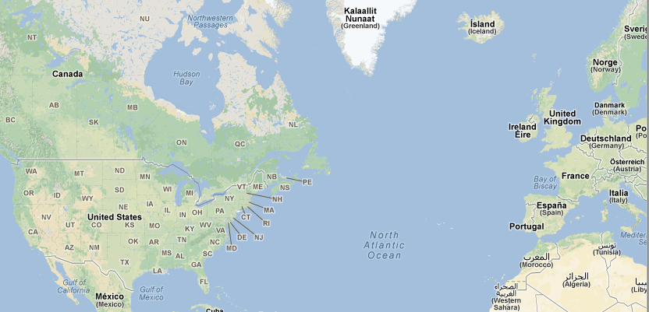
Simulation Production
You will typically not be generating you own simulation.
Simulating IceCube takes many computing cycles
The collaboration utilizes distributed computing resources from around the world
You can find information on generated datasets in
  http://wiki.icecube.wisc.edu/index.php/Simulation_Production
Simulations are stored in “Data Warehouse”
  In-ince: /data/sim/IceCube/[YEAR]
  IceTop: /data/sim/IceTop/[YEAR]
Tokio

Slide 52
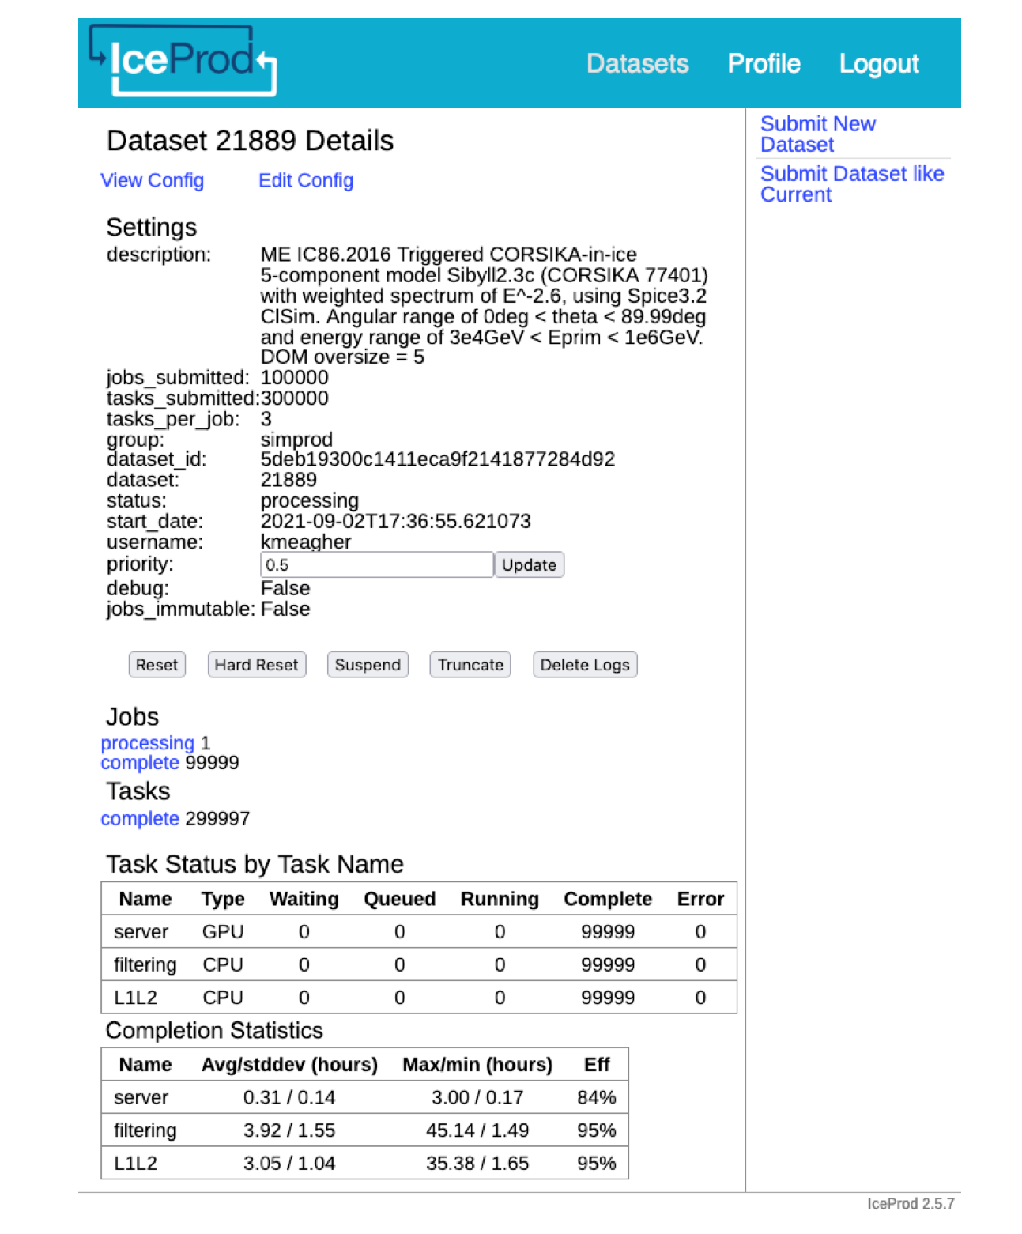
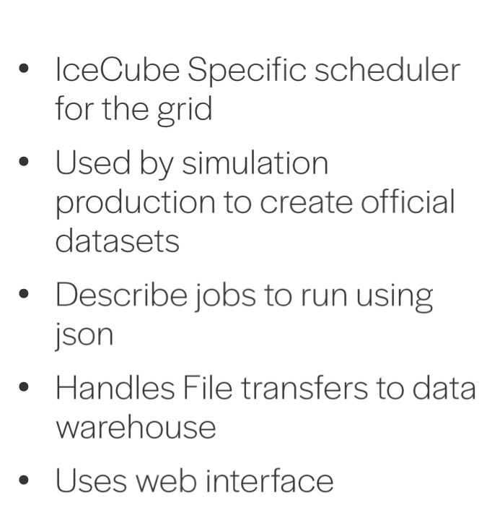
IceProd2
Distributed Computing
Data provenance
  Configuration
    which software, what versions,
  when/where it ran, ...
Dataset submission
  Monitor job status, resource usage
  Retry failed jobs - resubmit with different requirements

Slide 53
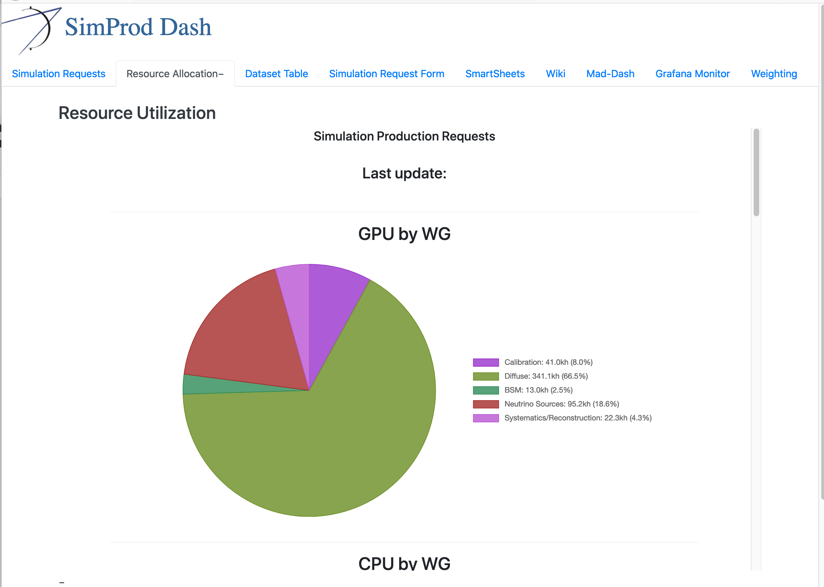
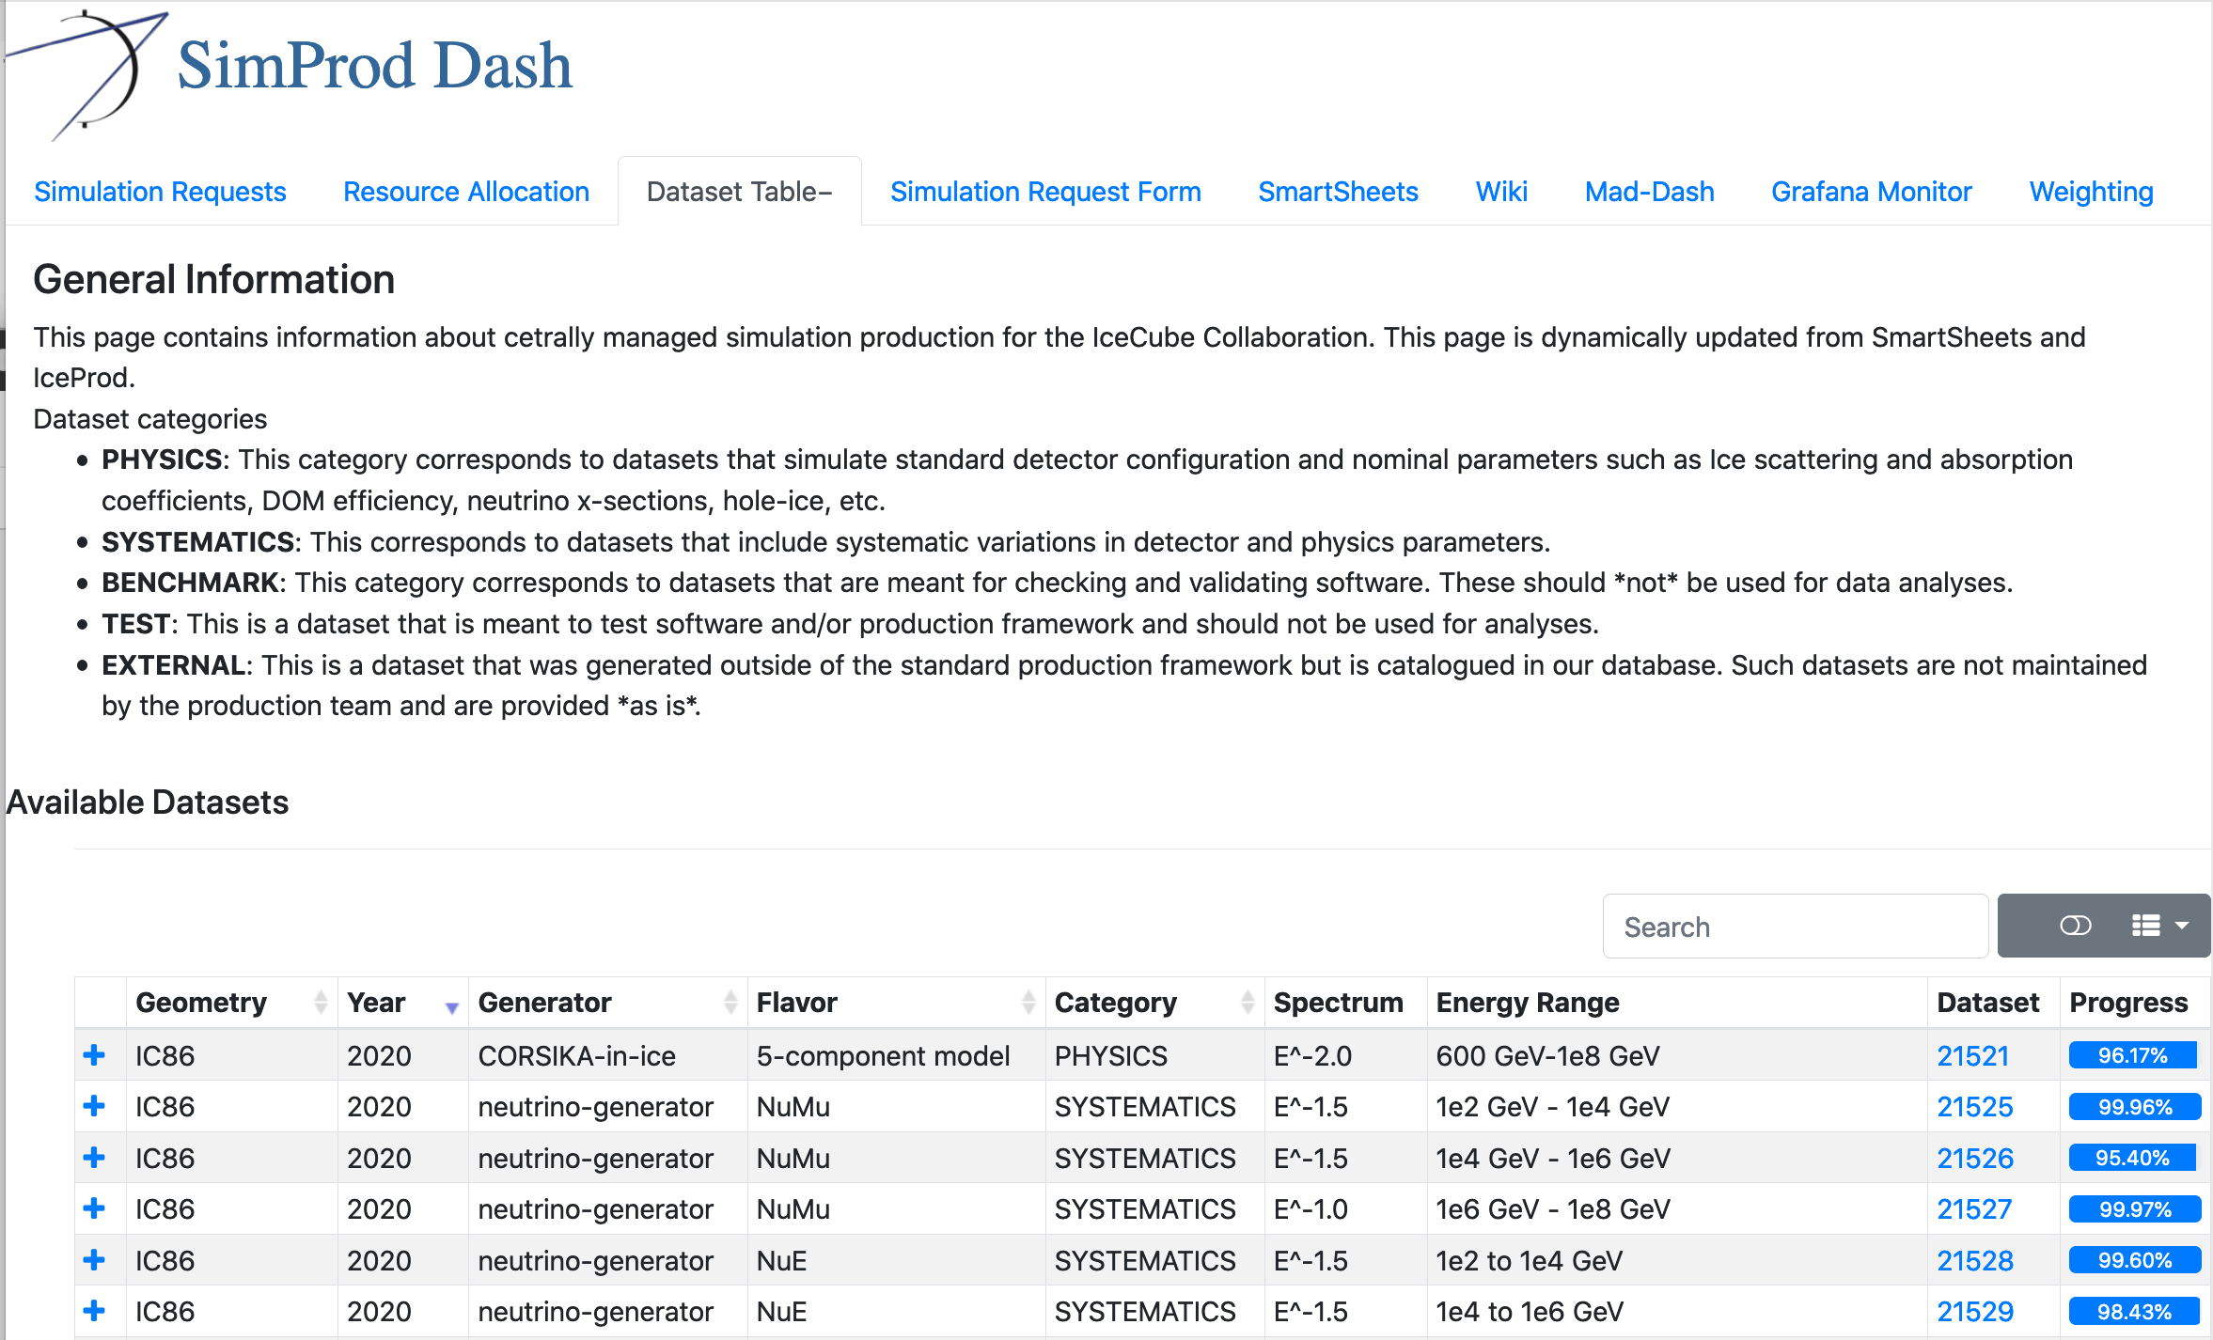
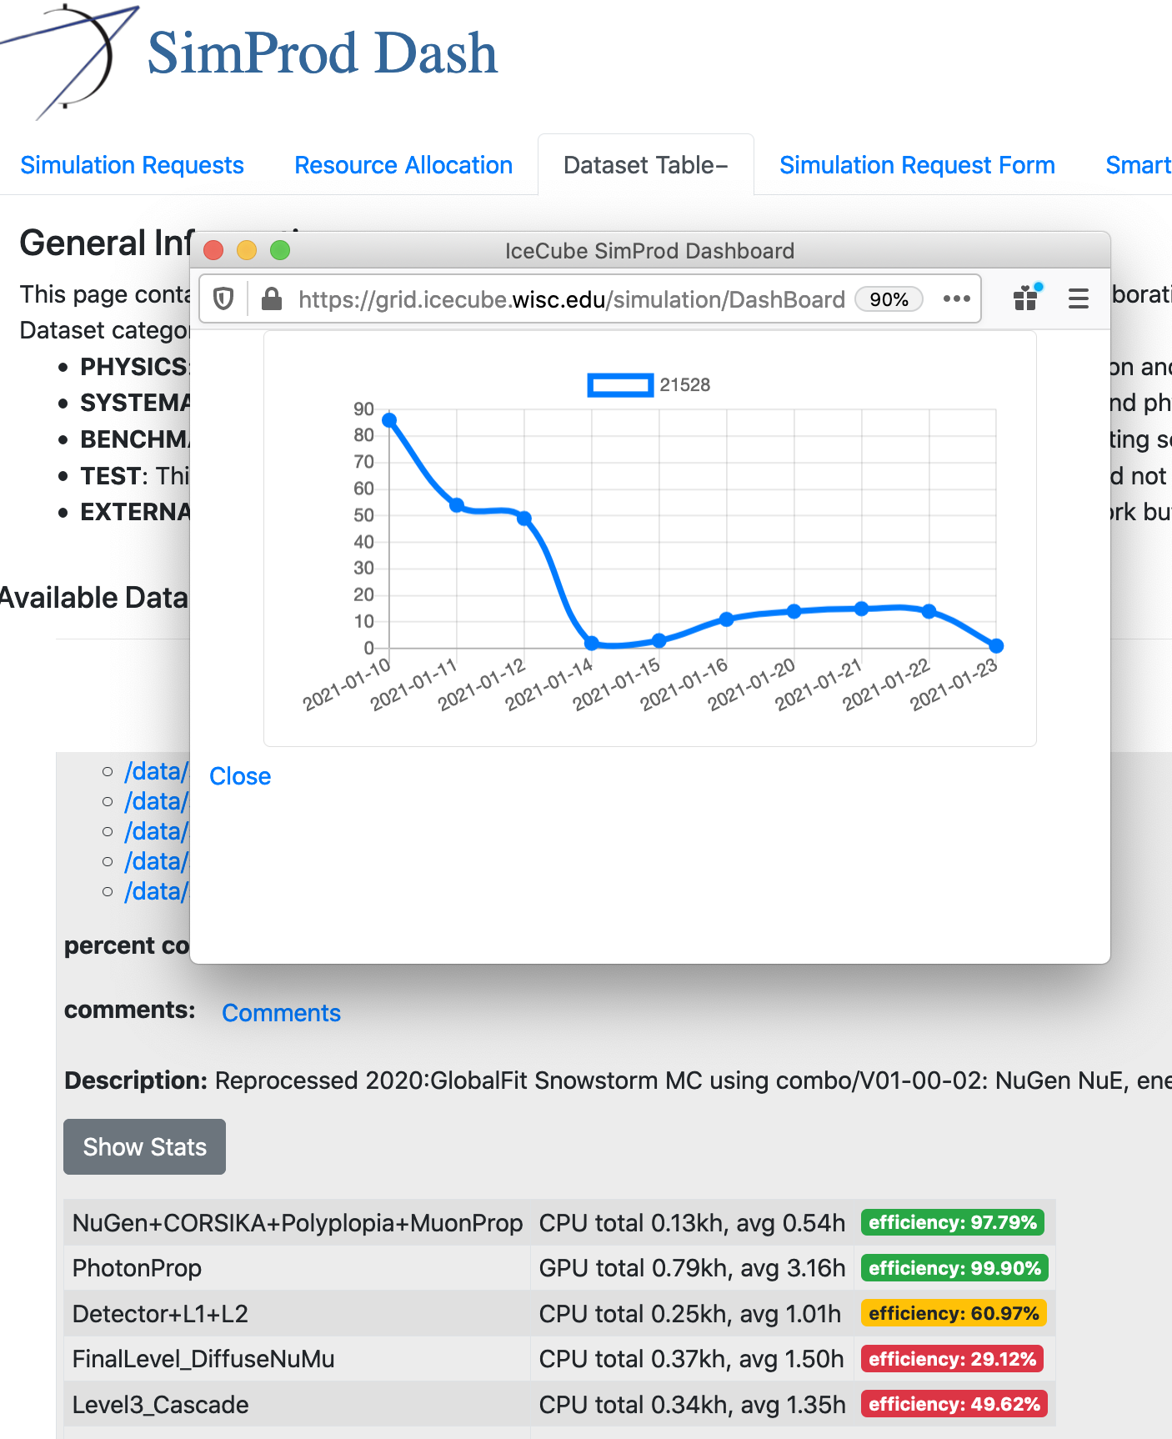
Simprod DashBoard
https://grid.icecube.wisc.edu/simulation/DashBoard
Catalog of official MC datasets
Simulation Requests
Dataset and resource Monitoring

Slide 54
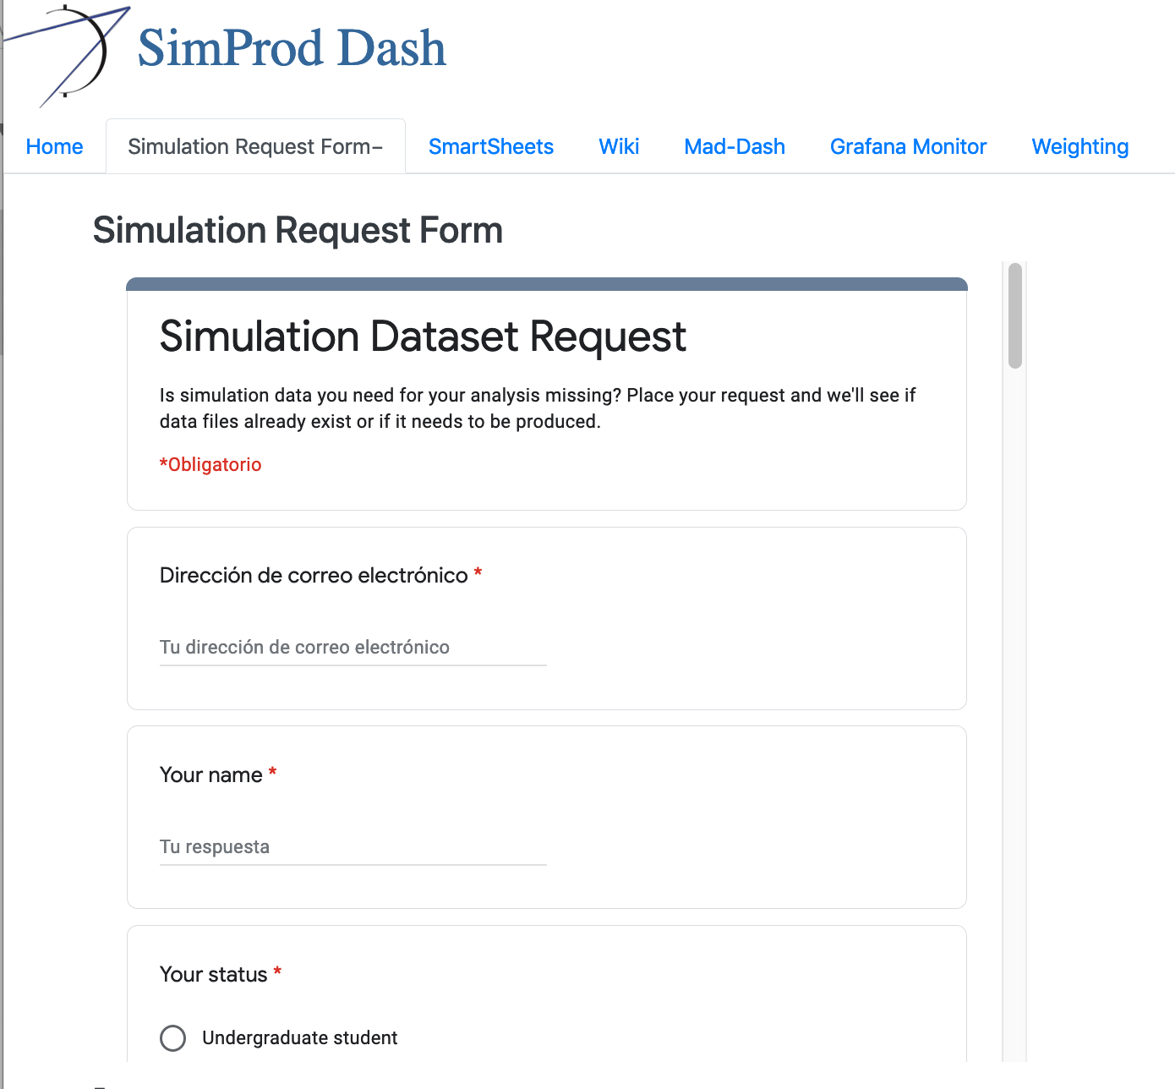
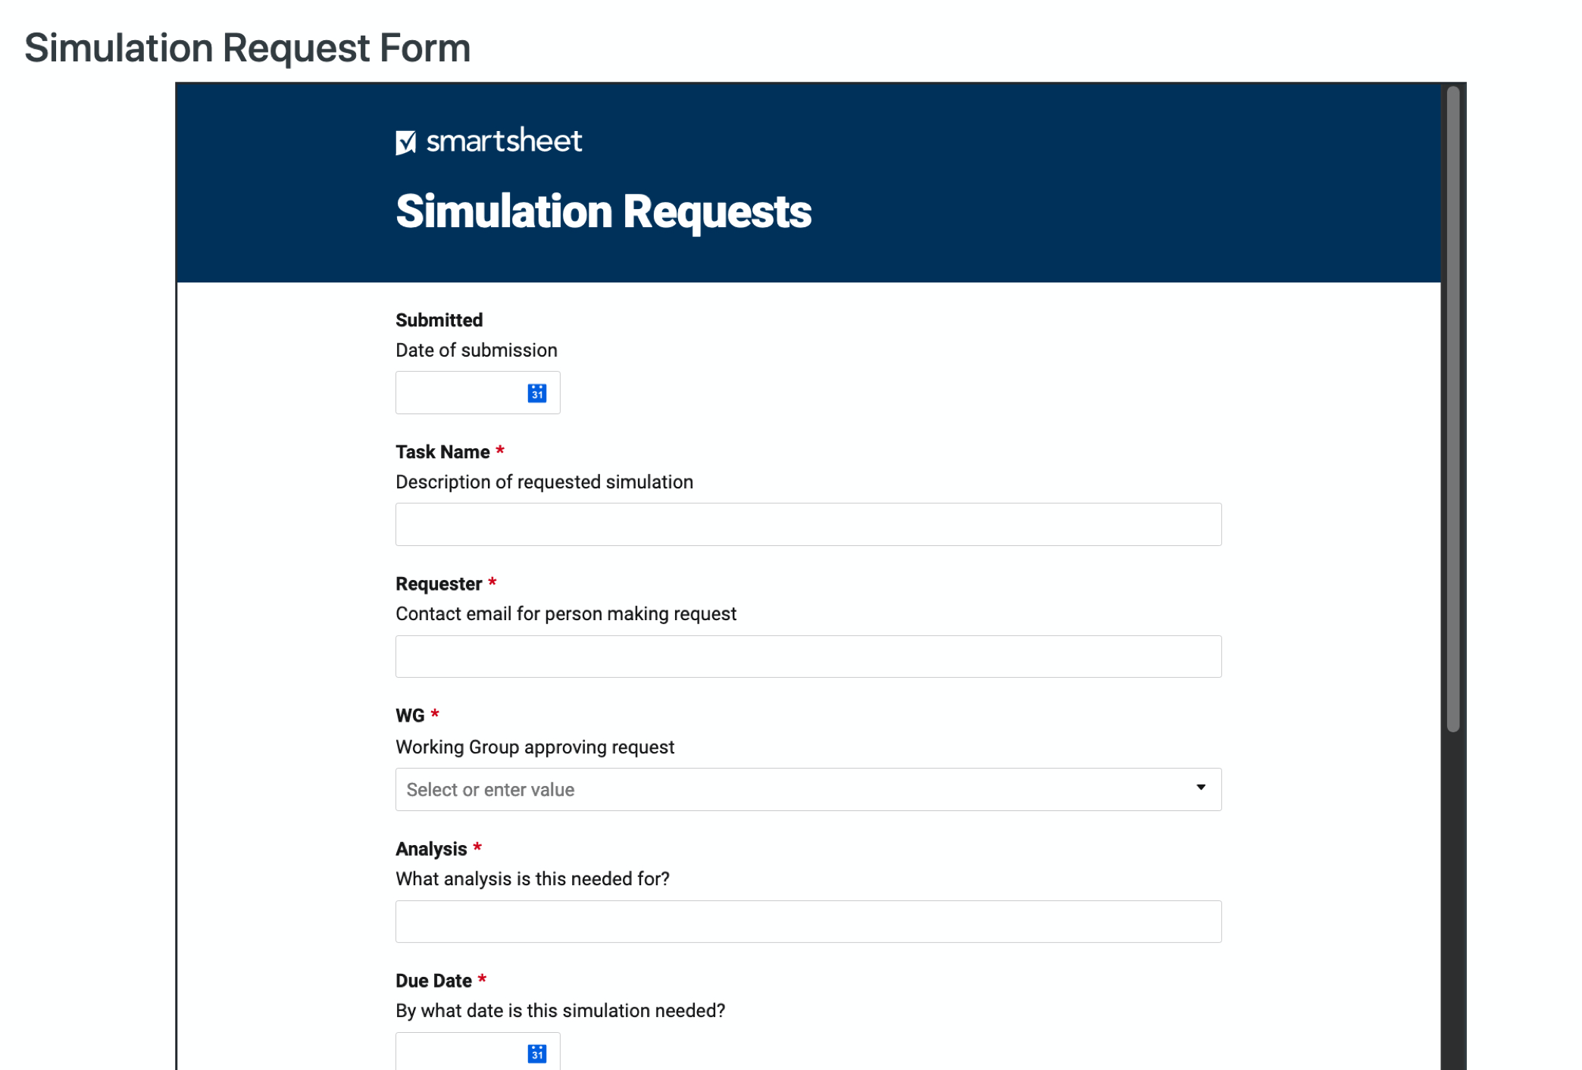
Sim-Prod Requests
Need high statistics simulations?
Discuss with your WG
Submit a request
Priority will be evaluated by tech leads
https://grid.icecube.wisc.edu/simulation/DashBoard/#simreqform

Slide 55
Weighting
SimWeights:
  https://icecube.wisc.edu/~juancarlos/simulation/Bootcamp_2021_Simulation_Weighting.html
Old IceTray weighting project:
  https://icecube.wisc.edu/~juancarlos/simulation/Bootcamp_2020_Simulation_Weighting.html

Slide 56
Backup

Slide 57
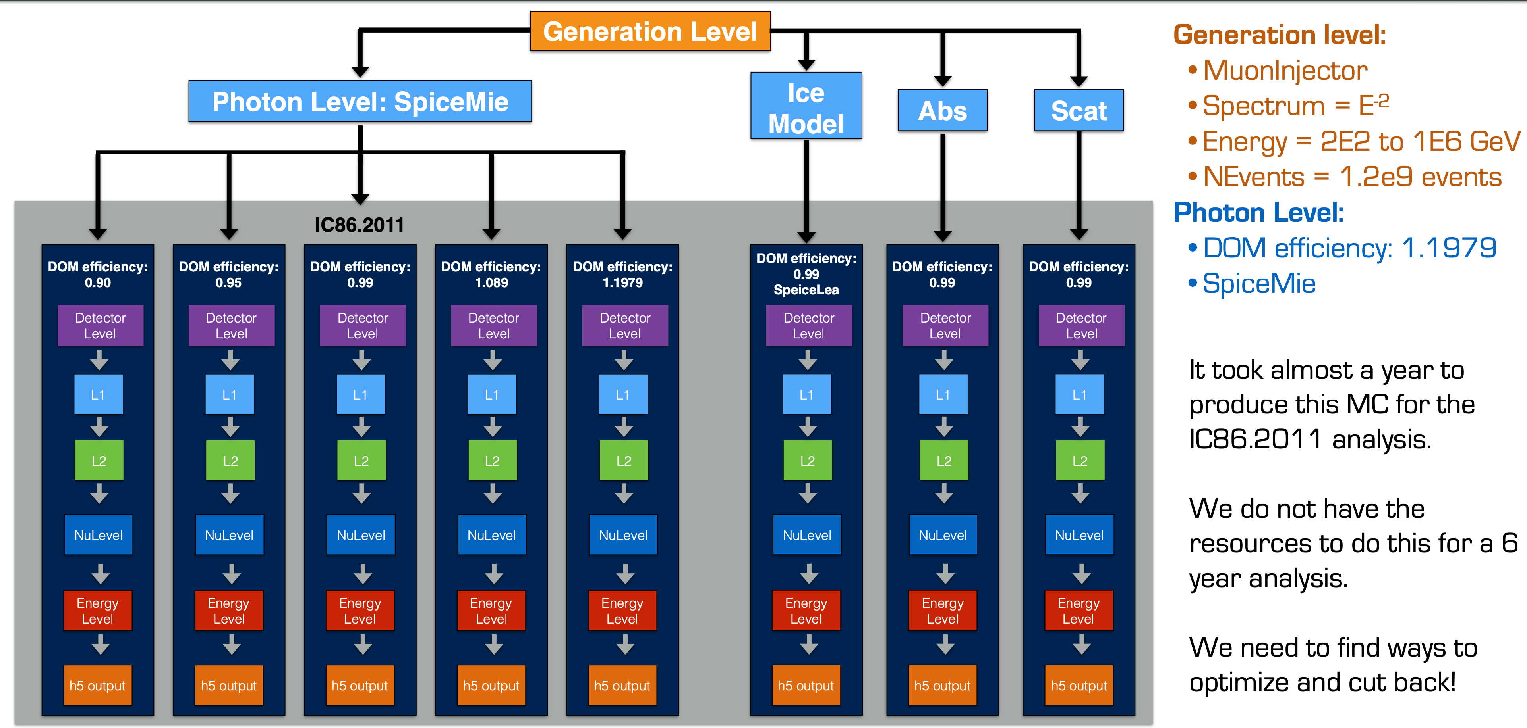
Example: High-Energy Sterile Neutrino MC Generation
Simulating Systematic Uncertainties
Spencer N. Axani

Slide 58
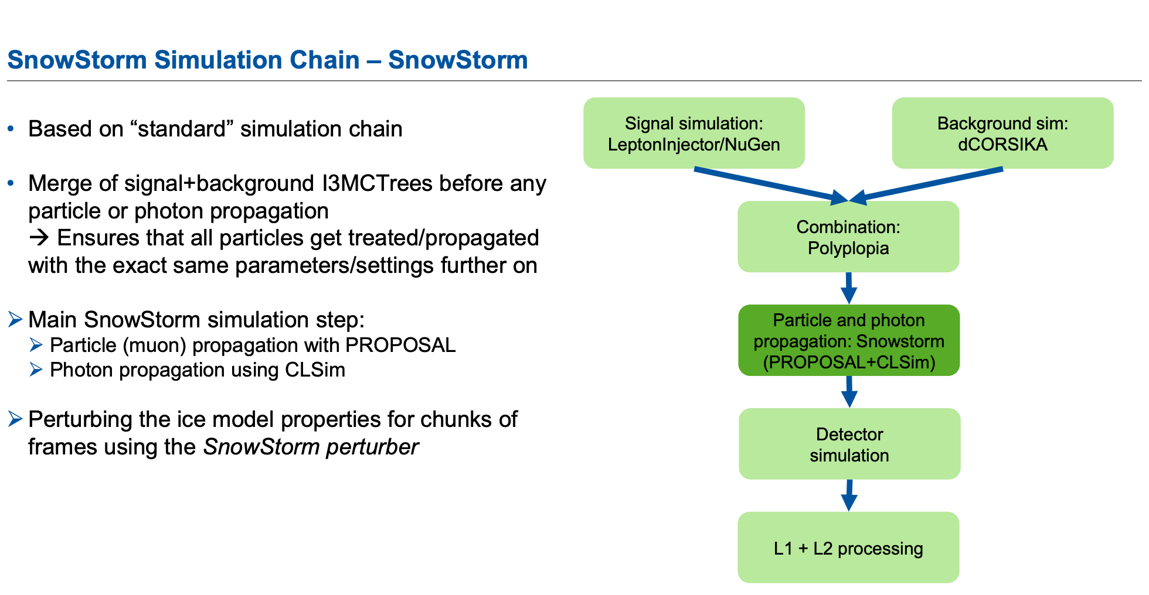
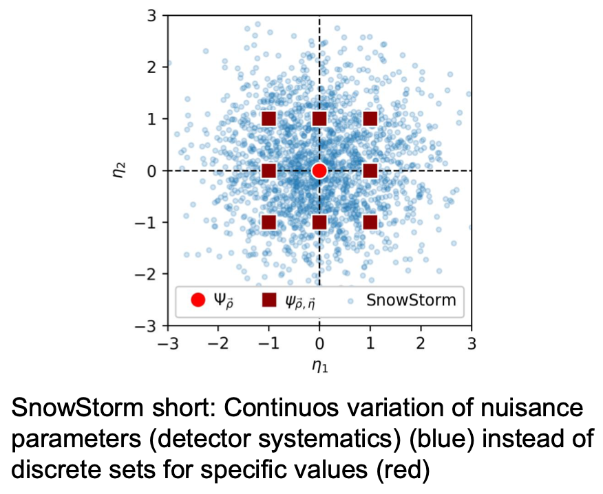
SnowStorm
https://events.icecube.wisc.edu/event/118/contributions/6499/attachments/5362/6082/DiffuseParallel_Brussels_SnowStormMCGlobalfit.pdf
Erik Ganster

Slide 59






CORSIKA weights
Weighting
CORSIKA produces events according to the flux given by
The number of events generated is
And the effective livetime of the simulation is given by
where
The rate of events is R = n/T
The CORSIKA spectrum is biased with a factor resulting in a flux
And each event is assigned a weight

Slide 60
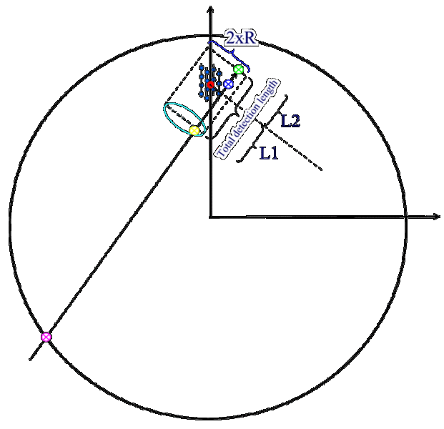
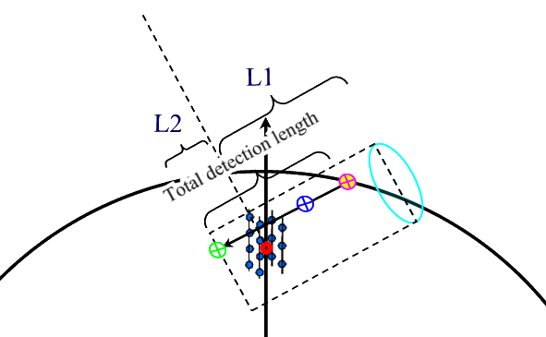

neutrino-generator
Calculates the propagation probability (i.e. that the neutrino will reach the detector)
It forces an interaction within a volume around the dector and computes the probability of this interaction
where Pint = TotalInteractionProbabilityWeight, E ^{− γ} is the neutrino generation energy spectrum shape, Emin and Emax is the minimum and maximum generation energy of neutrinos, Area is the generation surface, Ω the generation solid angle and T = 1sec is the timescale.
The weight corresponding to a given theoretically motivated neutrino flux is
For more details on how to use OneWeight see:
https://docushare.icecube.wisc.edu/dsweb/Get/Document-44937/OneWeight.pdf

