Slide 1
OptiXs
Benedikt Riedel
UW-Madison
Photon Propagation Workshop
Oct. 19, 2021

Slide 2
Photon Propagation in CLSim and PPC
Create photon
Propagate
26 iterations on average
but 622 maximum
Check collision
hit
0.001%
Store hit
Scatter
Absorb
Remove photon

Slide 3
How OptiXs works
Ray tracing components
OptiX execution model
Kernel
Ray generation
Ray generation
Miss
Rays
Any hit
GAS traversal
Bounding box
Intersection
Intersection
Hit?
Geometry
Any hit
Closest hit
Miss
Closest hit

Slide 4
Collision Detection in OptiXs
Ray generation
Create photon
Propagate
GAS traversal
optixTrace()
Geometry hit
Miss
Absorbed?
No
Closest hit
Yes
Cable hit
Scatter
Detector hit
Store hit
Next photon

Slide 5
Kernel runtime – RTX A6000
*
**
*Version from June, ** fresh results (treat with caution)

Slide 6
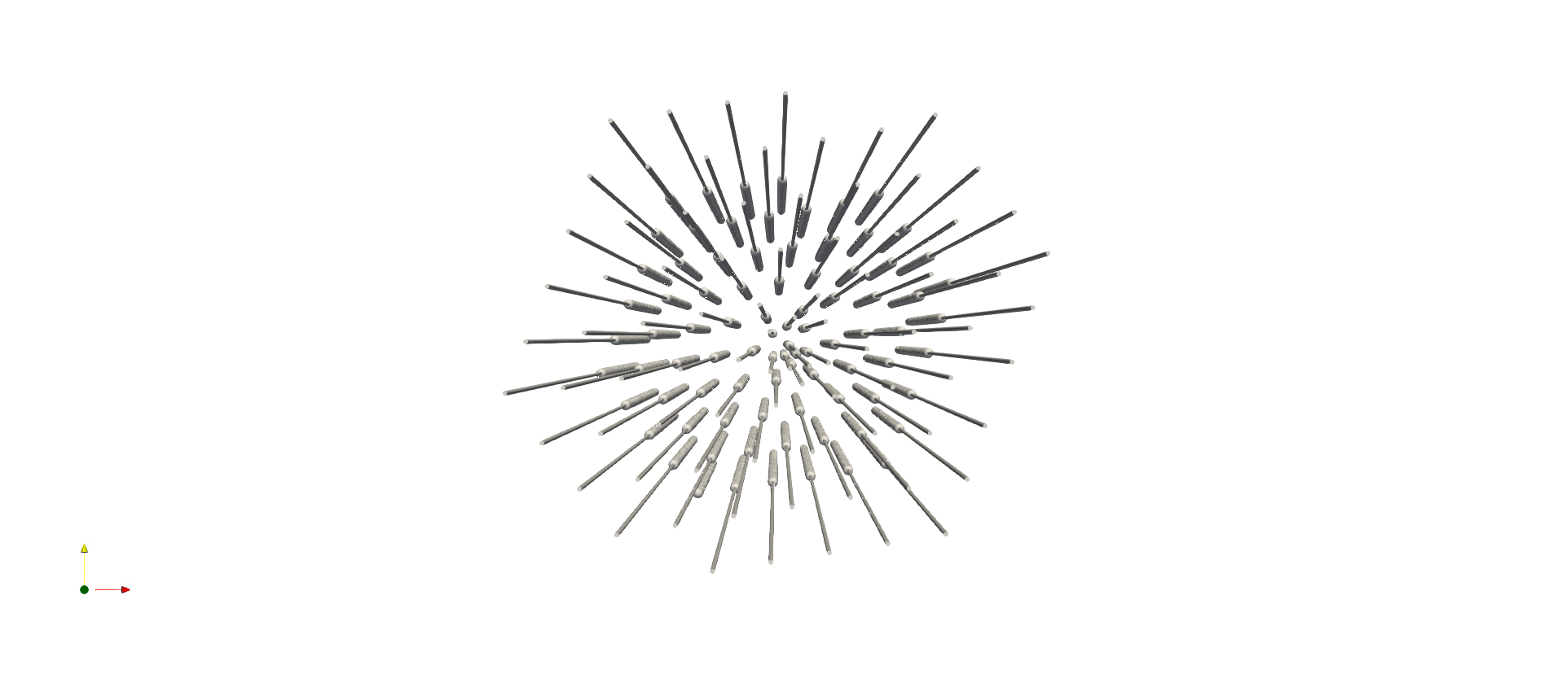
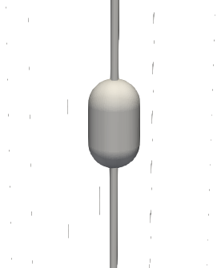
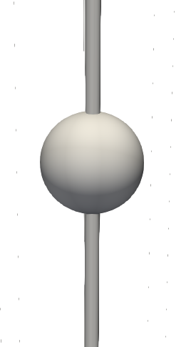
Why OptiXs
Flexibility
Fast paced iterations on
Geometry
Photo-detector shapes
Cable position
Cross-checks with existing simulation
CAD file -> detector geometry in minutes

Slide 7
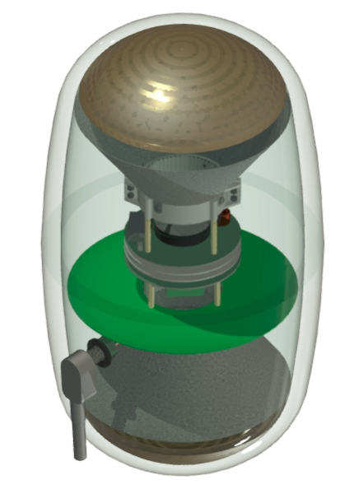
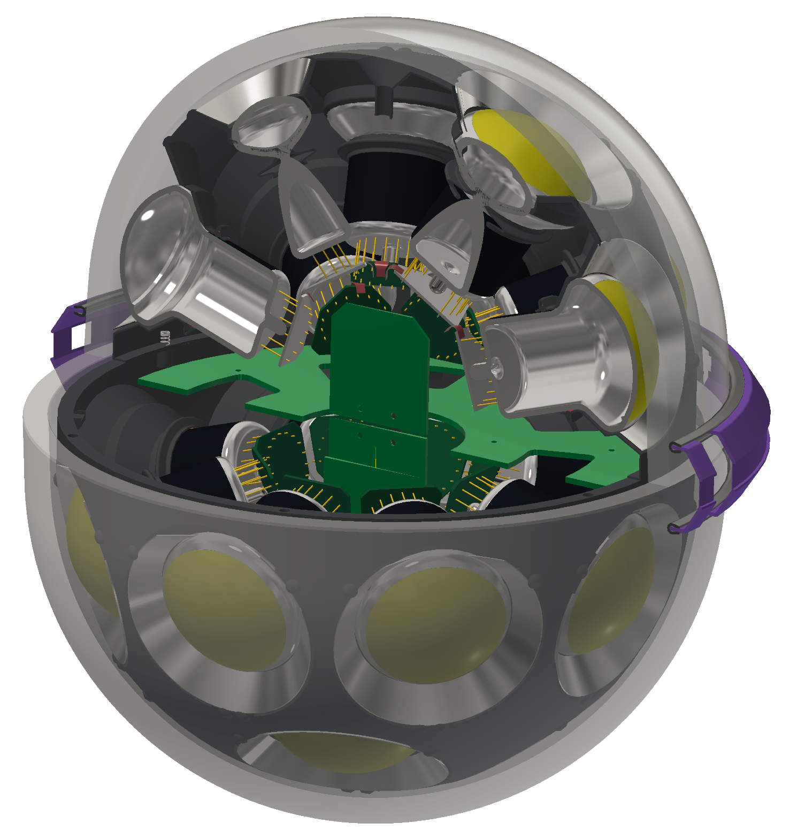
Why OptiXs
Non-expert was able to implement a whole detector with
dEgg
mDOM
Cables
Model | #Triangles | Detector | Cable | Total | [ms]
Sphere detectors | 9’907’200 | 42’099 | 0 | 42’099 | 575
Sphere detectors, cables | 9’926’640 | 40’978 | 132’209 | 173’187 | 575
Pill detectors | 12’291’120 | 61’437 | 0 | 61’437 | 570
Pill detectors, cables | 12’310’560 | 60’250 | 128’797 | 189’047 | 575

Slide 8
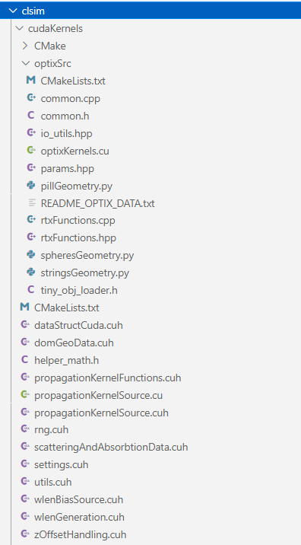
File Overview
optiX programs, CH and RG
Data struct handed to RG
Data holder for opitX
Still in same launch_CUDAPropogate function:
Creation of RTXDataHolder
Reading obj files
Memory allocations and optiX Parameters
optiXLaunch call w/ time measurements
Folder paths

Slide 9
Thank you!
Questions?

