Slide 1
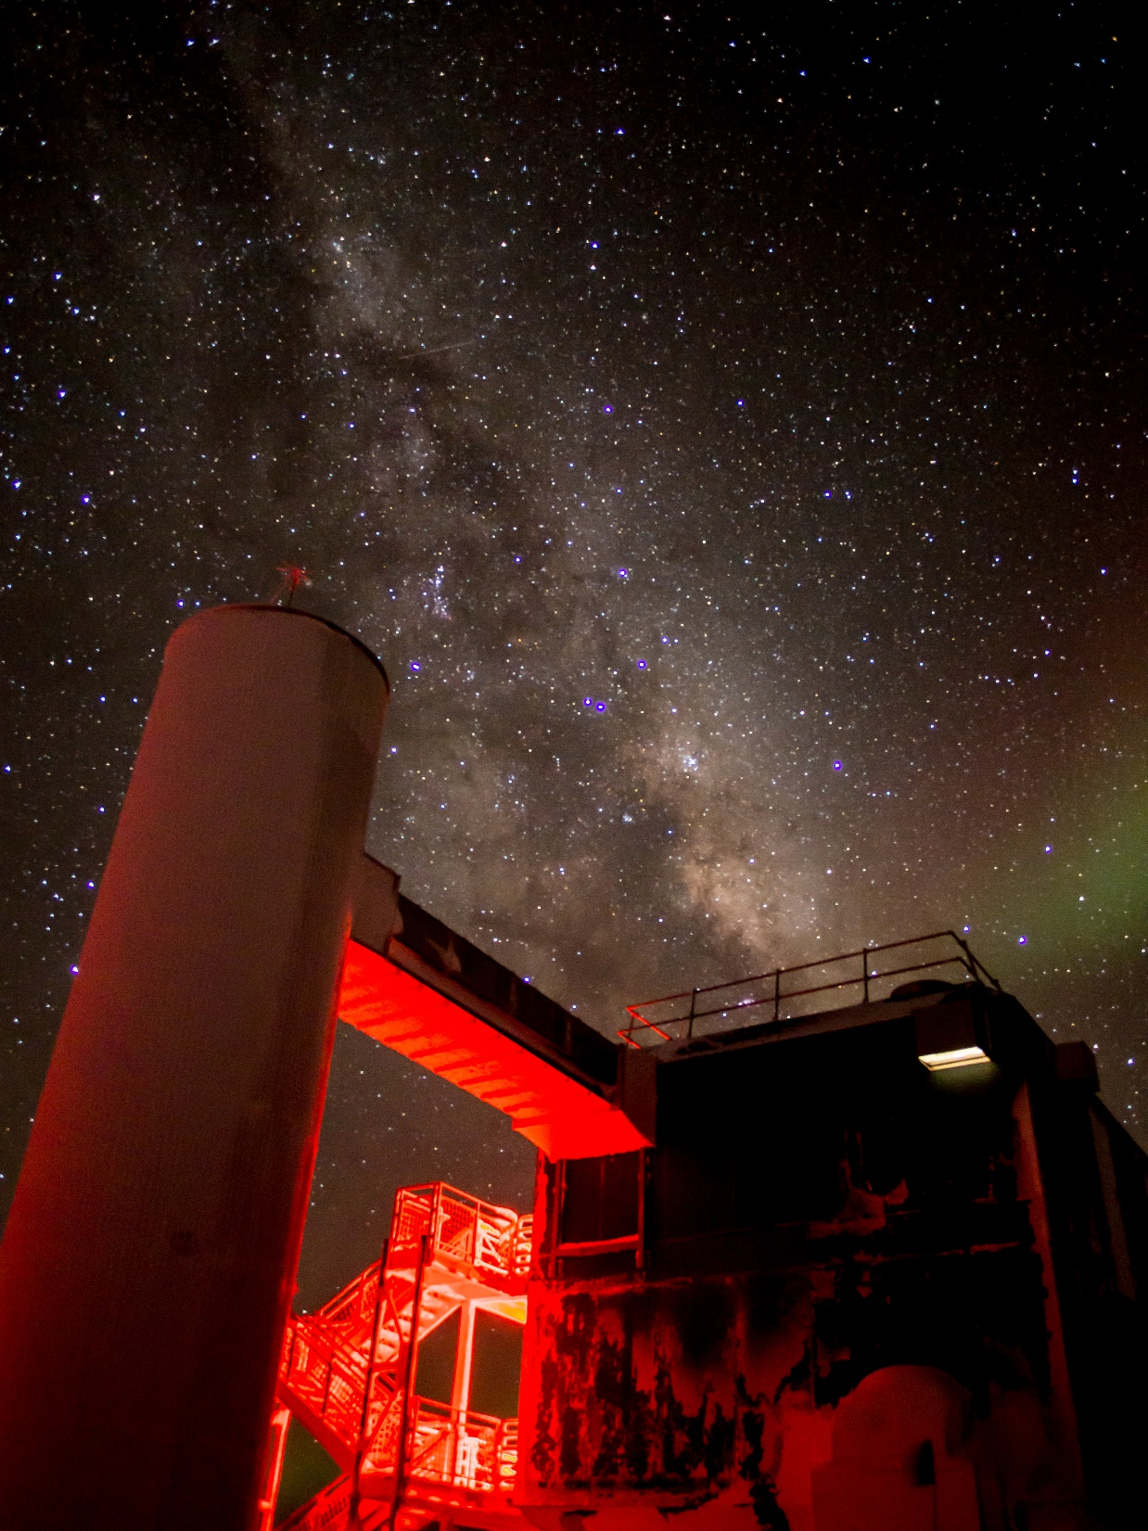


The Future of Neutrino Multimessenger Astronomy and Neutrino Physics at the South Pole
IceCube Gen2 Observatory + The IceCube Upgrade
Kael Hanson
Wisconsin IceCube Particle Astrophysics Center (WIPAC)
University of Wisconsin – Madison
Madison BOOTCAMP 2019

Slide 2
Challenge / Opportunity: Cosmic Horizons
Neutrinos are alone the only astronomical messengers capable of directly imaging the extreme energy sky. Photons interact with EBL and already at 100’s of TeV are limited to Mpc scales.
Charged cosmic rays processed by galactic and inter-galactic magnetic fields as well as galactic diffusion: energy and angles at observation no longer follow source.

Slide 3
IceCube Gen2 Science Mission
These are the questions to be answered by Gen2 …
Whitepaper coming soon!
What are the sources in the PeV Sky and how do they drive particle acceleration?
Where are cosmic rays of extreme energies produced and on which paths do they propagate through the Universe?
Are there signatures of new physics at PeV energies and above?
Whereas IceCube is and will continue to be the premier neutrino telescope for neutrinos from 1 – 100 TeV, Gen2 will concentrate its sensitivity in the energy region beyond 100 TeV to study the EHE range of the astrophysical neutrino flux.

Slide 4
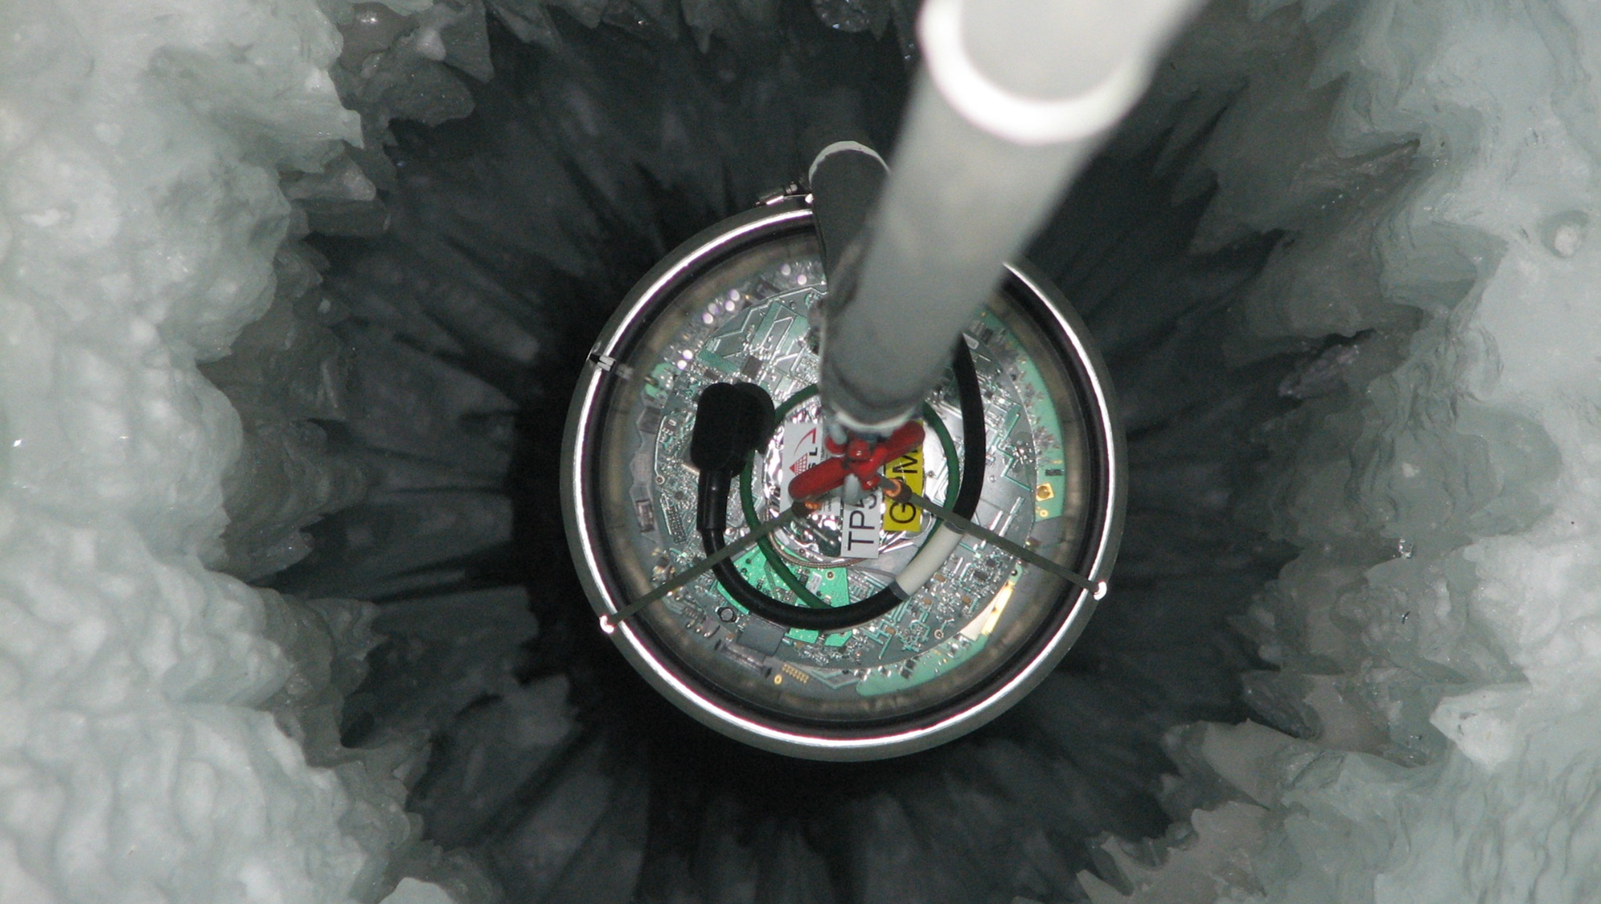
Part I: IceCube
Still the biggest TeV neutrino telescope

Slide 5
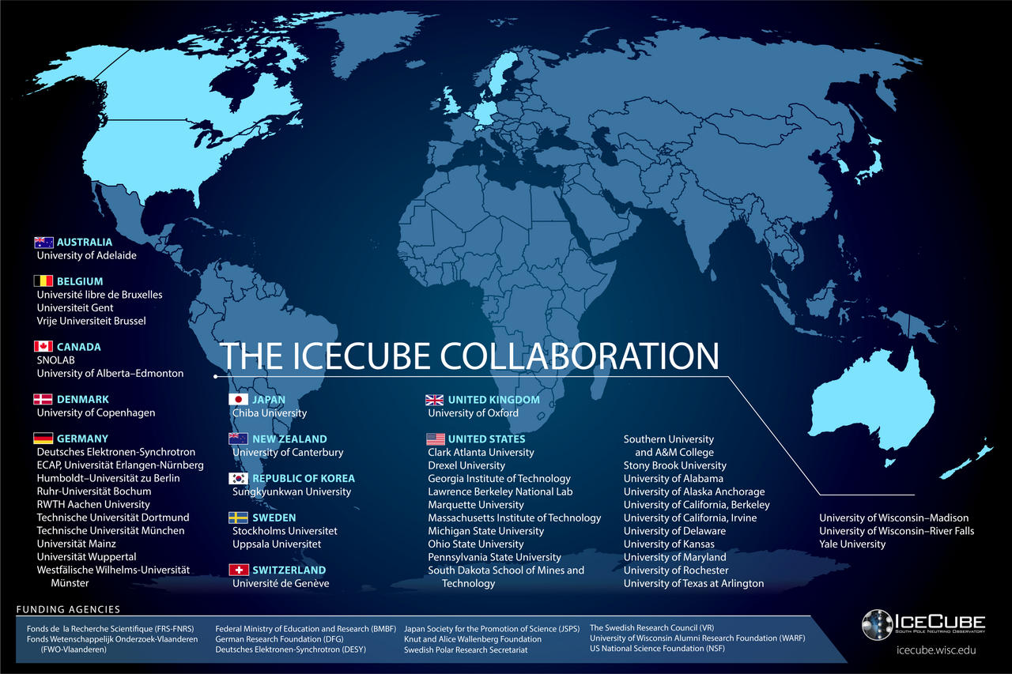
The IceCube Collaboration includes > 300 researchers from 47 institutes in 12 countries.
IceCube is one of the NSF’s large facilities (LIGO, LSST, … 2 dozen others).
The Operations and Management of the facility is handled by WIPAC at UW-Madison. In addition to having a large science group, our center supports the technical aspects: computing, data storage, detector maintenance, …

Slide 6
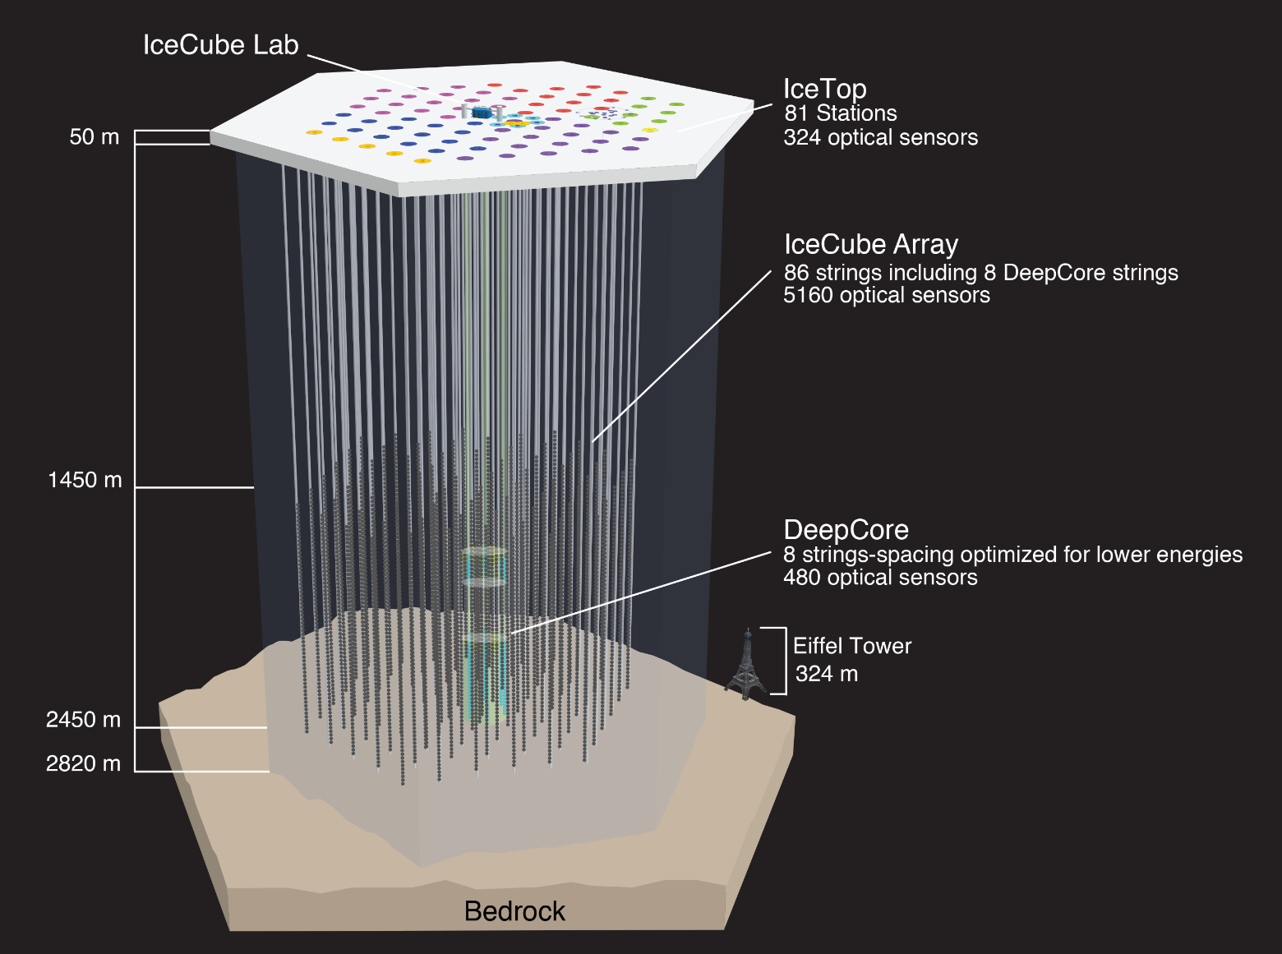
The IceCube Neutrino Observatory
IceCube construction began in 2002 with design and procurement of the drill. The first string to be deployed was in Jan 2005. Over the next 6 season 85 more strings were deployed with the last string being “tied off” on December 17, 2010. Full 86 string data taking started May 2011.
TPC: $279M USD - $40M non-US
The South Pole site was chosen
Because there is a lot of ice;
Logistic support: 5 million lbs. of cargo were delivered and 77 person-years of effort on-ice it took to make IceCube. Everything was at that time airlifted inside LC-130 Hercules aircraft.

Slide 7
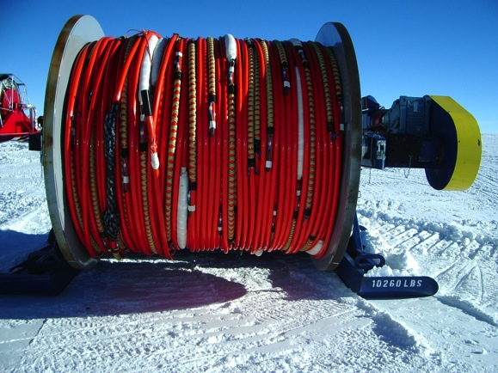
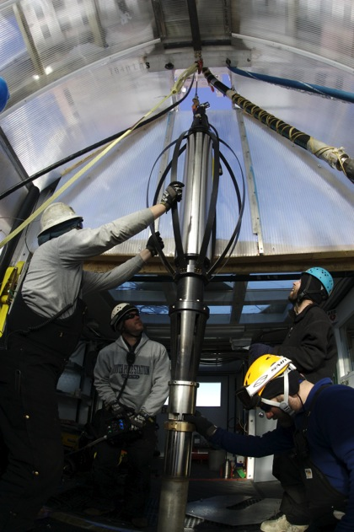
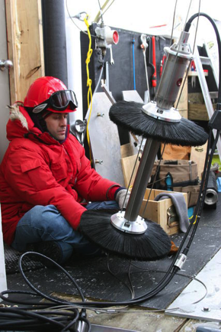
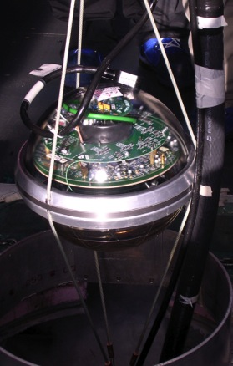
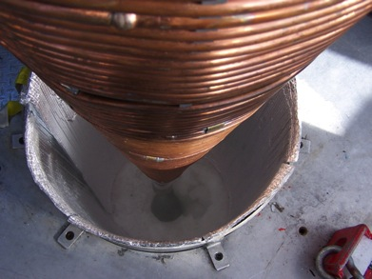
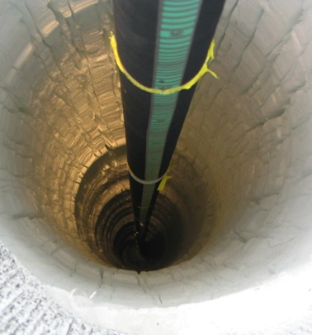
Drilling & Deployment

Slide 8
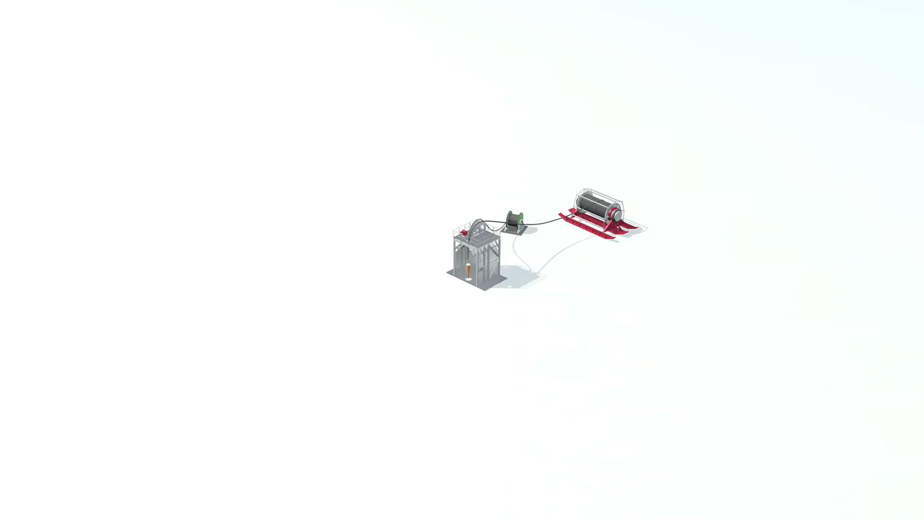
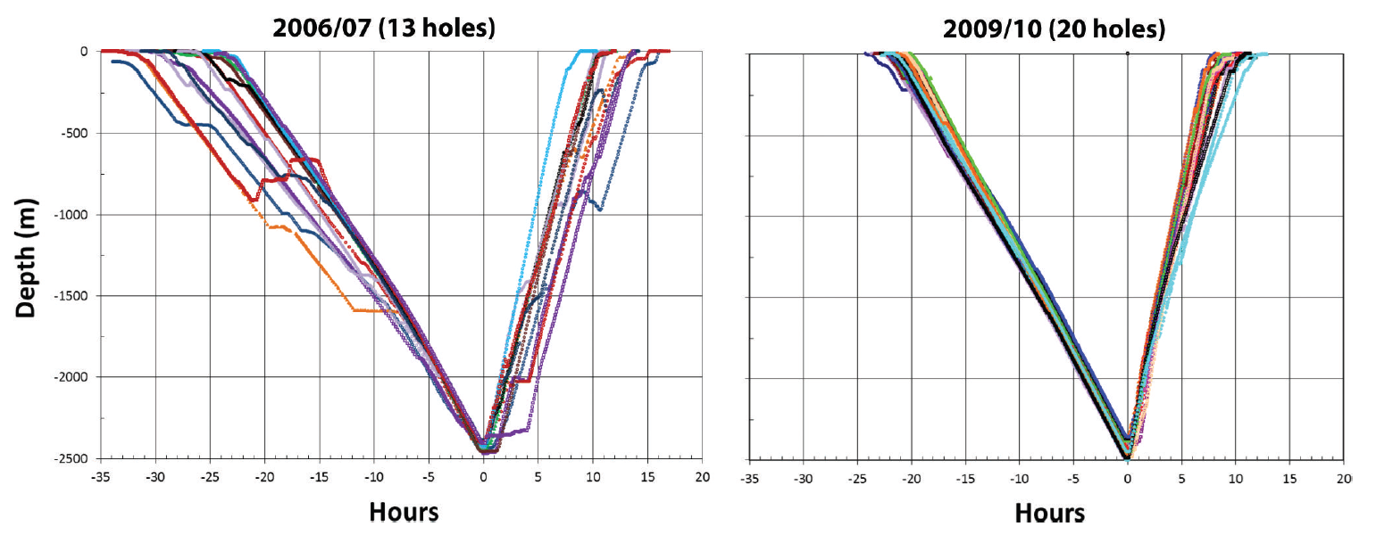
Hot Water Drilling
5 MW Drill power plant gives 195°F hot water in closed loop system.
5500 gallons AN-8 jet fuel / hole
30 man crew
30 h drilling – 3 day cycle time
“Hole lifetime” – 24hr
DOM installation – 8 hr
Typical freezeback times > weeks
DOMs not operated in liquid under normal circumstances.
Drilling improved over time. The first 2004-2005 hole took weeks to drill. A few years later the drill crew was able to get the time down to 50 h. By the end – 30 h was achieved with repeatable performance.

Slide 9
The IceCube Digital Optical Module (DOM)
Optical
Communicatons / Timing
Large Area Photocathode 10” 10-stage Hamamatsu R7081-02 PMT (QE 24% @ 420 nm); High QE variant (QE 35% @ 420 nm) used in DeepCore DOMs
Low noise 500 Hz bkg count rate in-ice @ 0.25 pe threshold.
Glass / Gel 0.5” thick Benthos pressure housing rated to 10,000 psi. Better transmission in 330 - 400 nm relative to AMANDA OM. Low radioactivity glass.
Optical calibration Each DOM calibrated ε(λ, T) in the lab to about 7%; in-situ flashers additionally permit in-ice optical measurements
Communications is digital at rate of 1 Mbit/s shared by 2 DOMs on a single copper pair.
The DOMs each timestamp PMT pulses using a local XO. Nevertheless, 1 ns time resolution is achieved through automatic clock synchronization protocol
Digitizer
IceCube adopted waveform readout of PMT pulses to deal with complex scattering of photons in ice. There are two digitizers:
300 MSPS ASIC 14-bit effective resolution but limited to ~500 ns
40 MSPS pipelined ADC capture to 6.4 µs
Smart Sensor
FPGA + ARM CPU SoC. 4k-hit deep memory buffer stores hits until readout over 1 Mbit digital link to surface.
Power supplied by 18 AWG Cu pair to surface (3.5 km). 96 V, 3.75 W per channel (DOM)
Power

Slide 10
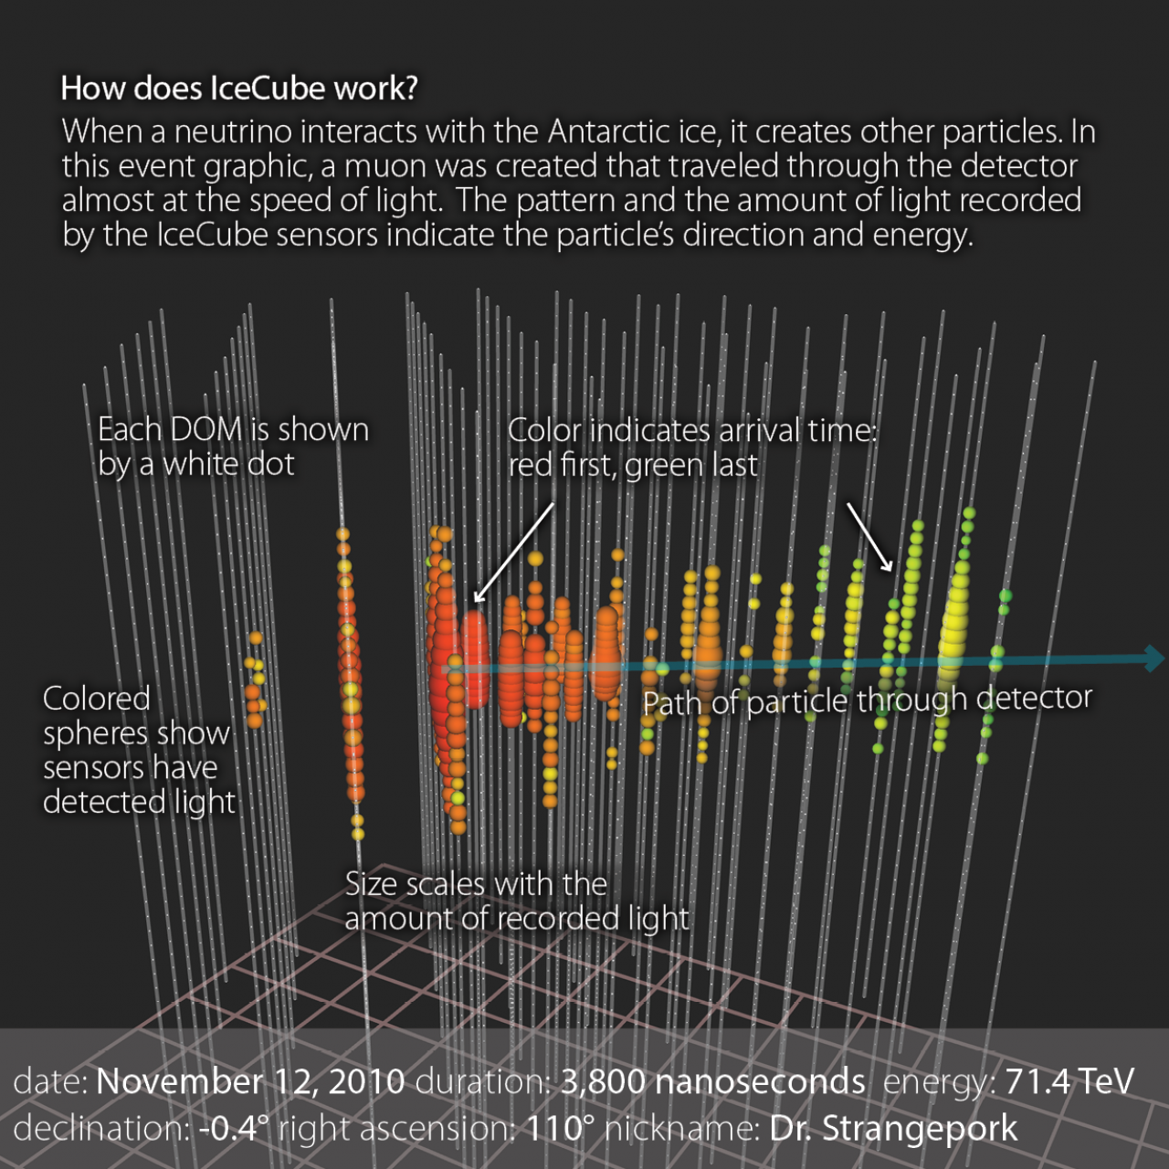
Detecting Neutrinos in the Ice
IceCube is “water” Cherenkov detector: we detect the charged ultrarelativistic secondaries which are produced in neutrino scattering in ice or detect CR muons and their. stochastic secondaries.
Ice is a good calorimetric medium: we can get 10% resolution on E (dE/dX for muons).
Scattering and non-uniformity is problematic both for precision reconstruction and for simulation of the detector. Still we are able to obtain O(½) degree angular resolution for tracks.

Slide 11
Flavor Identification in Giant NTs

Slide 12
Scattered Cherenkov Photon Tracks in Ice: A HE Muon

Slide 13
Photons from an electromagnetic cascade

Slide 14
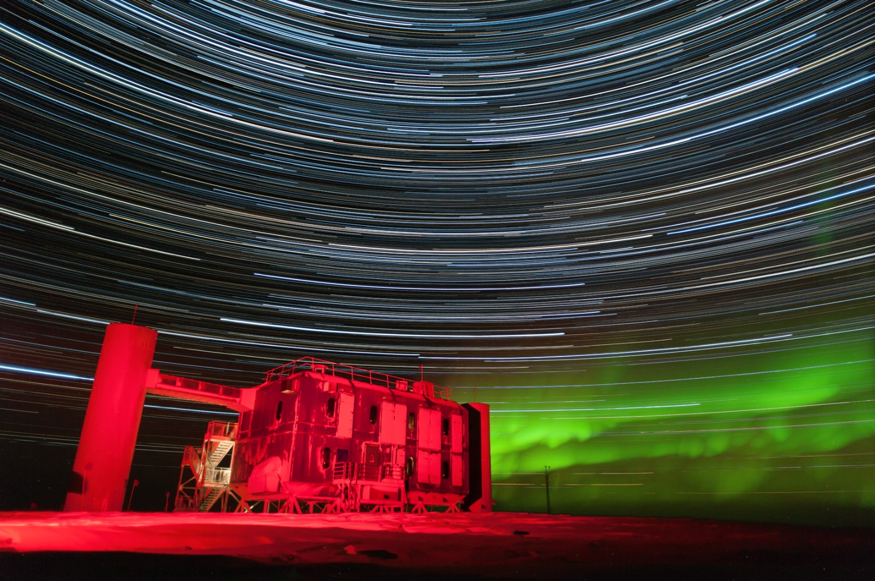
Part IIb: IceCube Gen2 – The Future of Neutrino Astronomy
IceCube Upgrade
High Energy Array
Cosmic Ray Array
Radio Array
IceCube Gen2 White Paper:
arXiv: 1412.5106v2

Slide 15

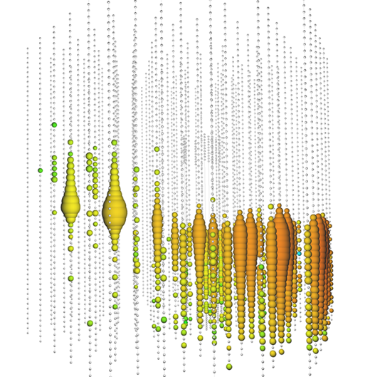
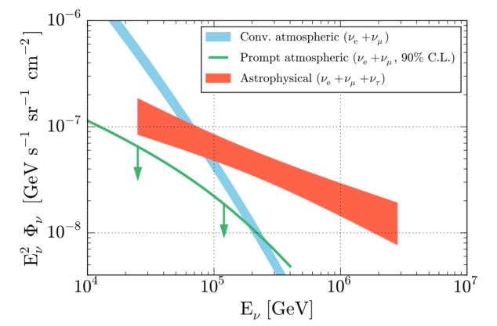
Getting Back to those PeV-Scale Neutrinos
Region above 100 TeV is sweet spot for neutrino astrophysics:
Background-free region for study of
  Point sources
  Correlation studies
  Energy spectra
Gen2/HEA would deliver O(10) events per year above 1 PeV
At PeV scales new phenomena arise which help disentangle flavors providing information on source physics:
  Tau double bangs – with separated bangs – O(1-2) per year in IceCube Gen2/HEA
  Glashow resonance events [arXiv:1108.3163 Battacharya, et al] have pure muon, tau lollipop signatures – discrimination of pp versus pγ at source.
IceCube Collaboration, ApJ 809, 98 (2015) – the IceCube global fit paper demonstrating a poorly constrained astrophysical signal nonetheless clearly above conventional and prompt atmospheric neutrinos.
A muon neutrino event recorded Jun 2014 which deposited 2.6 PeV of energy in the IceCube detector. The parent neutrino’s energy is in the range 5-10 PeV.

Slide 16
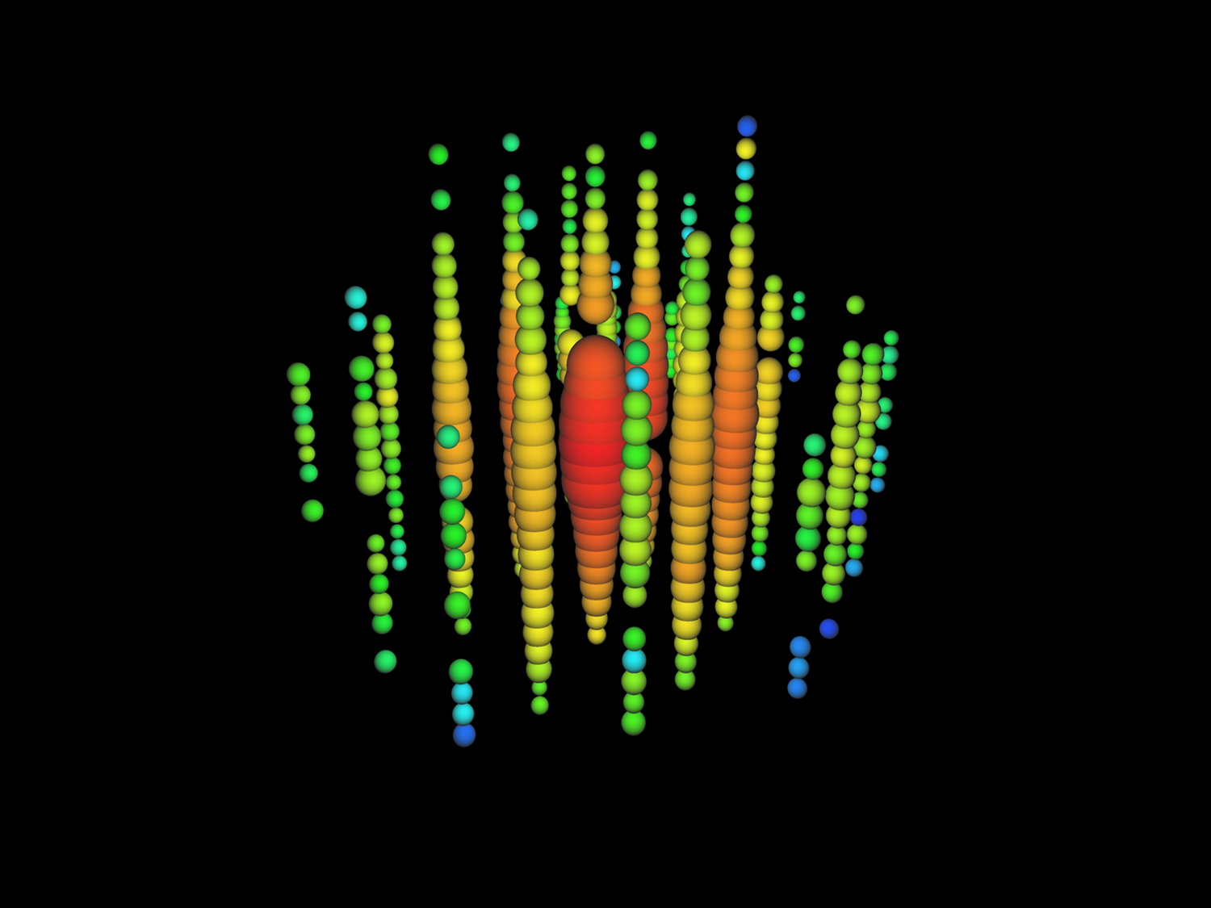
PeV neutrinos don’t need dense detector
Take Bert – one of the two original ~ 1 PeV neutrinos found in IceCube data.
Study reconstruction of this event with real sparse detector: IceCube with strings removed to simulate wider spacing. With 20 strings separated by 250 m
Vertex resolution 12 m
Angular resolution 30°
Energy resolution 10%

Slide 17
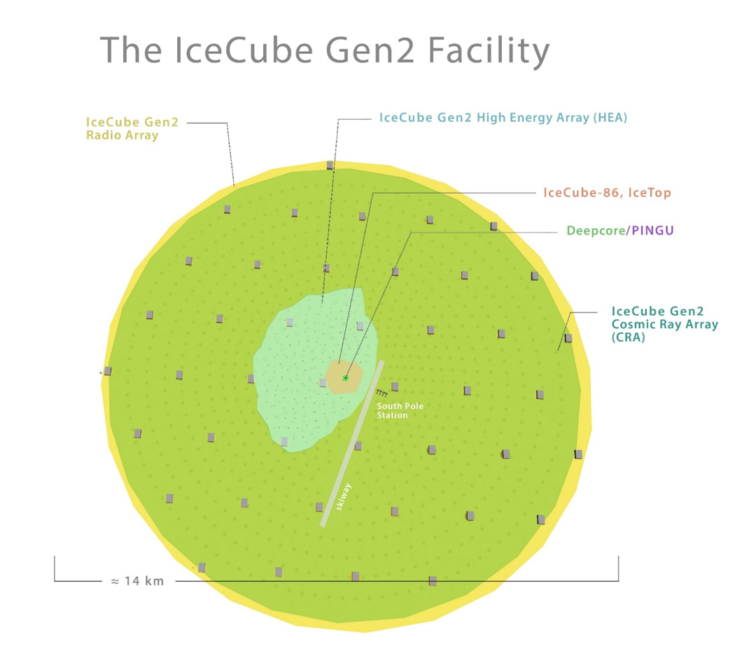
Conceptual Design
A conceptual drawing of the IceCube Gen2 Facility is shown at right. Specific points of design are likely to evolve quite a bit. However salient points are the multiple sub-detectors spanning energy range of ~ GeV to EeV:
  Upgrade: low energy, tau neutrinos, precision calibration of ice;
  High Energy Array (HEA) – 100 TeV+ neutrino detector using optical sensors evolved from IceCube
  Cosmic Ray Array (CRA) – veto array for HEA as well as exploration of cosmic ray physics
  Radio Array (RA) – ARA-like or perhaps much denser array of RF power envelope detectors. Overtakes optical in region 100 PeV+

Slide 18
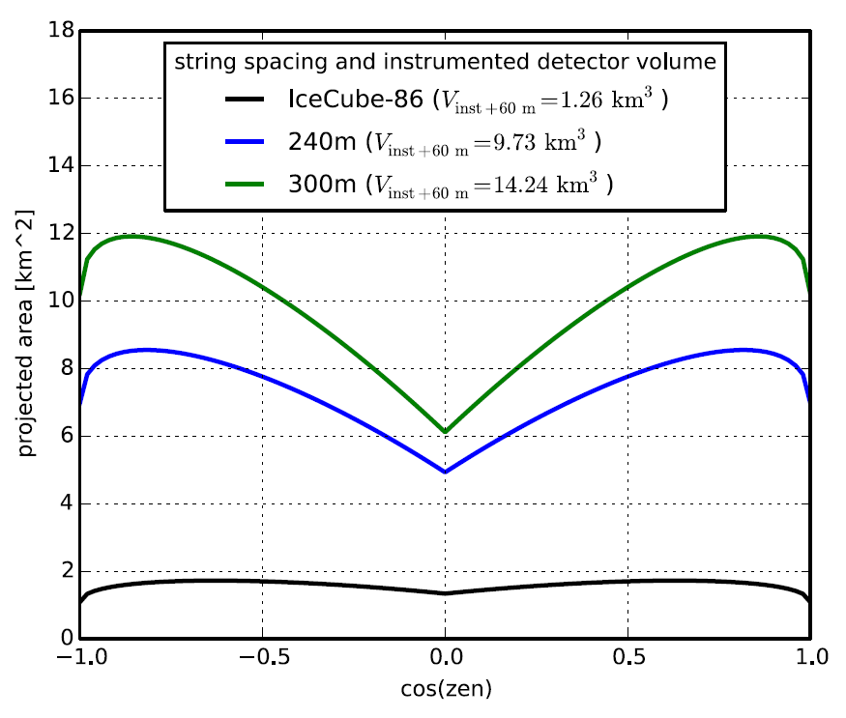
The Deep-Ice High Energy Array (HEA)
Gen2/HEA Parameters
# Strings | 120
DOMs / String | 80
String Length | 1.3 km
Gen2/HEA Performance Characteristics
Muon log₁₀ Energy Resolution | ~ 0.33
Muon Angular resolution | < 0.5°
Cascade Energy Resolution | 10%
Studies have focused on “sunflower” design given by Fermat spiral (no lanes). Keep-out regions at Pole limit extension to a wedge in SP Dark Sector but may be extended. Studies done simulating baseline string spacing of 240 m from IceCube data (remove strings from analysis) indicate no loss in event reconstruction for PeV-class events.

Slide 19
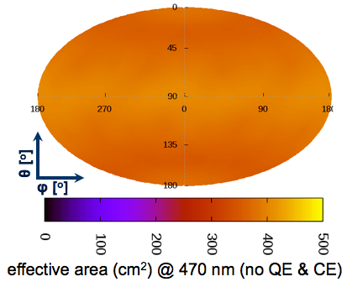
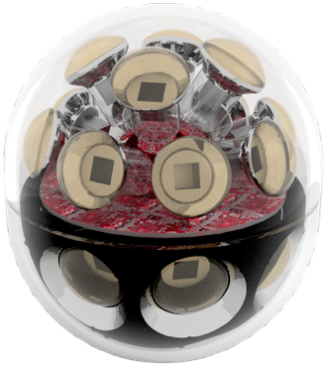
A multi-PMT optical module for IceCube-Gen2
Features
  24× 3” PMTs (Hamamatsu 12199-02)
  14” borosilicate glass pressure vessel
  rated @ 700 bar (Nautilus)
  Based on proven KM3NeT design
  Prototype to be tested in PINGU
  Advantages
  Uniform 4π acceptance
  2.4 times effective area of IceCube DOM
  @ similar price per photocathode area
  Directional sensitivity
  Local coincidences for e.g. background suppression
  Improved TTS (σ = 1.7 ns)
  (important for leading-edge timing precision)

Slide 20
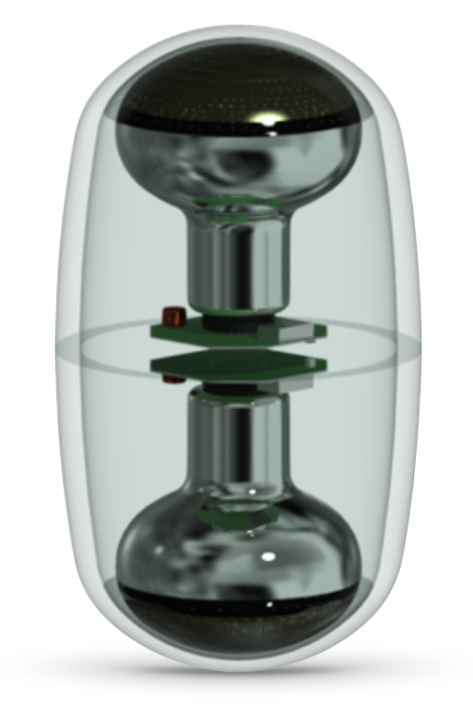
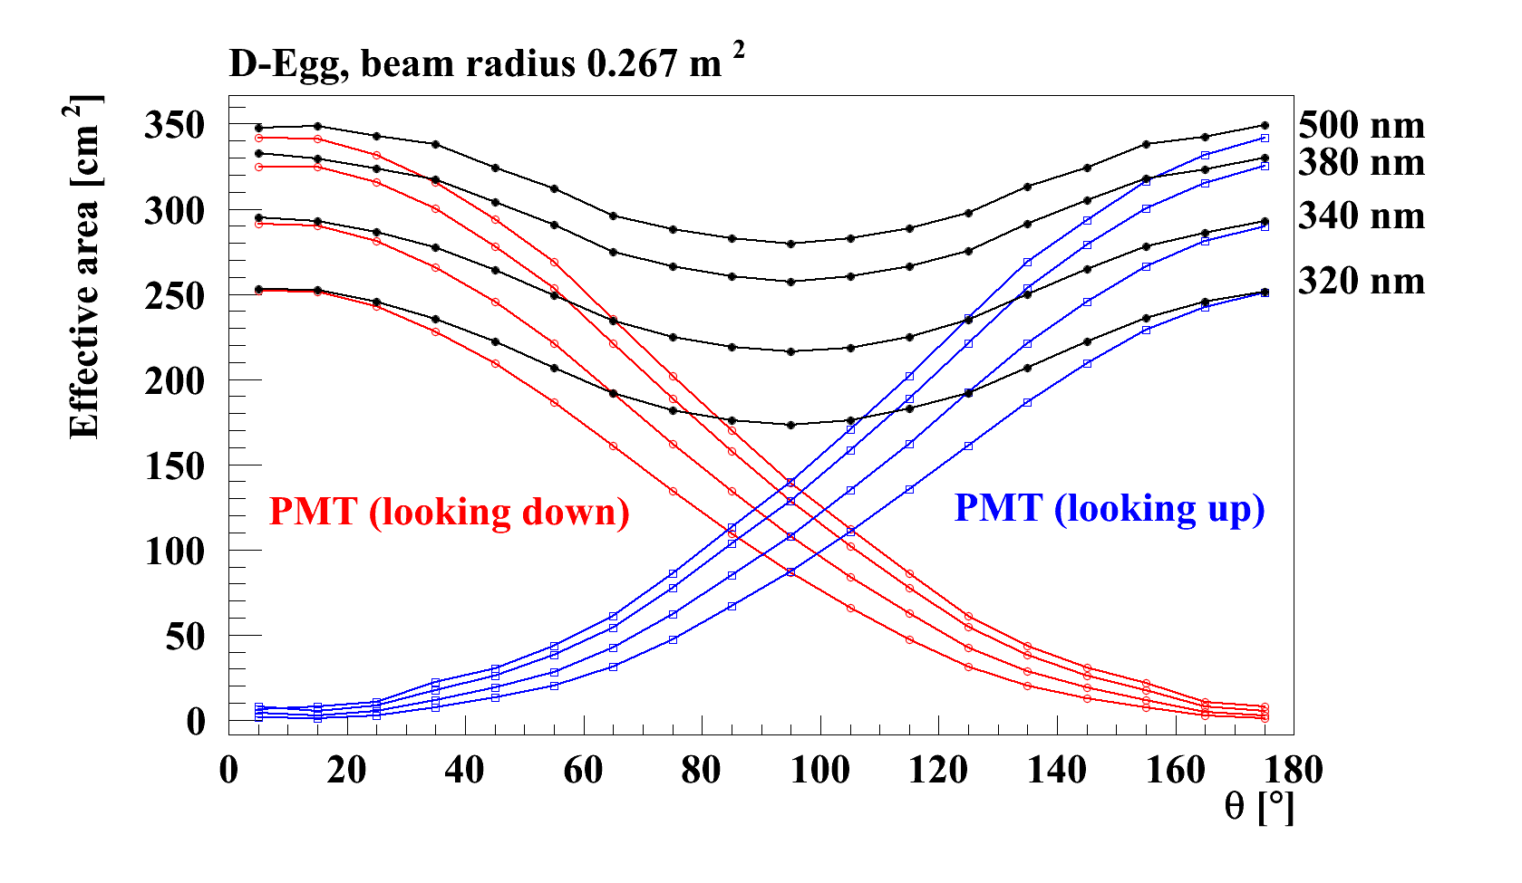
The D-Egg Dual 8” PMT + Improved Glass
My personal comments:
Whether or not we decide to use 2x 8” or 1x 10” PMT, the gains in UV photon collection from better glasses is well worth the research effort and should be a priority of the photo-detection R&D.
2 PMTs readout independently with new DOM mainboards equipped with 2 ADC channels. Schematic identical with pDOM mainboard. Now in first article production.
D-Egg uses 2x 8” PMTs. Naively, one would expect only about 30% enhancement in the photon effective area, however, better collection efficiency relative to 10” PMT and massive improvements in UV transparency of glass.

Slide 21
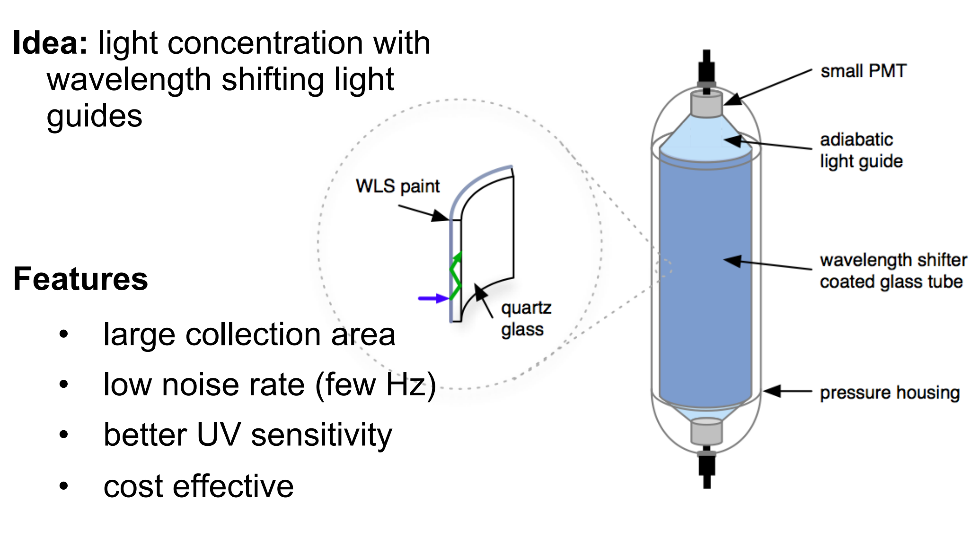
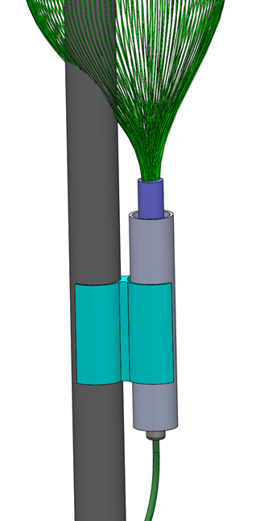
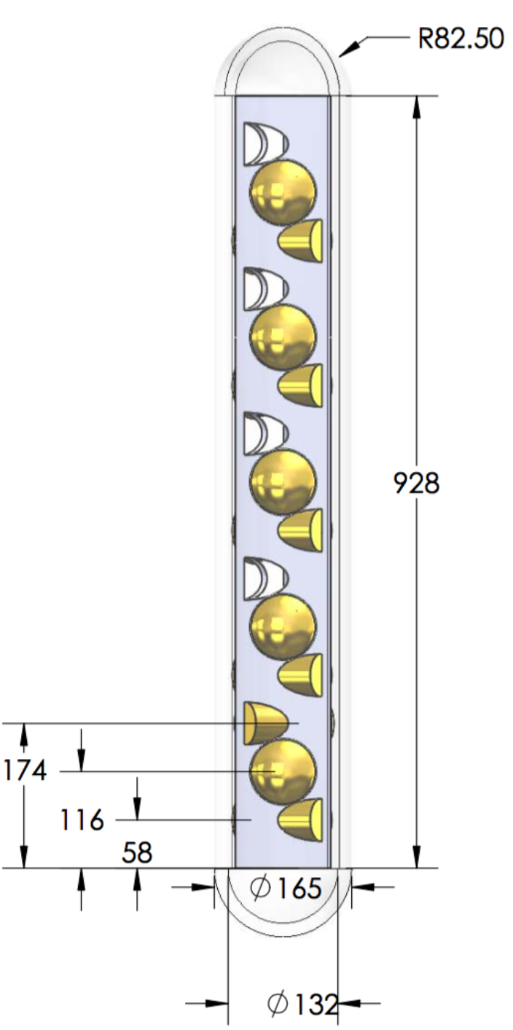
Other Concepts for Large-Area Photodetectors
Wavelength-shifting Optical Module (WOM)
WLS-Fibers
“Brussels Sprout”
Other concepts for cylindrical geometries better matching real-estate in drill holes under study. These modules could dramatically reduce cost and logistics.

Slide 22
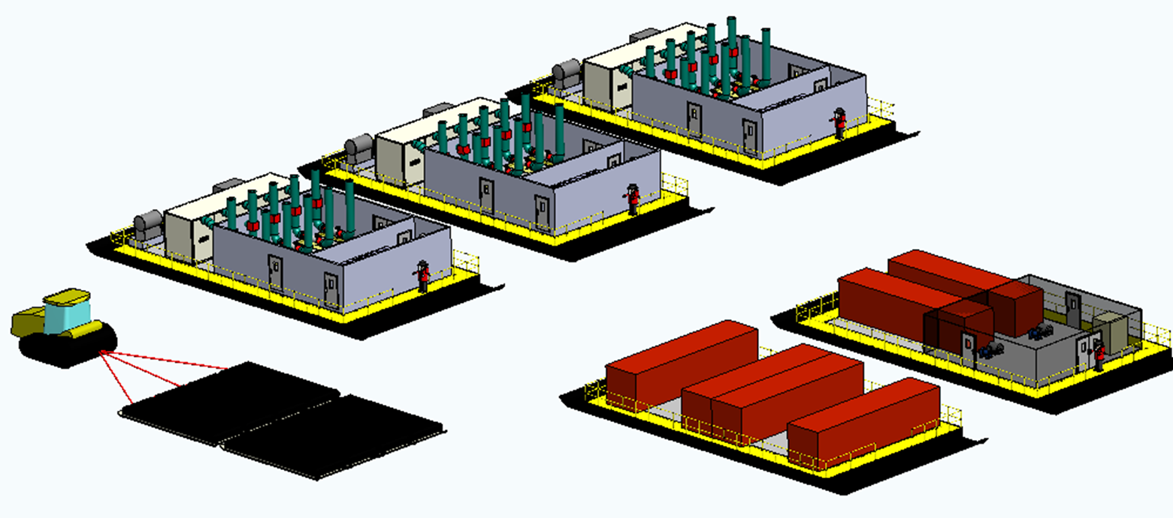
Mobile Drilling System
Meet or exceed EHWD thermal performance
Compatible with trending logistics
G2 Improvements
4.7MW thermal delivery to drill nozzle
48 hour hole production rate
90% thermal efficiency
Equipment and fuel delivered to Pole via traverse, minimize dependence on LC130s
Reduced logistical footprint at Pole, smaller crew
Safety
Mobility
Reliability
Degassed holes
(+8 hours)
Cleaner drill water
Reduced manpower
Reduced setup / decommission time
Quick Specs
Hole diameter | 60 cm
Hole depth | 2600 m
Hole spacing | 300 m
Hole lifetime | 30 hr
Total Thermal Output | 5.4 MW
Nom. Thermal power delivered to nozzle | 4.7 MW
Dry weight (est.) | 365 tons
Fuel/hole | 21,000 L
Max holes/season | 20-23
Crew size | 28
Construction cost | $20 M
Power Plant Sleds (3x)
Water Storage & Filtration
Fuel Bladders
Control Hub & Workshops

Slide 23
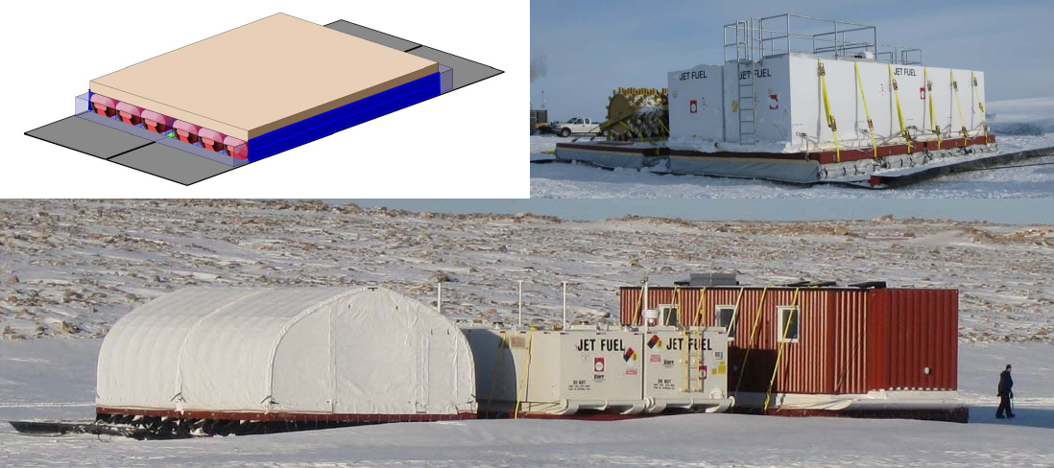
EHWD-G2: Air-Ride Cargo Sleds (ARCS)
Rigid deck atop of air bladders atop of PE panels
Far superior to ski-based traverse designs
In active development for high-payload traverses in Antarctic and Greenland
Drill system is “traverse ready” (one traverse sufficient to transport the drill system itself)
Figure from Lightweight Cargo Sleds for Polar Traverses. Lever, Song, Weale. Polar Technology Conference 2014
Notes:
The great news here is that this idea passes Jim Lever’s sanity check, and he thinks it is a good idea and is willing to work with us on it. This sled concept is critical to mobility.

Slide 24
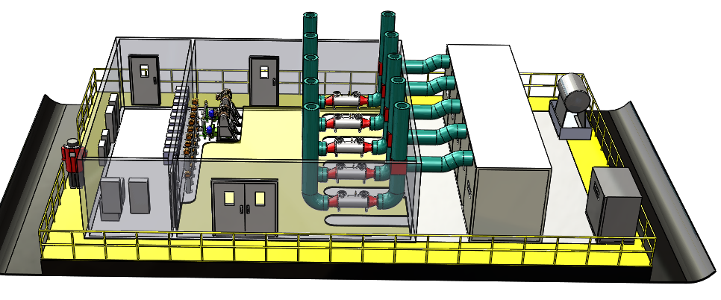
EHWD-G2 Overview: Power Plant Sled
High Pressure Pumps
Exhaust Heat Exchangers
C1000 Microturbine array
Fuel Daytank
Electrical Heater Bank
Electrical Closet
Air-Ride Cargo Sled

Slide 25
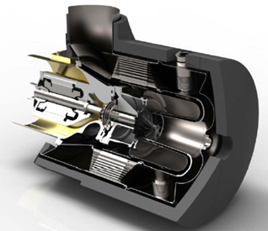
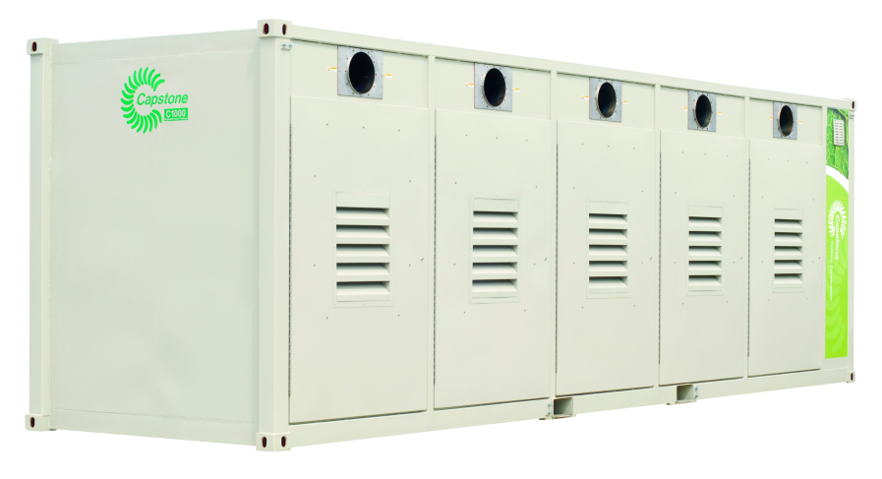
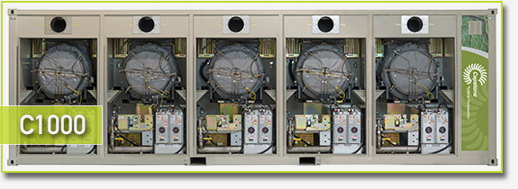
EHWD-G2: Microturbines
Fuel combustion in Capstone C200 microturbine. Flexible fuel – AN8 OK. High power density, low maintenance, ultra-low emissions. Easier recovery of waste heat. Combined heat and power thermal efficiency at 90%. Turnkey solution.
C1000 is 5 C200’s in parallel. Total output @ 3 km: 1.8 MW primarily from exhaust heat recovery. 3x power plants = 5.4 MW.
Challenges: large upfront cost – $1.5 M each; no experience in Antarctic environment. However Spring 2016 NSF is running evaluation at Summit Station in Greenland (J. Cherwinka).

Slide 26
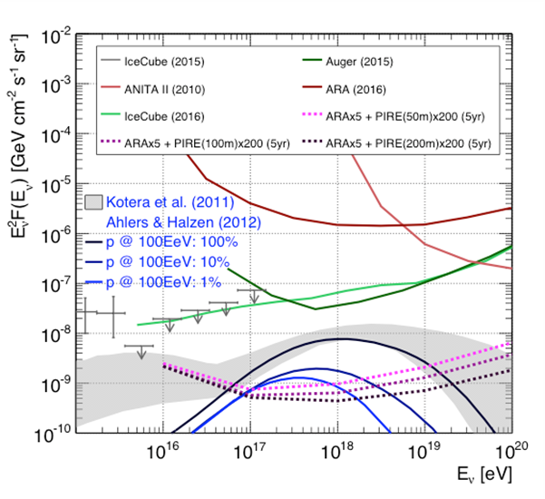
The Radio Array
Absolutely clear: when measuring effective area / cost, RF detection is at least 10x better than optical above 10¹⁷ eV.
Not clear: what is best method for RF detection:
Full band digitization (2-4 GSPS)
  Pros: very good time resolution (50 ps)
  Cons:
    Finicky digitizers
    Needs precise analog amplifier chain (pwr/cost)
    Time resolution dominated by other systematics
    Fine vertex angular resolution, no range.
RF power envelope detection
  Pros: low cost low power hardware and scalable.
  Cons: unproven, is information content sufficient for background discrimination?
Also not clear: can radio techniques be improved to obtain effective areas competitive with optical at 1-10 PeV? Interferometric techniques are being explored (ARA + Phased Array)
The ARA 2016 limit, sitting some 20-100x higher than IceCube may at first not seem impressive. However this is 2 ARA stations operating for ~ 1 year. About 0.001 cost of IceCube.

Slide 27
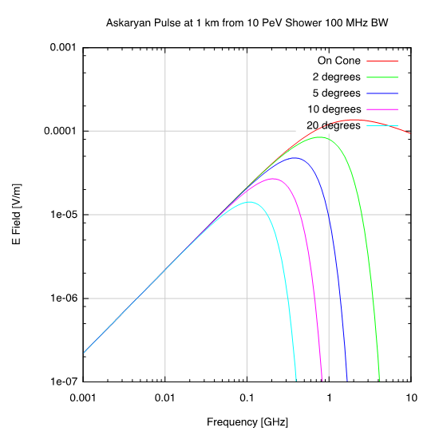
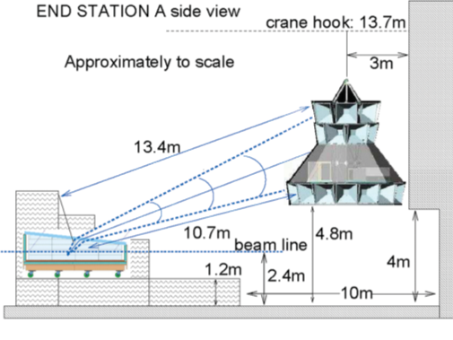
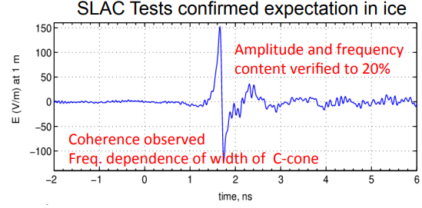
The Askaryan Effect
Coherent radiation from excess negative charge developed in EM shower (Compton production e-, very small amount e+ annihilation).
Radio pulse emitted in ice at Cherenkov angle (n=1.8 ➔ θ = 55°).
Broadband signal up to GHz frequencies on cone. Off cone RF power at sub-GHz – most of signal comes from here due to higher likelihood of antenna intercept.
Power goes like E_{cas}² :
For far field E field in plane of displacement vector and neutrino momentum
Highest power “on cone” but lower frequencies can be detected 5-10 degrees off cone.
Askaryan radiation observed in SLAC test beam on ice block (Gorham et al PRL 99 (2007) 171101

Slide 28
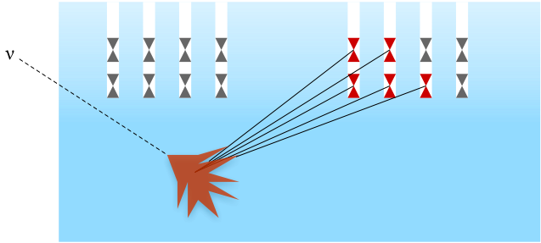
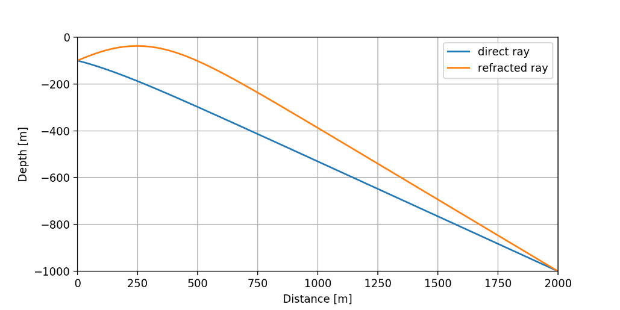
Askaryan in the Ice
Density gradient in firn layer transitions from n=1.8 in bulk to n=1.3 at surface.
Snell tells you that rays incident shallower than 44° from horizontal will be reflected back into the ice.
Rays at top of Cherenkov cone for neutrinos steeper than 10° don’t make it to surface.
Even worse for detectors like ANITA where RF has to escape to n=1 → acceptance limited to horizon +/- 1°.
Solution: dig – at 250 m bulk ice - 200 m chosen as acceptable compromise
Actual ray propagation in ice much more complex than simple picture:
  Ray-bending (a la mirage) due to gradient indexof refraction
  Actually are usually 2 ray solutions – this is now being exploited to reconstruct neutrino vertex.
https://github.com/bhokansonfasig/pyrex

Slide 29
Ice Attenuation of RF Waves
Ice is very good medium for RF transmission; colder ice is better ice
At Pole ice temperature at top is -55°C rising to -40°C at -1500 m. The shallow ice is the best ice for transmission of radio waves.
Measurements with ARA TestBed + 2400 m Deep Ice pulser yield attenuation length measurement of ~ 700 m for integrated path

Slide 30
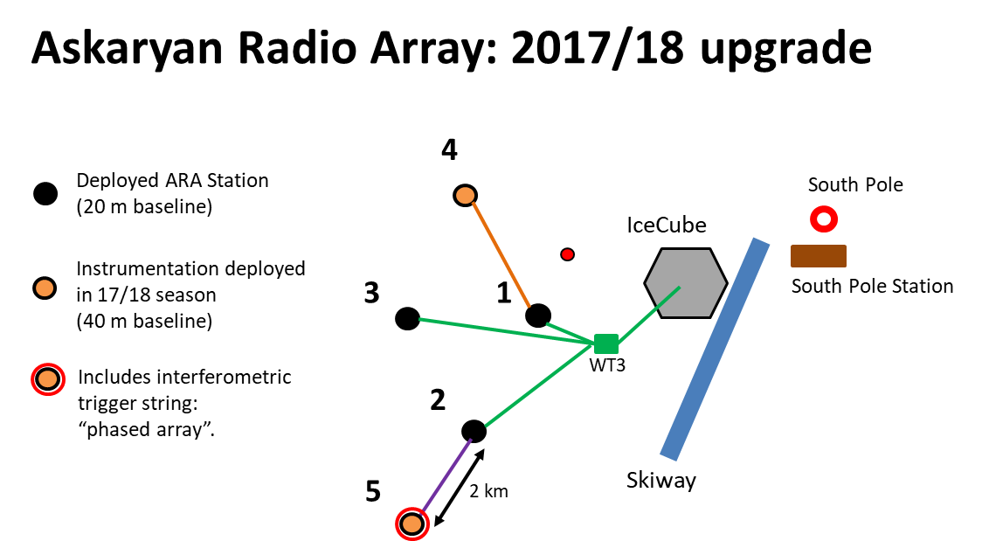
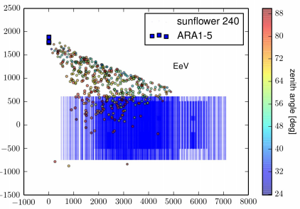
Current ARA Status
Hybrid Optical / Radio Events?
L. Lu – Hybrid In-Ice Detections ... Extensions Call 2019.04.10.

Slide 31
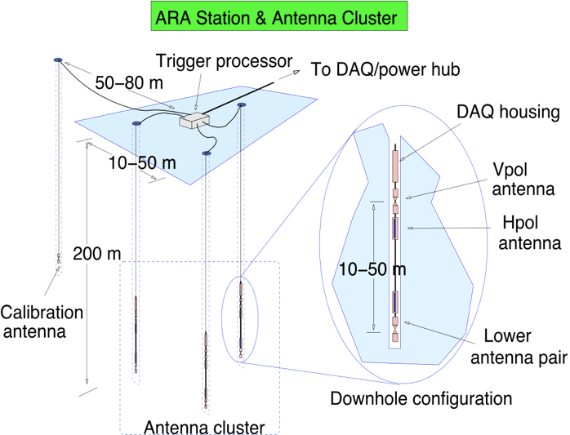
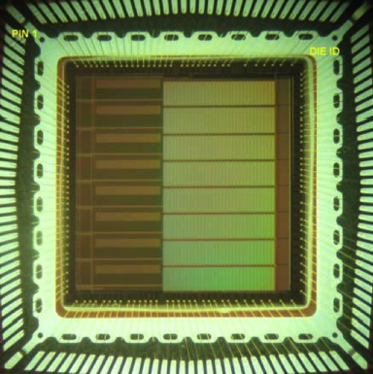
ARA Station Design
ARA design spec demands > 3 GHz sampling of RF transients from all antennas. This is acheved by the Ice Radio Sampler ASIC (IRS2) designed by G. Varner (U Hawai’i Manoa).
1 GHz analog B/W at input
Up to 4 GSPS
8 independent channels / chip
20 mW power dissipation per channel
Each channel contains 32k analog storage addressed as 512 random r/w blocks of 64 samples each.
On chip parallel Wilkinson converters
~ 15 µs/block conversion + readout time
ARA1-3 uses 1 IRS2 ASIC per string of 2 VPOL + 2 HPOL antennas: 4 such units per station.
Issues: sampling on higher channels (>3) compromised – 2x lower effective speed.

Slide 32
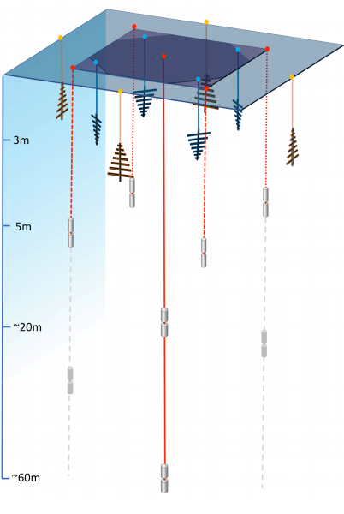
ARA and ARIANNA
ARIANNA @ McMurdo
30x30 grid of 8 under-ice LPDA spaced 1 km
Located on Moore’s Bay (Ross Sea Ice 100 km distant from McMurdo station)
500 m thick sea ice on water.
RF bounces off bottom
ARIANNA @ SouthPole
Ice at South Pole better (colder) and thicker → bigger target volume
Moore’s Bay detector design being adapted (merged?) with deep ARA-like dipoles to take advantage of double pulses.
Collaborations coming together

Slide 33
Part IIa: The IceCube Upgrade – Initial Extension to IceCube
7 Dense Strings
High Energy Array
Cosmic Ray Array
Radio Array

Slide 34
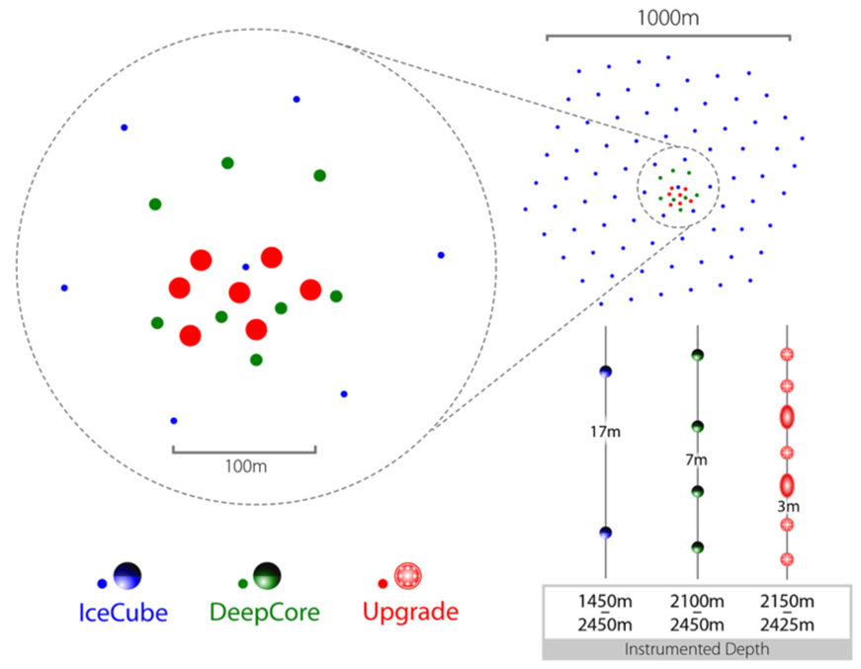
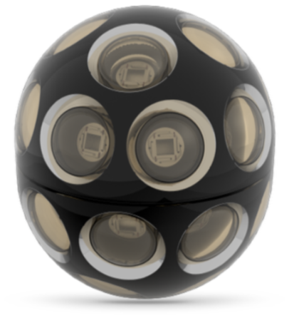
Gen2 Phase 1: First Steps
Science goals:
Probe unitarity of PMNS matrix
Improve calibration and characterization of ice for improved HE multimessenger neutrino astronomy
7 strings densely populated (92 modules in physics region) with next generation, high performance photodetectors:
Integrates with existing IceCube: data acquisition, event filtering, simulation will require extension;
No significant increase in steady-state operations;
Negligible increase in data rate
+3 kW power (+5% increase relative to IceCube)
500k lbs. cargo (10% IceCube Gen1)
Proposed project leverages significant effort already invested by US/Non-US IceCube groups to develop instrumentation and infrastructure for next-generation neutrino detector at South Pole.
Array | String Spacing | Module Spacing | Modules per String
IceCube | 125 m | 17 m | 60
DeepCore | 75 m | 7 m | 60
Phase 1 | 20 m | 3 m | 125

Slide 35
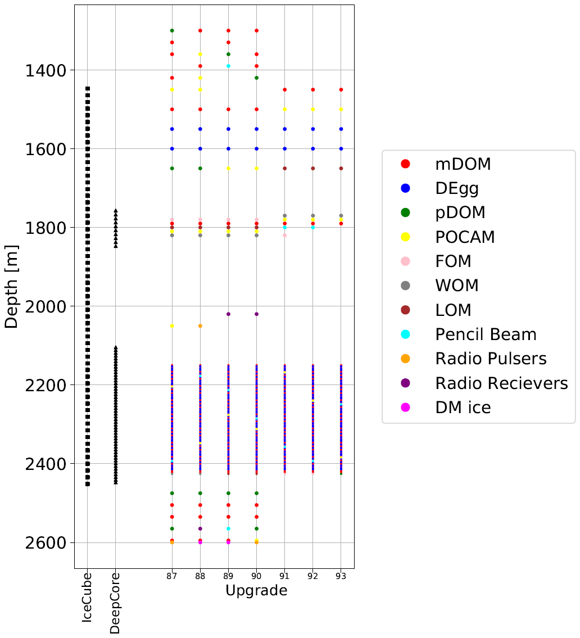
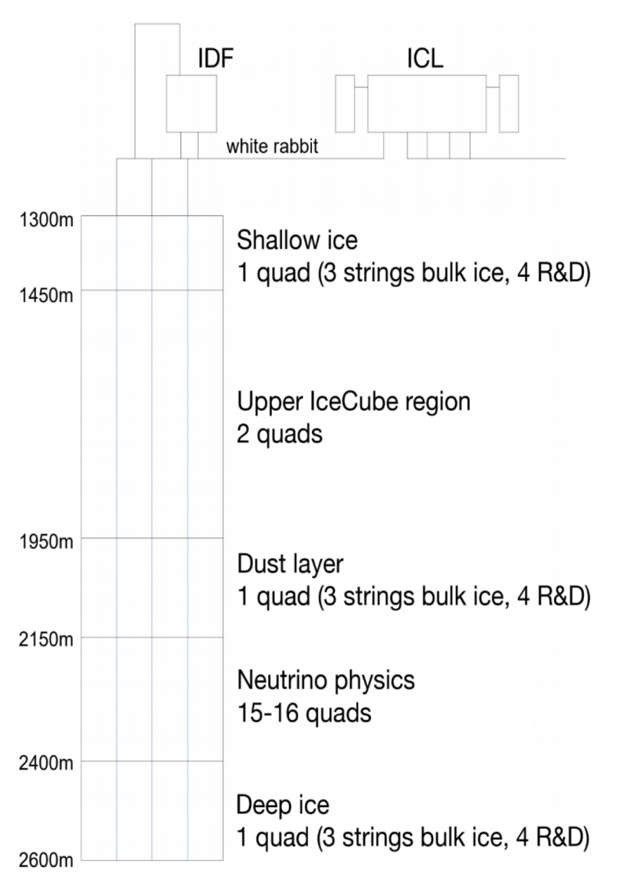
A Heterogeneous Detector

Slide 36
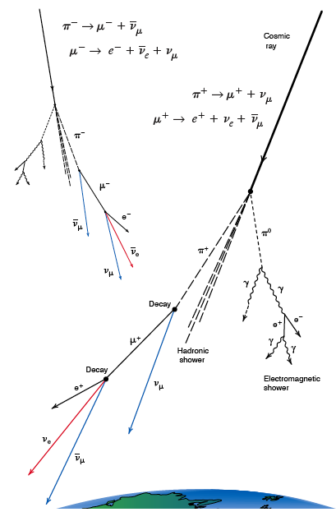
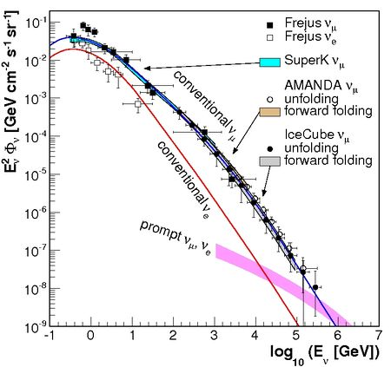
Atmospheric Neutrino “Backgrounds”
Neutrinos are also produced in quantity by cosmic ray interactions in the Earth’s atmosphere: decaying mesons yield muons, ν_{e}, and ν_{μ} (not ν_{τ} however). These form a nearly irreducible background for astrophysical neutrinos (IceCube detects 1 every 5 minutes vs 1/week for astrophysical ν).
The handle is the energy: because mesons lose energy in the atmosphere the flux of atmospheric neutrinos is approx. power law with spectral index -3.7.

Slide 37
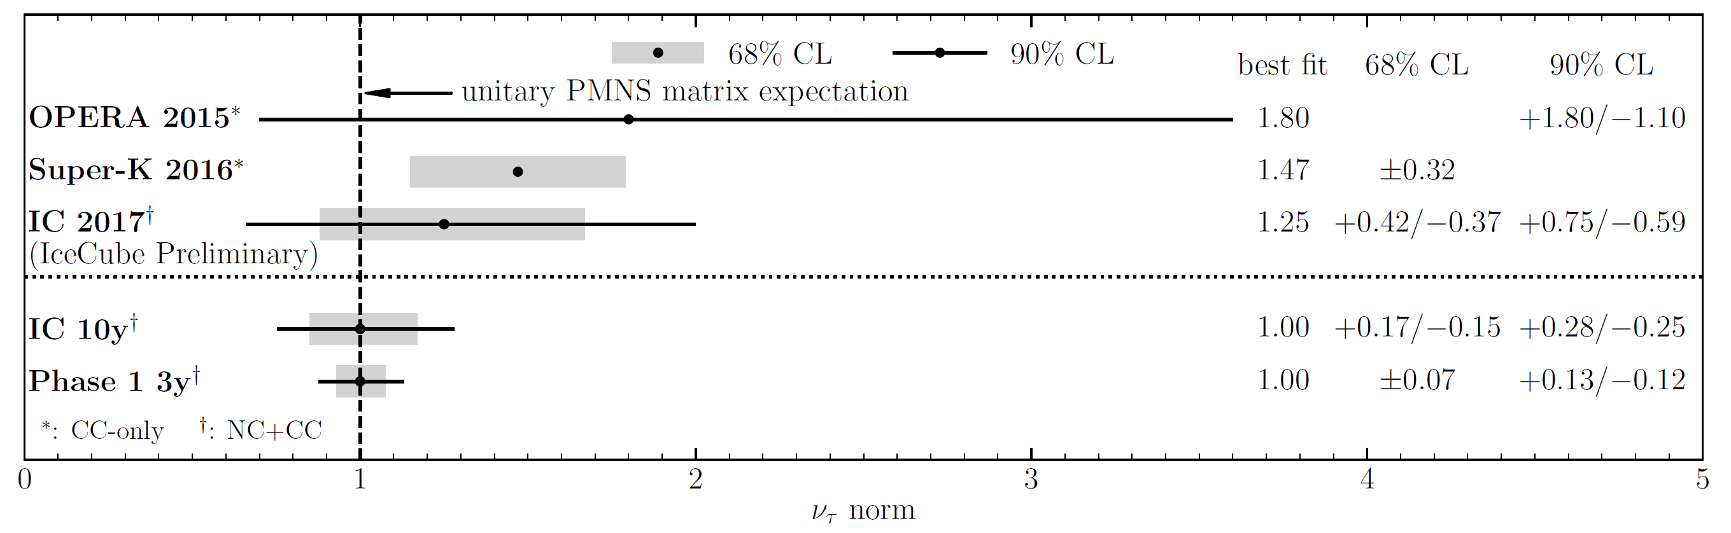

Neutrino Mixing
With only 7 but densely instrumented strings …
Expect 2500 CC+NC tau neutrino events per annum. Statistically measure taus based on energy and angle.
Will exlude no-tau appear w 14 sig after 3 years.
Best constraints on atmospheric mixing parameters (maximal mixing / octant for ATMNU).

Slide 38


Improving IceCube Reconstructions
Lack of precision knowledge of ice limits angular reconstructions – in particular bad at high energy where, contrary to expectation, the reconstruction gets worse. Cascade reconstruction (right) at PeV has median ang. res of 15° but would be improved to 3-5° with better ice characterization. This applies to muon reconstructions as well with improvements to 0.1 - 0.2 ° foreseen.
Obvious benefit to MMA is improved source localization: HESE-160427a, a 140 TeV track coincident with Pan-STARRS SN PS16cgx.
Improved flavor ID for tau neutrinos to better constrain source physics. This is currently limited by ice anisotropy uncertainty: tau double-pulse harder than PeV double bang.
Improved calibrations are retroactively applicable to 10+ years IceCube archival data!

Slide 39

Timeline
Time | Gen2 Milestone
2020 | Concept Design Review
2021 | Preliminary Design Review
2022 | Final Design Review; begin production
2025-2031 | Deployment 120 HEA deep ice strings

Slide 40
Conclusions / Predictions / Predications / Predilections
Neutrinos are going to play a key role in MMA from now and through the 2020’s. They allow us to reach into the ultrahigh-energy sky and peer deep into exotic high energy phenomena.
High hopes for IC170922. This could be interesting … stay tuned.
The next generation instrument is still a long way off (although this crowd seems entirely comfortable with missions more than a decade away). This will likely be a complex, broadband instrument, with optical + RF detection spanning 9 decades in energy!
In the short term, with a modest investment, we can improve our knowledge of the ice and get better multimessenger astronomy from IceCube going forward and going backwards too.

Slide 41

THE END

Slide 42

The Case for Multimessenger Astronomy
Take all you are given
High energy astrophysical acceleration sites are likely emitters of gammas, charged ions, and neutrinos. Each particle used as a messenger particle has it own strengths and weaknesses – we can push our knowledge deeper by combining them.
Gamma rays: point back to sources and easily detectible but there is problem of interactions in dense sources or in transit over not-so-long distances. PeV and above constrained to intergalactic-scale distances. EM and hadronic production possible and often difficult to discriminate.
Cosmic rays: and up to 10¹⁹ eV travel over cosmological distances. Not impossible but difficult to trace back to source due to deflection in GMF/IGMF. UHE detection requires large ground arrays.
Neutrinos: point back to sources and offer pristine look even deep into compact objects; no horizon – a good thing overall but has implications in point-source searches; require large, expensive underground or underwater (ice) detector facilities; radio is however promising economical technique at UHE.

Slide 43

IceCube Science

Slide 44
High-Energy Starting Event (HESE) Analysis
Strategy: focus on high-energy events (2 > PeV events in 1 year, either we got really lucky or the ice is full of them). The very simple cut developed (it is now running in real time at Pole) is this:
Qtot > 6000 p.e. : this will setup an energy threshold of approx. 30 TeV, but, again, there should be many events out there based on the two observations;
Use part of IceCube’s outer shell as a veto. It’s OK if hits occur in the veto as the particle exits (PC muons will do this) but not OK if the first hits occur in the veto region.
It is also possible to use data to check the veto performance
The HESE analysis was then sensitive to all flavors above about 60 TeV (muons are penalized slightly because some energy escapes); background could be estimated from data. The effective volume of the search was 400 Mton – about 40% efficient.

Slide 45


HESE 6-year Results
Earth opacity to UHE Neutrinos!

Slide 46






Realtime HE Neutrino Candidate Alerts

Slide 47


Meanwhile, in the Mediterranean
ARCA / ORCA
Slide from J. Hofestädt (Erlangen)
The new KM3NeT design baseline – blocks of 115 strings (see ORCA inset at right – ARCA spacing is O(100m)) using multi-anode optical modules. Two sites planned – ARCA (Italy) for the high-energy array and ORCA (France) for neutrino oscillations. A phased approach:
Phase | Blocks | Deliverable
1 | 0.2 | Engineering run – first science
2 | 2 ARCA | Measurement of HE neutrino flux
2’ | 1 ORCA | NMH
3 | 6 | Neutrino astronomy
On Dec 3rd 2015 the first string was deployed at the Capo Passero site off SE coast of Sicily. On 16 May 2016 two more lines deployed.
Strings are wound up in package shown at left and dropped off deployment vessel. ROVs then connect to junction box at 3500 m depth.

Slide 48
Reducing Hole Size: Faster Hole Delivery & Less Fuel
Obvious statement: drilling 140 holes is a big enterprise.
History tells us that the IceCube drill peaked out around 31h per hole (22h drill + 9h reaming).
Shrinking instrument diameter by just 4 cm (IceCube hole is ~60 cm), we can get this down to 25h (20% improvement) and save as much fuel (remember that we pay, theoretically, at least, upwards of $25/gallon at Pole and each hole needs 5500 gallons).
Further reductions in instrument diameter run into a speed limit but continue quadratic fuel savings.
The slides which follow describe a pilot study into an improved hot water drill conducted over a year in the past. The engineering team did not have information that smaller instrumentation might be used and it has been optimized to drill large holes. More engineering development is needed to explore further benefits of smaller holes.

Slide 49


Surface Veto
Generic surface array simulations just released at IceCube Gen2 meeting actually predict substantive gains in several FoM for CRA in the 10’s of millions price. Technology still unspecified: scintillator, frozen pool, IACT(??) or combo.

Slide 50

Scintillator Module ‘Prototypes’
Deploying thin sheets of extruded scintillator panels from MINOS: WLS fiber readout. Being deployed for purpose of understanding snow accumulation on IceTop tanks
Panels are cheap (these are free in fact). Extruded scintillator is 10x cheaper than cast plastic.
2 sheets left for Pole Sept 2015, installed Jan 2016, working.

Slide 51
Alternative Approaches to Consider
The preceding slides describe only one possible approach. Other approaches should be considered:
Minimal EHWD Restart (PINGU drill plan from 2013)
  Replace equipment
  Drill up to a couple dozen holes before boilers die
Other boiler options (fewer, larger boilers)
Hybrid options – some microturbines, some boilers
Alternative approaches are centered around thermal plant, whereas packaging is likely to stick with the air-ride cargo sled concept
Build two drills and cut production time by significant amount – this is now becoming the baseline plan.
Notes:
Other approaches and next steps will be discussed in the coming weeks

Slide 52


Ice
The complex ice structure deposited over 100 k-yr contains much structure and is prominent challenge for IceCube:
Simulation of 10¹⁰ photons or more for high energy events now possible with GPU acceleration
Not only is there z structure, there is tilt and directional anisotropy!
Ice properties measured with in-ice calibration sources:
12 high brightness 400 nm LEDs per DOM – a few DOMs have different colors;
Handful of special calibrated sources;
Dedicated dust logging of boreholes – IceCube also contains a few glaciologists.
Notes:
Dust! And ice flow

Slide 53
Large Facility Project Projections
I used to offer budgetary estimates for Gen2. Based on “bottoms-up” costing from IceCube even these projections were likely off by ±50%. Now with an open box on design I’m not even going to waste your time. Nonetheless, I think it’s safe to say we are talking over $150 million USD. For NSF this means MREFC from NSF’s large facilities office (LIGO, IceCube, LSST, ALMA, …) – not R&RA money.
Going by the book we think we will probably spend the next 2 years in R&D phase, then, hopefully, board the on-ramp to MREFC still with years before construction starts mid-2020’s.

Slide 54
Reducing Hole Size: Faster Hole Delivery & Less Fuel
Obvious statement: drilling 140 holes is a big enterprise. History tells us that the IceCube drill peaked out around 31h per hole (22h drill + 9h reaming). Shrinking instrument diameter by just 4 cm (IceCube hole is ~60 cm), we can get this down to 25h (20% improvement) and save as much fuel (remember that we pay, theoretically, at least, upwards of $25/gallon at Pole and each hole needs 5500 gallons). Further reductions in instrument diameter run into a speed limit but continue quadratic fuel savings.

Slide 55
Putting it all Together
Previous ‘global fit’ analysis (IceCube, ApJ 809 (2015) 98) best spectral fit above 20 TeV ~ -2.5
New analysis (IceCube, arXiv:1607.08006) high above 200 TeV favors harder spectrum ~ -2.13
Curiously strong high energy flux of neutrinos → Fermi LAT should see more gammas (Murase, Guetta, Ahlers, PRL 116 (2016) 071101): constrains neutrino production from gamma – transparent sources such as starburst galaxies, galaxy clusters
Non-observation of neutrinos from GRB (IceCube, ApJ 805 (2015) L5) excludes GRBs > 1%
Gamma dark sources: SNe surrounded by thick material, AGN cores, …

Slide 56


Evolving the IceCube DOM
To Improve
What’s good
Self-contained DAQ
300 MSPS, 14-bits (eff) waveform capture
Integrated high-voltage
0.5 Mpbs digital data comms
RAPCal: automatic clock sync in comms subsystem – O(1 ns) absolute precision.
Large-area, low-noise PMT
Pretty low-noise glass (500 Hz / 700 Hz background counting from STD/High QE)
Integrated optical calibration hardware (flasher board)
Very robust & reliable – of 5484 total channels deployed 5404 are now taking data.
Replace transient waveform capture ASIC with modern pipelined 14-bit 250 MSPS ADC:
    Eliminates need to pre-trigger ASIC (72 ns delay board)
    Unify 3 disparate gain channels to single channel – tricky calibration in IceCube
    Permit capture of arbitrarily long waveforms (currently limited to ~500 ns)
Update FPGA to modern process, high-density (Cyclone V)
Replace HV module (good performance but 25% efficiency)

Slide 57
Competetive Oscillation Physics Measurements

Slide 58

To EeV and Above
A combined radio – optical detector would have a powerful reach into EeV energies where GZK phenomena could be probed.
Shown at left is a comparison of neutrino effective areas for IceCube-86, a scaling for Gen2 performance, and a putative radio deployment of 100 km² scaled from the ARA detector.
At 10¹⁷ eV radio is the better technology. Not evident from this graph is the cost difference – radio would be more than an order of magnitude less expensive.

