Slide 1
What the Composition of Galactic Cosmic Rays Tells us About the Origin of GCRs
M.E. Wiedenbeck
Jet Propulsion Laboratory,
California Institute of Technology
with thanks to the ACE/CRIS and SuperTIGER instrument teams

Slide 2
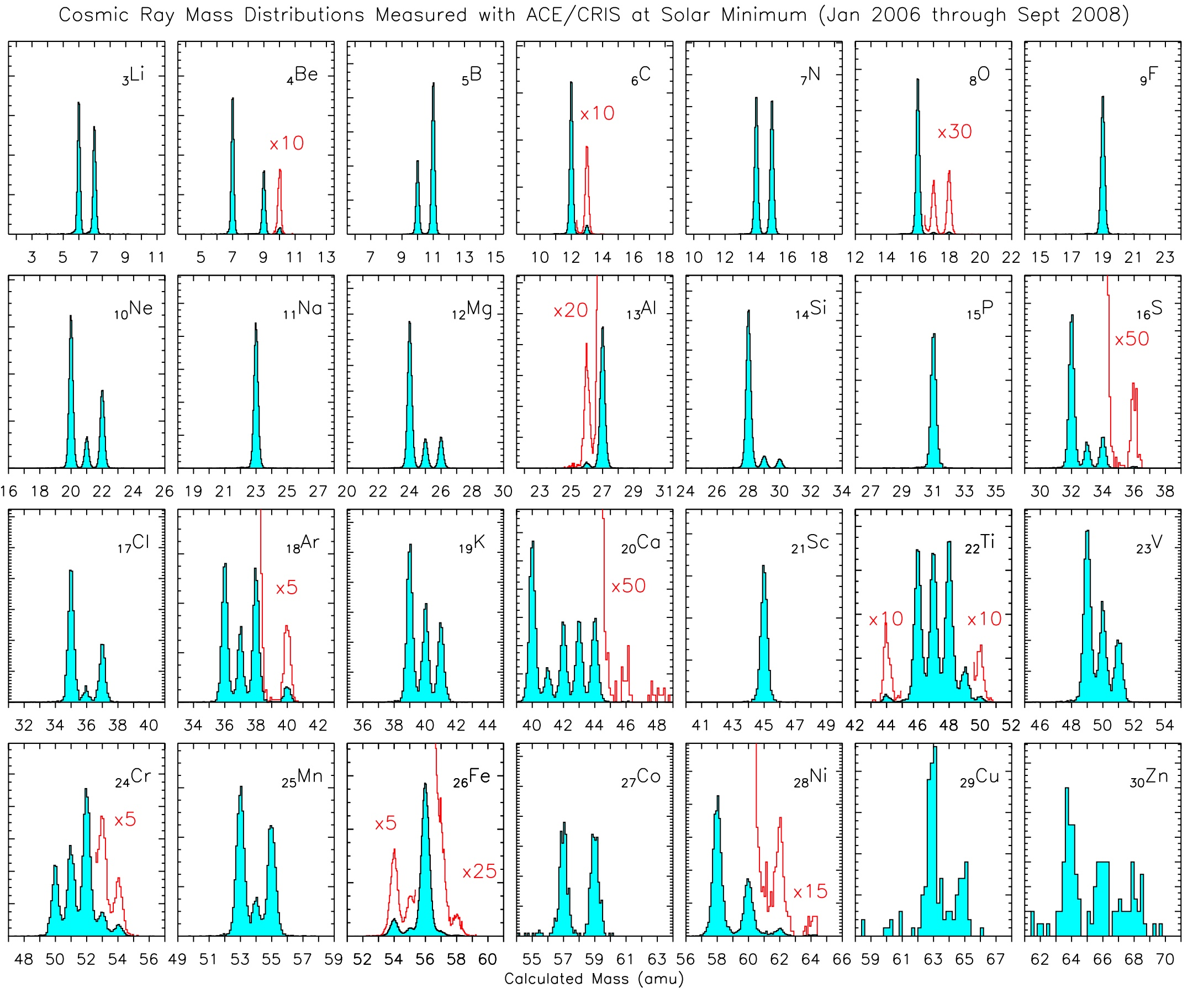
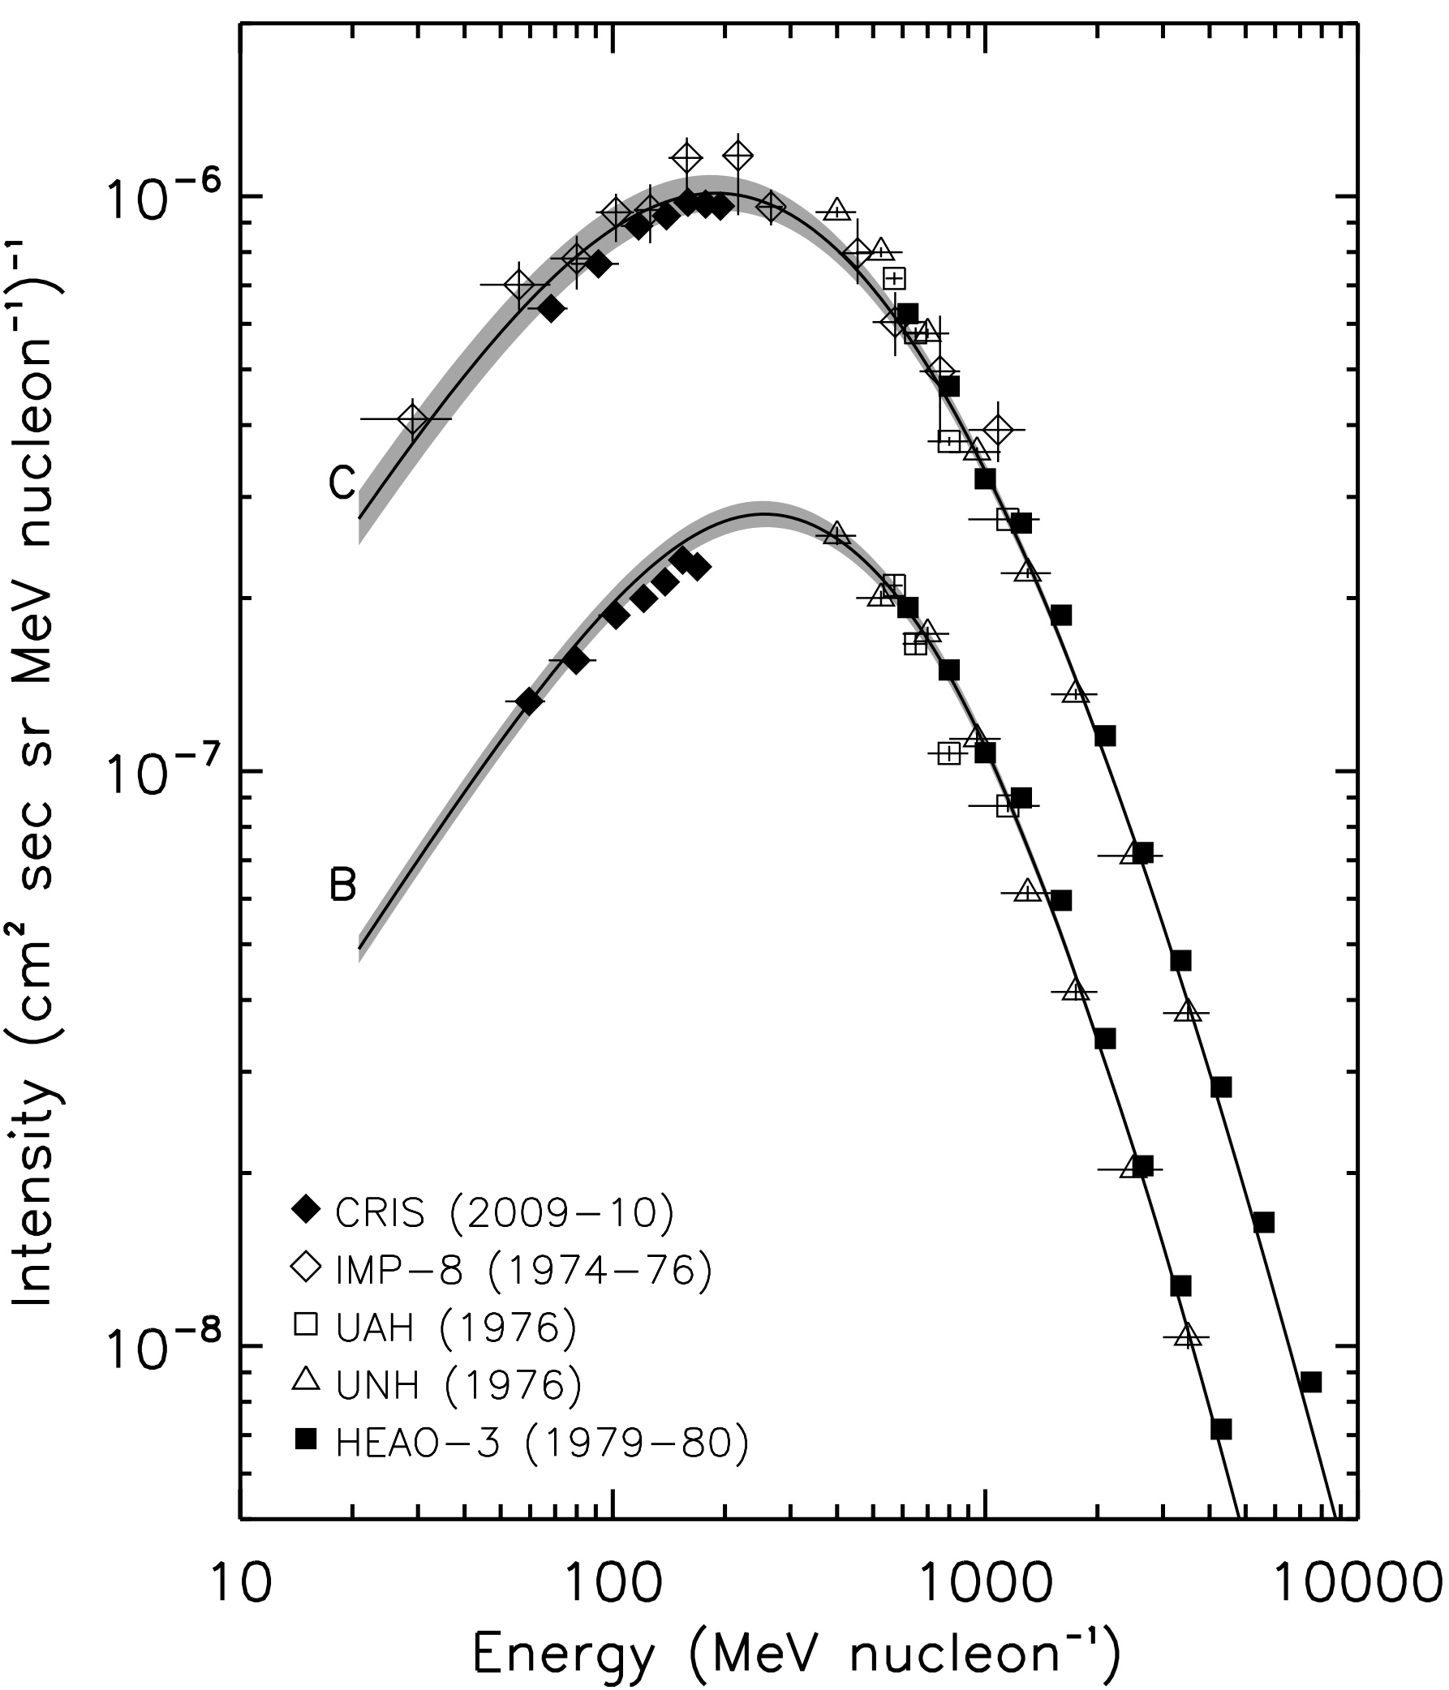
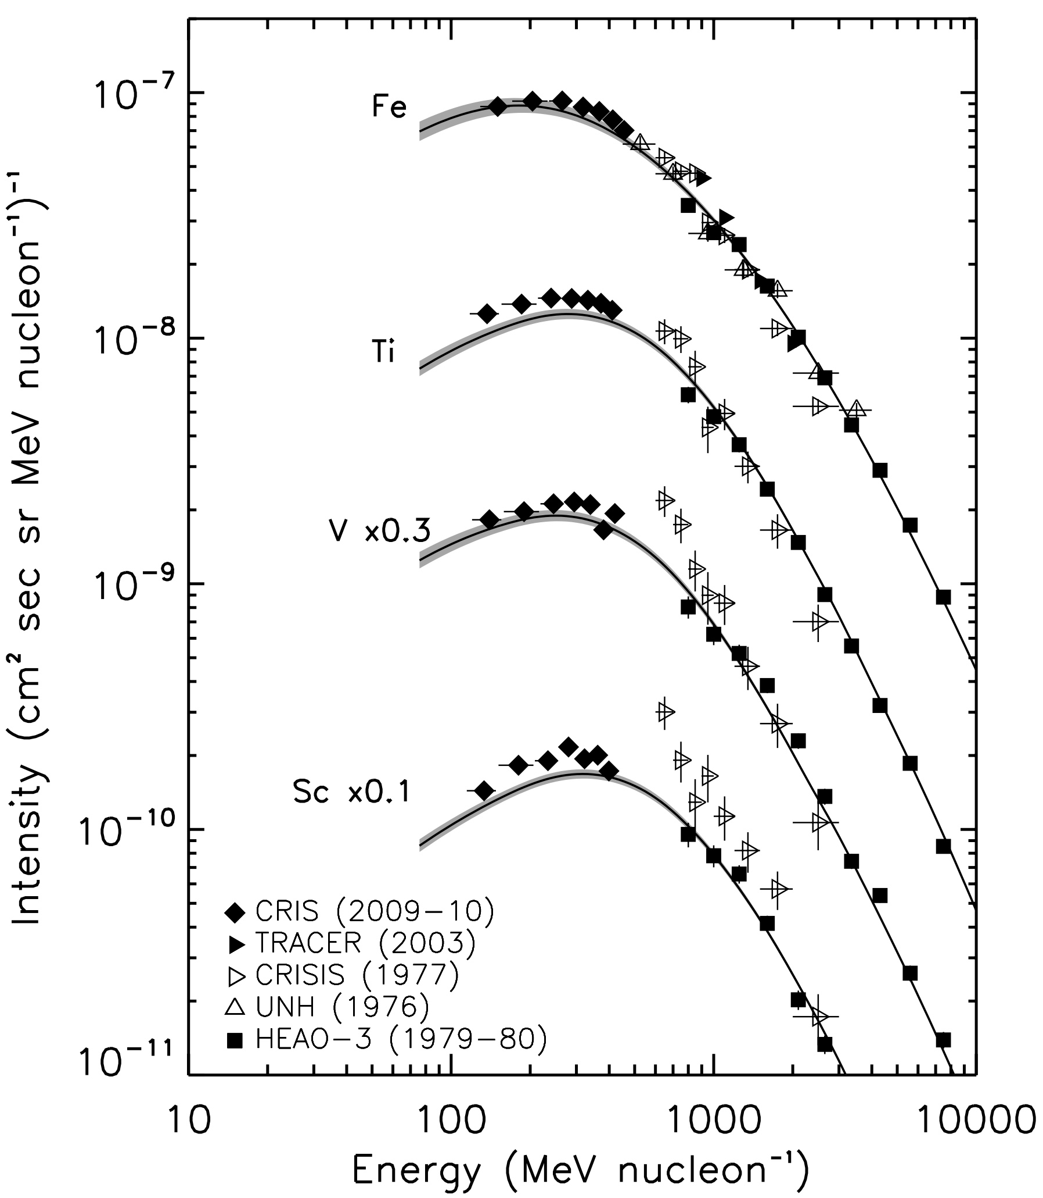
Isotopic Composition and Elemental Energy Spectra Have are Now Measured up to Z≃30 in Cosmic Rays below ~1 GeV/nuc
Lave et al., ApJ, 770, 117, 2013

Slide 3
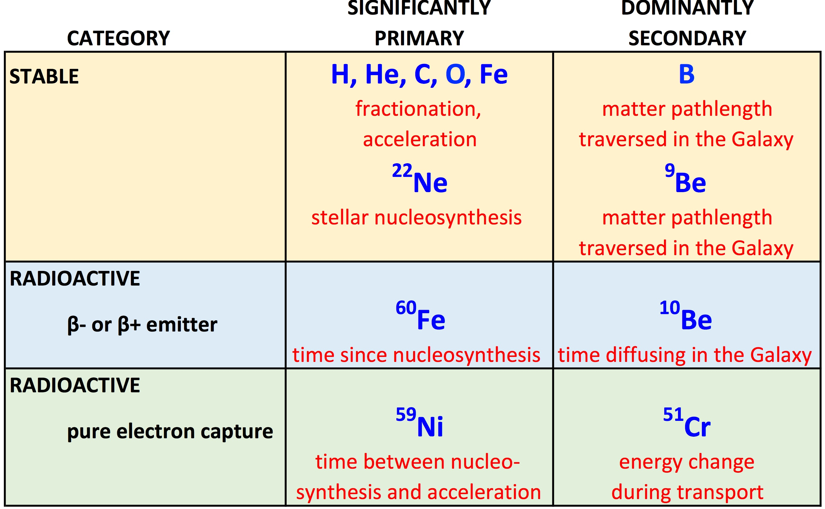
Categories of Cosmic Ray Elements and Isotopes and the Types of Information They Can Provide

Slide 4
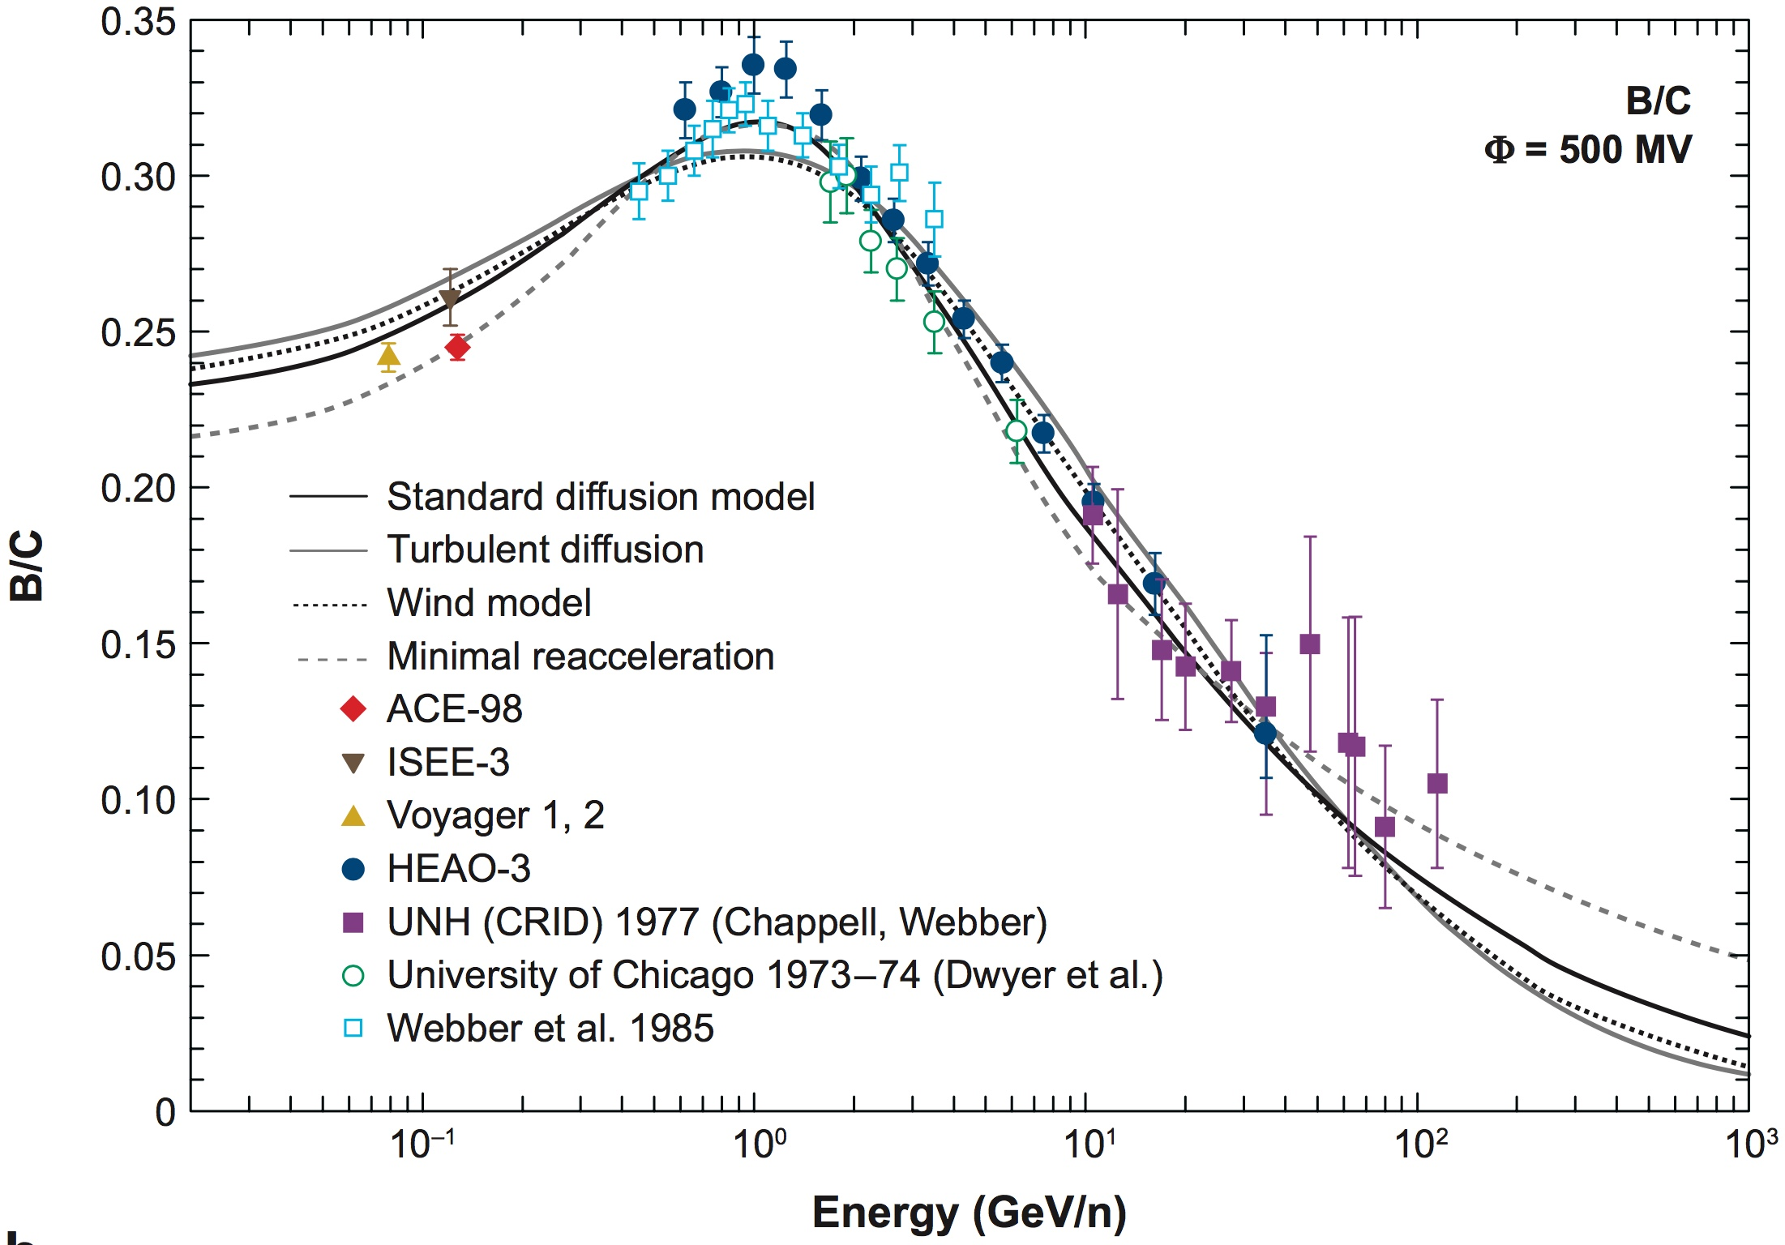
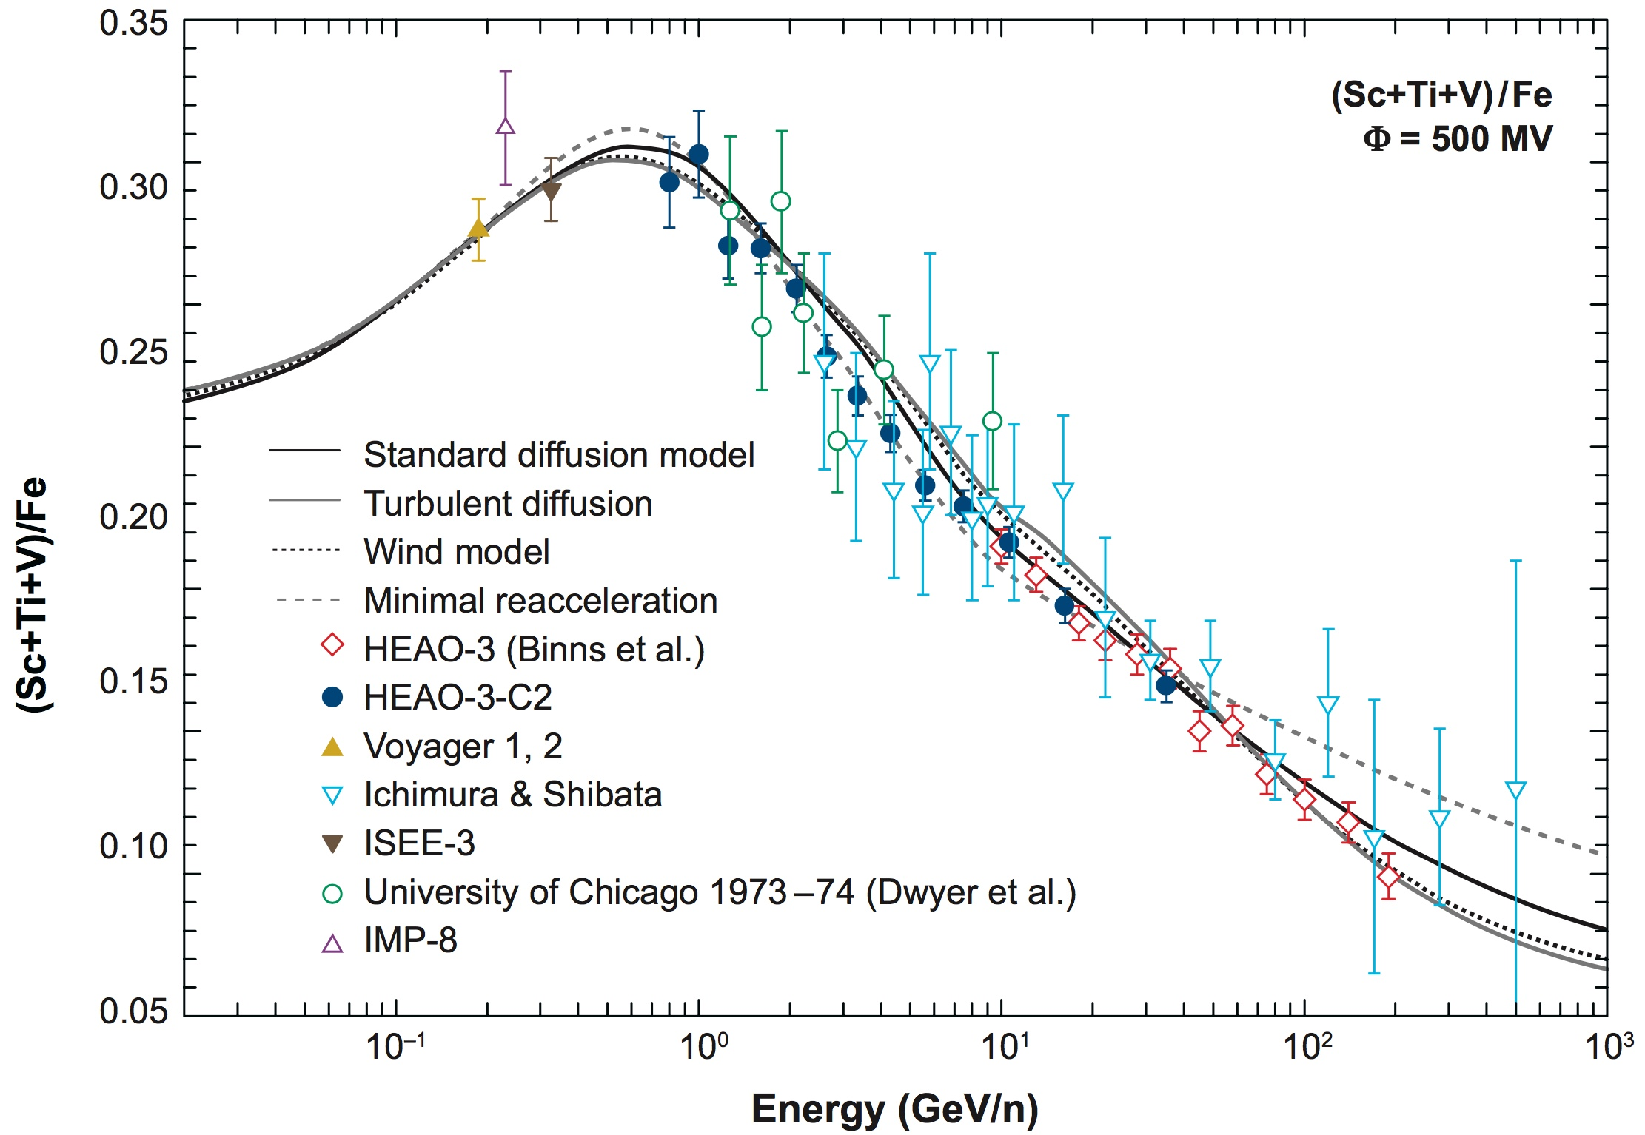
Secondary-to-Primary Ratios: Matter Traversed in the ISM
ratios used to derive the “target thickness” in which primaries must have interacted in order to procude the observed secondaries
one of the oldest uses of cosmic-ray composition data
now measured over a wide range of energies
measured fragmentation cross sections now available for interpreting the ratios
decreases at high and at low energies contain important clues about the physics of cosmic-ray transport in the Galaxy (weak reacceleration, shrouded sources, galactic wind, etc.)
Strong et al., Ann. Rev. Nucl. Part Sci., 57, 285, 2007

Slide 5
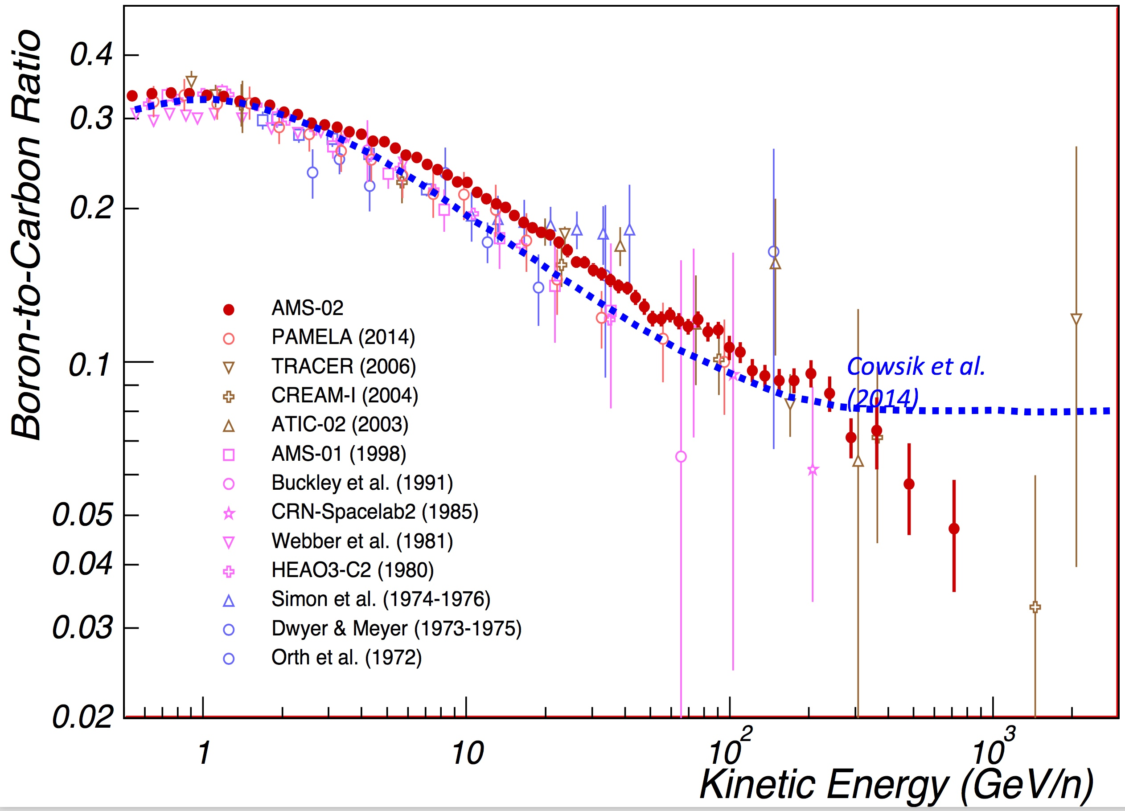
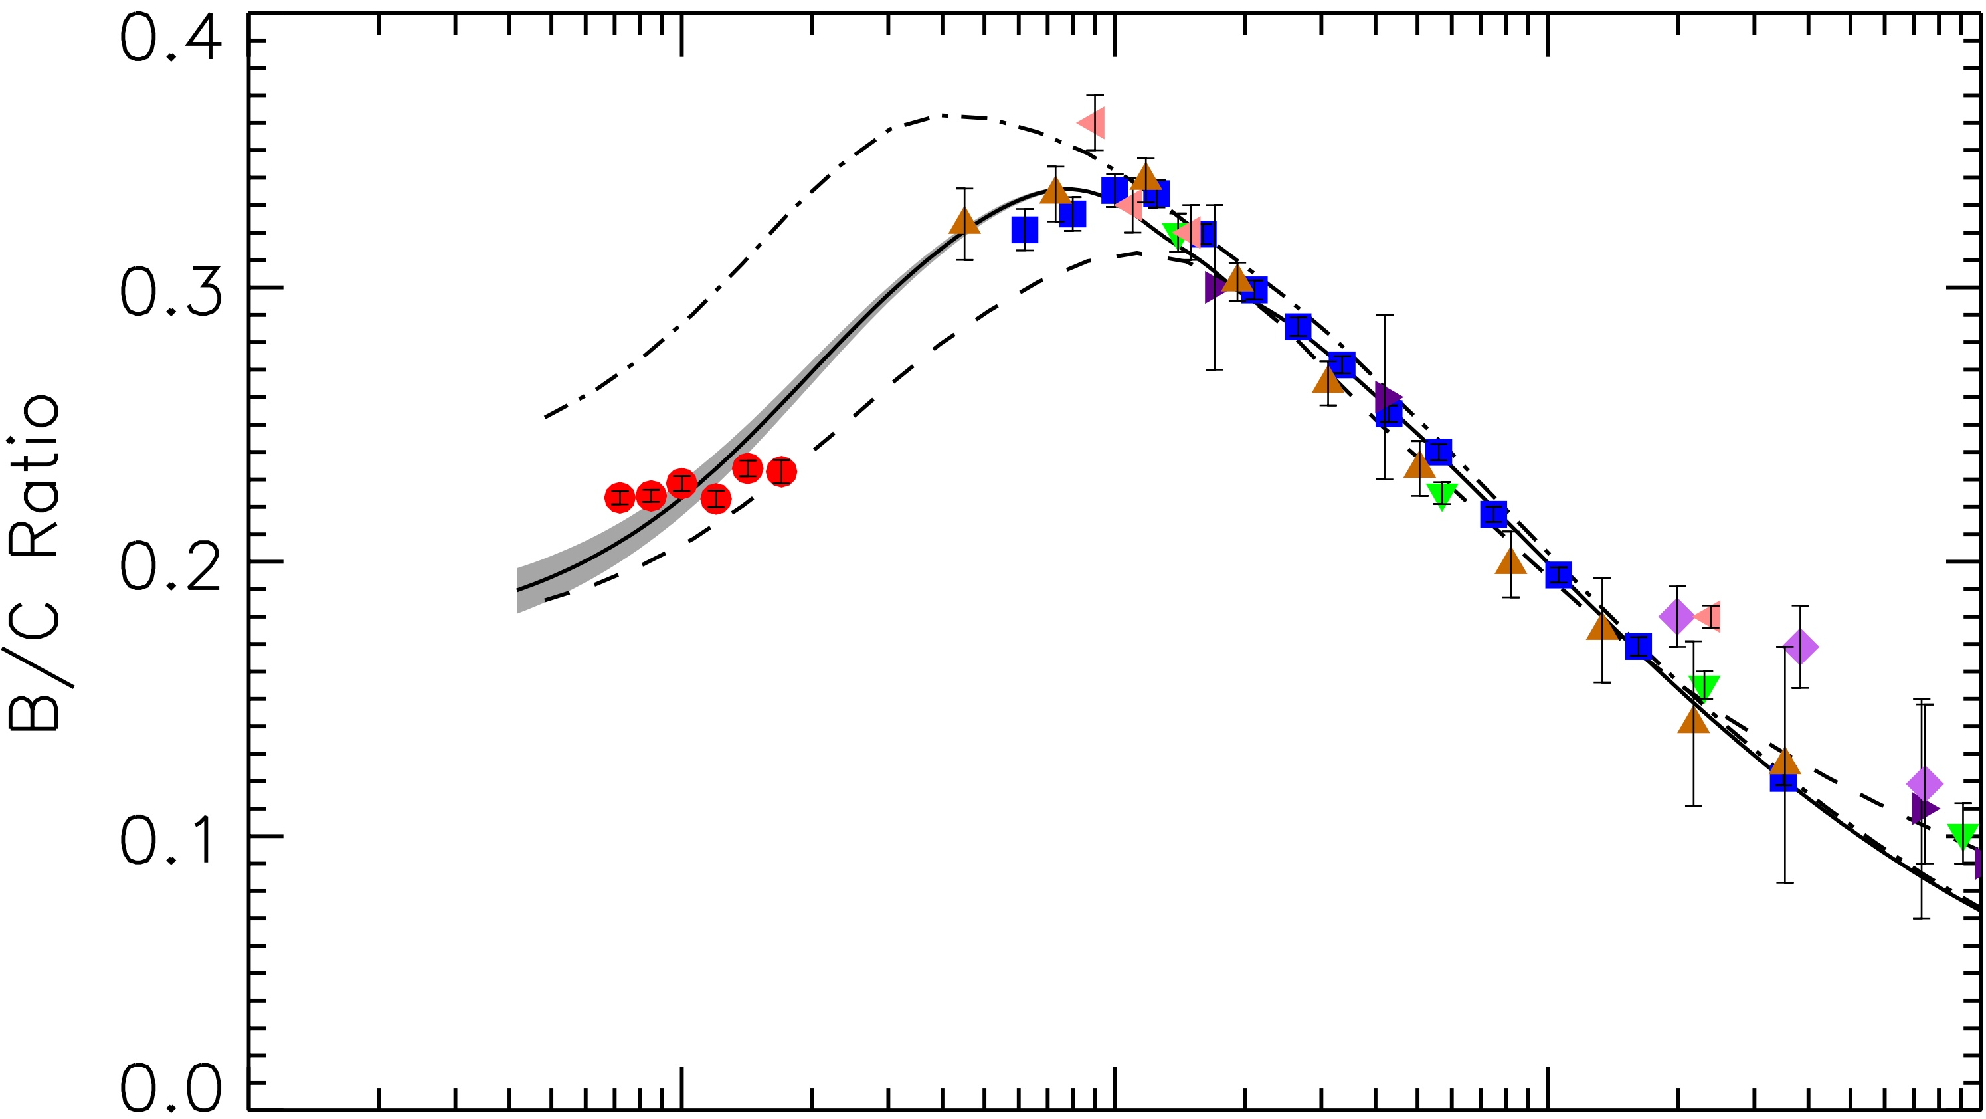
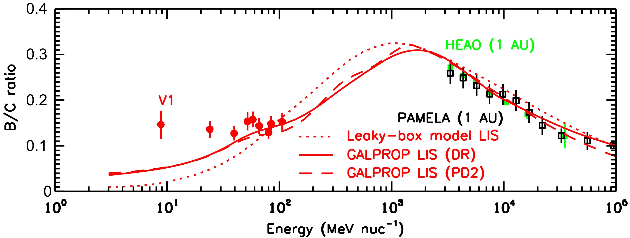
Secondary-to-Primary Ratios (B/C): Matter Traversed in the ISM
ratios used to derive the “target thickness” in which primaries must have interacted in order to produce the observed secondaries
one of the oldest uses of cosmic-ray composition data
now measured over a wide range of energies
Voyager 1 measurements now knowledge of B/C down to ~10 MeV/nuc in VLISM
decreases at high and at low energies contain important clues about the physics of cosmic-ray transport in the Galaxy (weak reacceleration, shrouded sources, galactic wind, etc.)
Schael presentation
1 AU
VLISM
0.1
1
10 GeV/nuc
Cummings et al., ApJ, 831, 18, 2013
Lave et al., ApJ, 770, 117, 2013

Slide 6
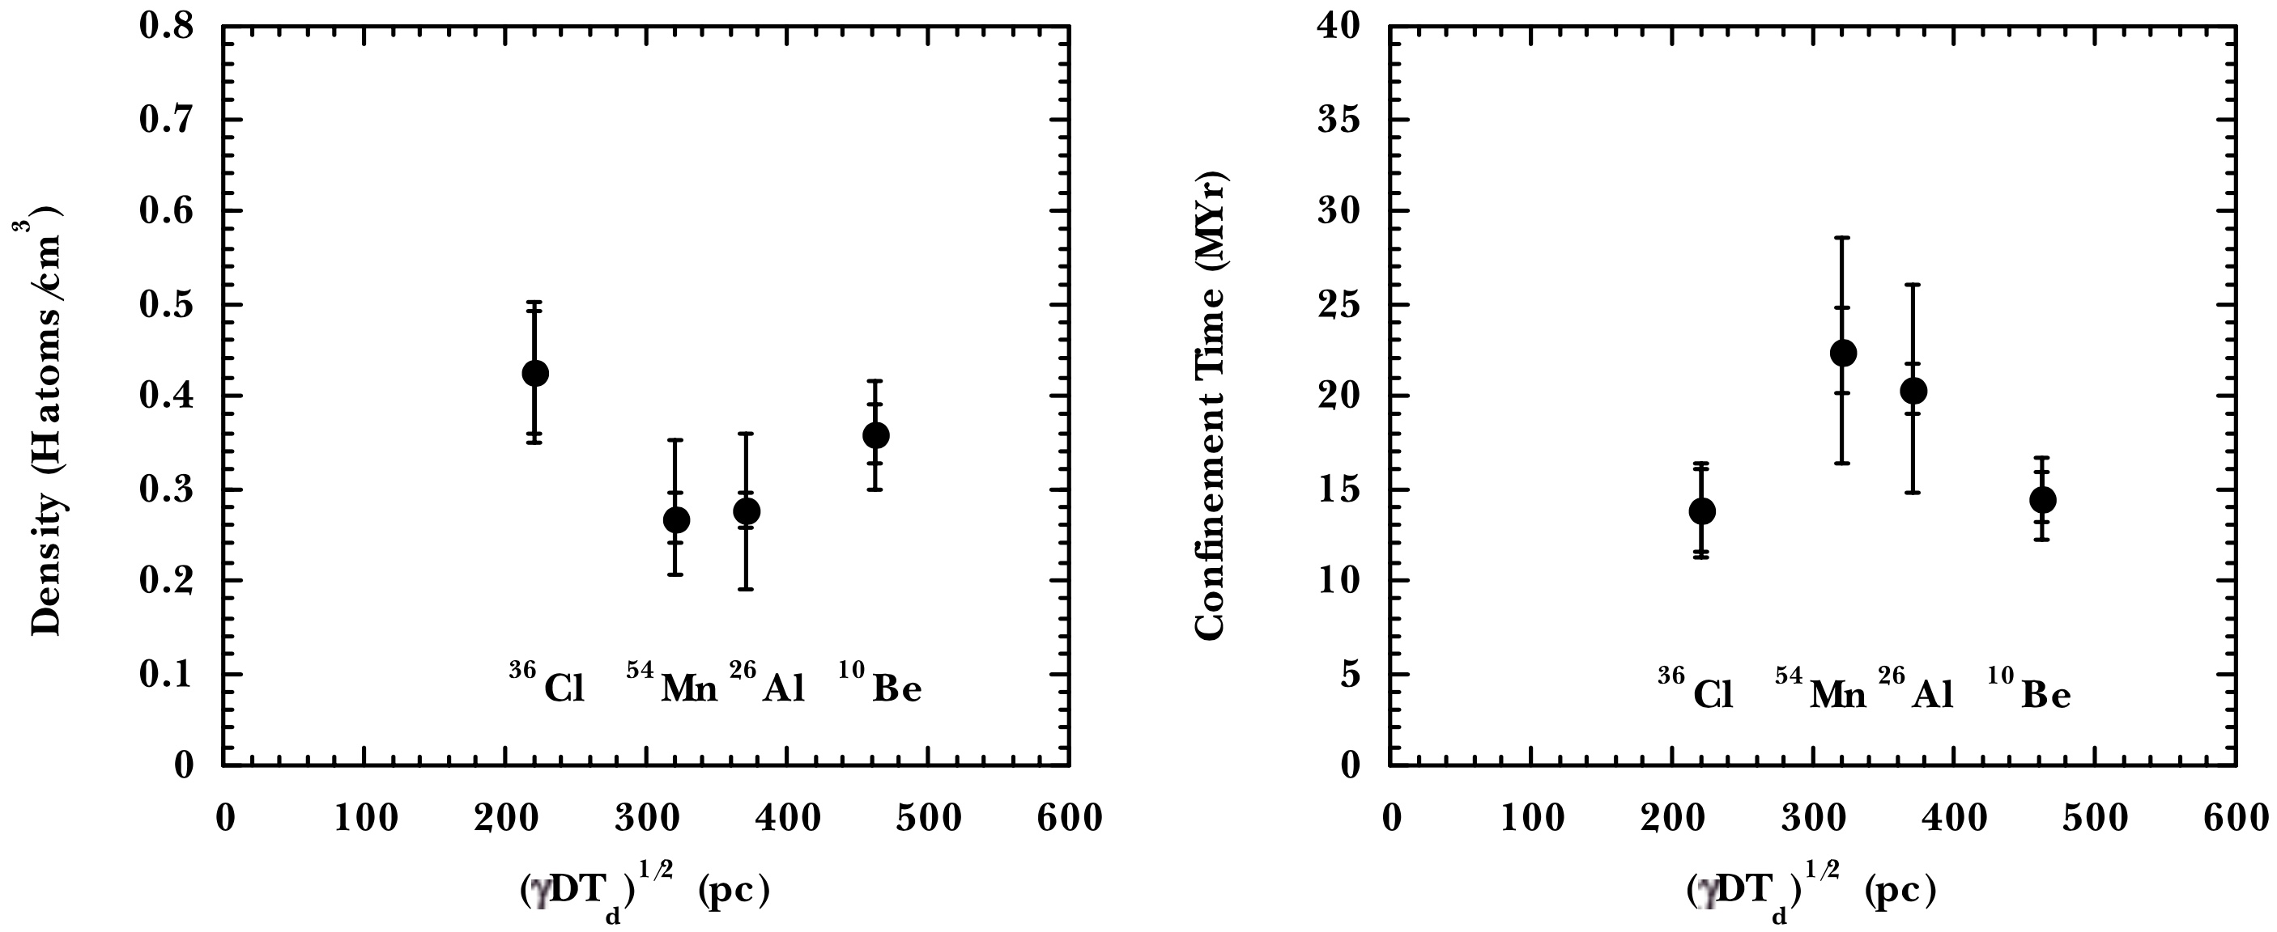
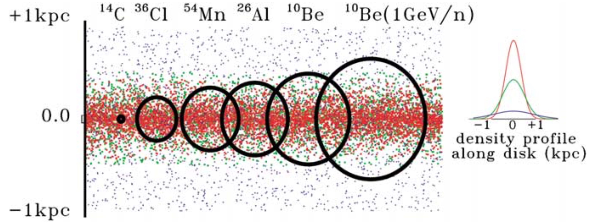
Where and for How Long do Secondary Cosmic Rays Propagate in the Galaxy?
ACE/CRIS data
Reconciling the amount of matter traversed (from B/C) with the time scale inferred from the decay of radioactive secondries requires interstellar densities ~0.3 H atoms/cm³, less than the “typical” IS desity estimate ~1/cm³.
Conclude that GCRs spend a significant fraction of their time in the galactic halo.
Cosmic-ray ¹⁴C (T_{1/2}=5730 yr) would sample only the galactic disk, but data are not yet sufficiently background-free to allow this short-lived nuclide to be measured.
Mewaldt et al., Space Sci. Rev., 99, 27, 2001
radii of circles drawn equal to the distance that each radionuclide can diffuse in it mean life time

Slide 7
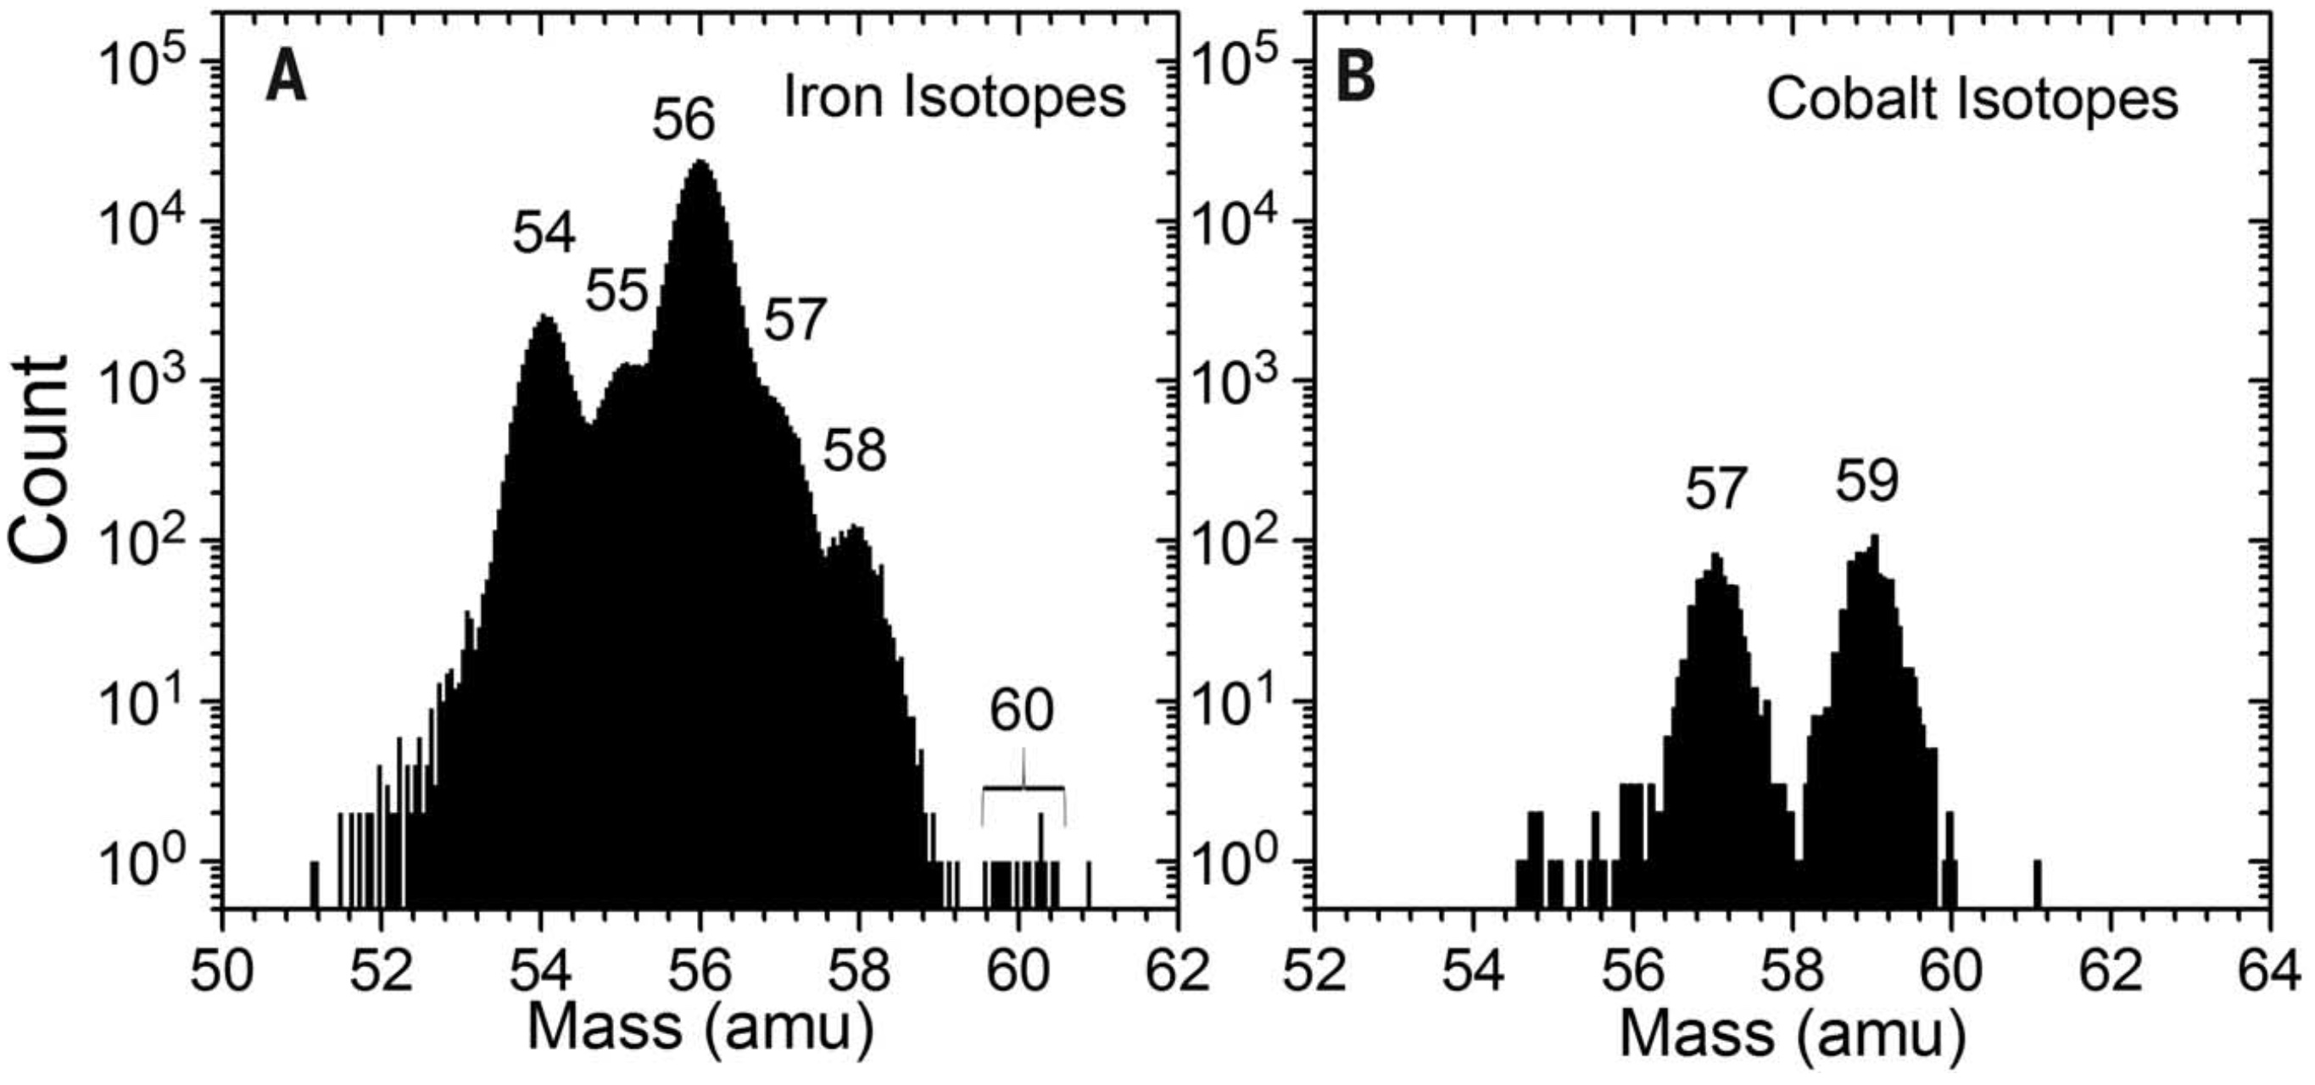
First Observation of a Primary Cosmic-ray Radionuclide (⁶⁰Fe)
⁶⁰Fe is synthesized in supernovae
there is no significant source of secondary ⁶⁰Fe
clock is started at the time of stellar nucleosynthesis and not stopped until detection
Fe isotopes:
54, 56, 57, 58: stable
55: e⁻ capture decay only
60: β⁻ decay (half-life: 2.6 Myr)
Co isotopes:
57: e⁻ capture decay only
59: stable (and product of ⁵⁹Ni decay)
15
⁶⁰Fe events
very little spillover
Binns et al., Science, 352, 677, 2016

Slide 8
Significance of Surviving ⁶⁰Fe
the ⁶⁰Fe primary clock is sensitive to the time between when this nuclide was synthesized in a supernova explosion and when it is observed
the fundamental conclusions that can be drawn from the observation of live ⁶⁰Fe in the cosmic rays are:
the nucleosynthesis event did not occur significantly longer ago than the 2.6 Myr half-life of ⁶⁰Fe
the nucleosynthesis event did not occur significantly farther away than cosmic rays can diffuse on this time scale, ~500 - 1000 pc
possible associations have been noted between the supernova that produced the GCR ⁶⁰Fe and events responsible for ⁶⁰Fe that has been found in samples from the ocean floor and from the lunar regolith indicating a nearby supernova ~2 Myr ago (reviewed by Fry et al., ApJ, 2016)
the derivation of the synthesized abundance of ⁶⁰Fe also depends on the the propagation history of cosmic rays between their sources and Earth—several people have pointed out that our initial estimate of the ⁶⁰Fe/⁵⁶Fe ratio in the synthesized material using a simple leaky-box model significantly underestimates the source ratio as compared to a more realistic model in which the synthesis occurs in the galactic disk but cosmic rays diffuse throughout a larger halo

Slide 9
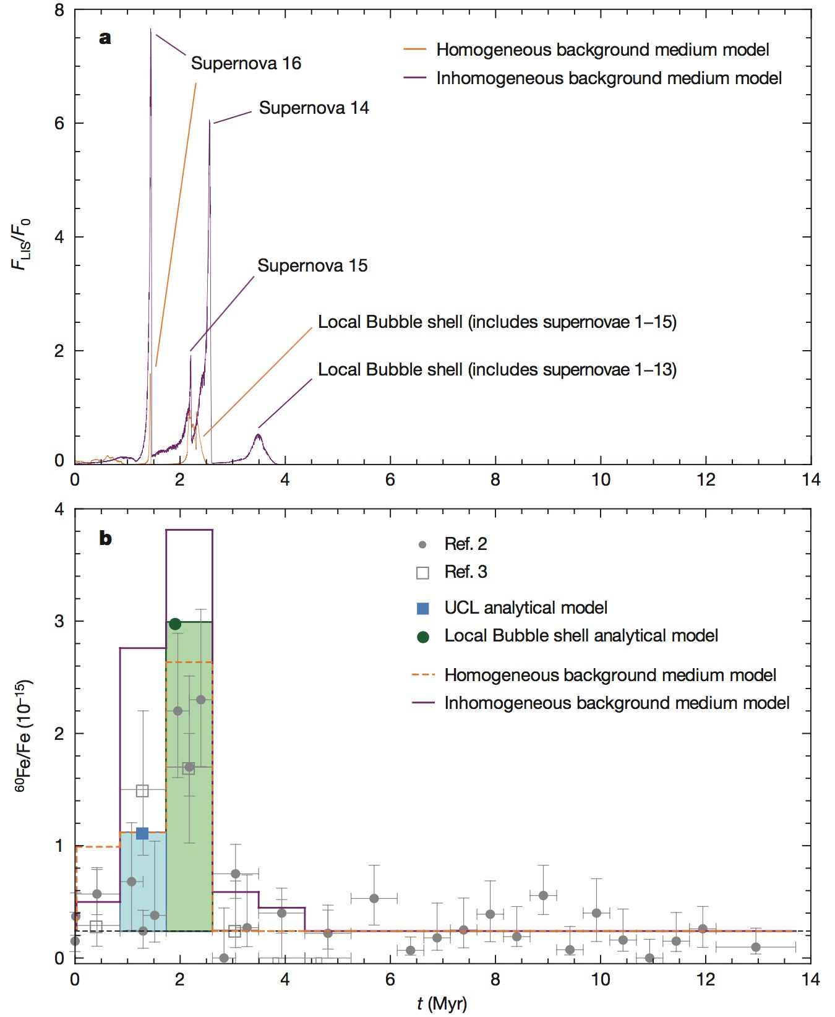
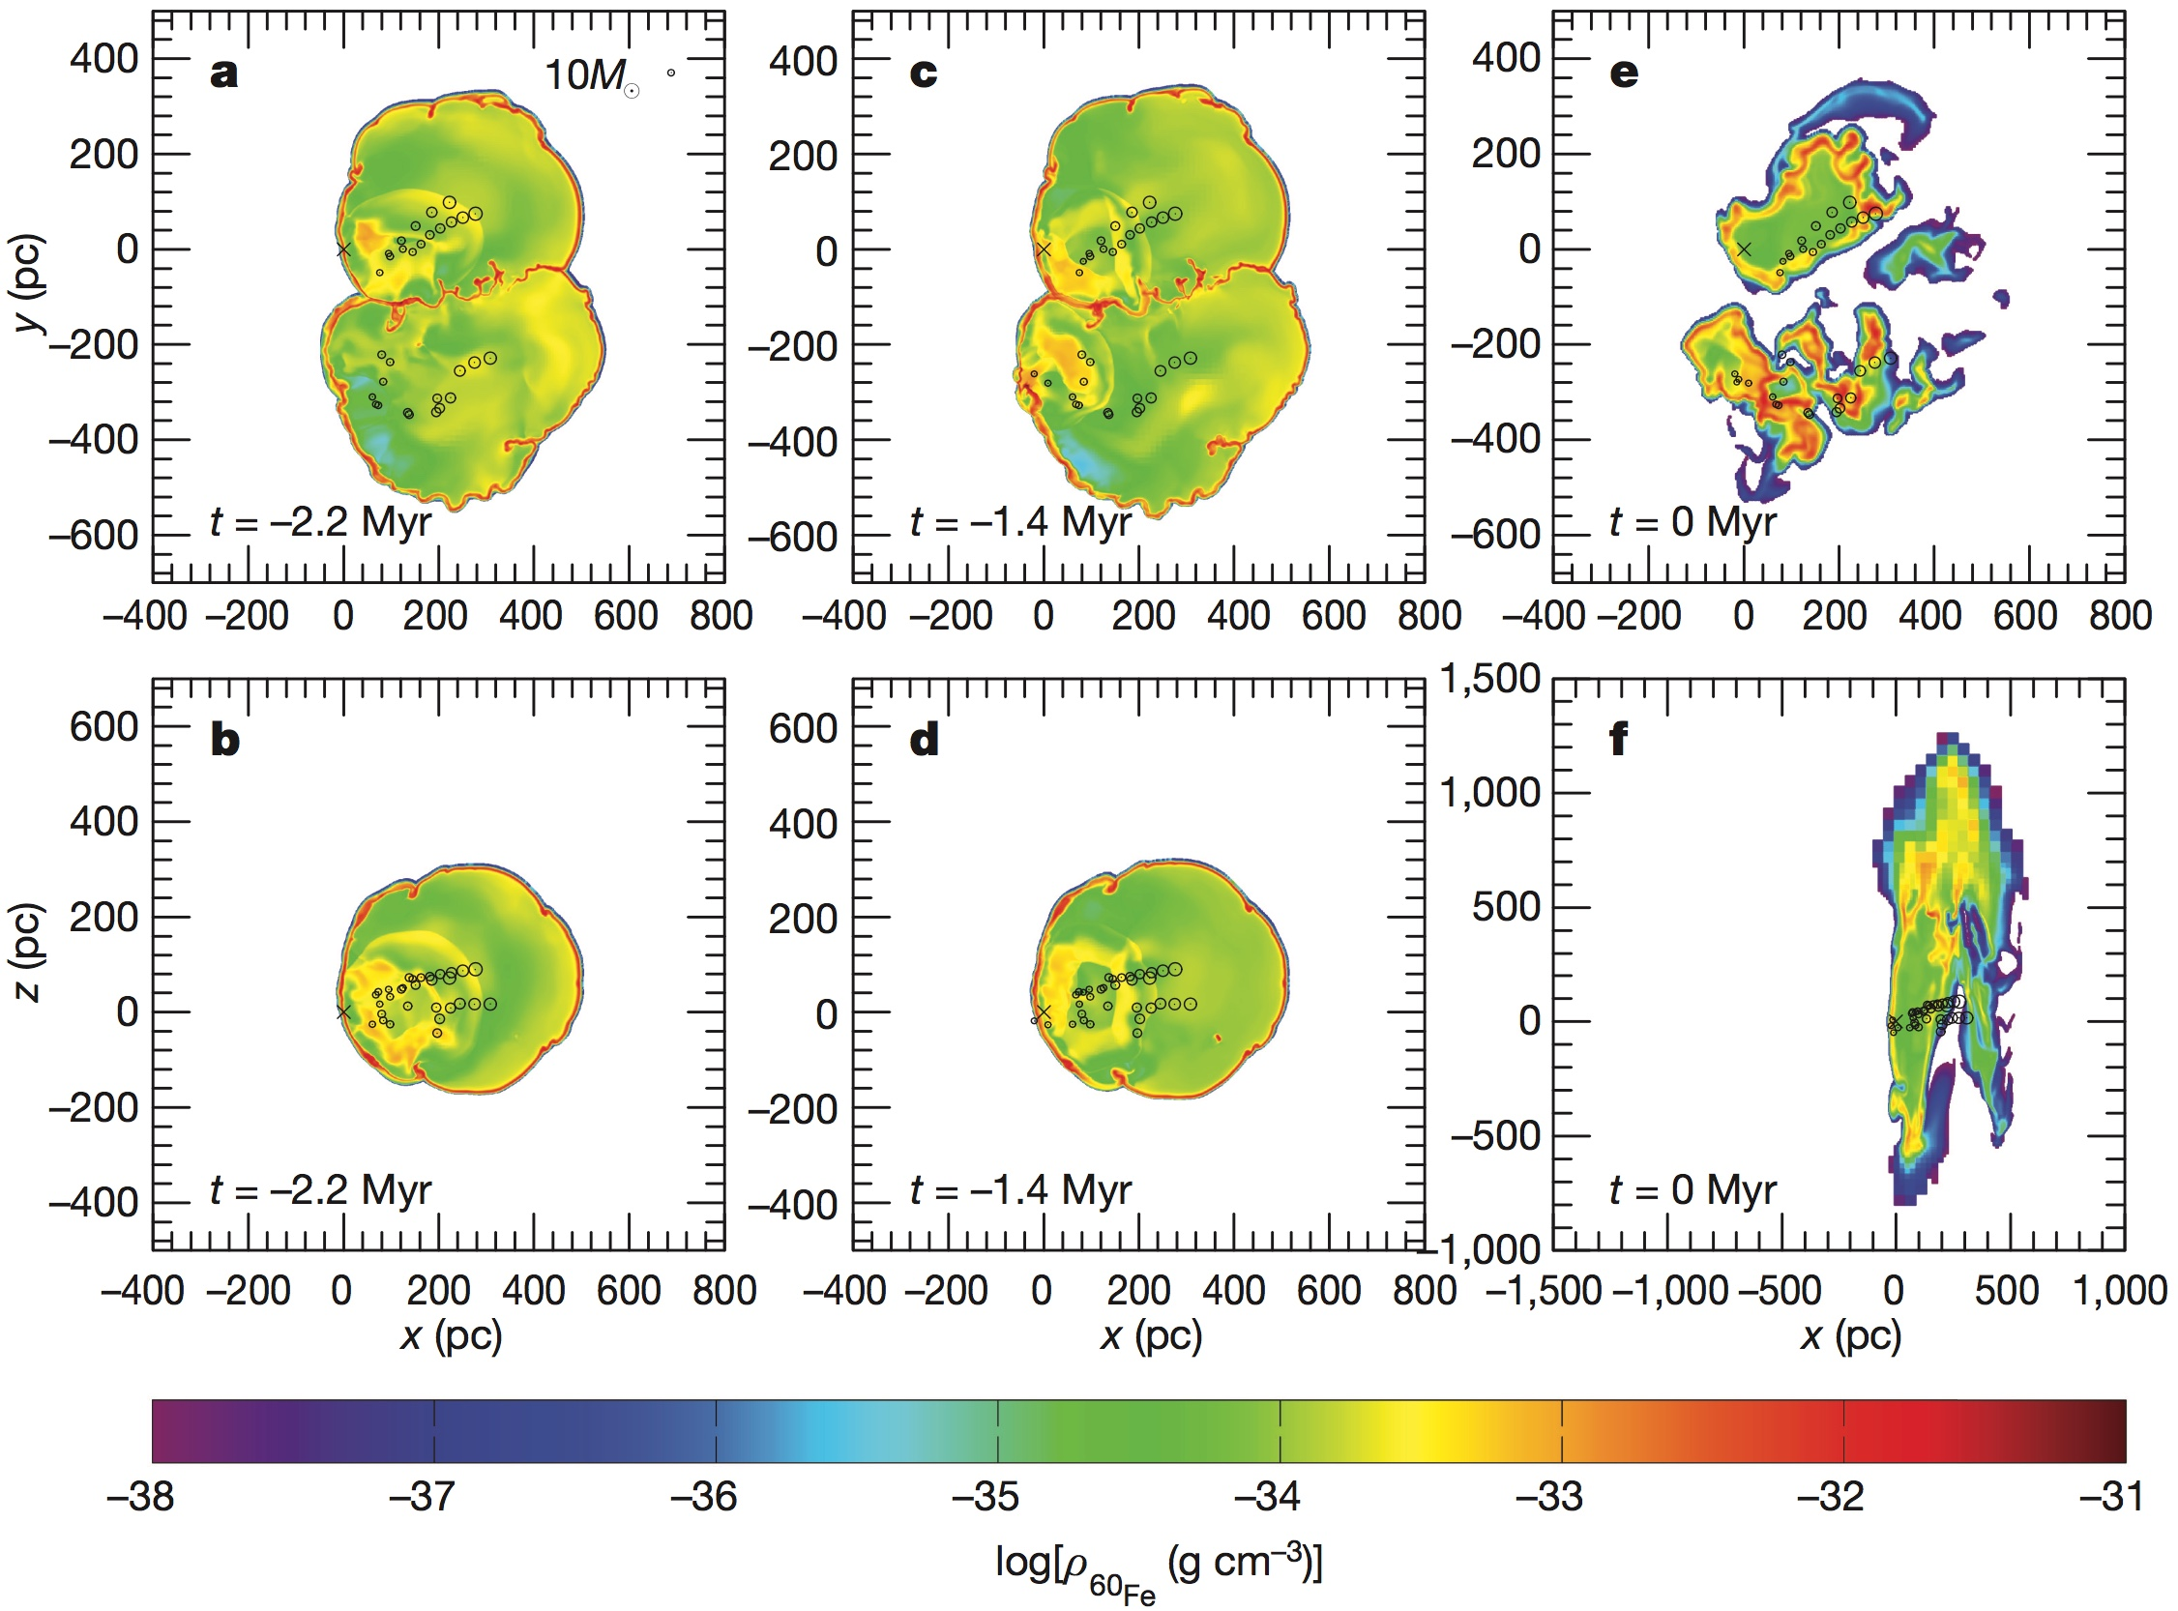
Where Could the ⁶⁰Fe Have Originated?
⁶⁰Fe detected in ocean sediments has been successfully modeled as coming from supernova that that occurred in the local bubble ~100 pc from the Sun ~2.3 Myr ago
these parameters are consistent with the requirement that cosmic-ray ⁶⁰Fe have come from a supernova <1 kpc away that exploded within the last few Myr
Breitschwerdt et al., Nature, 532, 73, 2016

Slide 10
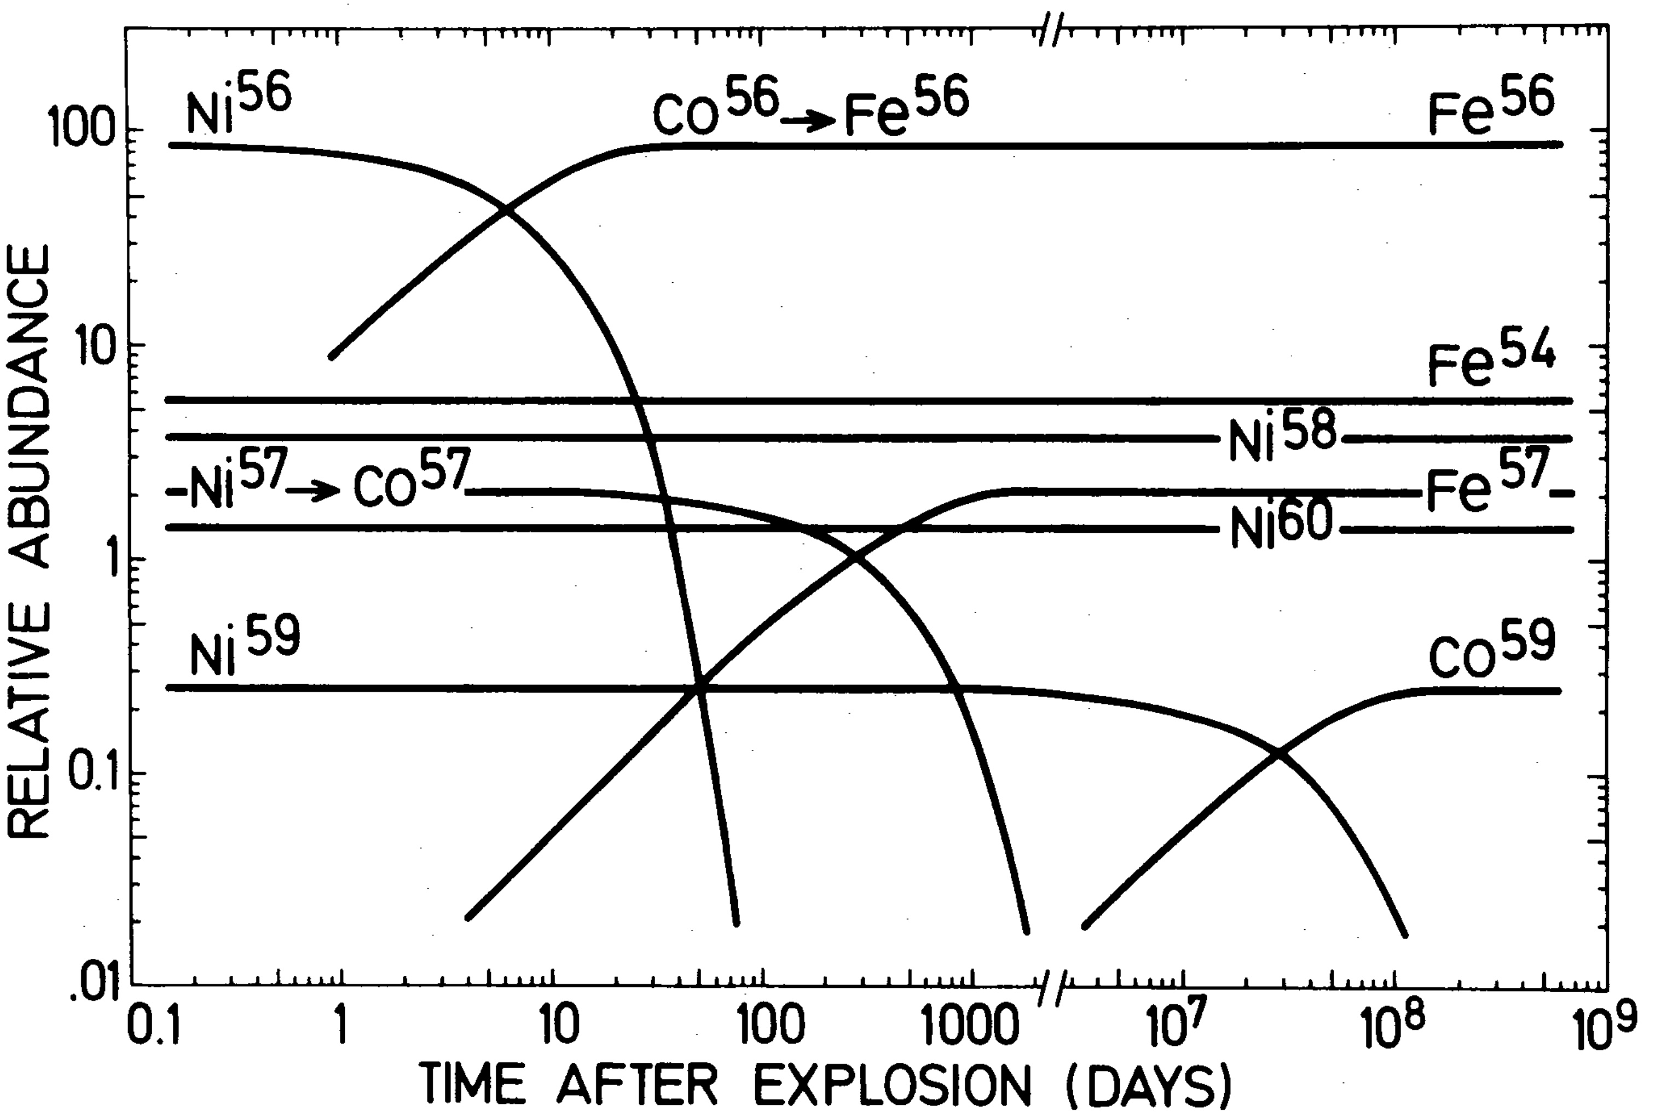
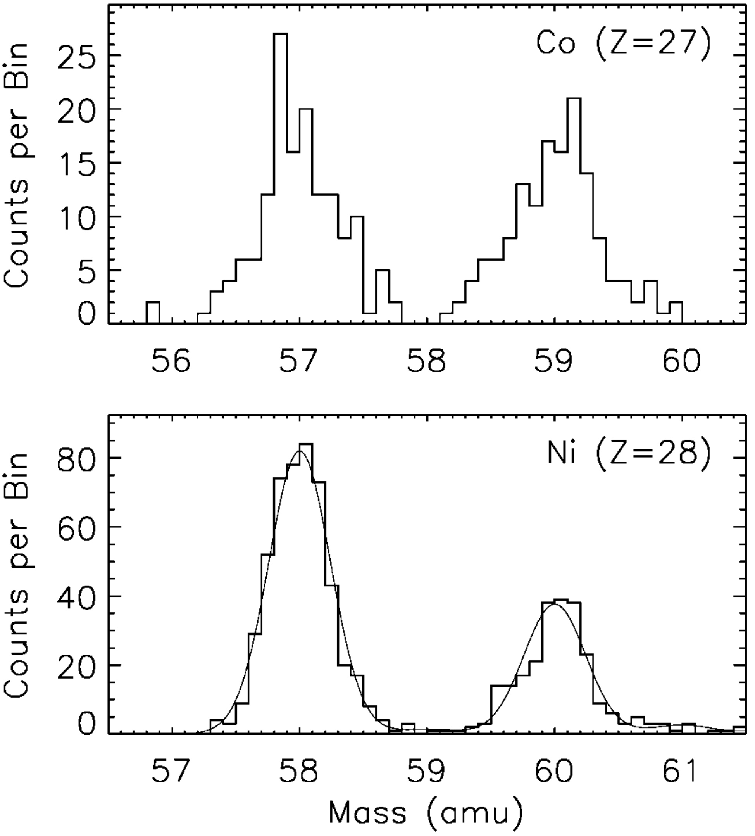
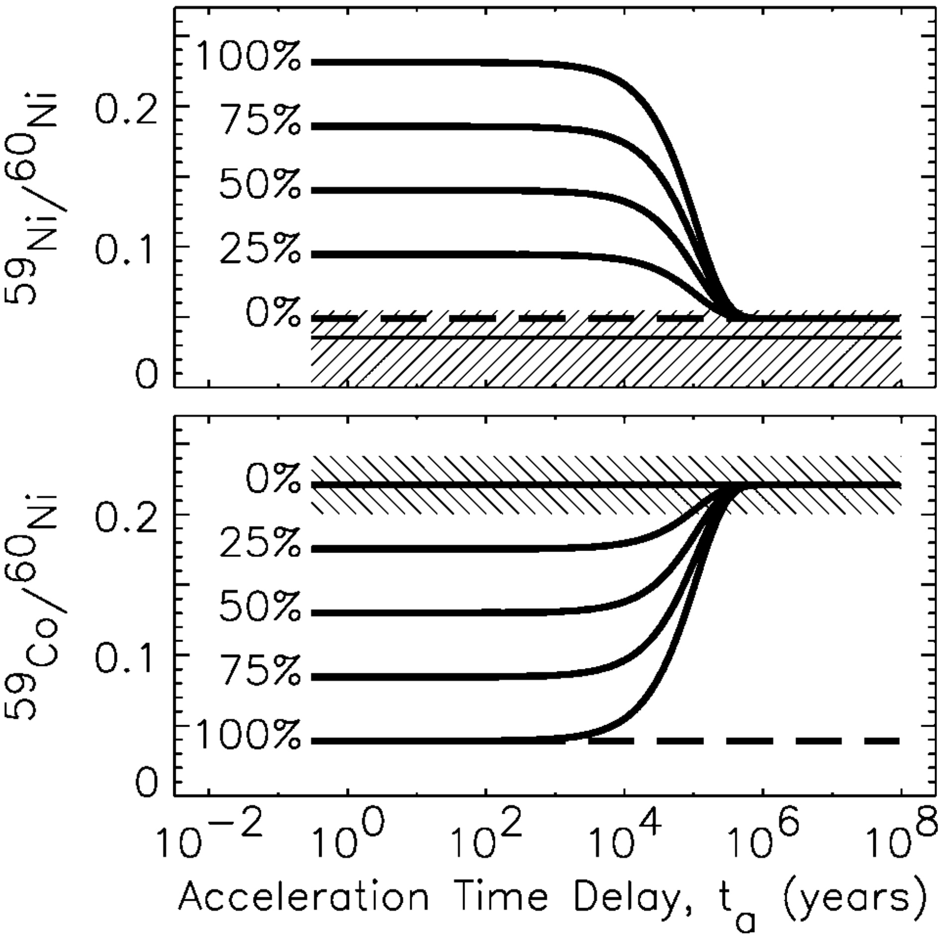
Primary Nuclides that Can Decay Only by Orbital Electron Capture
⁵⁹Ni + e⁻ ⇒ ⁵⁹Co
traversal of IS matter at cosmic-ray energies strips off orbital electrons and prevents further decays of ⁵⁹Ni
Soutoul & Cassé, ApJ (1978)
⁵⁹Co, the daughter product of ⁵⁹Ni decay, is present
⁵⁹Ni missing in arriving cosmic rays
fraction of mass-59 material synthesized as ⁵⁹Ni
CRIS measurements of Ni isotopes did not show evidence of ⁵⁹Ni
increased statistics since 1999 have not changed that situation
Wiedenbeck et al., ApJL (1999)

Slide 11
Interpretation of the Lack of ⁵⁹Ni in the Cosmic Rays
two possibilities:
⁵⁹Ni was present in supernova ejecta but it spent significantly longer than the half-life (76,000 yr) in the interstellar medium with electrons attached before being accelerated
the nucleosynthesis yield of ⁵⁹Ni was so low that the cosmic-ray measurements are not sensitive to the time between nucleosynthesis and acceleration
the early CRIS result (Wiedenbeck et al., ApJL, 1999) was interpreted as evidence for >10⁵ yr time delay between nucleosynthesis and acceleration (“possibility a”), based on nucleosynthesis yield calculations current at that time (Woosley & Weaver, ApJS, 1995)
recently, Neronov & Meynet (A&A 2016) pointed out that the more-recent supernova nucleosynthesis calculations of Chieffi & Limongi (ApJ, 2013) found much lower yields of ⁵⁹Ni, supporting “possibility b”
the question of whether the lack of ⁵⁹Ni is attributable to a long time delay between nucleosynthesis and acceleration remains open
resolving this question is important—a long time delay excludes the possibility that a supernova’s nucleosynthesis products could be accelerated by a shock driven by the same supernova
the resolution depends on conclusively establishing how much ⁵⁹Ni is synthesized and ejected by supernovae

Slide 12
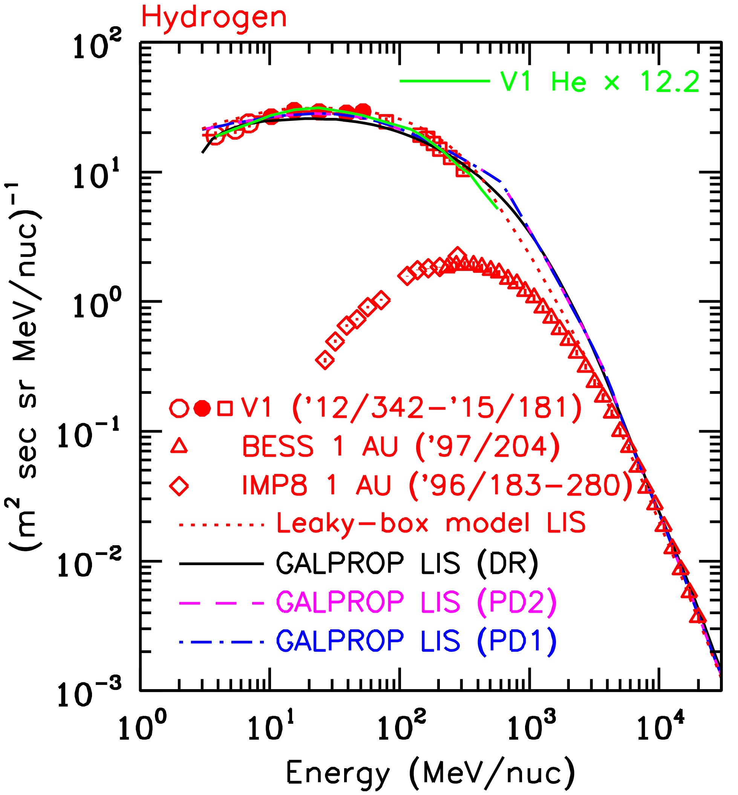
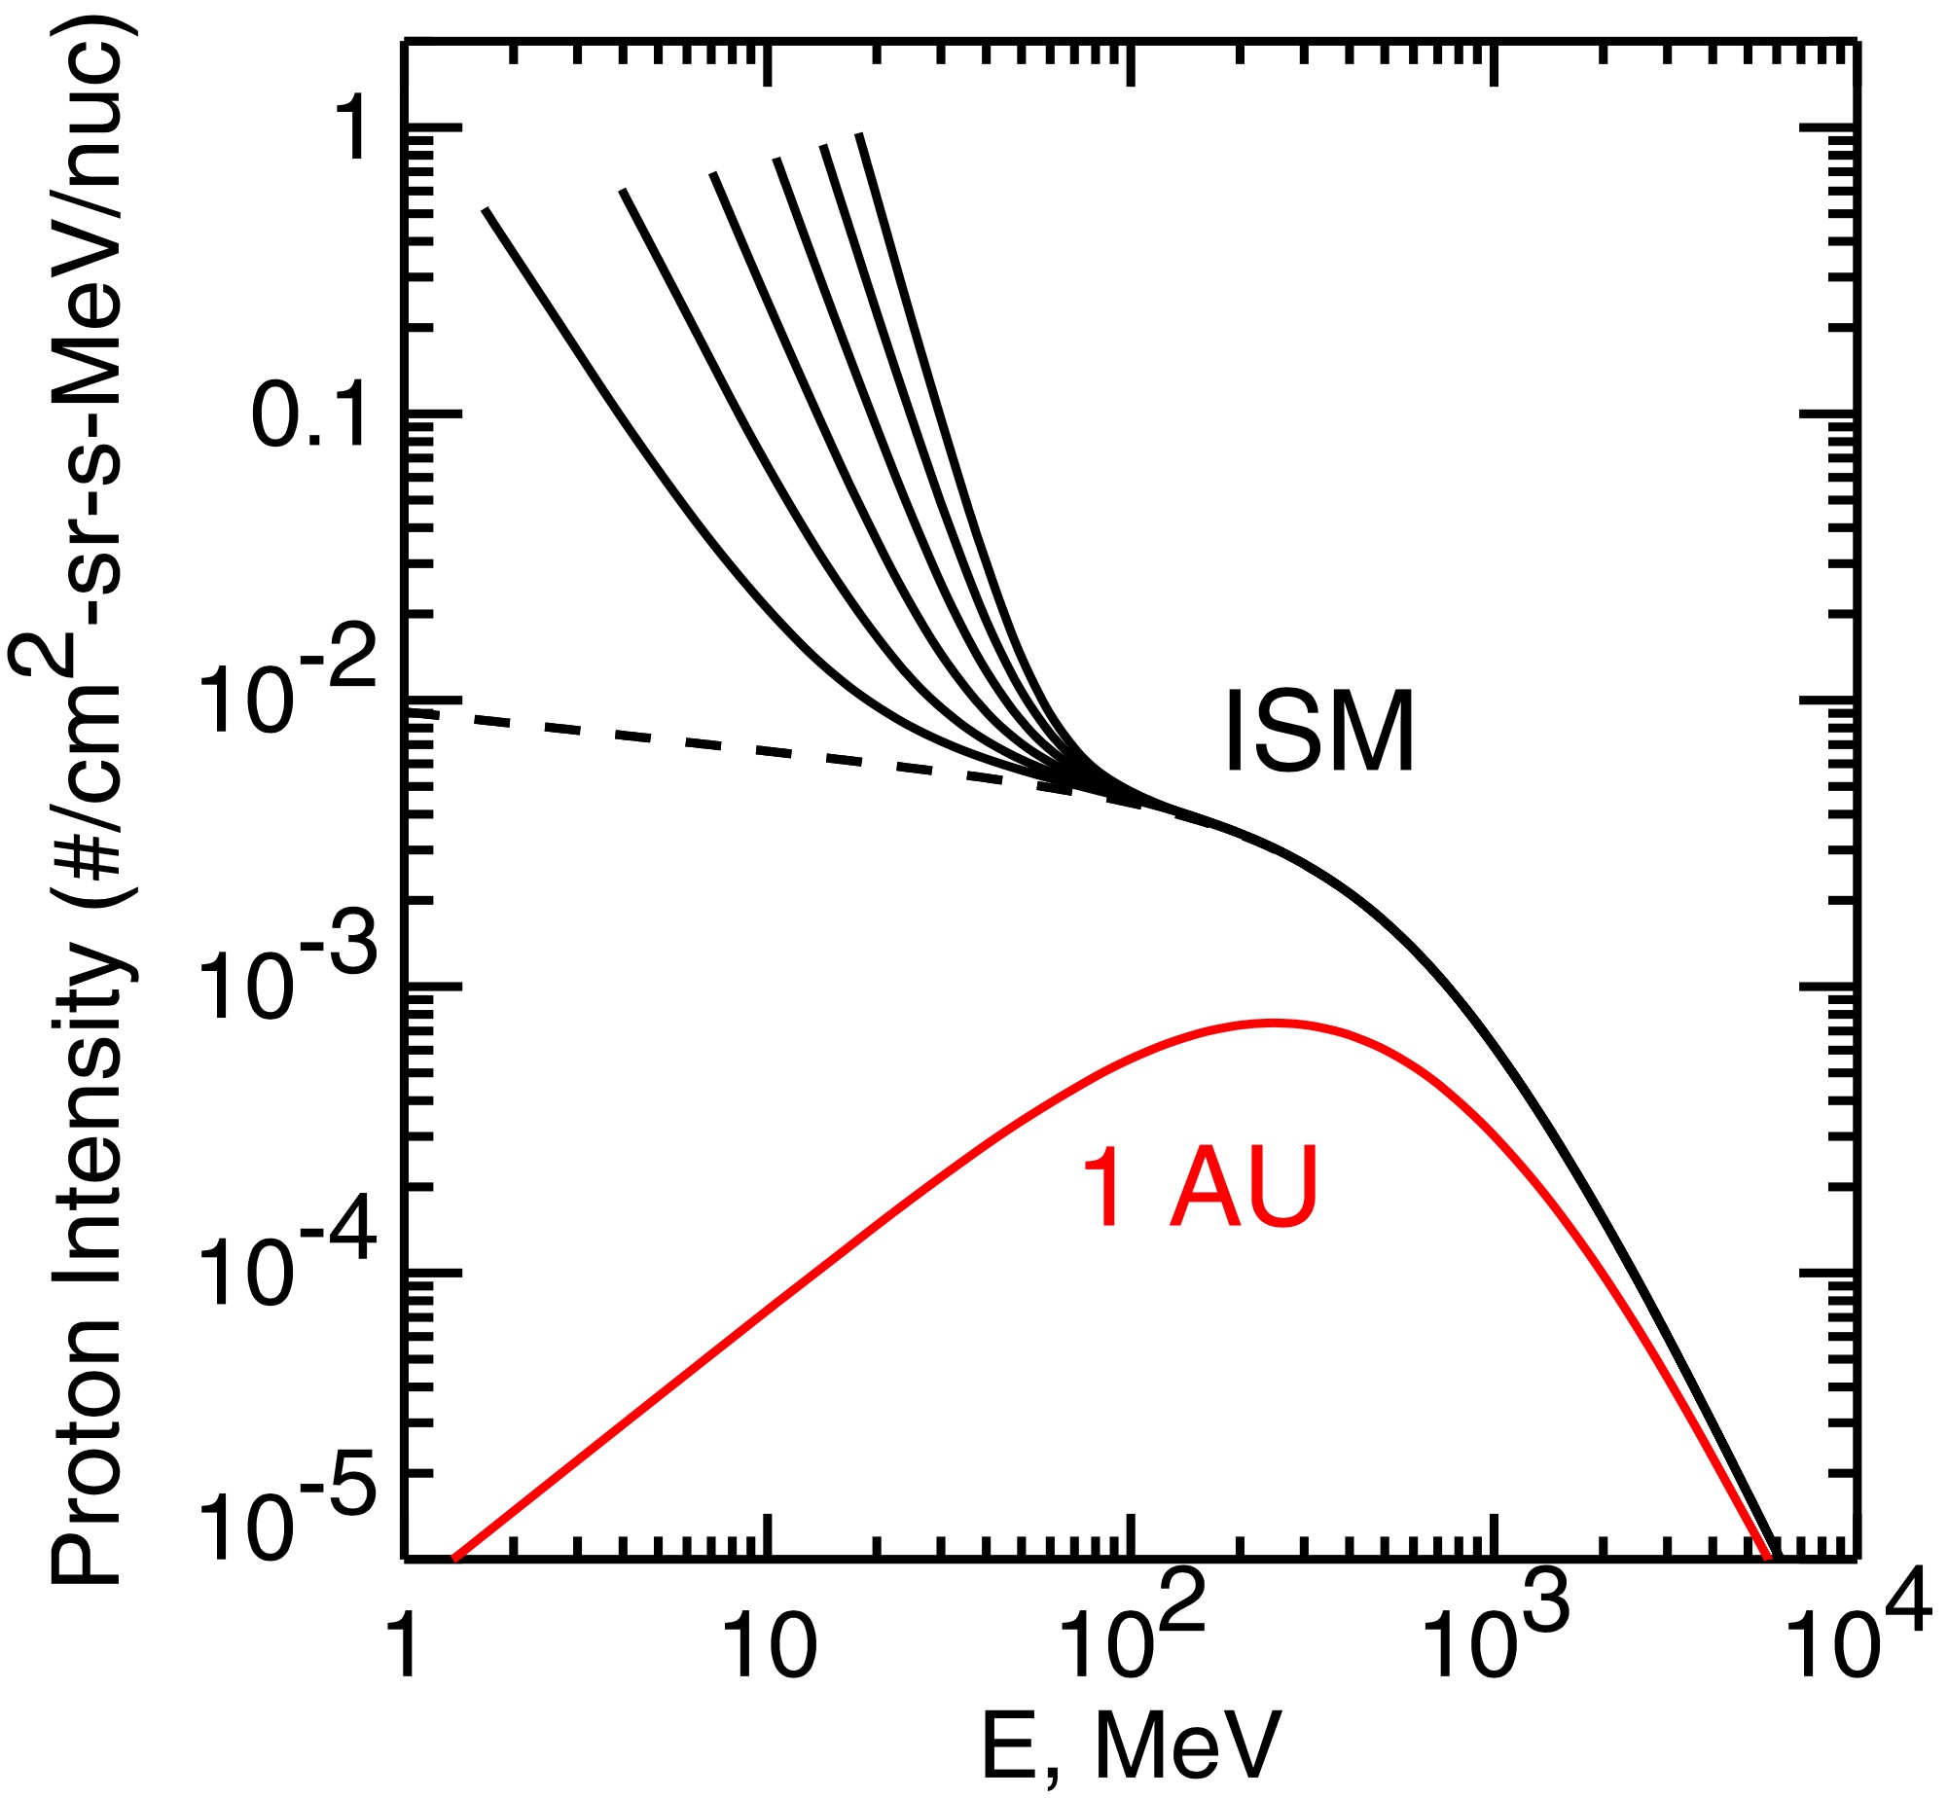
Cosmic Ray Intensity in the Very Local Interstellar Medium (VLISM)
solar modulation prevents cosmic rays below a few 100 MeV/nuc from penetrating to the inner heliosphere
spectra measured near Earth would allow high intensities below 100 MeV/nuc in the VLISM
direct measurements by Voyager 1 now rule out such extreme low-energy increases
provides constraints on contribution of GCRs to heating and ionizing the ISM (see Cummings et al. 2016)
ISM
1 AU
Wiedenbeck, SSR 176, 35, 2013
Cummings et al., ApJ 831,18, 2016

Slide 13
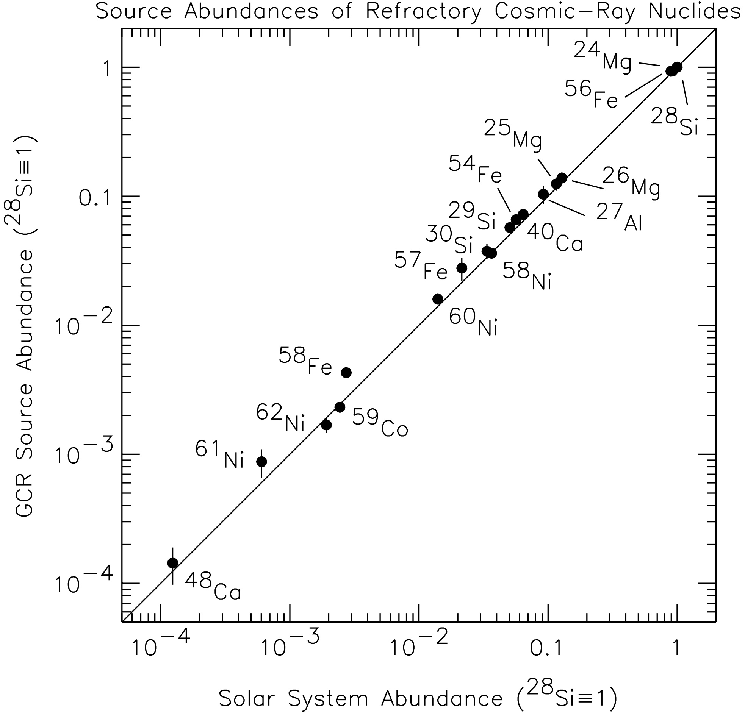
Source Composition of Refractory Cosmic-Ray Nuclides
within a factor ≲2, all refractory nuclides that have been studied with ACE/CRIS have been found to have solar-like relative abundances
no signature of a particular type of supernova source found—GCR source looks like a mix of many contributions, just like most ISM material
Wiedenbeck et al., Proc. 28th ICRC (Tsukuba), 4, 1899, 2003
see also Wiedenbeck et al., Space Sci. Rev., 99, 15, 2001

Slide 14
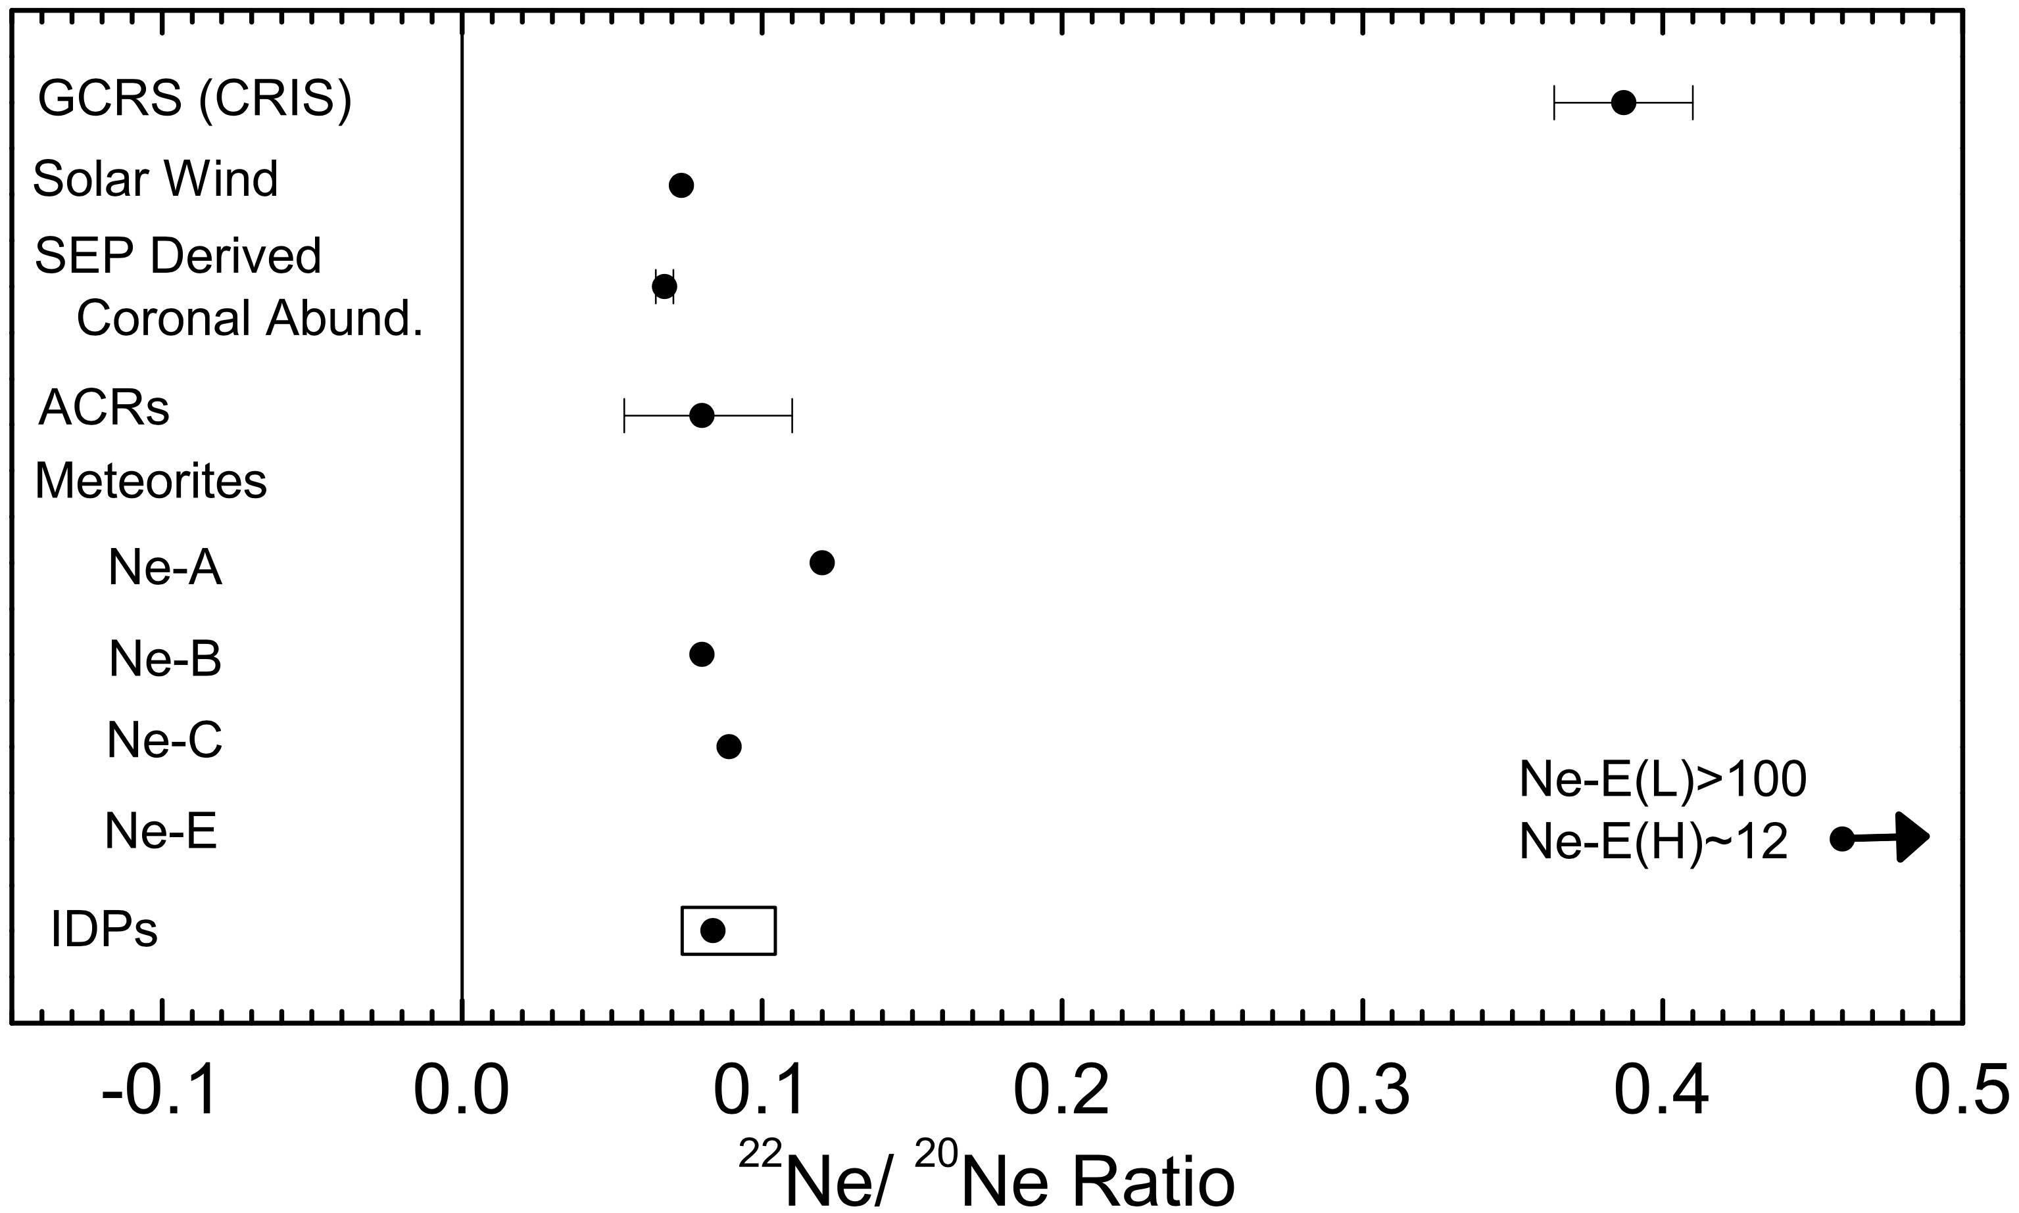
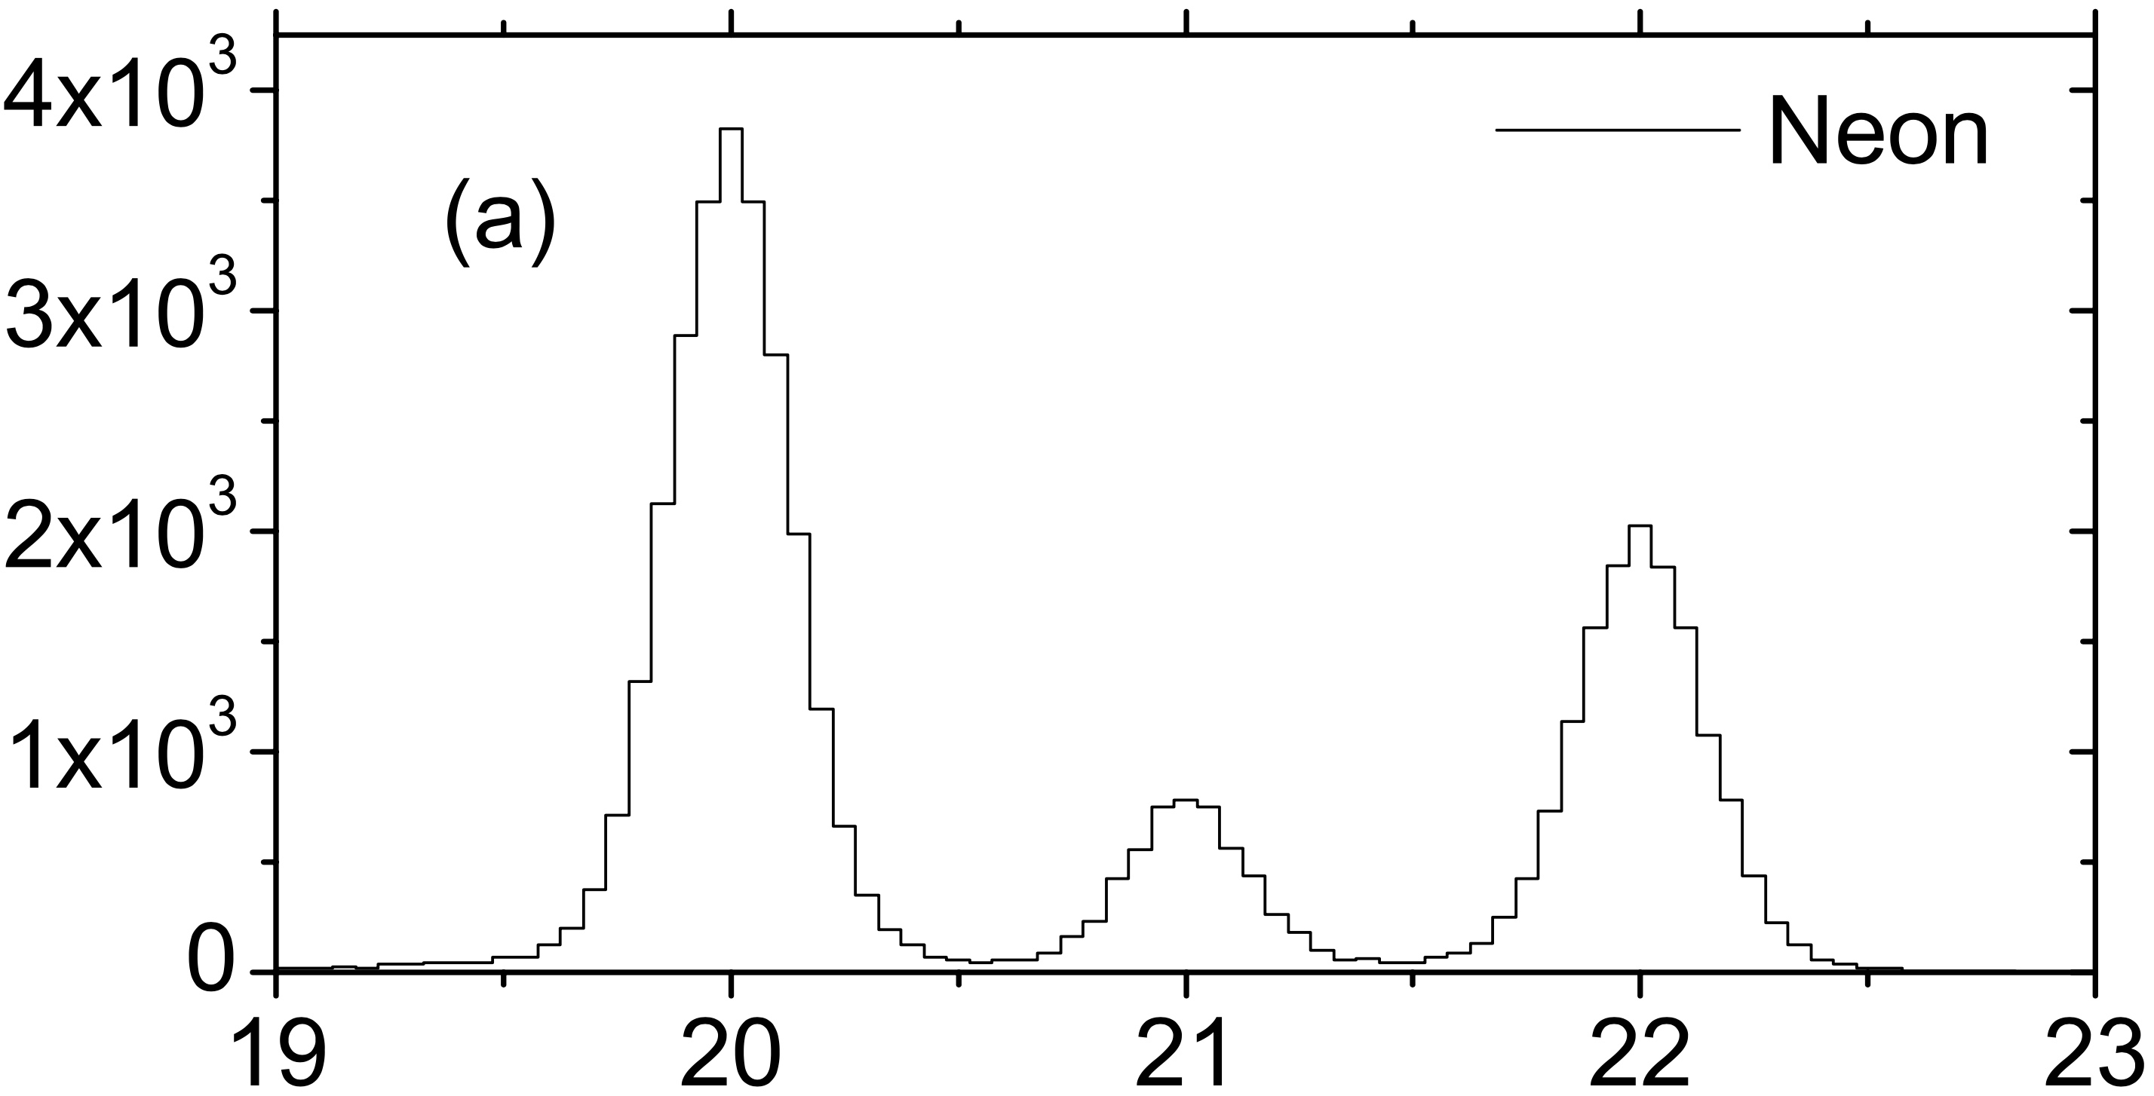
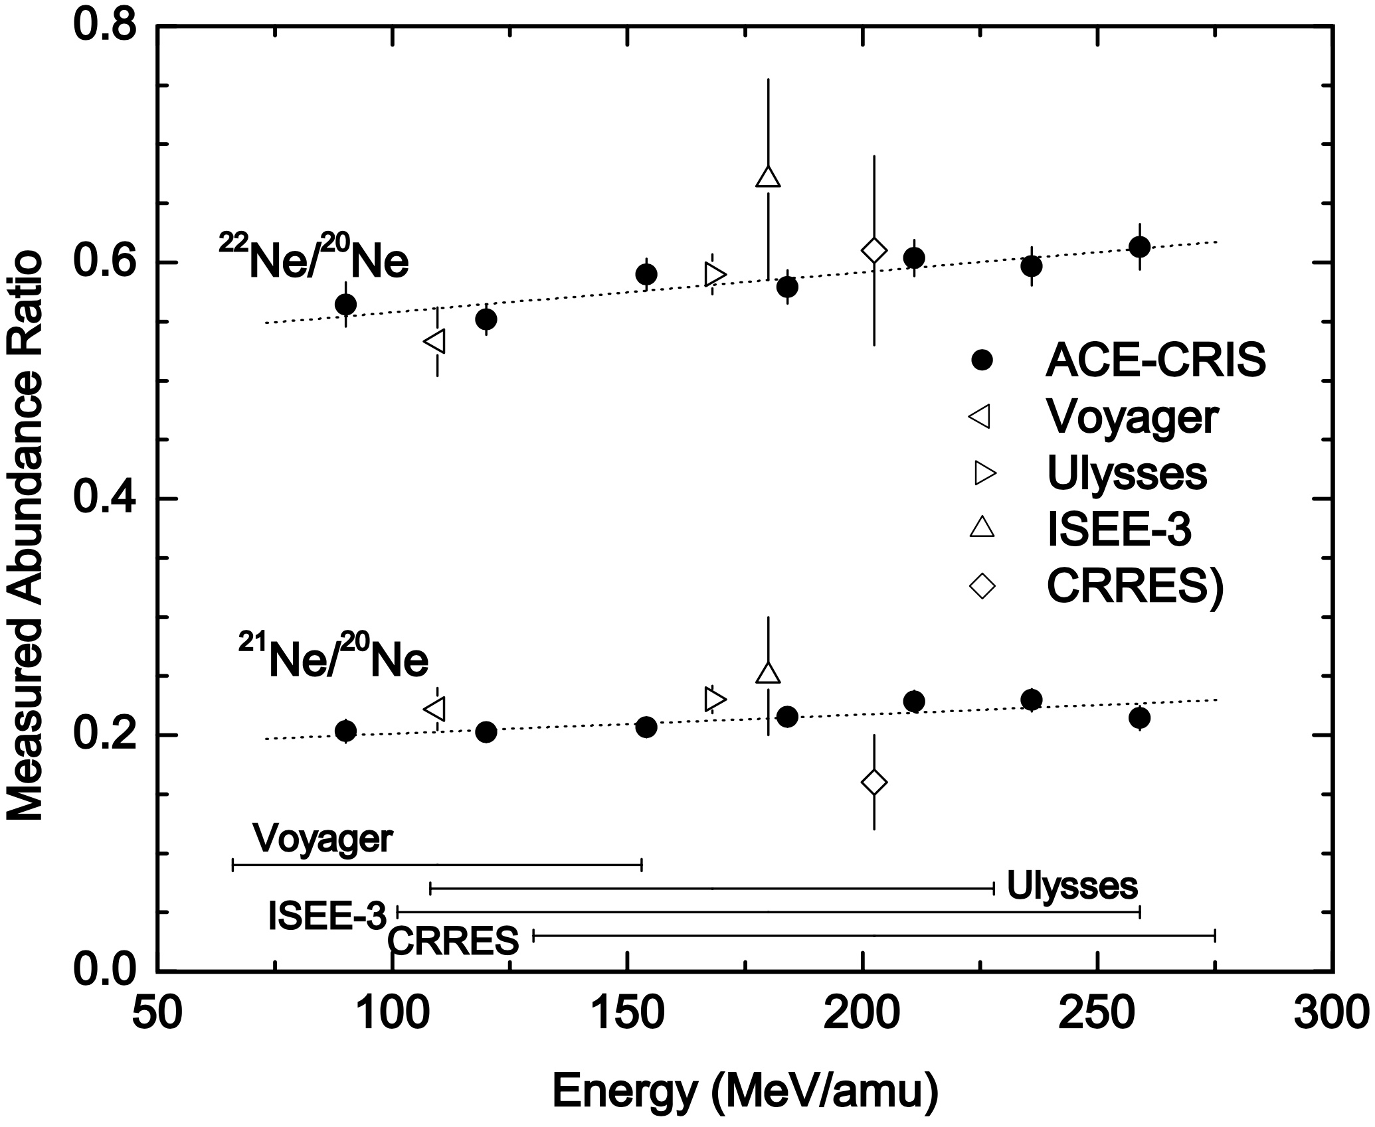
²²Ne/²⁰Ne – the Only GCR Source Isotope Ratio Thus Far Found to Differ Significantly from Solar
ACE / CRIS
Ne Isotopes
Counts per Bin
Calculated Mass (amu)
Cassé & Paul (1982) noted that Wolf-Rayet stars are a likely source for the cosmic-ray ²²Ne bacause:
they have high mass-loss rates via fast stellar winds
those winds have blown away the hydrogen shell leaving a surface rich in He-burning products
He burning produces large enhancements of ²²Ne because when H is burned to He by the CNO process, residual heavy elements get burned to ¹⁴N, which then captures alpha particles and produces ²²Ne
Binns et al., ApJ, 634, 351, 2005

Slide 15
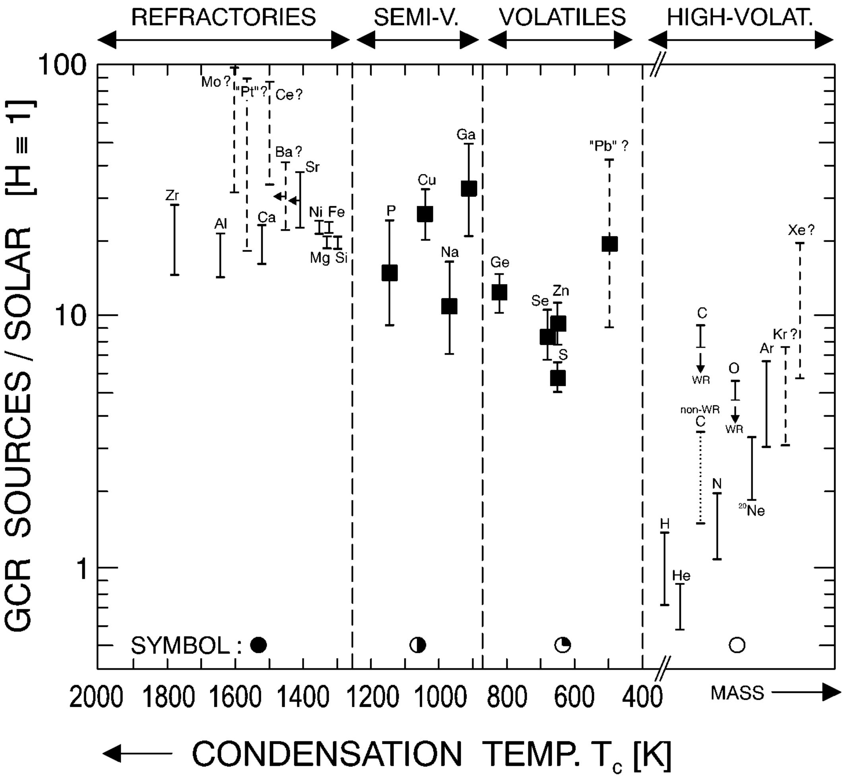
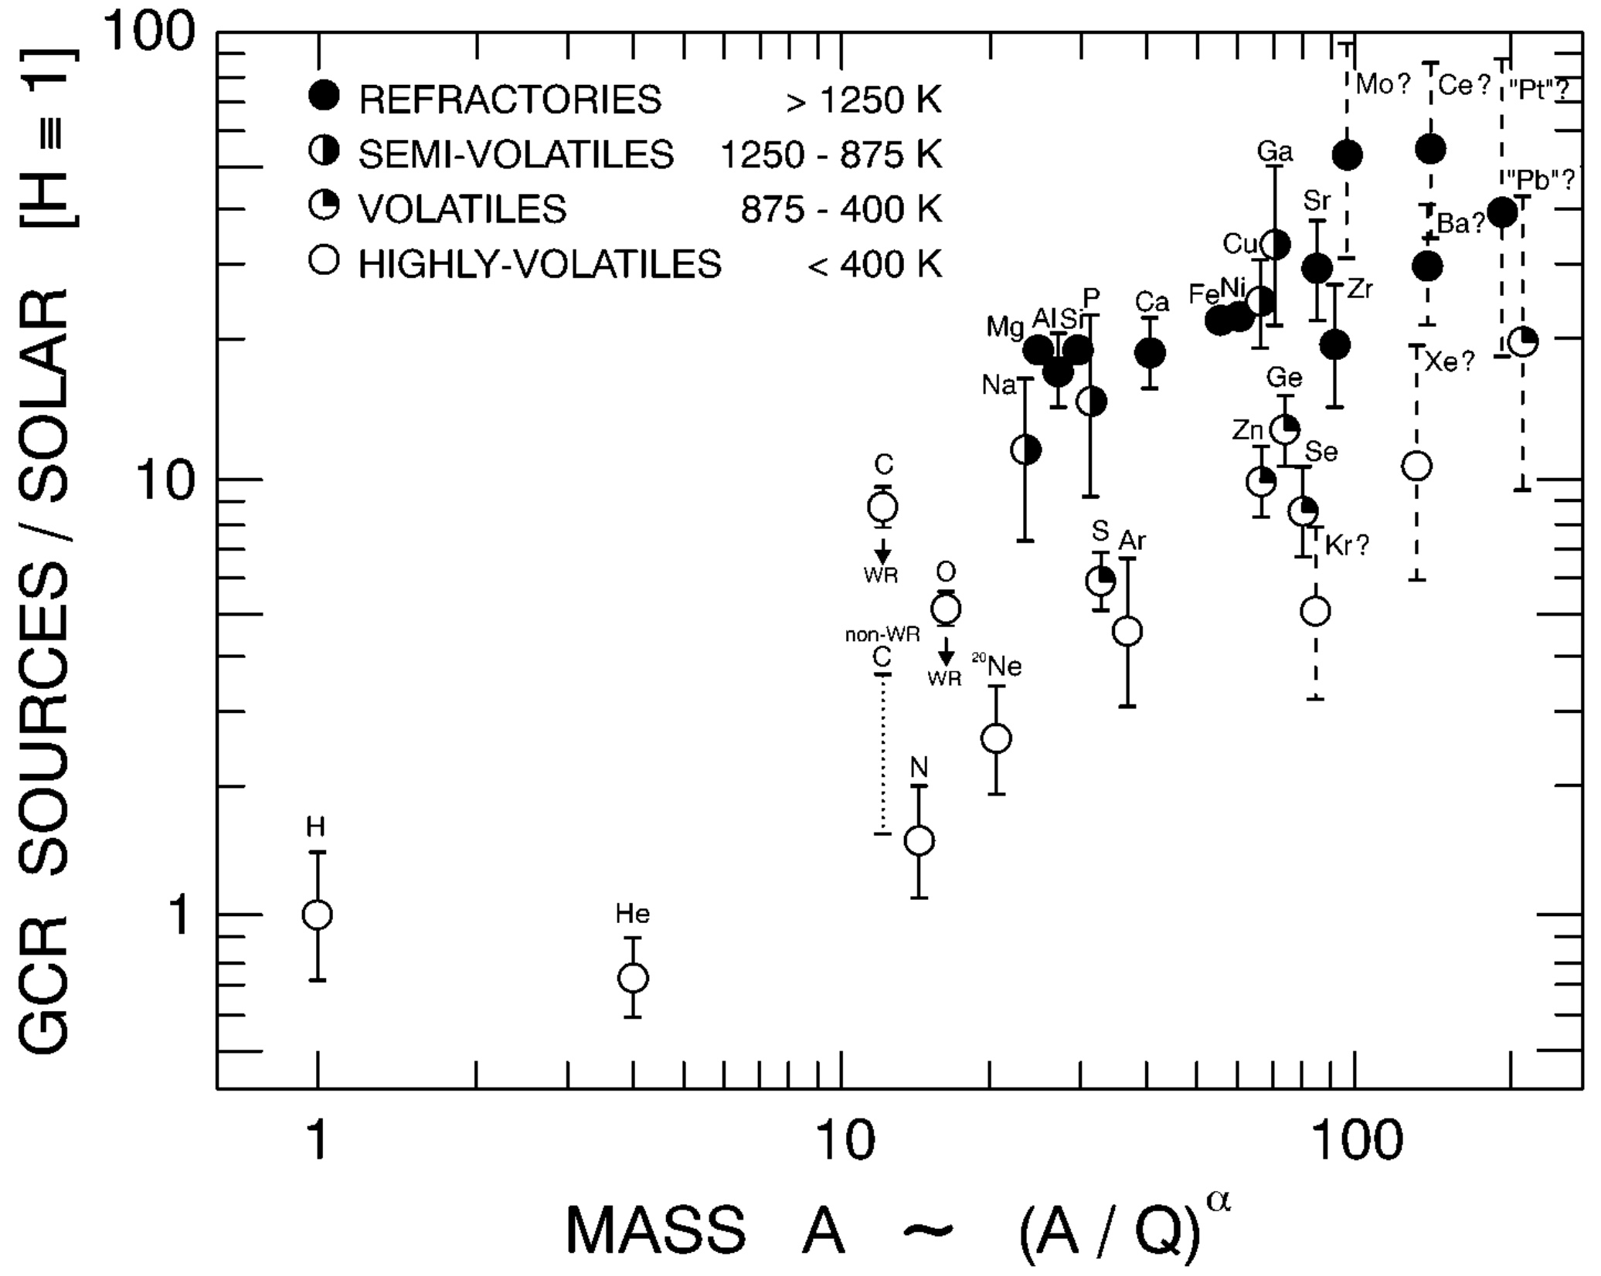
Fractionation Based on Volatility and Mass
ratios of GCR source abundances relative to solar values are a factor ~4 greater for refractory (low FIP) elements than for volatiles (high FIP)
Ellison, Drury & Meyer (1997) proposed that patter is due to acceleration of refractory grains by IS shocks followed by sputtering of suprathermal ions from fast grains in collisions with IS gas
process results in suprathermal ions that can be efficiently accelerated by subsequent shocks
density of O and B stars in the solar neighborhood (artist’s impression)
Meyer, Drury & Ellison, ApJ, 487, 182 1007

Slide 16
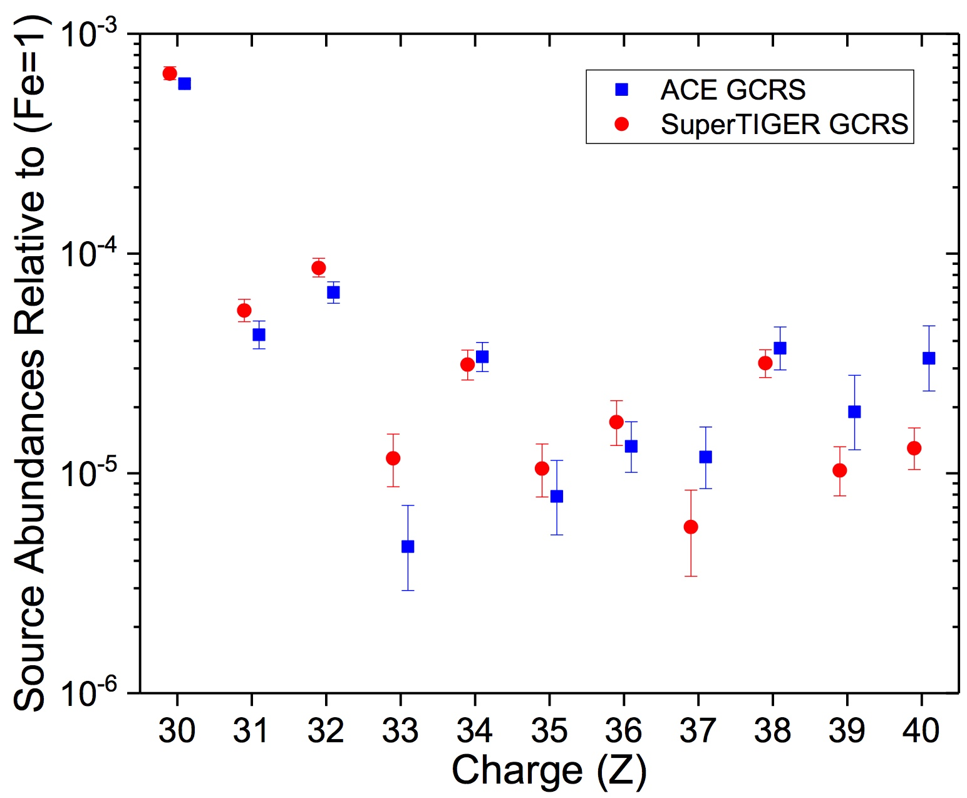
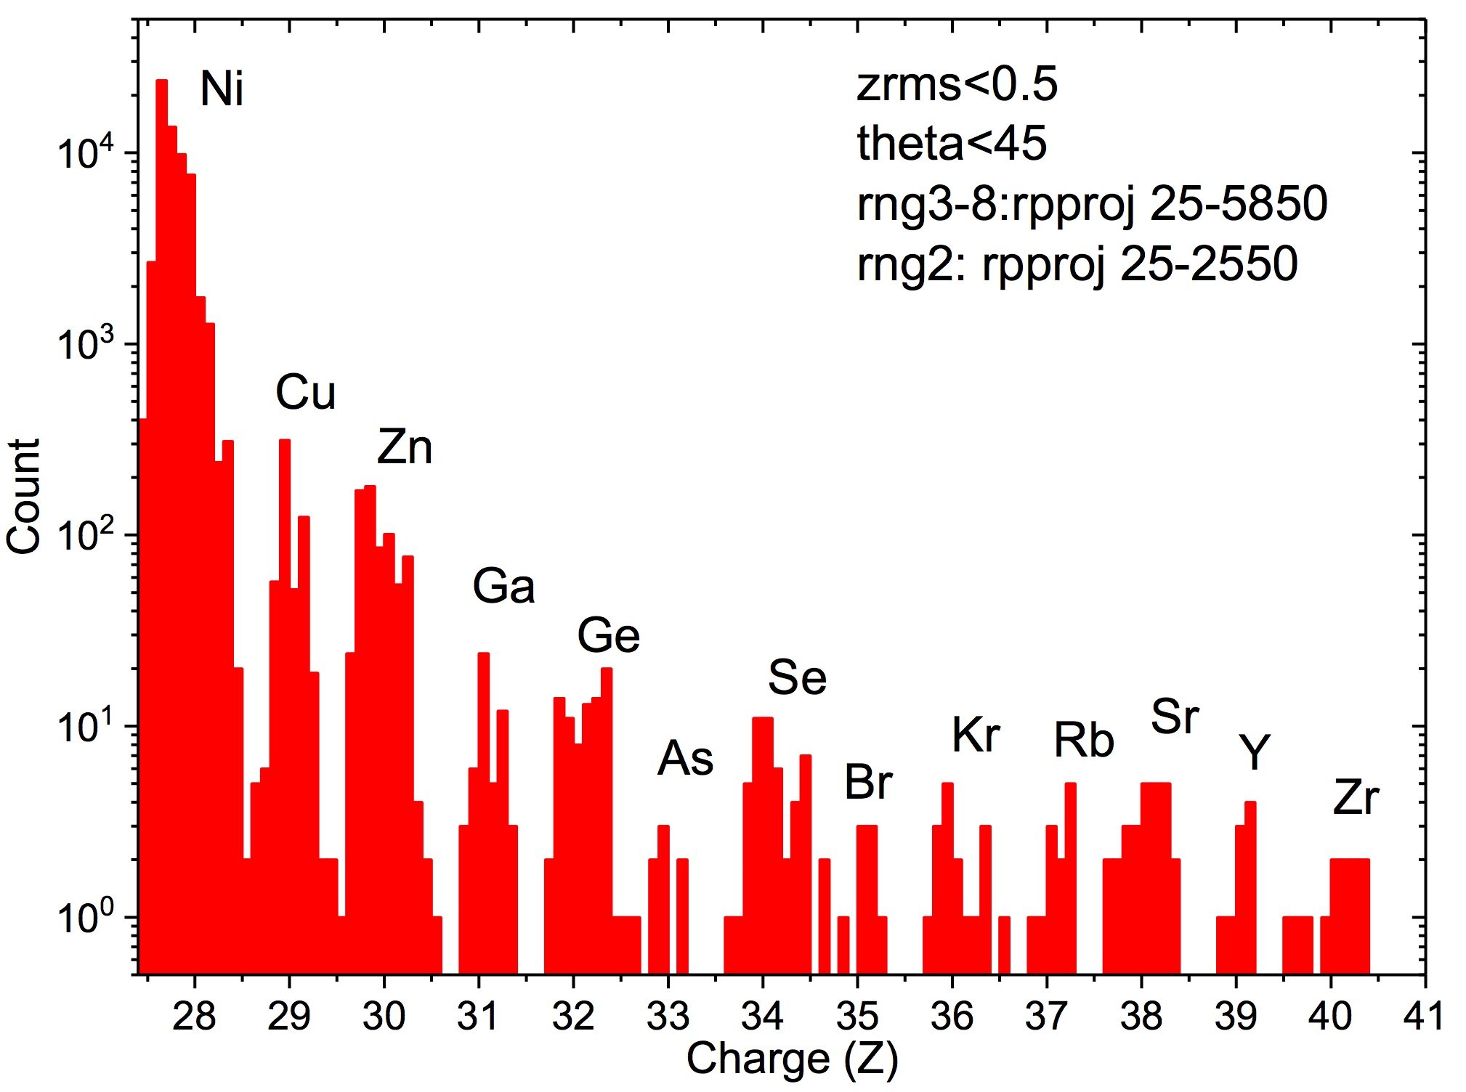
Relative Abundances of Ultraheavy Elements
elemental composition has now been extended up through ₄₀Zr by the TIGER and SuperTIGER balloon experiments (Rauch et al. 2009; Murphy et al. 2016) and by the ACE/CRIS satellite experiment
ACE / CRIS
Binns et al., Proc. 35th ICRC (Busan), paper CRD070 (presented by R. Mewaldt); see also Wiedenbeck ACE/CRIS Highlight Paper

Slide 17
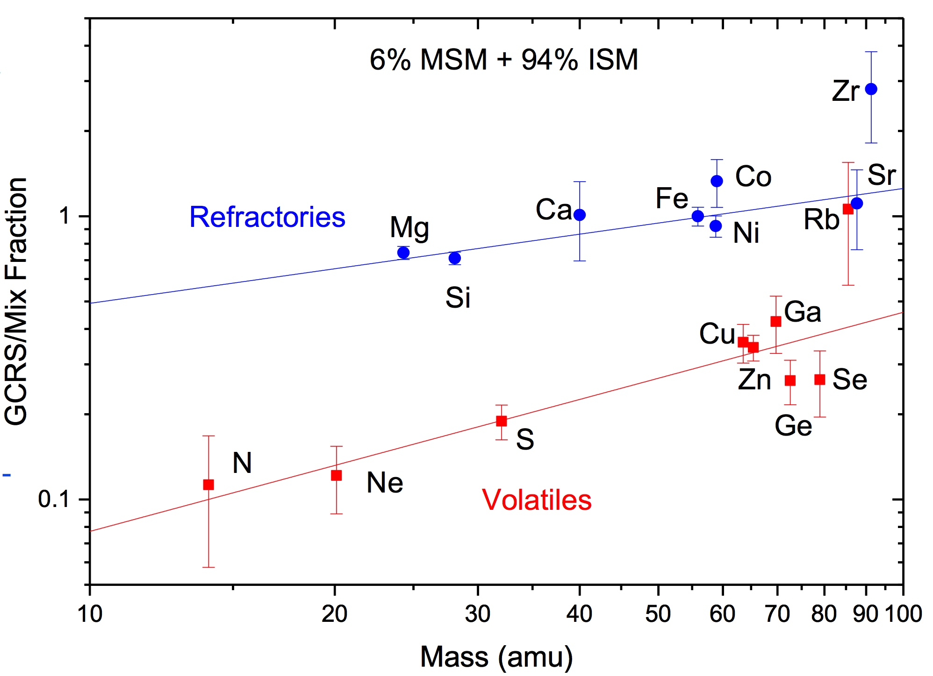
Fractionation Pattern
refractory elements are enhanced in GCRS relative to volatiles, which is believed to be due to efficient acceleration of dust grains (Ellison et al., ApJ, 1997)
Rauch et al. (2008) noted that fractionation is well organized as a function of mass, but only if it is assumed that the source material contains a small admixture of freshly synthesized and ejected “massive star material” (MSM) ⇒ taken as evidence for cosmic-ray acceleration in massive-star associations
ACE / CRIS
data
Binns et al., Proc. 35th ICRC (Busan), paper CRD070 (presented by R. Mewaldt); see also Wiedenbeck ACE/CRIS Highlight Paper

Slide 18
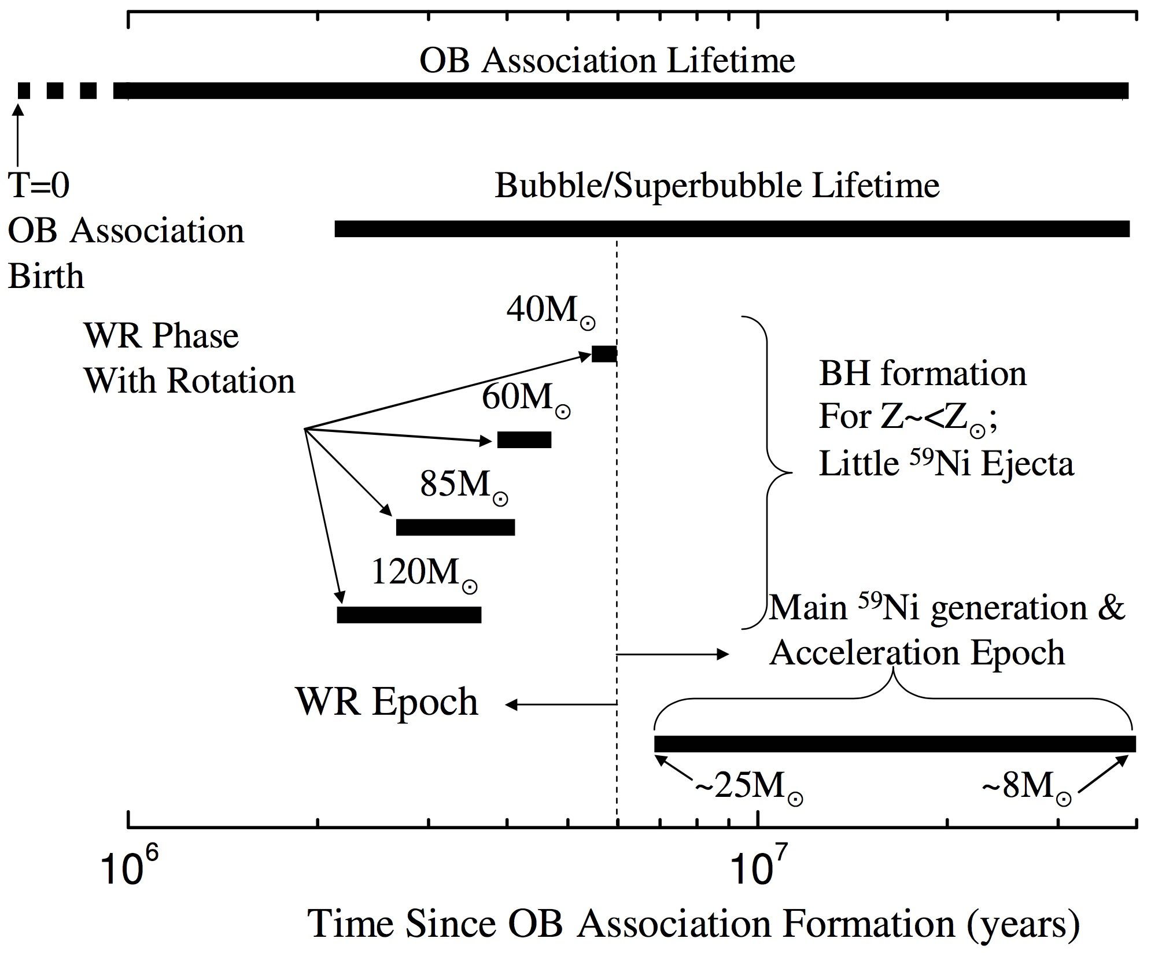
A Possible Scenario for Cosmic-Ray Acceleration in a Superbubble
Binns et al., Space Sci. Rev., 130, 439, 2007

Slide 19
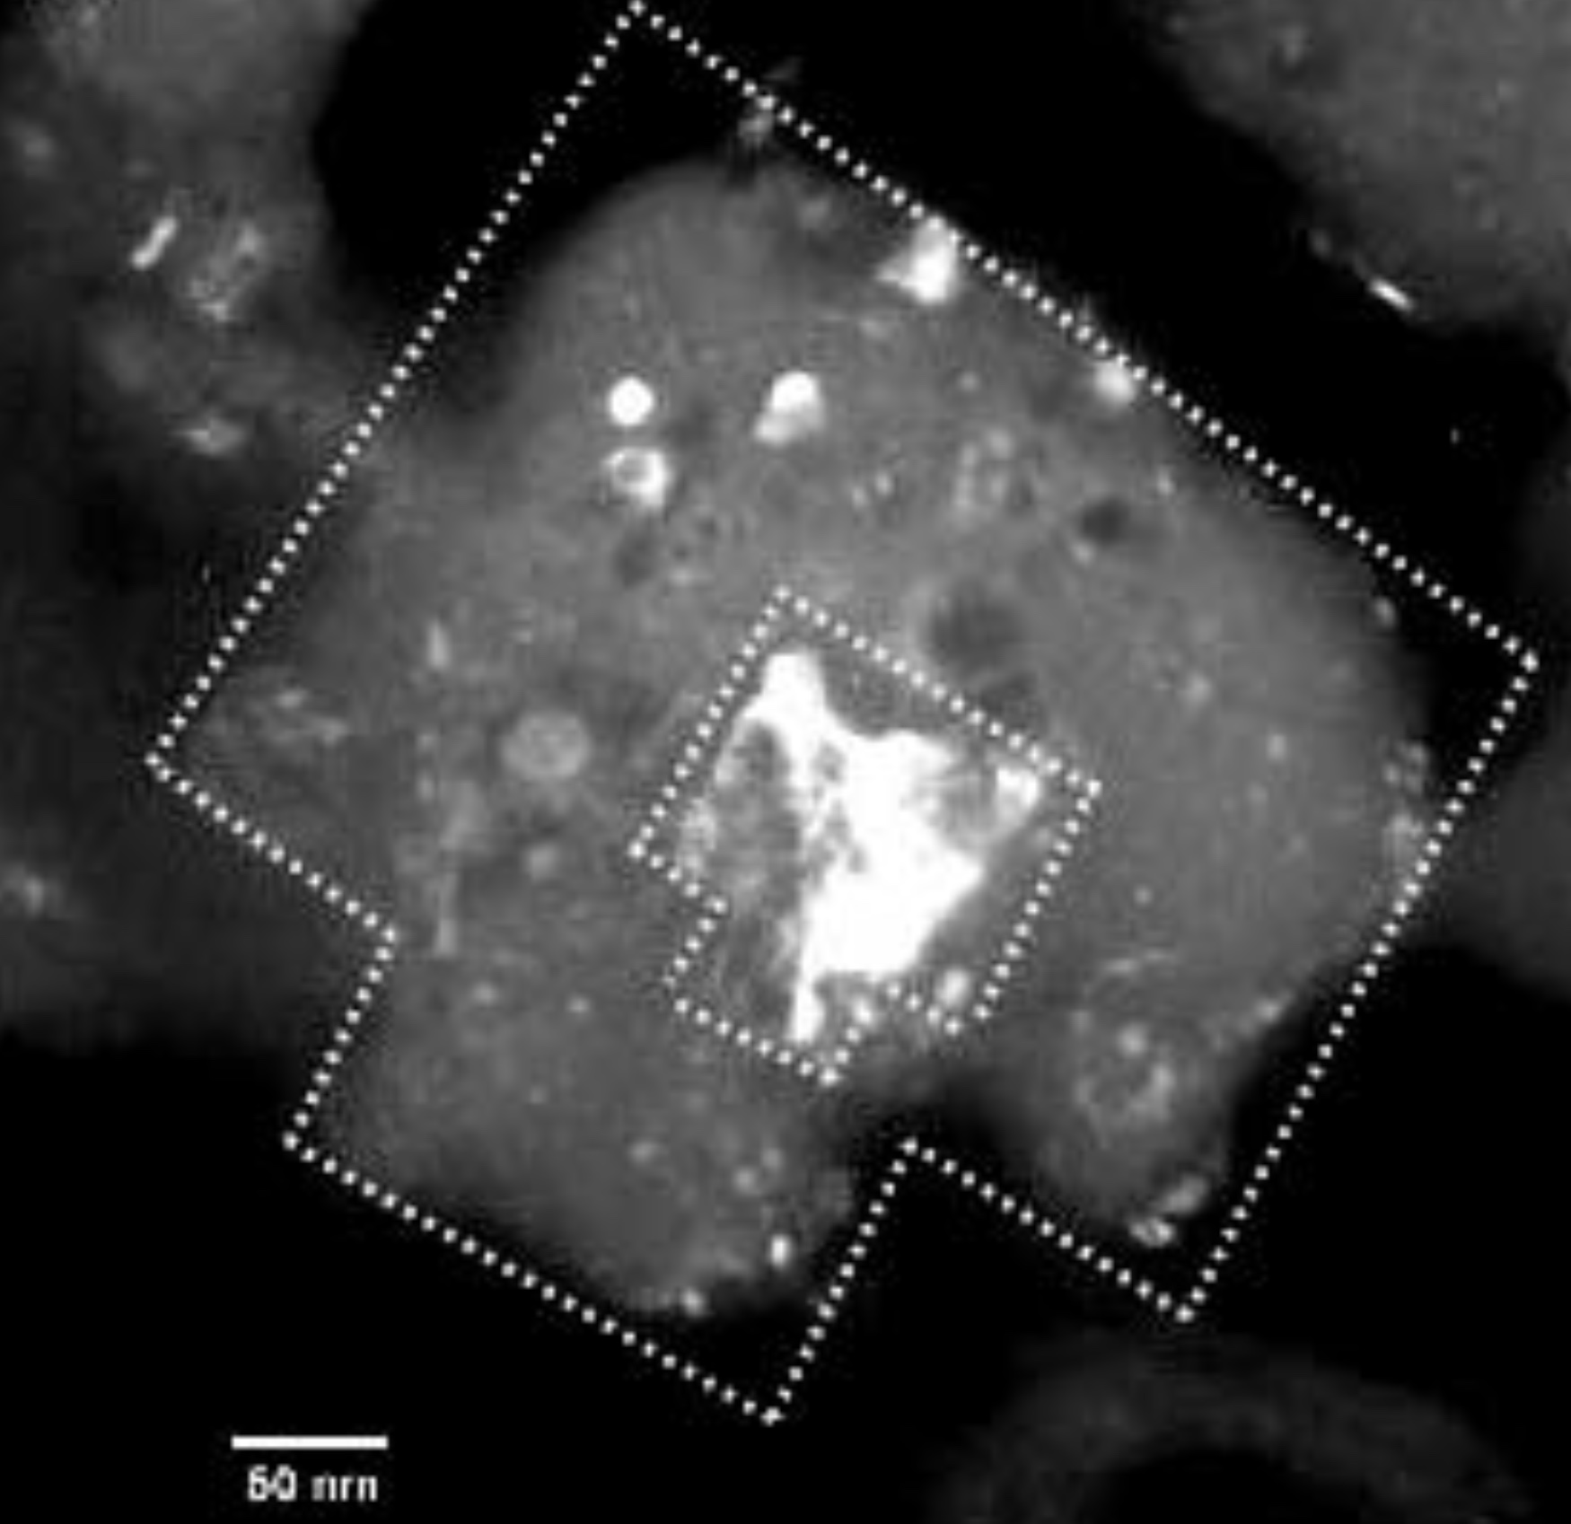
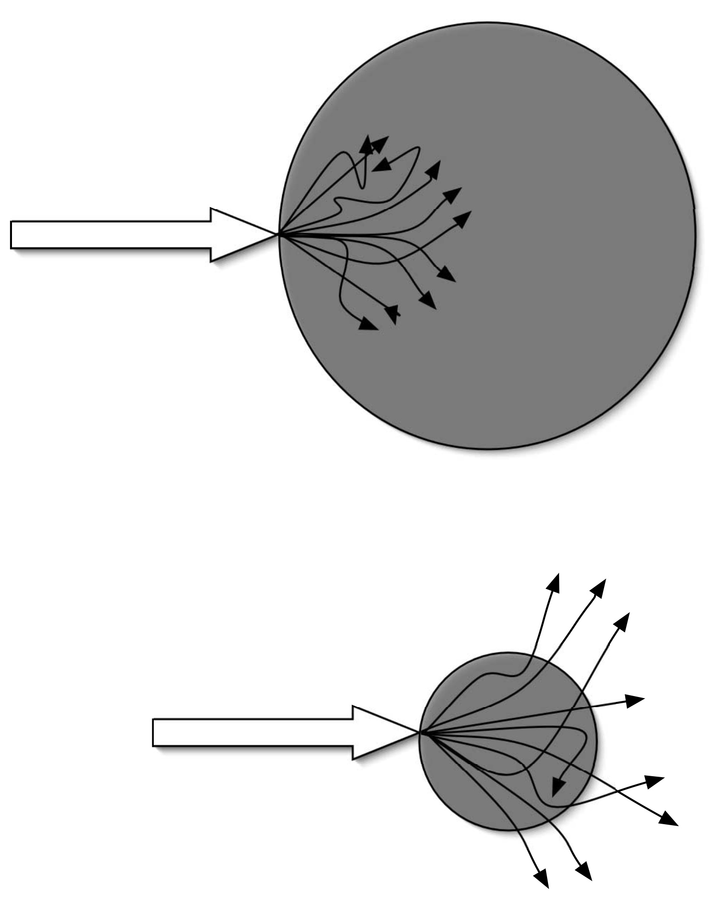
Possible Additional Evidence for Acceleration of Interstellar Dust
some interplanetary dust particles contain submicron size glass particles with embedded metal and sulfides (GEMS):
crystalline center
surrounded by glassy envelope
structure interpreted as due to exposure to ionizing radiation
Westphal & Bradley suggested grains are accelerated in IS shocks, similar to high-rigidity ions
passage through IS gas results in heavy bombardment with low-energy protons
irradiation can sometimes knock out suprathermal ions from the grain allowing them to be accelerated more efficiently by subsequent shocks
Westphal & Bradley, ApJ, 617, 1131, 2004

Slide 20
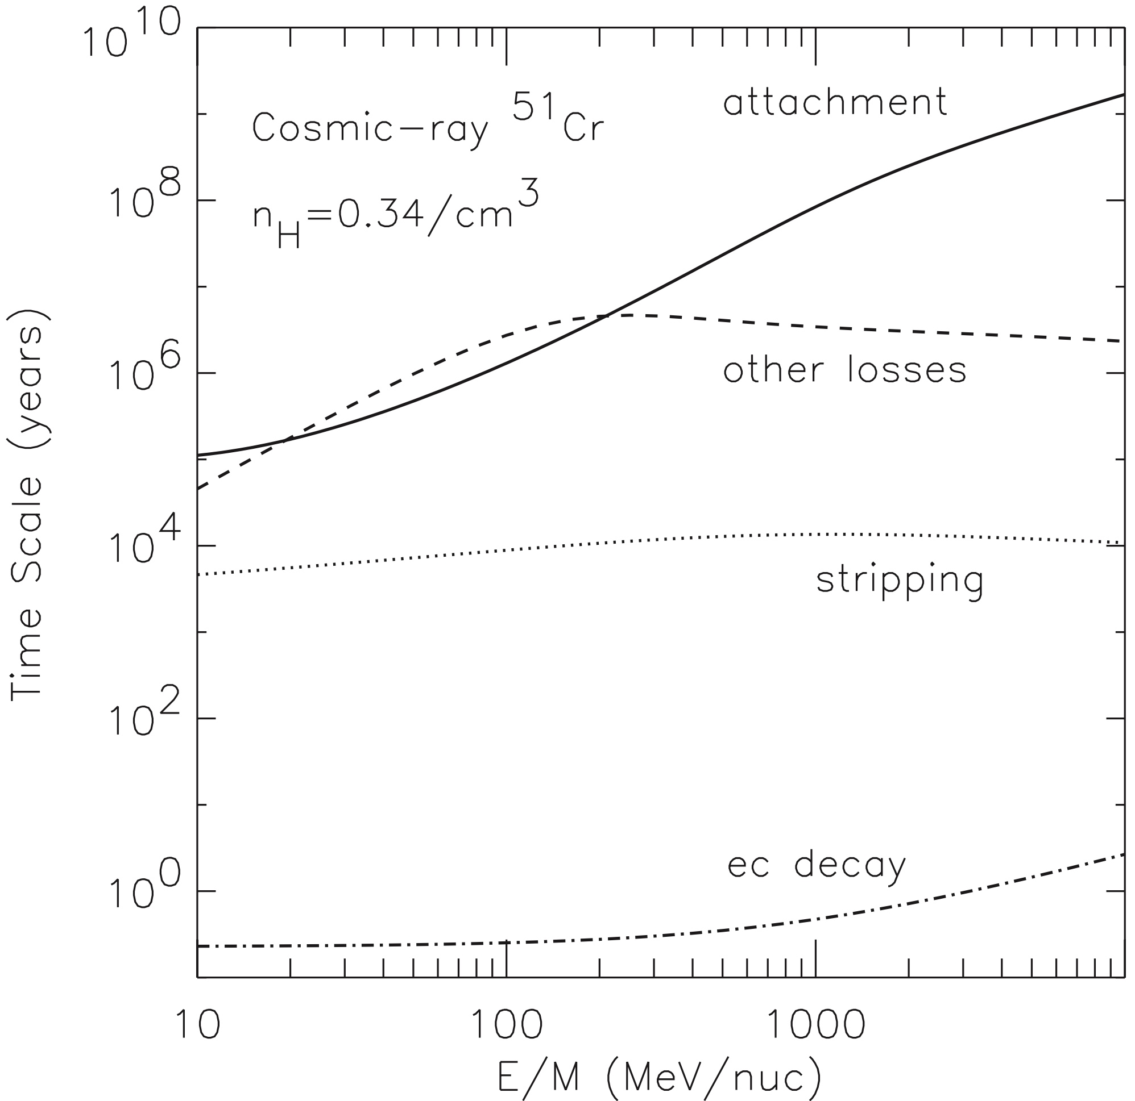
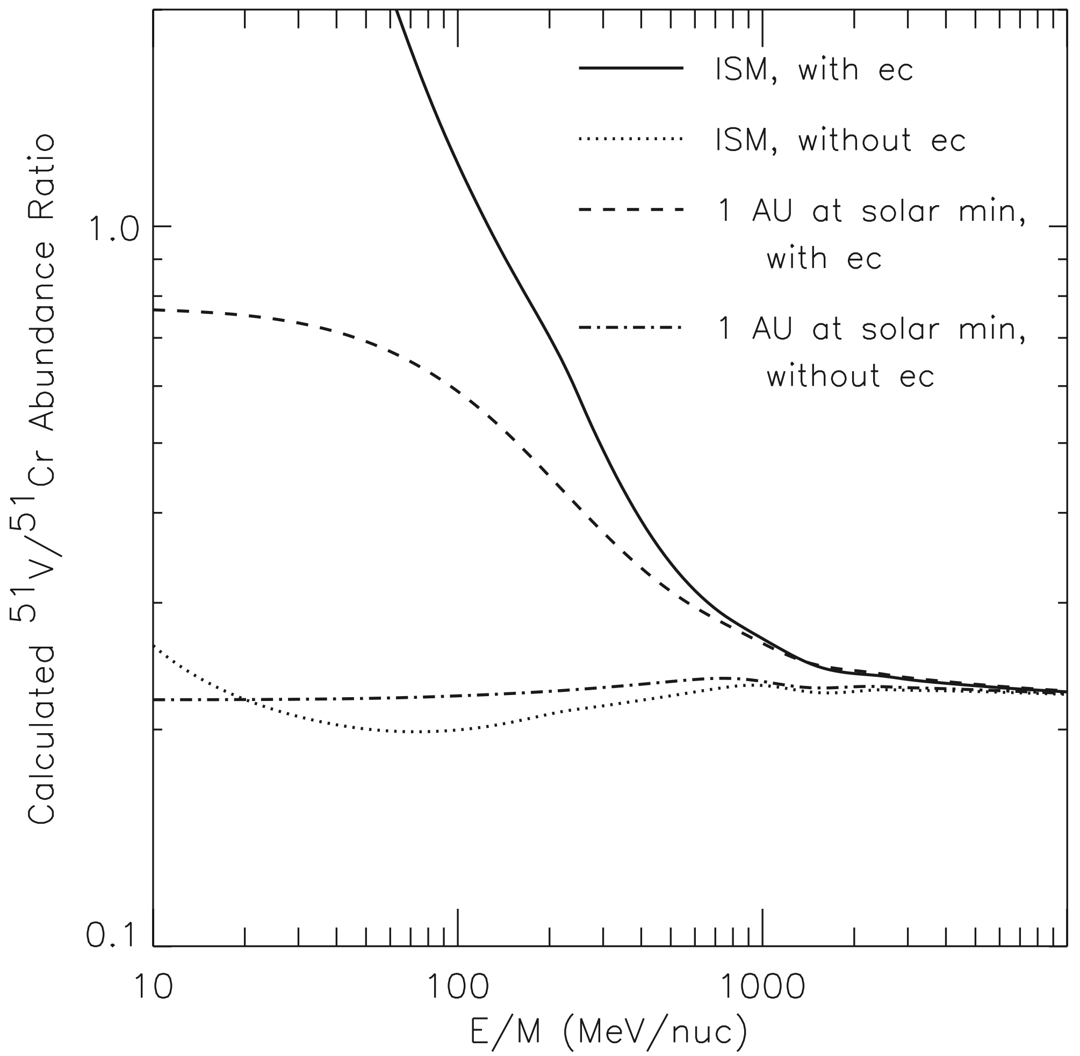
Electron Capture Secondaries Produced During Propagation
electron attachment cross sections fall rapidly with increasing energy
produces a “feature” in the spectra of ec parent and daughter spectra in the ISM
proposed as diagnostic of various energy-changing processes: adiabatic deceleration during solar modulation, weak reacceleration during propagation
time scales for physical processes during propagation in the ISM
effect of electron capture + ec decay on daughter-parent ratios in ISM and near Earth
laboratory half-life of ⁵¹Cr: 27 days
Niebur et al., JGR, 108, A10, 8033, 2003

Slide 21
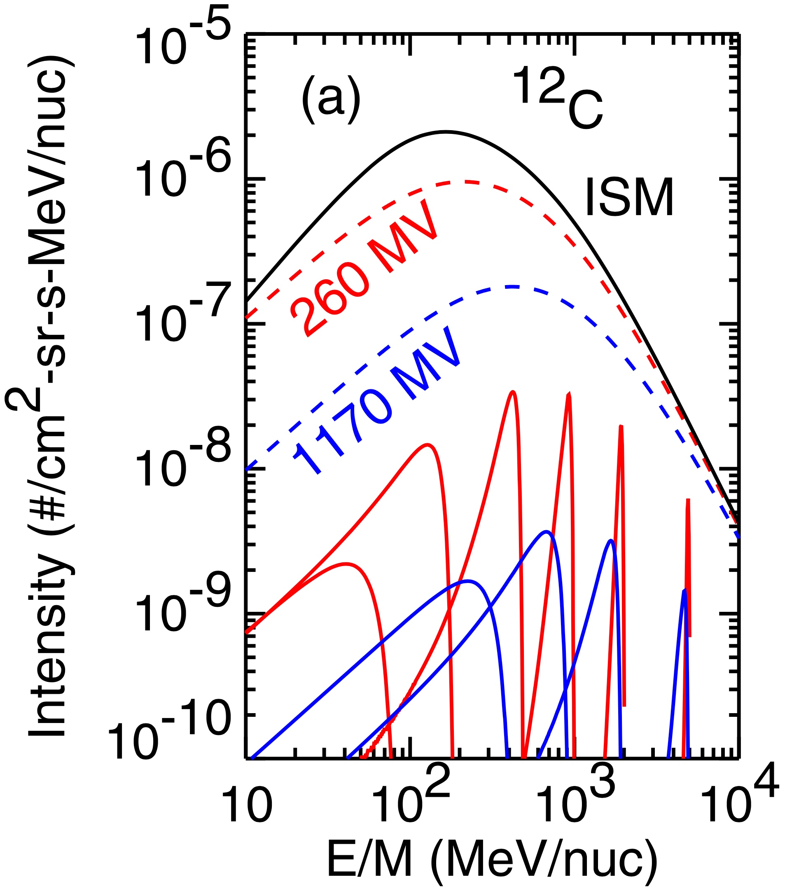
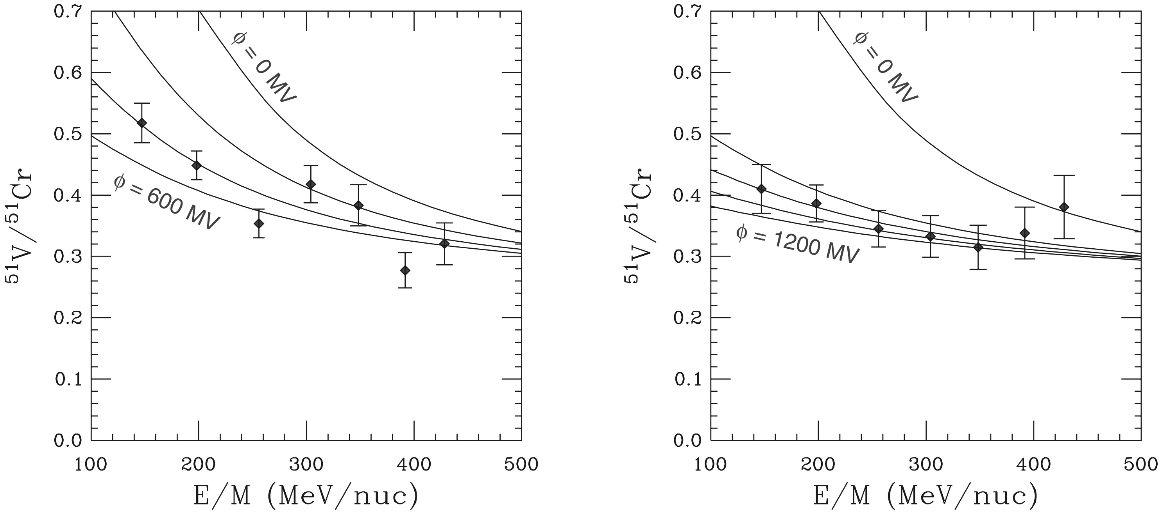
Energy Loss Due to Solar Modulation Probed Using
ec-decay Isotope Measurements
low-energy increase of ec parent/daughter ratio in the VLISM should appear at lower energy at 1 AU during solar maximum than at solar minimum
first attempt to observe effect of solar modulation changes on ec parent/daughter ratio ⁵¹V/⁵¹Cr made using isotope measurements from ACE/CRIS
ACE / CRIS data
calculated energy distributions at Earth due to mono-energetic distributions in VLISM:
solar min
solar max
solar minimum data points
solar maximum data points
Wiedenbeck, SSR 176, 35, 2013
Niebur et al., JGR, 108, A10, 8033, 2003

Slide 22
Conclusions
measurements of elemental and isotopic composition and elemental energy spectra below ~1 GeV/nuc are providing important constraints on the origin of cosmic rays and the cosmic ray environment of the solar system:
amount of matter traversed in the Galaxy
time to escape and mean density in regions traversed
upper limits on the time and distance from the supernova that synthesized ⁶⁰Fe
the very low-energy part of the cosmic-ray spectrum in the VLISM (and its contributions to ionizing and heating the ISM)
fractionation and the possible role played by acceleration of interstellar dust
contributions from nucleosynthesis in special environments (²²Ne)
a model of cosmic ray origin that appears to be consistent with the observations has nucleosynthesis and acceleration occurring in associations of massive stars:
contribute an admixture of “massive start material” that gets accelerated along with old, solar-like interstellar matter
drive supernova shocks that are subsequently responsible for the acceleration
an interesting question to consider: can the low-energy cosmic rays we observe near the solar system have predominantly been accelerated and confined locally?
in the local bubble? (density ~0.3 H/cm³ is compatible with radioactive seconaries)
what additional tests could answer this question?

