Slide 1
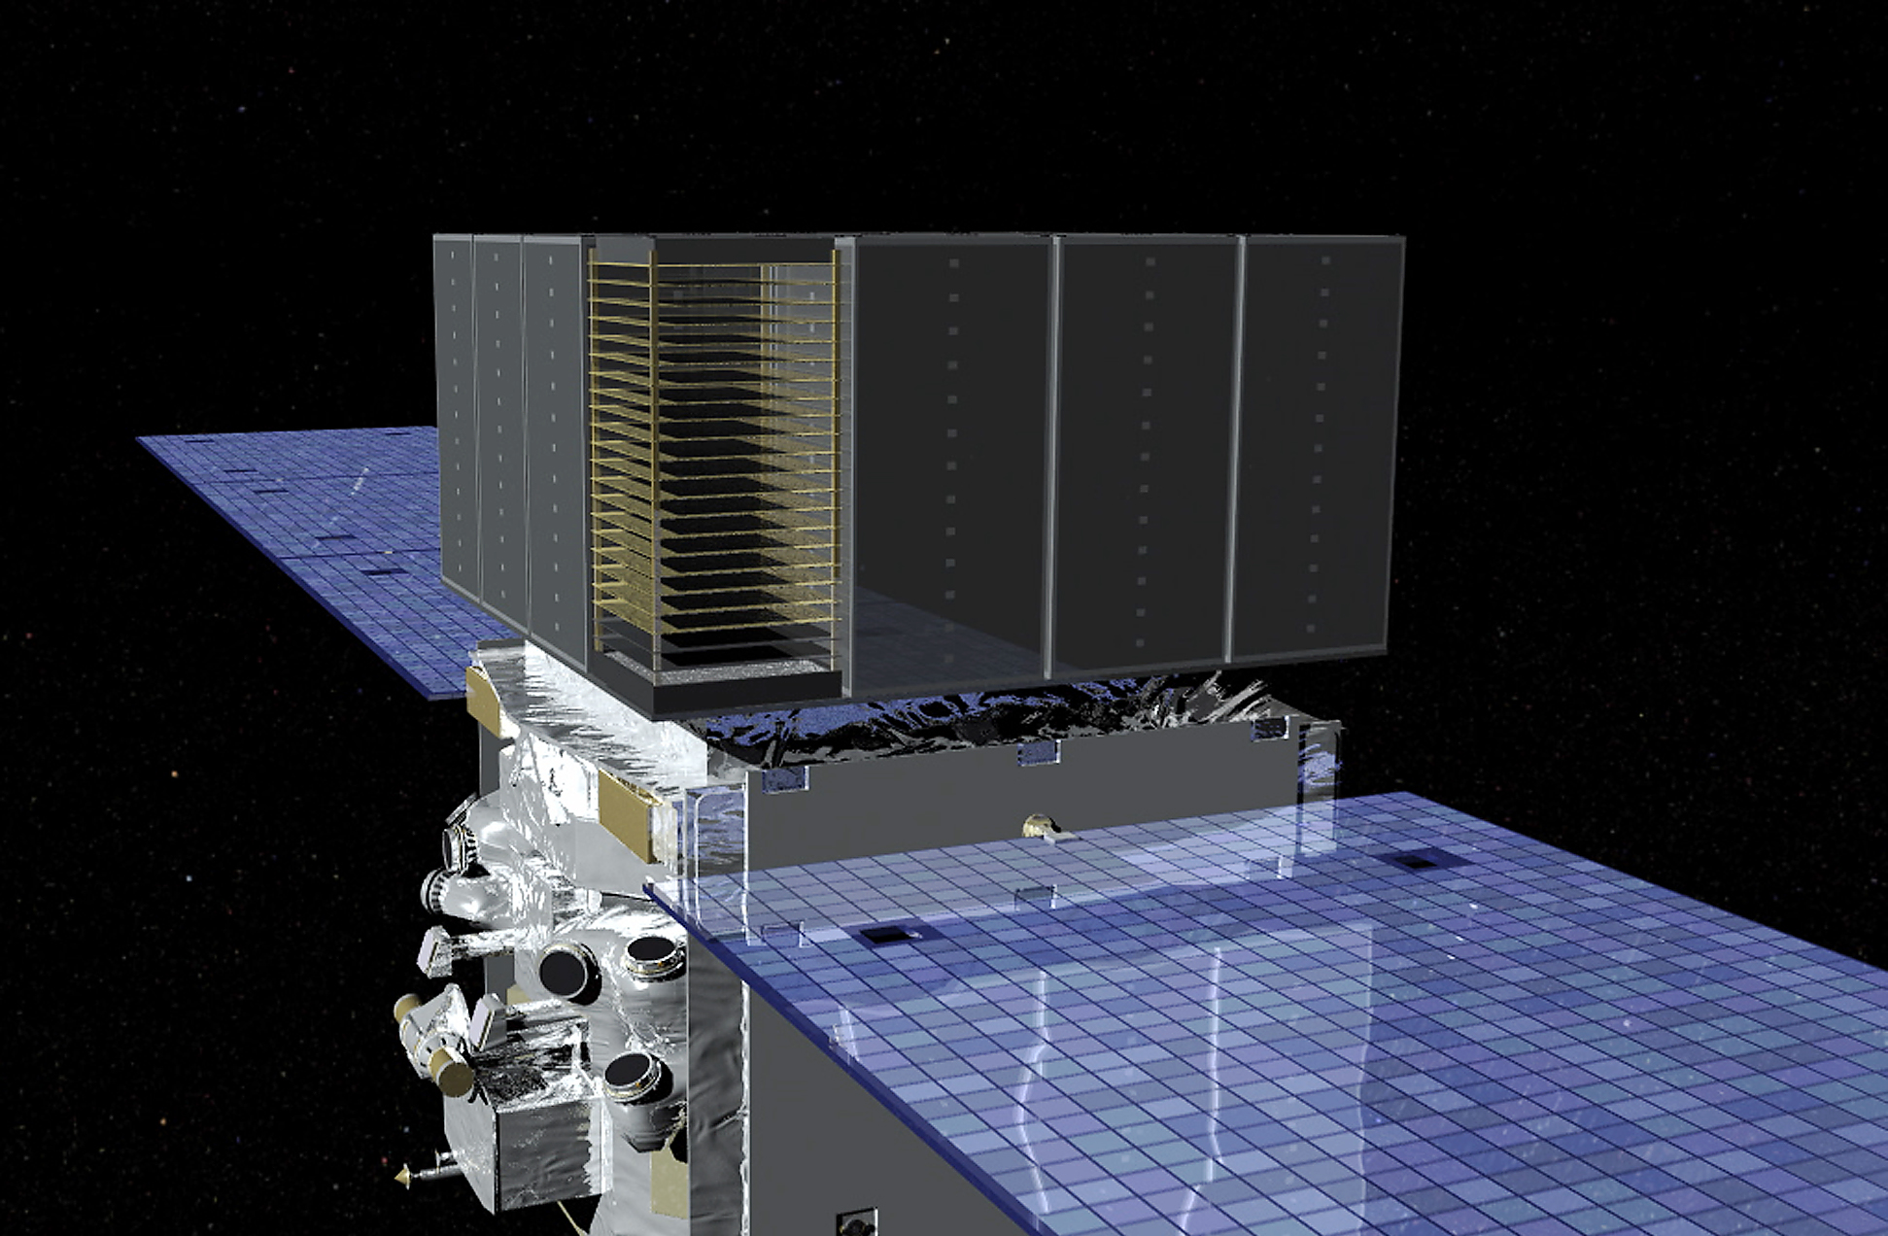

Fermi LAT studies of cosmic-ray anisotropy at the 100 GeV scale
Justin Vandenbroucke and Matthew Meehan (University of Wisconsin)
for the Fermi Large Area Telescope Collaboration
October 11, 2017
Cosmic Ray Anisotropy 2017, Guadalajara, Mexico
Notes:
Questions:
What is energy range of charge ID plot, and are backsplash effects included?

Slide 2
Outline
The Fermi Large Area Telescope
Cosmic-ray electron anisotropy
Cosmic-ray proton anisotropy
  Event selection and statistics
  Energy and angular resolution
  Reference map technique
  Preliminary results
Conclusion and outlook

Slide 3
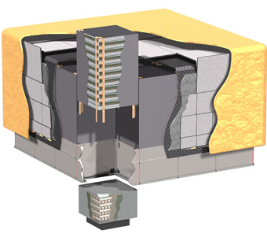
The Fermi Large Area Telescope (LAT)
Tracker: tungsten conversion foils + silicon strip detectors, 1.5 radiation lengths on-axis
Calorimeter: 1536 Cesium Iodide crystals, 8.6 radiation lengths on-axis, gives 3D energy deposition distribution
Anti-Coincidence Detector: charged particle veto surrounding Tracker, 89 plastic scintillator tiles + 8 ribbons
~1.8 m
γ
Tracker
A space-based detector complementary to ground-based instruments
Views 4π sky
Direct identification of primary particles
Low energy threshold
Small effective area compared to ground-based
ACD
e⁻
e⁺
Calorimeter
Atwood et al., ApJ 697, 1071 (2009)
Notes:
ACD ribbons are scintillator ribbons to cover gaps in tile coverage
26° orbit inclination
Dimensions and layout of CAL and ACD segments?
ACD: 0.9997 efficiency for tagging singly charged particles; 0.06 radiation lengths
On axis total: 10.1 radiation lengths
Tracker: 16 modules: tungsten conversion foils + 80 m² of silicon strip detectors in 36 layers, 1.5 radiation lengths on-axis (73 cm^2 of active silicon)
Calorimeter: 16 modules: 96 Cesium Iodide crystals per module, 8.6 radiation lengths on-axis, gives 3D energy deposition distribution
Anti-Coincidence Detector: charged particle veto surrounding Tracker, 89 plastic scintillator tiles + 8 ribbons,

Slide 4
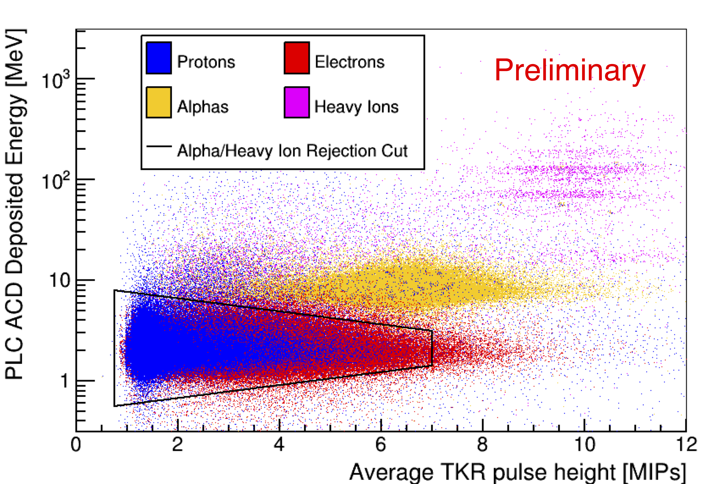
Charge identification
Unlike ground-based detectors, the LAT can cleanly separate protons, helium, heavy ions
Notes:
Three horizontal bands are CNO
H, He, B, Be, Li ,C, N, O

Slide 5
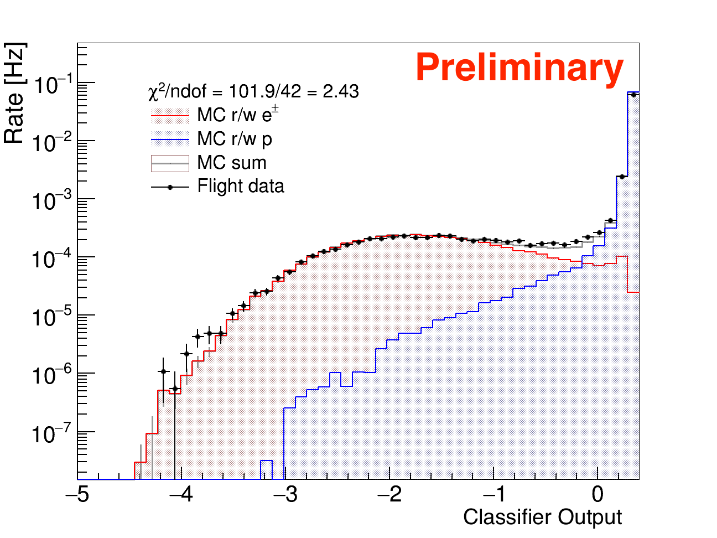
Hadron-lepton separation
example energy bin (455-830 GeV)
The LAT can cleanly separate protons and electrons
More details on classifier in Fermi LAT, PRD 95, 082007

Slide 6
Cosmic-ray electron+positron anisotropy search
also used to constrain dark matter:
Fermi LAT, PRD 84, 032007 (2011)
No anisotropy found between 42 GeV and 2 TeV
Upper limits constrain contribution from Vela (local pulsar)
PRL 118, 091103 (2017)
Notes:
First analysis was:
1 year of data, 1.6M events, upper limits 0.5% to 10%
PRD 82, 092003 (2010)
Latest analysis is:
6 years of data, Pass 8, 12.2M events
Factor of 7.6 in stats
Factor of 6 in livetime
So factor of 7.6/6 = 1.27 = ~30% improvement due to Pass 8

Slide 7
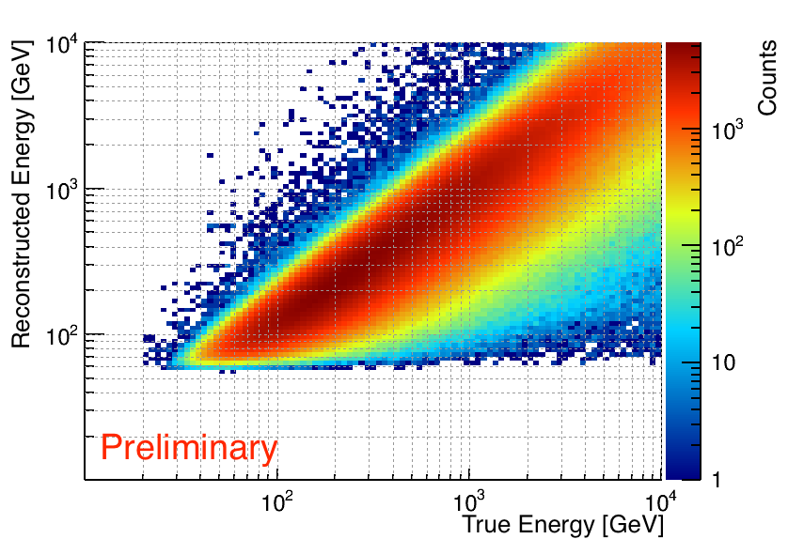
Proton energy resolution
Although hadronic showers are not contained, shower profile fit achieves good energy resolution

Slide 8
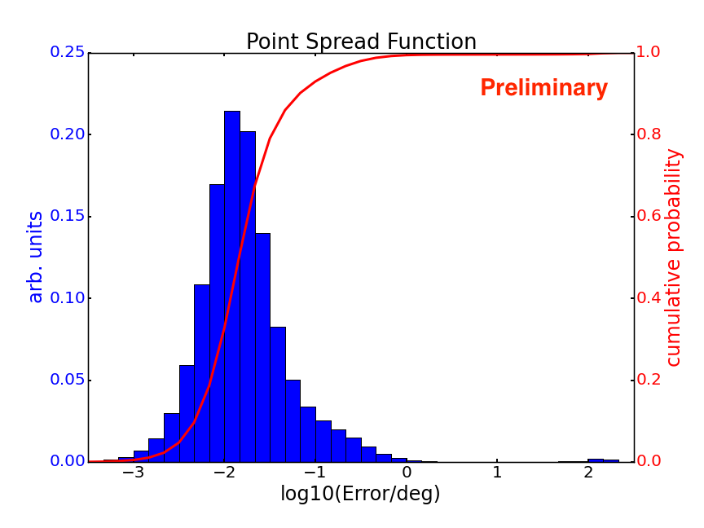
Proton angular resolution
Median angular error is ~0.01°
More than 90% of events are <0.1°

Slide 9
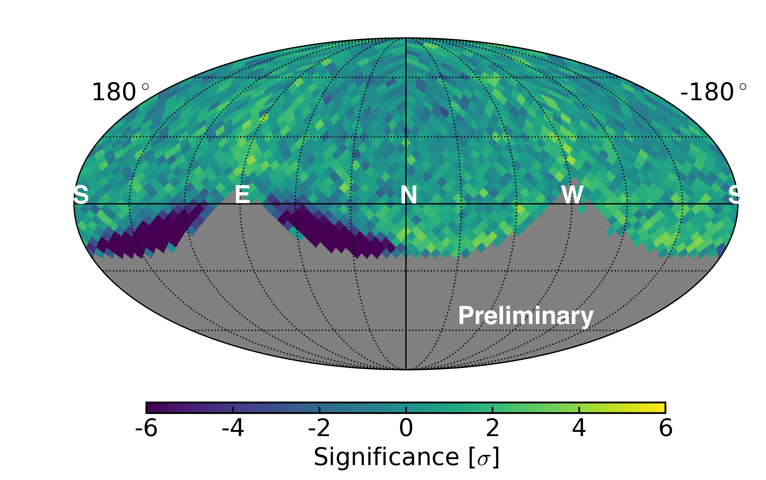
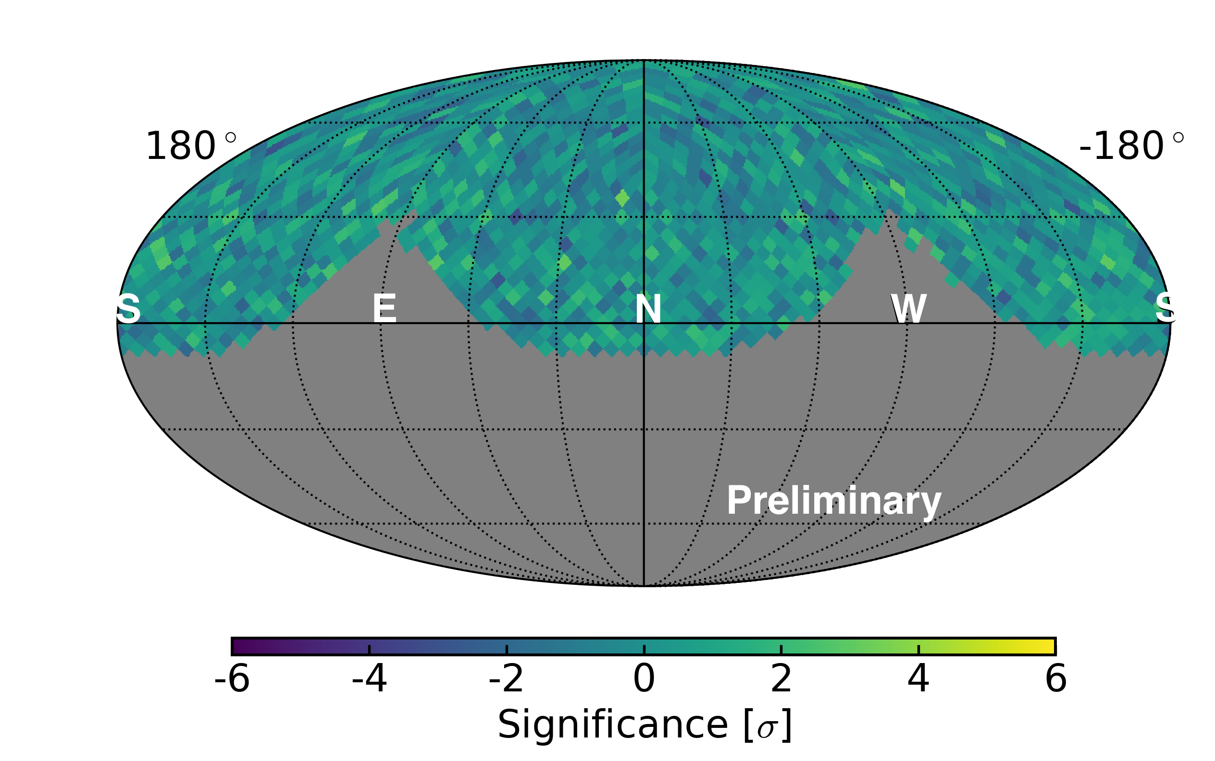
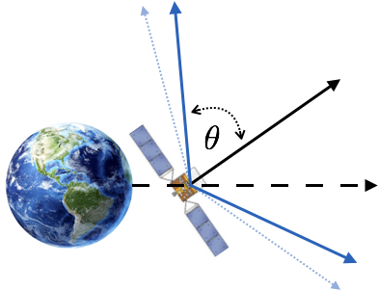
Removing geomagnetic effects by removing events far off the instrument axis
𝜃 < 60°
𝜃 < 45°
altitude-azimuth coordinates
(based on instantaneous spacecraft coordinates)
Example for lowest energy bin (78-139 GeV)
Tighter cut removes more events near horizon (with large geomagnetic deflection)
We use 𝜃 < 45°below 139 GeV and
𝜃 < 50°above 139 GeV

Slide 10
Data-driven reference map algorithm
In each energy bin and one-year time bin:
Determine average number of events N in each second of livetime
Histogram events in detector (theta, phi) coordinates
From N, choose Poisson count for each second of livetime
Choose direction of each event from (theta, phi) distribution
Calculate sky direction from spacecraft pointing
Build sky map
Average 25 realizations to beat down statistical noise

Slide 11
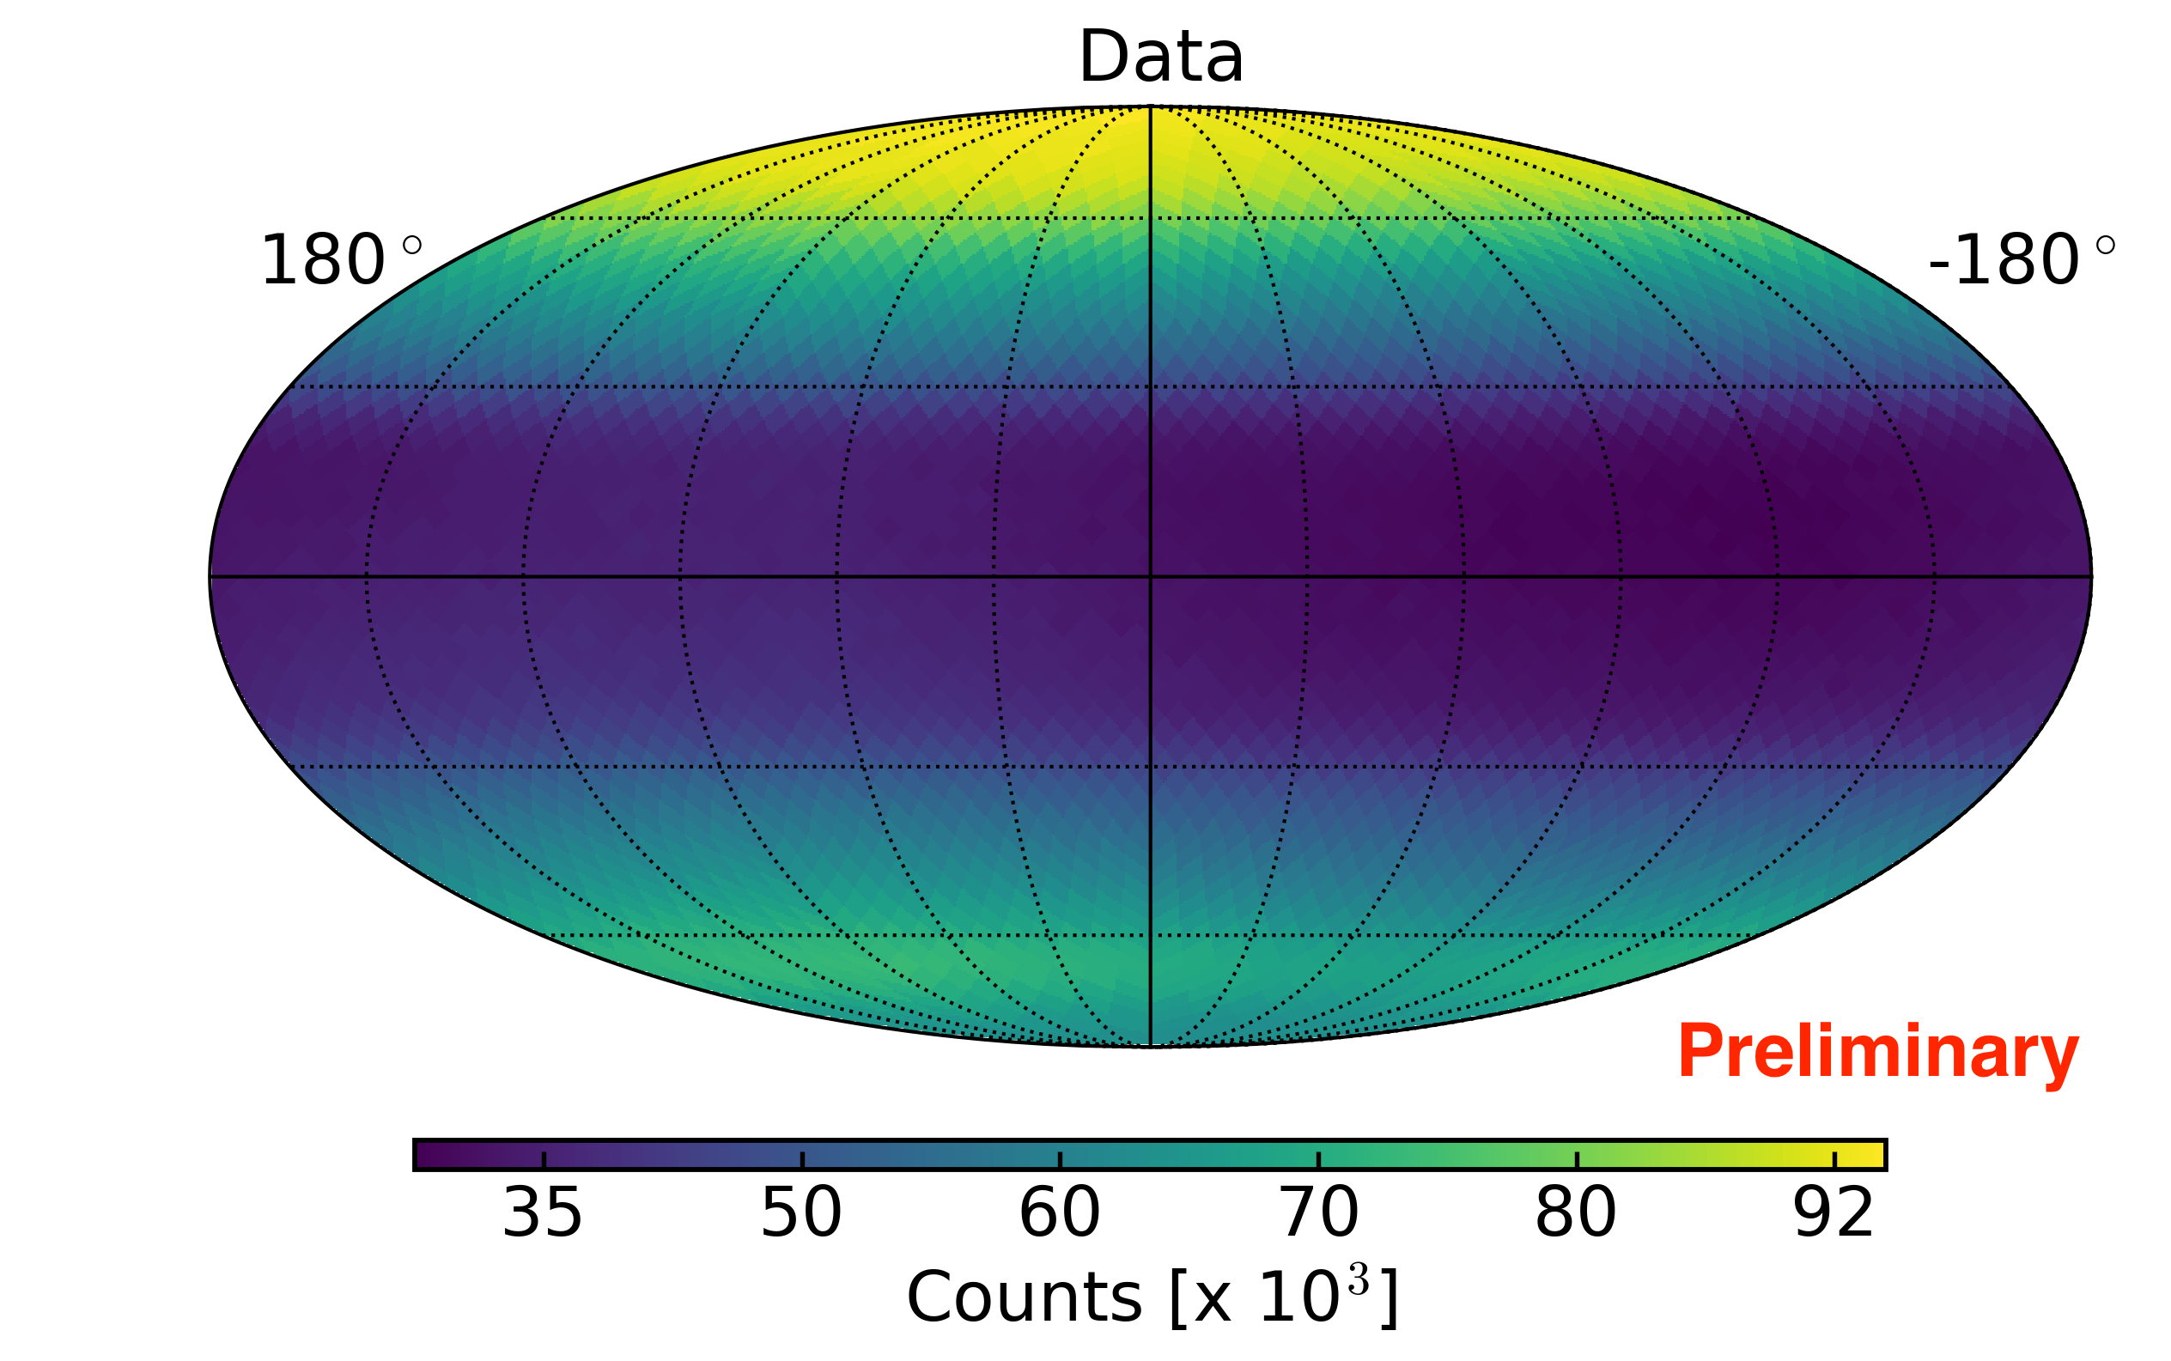
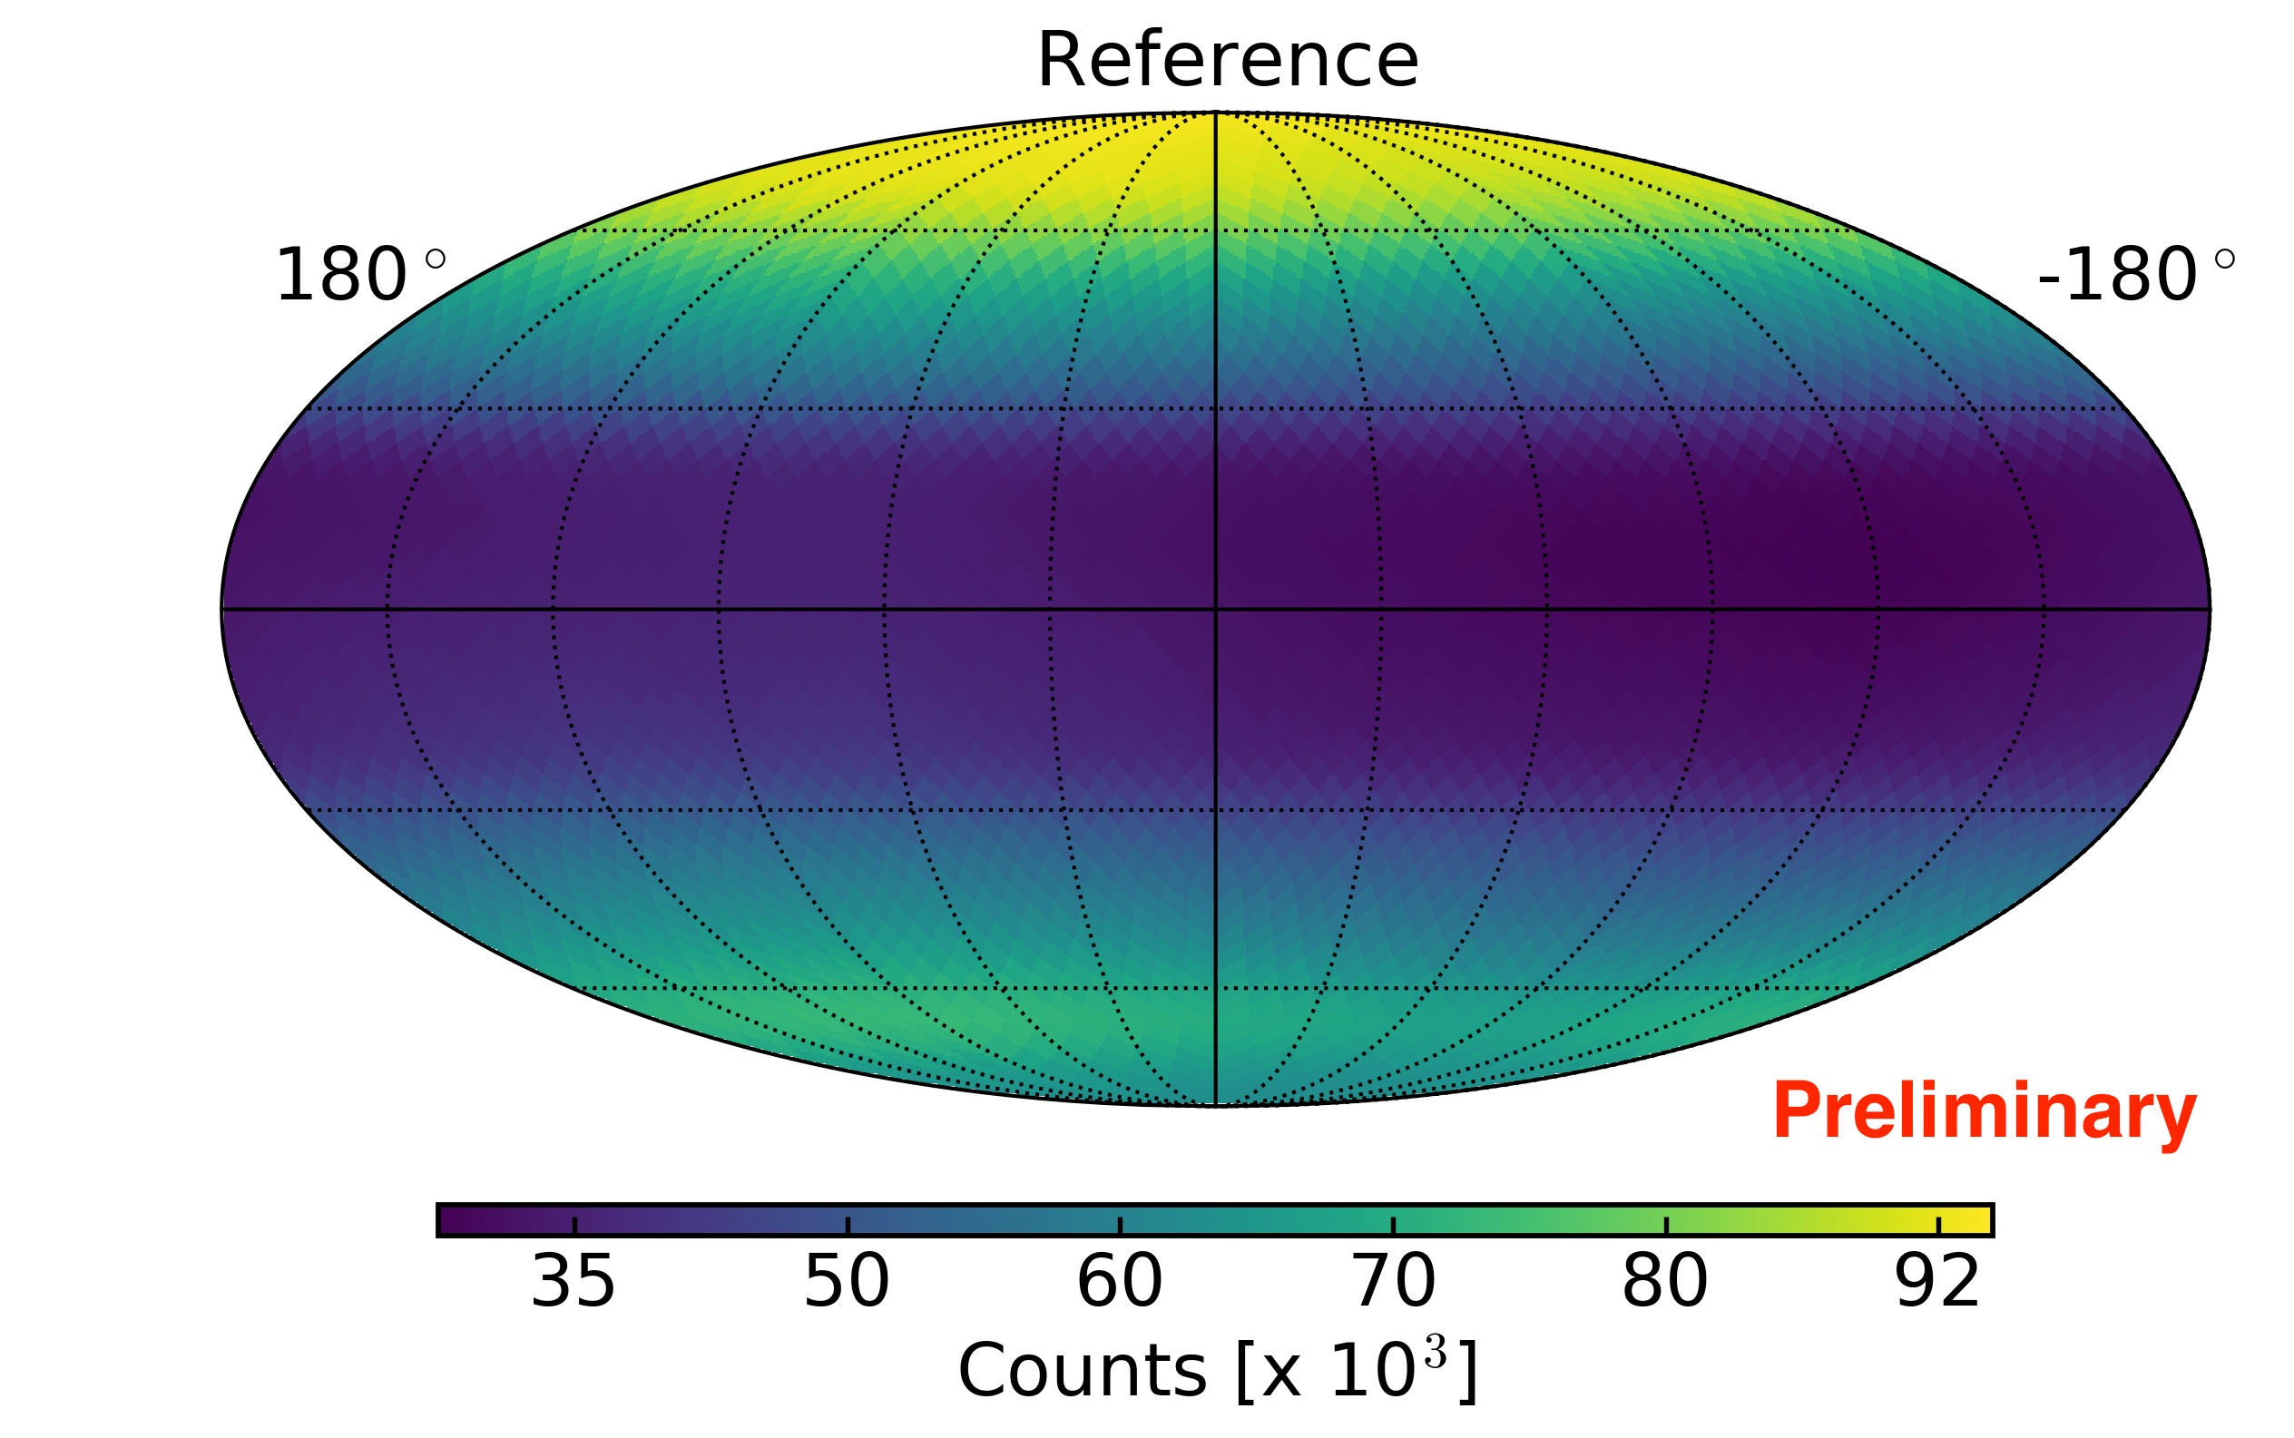
8 year reference map compared to data map
Data Reference
equatorial coordinates
Notes:
3072 pixels on the sky, each 13.4 sq deg
Reference map: average of 25 realizations

Slide 12
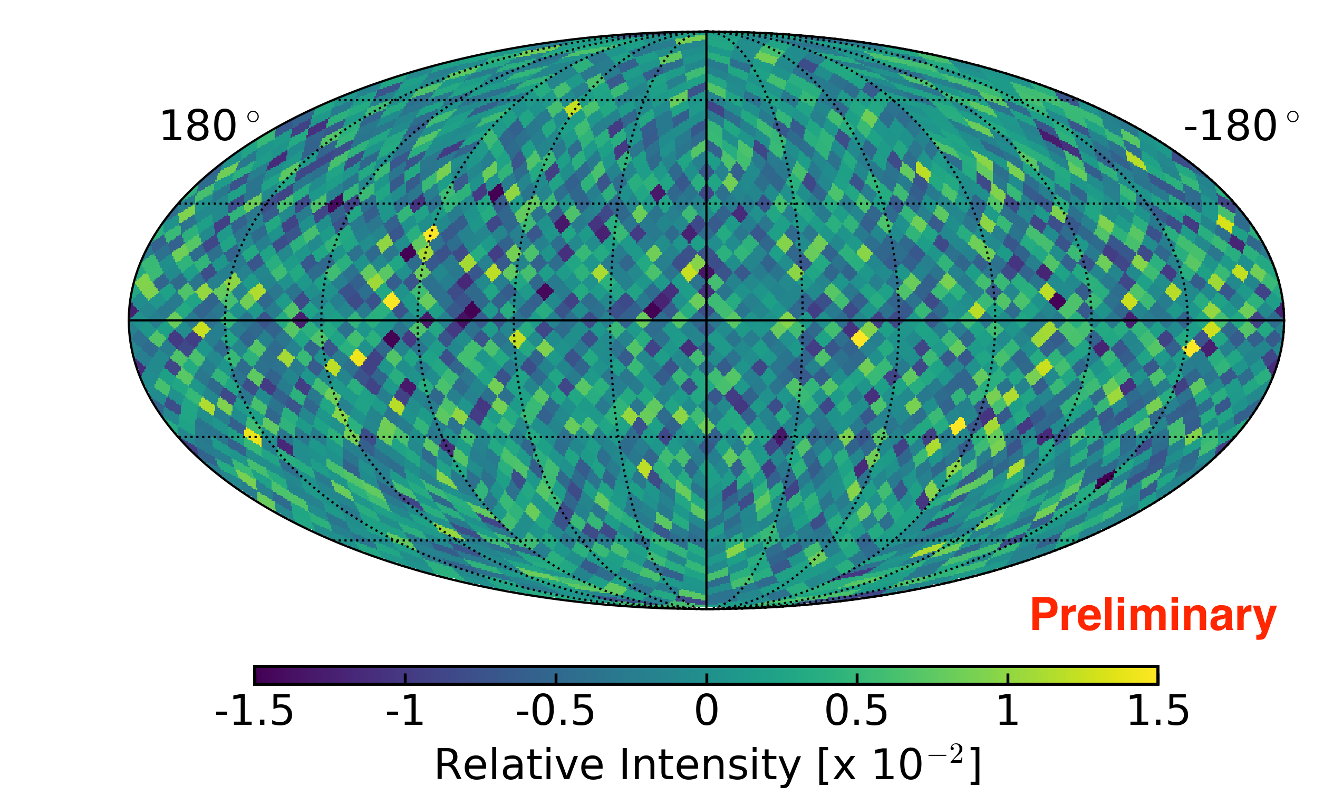
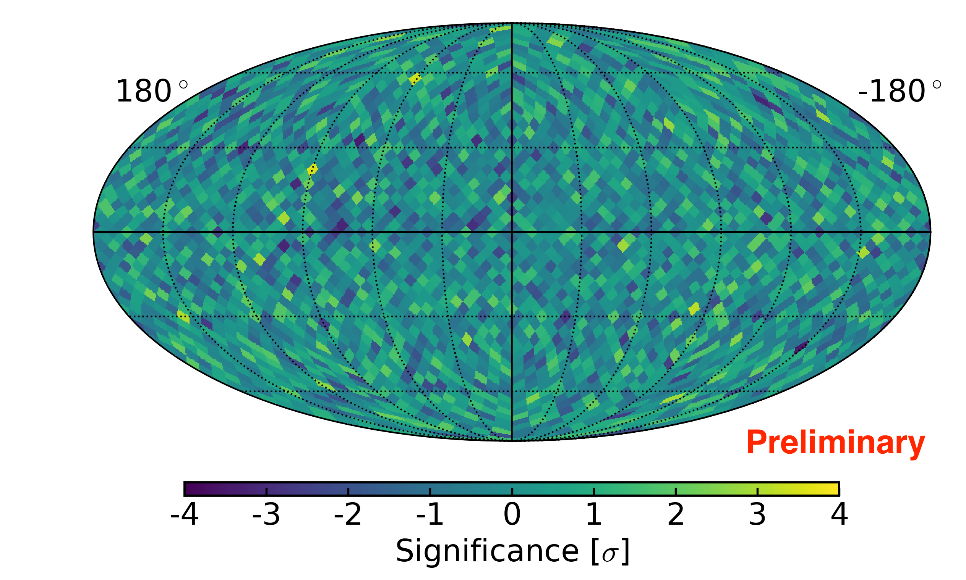
8 year relative intensity and significance
equatorial coordinates
(data - reference) / reference
Li-Ma significance
Notes:
3072 pixels on the sky, each ~13 sq deg

Slide 13
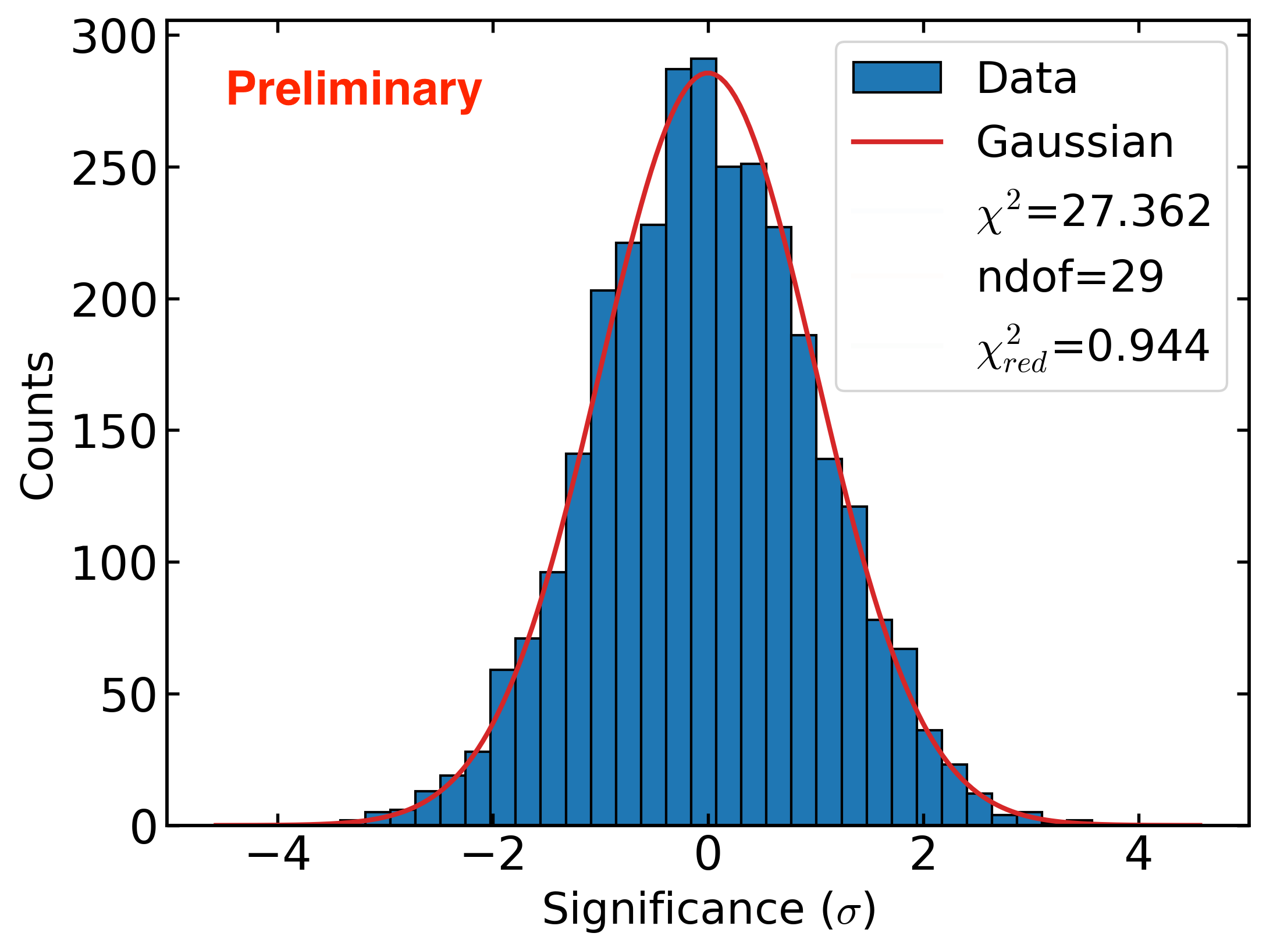
Single-pixel significance distribution

Slide 14
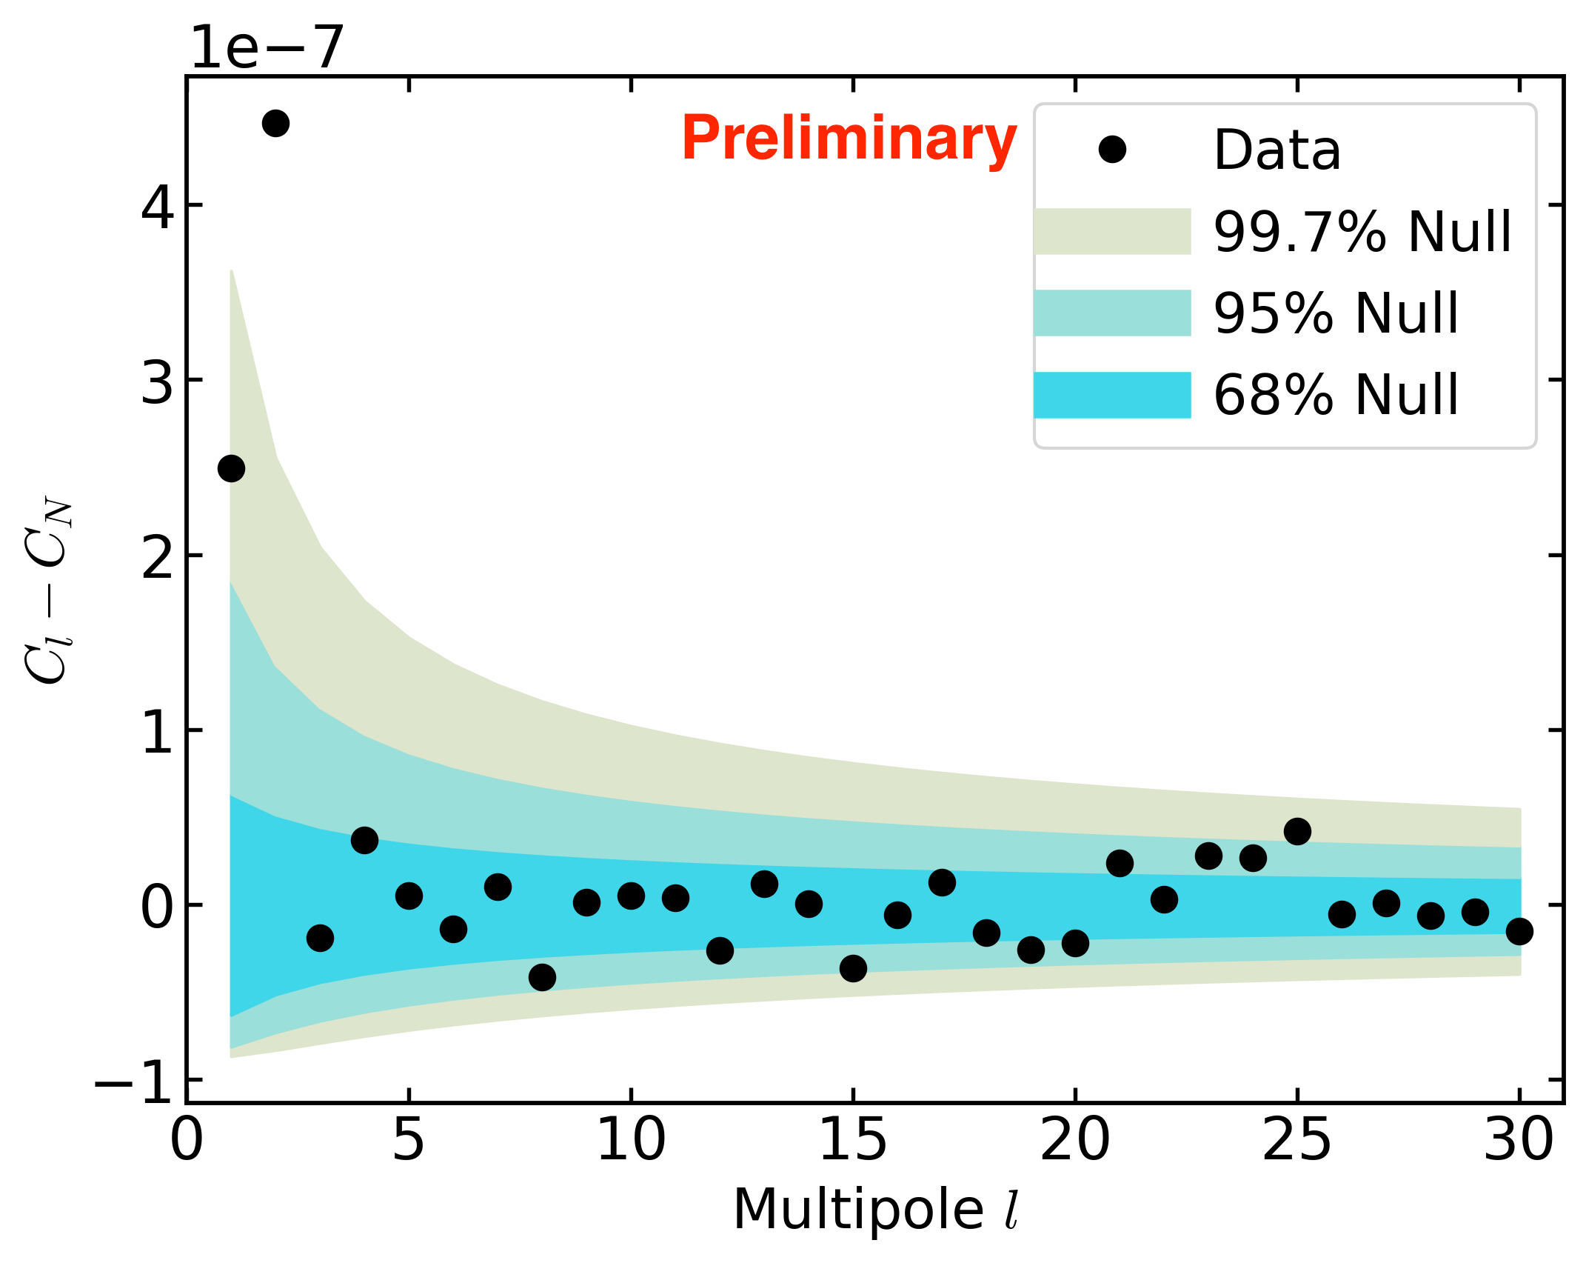
8 year angular power spectrum
cumulative (E_{reco} > 78 GeV)
C_{N} (noise power expected due to finite statistics) subtracted
Excess power found in dipole and quadrupole
We are investigating systematic effects that could explain them

Slide 15
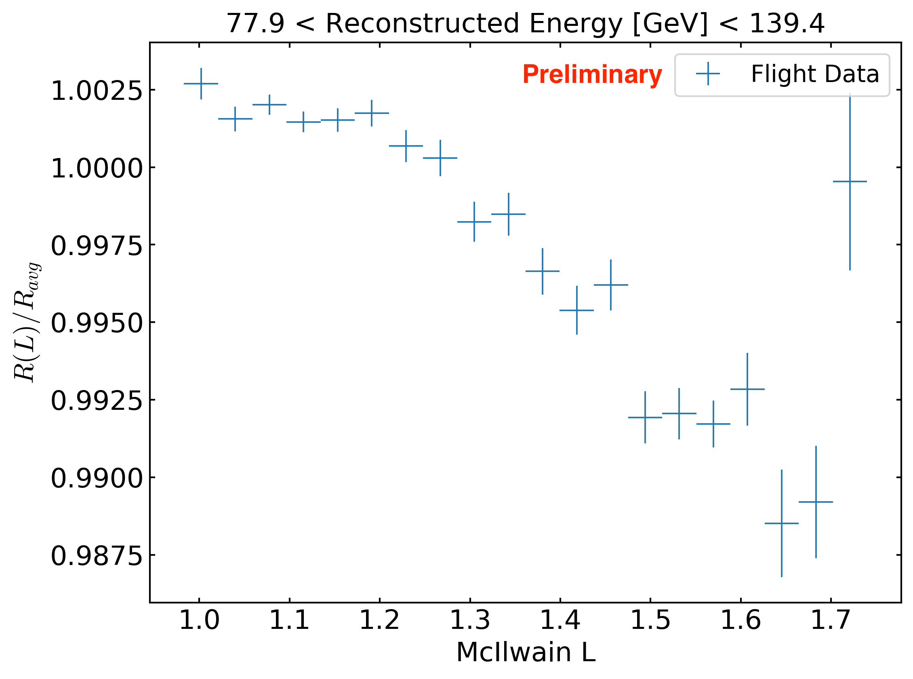
Systematic rate effect:
1% variation of event rate with local geomagnetic field
strong field
weak field
It is not a livetime effect (is present after livetime accounting)
Weaker field causes higher rate of low energy events: pileup/ghosts reduces rate of high quality events passing selection cuts
Original reference map algorithm assumed rate is constant (neglected this effect)
Can this explain excess dipole and quadrupole power?

Slide 16
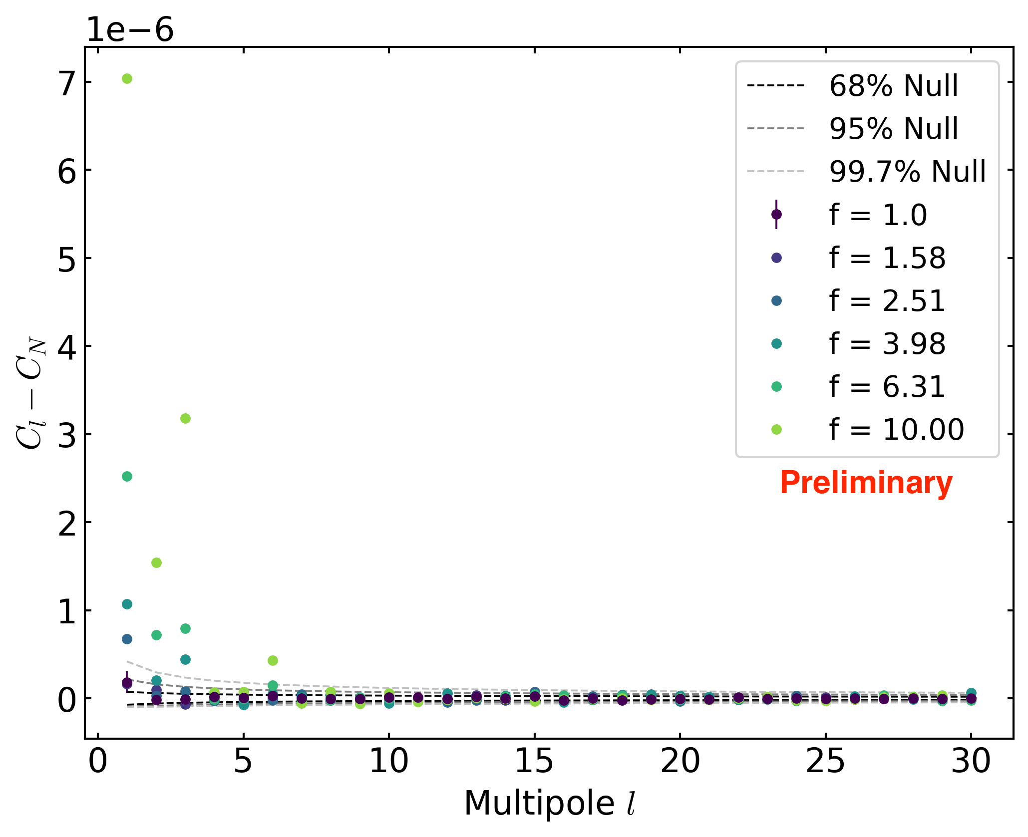
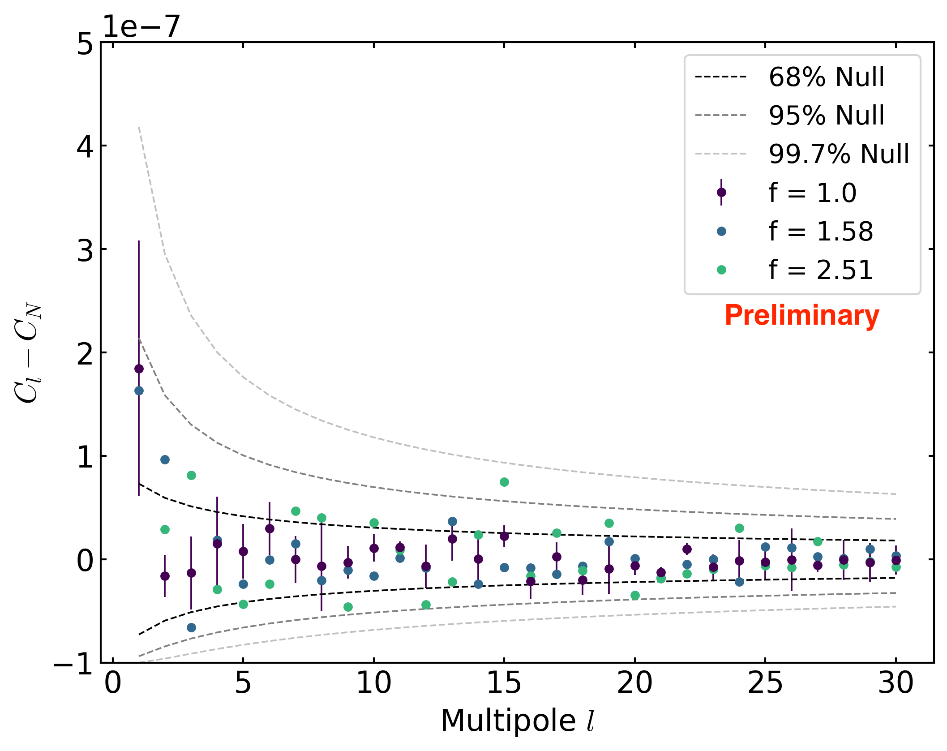
Monte Carlo investigation of geomagnetic rate effect
zoomed out
zoomed in
Monte Carlo with amplitude of rate variation scaled by factor f
For true size of effect (f=1):
  Slight excess power found in dipole
  No excess power found in quadrupole

Slide 17
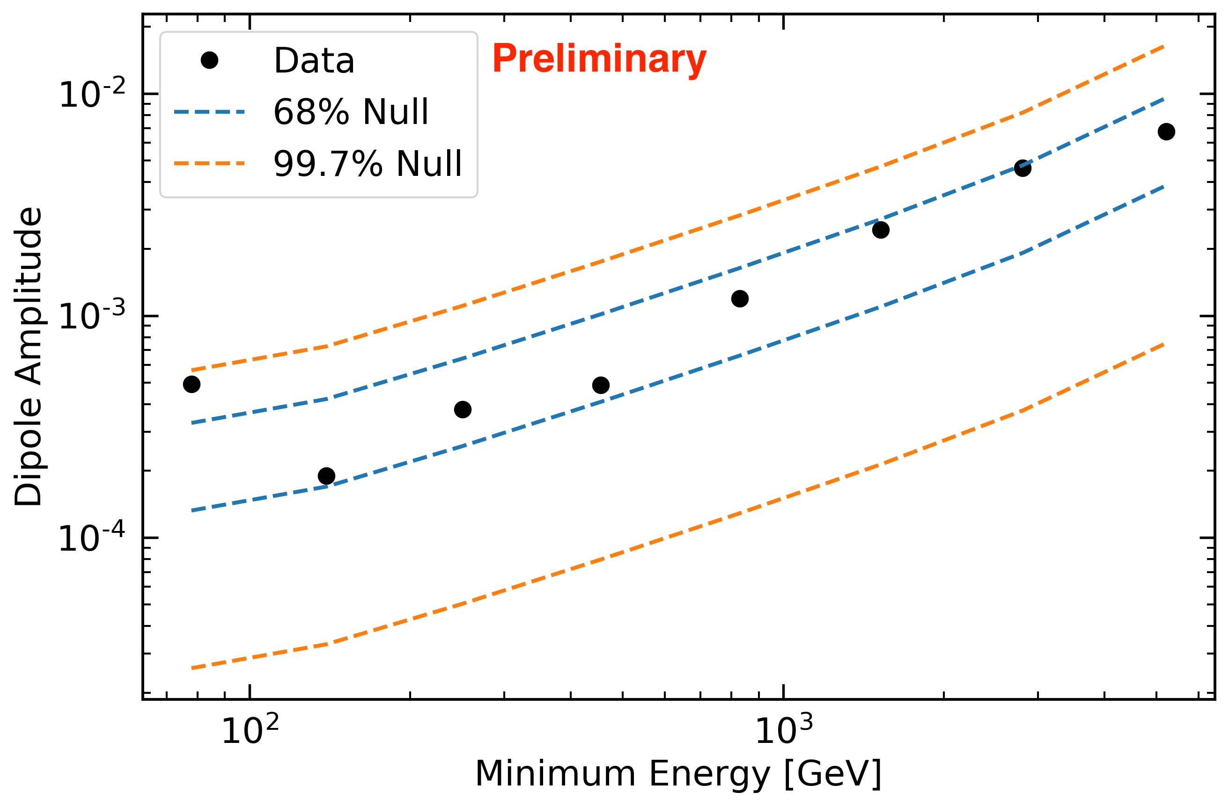
Dipole amplitude vs. energy
Bands give range of expected dipole amplitude due to statistical noise under null hypothesis (isotropic sky)

Slide 18
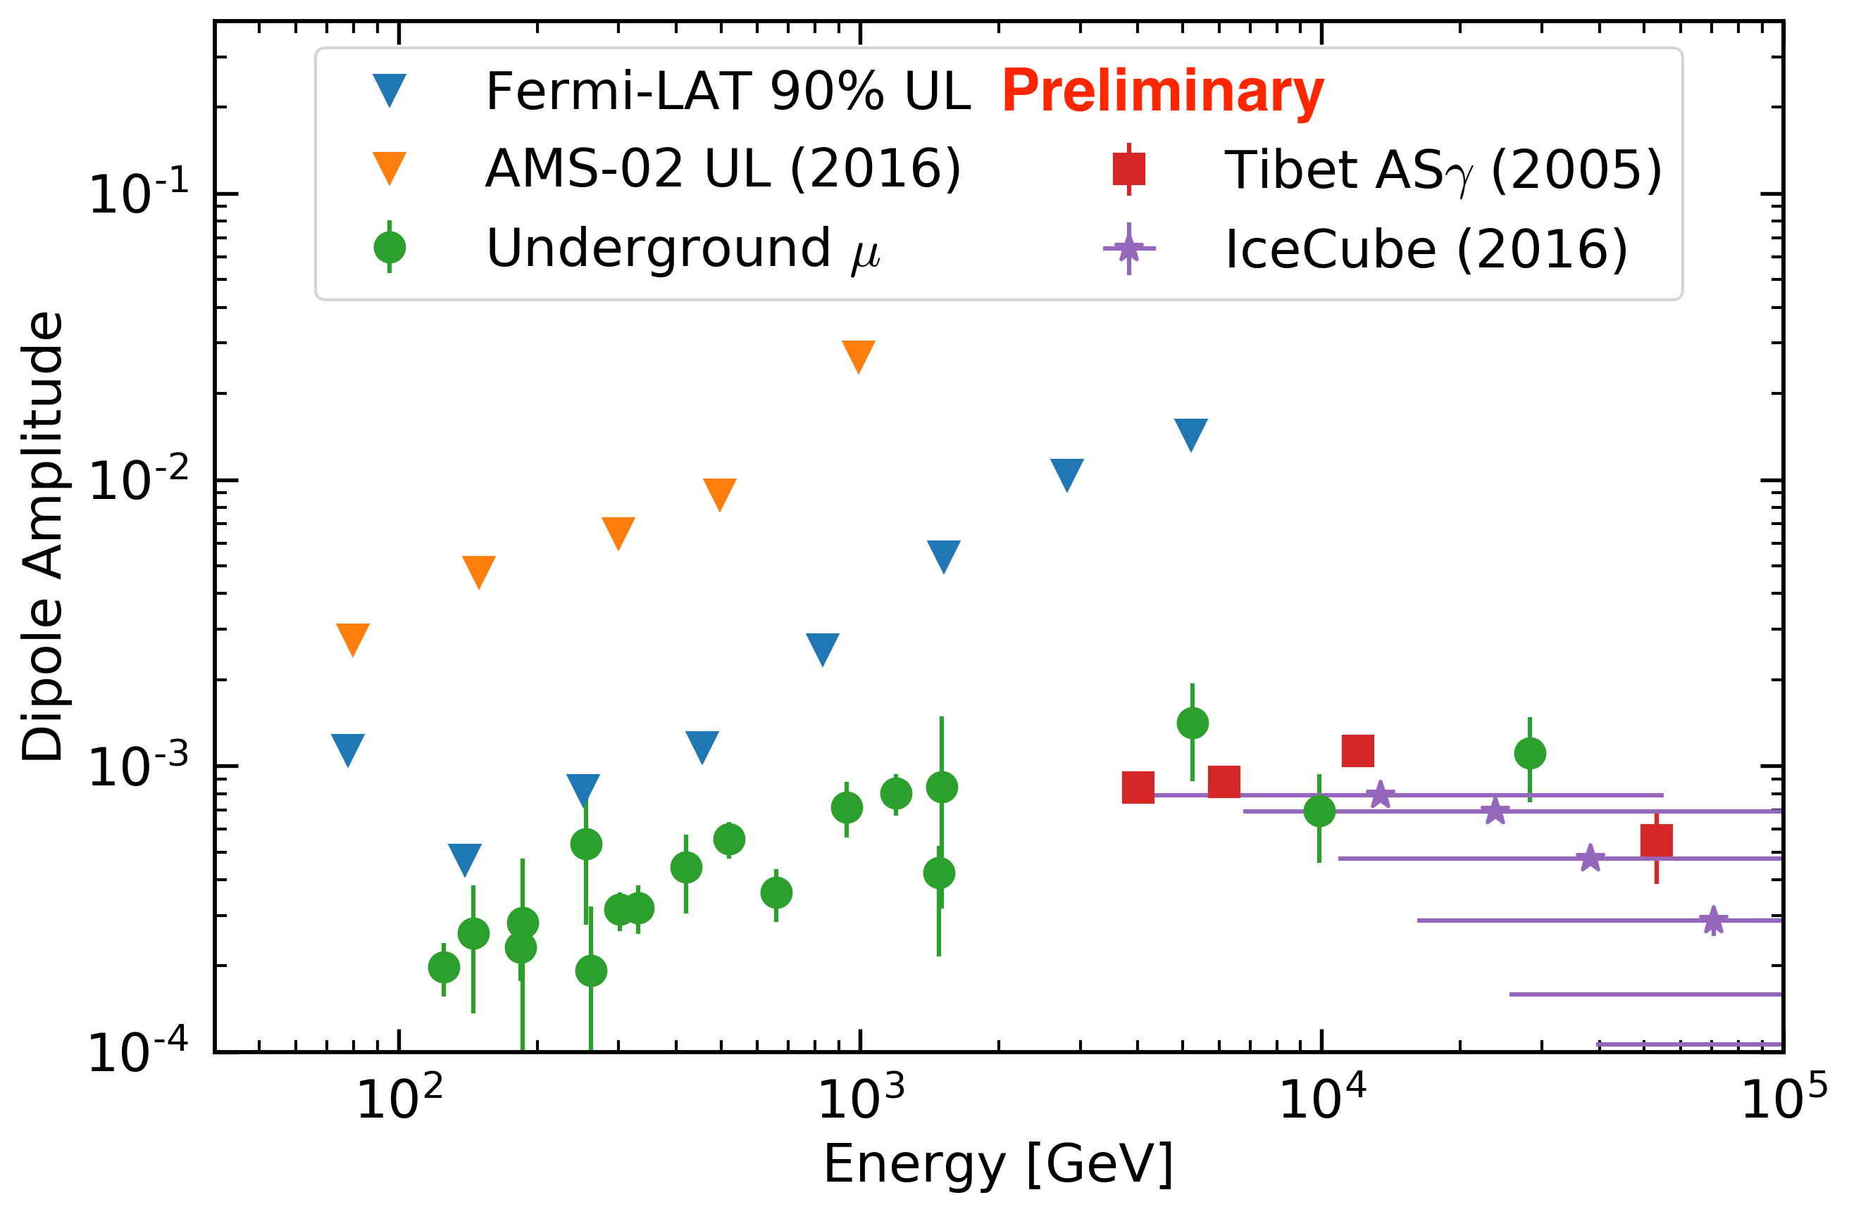
LAT dipole upper limits
Note: Fermi LAT upper limits are cumulative

Slide 19
Conclusion and outlook
LAT cosmic-ray electron anisotropy upper limits are strongest ever
0.16 billion well-reconstructed proton events recorded in 8 years of LAT data provide sensitivity to dipole amplitude ~5 x 10⁻⁴
1% geomagnetic variation in event rate produces small systematic effect consistent with small (>2 σ) observed dipole amplitude
Now developing (blind, first on Monte Carlo) McIlwain-dependent reference map construction to remove this systematic effect
Significant (>3 σ) quadrupole is under investigation: not due to rate effect but may be caused by another effect such as residual back-entering events
LAT upper limits on dipole amplitude between 78 GeV and 10 TeV
Strongest full-sky constraints (including dec. component) in any energy range
Strongest pure-proton constraints in any energy range
After understanding proton anisotropy systematics, will study solar dipole and heavier species (helium etc.)
More details in 1708.07796 (ICRC 2017)

Slide 20
Additional slides

Slide 21
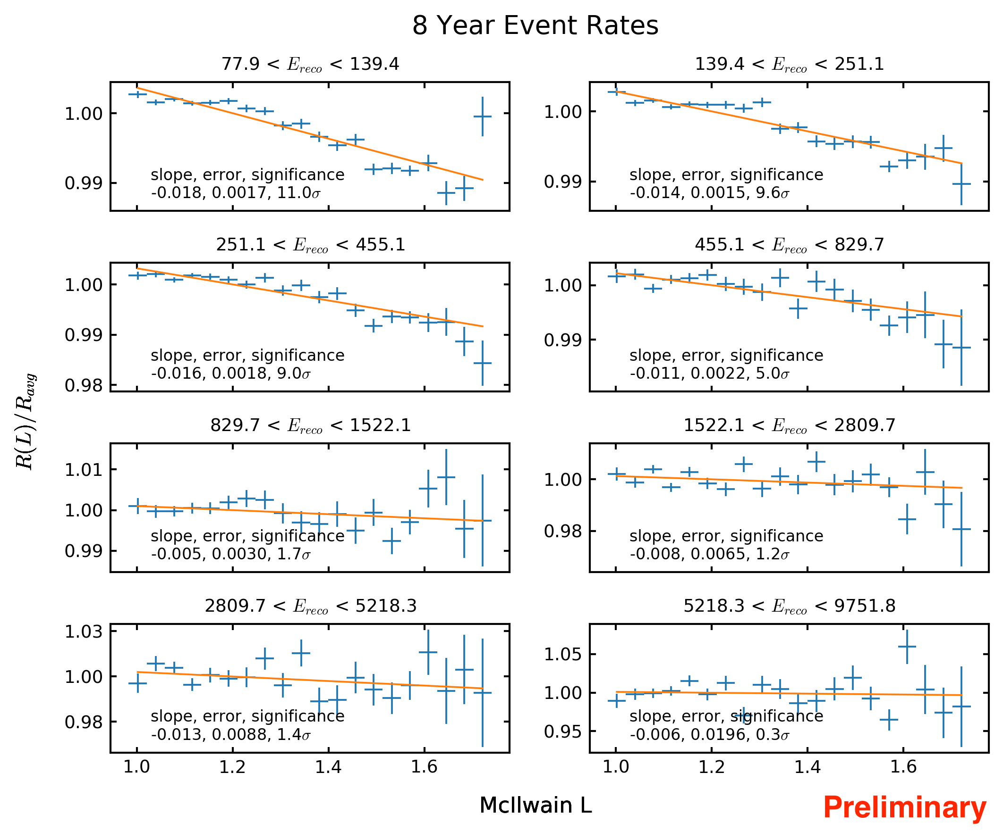
Dependence of rate on McIlwain L in 8 energy bins
Significant rate variation in lowest 4 energy bins; not in highest 4

Slide 22
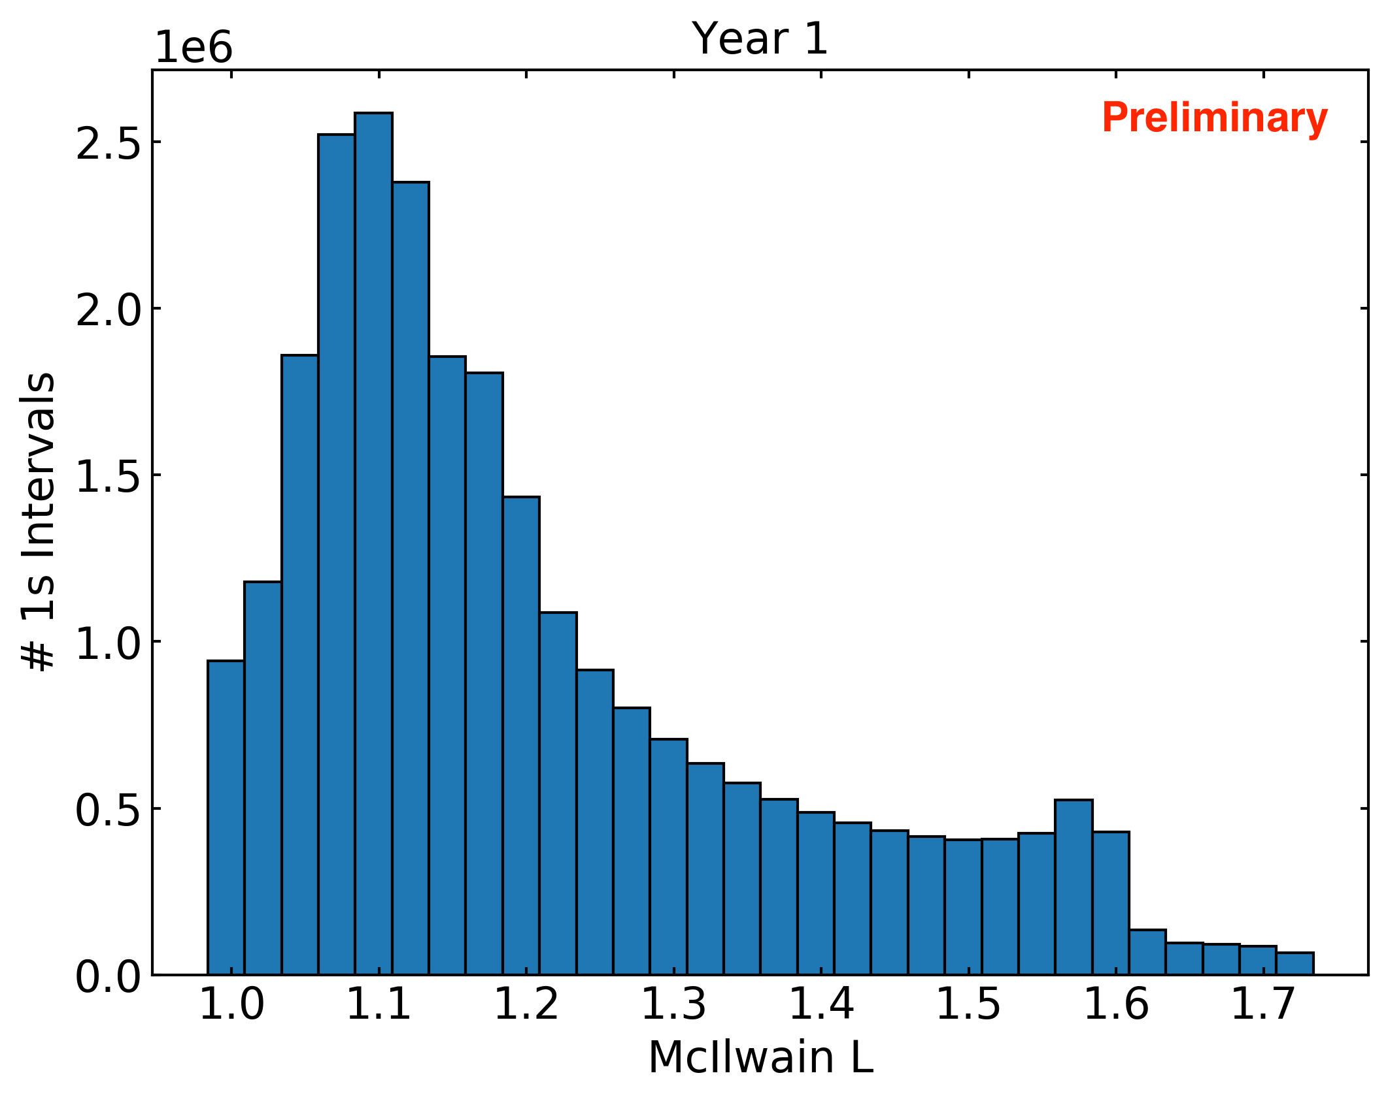
Distribution of LAT geomagnetic position (McIlwain L)

Slide 23
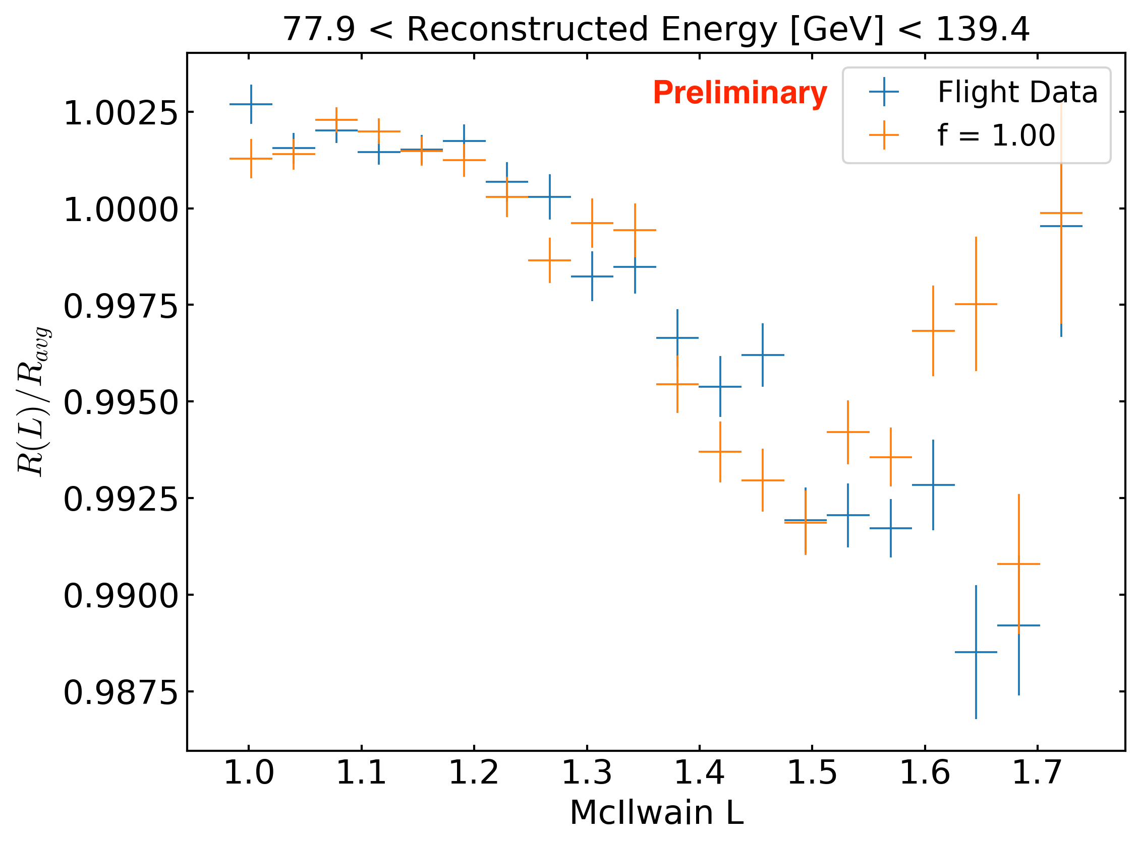
Monte Carlo investigation of rate effect
f is scale factor that determines amplitude of rate variation

Slide 24
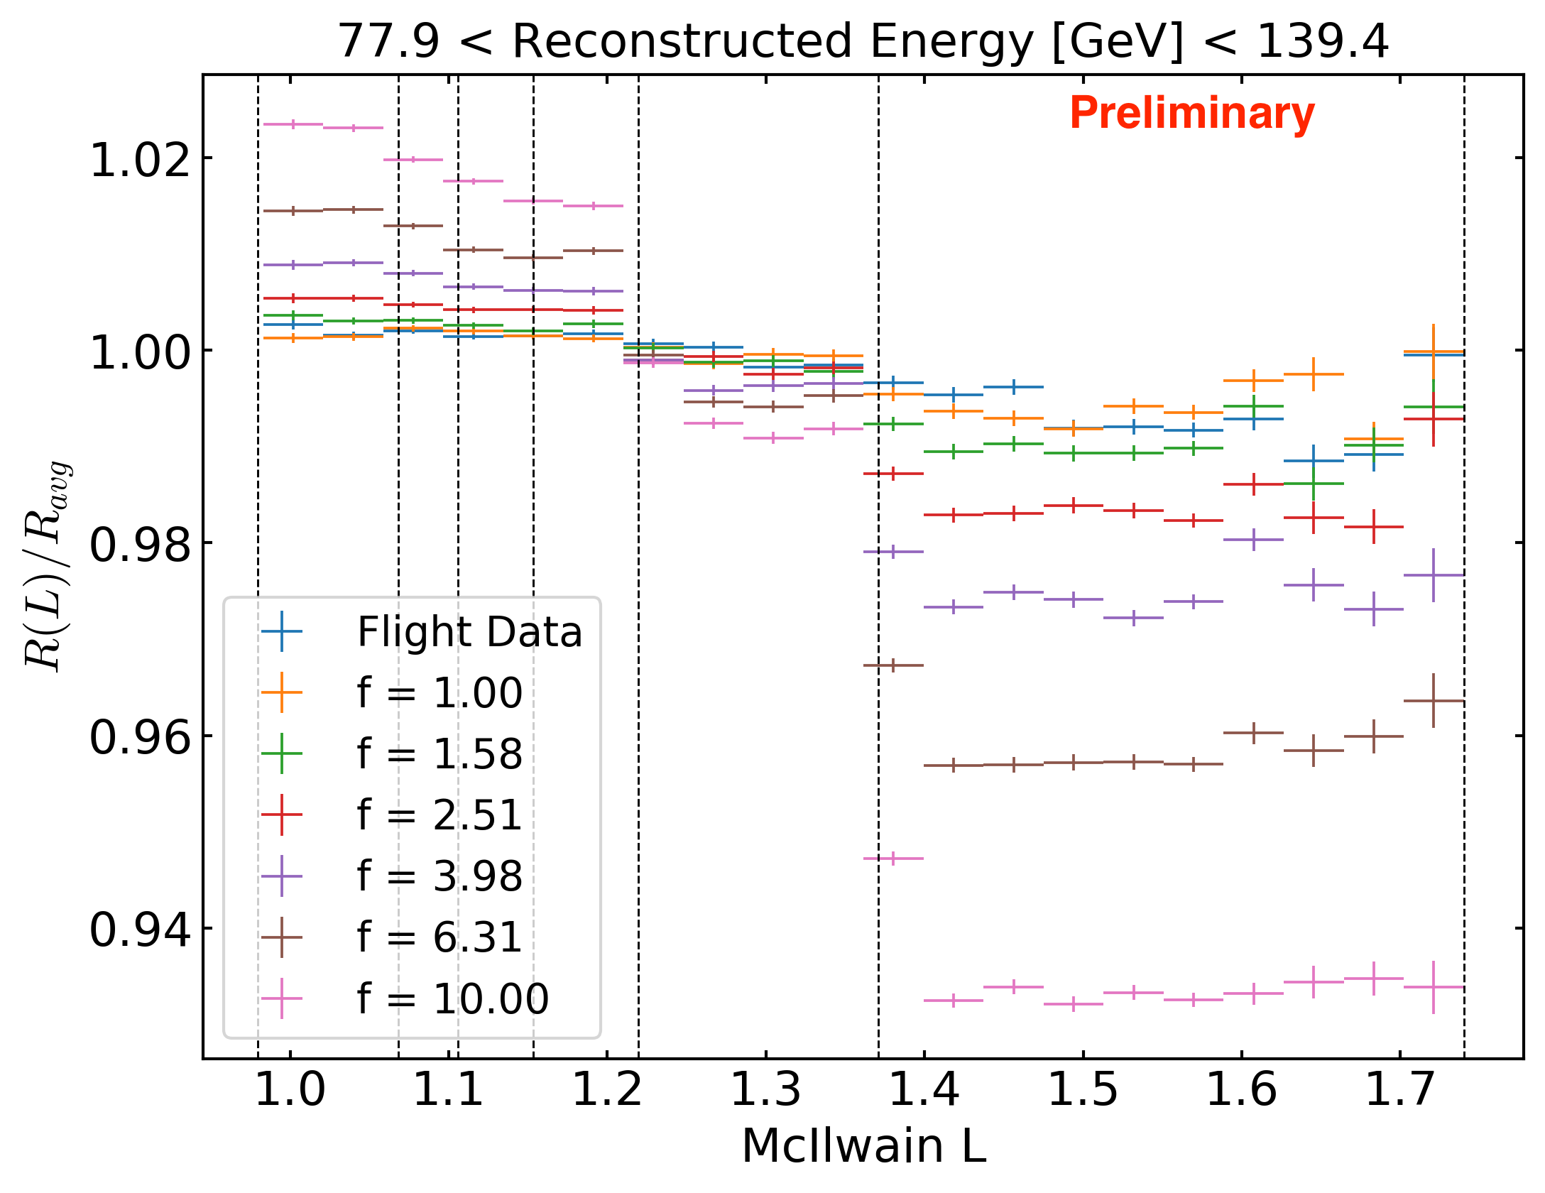
Monte Carlo investigation of rate effect
f is scale factor that determines amplitude of rate variation

Slide 25
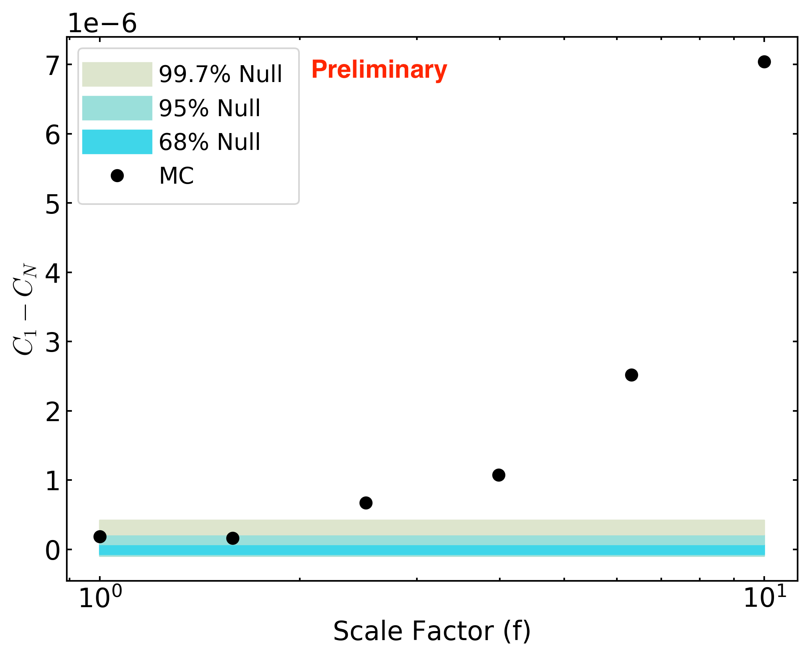
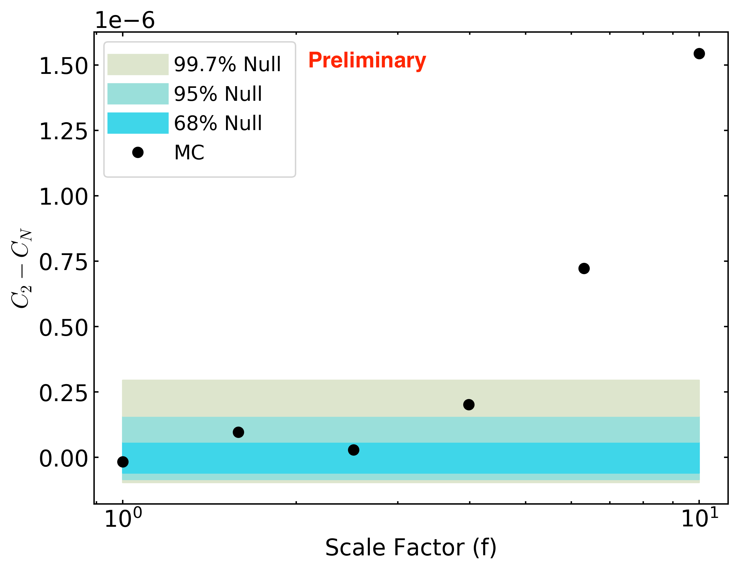
Monte Carlo investigation of rate effect
f is scale factor that determines amplitude of rate variation
For true size of effect (f=1):
  Slight excess power found in dipole
  No excess power found in quadrupole

Slide 26
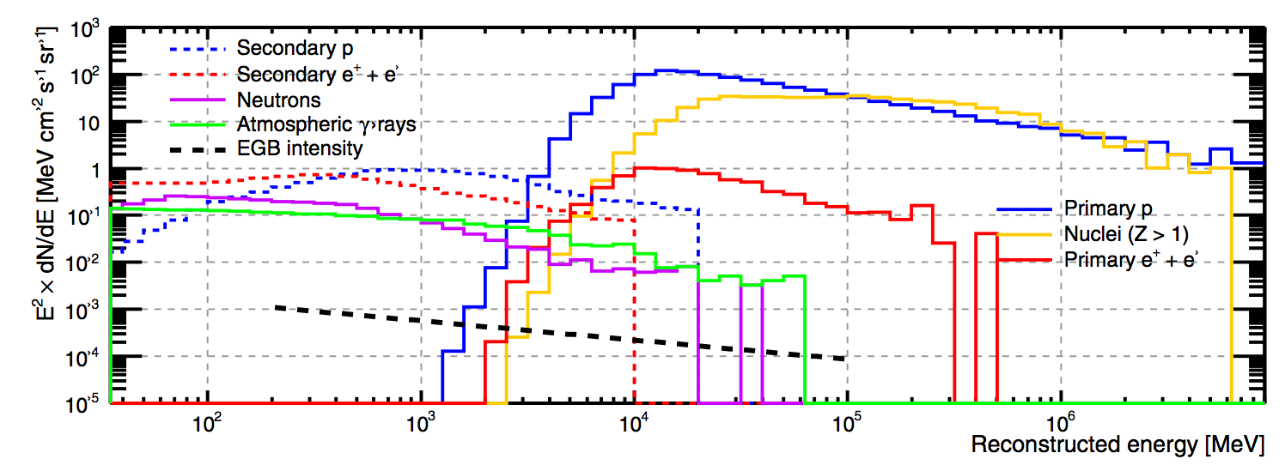
Particle fluxes at Fermi LAT
Fermi LAT, ApJS 203:4 (2012)

Slide 27
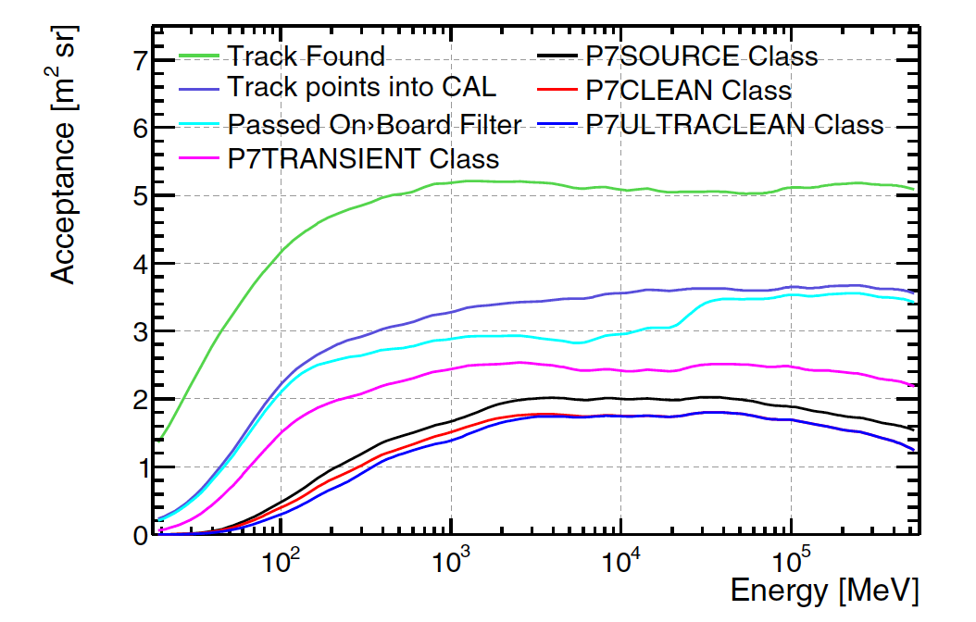
Fermi LAT gamma-ray acceptance (Pass 7)
Fermi LAT, ApJS 203:4 (2012)

Slide 28
Fermi LAT proton energy spectrum
David Green for Fermi LAT, ICRC 2017

Slide 29
Fermi LAT proton acceptance (Pass 8)
David Green for Fermi LAT, ICRC 2017

Slide 30
Fermi LAT proton statistics
David Green for Fermi LAT, ICRC 2017

Slide 31
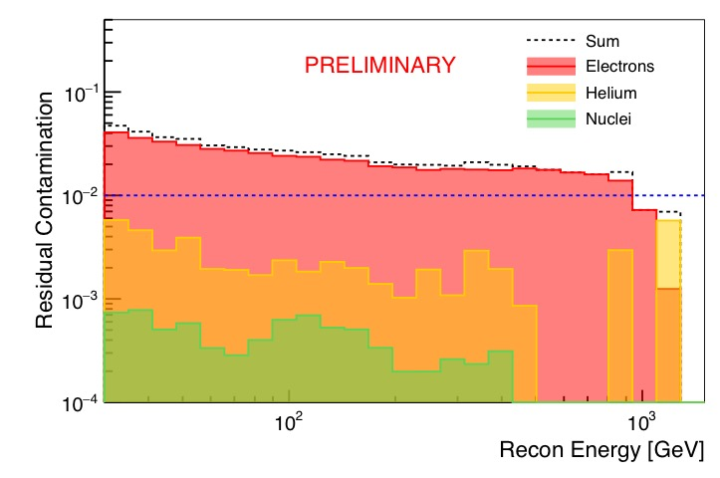
Contamination by other species in proton selection
David Green for Fermi LAT, ICRC 2017

Slide 32
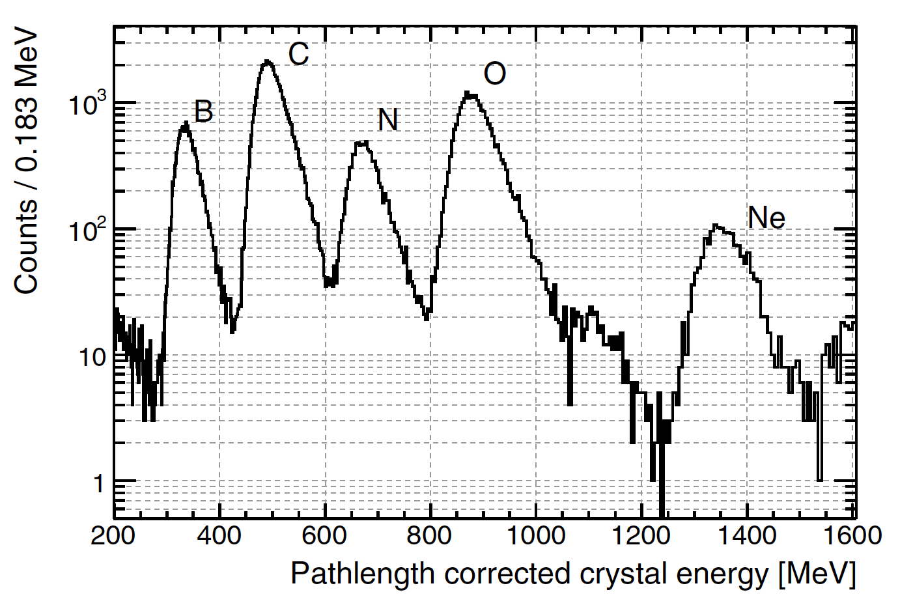
Heavy ions: charge resolution
flight data
Fermi LAT, ApJS 203:4 (2012)
Notes:
Figure 72. Distribution of the path length-corrected crystal energy deposition
for a sample of events used to inter-calibrate the low-energy and high-energy
CAL energy ranges. The peaks corresponding to the most abundant Galactic
CR species are clearly visible, though the composition differs somewhat from
the Galactic CRs because of secondary production in the ACD and TKR.
Ne: Z=10
dE/dx scales as Z^2 (Bethe-Bloch)
B/Ne Z ratio: 5/10 so 2^2 = expected ratio of 4
Actual ratio is 1350 / 350 = 3.9

Slide 33
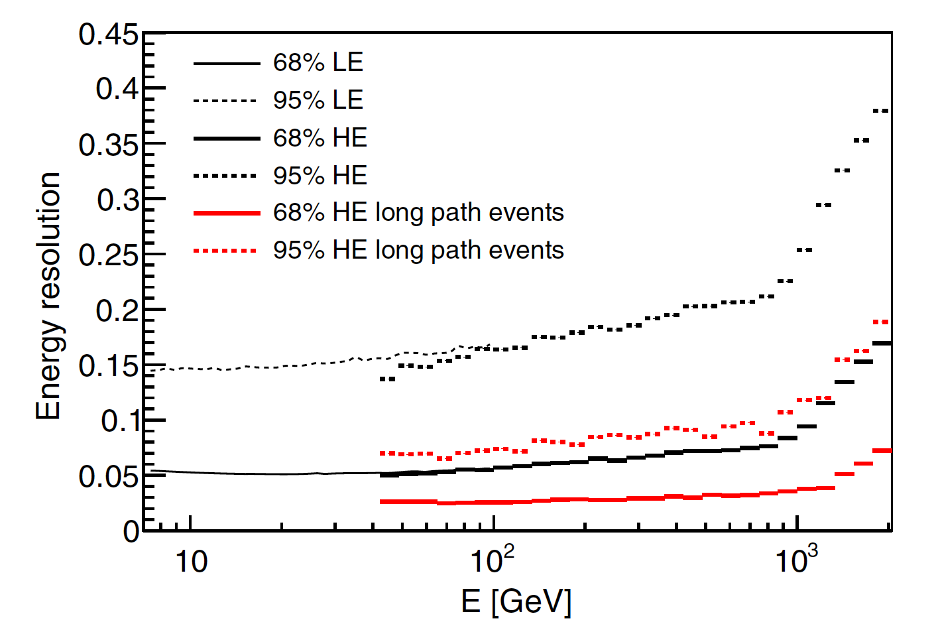
Cosmic-ray electron energy resolution
Fermi LAT, PRD 95 082007 (2017)

Slide 34
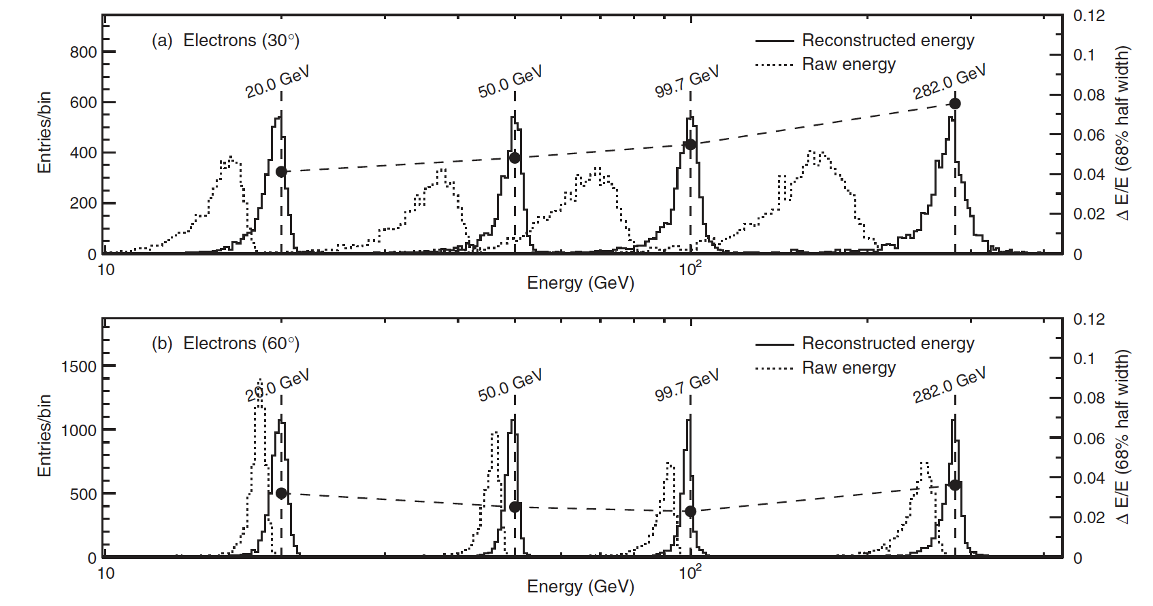
Cosmic-ray electron energy resolution
Fermi LAT, PRD 82, 092004 (2010)

Slide 35
Electromagnetic shower maximum: back of the envelope
What is maximum gamma or electron energy for which Xmax is contained within 10 radiation lengths?
t_{max} = X_{max}/X₀ = ln(E₀/E_{crit})/ln(2)
ln(2)*t_{max} = ln(E₀/E_{crit})
When does t_{max} = 10?
If Ecrit = 40 MeV (silicon),
  exp(6.9 ) = E₀/E_{crit}
  E₀ = E_{crit}*1022 = ~40 GeV if 10 radiation length pure Si
  Also tungsten
CAL (CsI) Ecrit = 11 MeV
  E₀ = ~10 GeV if 10 radiation length pure CAL
Notes:
http://pdg.lbl.gov/2016/AtomicNuclearProperties/critical_energy.html

