Slide 1
Heliospheric Effects on the Anisotropy of TeV Cosmic Rays
Ming Zhang
Florida Institute of Technology, Melbourne, FL, USA
Nikolai Pogorelov
University of Alabama in Huntsville. USA

Slide 2
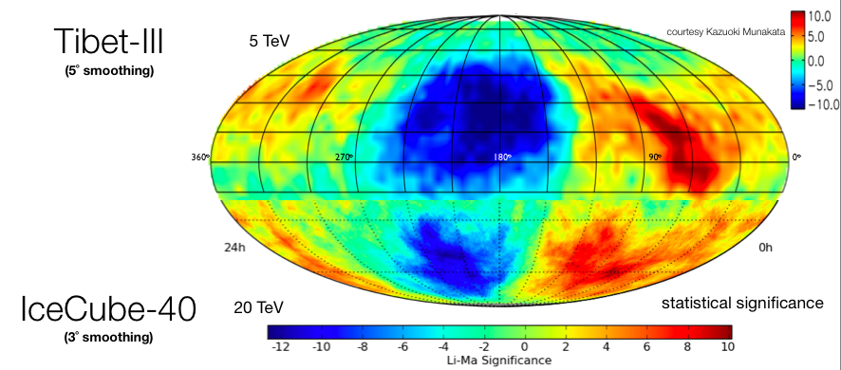
TeV cosmic ray anisotropy:
a transmission tomography of the heliosphere

Slide 3
Tibet ASγ anisotropy observations
Decomposition into two orthogonal dipoles and one bidirectional anisotropy and plus small features

Slide 4
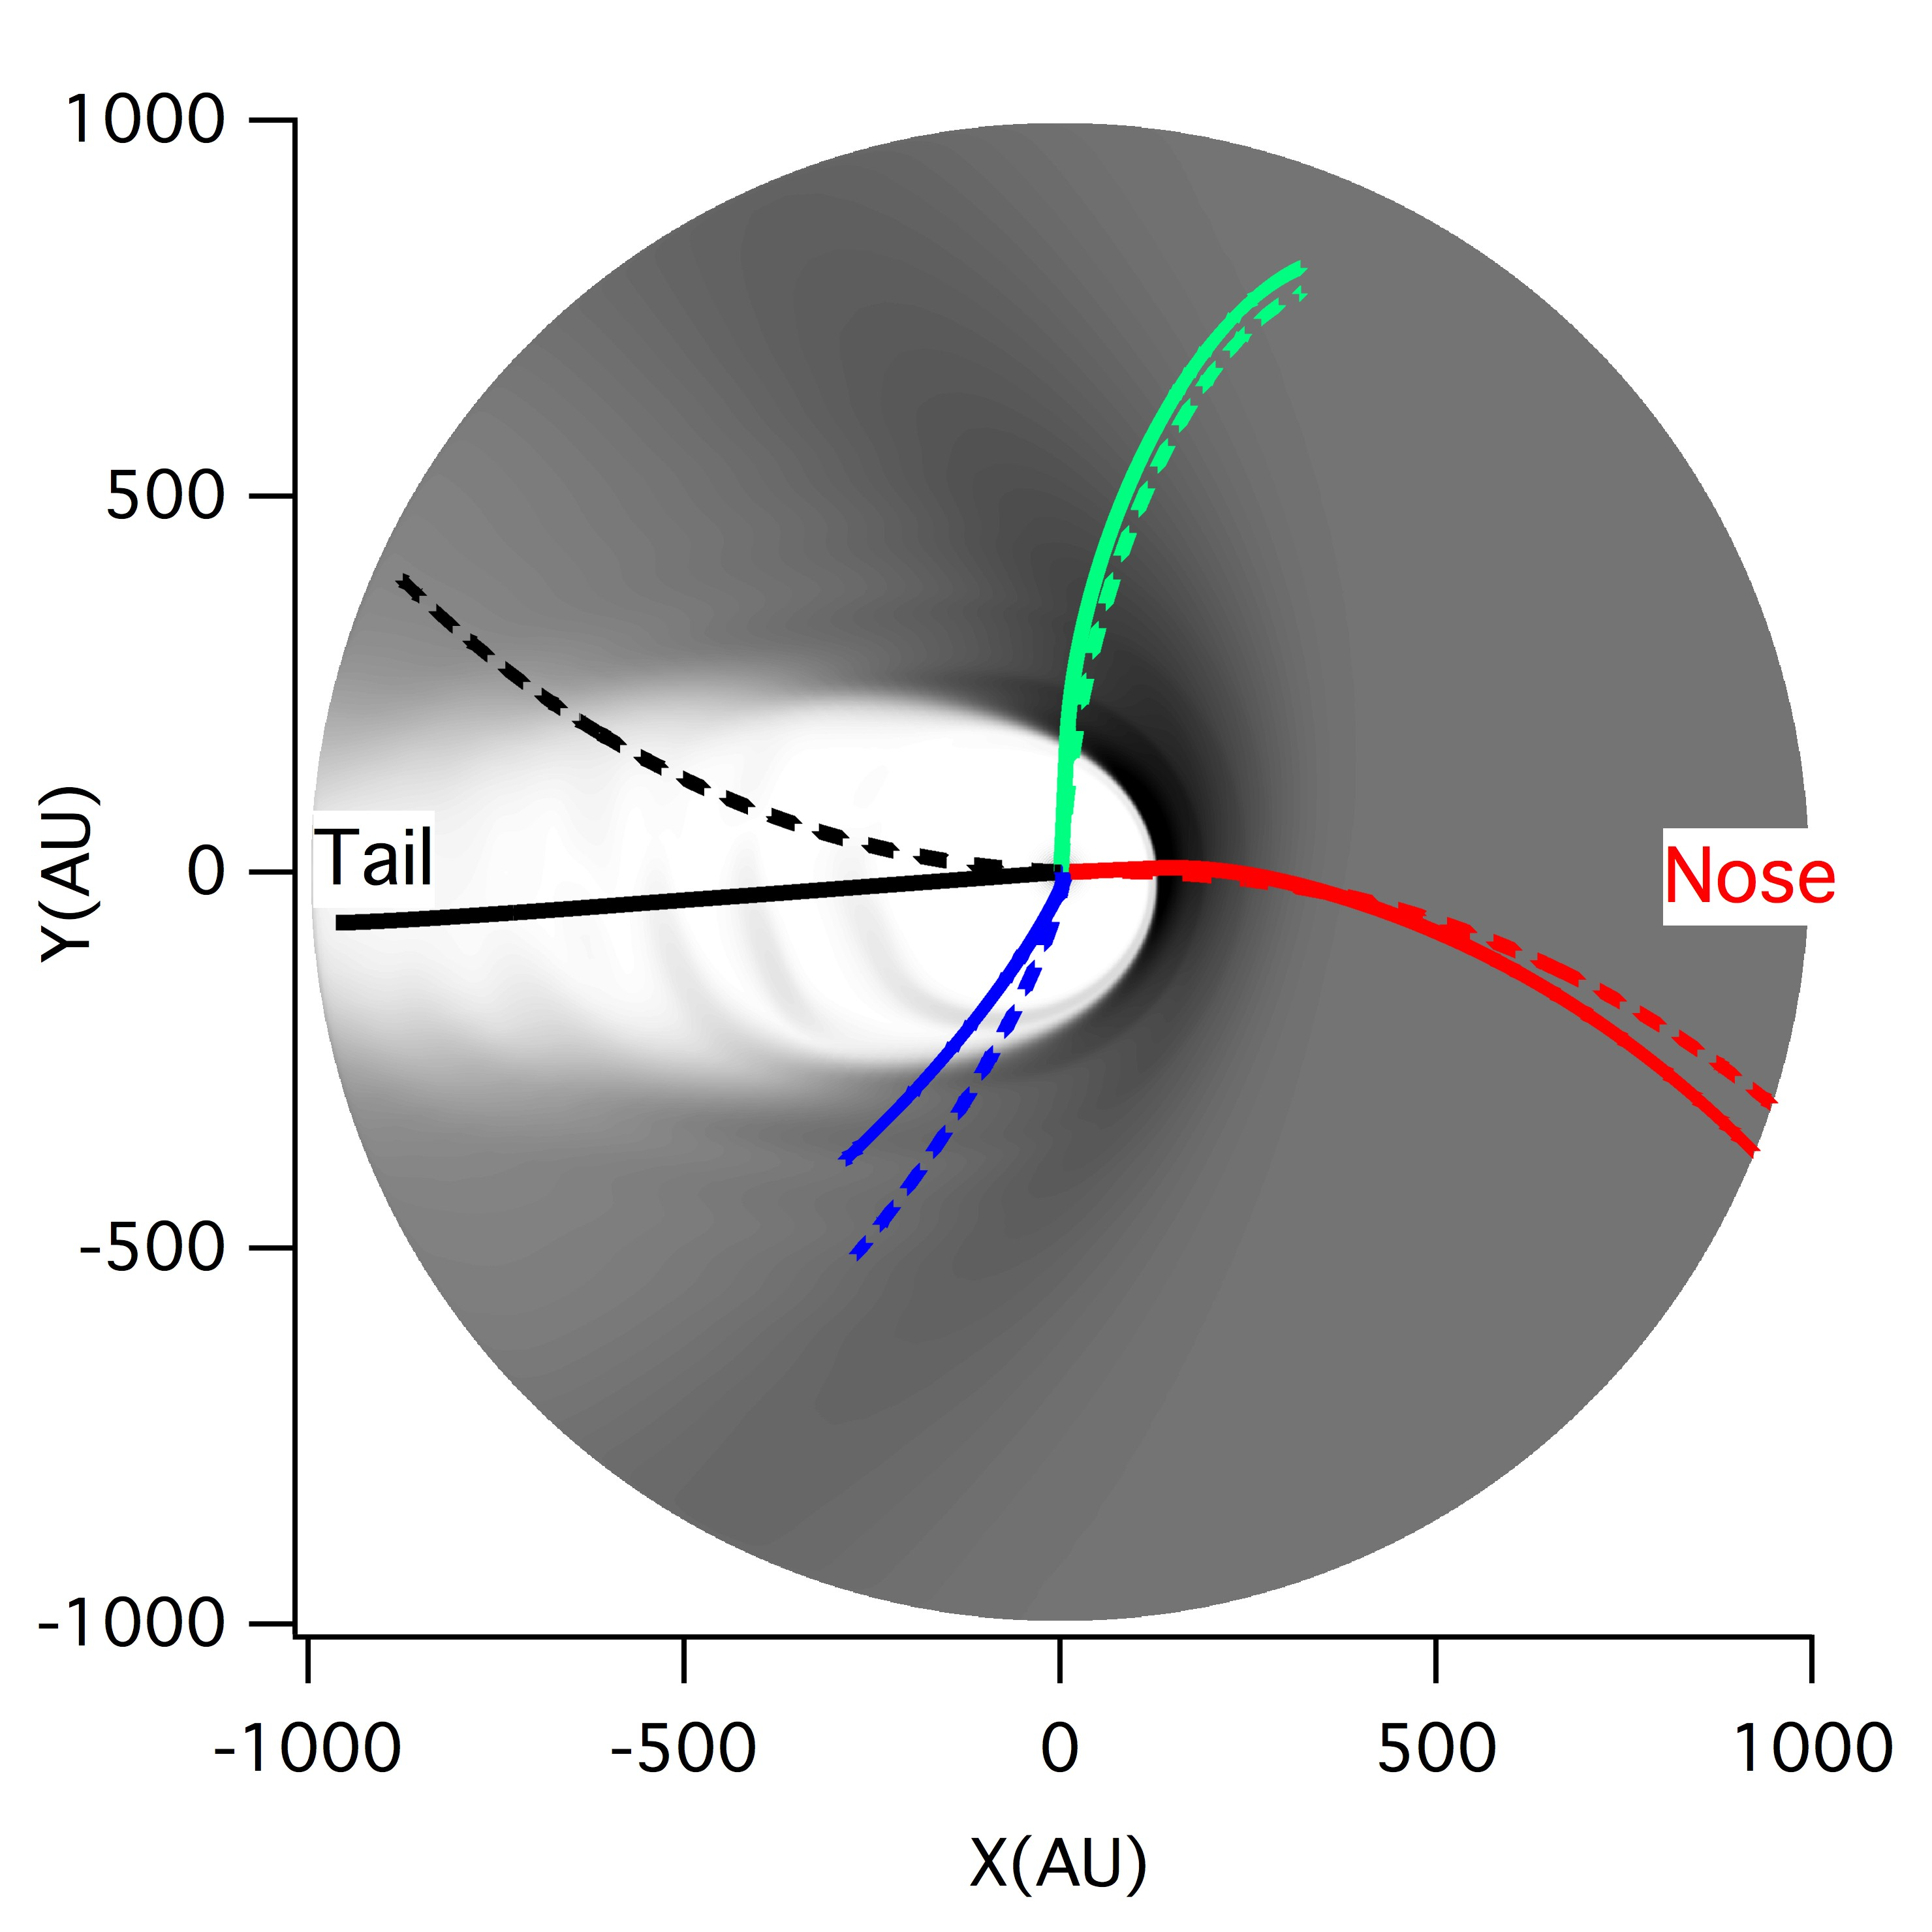
10-TeV proton trajectories
Final arrival directions: Nose, Pole, Flank, Tail
Size of heliosphere:
Nose: ~150 AU, Flank ~300 AU
Tail: A few thousand AU
Gyroradius of protons in 3 μG LISMF:
1 TeV: 74 AU, 10 TeV: 740 AU
300 TeV: 22 kAU
Heliosphere should affect the anisotropy of TeV cosmic rays

Slide 5
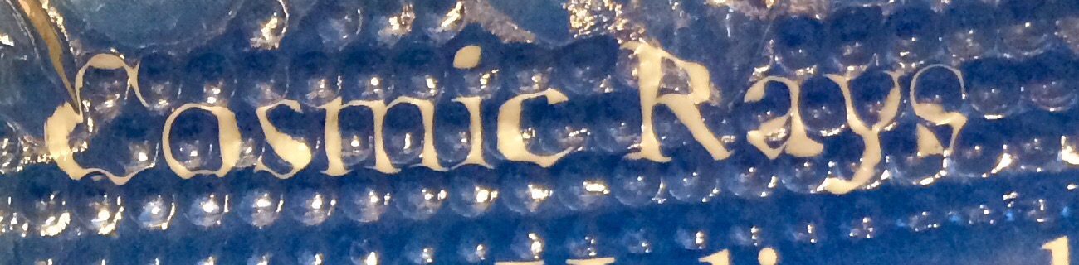
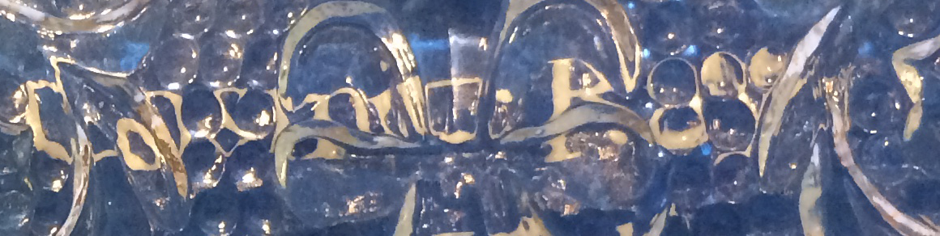
Optical image distortion

Slide 6
Liouville Mapping of Anisotropy
Anisotropy is a measurement of angular dependence of particle distribution in the observer’s reference frame
Liouville’s theorem (solution to Boltzmann-Vlasov Eq)
f is invariant upon transformation of reference frame
Anisotropy at Earth can be mapped from LISM by finding the relation between

Slide 7
Sources of anisotropy in LISM
Guiding center – diffusion approximation for magnetized population
1. Compton-Getting Anisotropy: Inhomogeneity of energy spectrum
(dipole)
2. Diffusion Anisotropy: Angular inhomogeneity which is related to spatial inhomogeneity
(dipole mainly parallel direction)
3. B cross Gradient Anisotropy: Spatial inhomogeneity as a function of guiding center
(dipole dominating perpendicular direction)

Slide 8
Mapping to Earth from ISM distribution through particle trajectory
with ideal MHD Heliosphere Model (UAH) where
Total anisotropy is a linear composition of the above 3 types of anisotropies (or 5 maps). Its outcome depends on the magnitude and direction of in local interstellar medium.

Slide 9
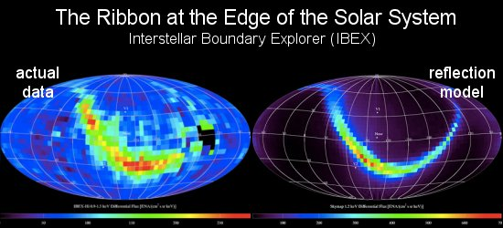
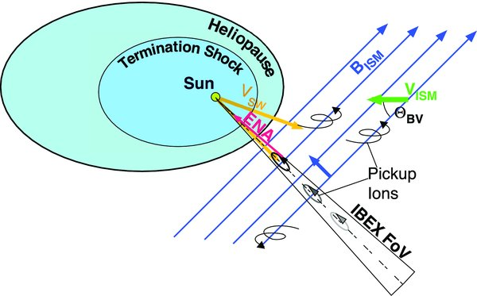
Magnetic field in LISM
Turbulence in Heliosphere:
Turbulence of local ISM magnetic field is likely to be low:
Scatter-free propagation through the heliosphere and surrounding before arrival:

Slide 10
Trajectories arriving in tail directions (XZ projection only)
(a) East side of HDP (b) West side of HDP
b
a

Slide 11
Trajectories separated by bow wave (XZ projection only): (c) West; (d) East
d
?
Bow wave
c

Slide 12
B_{ism}=4 μG
Map A:
Map A - Map C
Map B:
(Least χ² linear fit)
Map B - Map C
Map C:

Slide 13
Compton-Getting
Unidirectional
flow
b
c
d
e
a
f
Bi-directional
flow
Density gradient

Slide 14
TeV cosmic ray transport in LISM
Parallel to magnetic field
Perpendicular to magnetic field
TeV cosmic ray transport in LISM is dominated by parallel diffusion

Slide 15
Bow wave
Bow wave
Plane perp to B_{ism}
Plane perp to B_{ism}
HDP
HDP
Tibet Measurement

Slide 16
Tibet AS Data 5 TeV
Model with B_{ism}=3 μG
Bow wave
Plane perp to B_{ism}
HDP
Model with B_{ism}=4 μG
Model with B_{ism}=3.5 μG

Slide 17
Dependence on cosmic ray energy
5 TeV model fit
1ºX1º
10 TeV
1ºX1º
1 TeV
1ºX1º
1 TeV
5ºX5º smoothed

Slide 18
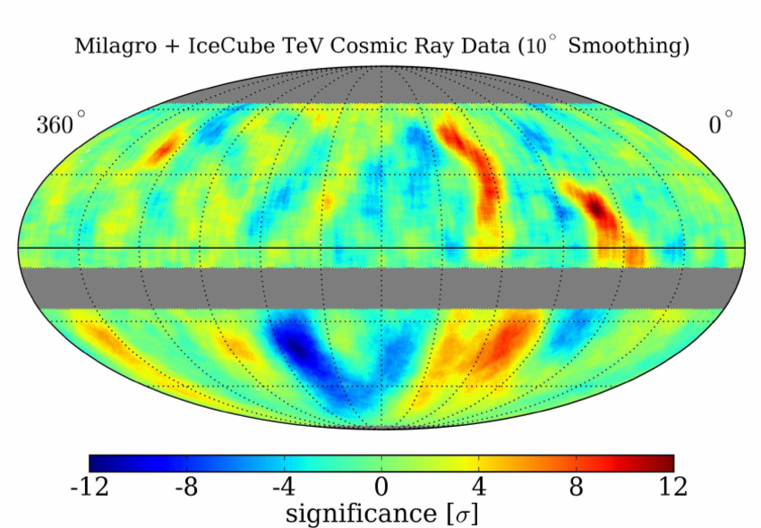
Milagro 1 TeV

Slide 19
Solar cycle variation of TeV cosmic ray anisotropy
Negative solar magnetic field
(sun is at the nose)
Positive (reverse) solar magnetic field
(sun is at the nose)

Slide 20
Sun shadow and surrounding in TeV cosmic ray anisotropy:
Future coronal magnetic field measurement

Slide 21
Summary
Map anisotropy from LISM to Earth using Liouville’s theorem.
Source of all anisotropies originates from LISM, where the cosmic ray distribution is a function of energy, pitch-angle and guiding center position.
Heliospheric magnetic field distort LISM anisotropy to form many small features in anisotropy images seen at Earth. TeV cosmic ray anisotropy images contain features related to
    Hydrogen deflection plane (HDP) in the heliotail
    Plane perpendicular to B_{ism}
    long heliotail
    Pitch angle anisotropy and density gradient of 5 TeV cosmic rays have been determined. The LISM anisotropy is dominated by a dipole pitch-angle anisotropy. It indicates that cosmic ray transport in LISM is mainly through parallel diffusive propagation. Little bi-directional suggestion little mirroring by ISM magnetic field or the field is nearly uniform. The cosmic ray density gradient in LISM is perpendicular to B_{ism}. Cosmic rays form filaments in magnetic flux tubes.
    Effects of interstellar magnetic field turbulence can only freely transmit thorough without much distortion or smear in limited areas. Stronger B_{ism} makes the situation worse.
    Sun shadow in TeV cosmic ray anisotropy can be used to explore the coronal magnetic field.

